Slide 1
Best Font for Online Reading: No Single Answer
Jakob Nielsen
on April 24, 2022
ACM Transactions on Computer-Human Interaction, Vol. 29, No. 4, Article 38. Publication date: March 2022.
A large new study of the best fonts for online reading is ultimately disappointing, because it doesn’t answer the most burning question: what font should you use for your website? But it still provides many intriguing findings, including the striking conclusion that there is no single answer to this question.

Slide 2
Towards Individuated Reading Experiences: Different Fonts Increase Reading Speed for Different Individuals
SHAUN WALLACE, ……
In our age of ubiquitous digital displays, adults often read in short, opportunistic interludes.
In this context of Interlude Reading, we consider if manipulating font choice can improve adult readers’ reading outcomes.
which fonts people prefer and which fonts make them more effective readers.

Slide 4
Interlude Reading.
We define Interlude Reading to capture opportunistic reading (during
short breaks), quick information gathering, and content consumption through social media platforms.
Examples are reading in a single brief sitting, on public transport, waiting in line, or taking a
brief break to browse news, social media, blog posts, or to read sections ofmore extensive work. Information
gathering of many types can fall under this umbrella. Increasingly, short, opportunistic
interludes occupy a central role in textual consumption, primarily as information overload drives
individuals to consume more information in smaller chunks and interleaved with other activities.
Thus, Interlude Reading cannot be categorized as either glanceable or long-form, requiring separate
research attention.
Interlude Reading aligns with easily digestible reading materials (i.e., a few paragraphs worth)
and fits Carver’s recommended range of 138–600 words per minute for reading with comprehension

Slide 5
352 partecipanti leggono 5 passaggi di testo 300-500 parole, come la pagina web media
Il testo è circa all’ 8 reading level,
recommendation for web content targeted at a broad consumer audience
16 different fonts,

Slide 6
While navigating the Internet, users mostly scan pages for useful information, as opposed to reading all the text word-for-word.
Thus, in real life, users only read 28% of the words on a webpage, or about 166 words.

Slide 7
The three main metrics collected were:
Subjective user preference: which font did each person like the best?
Reading speed in words per minute (WPM)
Comprehension score: percent of questions answered correctly after the user finished reading a passage

Slide 8
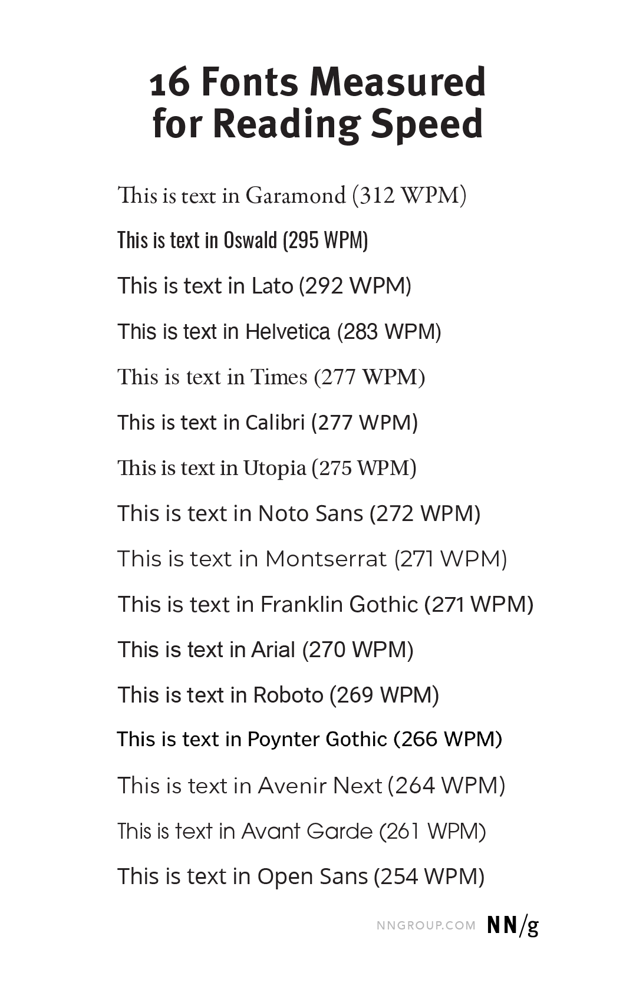

Slide 9
Fonts Matter
On average, any given participant read 35% faster in his or her fastest font (314 WPM)
compared to that same person’s slowest font (232 WPM, on average). Ogni persona legge 5 testi, a differenti velocità.
Tra la lettura più veloce e quella meno veloce c’e’ una differenza del 35%
Ma non c’e’ un font che è meglio per tutti
Garamond ha la velocità di lettura più alta in media (312), cioè non per tutti

Slide 10
Molti utilizzatori erano più veloci con altri font, sarebbero stati penalizzati usando Garamond.
Una volta su 2 un altro font dava risultati migliori
Quello più veloce da leggere era Frankling gothic
È possibile che Frankling sia un buon font per i poor reader
Garamond buono per i buoni lettori.

Slide 11
the distinction between Franklin Gothic and Garamond is simply more proof of the overall finding that different fonts are best for different people, with reading skills being a possible differentiator impacting font choice.
Non si può chiedere agli utenti, perchè non lo sanno (di solito si usa il default)
In this study, participants read 14% faster in their fastest font (314 WPM, on average) compared to their most preferred font (275 WPM, on average

Slide 12
Età
Users’ age had a strong impact on their reading speed, which dropped by 1.5 WPM for each year of age.
a 50-year old user will need about 11% more time than a 30-year old user to read the same text.
picking the wrong font penalizes older users more than young ones.

