Slide 1
How lectures use gestures and gaze during conferences and lectures using new technologies
Gisella Paoletti
Dept. Of Humanities
University of Trieste

Slide 2
An old pedagogical theme:
how to help to learn using adjunct aids,
in a new context, that of distance learning.

Slide 3
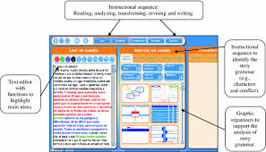
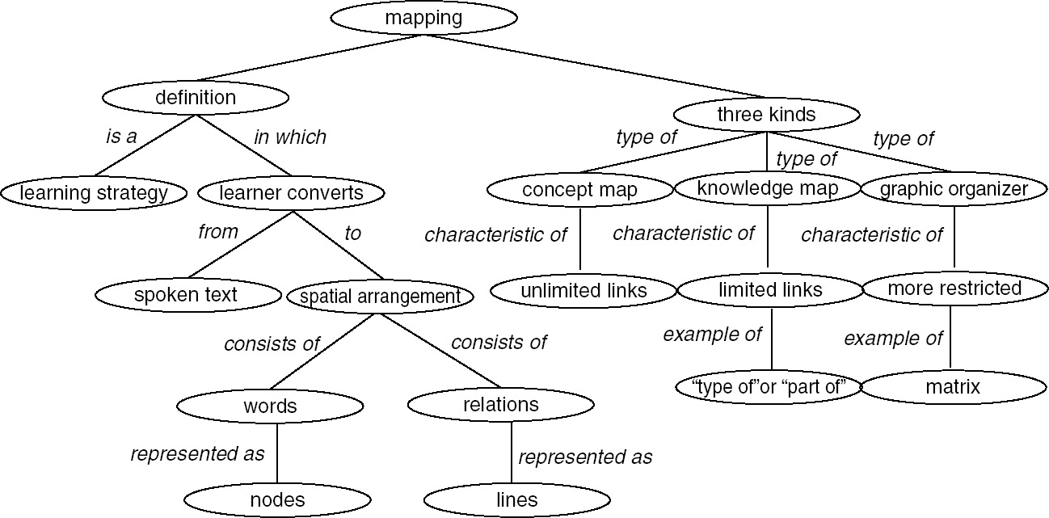
Adjunct Aids
Signaling with
Text (outlines, maps, underlining, multimodality,)
Voice
Gesture
Gaze

Slide 4
New presentations
Use of video-lessons
Zoom, Teams, Meet…

Slide 5
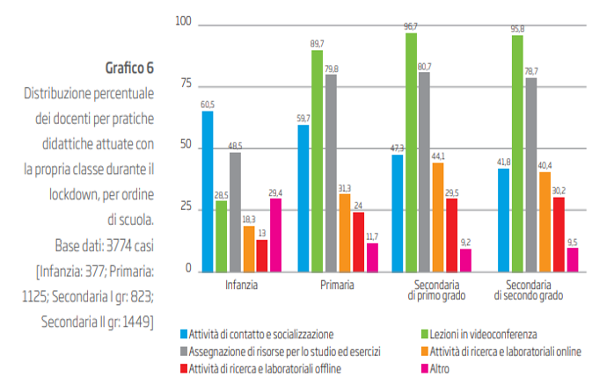

Slide 6
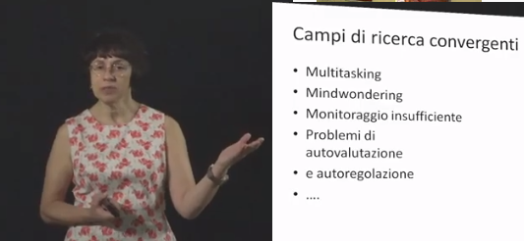
Format: Talking Head + PPT

Slide 7
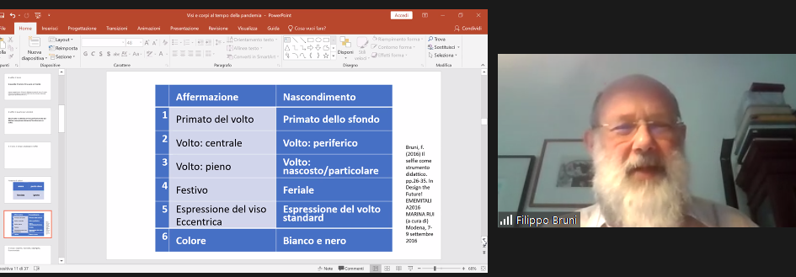

Slide 8
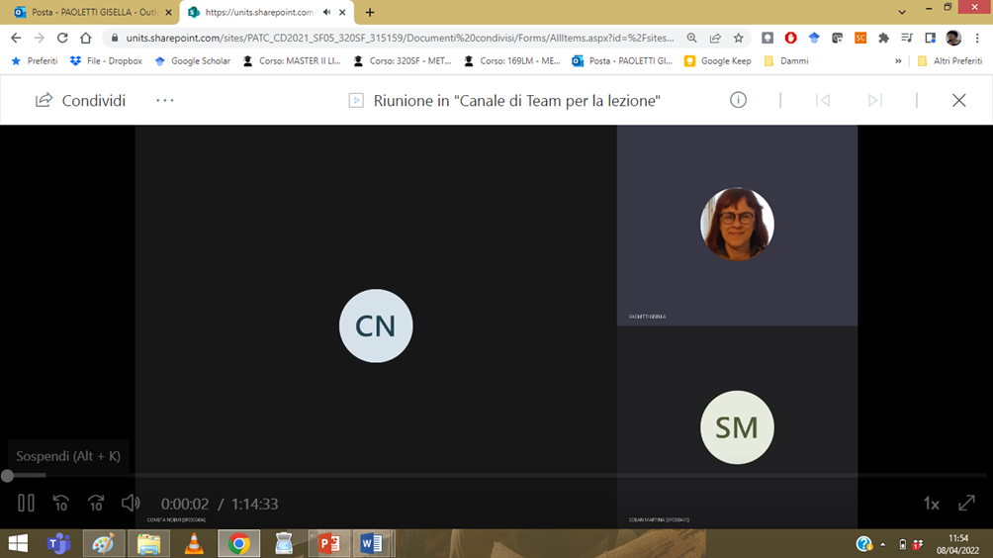

Slide 9
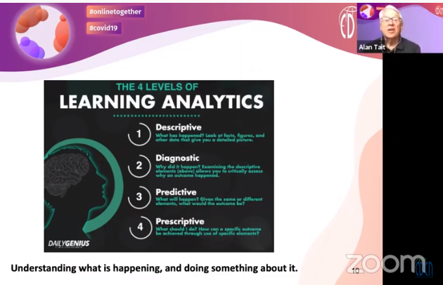
What is missing?
Body, gesture, hands, gaze…
No spatial contiguity

Slide 10
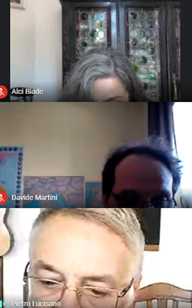

Slide 11
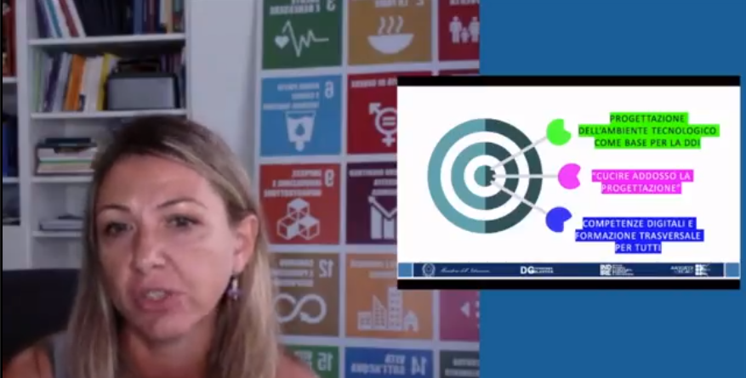
Incompatible gaze

Slide 12
Learners prefere TH+ppt
+less effort
+learn more
Shift attention
pay attention to the TH
…

Slide 13
Preference is not efficiency..
But The preference for a resource can transform the learning experience into a more enjoyable and engaging event

Slide 14
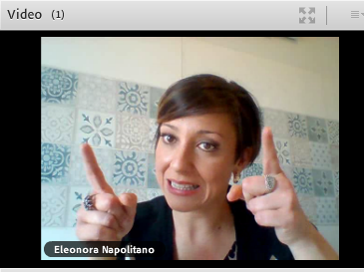

Slide 15
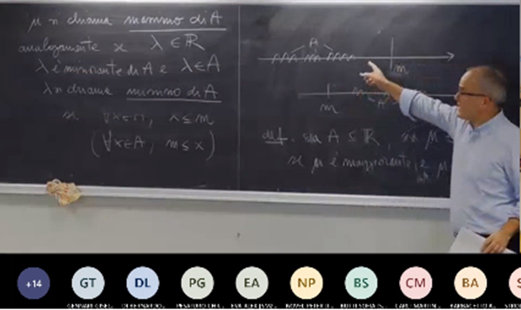
yes

Slide 16
Gaze guidance principle:
people learn better from a video lecture when the on screen instructor shifts gaze between the audience and the board while lecturing rather than looking only at the board or only at the audience (Mayer, Fiorella e Stull, 2020, p. 842 )
With the help of gestures, pointing, structuring…

Slide 17
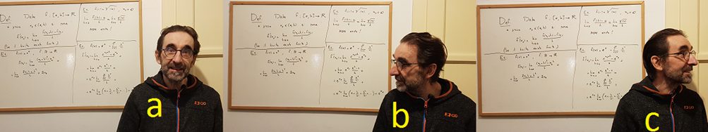
TH – distracting..
Compare:
Neutral TH
Compatible TH
Incompatible TH
If compatible there is an increase in learning

Slide 18
Thanks!

Slide 19
GESTURES - What gestures are we talking about?
In educational contexts, gestures are not much considered, even if we often talk about the lesson in presence as an optimal context, also because it favors interactivity and gestures.

Slide 20
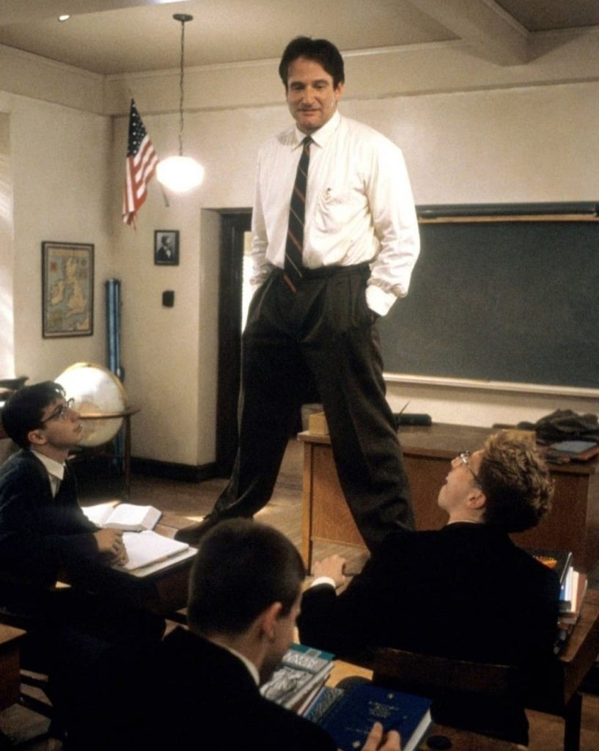
Talking Head. All of its parts play a role: face, eyes, mouth, torso, arms and hands

Slide 21
hypothesis
a video using a Talking Head might be more complete, in terms of information, when significant gestures are used.
Es: deictic gestures (by which one points to the object of speech),
baton, rhythmic gestures (by which a temporal structure is assigned to communication, for instance when moving a hand while changing subject)
iconic gestures (representing visually the object of speech: it is this big…).
On the contrary, gestures devoid of information do not help, although they often accompany speech, while serving different purposes: emphasis, color, emotional and social aspects.

Slide 22
Do virtual classes cause an impoverishment of social context and relationships?
Preliminary investigation
Subjects and method
We have observed online classes (the most recent, according to the Internet inventory) by 22 lecturers from various Departments of one Italian University who performed and recorded their own courses’ video-lessons.

Slide 23
Check list
Presence of the Talking Head (yes/no)
Size of the Talking Head (Miniature/large)
Type of the Talking Head (Full figure/close medium shot/close up)
Type of gaze, used to guide students’ attention (compatible/incompatible/not perceivable)
Type of gesture (absent/writing/deictic/baton/mouse tracking/highlighting)

Slide 24
Checklist | Data
Presence of the Talking Head (yes/no) | Yes: 20 No: 2
Size of the Talking Head (Miniature/large) | Miniature: 12 Large: 8
Type of the Talking Head (Full figure/close medium shot/close up) | Full figure: 3 Close medium shot: 4 Close up: 13
Type of gaze, used to guide students’ attention (compatible/incompatible/not perceivable) | Compatible: 3 Incompatible: 1 Not perceivable: 18
Type of gesture (absent/writing/deictic/baton/mouse tracking/highlighting) | Absent: 3 Writing: 3 Deictic: 3 Baton: 5 Mouse tracking: 6 Highlighting: 2

