Slide 1
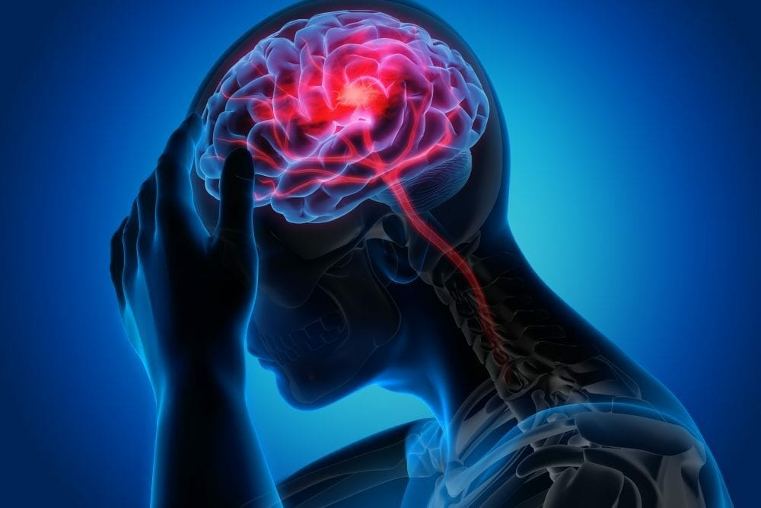
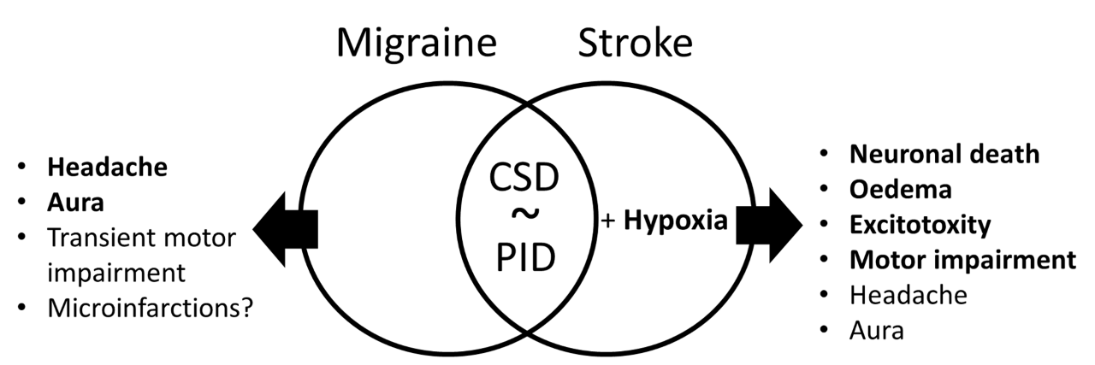

Intl. Master Degree
in Neuroscience
SEMINARS
Neural Circuits of Social Cognition
Prof. Francesco Papaleo
Italian Institute of Technology
Recognition and reaction to other emotional states is a fundamental and evolutionary conserved ability shaping animals’ life and survival. Here, I will show how using a combination of anatomical, genetic, chemogenetic, microendoscopic and fiber photometry approaches in mice, we were able to demonstrate the contribution of selective cell populations and brain circuits in the ability to discriminate conspecifics based on their emotional state. Overall, our findings provide new insights into the neurobiological mechanisms of emotion recognition.
Tuesday
28 November 2023
at 16:00
Room exCla
Building C1
dsv.units.it

