Slide 1

Economic Geography
4 – Transport and location
121EC
A.Y. 2023/2024
Dr. Giuseppe Borruso
Department of Economics, Business, Mathematics and Statistics
University of Trieste
E-mail. giuseppe.borruso@econ.units.it
Ph. +39 040 558 7008
Skype: giuseppe.borruso
Notes:
Slides with (*) in footnotes have been modified by Jean-Paul Rodrigue materials. (see copyright). I have modified and elaborated materials in order to be suitable for the current course.
Copyright © 1998-2010, Dr. Jean-Paul Rodrigue, Dept. of Global Studies & Geography, Hofstra University. For personal or classroom use ONLY.

Slide 2
Learning Objectives
In this lesson we will:
  Introduce the importance of Transport in Location;
  Present the factors characterizing a transport system;
  Examine the growth factors in transport demand;
  Scale of spatial organization of transport
  The spatial structure of transport costs
  Route selection issues

Slide 3
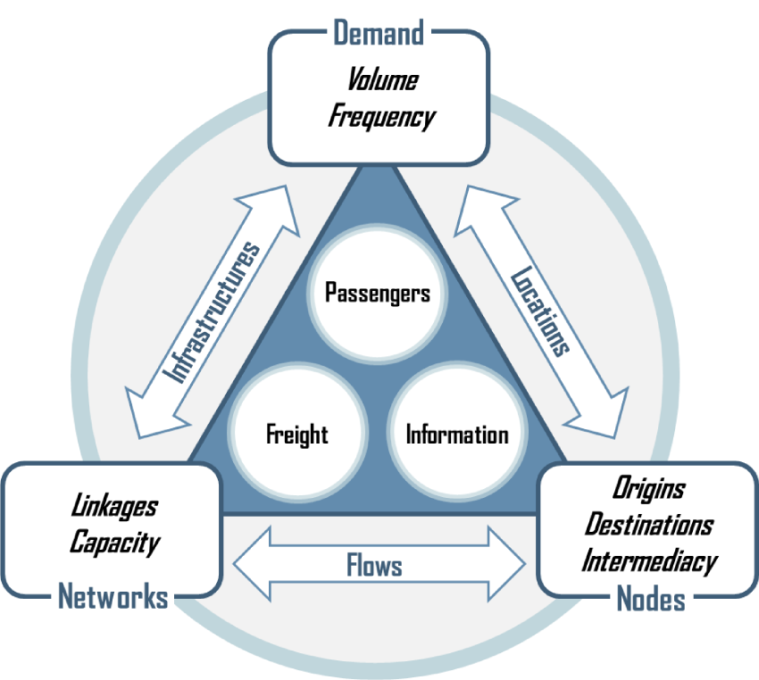
The Transport System
The transport system can be conceptualized as the set of relationships between nodes, networks and the demand. These relationships involve locations spatially expressing this demand, flows between them and infrastructures designed to handle these flows. All the components of a transport system are designed to facilitate the movements of passengers, freight and information, either as separate or joint components.

Slide 4
The Transport System
Demand. A derived function for the movement of people, freight and information for a variety of socioeconomic activities.
Nodes. Where movements are originating, ending and transiting (intermediacy); points of entry or exit in a transport system. They vary according to the geographical scale being considered ranging from local nodes (such as a subway station) to global nodes (such as port or airport terminals).
Networks. Composed of a set of linkages expressing the connectivity between places and the capacity to handle passenger or cargo volumes.
Locations. Nodes where demand is expressed as an origin, destination or point of transit. The level of spatial accumulation of socioeconomic activities (production and consumption) jointly defines demand and where this demand is taking place.
Flows. The amount of traffic over a network composed of nodes and linkages. This is jointly a function of the demand and the capacity of the linkages to support them.
Infrastructures. The conveyances such as roads and terminals expressing the physical reality of a network and designed to handle a demand with specific volume and frequency characteristics. Facilities enabling access to a network are jointly characterized by their centrality and the linkages that radiate from them.

Slide 5
Growth Factors in Transport Demand
Passengers
Freight
Passenger or ton-kms
Growth in production and consumption
Income growth
Quantity of Passengers or Freight
Industrial relocation
Economic specialization
Suburbanization
KM
Average Distance

Slide 6
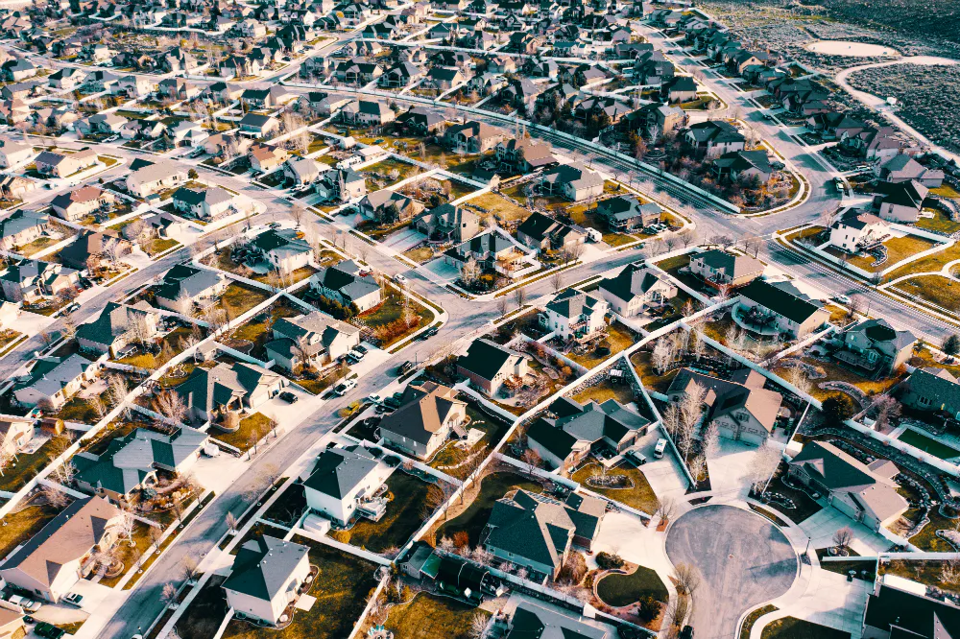
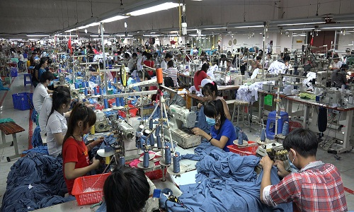
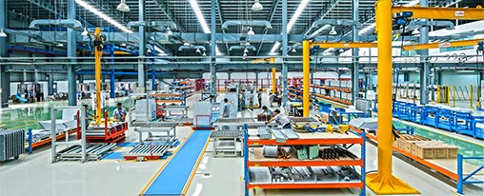
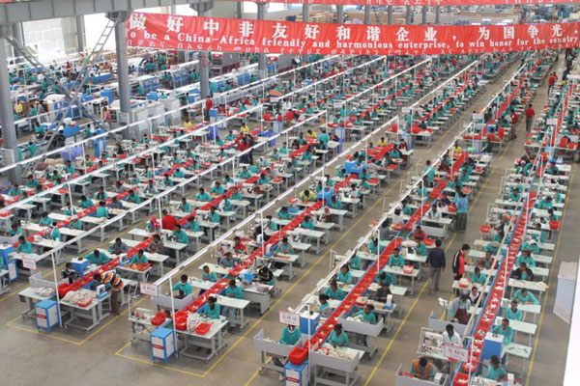
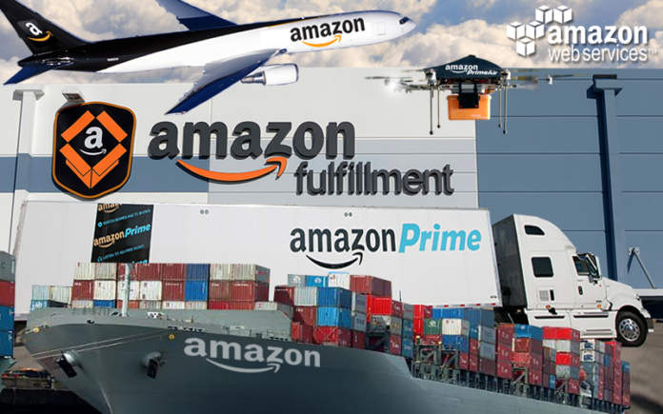
Suburbanization
Industrial relocation
Last mile & On Line market

Slide 7
The “Last Mile” in Freight Distribution
Massification
Atomization
Frequency
Capacity
GLOBAL
HINTERLAND
REGIONAL
LOCAL
Shipping Network
Corridor
Segment
Customer
“Last Mile”
Gateway
Inland
Terminal
Distribution
Center

Slide 8
Growth of (passengers and goods) transport and GDP (EU 27)
(1) cars, motor vehicles, two-wheelers, autbus and pullmans, trams, underground rail lines, railways, air transport, inland waterways, intra-EU maritime transportE
(2) Road railways inland waterways, pipelines, air and mairitime transport (intra EU)
GDP at constant prices and exchange rates 2000;
(Fonte: European Commission, Transport in Figures, 2010)

Slide 9
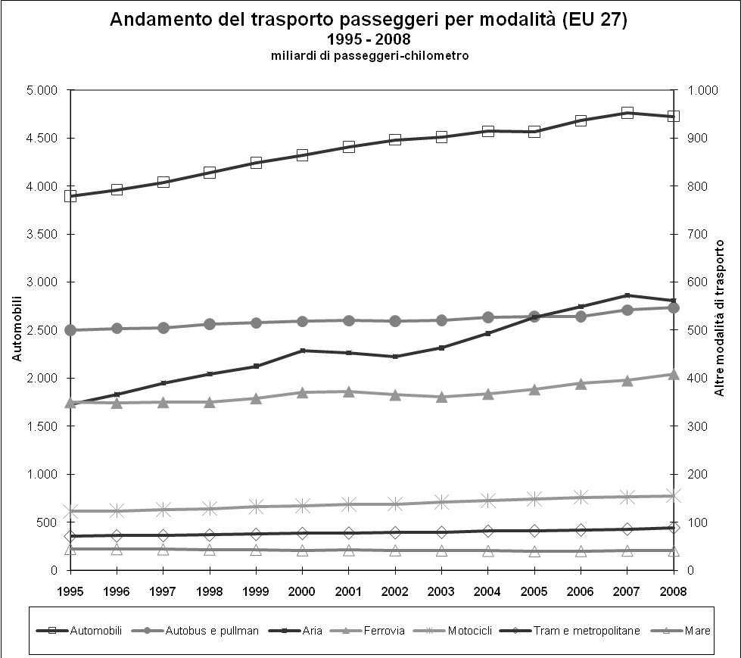
Transport modal split (EU 27) 1995 – 2007
Passengers transport
Goods transport
EUROPEAN UNION, Directorate-General for Energy and Transport - in co-operation with Eurostat, ENERGY AND TRANSPORT IN FIGURES 2010

Slide 10
Passengers Mobility Transition
Industrial
Revolution
Mass Production
Globalization
Individual
Motorized
Collective
Non-motorized
Economic Development

Slide 11
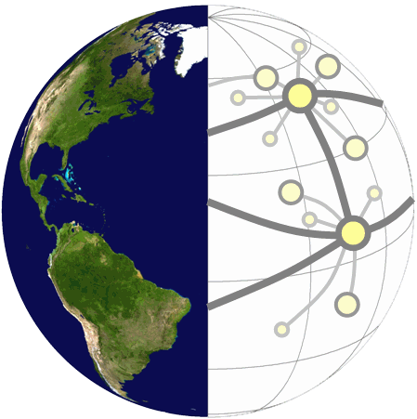
Scales of Spatial Organization for Transport
Scale |  | Nodes | Links | Relations
Global |  | Gateways and hubs (airports and ports) | Air and maritime lanes | Investment, trade and production
Regional |  | Cities | Corridors (rail lines, highways, canals) | Urban system and hinterland
Local |  | Employment and commercial activities | Roads and transit systems | Commuting and distribution

Slide 12
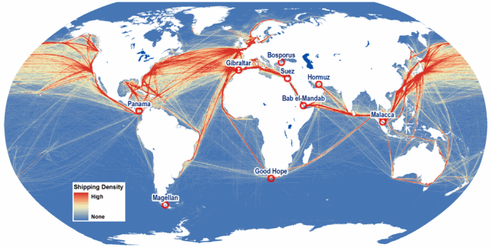
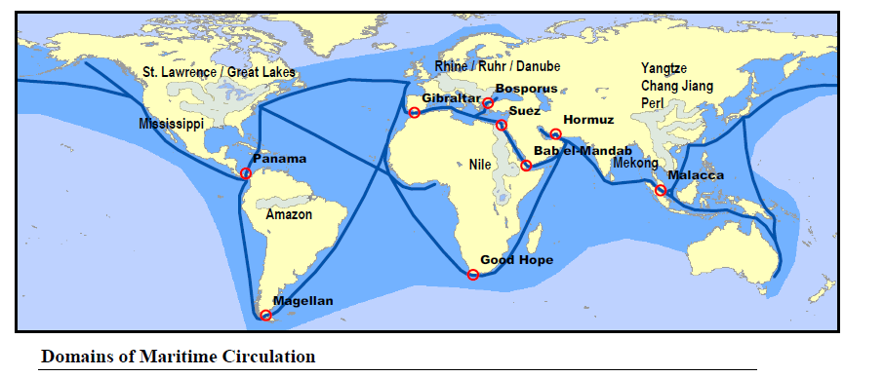

Slide 13
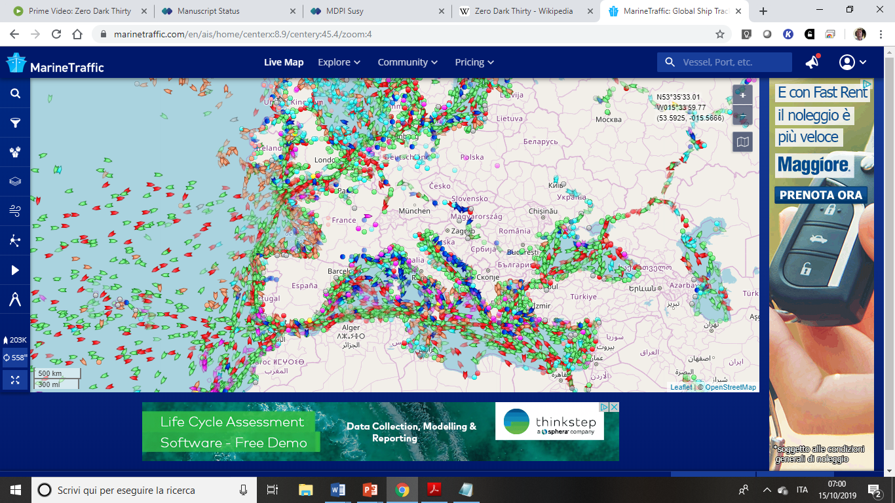
https://www.marinetraffic.com/en/ais/home/centerx:9.0/centery:45.4/zoom:4

Slide 14
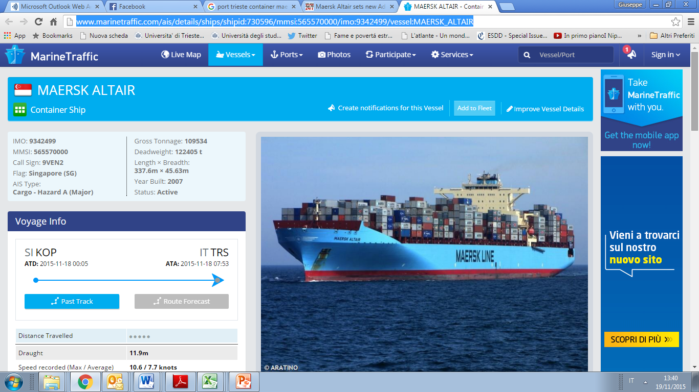
http://www.marinetraffic.com/ais/details/ships/shipid:730596/mmsi:565570000/imo:9342499/vessel:MAERSK_ALTAIR

Slide 15
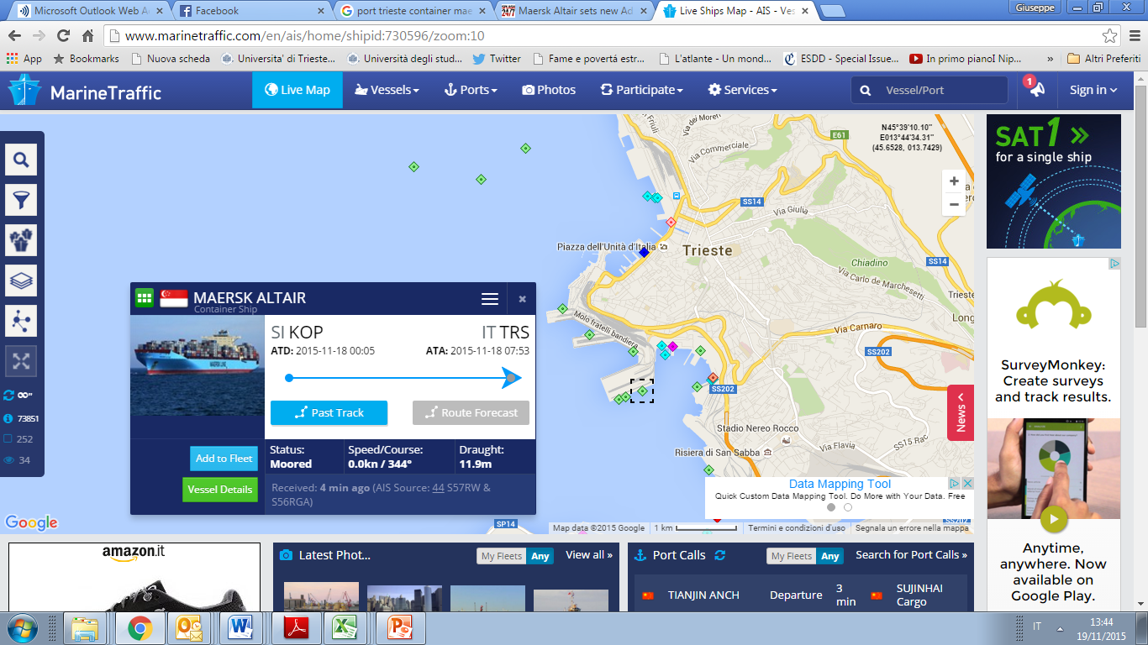
Large containerships in the Adriatic Sea
http://www.marinetraffic.com/en/

Slide 16
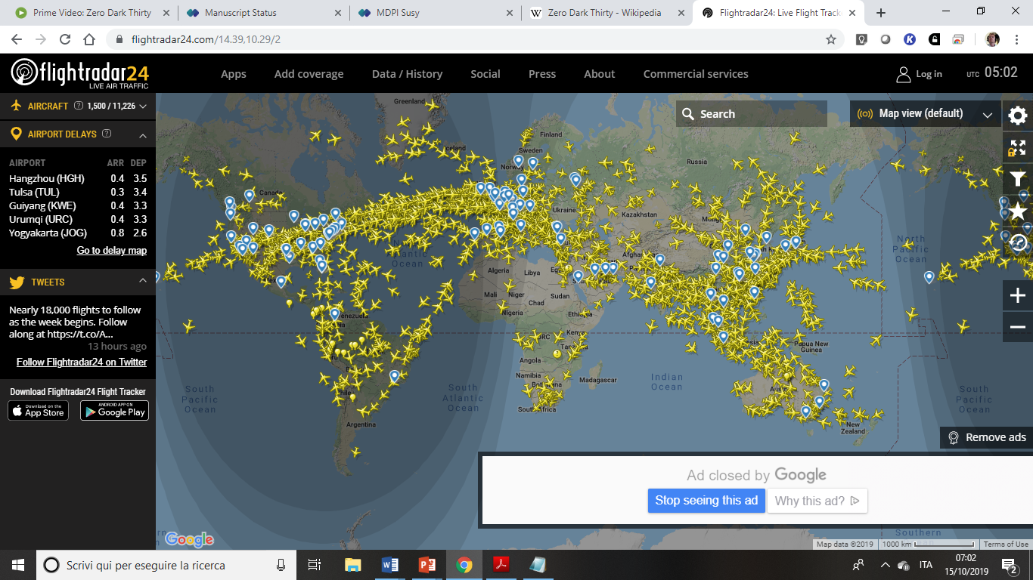
https://www.flightradar24.com/14.39,10.29/2

Slide 17
Relative advantages of different transport modes
Transport | Main technical advantage | Use
Rail | Minimal resistance to movement, general flexiibility, safety | Interurban transport of goods and containers. Not good for short range
Motorway | Flexibililty (in terms of routes); high speed and easiness of movement | Individual transport. Average size of goods moved; door-to-door; interurban and short range transport
Inland waterway | High productivity and low power per tonn | Low – speed movement of goods of bulky dimension and low added value
Air transport | High speed | High added value goods if compared to mass and volume (2% of global merchandise weight; 40% of value!)
Pipelines | Continuous flow. Top reliability and safety | Liquids (pipelines) and gas where volumes are high and delivery is needed as continuous
Haggett, 2001, p. 244 (da HAY W.H., An introduction to Transportation Engineering, New York, Wiley, 1961. p. 283

Slide 18
Transport modes and network structures
Transport/ communication | Object of transport | Nodes | Arcs | Flows
Road transport | Passengers/goods | cities; auto-port, airports, intersections | Road / motorway segments | Vehicles, passengers, goods
Rail transport | Passengers/goods | stations; intersections | Railway lines | Trains, passengers, goods
Air transport | Passengers/goods | Airports | Air routes | Airplanes/, passengers, goods
Maritime transport | Passengers/goods | Ports | Maritime roues | Ships/, passengers, goods
Pipelines | Commodities, raw materials; energy | Interchange stations (production sites / transfomartion sites) | Pipelines | m3; tonn of raw materials; commodities
Telecommunications | Data (information; messagges) | Transmission points / stations | Telephone cables; trans-oceanic cables | Data / information

Slide 19
Performance Comparison for Selected Freight Modes
Vehicle
Capacity
Truck Equivalency
1500 Tons
52,500 Bushels
453,600 Gallons
57.7
(865.4 for 15 barges in tow)
Barge
100 Tons
3,500 Bushels
30,240 Gallons
Hopper car
3.8
10,000 Tons
350,000 Bushels
3,024,000 Gallons
100 car train unit
384.6
26 Tons; 910 Bushels
7,865 Gallons
9,000 for a tanker truck
1
Semi-trailer truck
5,000 TEU
2,116
Panamax containership
300,000 tons
2 million barrels of oil
9,330
VLCC
124 tons
5
747-400F
Notes:
Note: modes are not to scale.

