Slide 1

Economic Geography
4 – Transport and location
121EC
A.Y. 2023/2024
Dr. Giuseppe Borruso
Department of Economics, Business, Mathematics and Statistics
University of Trieste
E-mail. giuseppe.borruso@econ.units.it
Ph. +39 040 558 7008
Skype: giuseppe.borruso
Notes:
Slides with (*) in footnotes have been modified by Jean-Paul Rodrigue materials. (see copyright). I have modified and elaborated materials in order to be suitable for the current course.
Copyright © 1998-2010, Dr. Jean-Paul Rodrigue, Dept. of Global Studies & Geography, Hofstra University. For personal or classroom use ONLY.

Slide 2
Learning Objectives
In this lesson we will:
  Introduce the importance of Transport in Location;
  Present the factors characterizing a transport system;
  Examine the growth factors in transport demand;
  Scale of spatial organization of transport
  The spatial structure of transport costs
  Route selection issues

Slide 3
The “Last Mile” in Freight Distribution
Massification
Atomization
Frequency
Capacity
GLOBAL
HINTERLAND
REGIONAL
LOCAL
Shipping Network
Corridor
Segment
Customer
“Last Mile”
Gateway
Inland
Terminal
Distribution
Center

Slide 4
Networks

Slide 5
Point to point vs Hub & Spoke
A
A
B
C
B
C
E
D
D

Slide 6

Point to point vs Hub & Spoke
A
A
B
C
B
C
E
D
D

Slide 7
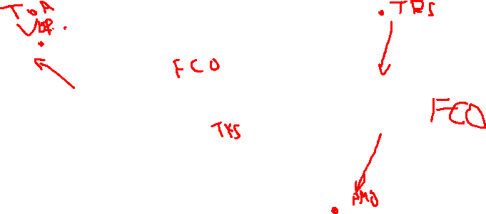
Gateways and Hubs
Gateway
Hub
Corridor

Slide 8

Modal
Gateways
Land
Logistics
Border
Manufacturing
Air
Maritime

Slide 9
Airline Deregulation and Hub-and-Spoke Networks
Before Deregulation
After Deregulation
Hub
Hub

