Slide 1

Economic Geography
6 – Transport and location
121EC
A.Y. 2023/2024
Dr. Giuseppe Borruso
Department of Economics, Business, Mathematics and Statistics
University of Trieste
E-mail. giuseppe.borruso@econ.units.it
Ph. +39 040 558 7008
Skype: giuseppe.borruso
Notes:
Slides with (*) in footnotes have been modified by Jean-Paul Rodrigue materials. (see copyright). I have modified and elaborated materials in order to be suitable for the current course.
Copyright © 1998-2010, Dr. Jean-Paul Rodrigue, Dept. of Global Studies & Geography, Hofstra University. For personal or classroom use ONLY.

Slide 2
Learning Objectives
In this lesson we will:
  Introduce the importance of Transport in Location;
  Present the factors characterizing a transport system;
  Examine the growth factors in transport demand;
  Scale of spatial organization of transport
  The spatial structure of transport costs
  Route selection issues

Slide 3
Air transport

Slide 4
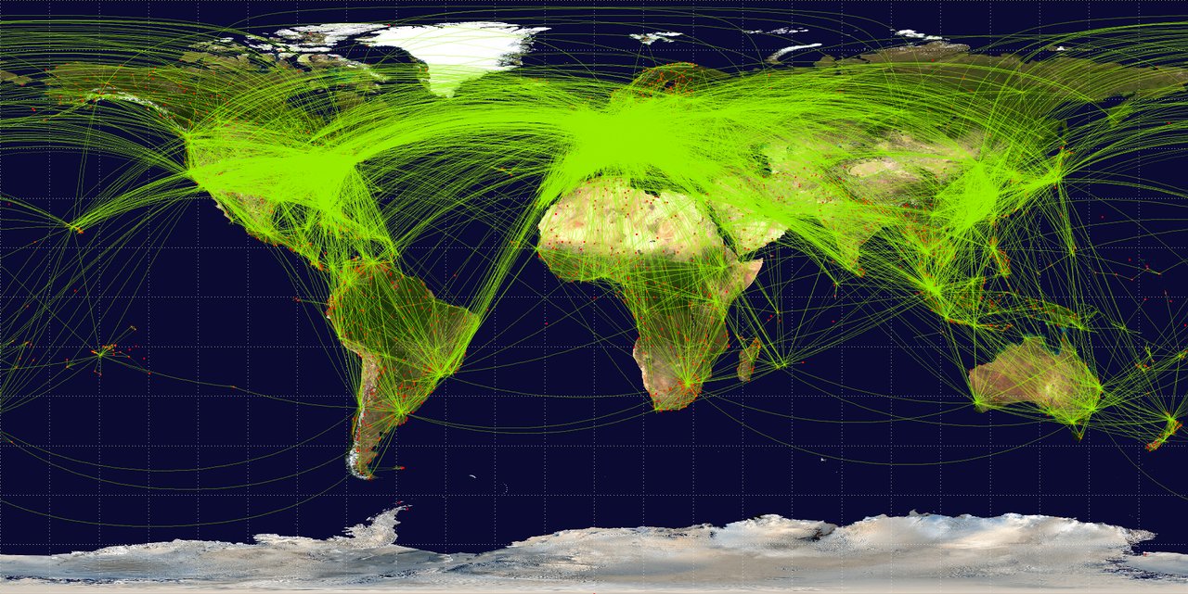
Route map of the world's scheduled commercial airline traffic, 2009
By Jpatokal (Own work) [CC BY-SA 3.0 (http://creativecommons.org/licenses/by-sa/3.0)
or GFDL (http://www.gnu.org/copyleft/fdl.html)], via Wikimedia Commons
Notes:
Map of scheduled airline traffic around the world, circa June 2009. Contains 54317 routes, rendered at 25% transparency. Base map is NASA Blue Marble (PD) plus airports from file:World-airport-map-2008.png, route data is from Airline Route Mapper, rendering by OpenFlights (Open Database License). PHP source code for rendering available at the OpenFlights SVN.

Slide 5
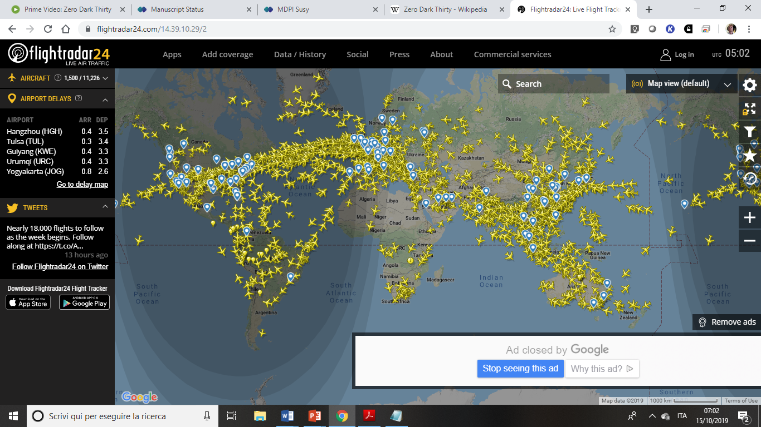
https://www.flightradar24.com/14.39,10.29/2

Slide 6
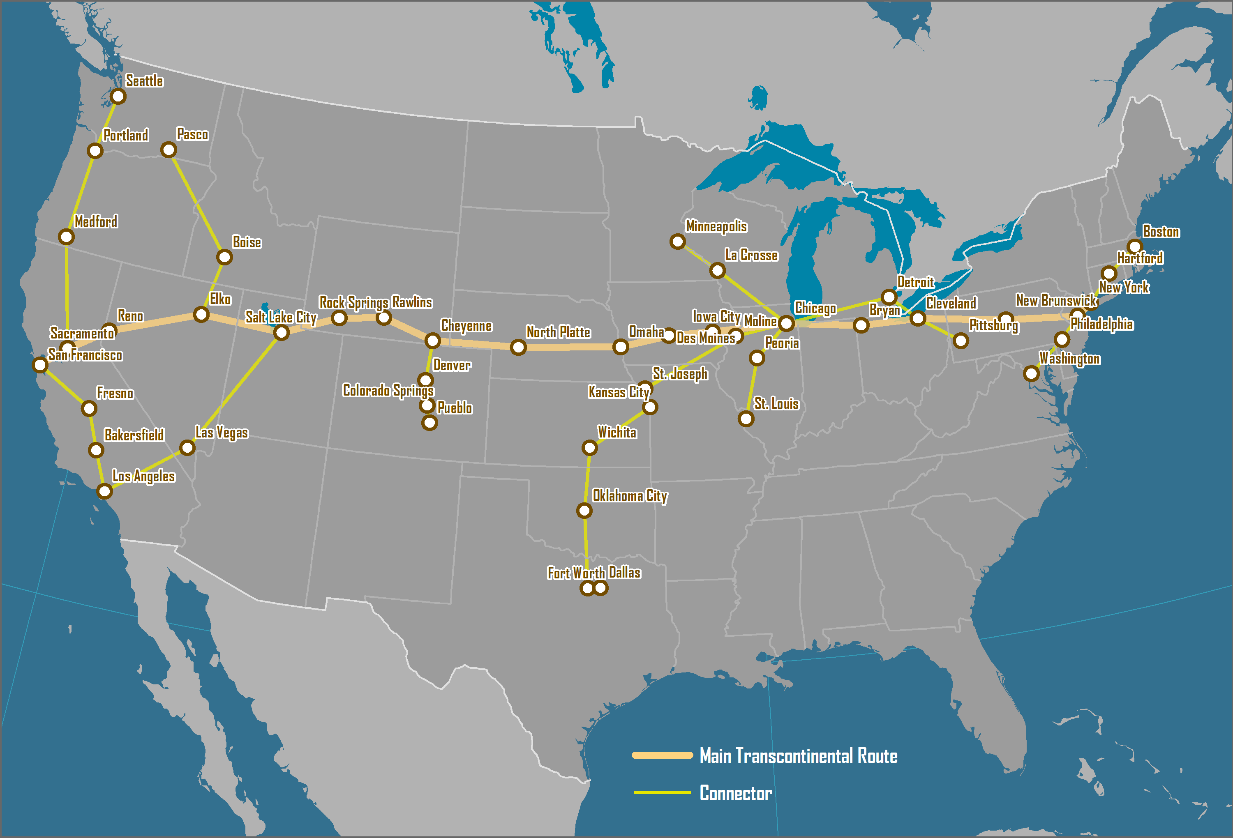
US Post Office Airmail Routes, 1921-26
Notes:
Source: adapted from C. Allaz (2005) History of Air Cargo and Airmail from the 18th Century, London: Christopher Foyle Publishing.

Slide 7
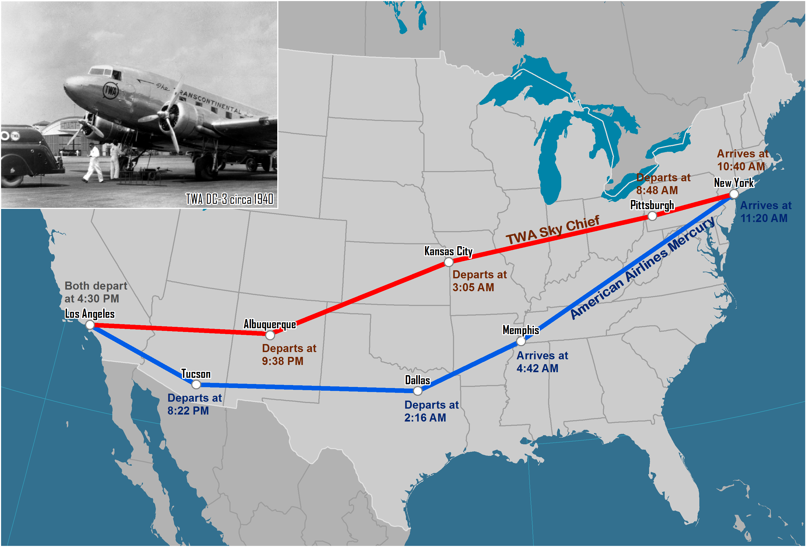
Selected Transcontinental DC-3 Routes, Late 1930s
Notes:
Source: Based on historic timetables available at www.airchive.com.

Slide 8
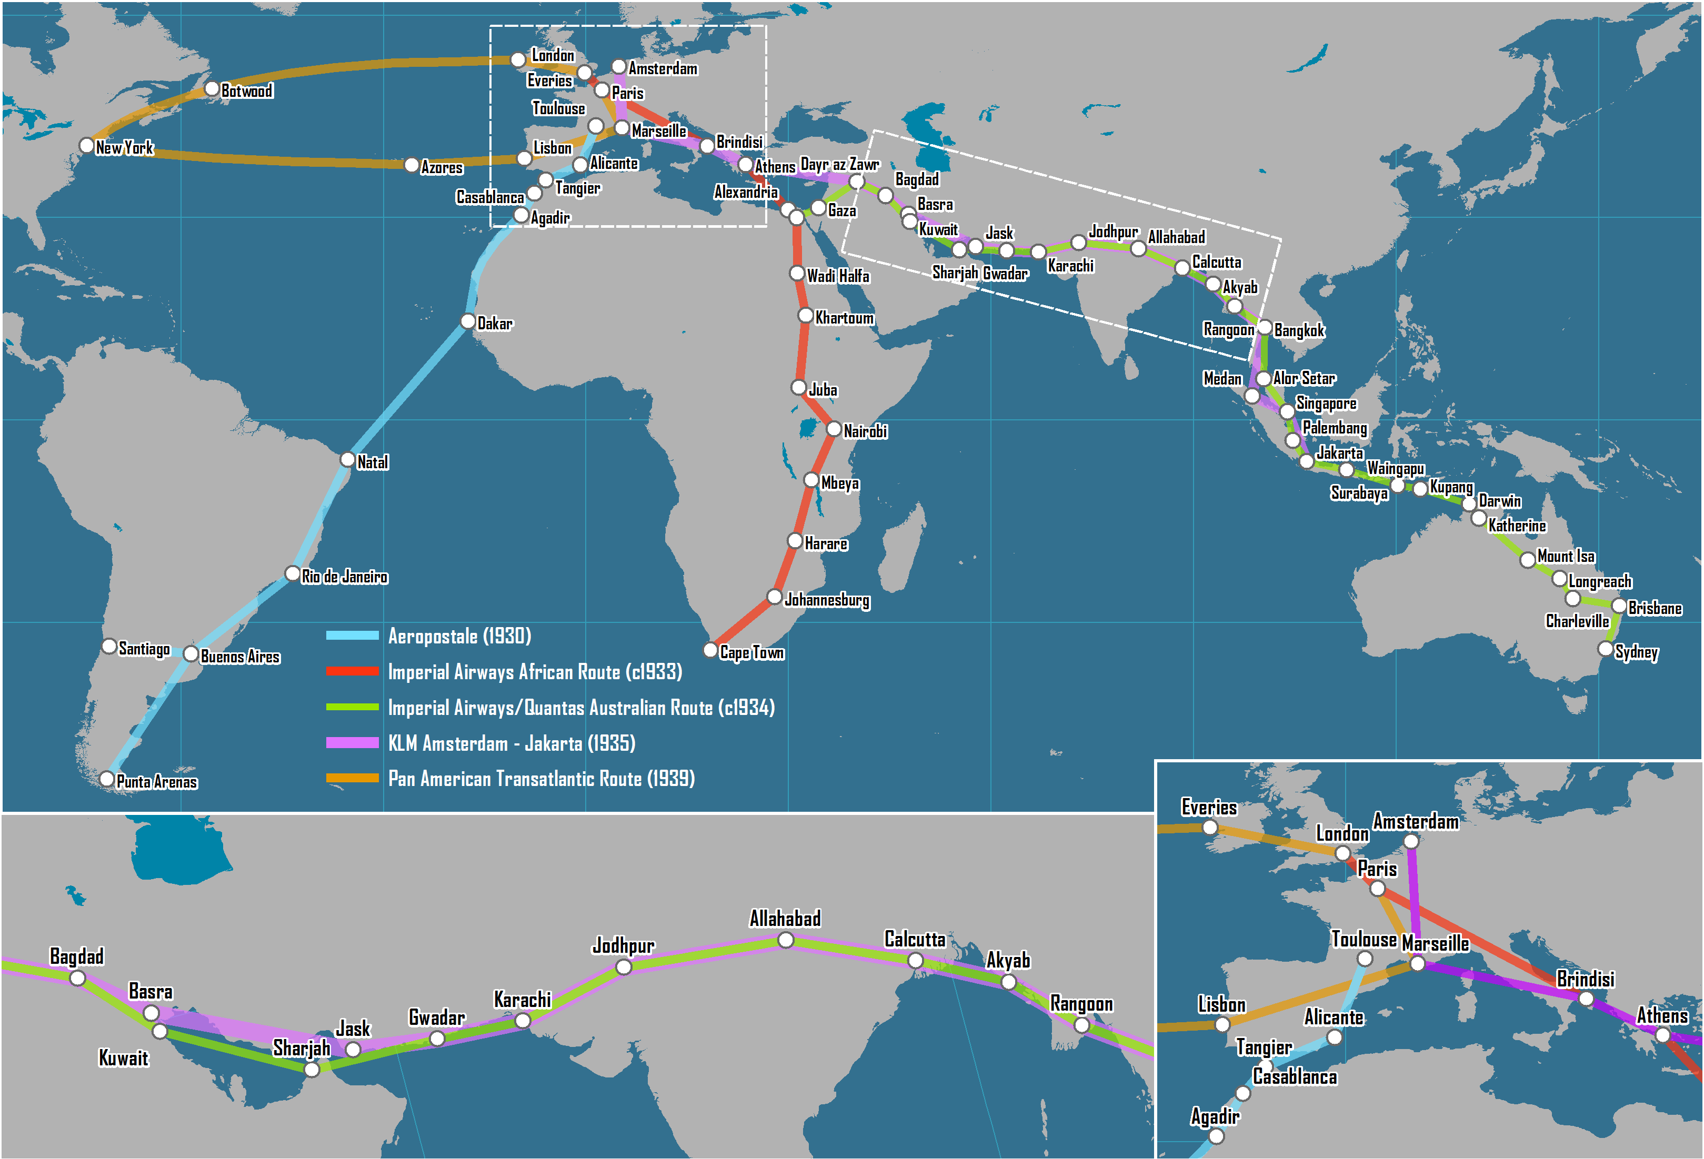
Early Intercontinental Air Routes, 1930s
Notes:
Source: adapted from B. J. Graham (1995) Geography and Air Transport, New York: Wiley, p. 13.

Slide 9
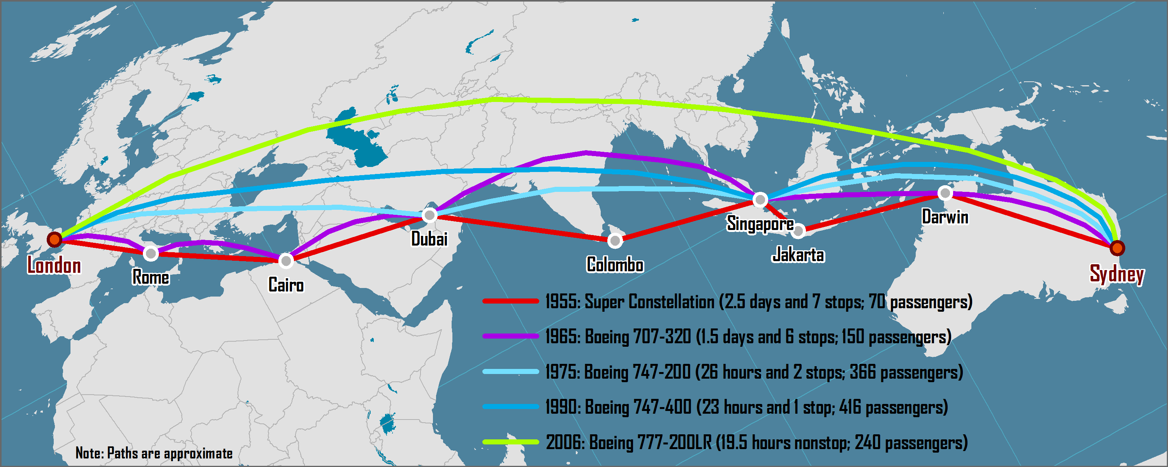
Shortest Air Route between London and Sydney, 1955 - 2006

Slide 10
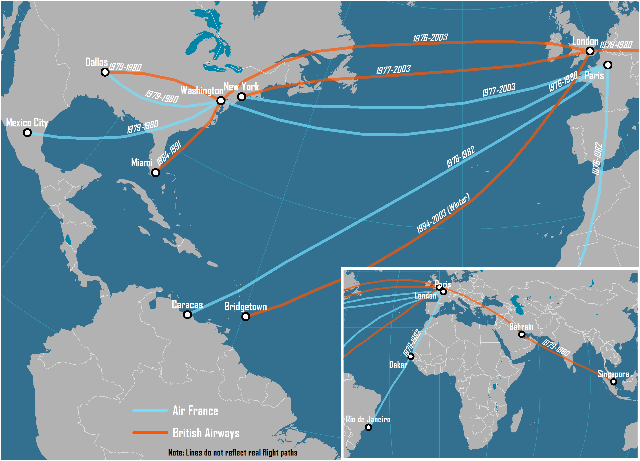
Concorde Services, 1976-2003

Slide 11
Average Airfare (roundtrip) between New York and London, 1946-2015 (in 2012 dollars)
Notes:
Source: Updated from Bowen, J. (2004) “World-Shapers: The Geographical Implications of Several Influential Jet Aircraft”, paper presented at the 2004 Conference of the American Association of Geographers.

Slide 12
Main Commercial Passenger Aircraft, 1935-2015
Aircraft | Year of First Commercial Service | Speed (km/hr) | Maximum Range at Full Payload (km) | Seating Capacity
Douglas DC-3 | 1935 | 346 | 563 | 30
Lockheed L-649 Constellation | 1943 | 560 | 8,200 | 95
Douglas DC-7 | 1953 | 555 | 7,500 | 105
Boeing 707-100 | 1958 | 897 | 6,820 | 110
Boeing 727-100 | 1964 | 870 | 4,300 | 134
Boeing 737-200 | 1967 | 780 | 3,500 | 97
Boeing 747-100 | 1970 | 907 | 9,045 | 385
McDonnell Douglas DC-10 | 1971 | 908 | 7,415 | 260
Airbus A300 | 1974 | 847 | 3,420 | 269
Boeing 767-200 | 1982 | 954 | 5,855 | 216
Boeing 747-400 | 1989 | 939 | 13,444 | 416
Boeing 777-200ER | 1995 | 1030 | 14,300 | 300
Airbus A340-500 | 2003 | 886 | 15,800 | 313
Airbus A380 | 2007 | 1050 | 14,800 | 544
Boeing 787-8 | 2012 | 902 | 15,700 | 250
Airbus A350 | 2015 | 902 | 15,200 | 280
Notes:
Source: adapted from T.R. Leinbach and J.T. Bowen (2004) Airspaces: Air Transport, Technology and Society, in D.B. Brunn, S.L. Cutter and J.W. Harrington (eds) Geography and Technology, Dordretch, The Netherlands: Kluwer.

Slide 13
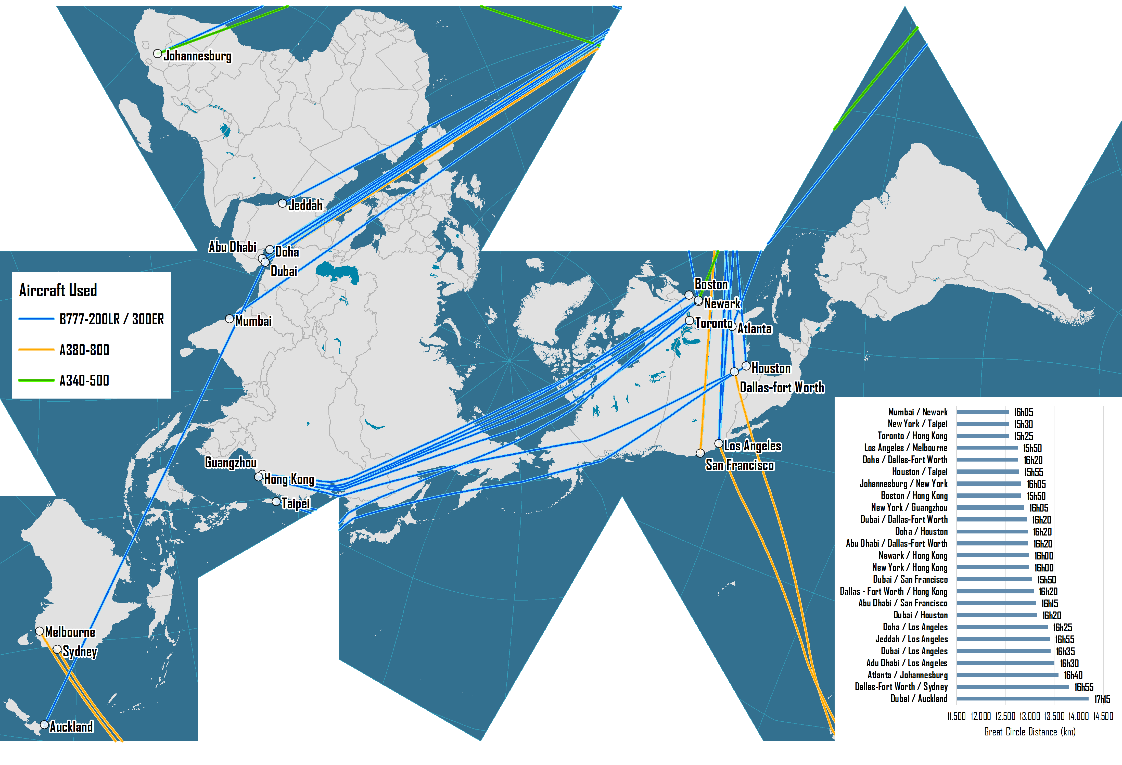
The World's Longest Nonstop Air Transport Routes, 2016

Slide 14
World Air Travel and World Air Freight Carried, 1950-2015
Notes:
Source: Airlines for America.
http://airlines.org/data/annual-results-world-airlines/

Slide 15
Annual Air Transportation Growth (Passengers and Freight) and Economic Growth, 1950-2015
Notes:
Source: Air Transport Association and Worldwatch Institute.

Slide 16
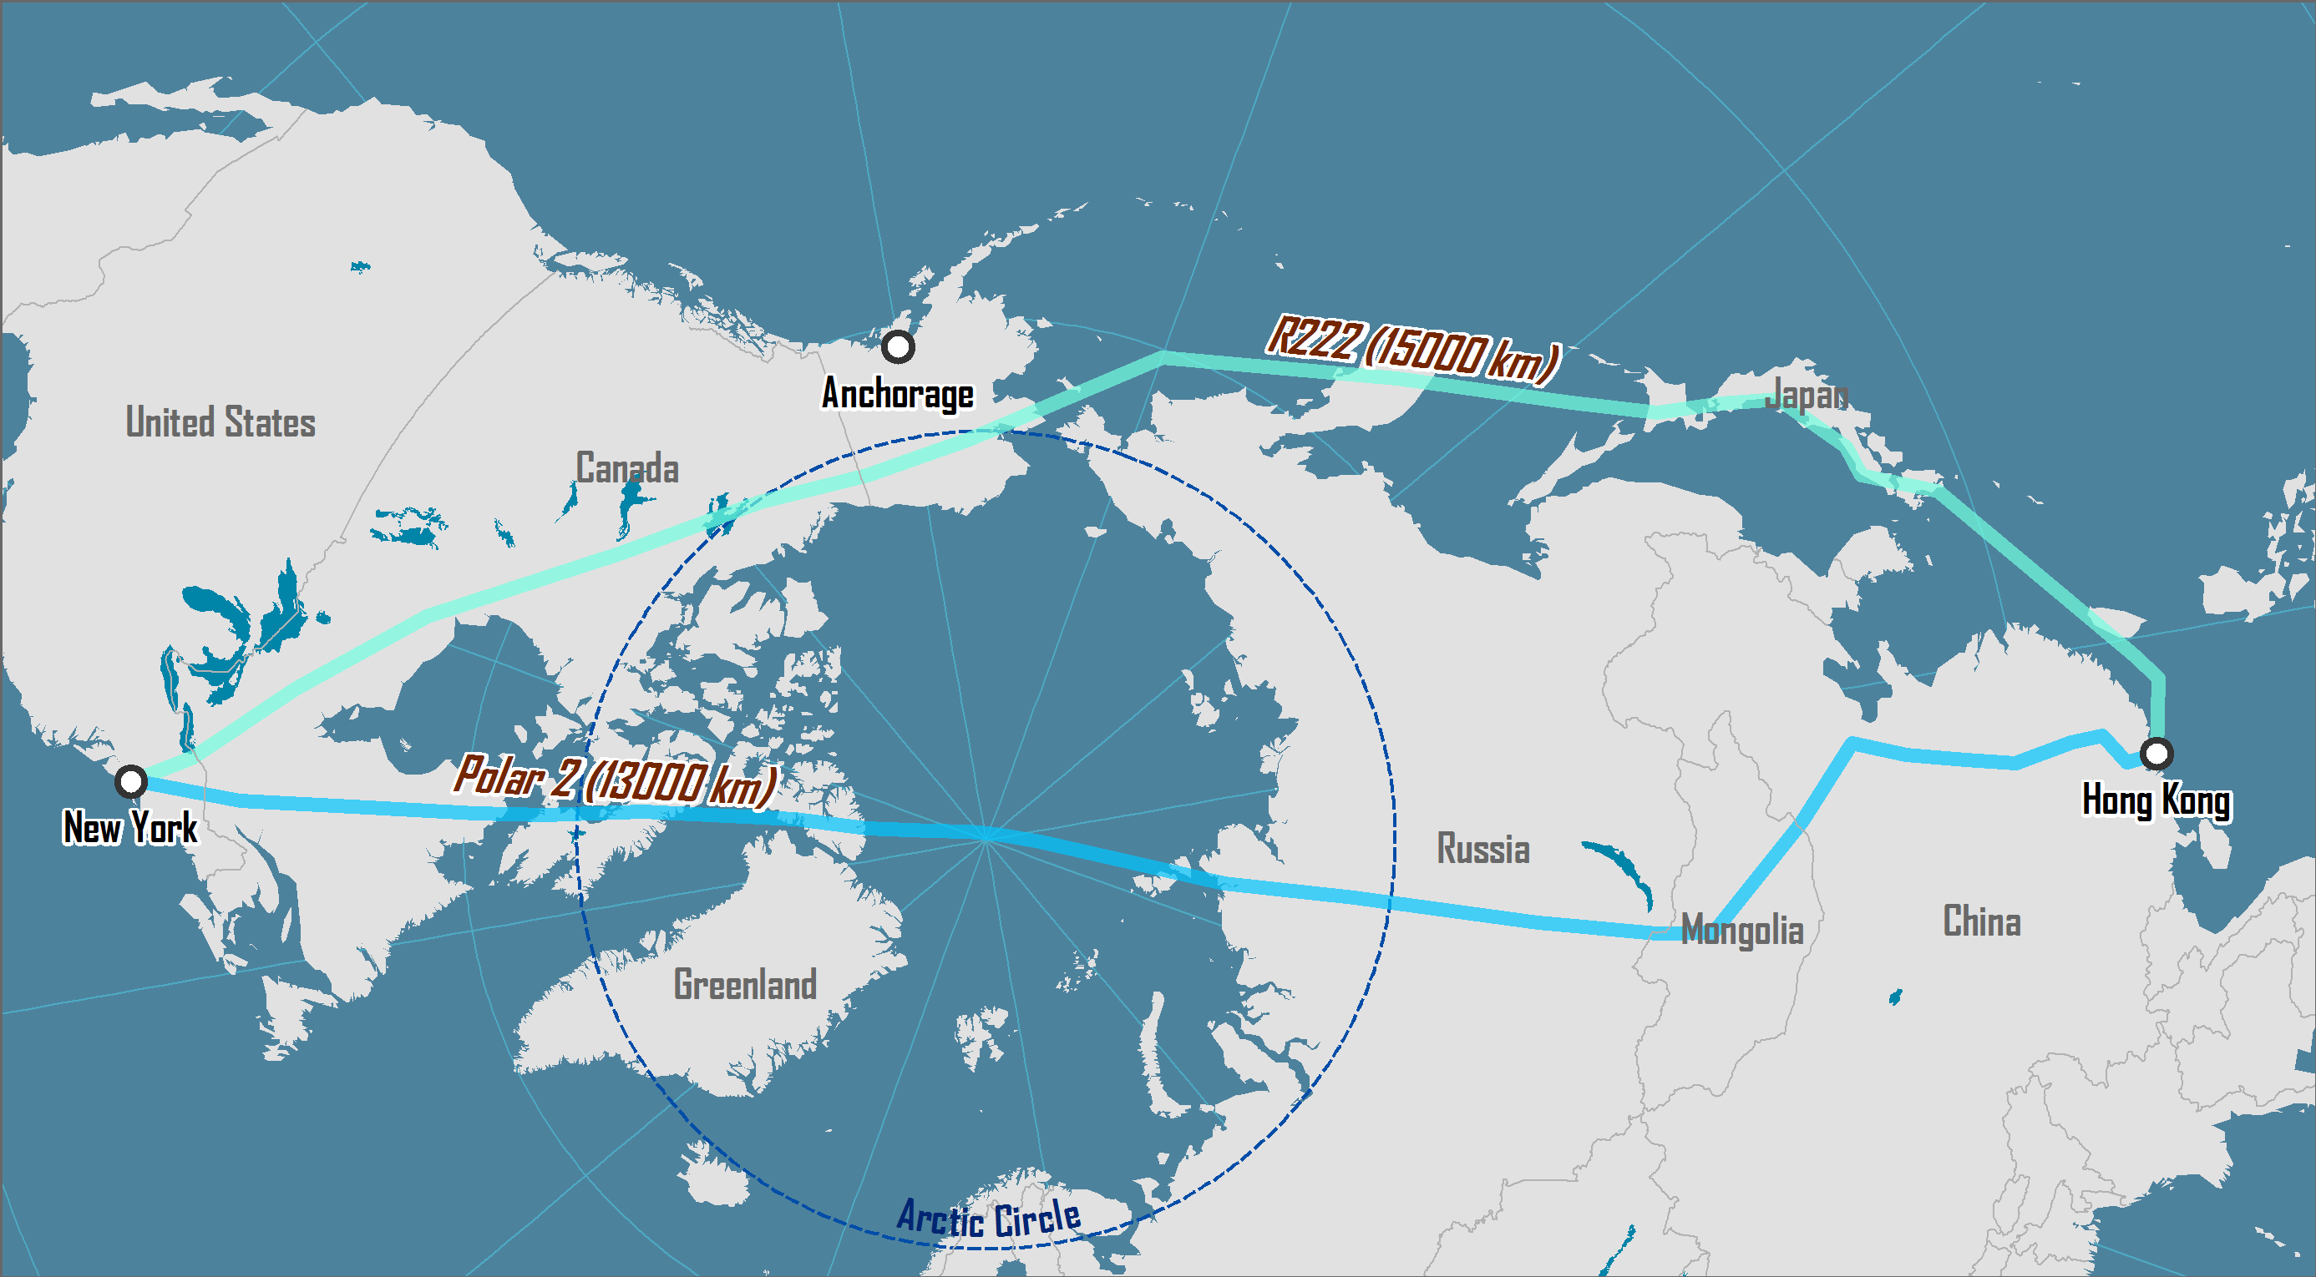
New York / Hong Kong Air Routes: Conventional and Polar

Slide 17
Airline Deregulation and Hub-and-Spoke Networks
Before Deregulation
After Deregulation
Hub
Hub

Slide 18
Strategies of Low-Cost Carriers
On-board operations | Optimum use of seating space. Minimal crew. Limited and paying cabin service.
Aircraft operations | Few (often one) types of aircraft used to minimize maintenance costs. Stair boarding instead of air bridges. Maximal usage of runway length (take-off thrust and braking on landing). Fast turn around to maximize aircraft use. No freight being carried.
Service network | Point-to-point services. Destinations commonly of less than two hours apart. Usage of secondary airports (lower gate rates).
Booking | Online booking to minimize transaction costs. No travel agent commissions.
Notes:
Source: adapted from Graham, B. and T. Vowles (2006) “Carriers within carriers: a strategic response to low-cost airline competition”, Transport Reviews, Vol. 26, pp. 105-126.

Slide 19
Strategies Used by Airlines to Save Fuel
Dimension | Strategy
Fleet | Retiring less fuel efficient aircrafts (e.g. DC-9, DC10, MD-80). Switching to more fuel efficient aircrafts (e.g. A330, A319).
Operations | Less engine idle at gates (electrical systems). Lower flying speed (-5%). More frequent plane and engine washing.
On board | Lighter seats. Removal of seat-pocket documents (e.g. magazines). Less water in bathrooms. Lighter service carts.
Passengers | Weight restrictions for luggage. Surcharges for first or second check-in luggage. Passengers weight surcharges (?)

Slide 20
Selected Low-Cost Carriers
Airline | Country | 2005 Fleet | 2005 Revenue (USD Millions)
Southwest | USA | 454 B737s | 7,584
EasyJet | UK | 62 A319s; 43 B737s | 2,365
Ryanair | Ireland | 107 B737s | 2,044
jetBlue | USA | 89 A320s; 19 ERJs | 1,701
Air Berlin | Germany | 8 A319s/A320; 40 737s; 3 Other | 1,457
Virgin Blue | Australia | 47 B737s | 1,335
WestJet | Canada | 56 B737s | 1,197
Gol | Brazil | 47 B737s | 1,140
Frontier | USA | 51 A318s/A319s/A320s | 944
AirAsia | Malaysia | 6 A320s; 21 B737s | 174
Notes:
Source: Air Transport World, July 2006.

Slide 21
Air Freedom Rights
First
Second
Third
Home
Country B
Country A
Fourth
Fifth
Sixth
Seventh
Eight
Ninth

Slide 22
Stages in Air Network Development
Stage 1
Stage 3
Stage 2
Stage 4
Notes:
Source: Adapted from O’Connor, K. (1995) “Airport Development in Southeast Asia”, Journal of Transport Geography, Vol. 3, No. 4, pp. 269-279.

Slide 23
Network Effect of Strategic Alliances
B
A
C
E
D

Slide 24
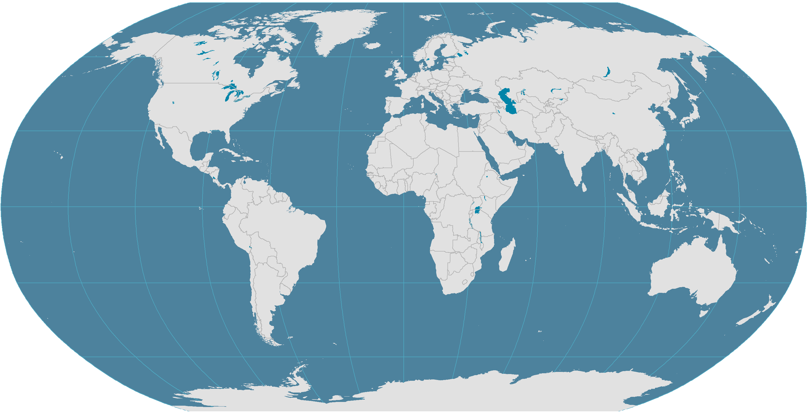
Major Air Traffic Flows Between Regions, 2010
North America
Europe
1.5%
8.7%
2.2%
13%
1.9%
1.1%
1.5%
19%
2.2%
2.9%
1.1%
1%
2.5%
7%
Northeast Asia
1.5%
2.8%
2%
1.6%
2.3%
1.7%
Middle East
1%
China
1.5%
1.1%
Central America
1.3%
1%
1%
South Asia
3%
Africa
Southeast Asia
2%
1.3%
South America
2%
Oceania
Notes:
Source: IATA, World Air Transport Statistics. In revenue passenger-km.

Slide 25
North America
Northeast Asia
Europe
Central America
China
Southeast Asia
South Asia
Oceania
South America
Middle East
Africa

Slide 26
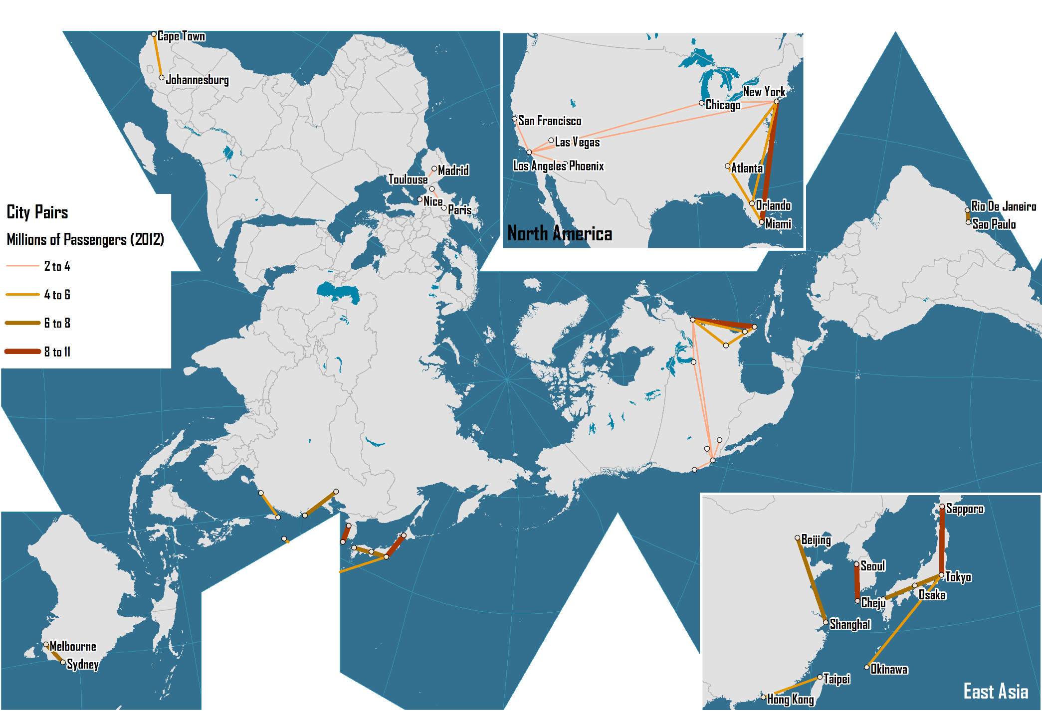
The World's Busiest Air Transport Routes, 2012
Notes:
Source: Amadeus.

Slide 27
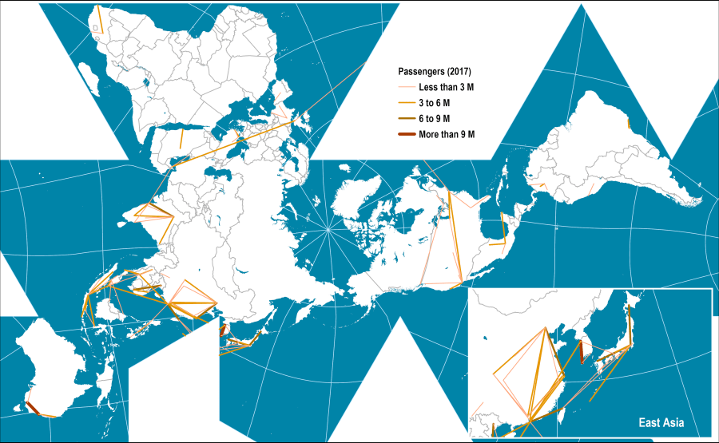
The World's Busiest Air Transport Routes, 2017
https://transportgeography.org/?page_id=2362

