Slide 1
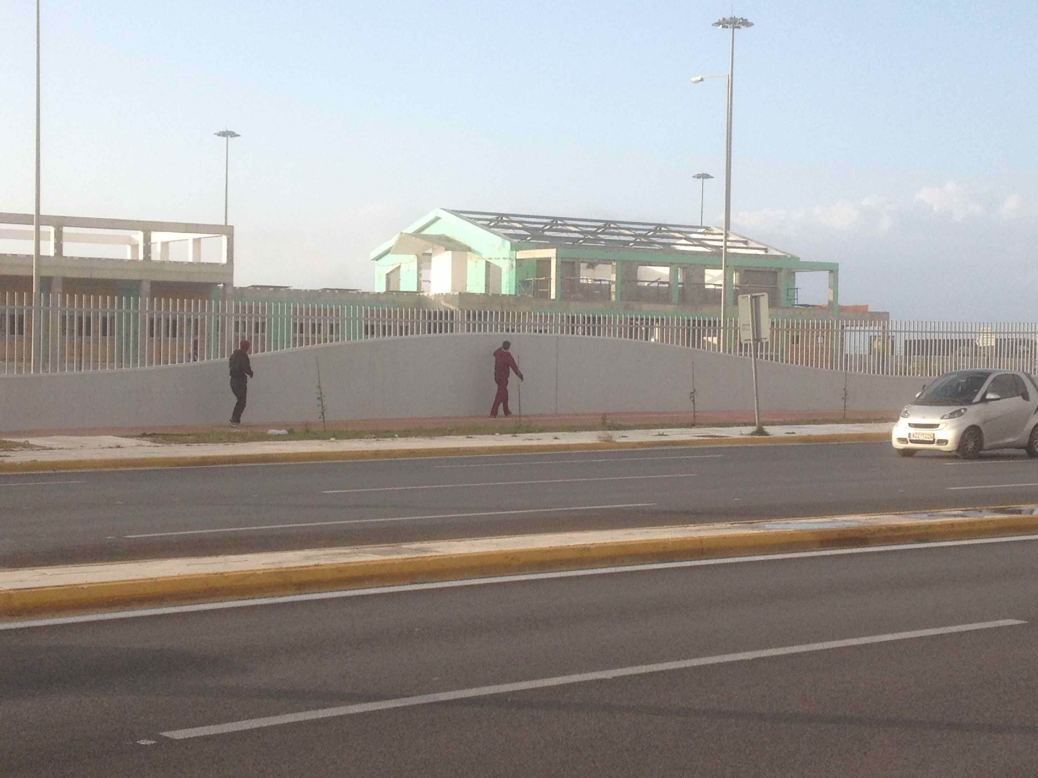


Afghani senza frontiere
Antropologia dei processi migratori
Alessandro Monsutti
Trieste, 16 novembre 2023

Slide 2
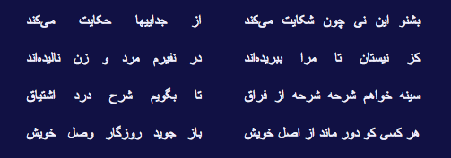
Listen to this reed as it is grieving; it tells the story of our separations.
Since I was severed from the bed of reeds, in my cry men and women have lamented.
I need the breast that’s torn to shreds by parting to give expression to the pain of heartache.
Whoever finds himself left far from home looks forward to the day of his reunion.
Jalaluddin Rumi (Mawlana, 1210-1273), Masnawi I, translated by Alan Williams, Rumi: Spiritual Verses, The First Book of the Masnavi-ye Ma'navi, London: Penguin, 2006.

Slide 3
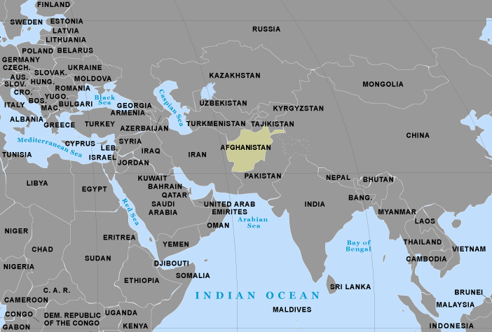
Afghanistan a marginal place; a crisis with global repercussions

Slide 4
Definition of a refugee
1951 United Nations Convention Relating to the Status of Refugees
A person who owing to a well-founded fear of being persecuted for reasons of race, religion, nationality, membership of a particular social group or political opinion, is outside the country of his nationality and is unable or, owing to such fear, is unwilling to avail himself of the protection of that country.
Durable solutions promoted by the UNHCR
Voluntary repatriation to the country of origin;
Local integration into the country of asylum;
Resettlement to a third country.

Slide 8
The transnational turn
Migration is no more a linear movement between a point of departure and a point of arrival;
It is a more complex circulation, an ongoing movement between two or more social spaces;
People maintain multiple ties using improved global transportation and telecommunication technologies;
The congruence of social space and territory is blurred;
Transnational social networks as systems.

Slide 9
Economic theories of migration
Neoclassical economics of migration: international migration is caused by geographic differences in the supply of and demand for labor (macro level); individual rational actors decide to migrate because a cost-benefit calculation leads them to expect a positive net return (micro level).
The new economics of migration: migration decisions are not made by isolated individuals, but by larger units of related people, typically households or extended families; the goal is not so much to maximize expected income, but to minimize risks by diversifying the allocation of household resources.

Slide 10
Three main theses
The normality of migration and the prior existence of transnational networks around Afghanistan;
The relevance of transnational networks for the social and economic reconstruction of Afghanistan;
The necessity to bring the existence of transnational networks and ongoing migration into the political debate.

Slide 11
Methodological implications
My research goal was to reconstruct the strategies mobilized by Afghans and not to highlight their motivations (for instance through the push and pull model); I asked how rather than why people migrate.
Focus on three flows or three “hows”
The spatial mobility of individuals, the migration routes, and the smuggling rings: how people travel? how do they cross fighting zones and international borders?
The transfer of goods and money, and the trading activities across international borders: how migrants send their savings to their family left in Afghanistan?
The circulation of information through visits, telephone, letters, and e-mail: how people communicate even if scattered and in spite of the absence of modern facilities in Afghanistan?

Slide 12
Policy implications
The three solutions to the refugee problems usually recommended and promoted by UNHCR are based on the idea that the movement must stop;
Considering the fact that ongoing migration is a tool of reconstruction and a constitutive feature of Afghan social life, there is a real necessity to go beyond these three solutions;
A more comprehensive solution that takes into account the strategies developed by the Afghan population. including the back and forth movements between Afghanistan, Iran and Pakistan, must be promoted.

Slide 13
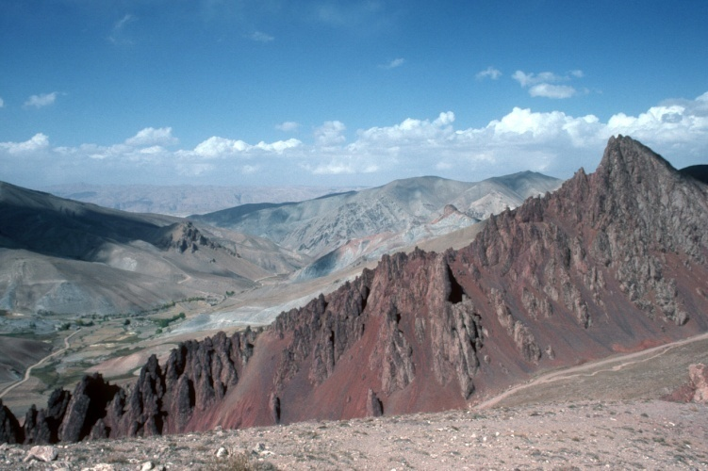
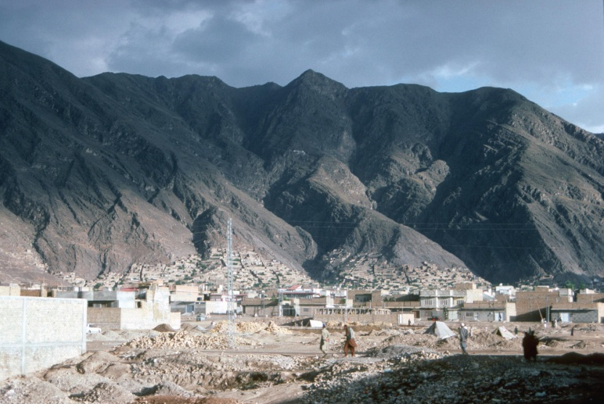
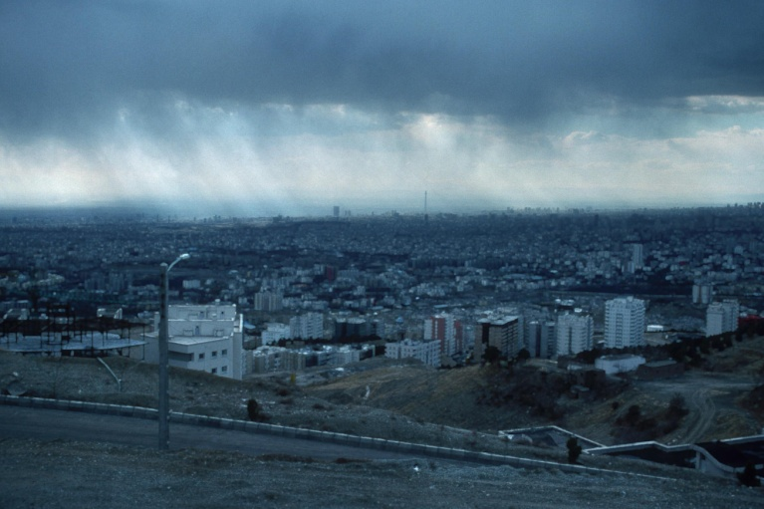
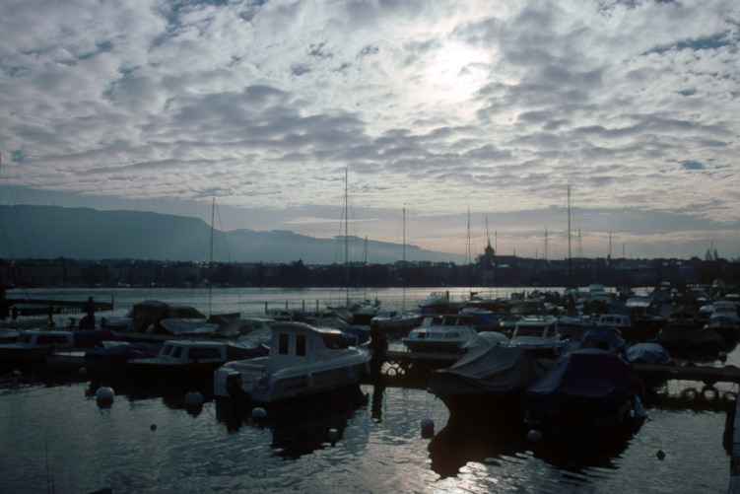
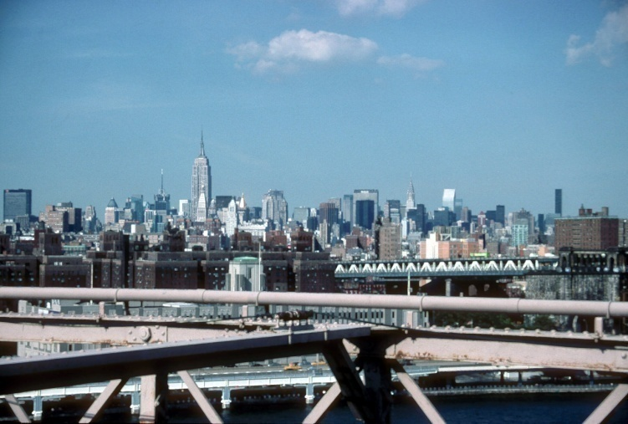
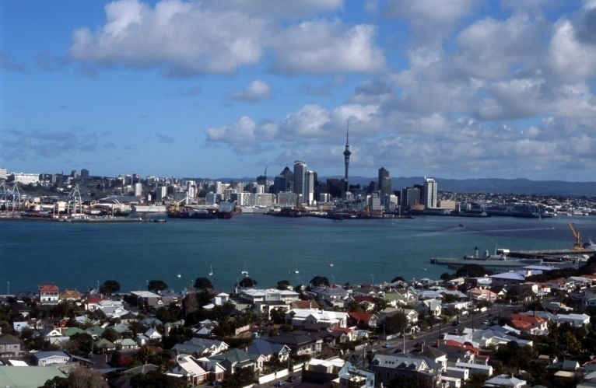
A multi-sited ethnography
Hazarajat
Quetta
Tehran
Geneva
New York
Auckland

Slide 14
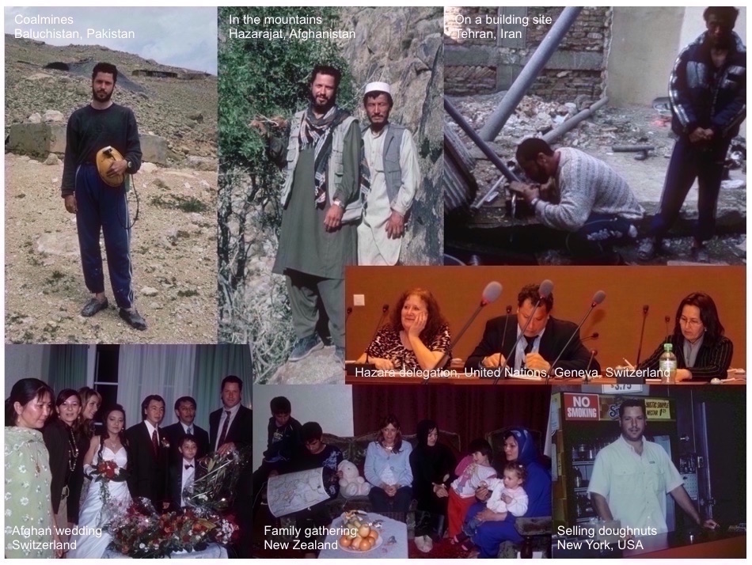

Slide 15
Main research sites in Afghanistan, Pakistan, and Iran

Slide 16
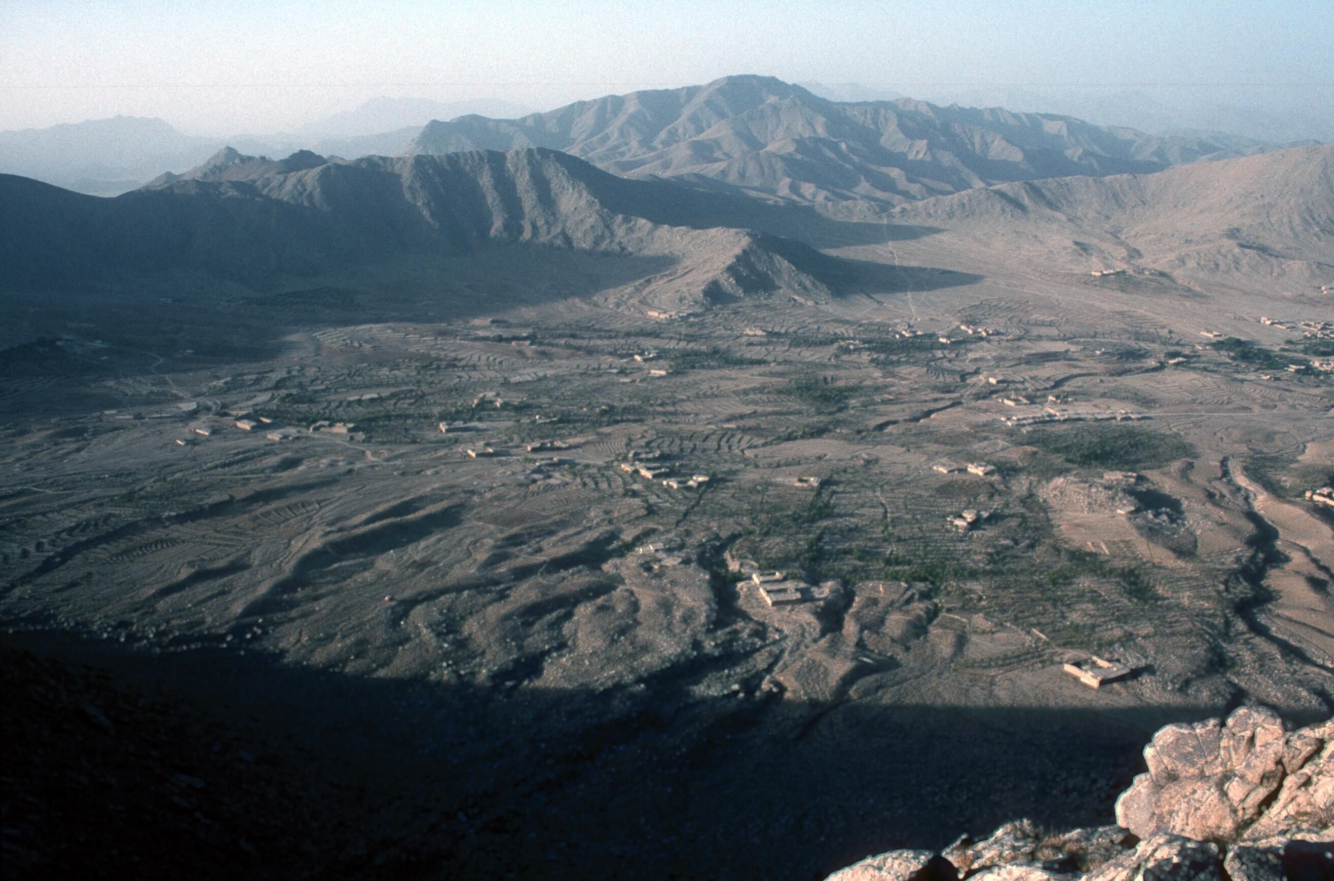

Slide 17
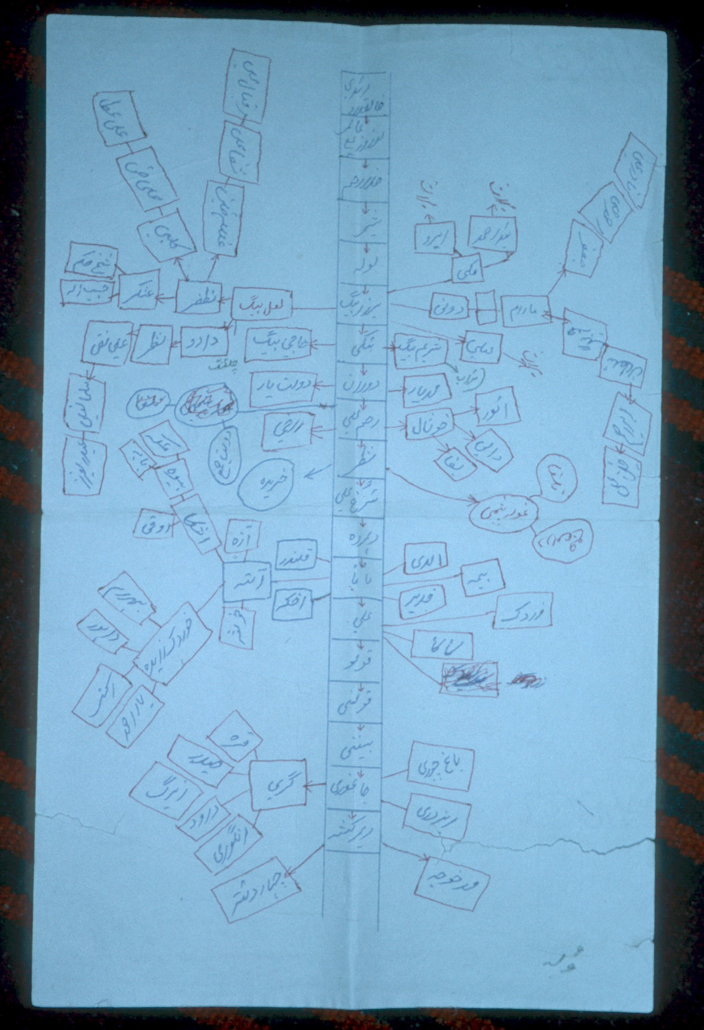

Slide 18
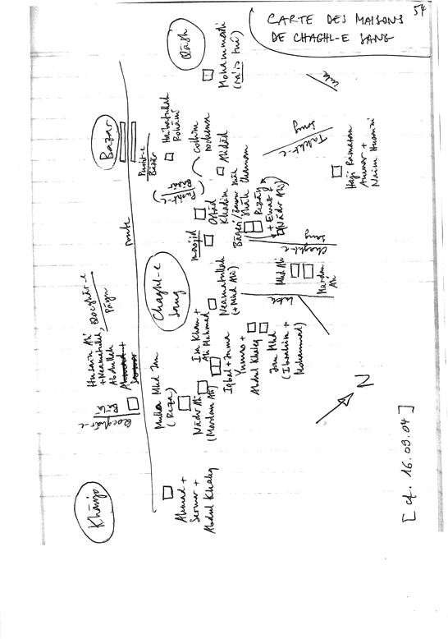

Slide 19
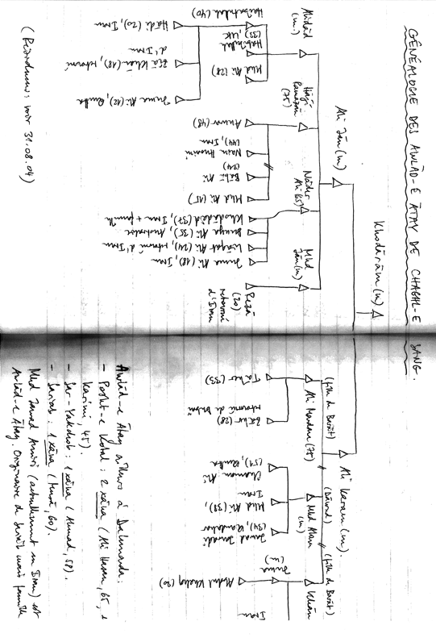

Slide 20

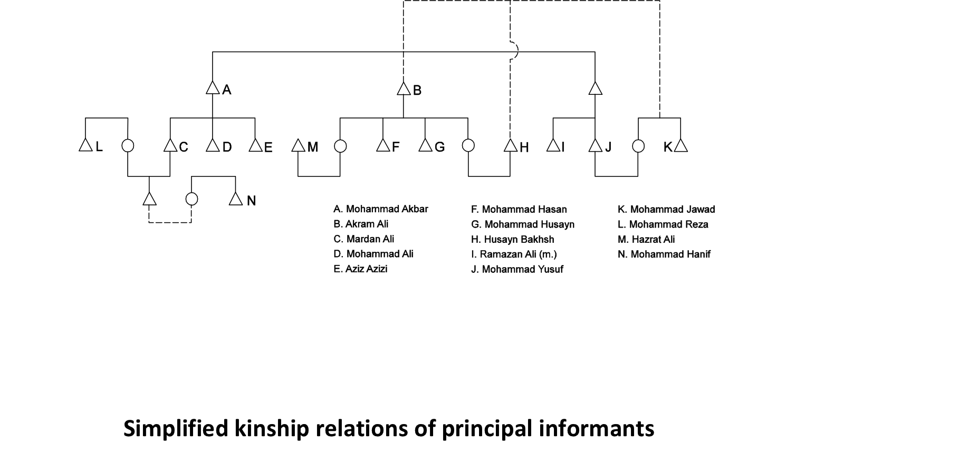

Slide 21
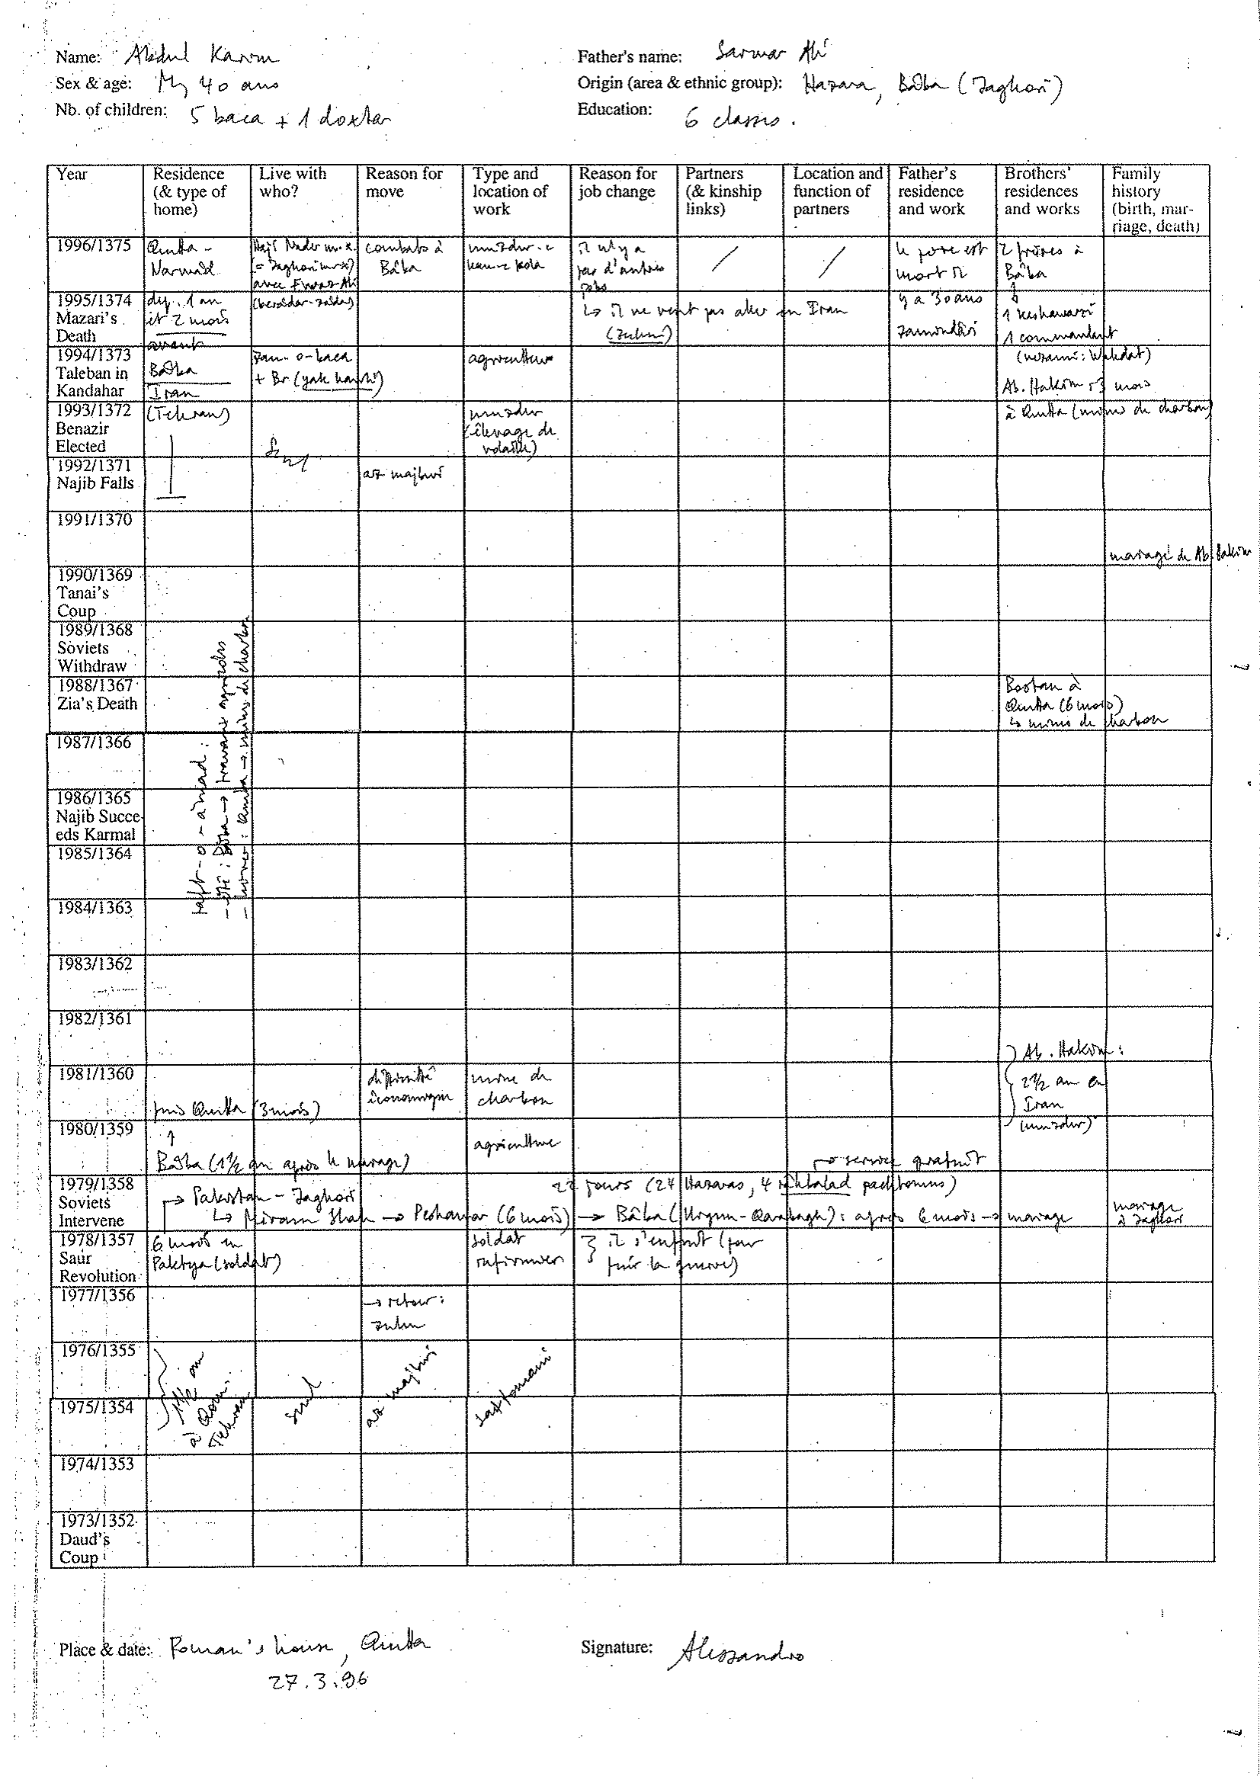

Slide 22
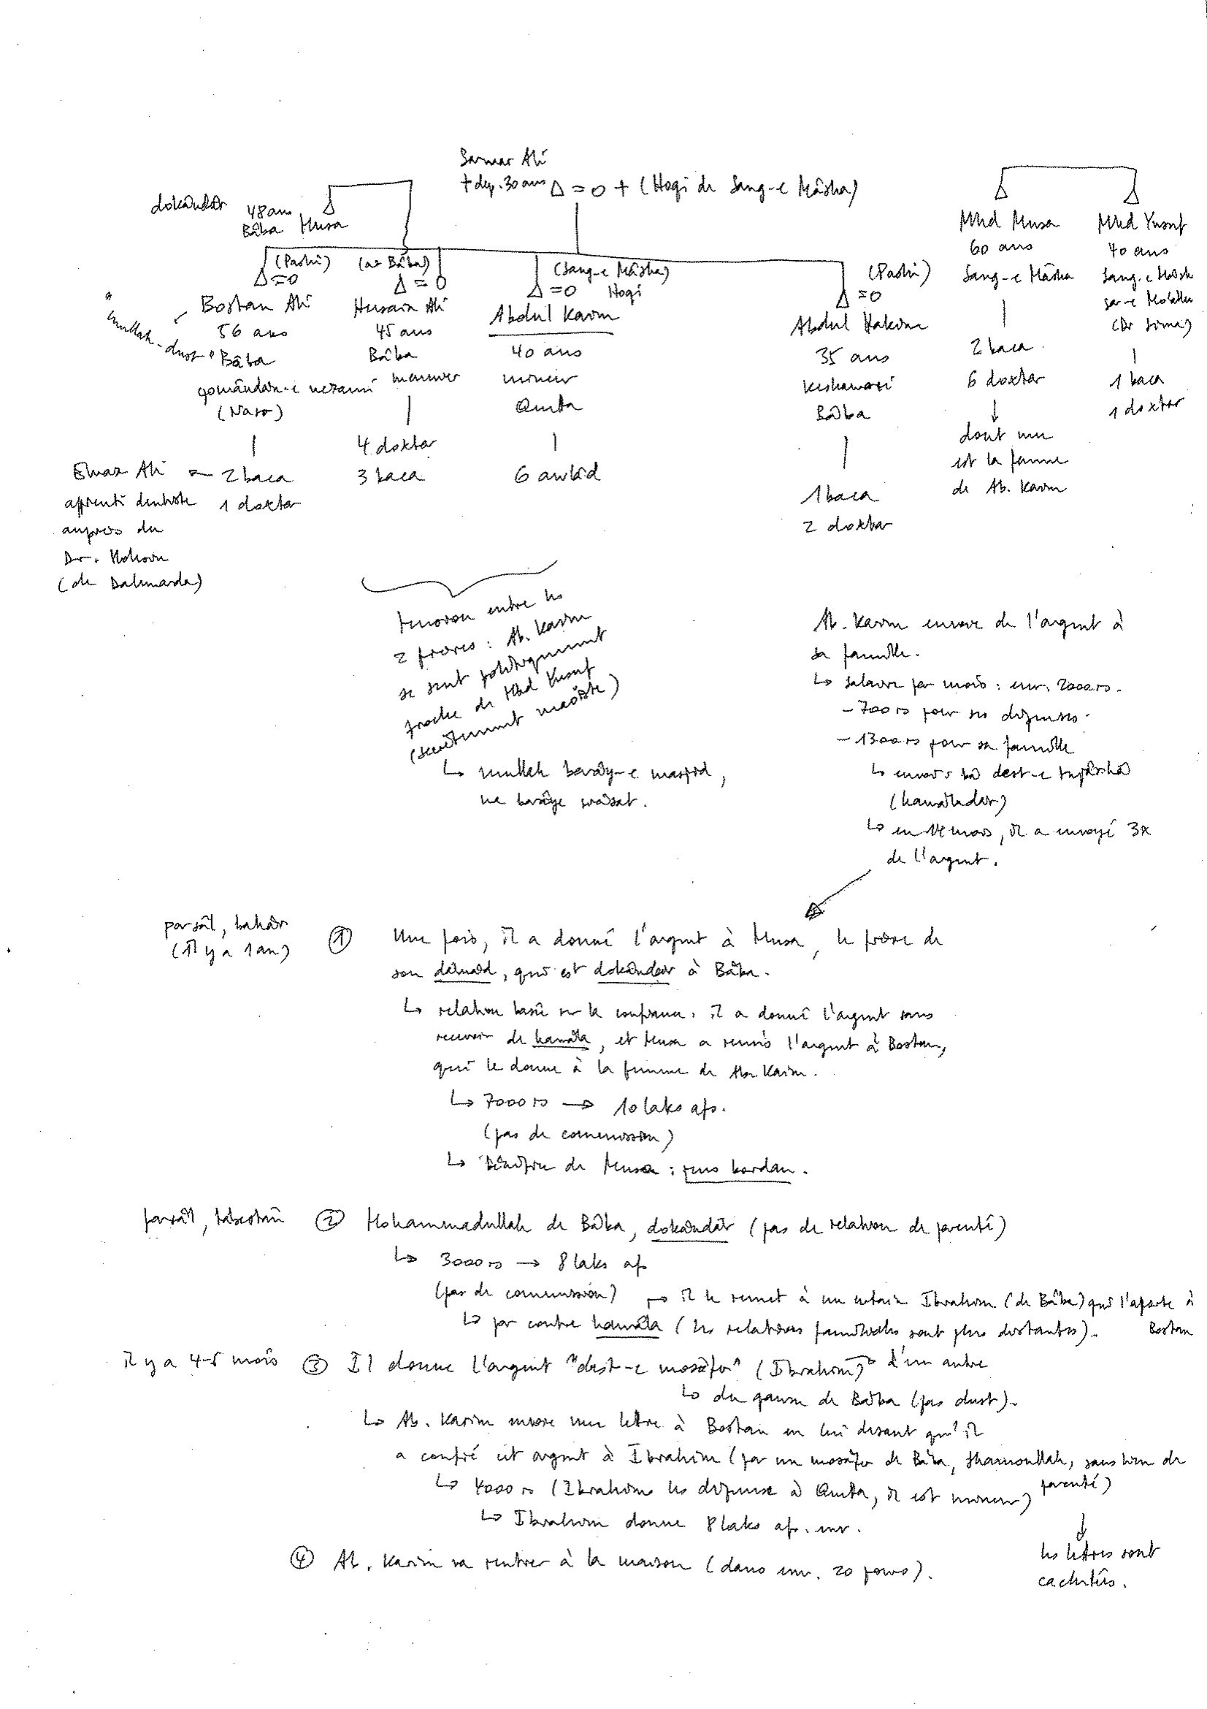

Slide 24
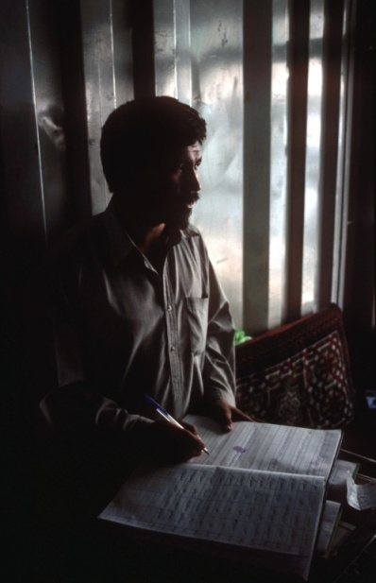
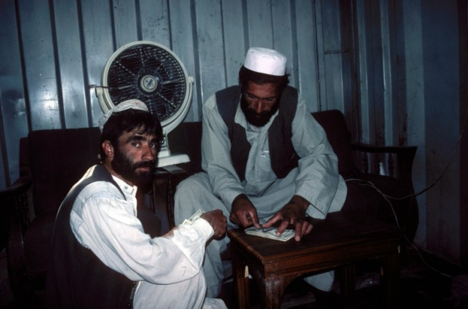
Remittances and Trade between Afghanistan, Pakistan, and Iran

Slide 25
Migration and the Hawâla System

Slide 26
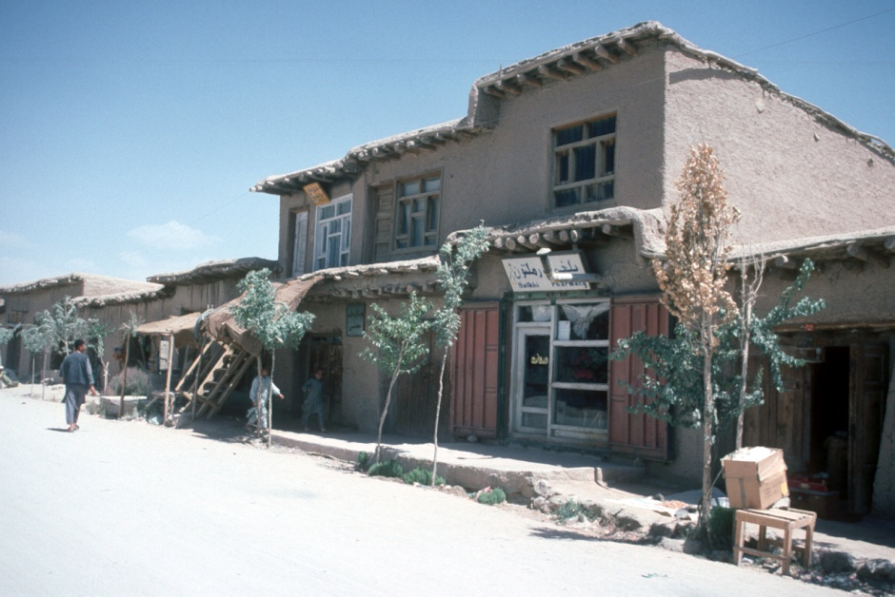
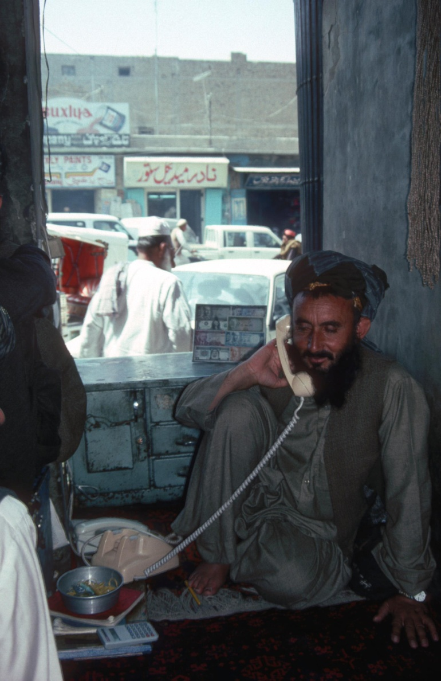
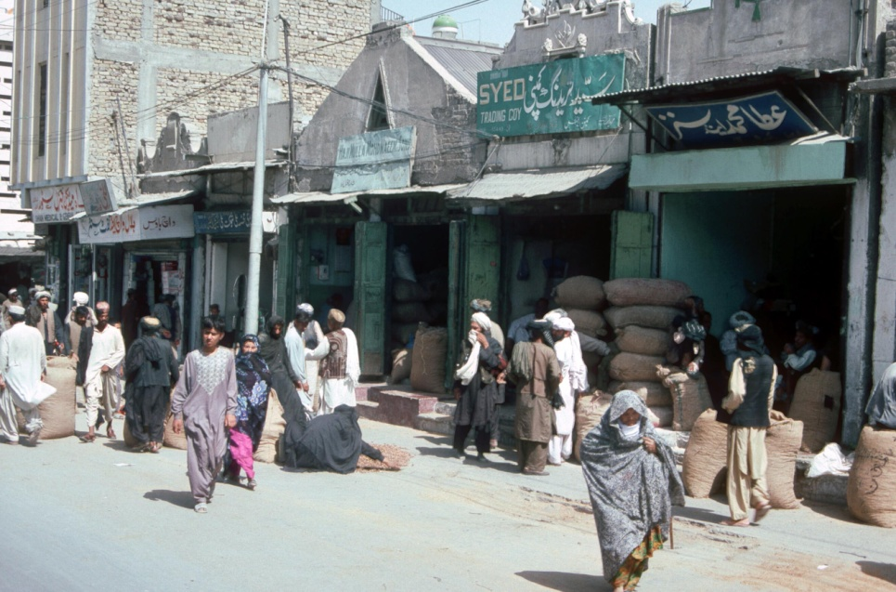

Slide 27
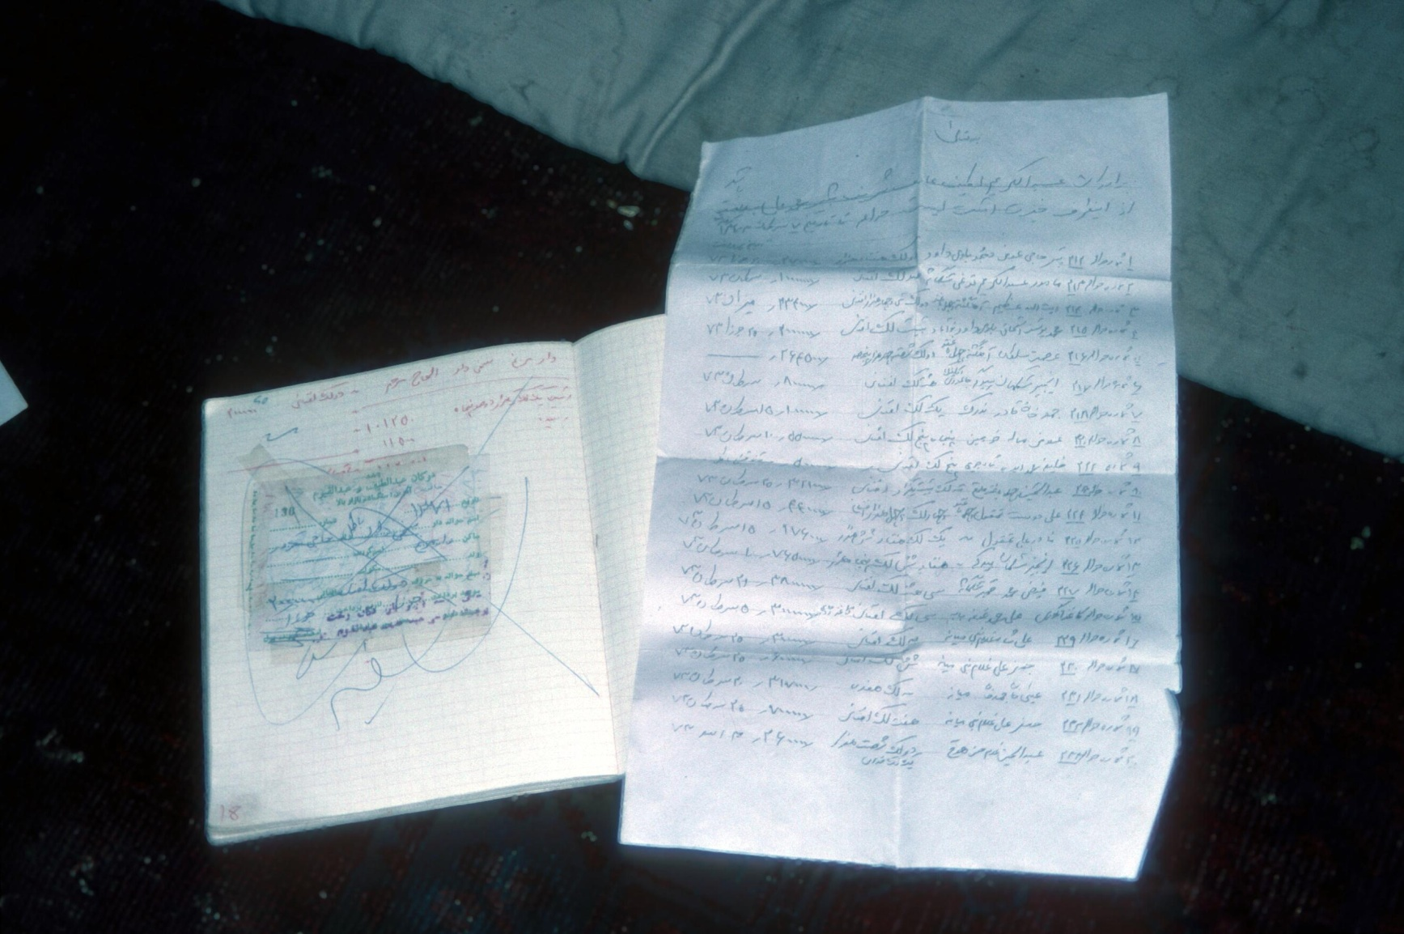

Slide 29
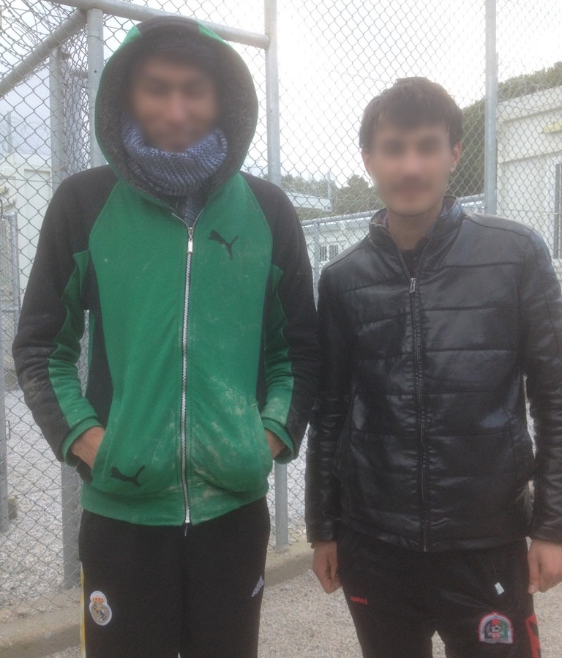
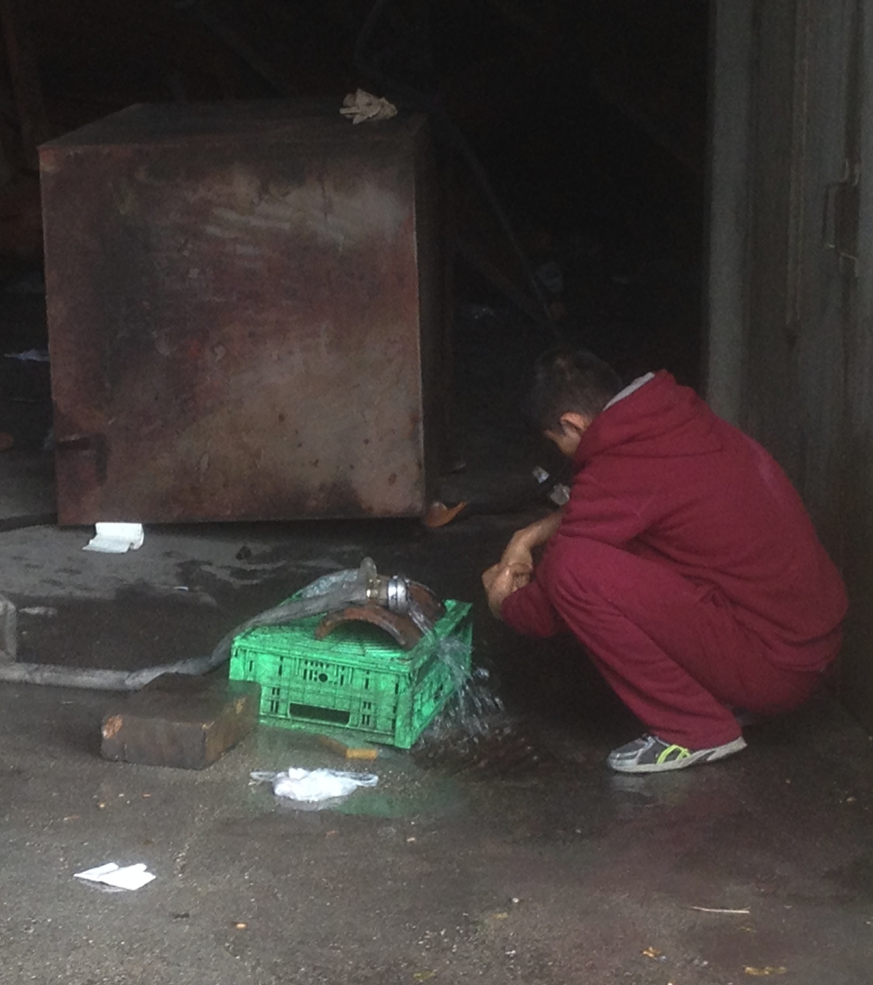
Vignette 1: Lesbos & Patras

Slide 30

Vignette 2: Friuli

Slide 31
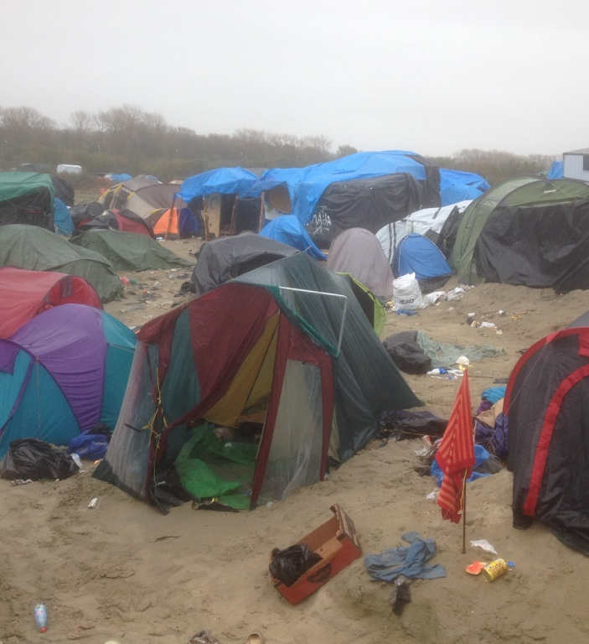
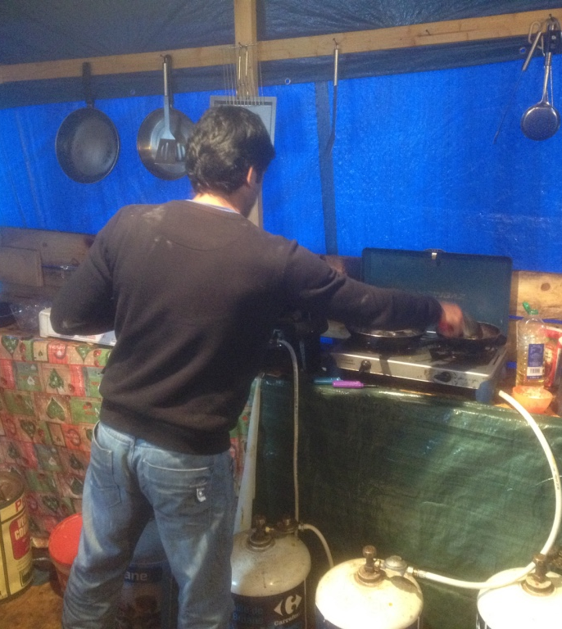
Vignette 3: Calais

Slide 32
Afghan migratory networks
Afghans are not mere victims; they are able to develop efficient responses and adapt to the world system using their social and cultural resources.
Afghan migratory networks form a transnational system; displacement and dispersion are not only a response to war and poverty, but may be a strategy.
The Afghan case partially blurs the boundary between forced and voluntary migration: the strategies of people labeled as refugees and those of economic migrants are often similar; refugees and other types of migrants share a number of social features; individuals may belong to several categories at a time or successively.
The international refugee regime promotes solutions that are based on the idea that movements must stop; for Afghans, mobility may be seen by contrast as a key-livelihood strategy.

