Slide 1
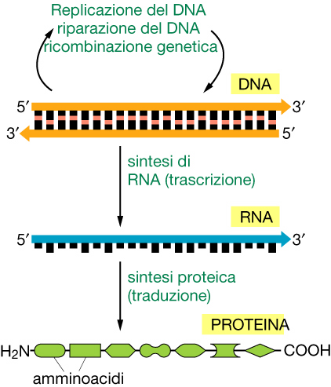
Genoma
trascrittoma
Proteoma

Slide 2
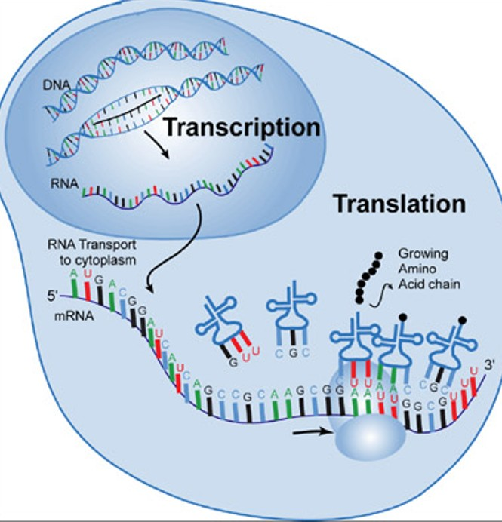

Slide 4
In eukaryotes, the bulk of mRNAs undergo decay by a pathway that is initiated by poly(A)-tail shortening.
Once the cell determines that an mRNA must be destroyed, one of two irreversible routes is taken (FIG. 1a). Either the 5′ cap is removed by a process known as decapping, which allows the mRNA body to be degraded in the 5′→3′ direction by the XRN1 exoribonuclease, or the unprotected 3′ end is attacked by a large complex of 3′→5′ exonucleases known as the exosome.

Slide 5
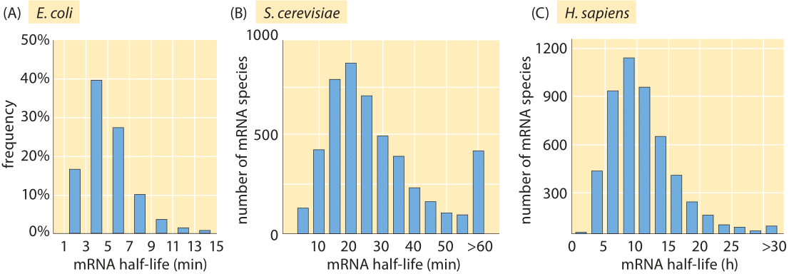

La diversa stabilità dei mRNA contribuisce alla regolazione dell’espressione genica

Slide 6
La diversa stabilità dei mRNA contribuisce alla regolazione dell’espressione genica

Slide 8
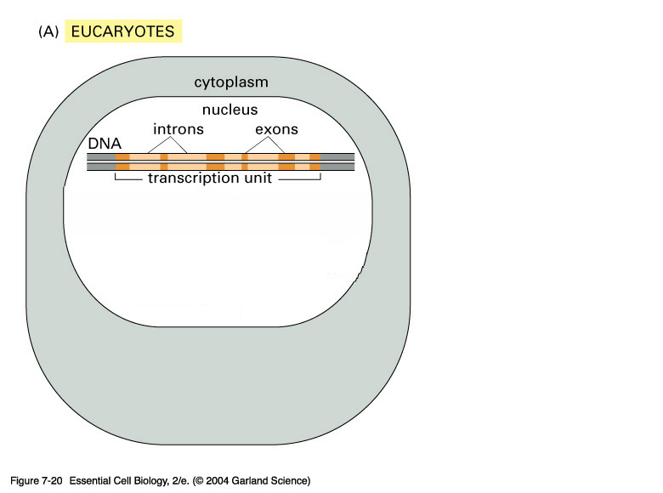
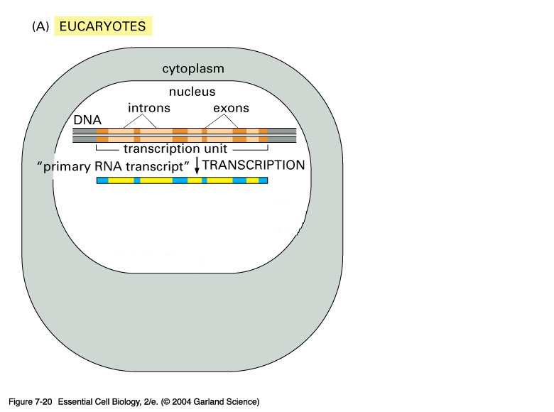
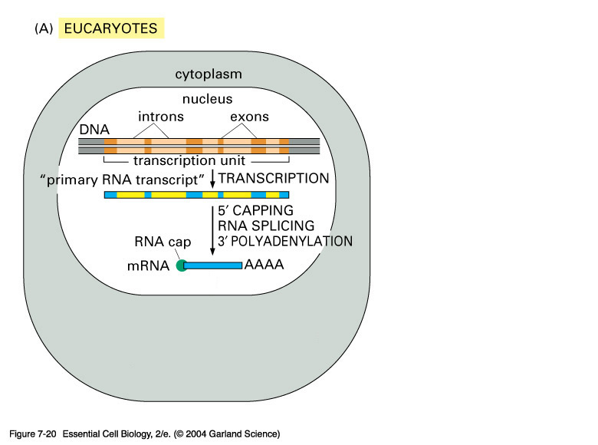
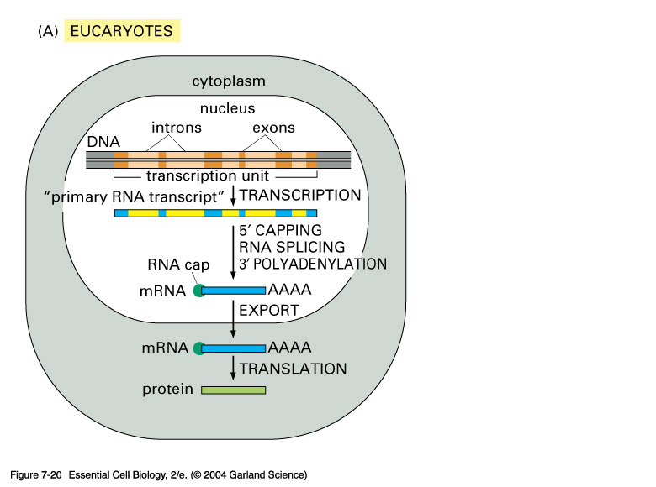
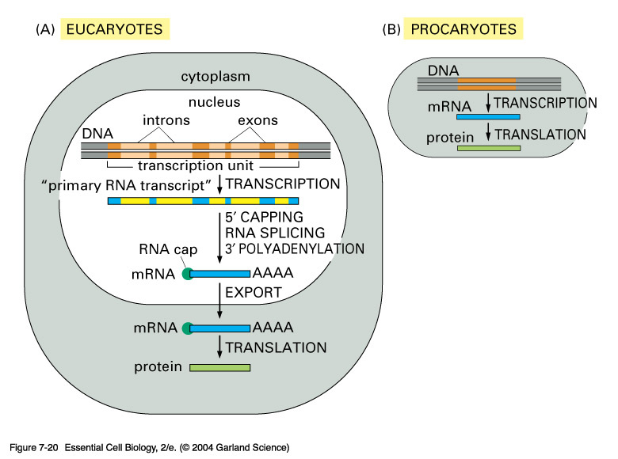
07_20_Pro_v_Eucar.jpg
Notes:
07_20_Pro_v_Eucar.jpg

Slide 9
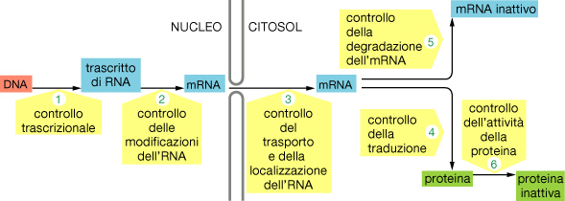
Il destino di un mRNA che raggiunge il citoplasma è di essere tradotto in proteina.
Anche a questo livello più meccanismi partecipano alla regolazione dell’espressione genica.

Slide 10
TRADUZIONE
Costituenti e fasi della traduzione
Struttura e funzione del ribosoma
Struttura e funzione del tRNA
Le aminoacil tRNA sintetasi
Poliribosomi
Inibitori della sintesi proteica: antibiotici, tossine e RNA interferenti

Slide 11
The GENETIC CODE
IS NOT THE GENOME
Definition
The genetic code is a set of rules
defining how the four-letter code of DNA is translated into the 20-letter code of amino acids, which are the building blocks of proteins.
The genetic code is a set of three-letter combinations of nucleotides called codons, each of which corresponds to a specific amino acid or stop signal.
https://www.nature.com/scitable/definition/genetic-code-13/

Slide 12
Caratteristiche del codice genetico
4 basi --> 20 amino acidi. No rapporto 1:1
“Codone” 3 basi specifica ogni aminoacido
4³ = 64 combinazioni
64 > 20 – il codice genetico è DEGENERATO :
>1 codone/amino acido
il codice è letto sequenzialmente e non è sovrapposto : cornice di lettura

Slide 13
Open Reading Frame (ORF)
5’
3’
AUG CCA AGU GUA ACC UCA GCG UUA CCA UCU UAA CCG
Met
Pro
Ser
Val
Thr
Ser
Ala
Leu
Pro
Ser
Stop
U C A G
Phe Ser Tyr Cys U
Phe Ser Tyr Cys C
Leu Ser STOP STOP A
Leu Ser STOP Trp G
Leu Pro His Arg U
Leu Pro His Arg C
Leu Pro Gln Arg A
Leu Pro Gln Arg G
Ile Thr Asn Ser U
Ile Thr Asn Ser C
Ile Thr Lys Arg A
Met Thr Lys Arg G
Val Ala Asp Gly U
Val Ala Asp Gly C
Val Ala Glu Gly A
Val Ala Glu Gly G
U
C
A
G

Slide 14
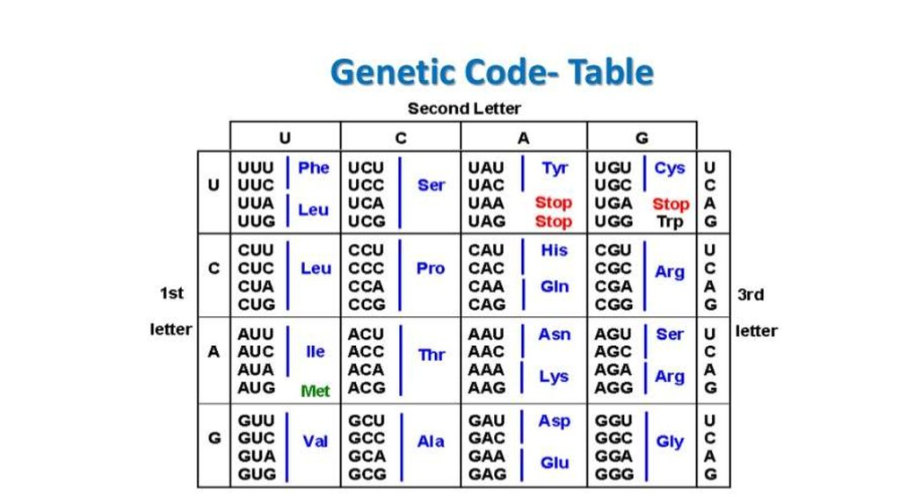
Deciphering the Code
Add Poly(U) RNA to “cell-free translation system”
  Extract of E. coli (gently break open cells), add Dnase. Extract contains ribosomes, enzymes, ATP, GTP, etc.
Examine Polypeptide chain: poly(Phe)
  UUU must be codon for Phe
  Similarly, AAA = Lys, CCC=Pro, etc.
Eventually chemical synthesis of RNA allowed:
  UCUCUCUCUC --> Ser-Leu-Ser-Leu
  UCU = Ser, CUC = Leu (only 2 reading frames exist)
  UACUACUAC --> combination of poly(Tyr), poly(Thr), poly(Leu)
  UAC = Tyr, ACU=Thr, CUA=Leu
  Etc.

Slide 15
Features of the Genetic Code
Degenerate
  Arg, Leu, Ser have 6 codons
  Most aa have 4 codons
  Met and Trp have only 1
Non random –
  Usually codons that only differ at 3rd position code for the same aa. (Silent base changes)

Slide 16
Open Reading Frame (ORF)
5’
3’
AUG CCA AGU GUA ACC UCA GCG UUA CCA UCU UAA CCG
Met
Pro
Ser
Val
Thr
Ser
Ala
Leu
Pro
Ser
Stop
U C A G
Phe Ser Tyr Cys U
Phe Ser Tyr Cys C
Leu Ser STOP STOP A
Leu Ser STOP Trp G
Leu Pro His Arg U
Leu Pro His Arg C
Leu Pro Gln Arg A
Leu Pro Gln Arg G
Ile Thr Asn Ser U
Ile Thr Asn Ser C
Ile Thr Lys Arg A
Met Thr Lys Arg G
Val Ala Asp Gly U
Val Ala Asp Gly C
Val Ala Glu Gly A
Val Ala Glu Gly G
U
C
A
G

Slide 17
Features of the Genetic Code
AUG is the start codon
  First codon in the translated region of a gene is AUG.
Codes for Met. In some cases Met gets cleaved.
STOP codons: UAG (amber) UAA (ochre), UGA (opal).
  Signal termination of the peptide chain.
Code is identical in most organisms.
But, code is not universal
  Mitchondria (and chloroplasts) have their own transcription/translation machinery.
  They have their own code: AUA &AUG code for Met ,UGA codes for Trp (not stop) AGA & AGG are stop codons (not Arg), etc.

Slide 18
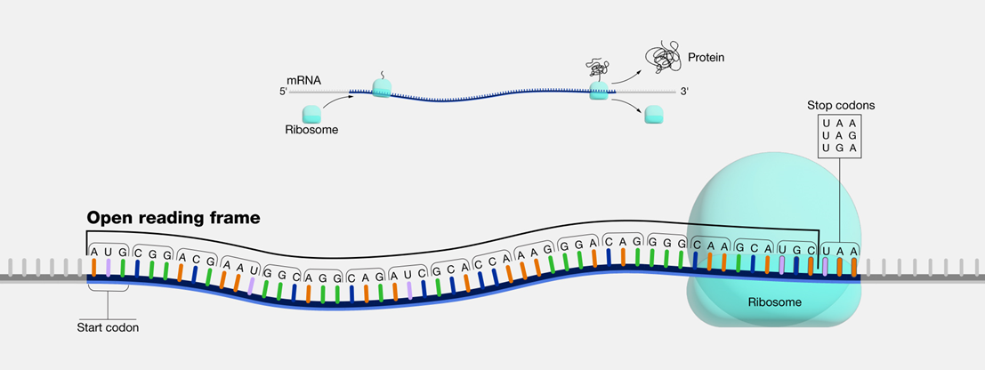
OPEN READING FRAME - ORF
An open reading frame, as related to genomics, is
a portion of a DNA sequence that does not include a stop codon (which functions as a stop signal).

Slide 19
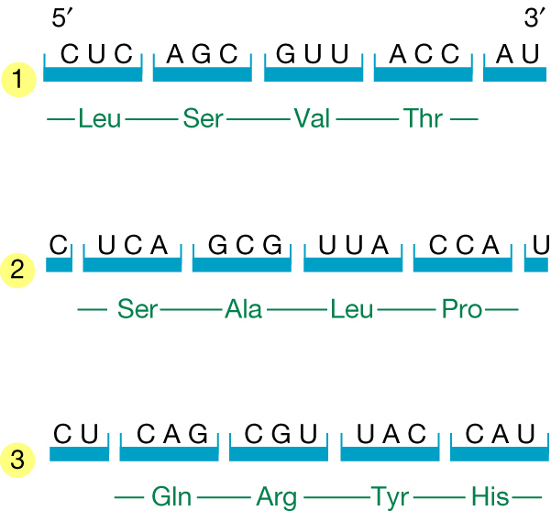
The three potential reading frames of an mRNA. Each reading frame would yield a different polypeptide.

Slide 20
Reading Frames
A single base deletion changes entire protein sequence that gets made, by changing the reading frame.
HERDOGHASONELEG
  HER DOG HAS ONE LEG
  HED OGH ASO NEL EG 1 base deletion
  HER DOG HAS ONE LEG
  HEE RDO GHA SON ELE G 1 base insertion
  HER DOG HAS ONE LEG
  HEE DOG HAS ONE LEG 1 base mutation

Slide 21
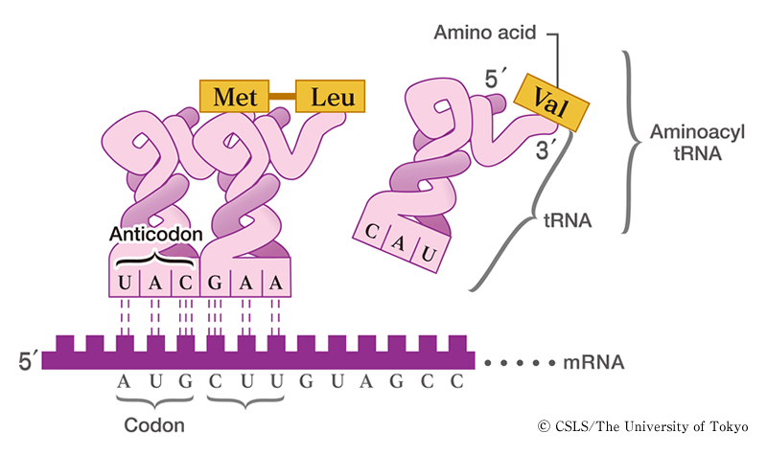

Slide 22
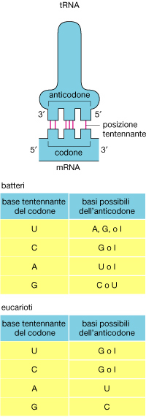
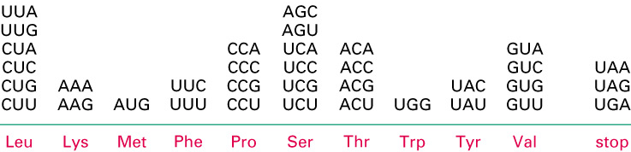
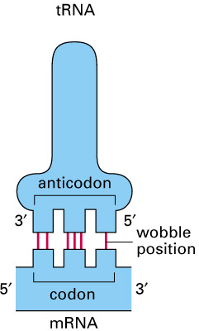
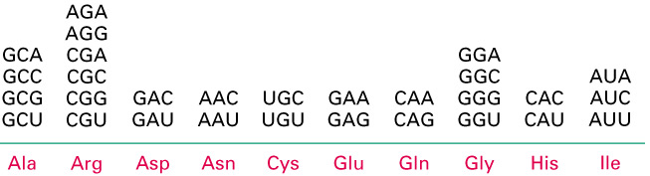
tRNA
AA
3’
5’
3 2 1
5’ 3’
1 2 3
mRNA

Slide 23
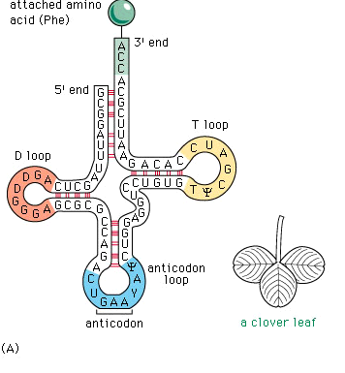
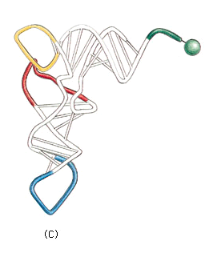
Transfer RNA (t-RNA)

Slide 24
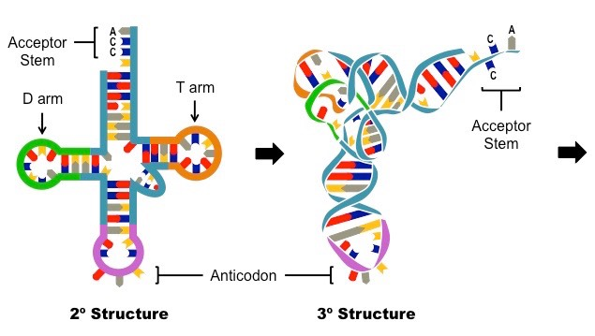
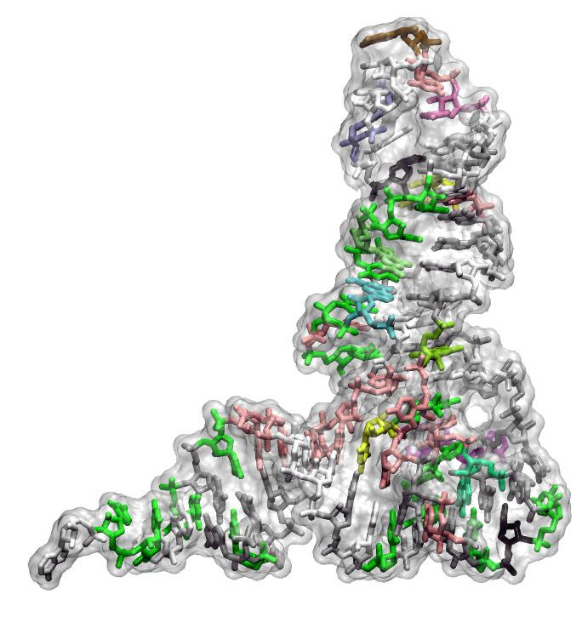
tRNA
Stabilized by base-pairing and long-range interactions between non-continguous parts of arms and loops
Most interactions are between invariant or conserved bases
Buries most of tRNA except acceptor stem, aa, anticodon

Slide 25
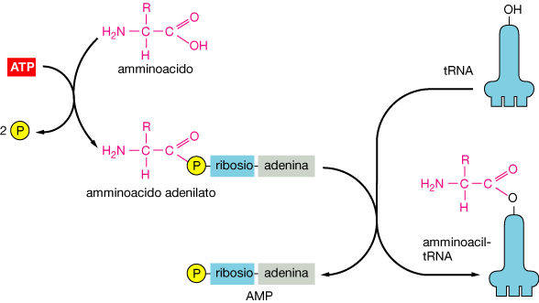
Caricamento del tRNA con l’amminoacido

Slide 26
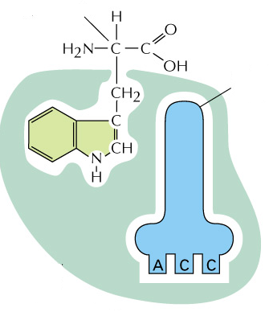

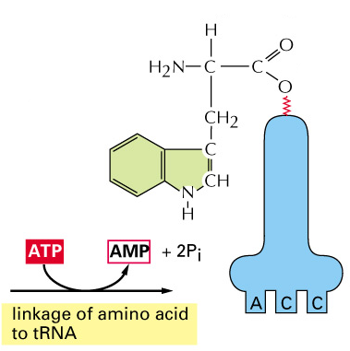
AA (Trp)
t-RNA
(Trp)
high-energy bond
codon-anticodon
base pairing
Aminoacyl-
tRNA synthetase (Trp)
mRNA
Le Aminoacil-tRNA sintetasi attivano i tRNAs con specifici amino acidi
Una singola e specifica aminoacil-tRNA sintetasi (ARS) riconosce tutti i tRNA per un dato amino acido.

Slide 27
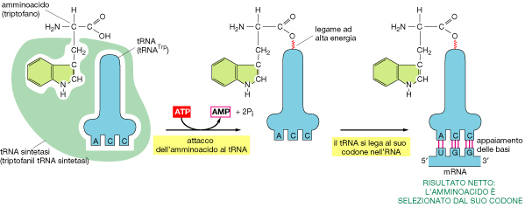
Le due fasi più importanti del processo di decodificazione.
1- Caricamento del tRNA con l’amminoacido (attivazione)
2- Appaiamento anticodone/codone nel ribosoma
amminoacido
tRNA
tRNA sintetasi

Slide 29
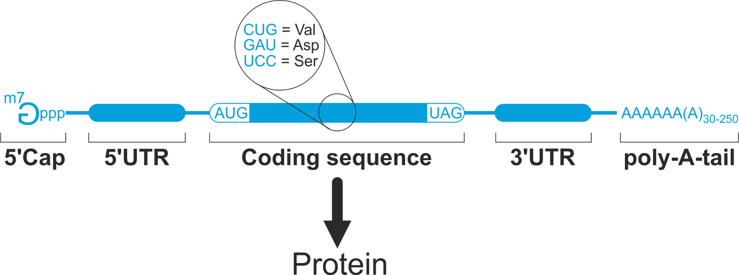
Costituenti principali dell’officina traduzionale: mRNA
La sequenza codificante (CDS) è solo una porzione del mRNA
- dal primo codone tradotto (AUG) al primo codone di stop (UAG,UGA,UAA).
Le sequenze adiacenti quella codificante sono definite
regioni non tradotte – UnTranslated Regions (UTR) e sono presenti al
5’ = 5’ UTR
e al
3’ = 3’ UTR

Slide 30
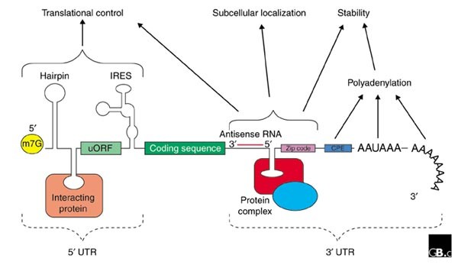
The untranslated regions (UTRs) in mRNA play critical role of regulating the stability, function, and localization of mRNA. T
he 3'-UTRs of mRNA also serve as templates for miRNA binding that regulates the turnover and/or function of the mRNA

Slide 31
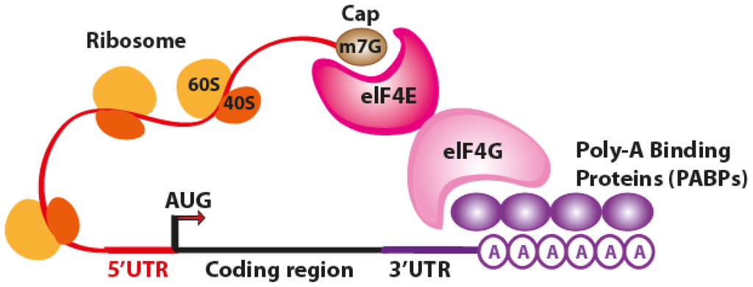
protein

Slide 32
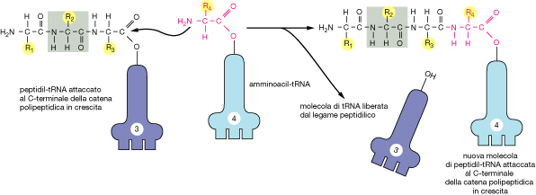

Slide 33
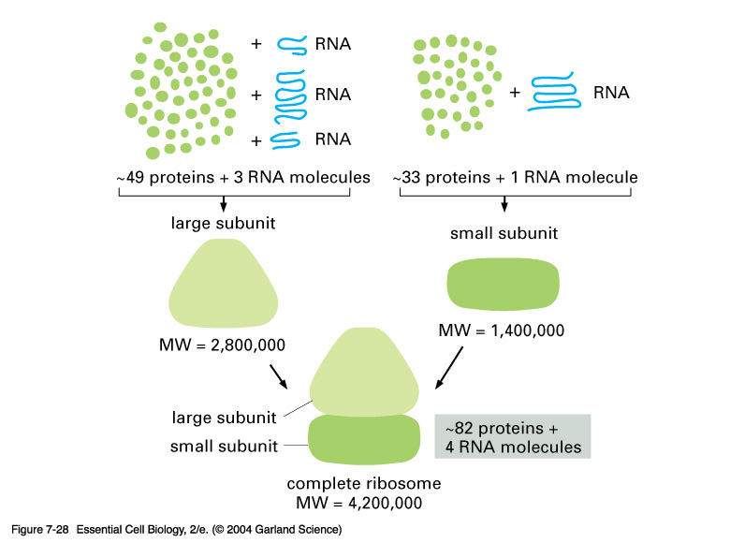
Ribosome
Small organelles, site of polypeptide synthesis
Enormous, complex
Several large RNAs plus >80 proteins

Slide 34
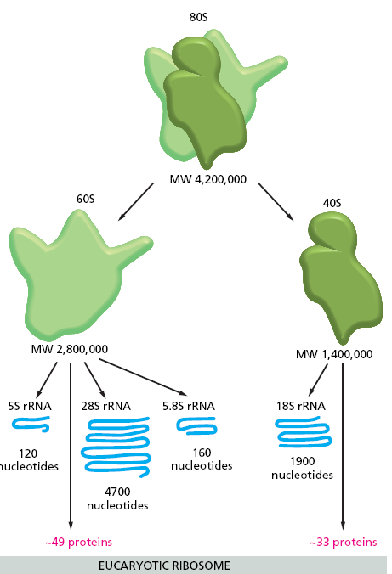
Ribosome
Functions:
  Binds mRNA so codons can be read
  3 binding sites for tRNAs
  Binding, interaction of other (non-ribosomal proteins) that promote Initiation, Elongation, Termination
  Catalyzes peptide bond formation
  Translates along mRNA
Old View: RNA scaffold, Proteins carry out peptide synth
New View: Ribosome is a ribozyme; proteins are present at every region except where peptide sythesis occurs. Proteins are “mortar” to stabilize RNA helices and hold together.

Slide 35
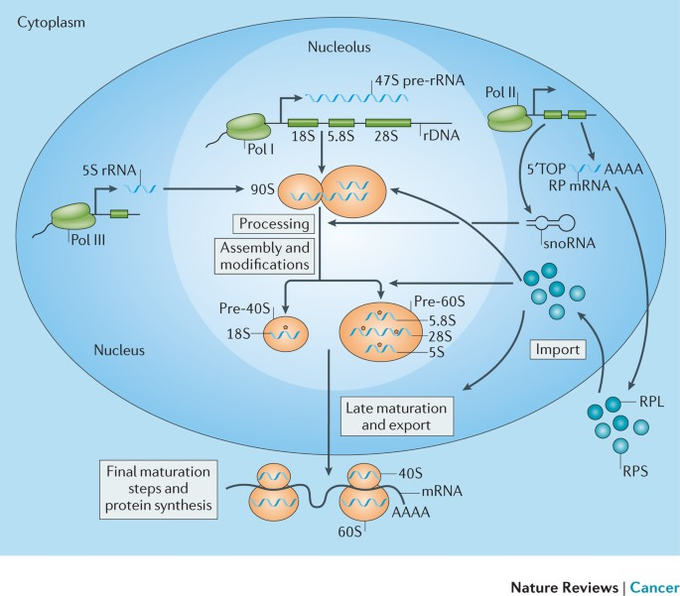
L’assemblaggio delle due subunità avviene nel nucleolo

Slide 36
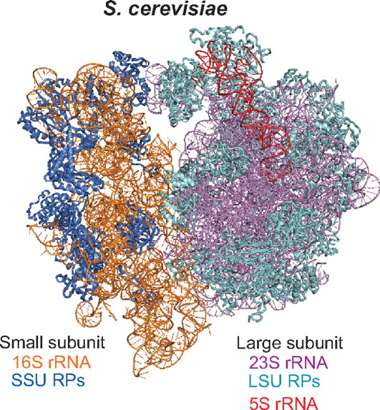
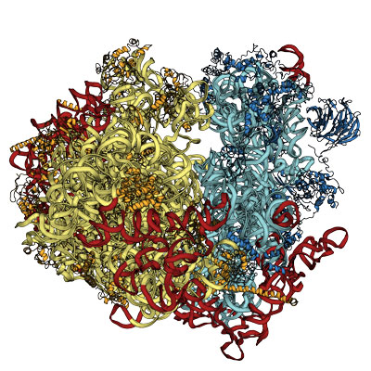
Structure of 80S ribosome from yeast. Proteins and RNA of small subunit are colored in blue, and large subunit is colored in yellow. Expansion segments are colored in red.

Slide 37
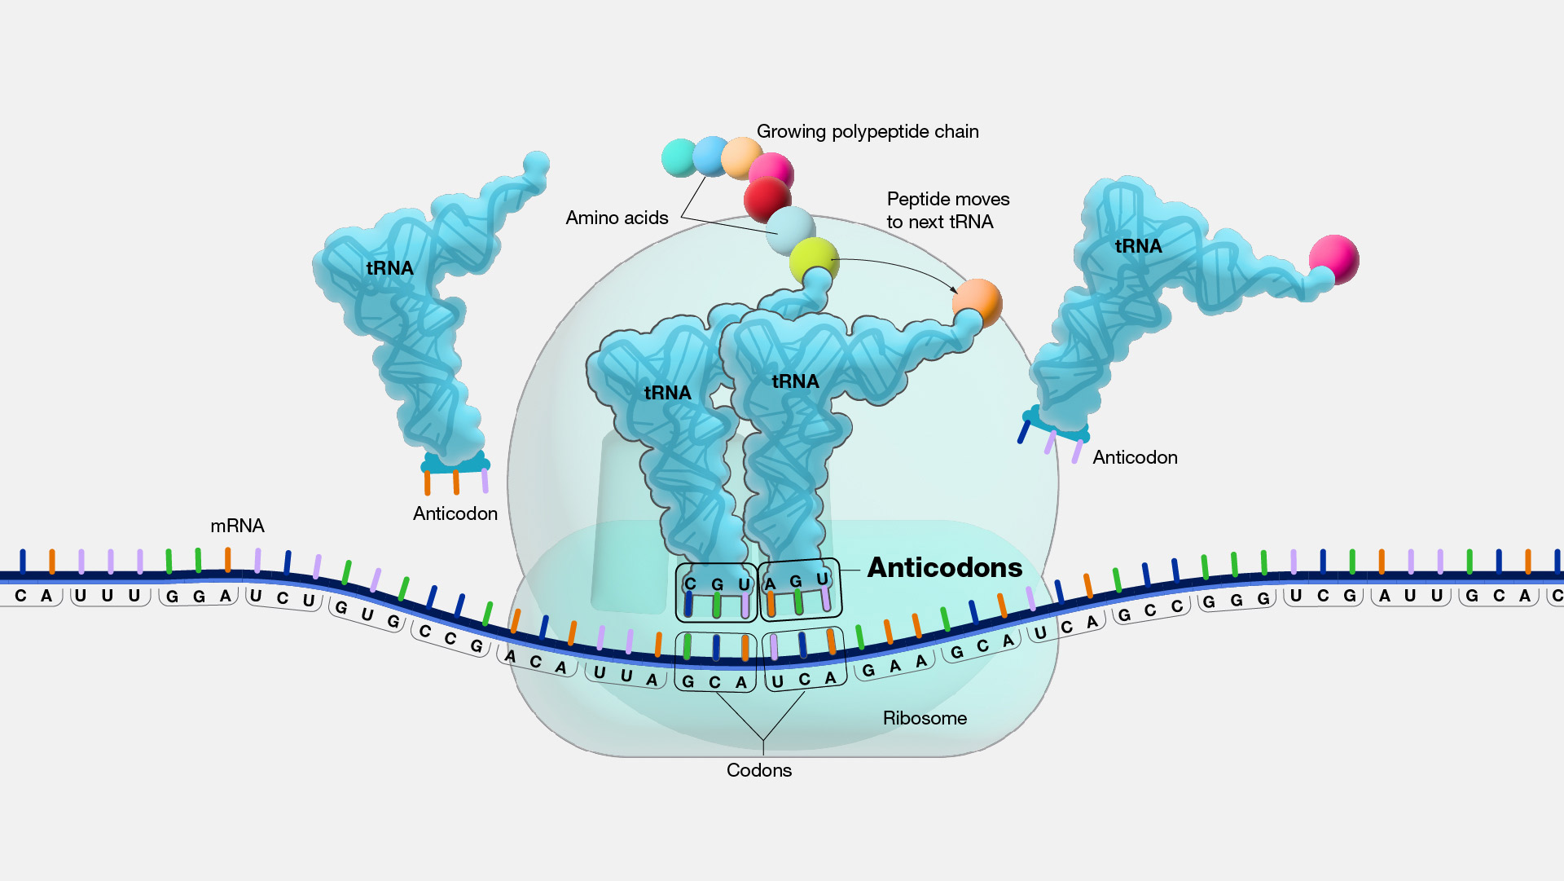
Ribosome Structure
Ribosome has 3 binding sites for tRNAs
A – Aminoacyl site – incoming aminoacyl tRNA
P – peptidyl site – tRNA to which growing chain is attached
E – exit site – deacylated tRNA
Channel for 1 mRNA, to align codon w/ anticodon.

Slide 38
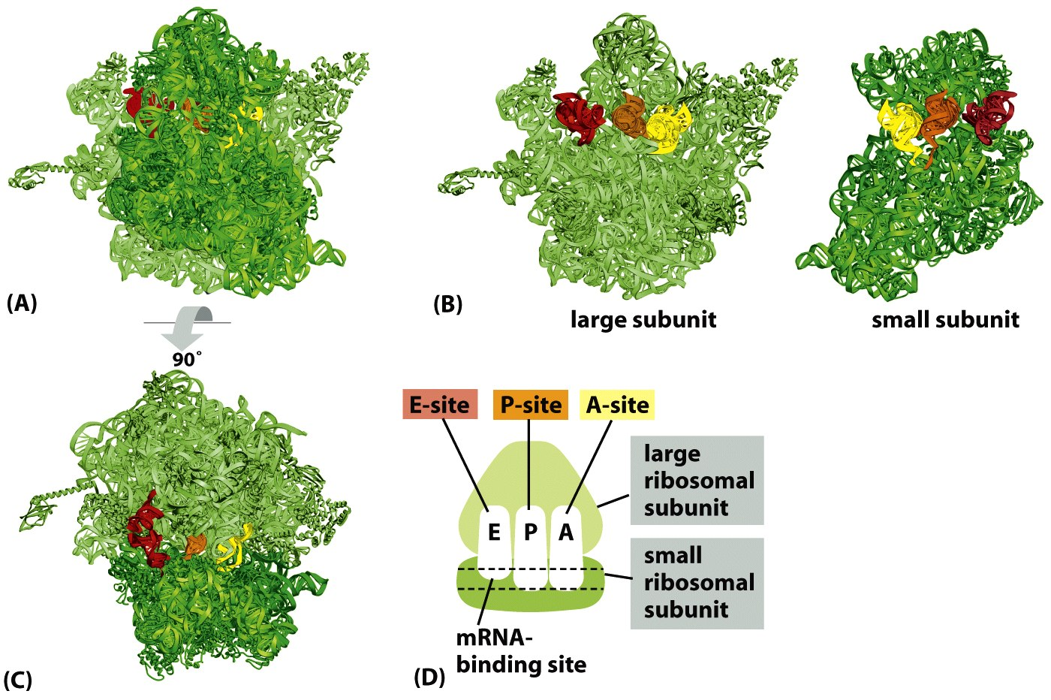

Slide 41

Initiation (eukaryotes)

Slide 42







Initiation (eukaryotes)
3’ poly(A) tail
mRNA
40S ribosomal subunit
+ initiation factors
Initiation
factors
5’ Cap structure
Linear scaning
60S ribosomal subunit

Slide 43
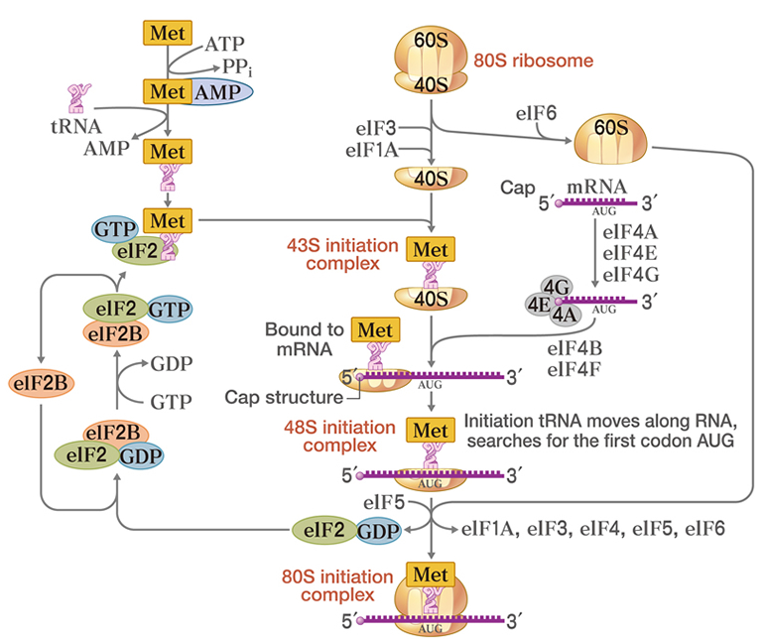

Slide 44
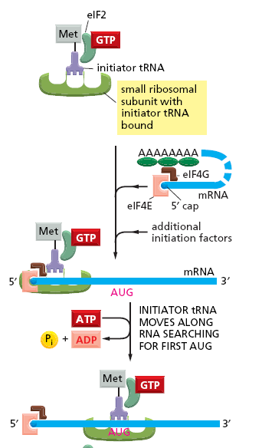
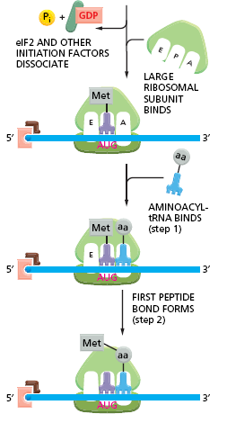

Slide 45
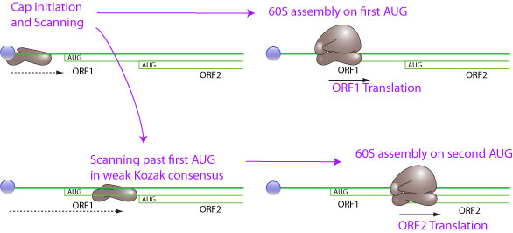
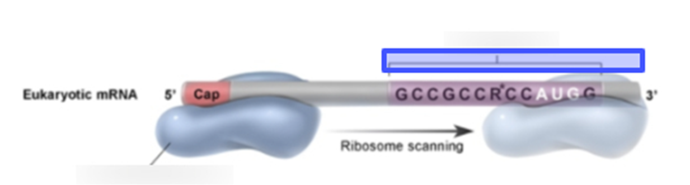
TERM
Kozak sequence
DEFINITION
helps the ribosome identify the start codon in eukaryotes
The nucleotides immediately surrounding the start site in eukaryotic mRNAs influence the efficiency of AUG recognition during the scanning process. If this recognition site differs substantially from the consensus recognition sequence (5′-ACCAUGG-3′, known as the Kozak sequence after its discoverer), scanning ribosomal subunits will sometimes ignore the first AUG codon in the mRNA and move to the second or third AUG codon instead

Slide 46
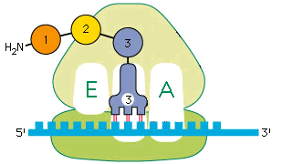
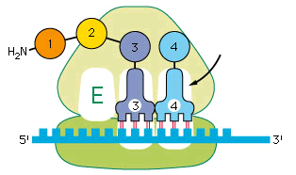
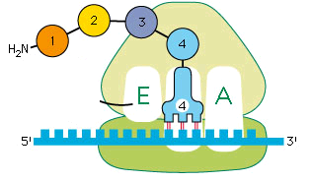

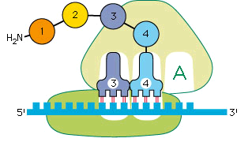

Elongation
Aminoacyl-t-RNA
Peptidyl-t-RNA
Elongation factors:
EF-Tu (EF-1) (*GTP)
EF-G (EF-2) (*GTP)
Peptidyl transferase
Translocation
7.8

Slide 47
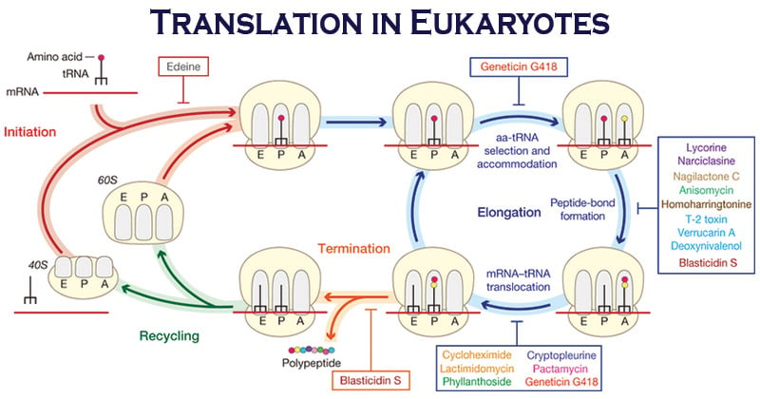
7.7

Slide 48
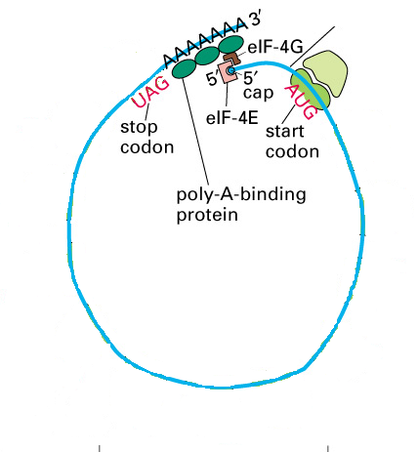
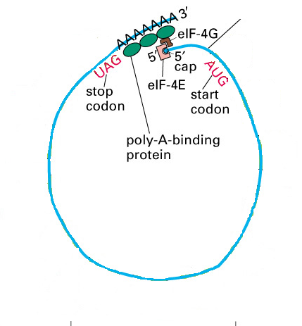
polisomi

Slide 49
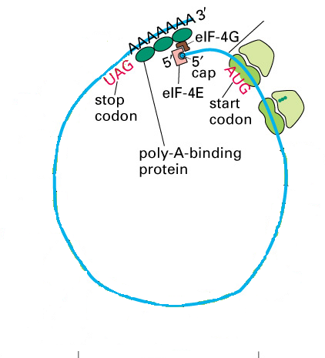
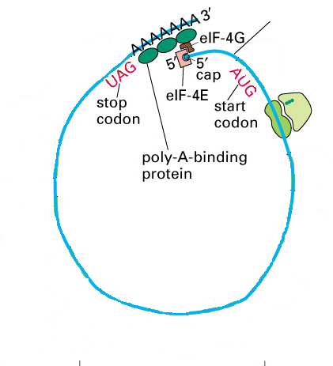
polisomi

Slide 50


polisomi

Slide 51


polisomi

Slide 52

polisomi

Slide 53


07_34_stop codon.jpg
Termination
Molecular mimicry
Notes:
07_34_stop codon.jpg

Slide 54

Termination
Termination codon required. UAA, UGA, UAG. No tRNAs for these codons.
Recognized by Release Factors: RF-1 (UAA, UAG; RF-2 (UAA, UGA).
RF-3 increases RF-1 & RF-2 binding.
  [Eucaryotes: eRF = RF-1 & RF-2]
RF binding causes ribosome
/ribozyme to transfer
peptide group to H₂O.
Creates COO- terminus
Release of RFs coupled
to GTP hydrolysis
Release of mRNA
Release Factor

Slide 55

Termination
7.5

Slide 56

Assuming that the synchronization period of length 3 in DNA or RNA is violated during the transcription or translation processes, the probability of reading a frameshifted stop codon is higher than if the code would have only one stop codon. Consequently, the synthesis of RNA or proteins will soon terminate.

Slide 57
Il destino di un mRNA che raggiunge il citoplasma è di essere tradotto in proteina.
Anche a questo livello più meccanismi partecipano alla regolazione dell’espressione genica.

Slide 58


Slide 59


What happens after protein synthesis?
Folding (30 – 40 aa can start while still on ribosome as chain emerges)
Chaperones to assist folding / prevent misfolding and aggregation
HSP 70 Chaperone
HSP60 chaperone

Slide 60

HSP 60 Chaperone
HSP 70 Chaperone

Slide 62


Slide 63
Ubiquitin can be covalently attached to target proteins
The major form of ubiquitin addition produces polyubiquitin chains in which
—once the first ubiquitin molecule is attached to the target—each subsequent ubiquitin molecule links to Lys48 of the previous ubiquitin, creating a chain of Lys48-linked ubiquitins that are attached to a single lysine side chain of the target protein

Slide 65

Degradazione tramite proteasoma
Proteasomes are very abundant, constituting approximately 1% of the total proteins in cells. They are dispersed throughout the cytosol and the nucleus.

Slide 66



Slide 67

What happens after protein synthesis?
S-S formation (once leave the reducing environment of cytoplasm)
Associate w/other subunits (assisted by chaperones?)
Covalent Post-translational modifications
Hsp70

Slide 68


Slide 69

blasticidin S (Bls), chloramphenicol (Cam), clindamycin (Cln), linezolid (Lnz), pleuromutilins (Plu), puromycin (Pmn), streptogramin A (SA) and sparsomycin (Spr). tuberactinomycins capreomycin (Cap) and viomycin (Vio), the aminoglycosides hygromycin B (HygB), neomycin (Neo) and paromomycin (Par), fusidic acid (Fus), spectinomycin (Spt) erythromycin (Ery), streptogramin B (SB ) telithromycin (Tel)).

Slide 70


Slide 71


