Slide 1
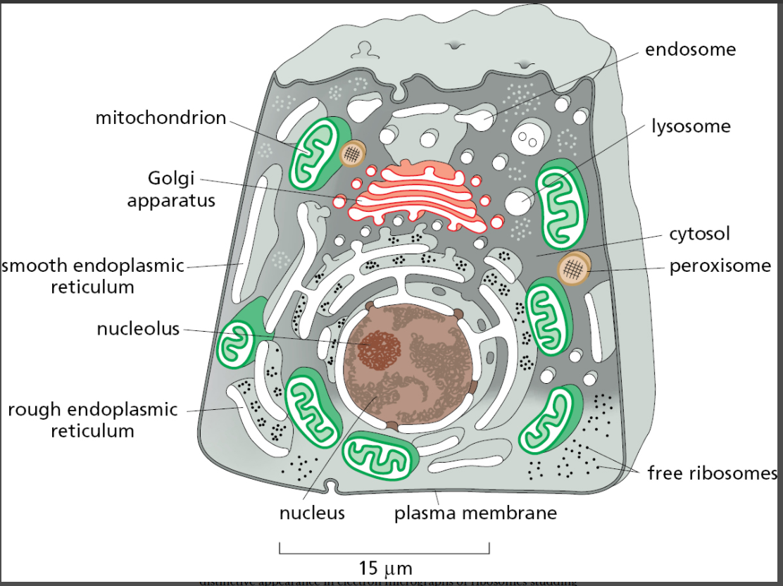
The major intracellular compartments of an animal cell
15.1

Slide 2
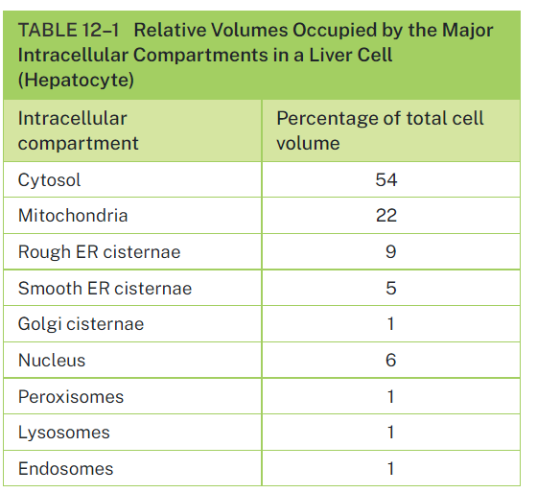

Slide 3
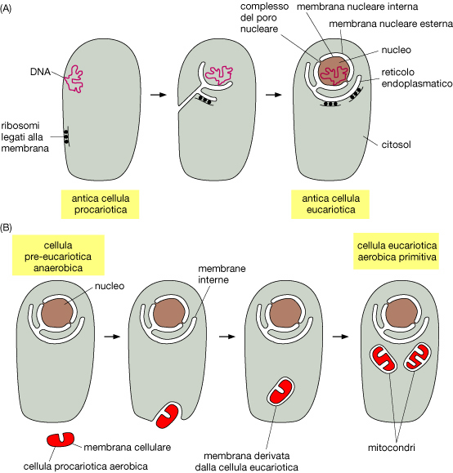

Slide 5
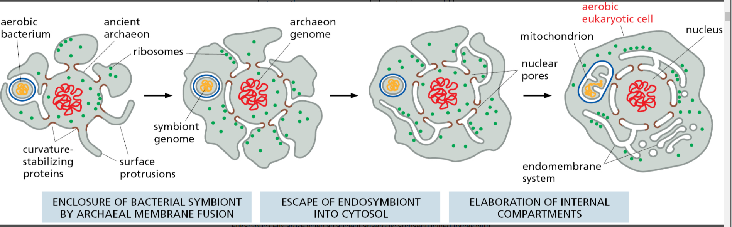
Figure 12–3 Evolutionary origins of the major internal membrane systems of a eukaryotic cell.

Slide 6
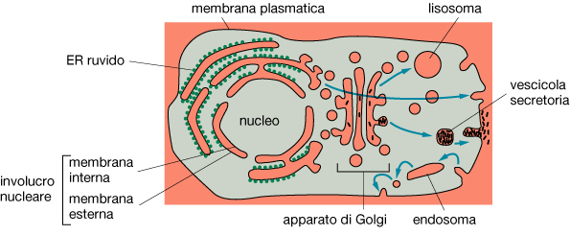

Slide 7
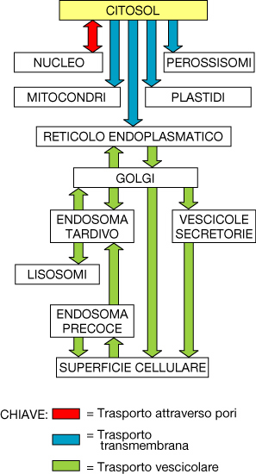

Slide 8
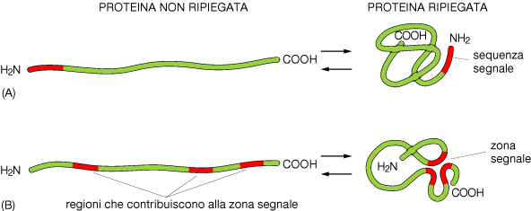
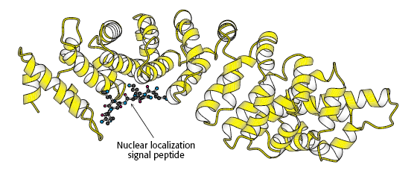
Sequenze e Zone SEGNALE
dirigono le proteine al corretto indirizzo cellulare

Slide 10
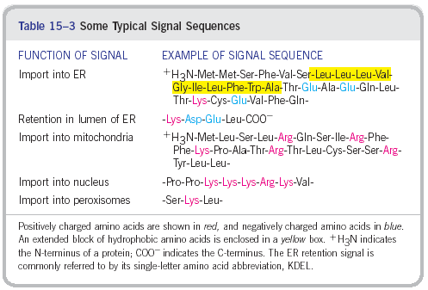

Slide 11


Slide 12
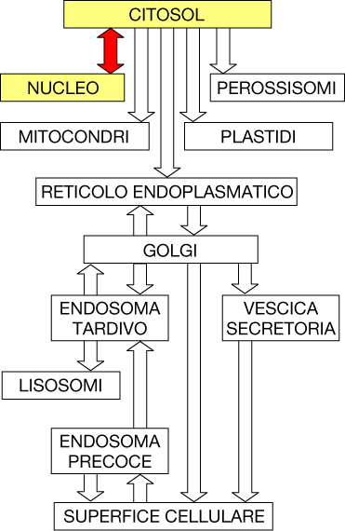

Slide 13
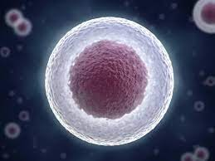
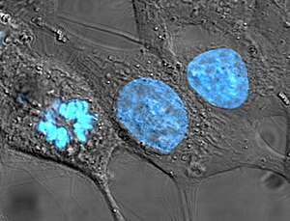
Nucleus Structure
About 10% of the cell volume
Contains:
DNA - condensed and organized with proteins as chromatin
Nuclear matrix – protein-containing fibrillar network
Nucleolus - (pl. nucleoli) –rRNA synthesis, ribosome assembly
Surrounded by nuclear envelope

Slide 14
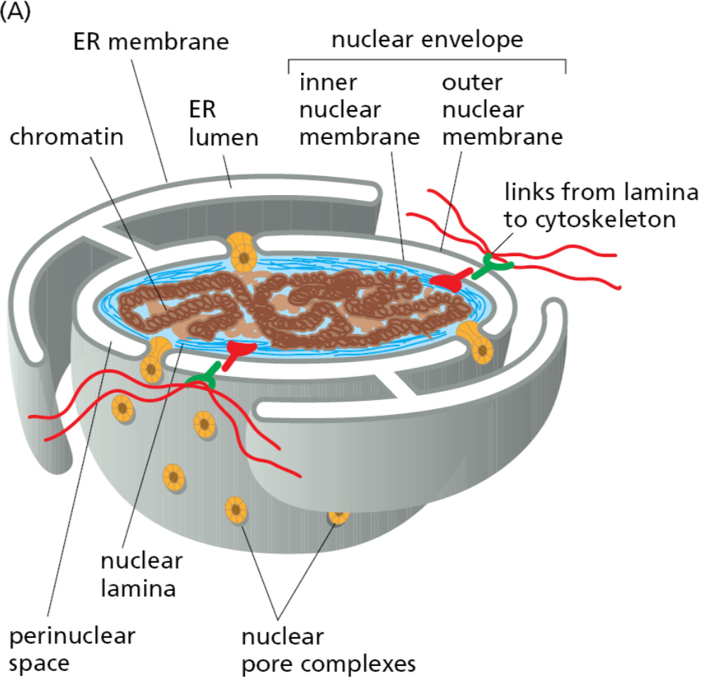

Slide 15
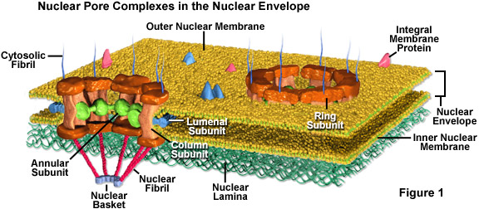
Nuclear envelope
2 lipid bilayer membranes, 10-50 nm apart
  - The outer membrane is continuous with endoplasmic reticulum
  - A denser layer of intermediate filaments, the nuclear lamina, is within the inner membrane
    - composed of lamin proteins
    - provides structure to nucleus
    - heterochromatin binding site

Slide 16
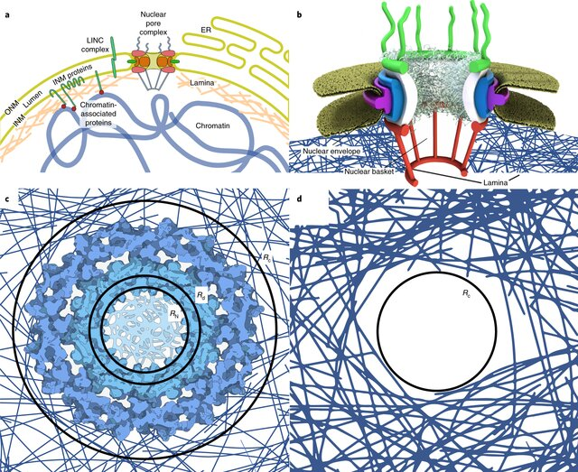
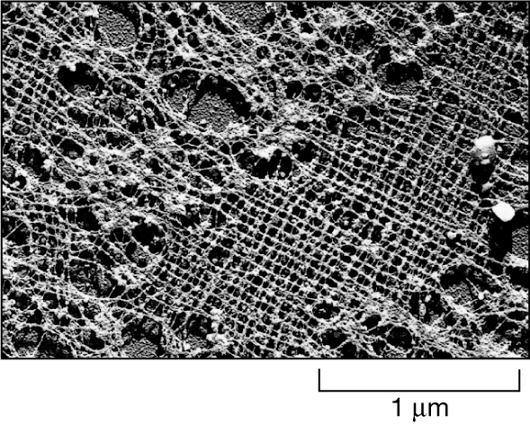
the nuclear lamina
The lamin proteins are members of the intermediate filament family of cytoskeletal proteins.
The lamina provides structural support for the nuclear envelope

Slide 17
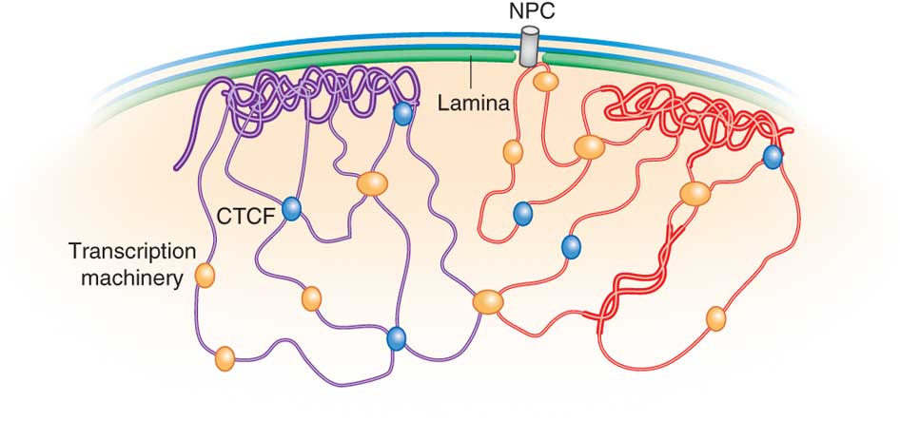
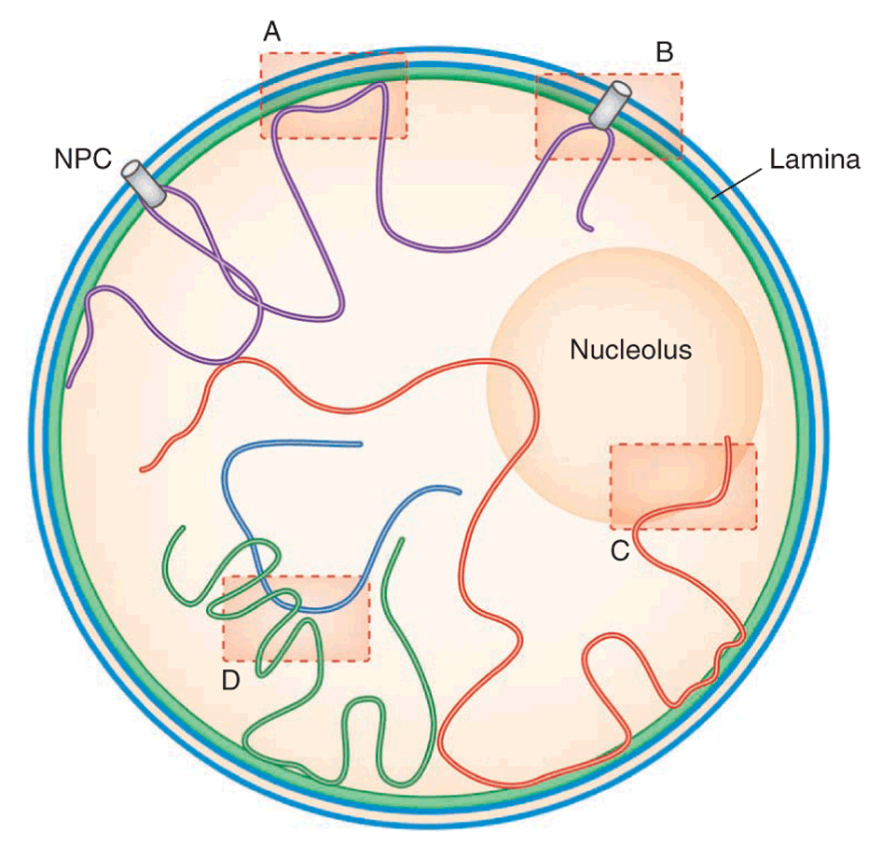
Lamina acts as an anchoring site for chromosomes and nuclear
pore complexes

Slide 18
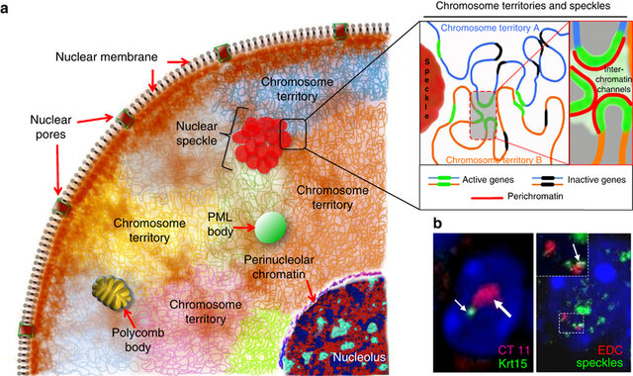
Chromosomes occupy specific regions of a nucleus, called "chromosome territories."
These subdomains might be doing much more than just keeping everything organized

Slide 19
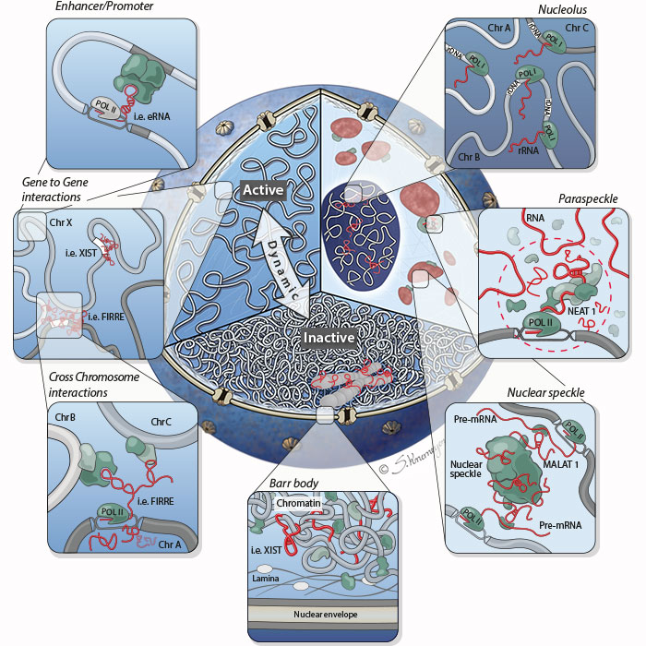
The nucleoplasm is not homogenous
It consists of many types of nuclear bodies, also known as nuclear domains or nuclear subcompartments.
These self-organizing structures gather machinery involved in various nuclear activities.

Slide 20
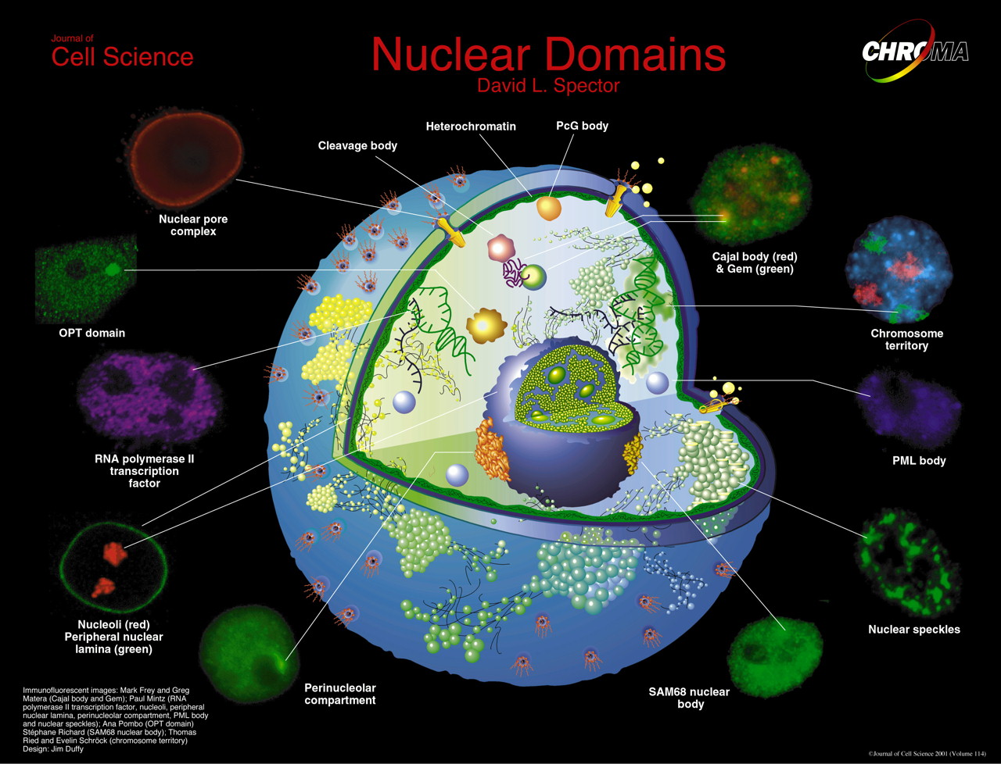

Slide 21
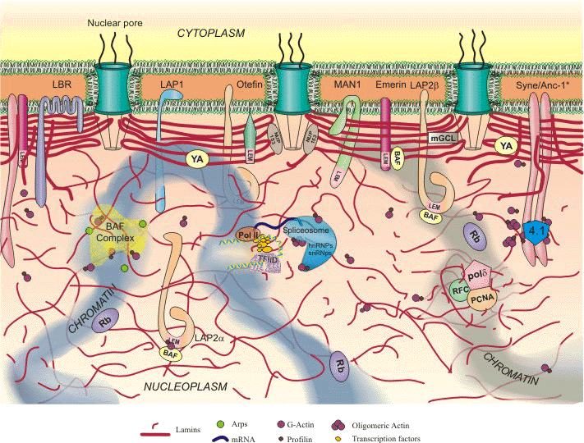


Defect in lamin A gene results in progeria – premature aging
12 year boy with progeria

Slide 22




Slide 24
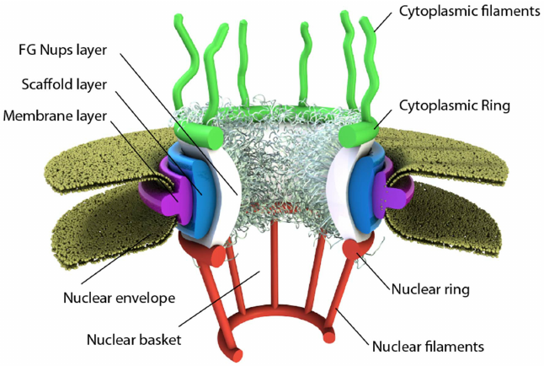
Nuclear Pores

Slide 25
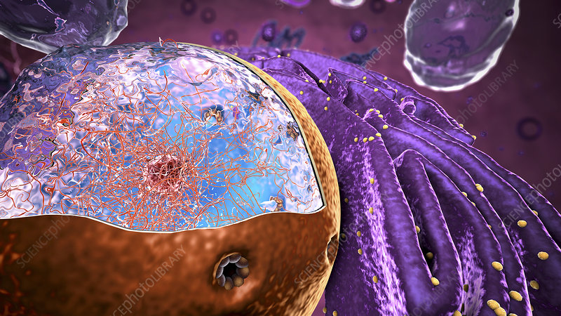

Slide 26
Nuclear Pores: ~3000/nucleus
Large and elaborate nuclear pore complexes (NPCs) perforate the nuclear envelope in all eukaryotes.
NPCs display eightfold rotational symmetry, with axial symmetry of the central core.
Each NPC is composed of a set of approximately 34 different proteins, or nucleoporins.
Hence, each nucleoporin is present in multiple copies, resulting in 500–1000 protein molecules in the fully assembled NPC

Slide 27
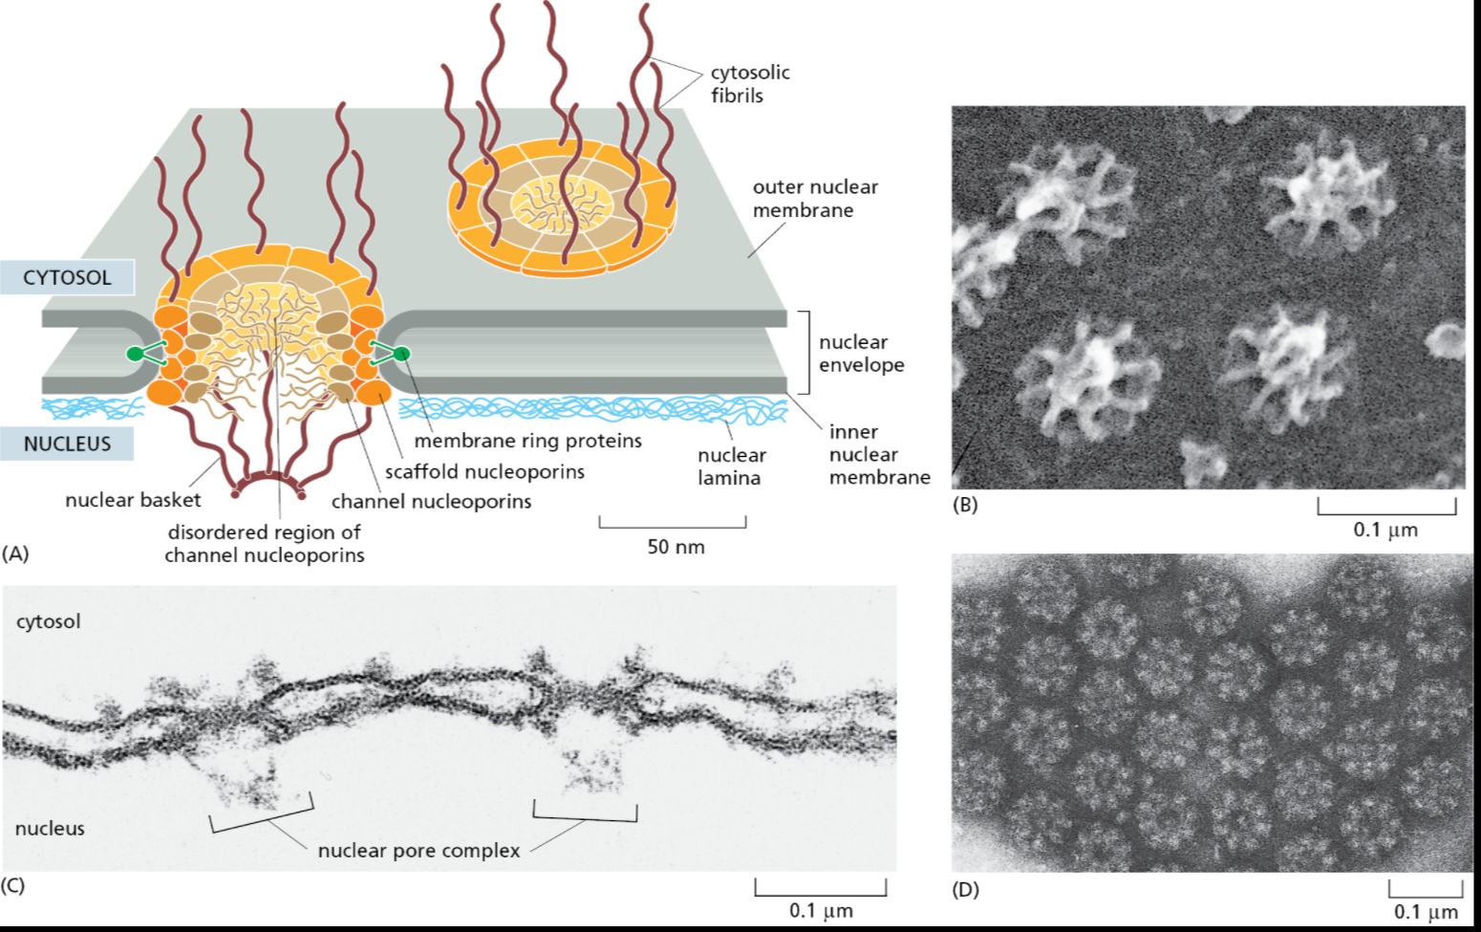
nuclear pore complexes (NPCs)
A typical mammalian cell contains 3000–4000 NPCs,
although that number varies widely, from a few hundred in glial cells to almost 20,000 in Purkinje neurons.

Slide 28
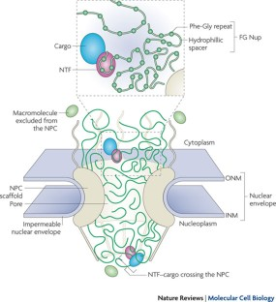
The role of nuclear pores
Small molecules and proteins of less than 9 nm can pass freely
Regulate transport of RNA and proteins into and out of nucleus
Traffic is FAST! 1 typical human cell has to import 560,000 ribosomal proteins/minute, export 14,000 assembled ribosomes/minute
Large proteins must be assisted

Slide 29
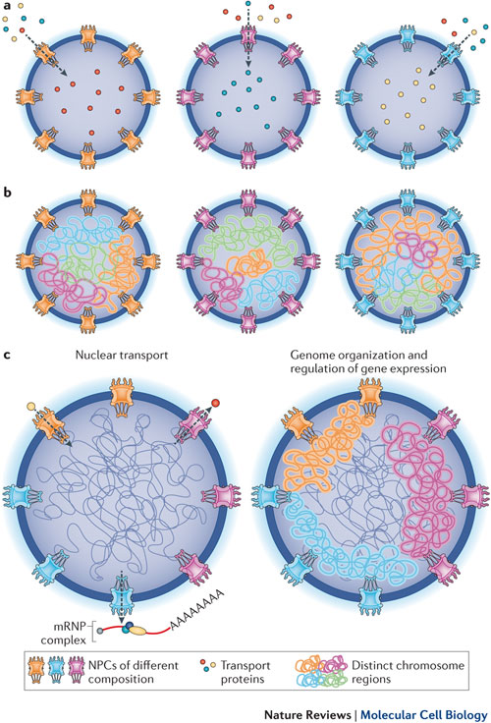
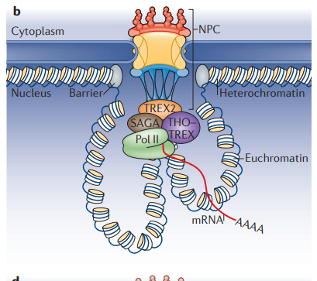
NPC functions in genome organization and gene expression

Slide 30
Nuclear Localization Signal (NLS)
-Pro-Pro-Lys-Lys-Lys-Arg-Lys-Val-

Slide 31
What happens when we alter the NLS?
Kalderson, Roberts, Richardson, Smith (1984) Cell 39:p499.
NLS
NLS
mutation

Slide 32
Another Experiment
What happens when we use recombinant DNA techniques to
add the NLS to a dummy protein?
Normal protein or modified protein (= NLS added) and injected to the cytoplasm
Microinjection Pipettes
Protein with NLS
Normal protein

Slide 33
So What?
This provided evidence of
nuclear transport receptors
  family of proteins associated with the nuclear pore complex
Importins recognize the NLS and bring proteins in
Another set of proteins, the exportins, work in the opposite direction (These recognize other signals)

Slide 34
there are at least 18 importin and 6 exportin genes in human

Slide 35
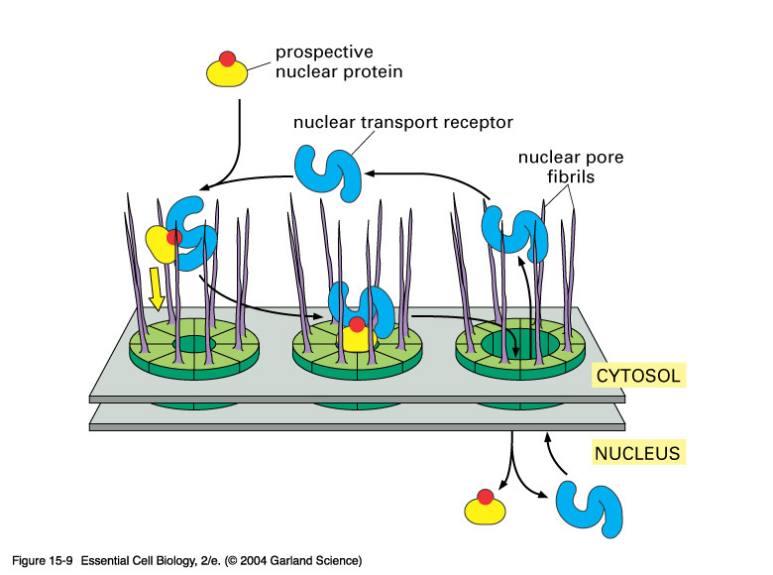
NLS
Notes:
15_09_pore_transport.jpg

Slide 36
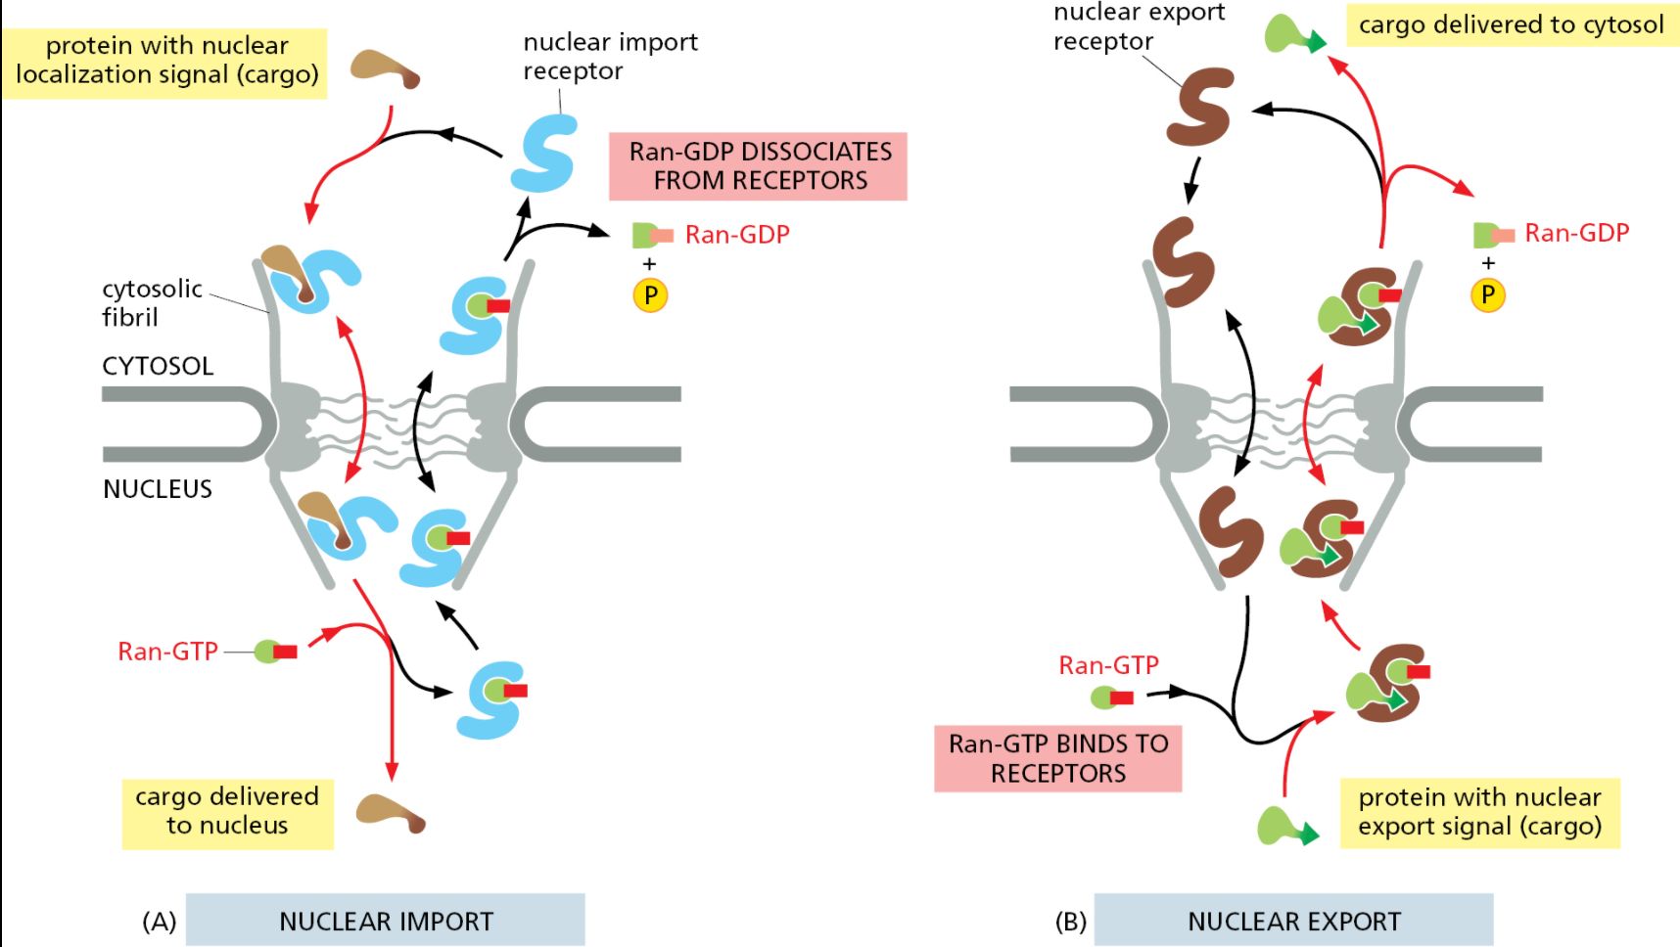
Nuclear import and nuclear export both use the Ran GTPase cycle.
Movement through the NPC of loaded nuclear transport receptors occurs along the FG repeats displayed by certain NPC proteins.

Slide 37
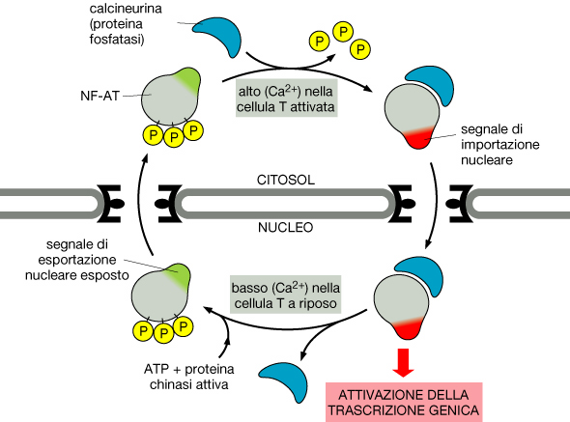
15.4

Slide 38
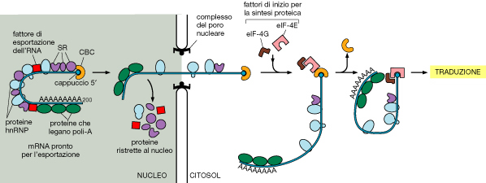

Slide 39
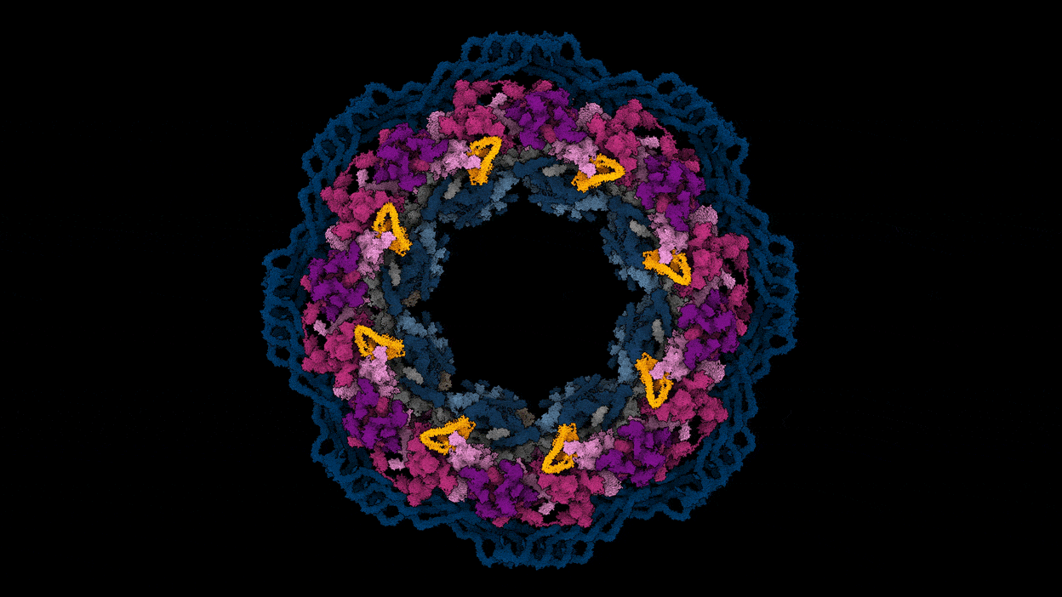

Slide 40
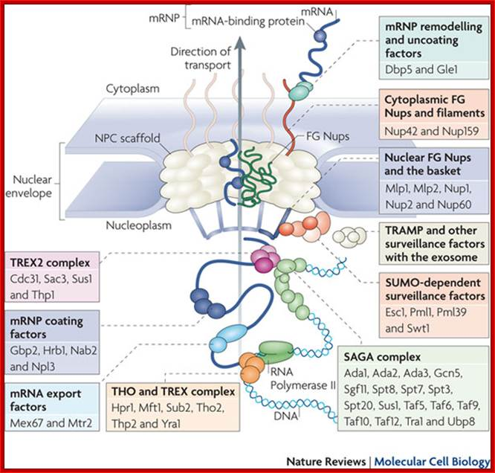

Slide 41
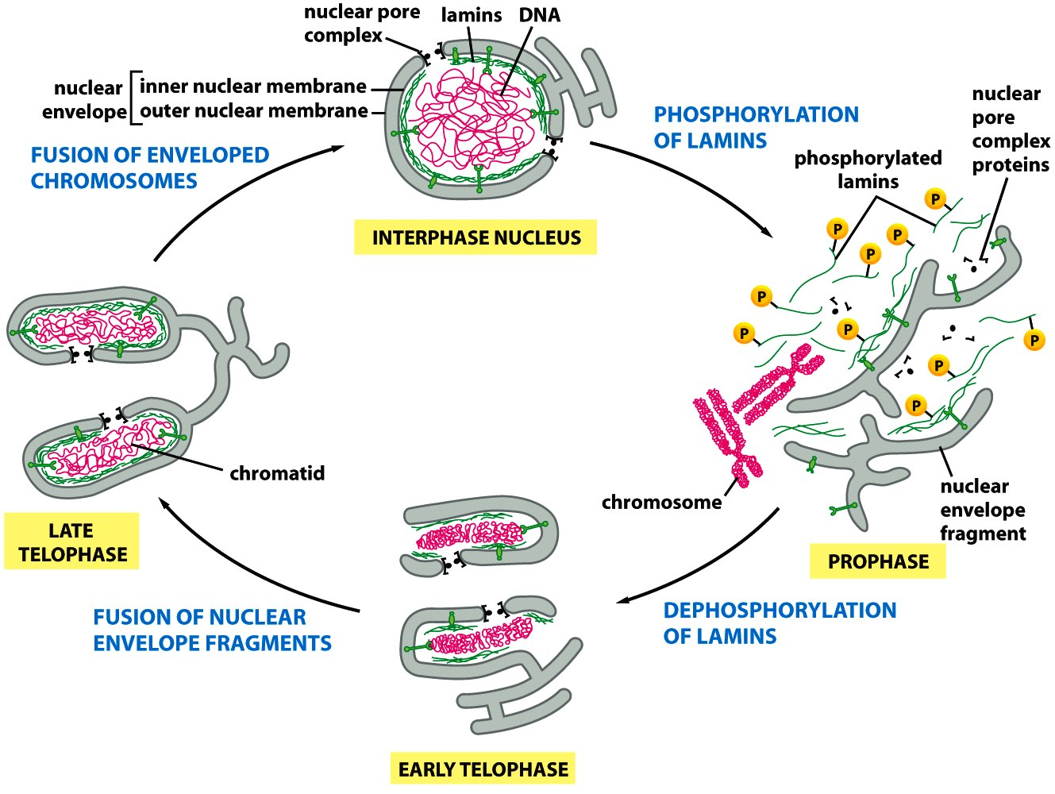
L’involucro nucleare è disassemblato durante la mitosi

