Slide 1
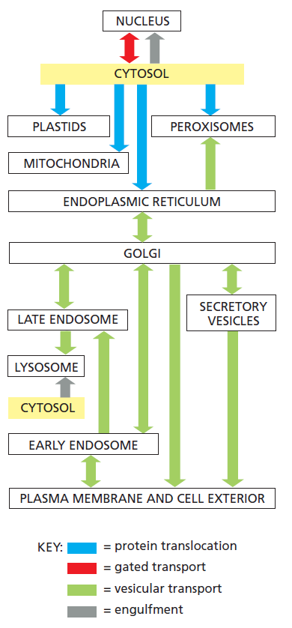

Slide 2
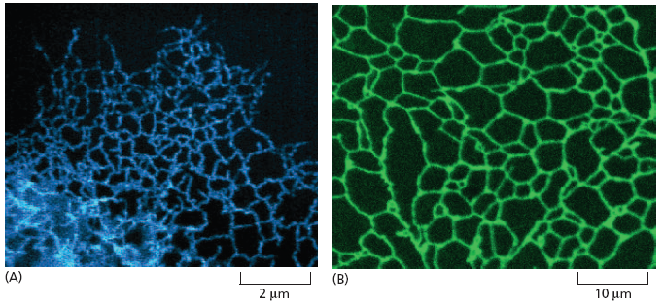

Slide 3
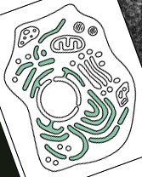
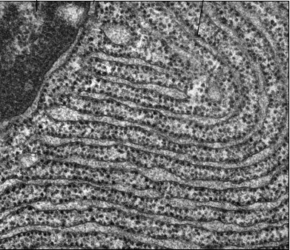
membrana RE
ribosomi
lume

Slide 4
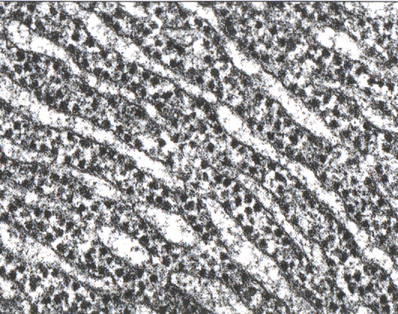
8
cytosol
ER lumen

Slide 5
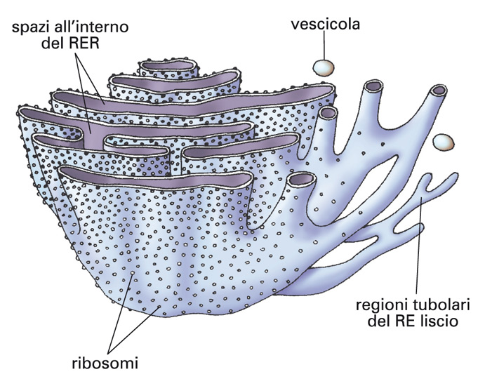
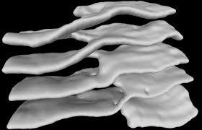

Slide 6
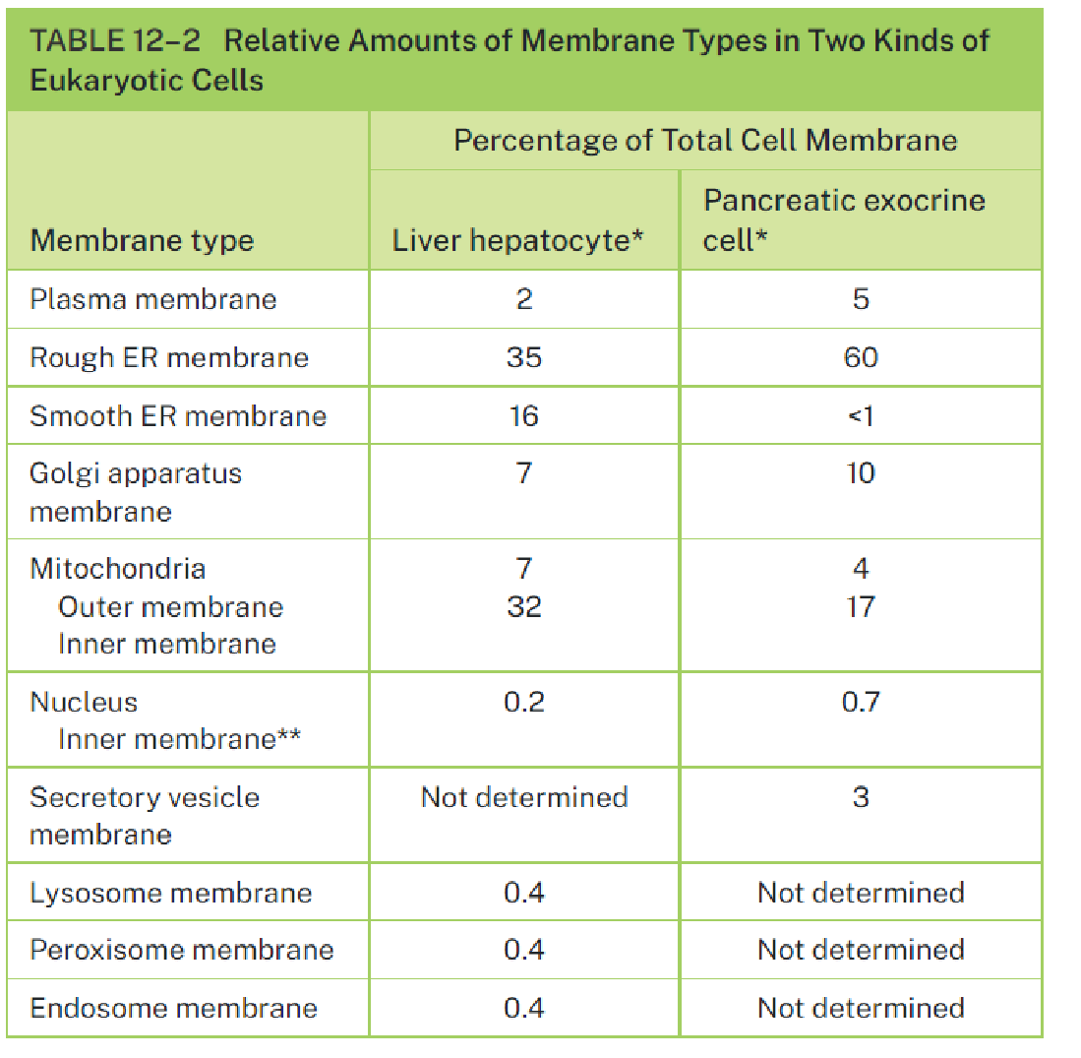
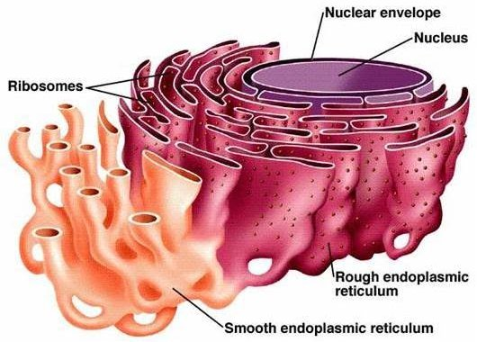
Volume
Surface

Slide 7
RER and SER

Slide 8
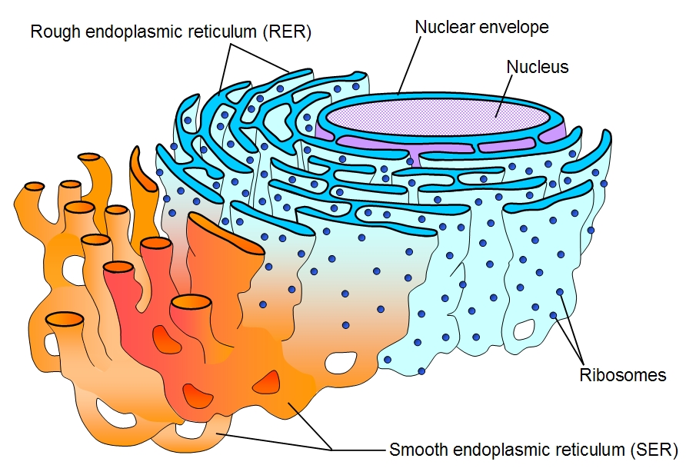

Slide 9
12.4

Slide 10
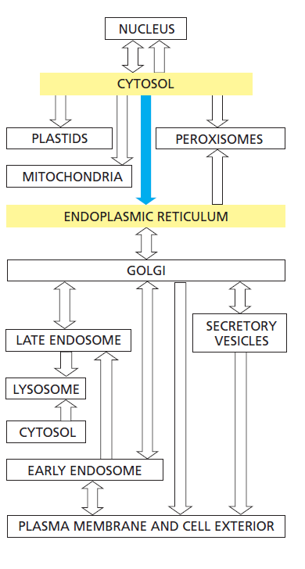

Slide 11
Gunter Blobel
Nobel Prize 1999
Signal hypothesis
"for the discovery that proteins have intrinsic signals that govern their transport and localization in the cell"

Slide 12
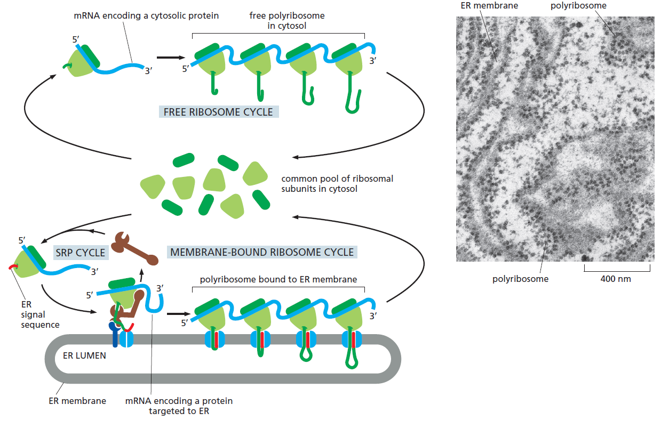
Two populations of ribosomes:
Free – cytosolic\
Bound - ER microsomes

Slide 13
Traduzione In vitro su polisomi liberi
?
La traduzione In vitro su polisomi liberi produce proteine più lunghe
Traduzione In vitro su polisomi legati all’ER

Slide 14
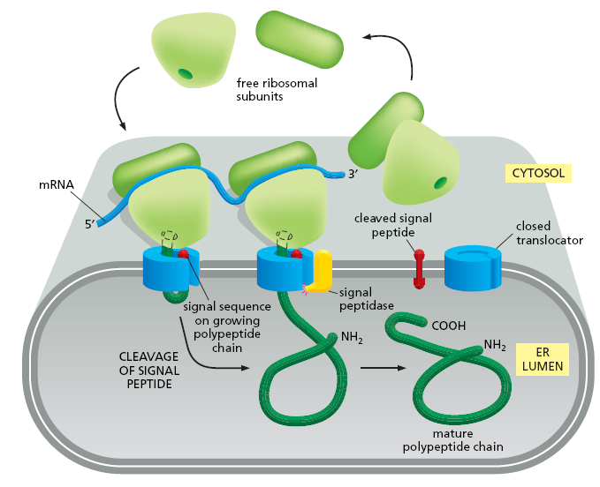
L’IPOTESI DEL SEGNALE

Slide 15
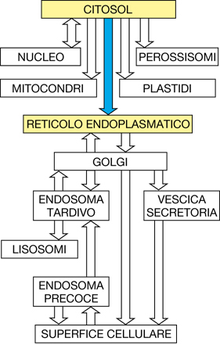

Slide 16
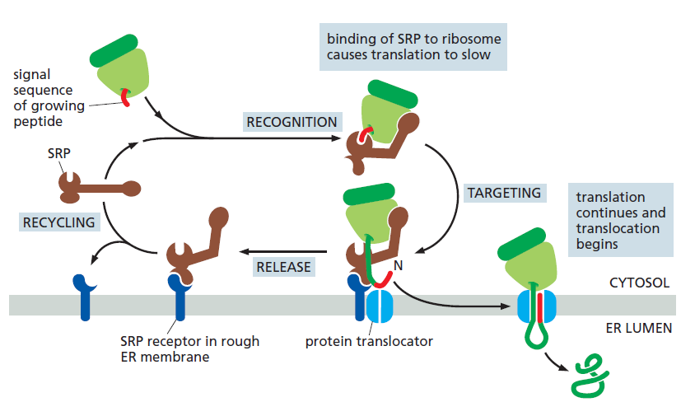

Slide 19
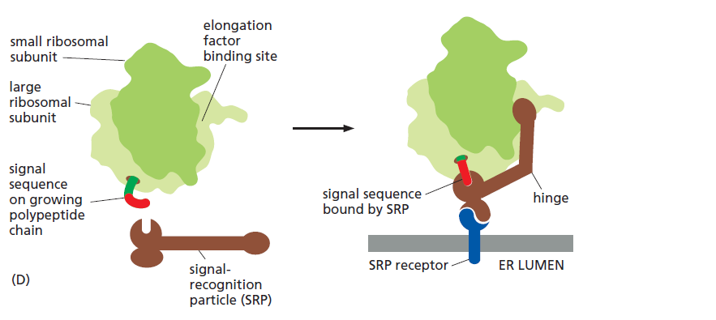
The ER signal sequence is guided to the ER membrane by at least two components:
a signal-recognition particle (SRP), which binds to the signal sequence,
and an SRP receptor in the ER membrane.

Slide 20
SRP is a large complex, it consists of:
- six different polypeptide chains
- bound to a single RNA molecule

Slide 21
Indeed, SRP dysfunction is involved in many different human diseases, including: congenital neutropenia; idiopathic inflammatory myopathy; viral, protozoal, and prion infections; and cancer.
If SRP recognizes the substrates but is unable to target them to ER, they may mislocalize or degrade.
All these events lead to dramatic consequence for protein biogenesis, activating protein quality control pathways, and creating pressure on cell physiology, and might lead to the pathogenesis of disease.

Slide 23
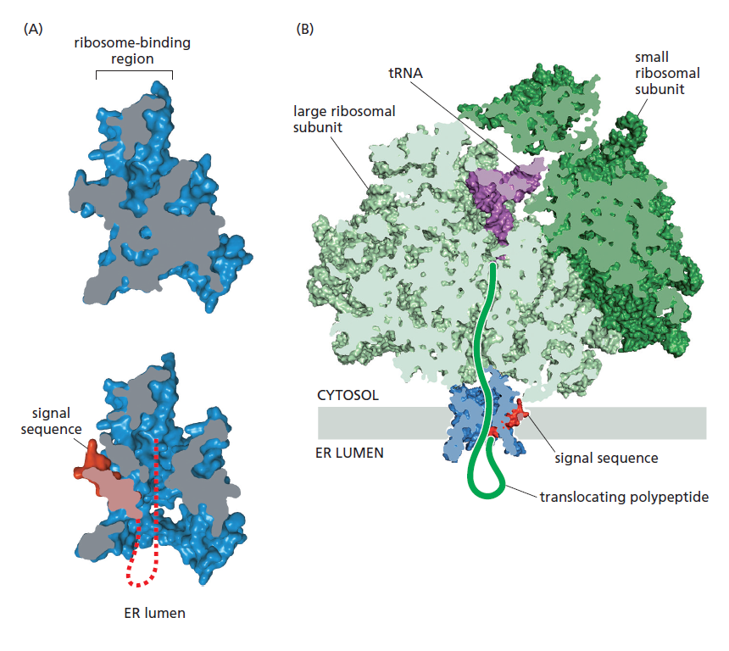
Sec61 translocator
Cross section through the structure of a translating ribosome (green) bound to a Sec61 translocator (blue) that has been opened by a signal sequence (red).

Slide 24
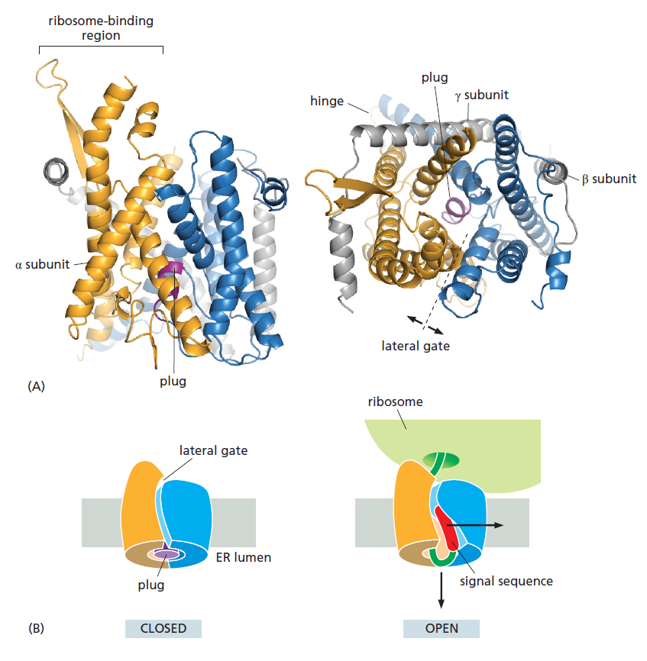
The structure of the Sec61 translocator revealed that 10 α helices surround a central channel (Figure 12–22). The channel is plugged by a short α helix that keeps the translocator closed when it is idle. It is important to keep the channel closed to prevent ions, such as Ca2+, from leaking out of the ER. During translocation, the plug moves out of the way so the polypeptide can pass through the channel.

Slide 26
L’IPOTESI DEL SEGNALE

Slide 27
Topologies of some integral membrane proteins synthesized on the rough ER

Slide 28
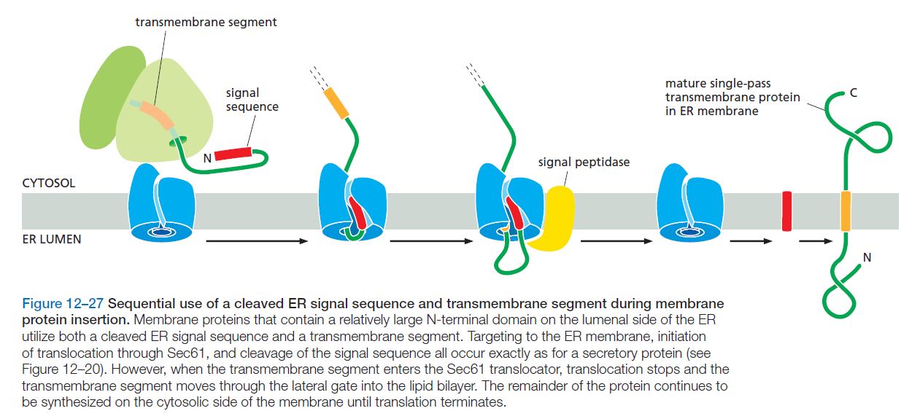

Slide 29
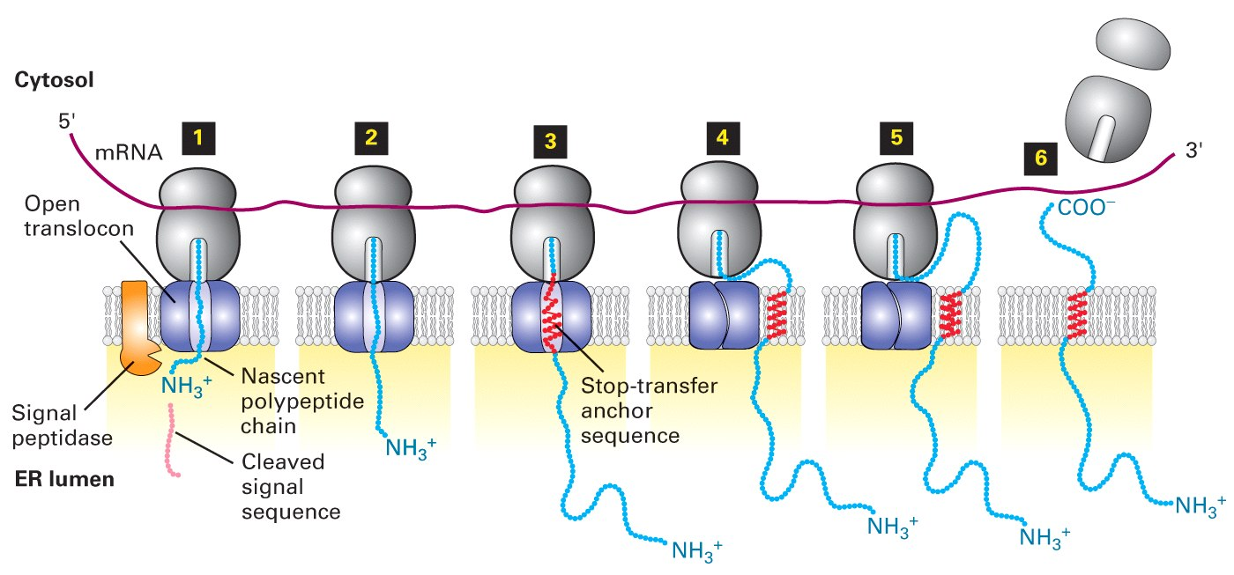
- an N-terminal signal sequence - an internal topogenic sequence
Type I protein
transmembrane proteins have:

Slide 30
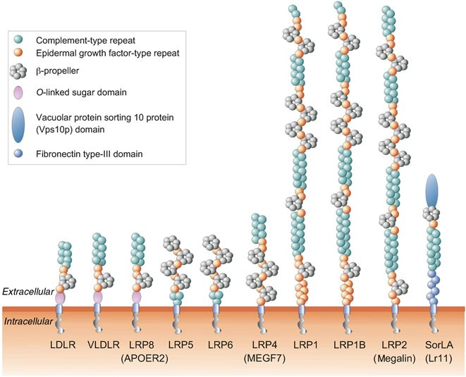

Slide 31
Topologies of some integral membrane proteins synthesized on the rough ER

Slide 32
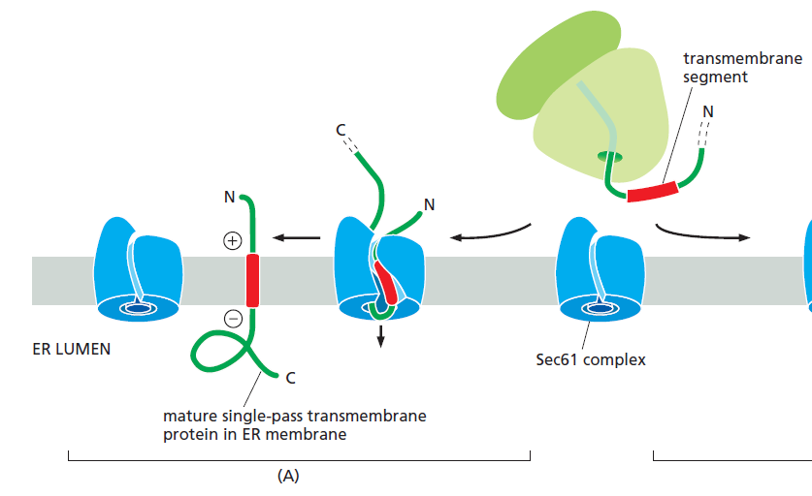

Slide 33
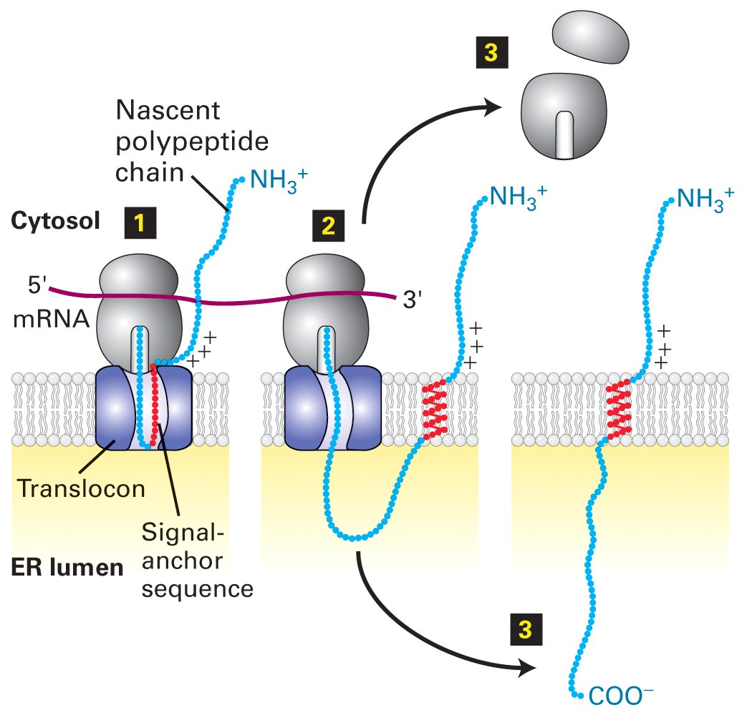
Type II transmembrane proteins - NO N-terminal signal sequence - A single internal signal-anchor sequence (directs insertion of single-pass)

Slide 34
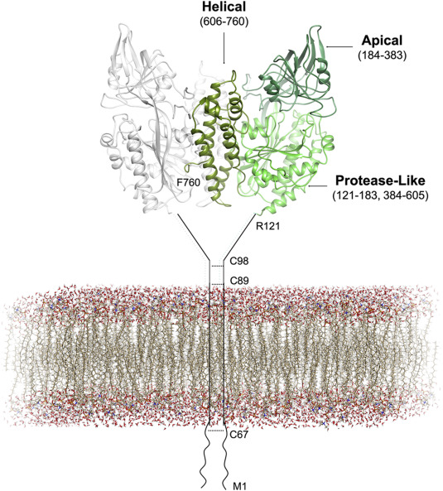
Overall structure of the human Transferrin Receptor 1

Slide 35
Topologies of some integral membrane proteins synthesized on the rough ER

Slide 36
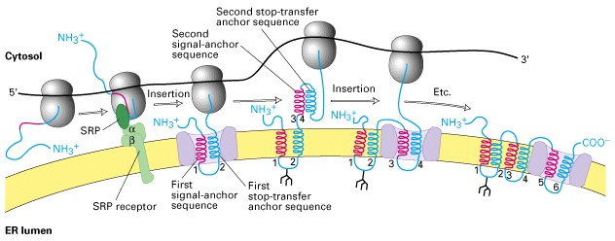
Multipass transmembrane proteins have multiple topogenic sequences

Slide 37
https://app.jove.com/it/embed/player?id=12128&access=843f572e1b&language=it&t=1&s=1&fpv=1
VIDEO 12.6

Slide 39
The attachment of a GPI anchor to a protein in the ER.
GPI-anchored proteins are targeted to the ER membrane by an N-terminal signal sequence
Within less than a minute, a transamidase enzyme in the ER cleaves the protein from its membrane-bound C-terminus and simultaneously attaches the new C-terminus to an amino group on a preassembled GPI intermediate.

Slide 40
Protein co- and post-translational
modifications in the ER
1 addition of carbohydrates (glycosylation)
2 formation of disulfide bonds
3 proper folding / quality control
4 assembly of multimeric proteins

Slide 41
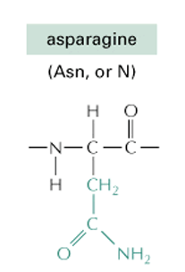
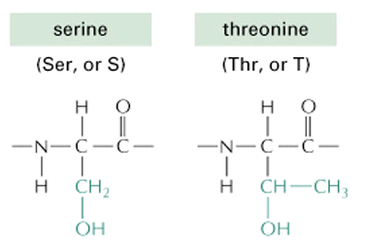
Sugar-Protein bonds
N-linked glycosylation
O-linked glycosylation

Slide 42
N glicosilazione
legame degli zuccheri al
N - terminale dell proteina
legame degli zuccheri all’azoto

Slide 43
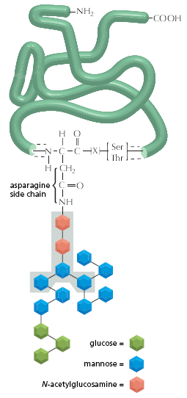
N-linked
glico
proteina
….. N - X - (S/T) ….
Asparagine-X-(Ser/Thr)
COOH
oligosaccaride
glyco-moiety

Slide 44
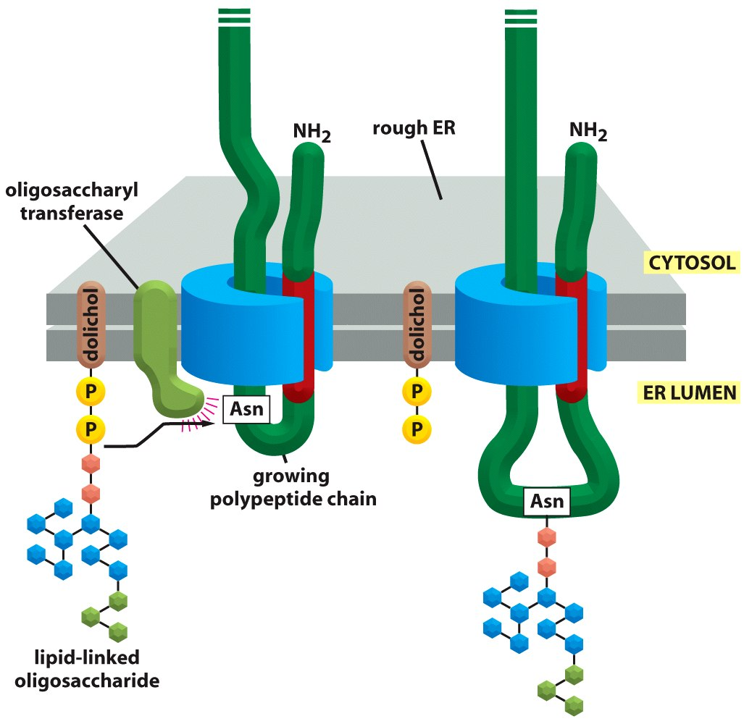
N-glicosilazione co-traduzionale

Slide 46
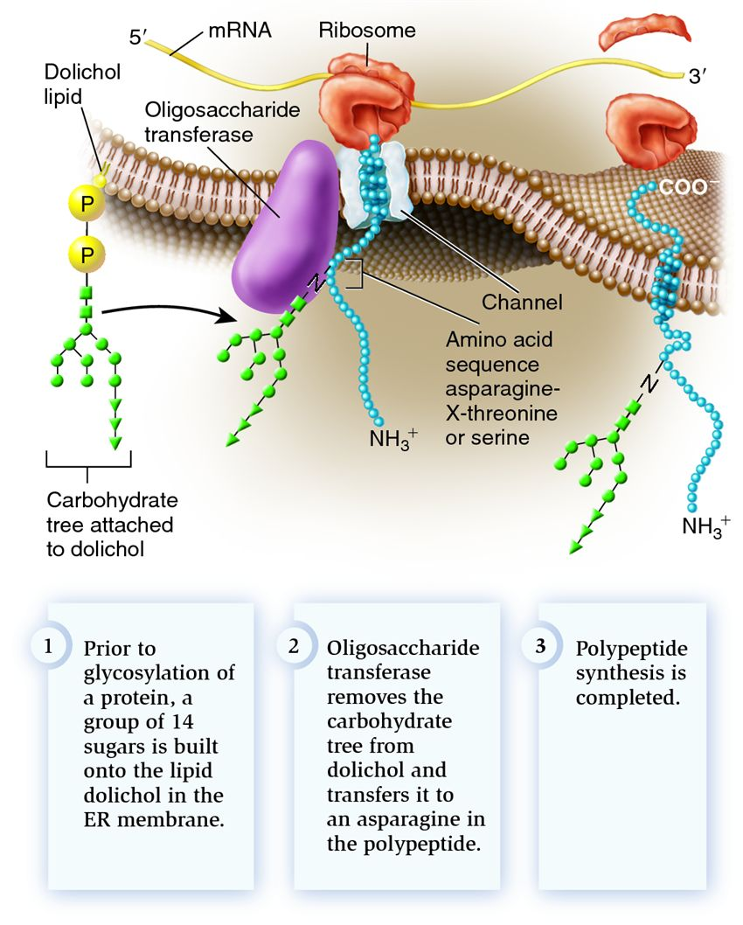

Slide 47
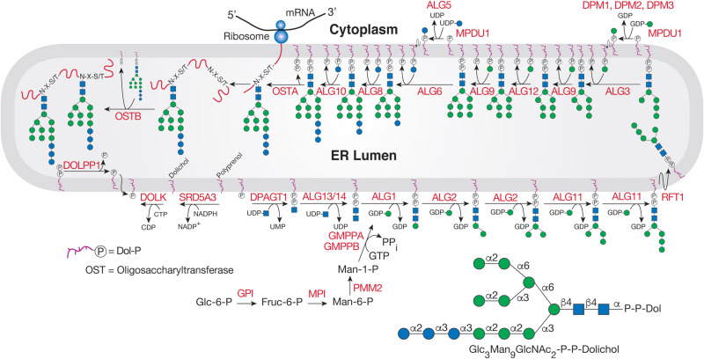

Slide 48
Protein co- and post-translational
modifications in the ER
1 addition of carbohydrates (glycosylation)
2 formation of disulfide bonds
3 proper folding / quality control
4 assembly of multimeric proteins

Slide 49
proteina disolfuro isomerasi - PDI

Slide 50
Protein co- and post-translational
modifications in the ER
1 addition of carbohydrates (glycosylation)
2 formation of disulfide bonds
3 proper folding / quality control
4 assembly of multimeric proteins

Slide 51
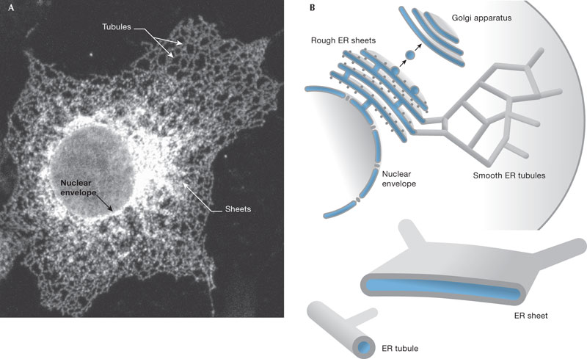

Slide 52
Chaperones: folding
ER
unfolded
protein
chaperone protein

Slide 53
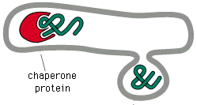
Chaperones: quality control
ER
properly folded protein
misfolded
protein
chaperone protein
refolding
Molte proteine non riescono a raggiungere il loro corretto stato ripiegato (>80% per alcune proteine)

Slide 54
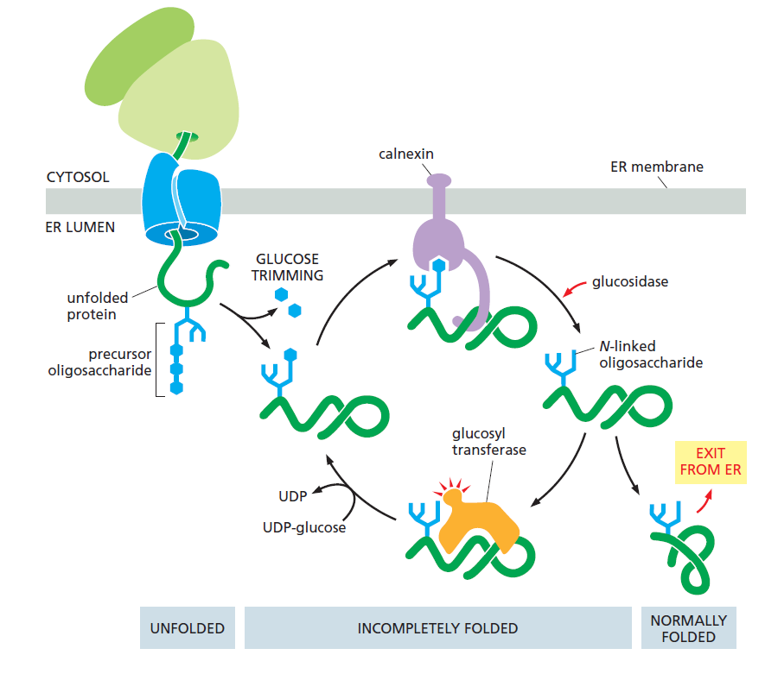
Two ER chaperone proteins:calnexin and calreticulin
These chaperones are carbohydrate-binding proteins, or lectins, which bind to oligosaccharides on incompletely folded proteins

Slide 55
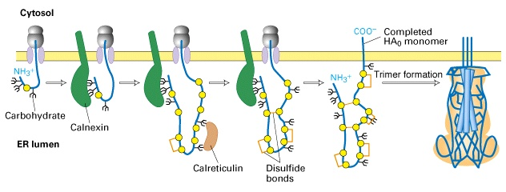
Correct folding of newly made proteins is facilitated by several ER proteins

Slide 56
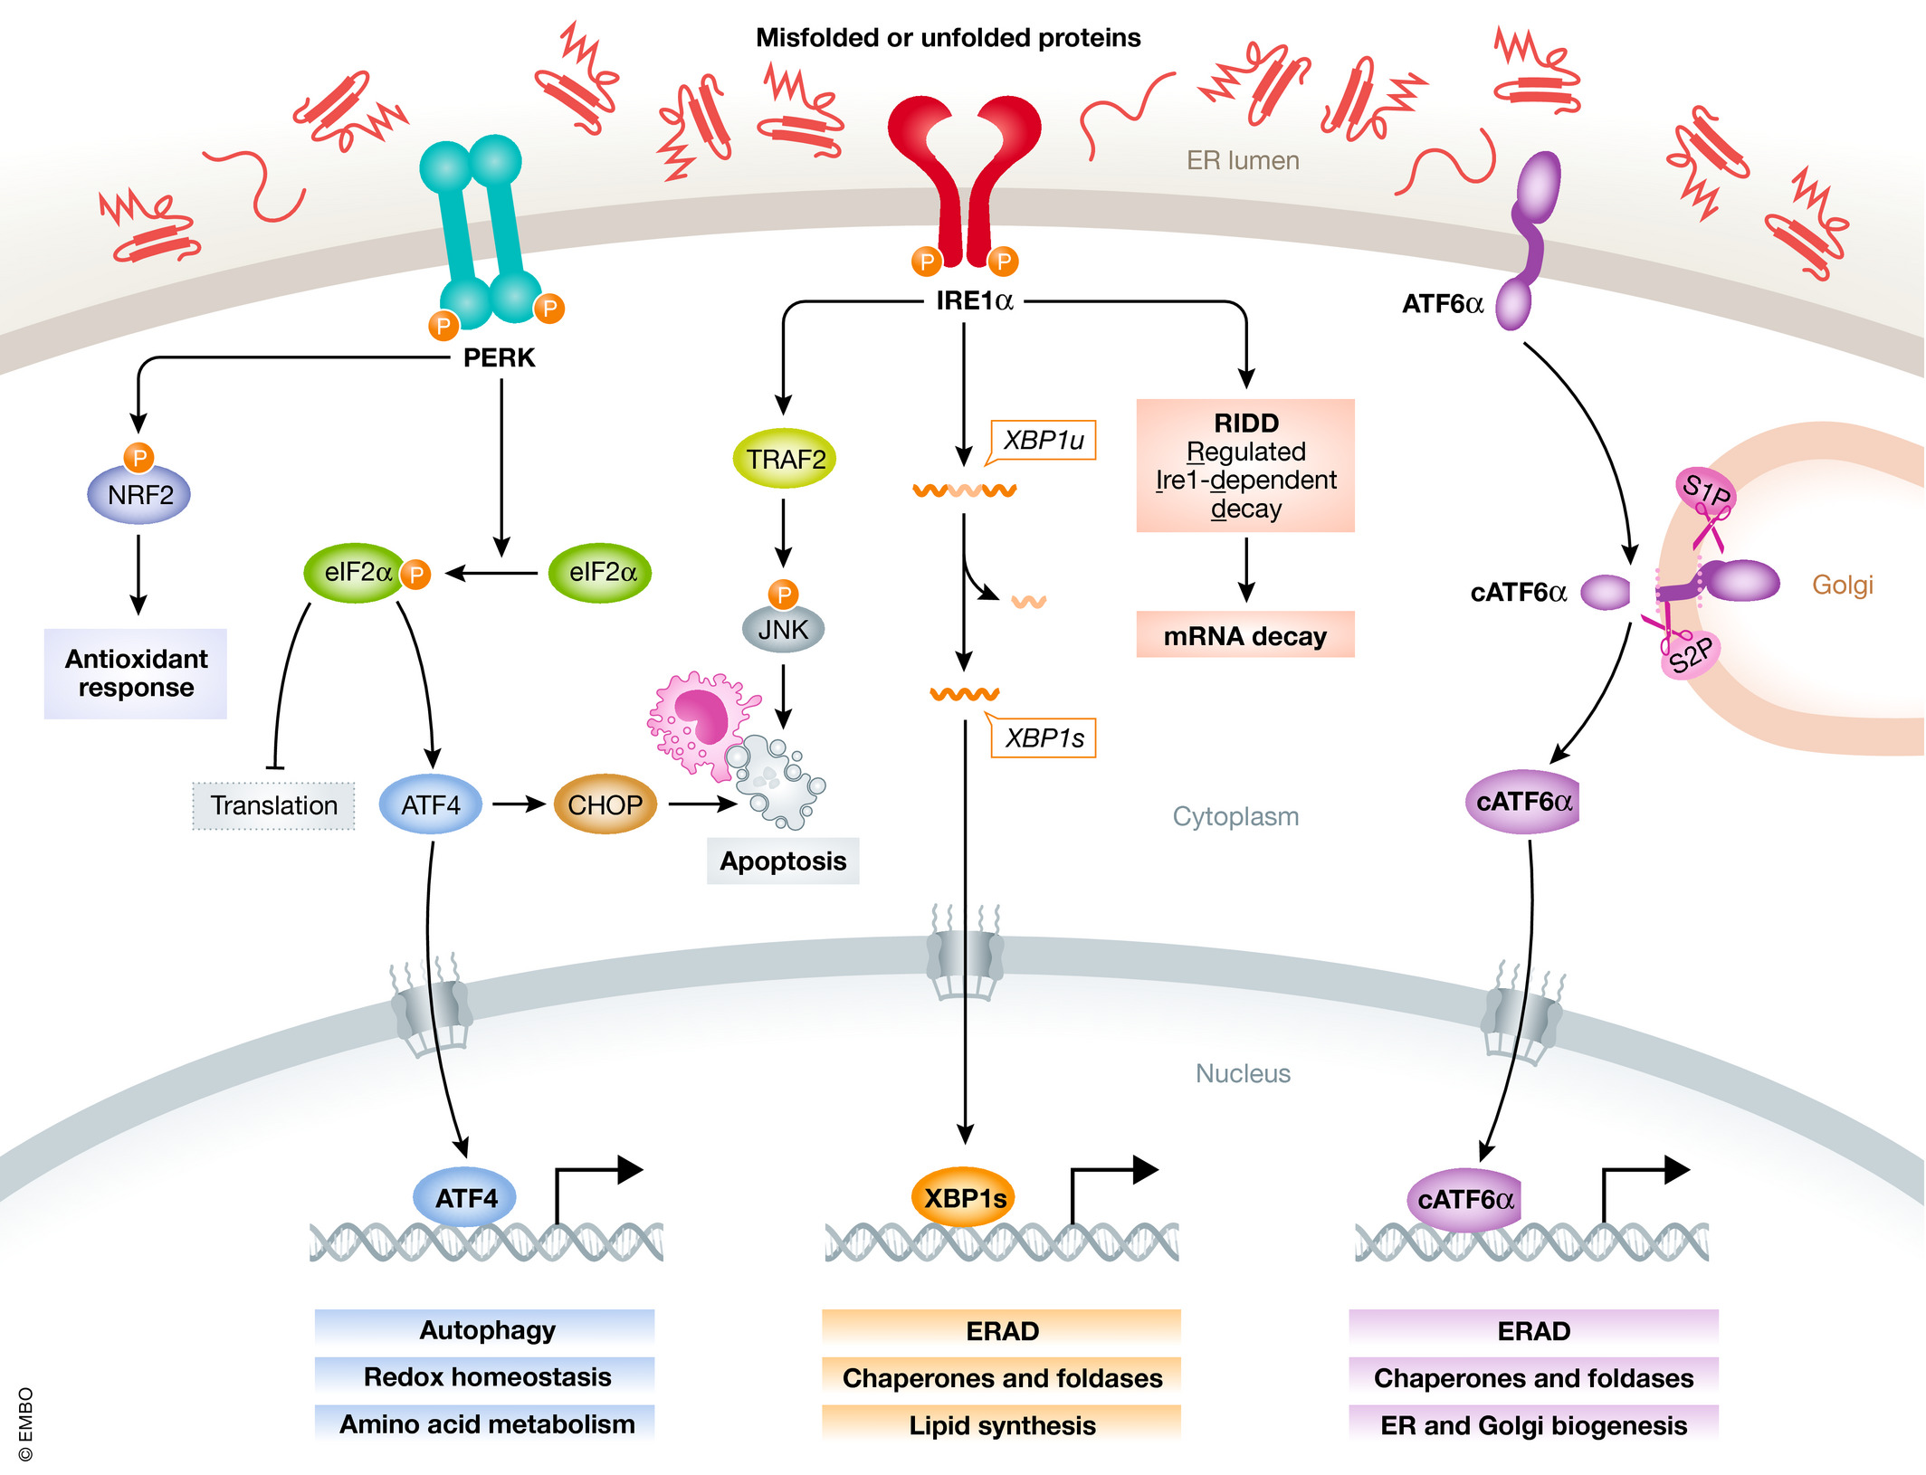
Alterations in the function of the endoplasmic reticulum (ER) can result in the accumulation of unfolded or misfolded proteins, a cellular condition referred to as ER stress.
ER stress engages the unfolded protein response (UPR), an adaptive reaction that reduces unfolded protein load to maintain cell viability and function.
In order to restore protein folding capacity with protein synthesis requirements, a coordinated transcriptional and translational network termed the unfolded protein response (UPR) is initiated.
The UPR monitors protein folding levels within the ER and readjusts folding capacity to match synthesis load, thus ensuring a successful balance for protein homeostasis

Slide 57
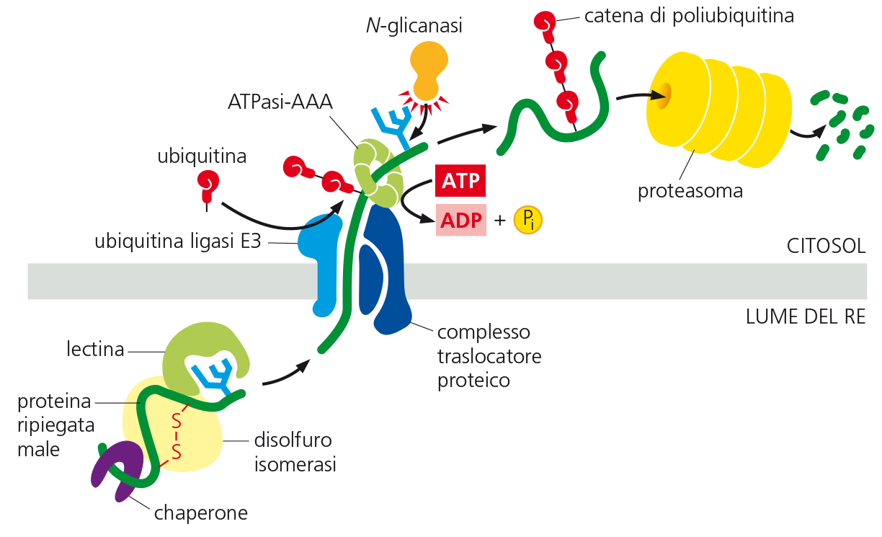
A failure in the polypeptide chain to adopt its native conformation may lead to activation of degradation pathways, including ER-associated degradation (ERAD).
In this process, misfolded protein is retro-translocated across the ER membrane into the cytosol, where it is ubiquitylated and targeted for degradation via the 26S proteasome.

Slide 58
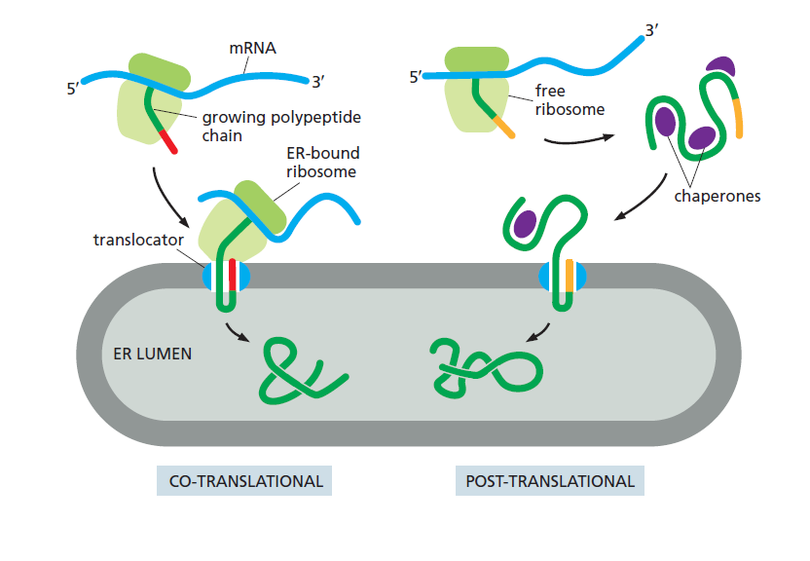

Slide 59
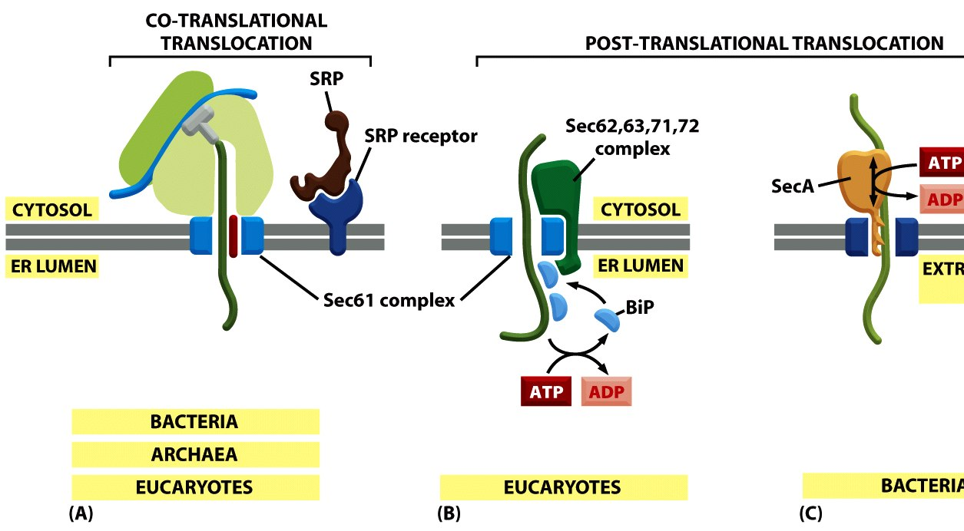
Figure 12-44 Molecular Biology of the Cell (© Garland Science 2008)

Slide 60
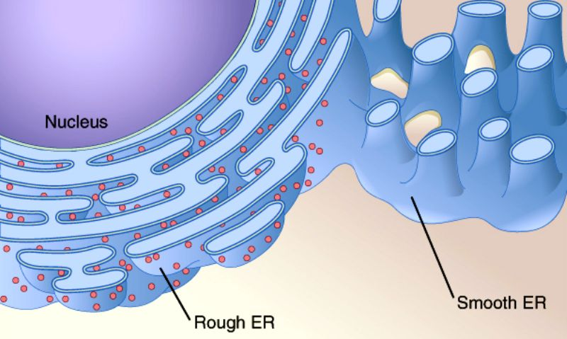
RER and SER
Reticolo endoplasmico liscio
Detossificazione di farmaci
Metabolismo glucidico (glicogeno)
Immagazzinamento di calcio
Sintesi di bio-membrane

Slide 61
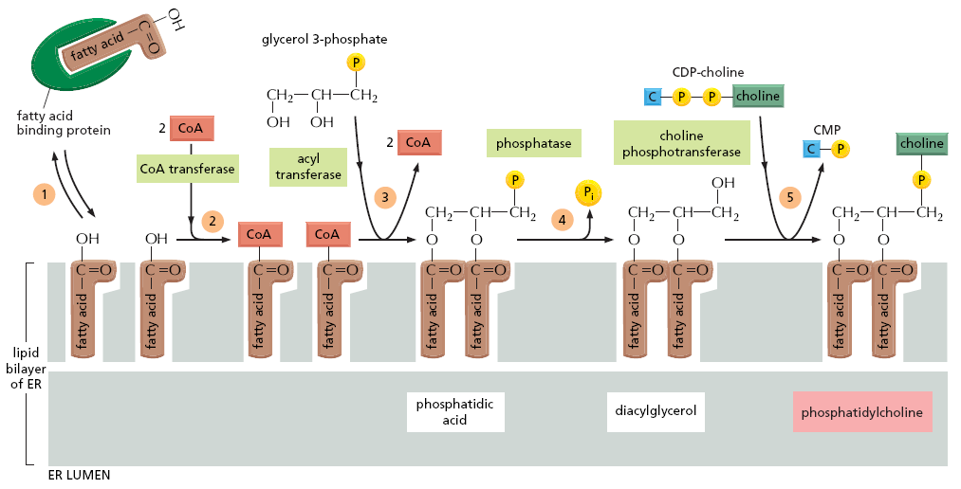
Endoplasmic reticulum (ER)-localized enzymes synthesize the vast majority of cellular lipids.
Signals from outside and inside the cell are directed to ER-localized enzymes, and lipid enzyme activities are defined by the integration of internal, homeostatic, and external information.

Slide 62
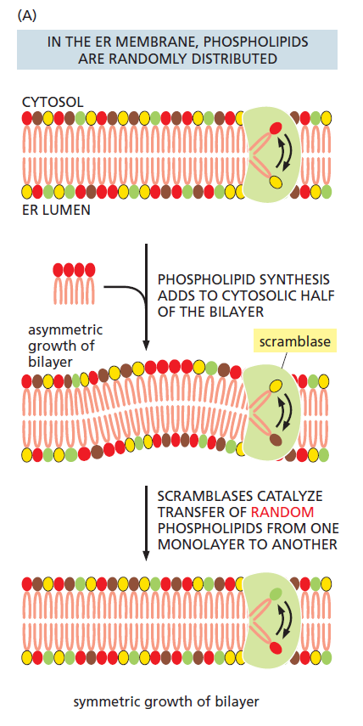
- phospholipid synthesis takes place in the cytosolic leaflet of the ER lipid bilayer
- there needs to be a mechanism that transfers some of the newly formed phospholipid molecules to the lumenal leaflet of the bilayer
scramblase
scramblase scrambles the inner and outer phospholipid leaflets.

Slide 63
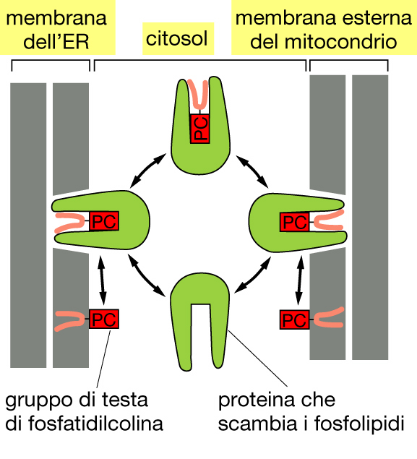
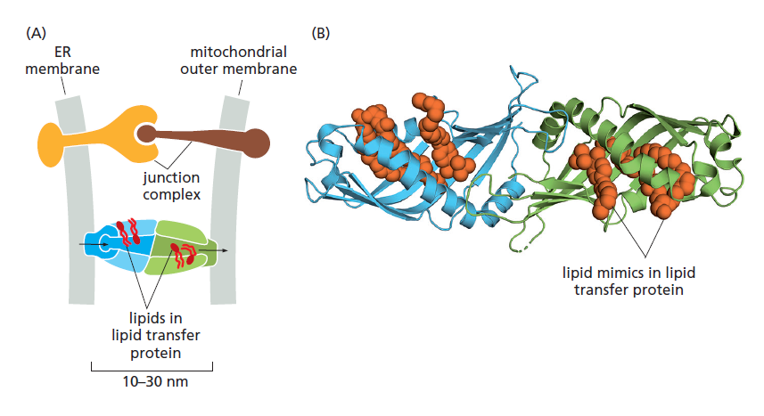
Lipids are distributed in a highly heterogeneous fashion in different cellular membranes.
the bulk of lipid traffic is mediated by a large group of lipid transfer proteins (LTPs), which move small numbers of lipids at a time using hydrophobic cavities that stabilize lipid

Slide 64
Flippase moves an outer phospholipid leaflet to the inner phospholipid leaflet.
Floppase does the opposite; it moves an inner phospholipid leaflet to the outer phospholipid leaflet.

Slide 65
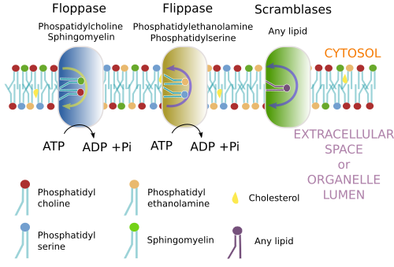
Flippase,floppase, and scramblase are enzymes that change the positions of phospholipids within cell membranes.
They are essentially lipid transport proteins that aid the movement of phospholipid molecules within the cell membrane.

Slide 66
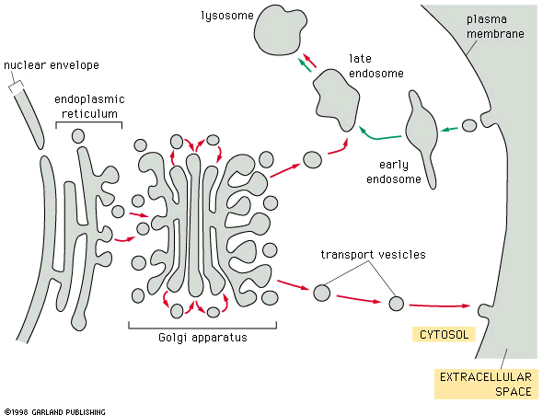
Vesicular transport
secretion
ER
Golgi
complex

