Slide 1
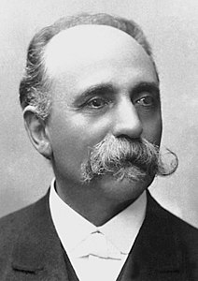
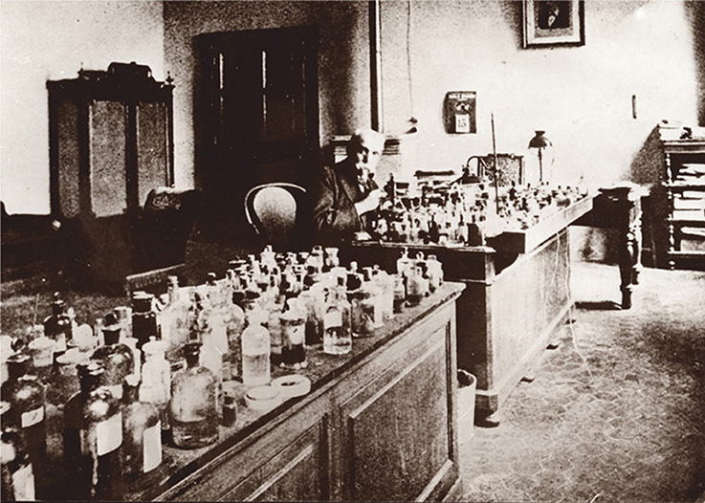
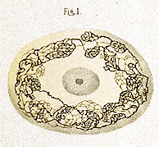
Nobel Prize 1906
Camillo Golgi

Slide 2
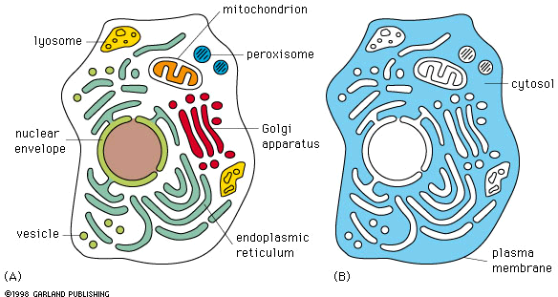

Slide 3
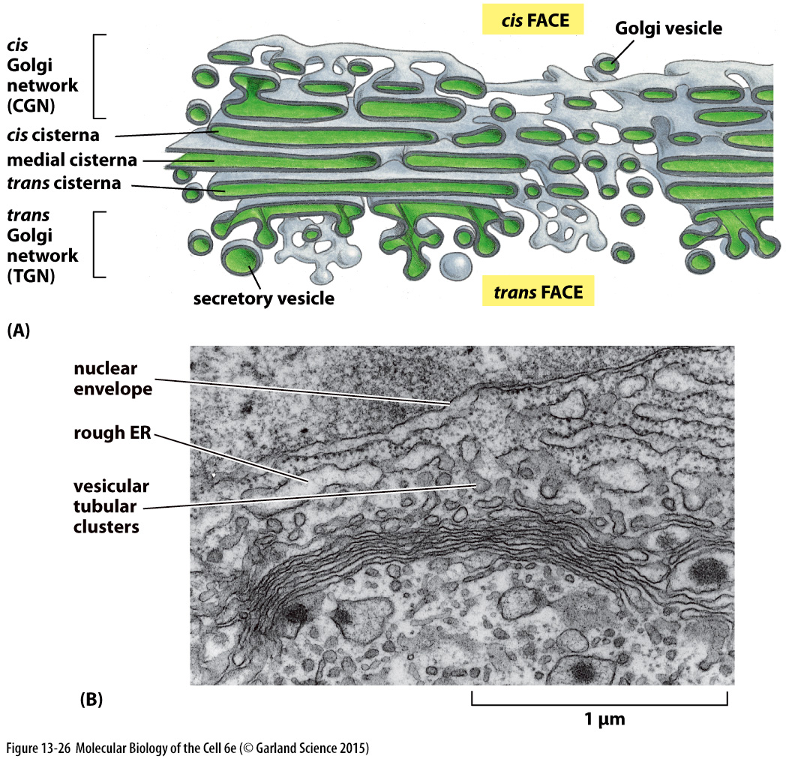
The Golgi Apparatus Consists of an Ordered Series of Compartments

Slide 4
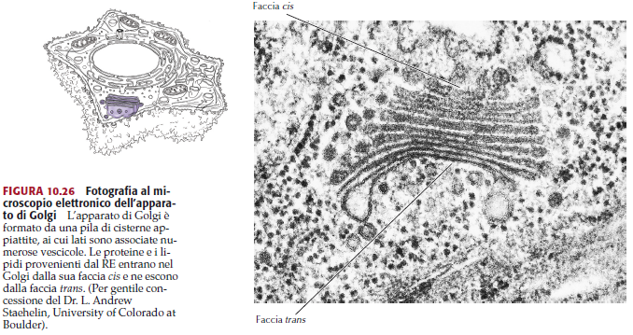

Slide 5
Reticolo Endoplasmatico
cis face
cis - Golgi
network
Golgi vesicle
cis
medial
trans
trans - Golgi
network
secretory vesicle
trans face
Membrana plasmatica

Slide 6
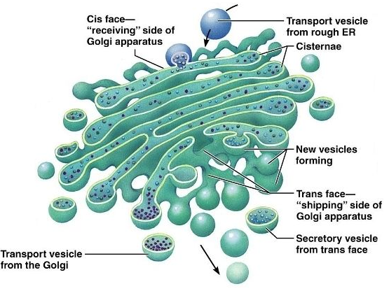
IL COMPLESSO DI GOLGI
È costituito da una serie di cisterne appiattite formate da membrana, sacchi discoidali impilati
è diviso in cis-Golgi e trans-Golgi
il cis-Golgi riceve le vescicole che arrivano dal RE
il trans-Golgi forma le vescicole secretorie o di trasporto

Slide 7
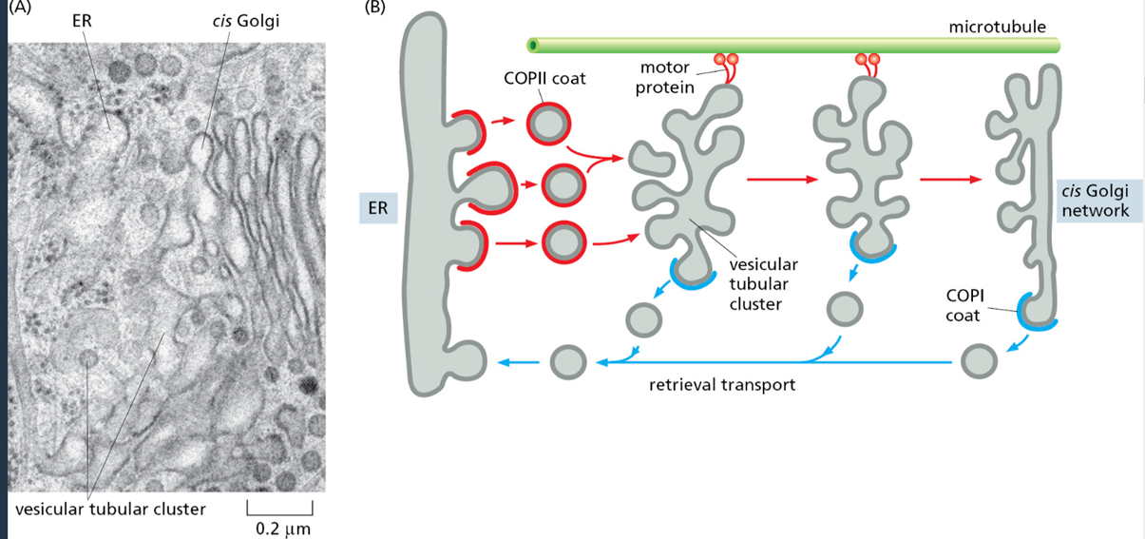
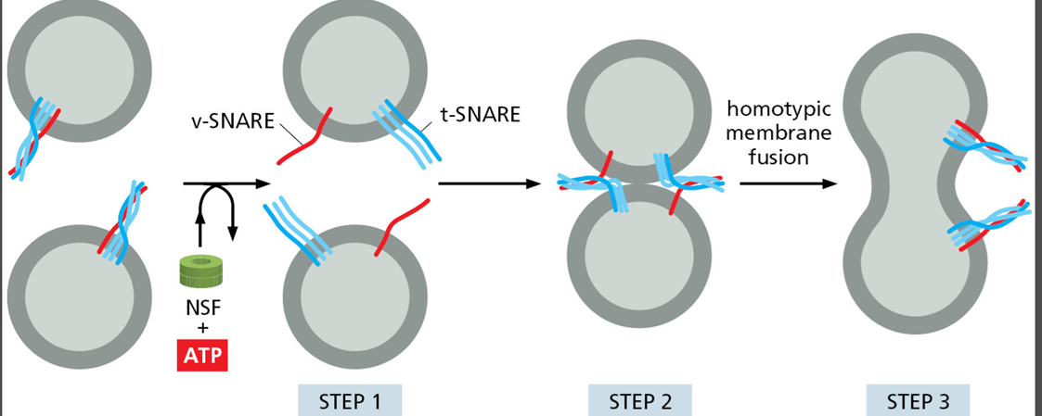
The structures formed when ER-derived vesicles fuse with one another are called vesicular tubular clusters
The clusters move quickly along microtubules to the Golgi apparatus with which they fuse
Homotypic membrane fusion.

Slide 8
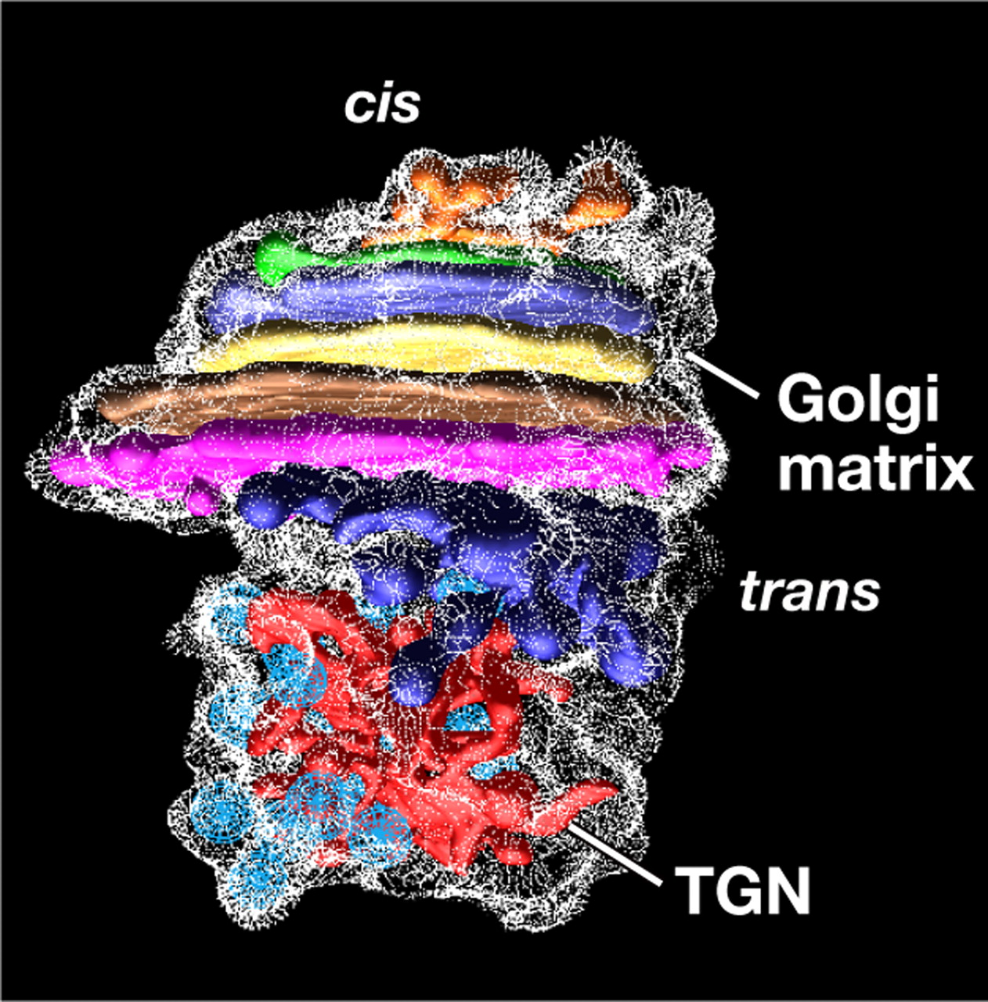
Golgi_1
CELL ORGANELLES 3

Slide 9
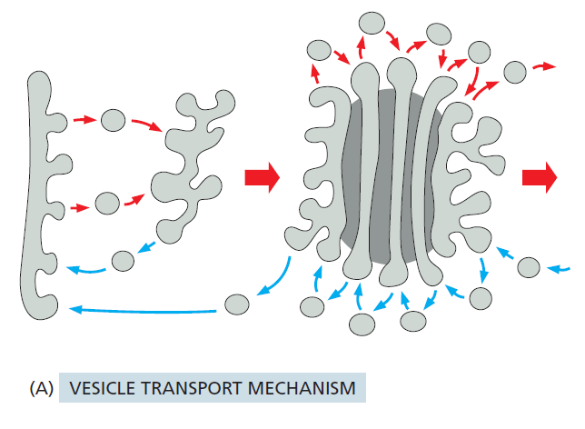
The vesicle transport mechanism
One mechanism involves the movement of cargo in transport vesicles from one compartment to the next while retrieving any escaped resident proteins using different transport vesicles

Slide 10
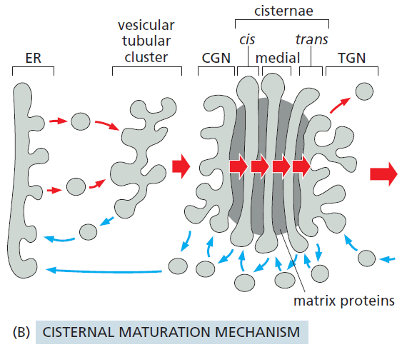
The cisternal maturation mechanism
According to this view, new cis cisternae continually form as vesicular tubular clusters arrive from the ER and fuse with transport vesicles containing Golgi resident proteins and enzymes.
As the cargo within a cis cisterna is modified, the enzymes leave in transport vesicles that will fuse with newly arriving vesicular tubular clusters.

Slide 11
The cisternal maturation mechanism
According to this view, new cis cisternae continually form as vesicular tubular clusters arrive from the ER and fuse with transport vesicles containing Golgi resident proteins and enzymes.
As the cargo within a cis cisterna is modified, the enzymes leave in transport vesicles that will fuse with newly arriving vesicular tubular clusters.

Slide 12
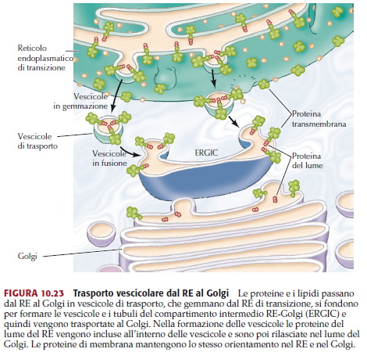

Slide 13
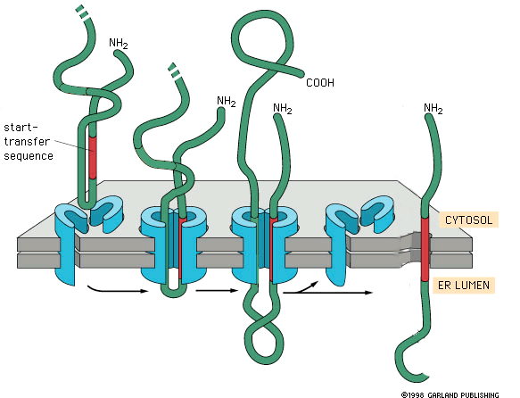

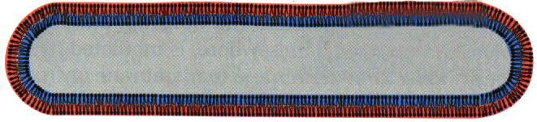
Vesicular transport
cytosol
ER
lumen
ER lumen
cytosol
Golgi
lumen

Slide 14
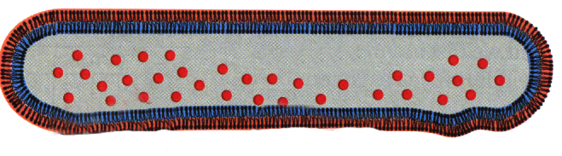
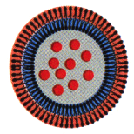
Vesicular transport
ER
lumen
cytosol
lumen
Golgi
fig. 13-2

Slide 15
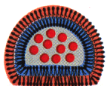
Vesicular transport
ER
lumen
cytosol
lumen
Golgi
fig. 13-2

Slide 16
Vesicular transport
ER
lumen
cytosol
lumen
Golgi
fig. 13-2

Slide 17
Vesicular transport
ER
lumen
cytosol
cis
lumen
Golgi
medial
trans
fig. 13-2

Slide 18
Vesicular transport
Trans Golgi
network
lumen
Plasma
membrane
fig. 13-2

Slide 19
Vesicular transport
Trans Golgi
network
lumen
Plasma
membrane
fig. 13-2

Slide 20
Vesicular transport
Trans Golgi
network
lumen
Plasma
membrane
fig. 13-2

Slide 21
Vesicular transport
Trans Golgi
network
lumen
Plasma
membrane
fig. 13-2

Slide 22
Vesicular transport
Trans Golgi
network
lumen
cytosol
Plasma
membrane
extracellular
medium
fig. 13-2

Slide 23
Reticolo Endoplasmatico
cis face
cis - Golgi
network
Golgi vesicle
cis
medial
trans
trans - Golgi
network
secretory vesicle
trans face
Membrana plasmatica

Slide 24
Funzione dell’apparato di Golgi
L'apparato del Golgi ha la funzione di
selezionare
rielaborare
esportare
i prodotti cellulari.

Slide 25
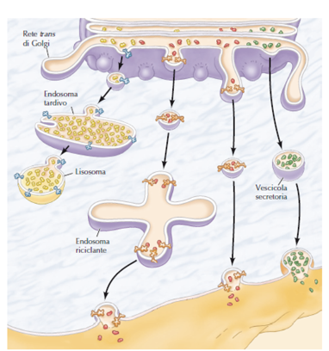
1- Funziona come stazione di smistamento, per la consegna di proteine a diverse destinazioni nella cellula:
Membrana plasmatica,
secrezione verso l’esterno della cellula,
smistamento al sistema di endosomi/lisosomi,
oppure riconsegna indietro all’ER.

Slide 26
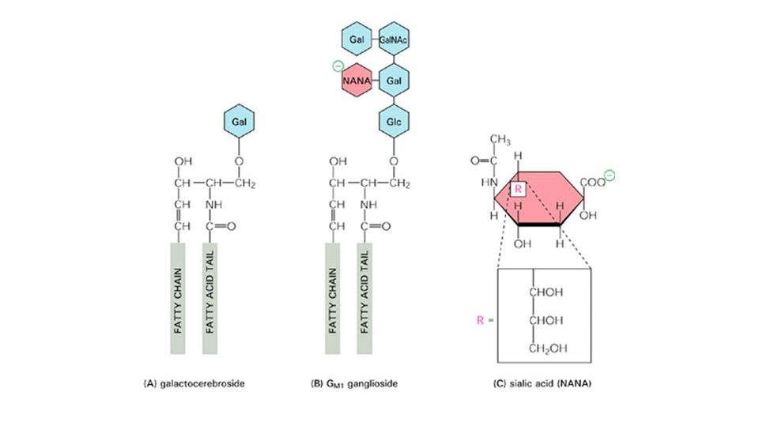
2- Sito di sintesi di sfingomielina e glicosfingolipidi:
Questi lipidi sono in grado di impacchettarsi strettamente nella membrana, ispessendola e rendendola meno permeabile alle molecole solubili in acqua.

Slide 27
Apparato di Golgi
3- Funziona come una «fabbrica di carboidrati»
- le glicoproteine, i polisaccaridi (nelle piante) e i proteoglicani ricevuti dall’ER sono ulteriormente processati.
Questo processamento permette a tali molecole di partecipare a numerose funzioni biologiche specializzate sulla superficie cellulare.
Più di 200 enzimi del Golgi partecipano alla biosintesi di glicoproteine e di glicolipidi:
Glicosiltrasferasi: aggiungono residui di zuccheri specifici.
Glicosidasi: rimuovono residui di zucchero specifici

Slide 28
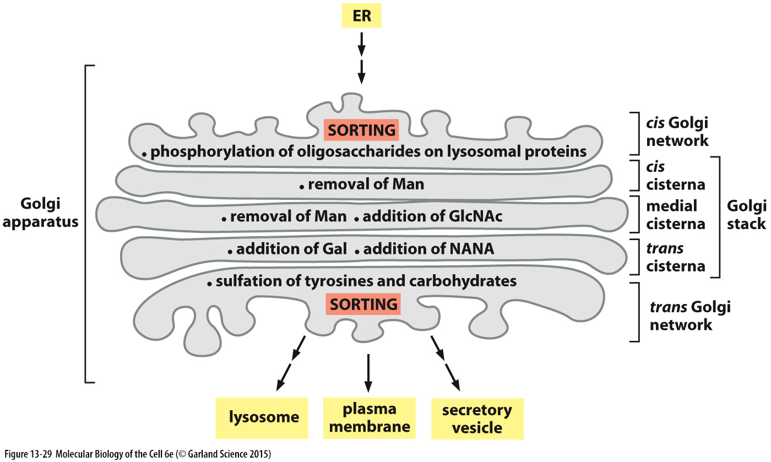

Slide 29
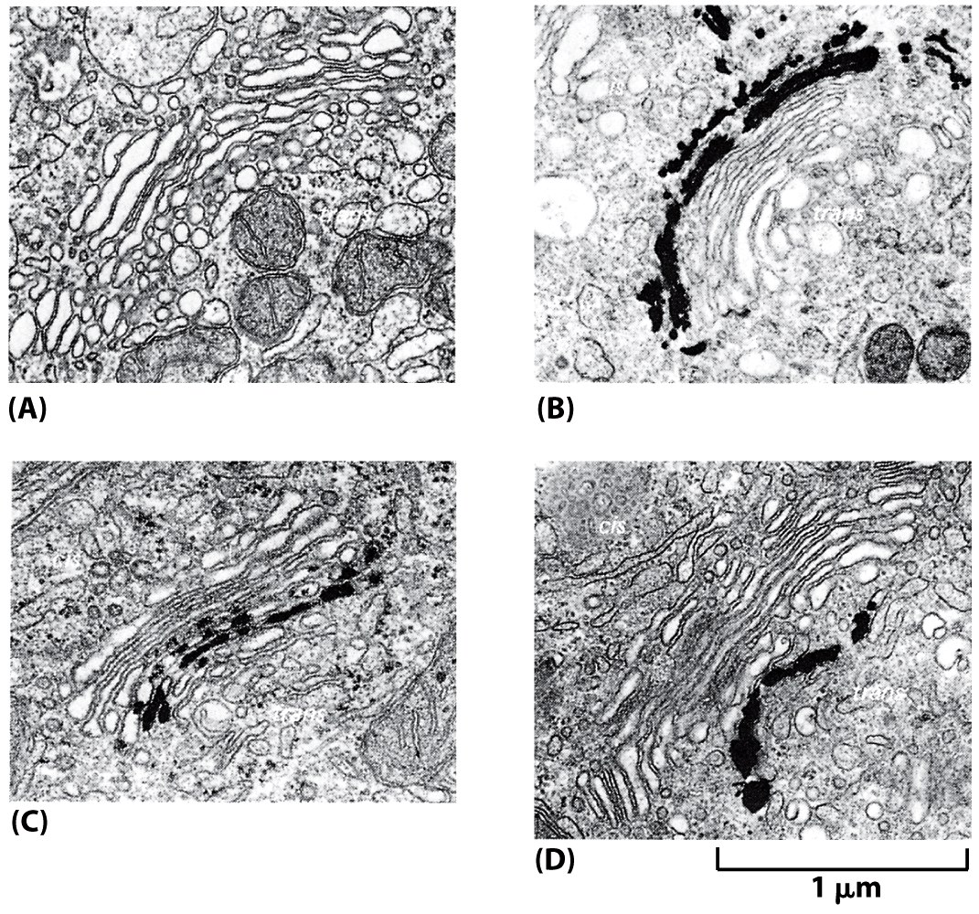
Figure 13-27 Molecular Biology of the Cell (© Garland Science 2008)

Slide 30
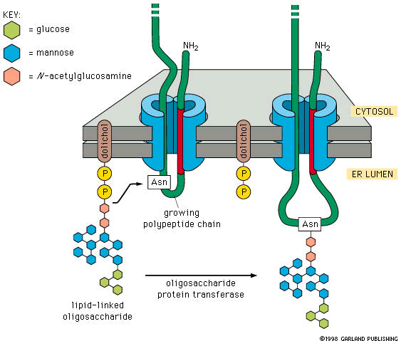
ER lumen
Golgi lumen

Slide 31
ER lumen
Golgi lumen
fig. 12-52

Slide 32
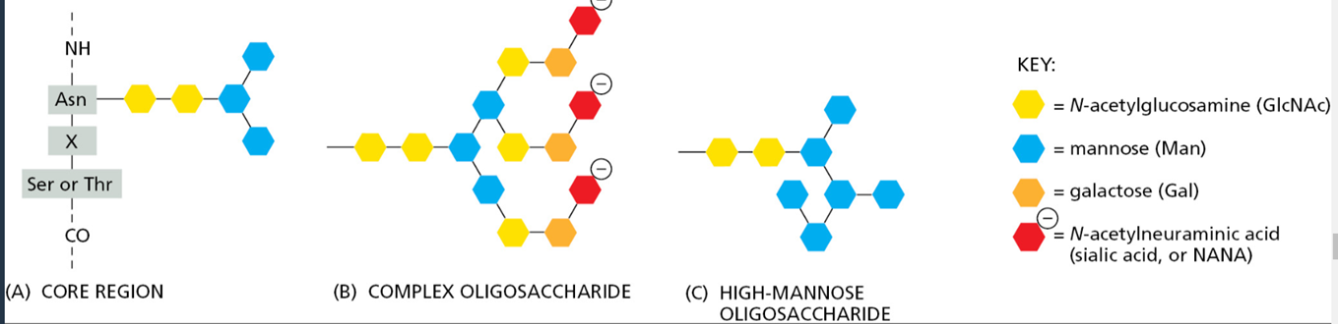
Due principali classi di oligosaccaridi presenti nelle proteine mature

Slide 33
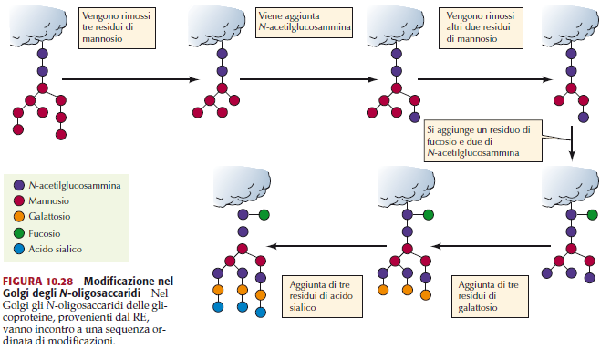

Slide 34
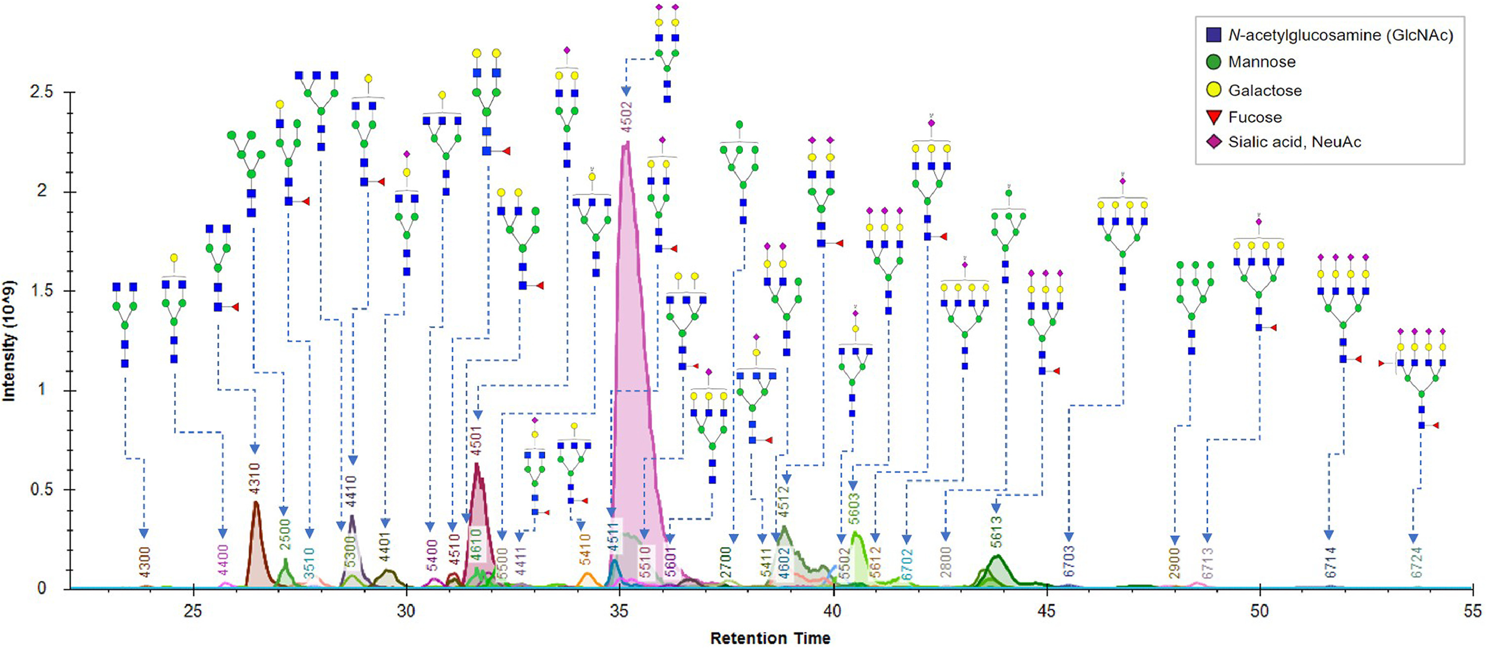
glycome patterns

Slide 35
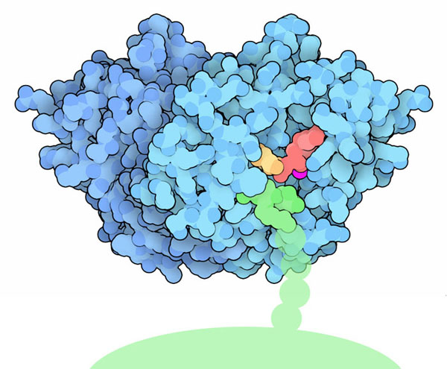
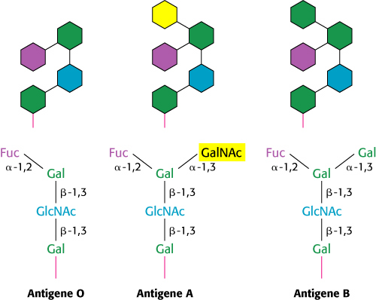
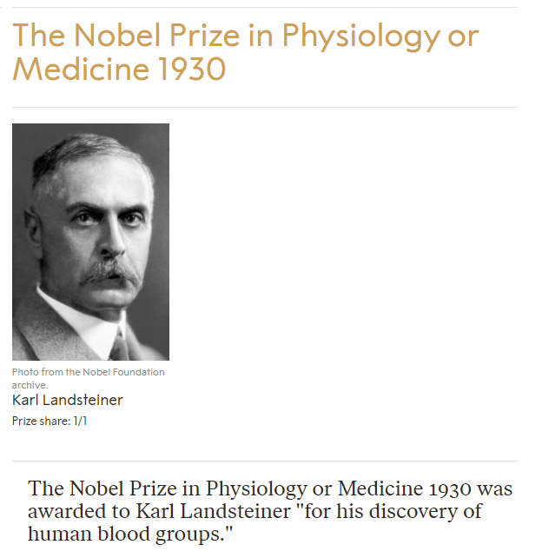
Es.: i gruppi sanguinei ABO sono determinati da due diverse glicosil transferasi

Slide 36
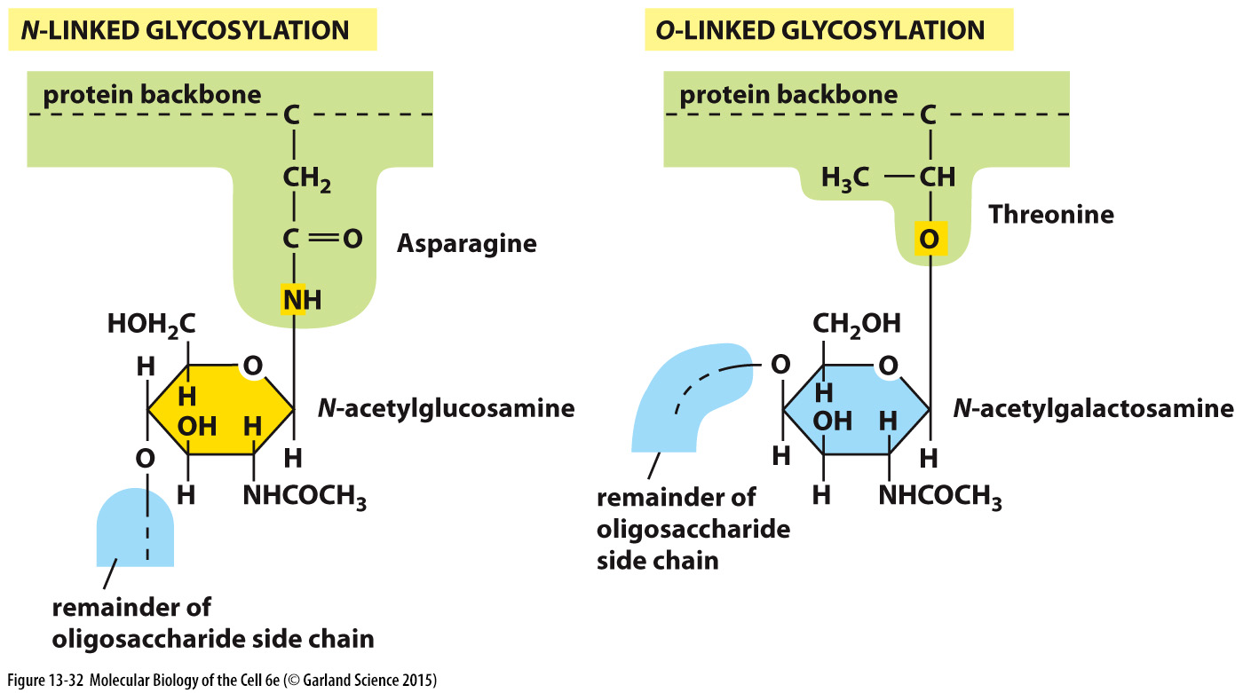
Proteoglycans Are Assembled in the Golgi Apparatus

Slide 37
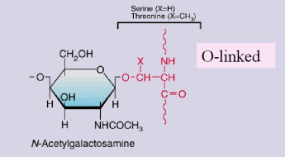
La O-glicosilazione
La O-glicosilazione è un processo altamente specifico, che non vede l'aggiunta "seriale" di carboidrati alla proteina in processazione.
Si svolge completamente nell'apparato del Golgi, dove zuccheri vengono legati al peptide a livello dell'atomo di ossigeno delle catene laterali di serina o treonina.
L'aggiunta riguarda un singolo carboidrato alla volta e solitamente il numero di zuccheri legati durante questo processo è limitato a pochi residui.
Serina o treonina

Slide 38
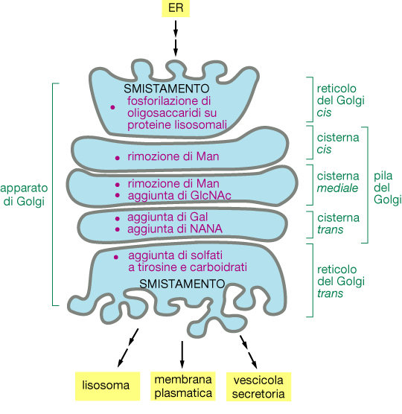
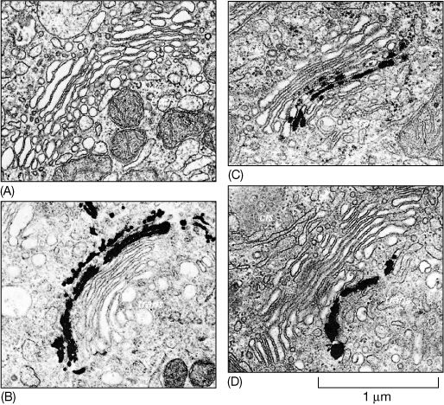

Slide 39
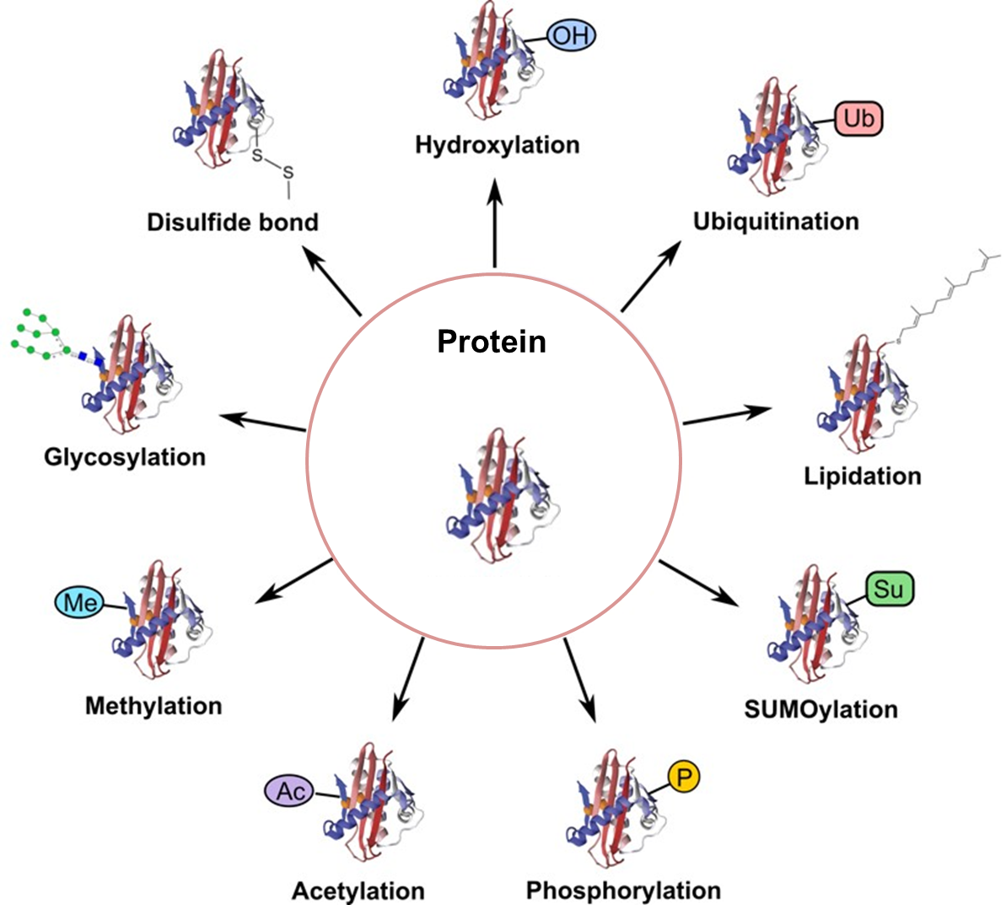
Post-translational modification (PTM) refers to the modification that occurs on a protein after translation catalyzed by enzymes

Slide 40
Affected gene | Protein | Affected PTM | Disease | Major clinical manifestations
MAN1B1 | α 1,2 mannosidase | glycosylation | MAN1B1-CDG | severe mental retardation, delayed speech
SLC35A1 | CMP-sialic acid transporter | glycosylation | SLC35A1-CDG | seizures, intellectual disability, ataxia, bleeding
SLC35A2 | UDP-galactose transporter | glycosylation | SLC35A2-CDG | intellectual disability, seizures, skeletal abnormalities
SLC35A3 | UDP-GlcNAc transporter | glycosylation | Arthrogryposis, mental retardation and seizures | autism spectrum disorder, hypotonia, epilepsy, and arthrogryposis
SEC23B | Sec23 homolog B | glycosylation | Dyserythropoietic anemia, congenital, type II | erythroblastic anemia: splenomegaly, gallstones, and iron overload potentially with liver cirrhosis or cardiac failure.
TRIP11 | Golgi microtubule associated protein 210 | glycosylation | Achondrogenesis type 1A | severe chondrodysplasia, lethal before or shortly after birth
UBE3A | Ubiquitin ligase E3A | glycosylation | Angelman syndrome | intellectual disability, seizures, lack of speech, and characteristic abnormal behavior
COG2 | Component of oligomeric Golgi complex 2 | glycosylation | COG2-CDG | microcephaly, developmental delay, intellectual disability, seizures, facial dysmorphism, liver dysfunction
SLC33A1 | Solute carrier family 33 (acetyl-CoA transporter), member 1 | acetylation | Spastic paraplegia-42 | spastic gait, increased lower limb tone, weakness and atrophy of the lower limb muscles, pes cavus
CHST3 | Chondroitin 6-O-sulfotransferase | sulfation | Spondylo-epiphyseal dysplasia with joint dislocations | unusual skeletal dysplasia
CHST6 | Corneal N-acetylglucosamine-6-O-sulfotransferase | sulfation | Macular corneal distrophy type II | progressive corneal opacification and reduced corneal sensitivity
CHST8 | GalNAc-4-O sulfotransferase I | sulfation | Peeling skin syndrome | general skin peeling
CHST14 | Dermatan sulfate GalNAc-4-O sulfotransferase I | sulfation | Ehlers-Danlos syndrome musculocontractural type 1 | craniofacial dysmorphism, congenital contractures of thumbs and fingers, clubfeet, severe kyphoscoliosis
ARSE | Arylsulfatase E | sulfation | Chondrodysplasia punctata 1 | stippled epiphyses, brachytelephalangy, nasomaxillary hypoplasia
PAPPS2 | PAPS synthase | sulfation | Brachyolmia type 4 | short-trunk stature, rectangular vertebral bodies, precocious calcification of rib cartilages, short femoral neck. Early death for severe cases.
SLA26A2 | Sulfate anion transporter | sulfation | Achondrogenesis type 1B | severe chondrodysplasia, early death of respiratory failure
 |  |  | Atelosteogenesis type 2 | pulmonary hypoplasia, lethal in infants
 |  |  | Epiphyseal dysplasia multiple 4 | joint pain, scoliosis, malformations of the hands, feet, and knees
 |  |  | Diastrophic dysplasia | scoliosis, clubfeet, malformed pinnae with calcification of the cartilage, cleft palate in some cases
GNTPG | N-acetylglucosamine-1-phosphotransferase gamma subunit | phosphorylation | Mucolipidosis III gamma | short stature, skeletal abnormalities, cardiomegaly, and developmental delay
GNTPAB | N-acetylglucosamine-1-phosphotransferase alpha and beta subunits | phosphorylation | Mucolipidosis II and III | Hip dislocation, gingival hyperplasian, thoracic deformities and hernia soon after birth. Delayed psychomotor development. Same clinical features for mucolipidosis III as described just above.
IMPAD1 | Golgi-resident PAP phosphatase | phosphorylation | Chondrodysplasia with joint dislocations | short stature, chondrodysplasia with brachydactyly, congenital joint dislocations, micrognathia, cleft palate, and facial dysmorphism
INPP5E | Inositol polyphosphate-5-phosphatase | phosphorylation | Morm syndrome | Mental retardation, truncal obesity, retinal dystrophy, and micropenis
 |  | phosphorylation | Joubert syndrome 1 | Heterogenous: hypoplasia of the cerebellar vermis with the characteristic neuroradiologic molar tooth sign , dysregulation of breathing pattern and developmental delay.
AKAP9 | A-kinase anchor protein 9 | phosphorylation | Long QT syndrome-11 | recurrent syncope, seizure, or sudden death
FAM20C | Golgi kinase (family with sequence similarity 20, member C) | phosphorylation | Raine syndrome | neonatal osteosclerotic bone dysplasia, increased ossification of the skull
CAMKMT | Calmodulin-lysine N-methyltransferase | methylation | 2p21 deletion syndrome | cystinuria, neonatal seizures, hypotonia, severe somatic and developmental delay, facial dysmorphism
MBTPS2 | Site-2 protease | proteolytic cleavage | IFAP syndrome with or without BRESHECK syndrome | ichthyosis follicularis, atrichia, and photophobia
ZDHHC8 | Zinc finger, DHHC-type containing 8 | palmitoylation | Schizophrenia susceptibility | hallucinations and delusions, inappropriate emotional responses, disordered thinking and concentration, erratic behavior
ZDHHC9 | Zinc finger, DHHC-type containing 9 | palmitoylation | X-linked mental retardation (Raymond type) | general intellectual limitations associated with impairments in adaptive behavior
ZDHHC15 | Zinc finger, DHHC-type containing 15 | palmitoylation | X-linked mental retardation-91 | general intellectual limitations associated with impairments in adaptive behavior
PPT1 | Palmitoyl-protein thioesterase 1 | palmitoylation | Neuronal ceroid lipofuscinosis 1 | Heterogenous: progressive dementia, seizures, and progressive visual deficiency. The cellular phenotype includes intracellular accumulation of autofluorescent lipopigment storage material.

Slide 41
