Slide 1
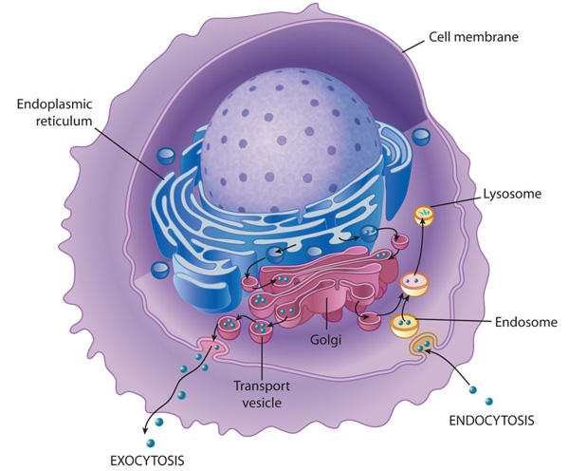

Slide 2
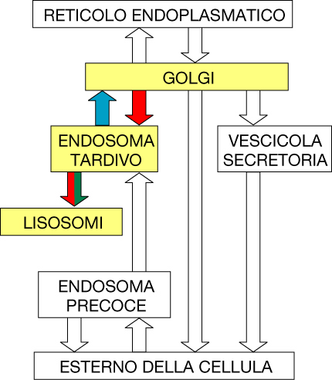
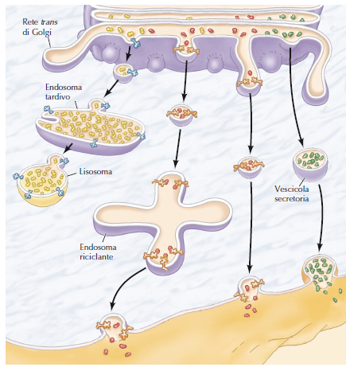

Slide 3
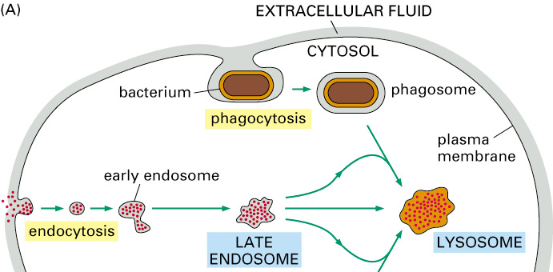
Funzioni dei lisosomi
Degradazione delle macro molecole
EXTRACELLULARI
(Proteasoma degrada le proteine citosoliche)

Slide 4
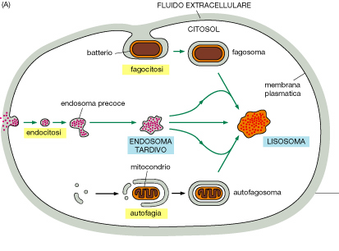
Funzioni dei lisosomi
Degradazione di organelli
INTRACELLULARI
(Proteasoma degrada le proteine citosoliche

Slide 5
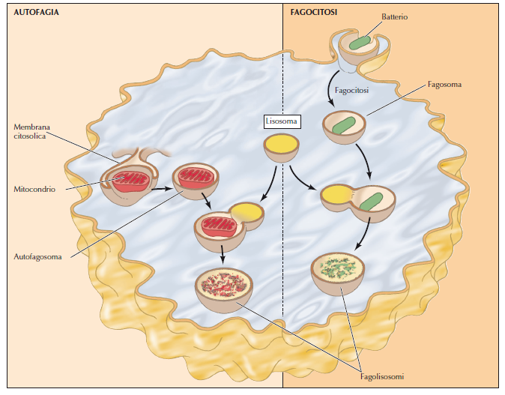
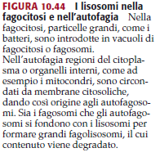

Slide 6
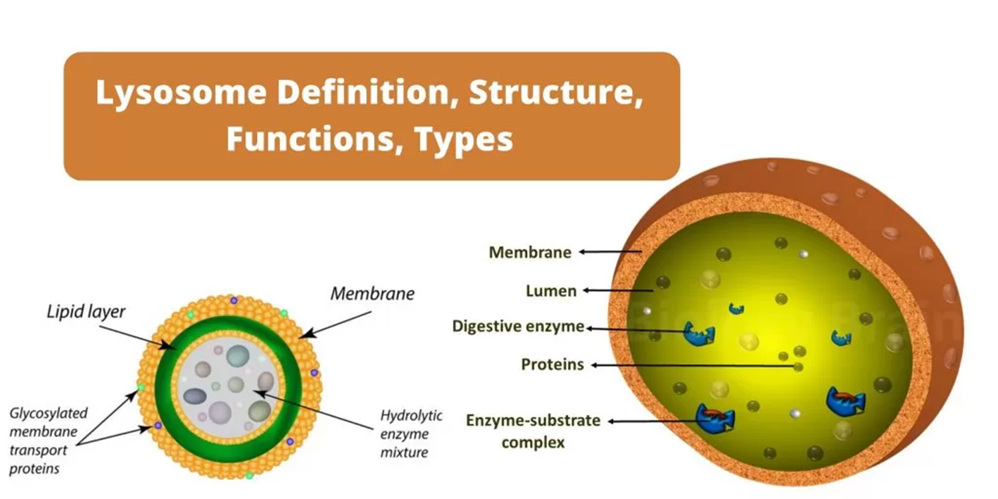
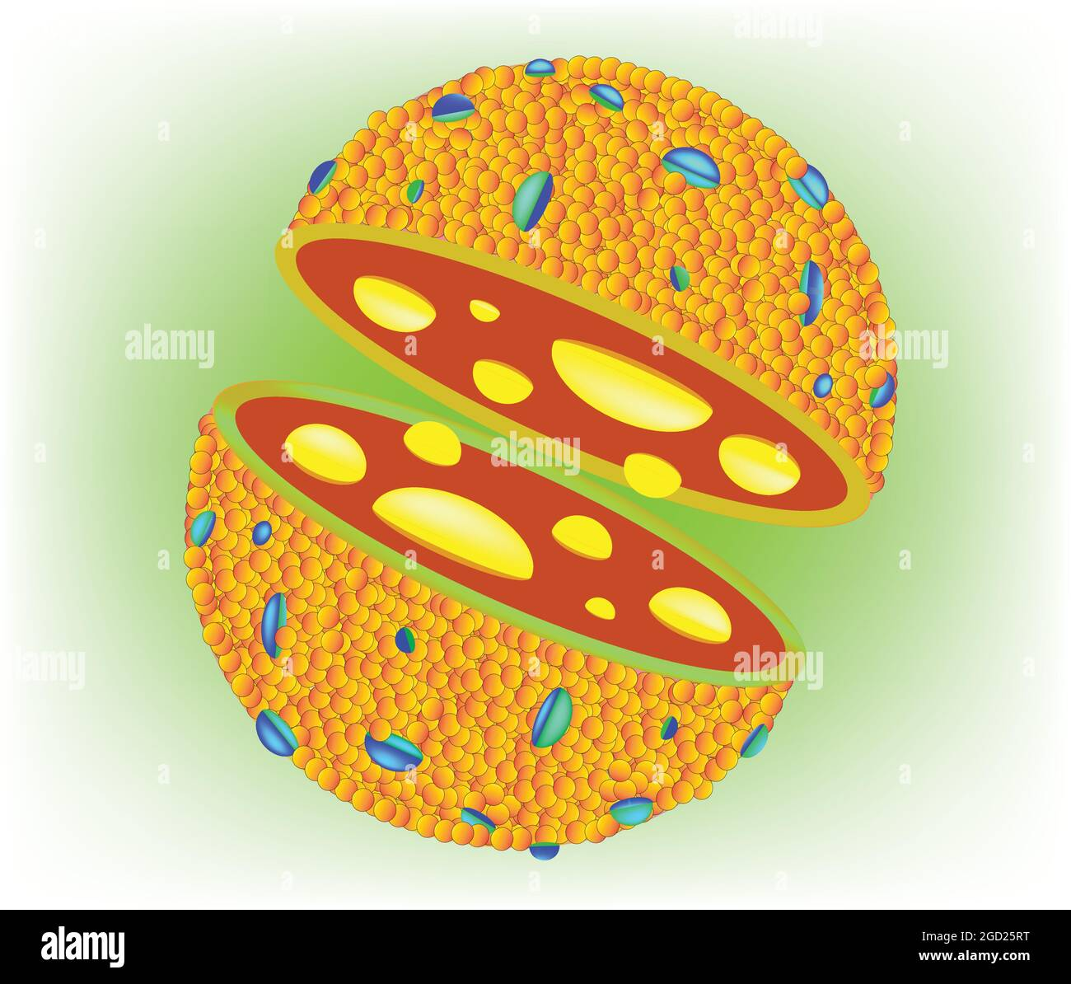

Slide 7
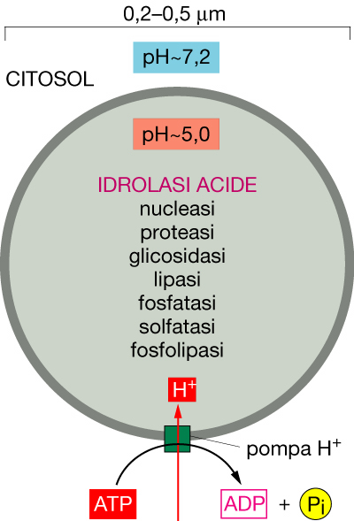
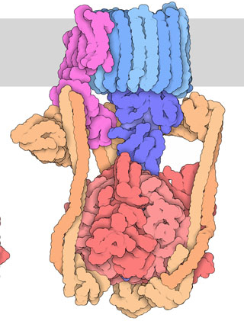
Lisosomi
3. V-type pumps are turbine-like protein machines constructed from multiple different subunits. The V-type proton pump transfers H+ into lysosomes

Slide 8
Lisosomi
To date, more than
60 kinds of acidic hydrolysis enzymes have been isolated from lysosomes.

Slide 9
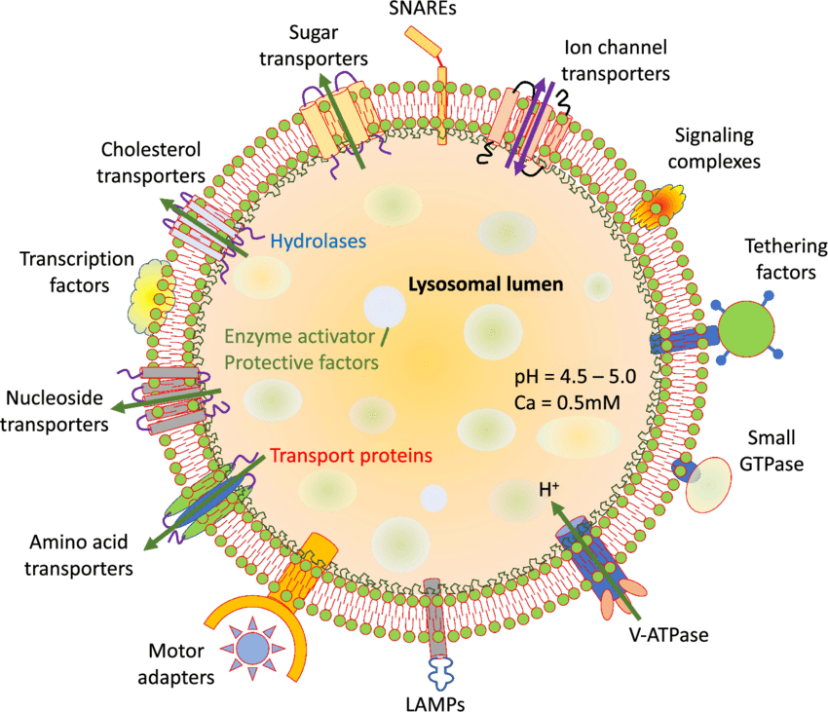
General structure and properties of lysosomes

Slide 10
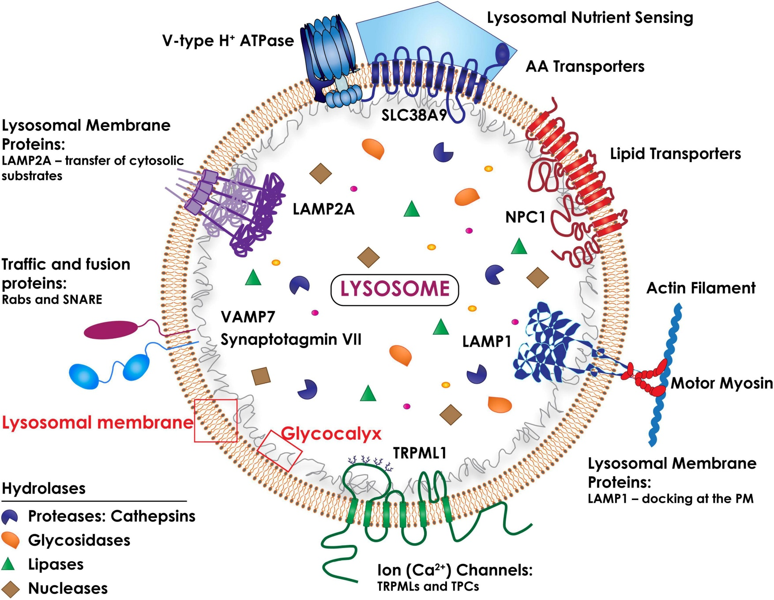

Slide 11
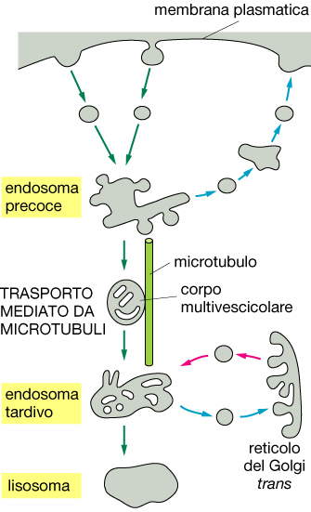

Slide 12
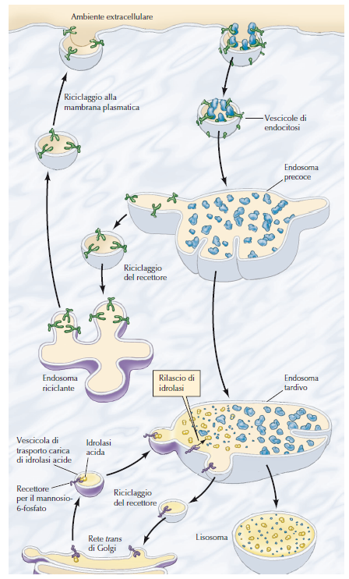
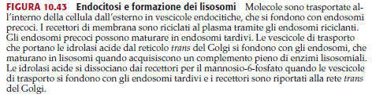

Slide 13
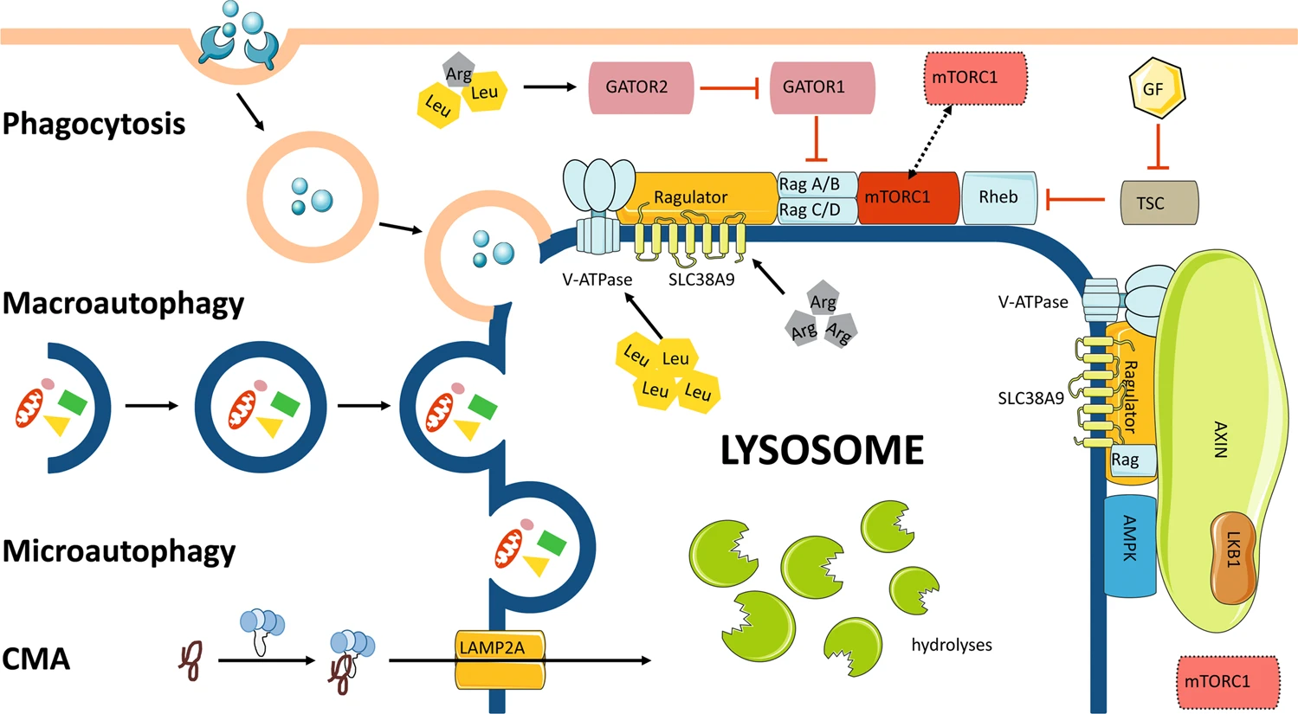
Lysosomes function as terminal sites of
- phagocytosis
- autophagy
Chaperone-mediated autophagy

Slide 14
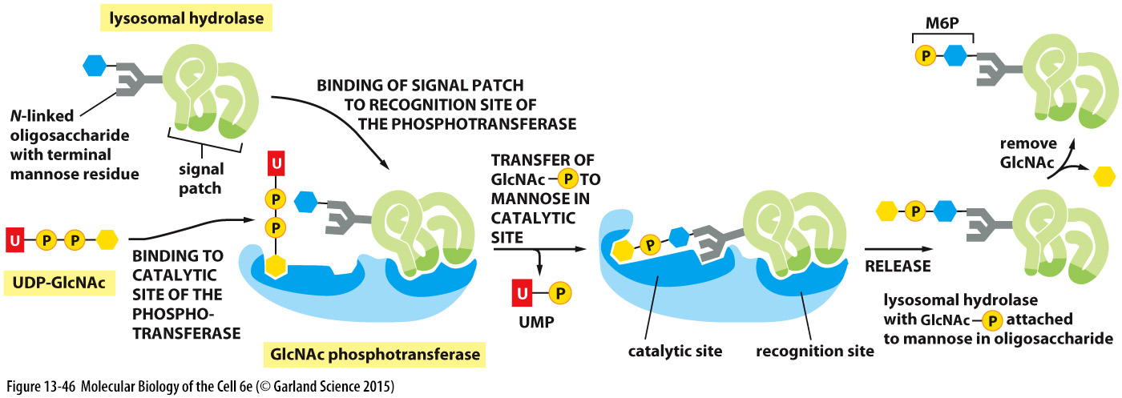
How do lysosomal enzymes get to
the lysosome?
Mannose
Mannose 6-phosphate (M6P)
sent to lysosomes

Slide 15
A Mannose 6-Phosphate Receptor Sorts Lysosomal Hydrolases in the Trans Golgi Network

Slide 16
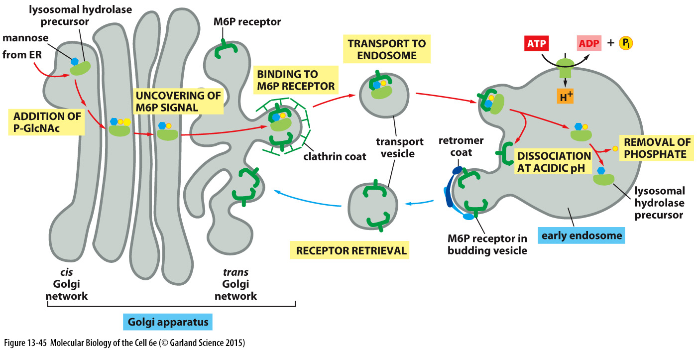
A Mannose 6-Phosphate Receptor Sorts Lysosomal Hydrolases in the Trans Golgi Network

Slide 17
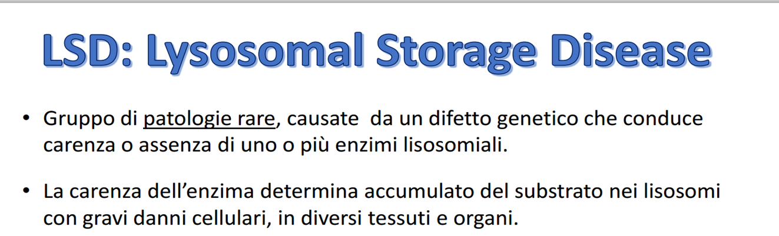
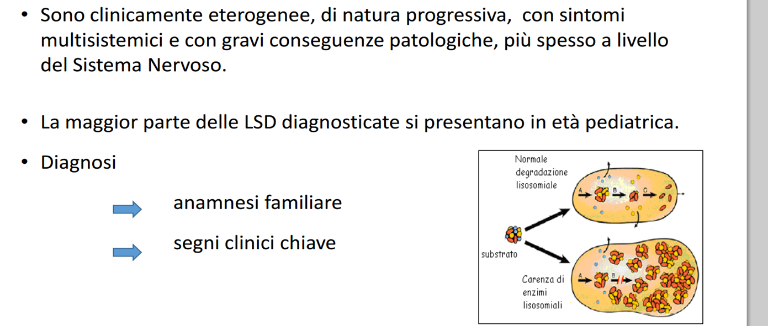

Slide 18
A Mannose 6-Phosphate Receptor Sorts Lysosomal Hydrolases in the Trans Golgi Network
Transferase absent in
I-cell Disease

Slide 19
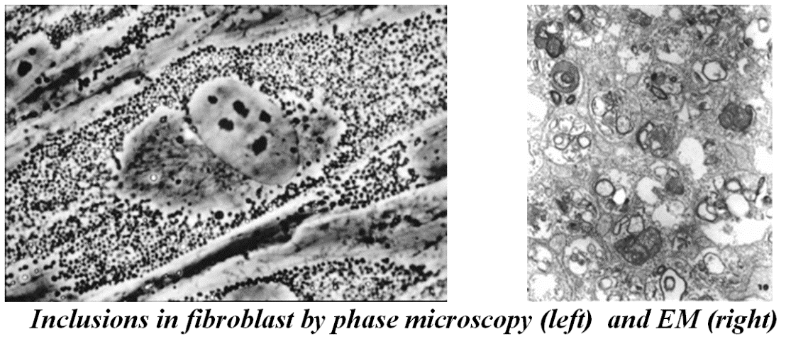
I-Cell disease (Mucolipidosis Type II)
Autosomal recessive (1/640,000 live birth)
Absence of N-acetylglucosaminyl-1-phosphotransferase.
No Man-6P signal -> enzymes are not targeted to lysosomes -> they are instead secreted to the media
Build up of proteins which cannot be degraded in vacuols.
Massive increase in number and size of vacuols which compromises cell architecture and function.
Overall symptoms
Growth failure and failure to thrive are rapidly progressive.
Developmental delay is severe and often the presenting symptom.
Coarse facial features and musculoskeletal abnormalities
Frequent upper respiratory tract infections
Death from pneumonia or congestive heart failure occurs in early childhood

Slide 20
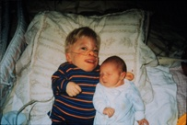

I-cell disease patient,
3.5 years old, with her 1week-old sister
  .
Tiny size (not much bigger than her newborn sister)
Skeletal abnormalities causing disproportionately large head
Fingers clenched (joints can’t relax)
Gums very swollen
The patient died shortly after this picture was taken
22-months-old, has inclusive-cell (i-cell) disease
This affects her breathing, digestion, joints and will lead to premature death

Slide 21
Biosynthesis and trafficking
of a lysosomal hydrolase
addition of clathrin coat
binding to M6P
receptor
addition of
phosphate
receptor-dependent
transport
removal of
phosphate
dissociation
at acidic pH
lysosome
receptor
recycling
Golgi apparatus
mature lysosomal
hydrolase

Slide 22
Malattie lisosomiali Classificate in vari gruppi:
Malattie dovute a trasporto lisosomiale alterato.
Malattie dovute al mancato trasporto degli enzimi lisosomiali.
Mucopolisaccaridosi: difetto nella degradazione dei mucopolisaccaridi (o GAG), che svolgono importanti funzioni nel tessuto connettivo.
Sfingolipidosi: difetto nella degradazione lisosomiale degli sfingolipidi, che comprendono sfingomieline, cerebrosidi e gangliosidi.
Oligosaccaridosi: accumulo di oligosaccaridi e di glicoproteine. In questa classe rientrano la Fucosidosi, la Sialidosi, la Mucolipidosi, la Mannosidosi.
Altre malattie lisosomiali (es. Malattia di Pompe, dovuta ad un
deficit di α-glucosidasi).

Slide 23
Malattia | Materiale prevalentemente accumulato | Deficit enzimatico
M. di Gaucher | Glucorebroside | Glucorebrosidasi
M. di Niemann-Pick | Sfingomielina | Sfingomielinasi
Leucodistrofia globoide | Galattocerebroside | Galattocerebrosidasi
Leucodistrofia metacromatica | Sulfatide | Aril-sulfatasi A
M. Di Fabry | Globotriaosilceramide | Alfa-galattosidasi A
Fucosidosi | Pentaesosilfuco-glicolipide | Alfa-fucosidasi
M. Di Farber | Ceramide | Ceramidasi
Gangliosidosi generalizzata | Ganglioside GM1 | GM1 ganglioside: beta galattosidasi
M. Di Tay-Sachs | Ganglioside GM2 | Esosaminidasi A
M. Di Sandhoff | Ganglioside GM2 | Esosaminidasi A e B

Slide 24
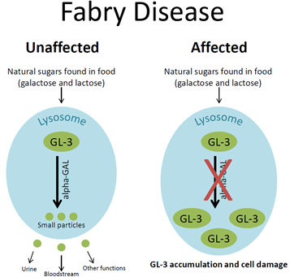
Fabry disease is a lysosomal storage disorder seen in one out of every 40,000
It is caused by a deficiency in the enzyme alpha-galactosidase
results in the body’s inability to break down specific fatty substances called globotriaosylceramide (abbreviated GL-3 or Gb3).
In people with Fabry disease, the enzyme is deficient, so Gb3 can’t be broken down and builds up in the cell.
Over time, this may result in deposits throughout the body, particularly in the kidneys, heart and nervous system, leading to a variety of symptoms.

Slide 25
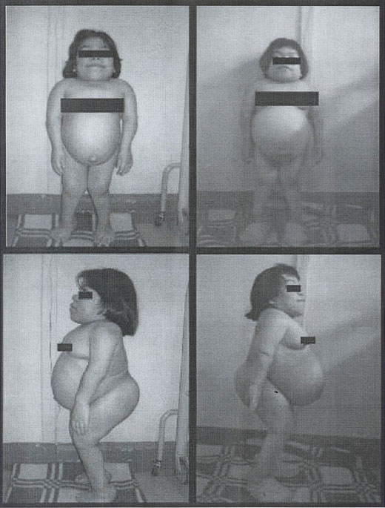
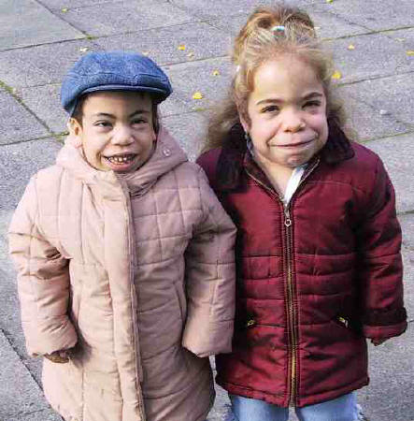
MPS VI (sindrome di Maroteaux-Lamy)
MPS IV (sindrome di Morquio)

Slide 26
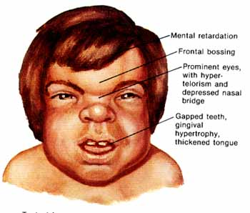
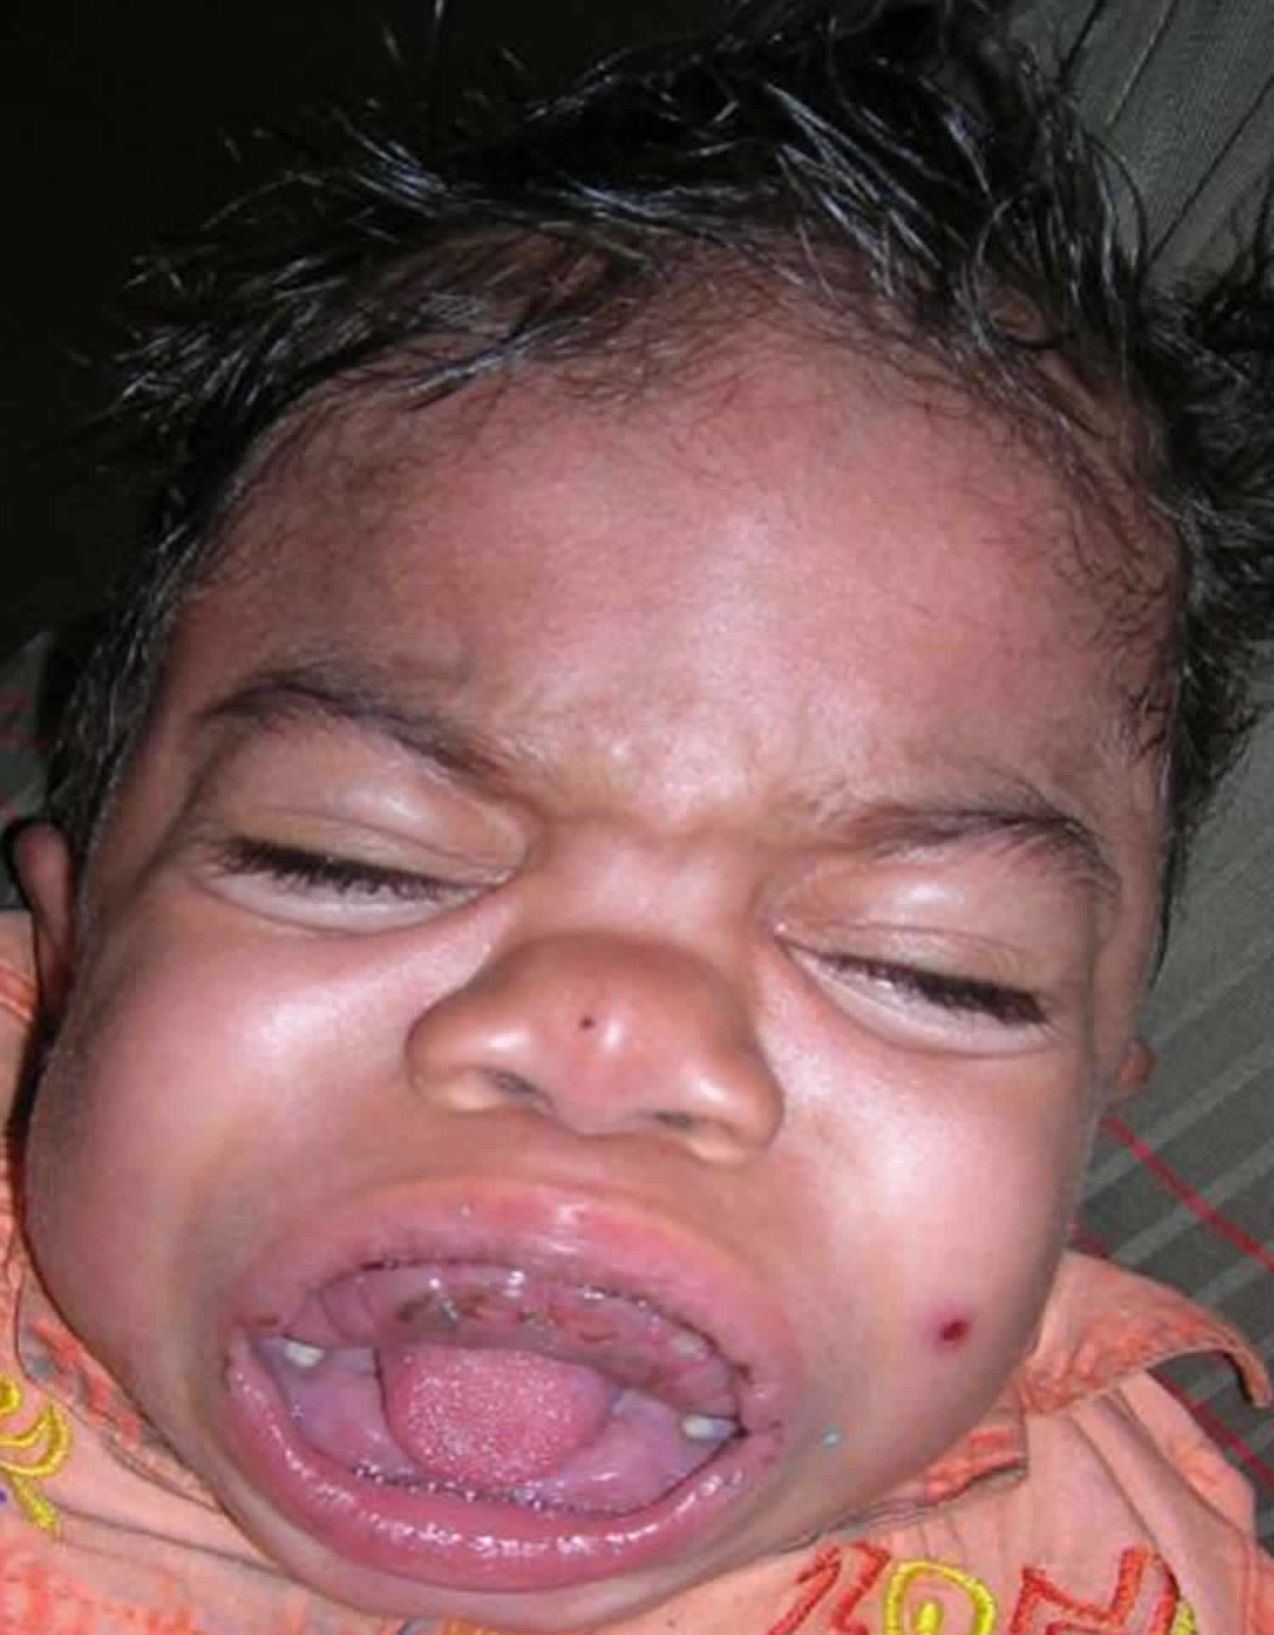
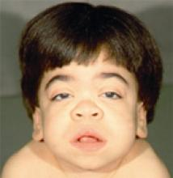
Hurler- Scheie
Mucopolysaccharidosis I is a lysosomal storage disorder that is abbreviated MPS I and sometimes called Hurler syndrome, Hurler-Scheie syndrome, or Scheie syndrome.
It is caused by a deficiency in the enzyme alpha-iduronidase
which is needed to break down certain complex sugars called glycosaminoglycans (abbreviated GAGs and formerly called mucopolysaccharides).

Slide 27
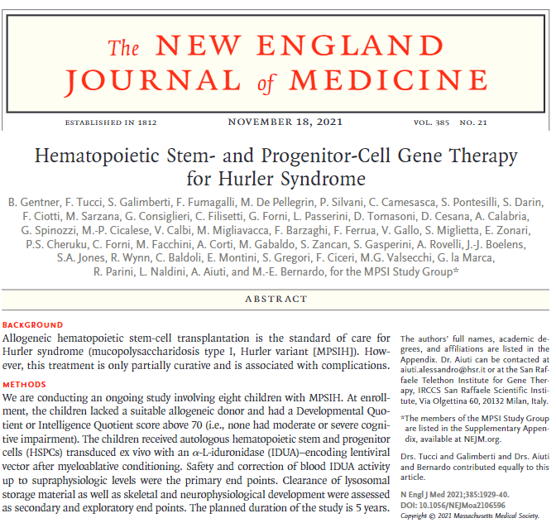

Slide 28
