Slide 1
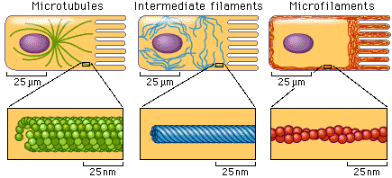
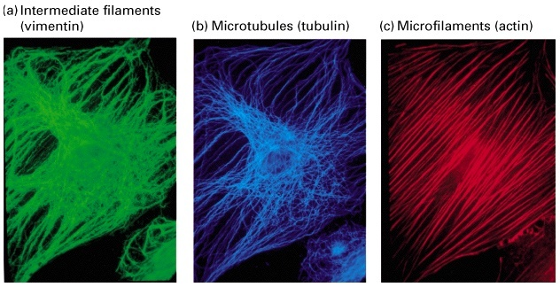
I Microtubuli

Slide 2
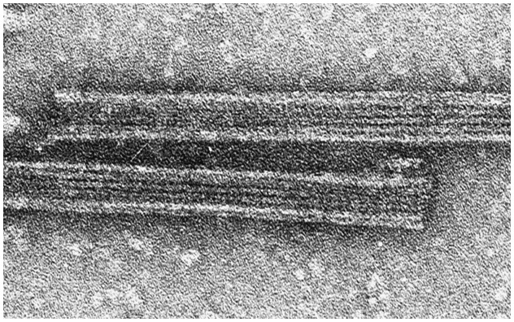
Microtubules
Tubular structures 25nm in diameter
Assembled from protein tubulin
Form cytoskeleton, mitotic spindle, centrioles, core of cilia and flagella

Slide 3
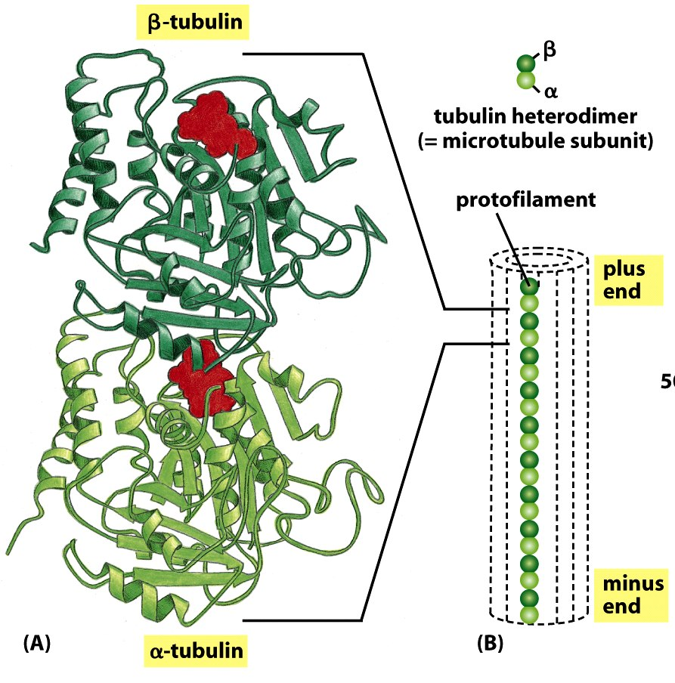
The tubulin consists of
α - tubulin
β - tubulin
heterodimers arranged in rows
protofilaments

Slide 4
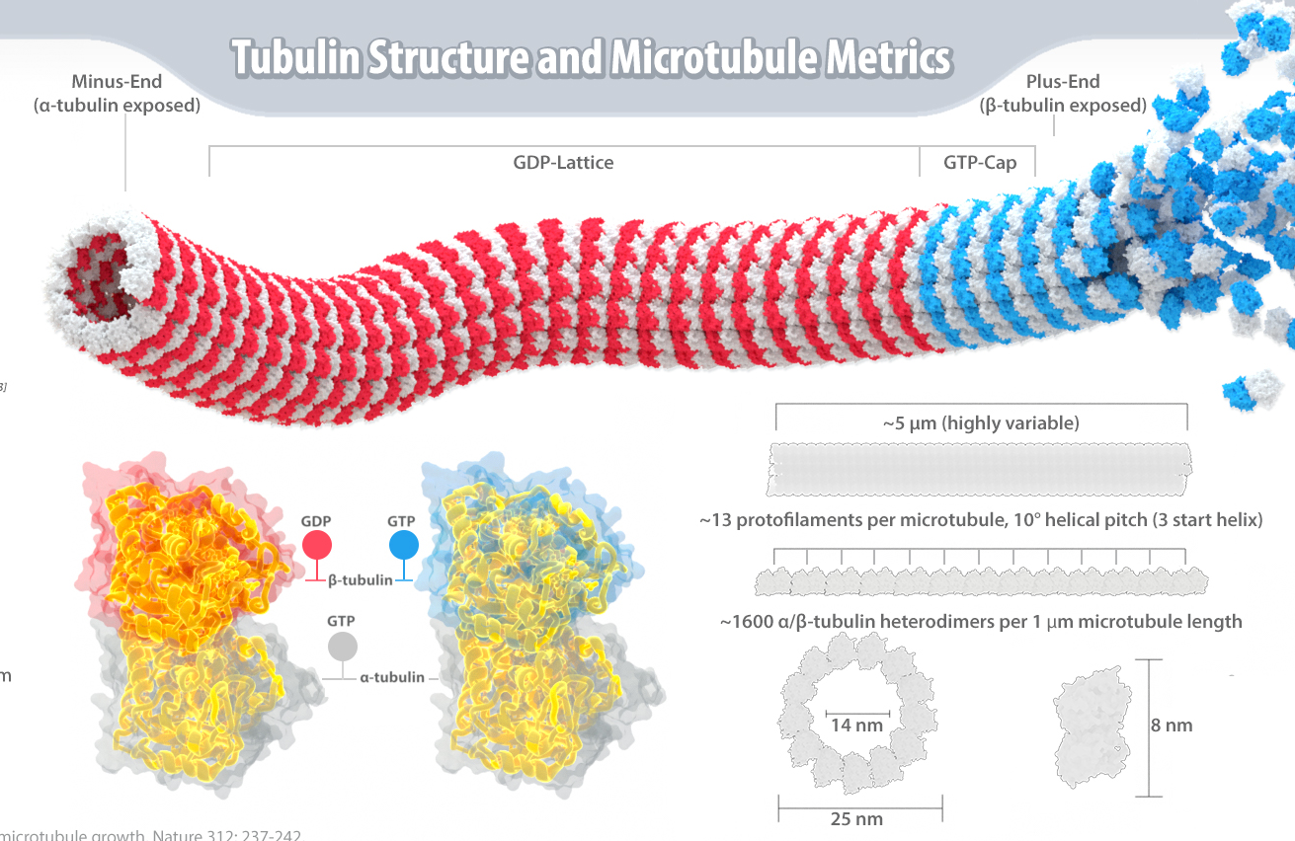
The most common form of a microtubule consists of
13 protofilaments
in the tubular arrangement
Microtubules have a
Plus end - for growing
Minus ends - for anchoring

Slide 5
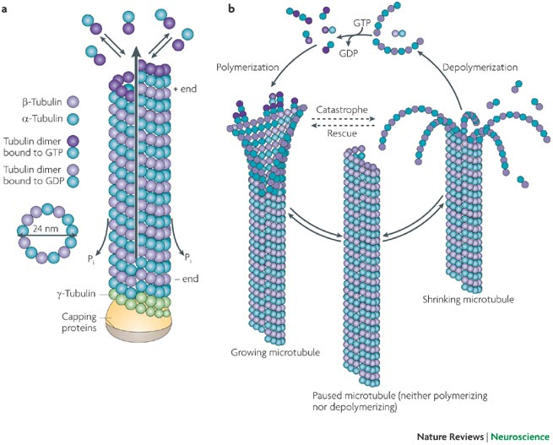
I microtubuli si assemblano e disassemblano preferenzialmente all’estremità (+)

Slide 6
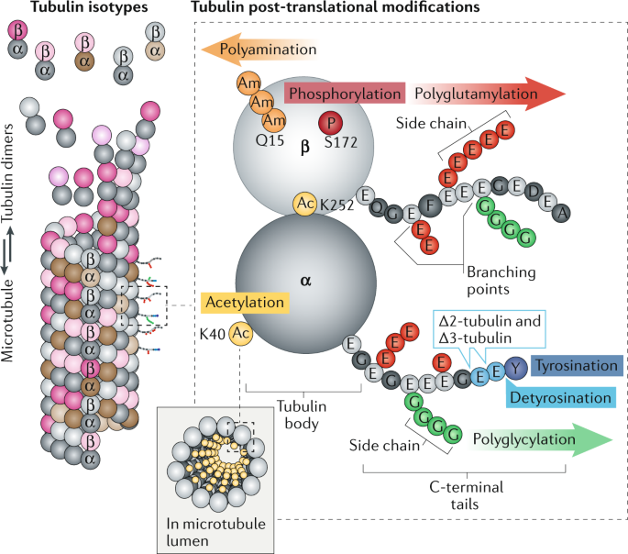
Post-translational modifications regulate microtubule function
Tubulin undergoes several post-translational modifications such as acetylation, polyglutamylation, and poly-glycylation, which have been shown to alter the association with certain MT motors as well as other proteins that can affect MT stability and dynamics.
Tubulin undergoes several post-translational modifications such as acetylation, polyglutamylation, and poly-glycylation, which have been shown to alter the association with certain MT motors as well as other proteins that can affect MT stability and dynamics.

Slide 7
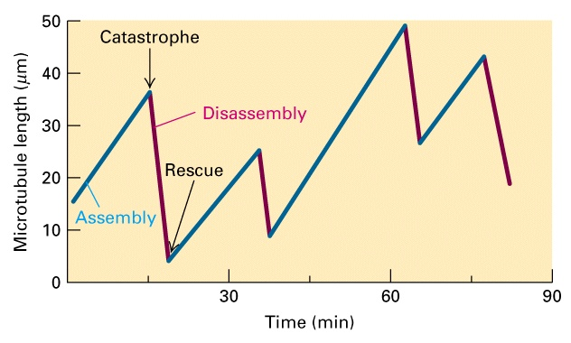
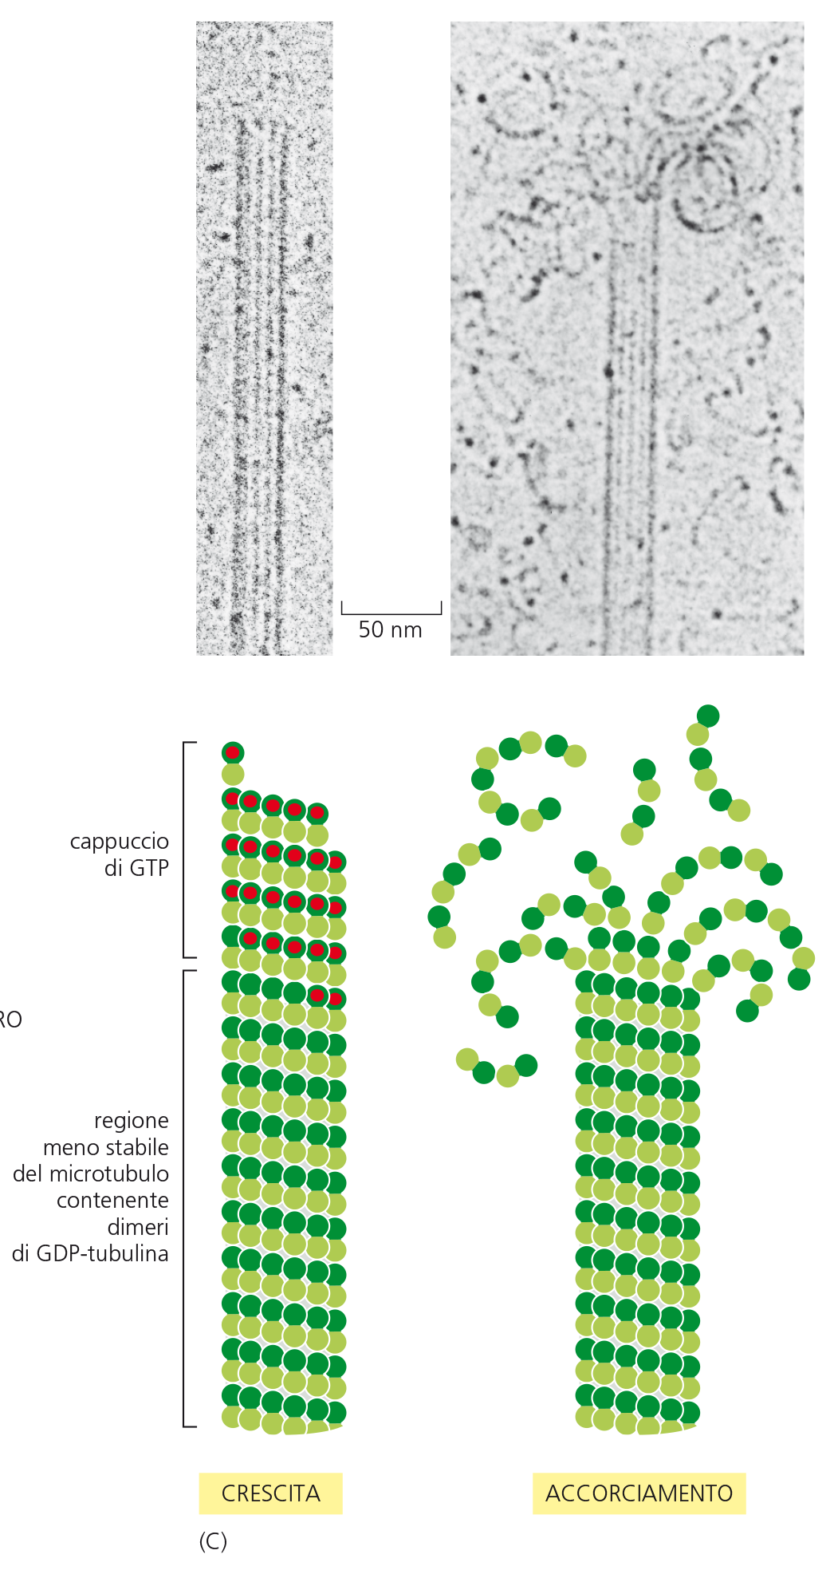
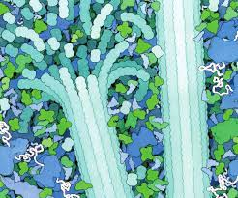
L’instabilità dinamica: una proprietà intrinseca del microtubulo

Slide 8
dynamic instability in vivo
VIDEO ASSEMBLY
Why is dynamic instability useful biologically?
Dynamic instability allows the cell to rapidly reorganize the cytoskeleton when necessary.
an array of microtubules can adapt quickly to changes in the environment, adopting new spatial arrangements in response to cellular needs

Slide 9
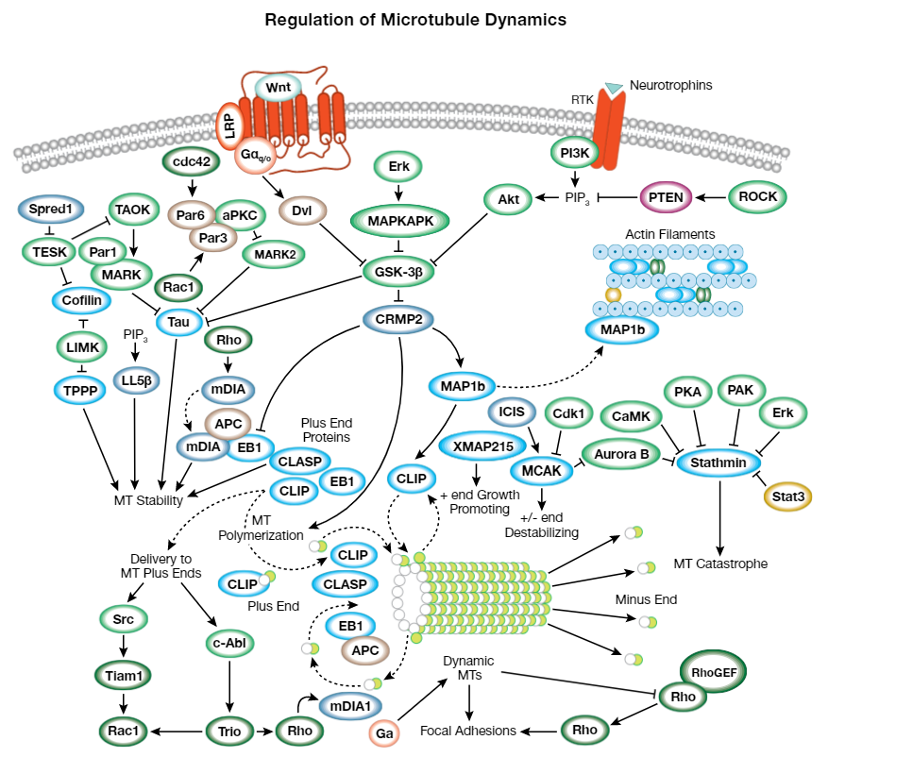

Slide 10
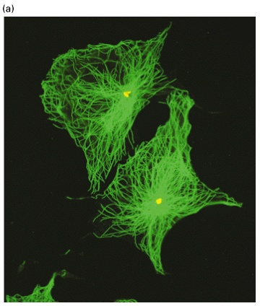
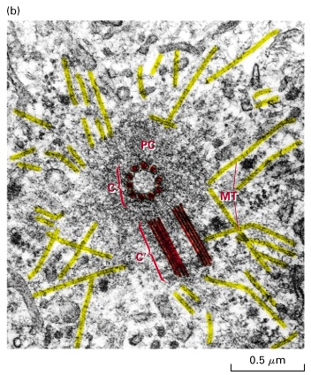
I microtubuli si formano a partire da centri di organizzazione microtubulare (MTOC)

Slide 11
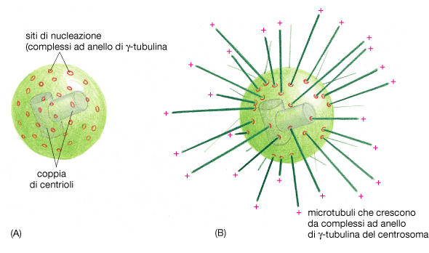
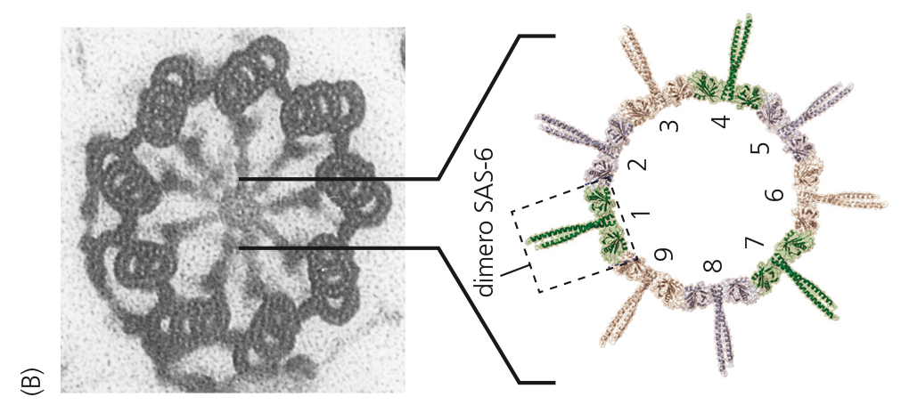
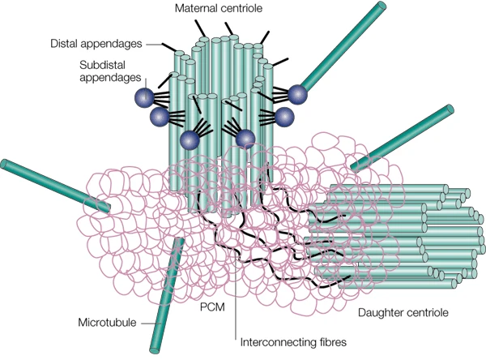
Centrosomes are evolutionarily conserved organelles that serve as main microtubule-organizing centers (MTOCs) of animal cells
Centrosomes are micron-scale cellular structures, which are composed of
- a pair of centrioles
surrounded by
- a complex matrix of yet more than 100 different proteins.

Slide 12
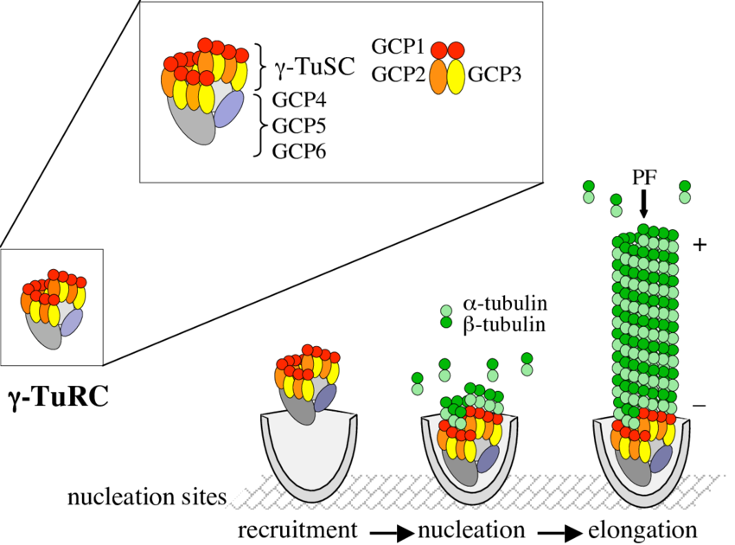
centrosome
As part of a multi-subunit ring complex, γ-tubulin has been shown to promote microtubule nucleation both in vitro and in vivo
The structural properties of the complex suggest that it also seals the minus ends of the polymers with a conical cap.

Slide 13
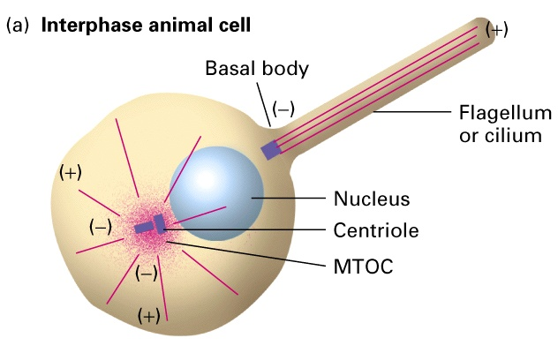
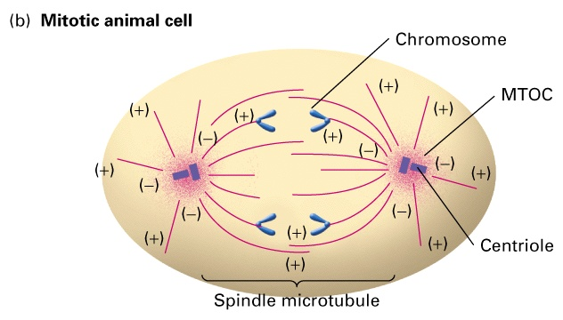
La maggior parte dei microtubuli hanno un orientamento costante rispetto ai propri MTOCs

Slide 14

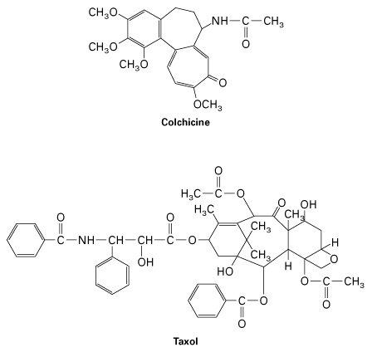
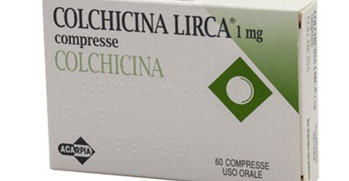
La Colchicina distrugge la dinamica dei microtubuli
La colchicina si lega ad una proteina dei microtubuli, la tubulina, e ne causa la depolimerizzazione.
Ciò determina un effetto antimitotico sulla cellula che viene bloccata allo stadio di metafase per la mancata genesi del fuso mitotico.
L'elevata tossicità della colchicina ne impedisca l'uso come composto antitumorale
La colchicina viene utilizzata sostanzialmente per il trattamento della gotta. È in grado, infatti, di eliminare il dolore e l'infiammazione che si hanno durante un attacco di artrite gottosa in un tempo compreso tra le 12 e le 24 ore.

Slide 15
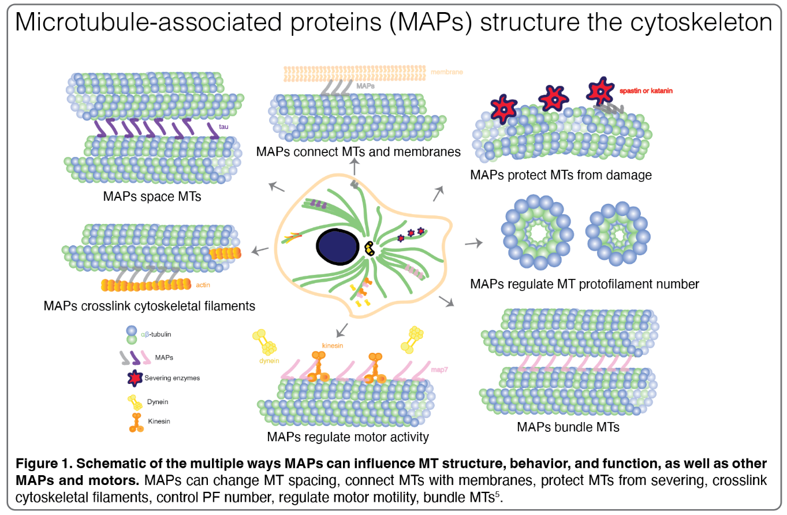
microtubule-associated proteins (MAPs)
Microtubules do not function alone;
they interact with a diverse array of microtubule-associated proteins (MAPs) that influence their assembly and dynamics.

Slide 16
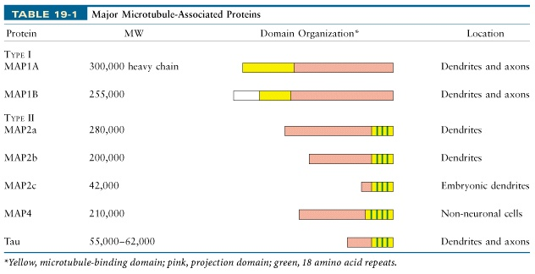
MAPs

Slide 17
VIDEO TAU

Slide 18
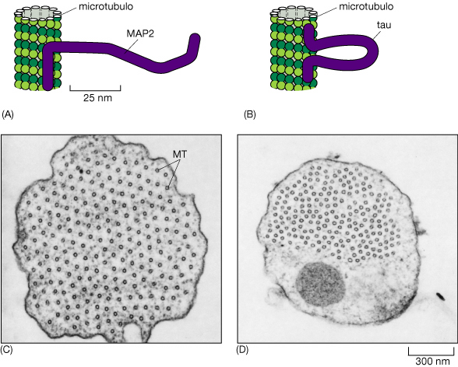
Proteine che si associano ai microtubuli (MAPs) legano i microtubuli tra loro
(C) Electron micrograph showing a cross section through a microtubule bundle in a cell overexpressing MAP2. (D) Similar cross section through a microtubule bundle in a cell overexpressing tau.

Slide 19
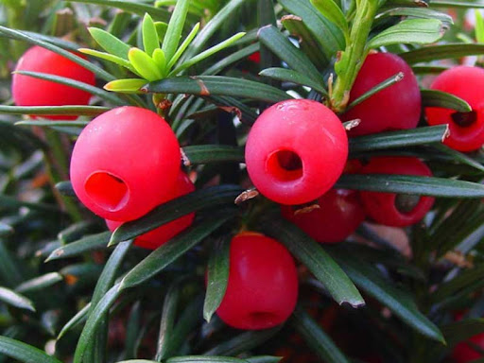
taxolo
In the early 1960s, the National Cancer Institute (NCI) in the United States initiated a programme of biological screening of extracts taken from a wide variety of natural sources.
One of these extracts was found to exhibit marked antitumour activity against a broad range of rodent tumours.
Although this discovery was made in 1962, it was not until five years later that two researchers, Wall and Wani, of the Research Triangle Institute, North Carolina, isolated the active compound, from the bark of the Pacific yew tree (Taxus brevifolia).

Slide 20
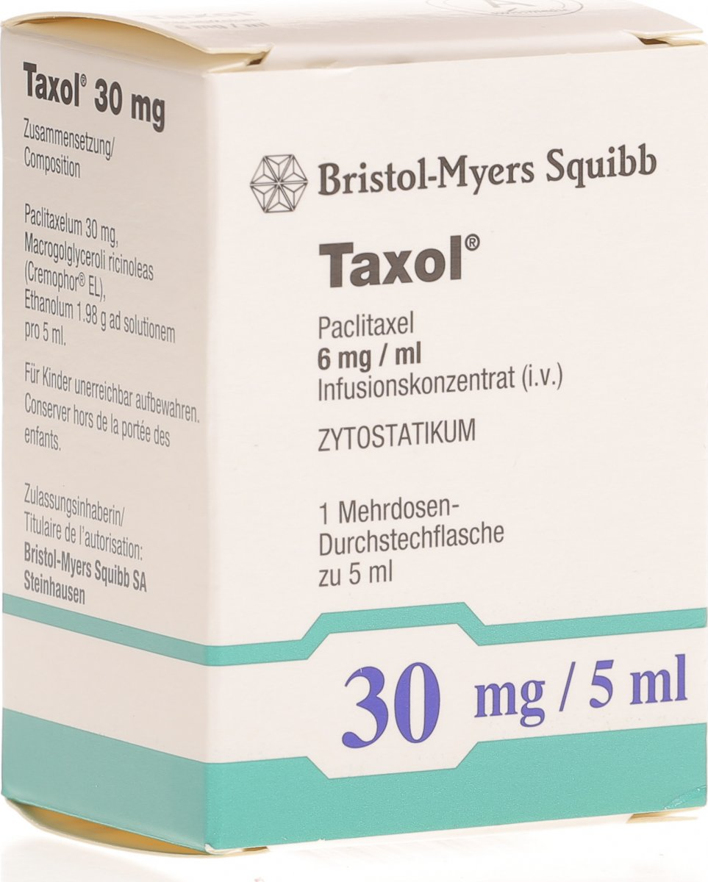
In fact, taxol was found to induce the assembly of tubulin into microtubules, and more importantly, that the drug actually stabilises them to the extent that mitosis is disrupted. Such a novel mode of action was be lieved to make taxol a prototype for a new class of anticancer drugs.
Renewed interest in taxol led to major problems, since many groups wished to conduct clinical trials, and so large quantities of this material were required. The natural source, the Pacific yew tree (left), is an environmentally protected species, which is also one of the slowest growing trees in the world. Isolation of the compound, which is contained in the bark, involves killing the tree, and the quantities availabl e by this method are pitifully small. It would take six 100-year old trees to provide enough taxol to treat just one patient.
Luckily, a closely related analogue of taxol, called baccatin III was discovered in the leaves of a European species of ornamental shrub Taxus baccata. Although the extraction and subsequent chemical elaboration of bacc atin III to taxol was very laborious, the source was renewable, and sufficient quantities were obtained to carry out clinical trials. Results, published in 1989 showed that taxol exhibits very promising activity against advanced ovarian cancer, and in 1992, the US Food and Drug Administration (FDA) approved taxol for the treatment of this condition. The treatment of other types of cancer also looks promising, and in 1994, taxol was approved for breast cancer.

Slide 21
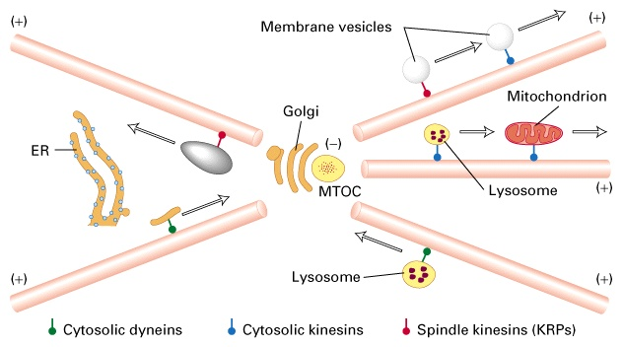
Molteplici proteine motrici sono responsabili del movimento di vescicole

Slide 22
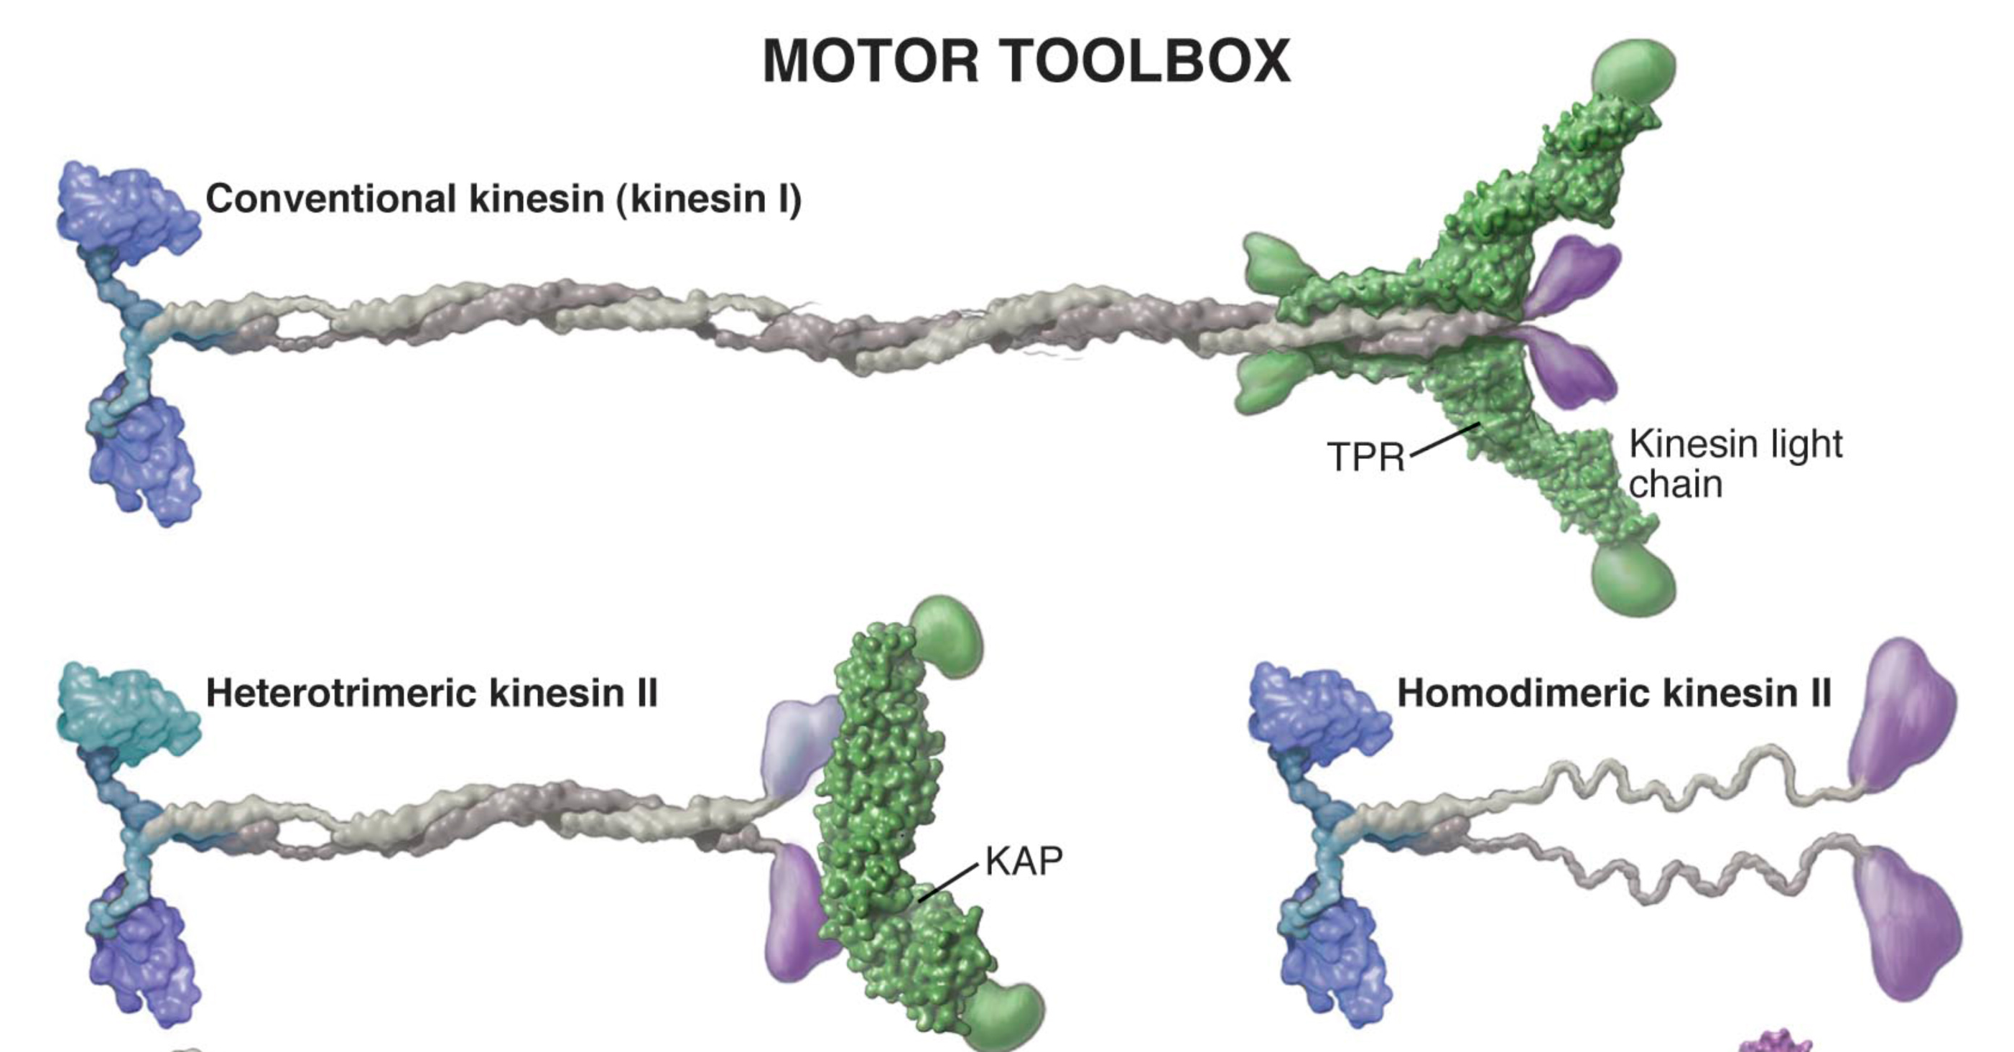
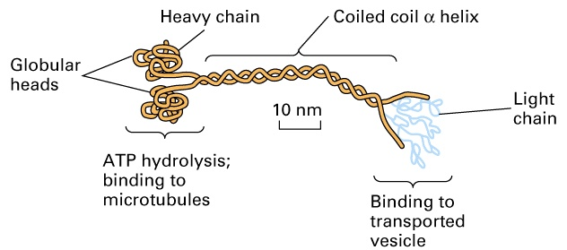
The motor proteins: Kinesin, dyneins

Slide 23
The motor proteins: Kinesin, dyneins move along microtubules (myosins move along microfilaments)
All require ATP for movement
Tipically kinesins and dyneins move along microtubules in opposite directions
Kinesins towards plus end (+)
dyneins towards minus end (-)
Kinensin is thought to be involved in movement of ER derived vesicles, endosomes, lysosomes, and secretory granules and movement within axons.

Slide 24
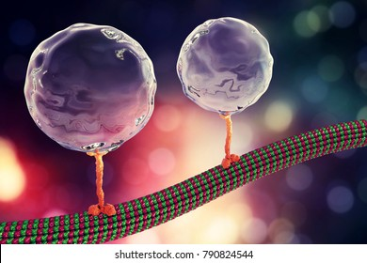
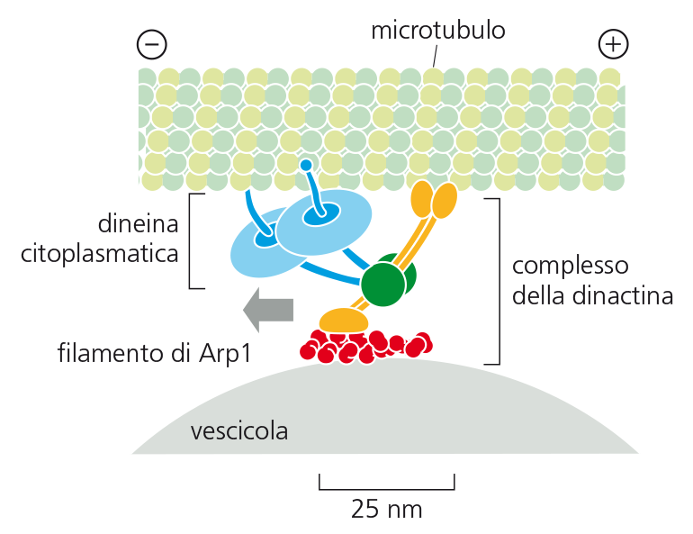

Slide 25
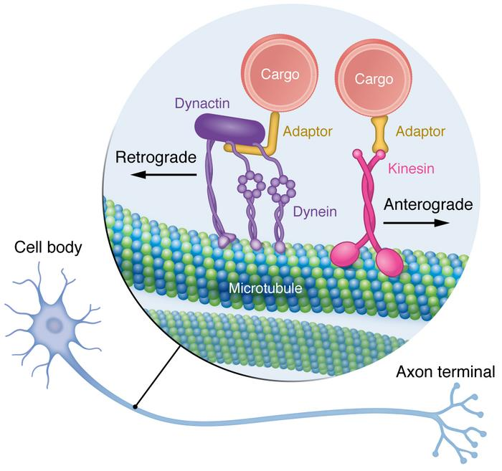
Kinesins towards plus end (+)
dyneins towards minus end (-)
17.5

Slide 26
Video nikon x2

Slide 27
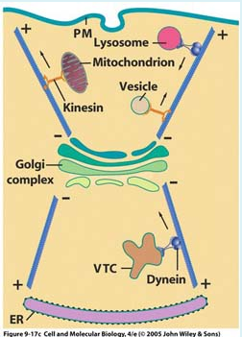
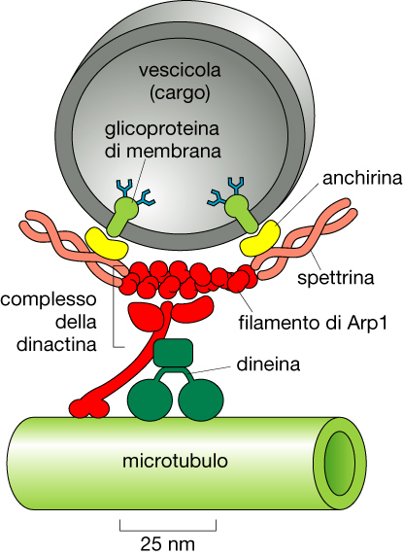

Slide 28
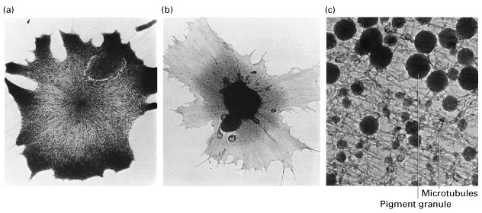
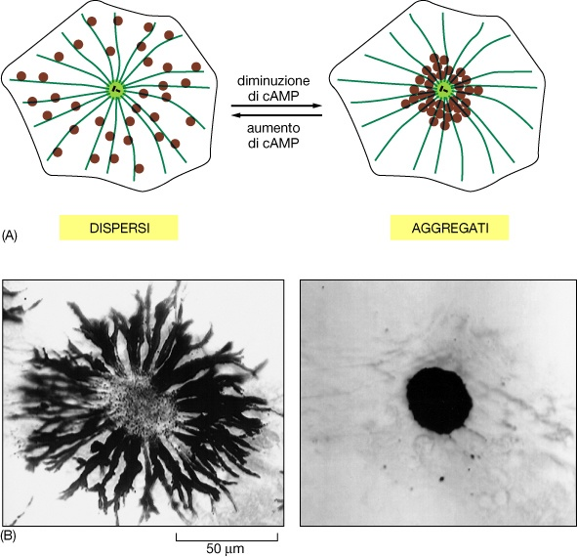
I granuli di pigmento si muovono lungo i microtubuli

Slide 29
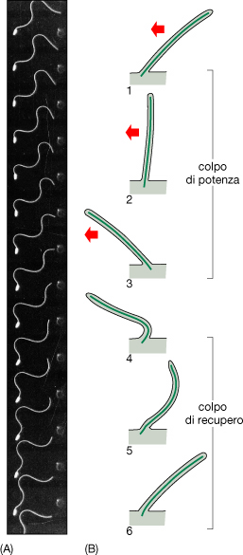
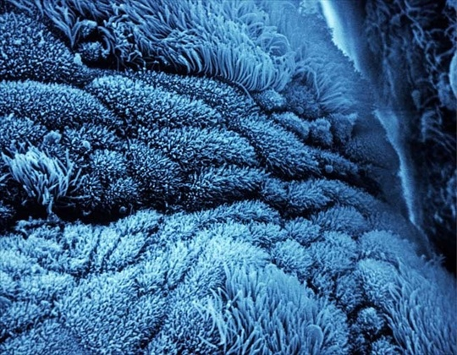
strutture mobili costituite da microtubuli e dineine
Cilia e flagelli

Slide 30
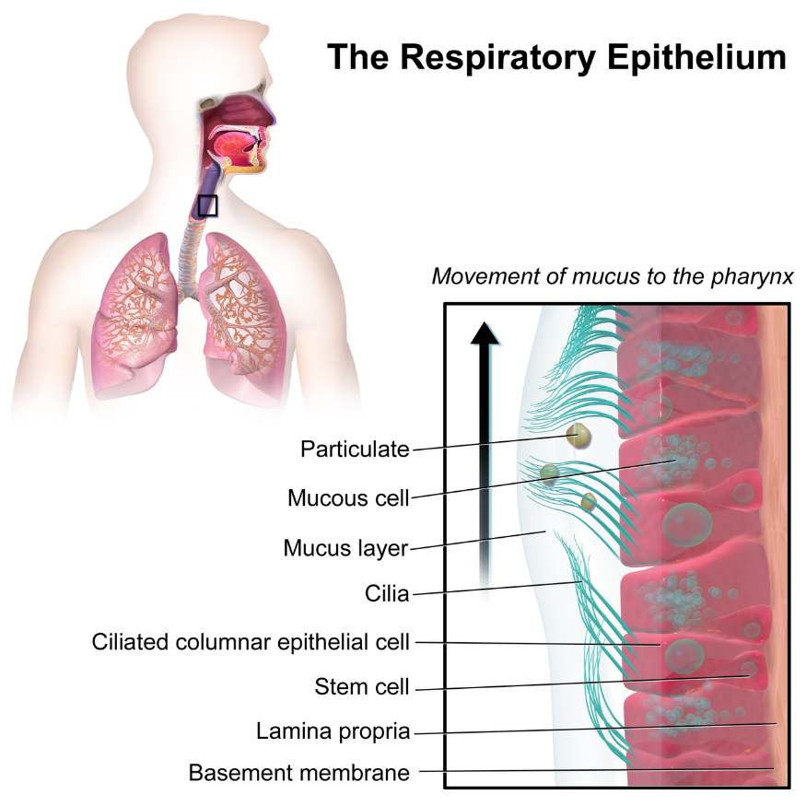
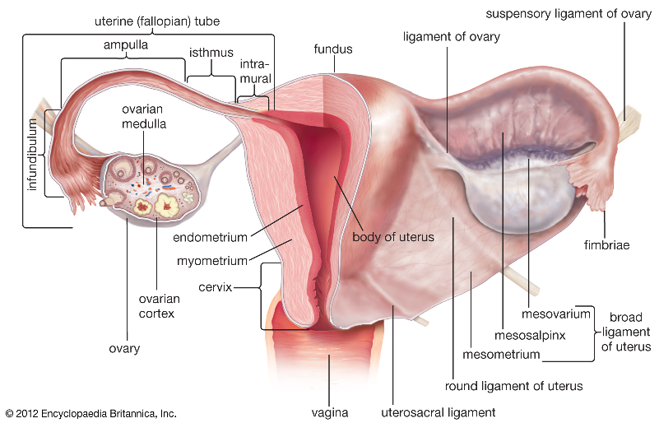
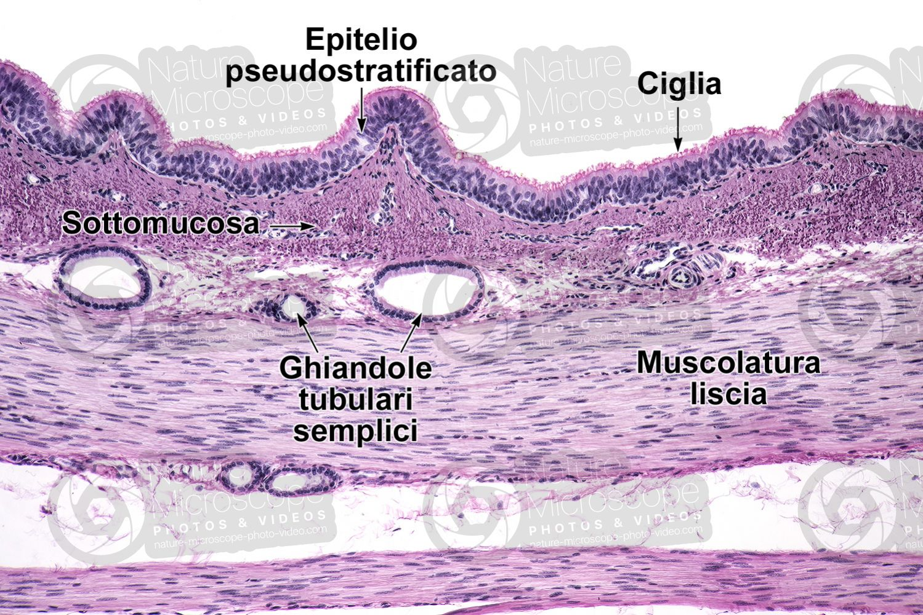

Slide 31
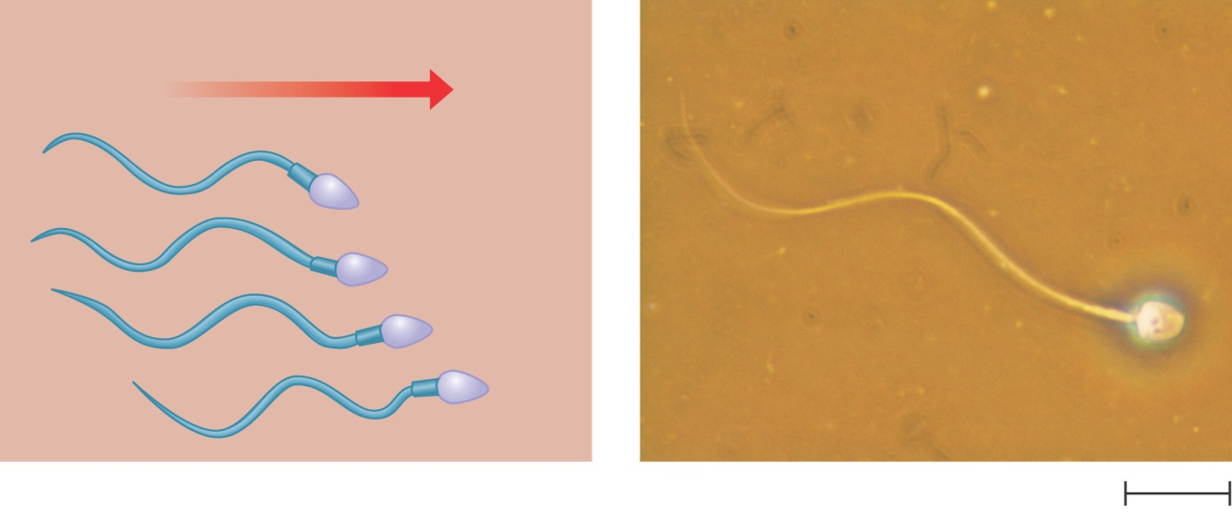
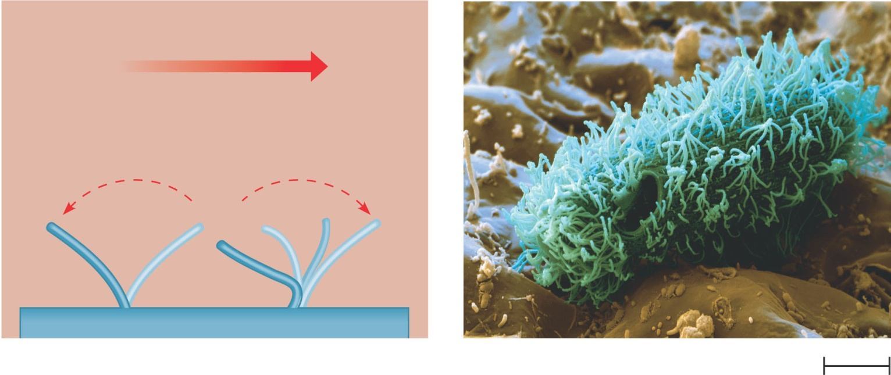
Flagella beating pattern and ciliary motion
(a) Motion of flagella. A flagellum
usually undulates, its snakelike
motion driving a cell in the same
direction as the axis of the
flagellum. Propulsion of a human
sperm cell is an example of
flagellatelocomotion (LM).
Direction of swimming
Figure 6.23 A
1 µm
(b) Motion of cilia. Cilia have a back-
and-forth motion that moves the
cell in a direction perpendicular
to the axis of the cilium. A dense
nap of cilia, beating at a rate of
about 40 to 60 strokes a second,
covers this Colpidium, a
freshwater protozoan (SEM).
Figure 6.23 B

Slide 32
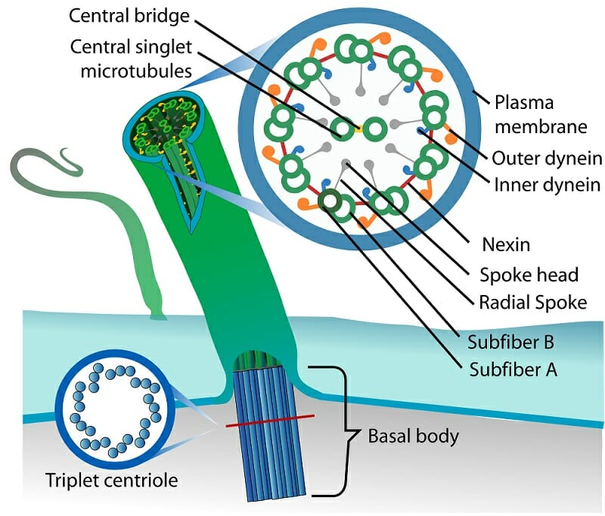
Cilia e flagelli condividono una ultrastruttura comune

Slide 33
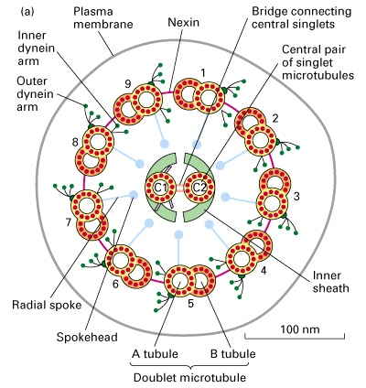
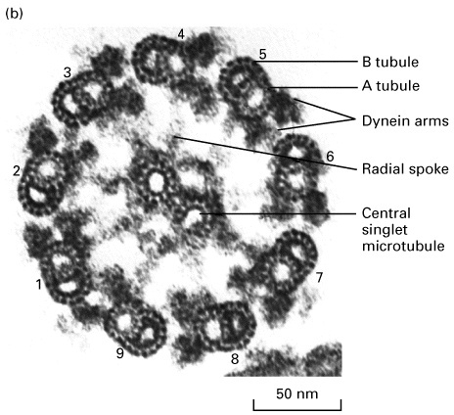
Struttura generale dei flagelli e delle cilia

Slide 34
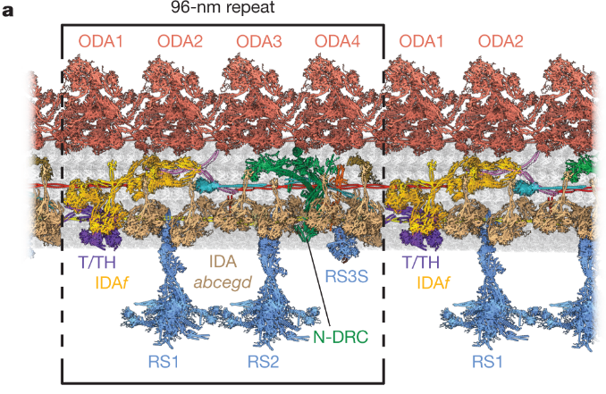

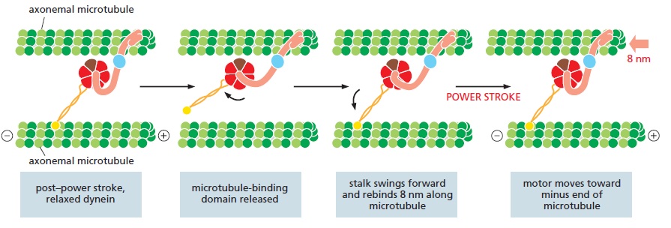
Nature volume 618, pages625–633 (2023)

Slide 35
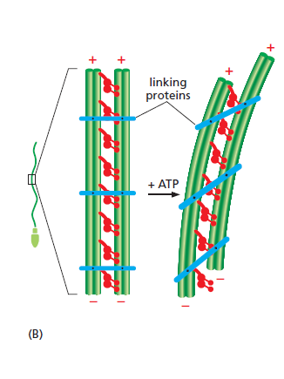
Il movimento dei microtubuli ciliari e flagellari dipende da una particolare dineina

Slide 36
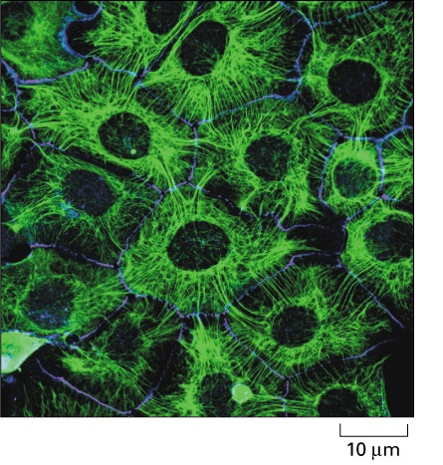

Intermediate filaments
Unlike plants and fungi, animal cells lack cell walls and, therefore, animals require other ways to stabilize cells and tissues.
Furthermore, animals require muscles for various essential activities such as breathing, the circulation of blood, peristaltic activities during the ingestion
of food and digestion, and locomotion.
These abilities of autonomous movement constitute a severe challenge to the integrity of tissues and generate the need for mechanisms to cope with mechanical stress

