Slide 1
DEAMS - Economic Geography The role of coffee within the today global business
Coffee, supply chain, wealth distribution and global challenges
Maurizio Zugna – mzugna@me.com

Slide 5
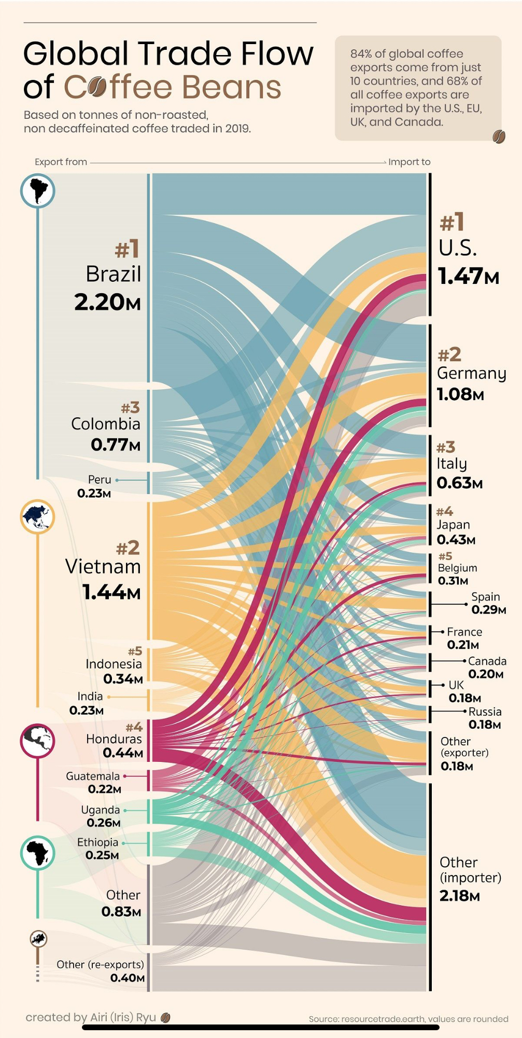
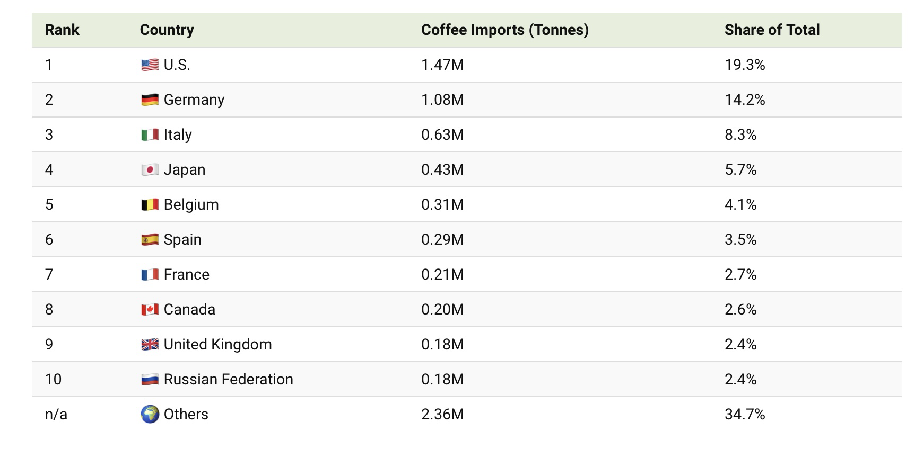
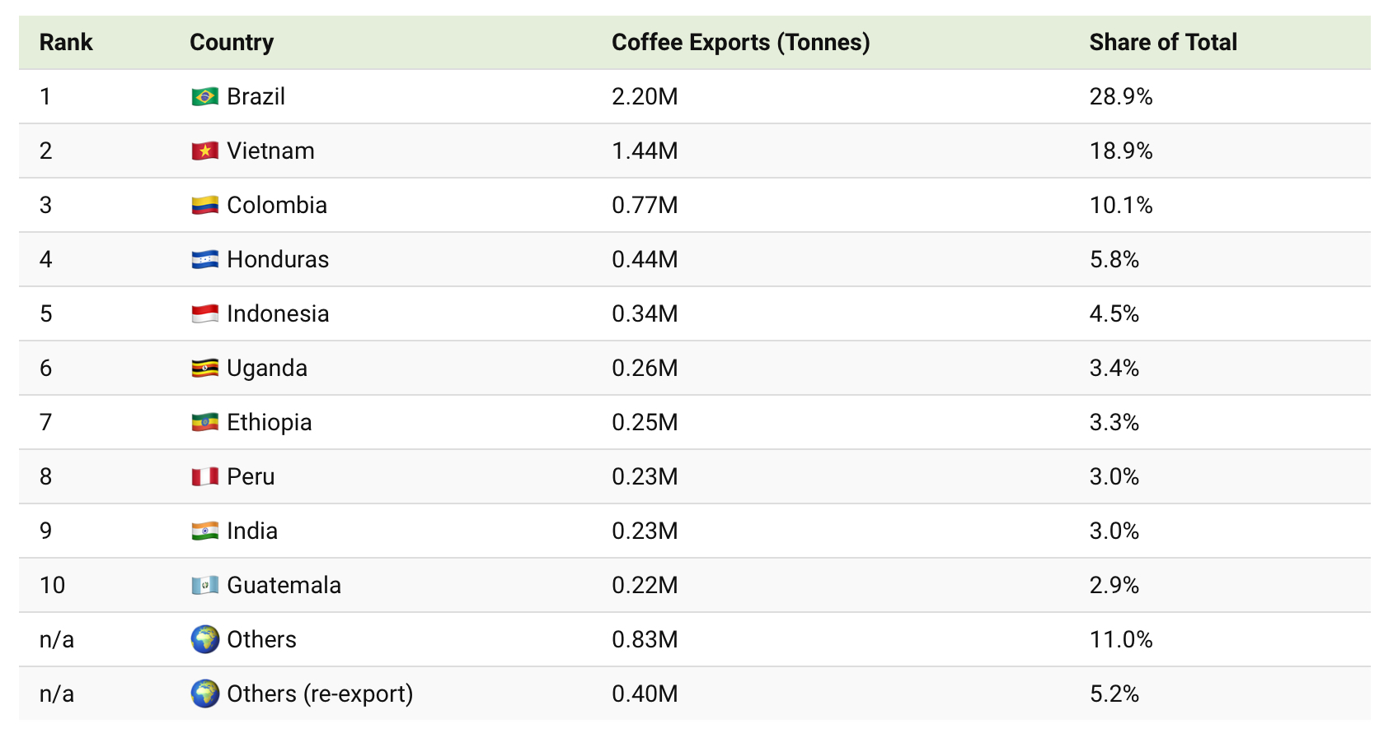
Coffee, supply chain, wealth distribution and global challenges
Largest world importers
Largest world exporters
Maurizio Zugna – mzugna@me.com

Slide 6
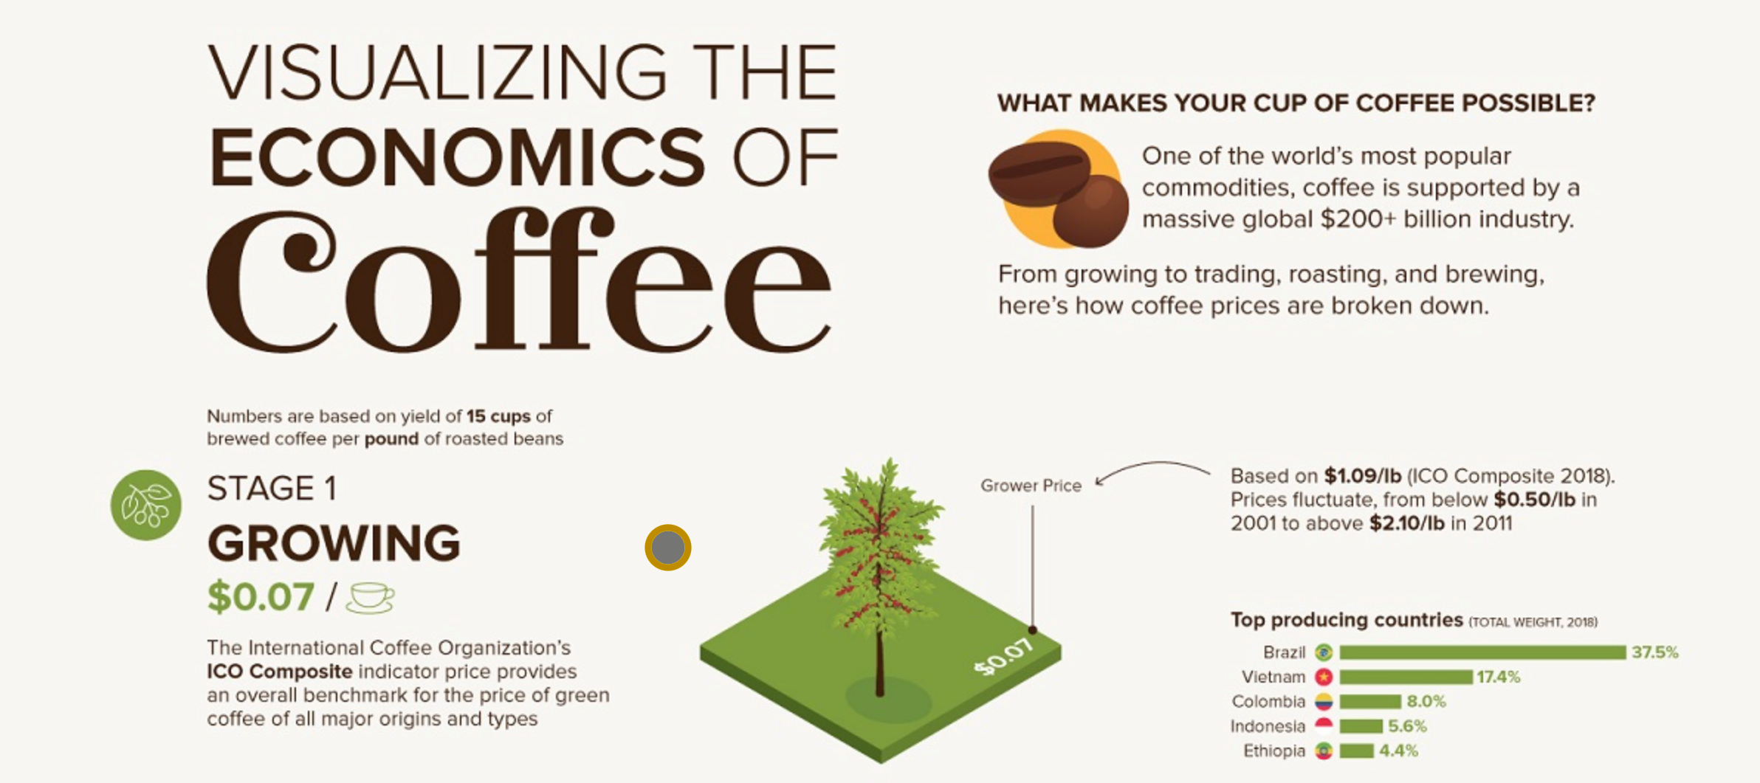
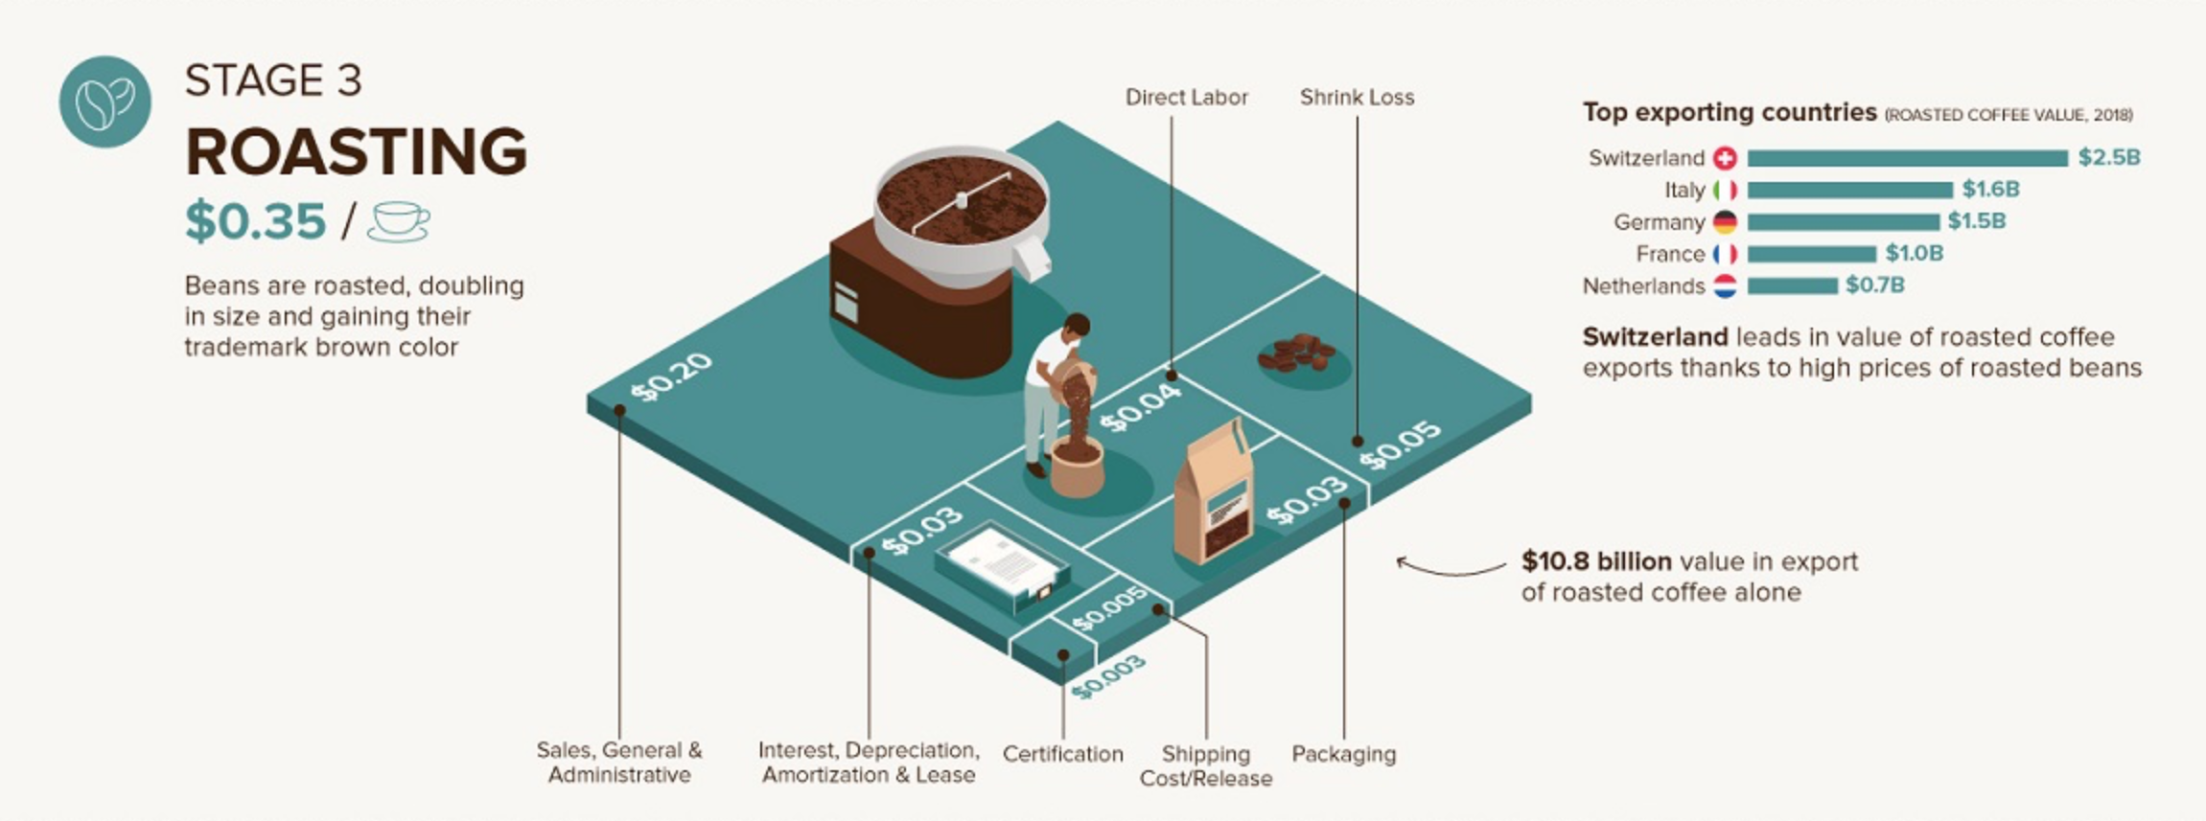
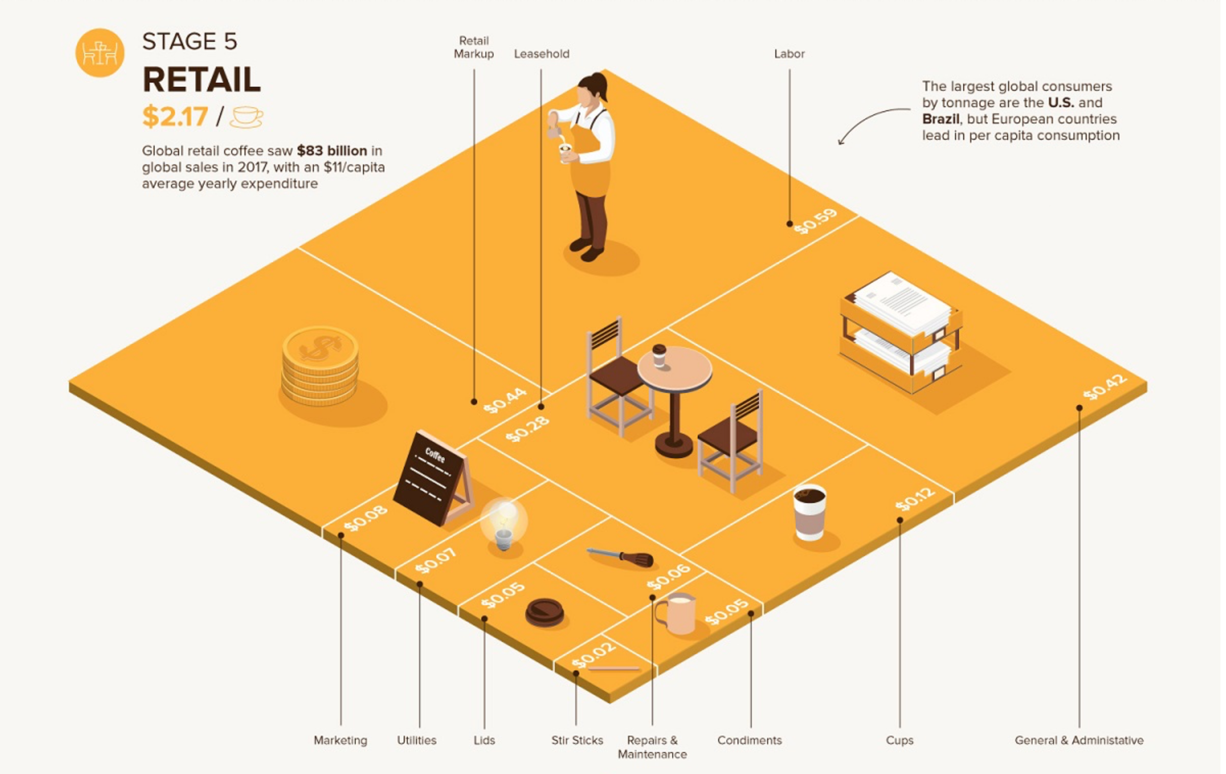

Slide 7
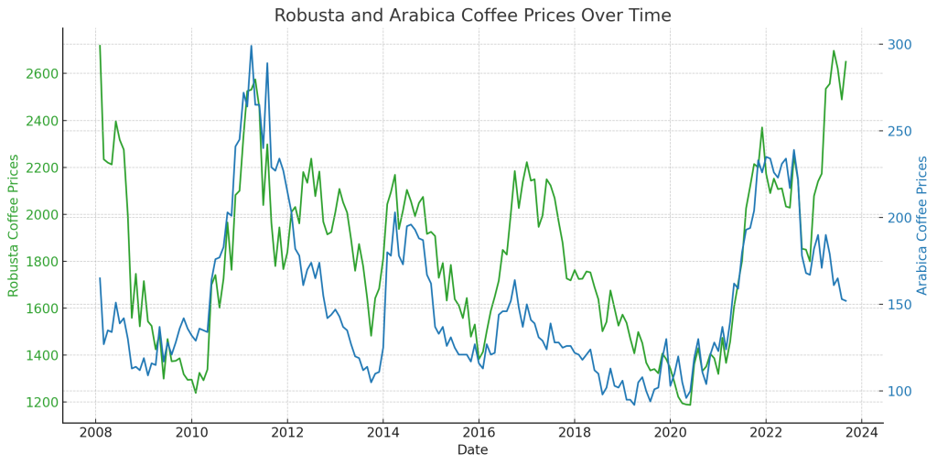
Coffee, supply chain, wealth distribution and global challenges
Maurizio Zugna – mzugna@me.com

Slide 9
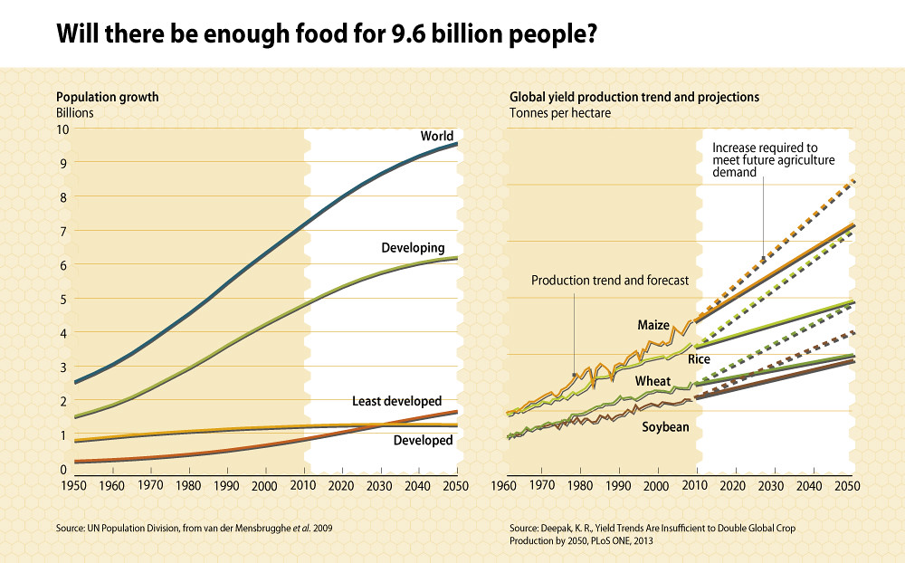
Coffee, supply chain, wealth distribution and global challenges
Maurizio Zugna – mzugna@me.com

Slide 10
Coffee, supply chain, wealth distribution and global challenges
The Global Coffee Market is estimated to be USD 493 Bn in 2022 and expected to reach USD 652.31 Bn by 2027, growing at a CAGR (compound annual growth rate) of 5.76% Market Dynamics
Drivers
Increasing Demand for Certified Coffee Products
Acceptance of Single-Serve Coffee Brew Systems by the Consumers
Increasing Demand Due to Rising Awareness of the Health Benefits of Coffee
Restraints
Rising Cost of Agricultural Input
Stringent Regulations on Labeling and Packaging by the Government
Opportunities
Altering Food Patterns of the Consumers
Growing Demand for R&D Products as a Healthier Option
Maurizio Zugna – mzugna@me.com

Slide 11
Coffee, supply chain, wealth distribution and global challenges
The Global Coffee Market is estimated to be USD 493 Bn in 2022 and expected to reach USD 652.31 Bn by 2027, growing at a CAGR (compound annual growth rate) of 5.76% (cont.)
Challenges
Unpredictable Weather Conditions
Availability of Substitutes Such as Tea
Market Segmentations The Global Coffee Market is segmented based on Coffee Bean, Product Type, Product, Distribution, and Geography.
By Coffee Bean , the market is classified into Arabica, Excelsa, Liberica, and Robusta.
By Product Type, the market is classified into Coffee Pods and Capsules, Ground Coffee, and Instant Coffee.
By Product, the market is classified into Coffee Pods & Capsules, Ground Coffee, Instant Coffee, and Whole-Bean.
By Distribution, the market is classified into Online Stores, Restaurant & Bars, Retail & Stores, and Supermarkets.
By Geography, the market is classified into Americas, Europe, Middle-East & Africa and Asia-Pacific.
Maurizio Zugna – mzugna@me.com

Slide 12
Coffee, supply chain, wealth distribution and global challenges
Market Dynamics 1
Drivers
Increasing Demand for Certified Coffee Product
Fair trade
Organic (bio)
Coffee coming from no-deforestation area (EUDR)
Specialty coffees
Acceptance of Single-Serve Coffee Brew Systems by the Consumers
Pods & capsules (no barista)
Increasing Demand Due to Rising Awareness of the Health Benefits of Coffee
Coffee & fitness
Cardio benefits
Maurizio Zugna – mzugna@me.com

Slide 13
Coffee, supply chain, wealth distribution and global challenges
Market Dynamics 2
Restraints
Rising Cost of Agricultural Input
Increasing costs of lands in producing countries (crop competition, urbanisation)
Increasing costs of fertilisers and chemical products (import, weak currency)
Limited availability of labour
Stringent Regulations on Labeling and Packaging by the Government
Increasing control on foodstuff production (components, emission, packaging)
Health regulation
Governmental control on shelf life, info to customers, etc
Maurizio Zugna – mzugna@me.com

Slide 14
Coffee, supply chain, wealth distribution and global challenges
Market Dynamics 3
Opportunities
Altering Food Patterns of the Consumers
New demand / new products / new consumers
Growing Demand for R&D Products as a Healthier Option
Coffee seen as health ingredient rather than only a drink
Challenges
Unpredictable Weather Conditions
Coffee production subject to weather factors (global warming, desertification)
Availability of Substitutes Such as Tea
Maurizio Zugna – mzugna@me.com

Slide 15
Coffee, supply chain, wealth distribution and global challenges
Maurizio Zugna – mzugna@me.com

