Slide 1
Catalyst characterization
Evolution of the catalyst: bulk techniques
Evolution of adsorbates: surface techniques
XRD
XANES/EXAFS
FT-IR of adsorbates
XPS

Slide 2
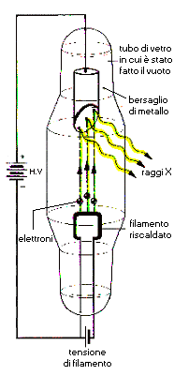
X-ray ray tubes
Vacuum tube
K_{α}
Anode
Characteristic
radiation
HV
X-rays
Intensity (a. u.)
K_{β}
Bremsstrahlung
radiation
Electrons
Cathode
λ_{min}
0.02
0.04
0.06
0.08
0.10
Wavelength (nm)
Filament supply
The spectrum from an X-ray tube has discrete fluorescent lines superimposed on
the continuous bremsstrahlung radiation

Slide 3

Energy Dissipation

Slide 4
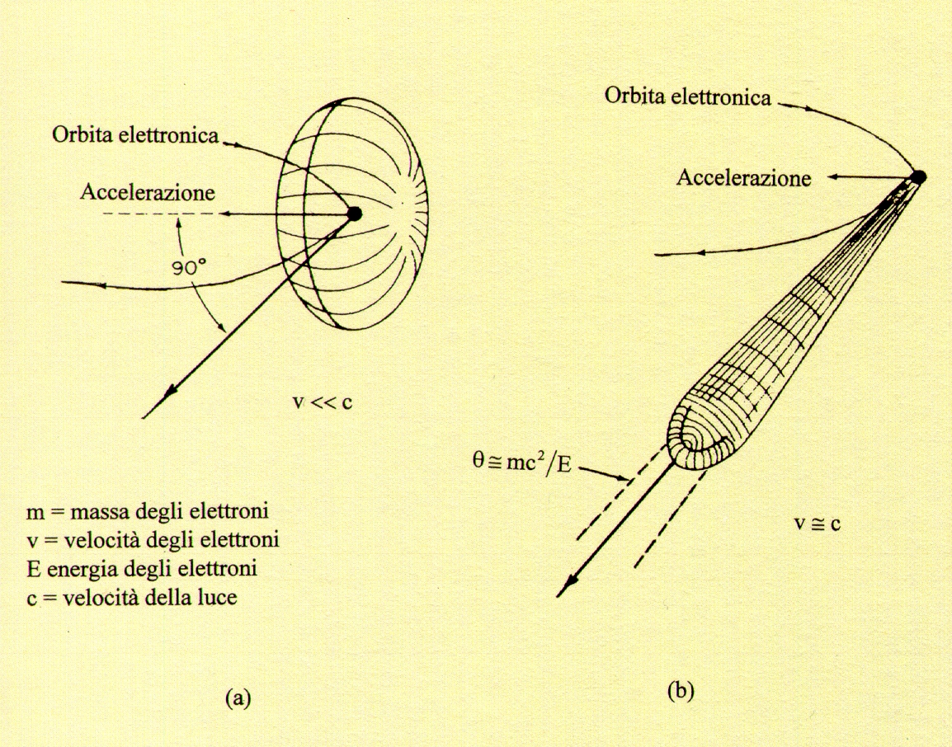
Synchrotron radiation angular distribution
Electron orbit
Electron orbit
e⁻
e⁻
Acceleration
Acceleration
v
v << c
Θ ≅ m₀c²/E
= 1/γ rad
m₀ = electron mass
v = electron velocity
E = electron energy
c = velocity of light
v ≅ c
v
Radiation angular distribution (a) electrons travelling at low speed and
(b) electrons travelling at relativistic speed (γ = (1-v²/c²)^{-1/2} ≅ 10000 at ESRF)

Slide 5
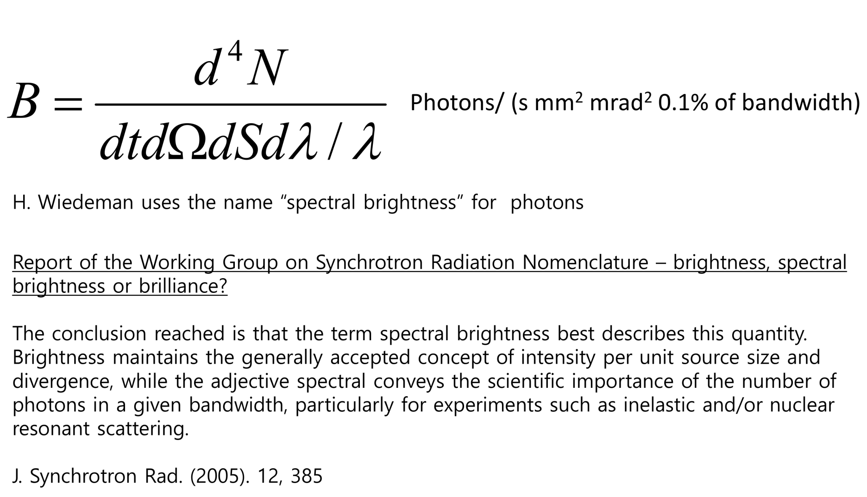
Synchrotron radiation – Spectral brightness

Slide 6
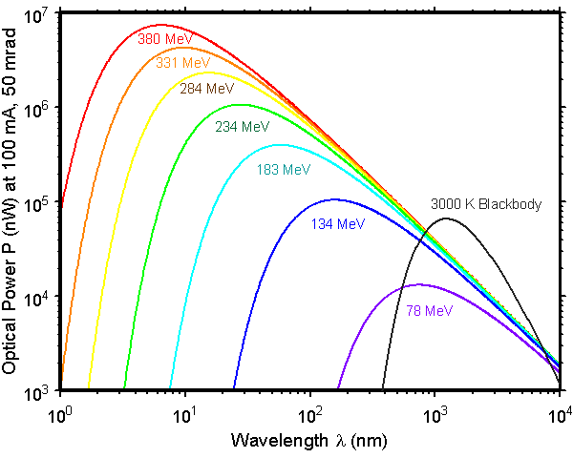
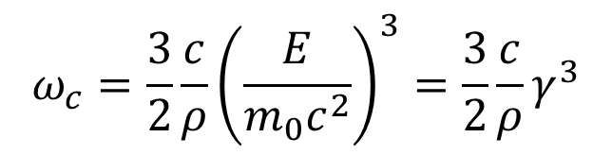
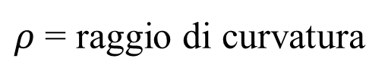
$$ω_{c}=\frac{3}{2}\frac{c}{ρ}{\left(\frac{E}{m_{0}c^{2}}\right)}^{3}=\frac{3}{2}\frac{c}{ρ}γ^{3}$$
$ρ$ = raggio di curvatura

Slide 7
How a Storage Ring Works
Front-end
Optical hutch
Booster
Experimental
hutch
Electron source
LINAC

Slide 8
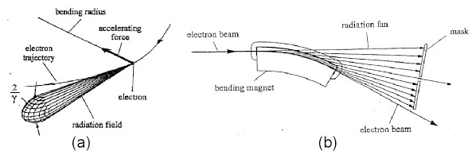
Emission from a bending magnet

Slide 9
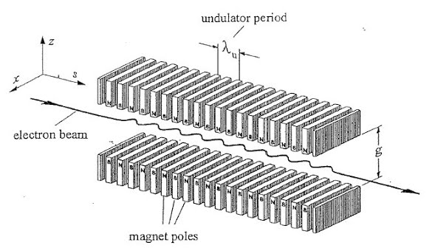
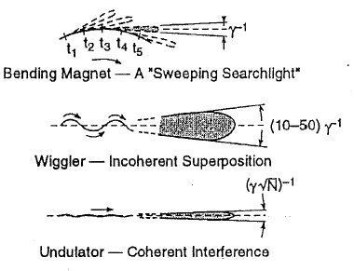
Insertion devices

Slide 10
Time structure
Light pulses
e⁻
e⁻
I
e⁻
e⁻
100 ps
t
1μs
Time pulsed emission is interesting for studying rapid reactions

Slide 11
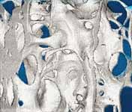
Fluorescence
Elemental analysis
I
Detector
X-rays
Sample
wavelength
Absorption
μ
2.0
1.0
X-rays
Sample
Detector
0.0
8800
8800
9000
9000
9200
9200
9400
9400
9600
9600
9800
9800
10000
Energy
10000
E (eV)
Imaging
X-rays
Detector

Slide 12
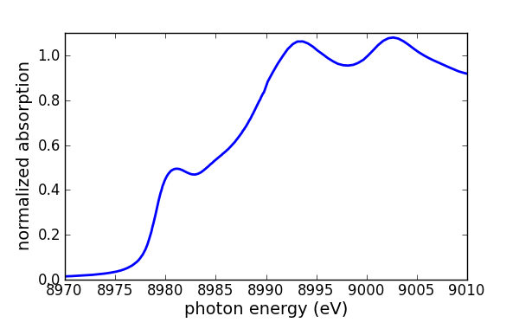
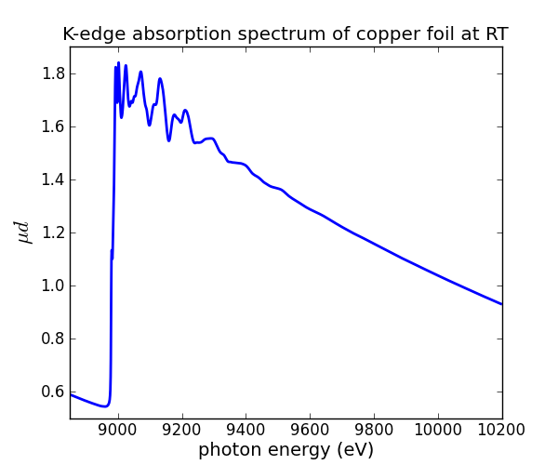
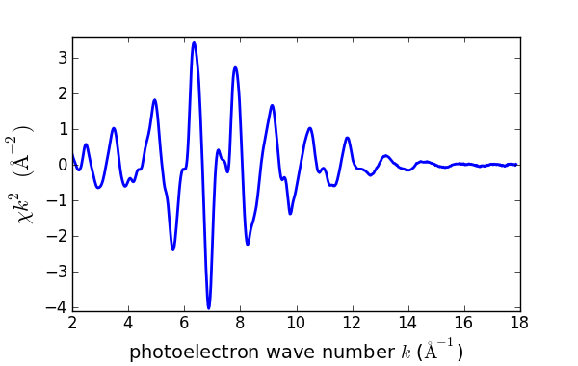
XAFS: X-ray Absorption Fine Structure
transmission experiment
I₀
I₁
x-rays
sample
XANES
X-ray Absorption
Near Edge Structure
EXAFS
Extended X-ray Absorption
Fine Structure
measured at Alba/CLÆSS

Slide 13
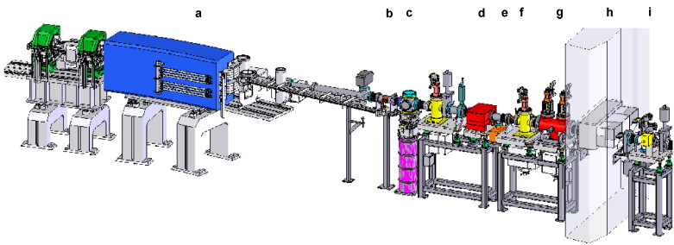
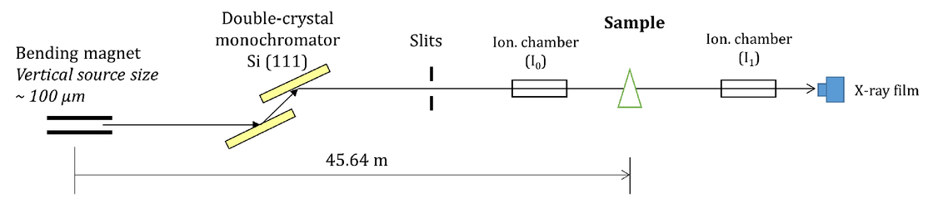
Beamline structure
Front-end
Optical hutch
Experimental hutch

Slide 14
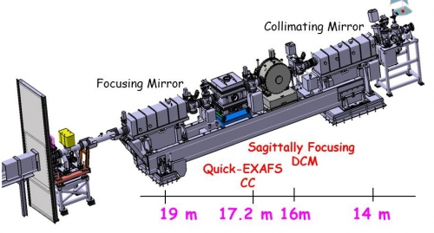
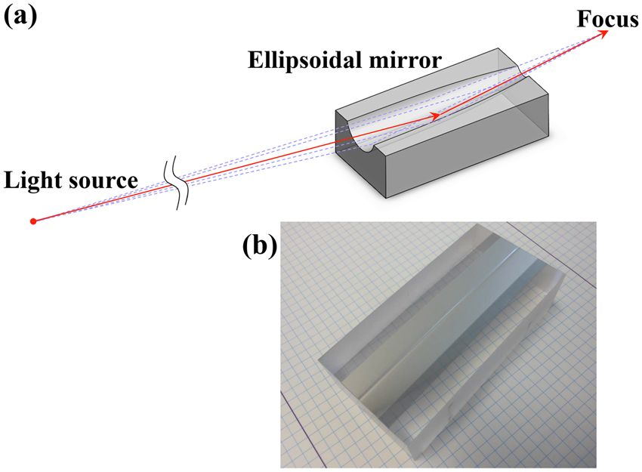
Beamline structure
Optical hutch
Mirrors
Metal thin film on substrate
Bended by piezoelectric devices

Slide 15
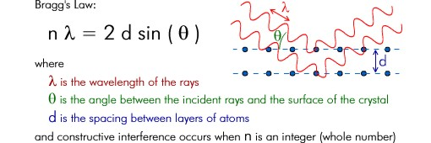
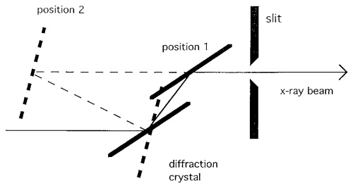
Beamline structure
Monochromator:
Si single crystals
(111)
(220)
(311)
Monochromator
Double-crystal
monochromator

Slide 16
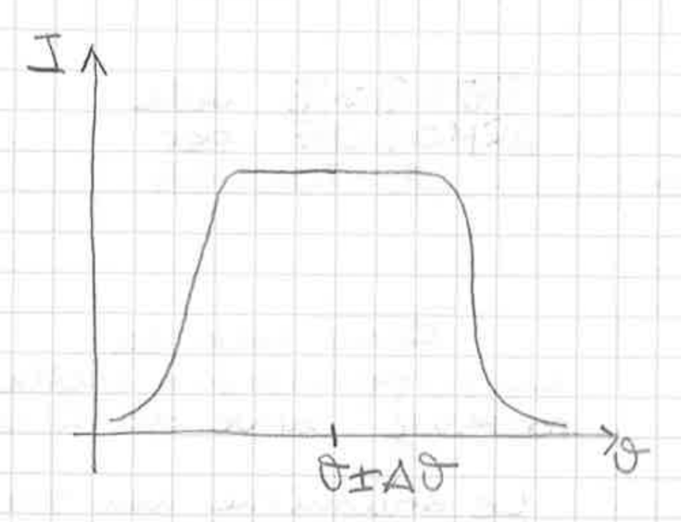
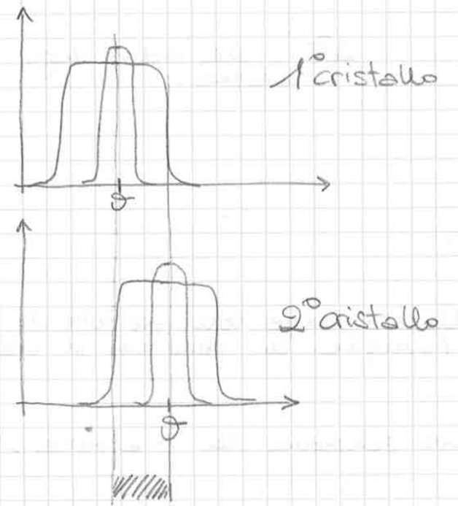
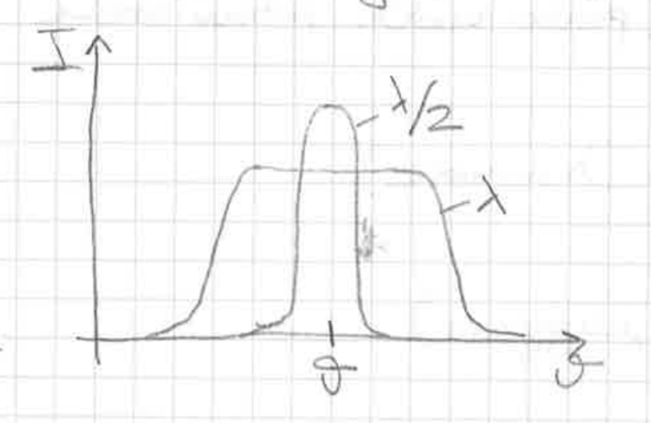
Monochromator – harmonic rejection by detuning
Rocking curve
Detuning
λ is diffracted by both the crystals and exits the monochromator.
λ/2 is eliminated from the beam.
Depends on λ

Slide 17
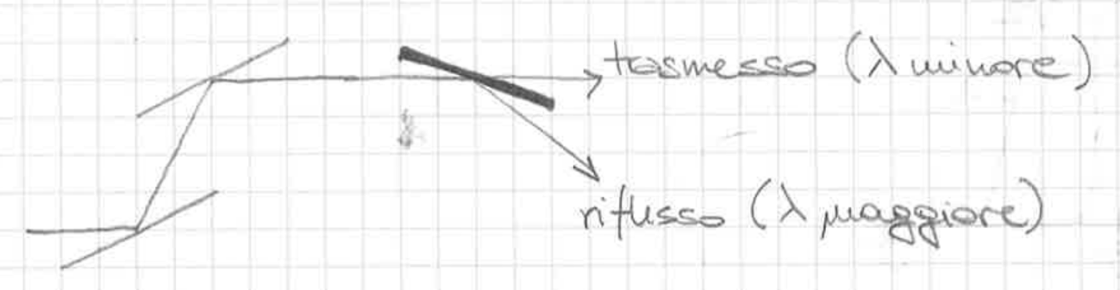
Monochromator – harmonic rejection by mirrors
Mirrors work under gracing incidence
Transmitted (higher frequency)
Reflected (lower frequency)

Slide 18
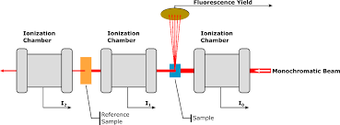
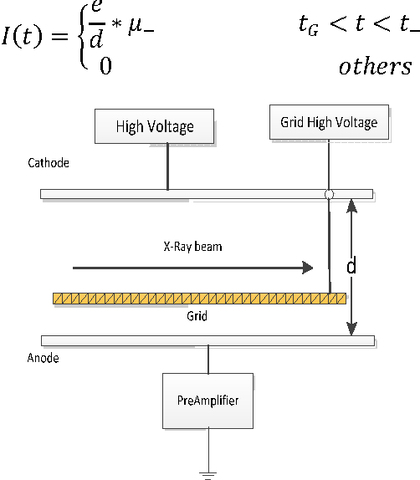
Experimental hutch
Ionization
chamber

Slide 19
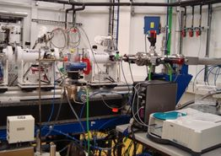
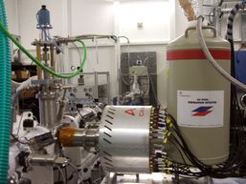
Experimental hutch
Ionization chamber
Fluo detector

Slide 20
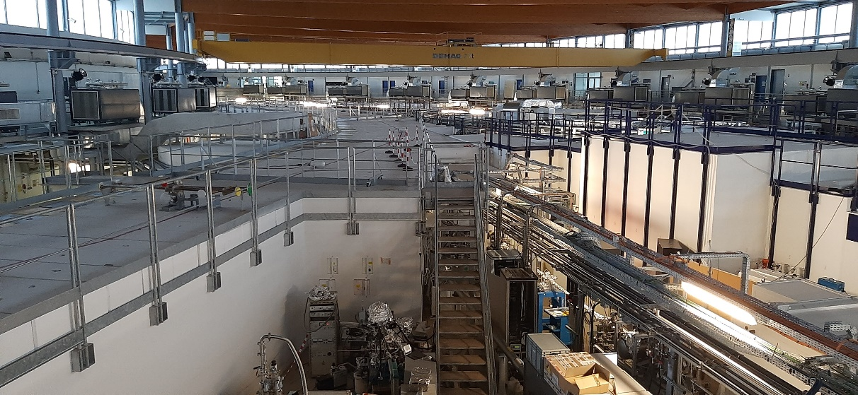
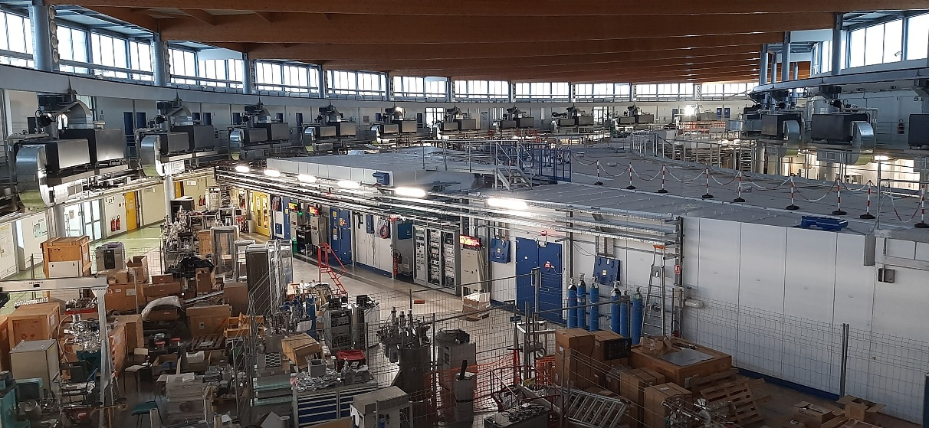

Slide 21
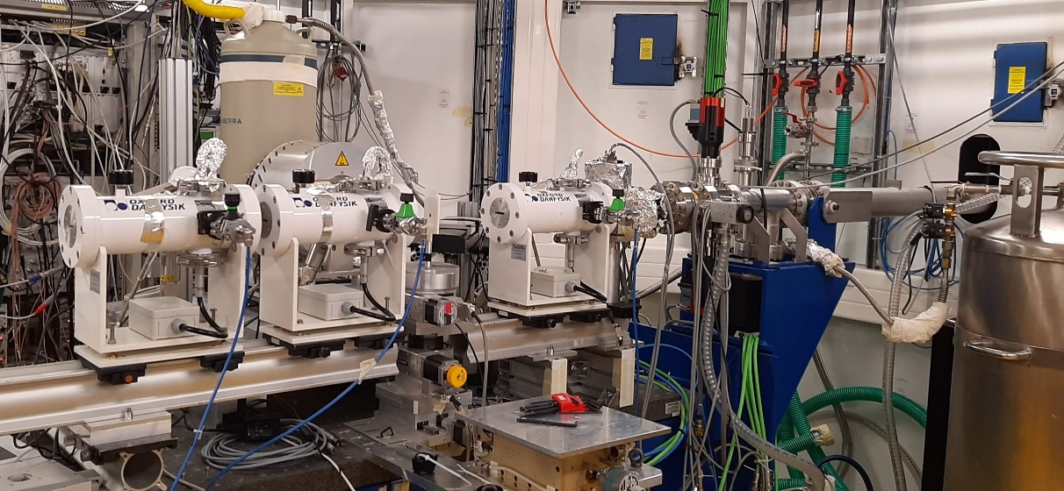
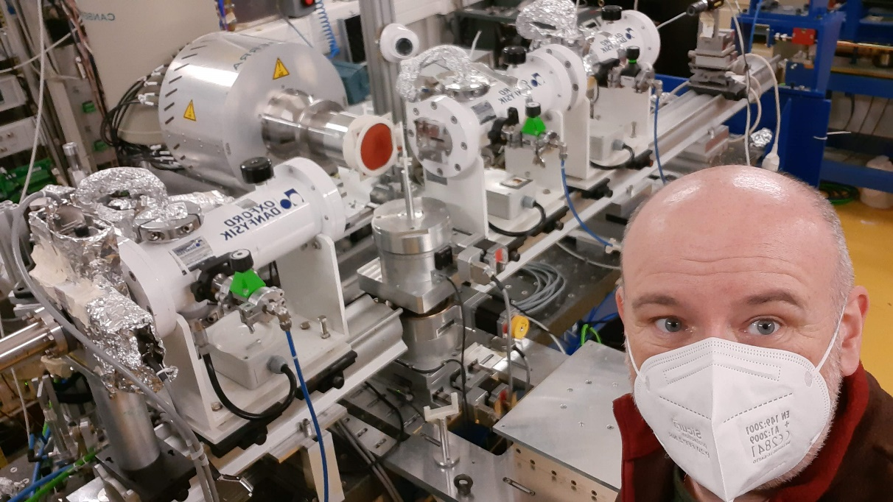

Slide 22
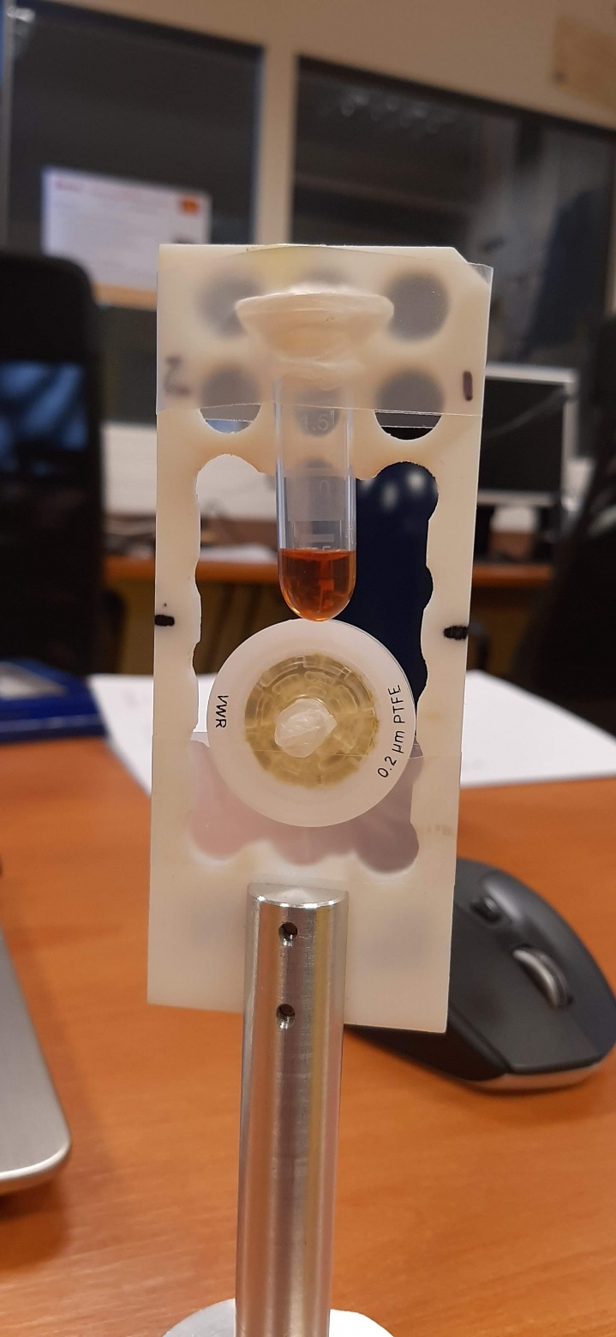
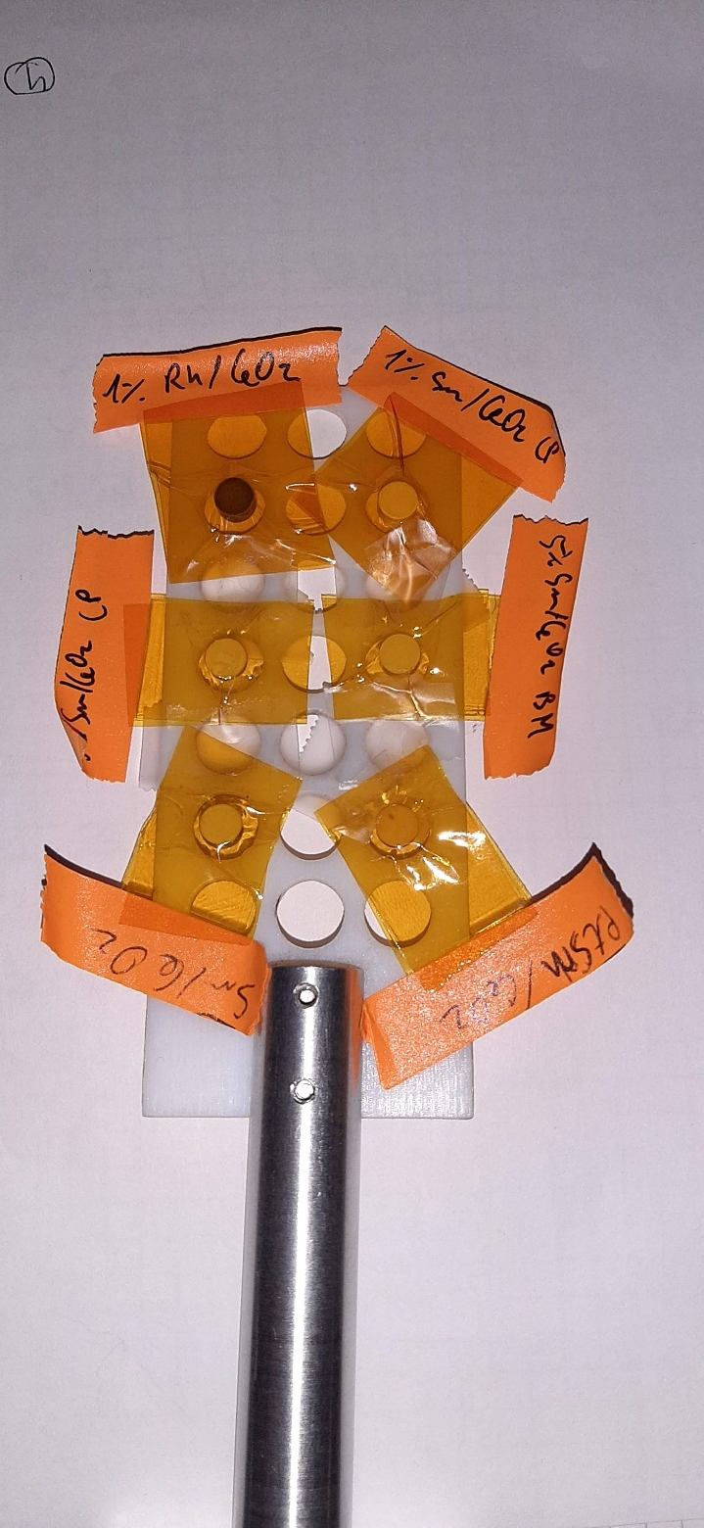

Slide 23



Qualitative Picture of XAFS
x-ray
Isolated atom
X
E _{photoelectron}
continuum
M₁–M₅
E_{F}
L₃ 2p_{3/2}
The outgoing wave is scattered by neighbors
L₂ 2p_{1/2}
L₁ 2s
X
E_{x-ray}
E_{x-ray}
Single
Scattering
K 1s

Slide 24



Qualitative Picture of XAFS
constructive interference –
absorption maximum
Here is where
the interference
is important!
destructive interference –
absorption minimum
X
Multiple
Scattering

Slide 25
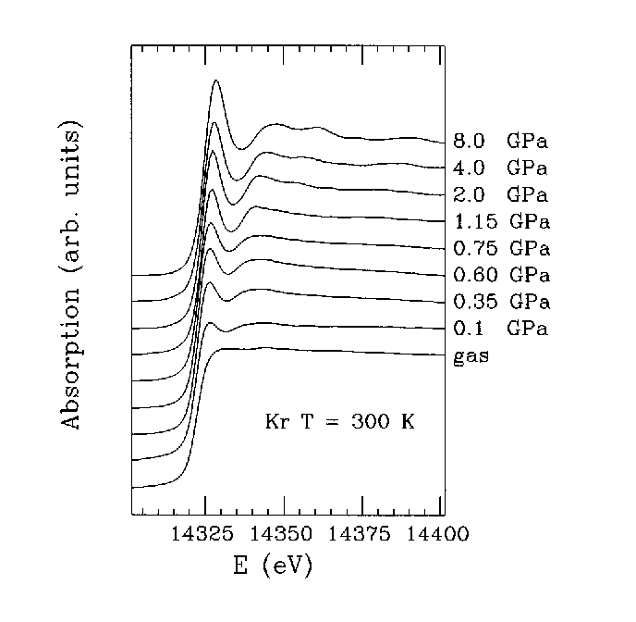
High-pressure EXAFS of solid and liquid Kr
Solid
Liquid
Gas
A. Di Cicco, A. Filipponi, J. P. Itié and A. Polian, Phys. Rev. B 54 (1996) 9086-9098

Slide 26
XANES vs EXAFS
Inelastic mean free path

Slide 27
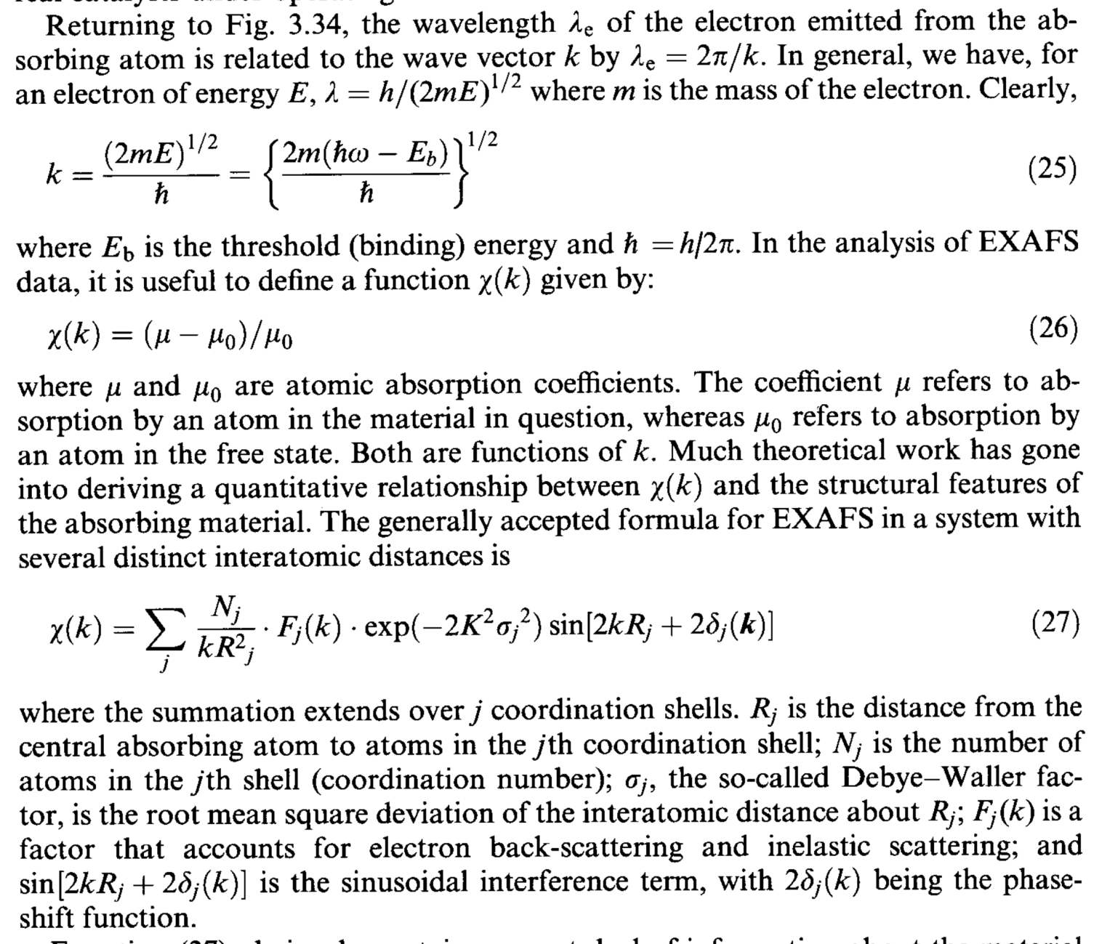
EXAFS standard formula

Slide 28
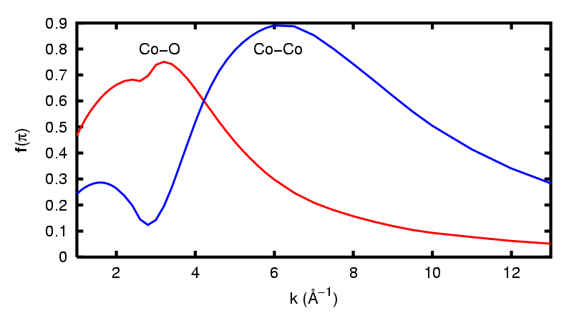
EXAFS standard formula
R_{i}
A
S_{j}
  absorber-scatterer distance: R_{i}
  coordination numbers: N_{i}
disorder along the absorber – scatterer distance: σ²
passive electron relaxation: S₀²
finite photo-electron mean free path: λ_{(k)}
function of scattering amplitude: f_{i(k)}
  phase function: φ_{i(k)}
Notes:
mettere colori secondo che si voglia conoscere o si conoscano i parametri

Slide 29
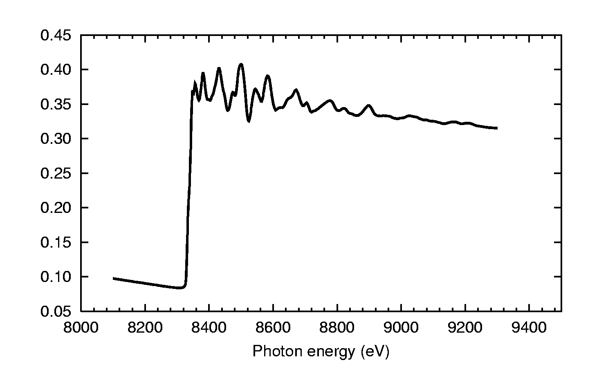

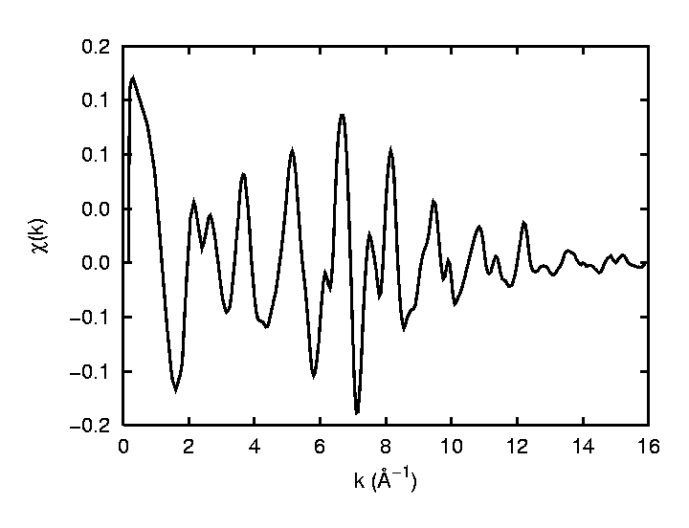
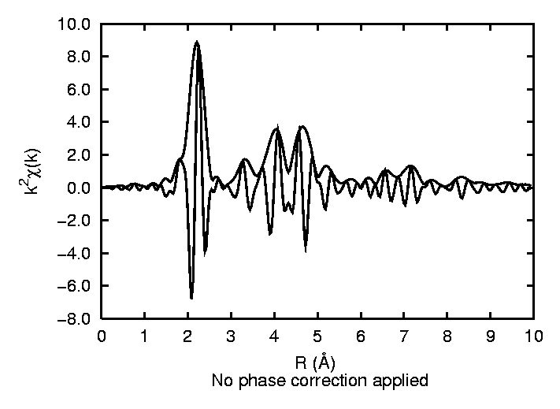
Ni K-edge
μ₀
Outline of EXAFS analysis
E₀
Δμ
1
Background subtraction
2
Fourier Transform
1
]
FT[
2

Slide 30
What we can learn from EXAFS
2.55 (real R_{Cu-Cu})
2.3
Unpleasant thing about EXAFS:
FT positions are shifted towards small distances.
More unpleasant: Each FT peak has its own shift.
Because of the phase shifts, extracting the
structural information from EXAFS requires
curve fitting with assumed (calculated) phase shifts.

Slide 31
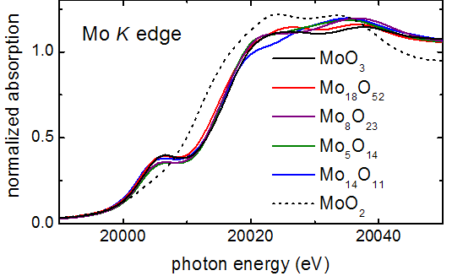
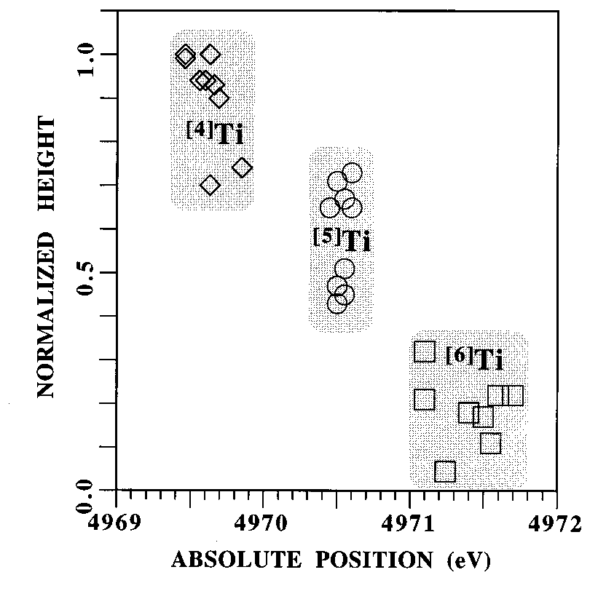
What we can learn from XANES: a) Pre-edge Peak
Dipole selection rule (only in central-symmetric case!): Δl = ±1
Consider K-absorption for transition metals:
initial state = 1s (l=0)
states near E_{F} are formed by nd electrons (l=2)
central-symmetry | non-central symmetry
no resonance | resonance (pre-edge peak)
T. Ressler et al. J. Phys. Chem. B 104, 27 (2000) 6360-6370
from [F. Farges, G. E. Brown, J. J. Rehr,
Phys. Rev. B 56 (1997) 1809]

Slide 32
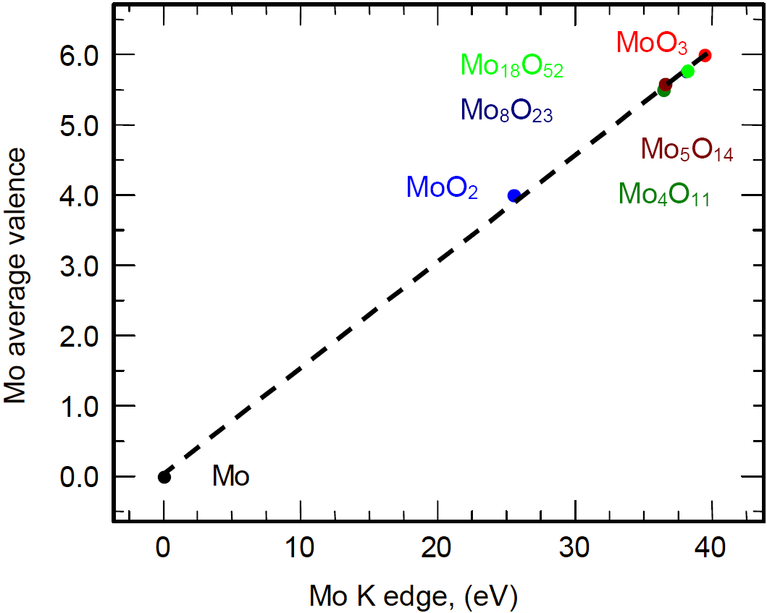
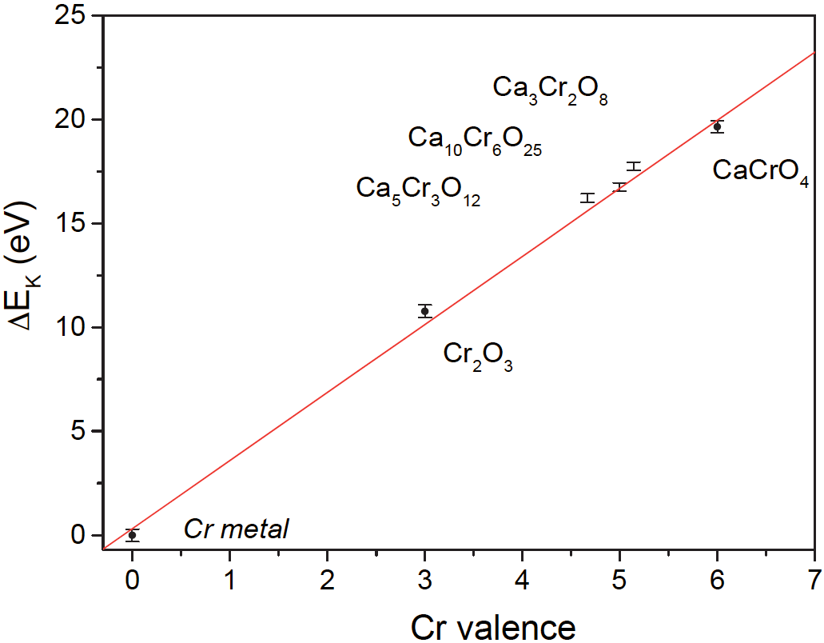
What we can learn from XANES: b) Edge Shift
T. Ressler, R. E. Jentoft, J. Wienold, M. M. Günter and O. Timpe:
J. Phys. Chem. B 104, 27 (2000) 6360-6370
I. Arčon, B. Mirtič, A. Kodre,
J. Am. Ceram. Soc. 81 (1998) 222–224
Why does it shift?
1) Electrostatic: it is harder for the photoelectron to leave a positive (oxidized) atom
2) Shorter bonds at higher oxidation states ⇒ Fermi energy is higher

Slide 33
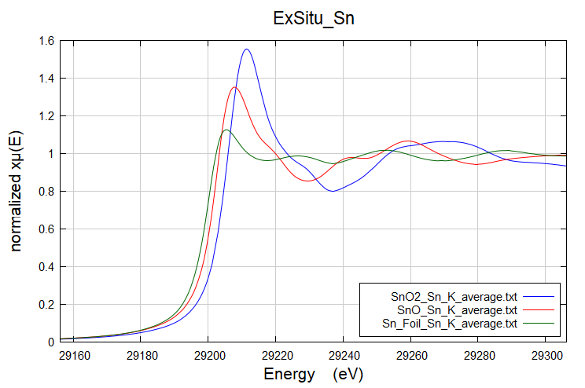
What we can learn from XANES: b) Edge Shift
Why does it shift?
1) Electrostatic: it is harder for the photoelectron to leave a positive (oxidized) atom
2) Shorter bonds at higher oxidation states ⇒ Fermi energy is higher

Slide 34
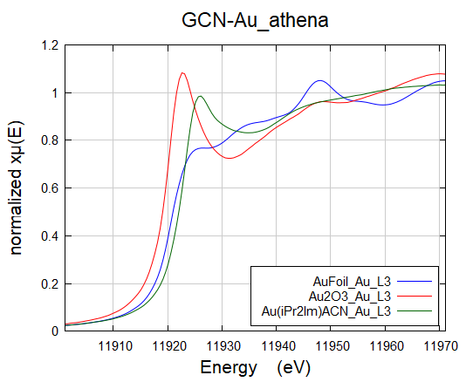
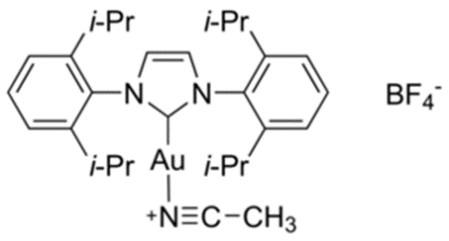
What we can learn from XANES: b) Edge Shift
Au(iPr₂Im)ACN
Why does it shift?
1) Electrostatic: it is harder for the photoelectron to leave a positive (oxidized) atom
2) Shorter bonds at higher oxidation states ⇒ Fermi energy is higher

Slide 35
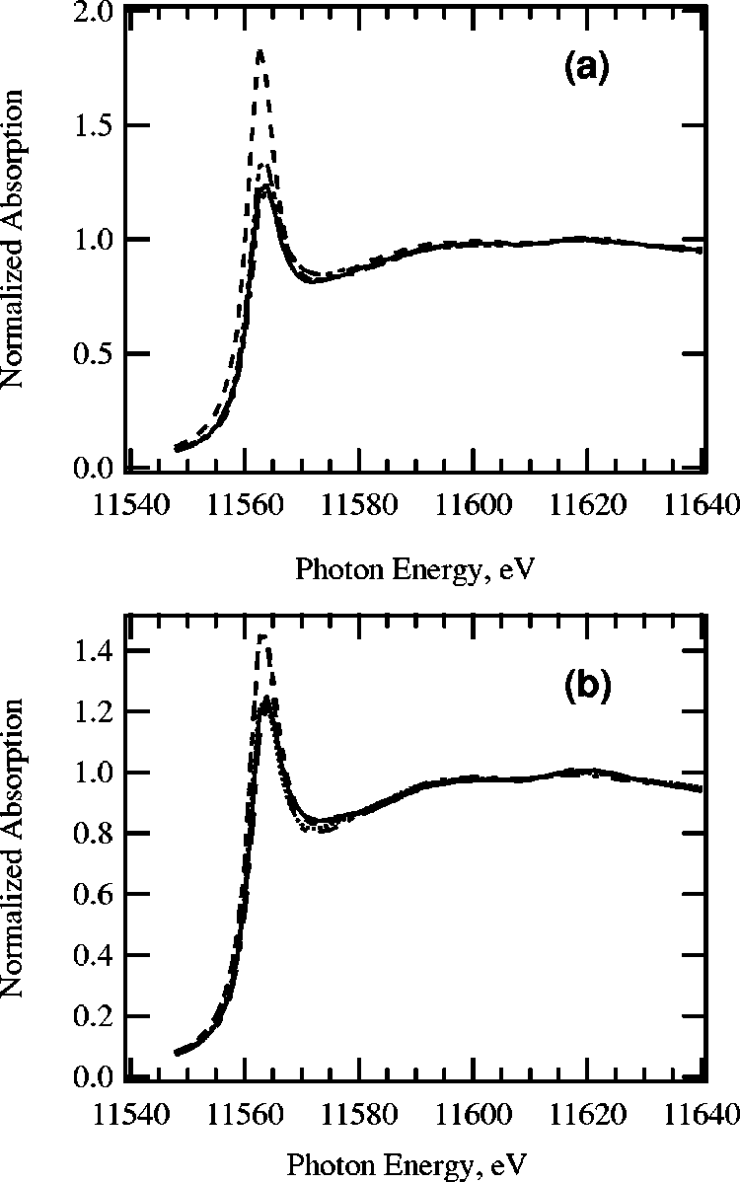
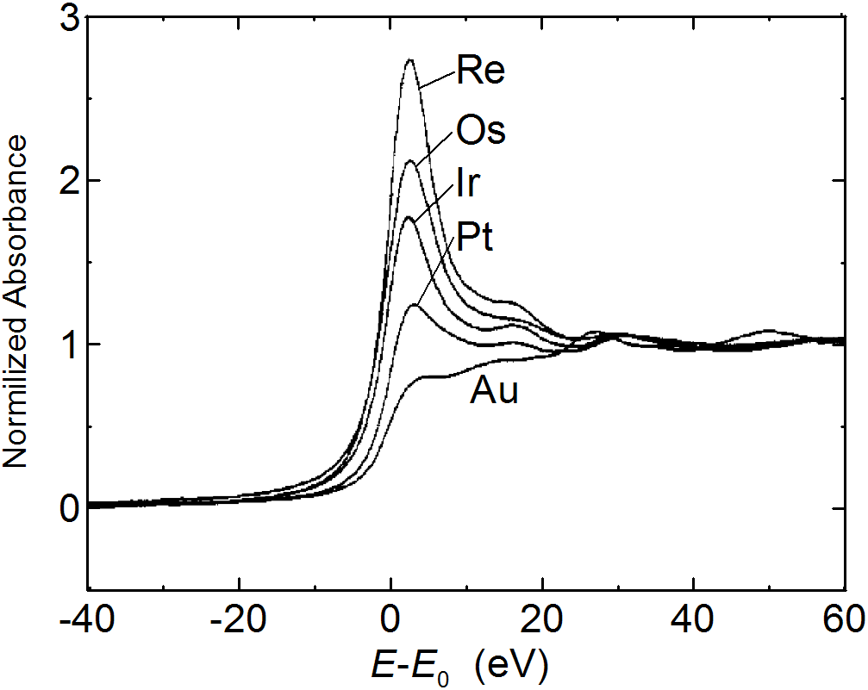
What we can learn from XANES: c) White Line
L₃ absorption edges for 5d metals:
(transition 2p_{3/2} → 5d)
…white line also depends on particle
size and morphology:
G. Meitzner, G. H. Via, F. W. Lytle, and J. H. Sinfelt,
J. Phys. Chem. 96 (1992) 4960
a) Pt₃ triangle (dashes), Pt₄ tetrahedron (solid), Pt₅ triangular bipyramid (dash-dot), and Pt₆ octahedron (dash-dot-dot);
(b) Pt₇ and Pt₄ clusters of different shape: planar ‘‘honeycomb,(dashes), D5h bipyramid (solid) , single-capped
octahedron (long dashdot), Pt₄ tetrahedron (dots), and Pt₄ planar rhombus (dash-dot).
from A. L. Ankudinov, J. J. Rehr, J. J. Low, and S. R. Bare, J. Chem. Phys. 116 (2002) 1911
Intensity is proportional to the number of free 5d
states and also depends on valence state. But…

Slide 36
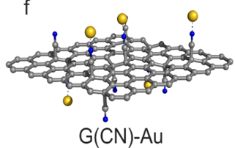
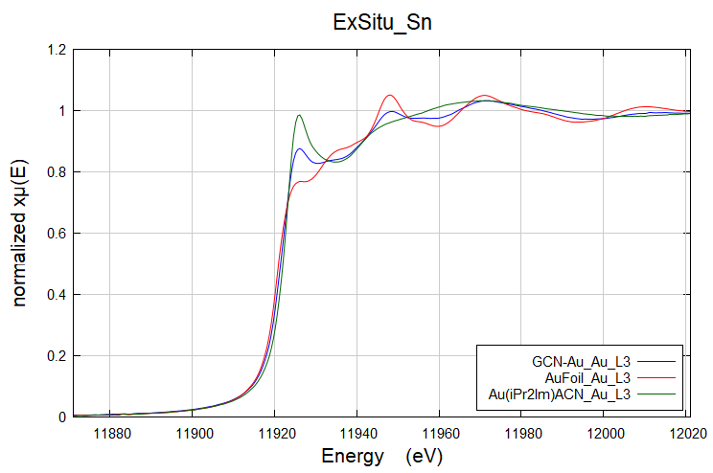
What we can learn from XANES: d) Speciation
By Linear Combination Analysis

Slide 37

What we can learn from XANES: d) Speciation
By Linear Combination Analysis
G(CN)-Au sample is composed by 48.6 mol% of Au(0) and 51.4 mol% of Au(I).

Slide 38


XAS and small objects: coordination numbers
A common subject: bulk metal versus metal clusters.
All atoms are both absorber and scattering centers.
Bulk: any atom is equivalent to the others;
Cluster: surface atoms have a diminished coordination number.
The average first coordination number depends on the size, i.e. surface to bulk ratio.
Infinite lattice
Small cluster
The EXAFS coordination number
is the weighted average
of the coordination numbers of all absorbers.

Slide 39



Example: Ag/CeO₂

Slide 40
Example: Application of EXAFS to Pd,Pt/C Catalysts (b)
Reduction treatment: in 5%H₂/He atmosphere, stepwise with ΔT=50°C.
Measurements at LN₂ temperature in order not to have interference of two effects: (i) due to different
temperature vibrations and (ii) due to different particle sizes.

Slide 41
Example: Application of EXAFS to Pd,Pt/C Catalysts (c)
Reference compound: metallic Pd foil
Checking your amplitudes and phases with reference spectra must be always the first step in every EXAFS study!
The difference between a simply reduced Pd/C sample (hydrided)
and one subsequently blown out by He flow (dehydrided)

Slide 42
ZrO₂
CeO₂
O
CeO₂ - ZrO₂
M = Ce or Zr

Slide 44
X-Ray Electron Spectroscopy (XPS)
Applications:
  catalyst composition
  chemical nature of active phase
  dispersion of active phase
Standard technique in catalyst characterisation
Recently developed Near Ambient Pressure techniques (quasi operando conditions).

Slide 45

X-Ray Electron Spectroscopy (XPS)

Slide 46
Binding Energy
Conservation of energy
E_{B} depends on chemical environment:
element
valence state
coordination (type of ligands, number, tetrahedral, octahedral. …)
corrects for potential difference between sample and analyser
hν = E_{B} + E_{kin} + E_{corr}
kinetic energy of emitted electron
energy of photons
binding energy of emitted electron

Slide 47


XPS Equipment
Number of emitted electrons measured as function of their kinetic energy

Slide 48


NAP-XPS Equipment

Slide 49
Where do Electrons come from?
Intensity of a peak depends on:
composition
position where electrons are emitted
Electrons interact with the solid
only a fraction of the emitted electrons reach detector with original kinetic energy
the longer the distance, the higher the number of “lost” electrons
z = distance travelled by electrons
λ = escape depth

Slide 50
Inelastic Mean Free Path
10.0
5.0
1.0
0.5
0.3
Au
Au
Au
Au
Au
Ag
Ag
Mo
Inelastic Mean Free Path (nm)
Ag
Au
Au
C
Au
Au
C
W
Ag
Ag
Be
Be
Ag
Be
Be
Ag
Ag
Be
C
Mo
Fe
W
Ag
Ag
Mo
Be
2 5 10 50 100 500 1000 2000
Electron energy (eV)

Slide 51
Is XPS a Bulk or a Surface Technique?
5000
4000
3000
XPS yield
2 nm
2000
1000
0.5 nm
0
0
2
4
6
8
10
12
Thickness of absorbing layer z (nm)
XPS is a surface-sensitive technique

Slide 52
XPS Survey of Al₂O₃
O 1s
Al₂O₃ Mg Kα
1253 eV
O(KVV)
745.3
N(E)
766.7
Auger transitions
780.6
E
O(KVV)
AUGER
805 765 725
C 1s
Al 2s
Al 2p
Satellite
Ar 2s
Ar 2p_{3/2}
O 2s
1000 900 800 700 600 500 400 300 200 100 0
E_{B}

Slide 53
Effect of Valence on Chemical Shift - Al and Al₂O₃
2p 72.85
Al
Al₂O₃
2p 74.7
86 76 66
‘Binding energy’ (eV)
Peak position determined by element and valence
Chemical information on elements

Slide 54

XPS spectrum of a Rh/Al₂O₃
Element specificity of binding energies (calibration of BE)
Linear relation between intensity of the peaks and atomic concentration

Slide 55

Xe 3d _{5/2} Chemical shift versus oxidation state
ΔE (Xe 3d _{5/2})

Slide 56

Application of XPS
XPS spectra of MoO₃/SiO₂/Si(100) after sulfidation in H₂S+H₂.
(From De Jong et al. J. Phys. Chem (1993)

Slide 57


Morphological Information
Dispersion of particles over a support from peak intensity ratio
XPS spectra of ZrO₂/SiO₂

