Slide 1
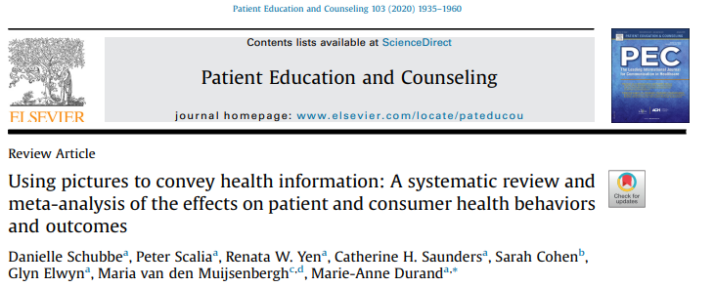

Slide 2
15 anni dopo
Review sistematica e metanalisi, selezionano ricerche RCT randomized controlled trials
Knowledge-understanding, recall, adherence
Esclusi gli studi che non hanno un controllo,
Fanno un sottogruppo su popolazione con una literacy sanitaria bassa.

Slide 3
The test of functional health literacy in adults: a new instrument for measuring patients' literacy skills
Design: The Test of Functional Health Literacy in Adults (TOFHLA) was developed using actual hospital materials. The TOFHLA consists of a 50-item reading comprehension and 17-item numerical ability test, taking up to 22 minutes to administer. The TOFHLA, the Wide Range Achievement Test--Revised (WRAT-R), and the Rapid Estimate of Adult Literacy in Medicine (REALM) were administered for comparison. A Spanish version was also developed (TOFHLA-S).
Setting: Outpatient settings in two public teaching hospitals.
Patients: 256 English- and 249 Spanish-speaking patients were approached. 78% of the English- and 82% of the Spanish-speaking patients gave informed consent, completed a demographic survey, and took the TOFHLA or TOFHLA-S.
Results: The TOFHLA showed good correlation with the WRAT-R and the REALM (correlation coefficients 0.74 and 0.84, respectively). Only 52% of the English speakers completed more than 80% of the questions correctly. 15% of the patients could not read and interpret a prescription bottle with instructions to take one pill by mouth four times daily, 37% did not understand instructions to take a medication on an empty stomach, and 48% could not determine whether they were eligible for free care.

Slide 5
risultati
L’uso di figure (pittogrammi, icone, cartoon photograps)
Aumenta in modo significativo
Knowledge-understanding,
Recall,
(anche se c’e’ molta variabilità)
ma non l’Adherence

Slide 6
Low health literacy
Risultati poco chari
Meglio gli interventi con testo breve

