Slide 1
Entrepreneurship
A.Y. 2023-2024
By Guido Bortoluzzi
Course Syllabus
Course code in TEAMS: h7nwq71
Notes:
If this PowerPoint presentation contains mathematical equations, you may need to check that your computer has the following installed:
1) MathType Plugin
2) Math Player (free versions available)
3) NVDA Reader (free versions available)

Slide 2
Entrepreneurship
Credits: 6-9 ECTS
COURSE INSTRUCTOR – Guido Bortoluzzi
Contact: guido.bortoluzzi@deams.units.it
Office hours: by appointment
Full Professor of Management at the University of Trieste (Italy) and Core Faculty member at MIB Trieste School of Management. Coordinator of the PhD Programme in Circular Economy.
Visiting lecturer in several international Universities, including the University of Northern Colorado (Greeley, U.S.) and the ISM University of Economics and Business (Vilnius, LT). My research interests include innovation management, Start-Ups, Business Models; Internationalization Strategy. I have published the results of my research in many scientific journals, including Harvard Business Review (German ed.), Technovation, Journal of Business Research, International Marketing Review, Journal of International Management, Management Decision, European Management Journal., European Journal of Innovation Management, and others.

Slide 3
Course objectives
The main aim of the course is to focus on how wannabe entrepreneurs and start-ups should plan, organize and manage activities in order to successfully launch their new ventures
After clarifying what entrepreneurship is (Chapter 1), the course will focus on four main topics:
Developing successful business ideas (Chapters 2, 3)
Developing a consistent business model (Slide on Business Model Canvas)
Writing a business plan (Chapter 6)
Moving from an Idea to an Entrepreneurial firm (Chapters 9, 10, 14)

Slide 4
Learning outcomes
Course learning outcomes (CLO) | Assessment methods
CLO1. KNOWLEDGE AND UNDERSTANDING. Students will learn the basic concepts of entrepreneurship and business model innovation, by mixing up theory and practice and by being exposed to real cases of successful start-ups. | EXAM
CLO2. APPLYING KNOWLEDGE AND UNDERSTANDING. By the end of the course, students will be able to comprehend and analyze an entrepreneurial process and to understand the main building blocks composing a business model. | EXAM
CLO3. MAKING JUDGMENTS. By the end of the course, students will become sophisticated analyzers of start-up firms able to articulate their own opinions on the consistency of a business model. | WORK GROUP
CLO4. COMMUNICATION SKILLS. By the end of the course, students will be able to describe and criticize a business model and to pitch and entrepreneurial idea of their own. | WORK GROUP
CLO5. LEARNING SKILLS. By the end of the course, students will have developed critical thinking abilities which are essential to the understanding of more complex texts and issues. | EXAM AND WORK GROUP

Slide 5
Schedule of the course, Moodle structure
You can find it in Moodle
Could be subject to changes according to guests’ availability. All modifications will be communicated through the Moodle platform (but you must be «enrolled» in the course to receive updates. So, do it asap).
Feel free to suggest new readings to share
Feel free to suggest new guests to invite to class

Slide 6
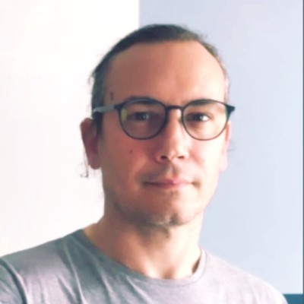
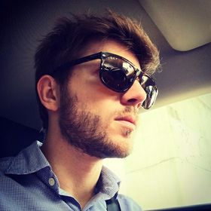
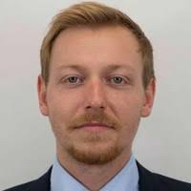
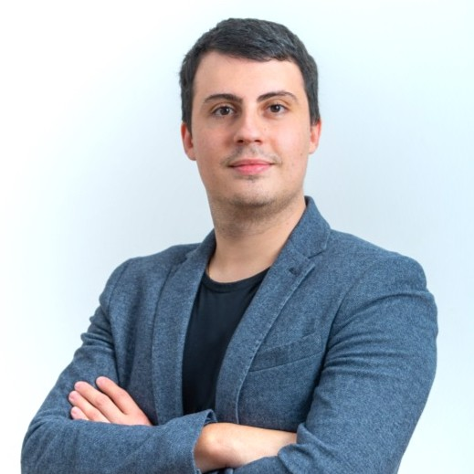
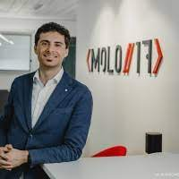
Our guests
Paolo Ganis
Stefano Luperto
Tommaso Pedicchio
Giovanni Spinelli
Daniele Angeli
Andrea Virgilio

Slide 7
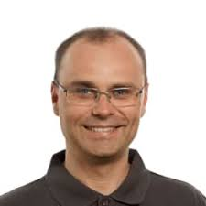
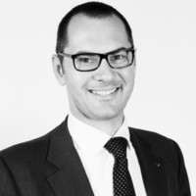
Our speakers
Aleš Pustovrh
Carlo Asquini

Slide 8
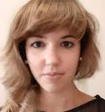
THE CO-LECTURERS OF THIS COURSE
CHIARA MARINELLI
(Business Model Canvas LAB)
GRAZIA
GARLATTI COSTA
(Ch.9 Building the New Venture Team)
MARCO
BALZANO
(Ch. 14 entrepreneurial growth)

Slide 9
Individual work, group work and assessment (attending students only)
6 CFU | WEIGHT ON FINAL GRADE
Group Work | 30%
Final (Written) Exam | 70%
9 CFU | WEIGHT ON FINAL GRADE
Group Work | 30%
Final (Written) Exam (“long” version) | 70%
The lecturer will provide up to 2 points to those students that will contribute to the success of the course with regular attendance, proactive participation to class discussions and group activities

Slide 10
Attending students: final exam
Final Exam (attending students only*)
A mix of multiple-choice and open questions. Study material:
Notes & Slides (mostly)
The “longer” part is related to the BM Canvas topic
*Students belonging to a group are considered “attending” per definition. However, it is possible to lose the status of “attending” student in case of poor participation to groups activities

Slide 11
Non attending students: final exam
Non attending students:
Written exam (text-book only); Selected text-book chapters: 1, 2, 3, 6, 8, 9, 10, 14
Students in the need of 9 CFU/ECTS will have to study also Part 1 of the book: Osterwalder A., Pigneur Y., Business Model Generation. John Wiley & Sons

Slide 12
FORMING THE GROUPS
Groups will be formed by 4 – 5 people.
They will be mixed (management & engineering & erasmus)
Groups will need a NAME and a TEAM LEADER.
The TEAM LEADER will send to the lecturer the list of the team-members in a .xls file (the FORMAT is already in MOODLE)

Slide 13
FORMAT

Slide 14
Do you have an entrepreneurial idea? Let’s share!
If you already have an innovative idea,
but do not know how to:
define it
find a working team
make it feasible
…here it is the right place!
Feel free to contact chiara.marinelli@phd.units.it
We will try to better understand what your idea is, what your exigencies are and arrange a team for you to bring about your innovative proposal

Slide 15
…and if you don’t have an idea, but would like to be engaged?
No worries! Ideas can come by chance, even at later stages of the course
In the meanwhile, if you want to:
give support to some colleagues of yours
engage in others’ ideas
…feel free to contact chiara.marinelli@phd.units.it
We will do our best to match your interests with the emerging ideas proposed by your colleagues

Slide 16
READY TO START (UP)

