Slide 2
In order to study which phase of the cell (tumour) process is influenced by the molecule under examination, experimental models are used.
They are distinguished as:
1. monovariable models
they are performed only in vitro since a single phase of the process is evaluated
2. Multivariable models
they include multiple process steps, they can be in vitro and in vivo (using mice or rats.)

Slide 3
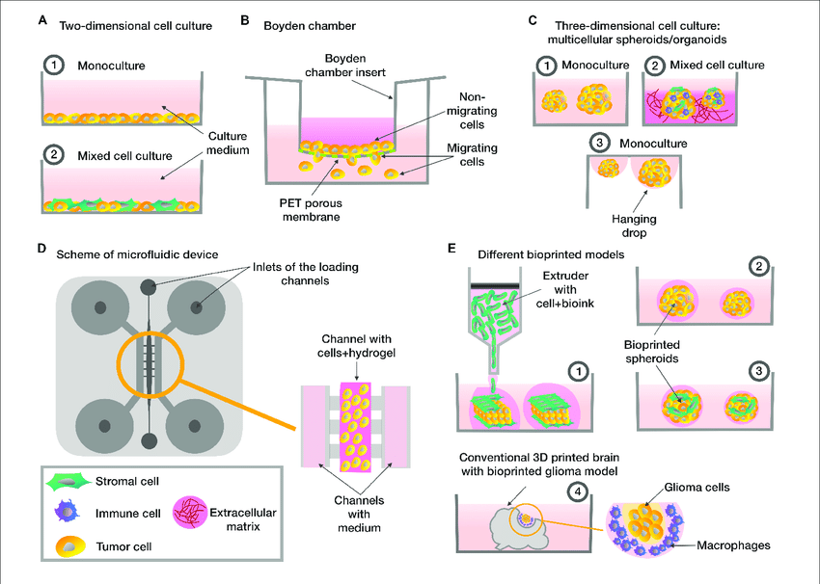
in vitro models
They allow to evaluate:
Adhesion
Spreading
migration
Invasion
Proliferation

Slide 4
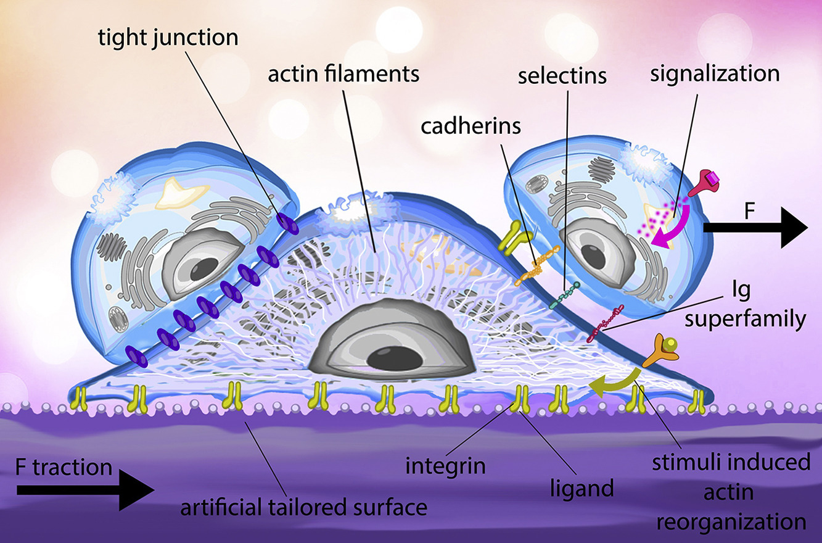
Cell adhesion
is a complex process involved in migration/invasion, embryogenesis, wound healing and tissue remodeling.
Cells adhere to the extracellular matrix, forming complexes with cytoskeleton components that can affect cell motility, differentiation, proliferation, and survival.

Slide 5
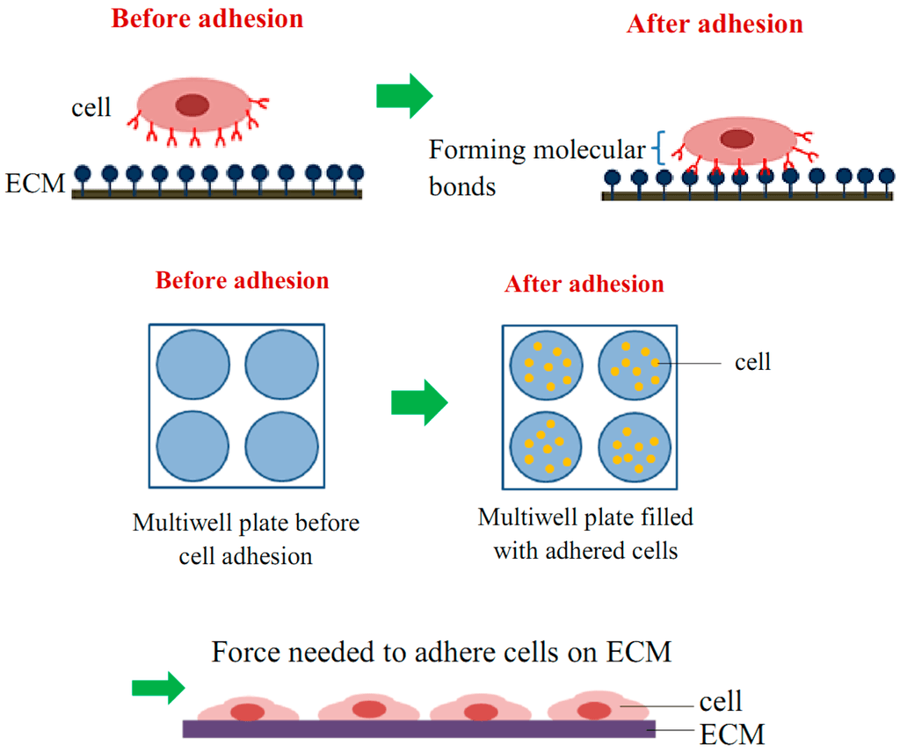
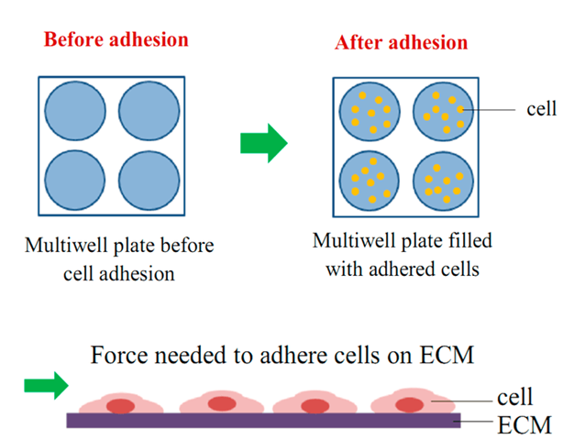
Cell adhesion
- Cells are seeded onto the substrate.
- Adherent cells attach, while non-adherent cells are washed away.
- Adherent cells are quantified.

Slide 6
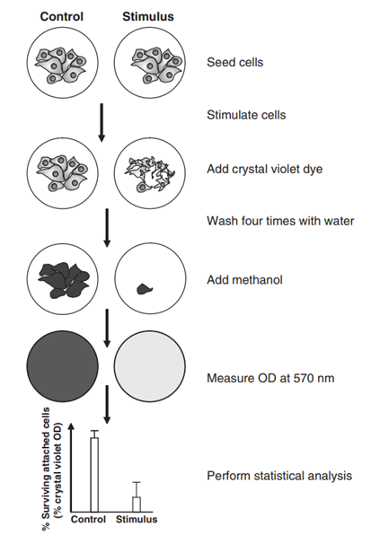
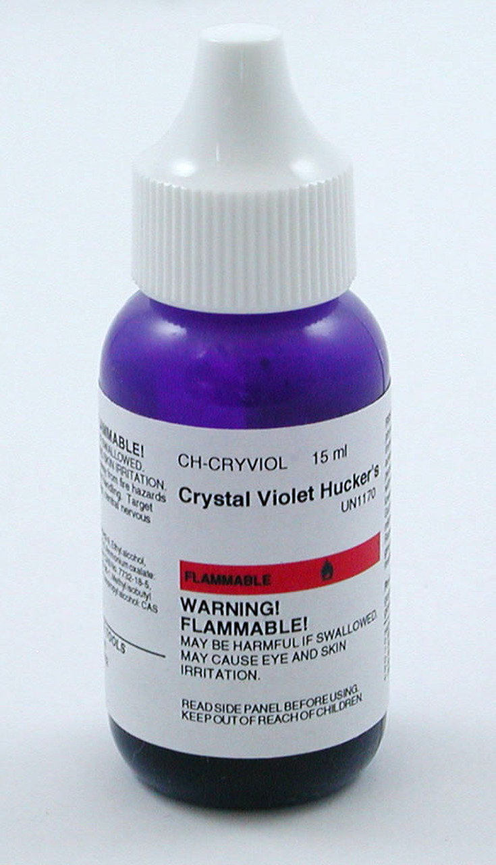
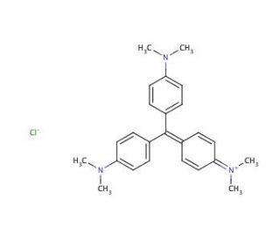
Crystal Violet staining
Crystal violet stains nucleic acids and proteins
It is used to reflect the cell number in 96-well plates.

Slide 7
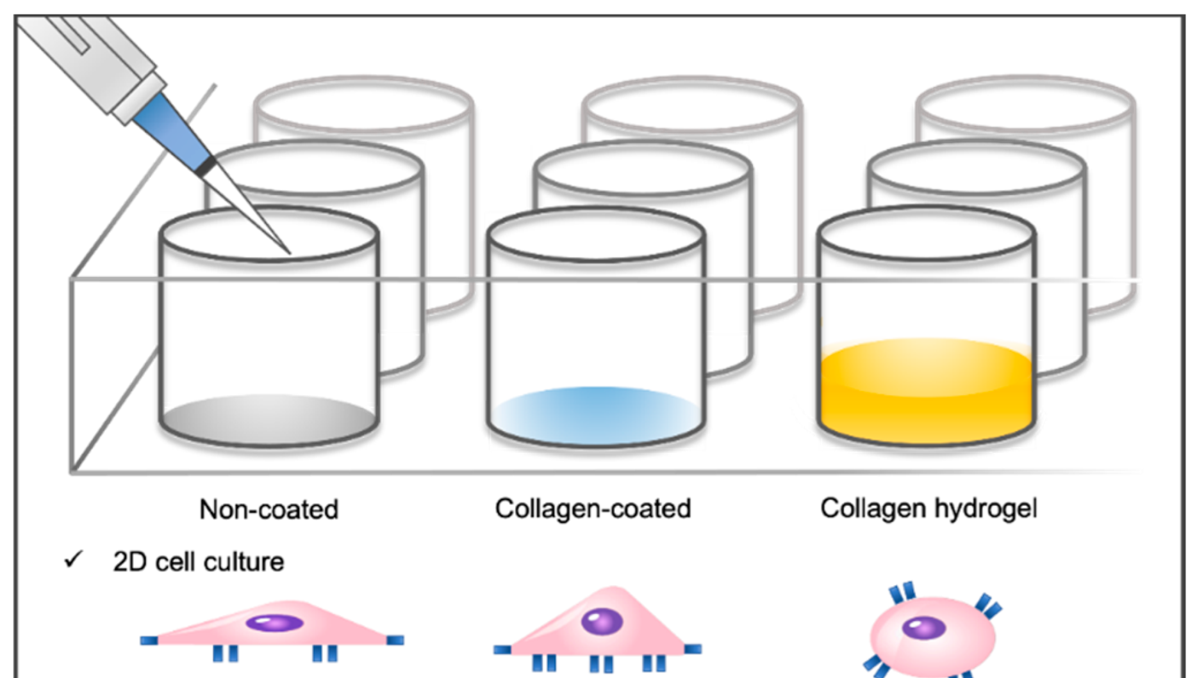
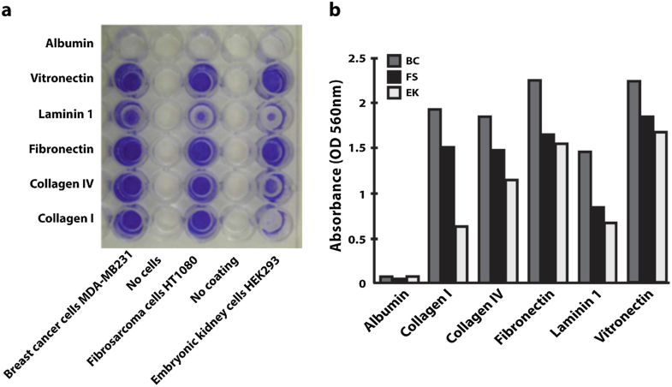
Fibronectin coated

Slide 8
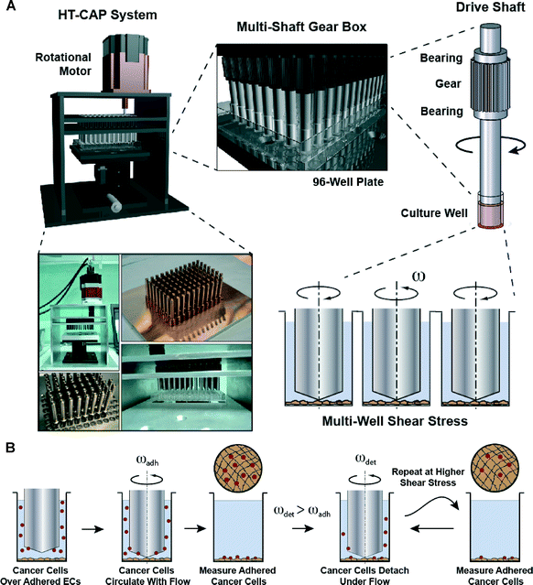

Slide 9
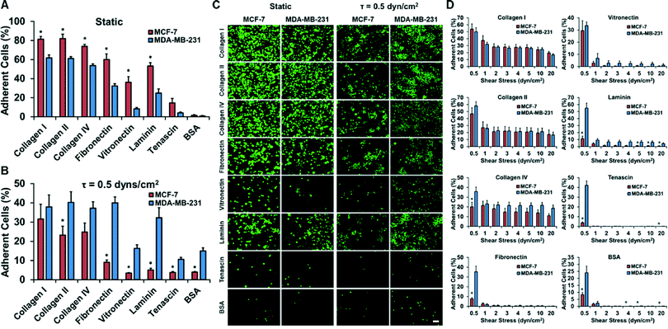

Slide 10
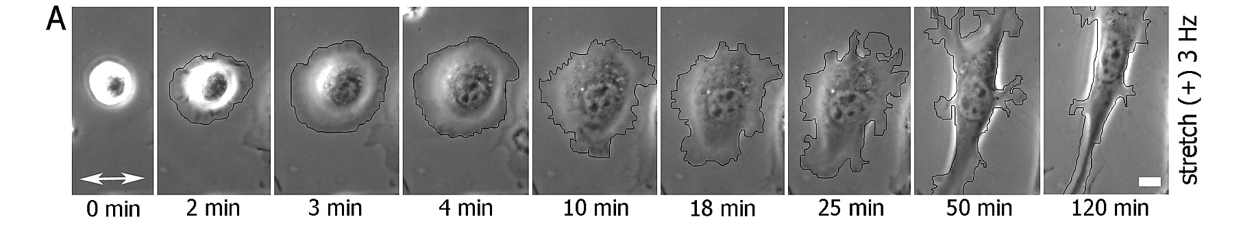
Cell spreading assay

Slide 11
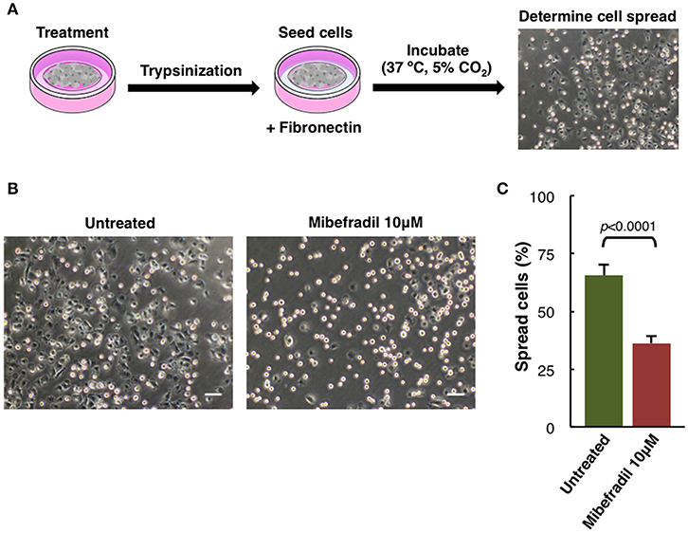
Cell spreading assay
- Cells were treated for 24 h,
- trypsinized
- seeded onto fibronectin coated plate.
- After 1 h cells were fixed with 2% PFA
- phase-contrast images were captured.
FIGURE 5. (B) phase-contrast images. Scale bars, 50 μm.
C) Plot showing the percentage of spreading cells. Round bright cells were considered unspread. Values are percentage of spread cells ± SD (n = 3 independent experiments; at least 600 cells for each experiment were counted). The corresponding p-value obtained by unpaired two-tailed Student's t-test is shown.

Slide 12
