Slide 1
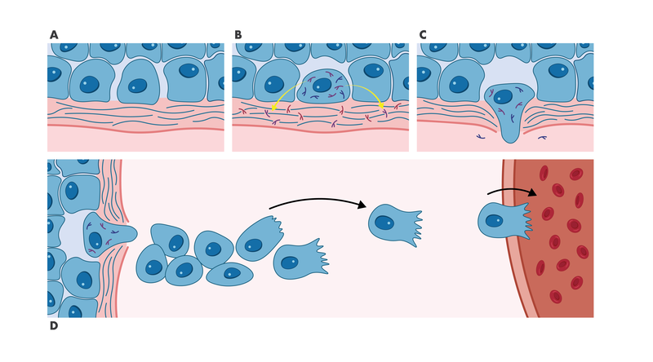
Early Metastasis Process
The early steps of the metastasis process involve
A) Loosening of the intercellular junctions between tumor cells,
B) Degradation of the intracellular matrix of the basement membrane,
C) Invasion into surrounding tissue,
D) Migration to endothelial vessels.
modeled with the Invasion Assay.
modeled with the Migration Assay.

Slide 2
Definition of migration and invasion
Migration is often used as umbrella term in biology to describe any directed cell movement within the body.
The ability to migrate allows cells to change their position within tissues or between different organs.
In pathology, invasion (of carcinomas) is defined as
the penetration of tissue barriers, and infiltration (intrusion) into the underlying interstitial tissues (by malignant tumor cells)

Slide 3
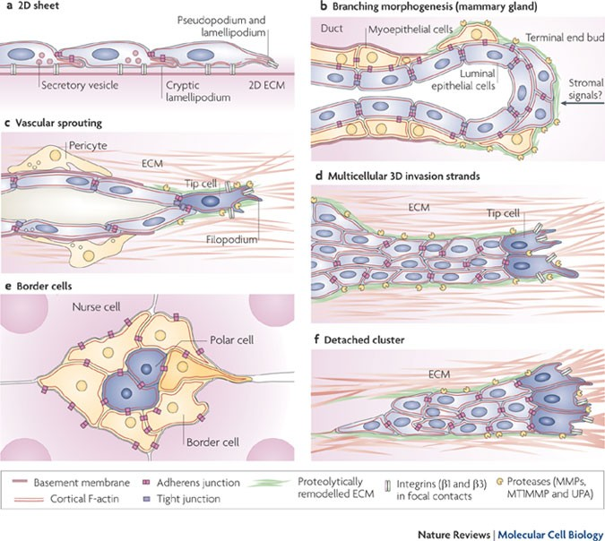
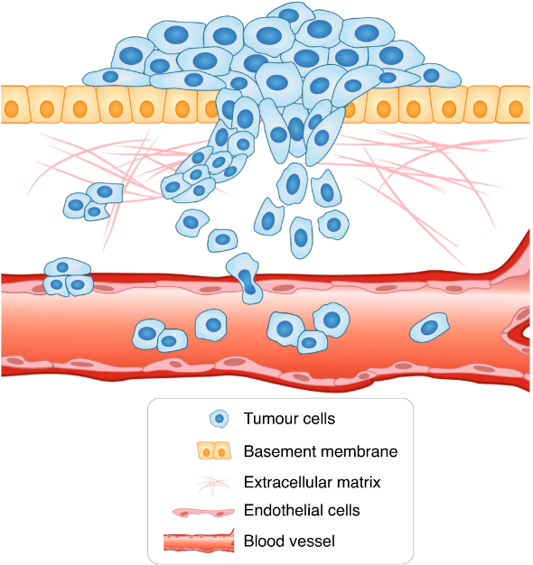
Migration and invasion are clearly separated terms in experimental cell biology.
Migration is defined as:
the directed movement of cells on a substrate such as basal membranes, ECM fibers or plastic plates.
Therefore, migration is occurring on 2D surfaces without any obstructive fiber network
Invasion is defined as:
cell movement through a 3D matrix, which is accompanied by a
restructuring of the 3D environment.
Invasion requires adhesion, proteolysis of extracellular matrix components and migration, therefore invading cells remodel the ECM.

Slide 4
Migration Assays
Wound healing assay
Cell Exclusion Zone assay
Boyden Chamber

Slide 5
In vitro wound-healing assay (scratch assay)
This popular, technically non-demanding and cheap assay can be used to study migration of cells on 2D surfaces.
A confluent plate of any type of attached cells is ‘‘wounded’’ by scraping off an area of cells, which is most easily done using a plastic pipette tip

Slide 6
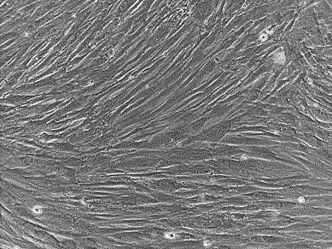
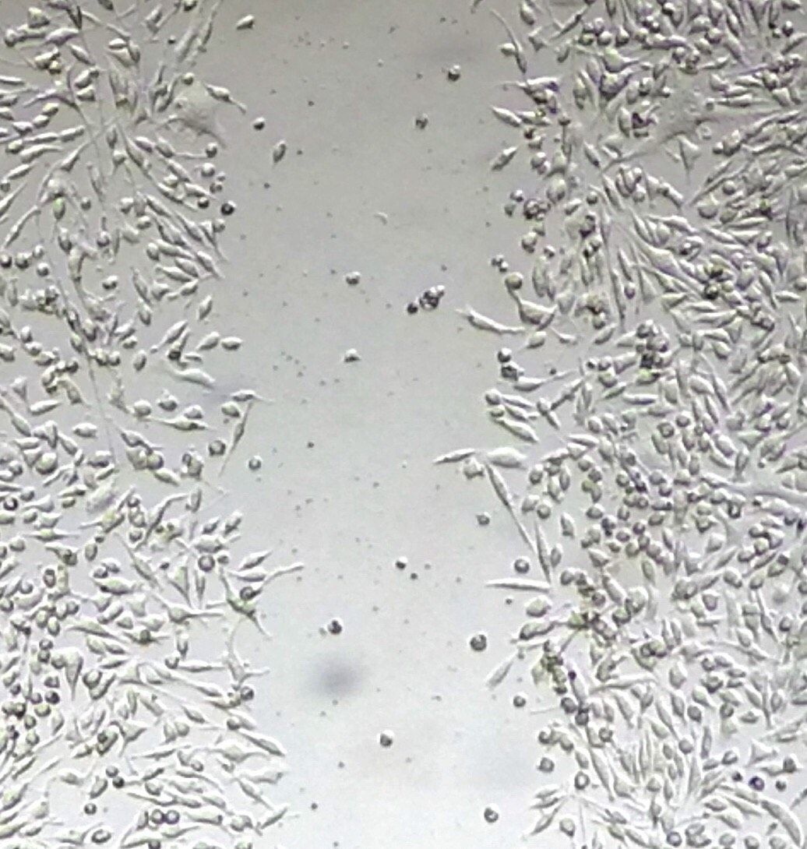
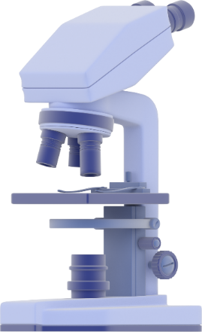
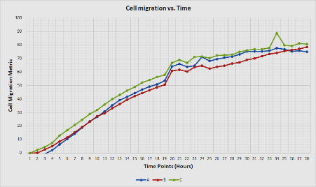
Workflow of the wound healing assay
1. Cell Culture
  Cell seeding
  Confluent monolayer
3. Data Acquisition
  Image capturing
  Gap measurement
  Data collection
2. Scratch Making
Data Analysis

Slide 7
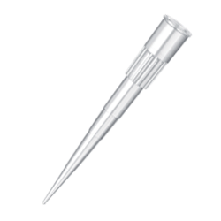
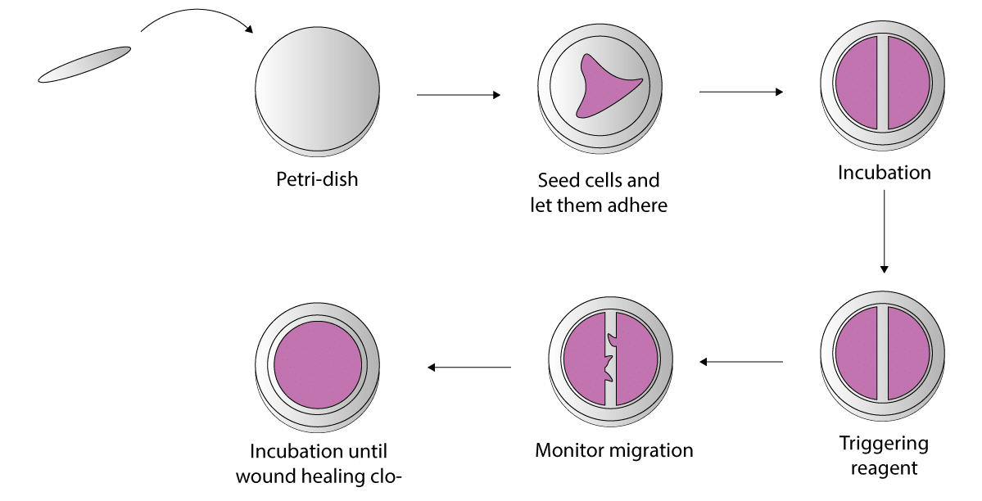
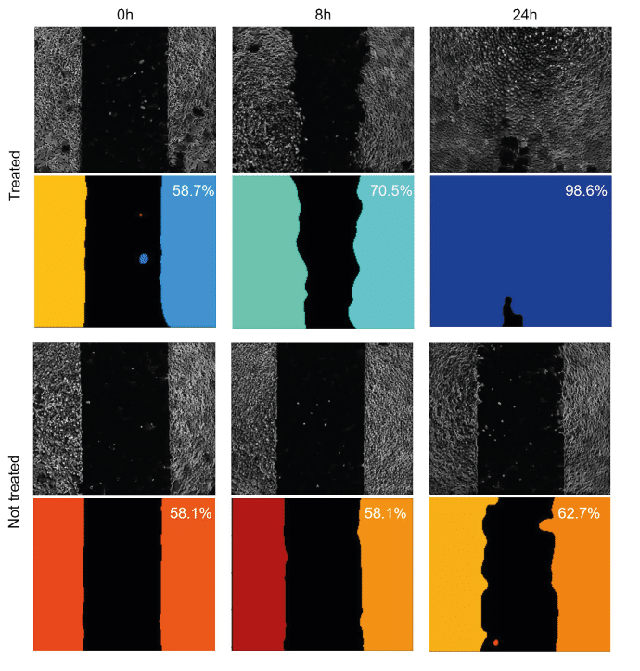
Workflow of the wound healing assay

Slide 8
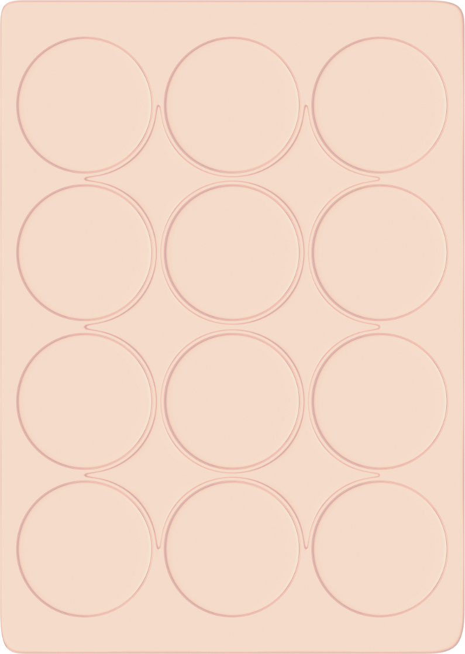
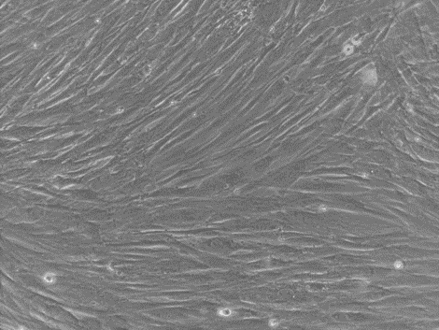
Cell Culture
Triplicates
The first step of the assay is to
culture a confluent cell monolayer.
This monolayer represents the in vivo conditions of the tissue before wounding such as, an intact epithelium.
Sample A
Sample B
Sample C
cell proliferation can be a confounding factor.
Cell proliferation can compete with cell migration to fill the gap made during the assay. If this occurs, the cell medium can be optimized to reduce cell proliferation.
Decreasing the concentration of serum (serum starvation) is the most common change.
Seed your cells in multi-well plates and incubate until they form near-confluent monolayers

Slide 9
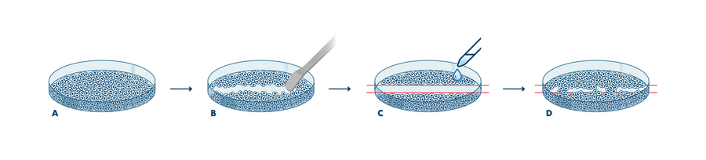
Scratch-making
After the cells have become confluent, the next step is to make a cell-free gap in the monolayer. The most frequently used method is to wound the monolayer by mechanical scratching (scratch wound) or stamping.
Drawbacks with the manual method of wounding include low throughput and well-to-well variation of the gap width.

Slide 10
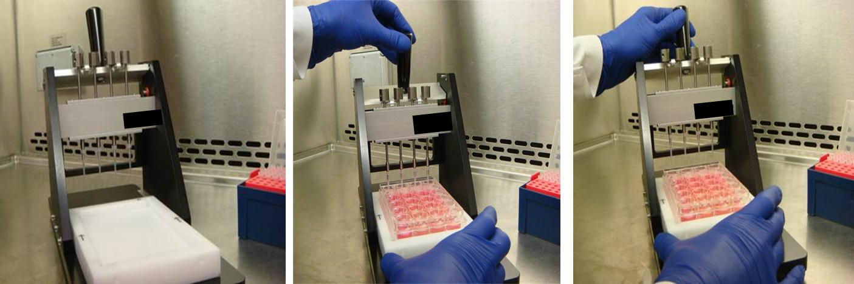
Scratch-making
This reproducibility can be improved with the use of commercial tools for making uniform gaps. Modifications to the wound healing assay that make use of automation can increase both throughput and improve reproducibility.
Ensuring reproducibility is important for the following data acquisition step.
To enhance reproducibility, a scratch-making device creates identical linear scratches in all wells.

Slide 11
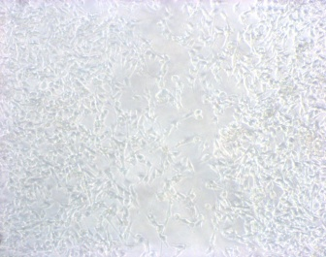
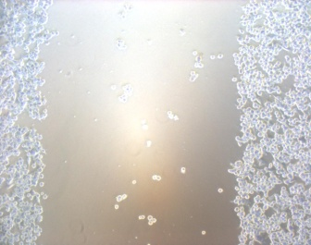
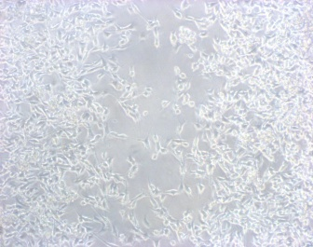
Migration
(Wound Healing Migration Assay)
CONTROL
TIME 0
Time 48 Hrs
*
Notes:
11

Slide 12
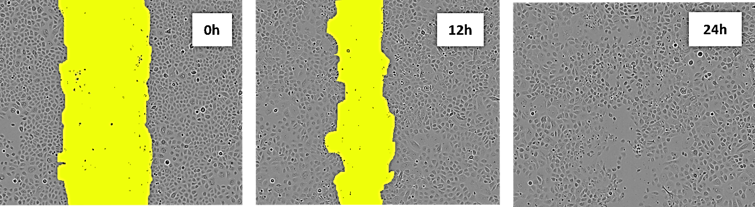
Data acquisition – scratch images for time-lapse
With a cell-free gap prepared, optical microscopy can be used to observe cells migrating into the wound area.
Cell migration is best viewed using phase-contrast imaging rather than fluorescence,
Collective migration of human skin cells in vitro. Example of images captured during a wound healing experiment. Keratinocyte monolayers were scraped with a pipette tip and images were taken at 0, 12, and 24 h using time-lapse photography as the cells repopulate the scratch area “wound” in the center.
The yellow color indicates the scratch area

Slide 13
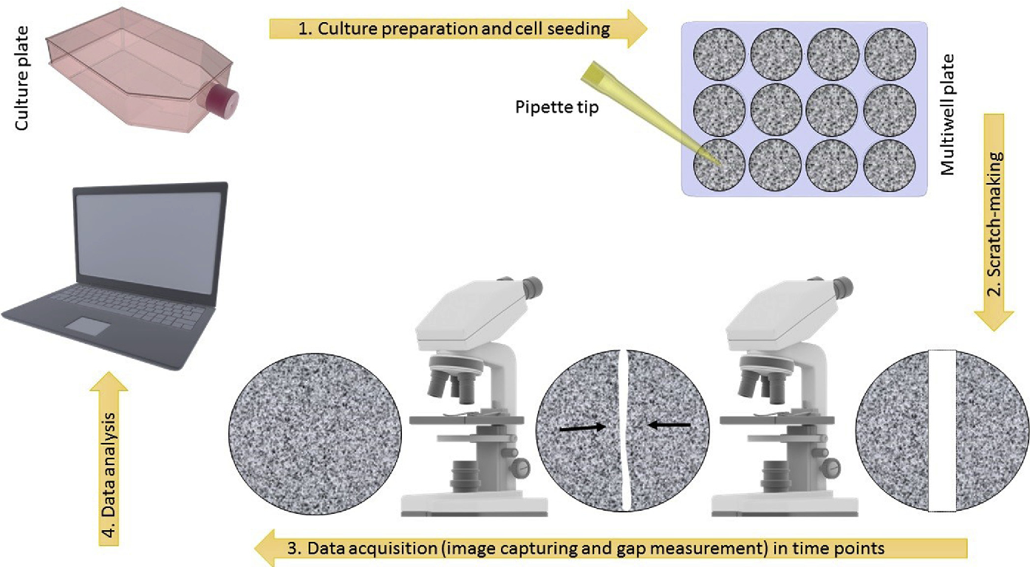
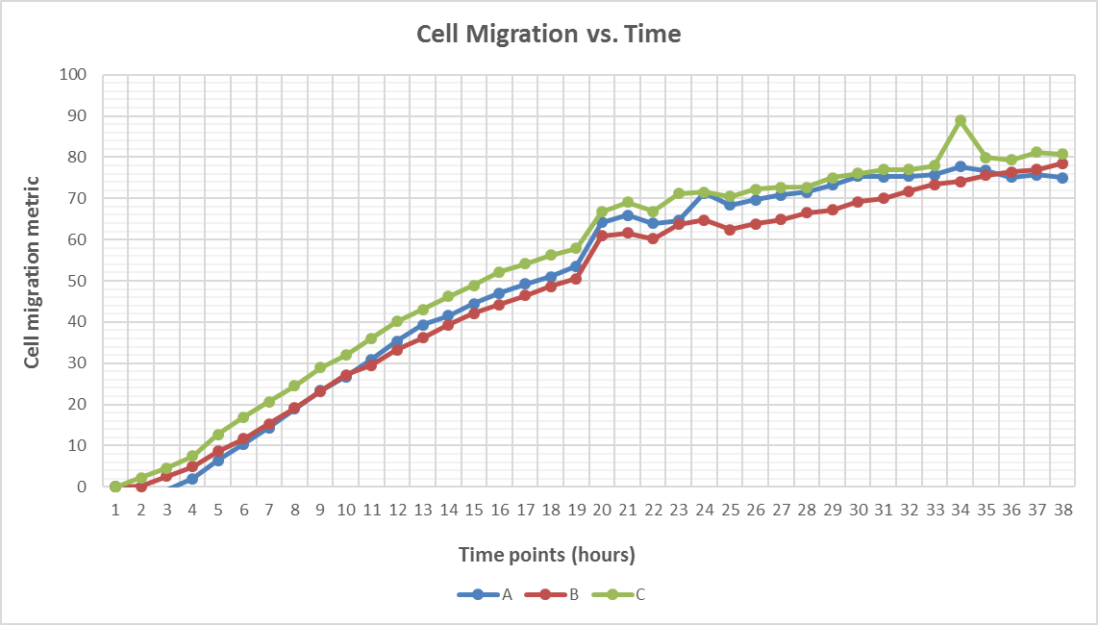
Data acquisition – scratch images for time-lapse
A series of time-lapse images (snapshot method) can be acquired as cells migrate into the cell-free gap.
These time points should be collected within 24 hours of the experiment being started to minimize the confounding effects of cell replication on gap closure.

Slide 14
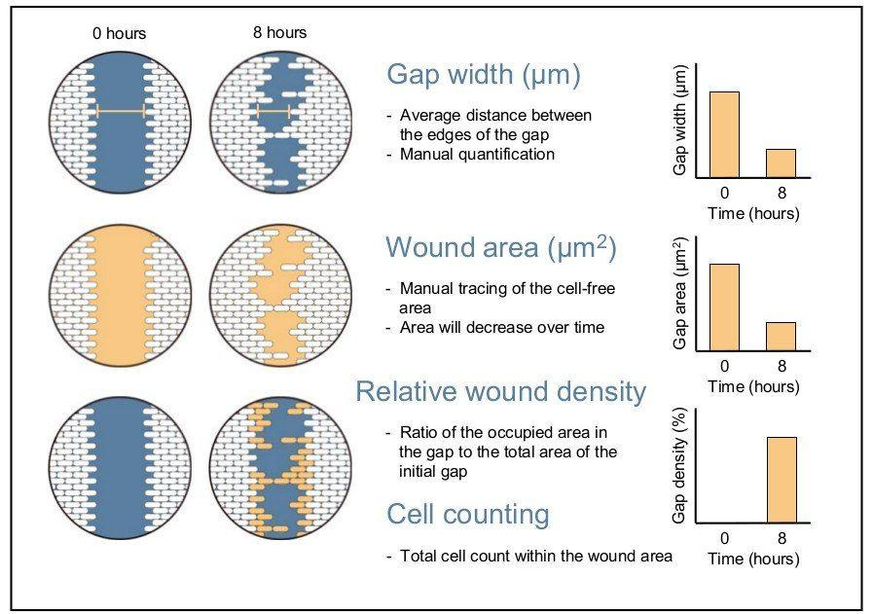
Data Analysis
Once images of the gap closing have been acquired, several methods of analysis can be used to quantify the rate of cell migration.
The first method measures the change in the wound width
The second method calculates the change in wound area over time as a percentage of wound closure.
The final method measures the relative wound density over time expressed as a percentage

Slide 15
Applications
Qualitative and Quantitative analysis of collective cell migration under different experimental conditions.
Studying the effects of cell-matrix and cell-cell interactions on cell migration.
High-throughput platforms for genes involved in cancer cell migration, small molecule screening and drug discovery.

Slide 16
Advantages
Relatively inexpensive and easy to perform
Can visually observe cell movement and morphology throughout the experiment
Testing conditions can be easily adjusted for different purposes
Creates a strong directional migratory response
Ability to coat assay surface with an appropriate extracellular matrix (ECM)
Suitable for endpoint and kinetic assays and amenable to high throughput screening platforms

Slide 17
Limitations
May not be suitable for studying specialized primary cells since a relatively large number of cells is required for the assay (performed in a tissue culture dish)
Not suitable for chemotaxis studies or for non-adherent cells
Lack of standardization in its application makes it difficult to reproduce experiments, especially when using manual scratching
Scratching introduces mechanical injury to the cells, leading to release of cellular contents into the surroundings and potentially influencing the migration process
Cell proliferation may confound the measurement of migration. Therefore, suppression of proliferation is a necessary intervention.

Slide 18
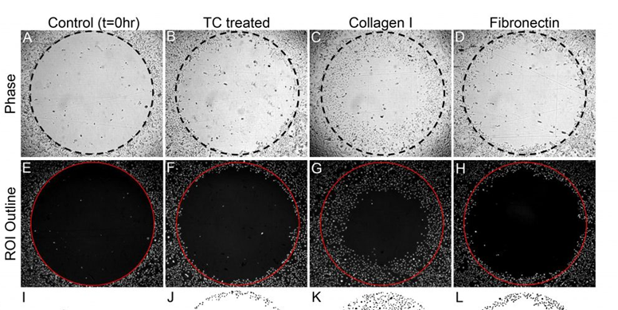
Cell exclusion zone assay
A possibility to circumvent the problem of cell remnants is to create cell exclusion zones at the time of cell seeding with e.g. microstencils
These stoppers are positioned prior to seeding of the cells and create an exclusion zone with the tip of the stopper

Slide 19
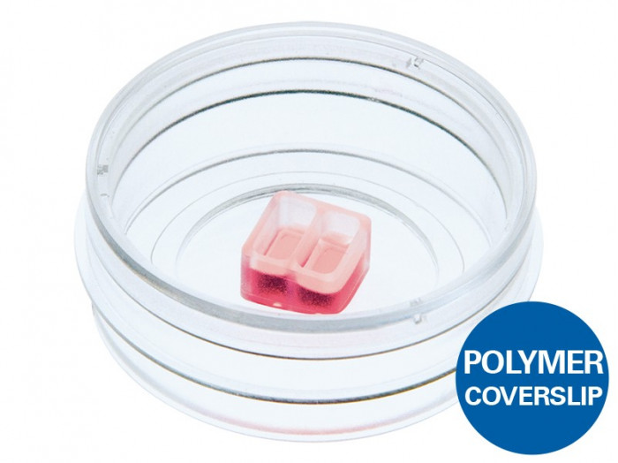
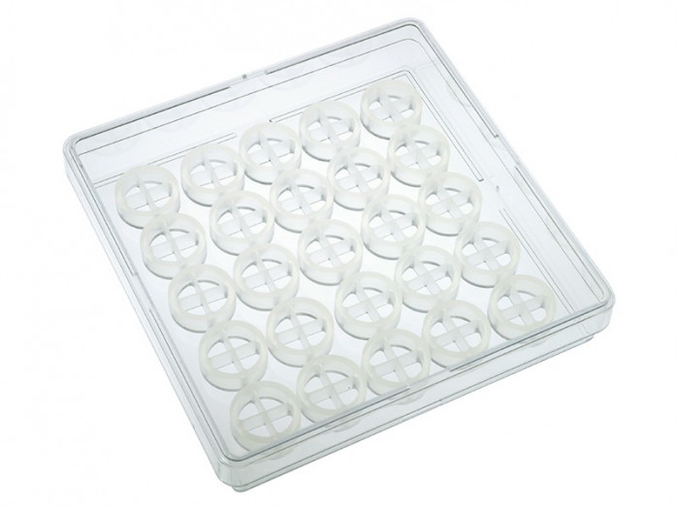
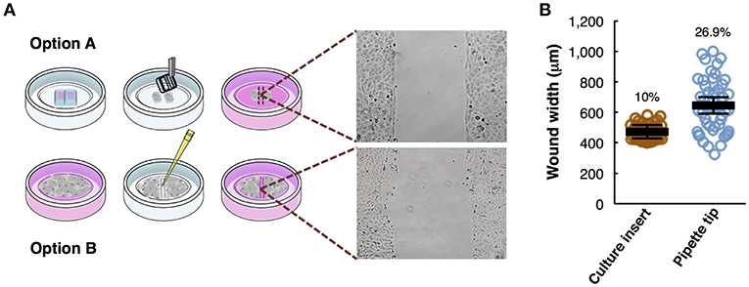
Video Wound healing
TEC_CELL_02_Cell Migration_IBI_Wound

Slide 20
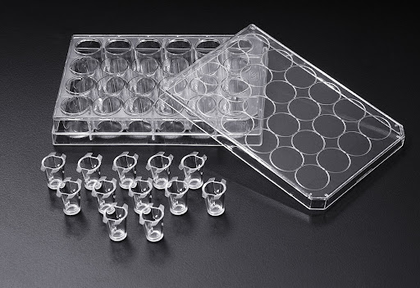
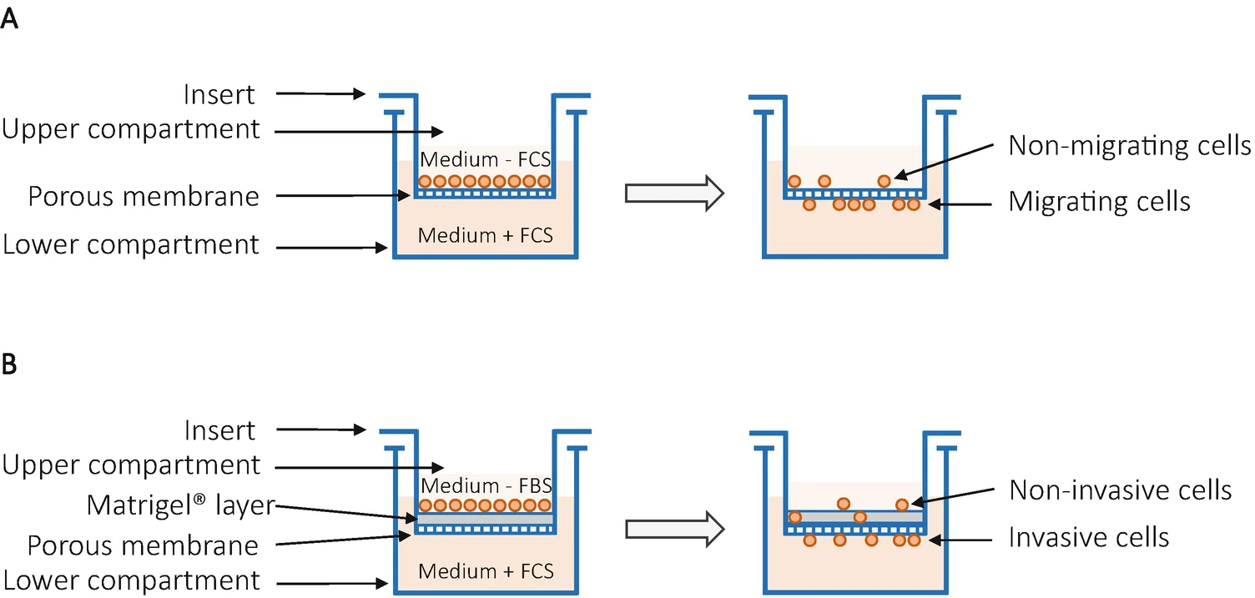
Transwell migration assay (Boyden chamber assay)
The transwell assay was originally introduced by Boyden (and is therefore often called Boyden chamber assay) to analyze the chemotactic responses of leukocytes.
Improved, simplified and disposable versions of the original chambers were developed.

Slide 21
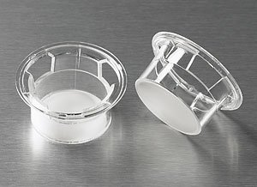
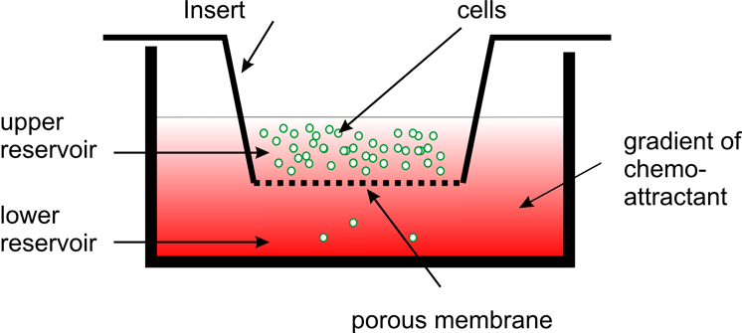
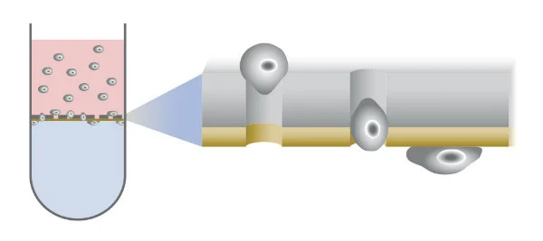
The principle of this assay is based on two medium containing chambers separated by a porous membrane through which cells transmigrate.
The size of the cells to be analyzed, determines the required pore size of the membranes.

Slide 22
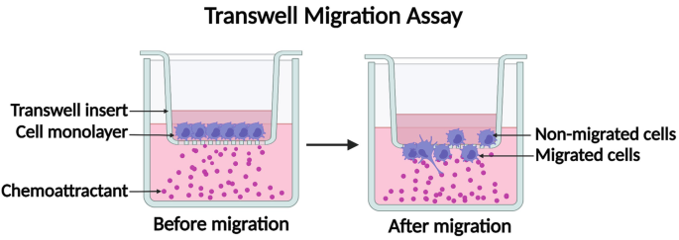
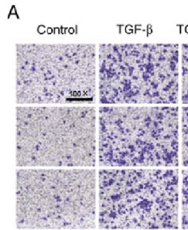
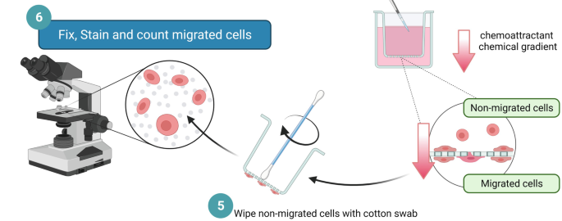
Cells are seeded in medium in the upper part
- migrate in vertical direction through the pores of the membrane into the lower compartment, in which medium containing an attractant or simply higher serum content is present.
Cell are stained and counted

Slide 23
The advantages of the method are:
the broad availability of different cell culture inserts and sizes;
the relative ease of the experimental setup and the – albeit only short – medium or cytokine/chemokine gradient between the upper (cell culture insert) and lower (culture vessel) growth medium.
there are some drawbacks
This method is an endpoint assay
if simple cell staining procedures are used. Non-invaded cells, which stayed on the upper side of the transwell insert, have to be eliminated prior to staining of the invasive cells at the bottom of the membrane.

Slide 24
Migration and invasion are clearly separated terms in experimental cell biology.
Migration is defined as:
the directed movement of cells on a substrate such as basal membranes, ECM fibers or plastic plates.
Therefore, migration is occurring on 2D surfaces without any obstructive fiber network
Invasion is defined as:
cell movement through a 3D matrix, which is accompanied by a
restructuring of the 3D environment.
Invasion requires adhesion, proteolysis of extracellular matrix components and migration, therefore invading cells remodel the ECM.

Slide 25
Transwell invasion assay
The principal technical setup of the transwell invasion assay equals the transwell migration assay.
In addition, the porous filter is overlaid by a thin layer of ECM, before seeding the cells into the top chamber .
The ECM occludes the membrane pores, blocking non-invasive cells from migrating through.
By contrast, invasive cells can degrade the matrix and move through the ECM layer and adhere to the bottom of the filter

Slide 26
Transwell invasion assay
ADESIONE
Le cellule tumorali aderiscono al substrato (Matrigel)
PROTEOLISI
Secrezione di matalloproteasi che idrolizzano il Matrigel

Slide 27
INVASIONE
Superata la barriera del Matrigel le cellule tumorali invadono il compartimento sottostante

Slide 28
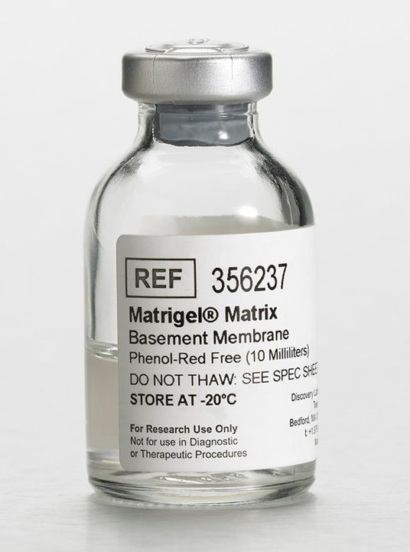
Corning Matrigel matrix is a solubilized basement membrane preparation extracted from the Engelbreth-Holm-Swarm (EHS) mouse sarcoma, a tumor rich in extracellular matrix proteins
The primary components of Matrigel are four major basement-membrane ECM proteins:
laminin (~60%),
collagen IV (~30%),
entactin (~8%)
heparin sulfate proteoglycan perlecan (~2–3%)
Matrigel also contains tumour-derived proteins, including growth factors

Slide 29
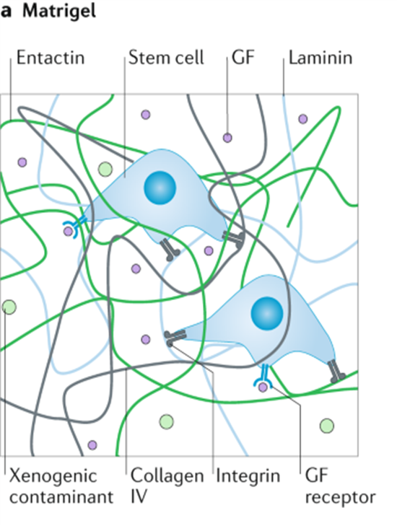
During preparation, the reconstituted form of Matrigel undergoes gelation at temperatures in the range 22–37 °C, during which entactin acts as a crosslinker between the laminin and collagen IV to create a hydrogel — a water-swollen, crosslinked network.
Application
Cell Growth and Differentiation
Metabolism/Toxicology Studies
Invasion Assays
in vitro and in vivo Angiogenesis Assays
in vivo Angiogenesis Studies and Augmentation of Tumors in Immunosuppressed Mice

Slide 30
Matrigel basement membrane matrix
Collagen I
Collagen IV
Fibrinogen
Fibronectin
Laminin
Bovine Serum Albumin (BSA)

Slide 31
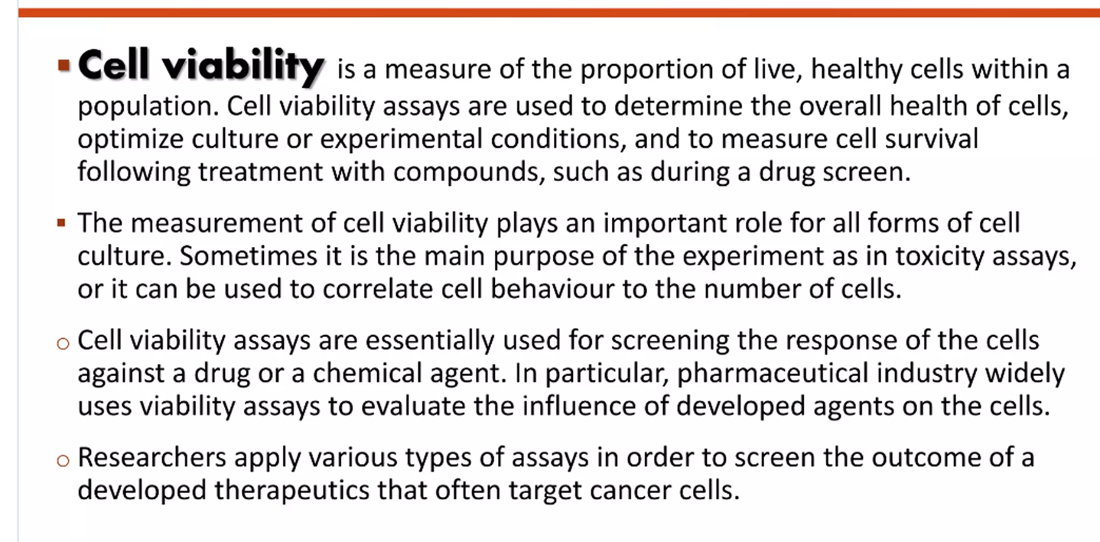

Slide 32
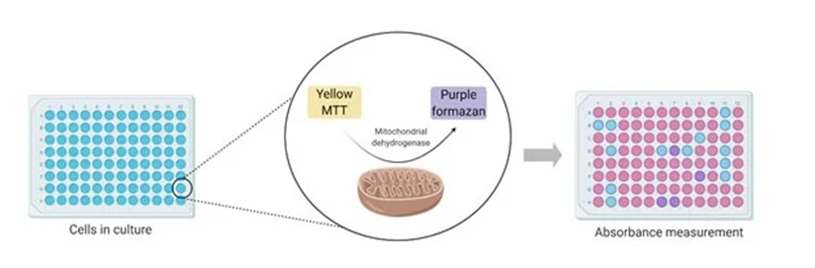
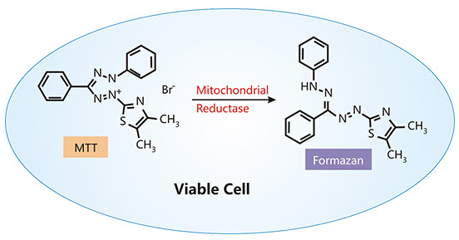
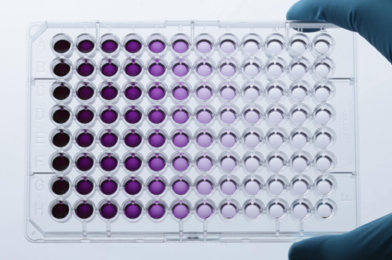
MTT Cell Proliferation Assay
Measurement of cell viability and proliferation forms the basis for numerous in vitro assays of a cell population’s response to external factors
The reduction of tetrazolium salts is now widely accepted as a reliable way to examine cell proliferation.
The yellow tetrazolium MTT (3-(4, 5-dimethylthiazolyl-2)-2, 5-diphenyltetrazolium bromide) is reduced by metabolically active cells
The resulting intracellular purple formazan can be solubilized and quantified by spectrophotometric means.

Slide 33
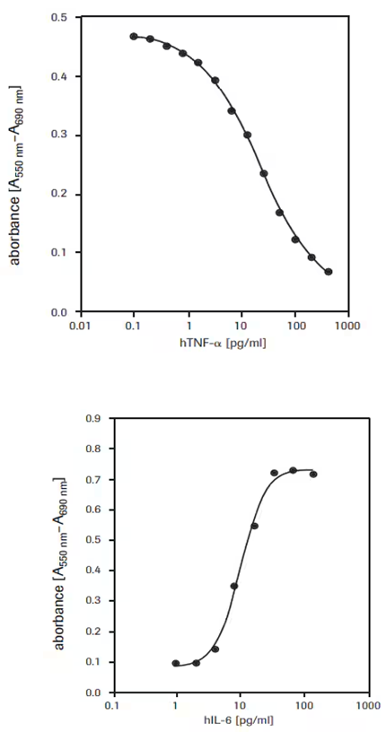
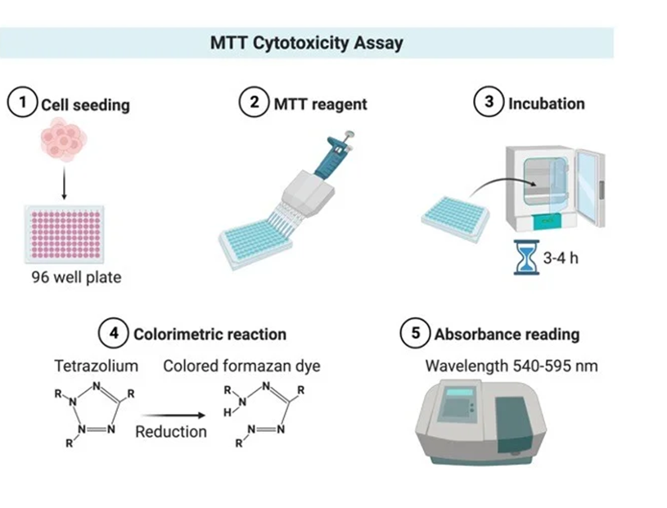
The MTT Cell Proliferation Assay measures the cell proliferation rate and conversely, when metabolic events lead to apoptosis or necrosis, the reduction in cell viability
PER MISURARE LA CITOTOSSICITÀ
PER MISURARE LA CRESCITA CELLULARE

Slide 34
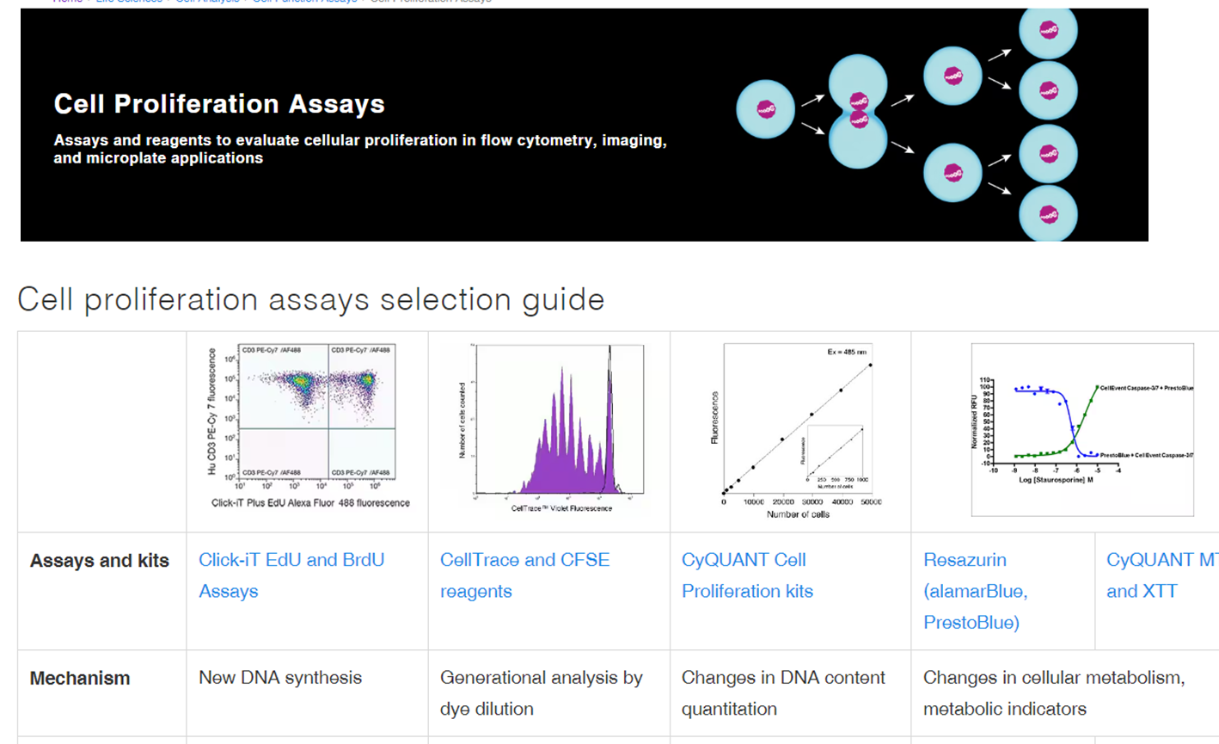
https://www.thermofisher.com/it/en/home/life-science/cell-analysis/cell-viability-and-regulation/cell-proliferation.html

