Slide 1
DATA PROTECTION AND CYBERSECURITY IN eHEALTH SYSTEMS 2

Slide 2
PRIVACY AND CONFIDENTIALITY
Privacy is an important part of confidentiality, especially when it comes to protected health information(PHI).
PHI is defined as individually identifiable health information transmitted or maintained by a covered entity or its business associates in any form or medium (45CFR160.103 [B1]).
The U.S. Health Insurance Portability and Accountability Act (HIPAA) limits the circumstances in which an individual’s PHI may be used or disclosed by covered entities (HHS [B7]).
Similarly, the EU General Data Protection Regulation states that personal data shall be processed lawfully, fairly, and in a transparent manner; collected for specified, explicit, and legitimate purpose; and kept in a form that permits identification of data subjects for no longer than is necessary for the purposes for which the personal data is processed (Official Journal of the EU [B19]).
loss of confidential protected health information (PHI), are not considered “patient harms” but are regulated by national privacy rules (GDPR, HIPAA)
Little excerpt from https://en.wikipedia.org/wiki/Cyberattack

Slide 3
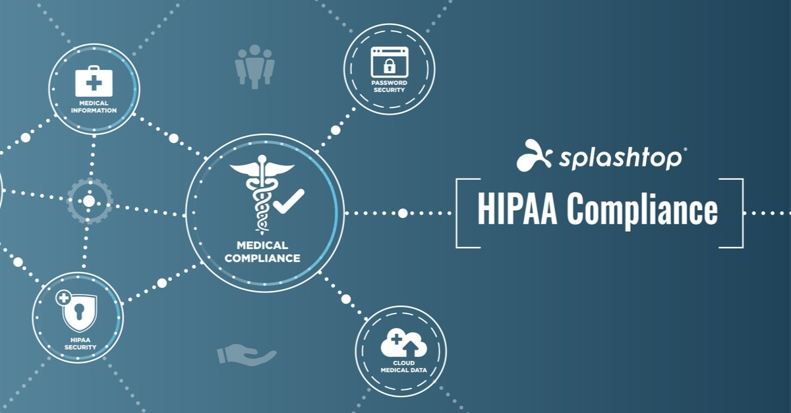
PROTECTION OF DATA

Slide 4
GDPR GOALS

Slide 5
GDPR PERSONAL DATA AND PROCESSING
Processing: operations performed on personal data, including by manual or automated means. It includes the collection, recording, organisation, structuring, storage, adaptation or alteration, retrieval, consultation, use, disclosure by transmission, dissemination or otherwise making available, alignment or combination, restriction, erasure or destruction of personal data.

Slide 6
GDPR: FINES

Slide 7
GDPR: INDIVIDUAL RIGHTS

Slide 8
GDPR: SUBJECTS

Slide 9
GDPR: SUBJECTS

Slide 10
HIPAA Security Rule
Health Insurance Portability and Accountability Act
The HIPAA Security Rule contains the standards that must be applied in order to safeguard and protect electronically created, accessed, processed, or stored PHI (ePHI) when at rest and in transit.
It has three parts:
technical safeguards
physical safeguards
administrative safeguards

Slide 11
HIPAA techincal safeguard

Slide 12
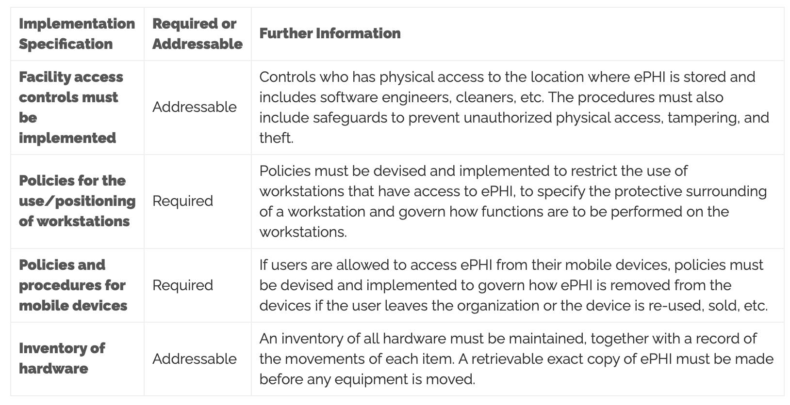
HIPAA physical safeguard

Slide 13
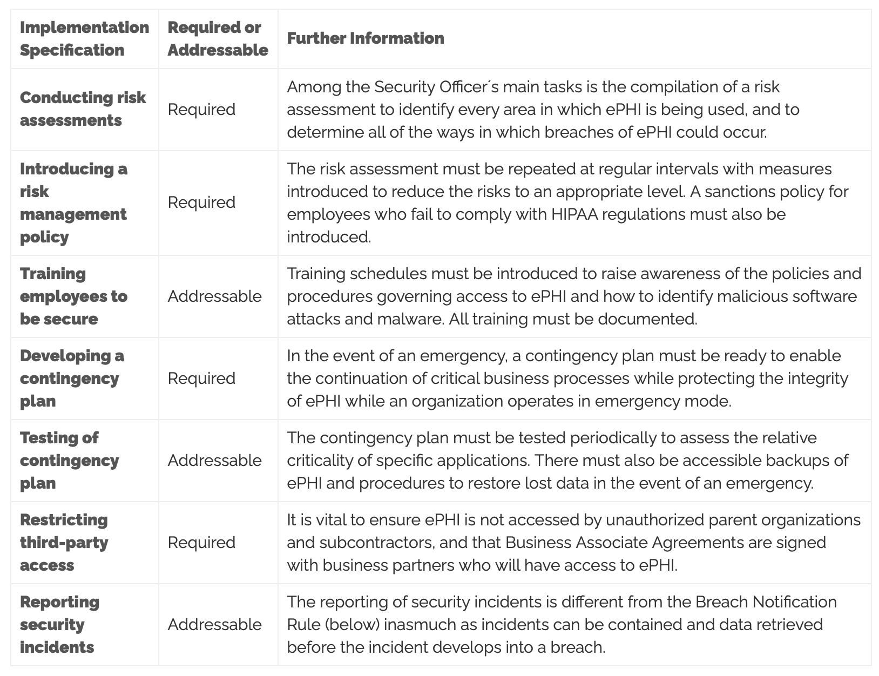
HIPAA administrative safeguard

Slide 14
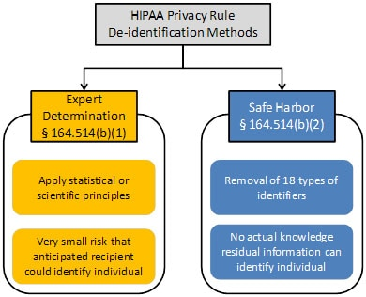
HIPAA de-identification
EXPERT DETERMINATION + SAFE HARBOR

Slide 15
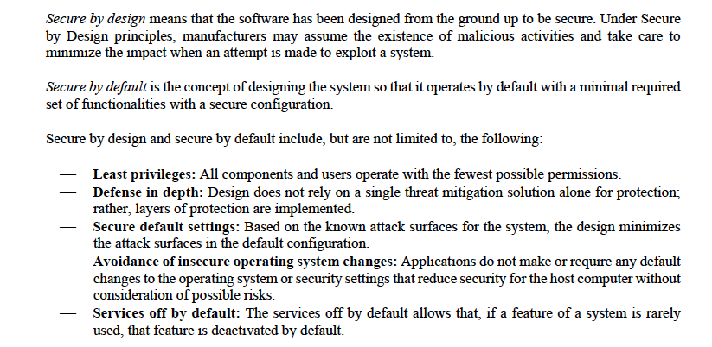
Secure by design and secure by default

Slide 16
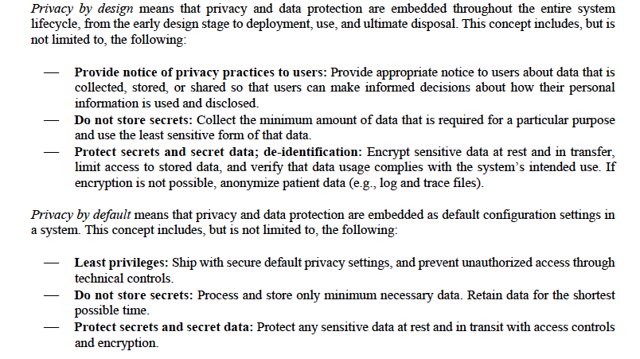
Privacy by design and privacy by default

Slide 17
Cybersecurity measures: detect, respond, and recover
Appropriate design should anticipate the need to detect and respond to dynamic cybersecurity risks, including the need for deployment of cybersecurity routine updates and patches as well as emergency workarounds
Detect:
Routine security and antivirus scanning
Tracking and control of software updates
Respond:
User notification of cybersecurity risk detection
Architecture to rapid deploy of patches and updates
Recover:
Implement features to protect critical functionality
Recovery of device configuration by authorized user

Slide 18
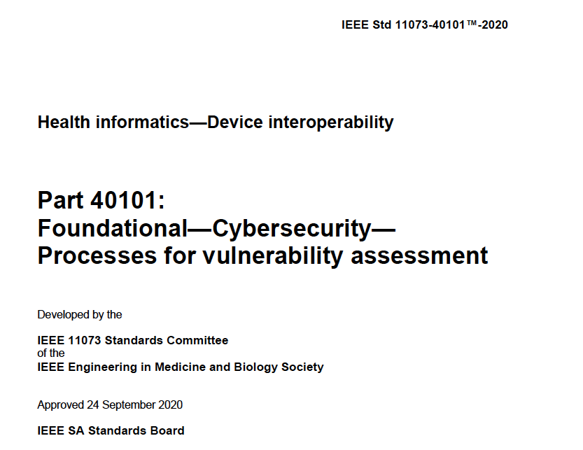
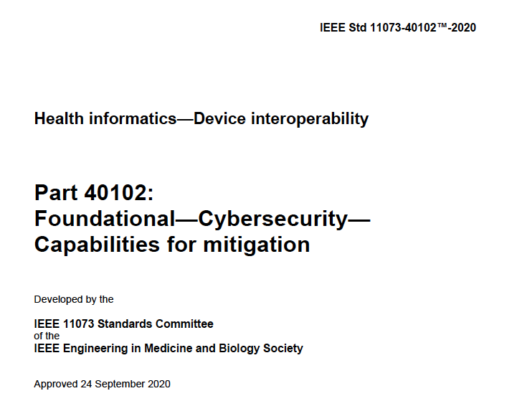
Approach to cybersecurity assessment
Family of standards devoted to point-of-care/personal complex eHealth devices/systems requiring interoperability

Slide 19
Cybersecurity risk assesment
Identification of assets, threats, and vulnerabilities
Assessment of the impact of threats and vulnerabilities on device functionality and end users/patients;
Assessment of the likelihood of a threat and of a vulnerability being exploited
Determination of risk levels and suitable mitigation strategies;
Assessment of residual risk and risk acceptance criteria

Slide 20
Identification of threats step 1. System Modeling
Formal process and system modeling helps identifying threats and vulnerabilities
Multiple techniques:
UML
Data flow diagrams (DFDs)

Slide 21
Data flow diagram
DFDs are a way to represent the entities involved with the functioning of the medical device, how those entities are related, and the assumed trust boundaries between them.

Slide 22
Example: definition of the system and use cases

Slide 23
Example: core technology

Slide 24
Example: AMPS device

Slide 25
Example: patient app

Slide 26
Example: cloud service

Slide 27
Example: high-level diagram

Slide 28
Example: detailed DFD

Slide 29
Trust boundaries
Trust boundaries do not physically reside in a given organization’s system, but instead represent ideas and assumptions being made by the threat modeling team about how different entities interact.
Trust boundaries help in later stages of the threat modeling process by identifying areas that require enhanced investigation.
Trust boundaries help capture the thought process of the threat modeling team and can be used to help convey that information to external reviewers.

Slide 30
Example: Trust boundaries

Slide 31
Example: Trust boundaries within a device

Slide 32
Identification of threats step 2. threat identification
There are several techniques:
STRIDE (Spoofing, Tampering, Repudiation, Information disclosure, Denial of service, Elevation of privilege)
Attack trees
Kill Chains and Cyber Attack Lifecycles
ATT&CK Framework

Slide 33
STRIDE
STRIDE is a mnemonic that articulates six types of potential threats against a system.

Slide 34
STRIDE per ELEMENT
STRIDE can be applied to the DFD elements or dataflow (“STRIDE per Element” approach).
This method is developed by analyzing which STRIDE threats tend to appear for individual DFD element types.
This approach creates a mapping where for a particular DFD element, there will be a list of STRIDE threats commonly associated with it.

Slide 35
STRIDE per application

Slide 36
Example: STRIDE per application

Slide 37
Attack trees
Top-down approach: starts from the threat

Slide 38
Attack trees
Bottom-up approach: starts from the damage

Slide 39
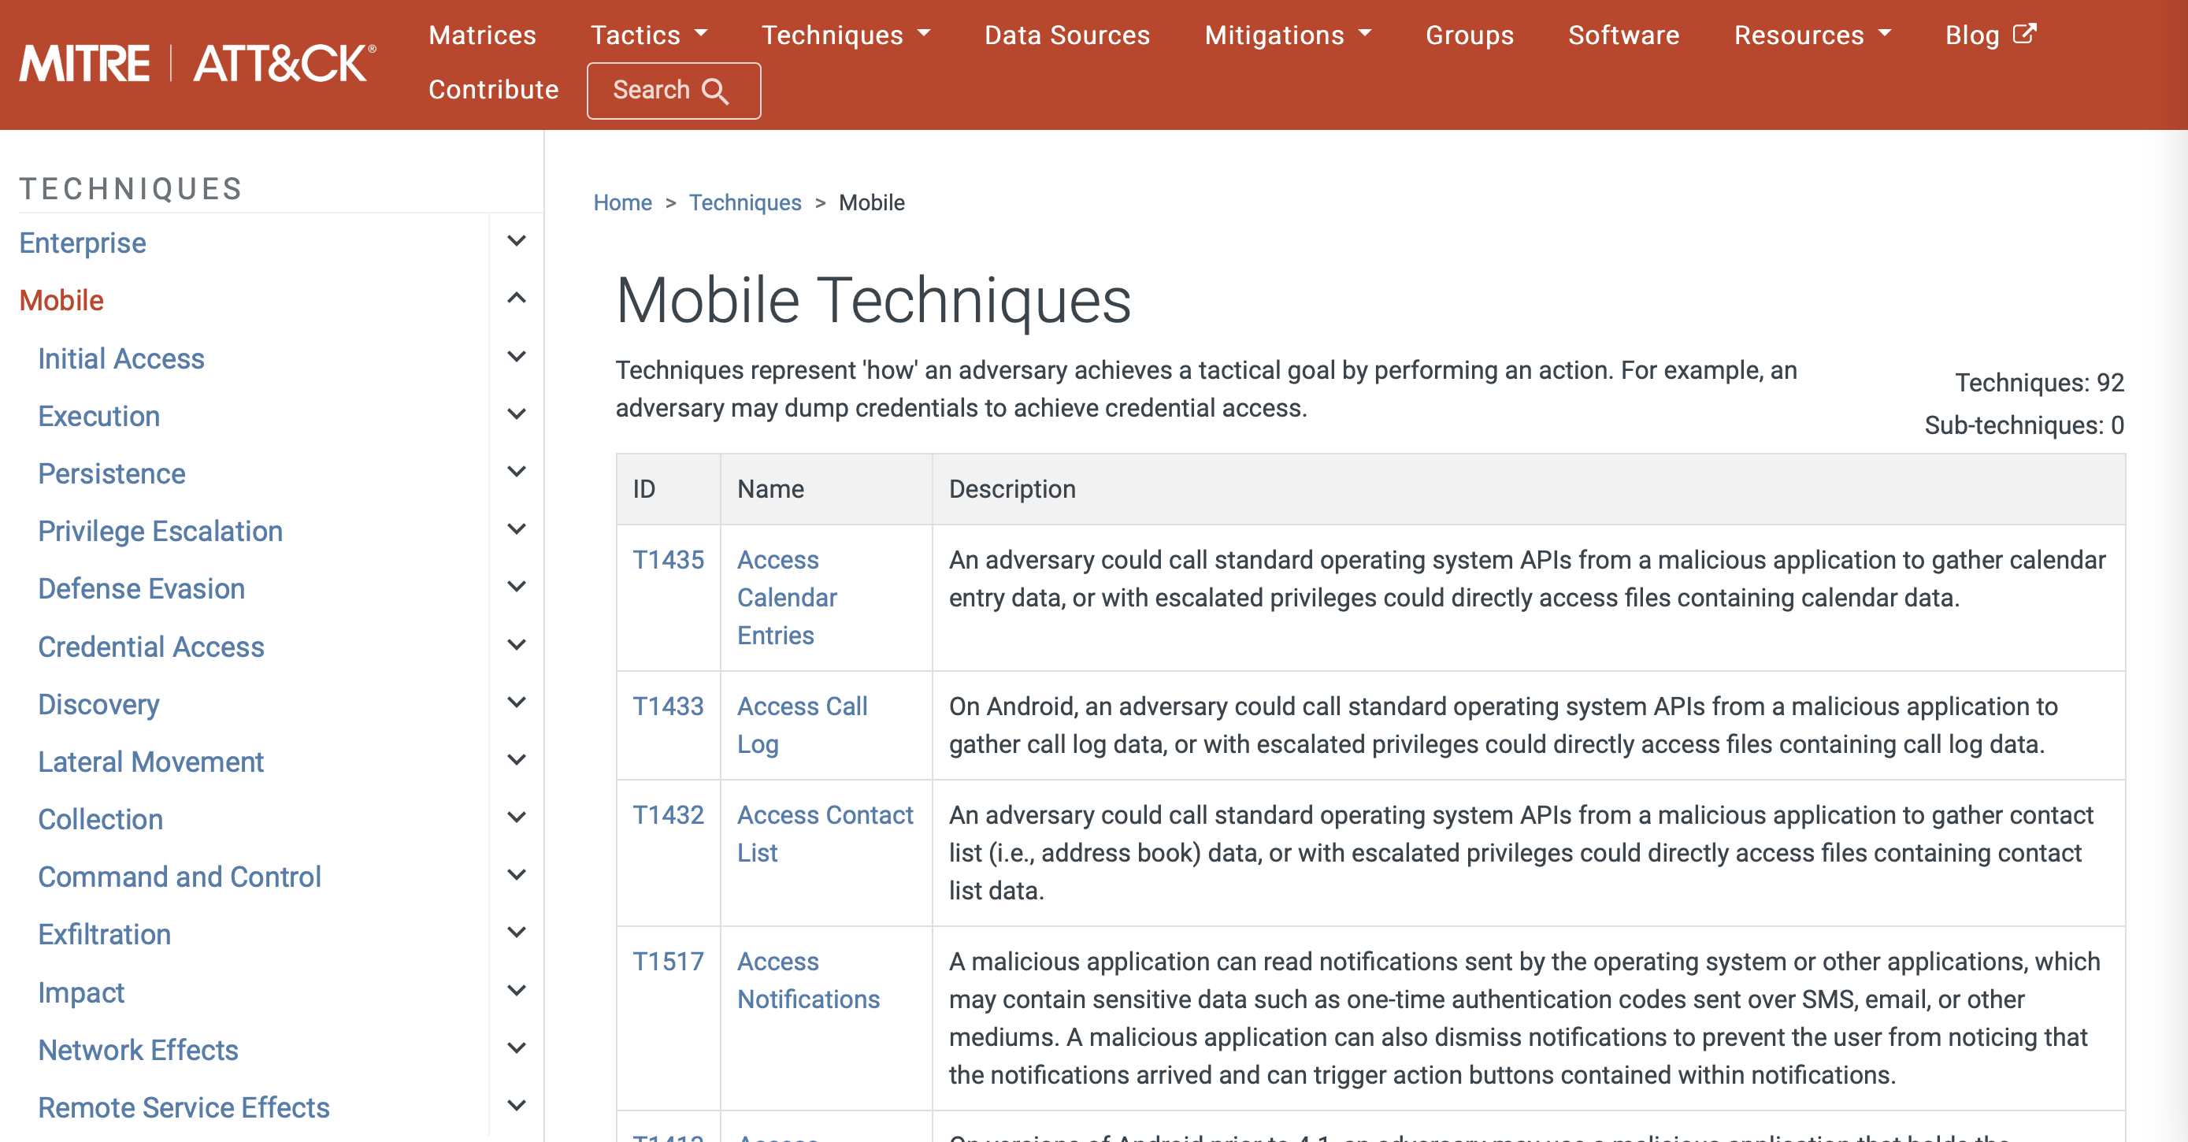
ATT&CK framework
ATT&CK is a public repository and framework for capturing and describing what attackers have done based on real-world data (https://attack.mitre.org)

Slide 40
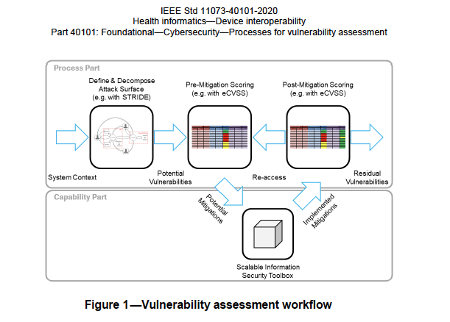
Scoring

Slide 41
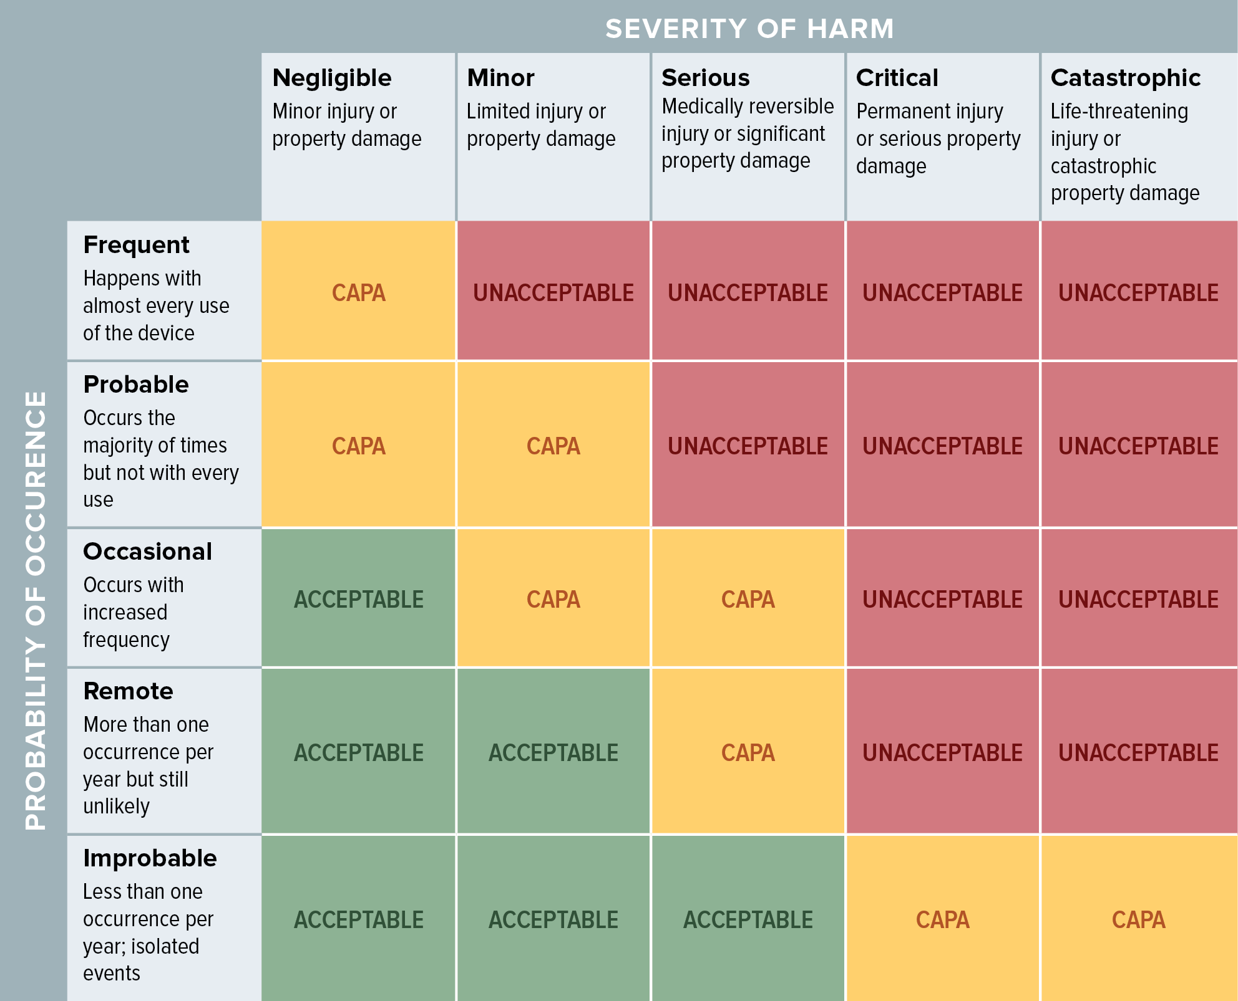
Assessment of impact and likelihood

Slide 42
embedded Common vulnerability Scoring System –eCVSS
The assessment has to be done before and after mitigation measures are put in place
Even in the case of security/privacy by design the mitigation measures are not considered in the first assessment
Two-level assessment:
System-wide level (system-wide metric): Represents the system requirements for a confidentiality, integrity, and availability (CIA) triad that are set once for the product and then applied to all vulnerabilities
Vulnerability level
base metric: intrinsic and fundamental characteristics of a vulnerability that are constant over time and user environments.
environmental metric: the characteristics of a vulnerability that are relevant and unique to a particular user’s environment.

Slide 43
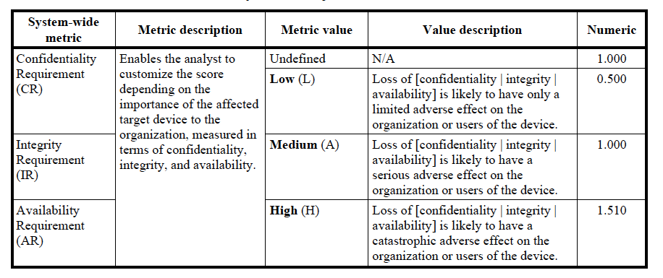
eCVSS system wide metric

Slide 44
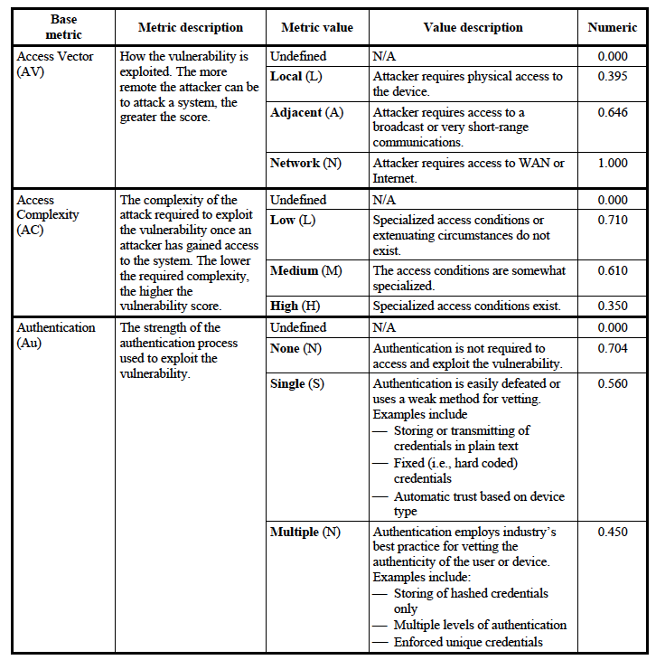
eCVSS Base metric 1

Slide 45
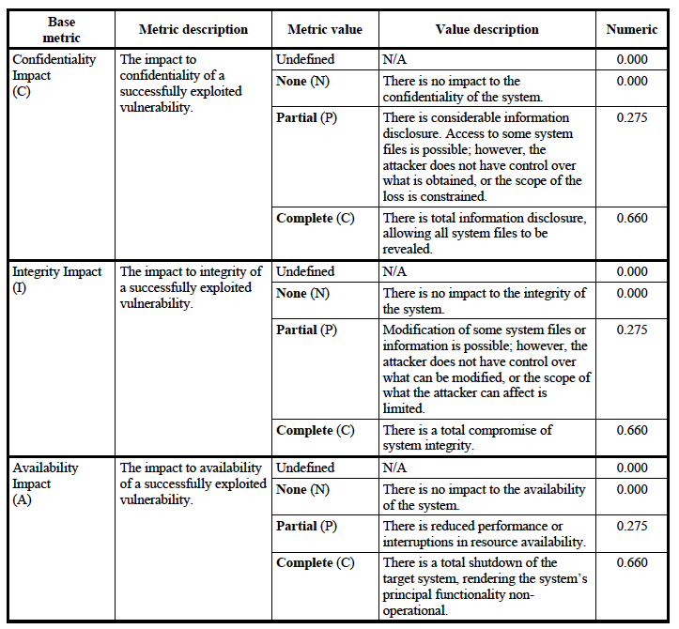
eCVSS Base metric 2

Slide 46
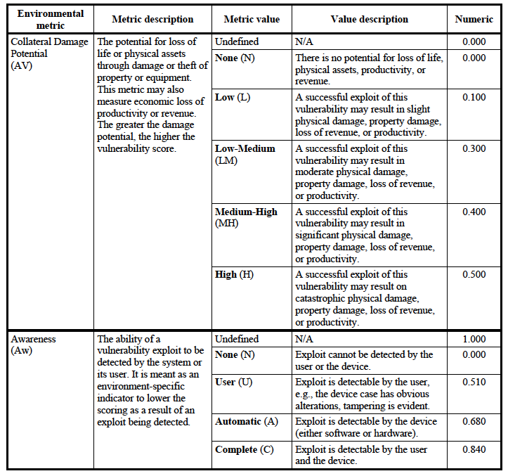
eCVSS Environmental metric

Slide 47
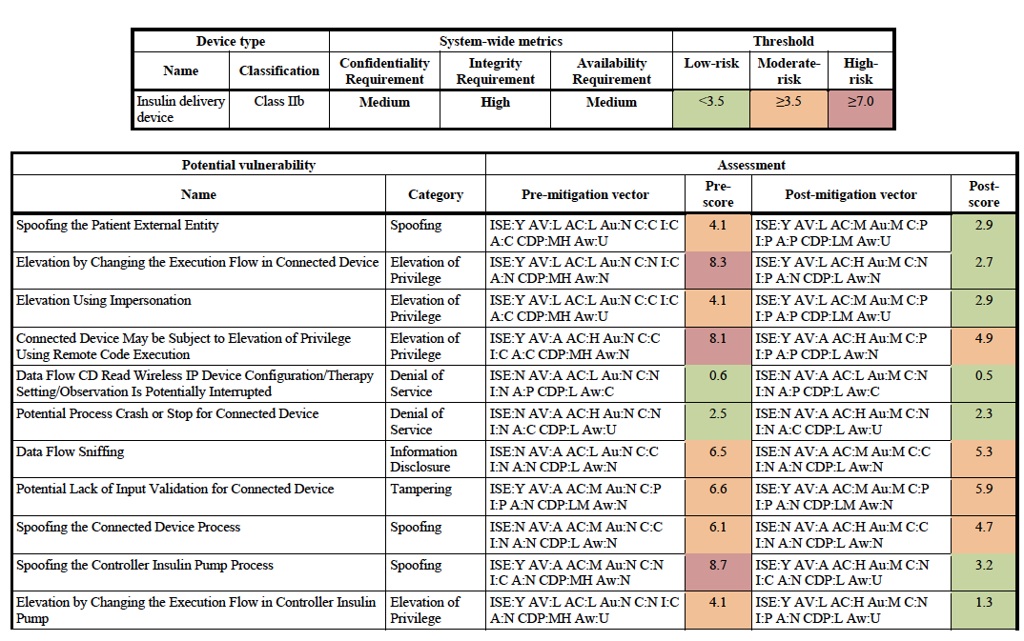
eCVSS example

Slide 48
Mitigation measures
There are four main strategies for addressing threats:
Eliminate
Mitigate
Accept
Transfer
Major mitigation measures:
Protect
Detect
Respond
Recover

Slide 49
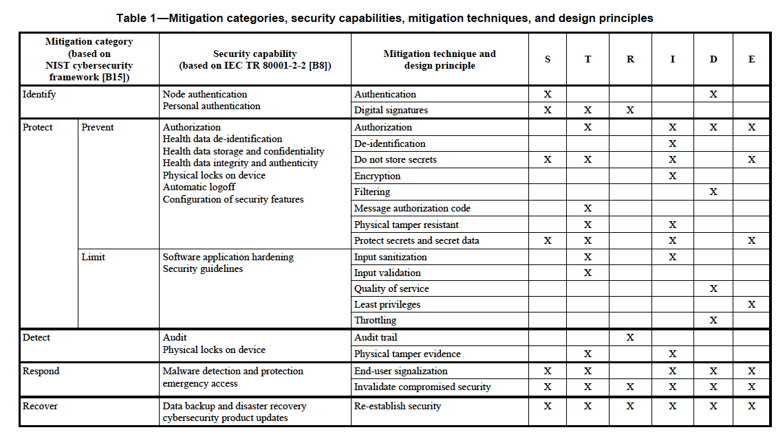
Mitigation measures
IEEE 11073 - 40102

Slide 50
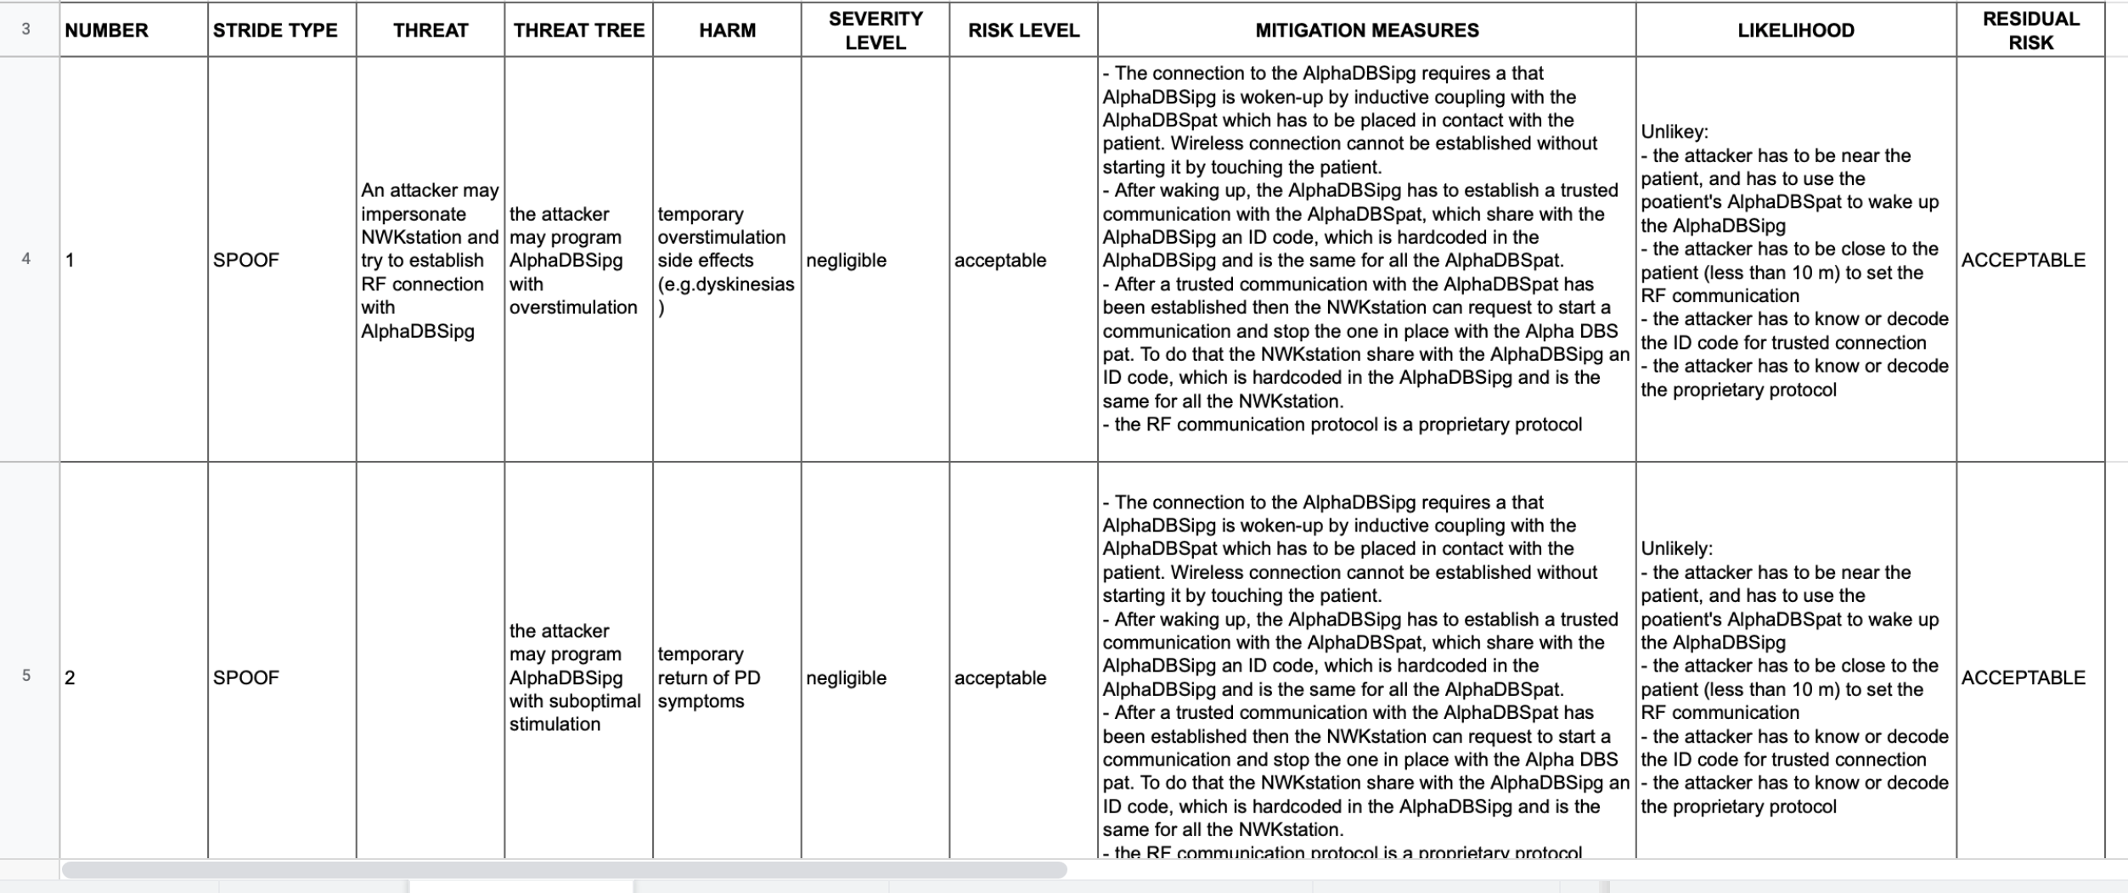
Cybersecurity risk assessment matrix

Slide 51
Traceability matrix
Traceability among requirements, specifications, identified hazards and mitigations, and Verification and Validation testing.
Mitigation measure | System requirement | Test case | Test execution | Test result | Issues

