Slide 1
Bioluminescence, fluorescence and fluorescent proteins

Slide 2
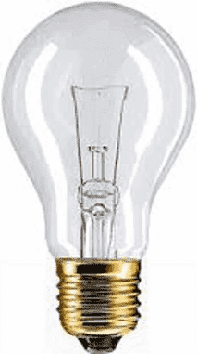
Incandescence, which is light generated by high temperatures.
Luminescence
Emission of light
without heat

Slide 3
Diversi tipi di LUMINESCENZA
TIPO
CHEMILUMINESCENZA
BIOLUMINESCENZA
FOTOLUMINESCENZA
(fluorescenza, fosforescenza)
ELETTROLUMINESCENZA
RADIOLUMINESCENZA
CAUSA
Reazione chimica
Reazione enzimatica
Assorbimento luce UV-vis
Corrente elettrica in gas ionizzato
Materiale radioattivo incorporato nel “fosforo”

Slide 4
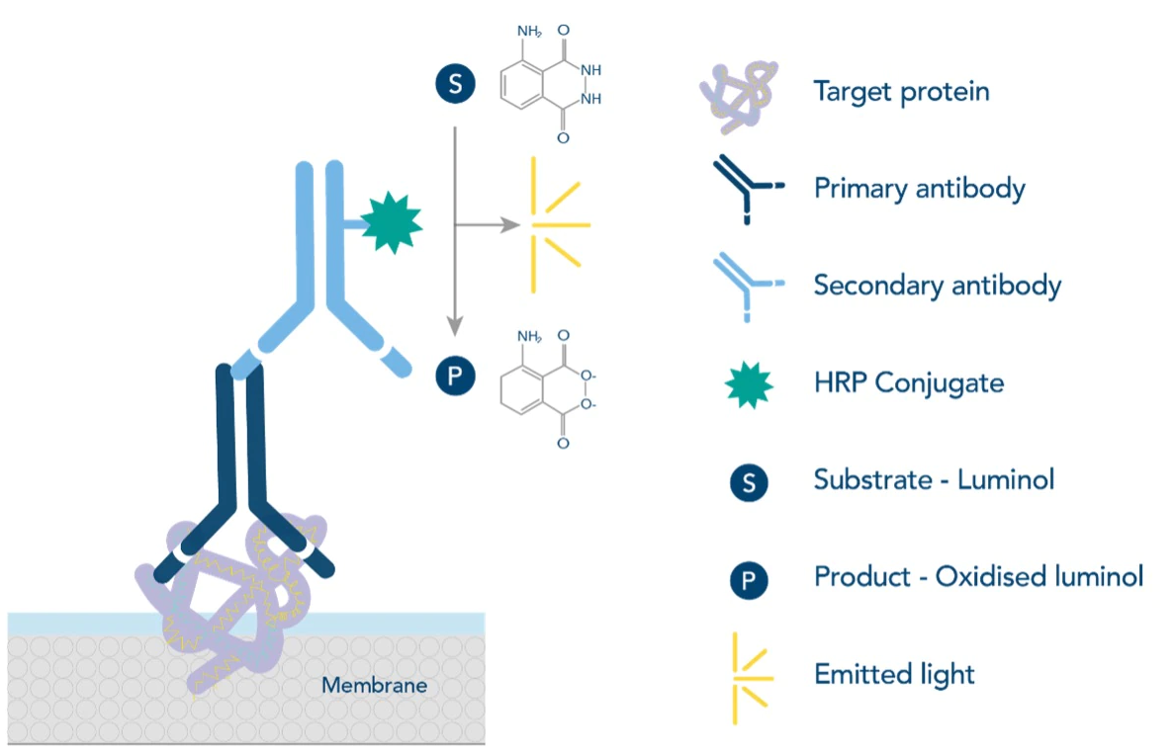
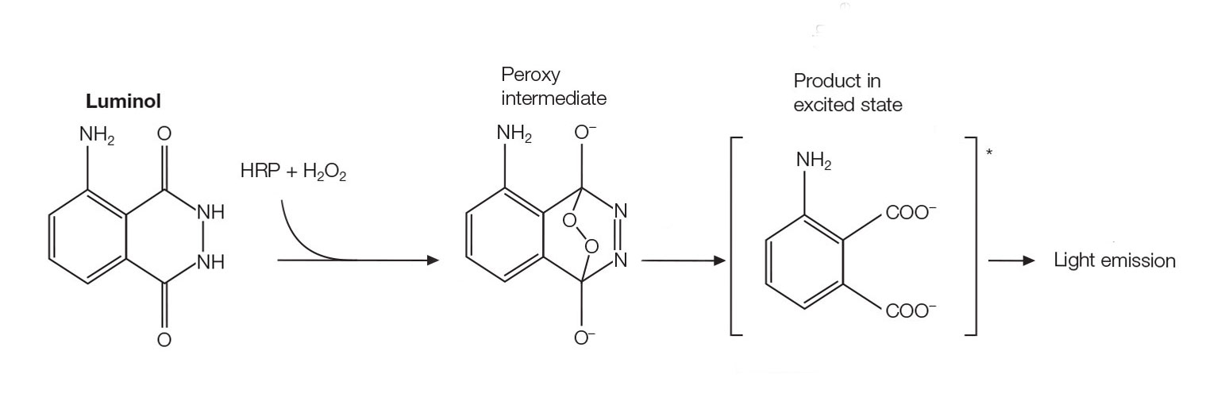
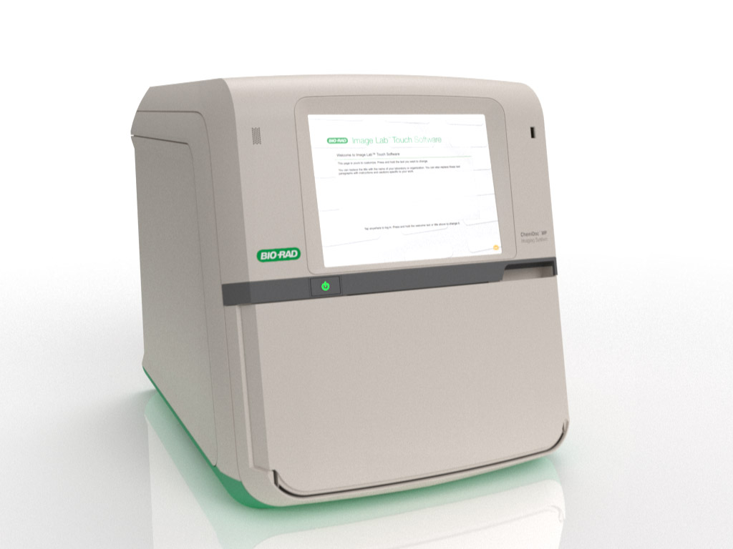
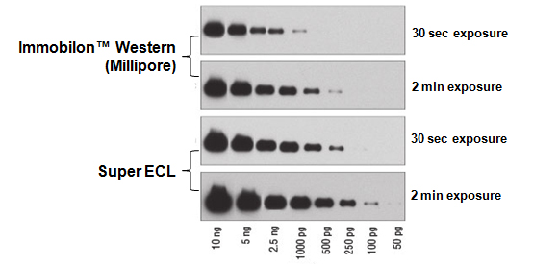
Diversi tipi di LUMINESCENZA
Reazione chimica
CHEMILUMINESCENZA

Slide 5
Diversi tipi di LUMINESCENZA
TIPO
CHEMILUMINESCENZA
BIOLUMINESCENZA
FOTOLUMINESCENZA
(fluorescenza, fosforescenza)
ELETTROLUMINESCENZA
RADIOLUMINESCENZA
CAUSA
Reazione chimica
Reazione enzimatica
Assorbimento luce UV-vis
Corrente elettrica in gas ionizzato
Materiale radioattivo incorporato nel “fosforo”

Slide 6
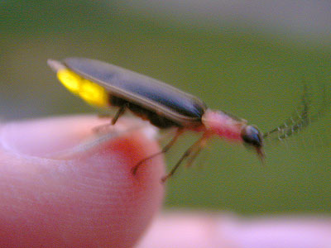
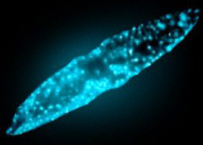
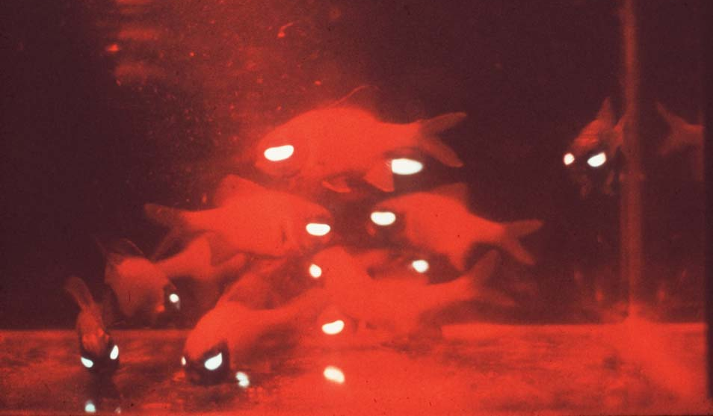
Luminescence
Bioluminescence
Makes its own light
Fireflies!
Dinoflagellates
Flashlight fish
Notes:
One form of luminescence that most divers are familiar with is bioluminescence. This is when animals or plants have chemicals that they can mix together to make light. The source of energy for the light emission is the chemical reaction. An example of this is fireflies – they are able to glow on their own without us having to do anything.
Just about every diver who has dived at night knows that if you turn out your light and shake your body you will see small glowing sparks in the water. This comes from bioluminescence in dinoflagellates, single-celled organisms in the water column. Most people have the terminology confused, and when we talk about fluorescence many divers say that they have already seen it, but they are really confusing it with bioluminescence. You have never seen any corals light up on their own, because they are not bioluminescent, but many are fluorescent.

Slide 7
Diversi tipi di LUMINESCENZA
TIPO
CHEMILUMINESCENZA
BIOLUMINESCENZA
FOTOLUMINESCENZA
(fluorescenza, fosforescenza)
ELETTROLUMINESCENZA
RADIOLUMINESCENZA
CAUSA
Reazione chimica
Reazione enzimatica
Assorbimento luce UV-vis
Corrente elettrica in gas ionizzato
Materiale radioattivo incorporato nel “fosforo”

Slide 8
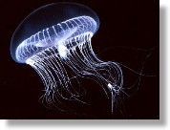
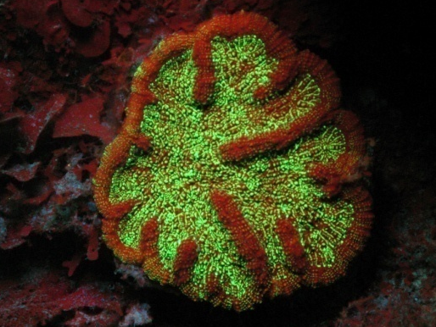
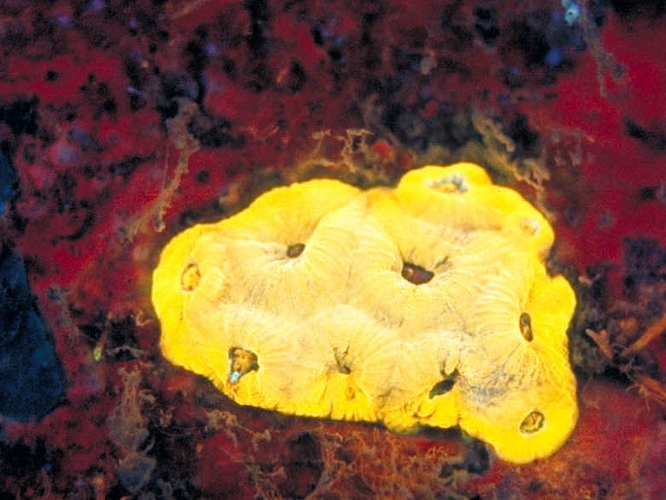
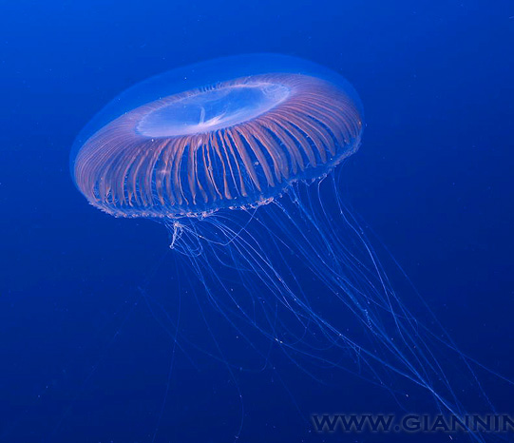
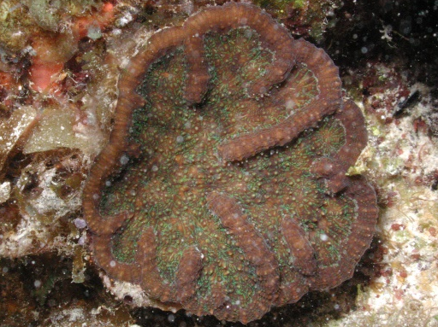
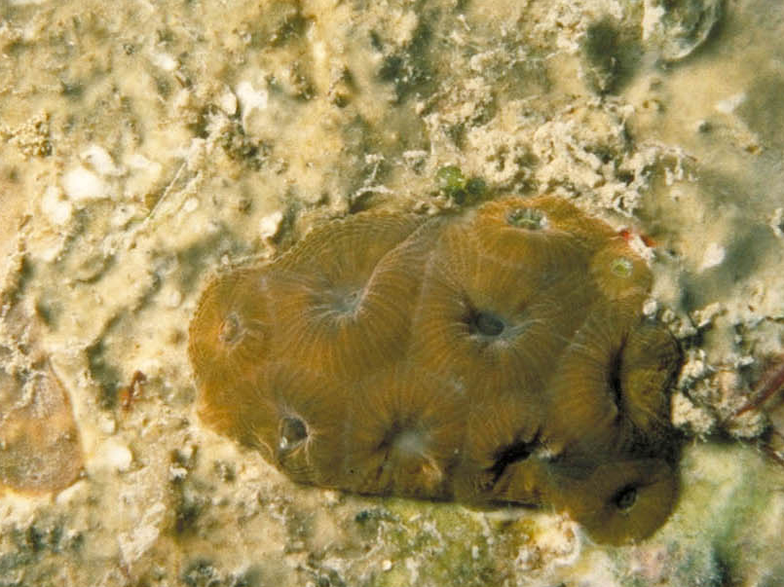
Luminescence
Fluorescence
Glows when you shine light on it
Jellyfish
Corals
Glow stops when you turn off the light
Notes:
Fluorescence is one of two kinds of light emission that can happen when you shine the right light on something. The other is phosphorescence.

Slide 9
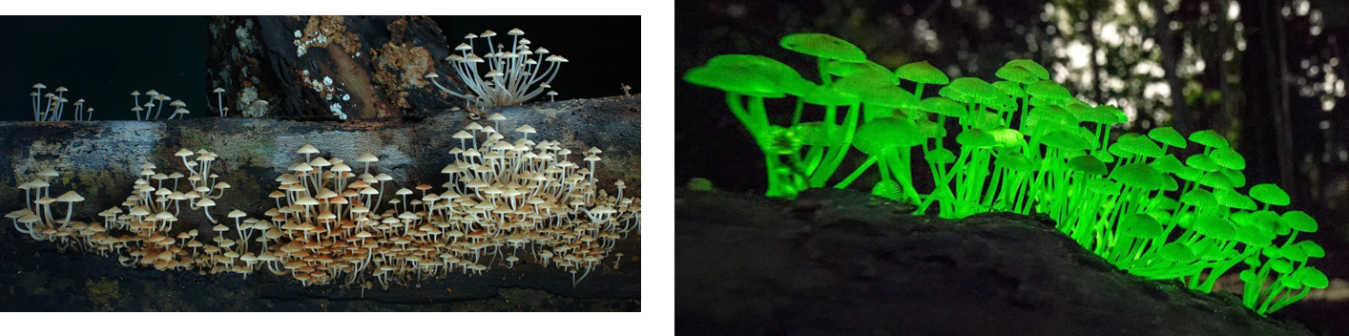
Luminescence
Phosphorescence
Glows when you shine light on it
Glows continues when you turn off the light

Slide 10
Fluorescence and phosphorescence
In phosphorescence the light is re-emitted over a longer time period
In fluorescence the light is immediately re-emitted
Fluorescence is
- the absorption of electromagnetic radiation (light) at one wavelength,
- its re-emission at another, longer wavelength

Slide 11
Fluorescence
Energy gap

Slide 12
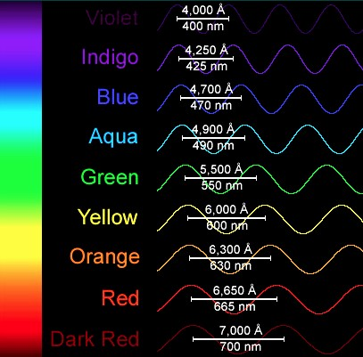
Electromagnetic Spectrum
Absorb
at high energy
Fluorescence
Emit
at low energy
shorter wavelength higher energy
longer wavelength lower energy
Decreasing energy

Slide 13
FLUORESCENZA
Emissione di radiazioni di una molecola che torna, da uno stato elettronico eccitato grazie all’assorbimento di luce, a quello fondamentale
L’emissione è spostata verso il rosso rispetto alla eccitazione
Parametri misurabili:
  Spettri di eccitazione ed emissione
  Intensità di fluorescenza
  Tempo di vita
  Polarizzazione

Slide 14
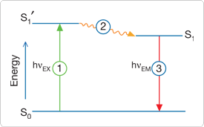
Excitation
Emission
Stage 1: Excitation
A photon of energy hν_{EX} is supplied by an external source such as an incandescent lamp or a laser and absorbed by the fluorophore, creating an excited electronic singlet state (S₁').
Stage 2: Excited-State Lifetime
The excited state exists for a finite time (typically 1–10 nanoseconds)
Stage 3: Fluorescence Emission
A photon of energy hν_{EM} is emitted, returning the fluorophore to its ground state S₀

Slide 15
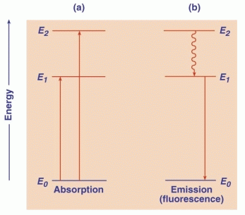

Slide 16
Resa quantica
La resa quantica
La resa quantica rappresenta la frazione di molecole
de-eccitate per fluorescenza

Slide 17
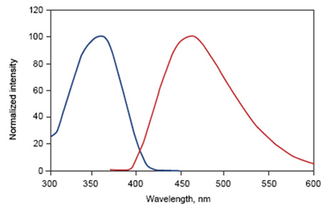

Slide 18
Diagramma di uno spettrofluorimetro
Sorgente
Σλ_{ex}
Monocromatore di eccitazione
λ_{ex}
Σλ_{em}
λ_{em}
campione
Monocromatore di emissione
Rivelatore

Slide 20
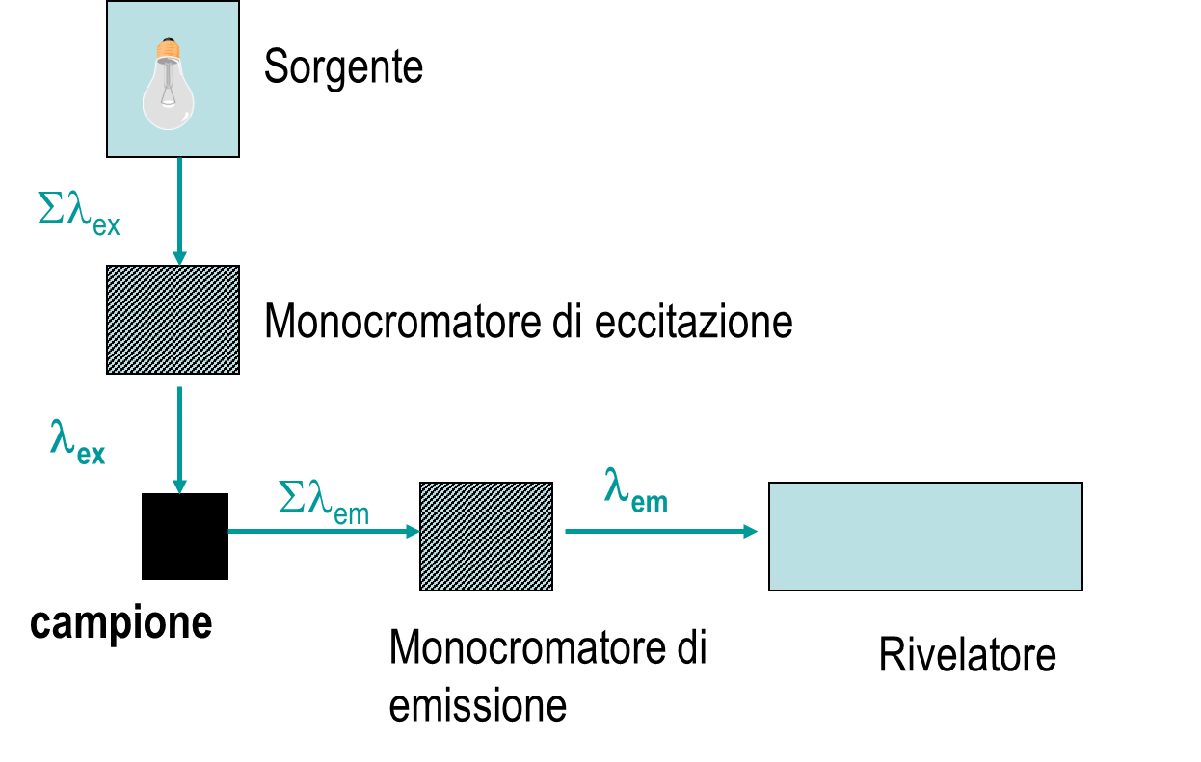
Spettri in Soluzione
SPETTRO DI EMISSIONE
Si illumina il campione con luce a lunghezza d’onda costante
si fa una scansione del monocromatore di emissione

Slide 22
Spettri in Soluzione
SPETTRO DI ECCITAZIONE
si fa una scansione del monocromatore di eccitazione
Si misura a lunghezza d’onda costante nel monocromatore di emissione

Slide 24
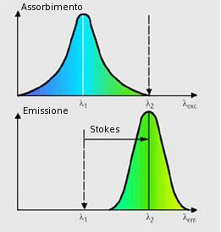

Slide 25
Stokes Shift
Stokes Shift is 25 nm
Fluorescein
molecule
495 nm
520 nm
Fluorescence Intensity
Wavelength

Slide 26
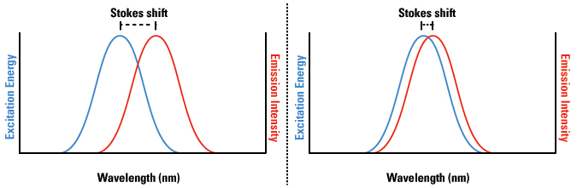

Slide 27
Fluorofori estrinseci
4’,6’ diamidino-2-fenilindolo

Slide 28
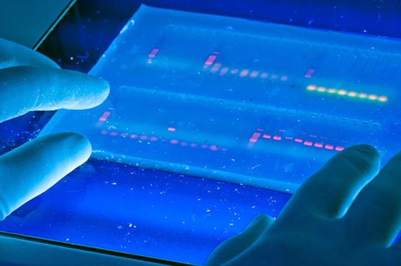
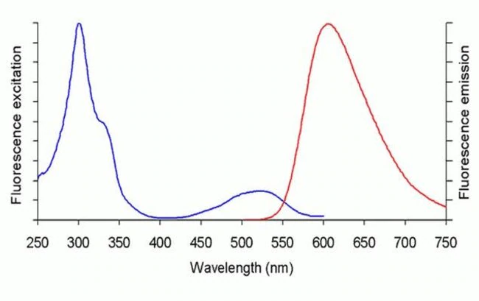
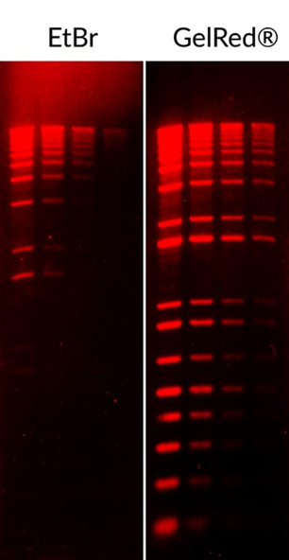
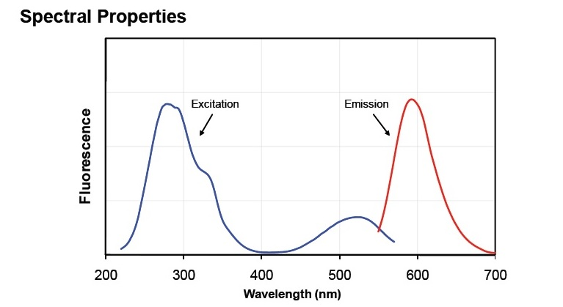

Slide 29
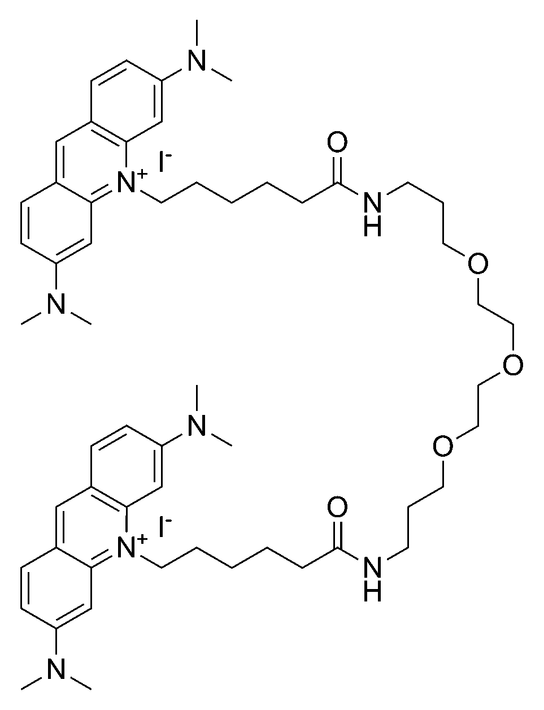
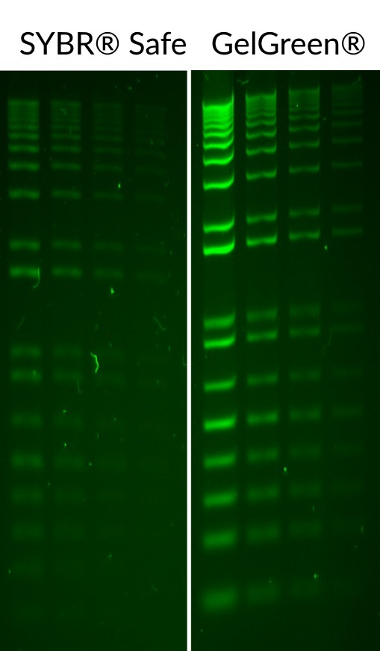
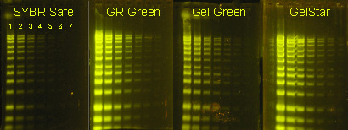
Gel green

Slide 30
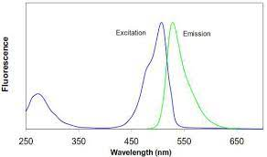

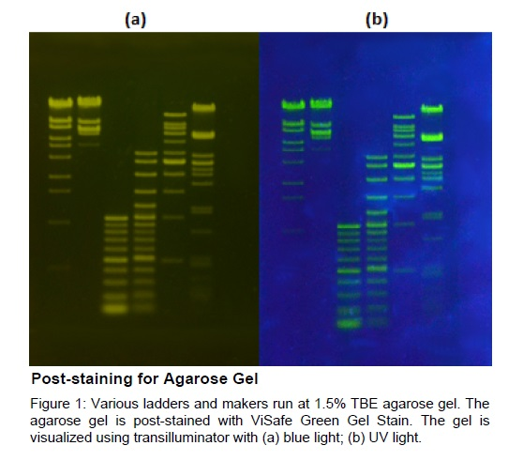
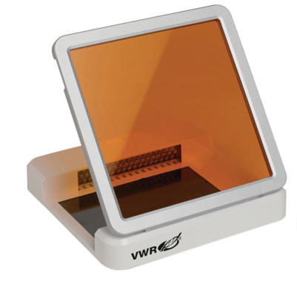
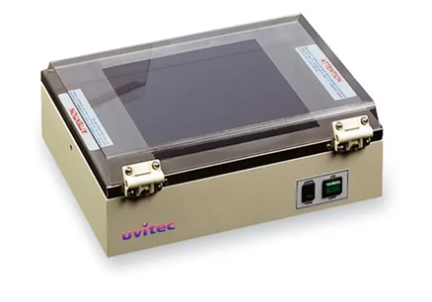
EtBr
Gel green

Slide 31
Fluorofori estrinseci
4’,6’ diamidino-2-fenilindolo

Slide 32
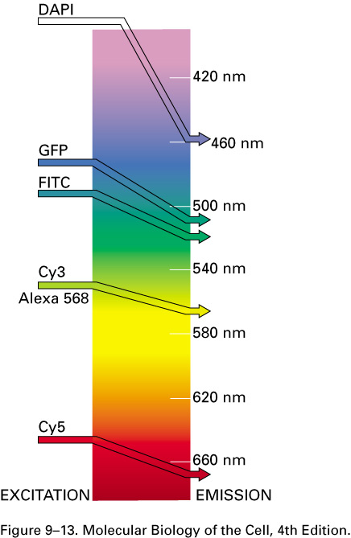
Absorb light at one wavelength and emit light at a specific and longer wavelength

Slide 33
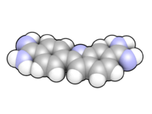

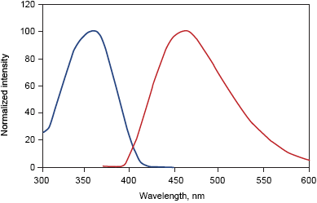
DAPI (4',6-diamidino-2-phenylindole)
is a fluorescent stain that binds strongly to A-T rich regions in DNA.
It is used extensively in fluorescence microscopy.
As DAPI can pass through an intact cell membrane, it can be used to stain both live and fixed cells, though it passes through the membrane less efficiently in live cells and therefore the effectiveness of the stain is lower.
DAPI has
absorption maximum at a wavelength of 358 nm (ultraviolet)
- emission maximum is at 461 nm (blue).

Slide 34
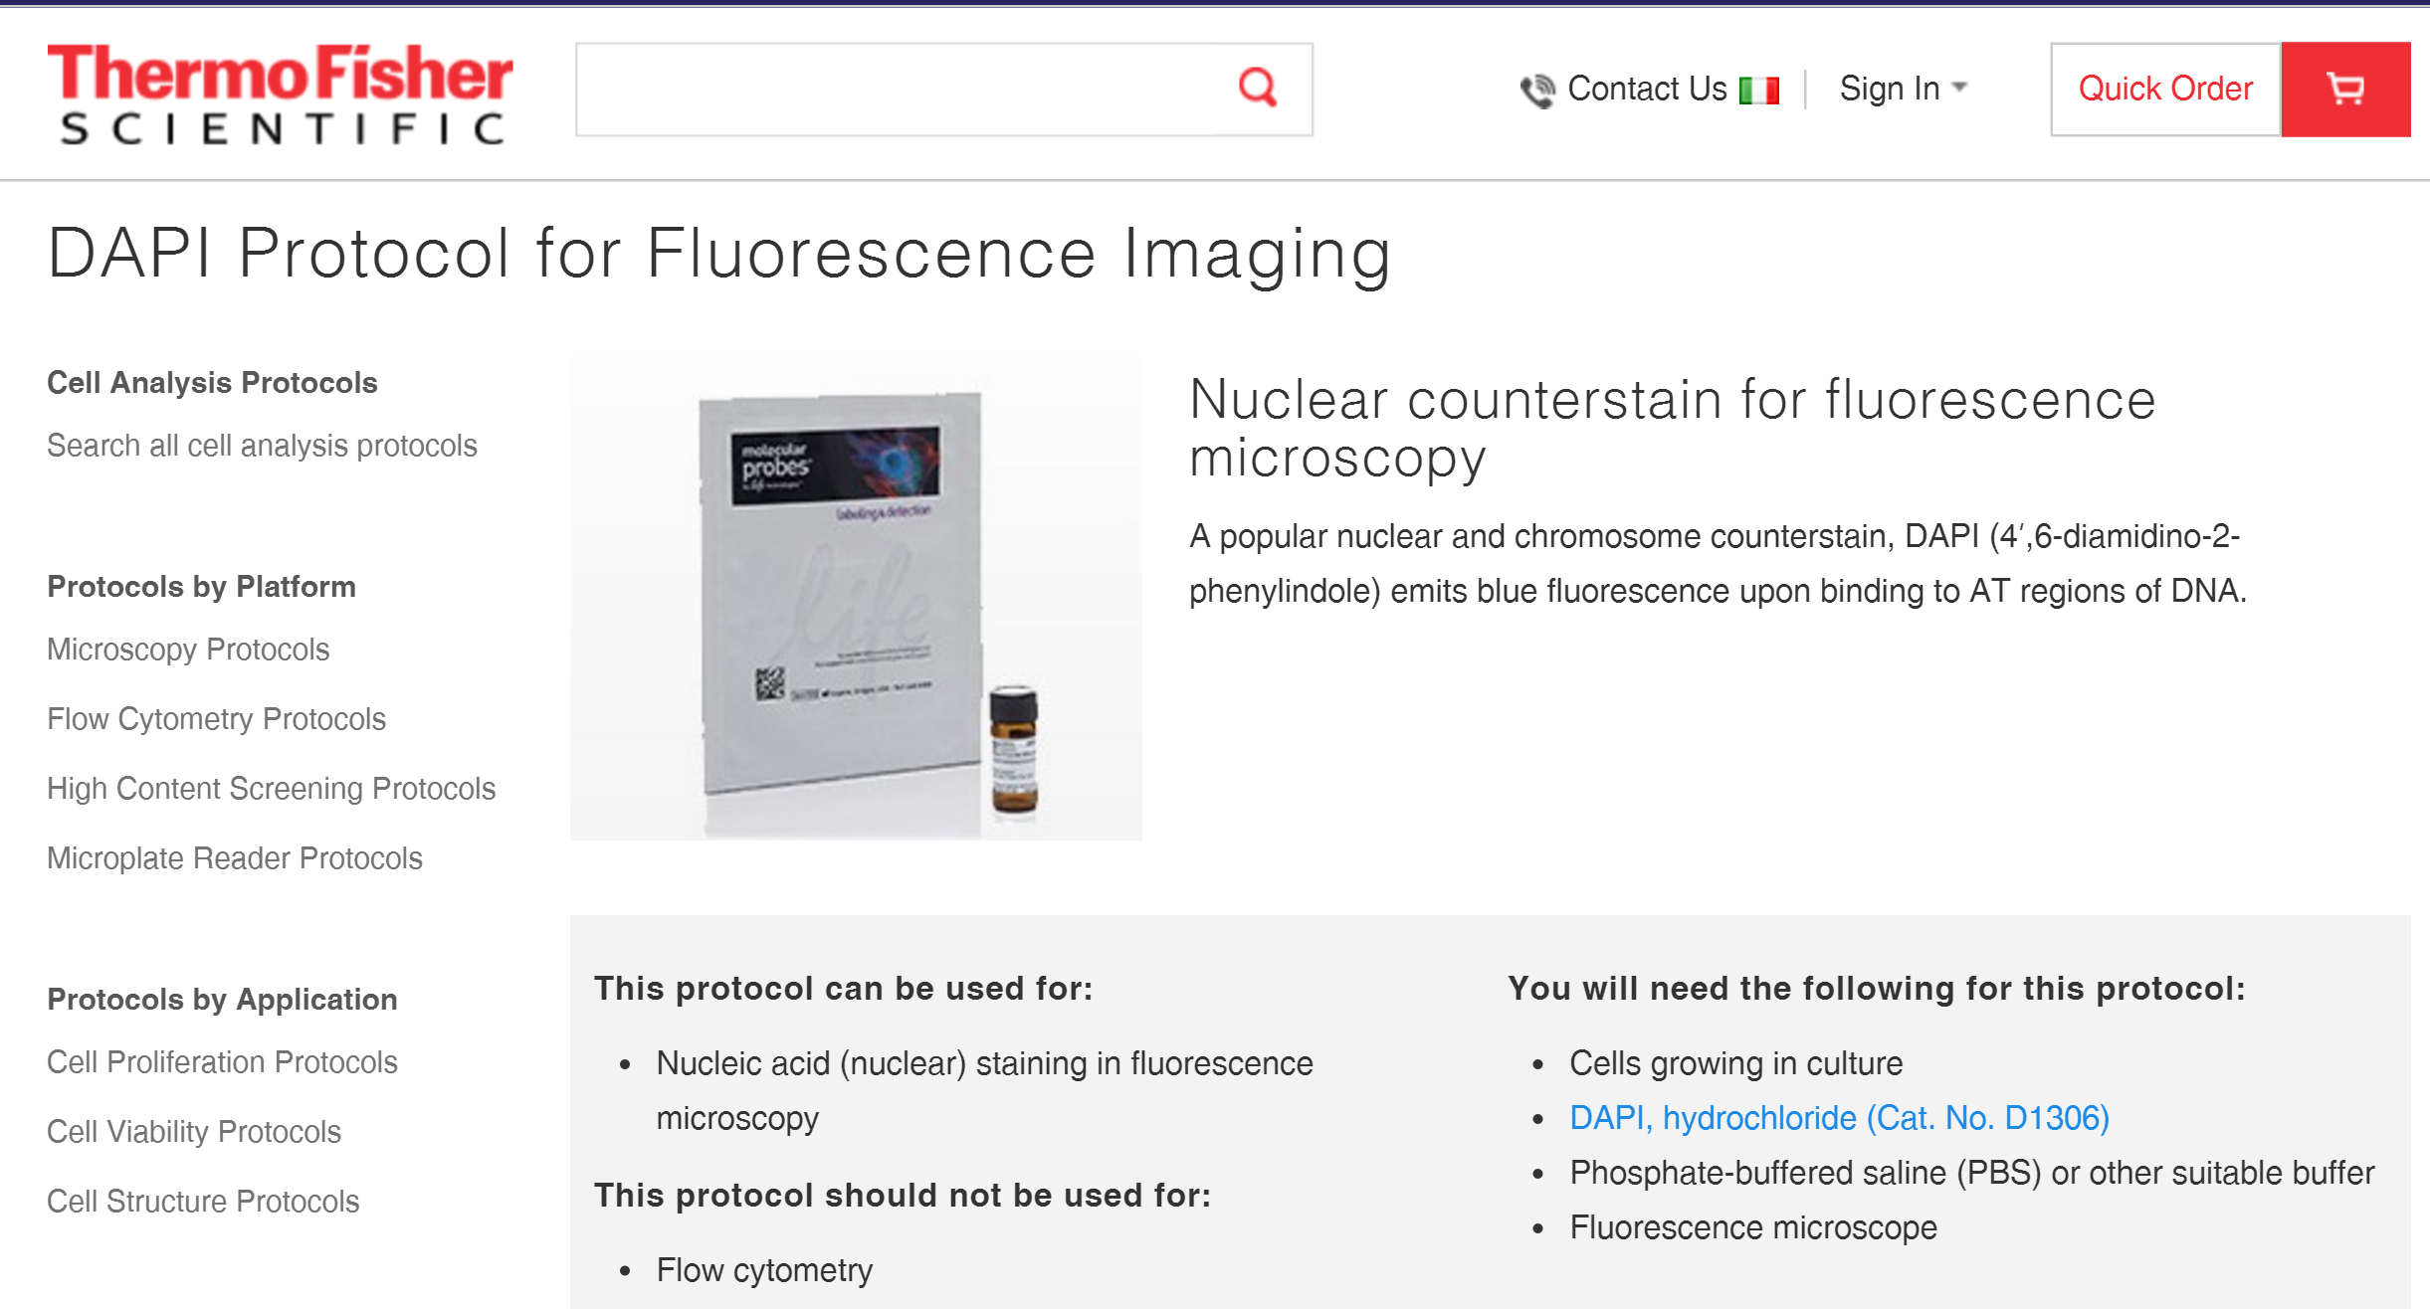

Slide 35
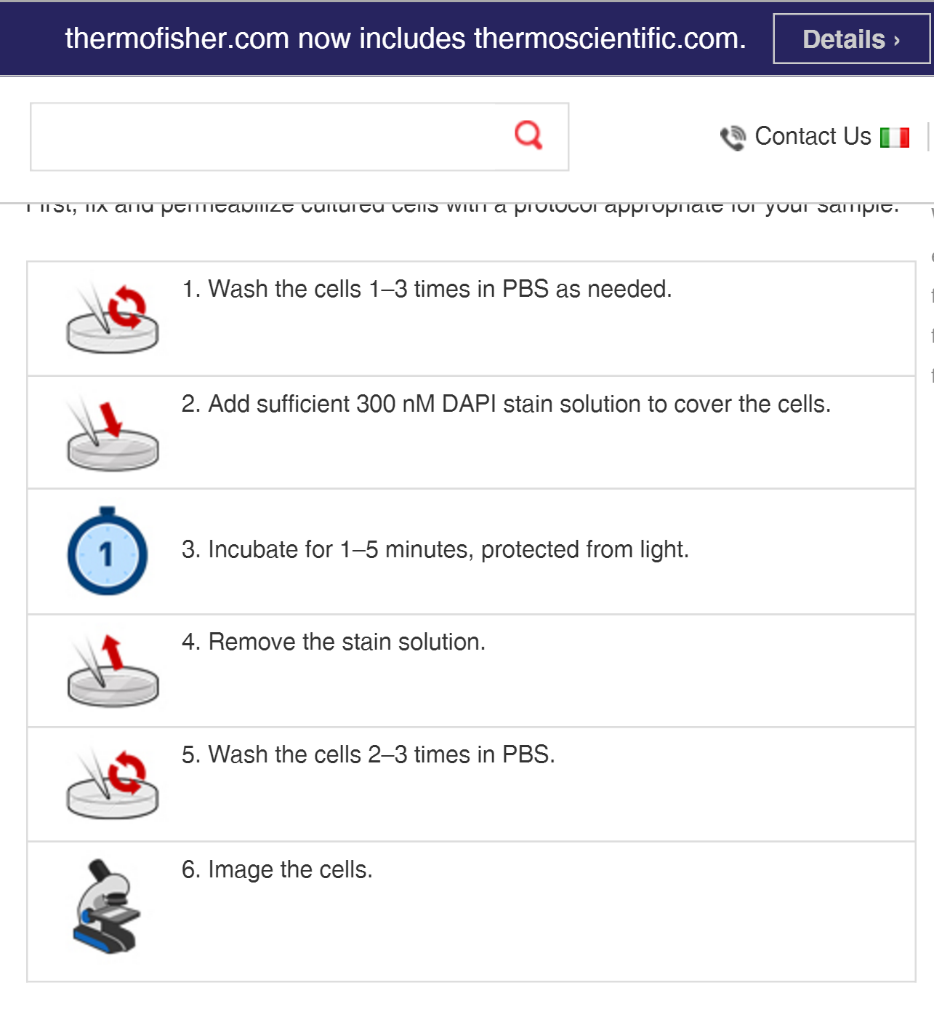
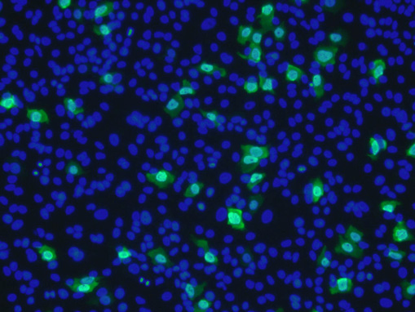
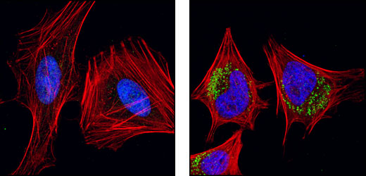

Slide 36
Fluorofori estrinseci
4’,6’ diamidino-2-fenilindolo

Slide 37
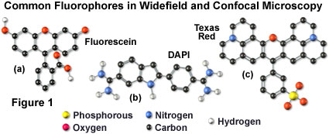

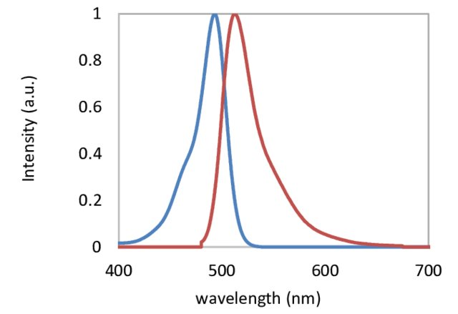
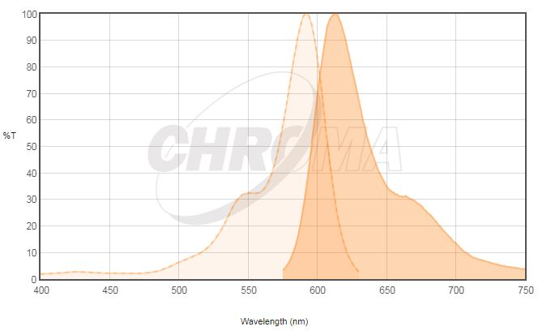
Fluorescein
Texas red
Excitation (㎚) | Emission (㎚)
498 | 517
Excitation (㎚) | Emission (㎚)
595 | 620

Slide 38
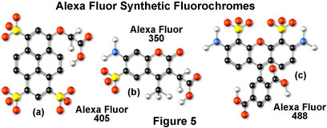
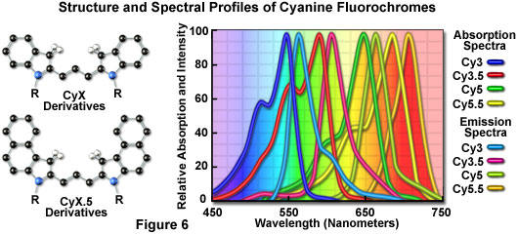

Slide 39
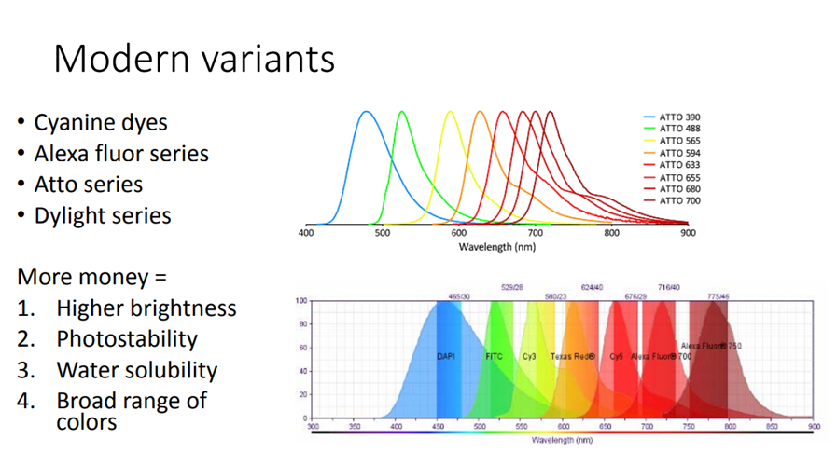

Slide 40
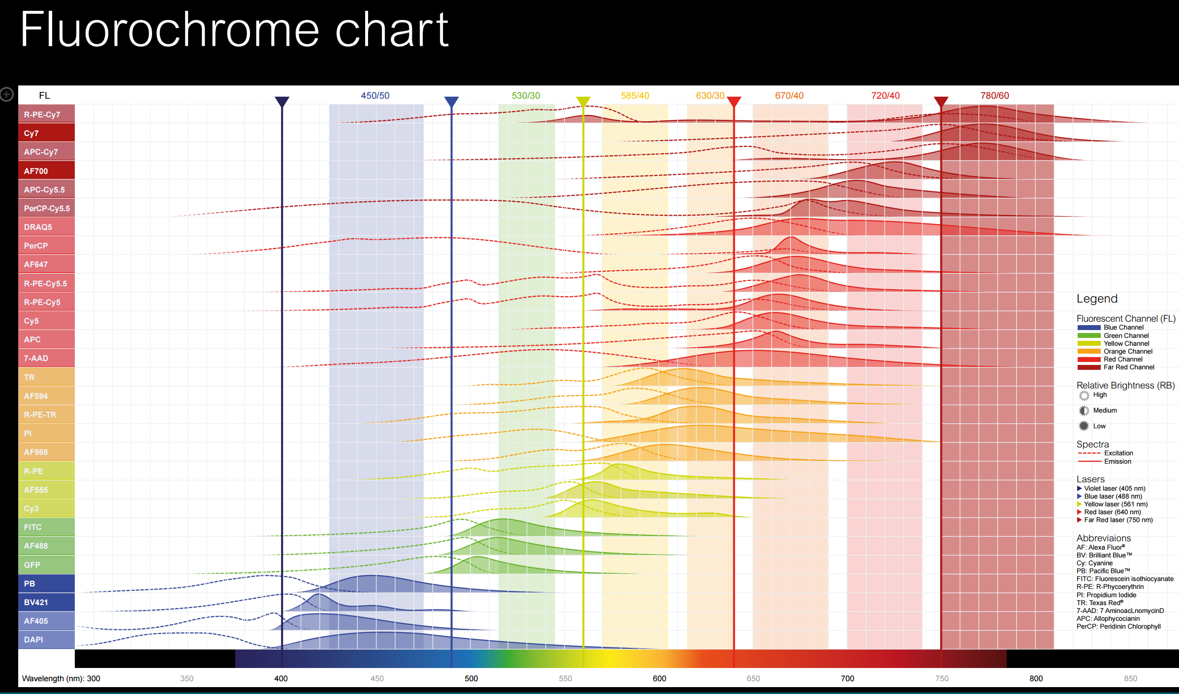

Slide 41
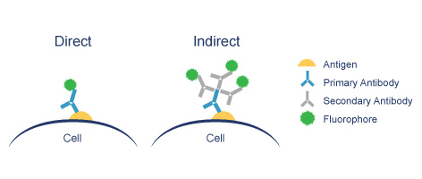
Fluorescence Microscopy
Major Function: Localization of specific cellular molecules – example proteins
Major Advantages:
  Sensitivity:“glow” against dark background
  Specificity: immunofluorescence
  Cells may be fixed or living
Fluorescent dyes or proteins (Flurochromes)
  flurochromes may be indirectly or directly associated with the cellular molecule
  Multiple flurochromes may be used simultaneously

Slide 42
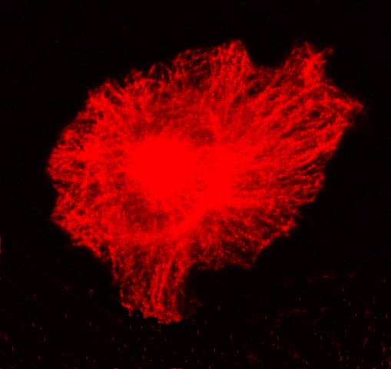
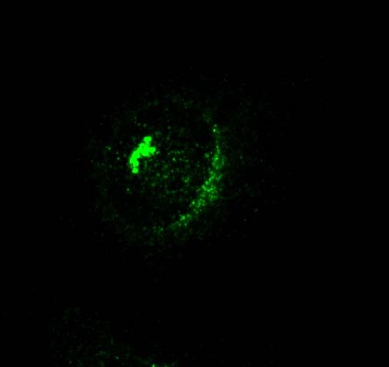


microtubules
centrosomes
Anti-tubulin MoAb
Goat anti-mouse-Rhodamine
Anti-pericentrin PoAb
Goat anti-mouse-FITC
DAPI
nucleus
MERGE

Slide 43

Stress Fibers
Focal Adhesions
Anti-vinculin MoAb
Goat anti-mouse-FITC
Rhodamine-Phalloidin

Slide 44


Slide 45


MitoTracker® probes for live cells
MitoTracker® probes are cationic dyes that are selectively sequestered by mitochondria in live cells because of their charge—like other mitochondrial dyes, they depend on the membrane potential for loading

Slide 46
MitoTracker dyes are cationic fluorophores that accumulate electrophoretically into mitochondria in response to the highly negative mitochondrial membrane potential.
However, unlike rhodamine MitoTracker dyes possess a reactive chloromethyl group that forms a covalent bond with thiols on proteins and peptides, which traps MitoTracker dyes within mitochondria.
Two of the more popular probes are MitoTracker® Deep Red and MitoTracker® Green.

Slide 47

CellLight® reagents for Golgi complex
Use CellLight® reagents when you want to label the Golgi complex in live cells to follow the dynamics of intracellular behavior.

Slide 48


Slide 49


