Slide 1
INTRODUCTION TO FLUTTER

Slide 2
DART PROGRAMMING LANGUAGE
The Dart language
is type safe - Snippet
var staticType = "String";
it uses static type checking to ensure that a variable's value always matches the variable's static type
Type Inference
dynamic dynamicType = "String"; dynamicType = 10;
Usage of dynamic type combined with runtime checks
Dart has built-in sound null safety.
The following code sample showcases several Dart language features, including libraries, async calls, nullable and non-nullable types, arrow syntax, generators, streams, and getters. To learn more about the language, check out the Dart language tour.

Slide 3
DART PROGRAMMING LANGUAGE
The Dart language
has type Inference
is type safe
it uses static type checking to ensure that a variable's value always matches the variable's static type
Usage of dynamic type combined with runtime checks
Dart has built-in sound null safety.

Slide 4
DART PROGRAMMING LANGUAGE – HELLO WORLD
void main() { print('Hello, World!'); }

Slide 5
DART PROGRAMMING LANGUAGE - VAR
Dart has built-in sound null safety.
var flybyObjects = ['Jupiter', 'Saturn', 'Uranus', 'Neptune']; var image = { 'tags': ['saturn'], 'url': '//path/to/saturn.jpg’};
void main() { /// Types declaration var name = 'Voyager I'; var year = 1977; var antennaDiameter = 3.7;
}

Slide 6
DART PROGRAMMING LANGUAGE – EXPLICIT/NULLABLE
is type safe
/// Explicit not nullable declaration and assignment int declaredType; declaredType = 5; /// Explicit nullable declaration and check int? nullableVariable; if(nullableVariable == null) print("Nullable");

Slide 7
DART PROGRAMMING LANGUAGE - STATIC/DYNAMIC
it uses static type checking to ensure that a variable's value always matches the variable's static type
/// Static type assignment var staticType = "String"; staticType = 10.toString(); /// Dynamic type assignment dynamic dynamicType = "String"; dynamicType = 10;

Slide 8
DART PROGRAMMING LANGUAGE – FINAL and CONST
Final is calculated only one time at runtime and then cannot be changed.
Const is calculated at COMPILE TIME and cannot be assigned or changed at runtime.
/// final and const variables final finalVar = DateTime.now(); const constVar = 3.14;

Slide 9
DART PROGRAMMING LANGUAGE – STRING FORMAT
/// String formatting print('String formatting:'); print(name + " " + year.toString() + " " + image['url'].toString()); print("$name $year ${image['url']}"); // Best practice for DART

Slide 10
DART PROGRAMMING LANGUAGE – IF STATEMENT
/// If Statement print("If statement:"); if (year >= 2001) { print('21st century'); } else if (year >= 1901) { print('20th century'); }

Slide 11
DART PROGRAMMING LANGUAGE – SWITCH CASE
/// Switch statement print("Switch statement:"); switch(year) { case(1977): print("Correct Year"); case(1978): print("Incorrect Year"); }

Slide 12
DART PROGRAMMING LANGUAGE – FOREACH
/// Foreach object for (final object in flybyObjects) { print(object); }

Slide 13
DART PROGRAMMING LANGUAGE – FOR CYCLE
/// For Cycle and increment operators for (int month = 1; month <= 3; month++) { print(month); } print("---"); for (int month = 1; month <= 3; ) { print(++month); // Count and print }

Slide 14
DART PROGRAMMING LANGUAGE – WHILE LOOP
/// While loop while (year < 1985) { year += 1; }

Slide 15
DART PROGRAMMING LANGUAGE – WHILE LOOP
/// Inline conditions var a = year ?? 0; // Not Null print(a); var b = year > 1982 ? 1 : -1; // Condition print(b);

Slide 16
DART PROGRAMMING LANGUAGE – IMPORT and =>
import 'DartLanguageTypesAndFlow.dart’;
void main () { /// '=>' operator flybyObjects.where((name) => name.contains('tu')).forEach(print);
}

Slide 17
DART PROGRAMMING LANGUAGE – CLASSES
/// class class Spacecraft { String name; DateTime? launchDate; /// Read-only non-final property int? get launchYear => launchDate?.year; /// Constructor, with syntactic sugar for assignment to members. Spacecraft(this.name, this.launchDate) { /// Initialization code goes here. }
}

Slide 18
DART PROGRAMMING LANGUAGE – METHODS
@override String toString() { return describe(); } /// Named constructor that forwards to the default one. Spacecraft.unlaunched(String name) : this(name, null); /// Method. String describe() { String tempString = ('Spacecraft: $name'); /// Type promotion doesn't work on getters. var launchDate = this.launchDate; if (launchDate != null) { int years = DateTime.now().difference(launchDate).inDays ~/ 365; return '$tempString Launched: $launchYear ($years years ago)'; } else { return '$tempString Unlaunched'; } } }

Slide 19
DART PROGRAMMING LANGUAGE – OBJECTS and LISTs
/// objects var Apollo = Spacecraft("Apollo 1", null); print(Apollo.toString()); var Apollo2 = Spacecraft("Apollo 2", DateTime.now()); print(Apollo2.toString()); /// Lists /// --- var SpacecraftList = {Apollo, Apollo2, Spacecraft("Moon Lander", DateTime(1978))}; SpacecraftList.forEach((spacecraft){print(spacecraft.toString());});

Slide 20
DART PROGRAMMING LANGUAGE – ENUM
/// Simple Enum enum PlanetType { terrestrial, ice, gas } /// Enum that enumerates the different planets in our solar system /// and some of their properties. enum Planet { mercury(planetType: PlanetType.terrestrial, moons: 0, hasRings: false), venus(planetType: PlanetType.terrestrial, moons: 0, hasRings: false), // ··· uranus(planetType: PlanetType.ice, moons: 27, hasRings: true), neptune(planetType: PlanetType.ice, moons: 14, hasRings: true); /// A constant generating constructor const Planet( {required this.planetType, required this.moons, required this.hasRings}); /// All instance variables are final final PlanetType planetType; final int moons; final bool hasRings; /// Enhanced enums support getters and other methods bool get isGiant => planetType == PlanetType.gas || planetType == PlanetType.ice; }

Slide 21
DART PROGRAMMING LANGUAGE – ENUM
/// Simple Enum enum PlanetType { terrestrial, ice, gas } /// Enum that enumerates the different planets in our solar system /// and some of their properties. enum Planet { mercury(planetType: PlanetType.terrestrial, moons: 0, hasRings: false), venus(planetType: PlanetType.terrestrial, moons: 0, hasRings: false), // ··· uranus(planetType: PlanetType.ice, moons: 27, hasRings: true), neptune(planetType: PlanetType.ice, moons: 14, hasRings: true); /// A constant generating constructor const Planet( {required this.planetType, required this.moons, required this.hasRings}); /// All instance variables are final final PlanetType planetType; final int moons; final bool hasRings; /// Enhanced enums support getters and other methods bool get isGiant => planetType == PlanetType.gas || planetType == PlanetType.ice; }

Slide 22
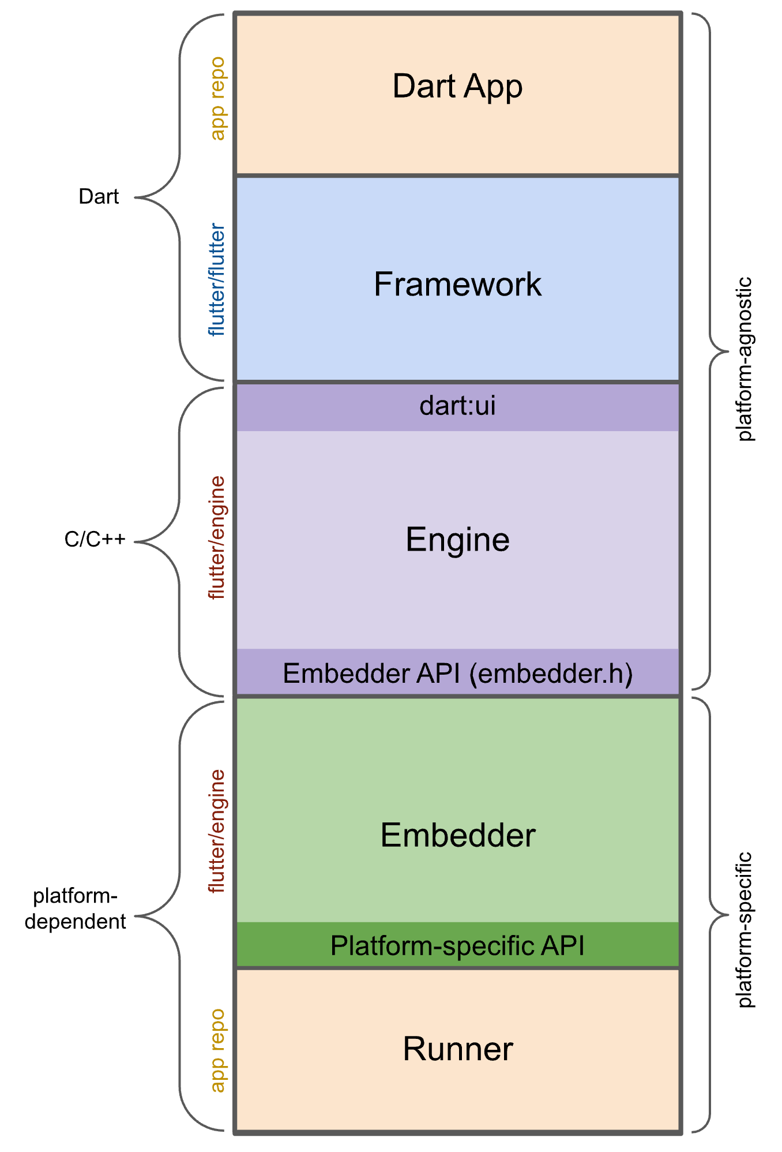
FLUTTER ARCHITECTURE
Dart App
Composes widgets into the desired UI.
Implements business logic.
Owned by app developer.
Framework (source code)
Provides higher-level API to build high-quality apps (for example, widgets, hit-testing, gesture detection, accessibility, text input).
Composites the app's widget tree into a scene.
Engine (source code)
Responsible for rasterizing composited scenes.
Provides low-level implementation of Flutter's core APIs (for example, graphics, text layout, Dart runtime).
Exposes its functionality to the framework using the dart:ui API.
Integrates with a specific platform using the Engine's Embedder API.
Embedder (source code)
Coordinates with the underlying operating system for access to services like rendering surfaces, accessibility, and input.
Manages the event loop.
Exposes platform-specific API to integrate the Embedder into apps.
Runner
Composes the pieces exposed by the platform-specific API of the Embedder into an app package runnable on the target platform.
Part of app template generated by flutter create, owned by app developer.

Slide 23
FLUTTER HELLO WORLD!
import 'package:flutter/material.dart'; void main() { runApp( const Center( child: Text( 'Hello, world!', textDirection: TextDirection.ltr, ), ), ); }

Slide 24
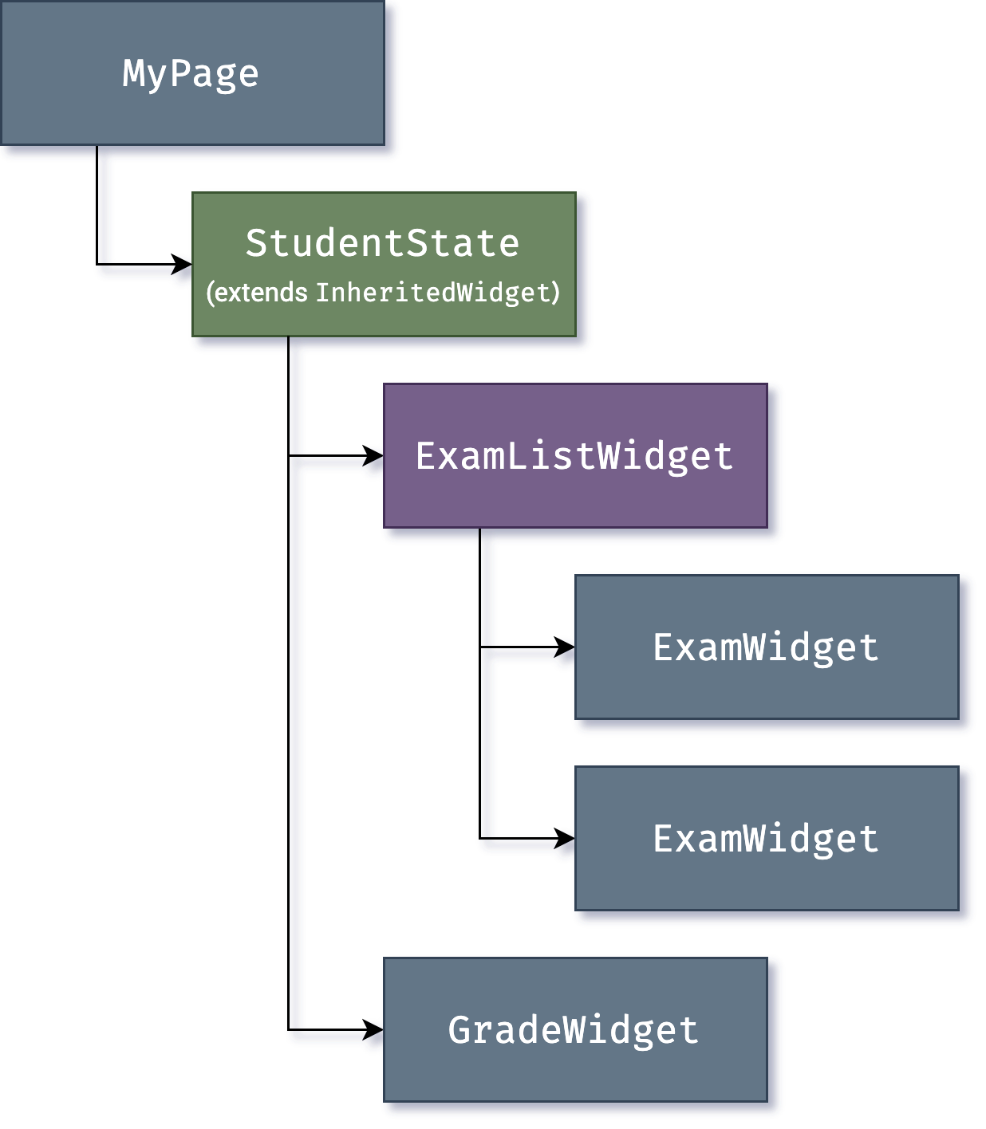
WIDGETs

Slide 25
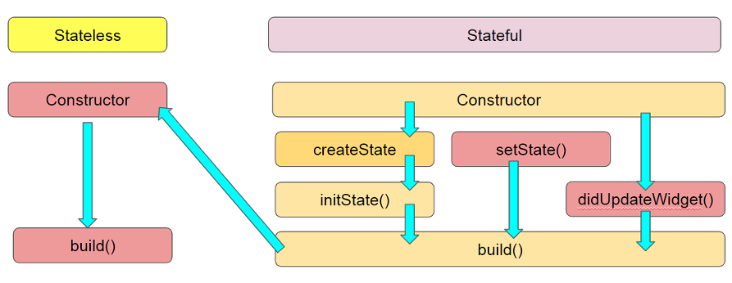
WIDGET LIFECYCLE

Slide 26
WIDGET LIFECYCLE
createState
When Flutter is instructed to build a StatefulWidget, it immediately calls createState()
Init State
Called when this object is inserted into the tree.
When inserting the render tree when invoked, this function is called only once in the life cycle. Here you can do some initialization, such as initialization State variables.
setState
The setState() method is called often from the Flutter framework itself and the developer.
didChangeDependencies
Called when a dependency of this [State] object changes.
didUpdateWidget
Called whenever the widget configuration changes.
deactivate
Called when this object is removed from the tree. Before dispose, we will call this function.
dispose
Called when this object is removed from the tree permanently.
didChangeAppLifecycleState
Called when the system puts the app in the background or returns the app to the foreground.
https://stackoverflow.com/questions/41479255/life-cycle-in-flutter

Slide 27
WIDGETS
https://docs.flutter.dev/ui/widgets
Text:
The Text widget lets you create a run of styled text within your application.
Row, Column:
These flex widgets let you create flexible layouts in both the horizontal (Row) and vertical (Column) directions. The design of these objects is based on the web's flexbox layout model.
Stack:
Instead of being linearly oriented (either horizontally or vertically), a Stack widget lets you place widgets on top of each other in paint order. You can then use the Positioned widget on children of a Stack to position them relative to the top, right, bottom, or left edge of the stack. Stacks are based on the web's absolute positioning layout model.
Container:
The Container widget lets you create a rectangular visual element. A container can be decorated with a BoxDecoration, such as a background, a border, or a shadow. A Container can also have margins, padding, and constraints applied to its size. In addition, a Container can be transformed in three-dimensional space using a matrix.

Slide 28
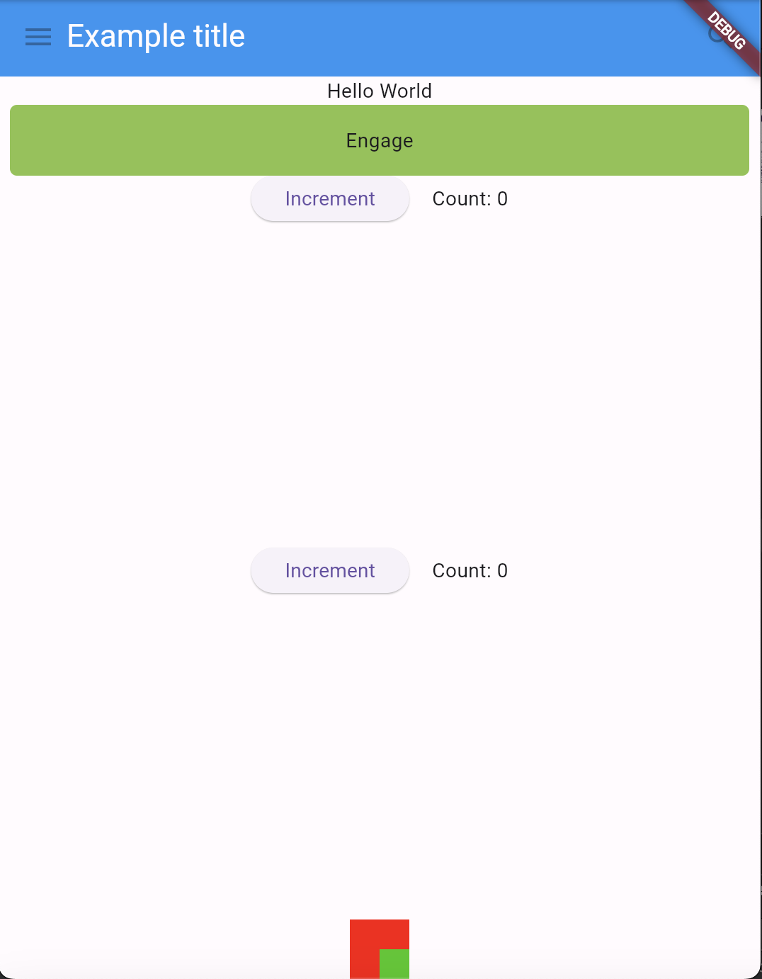
LET’S TRY TO USE ALL THE ELEMENTS!

Slide 29
DART – THROW and CATCH EXCEPTIONs
throw FormatException('Expected at least 1 section’);
try {
isThisThingWorking();
}
on Exception {
print(“This thing is not working!”);
}

Slide 30
DART – ASYNCHRONOUS PROGRAMMING (basic)
Asynchronous programming
A
B
A
C
B
Synchronous programming
?
C
U1
U2
S
U1
U2
S

Slide 31
DART – ASYNCHRONOUS PROGRAMMING (basic)
Future<void> fetchUserOrder() { // Imagine that this function is fetching user info from another service or database. return Future.delayed(const Duration(seconds: 2), () => print('Large Latte')); } void main() { fetchUserOrder(); print('Fetching user order...'); }

Slide 32
DART – ASYNCHRONOUS PROGRAMMING (basic)
Future<String> createOrderMessage() async {
var order = await fetchUserOrder();
return 'Your order is: $order’;
}
Future<String> fetchUserOrder() =>
Future.delayed( const Duration(seconds: 2), () => 'Large Latte', );
Future<void> main() async {
print('Fetching user order...’);
print(await createOrderMessage());
}

Slide 33
DART – ASYNCHRONOUS PROGRAMMING (basic)
// NOT WRITE LIKE THIS!!!
String createOrderMessage() {
var order = fetchUserOrder();
return 'Your order is: $order';
}
Future<String> fetchUserOrder() =>
// Imagine that this function is more complex and slow.
Future.delayed(
const Duration(seconds: 2),
() => 'Large Latte',
);
void main() {
print(createOrderMessage());
}

Slide 34
DART – ASYNCHRONOUS PROGRAMMING (basic)
import 'dart:math'; Future<String> createOrderMessage() async { var order = await fetchUserOrder(); return 'Your order is: $order'; } Future<String> fetchUserOrder() => // Imagine that this function is // more complex and slow. Future.delayed( Duration(seconds: Random().nextInt(5)), () => 'Large Latte',);
Future<void> getSugar() => // Imagine that this function is // more complex and slow. Future.delayed(Duration(seconds: Random().nextInt(5)), () => print('Sugar taken')); Future<void> main() async { print('Fetching user order...'); getSugar(); print(await createOrderMessage()); }

Slide 35
FLUTTER – THE MATERIAL CLASS
class ElabFTWAppRead extends StatelessWidget { const ElabFTWAppRead({super.key}); // This widget is the root of your application. @override Widget build(BuildContext context) { return const Material( child: MainPage(title: 'elabFTW API Read Main Page'), ); } }

Slide 36
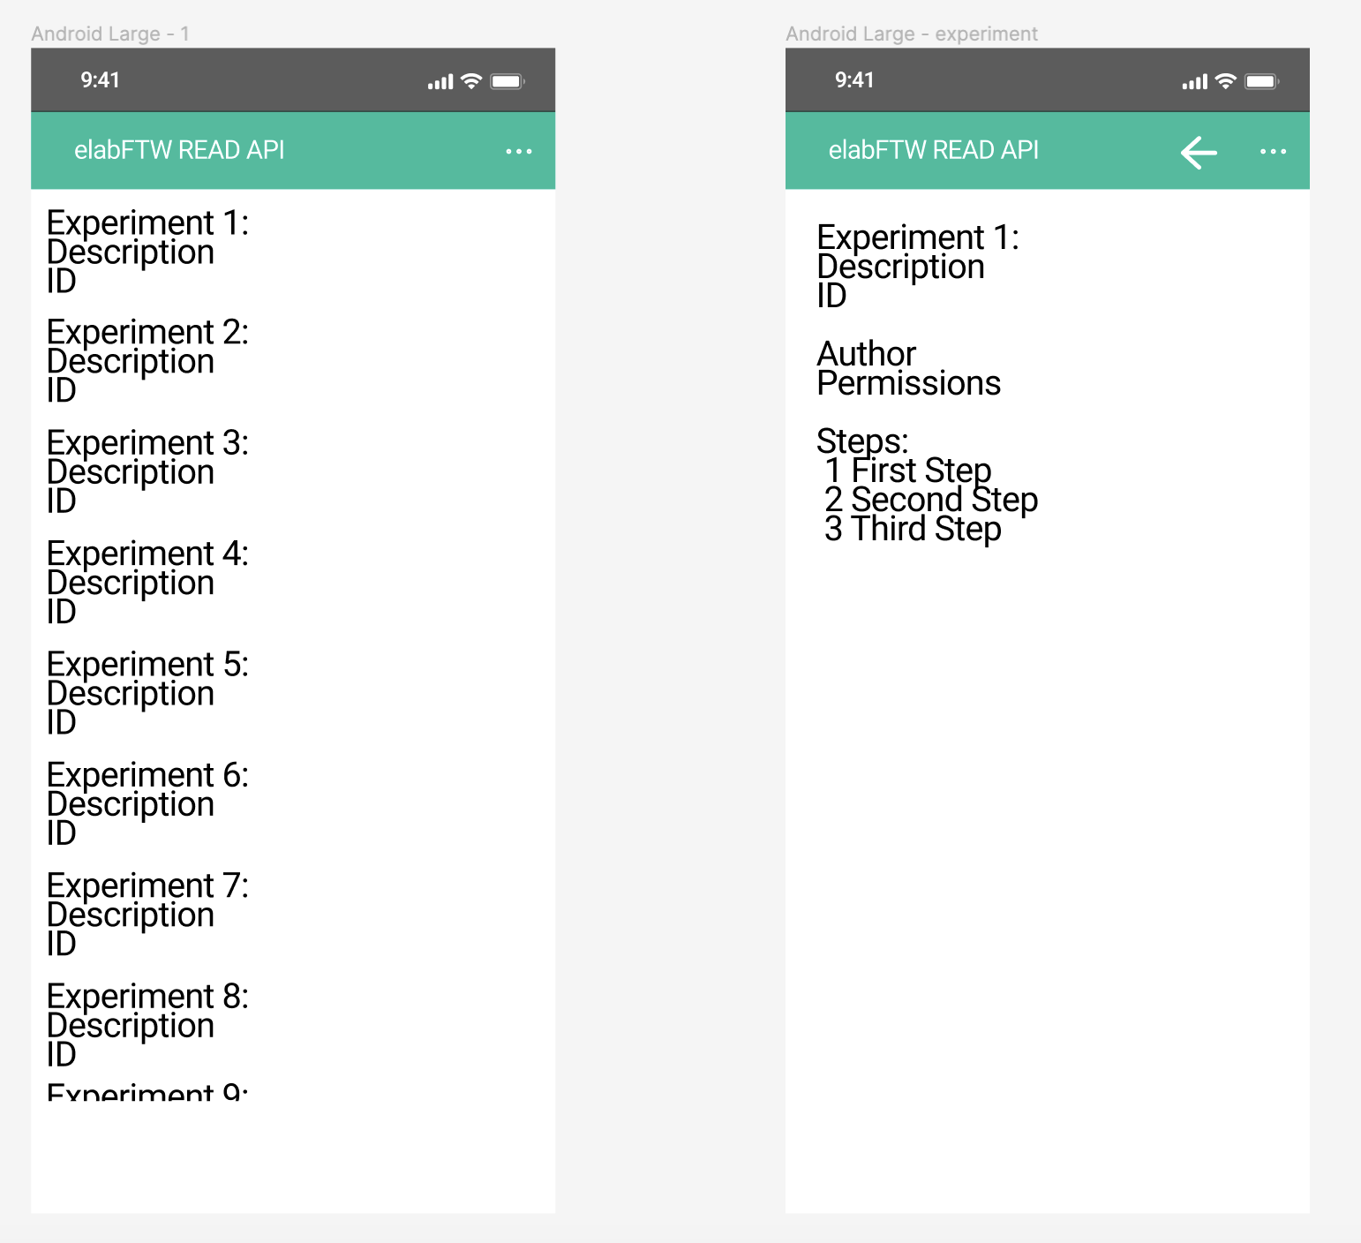
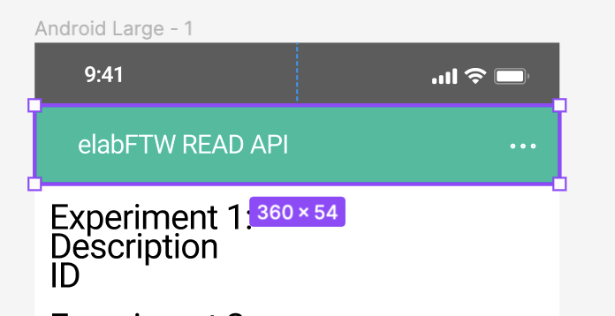
FLUTTER – UI DESIGN and CREATION

Slide 37
FLUTTER – UI DESIGN and CREATION
1 -:
Widget build(BuildContext context) { return Container( color: const Color(0xFF0BBD9D), width: 360, height: 54, padding: const EdgeInsets.only(left: 5, right: 5, top: 5, bottom: 5), child: Row(textDirection: TextDirection.ltr, children: [ … ] ), ); }
2
3
1
2 -:
Expanded( child: Align( alignment: Alignment.centerLeft, child: Text( title, textDirection: TextDirection.ltr, textAlign: TextAlign.center, style: const TextStyle( color: Colors.white, fontFamily: 'Roboto', fontSize: 14, ), ), ), ),
3 -: const Expanded( child: Align( alignment: Alignment.centerRight, child: Icon( textDirection: TextDirection.ltr, color: Colors.white, Icons.more_horiz, ), ), ), ])); } }

Slide 38
FLUTTER – THE MATERIAL APP CLASS
MaterialApp( theme: ThemeData(
brightness: Brightness.dark,
primaryColor: Colors.blueGrey ),
home: Scaffold(
appBar: AppBar(
title: const Text('MaterialApp Theme’), ),
),
)

Slide 39
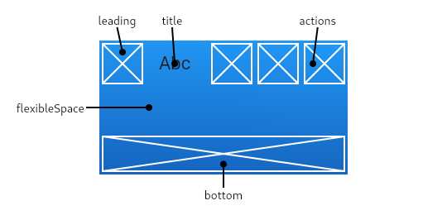
FLUTTER – APPBAR CLASS

Slide 40
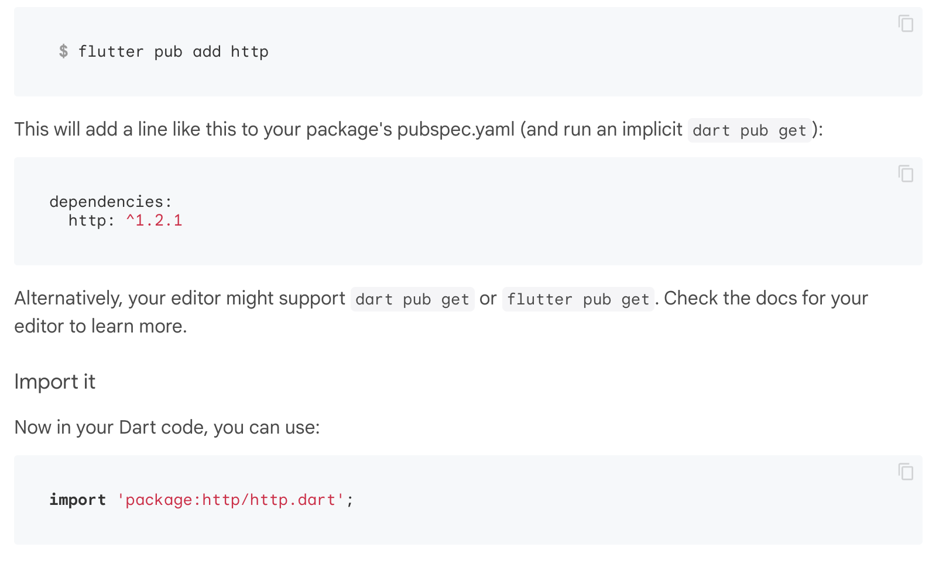
FLUTTER – HTTP PACKAGE

Slide 41
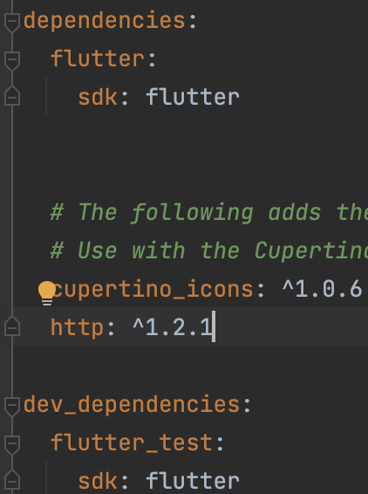
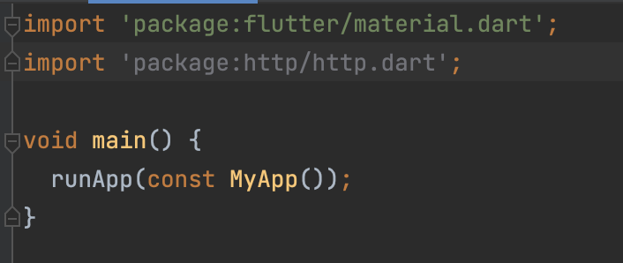
FLUTTER – HTTP PACKAGE
main.dart
pubspec.yaml

Slide 42
FLUTTER – HTTP PACKAGE
args: chrome/webbrowsers --web-browser-flag "--disable-web-security"

Slide 43
FLUTTER – API REQUESTs
late Future<String> _responseStr; final String API_Auth_Token = $TOKEN; Future<List<Map<int, String>>> fetchExperiments() async { print("get!"); final response = await http.get( Uri.parse( "https://prp-electronic-lab.areasciencepark.it/api/v2/experiments"), headers: {"Authorization": API_Auth_Token}); print(response.statusCode.toString()); if (response.statusCode == 200) { List experimentsList = json.decode(response.body); experimentsList.forEach( (element) => print("${element['id']} : ${element['title']}")); return List<Map<int, String>>.from(experimentsList.map((element) => <int, String>{element['id']: element['title']} as Map<int, String>)); } else { // If the server did not return a 200 OK response, // then throw an exception. throw Exception('Failed to find experiments'); } }
late Future<List<Map<int, String>>> futureExperiments; @override void initState() { super.initState(); futureExperiments = fetchExperiments(); }

Slide 44
FLUTTER – FUTURE BUILDER
child: FutureBuilder<List<Map<int, String>>>( future: futureExperiments, builder: (context, snapshot) { if (!snapshot.hasData) { return Center(child: CircularProgressIndicator()); } else { return Container( child: SizedBox( width: 200, height: 500, child: ListView.builder( itemCount: snapshot.data!.length, scrollDirection: Axis.vertical, itemBuilder: (BuildContext context, int index) { return GestureDetector( child: Text('${snapshot.data![index].keys}'), onTap: () => _showExperiment( snapshot.data![index].values.first), ); }))); } }), ),

