Slide 1
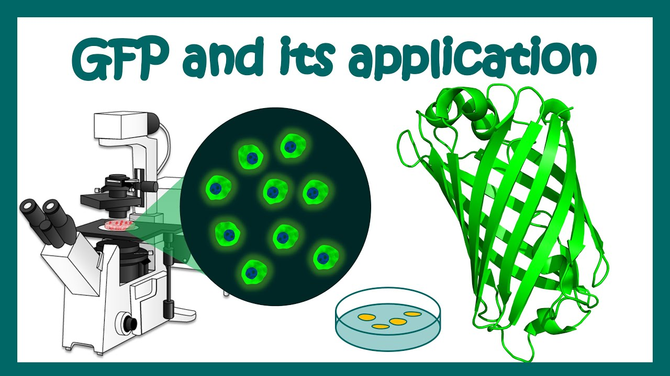
Fluorescent Protein in cell and Molecular biology
Fluorescent proteins are quite versatile and have been successfully employed in almost every biological discipline from microbiology to systems physiology.
These ubiquitous probes have been extremely useful as reporters for gene expression studies in cultured cells and tissues, as well as living animals.

Slide 2
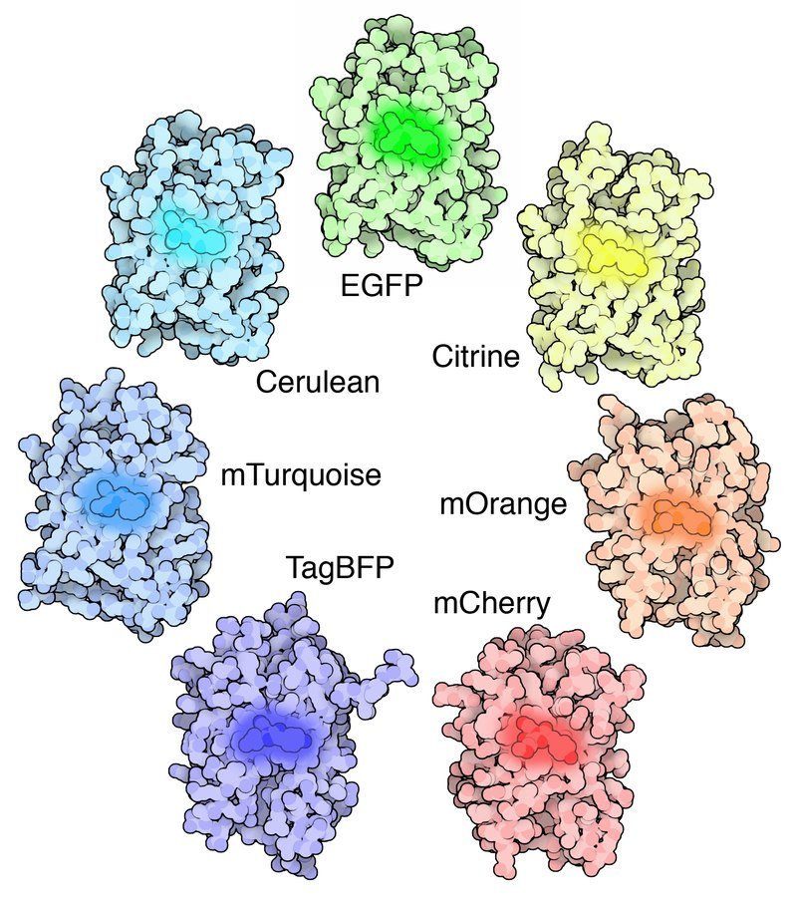
Two main ways to use fluorescent proteins
As a gene reporter
As a fusion-protein

Slide 3
Use of Green Fluorescent
Protein (GFP)
As a reporter molecule to monitor gene expression
  Transgenic organism made with
  the GFP-coding sequence
  under the transcriptional control of the promoter belonging to the gene of interest

Slide 4
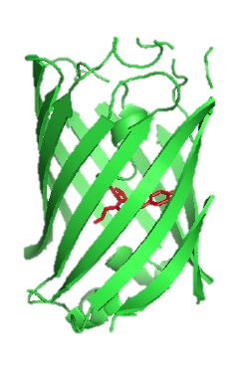
Gene A
Promoter
for gene A
Coding region
Can be used to
visualize the
expression of
Gene A
GFP-reporter gene construct
Promoter
for Gene A
Coding region for
GFP
Promoter for Gene A regulates the expression of GFP

Slide 5
Using fluorescent proteins as gene reporters
promoter
GFP gene
GFP expressed wherever original promoter is active
Whole cell is fluorescent

Slide 6
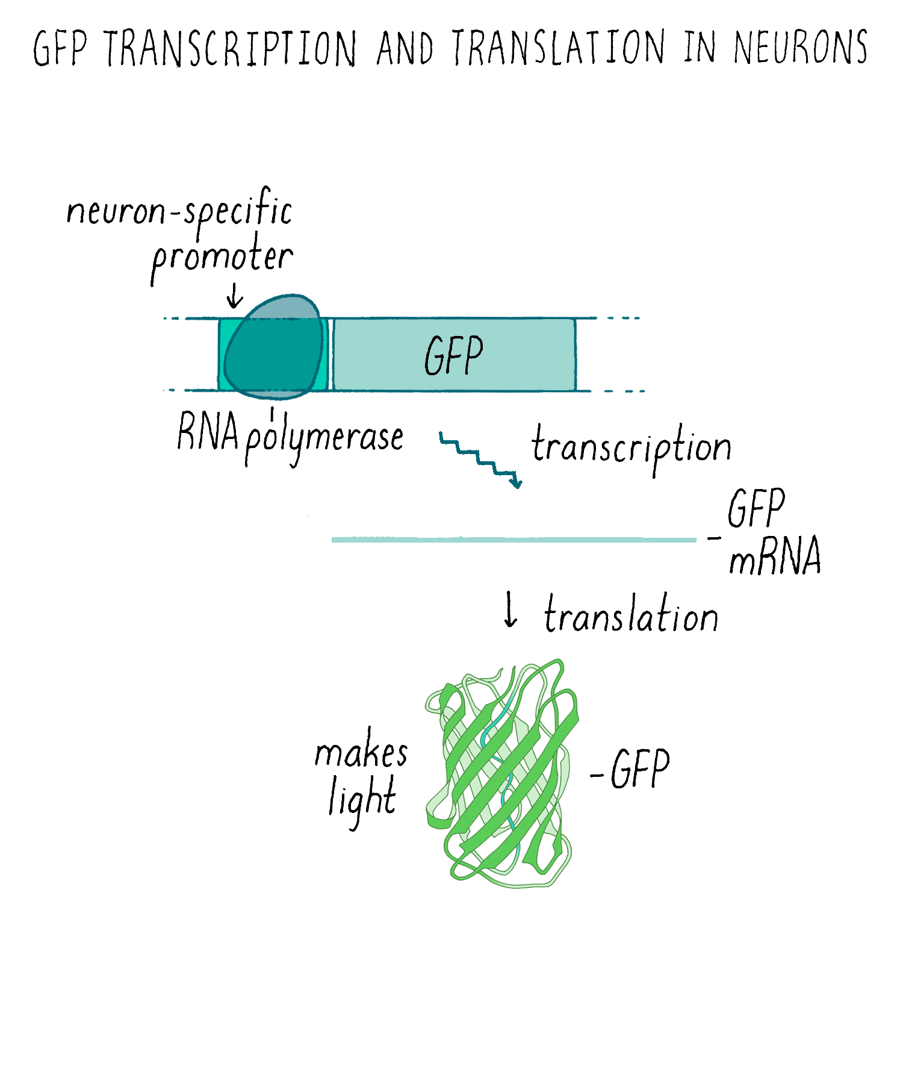
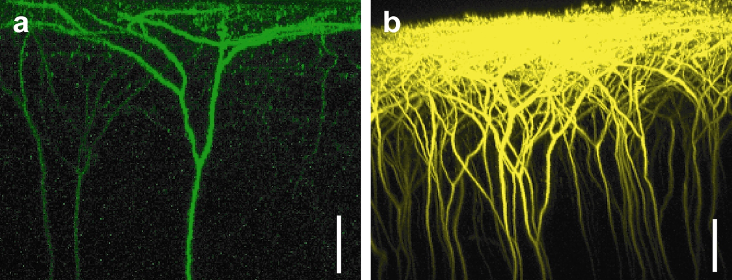
Using fluorescent proteins as gene reporters
GFP expressed wherever original promoter is active

Slide 7
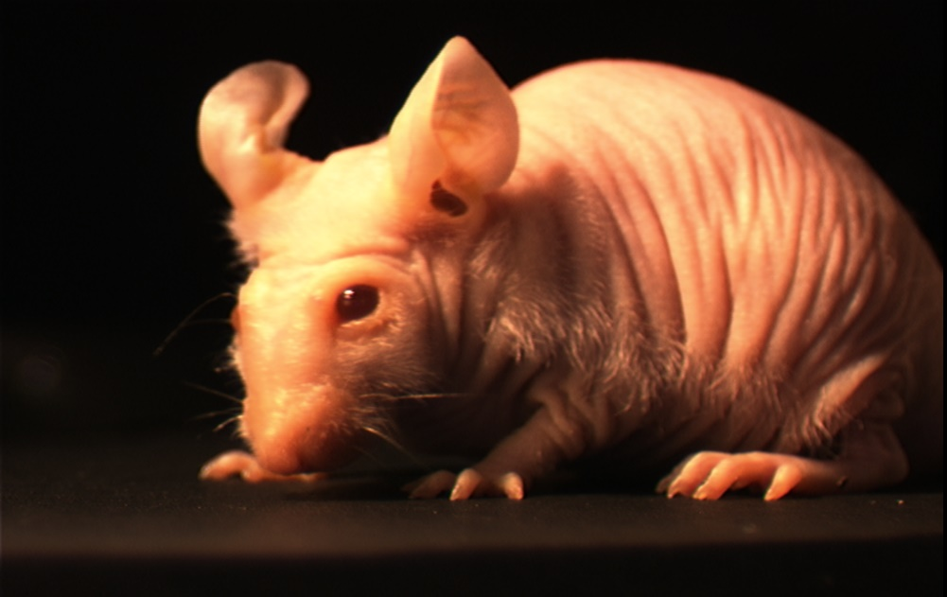
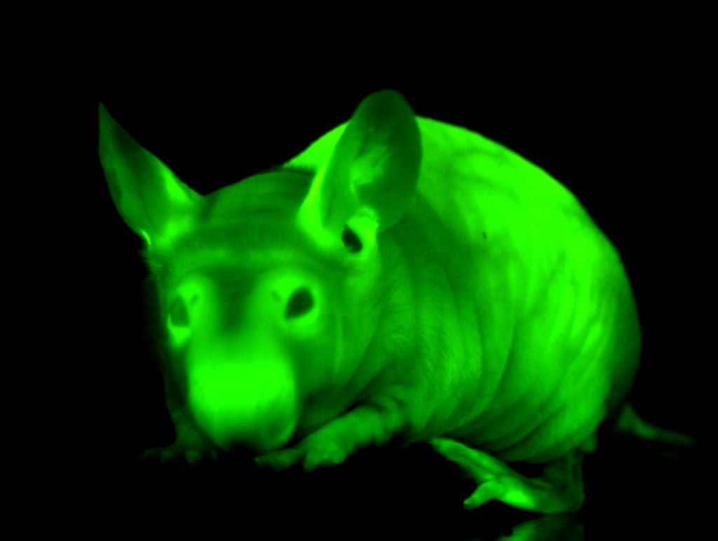
Transgenic GFP mice
Under normal light
Under blue light

Slide 8
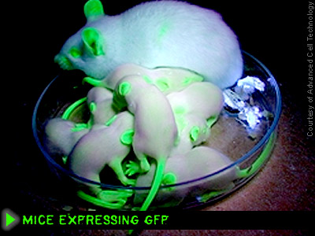
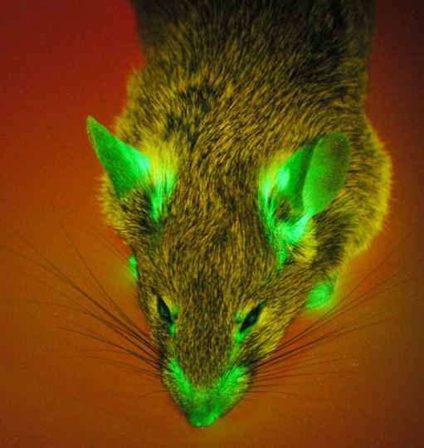

Slide 9
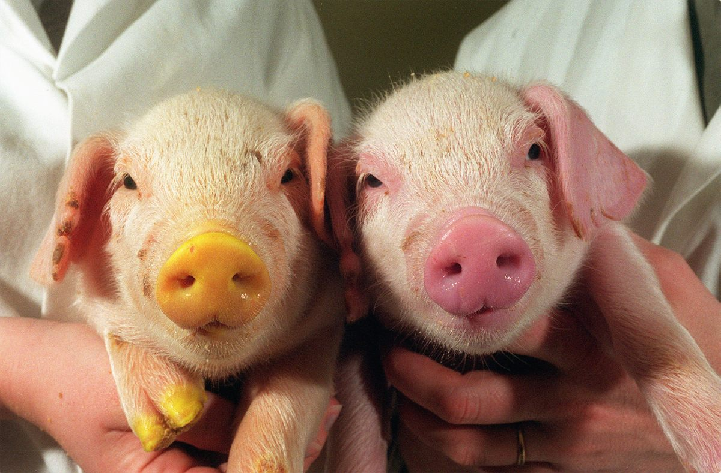
Transgenic pigs

Slide 10
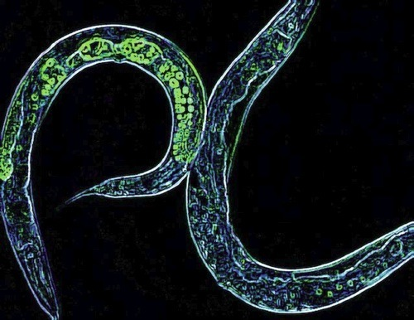

Slide 11
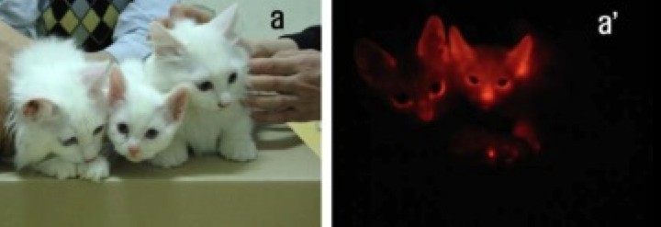
…and cats

Slide 12
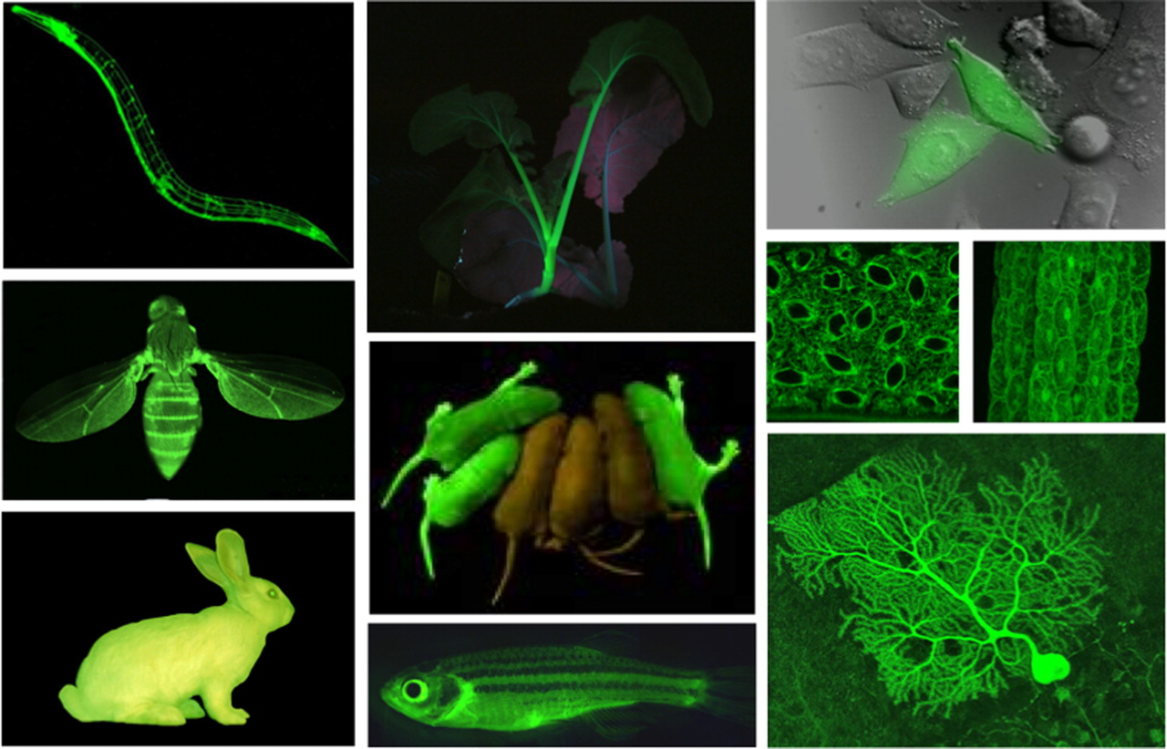

Slide 13
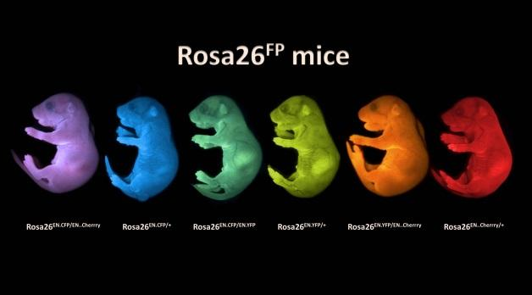

Slide 14
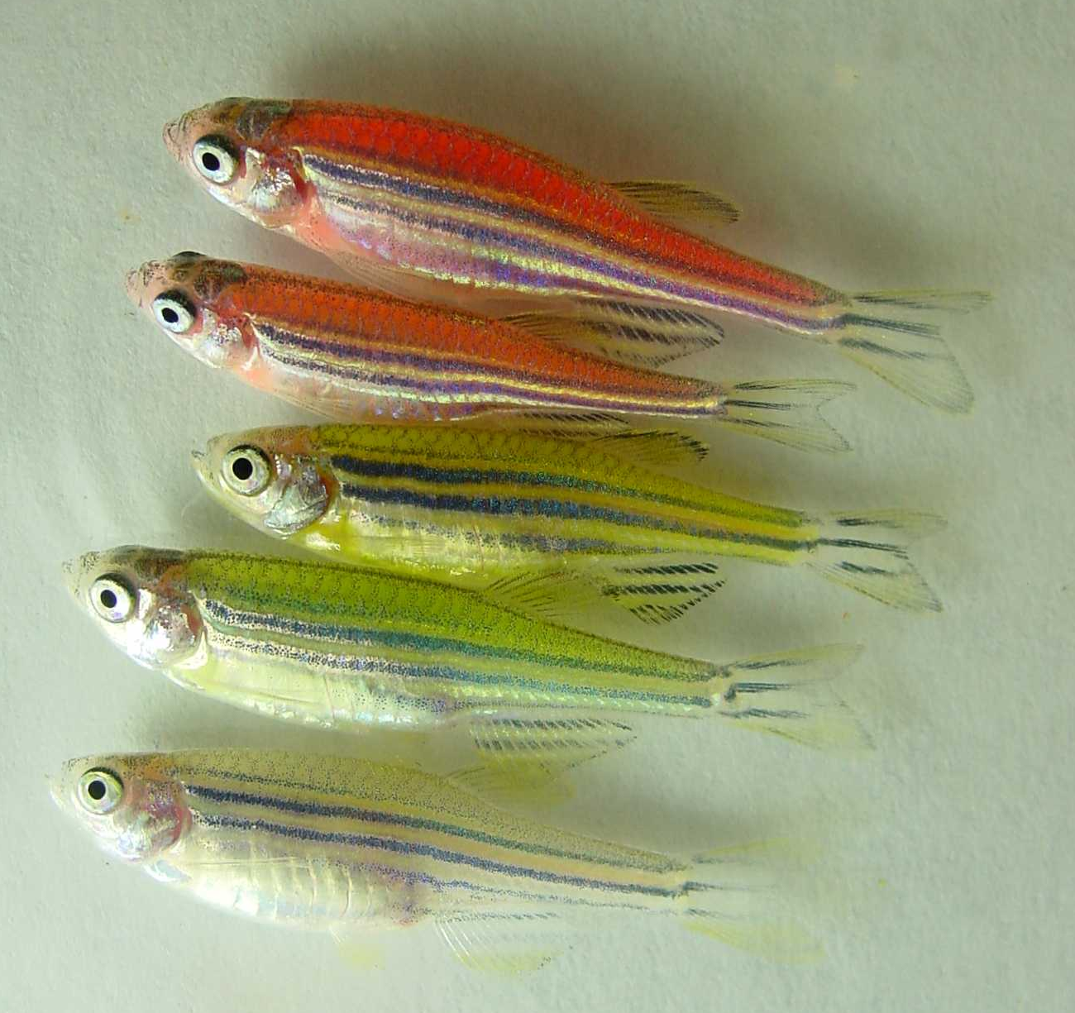
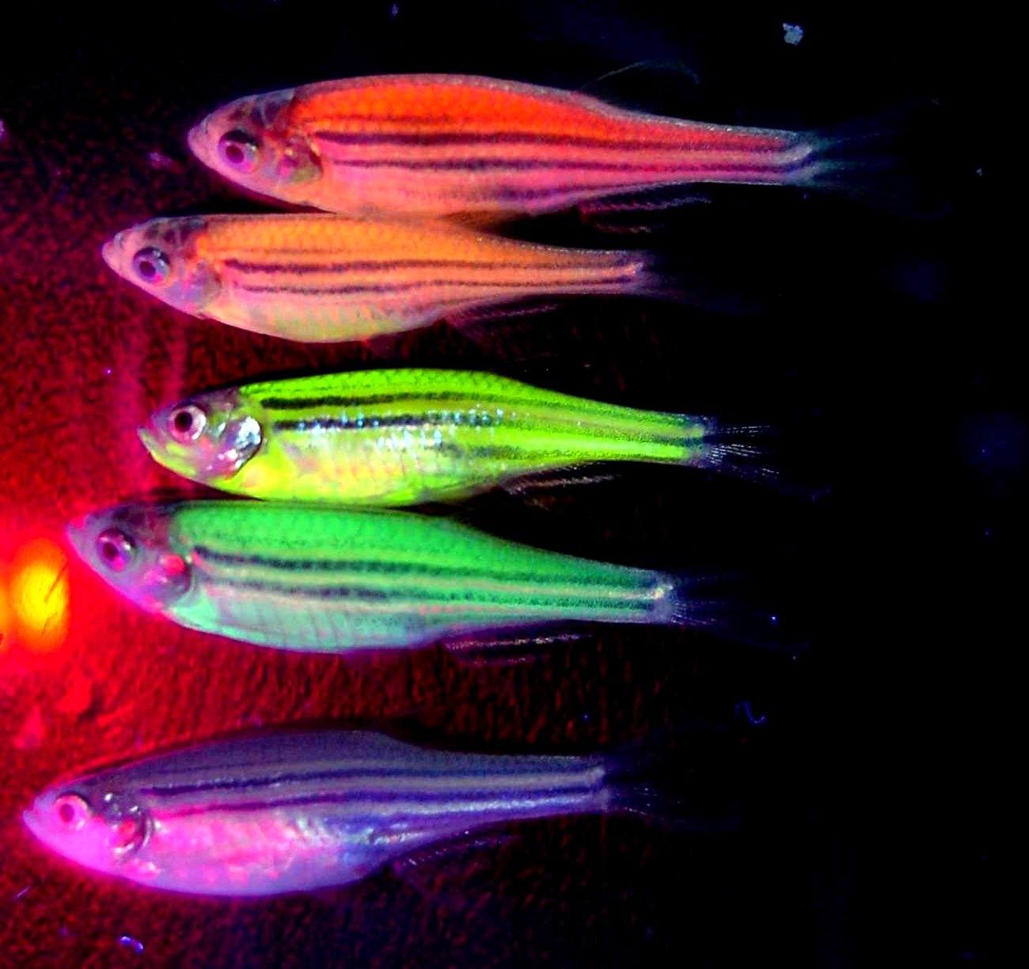
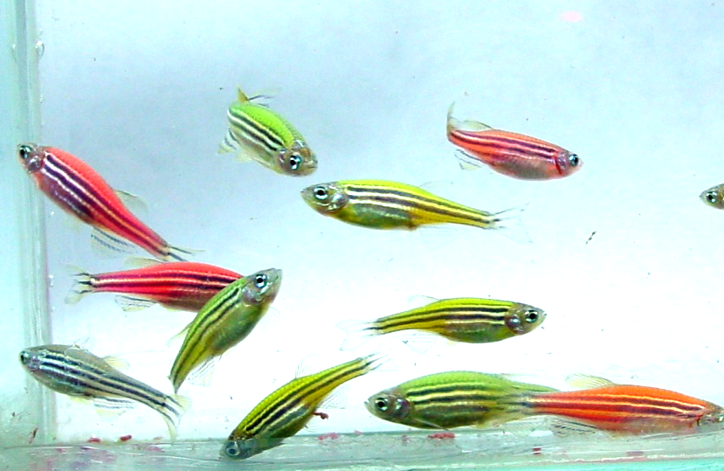
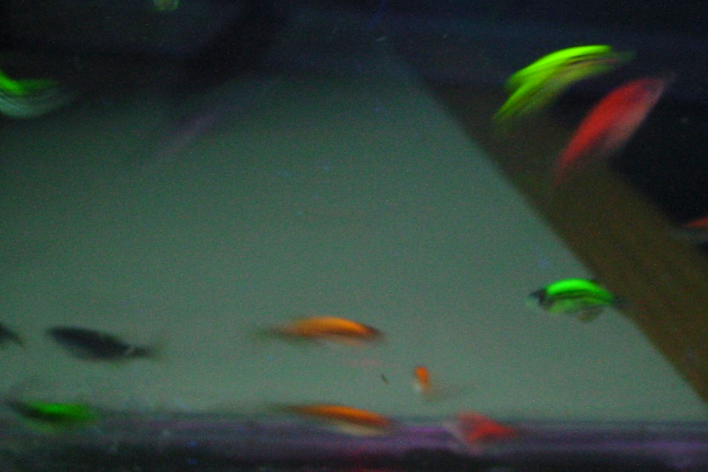
…and fish
A
B
Red
Red
Orange
Orange
Yellow
Yellow
Green
Green
Wild Type
Wild Type
C
D

Slide 15


Slide 16
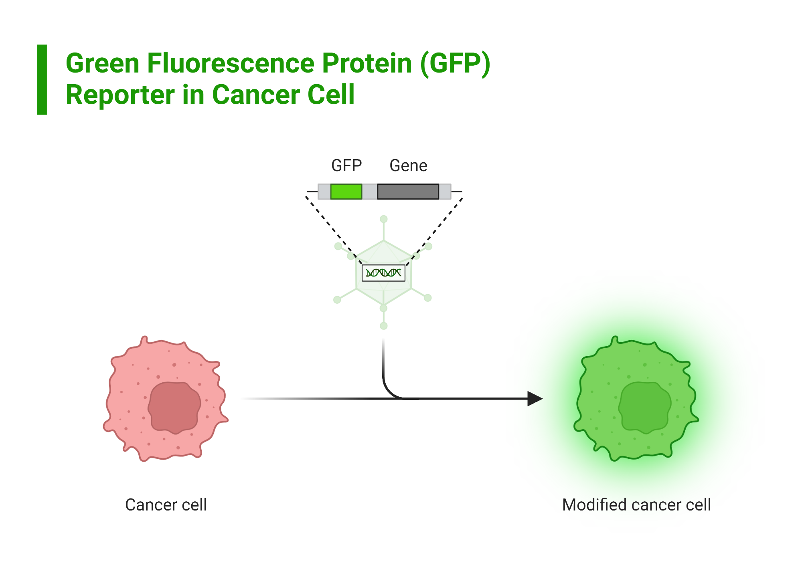
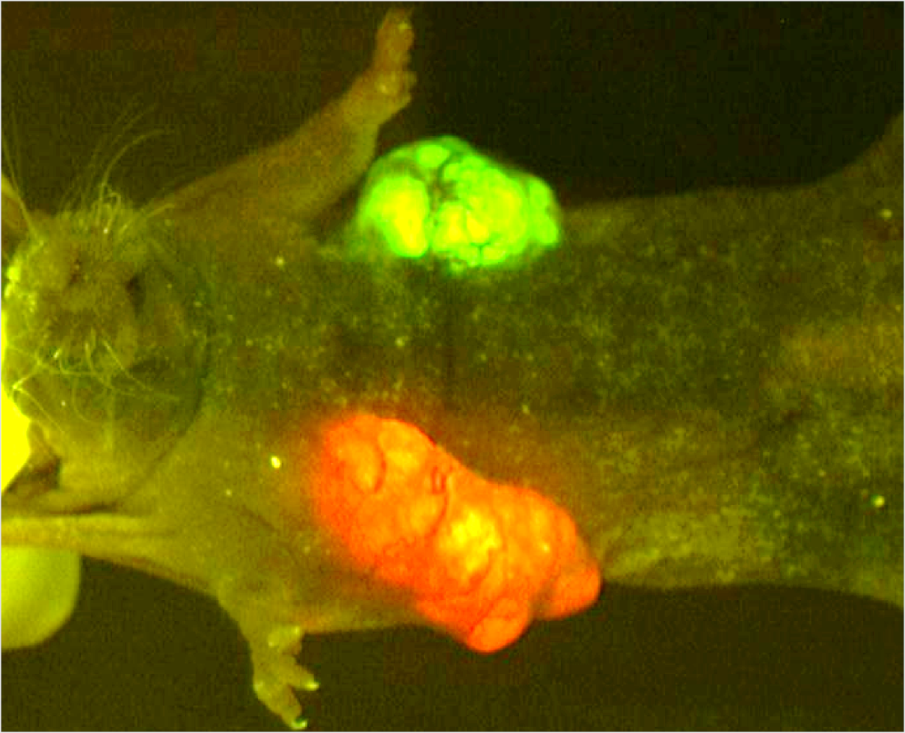
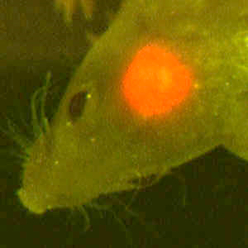
Mice with FP expressing tumors

Slide 17
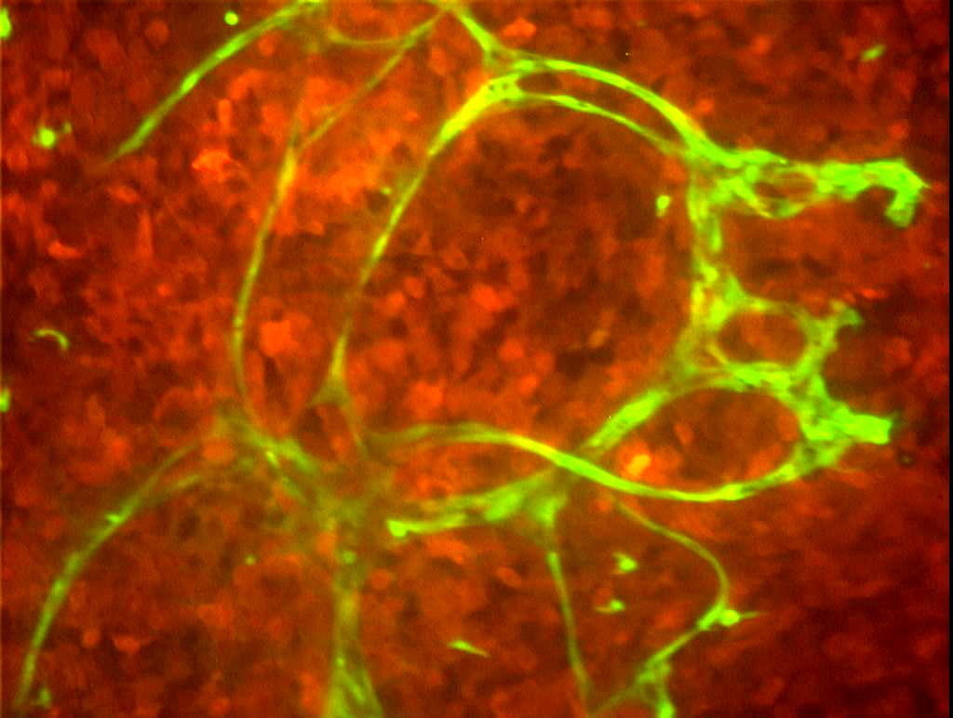
Visualizing tumor angiogenesis
GFP expressing
blood vessels
RFP expressing tumor

Slide 18
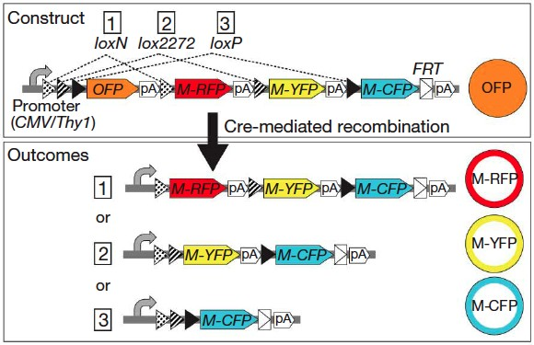
Expressing three color combinations

Slide 19
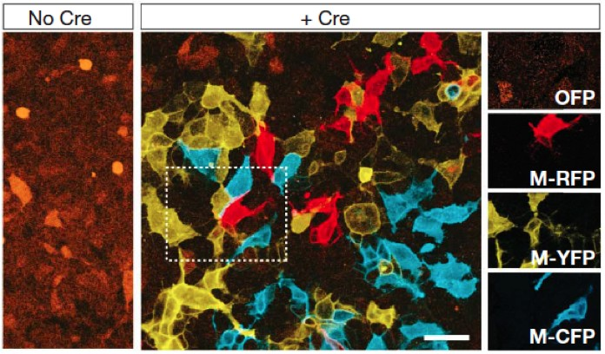
In tissue culture cells

Slide 20
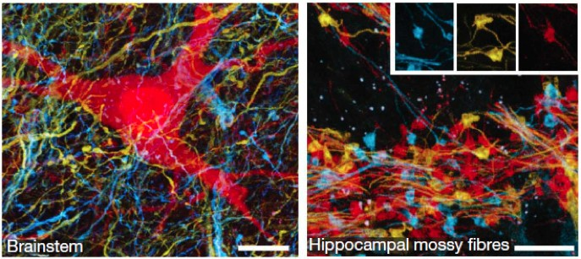
And in brains

Slide 21
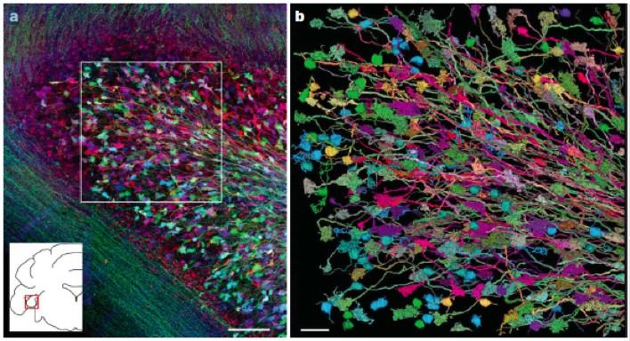

Slide 22
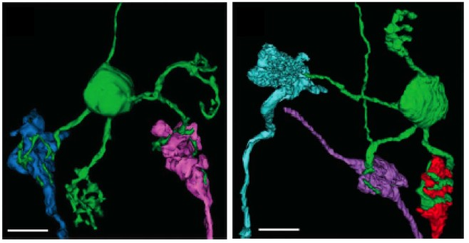
Individual neurons

Slide 23
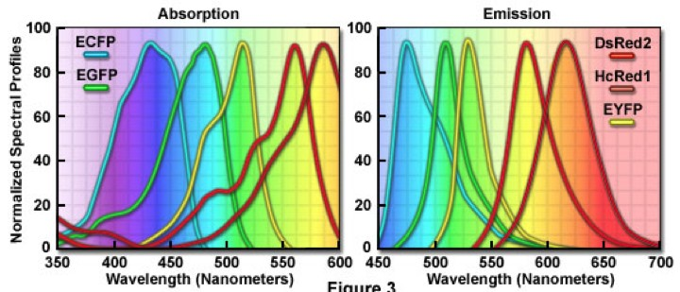
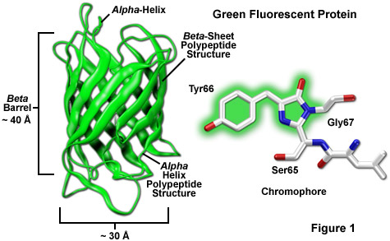
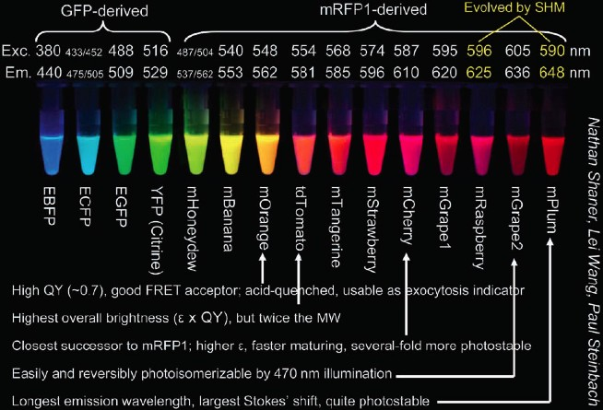
The fluorescent protein palette

Slide 24
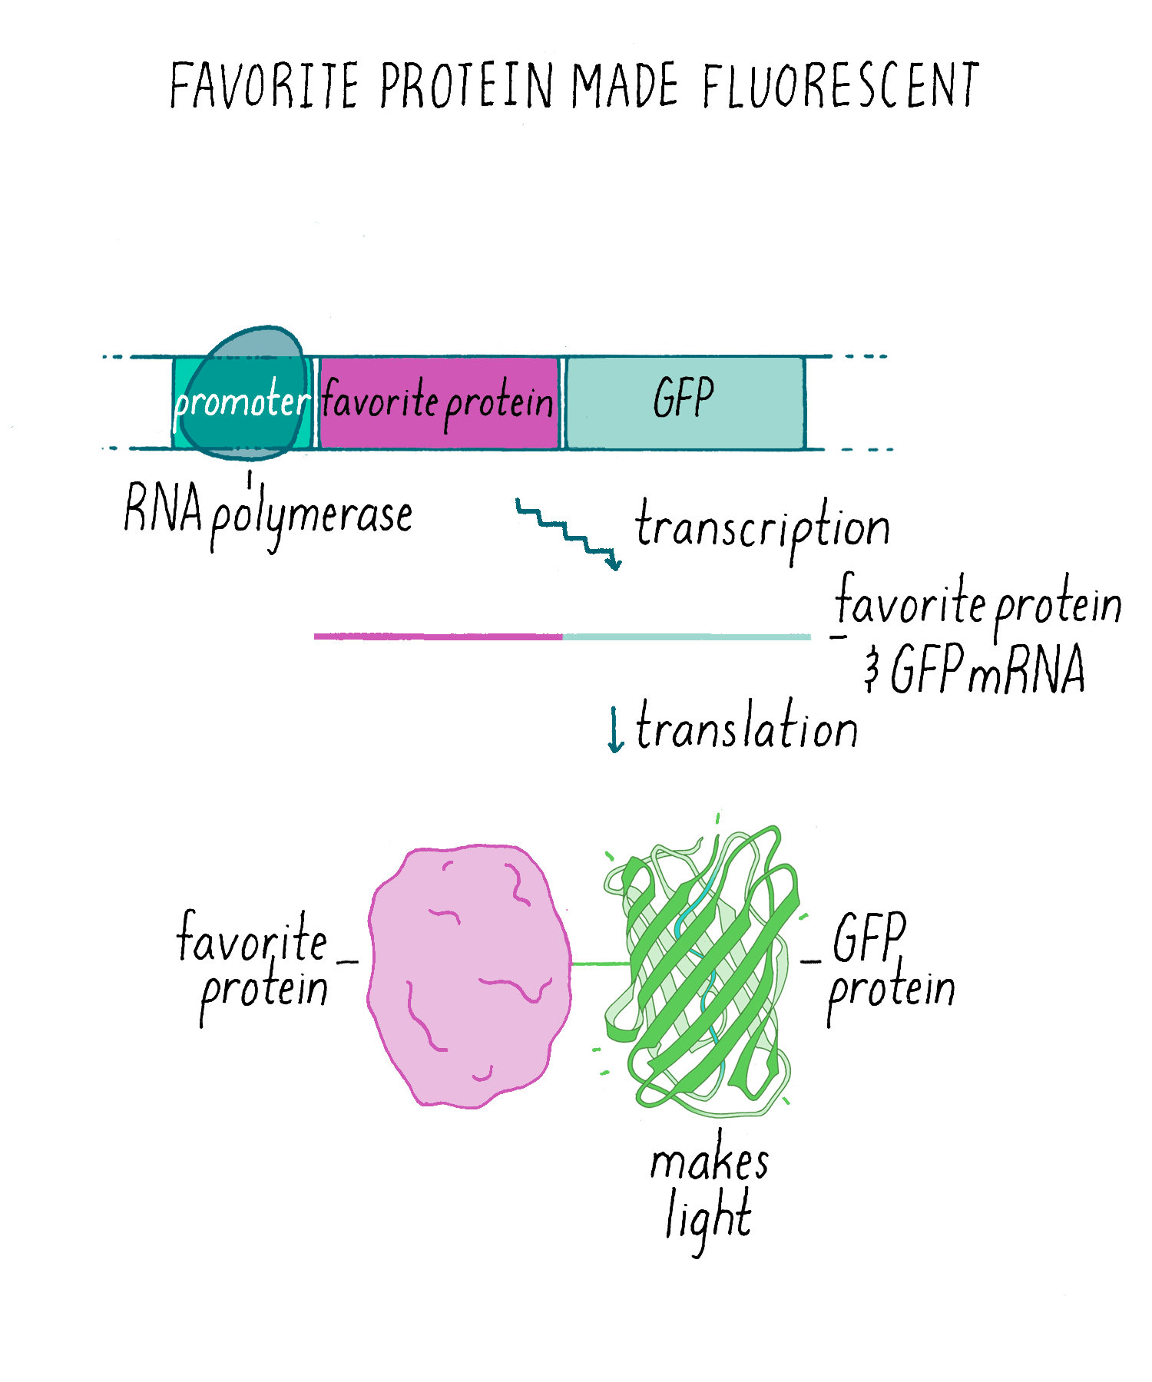
Use of Green Fluorescent Protein (GFP)
As a tag to localize proteins

Slide 25
Use of Green Fluorescent Protein (GFP)
As a tag to localize proteins
  The GFP-encoding sequence is placed at the beginning or end of the gene for another protein
  This yields a chimeric protein consisting of the protein of interest with a GFP domain attached
  GFP-fusion protein often behaves like the original protein, directly revealing its subcellular location

Slide 26
Proponiamo il
5 il 21 giugno e
il 17 luglio.

Slide 27
Using fluorescent proteins as fusion proteins
GFP expressed wherever (original) promoter is active
cell is fluorescent according to original protein presence

Slide 28
Three ways to make Green fluorescent protein “GFP” fusion constructs:
PROTEIN X
GFP
C-Ter Fusion
GFP
PROTEIN Y
N-Ter Fusion
PROTE-
GFP
-in Z

Slide 29
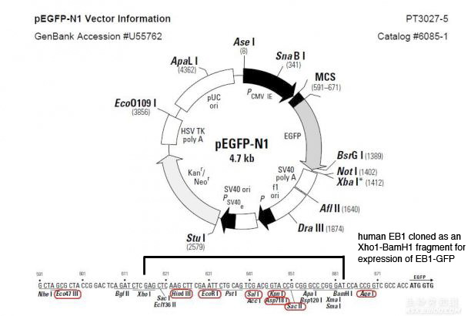
Clone protein HERE
PROTEIN X
GFP

Slide 30
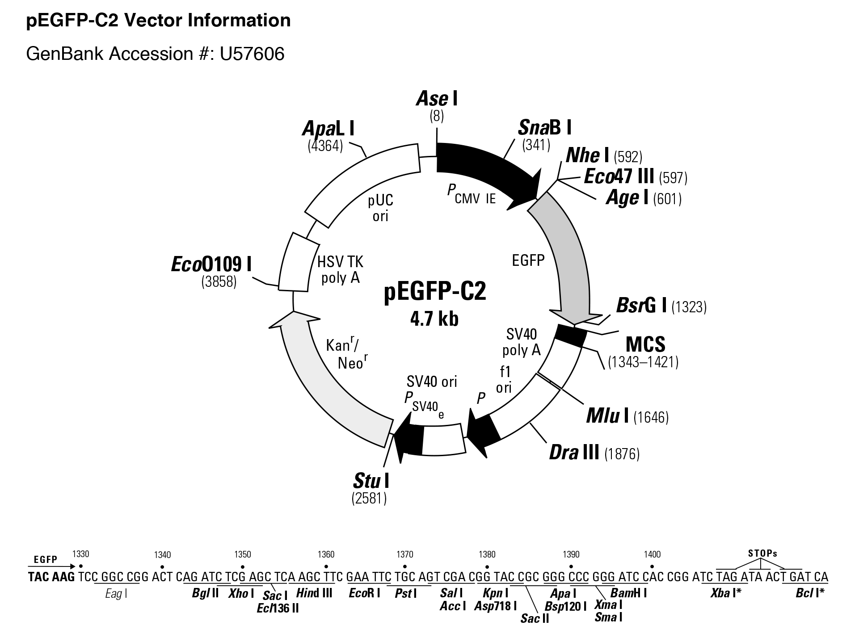
Clone protein HERE
GFP
PROTEIN Y

Slide 31
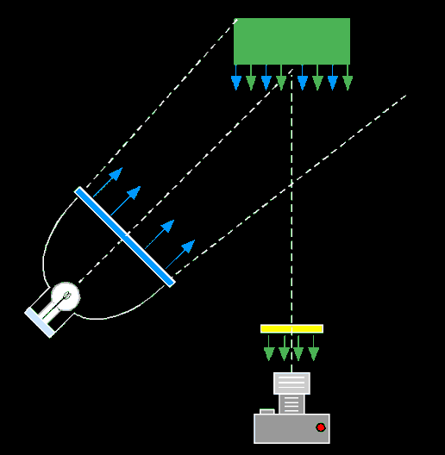
How to Image Fluorescence
Exciter filter
Barrier filter
Excitation source
Imaging device

Slide 32
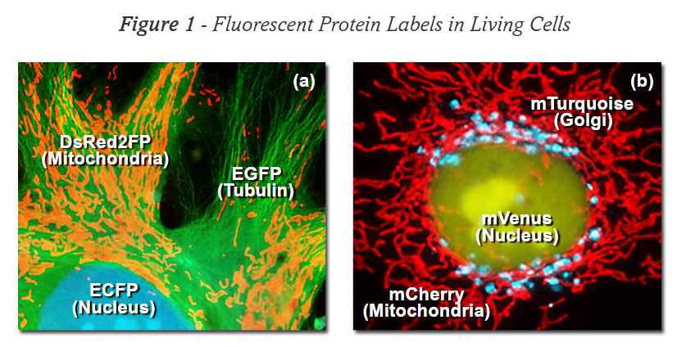
multiple fluorescent protein labeling in living cells using fusion products targeted at sub-cellular (organelle) locations.

Slide 33
Fig. 3. (A-L) Subcellular localization of selected monomeric FP fusions (listed in Table 1) with targeting proteins imaged in widefield fluorescence. Images are pseudocolored to match the FP emission profile.
(A) EBFP2-mito-N-7 (human cytochrome C oxidase subunit VIII; mitochondria);
(B)mCerulean-paxillin-N-22 (chicken;
focal adhesions);
(C) mTFP1-actin-C-7 (human _x0004_-actin; filamentous actin);
(D)mEmerald-keratin-N-17 (human cytokeratin
18; intermediate filaments);
(E) superfolder GFP-lamin B1-C-10
(human lamin B1; nuclear envelope);
(F) mVenus-Cx43-N-7 (rat _x0005_-1 connexin-43; gap junctions);
(G) YPet-EB3-N-7 YPet-EB3-N-7 (human microtubule-associated protein; RP/EB family
(H) mKO-Golgi-N-7 (Nterminal
81 amino acids of human _x0004_-1,4-
glactosyltransferase; Golgi complex);
(I) tdTomato-zyxin-N-7 (human zyxin;
focal adhesions);
(J) TagRFP-tubulin-C- 6 (human _x0005_-tubulin; microtubules);
(K)mCherry-vimentin-N-7 (human
vimentin; intermediate filaments);
(L)mPlum-_x0005_-actinin-N-19 (human nonmuscle; cytoskeleton).
M-Q) Fusion of mEGFP with human histone H2B (mEGFP-H2B-N-6). (M) interphase;
(N)prophase; (O) prometaphase;
(P)metaphase; (Q) anaphase.

Slide 34
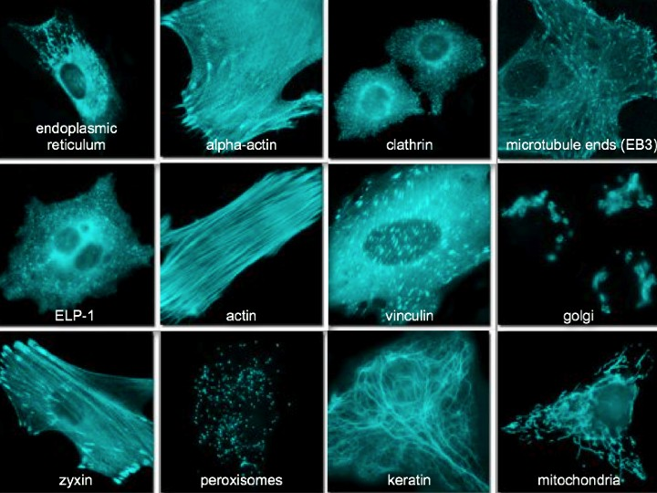
Michael W. Davidson

Slide 35
