Slide 1
Nanoparticle Synthesis
  Wet Chemistry
  High-temperature decomposition of organic precursors
  Attrition
  Pyrolysis
  RF Plasma
  Pulsed Laser Method
  Biosynthesis
  …..

Slide 2
Liquid phase synthesis
Precipitating nanoparticles from a solution of chemical compounds can be classified into five major categories:
(1) colloidal methods;
(2) sol – gel processing;
(3) microemulsions method;
(4) hydrothermal synthesis;
(5) polyol method.
Solution precipitation relies on the precipitation of nanometer-sized particles within a continuous fluid solvent. An inorganic metal salt, such as chloride, nitride and so on, is dissolved in water. Metal cations exist in the form of metal hydrate species, for example, Al(H₂O)³⁺ or Fe(H₂O)₆³⁺.
These hydrates are added with basic solutions, such as NaOH or NH₄OH.
The hydrolyzed species condense and then washed, filtered, dried and calcined in order to obtain the final product.

Slide 3

Colloidal Chemical Methods
Colloidal methods are simple, easy, cheap and well established wet chemistry precipitation processes in which solutions of the different ions are mixed under controlled temperature and pressure to form insoluble precipitates.
For metal nanoparticles the basic principles of colloidal preparation were known since antiquity. E.g. gold colloids used for high quality red and purple stained glass from medieval times to date.
However, proper scientific investigations of colloidal preparation methods started only in 1857 when Faraday has published results of his experiments with gold. He prepared gold colloids by reduction of HAuCl₄ with phosphorus.
Aggregation is prevented by electrostatic repulsion or the introduction of a stabilizing reagent that coats the particle surfaces.
Particle sizes range from 1-200 nm and are controlled by the initial concentrations of the reactants and the action of the stabilizing reagent.

Slide 4
Precipitation/coprecipitation
Mg²⁺_{(aq)} + 4H₂O → Mg(OH)₂ +2H₃O⁺_{(aq)}
K_{ps} = [Mg²⁺ ][OH⁻]² = 1,8 x 10⁻¹¹
Fine tuning of pH to avoid consecutive precipitation
Metal precursors chlorides, nitrates, acetate,..
Precipitating agents, NaOH, NH₄OH, Na₂CO₃….
Precipitate must
Be cheap:
have low solubility;
be easy to decompose;
lead to safe decomposition.

Slide 5
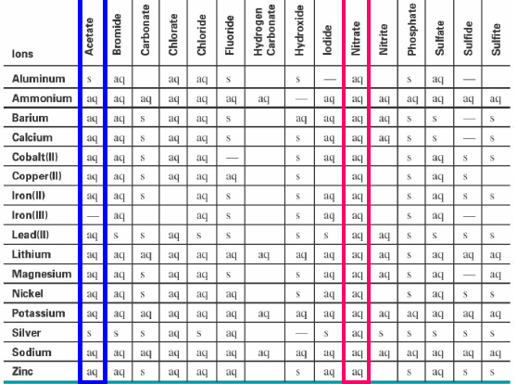
Solubility : RT and atm P

Slide 6
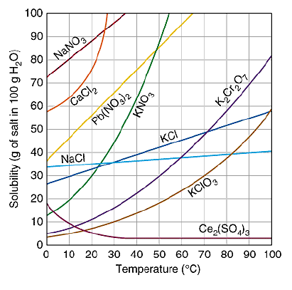
Solubility : effect of temperature

Slide 7
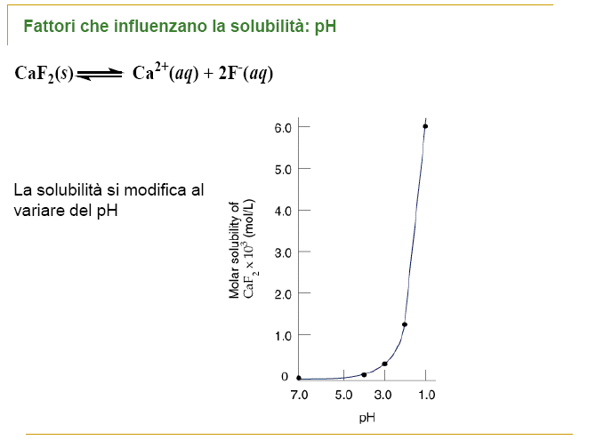
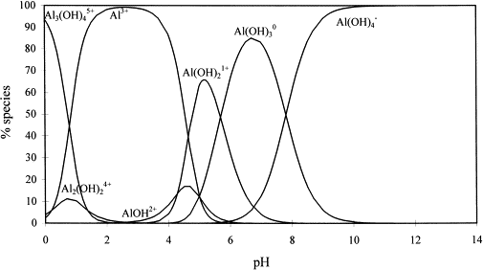
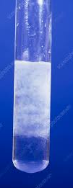
Solubility : effect of pH

Slide 8
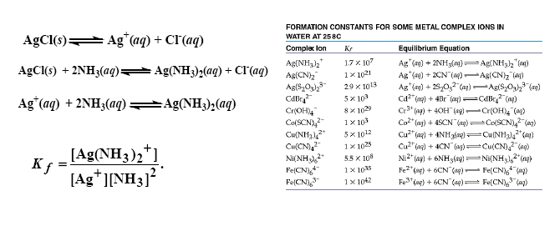
Solubility : Complex formation

Slide 9
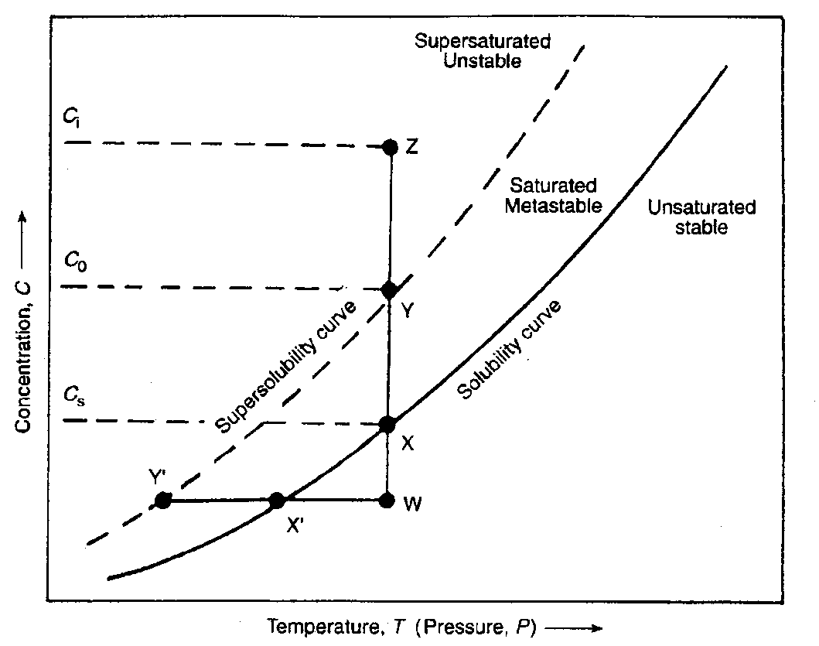
Precipitation/coprecipitation
Precipitation occurs in three steps
supersaturated solution;
nucleation;
grain growth
The solubility curve is a function of temperature and concentration (pH); the supersaturated solution is unstable. The supersaturated conditions can be obtained by solvent evaporation, by dropping the temperature or by increasing the pH of the solution.
• Saturated solution: A solution that contains the maximum amount of a solute that can be dissolved at equilibrium at a given temperature.
• Unsaturated solution: A solution that contains less than the maximum amount of a solute that can be dissolved at a given temperature.
• Supersaturated solution: A solution that contains more than the maximum amount of a solute that can be dissolved under equilibrium conditions at a given temperature. When a supersaturated solution is disturbed in any way, the excess solute will separate and the equilibrium solubility is restored.

Slide 10
Precipitation /co-precipitation
Nucleation = the appearance of «solid nuclei» in the solution. It can be homogeneous (agglomeration of ions from the pure solution) or heterogeneous (crystallization agents).
The dimension of the final nanoparticles depends on the ration between the rates of nucleation and growth, and on the possible aging strategies.
nucleation growth
The rate of nucleation depends on the level of supersaturation (easier preparation with low solubility compounds)
Highly soluble compounds leads to a rapid dissolution of the smallest nanoparticles followed by deposition on the largest nanoparticles with the obtainment of large precipitate.
primary
time
          Induced /secondary

Slide 11
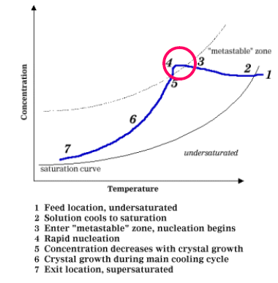
Precipitation /co-precipitation

Slide 12
Precipitation/coprecipitation
Weimarn’s law
D x C₀ = constant
C₀ = initial concentration
D = particle dimention
C_{s} = solubility
L₁’ > L₁” > L₁”’ = solubility
When C₀ is high = the precipitation is controlled by nuclei formation
When C₀ is small = the precipitation is controlled by the rate of nuclei growth

Slide 13
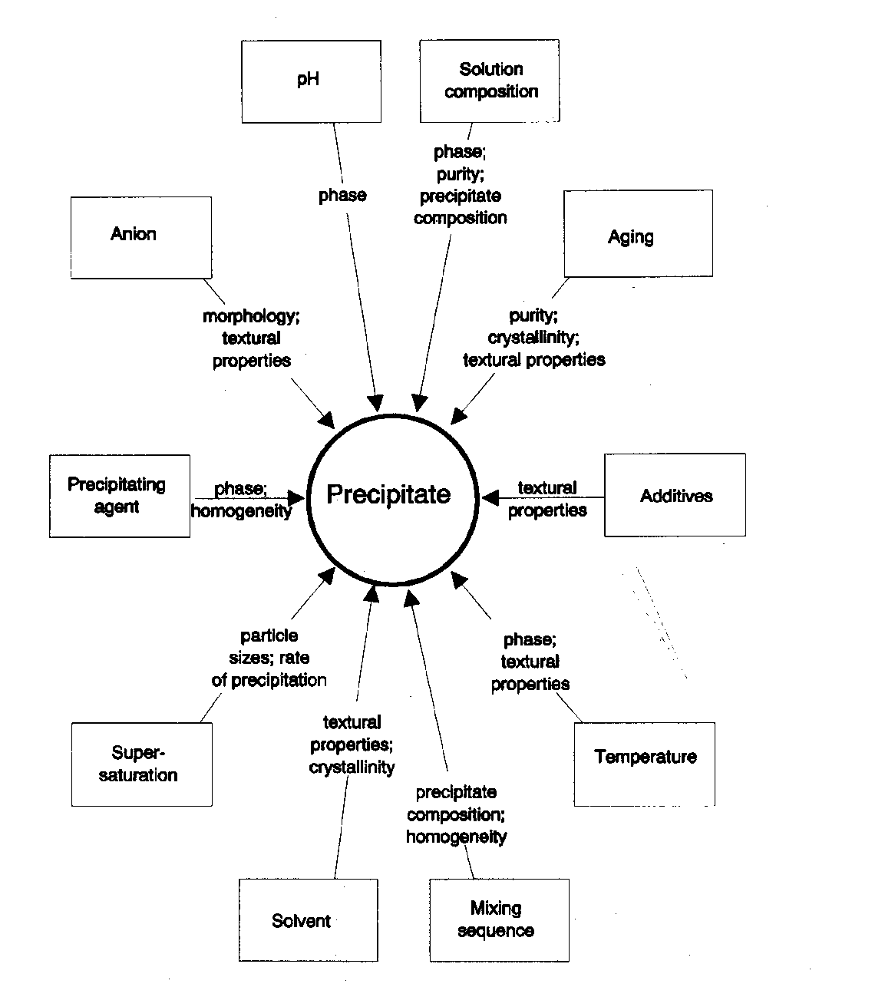
Factors influencing precipitate formations

Slide 14
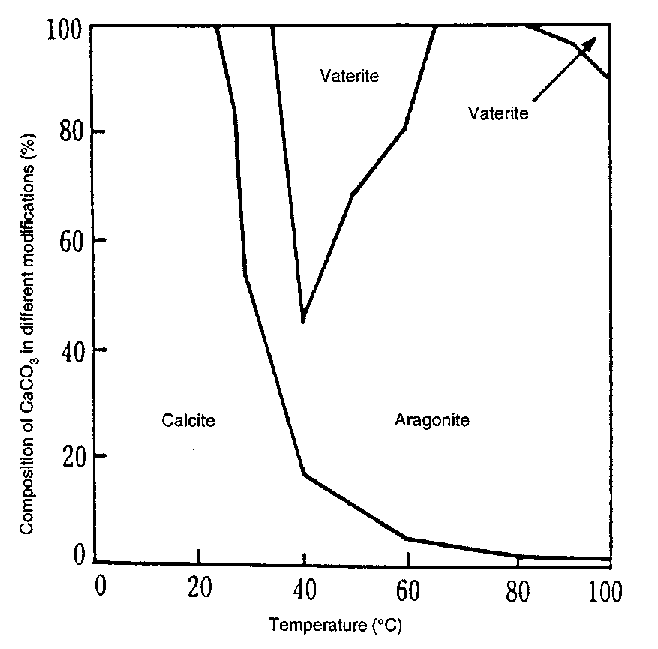
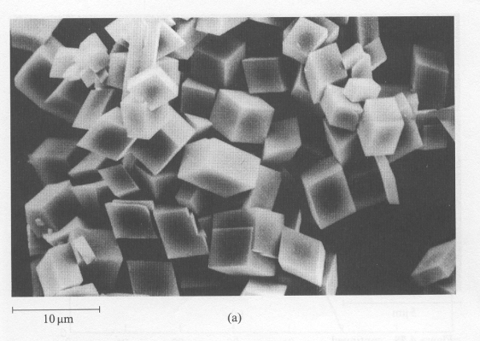
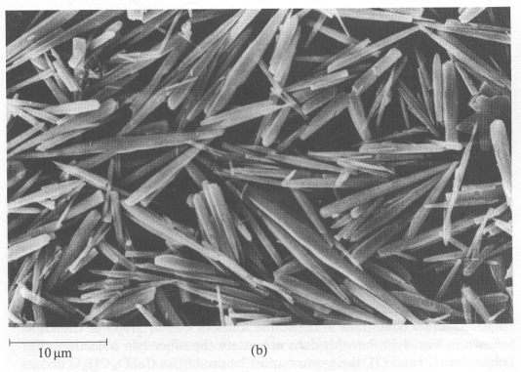
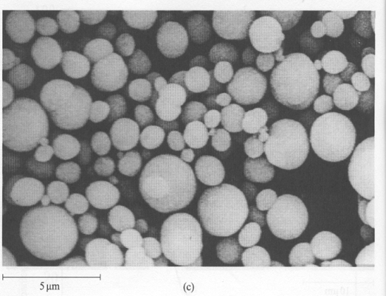
Precipitation/coprecipitation
Effect of Temperature and Concentration on the precipitation of CaCO₃
(a) Calcite (T<25°C)
(b)Aragonite (70-80°C)
(c) Vaterite (T> 40°C high concentration)
Ca(HCO₃)₂ (aq) → CaCO₃ ↓ + H₂O + CO₂

Slide 15
Precipitation/coprecipitation
Ca(OH)₂
CaCl_{2 (aq)}+2 NaOH _{(aq)} → Ca(OH)₂ _{(s)} + 2 NaCl _{(aq)}

Slide 16
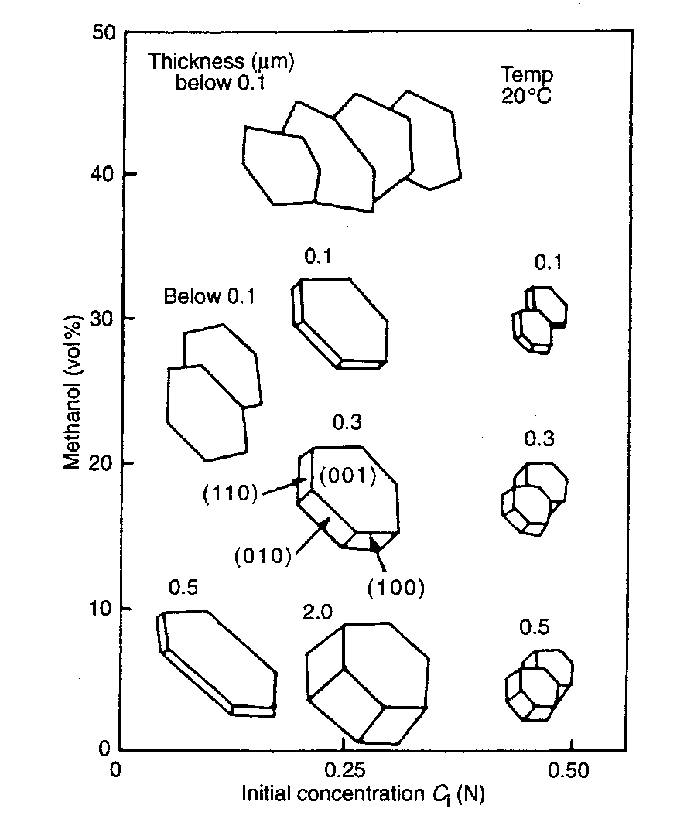
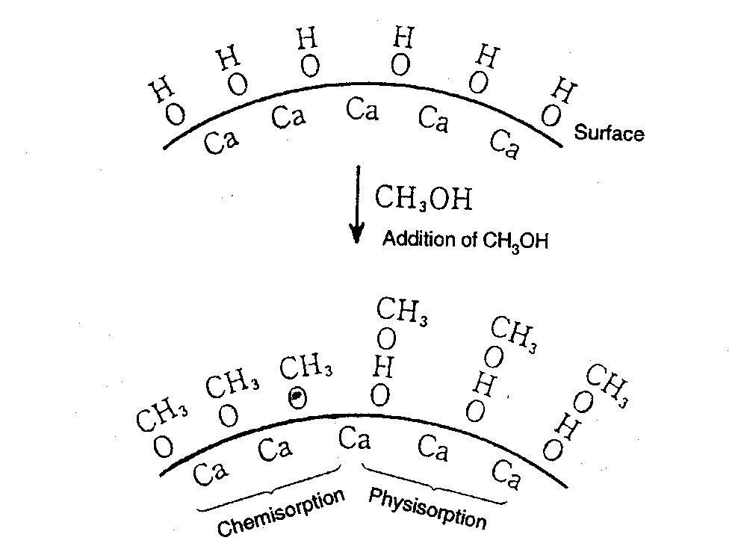
Precipitation/coprecipitation
Addition of NaOH to a CaCl₂/H₂O/methanol solution
Adsorption of •OCH₃ on the 001 facets with the suppression /inhibition of their growth

Slide 17
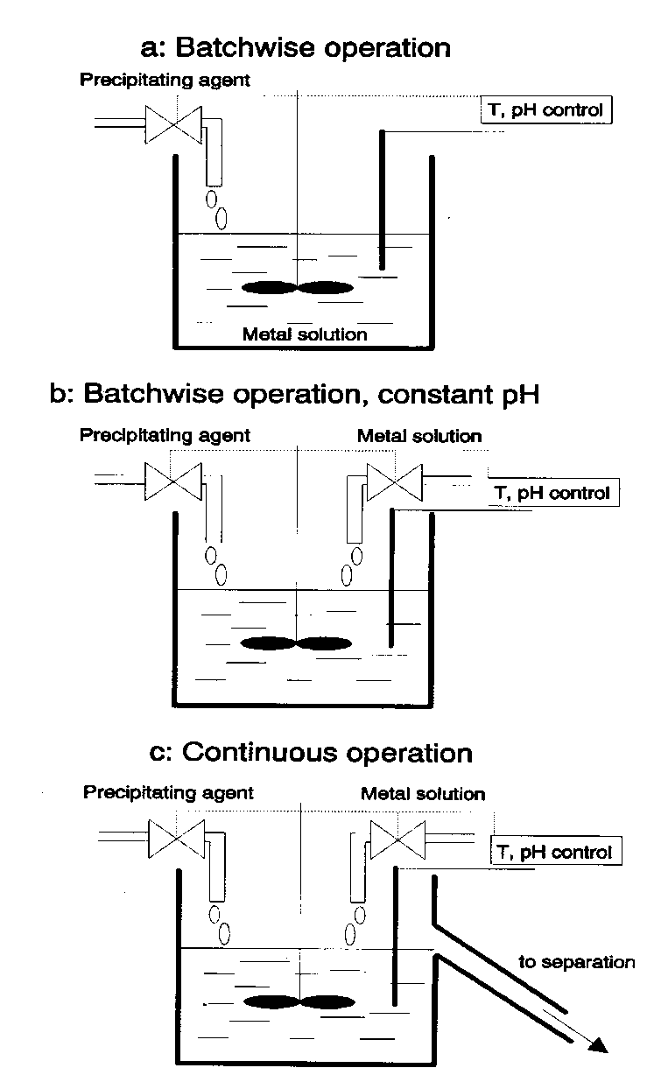
Precipitation by increasing pH
:
  increasing the pH (one element to precipitate)
  at constant pH (the most used case)
  at constant pH in a continuous flow

Slide 18
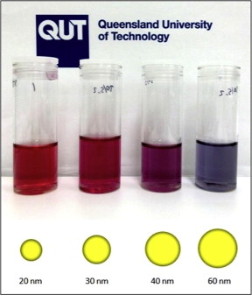
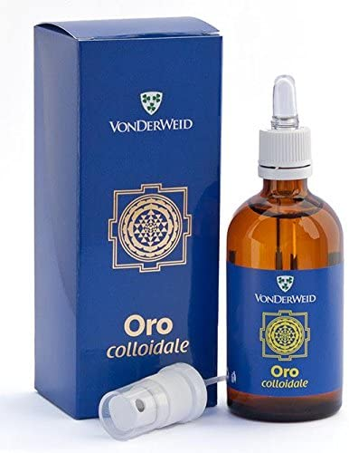
Colloidal Chemical Methods
Examples: Gold
  A common method for preparing colloidal gold nanoparticles involves combining hydrogen tetrachloroaurate (HAuCl₄) and sodium citrate (Na₃C₆H₅O₇) in a dilute solution.
  Upon dissociation, the citrate ions (C₆H₅O₇³⁻) reduce Au³⁺ to yield 30-40 nm gold particles.

Slide 19
Formation of Gold Nanoparticles
Sodium
Citrate
Red Color = Gold NP
HAuCl₄
HAuCl₄
Gold
NP
Heat
Heat a solution of chloroauric acid (HAuCl₄) up to reflux (boiling). HAuCl₄ is a water soluble gold salt.
Add trisodium citrate, which is a reducing agent.
Continue stirring and heating for about 10 minutes.
  During this time, the sodium citrate reduces the gold salt (Au³⁺) to metallic gold (Au⁰).
  The neutral gold atoms aggregate into seed crystals.
  The seed crystals continue to grow and eventually form gold nanoparticles.
J. Chem. Ed. 2004, 81, 544A.

Slide 20
Formation of Gold Nanoparticles
Reduction of gold ions: Au(III) + 3e⁻ → Au(0)
Seed Crystal
10’s to 100’s of Atoms
Nucleation of Au(0) seed crystals:
Growth of nanoparticles:
Isotropic
Growth
Spherical
Nanoparticles
Surface capped
with citrate anions
Seed
Adding surfactant to growth solution
caps certain crystal faces and promotes
growth only in selected directions.
Anisotropic
Growth
Nanorods

Slide 21
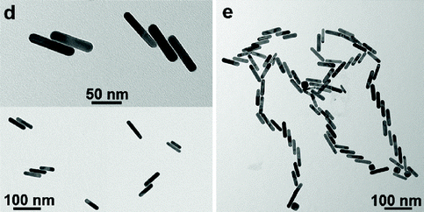
Colloidal Gold Nanorod Clusters
A seed solution of gold nanoparticles was prepared by borohydride (30 mM, 0.3 mL) reduction of HAuCl₄ (0.25 mM, 5 mL) in aqueous cetyltrimethylammonium bromide (CTAB) solution (0.1 M).
2. An aliquot of seed solution (24 μL) was added to a growth solution (10 mL) containing CTAB (0.1 M), HAuCl₄ (0.5 mM), ascorbic acid (0.8 mM), …... Mixtures were left undisturbed for 4 h at 27 °C.
Langmuir 2012, 28, 24, 8826-8833

Slide 22
Colloidal methods : Molybdenum
  1-5 nm molybdenum nanoparticles can be created at room temperature by reducing MoCl₃ in a toluene solution in the presence of sodium triethylborohydride (NaBEt₃H).
  MoCl₃ + 3NaBEt₃H → Mo + 3NaCl + 3BEt₃ + (3/2) H₂
The main applications of molybdenum nanoparticles are as additives in alloys for hi-tech applications, such as high-vacuum or corrosive environments.
Some of these areas are as follows:
- High-temperature lubrication;
- Hard alloys, cutting tools, textiles;
- Microelectronics films;
- Sintering additives, coatings, plastics, nanowire and nanofiber;
- High-power vacuum valve, heater tube and X-ray tube.

Slide 23
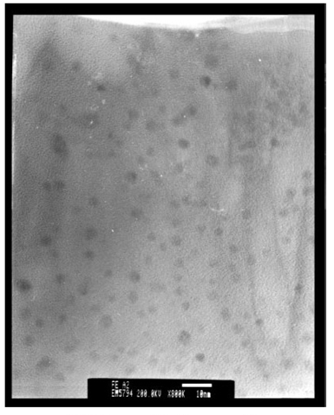
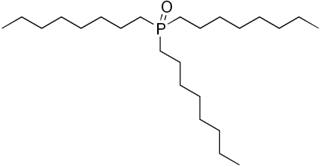
Colloidal methods: Iron
  3 nm Fe nanoparticles produced by reducing FeCl₂ with sodium borohydride (NaBH₄) in xylene.
  Trioctylphosphine oxide (TOPO) was introduced as a capping agent to prevent oxidation and aggregation.
TEM image of Fe nanoparticles
Phys. Chem. Chem. Phys., 2001, 3, 1661-1665

Slide 24
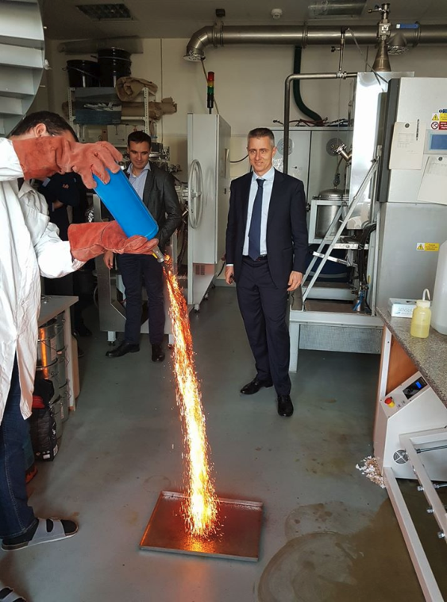
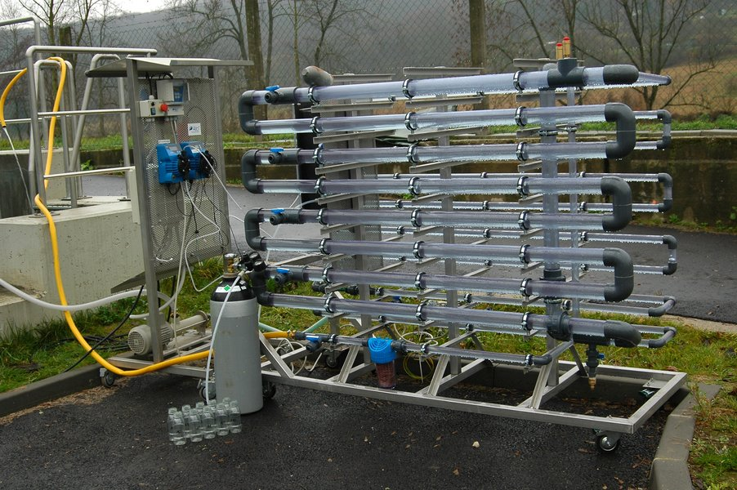
Colloidal methods : Iron
NaBH₄ (0.2 M) is added into FeCl₃•6H₂O (0.05 M) solution (~1:1 volume ratio). Ferric iron is reduced via the following reaction:
4 Fe³⁺ + 3BH₄ ⁻ + 9H₂O → 4Fe⁰ + 3H₂BO₃⁻ + 12H⁺ + 6H₂
Nano zero-valent iron for groundwater cleanup, have been deployed at full-scale cleanup sites
https://nanoiron.cz/en/

Slide 25
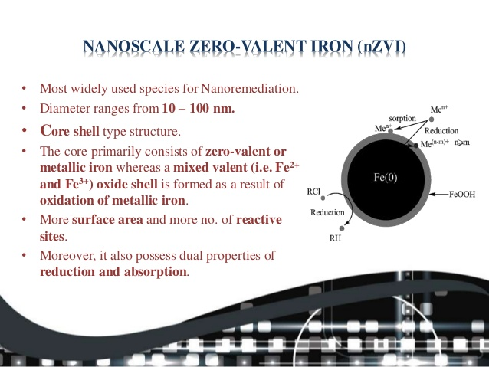

Slide 26
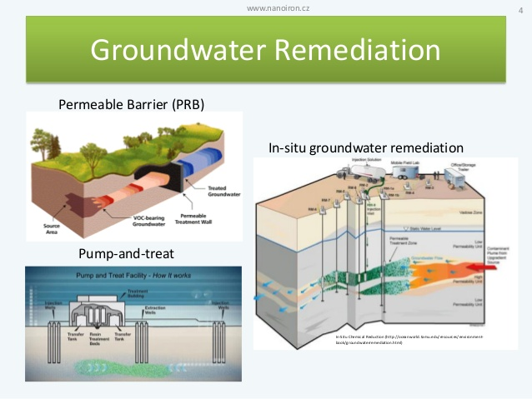

Slide 27
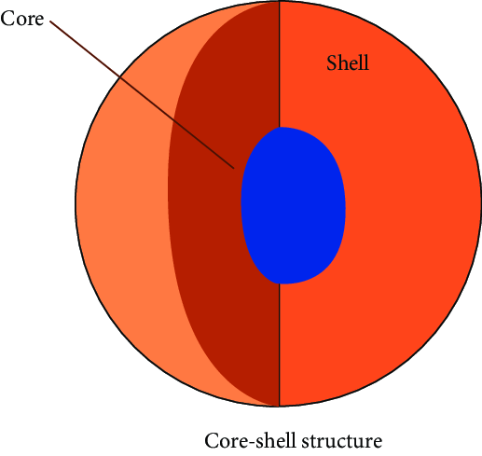
Colloidal methods : M/Fe core-shell nanoparticles
Palladized Fe particles are prepared by soaking the nanoscale iron particles with an ethanol solution of 1wt% of palladium acetate ([Pd(C₂H₃O₂)₂]₃). This causes the reduction and deposition of Pd on the Fe surface:
Pd²⁺ + Fe ⁰ → Pd⁰ + Fe²⁺
Similar methods may be used to prepared Fe/Pt, Fe/Ag, Fe/Ni, Fe/Co, and Fe/Cu bimetallic particles. With the above methods, nanoparticles of diameter 50-70 nm may be produced. The average specific surface area of Pd/Fe particles is about 35 m²/g.

Slide 28
Precipitation of magnetite Fe₃O₄ nanoparticles
2 Fe³⁺ + Fe²⁺ + 8 OH⁻ → Fe₃O₄↓ + 4 H₂O
The size and shape of the nanoparticles can be controlled by adjusting pH, ionic strength, temperature, or the Fe(II)/Fe(III) concentration ratio.
Optimum conditions for this reaction are pH between 8 and 14, Fe³⁺/Fe²⁺ ratio of 2:1 and a non-oxidizing environment.
2 Fe₃O₄ + O₂ → 2 γ - Fe₂O₃ maghemite
"Magnetic Iron Oxide Nanoparticles: Synthesis, Stabilization, Vectorization, Physicochemical Characterizations, and Biological Applications". Chemical Reviews. 108 (6): 2064–110

Slide 29
Ferrofluid Fe₃O₄ nanoparticles
Ferrofluids are composed of very tiny nanoscale particles (diameter usually 10 nanometers or less) of magnetite, hematite or some other compound containing iron, and a liquid. This is small enough for thermal agitation to disperse them evenly within a carrier fluid, and for them to contribute to the overall magnetic response of the fluid.
Common ferrofluid surfactants
The surfactants used to coat the nanoparticles include, but are not limited to:
oleic acid
tetramethylammonium hydroxide
citric acid
soy lecithin
These surfactants prevent the nanoparticles from clumping together, ensuring that the particles do not form aggregates that become too heavy to be held in suspension by Brownian motion. The magnetic particles in an ideal ferrofluid do not settle out, even when exposed to a strong magnetic, or gravitational field.

Slide 30
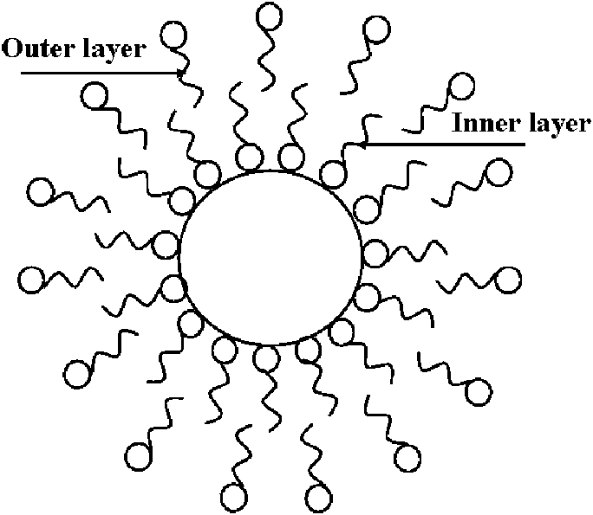
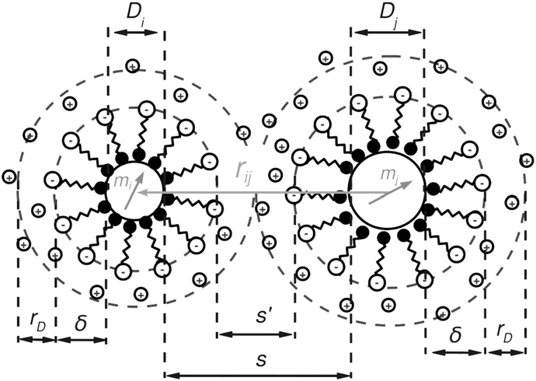
Ferrofluid surfactants
A surfactant has a polar head and non-polar tail (or vice versa), one of which adsorbs to a nanoparticle, while the non-polar tail (or polar head) sticks out into the carrier medium, forming an inverse or regular micelle, respectively, around the particle.
Electrostatic repulsion then prevents agglomeration of the particles.

Slide 31
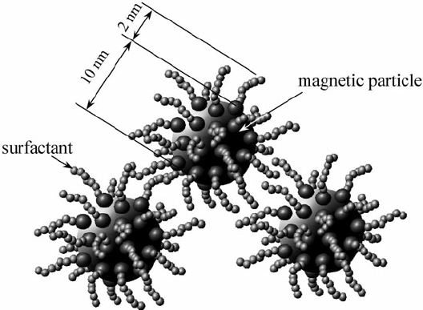
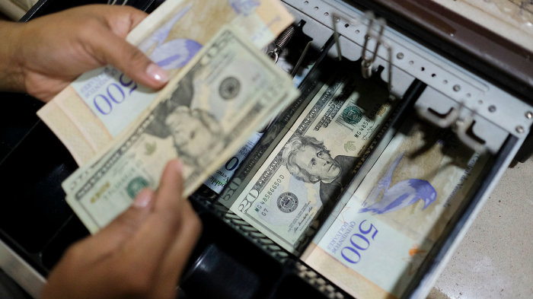
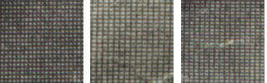
Ferrofluid surfactants
The addition of surfactants decreases the packing density of the ferroparticles while in its activated state, thus decreasing the fluid's on-state viscosity, resulting in a "softer" activated fluid. While the on-state viscosity (the "hardness" of the activated fluid) is less of a concern for some ferrofluid applications, it is a primary fluid property for the majority of their commercial and industrial applications and therefore a compromise must be met when considering on-state viscosity versus the settling rate of a ferrofluid.
The backgrounds from behind the president's face on a $1, $5 and $10 bill: Note the different spacing used in each one.

Slide 32
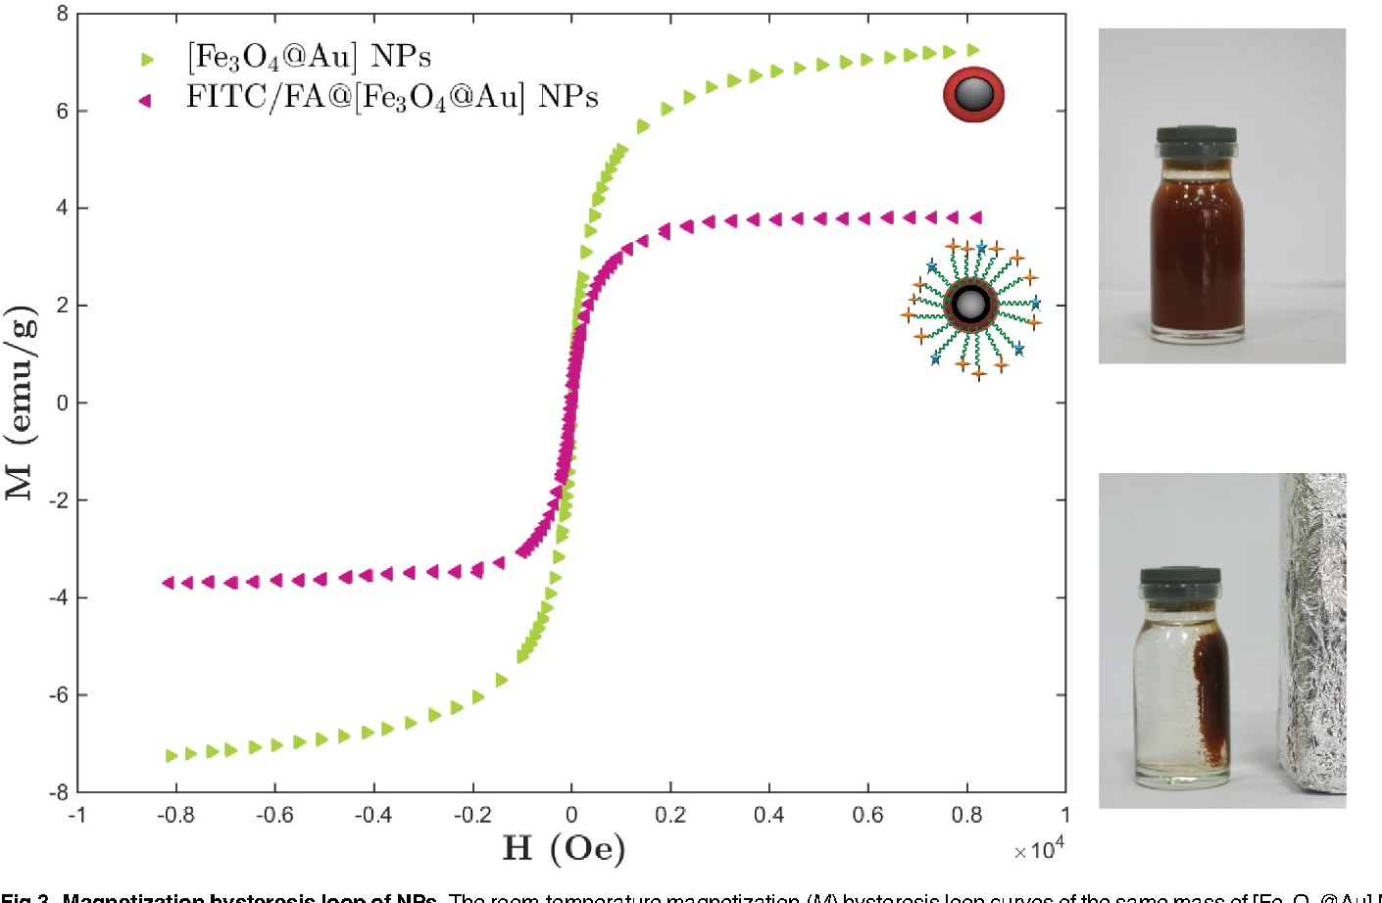
Ferrofluid surfactants
While surfactants are useful in prolonging the settling rate in ferrofluids, they also prove detrimental to the fluid's magnetic properties (specifically, the fluid's magnetic saturation).
Magnetic saturation is the state reached when an increase in applied external magnetic field H cannot increase the magnetization of the material further.

Slide 33
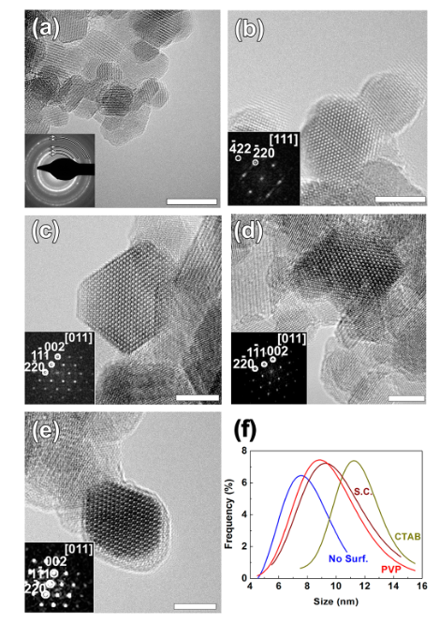
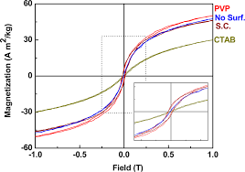
Ferrofluid surfactants
Surfactants prove detrimental to the fluid's magnetic saturation.
Size effects
J.Phys.Chem.C 2014, 118, 16209−16217

Slide 34
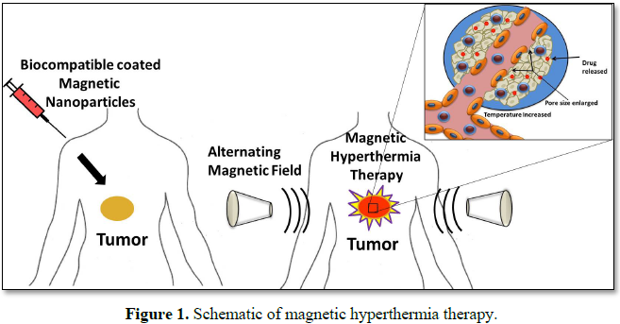
Fe₃O₄ nanoparticles anticancer applications
Iron oxide nanoparticles may be used in magnetic hyperthermia as a cancer treatment method. In this method, the ferrofluid which contains iron oxide is injected to the tumor and then heated up by an alternating high frequency magnetic field. The temperature distribution produced by this heat generation may help to destroy cancerous cells inside the tumor.

Slide 35
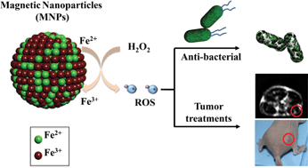
Fe₃O₄ nanoparticles anticancer applications
Iron oxide nanoparticles are used in cancer magnetic nanotherapy that is based on the magneto-spin effects in free-radical reactions and semiconductor material ability to generate oxygen radicals, furthermore, control oxidative stress in biological media under inhomogeneous electromagnetic radiation. The magnetic nanotherapy is remotely controlled by external electromagnetic field reactive oxygen species (ROS) and reactive nitrogen species (RNS)-mediated local toxicity in the tumor during chemotherapy with antitumor magnetic complex and lesser side effects in normal tissues.
J. Mater. Chem. B, 2013,1, 5100-5107

Slide 36
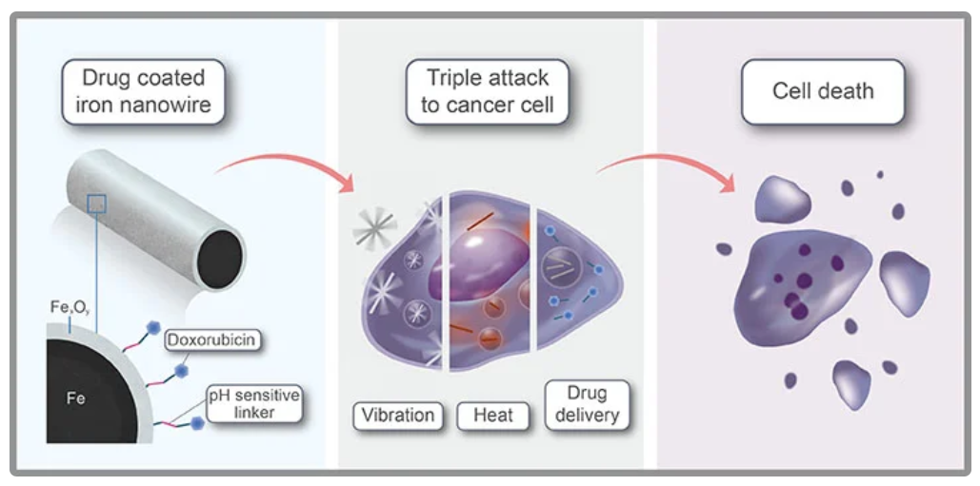
Fe₃O₄ nanoparticles
Magnetic complexes that consist of iron oxide nanoparticles loaded with antitumor drug have additional advantages over conventional antitumor drugs due to their ability to be remotely controlled while targeting with a constant magnetic field and further strengthening of their antitumor activity by moderate inductive hyperthermia (below 40 °C).

Slide 37
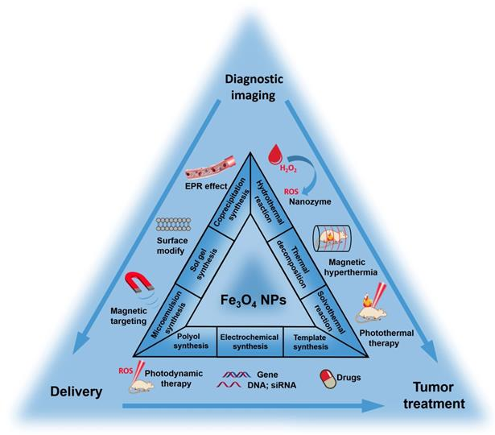
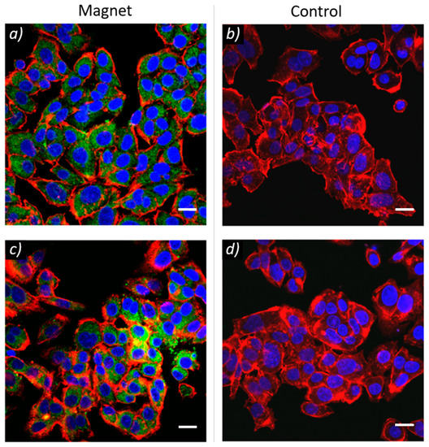
Fe₃O₄ nanoparticles
Multifunctional magnetic complexes with magnetic memory can combine cancer magnetic nanotherapy, tumor targeting and medical imaging functionalities in theranostics approach for personalized cancer medicine.

Slide 38
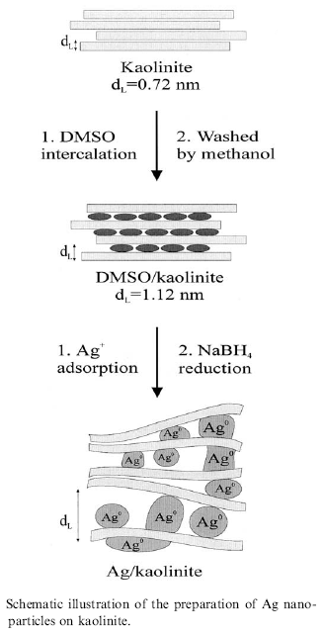
Colloidal methods: Silver
  The reduction of AgNO₃ by NaBH₄ in aqueous solution can produce small diameter (< 5nm) silver nanoparticles.
  The reduction can take place even in confined space, such as between layers of kaolinite, a layered silicate clay material that functions to limit particle growth.
  Dimethyl sulfoxide is used as a capping agent to prevent aggregation of the Ag particles.
R. Patakfalvi et al. / Colloids and Surfaces A: Physicochem. Eng. Aspects 220 (2003) 45/54

Slide 39
Sol-Gel technique
Sol-gel technology is a well established colloidal chemistry technology, which offers possibility to produce various materials with novel, predefined properties in a simple process and at relatively low process cost.
The sol is a name of a colloidal solution made of solid particles (50-100 nm in diameter) suspended in a liquid phase.
+
The gel can be considered as a solid
scaffold incorporating the solvent.
Sol-gel process consists
in the chemical transformation of a liquid (the sol)
into a gel state and with subsequent post-treatment
and transition into solid oxide material.
The point of gelification depends on pH, ionic strength, temperature,
concentration….
The main benefits of sol–gel processing are
the high purity and uniform nanostructure
achievable at low temperatures.
Ultra-fine α-alumina 99.99%, high purity & ultra-fine TiO₂, SiO₂ & Al₂O₃ with controlled porosity

Slide 40
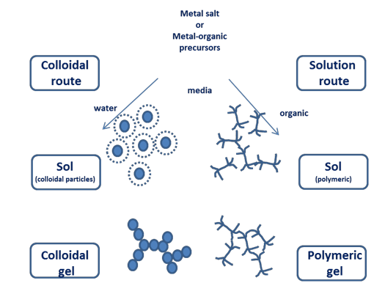

Slide 41
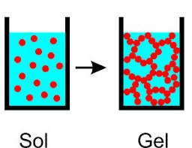
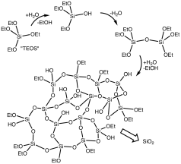
Sol-Gel technique
partial hydrolysis of metal alkoxides to form reactive monomers,
M-OR + H₂O → M-OH + ROH
2. condensation of these monomers to form colloid-like oligomers (sol formation),
M-OH + XO-M → M-O-M + X-OH (X = H o R) water or alcohol condensation
M-OH + XO-M → M-(OH)-M-OX (X = H o R)
3. additional hydrolysis to promote polymerization
and cross-linking leading to a three-dimensional
matrix (gel formation).
This process occurs in liquid solution of organometallic precursors (Tetramethyl orthosilicate (TMOS), Tetraethyl orthosilicate (TEOS), Zr(IV)-Propoxide, Ti(IV)-Butoxide, etc. ), which, by means of hydrolysis and condensation reactions, lead to the formation of a new phase (SOL).

Slide 42
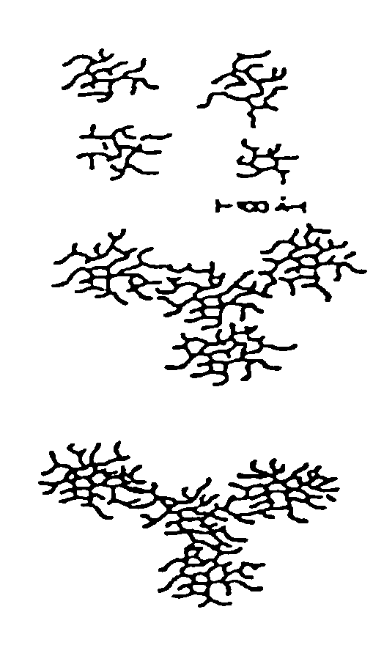
Basic catalysis
δ⁻
δ⁻
Away from gelation point: isolated branched structure
Closed to gelation point
Growth and branch
Gelation point
Interconnected Polymers

Slide 43

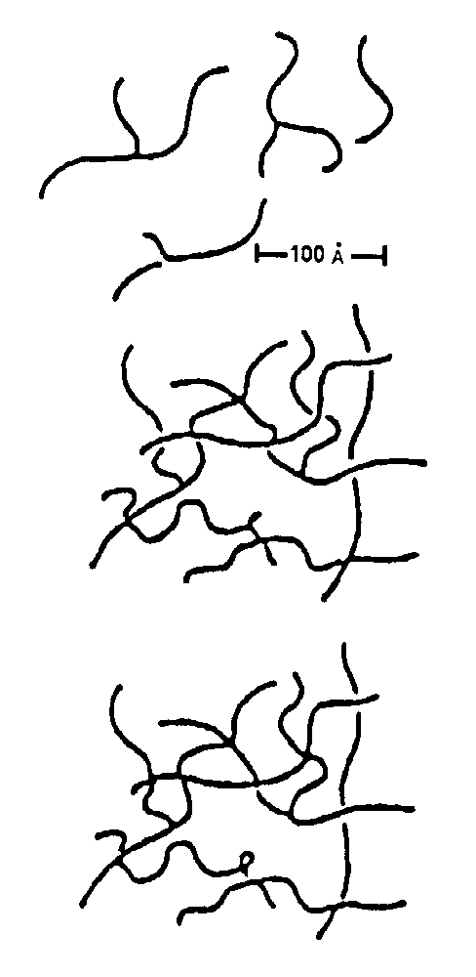
Acid Catalysis
+
δ⁺
δ⁺
Away from gelation point
Closed to gelation point
Primary interconnection
Gelation point
Branching from the interconnection points

Slide 44
Sol-Gel technique
In the case of the colloid, the particle density may be so low that a significant amount of fluid may need to be removed initially for the gel-like properties to be recognized. The simplest method is to allow time for evaporation and sedimentation to occur, and then, if necessary, pour off the remaining liquid. Centrifugation can also be used to accelerate the process of phase separation.
Removal of the remaining liquid (solvent) phase requires a drying process, which is typically accompanied by a significant amount of shrinkage and densification. The rate at which the solvent can be removed is ultimately determined by the distribution of porosity in the gel. The ultimate microstructure of the final component will clearly be strongly influenced by changes imposed upon the structural template during this phase of processing.

Slide 45
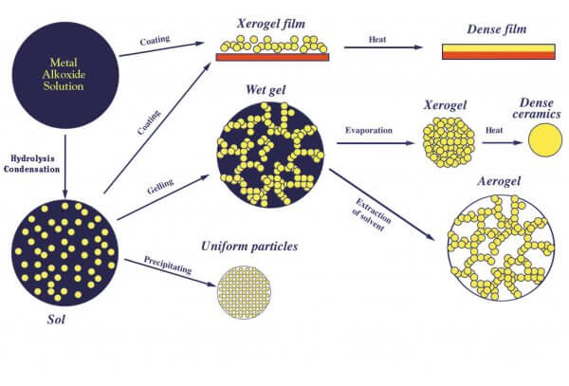
Sol-Gel technique

Slide 46
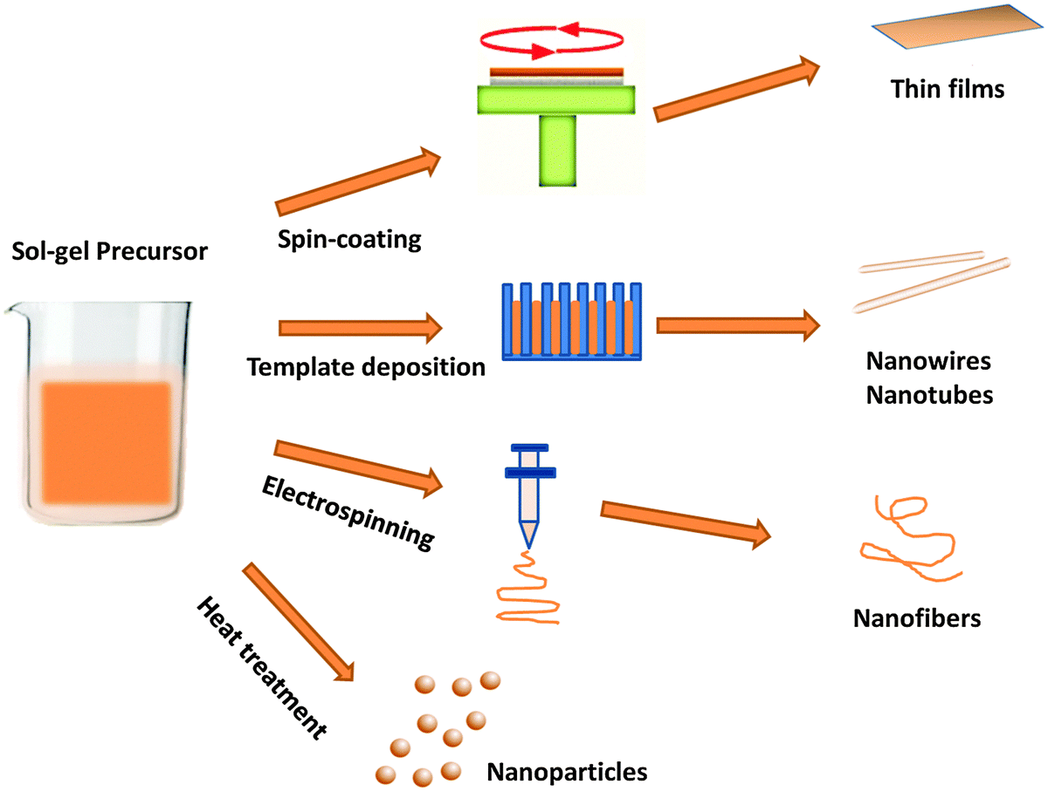
Sol-Gel technique

Slide 47
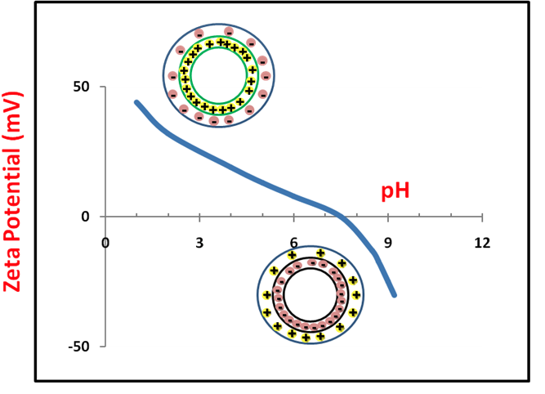
Sol-Gel technique
At low pH the particle surface is protonated and positively charged.
At high pH the particle surface is negativelly charged.
Surface charge is compensated by ions in solution.
The zeta potential is a key indicator of the stability of colloidal dispersions. The magnitude of the zeta potential indicates the degree of electrostatic repulsion between adjacent, similarly charged particles in a dispersion. For molecules and particles that are small enough, a high zeta potential will confer stability, i.e., the solution or dispersion will resist aggregation.

Slide 48
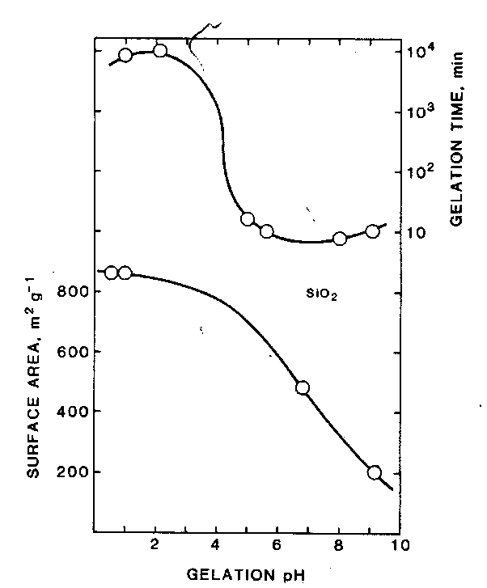
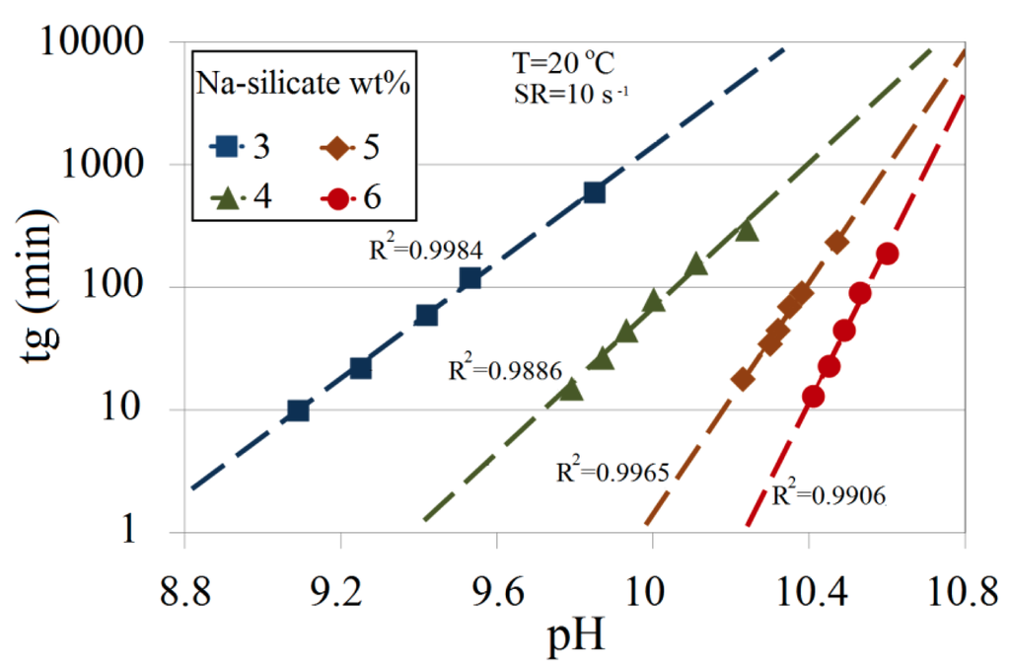
Stability behavior of a colloid depending on zeta potential
Zeta potential (mV) | Stability behavior
0 to ±5 | Rapid coagulation or flocculation
± 10 to ± 30 | Incipient instability
± 30 to ± 40 | Moderate stability
± 40 to ± 60 | Good stability
> 61 | Excellent stability
Gelation time is minimum at zero zeta potential (IEP)
Dependence of Silica gelation time from pH and concentration
Energies 2014, 7, 568-590

