Slide 1
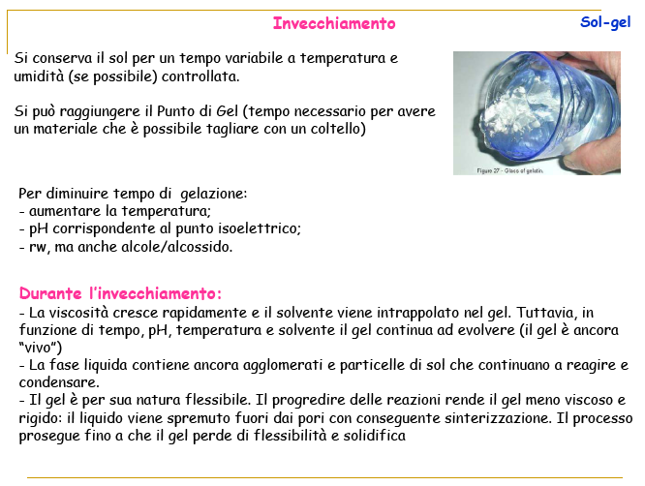

Slide 2
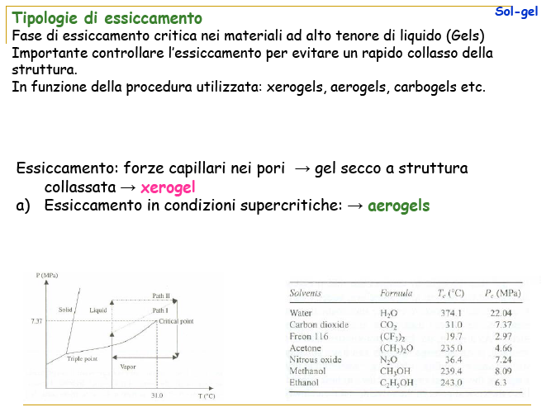

Slide 3
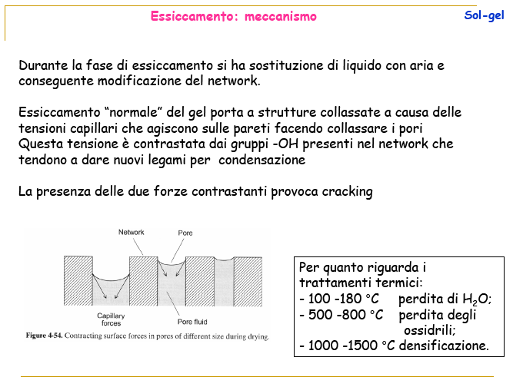

Slide 4
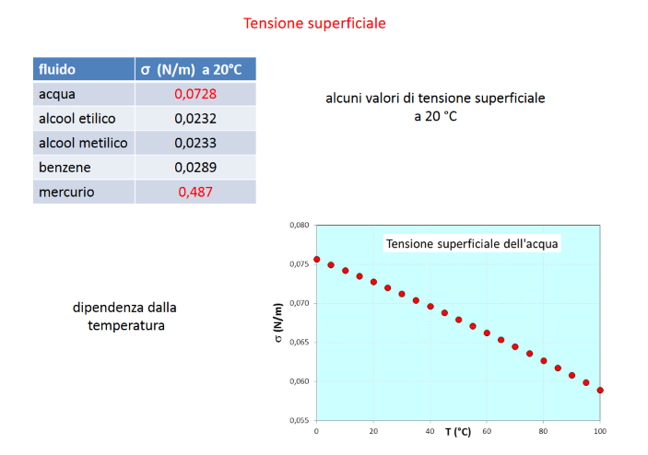

Slide 5
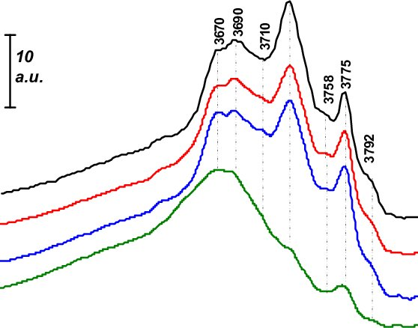
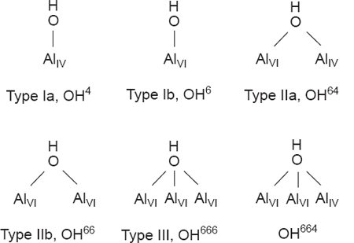
FTIR spectra of hydroxyl cover of γ-Al₂O₃ (a) and γ-Al₂O₃ after hydrothermal treatment for 3 h at 150 (b), 180 (c) and 200 °C (d). The samples were calcined and outgassed at 500 °C

Slide 6
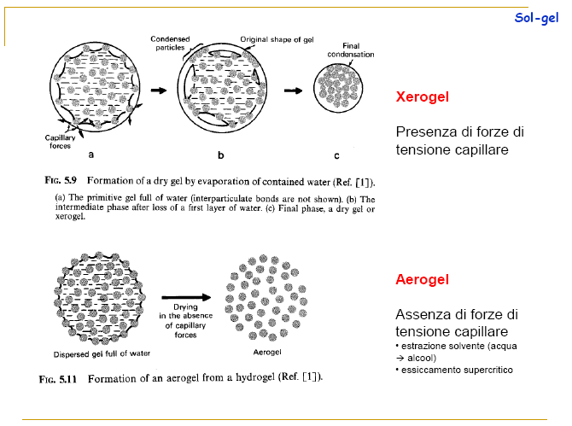

Slide 7
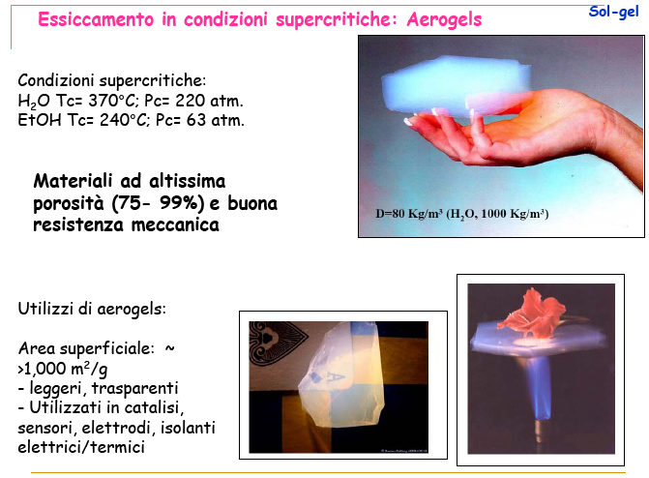

Slide 8
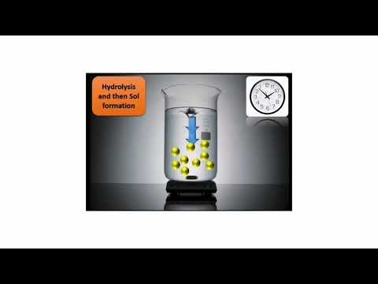
Sol-Gel method for TiO₂ nanoparticle preparation

Slide 9
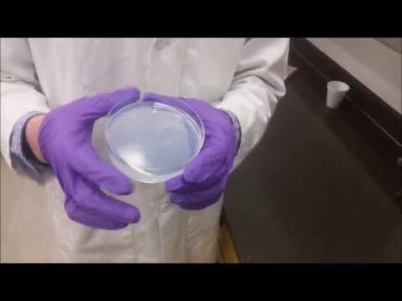
Sol-Gel method for SiO₂ aerogel preparation
https://www.youtube.com/watch?v=hFSbgANbKuw

Slide 10
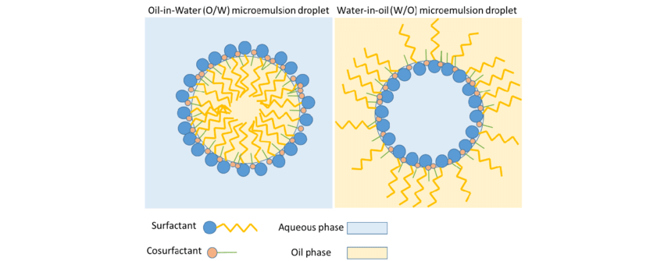
Microemulsion : nanoreactors
A polar phase (water), a nonpolar phase (oil) and an emulsifier (surfactant)
Microemulsion
1–100 nm.
Reverse
Microemulsion
aqueous core
5–10 nm.
* Co-surfactant : a medium chain alcohol
Spherical shape. The core size can be tune by varying the concentration of the dispersed phase and the surfactants
A microemulsion is a macroscopically homogeneous system and possesses spherical droplets of the size <50 nm that do not require the higher input of energy and shear reaction conditions, in contrast to conventional emulsions, which are cloudy, kinetically stable and thermodynamically unstable systems

Slide 11
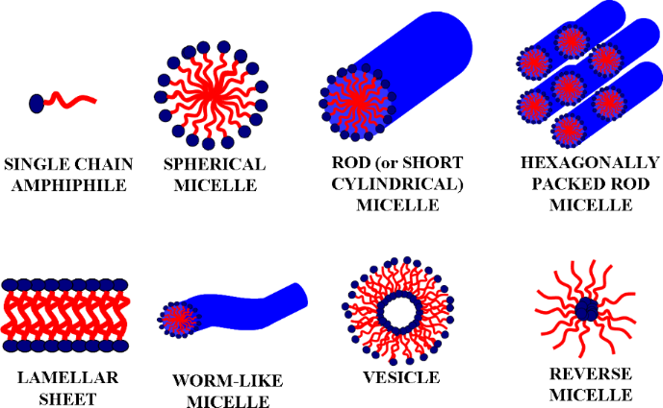
Microemulsion : nanoreactors

Slide 12
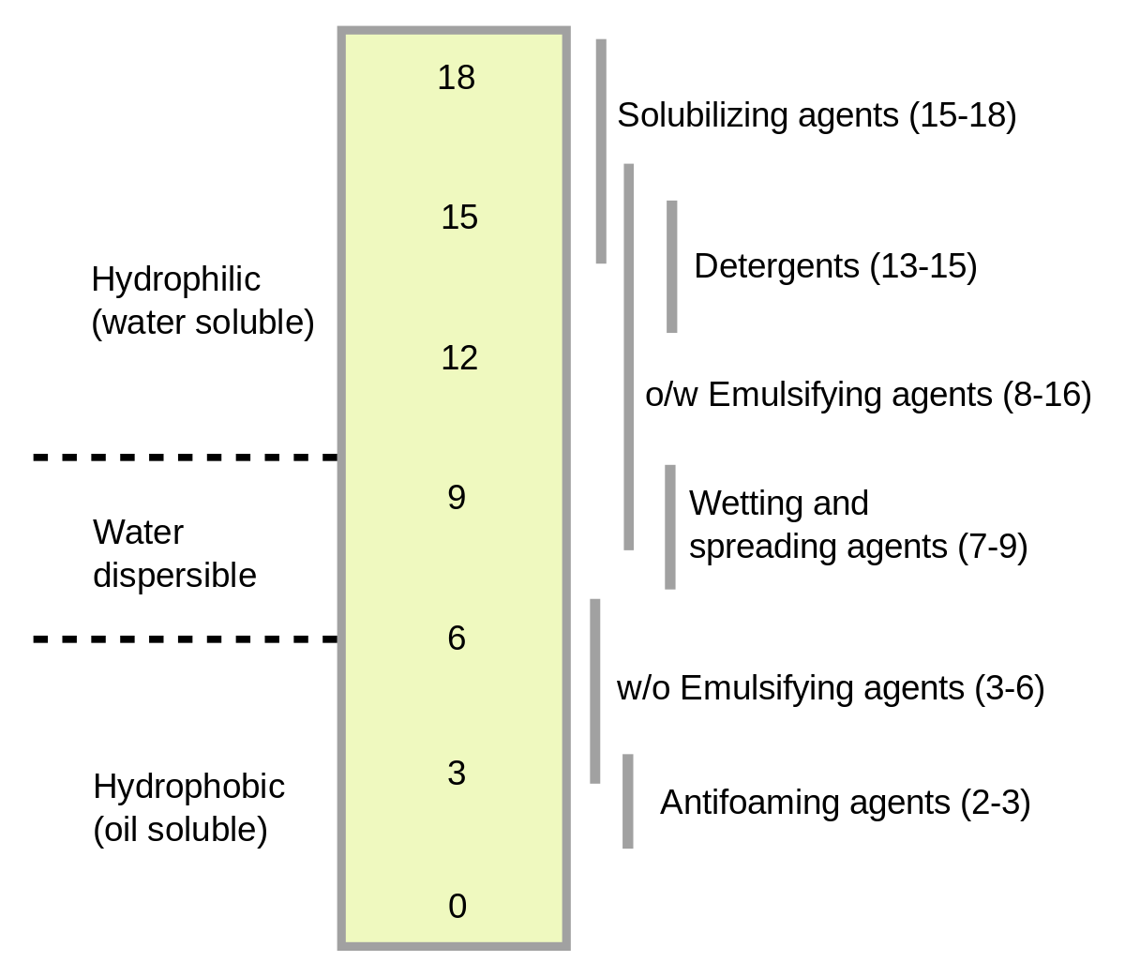
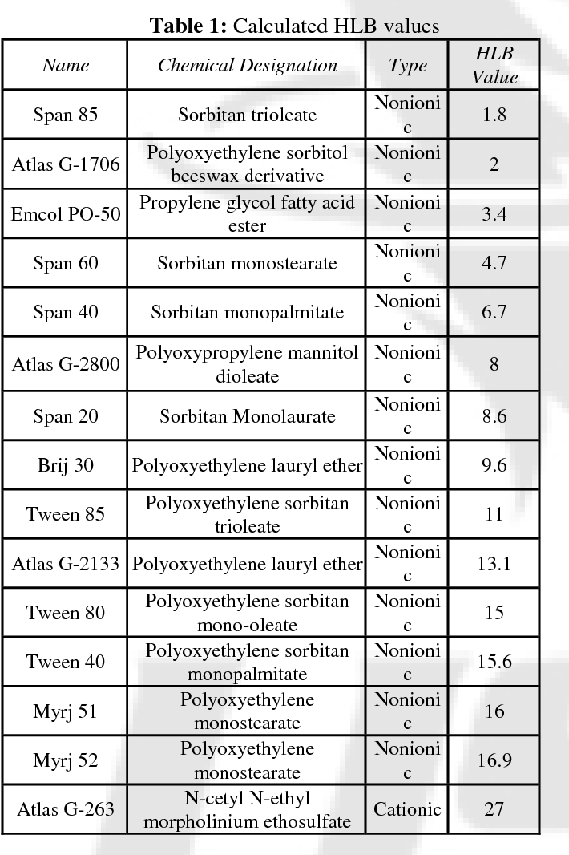
hydrophilic-lipophilic balance (HLB) value
HLB = 20 for a 100 % hydrophilic non ionic surfactant

Slide 13
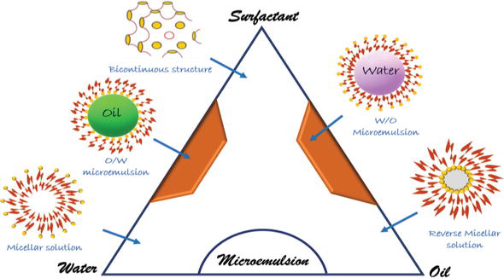
Microemulsion : nanoreactors
bicontinuous “sponge” to water-swollen inverse micelles dispersed in oil (W/O microemulsion) phase
Mixture of (O/W and W/O)
Depending on the hydrophilic-lipophilic balance (HLB) value of the surfactant and the oil/water ratio, the formed microstructure can exist in oil-in-water (O/W), water-in-oil (W/O), hexagonal, reverse hexagonal, or a mixture of (O/W and W/O) called bicontinuous/lamellar phase. In general, the surfactants having HLB of 3–6 promote the formation of W/O microemulsions whereas with HLB of 8–18 facilitate the formation of O/W microemulsions.

Slide 14
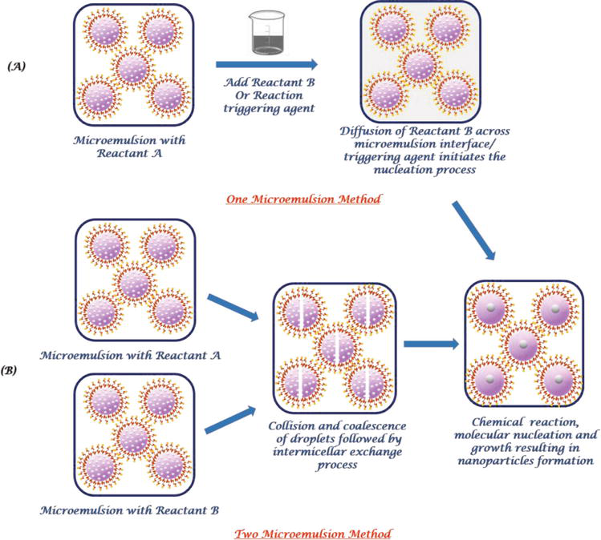

Slide 15
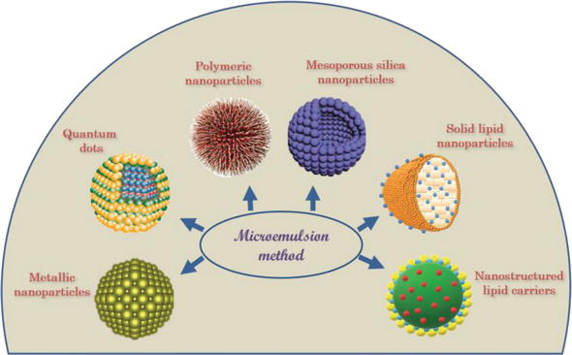
Microemulsion : nanoreactors
Metallic nanoparticles : Ag, Au, Pt, Pd, Cu, Ni, Mo, Ru, Se, Fe, Ce
and their oxides, sulfides, fluorides, chromates, phosphates
Quantum dots: CdX (X = S, Se, Te), carbon dots, Si QDs, graphene QDs, Ag₂Se, Ag₂S, ZnS, InP, etc
https://www.intechopen.com/books/microemulsion-a-chemical-nanoreactor/microemulsions-as-nanotemplates-a-soft-and-versatile-approach

Slide 16
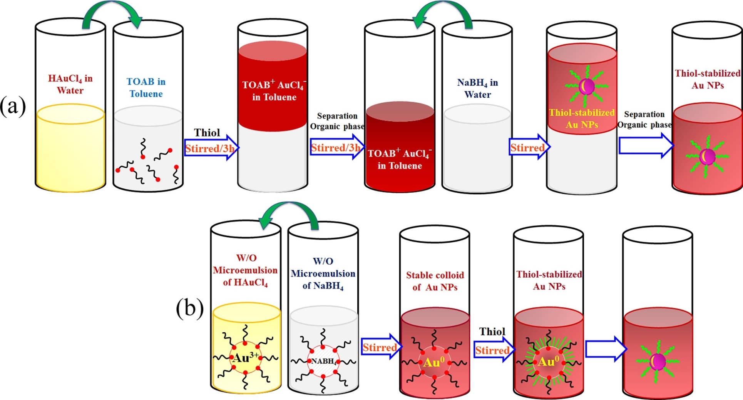
A microemulsion method for preparation of thiol-functionalized nano Au
the two-phase
Brust method
Thiol-functionalized Au NPs (having diameter 3–4 nm) by using W/O microemulsion (toluene/tetraoctylammonium bromide/water) where HAuCl₄ was employed as a precursor and NaBH₄ as a reducing agent.
Particuology, Volume 37, April 2018, Pages 33-36

Slide 17
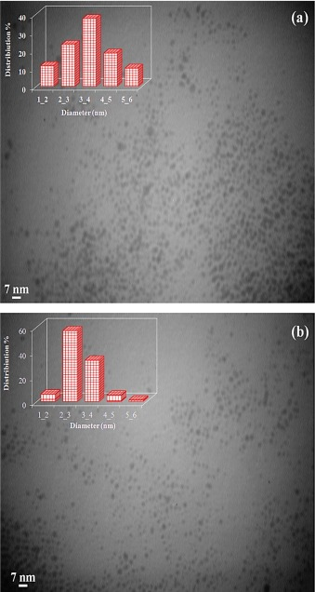
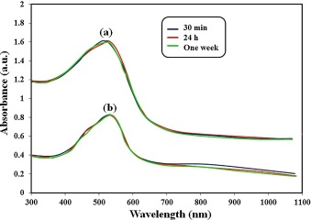
A microemulsion method for preparation of thiol-functionalized nano Au
TEM images of stabilized AuNP colloid solutions, prepared by the (a) two- phase Brust method and the (b) microemulsion technique.
Particuology, Volume 37, April 2018, Pages 33-36

Slide 18
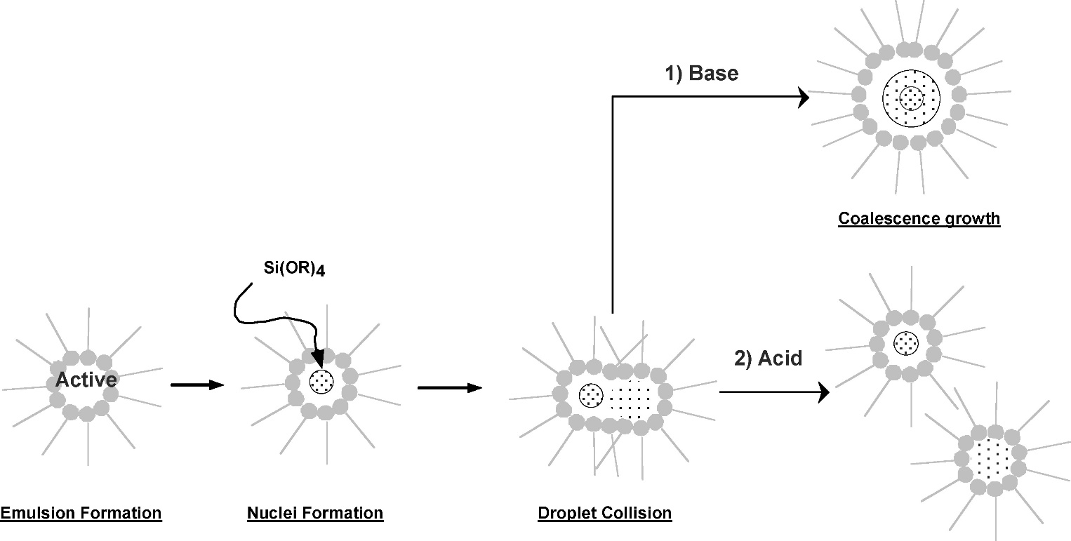
A microemulsion method for preparation of SiO₂
Nucleation in water-in-oil microemulsions takes place when the concentration of hydrolyzed precursors present in the reverse micelle droplets exceeds the nucleation threshold C_{n}.
W/O
The final particle size increases with the number of collisions or micellar exchanges.
Tetraethyl orthosilicate (TEOS) is exploited as the common source of silicon alkoxide
Base catalysis of sol−gel reactions promotes hydrolysis, condensation, and, more importantly, dissolution.
Acid catalysis, in contrast, promotes hydrolysis but hinders both condensation and dissolution reactions.
https://pubs.acs.org/doi/10.1021/la0624283

Slide 19
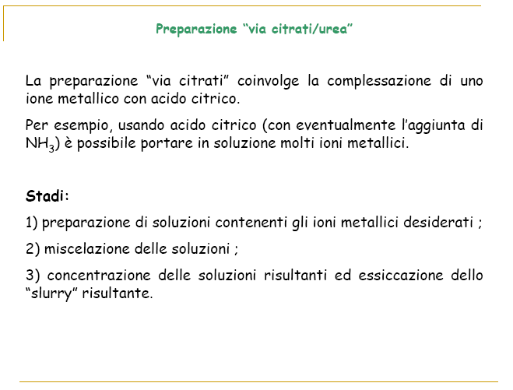

Slide 20
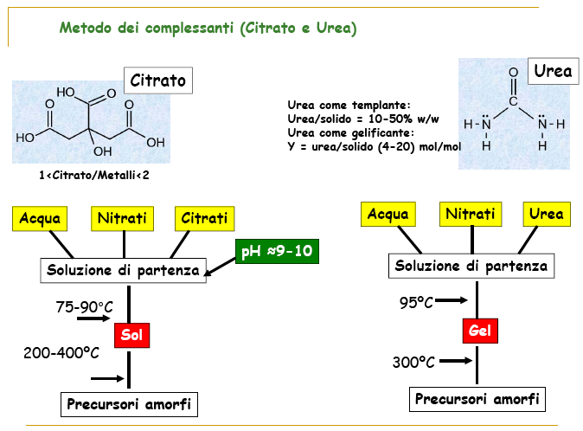

Slide 21
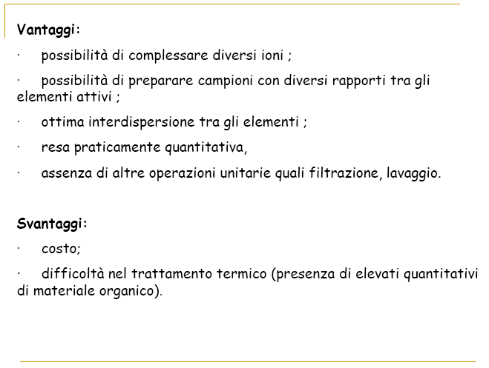

Slide 22
Reazione idrotermale
Questo metodo di sintesi consiste nella dissoluzione e ricristallizzazione di materiali a bassa solubilità. In questo processo una sospensione/soluzione viene trattata in condizioni di alta T e P (differisce da un semplice processo di “ageing” per le condizioni)
⬇
Evoluzione verso sistemi termodinamicamente più stabili (ingrossamento di cristalli, trasformazioni strutturali, sintesi idrotermali, cristallizzazione di amorfi)
La velocità delle trasformazioni idrotermali è generalmente bassa – lo stadio lento è la dissoluzione
⬇
Possibilità di accelerare la velocità con aggiunta di sostanze mineralizzanti (acidi, basi, complessati)

Slide 23
Attrition
Attrition is a mechanical method for creating certain types of nanoparticles.
Macro or micro scale particles are ground in a ball mill, a planetary ball mill, or other size reducing mechanism.
The resulting particles are separated by filters and recovered.
Particle sizes range from tens to hundreds of nm.
Broad size distribution and varied particle geometry.
May contain defects and impurities from the milling process.
Generally considered to be very energy intensive.

Slide 24
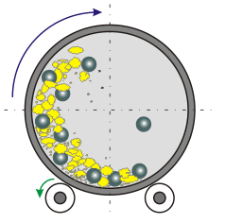
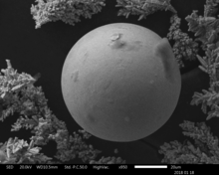
Attrition: Rotary Ball Mill
A hollow steel cylinder containing tungsten carbide (WC), corundum (α-Al₂O₃) or ZrO₂ balls and a solid precursor rotates about its central axis.
Particle size is reduced by brittle fracturing resulting from ball-ball and ball-wall collisions.
Milling takes place in an inert gas atmosphere to reduce contamination.

Slide 25
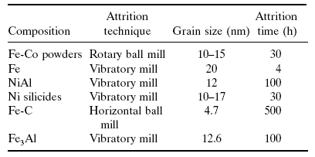
Attrition: Examples

Slide 26
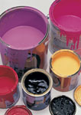



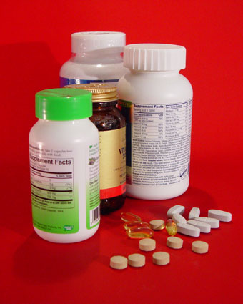

Pyrolysis: Industrial method for many products
TiO₂
Tires
Optical
fibers
Paints
SiO₂
Carbon Black
Makeup
Carbon black - 8 million tons $8 billion
TiO₂ - 2.5 million tons, $5 billion
SiO₂ - 2.0 million tons, $2 billion
Inks

Slide 27
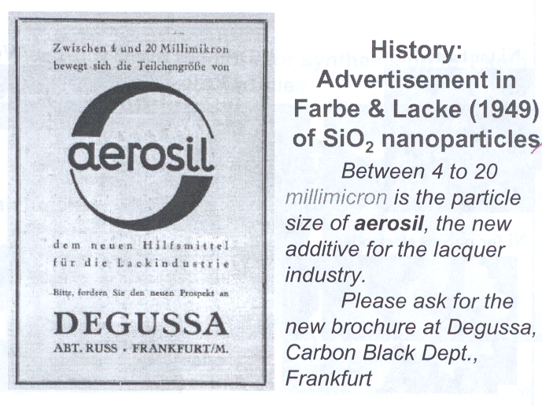

Slide 28
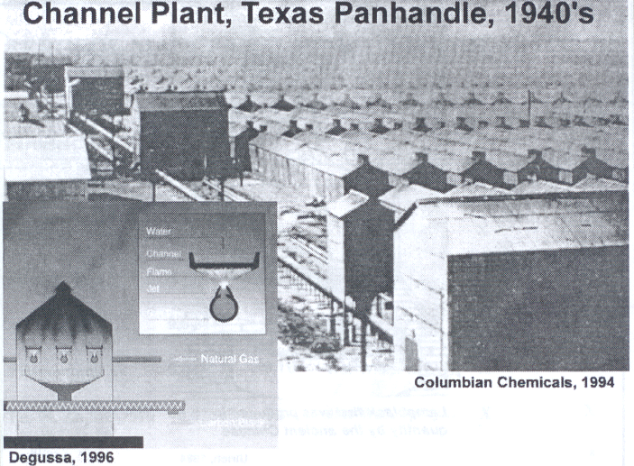

Slide 29
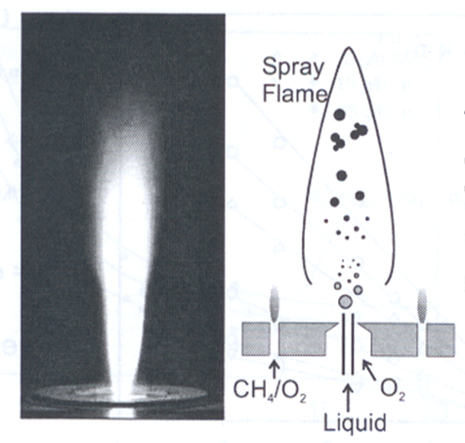
Pyrolysis: popular method for creating nanoparticles, especially oxides
A precursor (liquid or gas) is forced through an orifice at high pressure and burned.
The resulting ash is collected to recover the nanoparticles.
Large volume of gas leads to high rate of material synthesis.
Flame Spray Pyrolysis (FSP)
Aggregation
Condensation
Coagulation
Nucleation
Droplet evaporation
Versatile
Large Variety of precursors
Controllable
Scalable

Slide 30
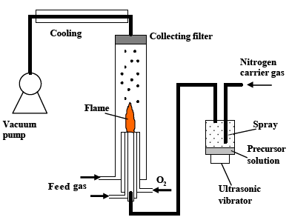
Pyrolysis: System Overview

Slide 31
Pyrolysis
Aggregates and Agglomerates:
Aggregate – An assemblage of particles rigidly joined together by chemical or sinter-forces.
Agglomerate – A loosely coherent assembly of particles and/or aggregates held together by weak interactions
Current aerosol instruments cannot distinguish between them.
  Aggregates Agglomerates

Slide 32
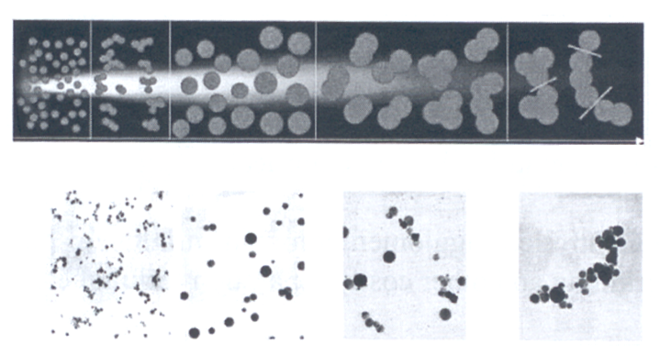

Pyrolysis: Agglomerate Formation Sequence
TiO₂
Monomers
Transient Hard
Agglomerates
Spherical
Particles
Hard Agglomerates
Soft Agglomerates
Distinction between hard and soft agglomerates is largely empirical.
Controlled agglomeration can minimize post-grinding and other costly separation techniques.

Slide 33
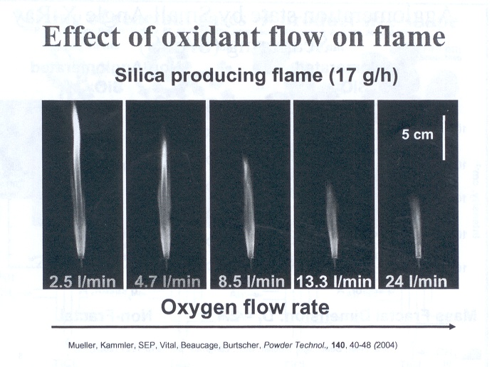
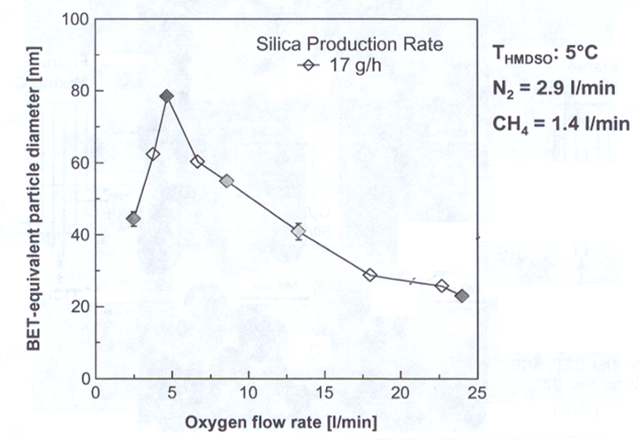
Pyrolysis: Particle Size Controlled by O₂ Flow
Impact of oxygen
Aids in combustion
Provides chemistry in the reaction
Acts as a diluent, cools the flame, prevents agglomeration
All of these variables can be decoupled by burner design. Which is cheaper than increasing oxygen flow.
Excess oxygen makes the flame burn cooler resulting in smaller diameter particles

