Slide 1
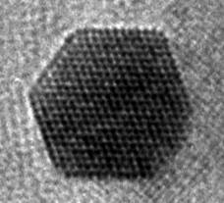
Transmission Electron Microscopy

Slide 2
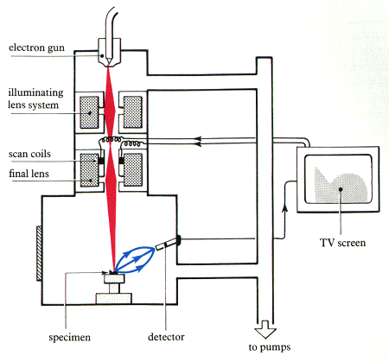
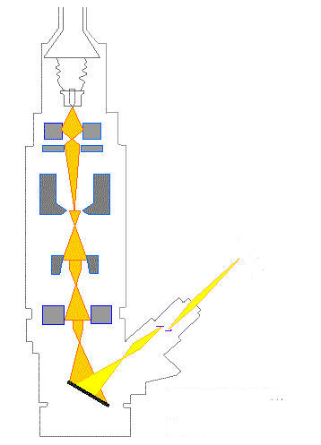
SEM & TEM
Electron gun
Electron gun
Electron gun
Electron gun
Condenser lens
Condenser lens
Objective lens
Objective lens
Specimen
Specimen
Projector lens
Projector lens
Fluorescent screen
Fluorescent screen
Digital camera
Specimen
Digital camera
Scanning electron microscope
Transmission electron microscope

Slide 3
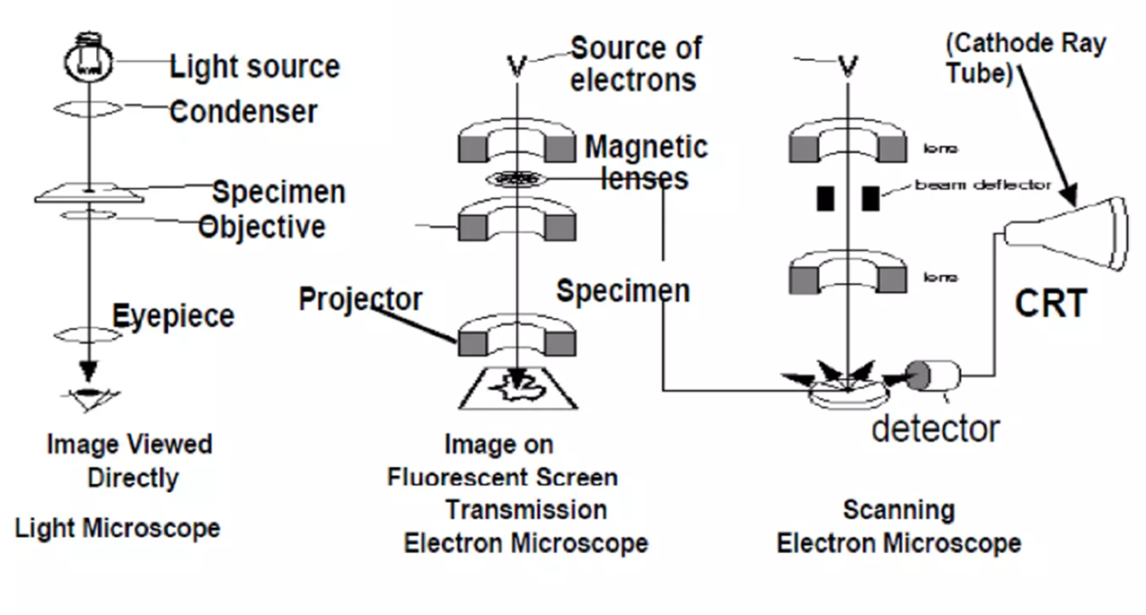
SEM & TEM

Slide 4
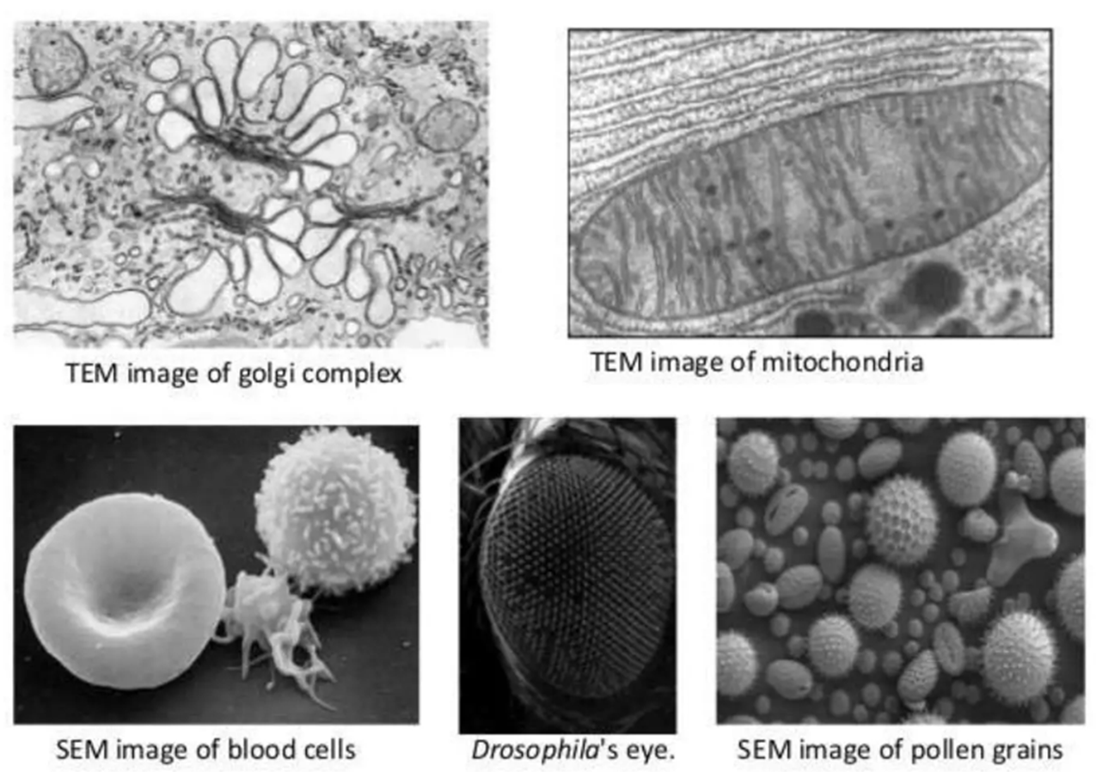
SEM & TEM

Slide 5
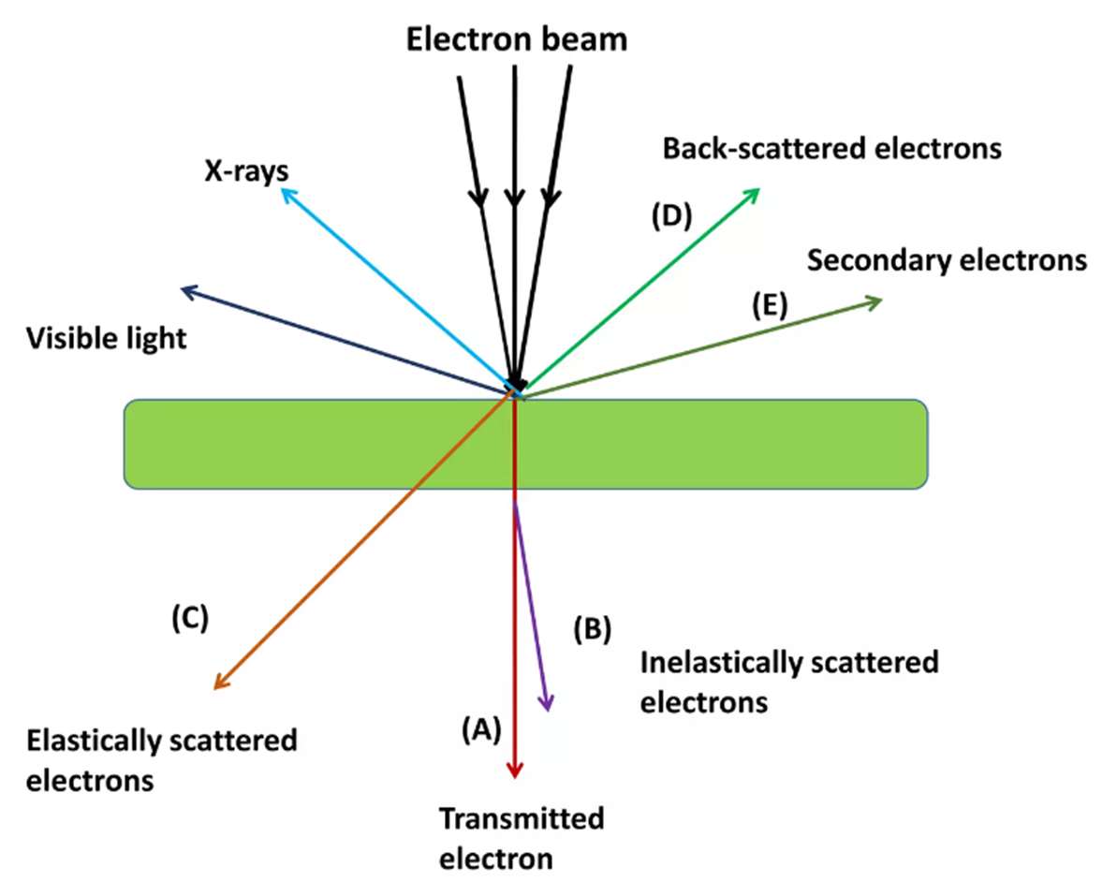
SEM & TEM

Slide 6
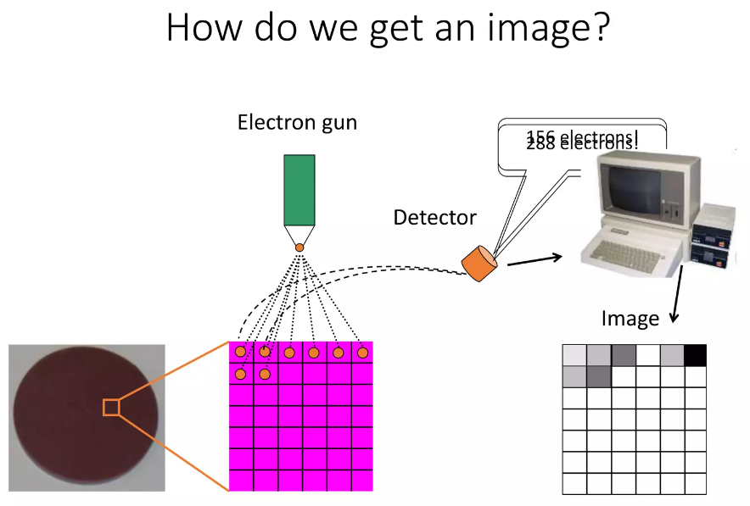
SEM

Slide 7
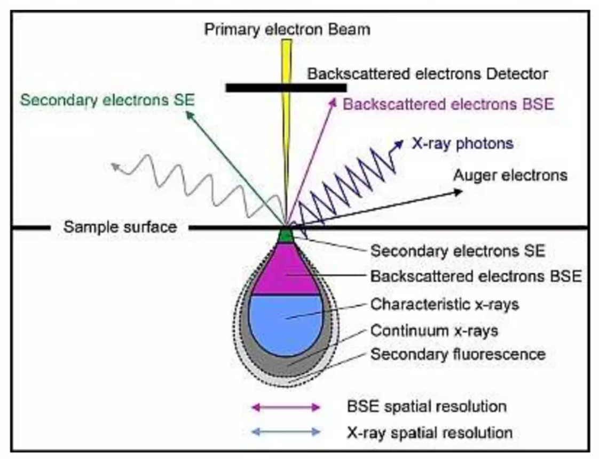
SEM

Slide 8
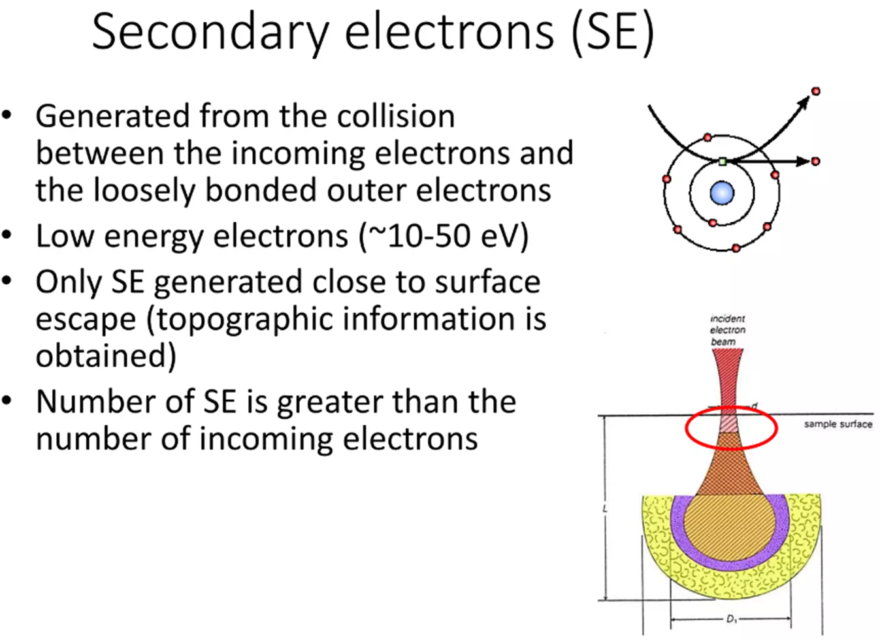
SEM

Slide 9
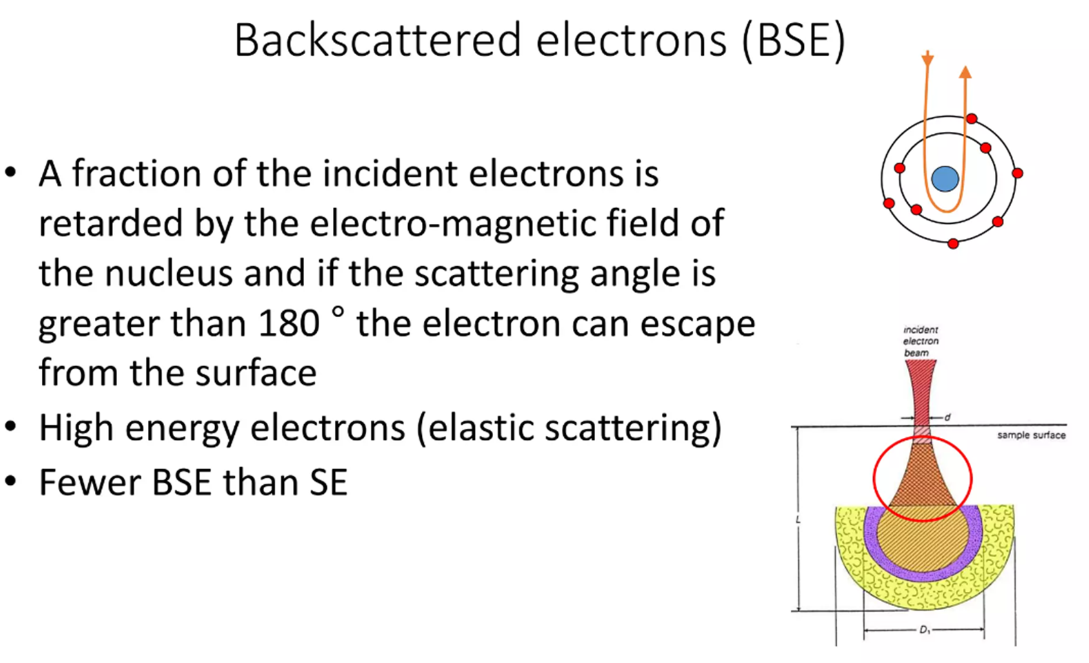
SEM

Slide 10
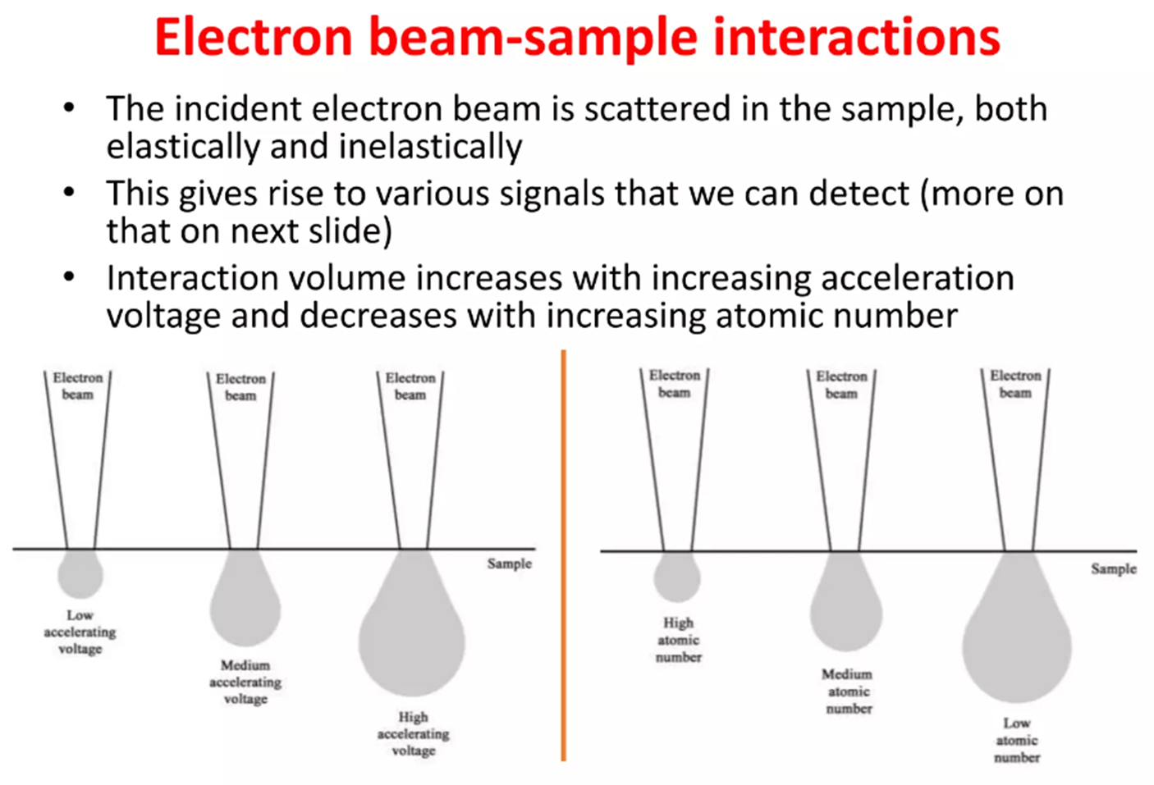
SEM

Slide 11
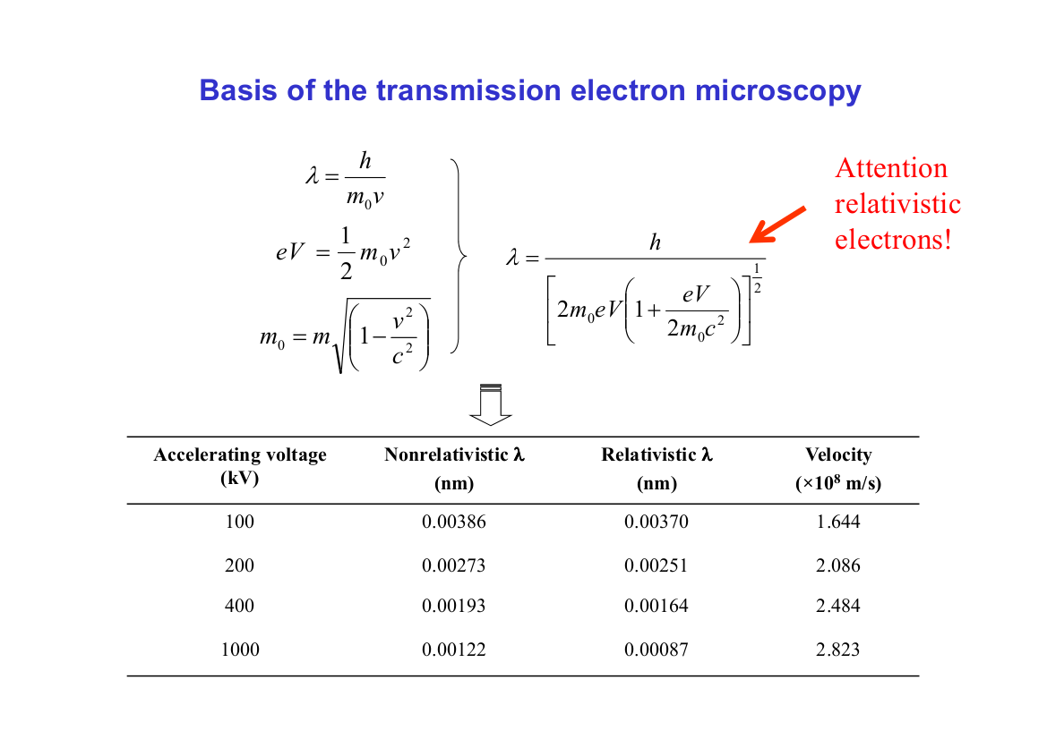

Slide 12
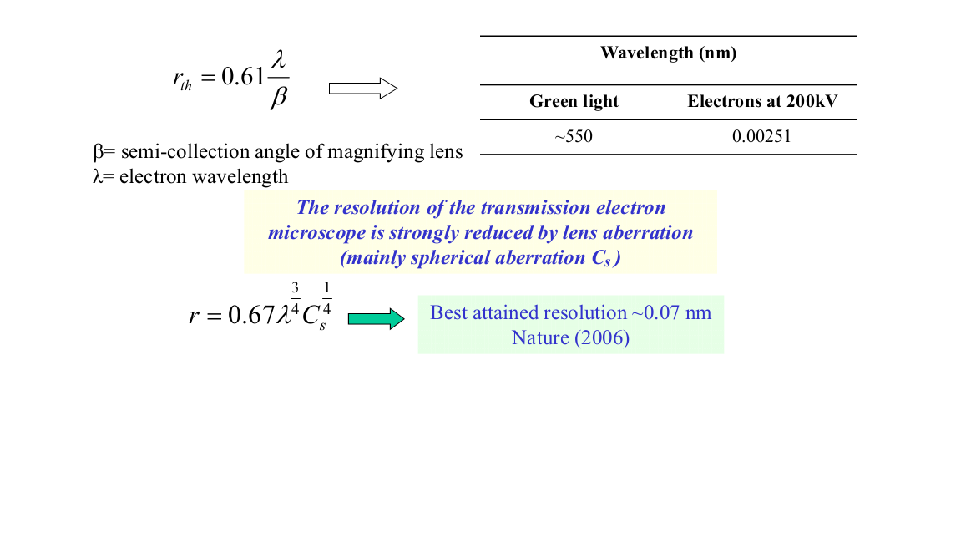
Theoretical resolution r_{th}

Slide 13
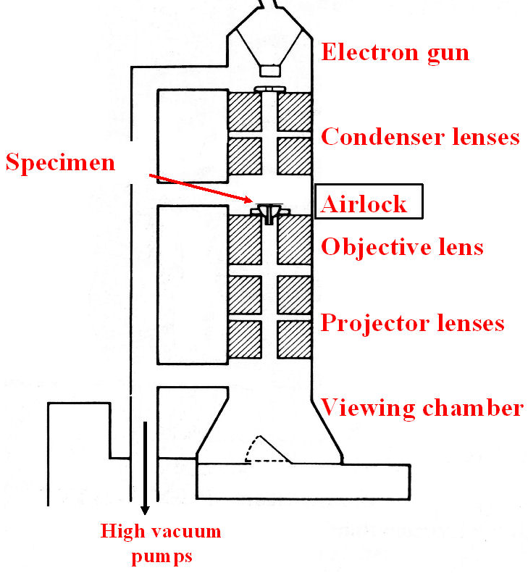
Components of the TEM
Electrons emitted by the gun are accelerated, typically by 80 - 200 kV.
The condenser lenses focus the beam onto the specimen, which is introduced into the microscope through an airlock.
The objective lens forms a focussed image, which is enlarged by the projector lenses.
The image is viewed on a fluorescent screen or a computer monitor.

Slide 14
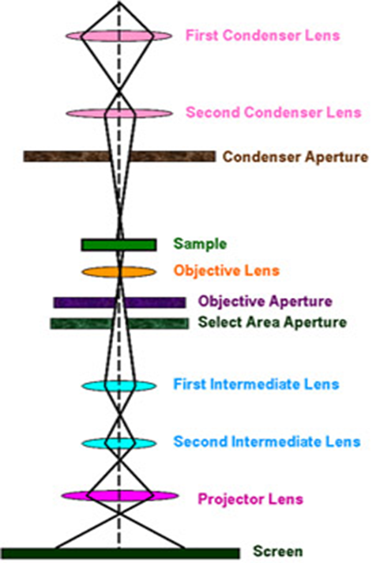
Scheme of beam within a TEM

Slide 15
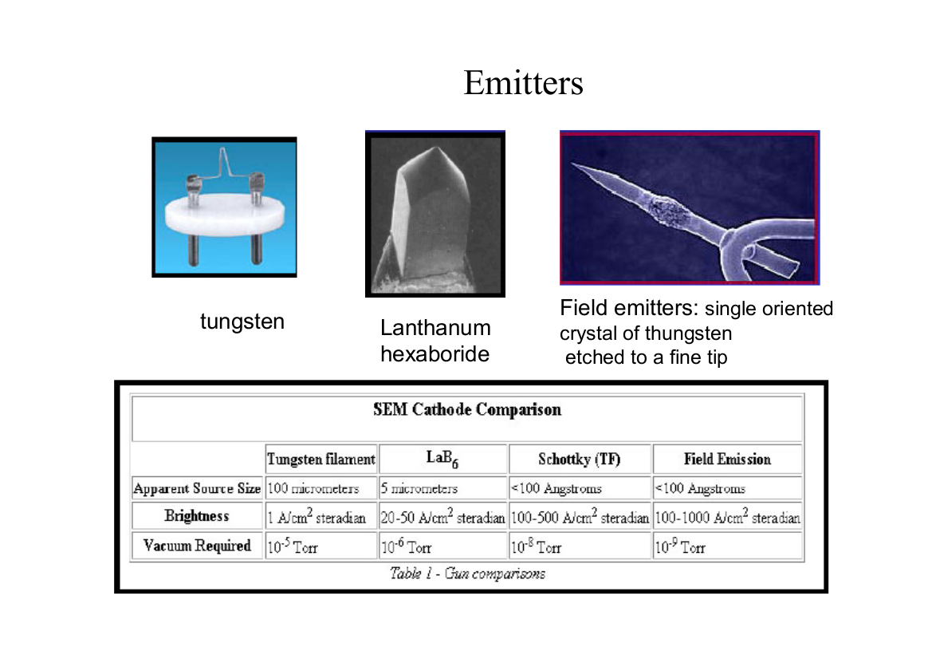

Slide 16
Accelerating voltage
Electrons emitted by the filament are accelerated by a series of anodes. For transmission electron microscopy, accelerating voltages typically range from 60 kV to 300 kV. Higher accelerating voltages give higher resolution, but less contrast. High accelerating voltages can also result in greater specimen damage. For these reasons, studies of biological samples tend to employ low accelerating voltages (60 kV to 100 kV), while studies of inorganic materials, which often require higher resolution, usually employ an accelerating voltage of 200 kV or more.

Slide 17
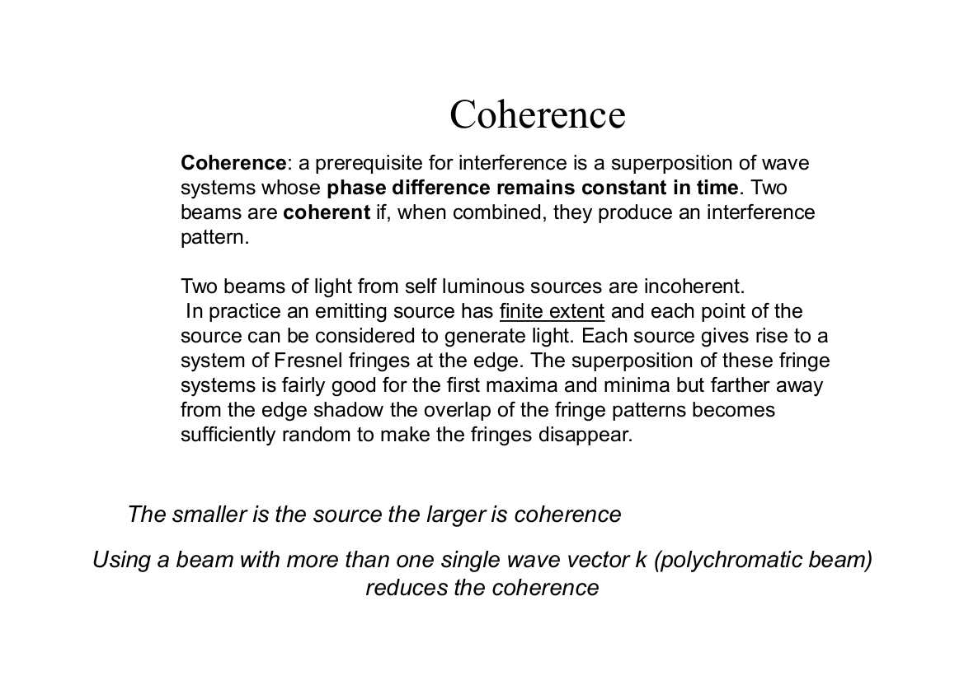

Slide 18
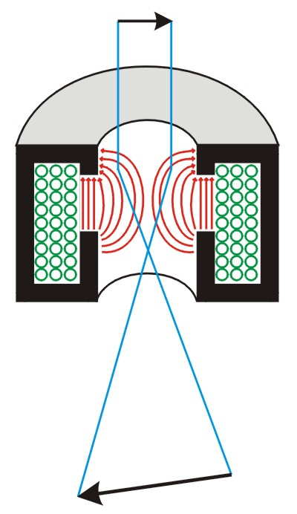
Electromagnetic lenses
All modern TEMs use electromagnetic lenses. These consist of a coil of copper wires inside iron pole pieces.
A current through the coils creates a magnetic field, symbolized by red lines in the diagram on the left. Electrons close to the centre are less strongly deflected than those passing through the lens far from the axis.

Slide 19
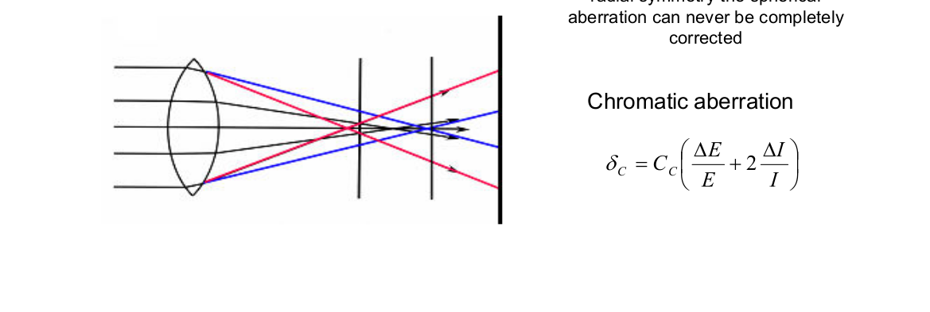
Chromatic aberration
Chromatic aberration is caused by a lens having a different refractive index for different electron energies. It is present in all electron lenses, but can be reduced by minimising the energy spread of the electron source. Field emission sources have the lowest energy spread. There is currently interest in developing chromatic aberration correctors for TEM, but this is still at quite an early stage.

Slide 20
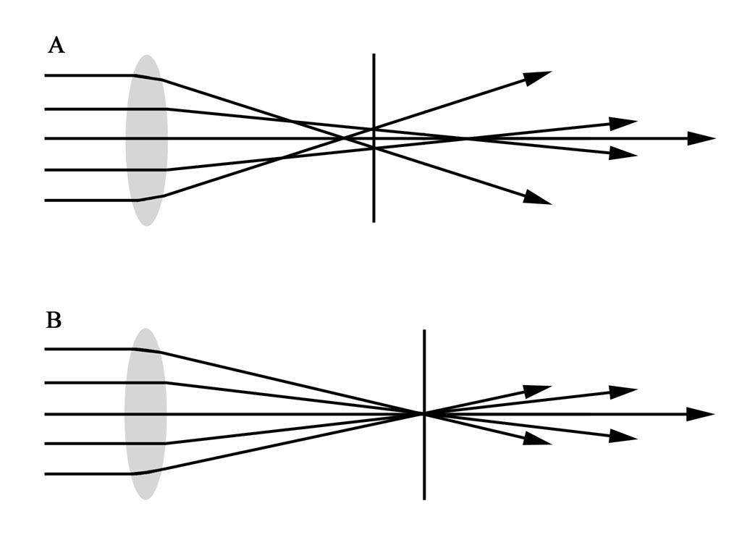
Spherical aberration
A lens suffers from spherical aberration if it focuses rays more tightly if they enter it far from the optic axis than if they enter closer to the axis. It therefore does not produce a perfect focal point. This is illustrated in diagram A on the right.

Slide 21
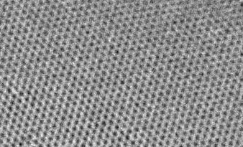
Spherical aberration correctors
In recent years, spherical aberration correctors have been developed for transmission electron microscopes, and this has greatly improved their resolving power. Aberration corrected TEMs can have a resolution of 0.1 nm or better.
Using these new ultra-high resolution TEMs it is possible to image the atomic structure of crystals such as graphite, as shown on the right.

Slide 22
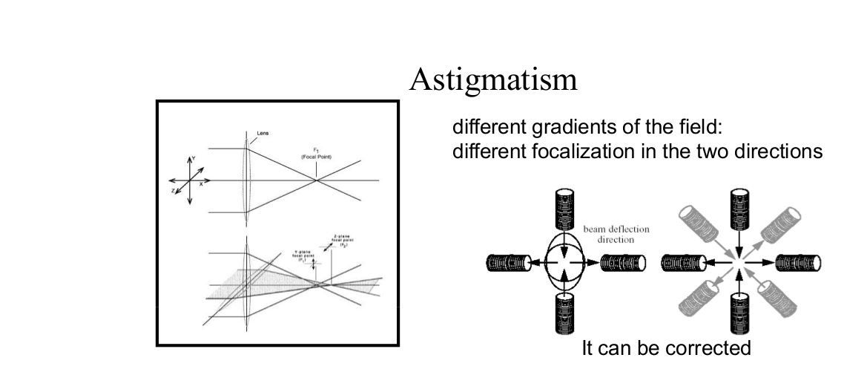

Slide 23
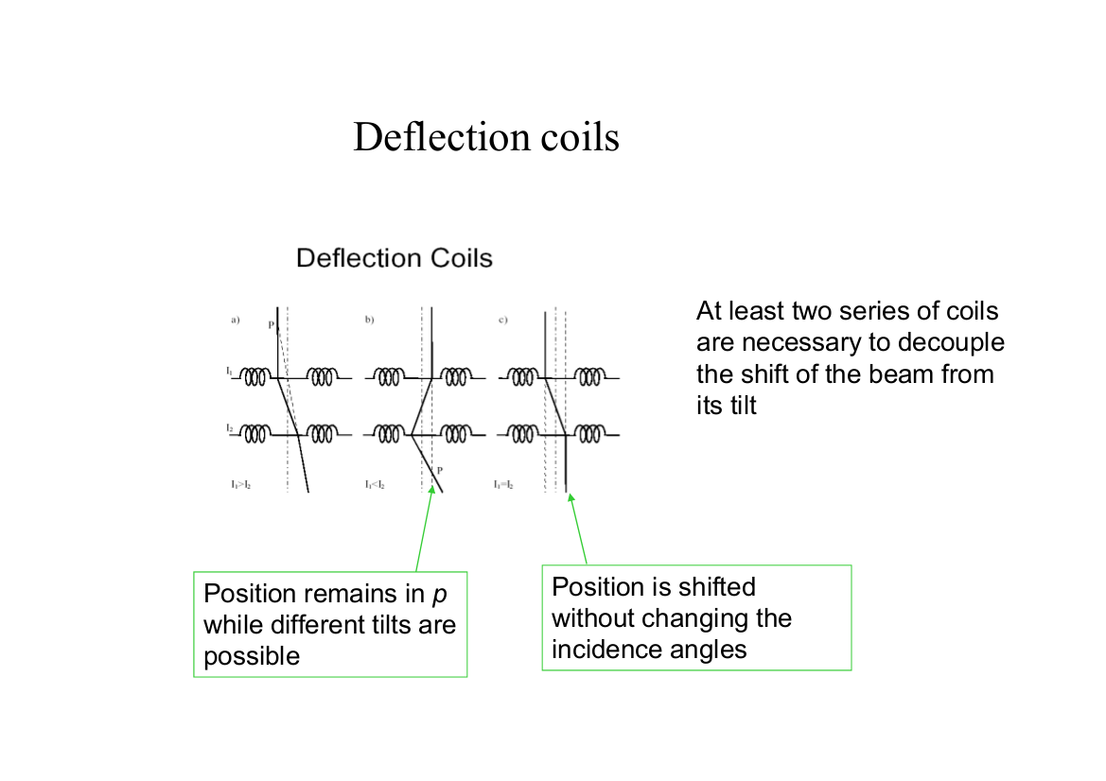

Slide 24
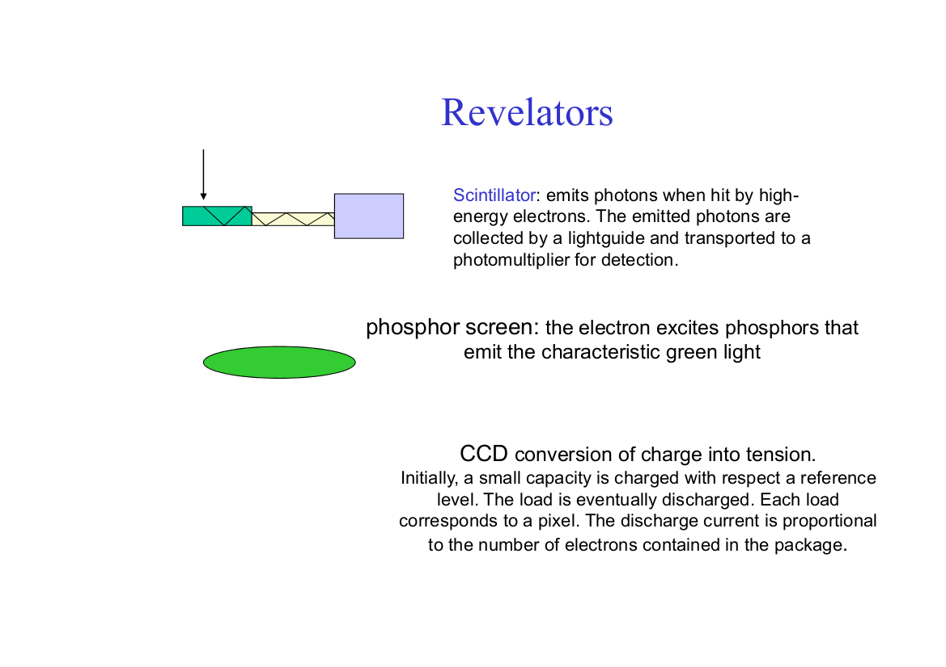
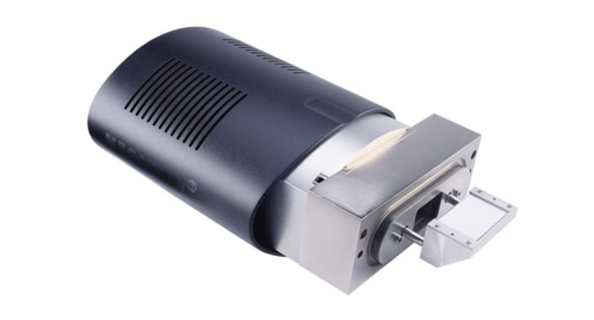

Slide 25
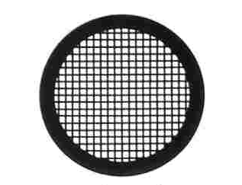
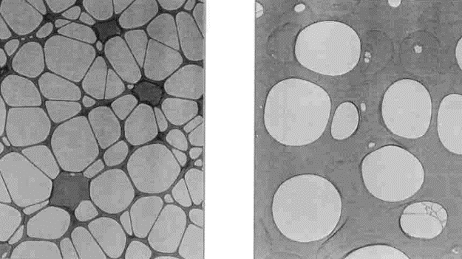
Transmission electron microscopy
Specimens for TEM
3 mm TEM grid
Carbon films

Slide 26
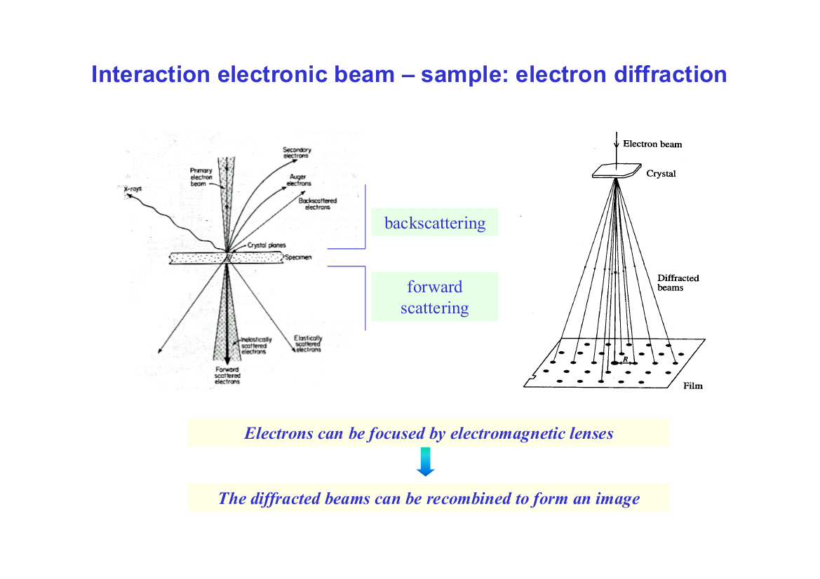

Slide 27
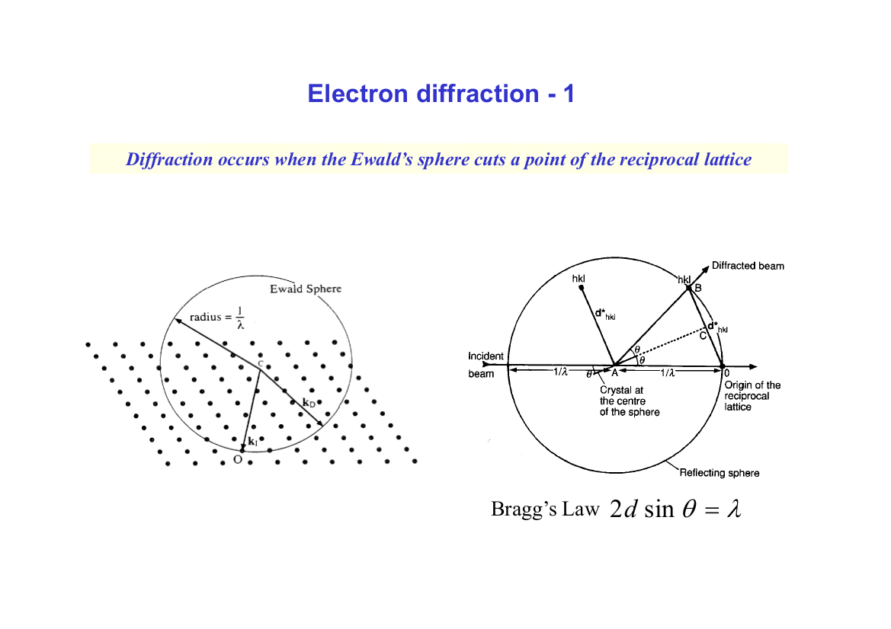

Slide 28
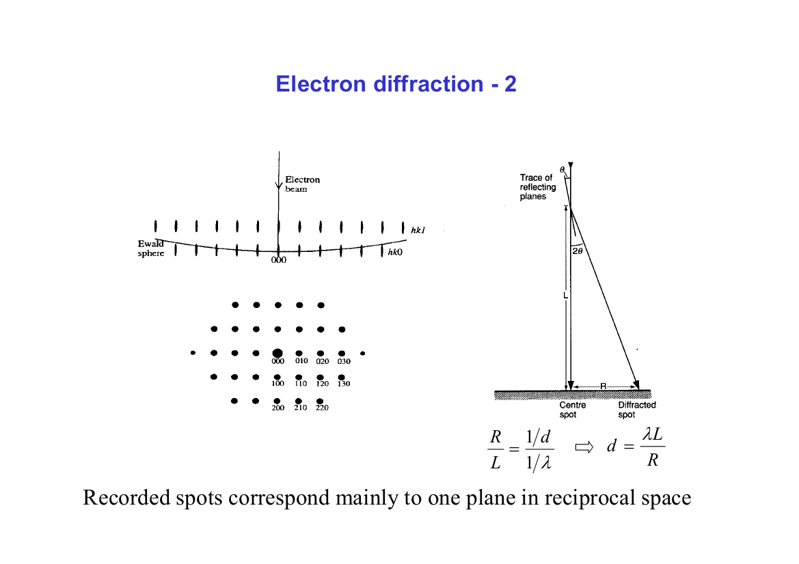

Slide 29
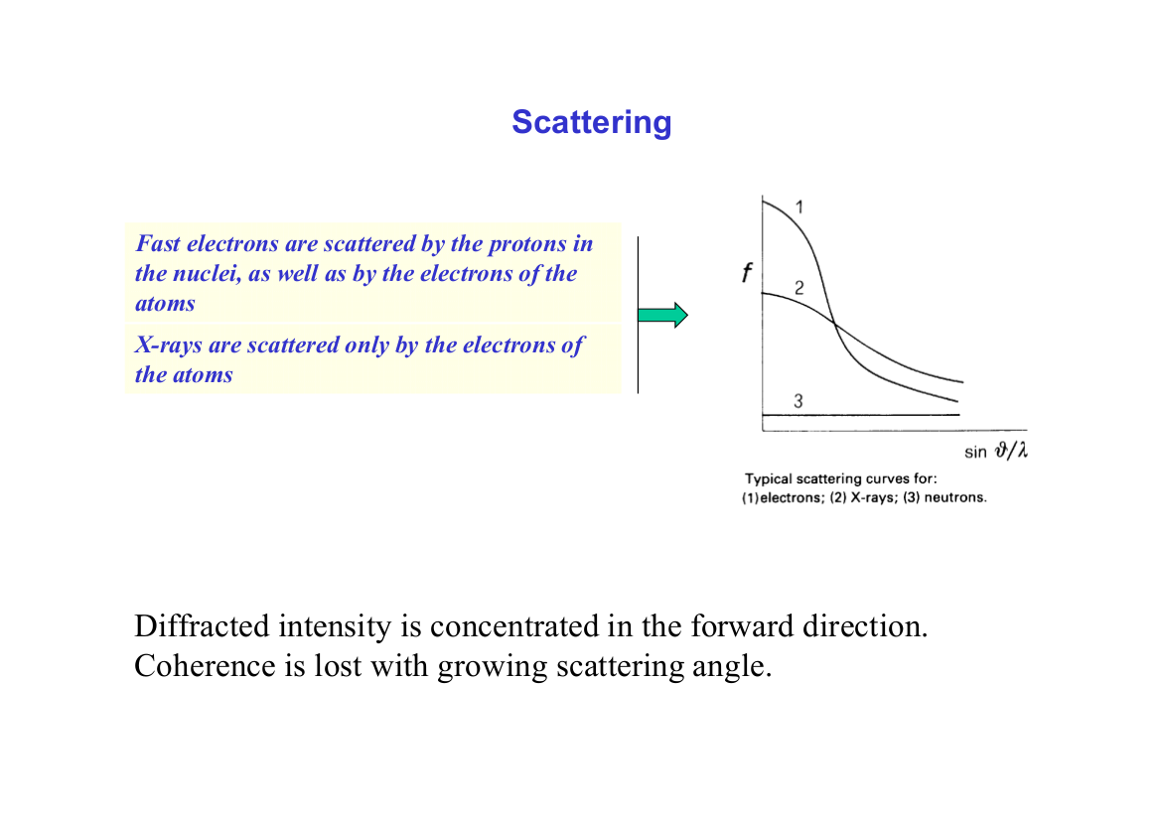

Slide 30
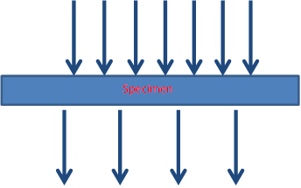
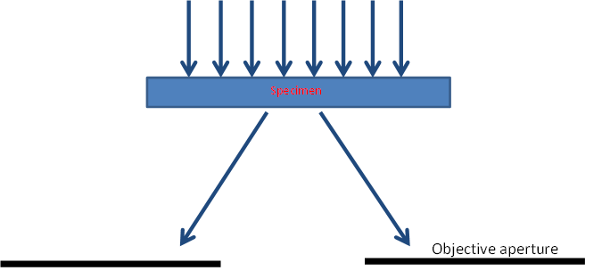
Contrast in the TEM – Scattering
Biological and “soft matter”
Absorption contrast:
Heavy atoms absorb more electrons than light atoms.
Scattering contrast:
Some electrons blocked by objective aperture.

Slide 31
Positive staining
Electron-dense heavy metal salt selectively stains certain features within the sample.
Block copolymer containing polystyrene and polymethylmethacrylate stained with ruthenium tetroxide.

Slide 32
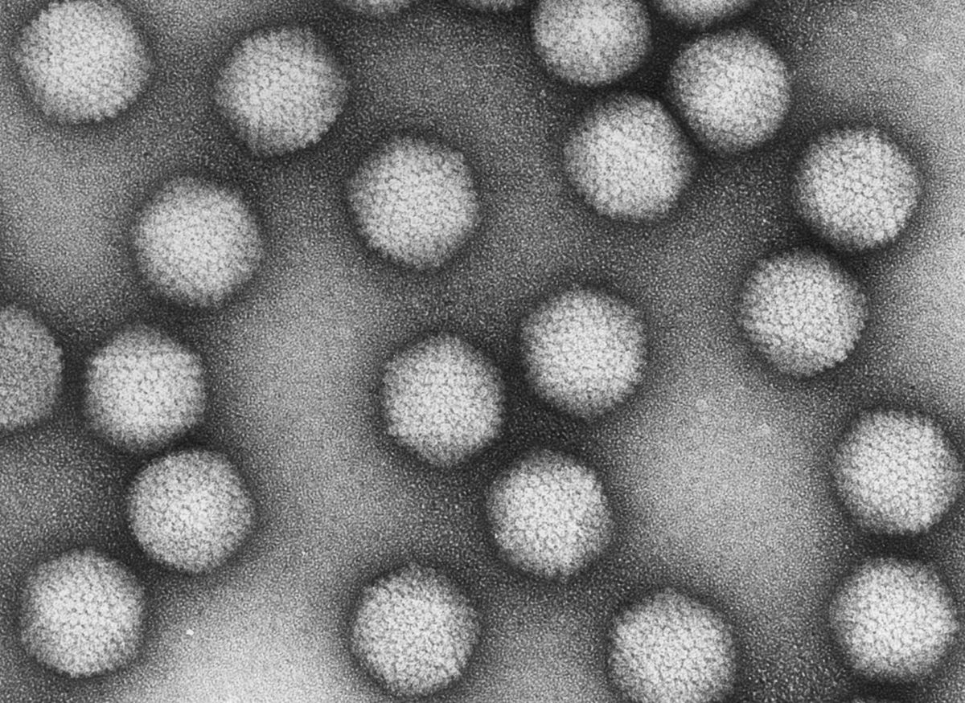
Biological TEM - negative staining
Surrounding biomolecules with thin amorphous layer of heavy metal salt. Reveals structure, and reduces structural flattening that occurs in the absence of stain.
Commonly used stains: uranyl acetate, uranyl formate, sodium/potassium phosphotungstate, ammonium molybdate.
Adenovirus negatively stained with uranyl acetate

Slide 33
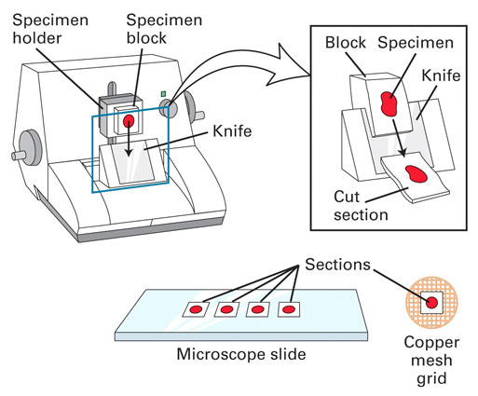
Biological TEM – preparing specimens from tissue
Fix → dehydrate → set in resin → section → deposit on grids → stain
Microtome

Slide 34
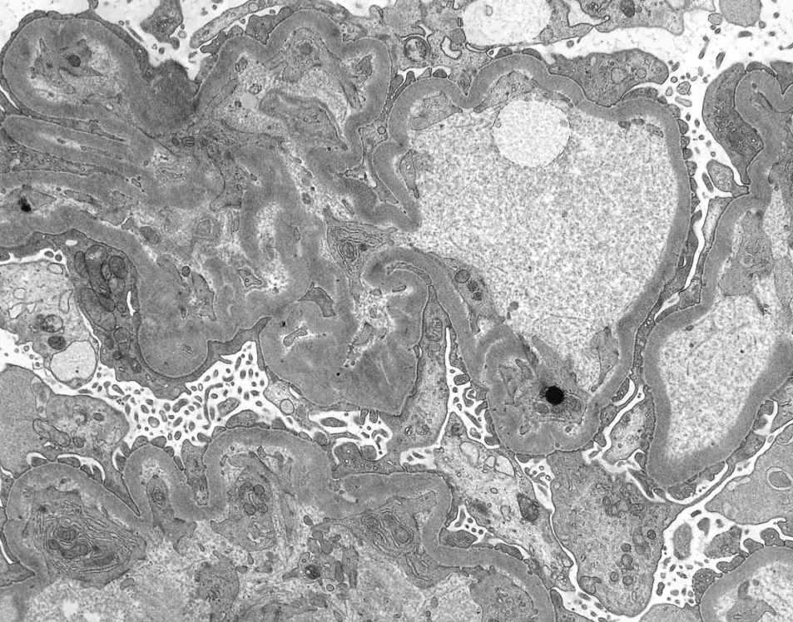
Biological TEM – thin section
Kidney

Slide 35
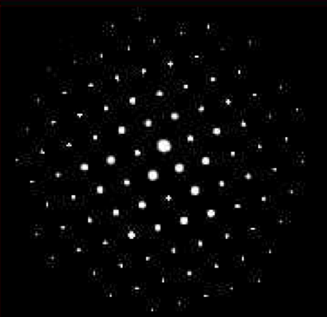
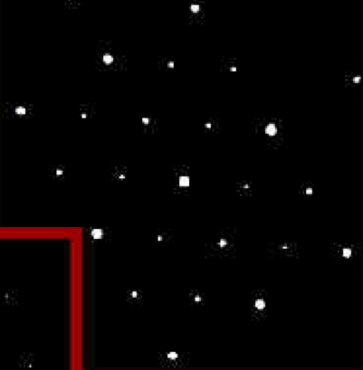
Contrast in the TEM - Diffraction
Diffraction pattern from single crystal
Cr₂₃C₆ - F cubic
a = 10.659 Å
Ni₂AlTi - P cubic
a = 2.92 Å

Slide 36
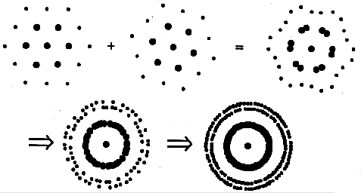
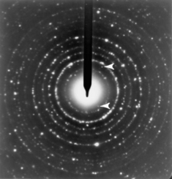
Contrast in the TEM - Diffraction
Polycrystalline materials
polycrystalline BaTiO₃ spotty Debye rings

Slide 37
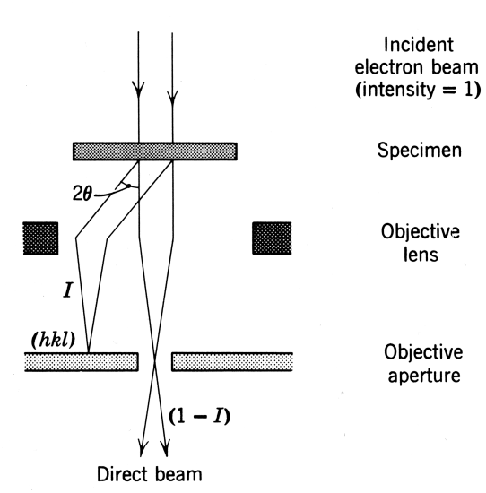
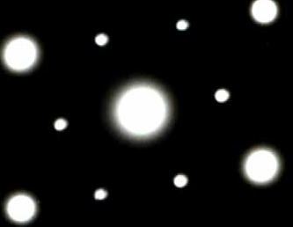
Contrast in the TEM - 2
Diffraction contrast

Slide 38
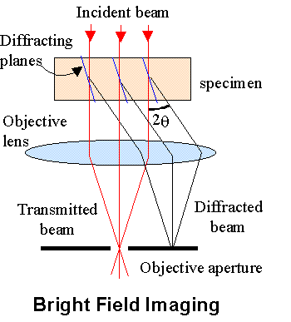
Bright Field Imaging
If the main portion of the near-forward scattered beam is used to form the image
  transmitted beam
  000 beam
  zero-order beam

Slide 39
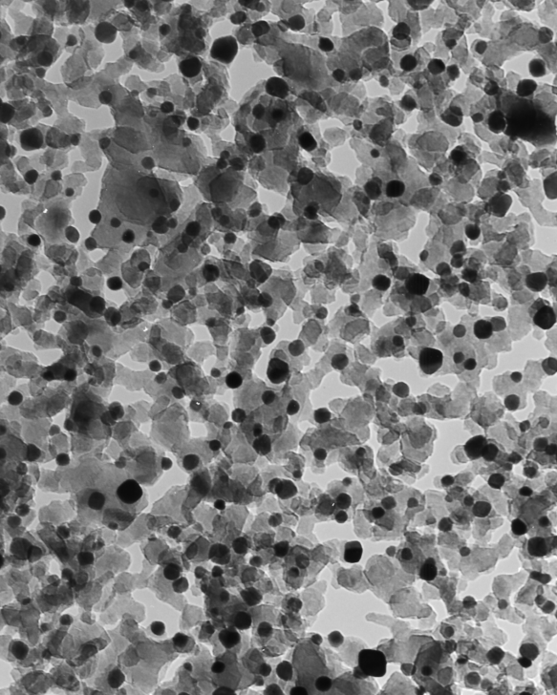
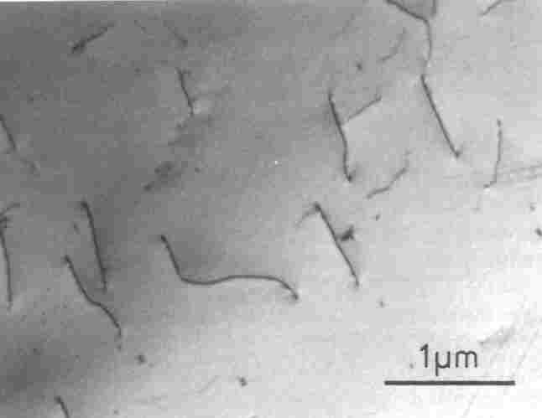
Transmission electron microscopy
TEM in physical science – bright field imaging
Dislocations in stainless steel foil
Platinum/alumina catalyst

Slide 40
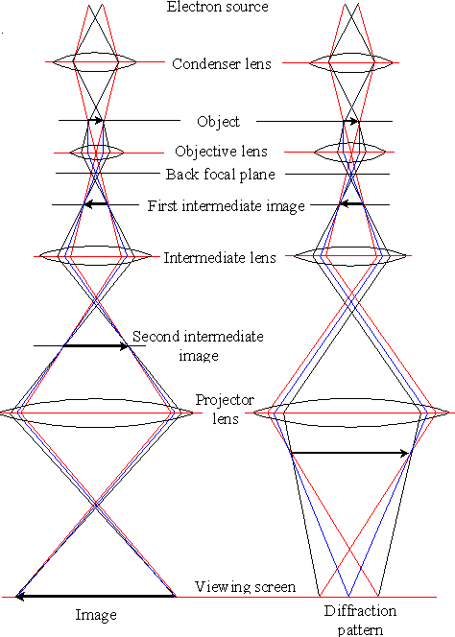
Ray Paths in the TEM

Slide 41
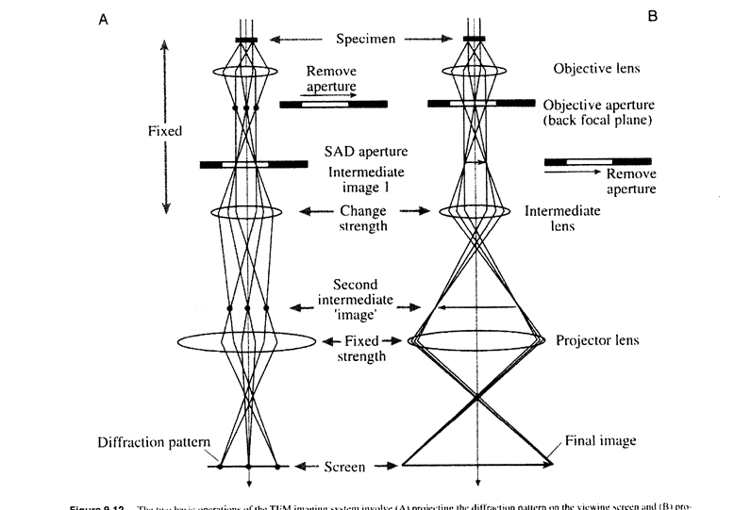

Electron Diffraction
TEM Imaging Modes: Diffraction vs BF

Slide 42
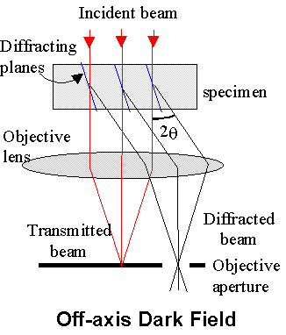
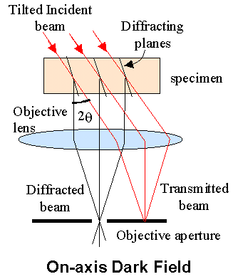
Dark Field Imaging
If the transmitted beam is excluded from the image formation process
  off-axis imaging
  tilted beam imaging

Slide 43
TEM Imaging:
Ray Paths

Slide 44
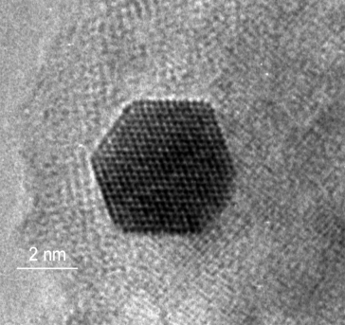


Contrast in the TEM - 3
Phase contrast: lattice imaging

Slide 45


Slide 46


Slide 47

High Angular Annular Dark Field
Scattered intensity = f(Z²)
HAADF detector is highly sensitive to heavy atoms
θ₃ > 50 mrad
Scattered
electrons
θ₂ 10 – 50 mrad
Diffracted
electrons
θ₁ < 10 mrad
Transmetted
electrons

Slide 48


Slide 49

Energy Dispersed Spectroscopy

Slide 50

Electron Energy Loss Spectroscopy
- EELS -

Slide 51


Slide 52


Slide 53


