Slide 1
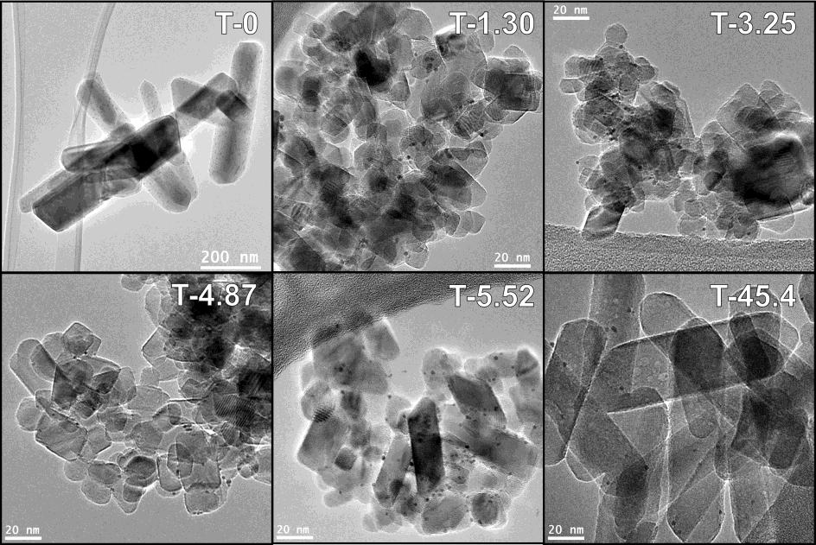
TiO₂ polymorphs
Appl. Catal. A - Gen. 2016, 518, 167–175

Slide 2
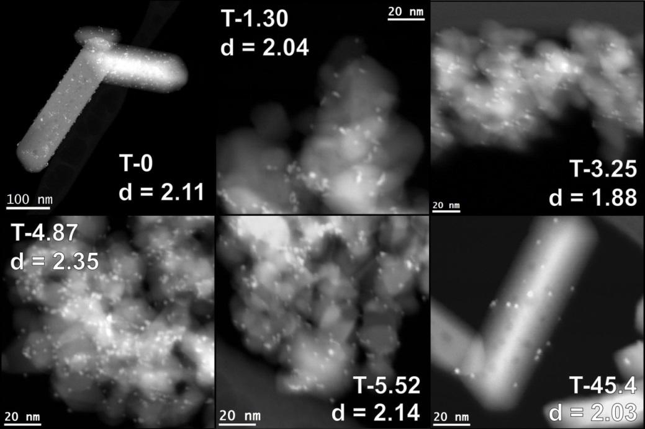
TiO₂ polymorphs
Appl. Catal. A - Gen. 2016, 518, 167–175

Slide 3
TiO₂ polymorphs
Appl. Catal. A - Gen. 2016, 518, 167–175

Slide 4
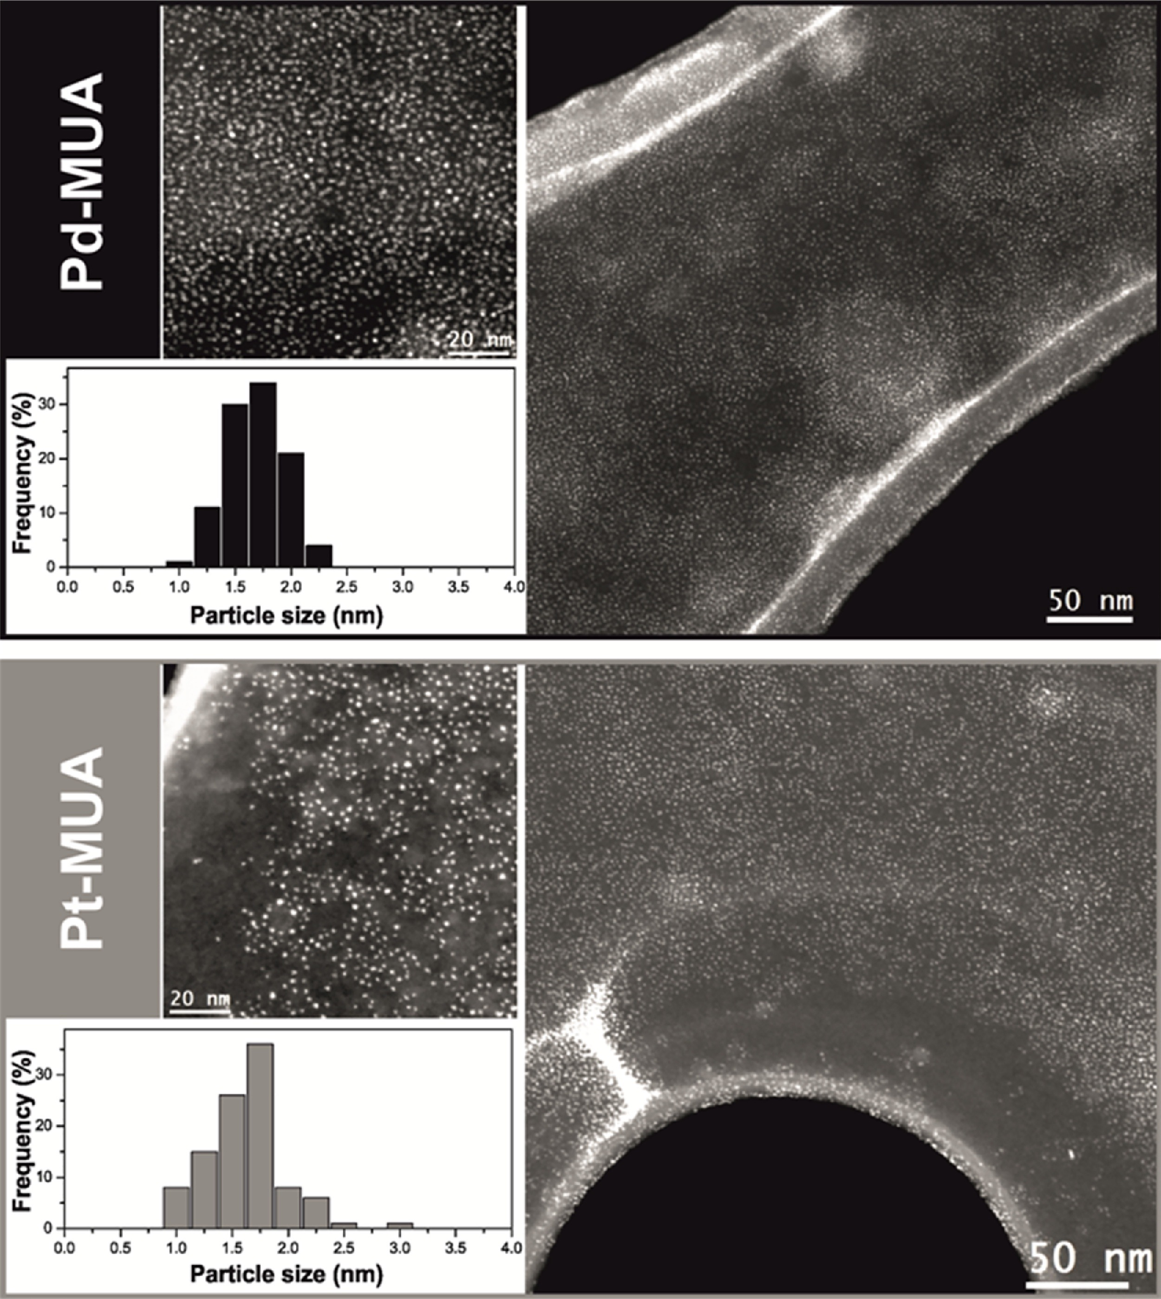
Pt-Pd Bimetallic nanoparticles
Appl. Catal. B-Environ., 2018, 236, 88-98

Slide 5
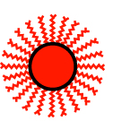
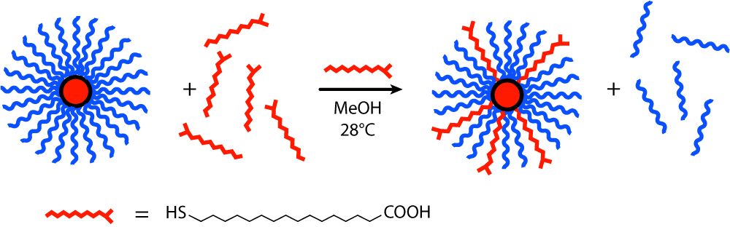
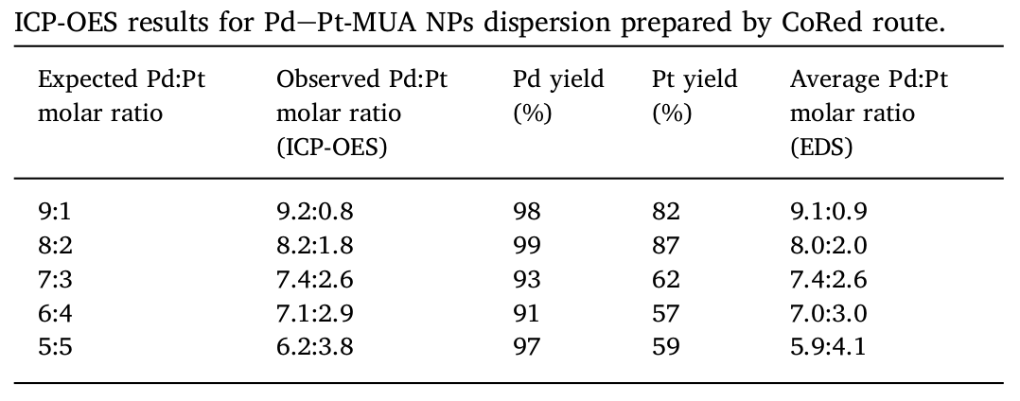
Pt-Pd Bimetallic nanoparticles
CoRed nanoparticles
K₂PdCl₄
+
K₂PtCl₄
H₂O/Acetone
+ MUA + NaBH₄
Appl. Catal. B-Environ., 2018, 236, 88-98

Slide 6
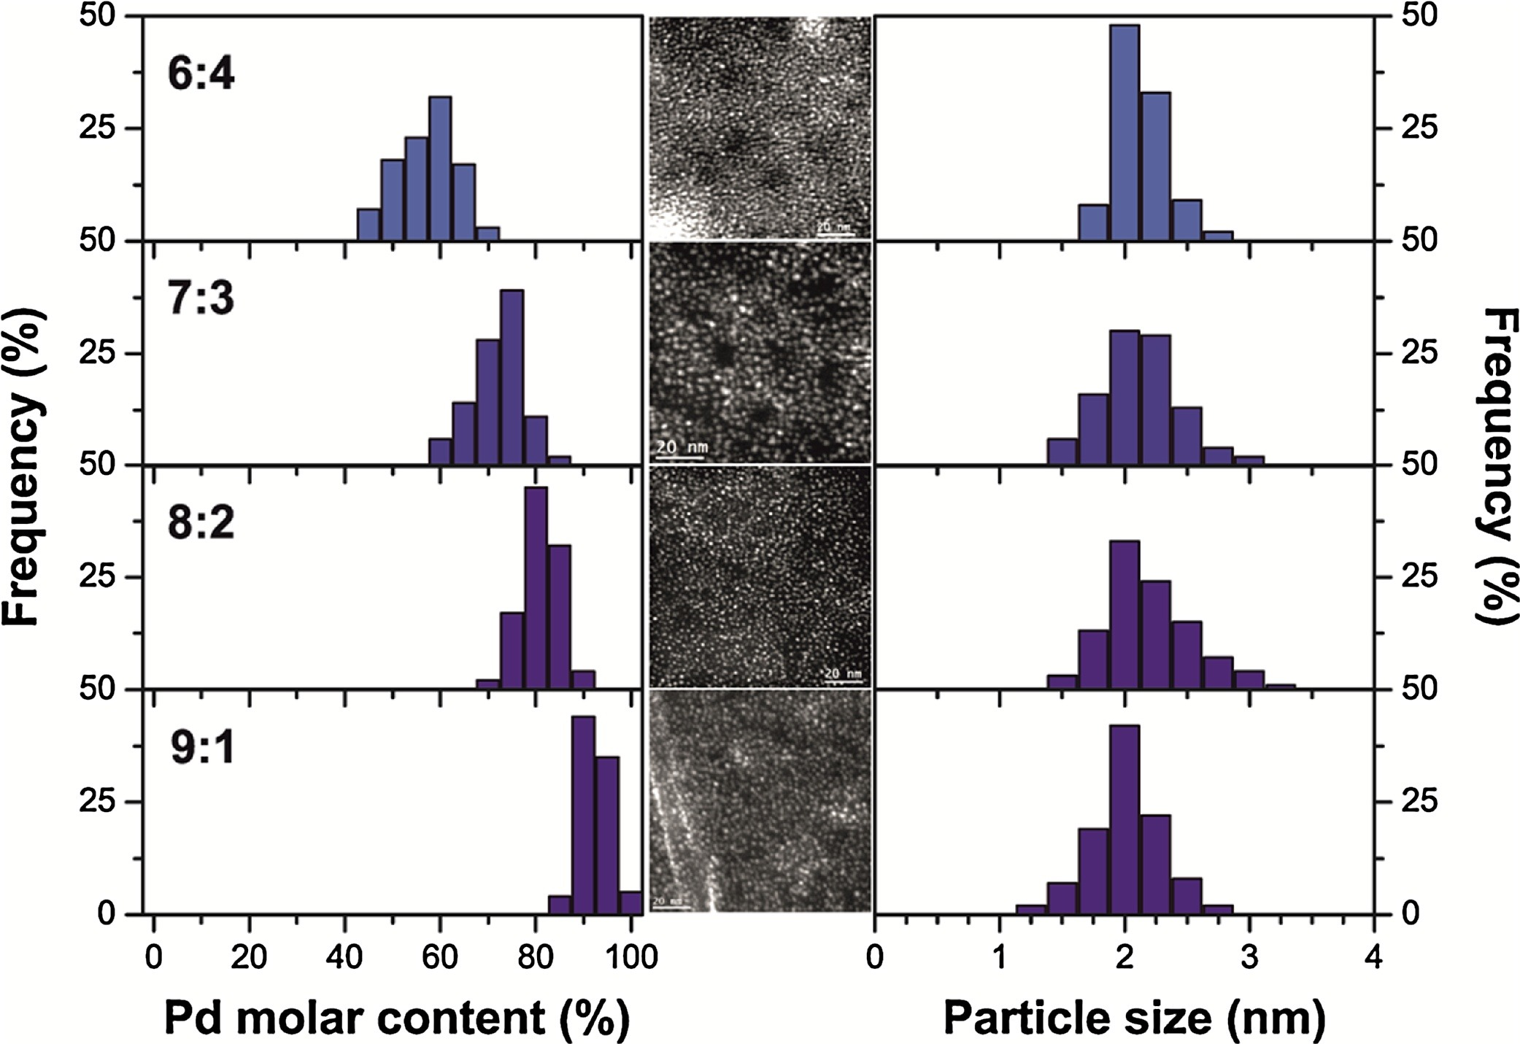
Pt-Pd Bimetallic nanoparticles
K₂PdCl₄
+
K₂PtCl₄
H₂O/Acetone
+ MUA + NaBH₄
Appl. Catal. B-Environ., 2018, 236, 88-98

Slide 7
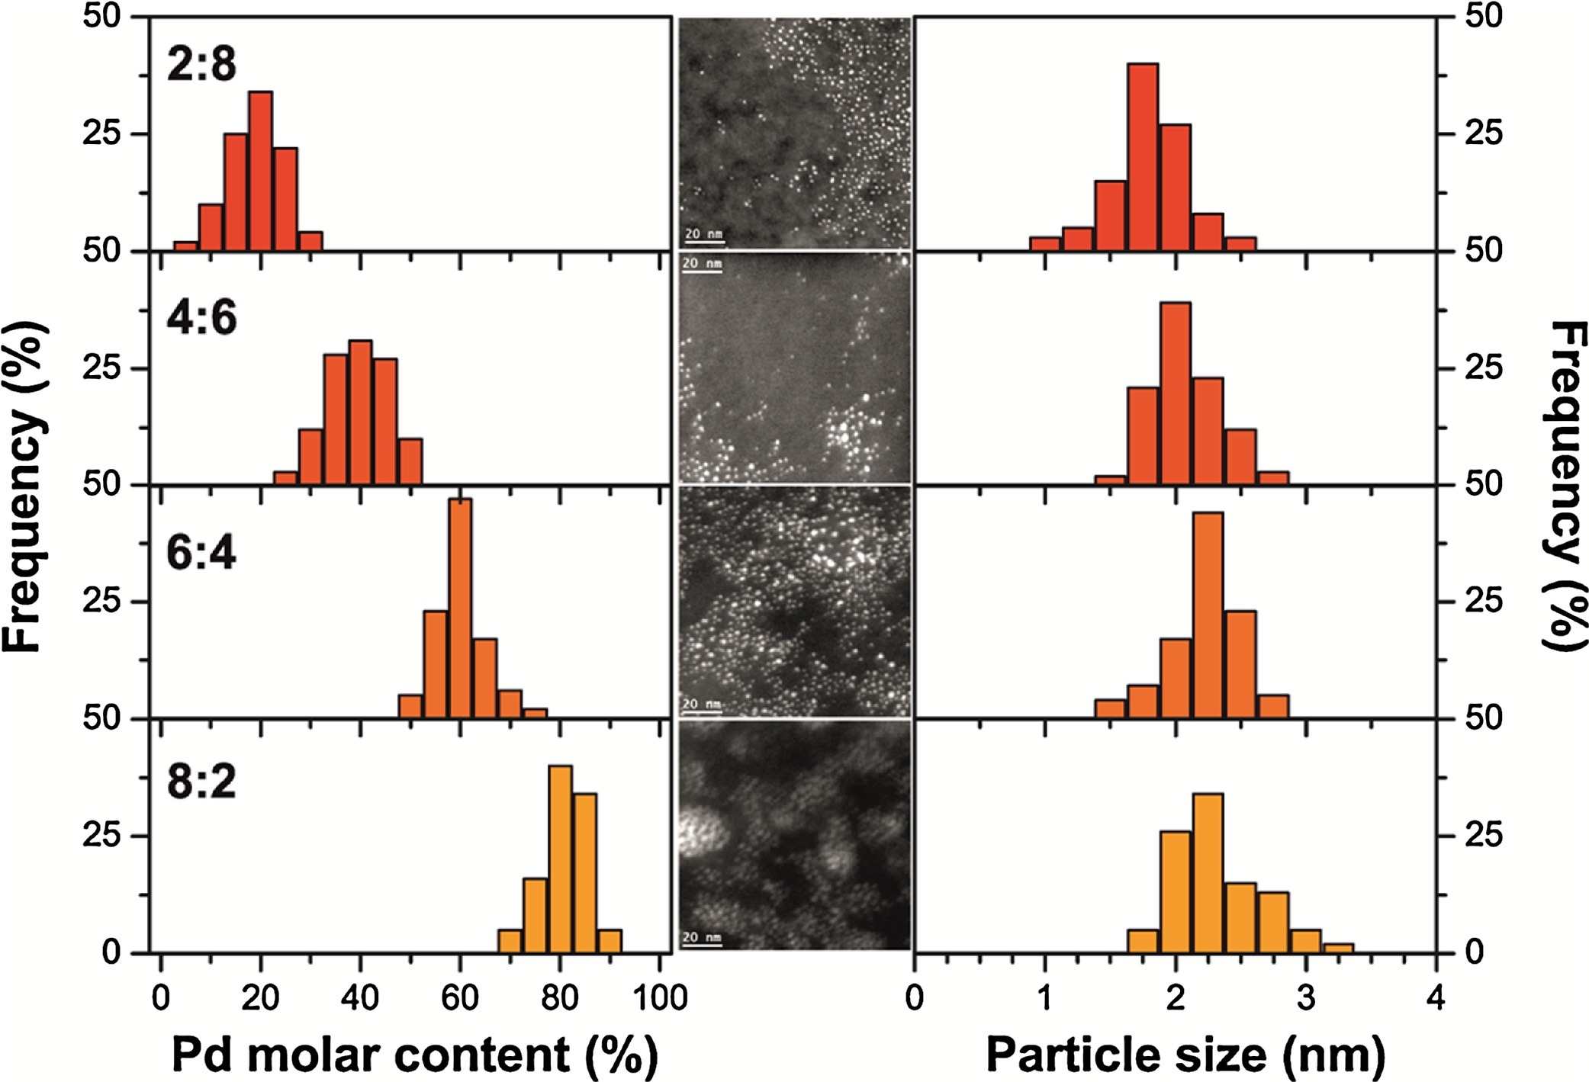
Pt-Pd Bimetallic nanoparticles
PreRed nanoparticles
K₂PdCl₄
+
Pt NPs
H₂O/Acetone
+ MUA + NaBH₄
Appl. Catal. B-Environ., 2018, 236, 88-98

Slide 8
MWCNT/Pd@TiO₂ hybrid materials
​Green Chem. 2017, 19, 2379-2389

Slide 9
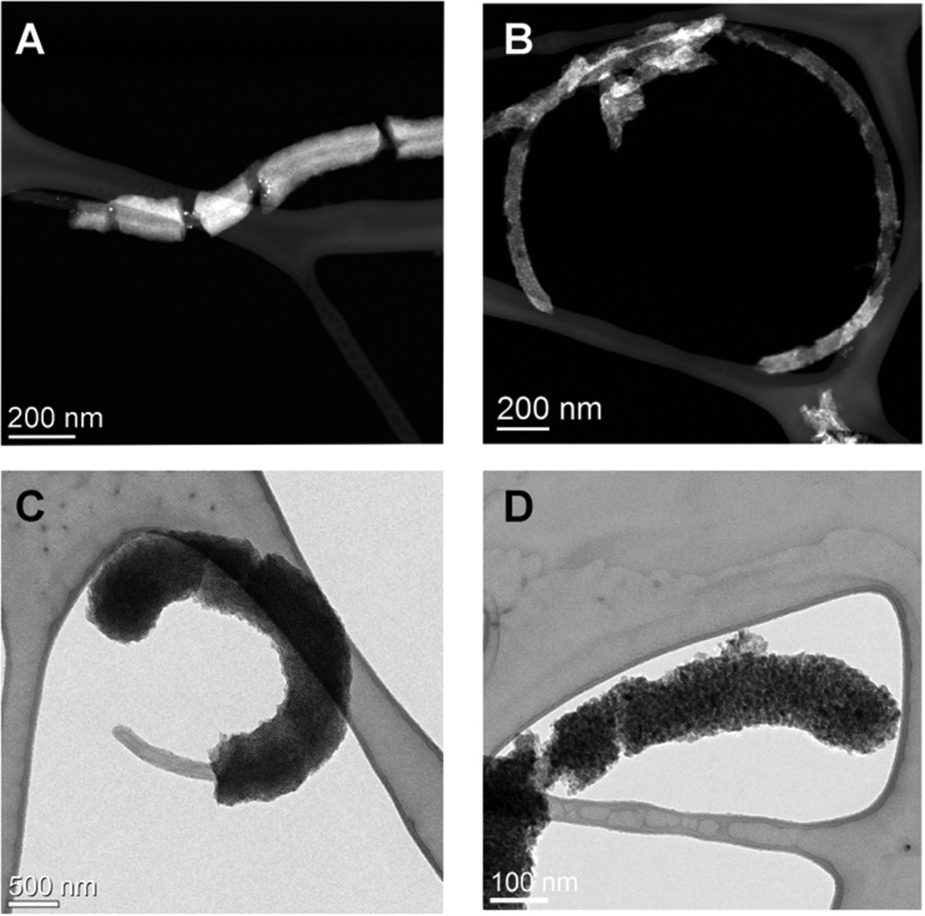
MWCNT/Pd@TiO₂ hybrid materials
​Green Chem. 2017, 19, 2379-2389

Slide 10
MWCNT/Pd@TiO₂ hybrid materials
​Green Chem. 2017, 19, 2379-2389

Slide 11
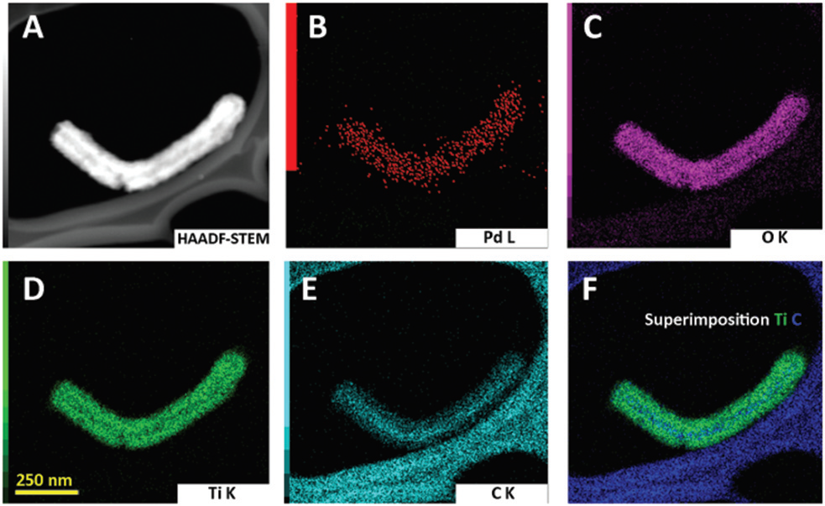
MWCNT/Pd@TiO₂ hybrid materials
EDS mapping
​Green Chem. 2017, 19, 2379-2389

Slide 12
Fe@CNT/Pd@TiO₂
hybrid materials
A) low magnification and B) high magnification HRTEM and C) HAADF-STEM images of sample Fe@CNTs/Pd@TiO₂-magn thermally treated (inset of C: magnification showing the individual Pd NPs); D) EDX mapping showing carbon (red) and iron (green); E) EDX mapping showing titanium (blue), oxygen (red) and iron (green). (For interpretation of the references to colour in this figure legend, the reader is referred to the web version of this article.)
Appl. Catal. B-Environ., 2018, 227, 356-365

Slide 13
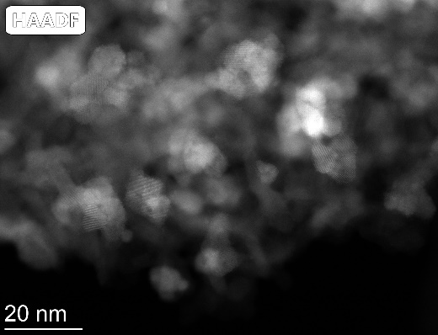
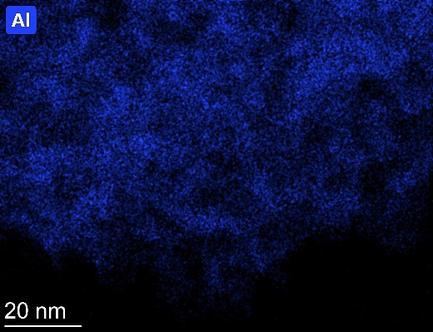
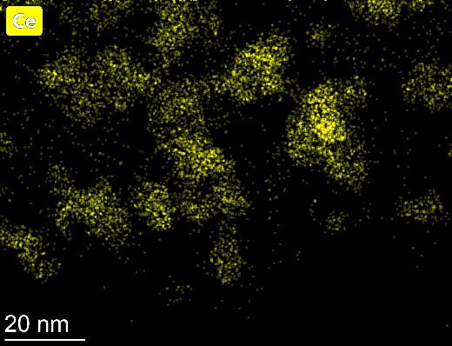
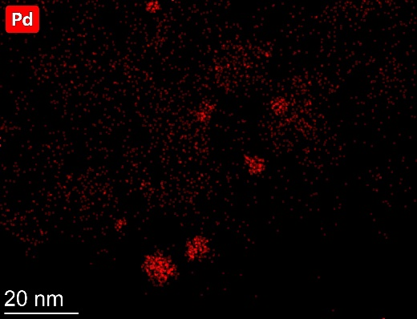
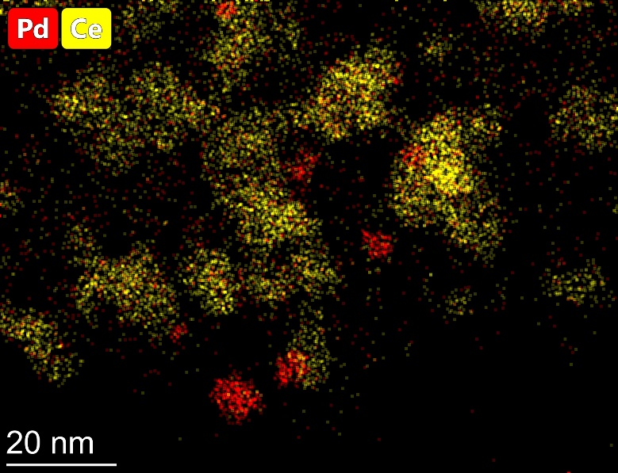
Pd/CeO₂/Al₂O₃ catalysts for CH₄ combustion
Fresh

Slide 14
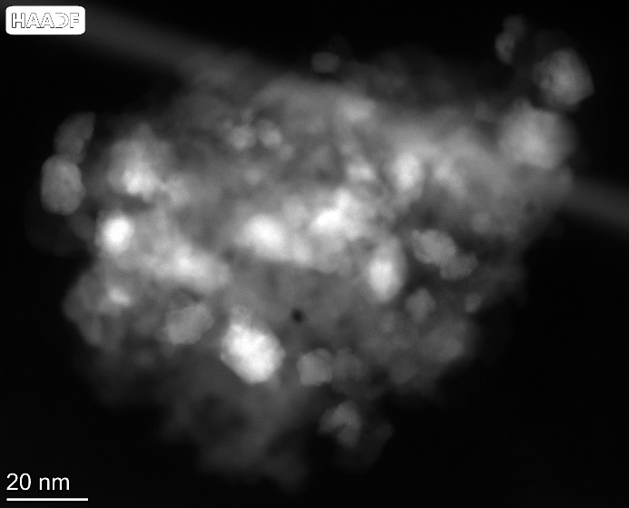
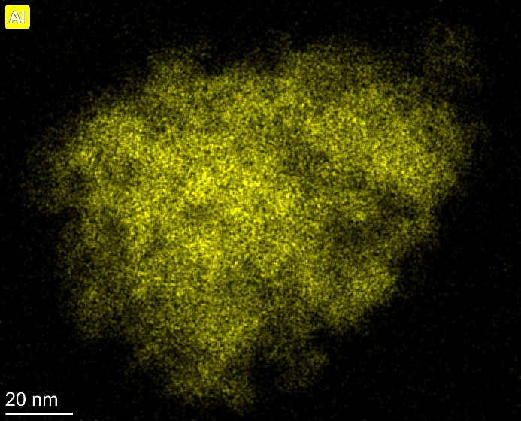
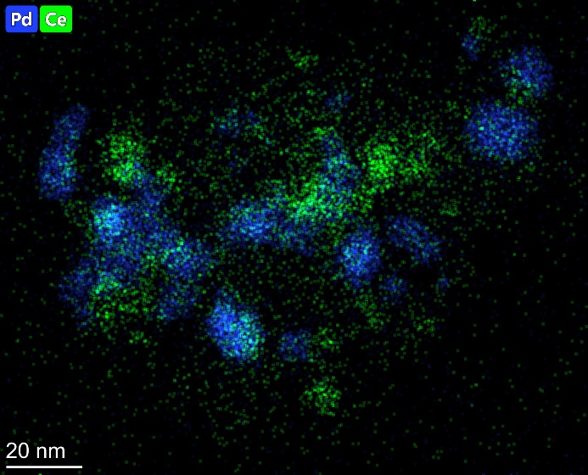
Pd/CeO₂/Al₂O₃ catalysts for CH₄ combustion
Used 650°C for 72h

Slide 15
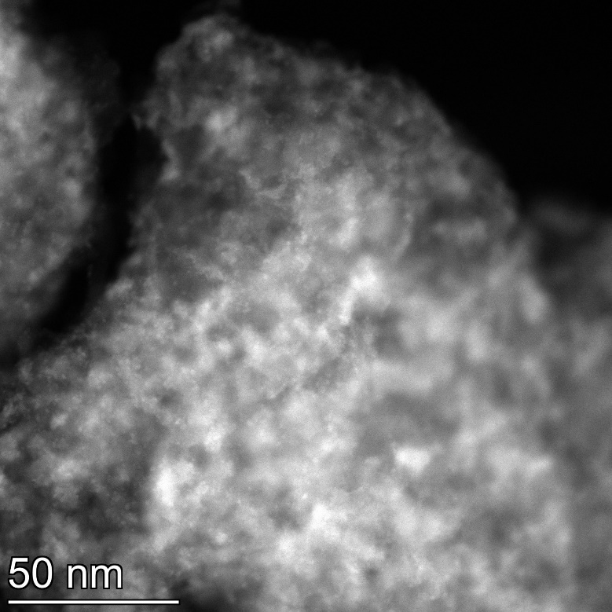
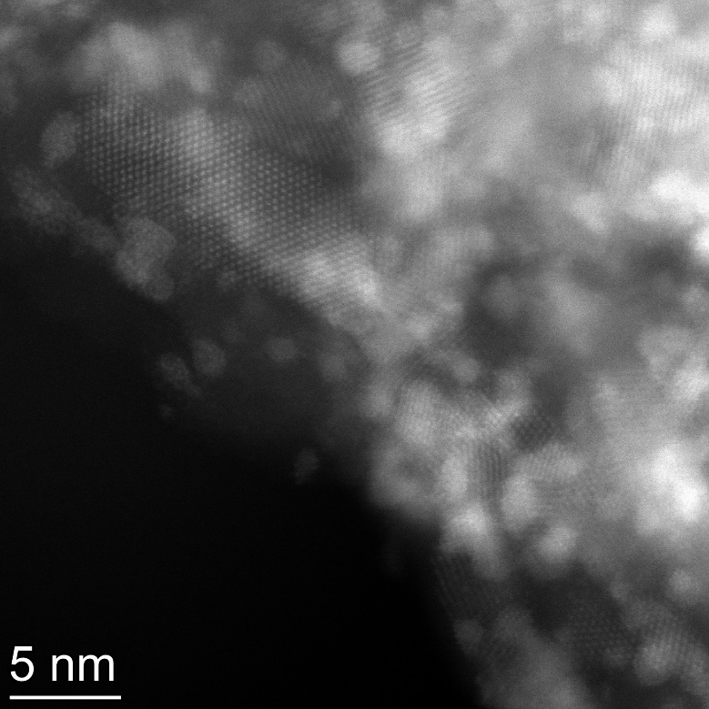
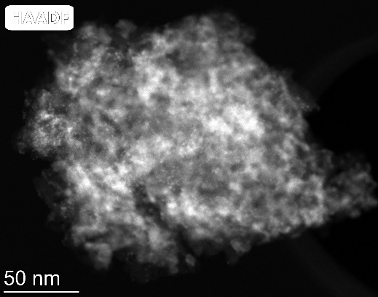
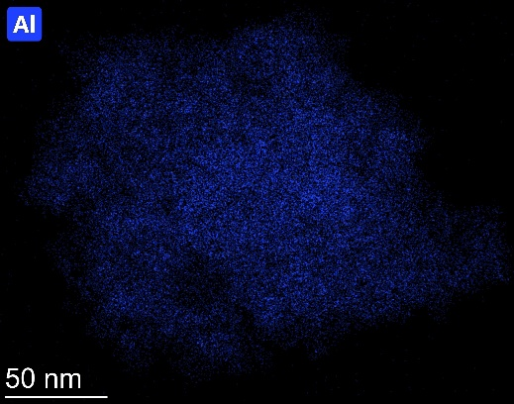
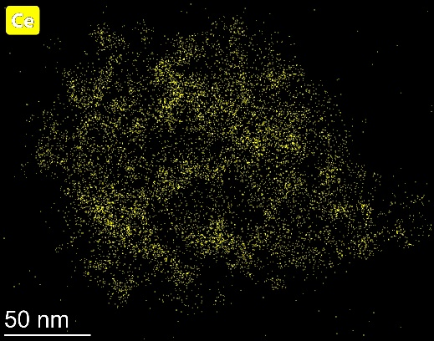
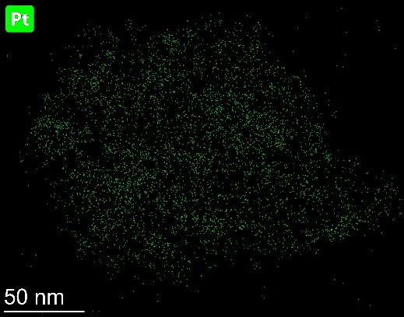
Pt/CeO₂/Al₂O₃ catalysts for CH₄ combustion
Fresh

Slide 16
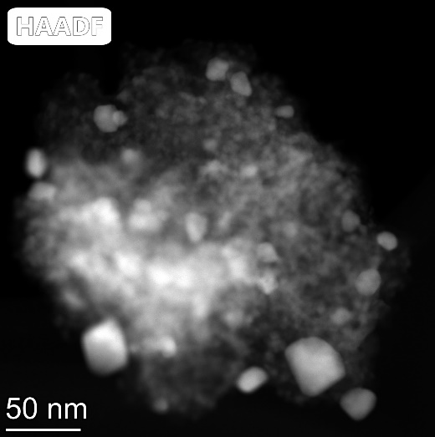
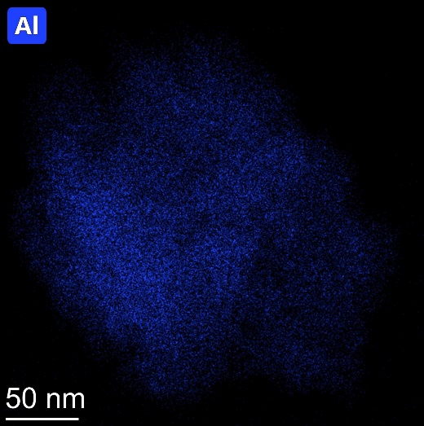
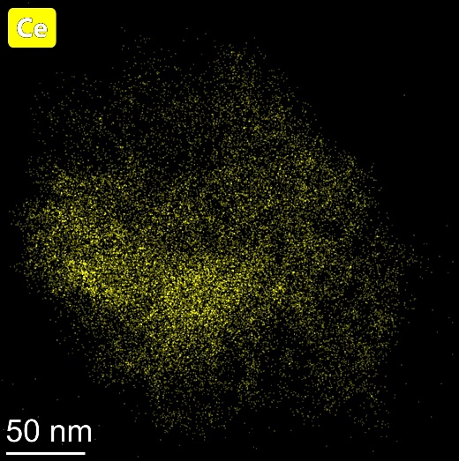
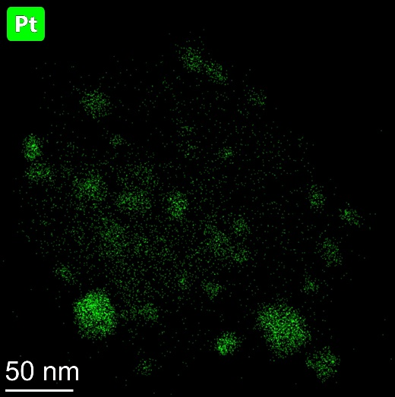
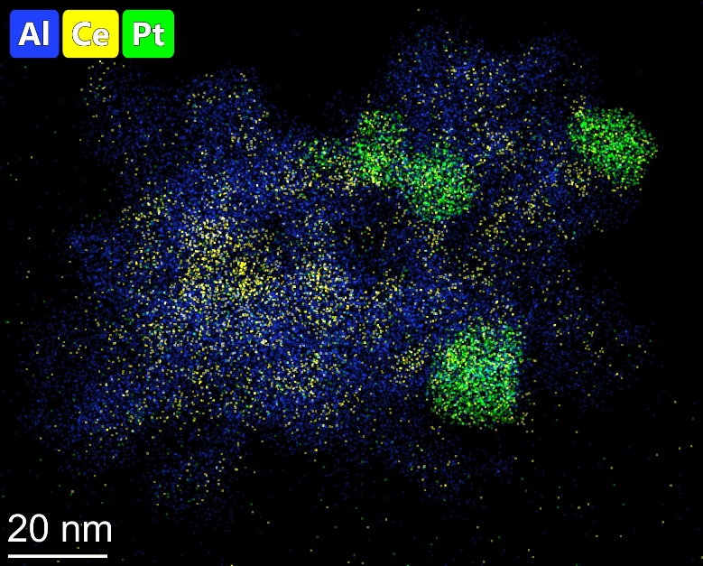
Pt/CeO₂/Al₂O₃ catalysts for CH₄ combustion
Used 650°C for 72h

Slide 17
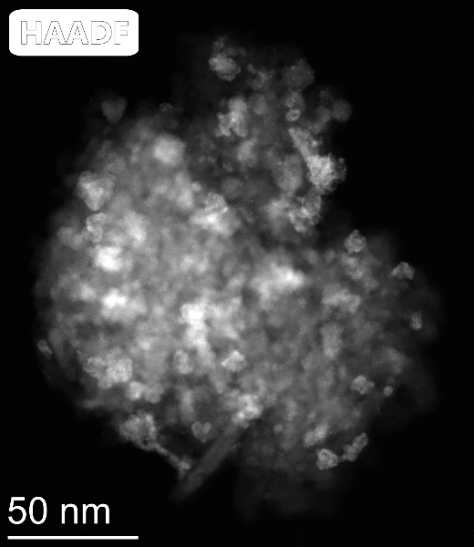
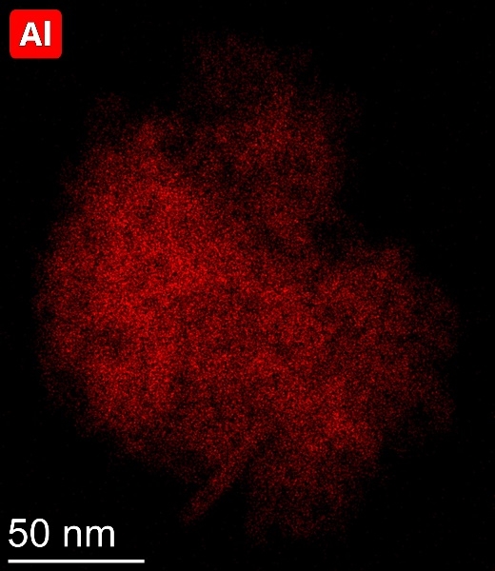
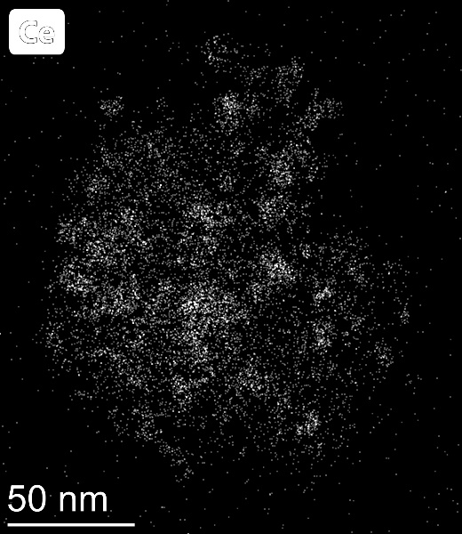
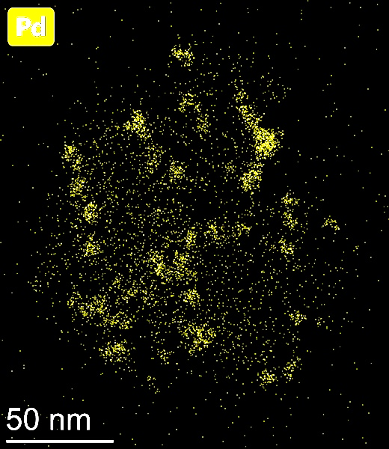
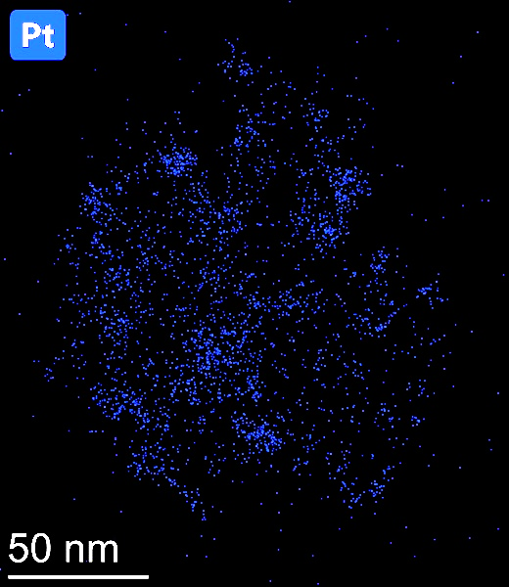
Pd-Pt/CeO₂/Al₂O₃ catalysts for CH₄ combustion
Fresh

Slide 18
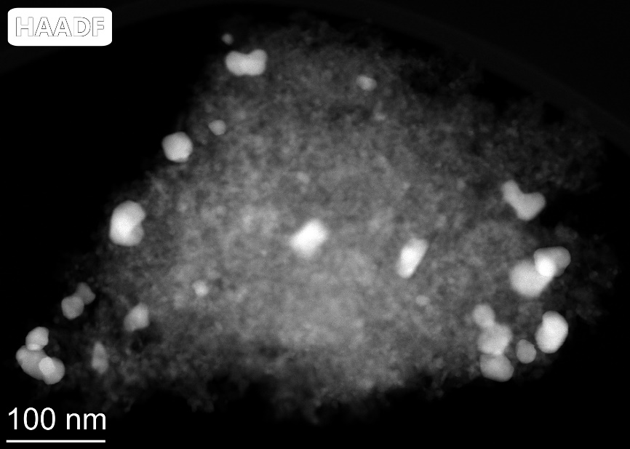
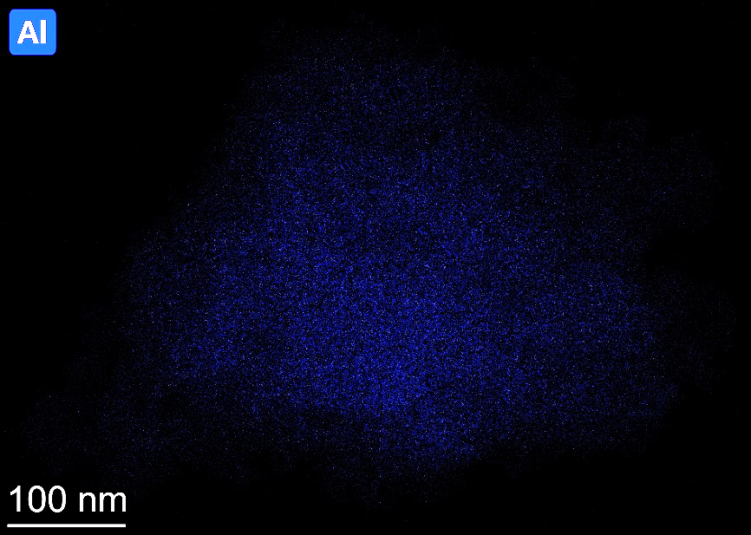
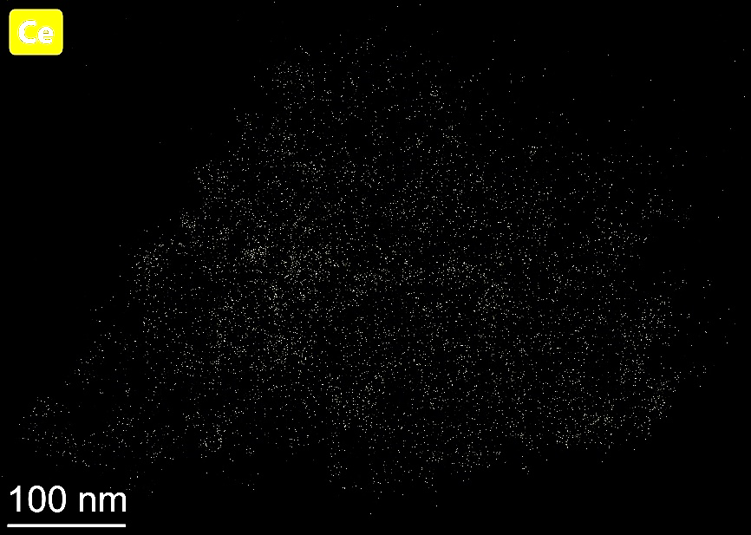
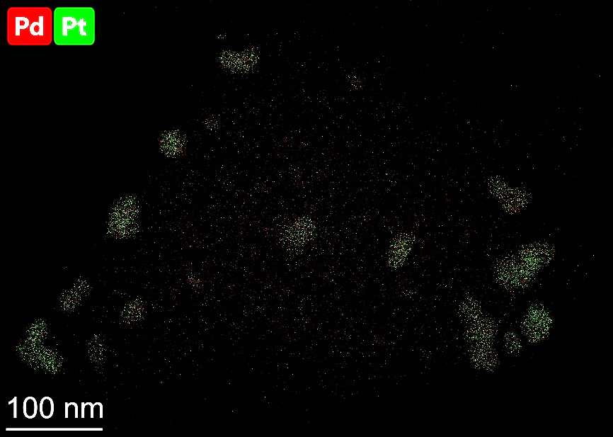
Pd-Pt/CeO₂/Al₂O₃ catalysts for CH₄ combustion
Used 650°C for 72h

