Slide 1

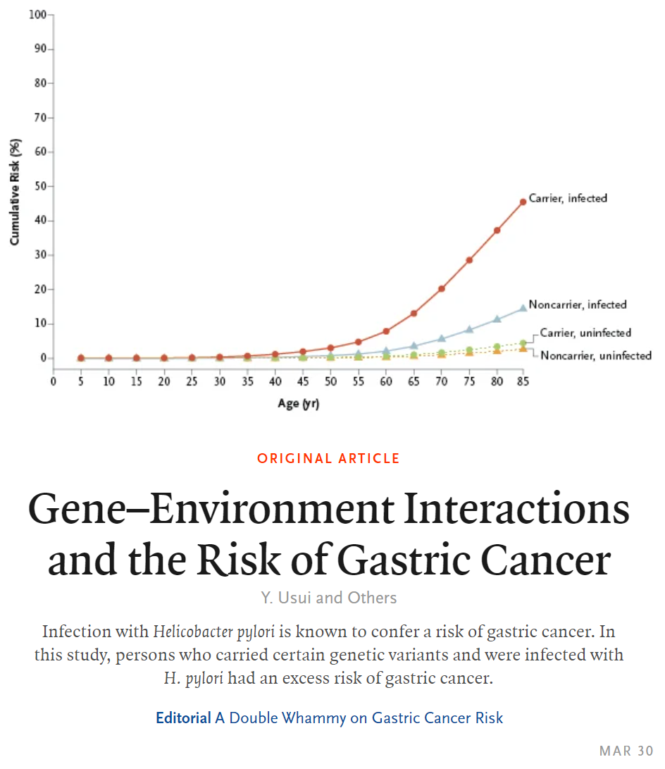
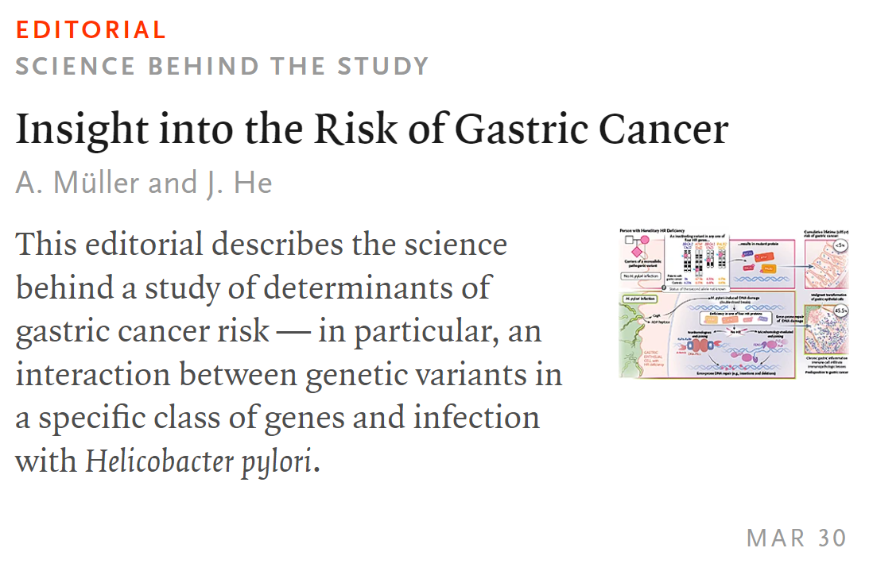
Edizione del 30 MARZO 2023

Slide 2

association between germline pathogenic variants in 27 cancer predisposing genes and the risk of gastric cancer in a sample of 10,426 patients with gastric cancer and 38,153 controls from BioBank Japan

Slide 3
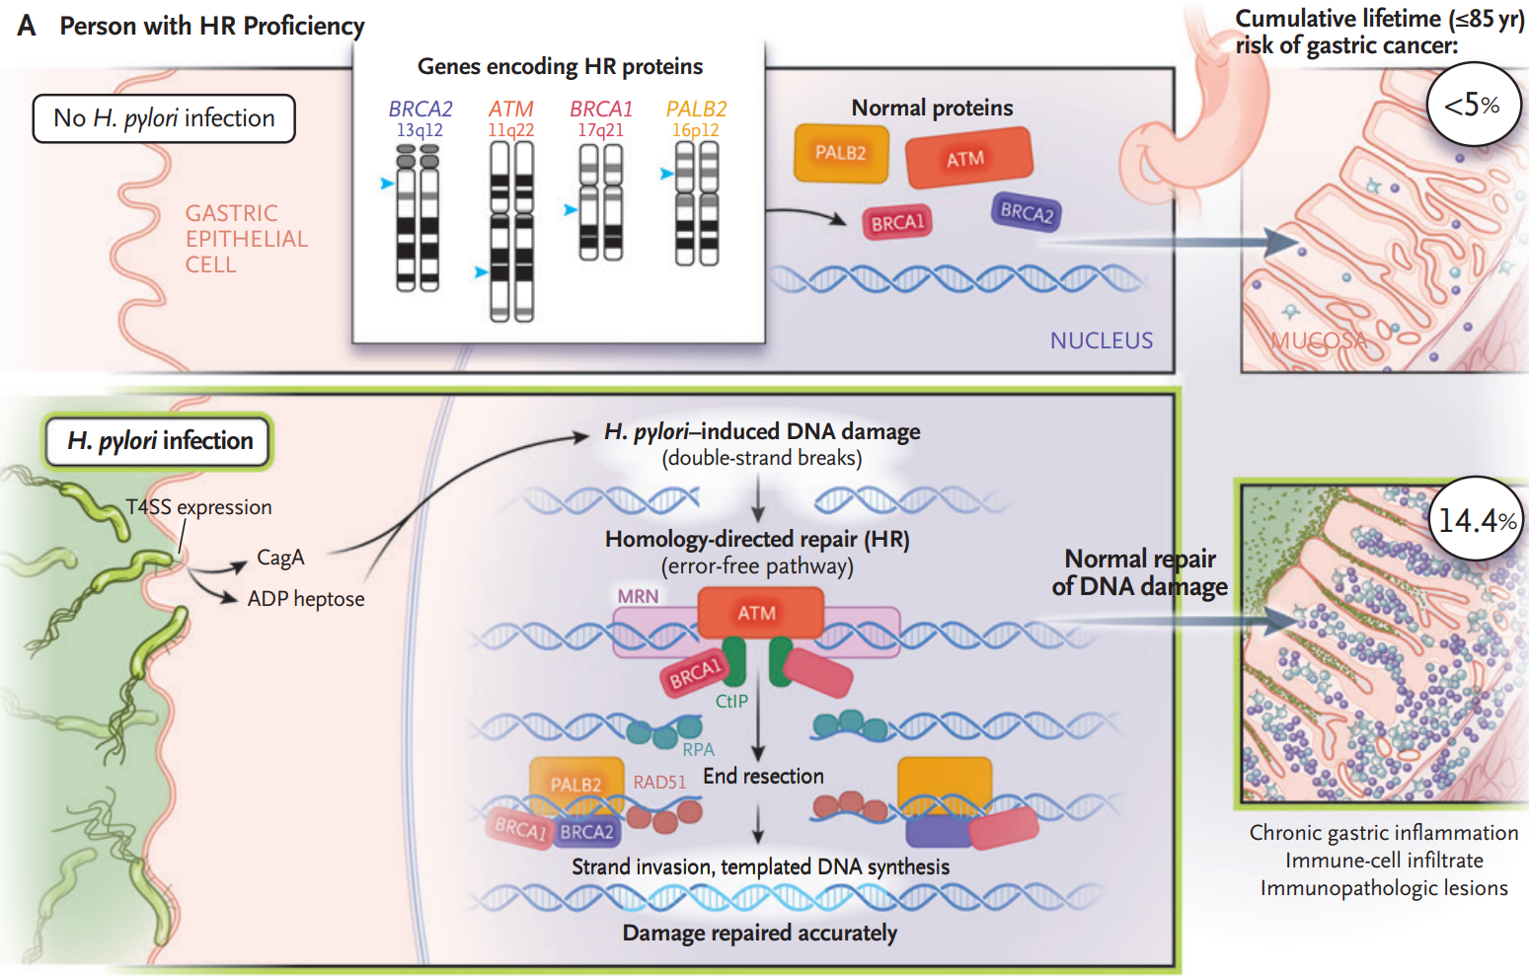
Notes:
HR homologous recombination

Slide 4
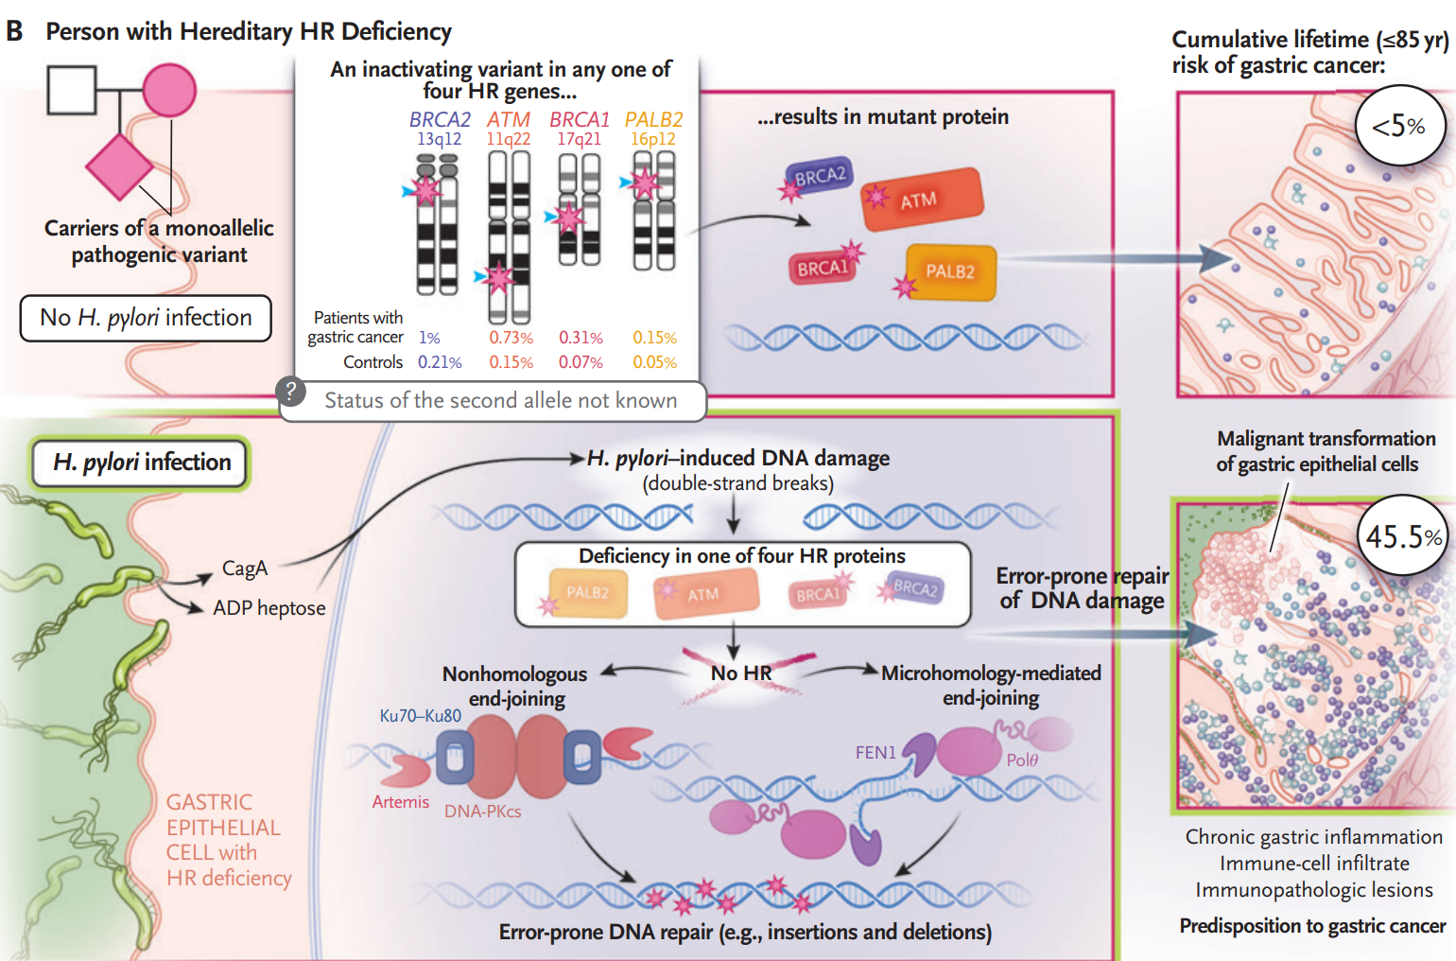

Slide 5
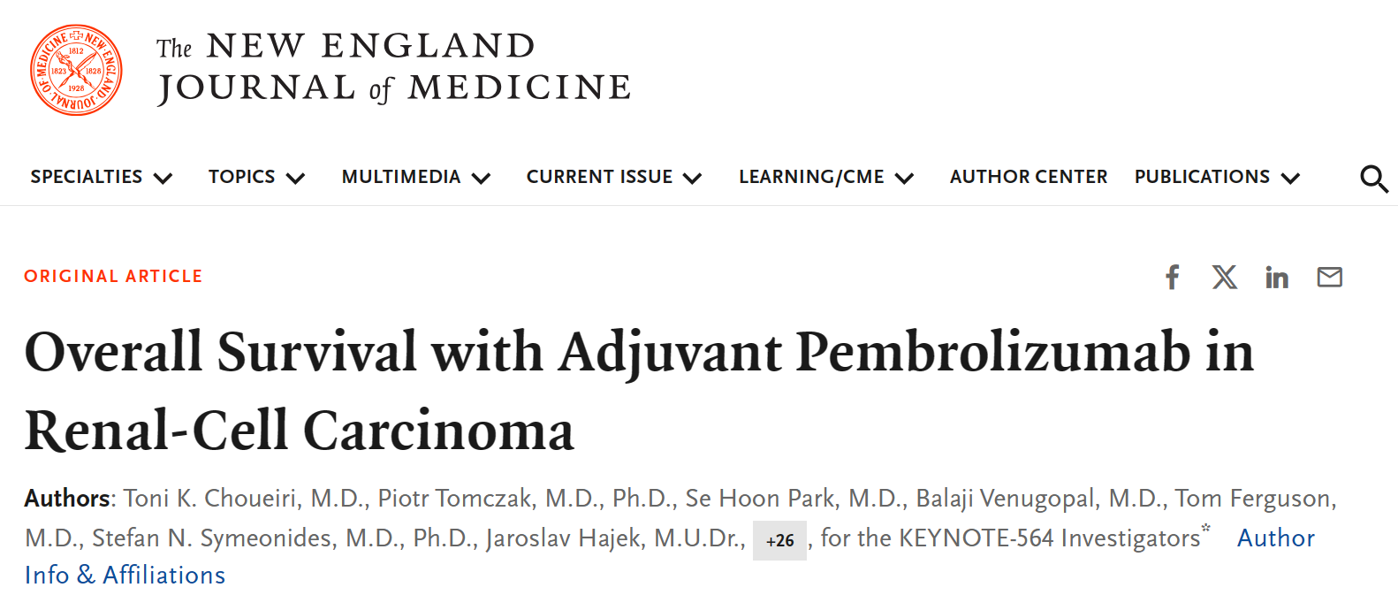
Edizione del 17 APRILE 2024

Slide 6
