Slide 1
FLUTTER and API REST esercitazione “elabFTW”

Slide 2
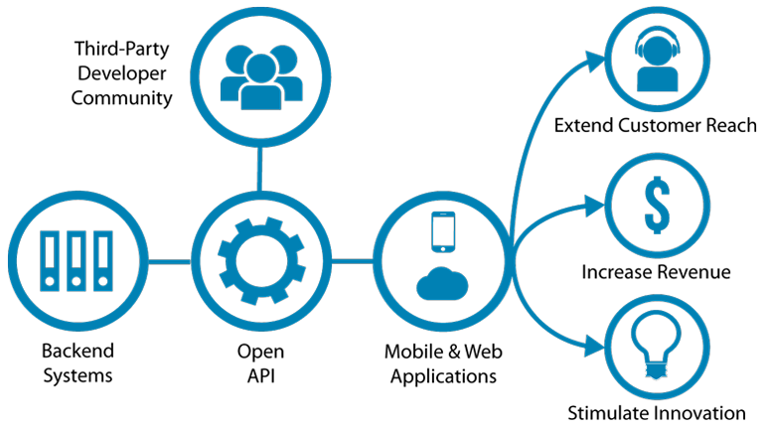
COS’E’ UN APPLICATION PROGRAMMING INTERFACE
openAPI

Slide 3
REST vs SOAP in breve
Simple Object Access Protocol (SOAP)! → POST ← GET, xml is an envelope
HTTP POST /ReturnValue HTTP/1.0 Host: www.abc.net Content-Type: text/xml; charset = utf-8 Content-Length: nnn
<?xml version = "1.0"?> <SOAP-ENV:Envelope xmlns:SOAP-ENV = "http://www.w3.org/2001/12/soap-envelope"
SOAP-ENV:encodingStyle = "http://www.w3.org/2001/12/soap-encoding">
<SOAP-ENV:Body xmlns:m = "http://www.abc.net/values"> <m:Value> <m:ValueName>Temperature</m:ValueName> </m:GetValue> </SOAP-ENV:Body>
</SOAP-ENV:Envelope>
HTTP/1.0 200 OK Content-Type: text/xml; charset = utf-8 Content-Length: nnn
<?xml version = "1.0"?> <SOAP-ENV:Envelope xmlns:SOAP-ENV = "http://www.w3.org/2001/12/soap-envelope"
SOAP-ENV:encodingStyle = "http://www.w3.org/2001/12/soap-encoding">
<SOAP-ENV:Body xmlns:m = "http://www.abc.net/values"> <m: ValueResponse > <m: Value >25.0</m: Value>
</m: ValueResponse > </SOAP-ENV:Body>
</SOAP-ENV:Envelope>
How to “move fast”: HTTP GET http://www.abc.net?value=temperature -> Response…
With RESTful: HTTP GET http://www.abc.net/values/temperature -> 25.0 (in JSON: {“temperature”: 25.0})
also: let’s use all the commands available in HTTP

Slide 4
HTTP Commands
Request method | RFC | Request has payload body | Response has payload body
GET | RFC 9110 | Optional | Yes
HEAD | RFC 9110 | Optional | No
POST | RFC 9110 | Yes | Yes
PUT | RFC 9110 | Yes | Yes
DELETE | RFC 9110 | Optional | Yes
CONNECT | RFC 9110 | Optional | Yes
OPTIONS | RFC 9110 | Optional | Yes
TRACE | RFC 9110 | No | Yes
PATCH | RFC 5789 | Yes | Yes
https://en.wikipedia.org/wiki/HTTP

Slide 5
RESTful
Uniform interface: One piece of data belong to a single URI
Client-server decoupling: You only need to know the URI of the server to interact
Statelessness: all the information to process is included in the message, no previous operations required
Cacheability: everything that is cacheable must be cached, to improve performance (client AND server side)
Layered system architecture: the architecture is transparent to the layers inside
Code on demand*: could give runnable code as a response (this is risky and must be done only on-demand).

Slide 6
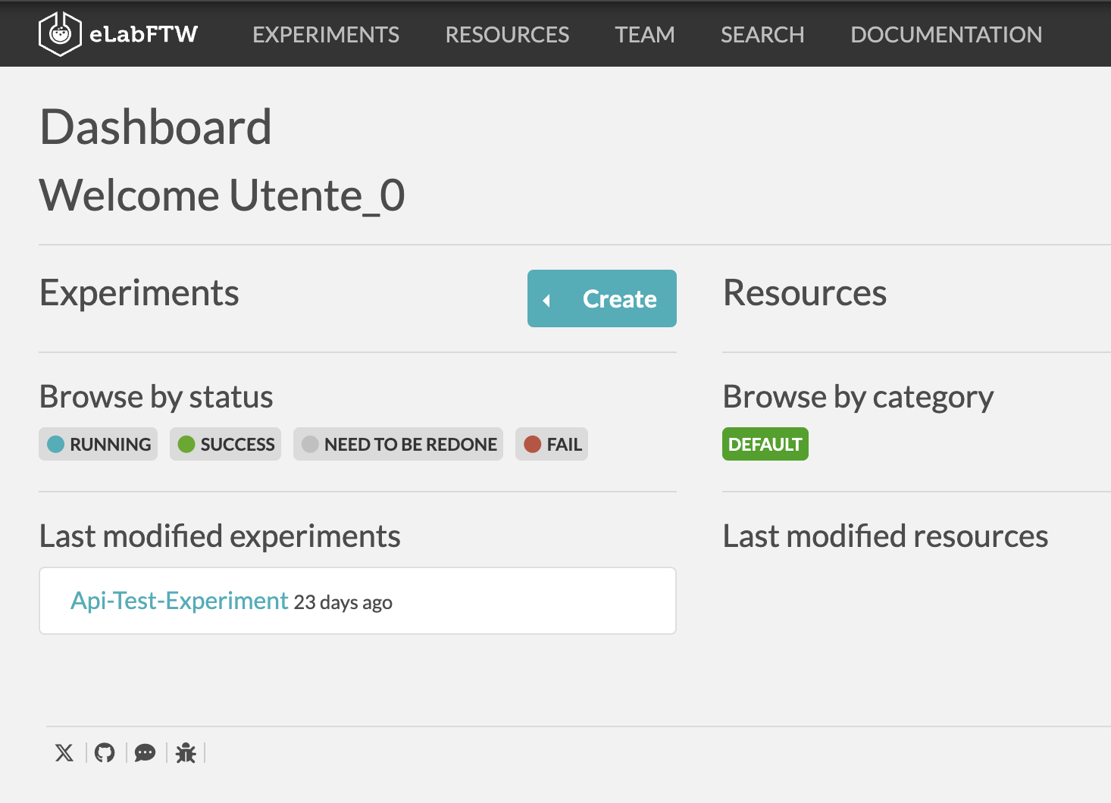
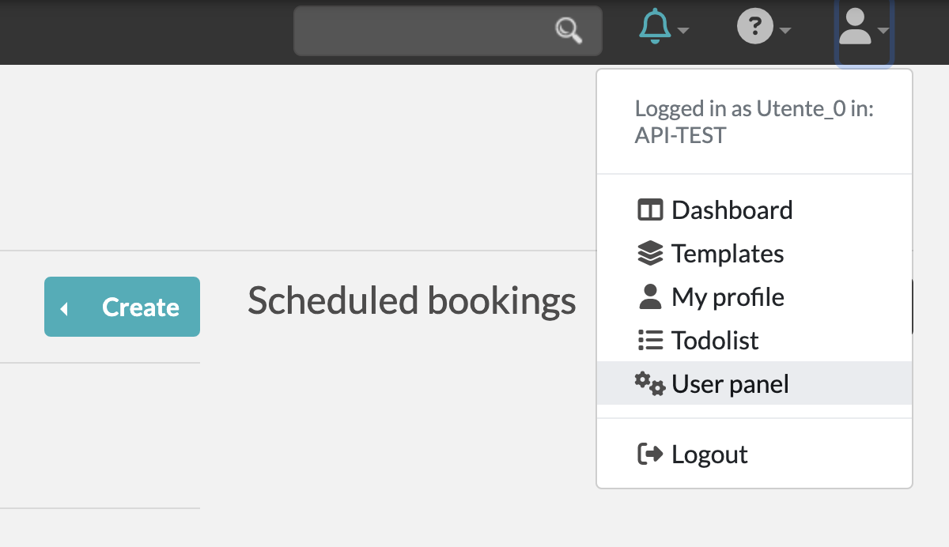
elabFTW
https://www.elabftw.net/

Slide 7
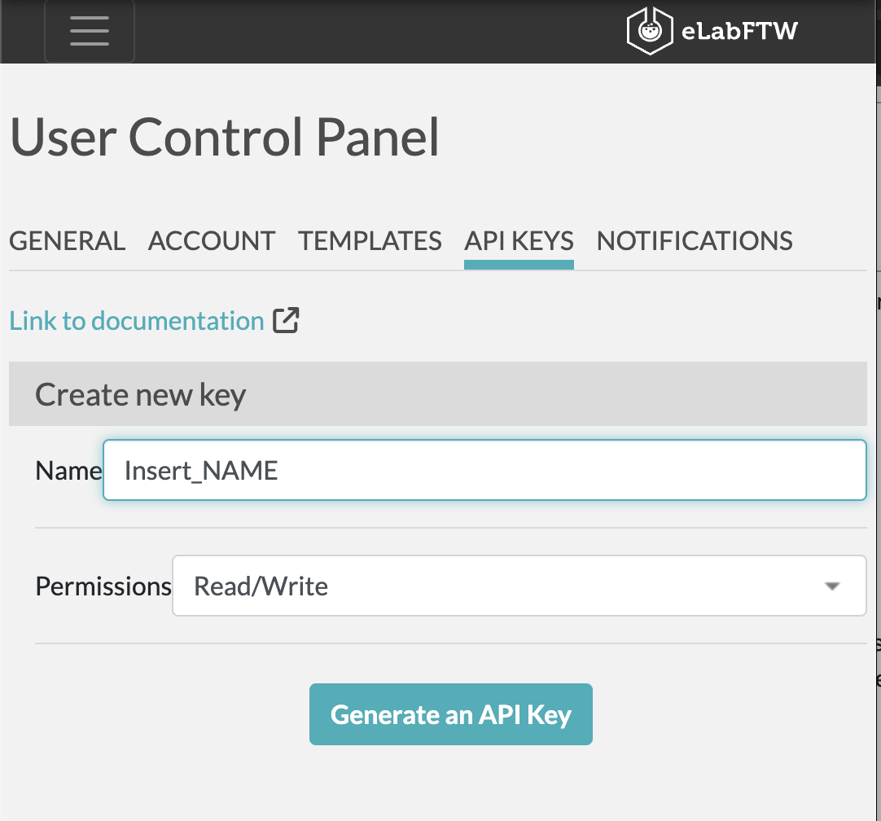
generate a personal API Key
https://www.elabftw.net/

Slide 8
Let’s see if the key works
Unix:
curl https://prp-electronic-lab.areasciencepark.it/api/v2/experiments -H "Authorization: [INSERT YOUR KEY HERE]” - GET the list of experiments
Windows POWERSHELL:
Invoke-WebRequest -Uri "https://prp-electronic-lab.areasciencepark.it/api/v2/experiments/56" -Method Get -Headers @{ Authorization = '[INSERT YOUR KEY HERE]’ }
POST/PATCH:
Unix:
curl -i -H "Content-Type: application/json" -H "Authorization: [INSERT YOUR KEY HERE] " -X PATCH -d '{"title": "test patch", "date": "2024-04-29", "body": "elabFTW API patch"}’ https://prp-electronic-lab.areasciencepark.it/api/v2/experiments/[Experiment id]
Windows POWERSHELL:
Invoke-WebRequest -Uri "https://prp-electronic-lab.areasciencepark.it/api/v2/experiments/[Experiment id]" -Method POST -Headers @{ Authorization = '[INSERT YOUR KEY HERE]’ } -Body @{title = ’test’}

Slide 9
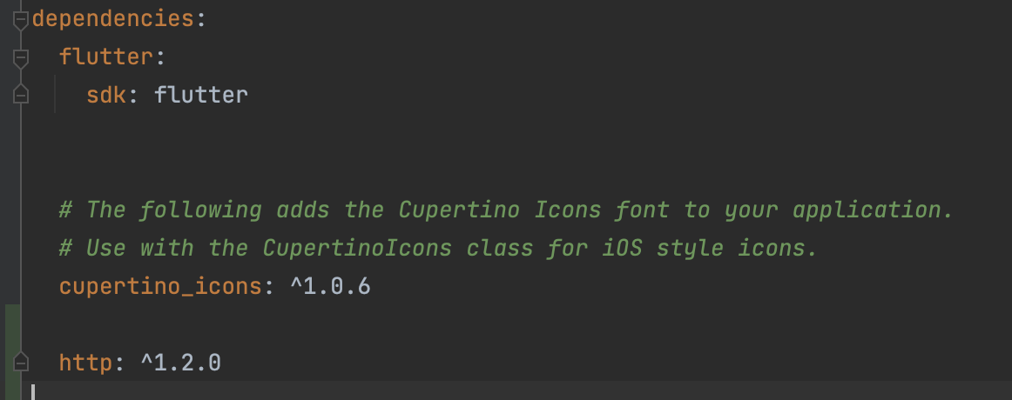
WHAT WE NEED
Packages:
import 'dart:convert'; import 'package:flutter/material.dart'; import 'package:http/http.dart' as http;
add http: ^1.2.0 under dependencies in
pubspec.yaml
If you are debugging with browsers/macos, add –web-browser-flag “—disable-web-security”

