Slide 1
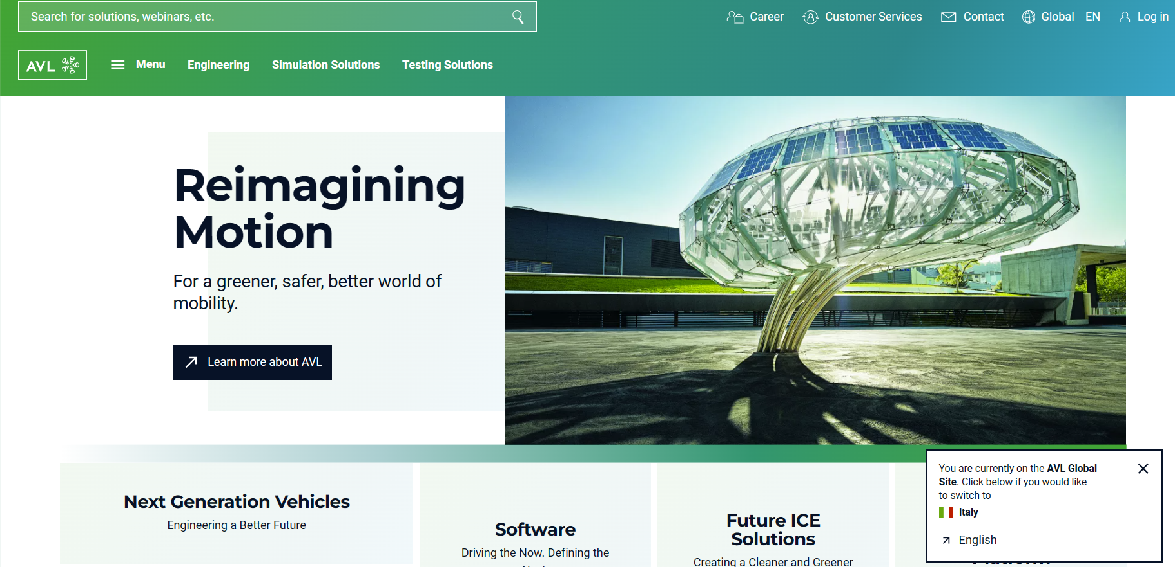
AVL 16 May h 14-17-30

Slide 2
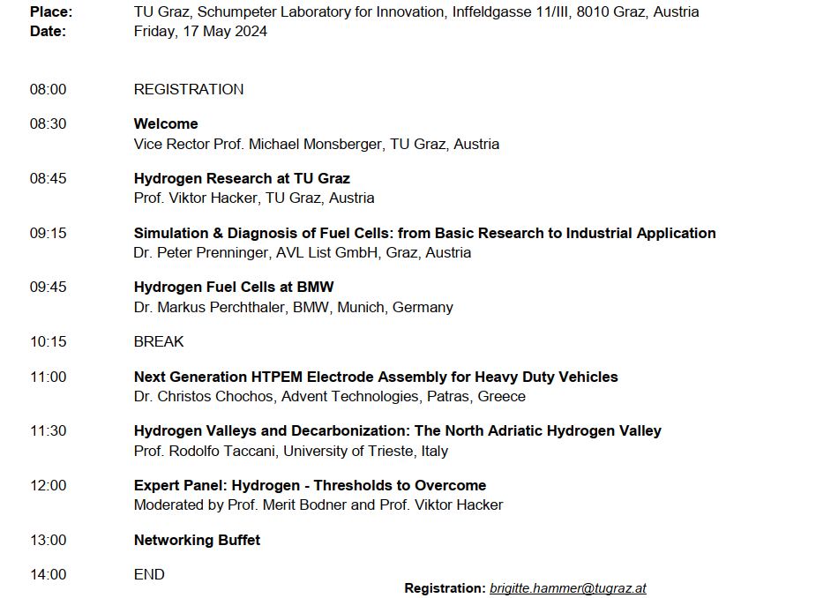
TU Graz Workshop 17 May h 8 - 14

