Slide 1

RIBOPRAMP
Optimization of Proline-rich antimicrobial peptides as new antibiotic targeting the bacterial ribosome.

Slide 2
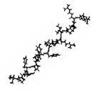
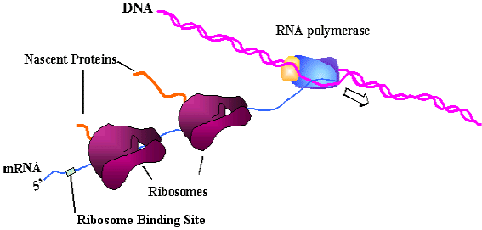
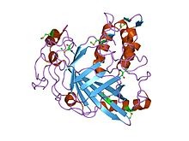
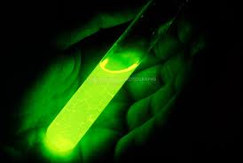
in vitro transcription/translation
Peptide
T7
Bacterial extract
DNA
template
Luciferase production
Luminometry

Slide 3
Toe-print
Peptide
T7
E. coli purified
Translational
machinery
DNA
template
DNA
templates
atg
PPP
atg
Missing AA

Slide 4
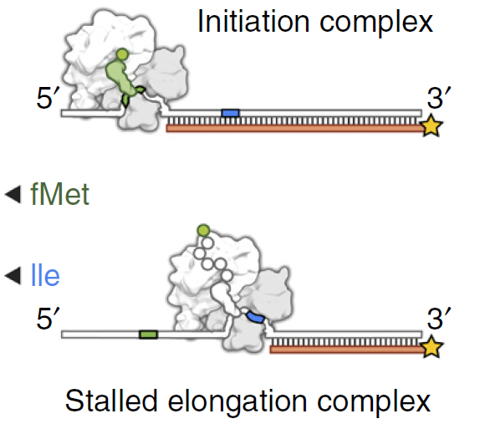
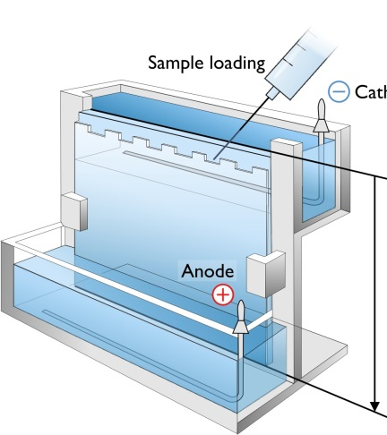
Toe-print

Slide 5
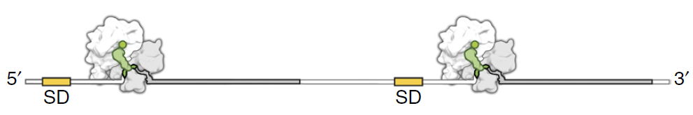
Disomes formation
Peptide
T7
Bacterial extract
DNA
template

Slide 6
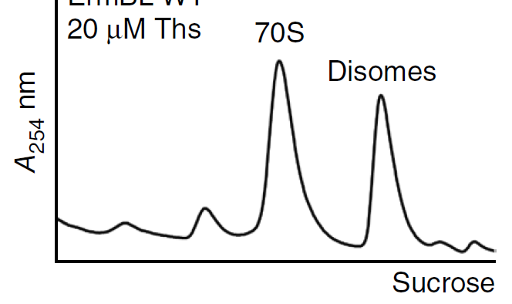
Disomes formation

Slide 7
Bac5 fragments

Slide 8
Antimicrobial activity
Bac5(1-15) RFRPPIRRPPIRPPF
Bac5(1-25) RFRPPIRRPPIRPPFYPPFRPPIRP
Bac5(1-31) RFRPPIRRPPIRPPFYPPFRPPIRPPIFPPI

Slide 9
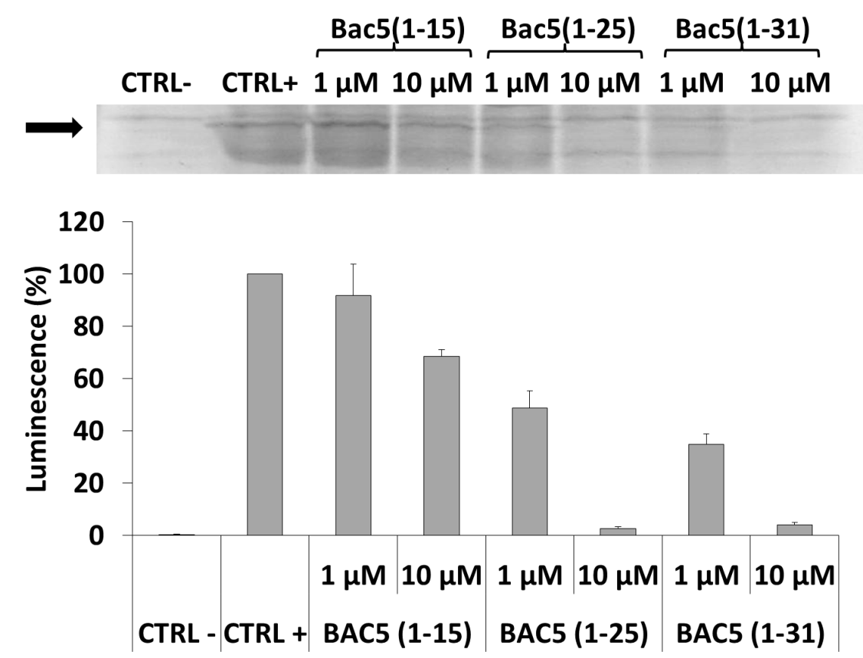
In vitro transcription/translation on E. coli lysates

Slide 10
In vitro transcription

Slide 11
In vitro transcription/translation on rabbit lysates

Slide 12
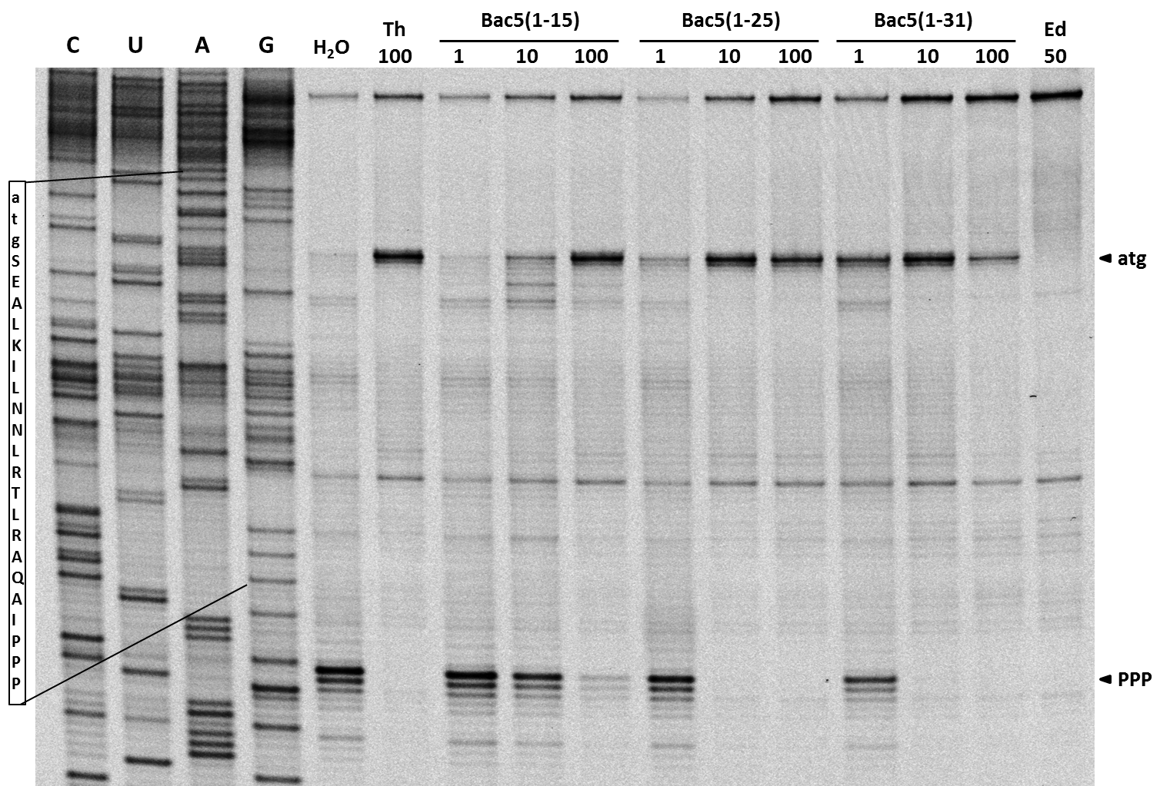
Toe-print

Slide 13
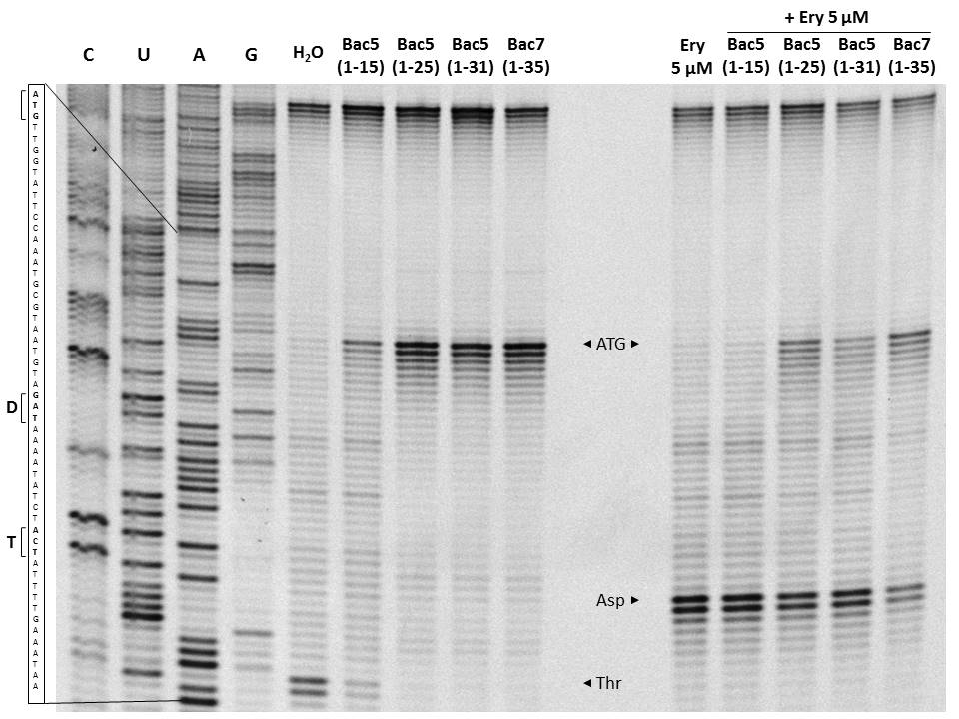
Toe-print: competition with erytromycin

Slide 14
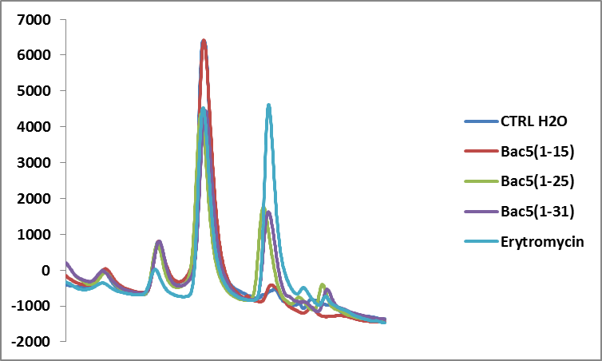
Disomes formation
All 10 µM
Sucrose (10%-60% w/v)

Slide 15
Future perspectives…
Structure by
cryo-electron microscopy

Slide 16
Tur1DB & Tur1Seq

Slide 18
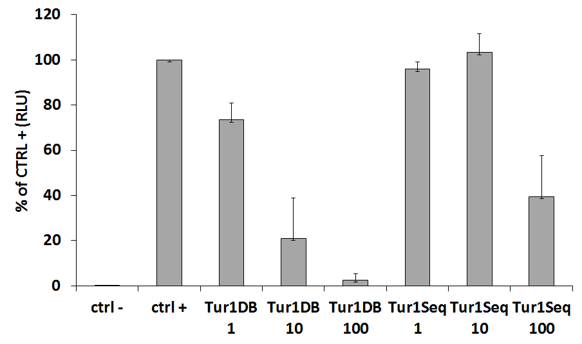
In vitro transcription/translation on E. coli lysates

Slide 19
In vitro transcription/translation on rabbit lysates

Slide 20
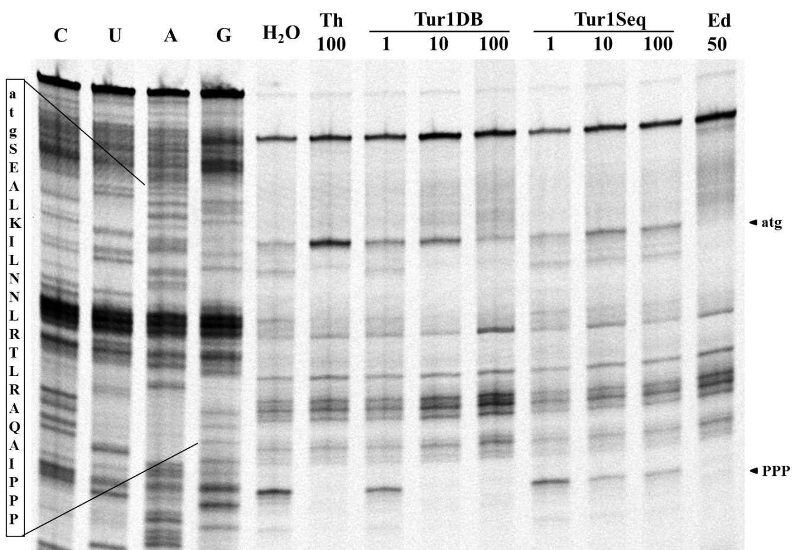
Toe-print

Slide 21
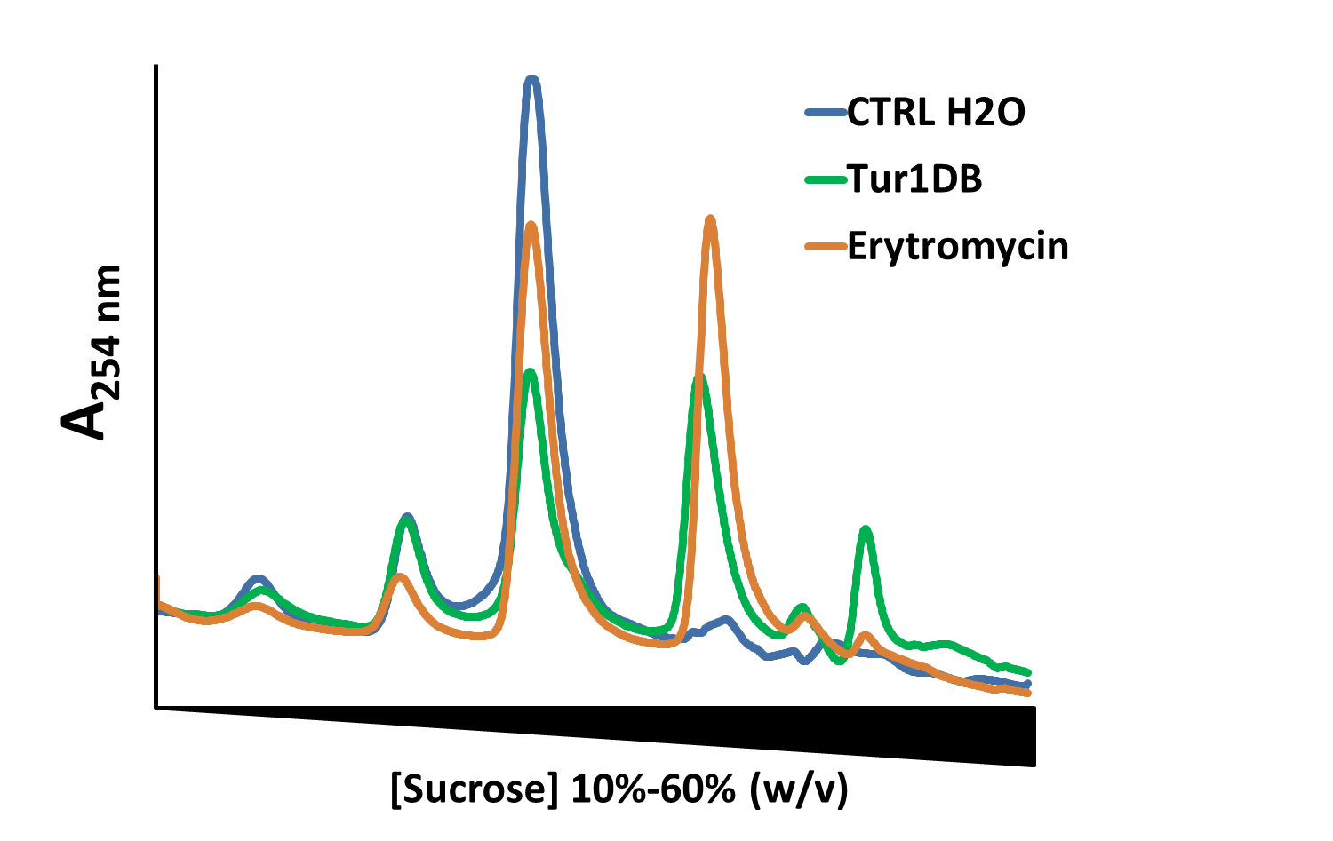
Disomes formation
10 µM
10 µM

Slide 22
Tur1DB fragments
Tur1 DB RRIRFRPPYLPRPGRRPRFPPPFPIPRIPRIP
Tur1DB116 RRIRFRPPYLPRPGRR
Tur1DB824 YLPRPGRRPRFPPPFP
Tur1DB1632 PRFPPPFPIPRIPRIP

Slide 23
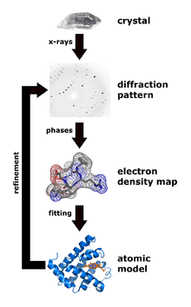
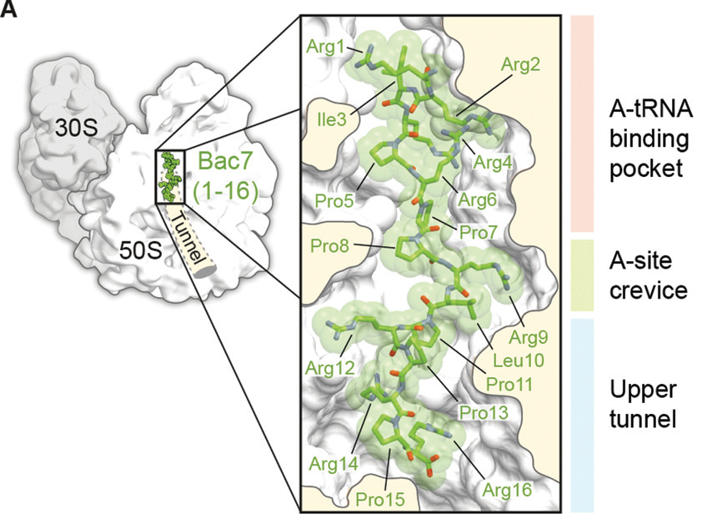
Preliminary data and perspectives…

Slide 24
Bac7(1-16) libraries

Slide 25
Bac7(1-16) Ala and Arg scan

Slide 26
>64
64
32
16
8
4
2
0

Slide 27
>64
64
32
MIC (µM)
16
8
4
2
0

Slide 28
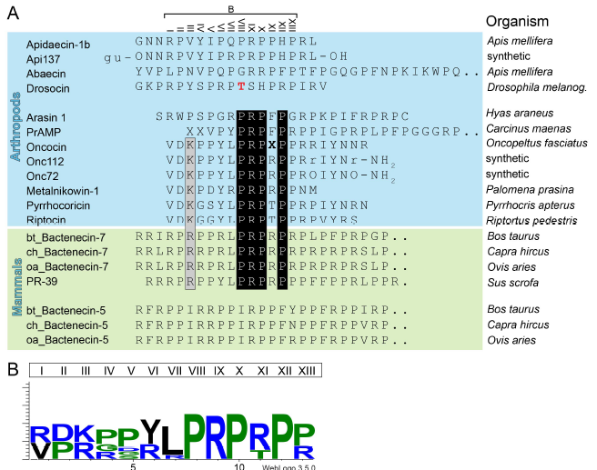

Slide 29
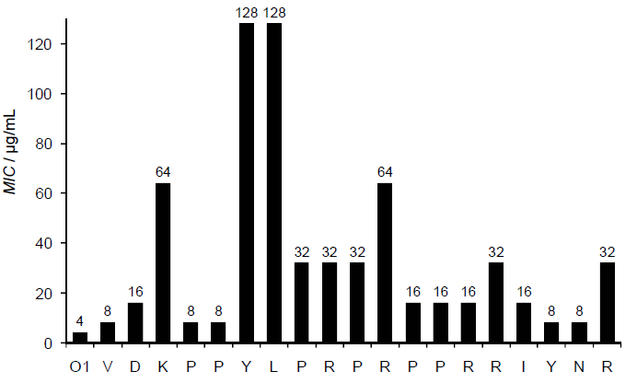
>64
64
32
16
8
4
2
0

Slide 30
Future perspectives
Next round of synthetic peptides
Screening for activity (ribosomes and bacteria)
Cytotoxicity
Flowcytometry on the best candidate

Slide 31
Grazie!

Slide 35
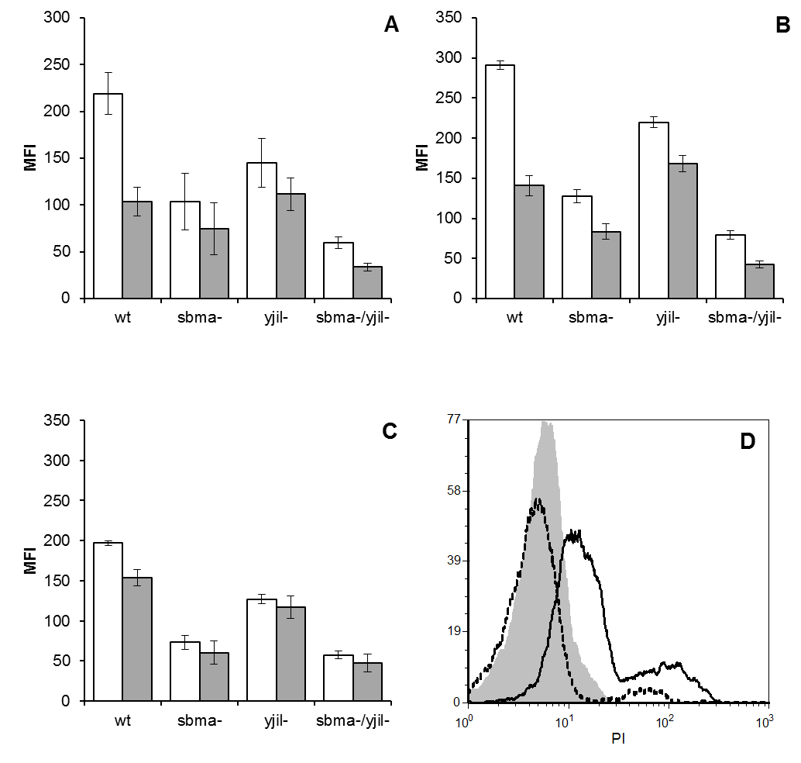
Flow-cytometry

Slide 36
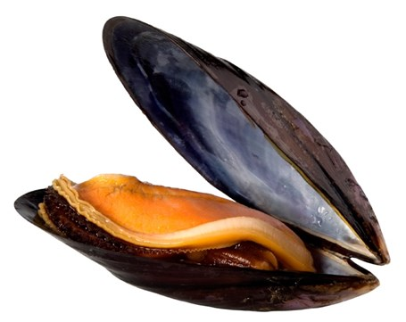
A new PR-AMPs: MyticalinA5 (Myt5)
Mytilus galloprovincialis
YSWPRMPRIPRLPRYPRYPRYPRYPRWPRHPTIYA-NH2

Slide 37
In vitro TR/TR in presence of Myticalin 5 (E. coli system)

Slide 38
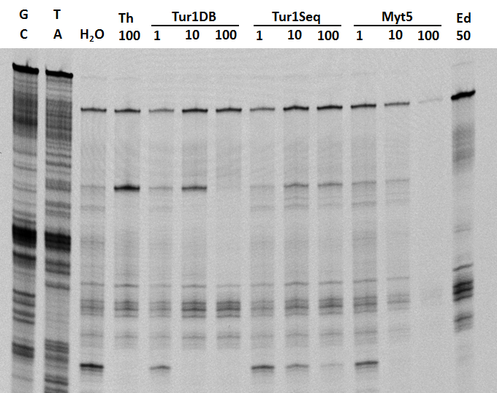

Slide 39
In vitro transcription in presence of Myt5

Slide 40
mRNA degradation CTRL
Pellet!!
RNA/Myt5
Precipitation?

Slide 41
In vivo translation on E. coli system

