Slide 1
Discovering Macromolecular Interactions

Slide 2
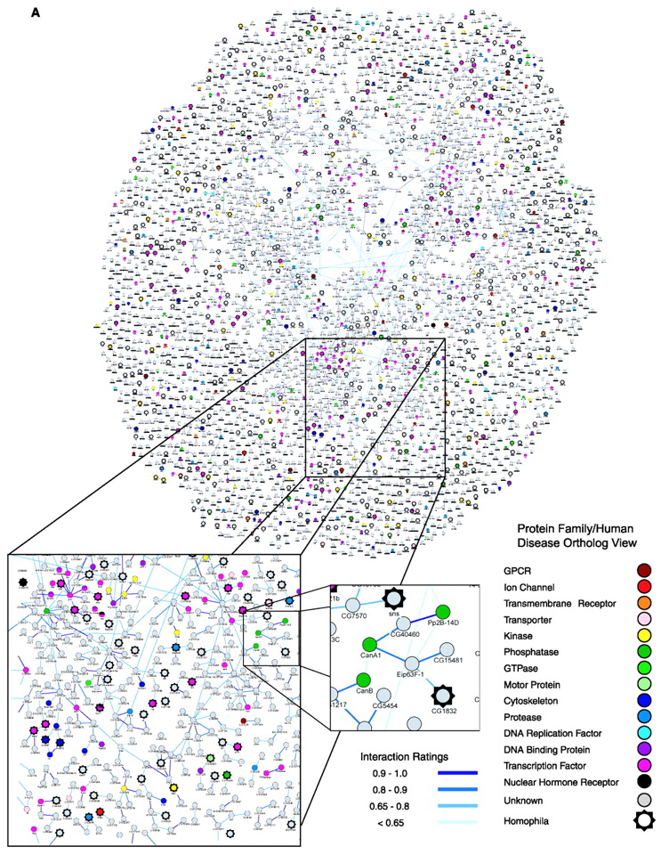

Slide 3
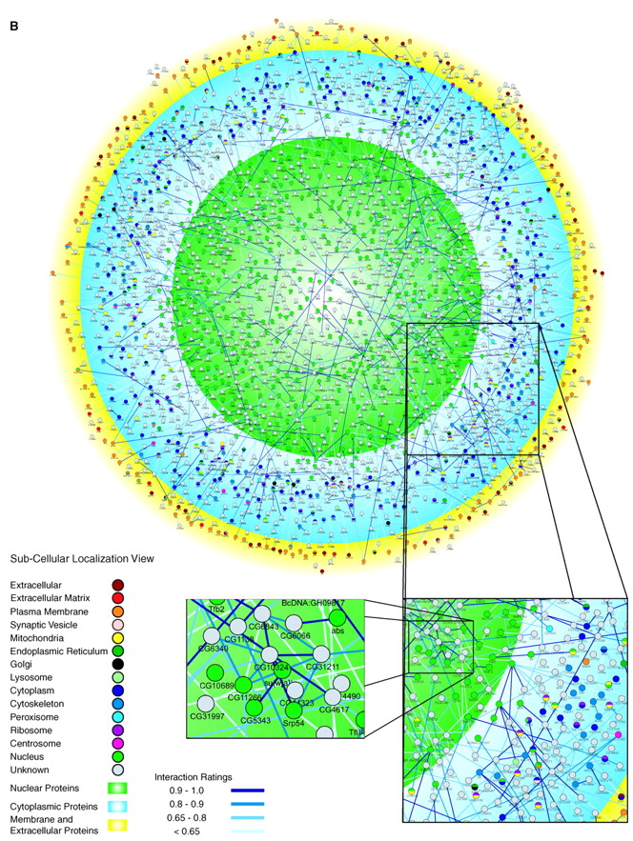

Slide 4
An experimental strategy for identifying new molecular actors in a process

Slide 5
An experimental strategy for identifying new molecular actors in a process
DATABASE search
Candidate approach
General screening

Slide 6
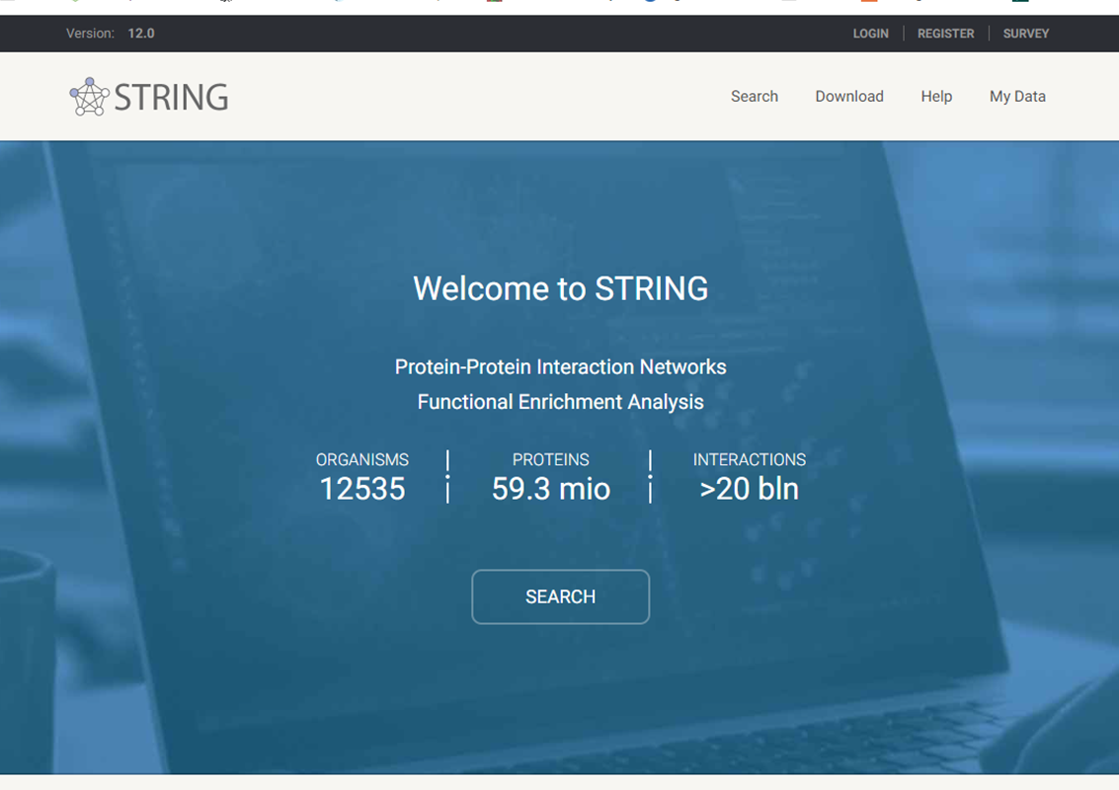

Slide 7
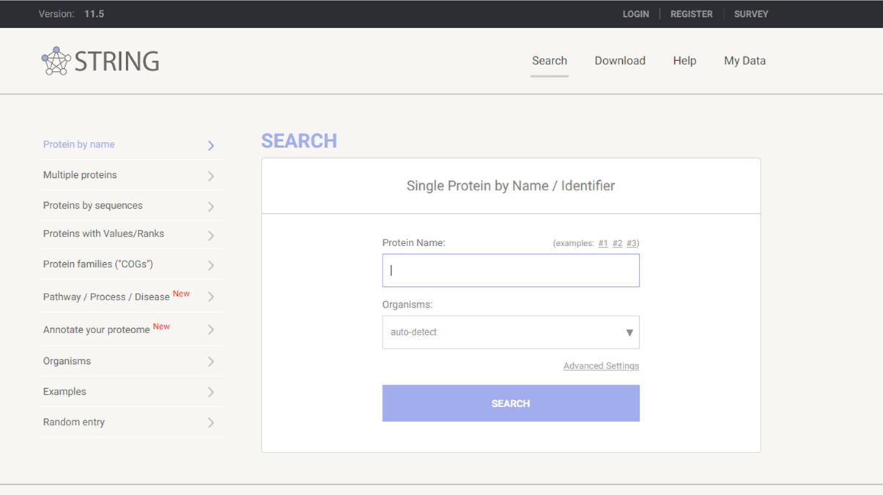

Slide 8
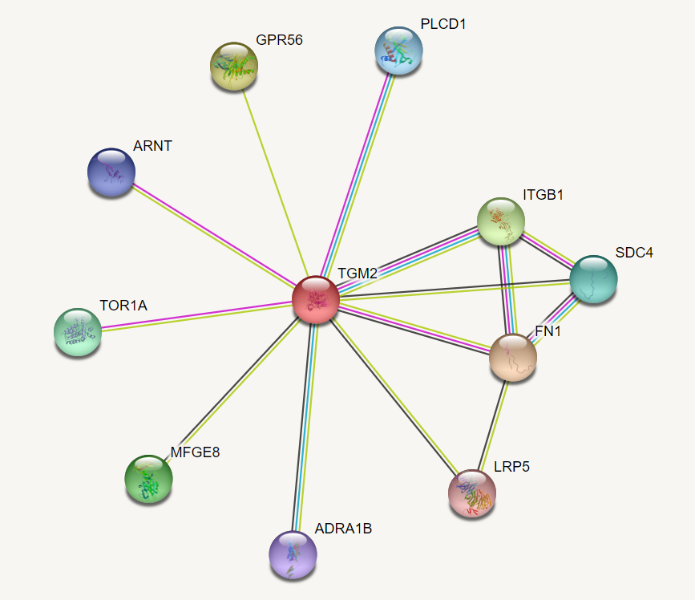

Slide 9
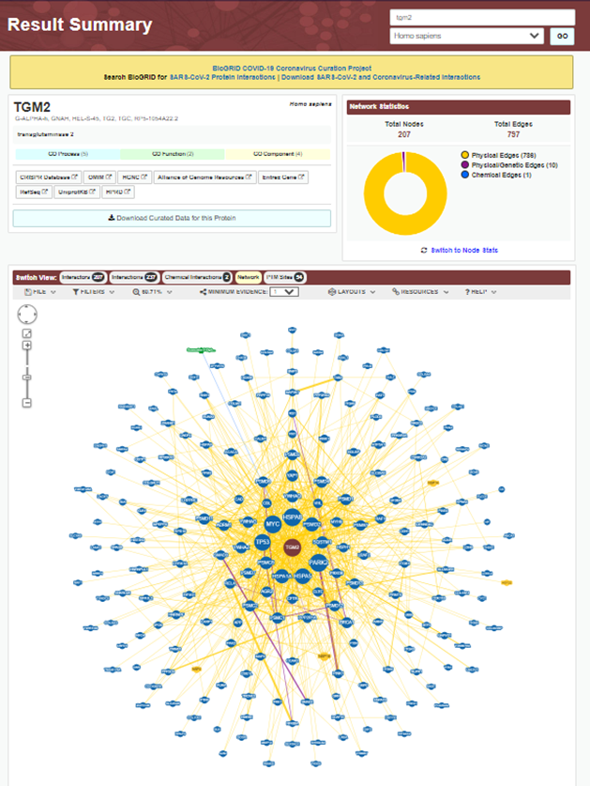
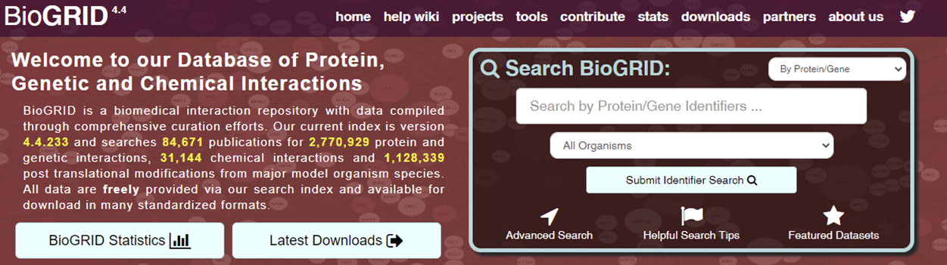

Slide 10
An experimental strategy for identifying new molecular actors in a process
DATABASE search
Candidate approach
General screening

Slide 11
Types of Interactions
Protein / nucleic acid
  DNA
  RNA
Protein / Protein
  extracellular
  intracellular

Slide 12
Interaction Methods
(co)-immunoprecipitation
glutathione-S-transferase (GST) pull down
co-purification
  chromatography, tandem affinity purification (TAP)
yeast two hybrid
phage display/expression libraries
FRET
solution binding- Scatchard analysis

Slide 13
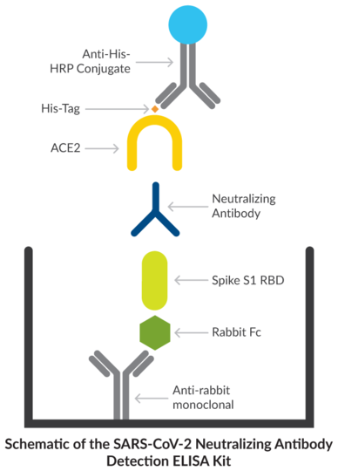
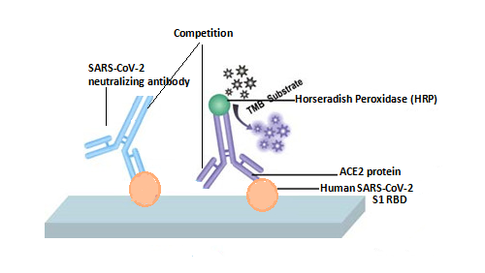
Professore mi scusi, ma se io nell'esame le proponessi un approccio diametralmente opposto nell'identificazione di anticorpi neutralizzanti, ovvero
- coating di Spike,
- saturazione,
- contatto con siero di paziente
- e in ultima battuta utilizzassi una subunità ACE2 solubile ad esempio biotinilata.
per Lei sarebbe comunque un approccio valido o non mi darebbe punti?

Slide 14
(Co)-
ImmunoPrecipitation (IP)
Immunoprecipitation (IP)
is a cellular and molecular biology method used in laboratories to isolate or purify a specific antigen (or protein of interest) via a solid phase (agarose or Sepharose™ resin or magnetic particles).
Using an antibody to isolate and purify a protein from a whole cell lysate.
Normally you will “only” purify the protein the antibody recognizes.
Any additional proteins that co-purify are candidates for interacting proteins.

Slide 15
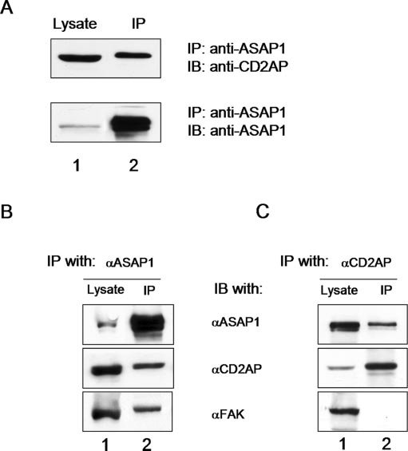

Slide 16
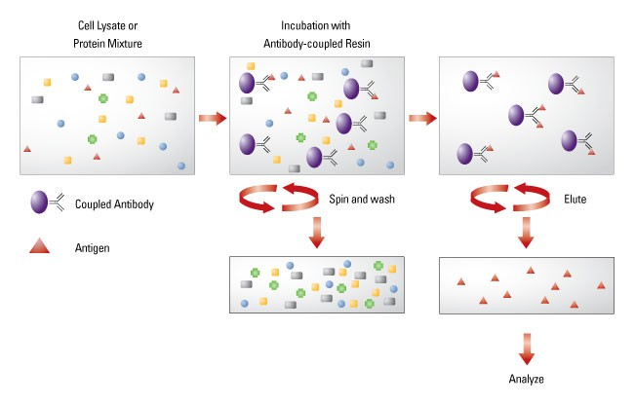
Immunoprecipitation (IP)
Immunoprecipitation is one of the most widely used methods for antigen detection and purification.
1- lysate cell
2- Add an antibody
(monoclonal or polyclonal) against a specific target protein
forms an immune complex with that target.

Slide 17
Immunoprecipitation (IP)
3- The immune complex is then captured, or precipitated, on a beaded support
to which an antibody-binding protein is immobilized (such as Protein A or G),
and any proteins not precipitated on the beads are washed away.

Slide 18
Immunoprecipitation (IP)
4- the antigen (and antibody, if it is not covalently attached to the beads and/or when using denaturing buffers) is eluted from the support
and analyzed by sodium dodecyl sulfate-polyacrylamide gel electrophoresis (SDS-PAGE),
often followed by Western blot detection to verify the identity of the antigen.

Slide 19
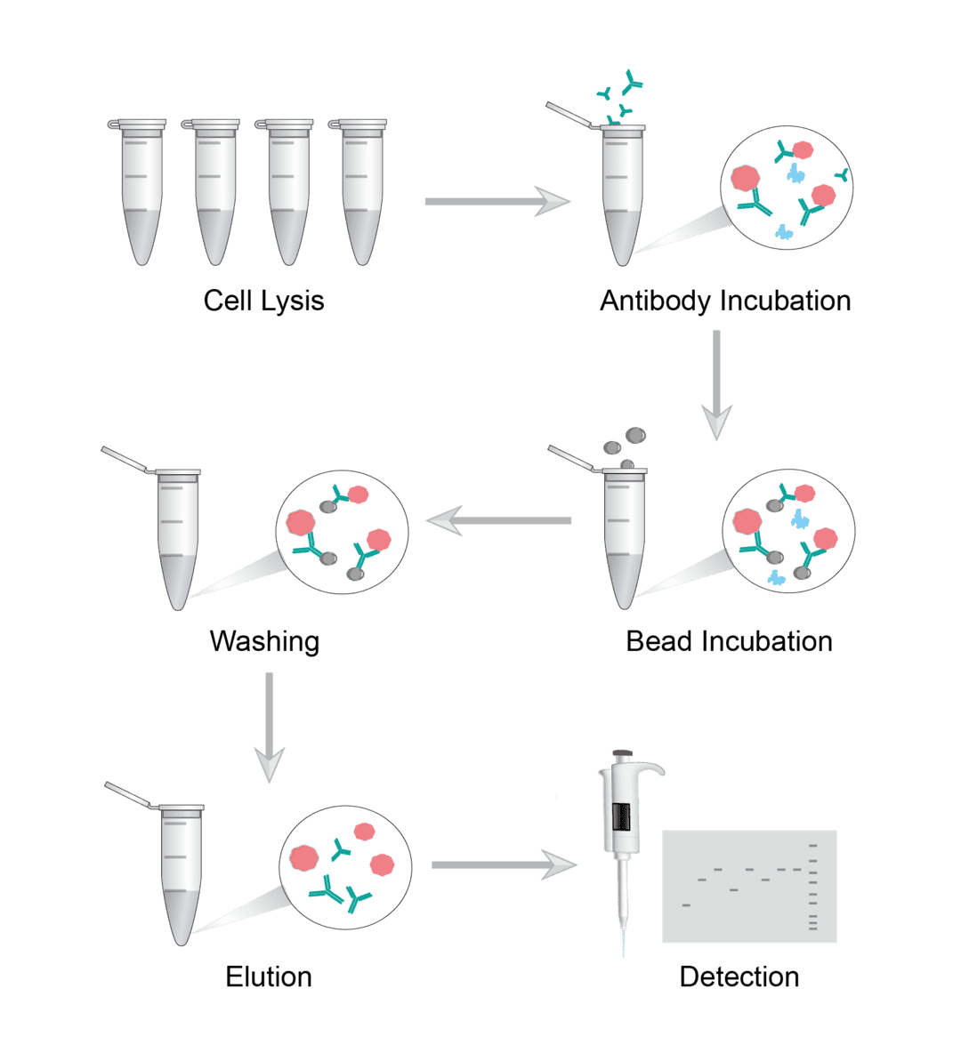

Slide 20
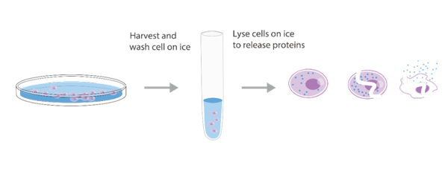
IP optimization
Empirical testing is nearly always required to optimize IP conditions to obtain the desired yield and purity of target proteins.
Lysis Buffers
The quality of the sample that is used for IP applications critically depends on the right lysis buffer, which
stabilizes native protein conformation,
inhibits enzymatic activity,
minimizes antibody binding site denaturation
maximizes the release of proteins from the cells or tissue.
The lysis buffer used for a particular application depends on the target proteins that will be immunoprecipitated, because the location of the protein in the cell (e.g., membrane, cytosol, nucleus) affects the ease of release during lysis.

Slide 21
Non-denaturing buffers
are used when
the IP antigen is detergent-soluble
the antibody can recognize the native form of the protein.
These buffers contain non-ionic detergents, such as NP-40 or Triton X-100.
Denaturing buffers
such as radio-immunoprecipitation assay (RIPA) buffer
are more stringent than non-denaturing buffers because of the addition of ionic detergents like SDS or sodium deoxycholate.
While these buffers do not maintain native protein conformation, proteins that are difficult to release with non-denaturing buffers, such as nuclear proteins, can be released with denaturing buffers.
Both buffers contain NaCl and Tris-HCl and have a slightly basic pH (7.4 to 8).

Slide 22
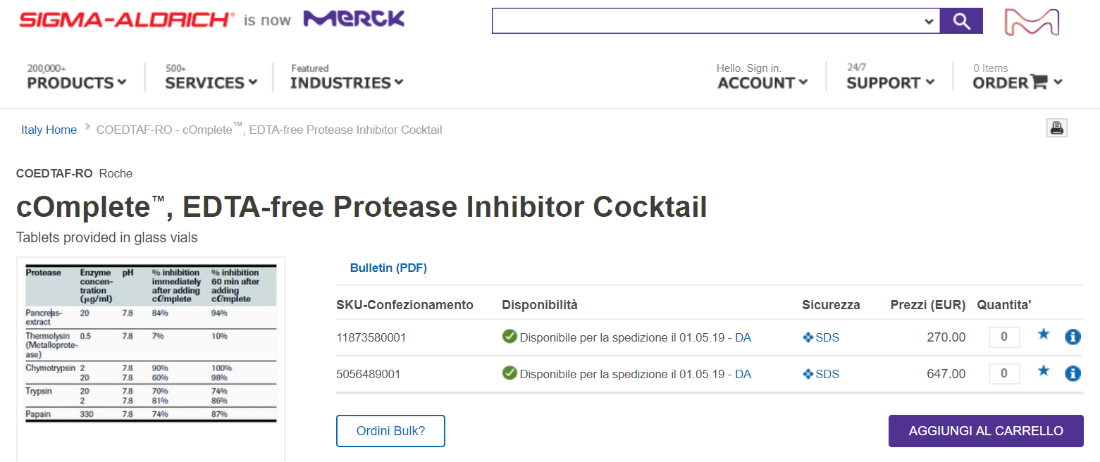
Because cell lysates also contain proteases and phosphatases that can modify or degrade the target protein, most IP protocols are performed at 4°C.
Proteasomal inhibitors, such as PMSF, aprotinin and leupeptin are commonly added to the lysis buffer just prior to use, along with sodium orthovanadate or sodium fluoride as a phosphatase inhibitor.
While these components can be added individually, commercial inhibitor cocktails are available that are higher quality and easier to use.

Slide 23
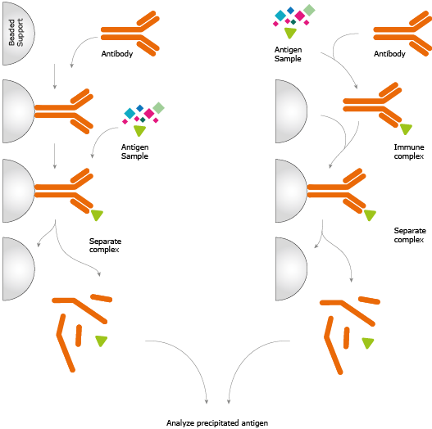
Diagram of immunoprecipitation (IP)
pre-immobilized antibodies.
or free antibodies.

Slide 24
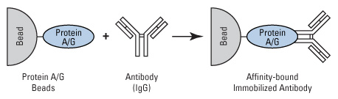
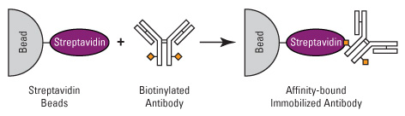
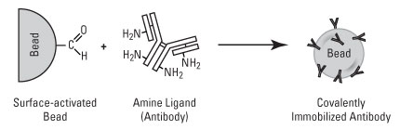

Slide 25
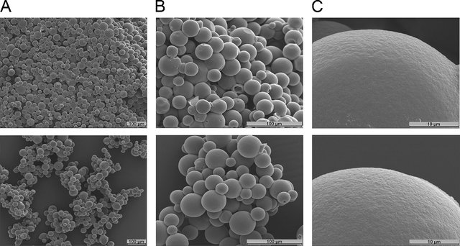
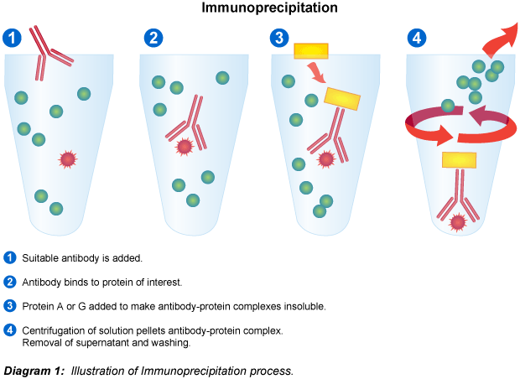
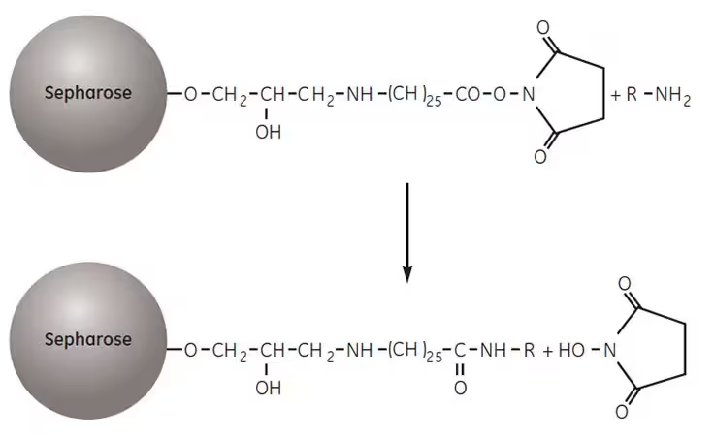
Because IP developed as an adaptation of column affinity chromatography, the IP technique was first done using small aliquots (10–25 µL) of agarose resin in microcentrifuge tubes.

Slide 26
Magnetic particles, such as Dynabeads™ and Pierce™ magnetic beads, have largely replaced agarose beads as the preferred support for immunoprecipitation and other micro-scale affinity purification procedures.
Magnetic particles are solid and spherical, and antibody binding is limited to the surface of each bead.

Slide 27
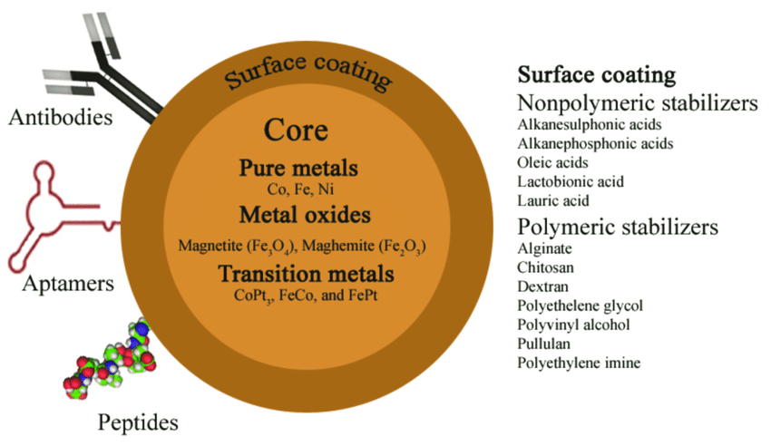
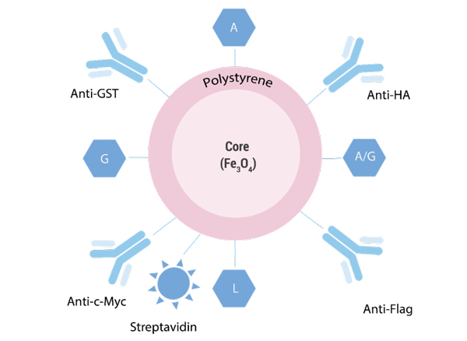
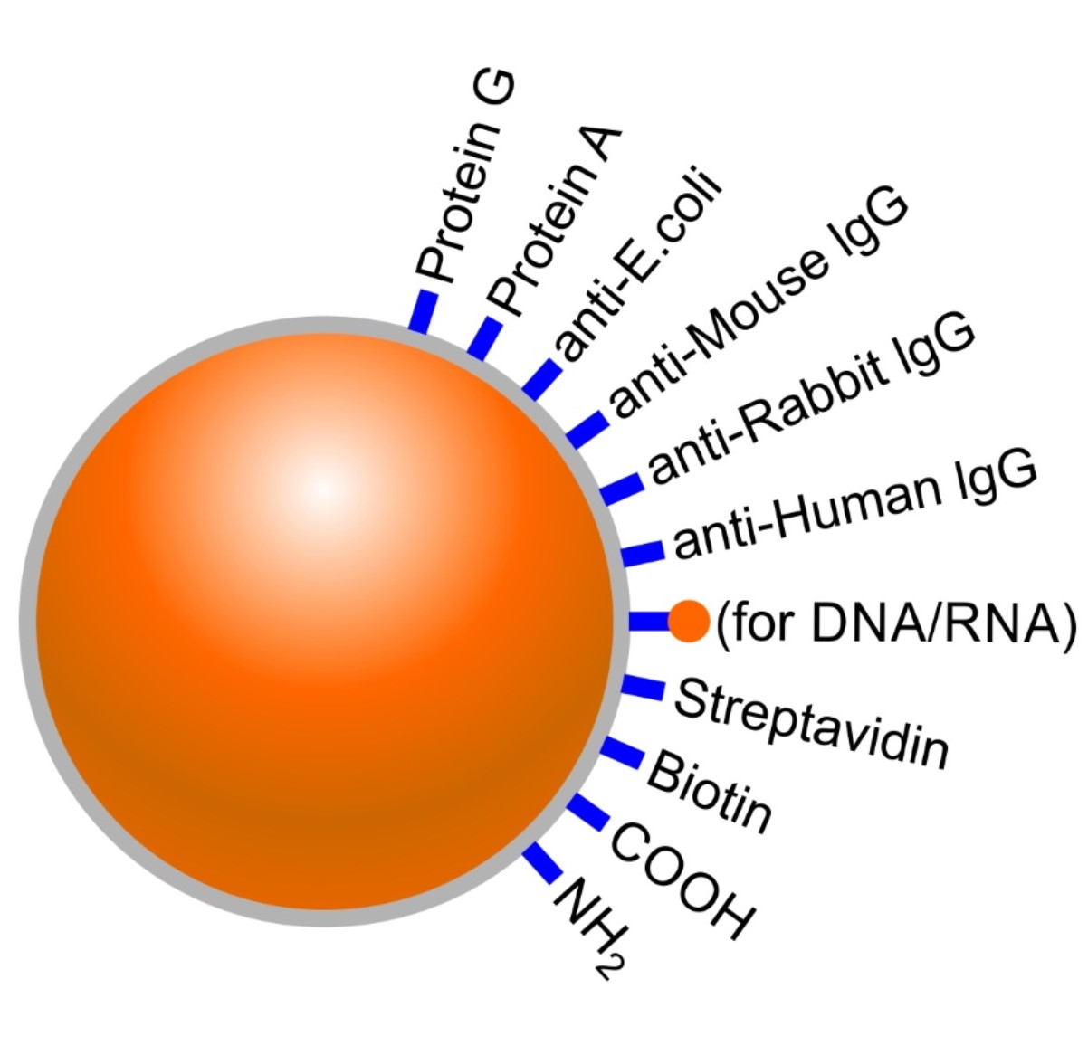

Slide 28
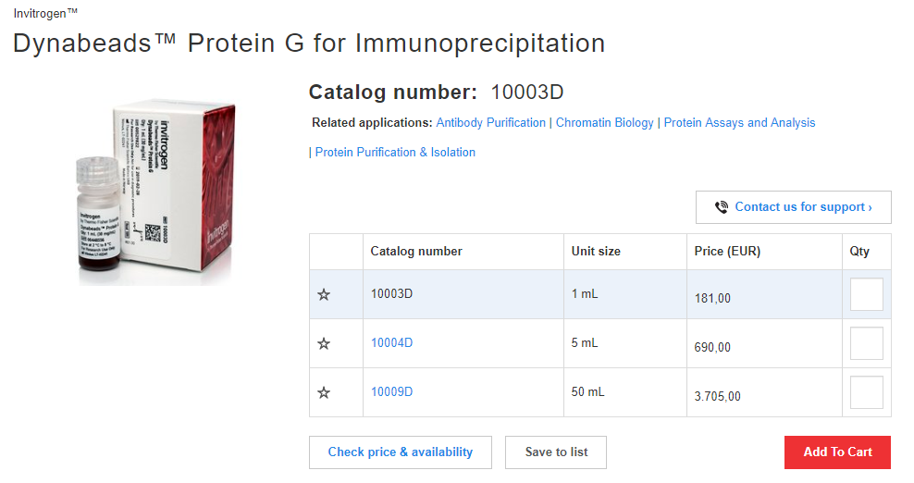
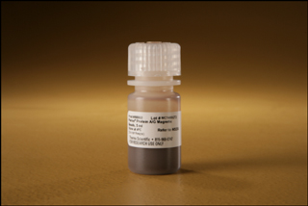
The advantages of magnetic beads for IP
Capacity and yield–, even if the antibody-binding capacity is lower compared to agarose, the final antigen yield is often the same or greater with magnetic beads.
Reproducibility and purity–magnetic beads generally provide higher reproducibility and purity compared to agarose. Pre-clearing is usually not necessary with magnetic beads.
Ease of use, speed, and automation an individual magnetic bead IP experiment can be completed in about 30 minutes.

Slide 29


Slide 30
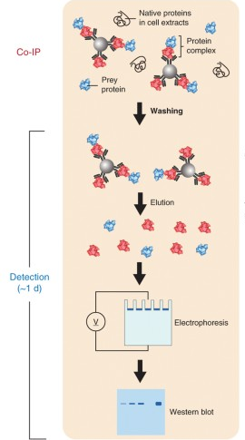
Co-Immnunoprecipitation (Co-IP)
Co-immunoprecipitation is an extension of IP that is based on the potential of IP reactions to capture and purify the primary target (i.e., the antigen) as well as other macromolecules that are bound to the target by native interactions in the sample solution.
Therefore, whether or not an experiment is called an IP or co-IP depends on whether the focus of the experiment is the primary target (antigen) or secondary targets (interacting proteins).

Slide 31
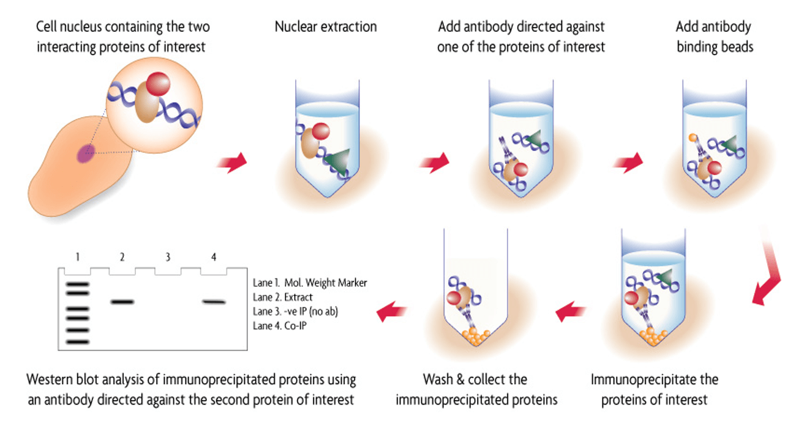

Slide 32
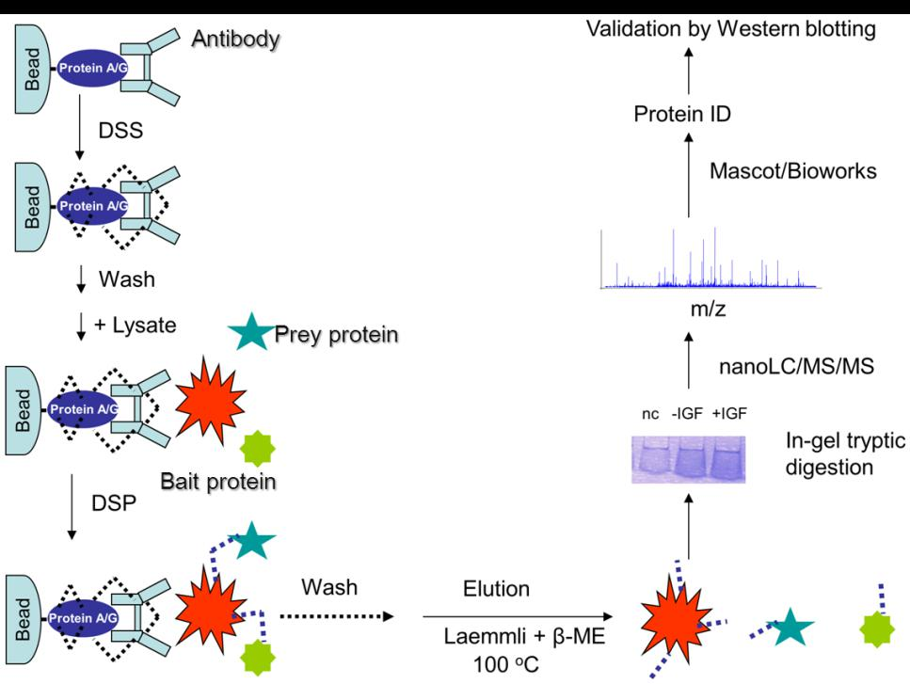

Slide 33
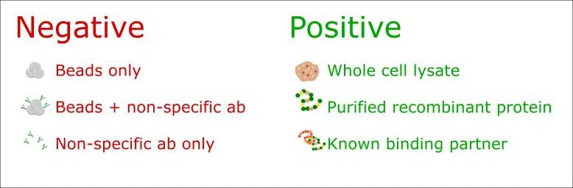
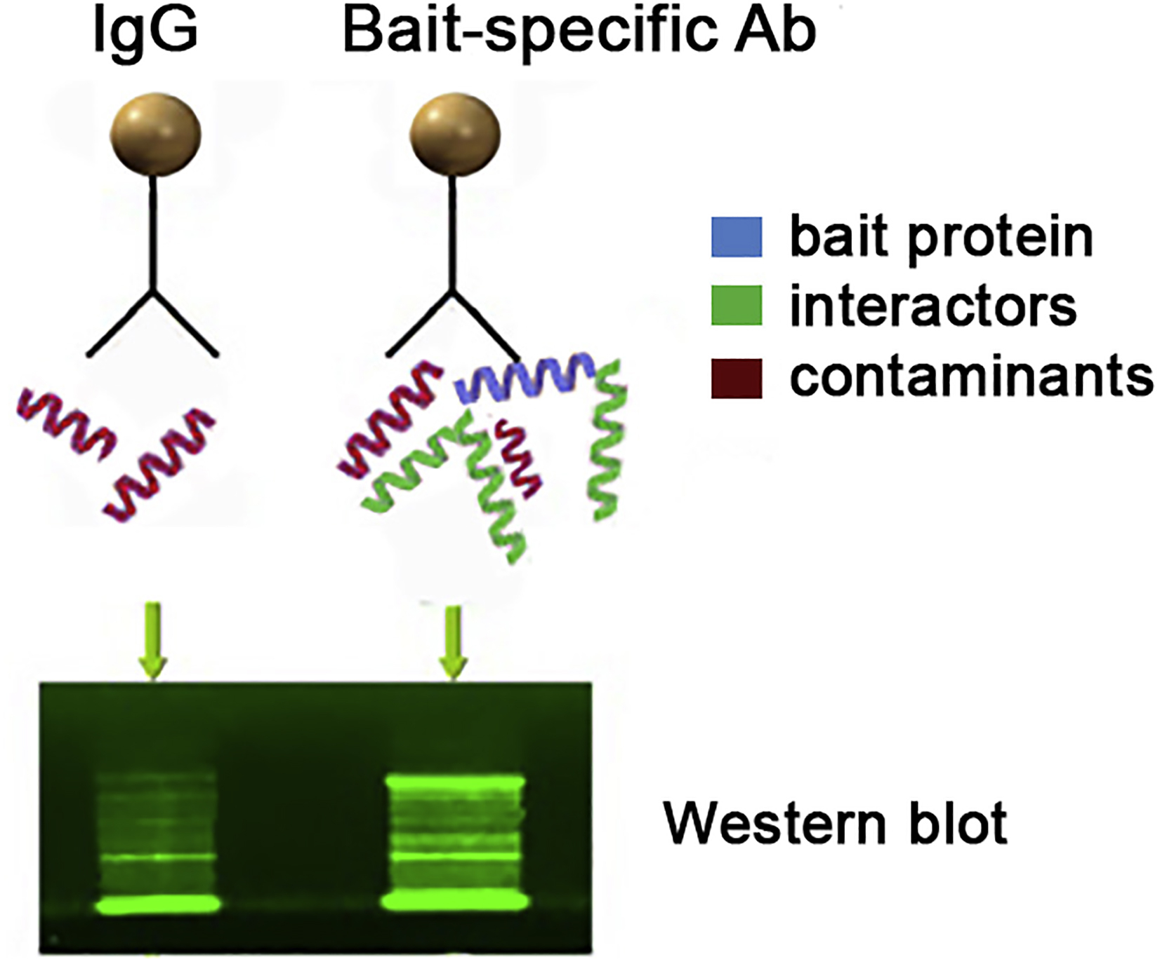
Controls are crucial for a successful Co-IP experiment

Slide 34
Co-Immunoprecipitation (Co-IP)
Advantages | 1.Proteins that interact in Co-IP are post-translationally modified and conformationally natural. 2.Proteins that interact in Co-IP are in a natural state. 3.Interacting protein complexes in a natural state can be obtained.
Disadvantages | 1.Low-affinity and instantaneous protein-protein interactions may not be detected in Co-IP. 2.Two proteins may not be directly combined. There may be some influence of another substance. 3.In order to select detecting antibody, researchers should predict the target protein. If the forecasting is incorrect, nothing will be obtained.

Slide 35
Fusion protein affinity chromatography
Express the protein of interest as a fusion protein.
  6-8X His residues
  Glutathione S-transferase (GST)
  Other “tags”
Bind and purify the protein of interest + interacting protein
  Poly His residues will bind Ni²⁺
  GST will bind glutathione

Slide 36
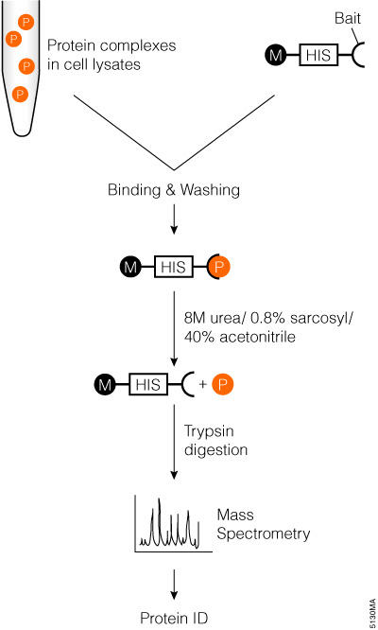

Slide 37
Fusion proteins - identifying interactions.
In vitro - overexpress protein in vitro
  Bind fusion protein to a column and run whole cell lysate through the column. Identify proteins that “stick” to the fusion protein.
In vivo - express fusion protein in vivo
  Purify complexes from the cell

Slide 38
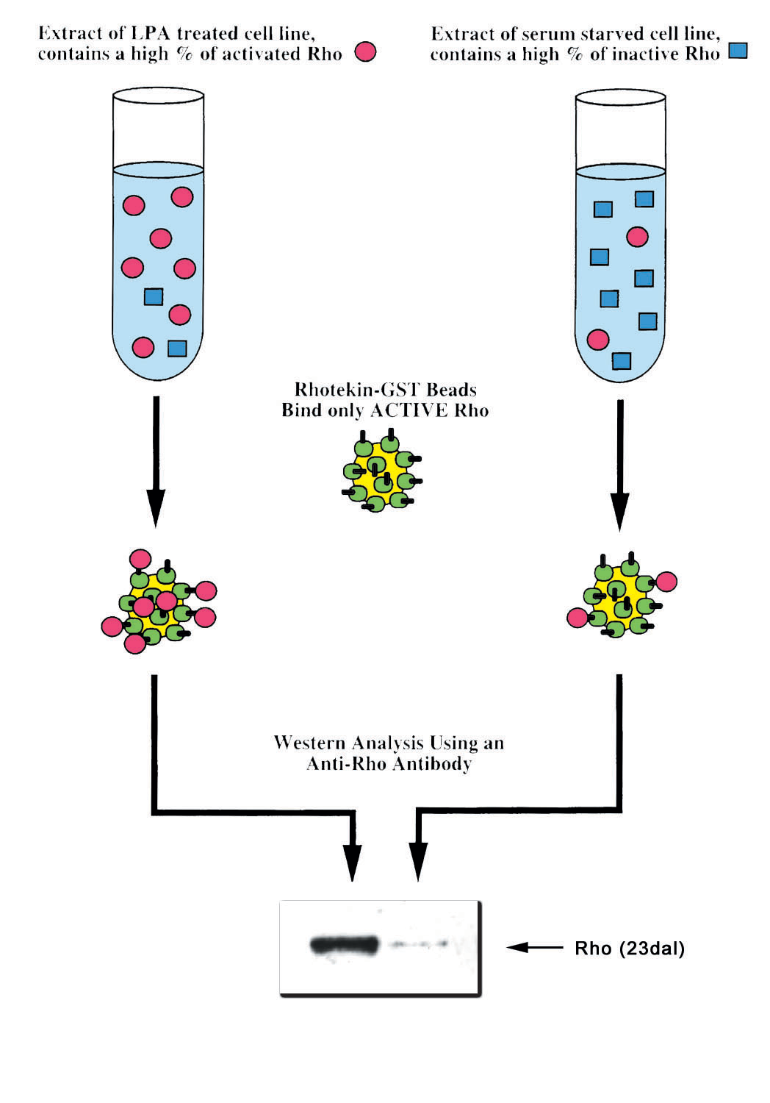

Slide 39
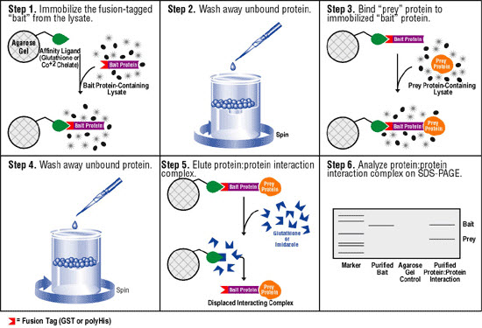

Slide 40
Difficulties when using biochemical approaches
Stability of protein:protein interactions.
  Many are not stable enough to survive purification.
Is the fusion protein functional?
  Many times fusions will not be functional.
Quality of the antibody.
  Is it good enough to precipitate enough protein for analysis?

