Slide 2
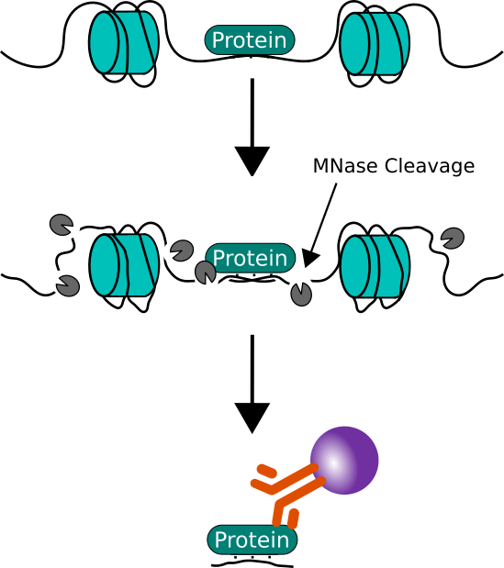
ChIP = Chromatin Immuno Precipitation
What is ChIP?
Chromatin immunoprecipitation, or ChIP, is:
- an antibody-based technology
- used to selectively enrich specific DNA-binding proteins along with their DNA targets.

Slide 3
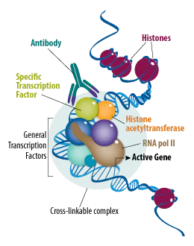
2. When is ChIP used?
ChIP utilizes antibodies that selectively recognize and bind proteins, including
- histones,
- histone modifications,
- transcription factors,
- cofactors, to provide information about chromatin states and gene transcription.
ChIP can be used to answer a multitude of scientific questions involving the interaction of proteins and chromatin.
For example, ChIP can be used to
- compare the presence of certain proteins at various loci,
- map the various proteins across a genomic region of interest,
- quantify protein binding to an inducible gene in response to a stimulus over time.
https://www.cellsignal.com/applications/chip-and-chip-seq/regulation-expression-in-cell-and-tissue

Slide 4
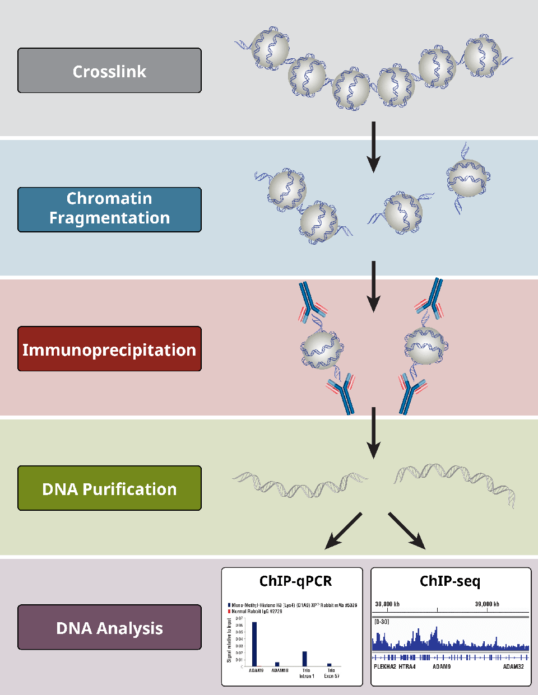
3. How does ChIP work?
The principle behind ChIP is relatively straightforward and relies on the use of an antibody to isolate, or precipitate, a certain protein, histone, transcription factor, or cofactor and its bound chromatin from a protein mixture that was extracted from cells or tissues.
In ChIP-PCR or ChIP-seq, immune-enriched DNA fragments are then able to be identified and quantified using widely available PCR or qPCR reagents and Next Generation Sequencing (NGS) technologies.

Slide 5
What is native ChIP (N-ChIP) vs crosslinked ChIP (X-ChIP)?
There are 2 types of ChIP techniques that can be carried out depending on the experimental question and the starting material for the experiment:
N-ChIP
no fixing agent is used to crosslink proteins to the chromatin. Instead, native chromatin is isolated from cell nuclei that are digested with a nuclease.
N-ChIP offers the advantage of better recognition and binding of antibodies to their target antigens.
it can only be used for the detection of histones. In addition, loss of protein binding during the chromatin digestion and immunoprecipitation steps may bias the data or impede proper analyses.
X-ChIP
chemical fixatives such as formaldehyde are used to crosslink the protein of interest to the DNA and fragmentation of chromatin is achieved through sonication or nuclease digestion.
The advantage of X-ChIP is that it can be used with histone and non-histone proteins and generally requires less cellular starting material than N-ChIP.

Slide 7
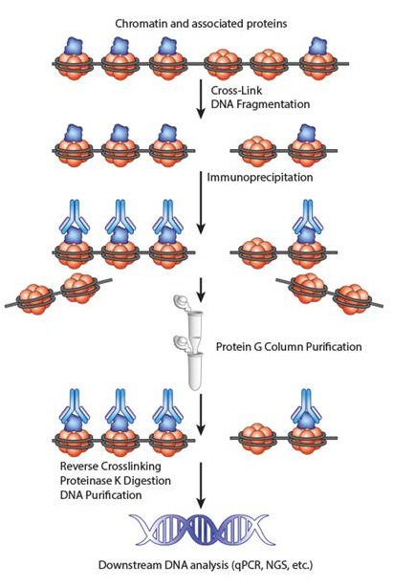

Slide 8


Slide 10
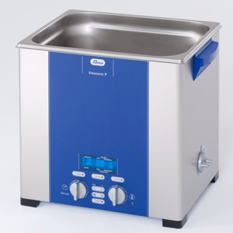
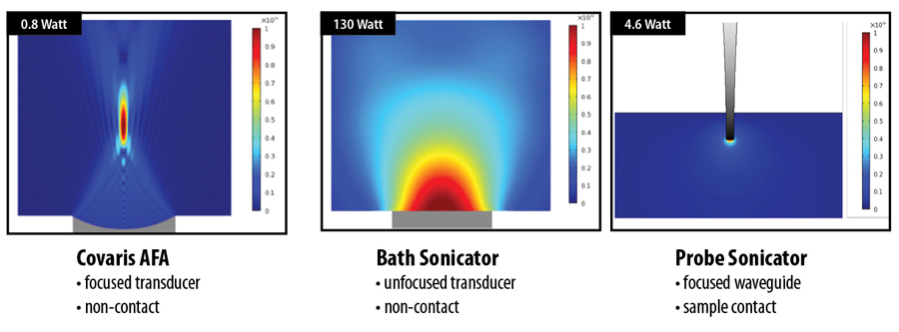
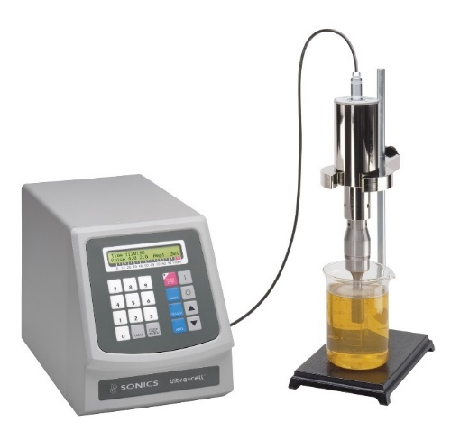
Bath sonicators
isolate the sample from the energy source but require significantly more energy input than probe sonicators because the entire water bath is energized.
A probe sonicator is in direct contact with the sample and thereby can impart more concentrated energy to the sample than bath sonicators.
However, the direct contact is problematic for small volumes, as well as leading to sample cross-contamination and also contamination by erosion of the probe tip.
Both probe and bath sonicators are notoriously unpredictable and often over-heat samples when attempting to achieve a desired biological or chemical event.

Slide 11
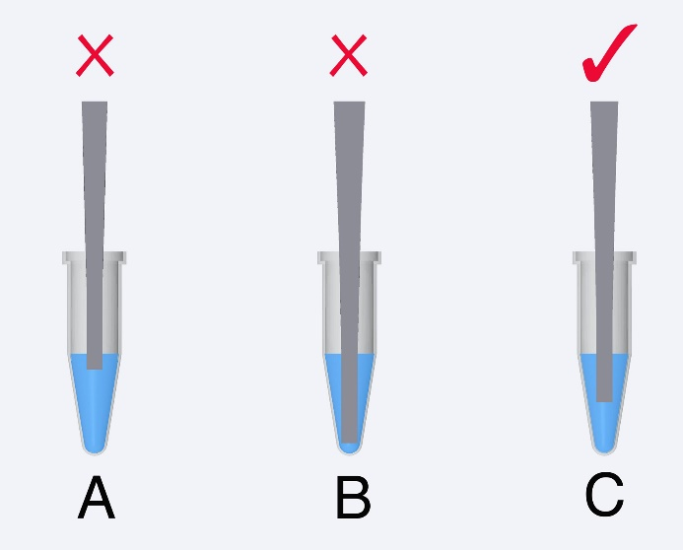
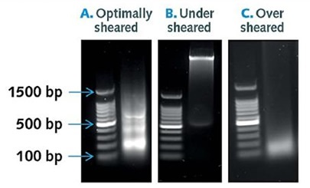
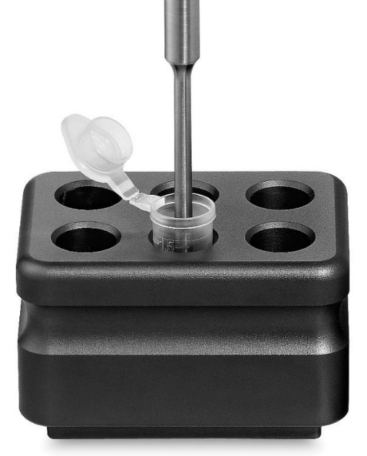
Tip Depth / Foaming Issue
P﻿robes/tips must be submerged properly.
I﻿f the tip is not submerged enough the sample will foam or bubble. If the tip is too deep it will not circulate the sample effectively.
Both conditions will end up with poor results. Foaming often occurs with samples volumes below 1ml. Foaming can also be caused when the amplitude setting is too high.
There are many options for keeping samples cool during sonication:
Use the pulse mode to reduce heat buildup.
Put samples on ice along with the pulse mode.

Slide 12
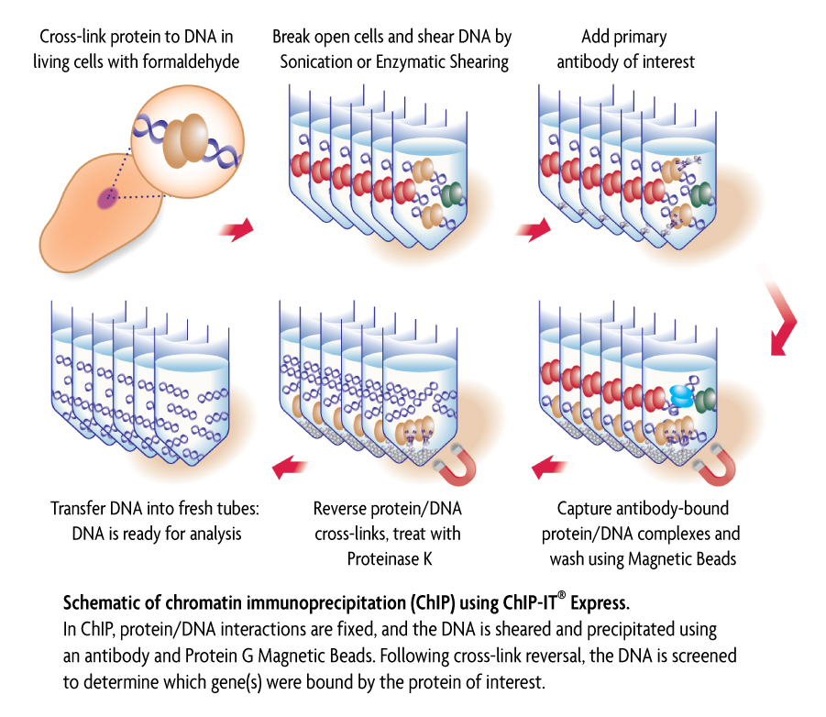
La qualità dell’anticorpo è fondamentale in questa fase
- Deve riconoscere la proteina legata al DNA
- Deve essere altamente specifico
Necessaria una pre-taratura per ridurre il legame aspecifico
-Gli immunocomplessi sono poi precipitati con Prot G/A Sepharose/ Magnetic beads
(lega la regione Fc dell’anticorpo)
- lavaggi stringenti riducono il background

Slide 13
Reverse cross linking = Incubation at 65 °C
RNA and protein digestion = RNAseA and proteinase K
DNA purirication = Phenol chloroform + EtOh /column
DNA Analysis

Slide 14
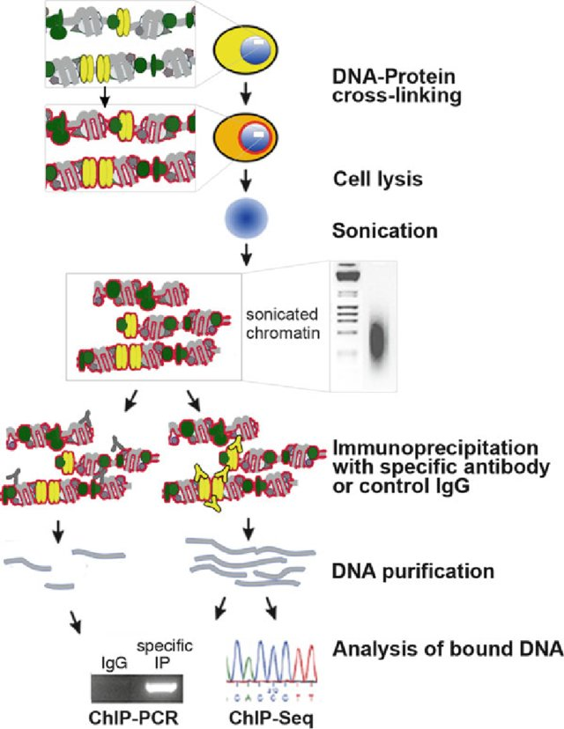
DNA-binding proteins are crosslinked to DNA with formaldehyde in vivo.
Isolate the chromatin. Shear DNA along with bound proteins into small fragments.
Bind antibodies specific to the DNA-binding protein to isolate the complex by precipitation. Reverse the cross-linking to release the DNA and digest the proteins.
Use PCR to amplify specific DNA sequences to see if they were precipitated with the antibody.

Slide 15
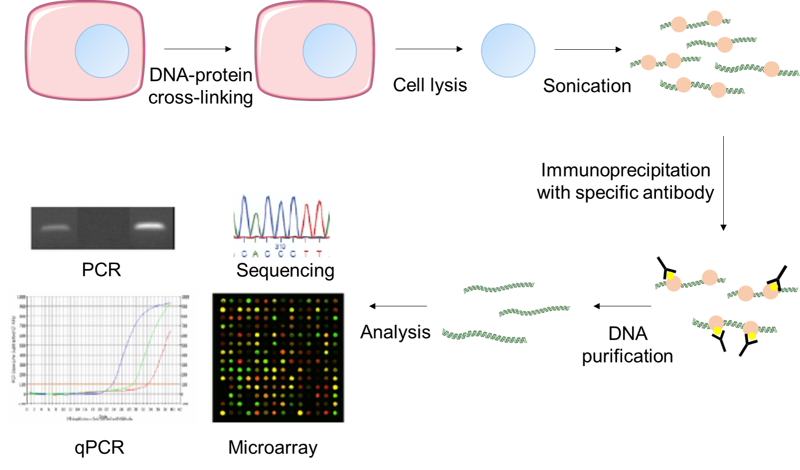
If we have the “right” antibody, we can extract (“immunoprecipitate”) from living cells the protein of interest bound to the DNA
And - we can try to identify which were the DNA regions bound by the protein

Slide 16
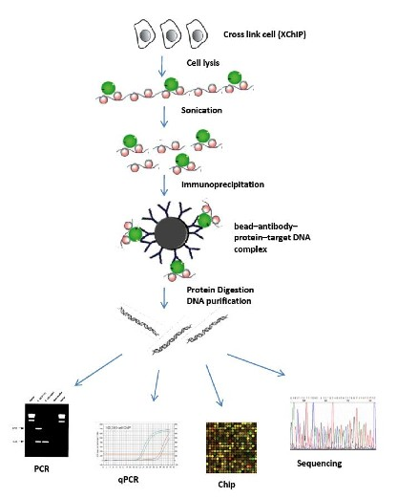
“ChIP”

Slide 17
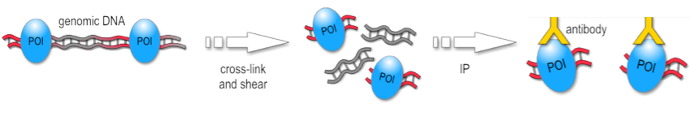
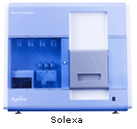
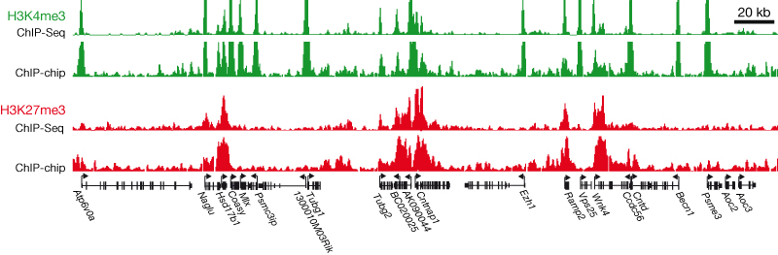
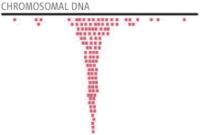
ChIP-seq overview
DNA + bound protein
Fragment DNA
Immunoprecipitate
Sequence
Prepare sequencing library
Release DNA
Map sequence tags to genome
& identify peaks
Adapted from slide set by: Stuart M. Brown, Ph.D.,
Center for Health Informatics & Bioinformatics, NYU School of Medicine

Slide 18
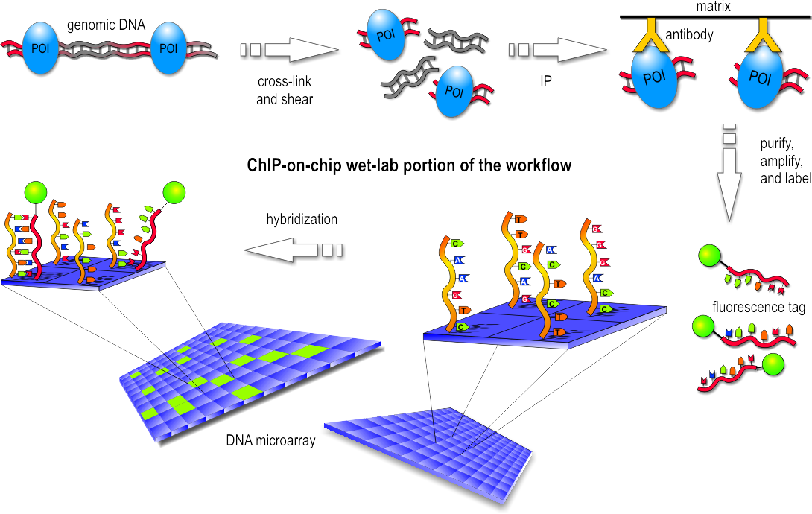
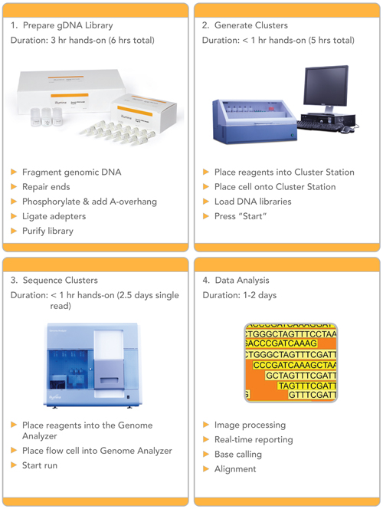
ChIP-seq
Challenges:
Millions of segments
Mapping to genome
Visualization
Peak detection
Data normalization
…

Slide 19
ChIP-seq big picture
Combine high-throughput sequencing with Chromatin Immuno-precipitation to identify specific protein-DNA interactions genome-wide, including those of:
  Transcription factors
  Histones (various types and modifications)
  RNA Polymerase (survey of transcription)
  DNA polymerase (investigate DNA replication)
  DNA repair enzymes
… or fragments of DNA that are modified (e.g. methylated)

Slide 20
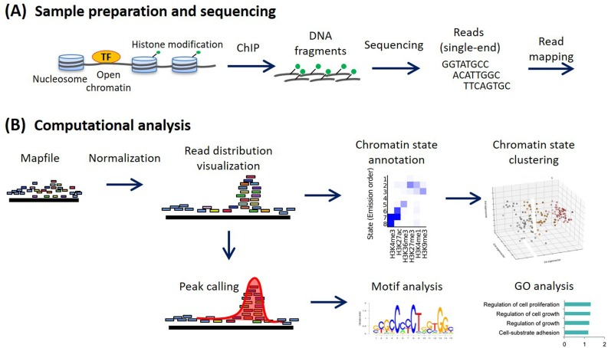

Slide 21

RNA immunoprecipitation (RIP)
RIP is an antibody-based technique used to map in vivo RNA-protein interactions.
The RNA binding protein (RBP) of interest is immunoprecipitated together with its associated RNA for identification of bound transcripts (mRNAs, non-coding RNAs or viral RNAs).
Transcripts are detected by real-time PCR, microarrays or sequencing.

Slide 22
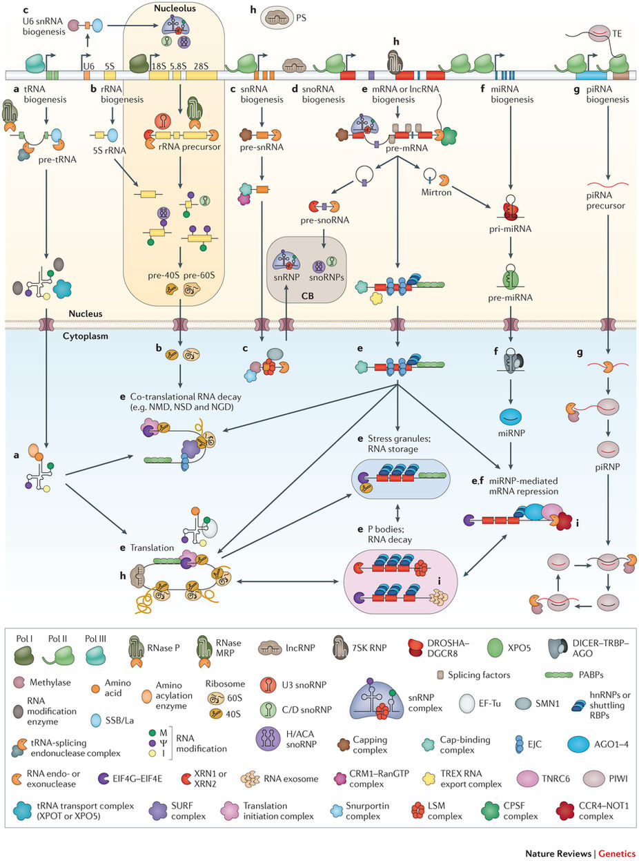

Slide 23

https://attract.cnic.es/

Slide 24
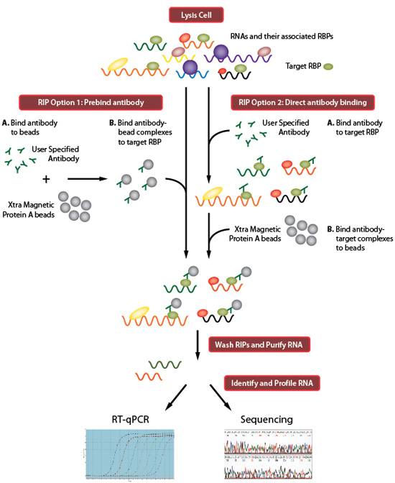

Slide 25
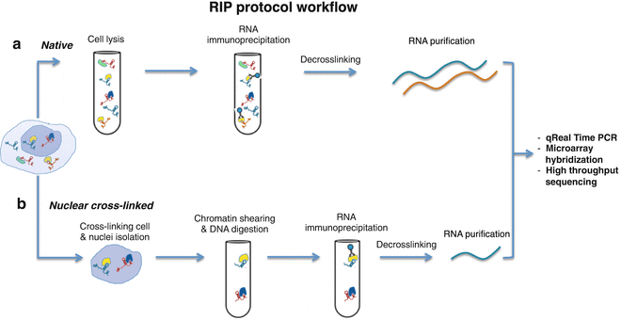
There are two main RIP variants:
Native RIP: direct identification of the bound RNA and the protein of interest in the immunoprecipitated sample, this approach typically allows recovery of high affinity protein-RNA interactions
Cross-linked RIP: live cells are treated with formaldehyde first, to generate RNA-proteins cross-links, this allows precise mapping of the direct and indirect binding site of the protein to the RNA

Slide 26
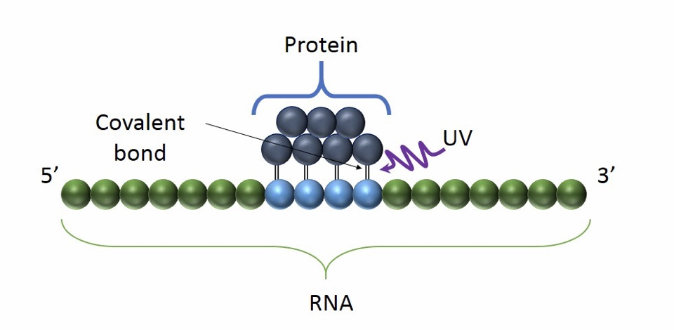
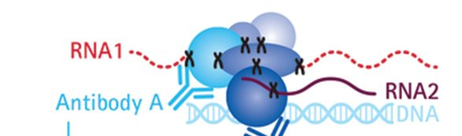
Formaldehyde crosslinking
UV crosslinking
RIP
CLIP
CLIP is an antibody-based technique used to study RNA-protein interactions related to RNA immunoprecipitation (RIP) but differs from RIP in the use of UV radiation to cross-link RNA binding proteins to the RNA that they are bound to.
This covalent bond is irreversible, allowing stringent purification conditions.

Slide 27
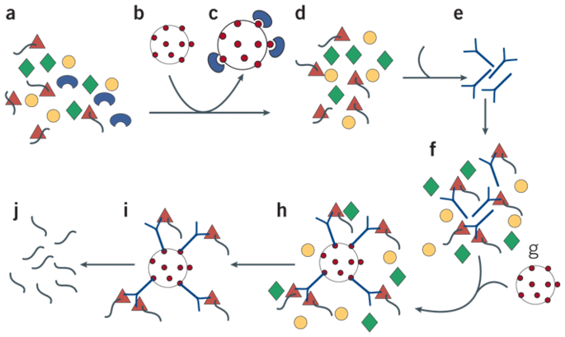
Immunoprecipitation of mRNA-protein complexes

