Slide 1

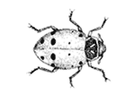
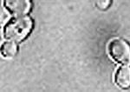
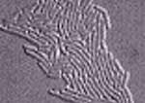
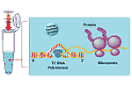
Protein Expression Systems
Mammalian
Insect
Yeast
Bacterial
Cell-free

Slide 2
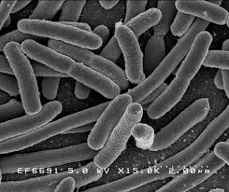
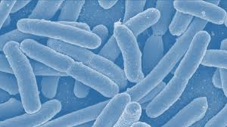
Protein Expression in Bacteria
Advantages/disadvantages
Genetic elements essential for the expression
Overview of the available expression systems and expression strains

Slide 3
Goals in recombinant protein production
To obtain
as much as possible good expression + good cell growth
soluble folded protein reduced aggregation
in a form that is easy to purify use of secretion and tags
Common problem:
High expression → danger of aggregation → decreased cell growth

Slide 4

Advantages
Fast growth
Cheap medium and equipment for growing
Good knowledge of the host

Slide 5
Disadvantages
Limitation for expression of eukaryotic proteins due to:
differences in post-translational modifications
SS bonds, glycosylation etc etc
different frequencies with which the different codons appear in genes of these organisms
E.g. CGT, CGC, CGG, AGG, AGA, CGA code for arginine, but the last 3 (AGG, AGA, CGA) are rarely used in E. coli and it has low amounts of respective tRNAs.

Slide 6
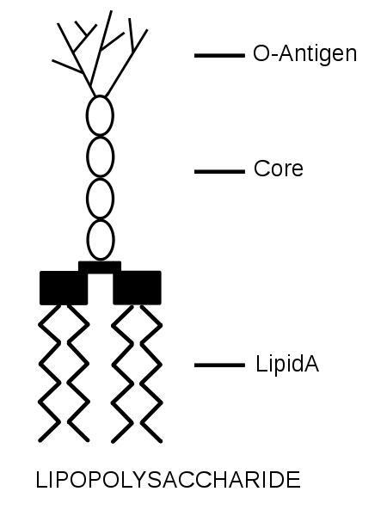
Disadvantages
Accumulation of lipopolysaccharides – LPS
(generally referred to as endotoxins) …
LPS acts as the prototypical endotoxin
it binds the CD14/TLR4/MD2 receptor complex in many cell types, but especially in monocytes, dendritic cells, macrophages and B cells,
promotes the secretion of pro-inflammatory cytokines, nitric oxide, and eicosanoids

Slide 7
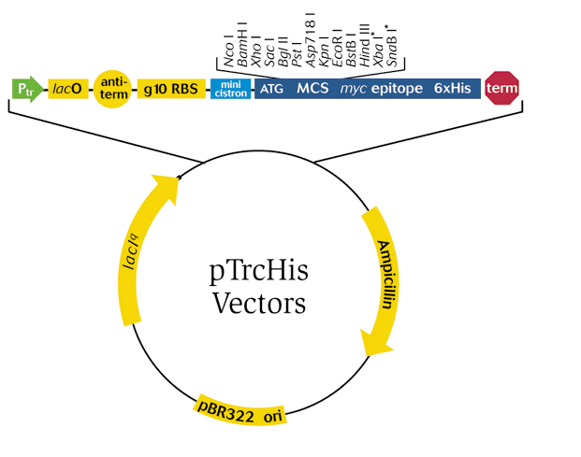
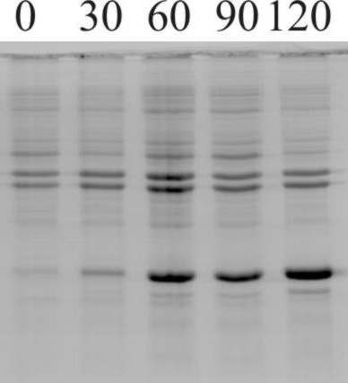

Slide 8
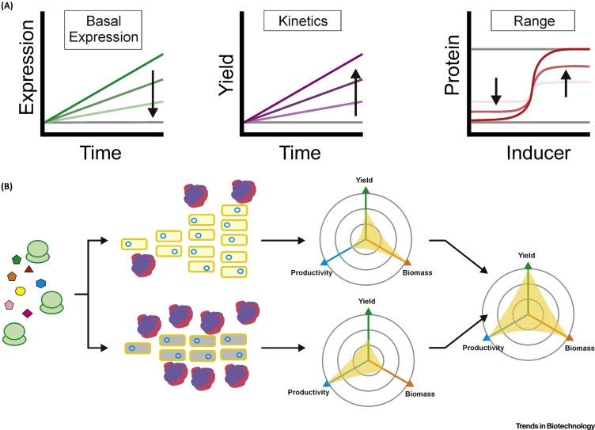

Slide 9
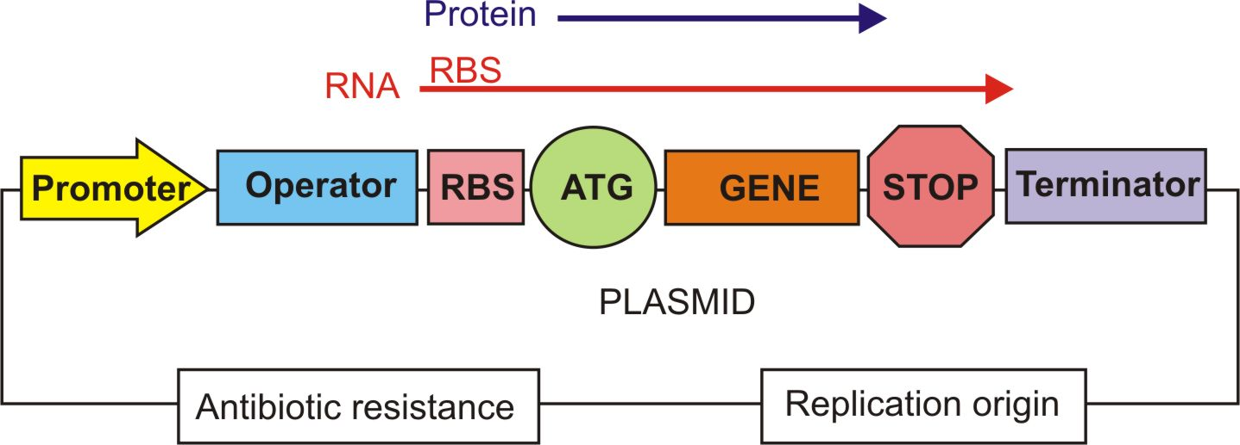
Genetic Elements Essential for Expression

Slide 10
Replication Origin
Plasmid | Replicon | Copy Number
pBR322 | pMB1 | 15-20
pUC | pUC | 500-700
pACYC | p15A | 18-22
pSC101 | pSC101 | 5
colE1 | colE1 | 15-20

Slide 11
Genetic Elements Essential for Expression

Slide 14
Genetic Elements Essential for Expression

Slide 16
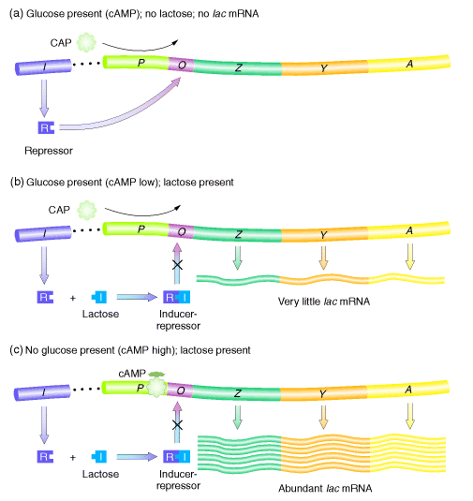
Plac: Regulation

Slide 17
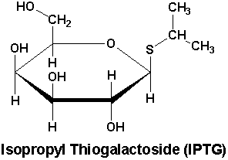
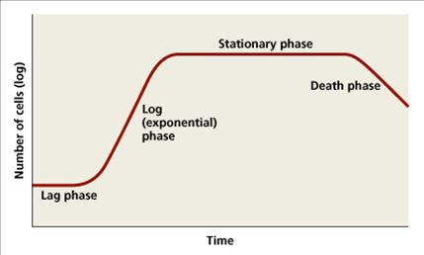

Slide 18
Plac, Ptac: Characteristics
 | Level of expression (inductor) | Key features
Plac | Low level up to middle (IPTG) | Weak, regulated. Suitable for expression of gene products at very low intracellular level. Comparatively expensive induction.
Ptac (trp-lac) | Moderately high (IPTG) | High-level, Regulated expression still possible. Comparatively expensive induction. High basal level.

Slide 19
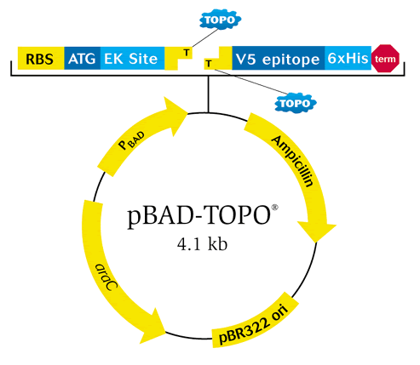
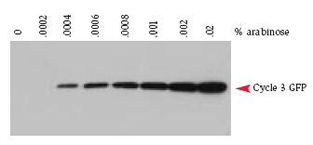
pBAD

Slide 20
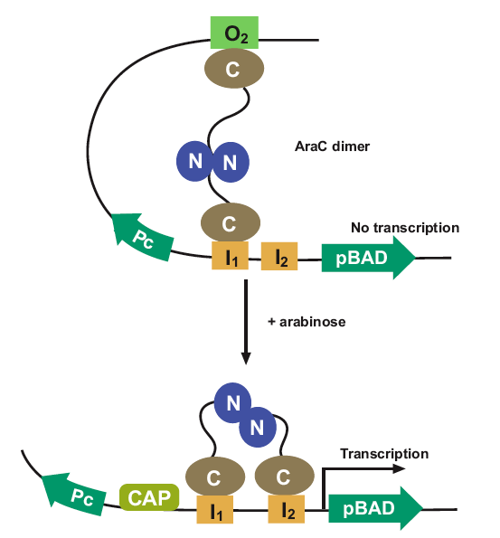
P_{PBAD}: Regulation
PBAD.
- expression of the gene is controlled by the AraC activator.
Expression from pBAD is induced to high levels on media containing arabinose.
Moreover, expression from pBAD is tightly shut off on media containing glucose but lacking arabinose.
transcription by P_{BAD} | High Arabinose | Low Arabinose
High Glucose | Repressed | Repressed
Low Glucose | Active | Repressed

Slide 21
pBAD
 | Level of expression (inductor) | Key features
P_{PBAD} | Variable from low to high level (L-arabinose) | Can fine-tune expression levels in a dose-dependent manner. Tight regulation possible. Low basal level. Inexpensive inducer.

Slide 22
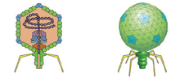
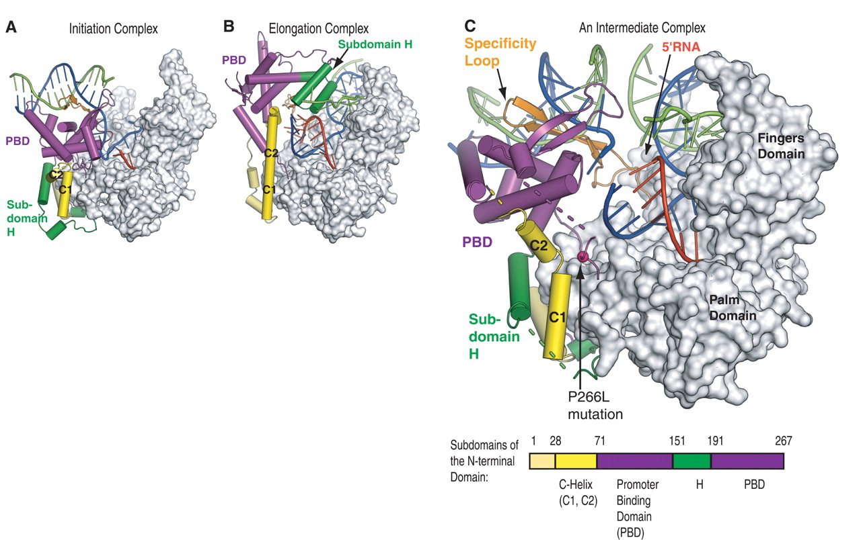
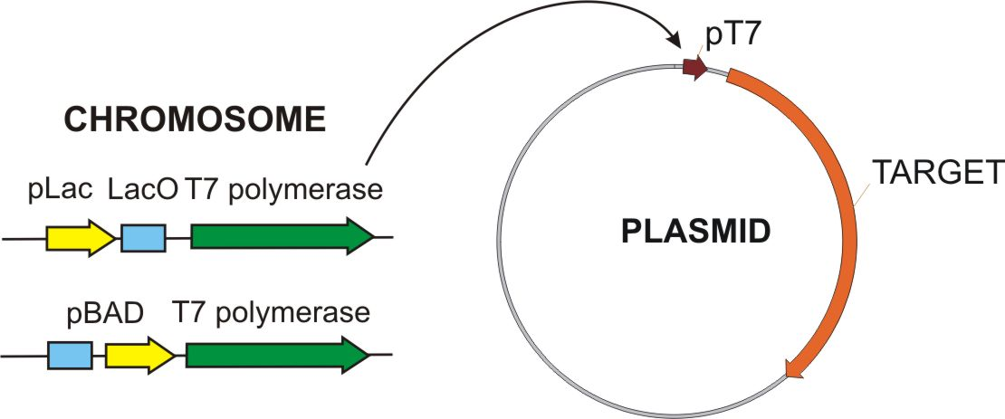
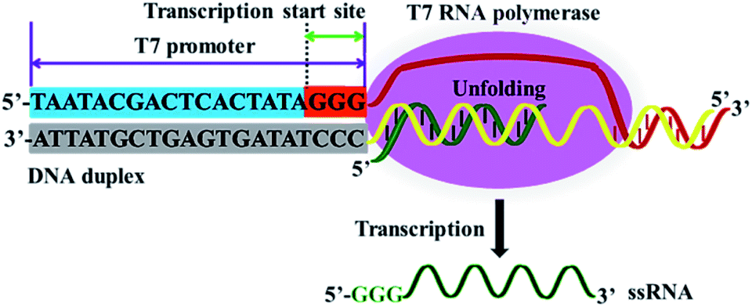
T7 promoter and Combinations
T7 Phage
RNA polymerase

Slide 23
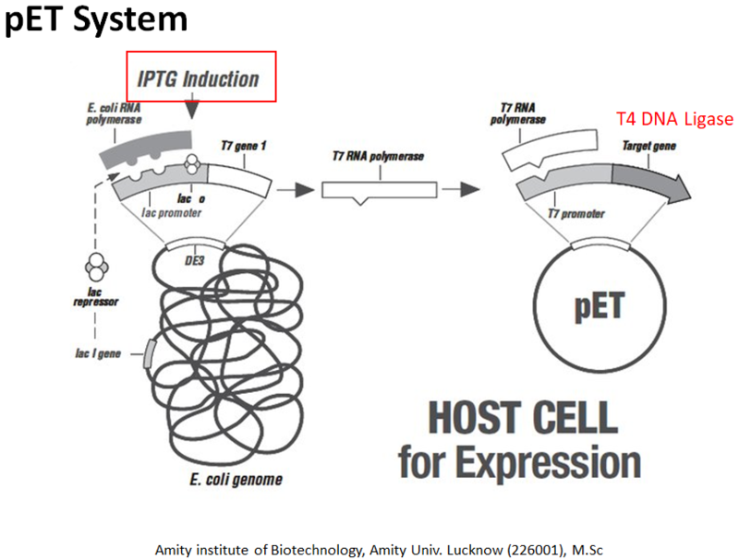
T7 promoter and Combinations

Slide 24
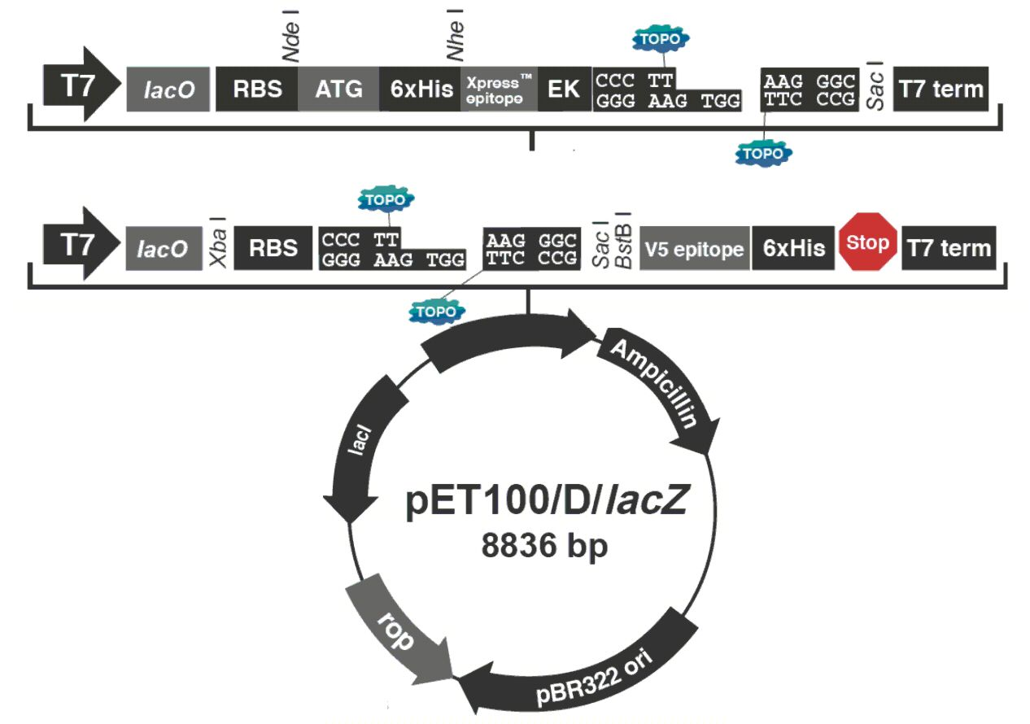
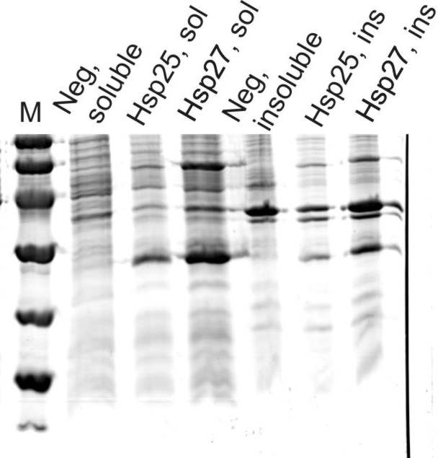
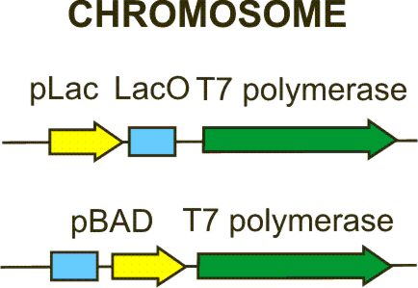
pET vector system

Slide 25
Genetic Elements Essential for Expression

Slide 26
RBS, START, and STOP
Ribosome Bindind Site (RBS):
RBS RBS 5-9 n START STOP GAAGGAATTCAGGAGCCCTTCACCATG ... ...TAA
START codons:
E. coli uses 77% ATG (AUG), 14% GTG (GUG), 8% TTG (UUG) and a few others
STOP codons: (x2...)
TAG (UAG), TAA (UAA), TGA (UGA),

Slide 27
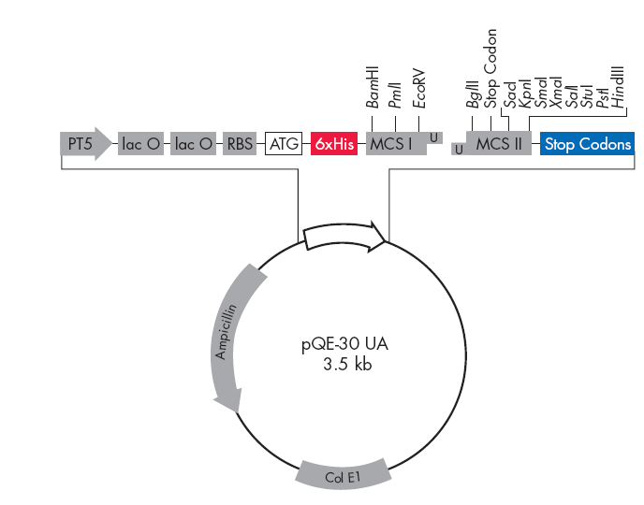
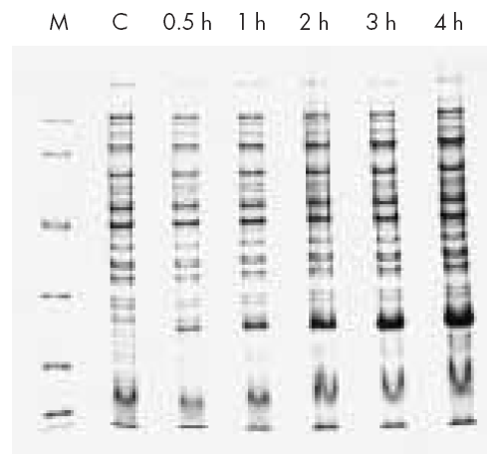
pQE
Translational vector + CDR

Slide 28
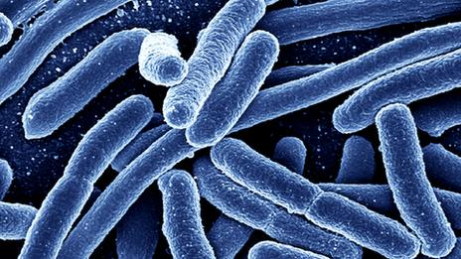
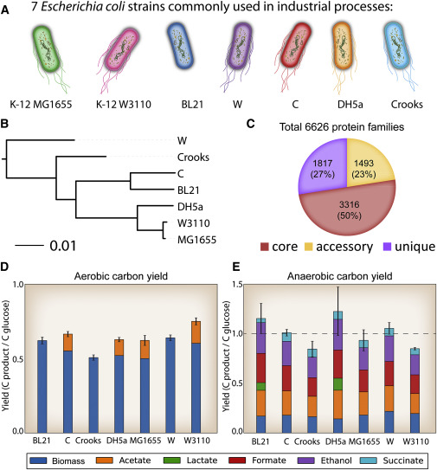
Expression strains
Despite significant success in engineering E. coli for industrial production of chemicals and proteins, there is no unified fundamental basis for selection of one strain over another for a given metabolic engineering project or expression of a given construct.
The choice of host strain for production of a given compound has a significant impact on results and up until now represented a major brute force screening effort.
Thus, an important question remains to be addressed: what strain of E. coli is best suited for production of a desired product?

Slide 29
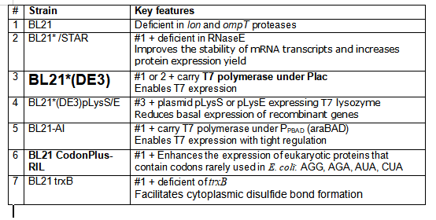
Expression strains

Slide 30
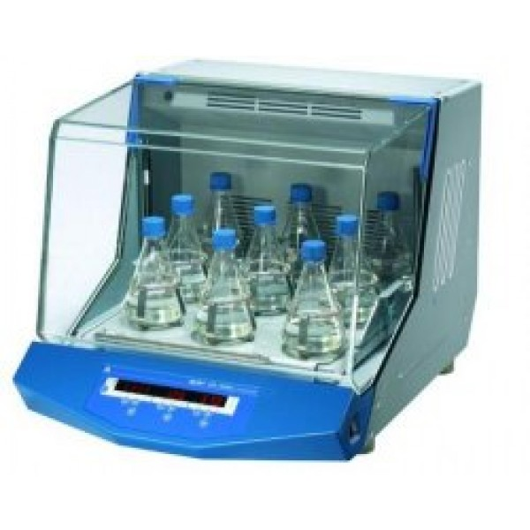
Expression optimization
E.coli strain
Level of inducer (e.g. arabinose)
Time of induction
Temperature of the induction step (popular - 18ºC overnight)

