Slide 1
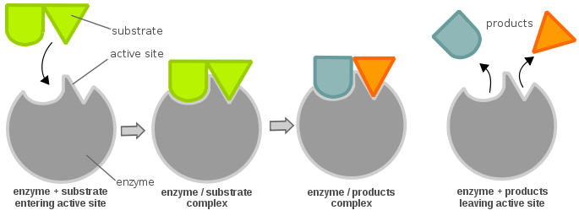
Lesson 6
Enzyme kinetics
Prof. Sabrina Pricl
A.Y. 2024-2025

Slide 2
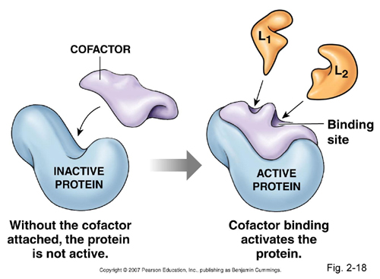
Generalities
Enzymes are biological catalysts
Very specific, targeting only one defined reacting species (substrate)
Enzymes are proteins
Some have a nonprotein part called cofactor
Cofactors can be
  metal ions (Mg⁺⁺)
  Organic molecules (coenzymes)
Only one region of the enzyme is responsible for substrate interaction (active site)
Molecular Biology for Engineering – Lesson 6

Slide 3
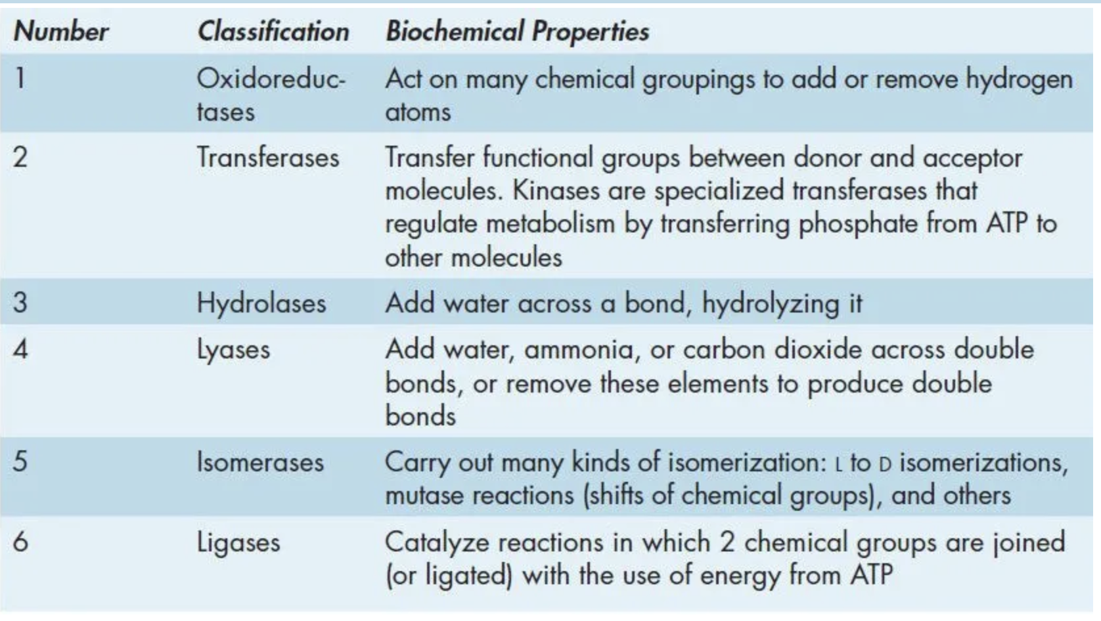
Enzyme classification
Enzymes names begin with EC followed by 4 numbers separated by dots
  EC 2.7.4.4
First number → which of the 6 major enzyme classes the molecules belongs to
Other numbers → enzyme sub-classes
Names are indicative of the action performed

Slide 4
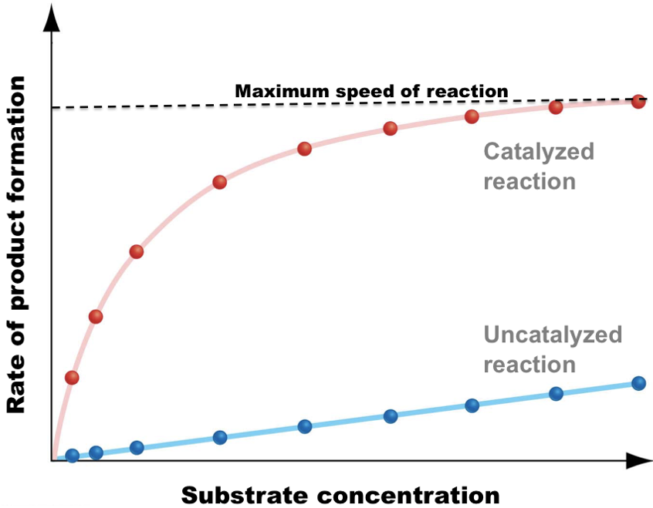
Enzyme kinetics
Enzyme assay → Experiment to determine the enzyme’s catalytic activity
Plot of reaction rate (V) vs. [substrate = S] in the absence (blue) and presence (red) of enzyme
Note:
  In both cases, at low [S] both curves are approximately linear
    first-order kinetics
  At equal, intermediate [S], V in enzyme-catalyzed is substantially higher than in uncatalyzed reaction
  In uncatalyzed reactions V continues to increase with [S] while in enzyme-catalyzed reactions it reaches an asymptotic value V_{max}
    V becomes independent of [S] → zero-order kinetics

Slide 5
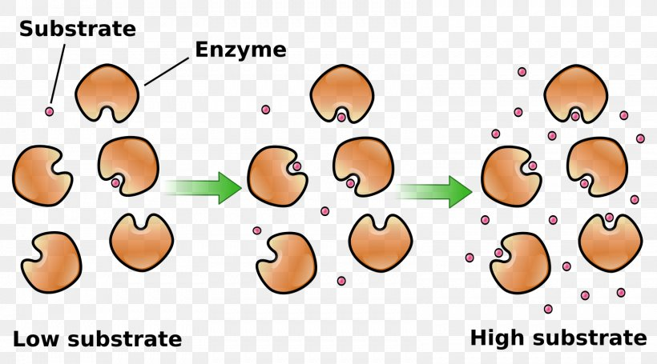
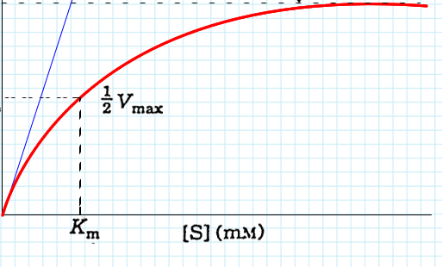
Enzyme kinetics
V_{max} corresponds to a specific condition called enzyme saturation
V = (V_{max} [S])/([S] + K_{m})
>
V = V_{max}
>
V (μM/min)
>
All enzyme molecules are part of a enzyme-substrate complex and no free enzyme molecules are available to accommodate additional substrate molecules

Slide 6
The Michaelis-Menten equation
V = (V_{max} [S])/([S] + K_{m})
Three further important points on the graph in the first-order kinetics region
  The point at which V = ½ Vmax
  [S] at which V = ½ Vmax = K_{m} [in mol/L or M]
    K_{m} = Michaelis-Menten constant → rough measure of the affinity of the enzyme for the substrate
      K_{m} varies in a wide range for different enzymes
  In this region, the behavior of V = f[S] is described by the so-called Michaelis-Menten equation
>
>
V = V_{max}
V (μM/min)
>
At low [S], [S] << K_{m} → V = (V_{max} [S])/K_{m}
At high [S], [S] >> K_{m} → V = V_{max}
At [S] = K_{m} → V = ½ V_{max}
V = (V_{max} [S])/([S] + K_{m})

Slide 7
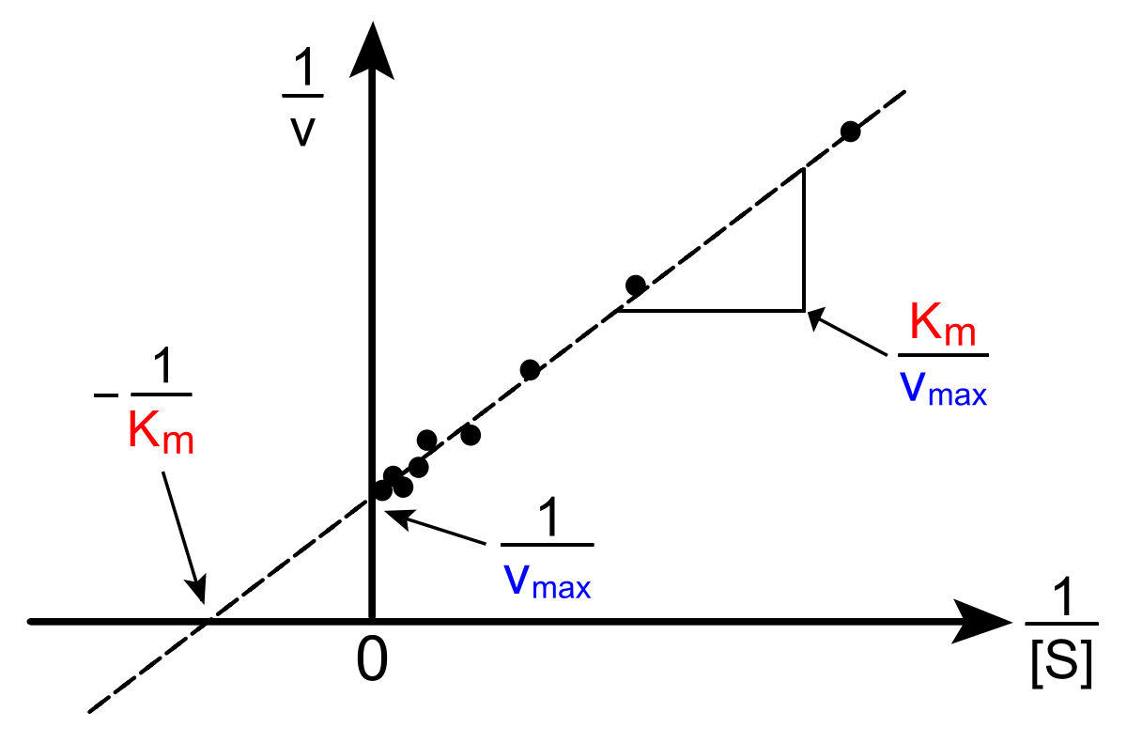
The Lineweaver-Burk plot
K_{m} and V_{max} can be easily found by data fitting with a spreadsheet
  Yet, a Lineaweaver-Burk (or double-reciprocal plot) is still exceedingly common
Main problem with LB plots
  Overemphasizes low [S] velocities
  Gives more an order of magnitude of K_{m} and V_{max} than an accurate estimate of values
1/V = [(K_{m}/V_{max}) x 1/[S]] + 1/V_{max}

Slide 8
Quiz time
An enzymatic assay yielded the following data set:
Q1. Determine V_{max} and K_{m}
[S] [μM] | V (μM/min)
1 | 49
2 | 96
8 | 349
50 | 621
100 | 676
1000 | 698
5000 | 699

Slide 9
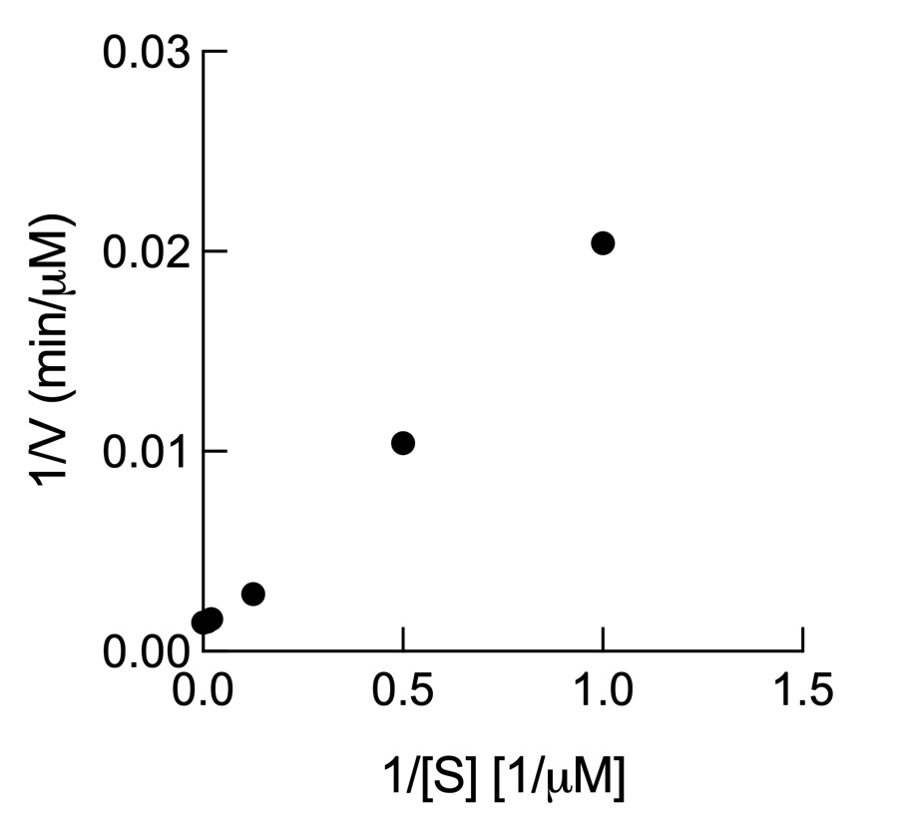
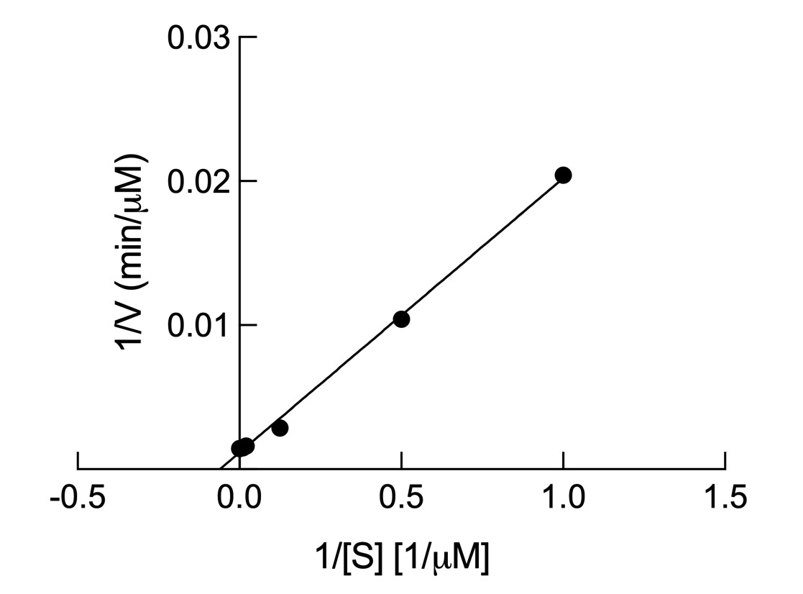
Quiz time
R1.
V_{max} 863 μM/min
K_{m} 16.4 μM
R² 0.9977
V_{max} 717 μM/min
K_{m} 9.13 μM
R² 0.9945

Slide 10
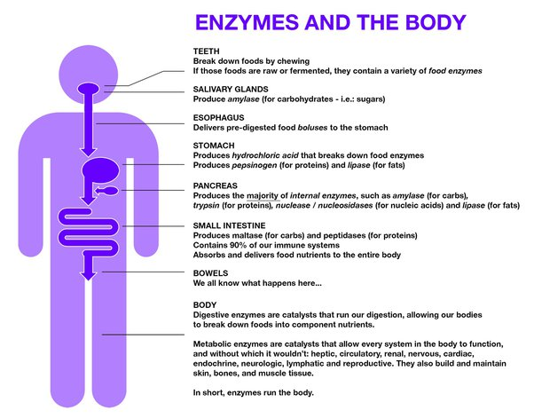
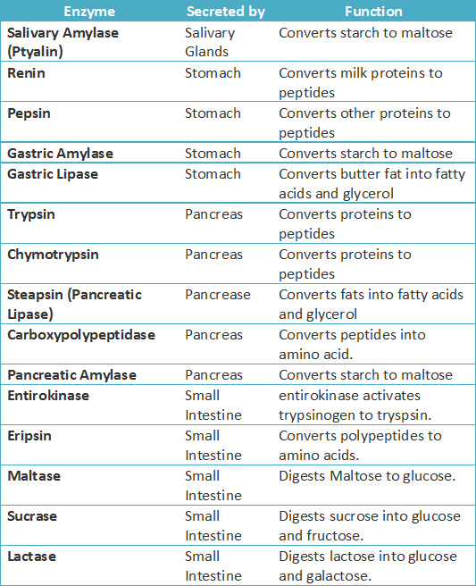
(Some) Enzymes and the body

Slide 11
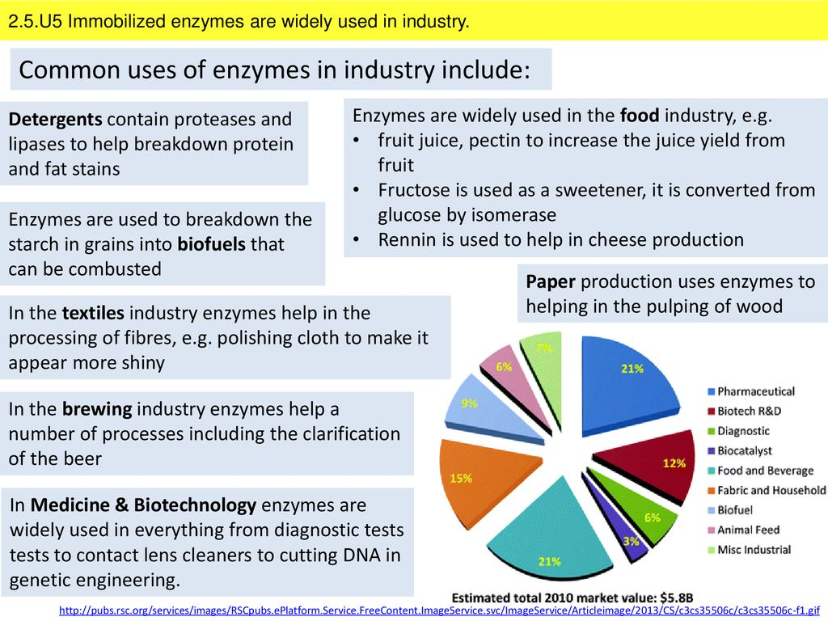
Where the money is: enzymes and industry
The global market for enzymes in industrial applications should grow from $6.4 billion in 2021 to $8.7 billion by 2026, at compound annual growth rate (CAGR) of 6.3% for the period of 2021-2026.

