Slide 1


UNIVERSITY OF TRIESTE – DEAMS DEPARTMENT
BACHELOR COURSE IN BUSINESS & MANAGEMENT
A.Y. 2024 – 2025
COURSE INTRODUCTION & SYLLABUS
Management of Innovation
INSTRUCTOR
Guido Bortoluzzi (Ph.D)

Slide 2
Management of Innovation
Course duration: 60 hours
Credits: 9 ECTS
COURSE INSTRUCTOR – Guido Bortoluzzi
Contact: guido.bortoluzzi@deams.units.it
Office hours: by appointment
Full Professor of Innovation Management and Entrepreneurship and Business Modelling at the University of Trieste.
Coordinator of the PhD program in Circular Economy of the University of Trieste.
Scientific Coordinator of the MBA Program in International Business at MIB Trieste School of Management
Visiting lecturer in several international Universities, including University of Northern Colorado (Greeley, U.S.) and ISM University of Economics and Business (Vilnius, LT).
Research interests deal with Innovation and creativity, Start-Ups, Business Models. Publish in several international journals, including Technovation, Journal of Business Research, International Marketing Review, Harvard Business Manager

Slide 3
Course objectives
The main aim of the course is to focus on how firms should manage innovation-related activities in order to increase the likelihood to remain competitive in a fast-changing economic and technological environment.
After clarifying what innovation is and why it is so important for the competitiveness of firms, the course will focus on four main aspects:
  the organizational antecedents to innovation,
  the innovation strategy,
  the innovations sources,
  the innovation process.

Slide 4
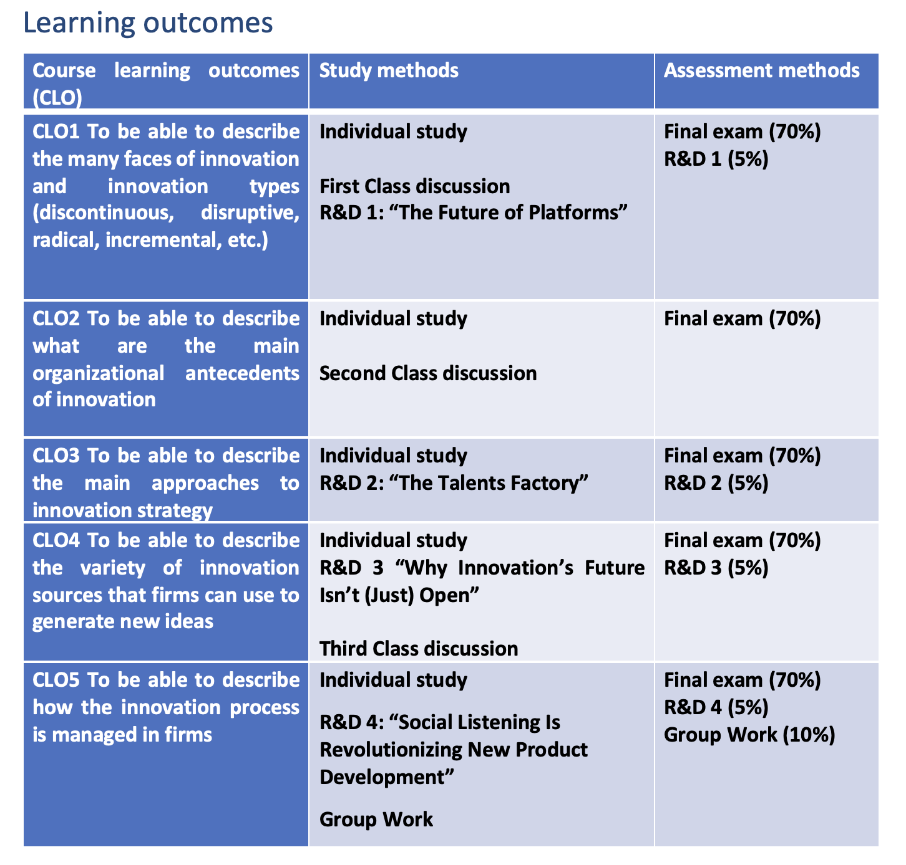
Learning outcomes

Slide 5
SCHEDULE OF THE COURSE
You can find it in Moodle
May be subject to change (check for the different versions). All modifications are communicated through the Moodle platform (but you must join the course to receive updates. So do it asap).

Slide 6
Individual work, group work and assessment (attending students only)
ACTIVITY | WEIGHT ON FINAL GRADE
Reading & Discussions | 20%
Group Work | 10%
Final Exam* | 70%
* The lecturer can provide extra points to those students that will contribute to the success of the course with regular attendance and active participation to class discussions and group activities. A P2P evaluation system will be used to evaluate the commitment of each student within groups. The lecturer will exclude from groups those students who do not provide an acceptable contribution to the group activities (Class Discussions, R&D, and Group Work) and hence consider them as “non-attending students”.

Slide 7
Course requirements
“Reading and Discussion” (R&D) sessions (20%)
During the “Reading & Discussion” sessions, students will work in group. Every outcome will be evaluated and will contribute (5% each) to each student’s final grade.
Groups will be asked to read in advance some papers and to answer to some specific questions made by the lecturer through a .doc document or a PPT presentation.
Each group will be evaluated on:
(1) the ability to use vocabulary, theories and concepts learnt in class
(2) the overall quality (care, precision) and consistency of the work done
Group Work (10%)
Specific instructions will be provided by the lecturer during the course

Slide 8
Exam: Attending students
Multiple-choice test reserved to ATTENDING students only. Students belonging to a group and being systematically present in class and active in their groups are considered ATTENDING.
Attending students not behaving correctly, will become “non attending”. The decision is mine
The scoring rule is the following: +1 for every correct answer; 0 for no answer; -0.5 for every wrong answer.
Students will be asked to study their notes, the slides and the papers read in preparation for the R&D sessions and for the Class discussions.

Slide 9

Exam: Non attending students
Joe Tidd and John Bessant, MANAGING INNOVATION. Integrating Technological, Market and Organizational Change (7th edition), Wiley
Study chapters 1 to 10 excluding chapter 2
Non-attending students will be evaluated only on the results of the final exam (100%) that will consist of 3 open questions. To get prepared for the exam, non-attending students are required to STUDY in depth Chapters 1-10 (from 1 to 10) of the textbook, excluding chapter 2. Non-attending students using the content of the slides to answer to the questions will be penalized (-6 points per answer).

Slide 10
FORMING THE GROUPS
Groups will be formed by (min) 4 – 5 (max) people.
Find a NAME for the group and choose a TEAM LEADER.
The TEAM LEADER will be the only one that will send files to the lecturer
The TEAM LEADER will send to the lecturer the list of the team-members by the end of the week in a .xls file (download the FORMAT from MOODLE)

Slide 11
FORMAT
GROUP A
NAME | SURNAME | POSITION | EMAIL
MARIA | BOLLE | TEAM LEADER | maria.bolle@studenti.units.it
PATRICIA | URQUIOLA |  | patricia.urquiola@studenti.units.it
JEORGE | AMADO |  | jeorge.amado@studenti.units.it
ANDREA | DE CONTI |  | andrea.deconti@studenti.units.it
GIULIA | TOC |  | giulia.toc@studenti.units.it

Slide 12
About your thesis and beyond
Available for “applied” thesis and “super-thesis”
Available for “University” internships
Start looking around and applying NOW for your master’s degree.
I write recommendation letters only to students actively participating in my course.

