Slide 1
LECTURE 4
Preparation of samples and sequencing libraries

Slide 2
PREMISES
What we will see in this block of slides concerns mainly the preparation of sequencing libraries from genomic DNA for whole genome sequencing or resequencing applications
Slightly different techniques (which we will address from time to time in subsequent lectures), however, are used for other types of approaches. For example, RNA-sequencing requires special precautions (e.g. reverse transcription to cDNA) because of the low stability of this nucleic acid, which can be easily degraded
Some targeted resequencing approaches (e.g., those based on amplification by PCR) do not require the genomic DNA fragmentation steps that will be described, being limited to purification of the amplified fragment post-PCR
Various techniques for preparing fragments for inclusion in the library then converge on the same strategy of adding adapters (and possible barcodes), effectively making some of the considerations in the following slides valid for approaches other than genomic sequencing as well

Slide 3
SEQUENCING LIBRARIES: A DEFINITION
Original definition: «collection of DNA fragments that is stored and propagated in a population of micro-organisms through the process of molecular cloning”
However, the term “library” is used with a different meaning today in the context of NGS, since as we have seen NGS sequencing does not require any cloning. In a nutshell, we could define a library as a “collection of DNA molecules prepared in such a way as to make them compatible with a given sequencing platform.” This is why we can talk about “Illumina libraries,” “Nanopore libraries,” etc., each of which is prepared with different kits and has distinct characteristics, although there are often points of contact that may even allow cross-platform compatibility.
Since that is to say, what makes a library compatible or not with a sequencing platform is the presence of (known) adapters at the ends of each fragment, an even more appropriate definition might be that of a “collection of DNA molecules modified through the addition of adapters compatible with a given sequencing platform”

Slide 4
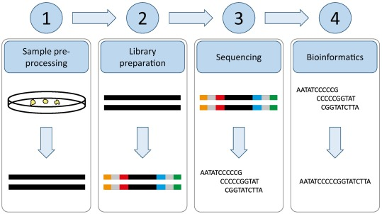
SEQUENCING LIBRARIES: INSERT SIZE
INSERT
Unknown sequence which needs to be sequenced, which therfore excludes the sequence of its attached known adapters
UNIFORM INSERT SIZE
Products of amplification of a known target by PCR (metabarcoding)
Digestion products of particular restriction enzymes (e.g., 2b-RAD libraries)
VARIABLE INSERT SIZE
All approaches requiring DNA fragmentation (most applications)
PCR products of known targets of variable size by multiplex PCR

Slide 5
FACTORS TO CONSIDER WHEN PREPARING A GENOMIC LIBRARY FOR NGS
Amount of starting material (extracted genomic DNA) depending on (a) approach required (de novo sequencing vs resequencing) and (b) type of sequencing platform used - N.B. the same factor is also critical for other types of approaches, including those based on RNA extraction
Presence of compositional bias in the genome of interest: particularly high or particularly low GC content. These situations can be a source of bias in second-generation sequencing approaches that use fragmentation + ligation steps and subsequent amplification to generate clonal clusters
N.B. some of these biases (if known) can be mitigated through the use of special technical arrangements (use of specific polymerases, modification of amplification protocol, use of different buffers for enzymatic reactions)

Slide 6
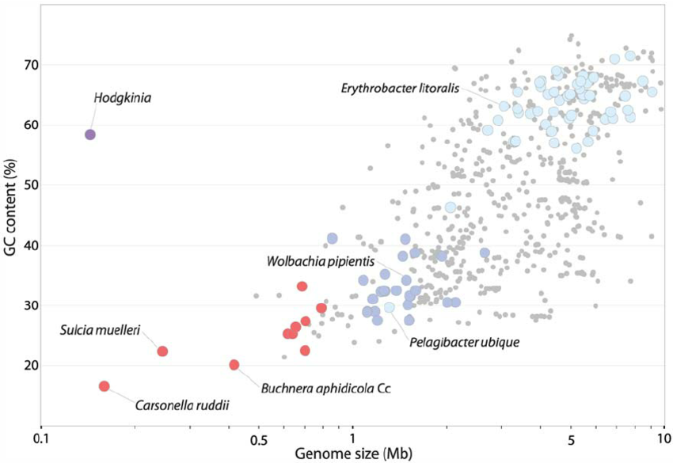
GC CONTENT IN DIFFERENT ORGANISMS
Relative GC content can be highly variable even in organisms that are quite close evolutionarily to one another
There is often a relationship with genome size (also related to the number and type of repetitive elements)
Human genome: 41% GC
Extreme example: Plasmodium falciparum -> 20% GC

Slide 7
FACTORS TO CONSIDER WHEN PREPARING A GENOMIC LIBRARY FOR NGS
There are now a large number of commercial kits for the preparation of genomic libraries, distributed by various companies
They may require minimum quantities ranging from a range of several micrograms to even a few tens of nanograms of starting DNA, depending on the objective of a study and, most importantly, the type of library to be prepared and the sequencing platform selected
In general, however, it should always be kept in mind that a larger amount of starting DNA implies a lower need for amplification, which ultimately ensures a higher complexity of the library itself
What is meant by the complexity of a library? Representation of the widest possible view, in the included fragments, of the sequence diversity present in the starting genome: uniform distribution of reads along chromosomes, no enrichment of specific regions, etc.% GC

Slide 8
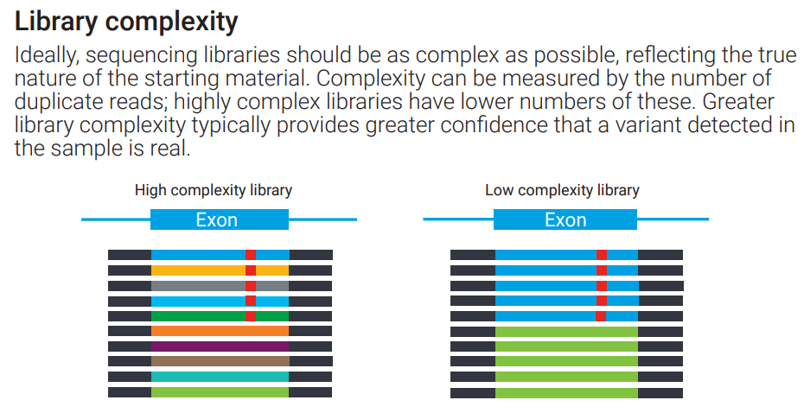
LIBRARY COMPLEXITY: SOME ADDITIONAL DETAILS TO BETTER UNDERSTAND THIS CONCEPT
The concept of “complexity” of a library can also be applied to several other types of approaches
In the example in the figure we see a resequencing involving data mapped to an exon, showing a SNP (shown in red)
The complexity of a library can be estimated by assessing the presence of duplicate reads, that is, 100 percent identical to each other, not only by sequence, but also by start and end positions. A very high fraction of duplicate reads could indicate technical problems (in a genomic library, but for example not in amplicon sequencing-based approaches)
In this example, the differently colored reads are “different” not in the sense that they show polymorphisms, but in the sense that their start and end positions are “out of phase” while covering the entire exon (which is expected, because let us remember that genomic DNA fragmentation is a random process

Slide 9
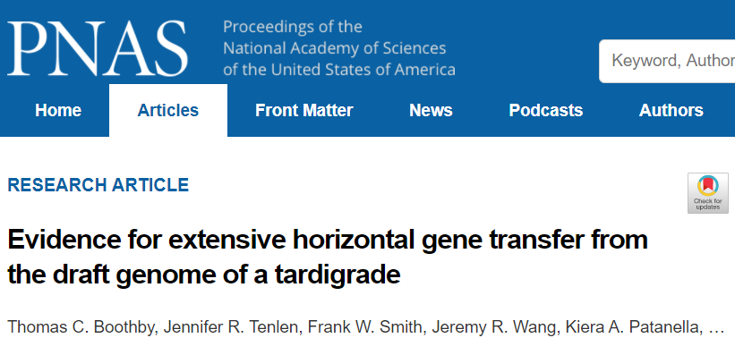
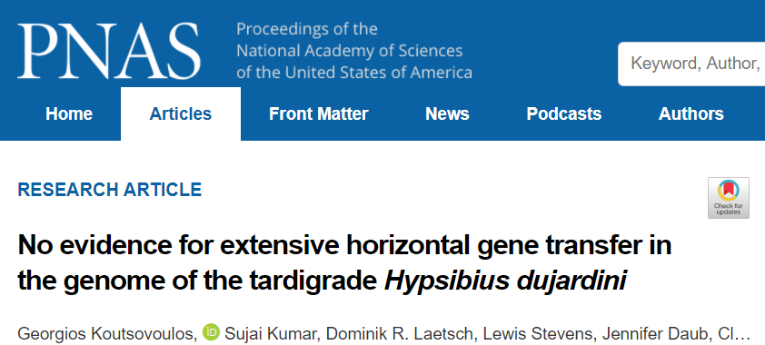
FACTORS TO CONSIDER WHEN PREPARING A GENOMIC LIBRARY FOR NGS
Limit exogenous contamination as much as possible! Tissues of an organism are not axenic -> I can extract a mix of the target genomic DNA + that of associated microorganisms (symbionts and pathogens). Viruses? Microalgae and protists in aquatic organisms?
It is appropriate to choose a tissue that is as “clean” as possible, avoiding, for example, the digestive tract, which may include DNA derived from organisms that my target species has fed on

Slide 10
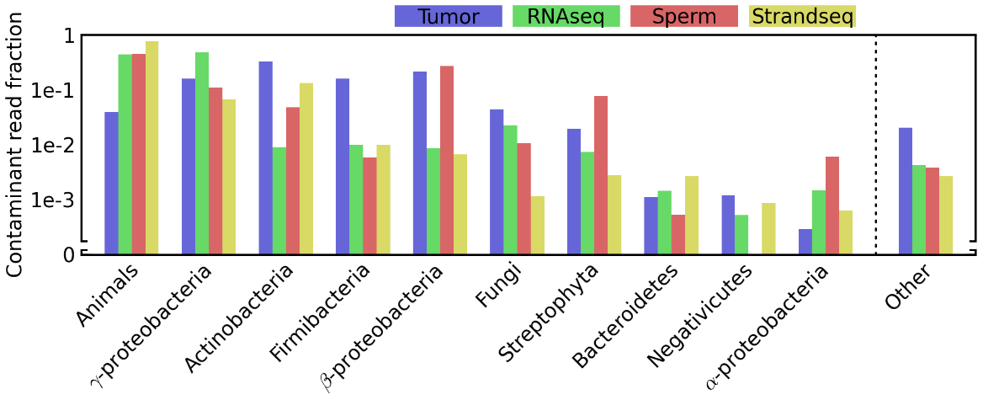
BE CAREFUL ABOUT THE POSSIBLE SOURCES OF EXOGENOUS CONTAMINATION OR CROSS-CONTAMINATION
Patterns of cross-contamination in a multispecies population genomic project: detection, quantification, impact, and solutions
Ballenghien et al., BMC Biology, 2017
«nearly all the detected contamination events of between-species contamination involved species that were sent the same day to the same company”
Contamination may also unknowingly happen in the lab, e.g. during the nucleic acid extraction or library prep phases!
Diverse and Widespread Contamination Evident in the Unmapped Depths of High Throughput Sequencing Data
Lusk, PlosONE, 2014
Esempio di ciò che può accadere in dataset umani

Slide 11
HOW CAN CONTAMINATION RISKS BE MINIMIZED?
Select tissues appropriately: they should be “clean,” where the presence of exogenous contamination is least likely (e.g., no digestive tissue!)
Thoroughly clean/wash organisms (remove epibionts, soil, water or other environmental debris)
Check for parasites and infections and take them into account in downstream analysis steps, if necessary (decontamination can be also potentially applied to the reads, with in silico methodologies)
Work in a dedicated environment, cleaning the equipment (scalpels, tweezers, etc.) used for dissections. Do not work in parallel on several different species, or do so in separate rooms!
Pay equal attention to plasticware, extraction kits, library preparation kits, and various reagents
Learn from your previous mistakes (sequencing centers use well-established protocols to minimize these risks)

Slide 12
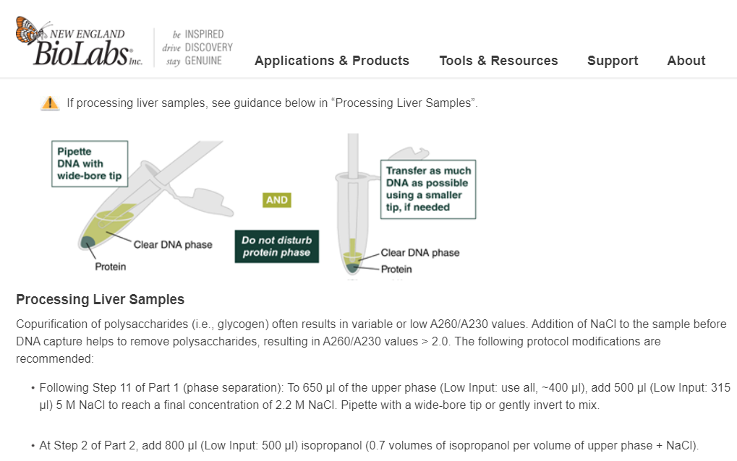
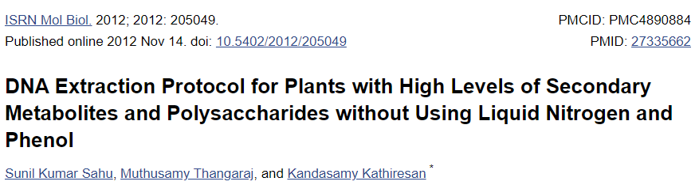
FACTORS TO CONSIDER WHEN PREPARING A GENOMIC LIBRARY FOR NGS
It is often required to obtain “pure” DNA, i.e., with good 260/230 and 260/280 nm absorbance ratios, which is an indication of the absence of impurities of various kinds (polysaccharides, photosynthetic and non-photosynthetic pigments, metabolites, etc.).
It also depends on the fabric, with special arrangements that can be made in some cases
Tradeoff between quality and quantity!
Key choice for PacBio/ONT.

Slide 13
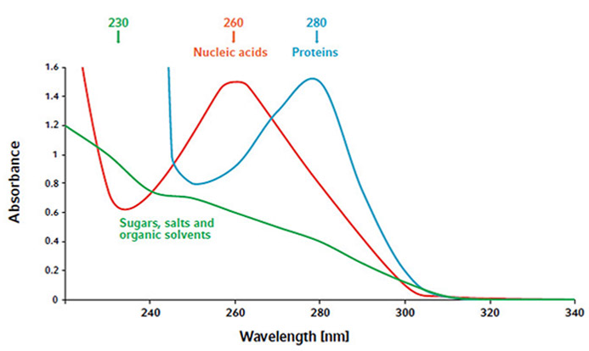
FACTORS TO CONSIDER WHEN PREPARING A GENOMIC LIBRARY FOR NGS
Absorbance ratios, a quick review
Nucleic acids have an absorbance peak at 260 nm: this DOES NOT PERMIT discrimination between DNA and RNA -> in case it is necessary to use single (x RNA) or double helix (x DNA) nucleic acid intercalating fluorophores
This is not a measure of nucleic acid integrity, but solely and exclusively of “purity.” I could get extremely pure but extremely degraded DNA, which would not be possible to use for any application

Slide 14
FACTORS TO CONSIDER WHEN PREPARING A GENOMIC LIBRARY FOR NGS
The problem of quantity... How much DNA can I get from the extraction of genomic DNA from a tissue?
It depends on many factors: cell size, “compactness” of the tissue, but especially nuclear content of genomic DNA
Counterintuitive (and often little considered) aspect: given the same cell size, the nuclear DNA content varies considerably depending on the species being considered due to different genome sizes
C-value: nuclear DNA content in pg of each haploid cell (gametes)
Equivalent to half the DNA content of a somatic cell of a diploid eukaryotic organism

Slide 15
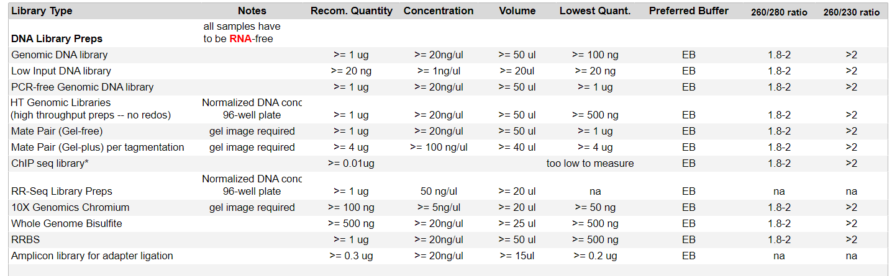
FACTORS TO CONSIDER WHEN PREPARING A GENOMIC LIBRARY FOR NGS
It is always good to check the quantity required by a protocol (or by a sequencing center, in the case of an external service) before starting a project, so as to avoid nasty surprises!
Pay attention not only to the quantity, but also to the concentration and resuspension buffer required (in addition to quality, of course!).

Slide 16
FACTORS TO CONSIDER WHEN PREPARING A GENOMIC LIBRARY FOR NGS
Simplified calculation: 1Gb of genomic sequence corresponds to about 1 pg of DNA -> human c-value = about 3
The content of a human diploid cell is about 6.5 pg
I have to ask myself: how many millions of cells will I need to obtain the amount of genomic DNA required to prepare the library of my interest? Consequently, what weight of tissue will I need to start from for extraction?
Relatively simple calculation for cultured cells, due to the possibility of direct counting (e.g., fibroblasts) -> a small convergence flask typically contains 500 thousand/1million fibroblasts
Less trivial calculation for blood samples (erythrocytes are not nucleated in some species!).Calculation not at all trivial for tissues (partly because much of the weight is given by extracellular matrix) -> requires prior knowledge of biological samples and extraction yield -> for de novo approaches we often rely on information available for phylogenetically close species

Slide 17
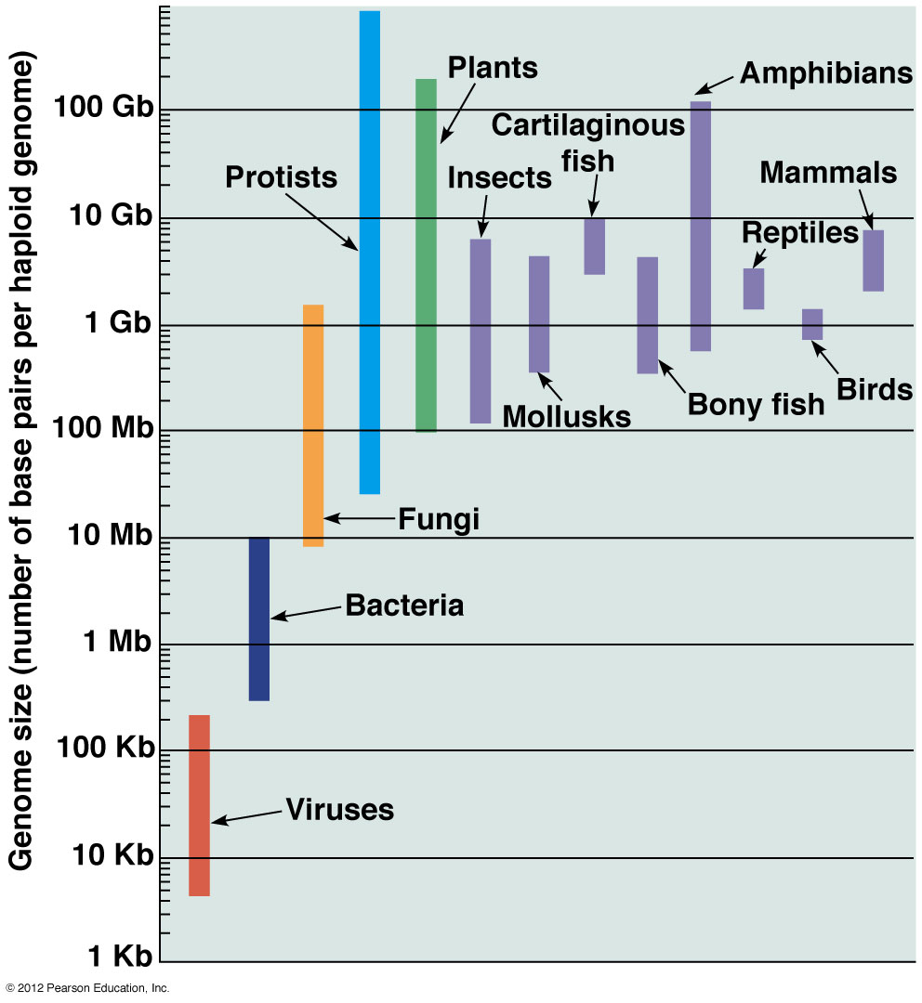
GENOME SIZE
Knowing the size of the genome (at least approximately) as we shall see is also most useful for planning the depth of sequencing
This allows to make a cost prediction…
And to decide on the sequencing strategy (and type of library) to use
C-value paradox -> the apparent morphological and physiological complexity of an organism does not correlate with the size of a genome
There are some resources to help us make estimates: http://www.genomesize.com or the size of “related” genomes that have already been sequenced (e.g., from NCBI genomes)
Therefore, we NEVER SEQUENCE “blindly.”
As we will see in extreme cases (“unique” species) one can proceed with an exploratory approach -> Illumina sequencing round and estimate genome size (and heterozygosity) with a k-mer approach

Slide 18
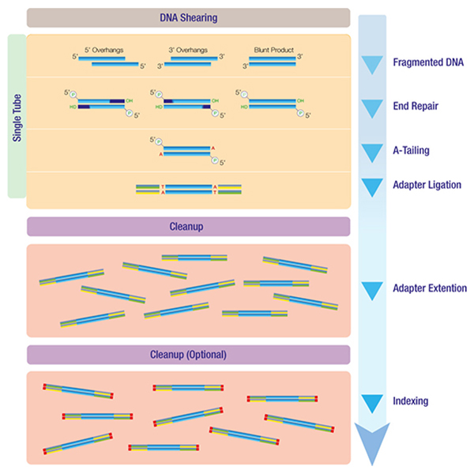
HOW TO PREPARE SEQUENCING LIBRARIES COMPATIBLE WITH SECOND GENERATION SEQUENCING PLATFORMS?
We will now examine some common methodologies that are used for the preparation of genomic DNA that are compatible with the construction of Illumina libraries from genomic DNA, but that are often applicable, with minor modifications, also for the construction of libraries for other second-generation NGS sequencing approaches
N.B. (1) the preparation of DNA samples for ONT/PacBio sequencing is very different, as the DNA is not fragmented in the same way (in some cases it is not fragmented at all!). Therefore, a high molecular weight (HMW DNA) extraction is required.
N.B. (2) the preparation of RNA samples shares some aspects, but requires further precautions!

Slide 19
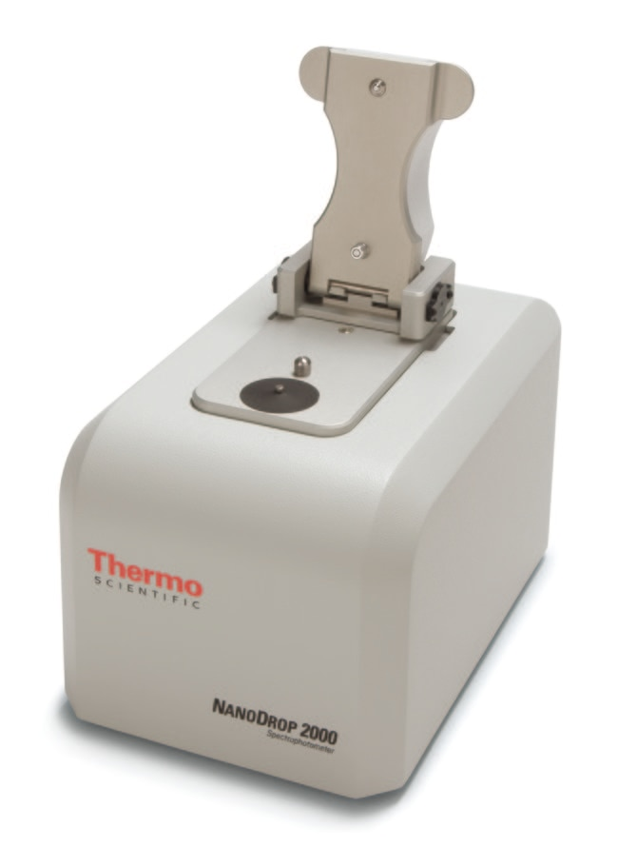
EVALUATING THE QUALITY OF EXTRACTED DNA
Spectrophotometric techniques: exploit the absorbance of DNA at 260nm and that of other possible contaminants at 230 and 280 nm. A “pure” DNA is expected to have a 260/280 ratio near 1.8 or higher. Lower values indicate contamination
Pulsed-field gel electrophoresis (PFGE): in a traditional gel, DNA fragments larger than 15-20 Kb migrate at the same rate and are not separated. This technique periodically alternates the direction of the electric field, allowing better separation (albeit with longer timelines than in a classic electrophoresis) of high molecular weight DNA
Most useful for applications where the longest possible fragments are required (ONT and PacBio, i.e. third generation)
N.B. Before sequencing, it will also be necessary to similarly check the size of the fragments obtained as a result of library preparation
For quantification, which must be very accurate, fluorimetric methods using double-helix nucleic acid intercalants, such as QuBit

Slide 20
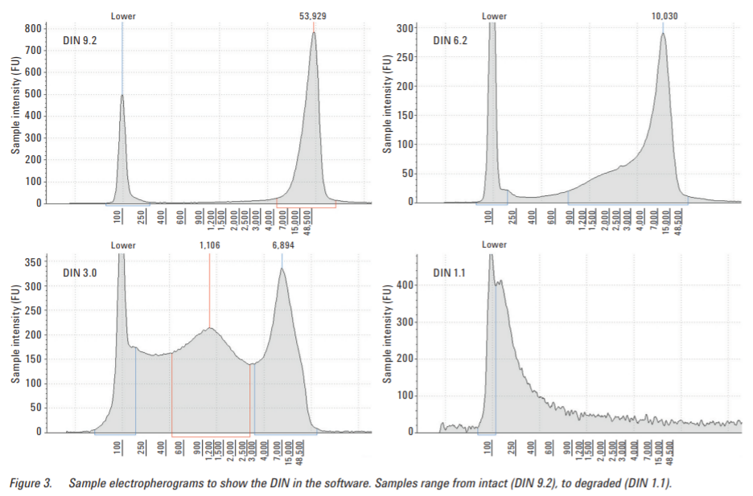
EVALUATING THE QUALITY OF EXTRACTED DNA
Some instruments based on automated electrophoresis allow direct calculation of the “quality” of genomic DNA (in terms of integrity) by assessing the profile of molecular weights of the fragments obtained
This is the example of the Agilent TapeStation, which calculates the DIN (DNA Integrity Number) for each sample, which can take values from 1 to 10
Interpretation of graphs: x-axis: fragment size; y-axis: signal intensity
N.B. this interpretation obviously does not apply to amplification products by PCR, which have a well-defined length, which should therefore be checked without DIN calculation

Slide 21
HOW TO PREPARE SEQUENCING LIBRARIES COMPATIBLE WITH SECOND GENERATION SEQUENCING PLATFORMS?
Main steps in preparing an NGS sequencing library from gDNA (as we shall see, often applicable to RNA-seq libraries as well):
Fragment the DNA and select fragments of the desired length (if the library is derived from a PCR product obviously no fragmentation is needed, and usually this allows direct addition of adapters, as per step 3, by their attachment to the end of primers)
(Convert target molecules to double-stranded DNA sequences), if they are not already: this step is necessary, for example, for RNA-seq approaches
Attach adapter sequences (with different structure depending on the type of library and sequencing platform) to both ends
Quantify and assess the quality (range of fragment sizes obtained) of the final product of the preparation before proceeding with sequencing

Slide 22
FRAGMENTATION APPROACHES
Fragmentation strategy is a key parameter in the preparation of a second-generation NGS sequencing library. Possible approaches to proceed are of the type:
PHYSICAL (Acoustic shearing, hydrodynamic shearing, sonication, nebulization)
ENZYMATIC (transposase, restriction enzymes, nicking enzymes)
REGARDLESS OF THE TYPE OF FRAGMENTATION CHOSEN, THIS SHOULD PRODUCE FRAGMENTS AS RANDOM AS POSSIBLE, SO AS NOT TO INTRODUCE BIAS AND TO MAINTAIN GOOD REPRESENTATIVENESS OF THE STARTING SAMPLE -> CREATION OF HIGH COMPLEXITY LIBRARIES

Slide 23
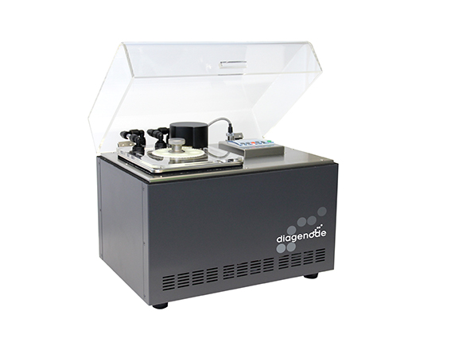
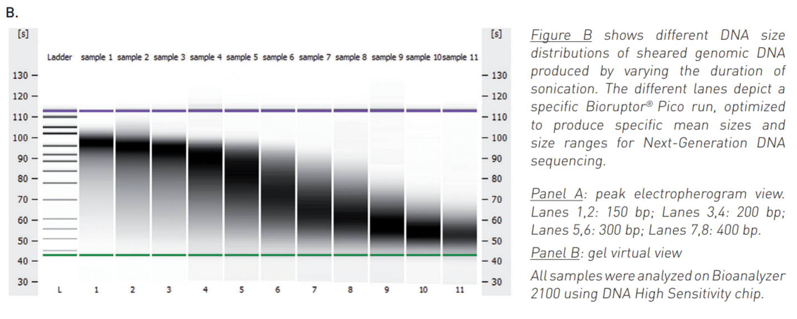
PHYSICAL METHODS: SONICATION
The easiest and cheapest strategy. An example is the Bioruptor (Diagenode, Belgium). Fragmentation can produce DNA fragments from a few doze bp up to several Kb in length
Fragmentation by unfocused, longer wavelength acoustic energy. Much heat is produced via “sonication bursts,” and a cooling period is therefore required between bursts. The number of bursts determines the size of fragments
CONS: risk of over-heating -> cooling -> longer required time. Risk of contamination (probe-based sonication)

Slide 24
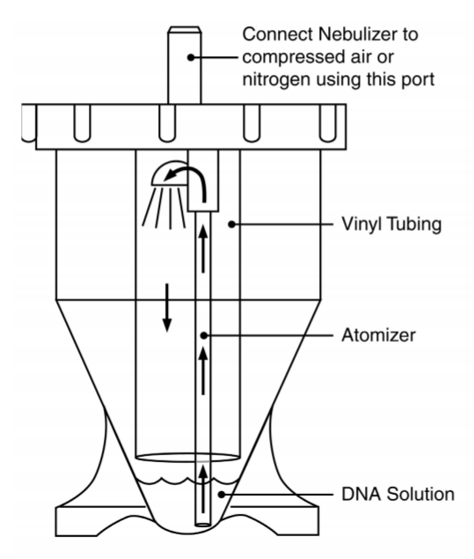
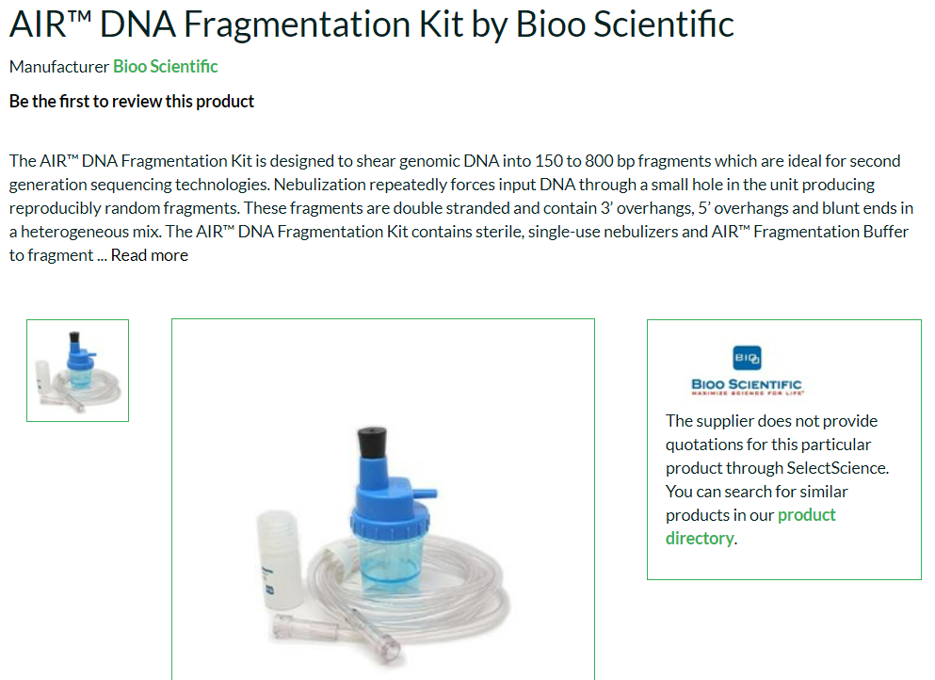
PHYSICAL METHODS: NEBULIZATION
Example: nebulizers produced by Life Tech (Grand Island, NY).
Compressed air is used to force the passage of DNA present in aqueous solution through a small-sized hole
The pressure used determines the size of the fragments (typically 700bp to 5 Kb)
CONS: high sample loss, requires high input DNA

Slide 25
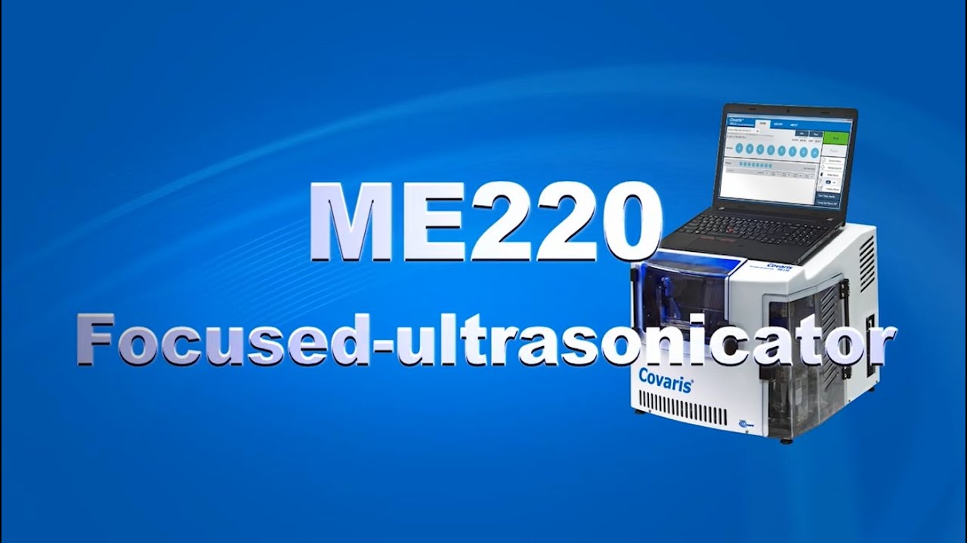
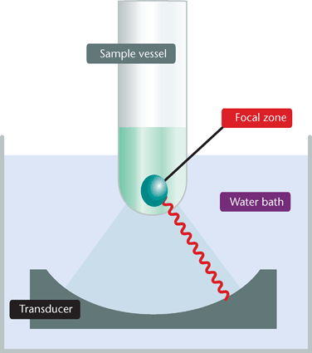
PHYSICAL METHODS: ACOUSTIC SHEARING
The Covaris® (Woburn, MA) is an instrument capable of creating DNA fragments between 100bp and 5 Kb in size
Adaptable, through the use of special tubes, to processing larger fragments for special applications (e.g., 6-20 Kb fragments for Illumina Mate-Pair libraries, with gTubes)
Fragmentation by focused acoustic energy at high frequency and low wavelength. Fragment size regulated by frequency and treatment duration. Fragmentation occurs without temperature alteration
CONS: requires specialized instruments, much more expensive than sonication and nebulization

Slide 26
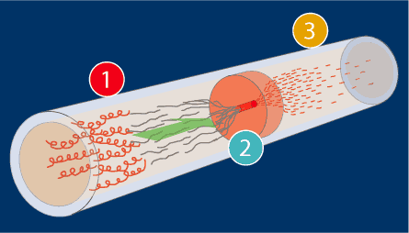
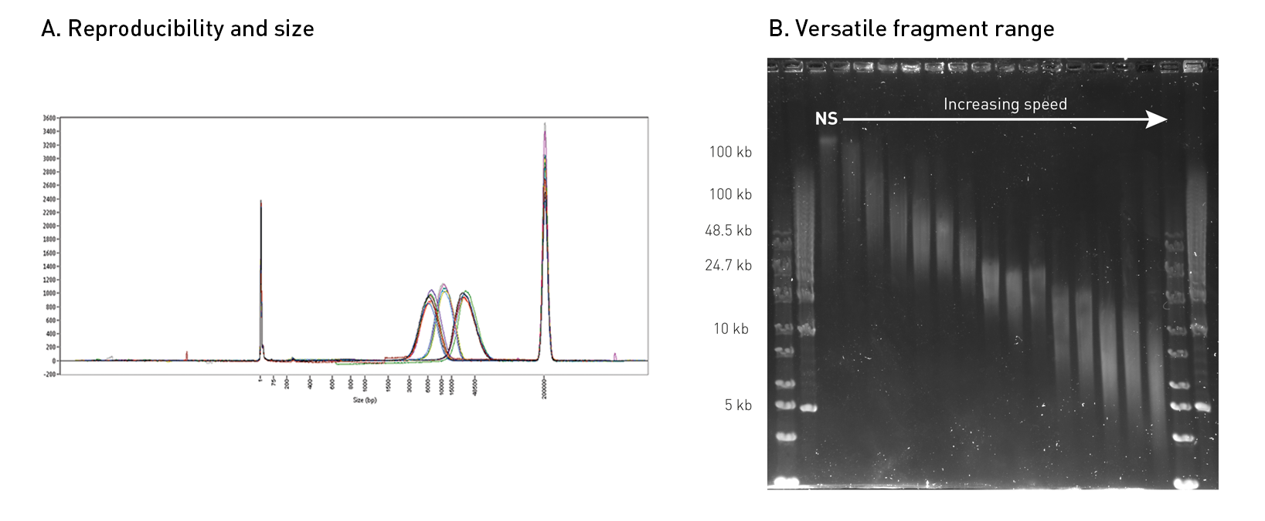
PHYSICAL METHODS: HYDRODYNAMIC SHEARING
Example: Megaruptor 3 (Diagenode, Belgium)
Usually used to obtain larger fragments (1-75 Kb), compatible with third generation platforms
DNA is forced through a passage through the narrow orifice of a syringe. The rate of passage regulates the size of the fragments obtained
Alternative: centrifugal shearing. A centrifugal force is applied to force the DNA through holes of a predefined size. The speed of rotation determines the size of the fragments obtained

Slide 27
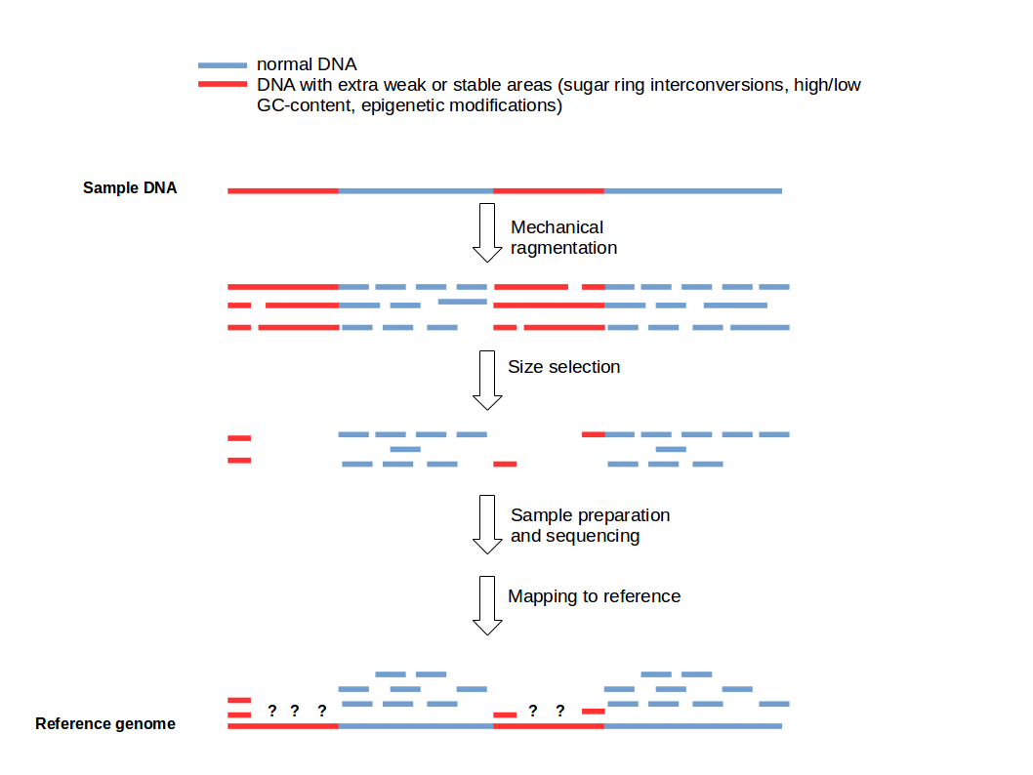
PHYSICAL METHODS: GENERAL DISADVANTAGES
Generation of fragments not random!
Bias towards very stable or extremely “weak” genomic regions
Often very large amounts of genomic DNA required (over 1 microgram per acoustic shearing)
High risk of “sample loss” due to DNA damage -> critical aspect for rare material or small organisms from which it may be difficult to recover amounts of genomic DNA in the microgram range
Difficulty in processing many samples in parallel
All physical fragmentation methods usually generate fragments with 5′ and 3′ protruding ends that need to be repaired (by enzymatic means) to generate blunt ends BEFORE the ligation of adapters

Slide 28
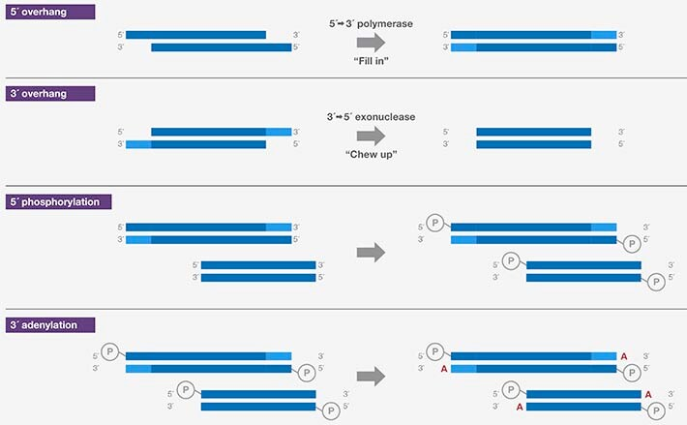
PHYSICAL METHODS: END REPAIR
5′ overhangs are filled in by 5′→3′ polymerase activity of an enzyme such as T4 DNA polymerase or Klenow fragment
3′ overhangs are removed by 3′→5′ exonuclease activity of an enzyme such as T4 DNA polymerase
5′ ends of the blunted DNA fragments are phosphorylated (for efficient subsequent ligation) by an enzyme such as T4 polynucleotide kinase
3′ ends of the blunted DNA fragments are adenylated (A tailing), which is required for T–A ligation with Illumina adapters, by an enzyme such as Klenow fragment (exo–) orTaq DNA polymerase

Slide 29
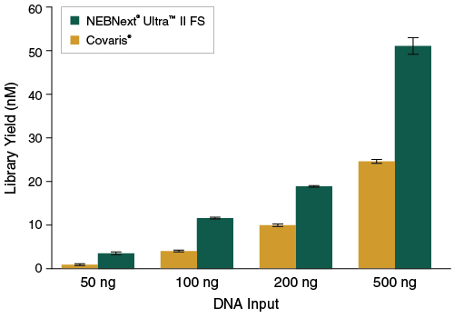
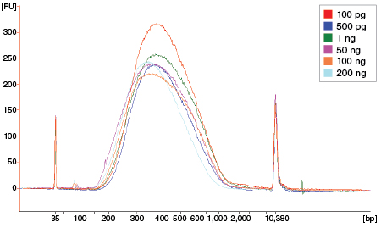
THE ALTERNATIVE – ENZYMATIC METHODS
Greater flexibility and usually lower cost (no special instrumentation required!)
Ability to process many samples in parallel
Low risk of sample loss and higher yield of reaction
Historical problem with these methods = non-random cutting by enzymes (recognition of consensus sequences, they were restriction enzymes)
Goal for development of new enzymatic fragmentation methods -> random cut -> bias reduction

Slide 30
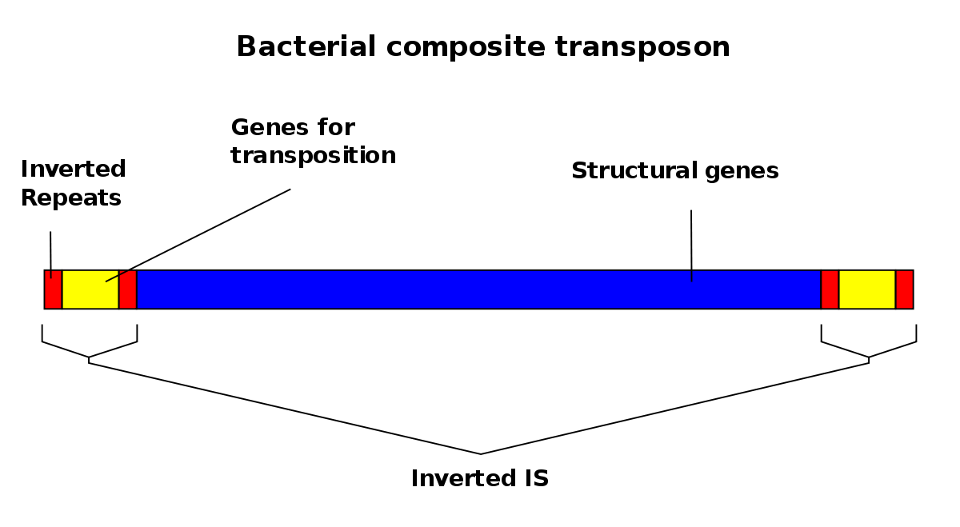
THE ALTERNATIVE – ENZYMATIC METHODS
The most advanced methods are based on the use of transposases, enzymes that allow transposons to move within genomes
Some companies, such as NEB (New England Biotechnologies or Illumina itself) have developed highly advanced fragmentation methods based on this technology. The “rapid kits” marketed by ONT also use transposases
Transposase binds the inverted repeats (in red in the graph) at both ends of the region to be transposed, creates a loop and cleaves off the fragment
In these kits, transposase is often linked to magnetic beads that facilitate the retrieval of fragments with suitable insert sizes following library preparation (bead-linked transposomes, BLTs)
N.B. tagmentation does not require end repair

Slide 31
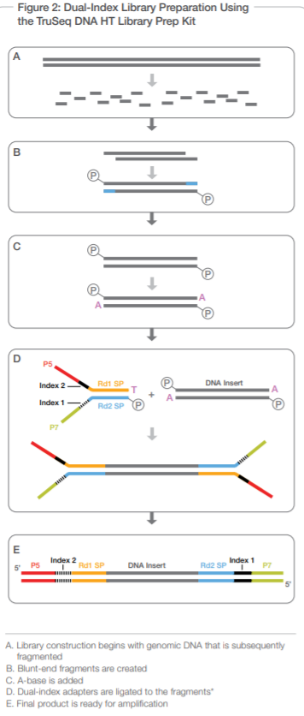
LIBRARY PREPARATION – ILLUMINA
“Classic” approach -> TruSeq libraries (compatible with Illumina SE or PE sequencing)
Input required -> 1/2 micrograms of genomic DNA
Fragmentation supported with nebulization, acoustic shearing or sonication
Inserts of 300-500 bp (> size, > DNA input)
Creation of blunt-end fragments by end-repair
Addition of an A ("A tailing”) for ligation with adaptors containing a ”T overhang”
Denaturation and amplification follow to obtain barcoded libraries (the added adapters contain the indexes) ready for sequencing

Slide 32
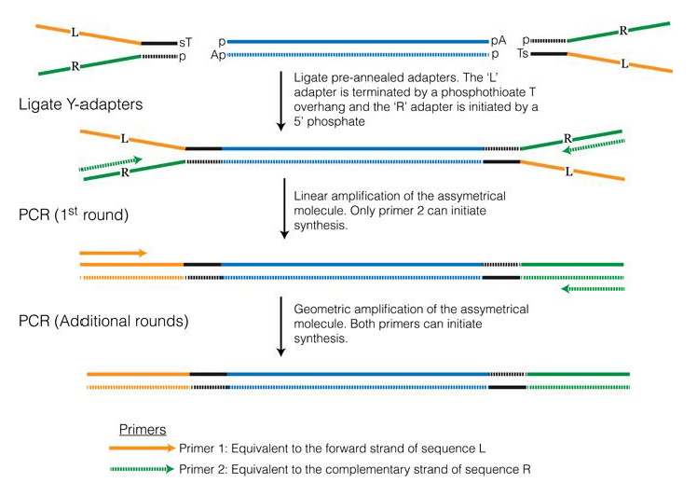
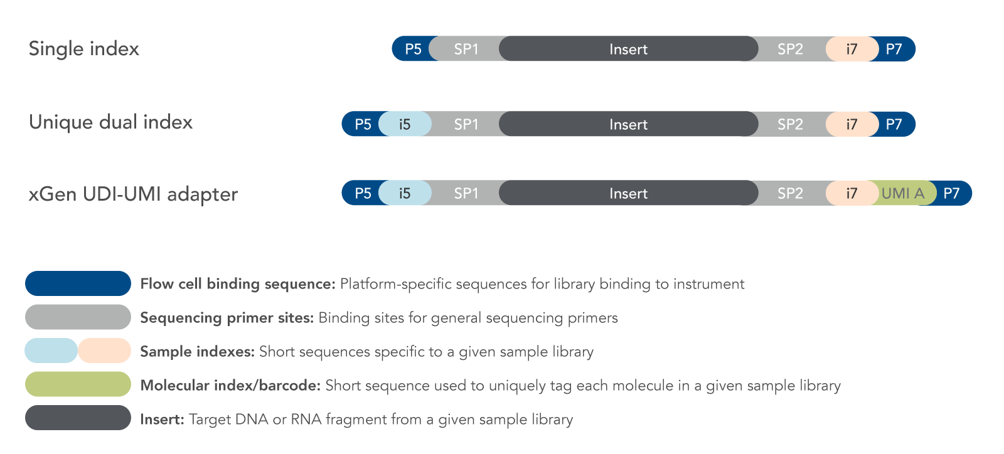
LIBRARY PREPARATION – ILLUMINA LIBRARIES
Illumina Y adapters
They include:
-external sequences for hybridization with the flowcell and cluster generation via bridge amplification
-primers for SBS
-barcode (index)
N.B. i «dual indexes» are used to improve demultiplexing, limiting the issue of «index hopping»
UMI «Unique molecular identifiers» can be added to identify PCR-duplicated fragments, thereby reducing error rates

Slide 33
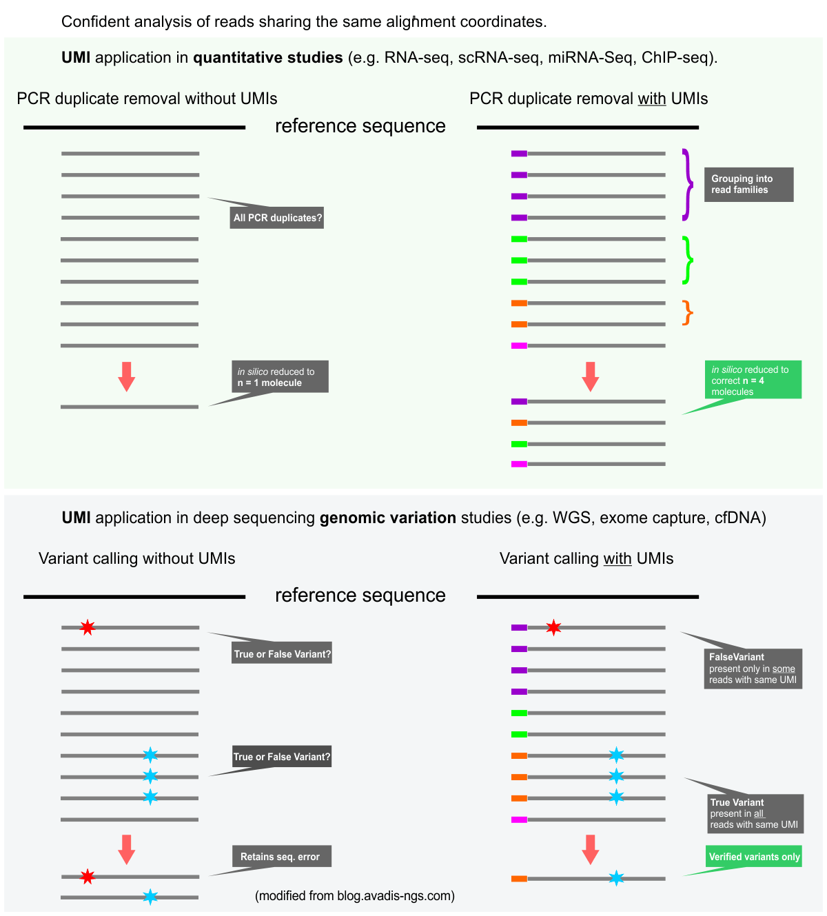
A FEW WORDS ABOUT UMI
They are random oligonucleotide sequences that are inserted BEFORE any step involving PCR amplification and uniquely identify each fragment in the library (i.e. should be unique identifiers for each cluster)
The difference with barcodes (which can be single or dual index) is that the latter identify ALL fragments belonging to the same sample and are used for demultiplexing libraries sequenced in the same run
UMIs are very useful in experiments where the QUANTITATIVE aspect is very important, because they allow highlighting any duplicates caused by PCR, i.e., technical artifacts that should be excluded
They are therefore used a lot in single-cell RNA-seq, ChIP-seq, and other approaches that we will see, but they are not essential for genomic sequencing approaches, for example
Also essential for identifying ultra-rare variants, discriminating them from sequencing errors

Slide 34
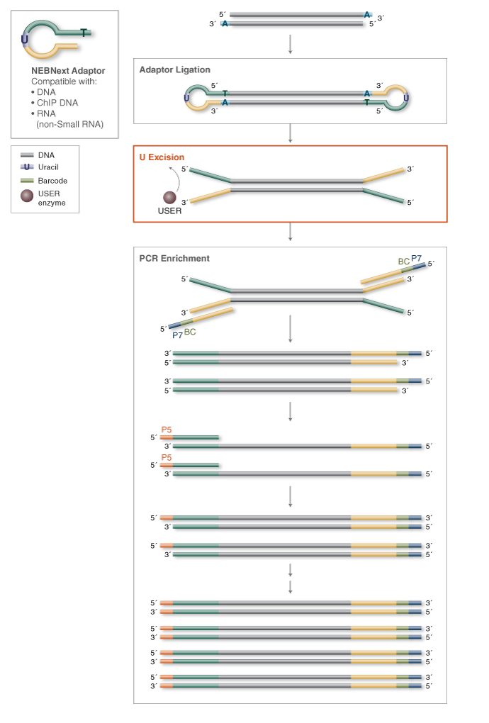
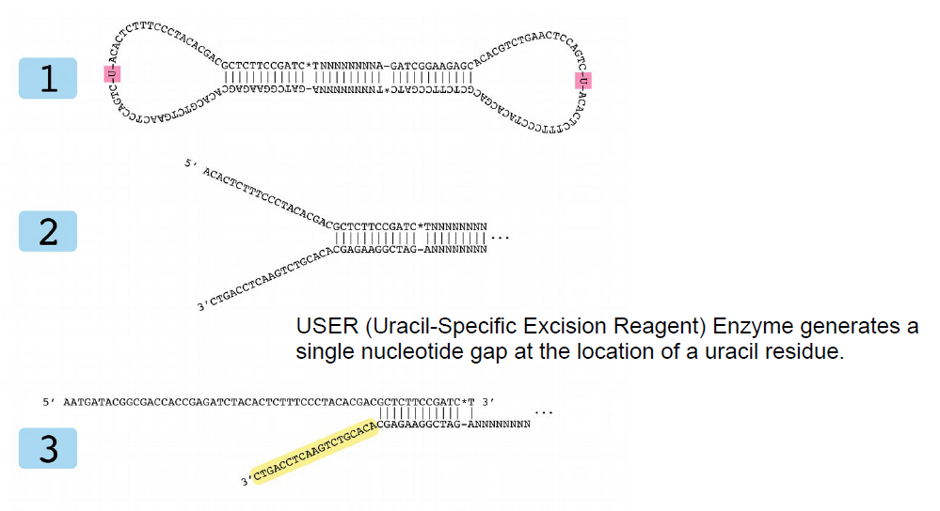
LIBRARY PREPARATION – ILLUMINA LIBRARIES
Some companies have thought of developing techniques for introducing different types of adapters to minimize some technical problems (e.g., dimer formation of adapters)
Example: NEBnext adapters (New England Biotechnologies)

Slide 35
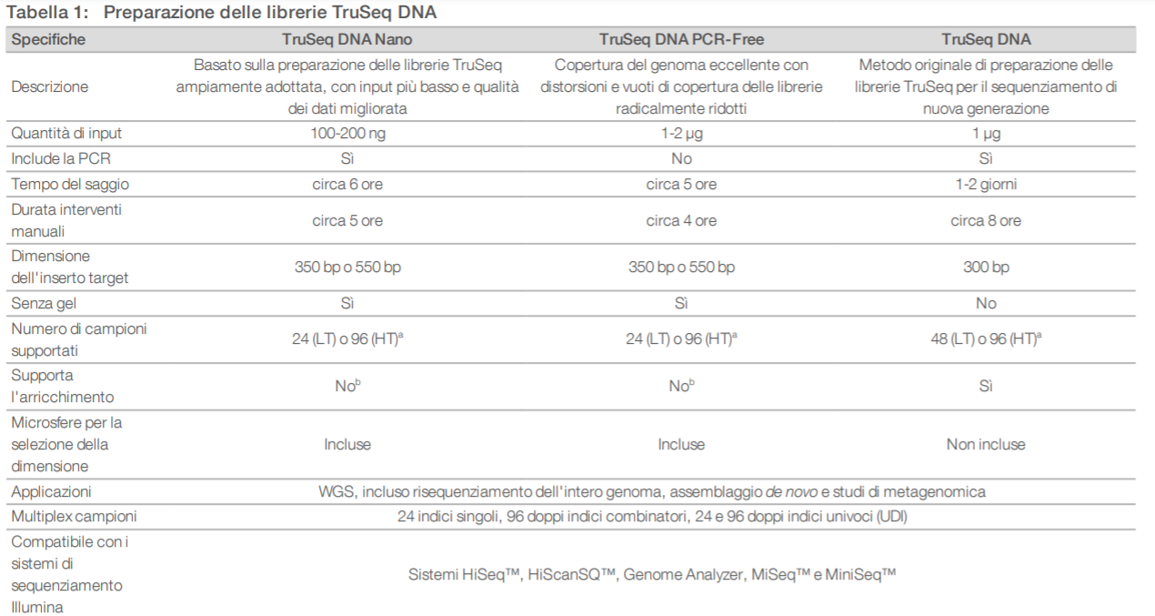
ILLUMINA LIBRARIES – LOW INPUT DNA AND «PCR-FREE» APPROACHES

Slide 36
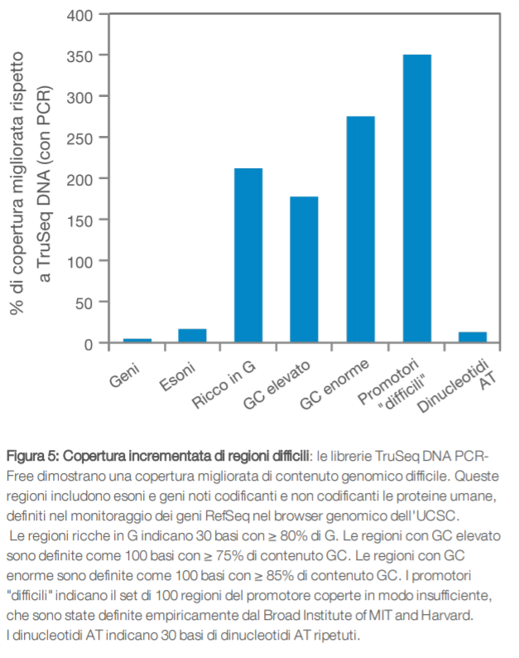
ILLUMINA LIBRARIES – LOW INPUT DNA AND «PCR-FREE» APPROACHES
All library preparation kits include a step for selection of desired fragment sizes. Originally this was done by selection on agarose gels, but in the latest generation of kits (especially low-input kits) this has been replaced by the use of special microspheres
“PCR-free” protocols aim to eliminate amplification step-related bias as much as possible, providing more uniform coverage of all genomic regions, regardless of complexity and GC content -> however, they require large amounts of gDNA!
The TruSeq DNA nano kit allows preparation of a genomic sequencing library from 100 nanograms of DNA (but is not PCR-free). For comparison, the TruSeq PCR-free kit requires 10 times as much.

Slide 37
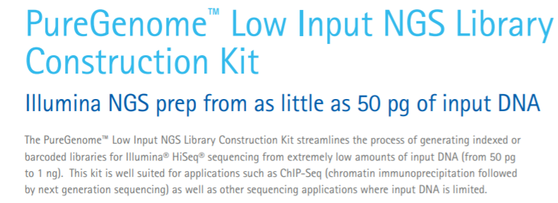
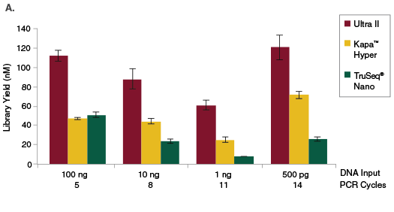
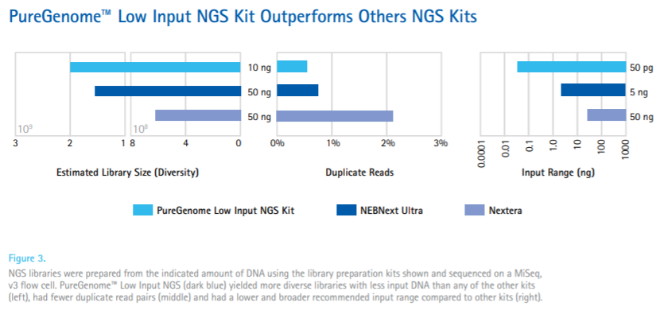
ILLUMINA LIBRARIES – LOW INPUT DNA AND «PCR-FREE» APPROACHES
NEBNext® Ultra™ II DNA Library Prep Kit
Useful for unicellular organisms, very small animals, plants or fungi, or approaches dealing with difficult samples (ancient damaged DNA)

Slide 38
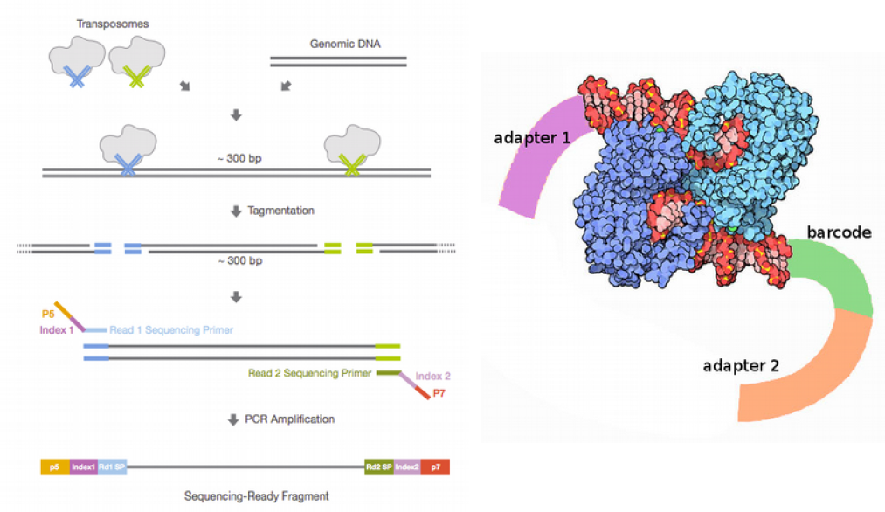
HOW ARE ADAPTERS ADDED BY TRANSPOSOMES? AN EXAMPLE: NEXTERA TAGMENTATION
Very rapid method
Latest applications make use of BLT (Bead-Linked Transposomes)
Very similar methods are also used to prepare libraries compatible with other sequencing methodologies (e.g. Oxford Nanopore)
Transposon activity is used to fragment and add adapters in a single step
https://emea.illumina.com/techniques/sequencing/ngs-library-prep/tagmentation.html
https://emea.illumina.com/products/by-brand/nextera/infographic.html

Slide 39
WHAT ABOUT ION TORRENT LIBRARIES?
Although prepared much more often from amplicons (targeted resequencing approaches, metabarcoding, etc.) they use strategies similar to those already described for Illumina
As in Illumina kits, there is the possibility of adding barcodes and there are also options that take advantage of transposome activity
Keep in mind that in this case the binding between fragments and barcodes is not given by the complementarity of the adapters with fragments immobilized on the surface of the barcodes, but by the binding between biotin (present conjugated to one of the 2 adapters) with the streptavidin that coats the barcodes themselves
The adaptors therefore serve only for clonal amplification and eventual multiplexing, not for hybridization with probes present on the marbles, as this task is performed by the biotin/streptavidin interaction

Slide 40
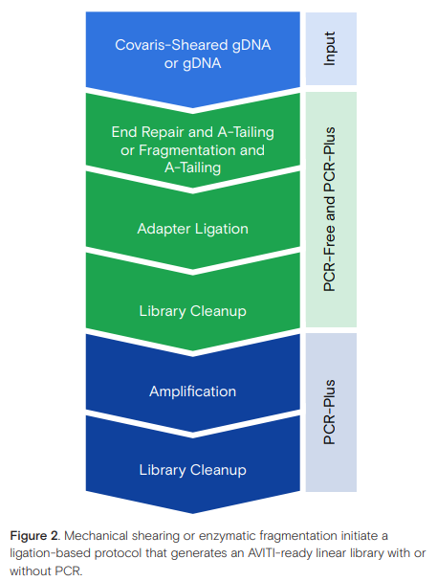
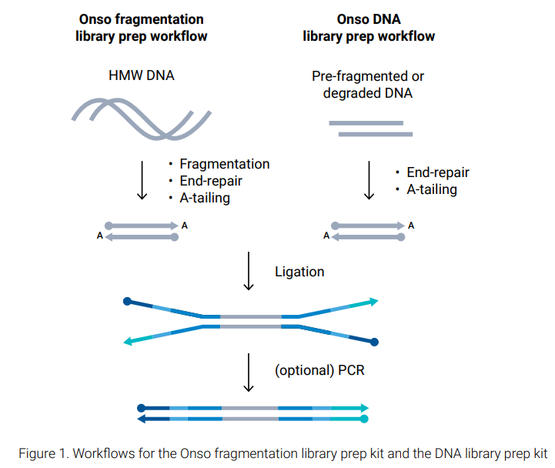
LIBRIARIES FOR OTHER SECOND GENERATION APPROACHES
The strategy is very similar, although the sequences used for generating polonies, for sequencing or as indexes change (also due to copyright issues)
The libraries for PacBio Onso for example resemble the Illumina ones in every way (in fact they are still Y adapters)
For commercial issues, new sequencers (such as AVITI) can use libraries prepared with a special kit, or convert third party libraries (from other companies, e.g. Illumina), making them compatible with new sequencing platforms
N.B. let us remember that, as similar as they may seem to each other, some sequencing techniques generate polonies on solid phase and others do not, requiring in some cases circularization of the molecules

Slide 41
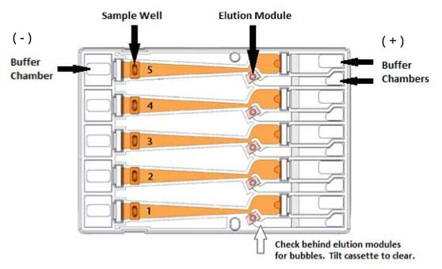
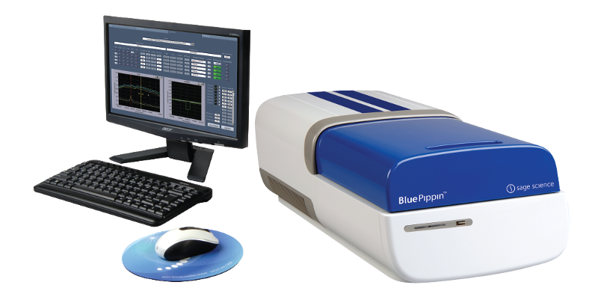
LONG READ APPLICATIONS - FRAGMENT SELECTION
Traditionally, the selection of fragments of desired length was done following gel run
As mentioned prior, some Illumina library preparation kits use beads that facilitate the selection of fragments within a given size range
Dedicated tools, such as Blue Pippin (Sage Science), can be used for long-reads
See the video on Moodle or here: https://www.youtube.com/watch?v=7MocmyYG-FM

Slide 42
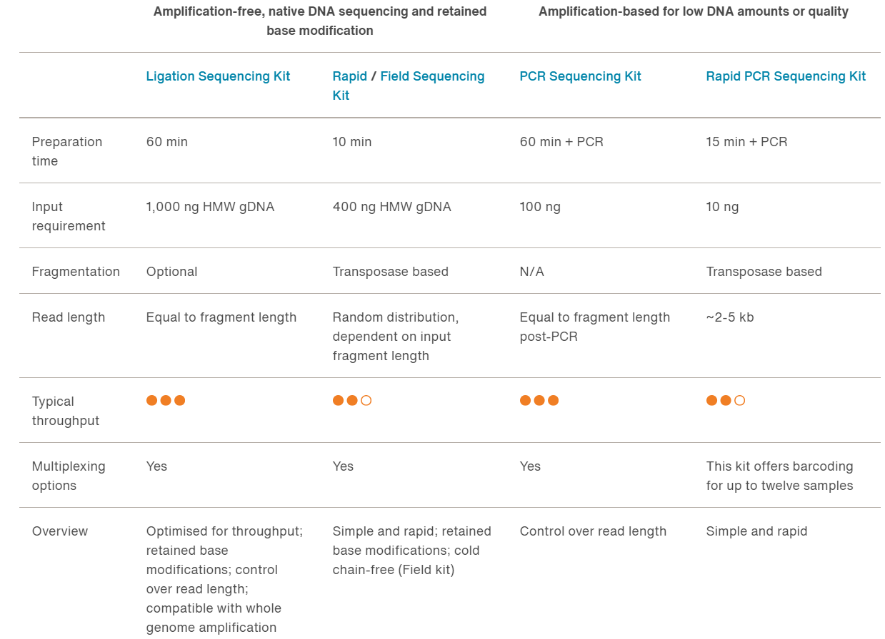
ONT LIBRARIES - OPTIONS
Several options selectable depending on the amount (and quality) of genomic DNA available
PCR-free approaches (preferable where possible) vs. aplification-based approaches (requiring working on smaller fragments!)
“Quick and dirty” transposase-based methods (field amplifications, less labor-intensive), with lower thoughput
Ligation-based methods more laborious, but provide better throughput
N.B. the introduced adapters are bound to a motor protein that allows translocation of DNA through the nanopore

Slide 43
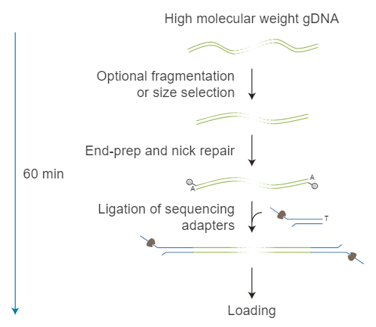
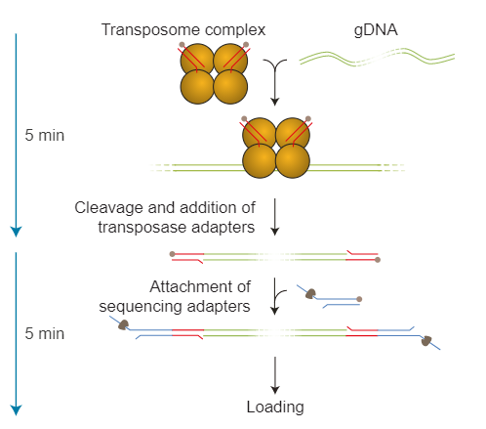
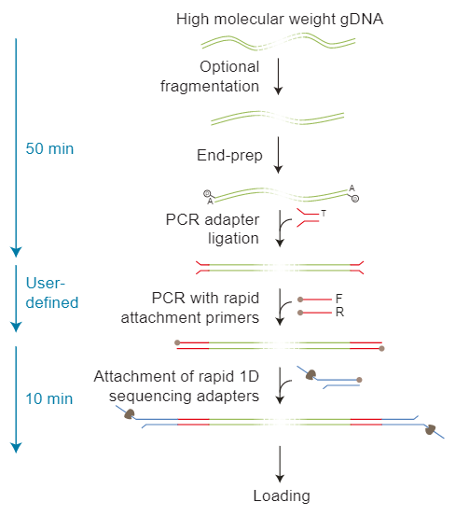
LIBRERIE ONT - OPTIONS
«standard» Ligation Kit Rapid kit Amplification-based kit
“Field kits” function similarly to rapid kits, but include numerous freeze-dried reagents that can be transported at room temperature

Slide 44
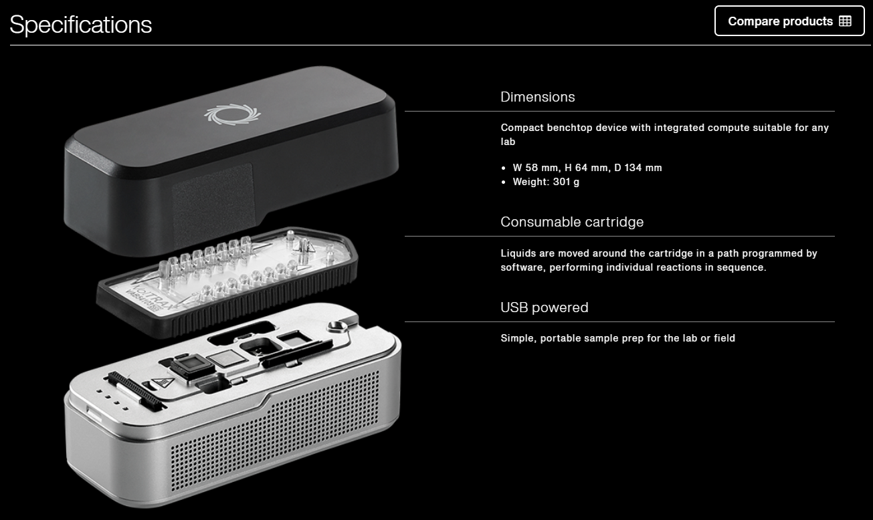
VolTRAX
Reduction in manual skills on the part of the operator
Increased reproducibility
Use in the field as well (powered by USB)
User-definable protocols
See video on moodle

Slide 45
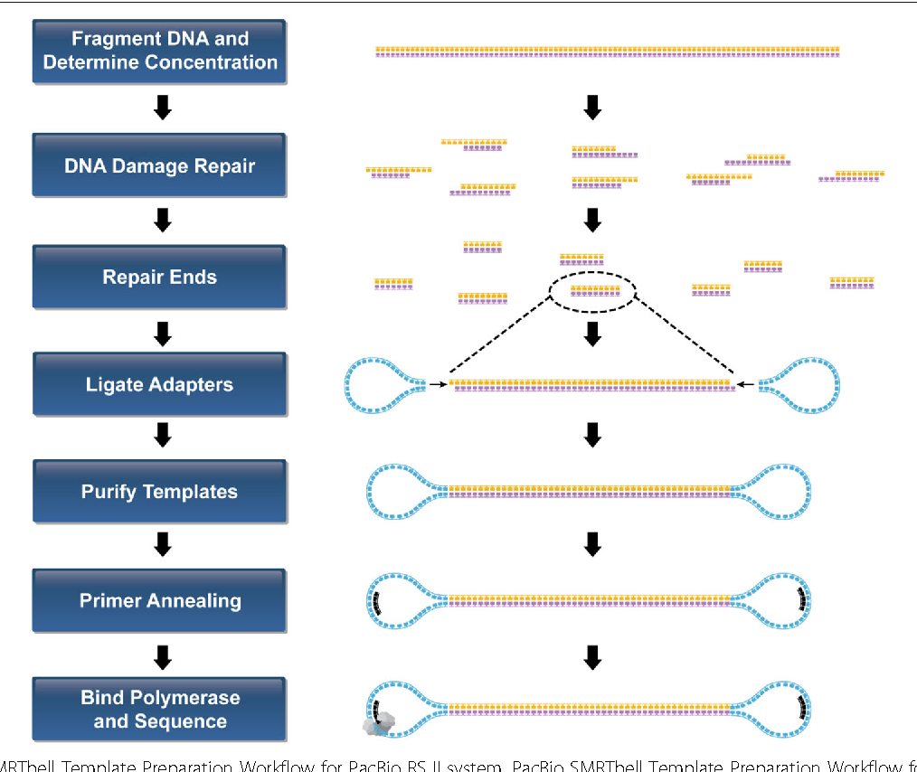
PACBIO LIBRARIES
Approximately 3 micrograms of genomic DNA or more are required for the construction of a standard SMARTbell library to be sequenced with HiFi mode
However, PCR-free protocols are available that can go down to 400-500 ng, with the limitation that they can be applied to relatively small genomes (<1 Gb)
Approaches with ultra low input (up to 5 ng) require amplification
Similar approach to NEBnext libraries, but without USER activity (remember that SMRT sequencing requires circularization)

Slide 46
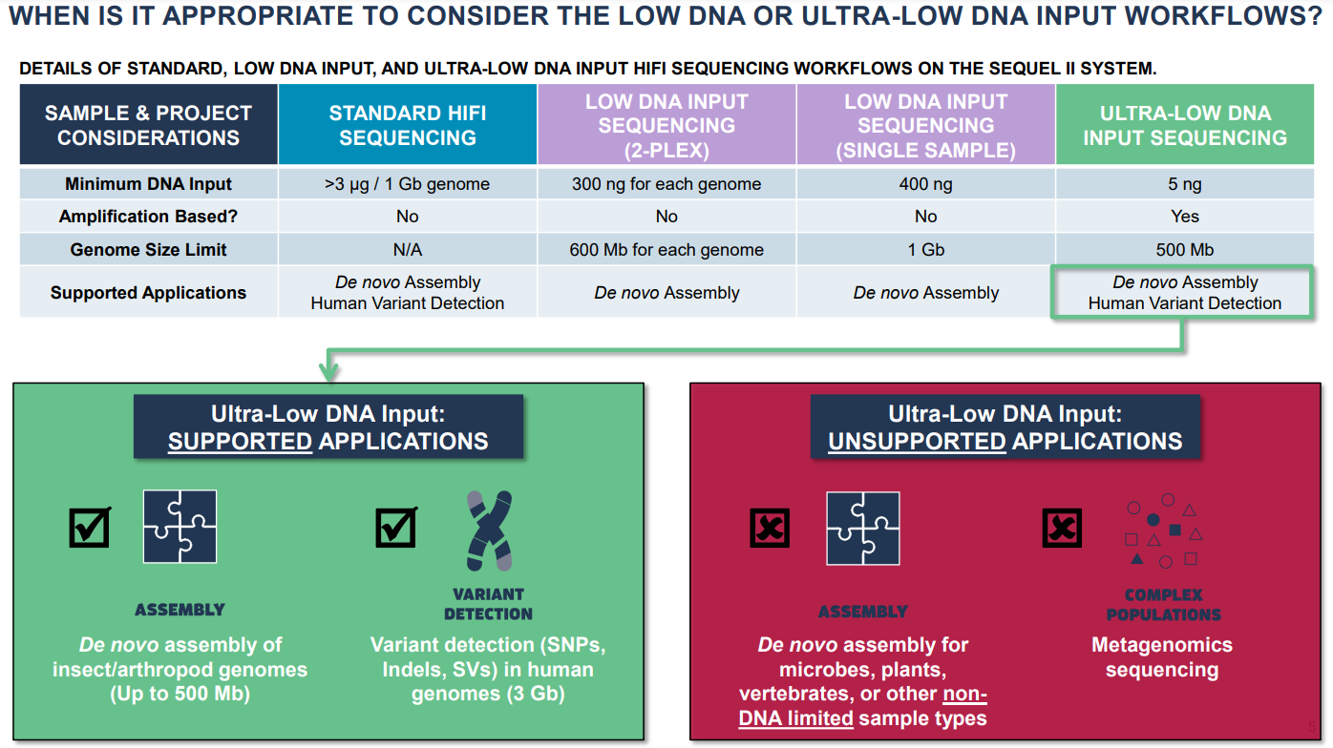
PACBIO LIBRARIES: LOW and ULTRALOW DNA INPUT - APPLICATIONS AND LIMITATIONS

Slide 47

YOU CAN'T SEQUENCE EVERYTHING: THE QUALITY OF THE STARTING GENOMIC DNA IS CRITICAL

Slide 48



VERIFICATION OF THE SUCCESSFUL CONSTRUCTION OF A LIBRARY
Agilent Bioanalyzer and TapeStation systems (microfluidic-based automated elecrophoresis
Electropherogram analysis (simpler and more practical than an agarose gel)
Allows better visualization of insert size ranges, with higher resolution of molecular weights

Slide 49


BIOANALYZER PROFILES – A FEW EXAMPLES
When dealing with a library, whether obtained by PCR or by fragmentation, I expect (in almost all cases, but there are exceptions!) a distribution of lengths around a single peak. The presence of two or more peaks is often an indication of poor quality
The creation of secondary peaks is common when preparation kits include amplification steps that, if set incorrectly, can lead to the amplification of unwanted secondary products

Slide 50


BIOANALYZER PROFILES – A FEW EXAMPLES
A. Good library. Main peak around 300nt, tail of larger fragments, nearly unnoticeable primer dimer (blue arrow)
C. Very bad library. Very high abundance of primer dimers compared with library fragments (was initial DNA input too low?) and bad fragmentations, as in B
B. Bad library. Fragment size much higher than expected (unsuccessful fragmentation?), primer dimers quite abundant
N.B. it is alway useful to inspect negative controls (no template controls) to verify the presence of unwanted amplification products

