Slide 1
LECTURE 5
Whole genome sequencing: assembly strategies and quality evaluation

Slide 2
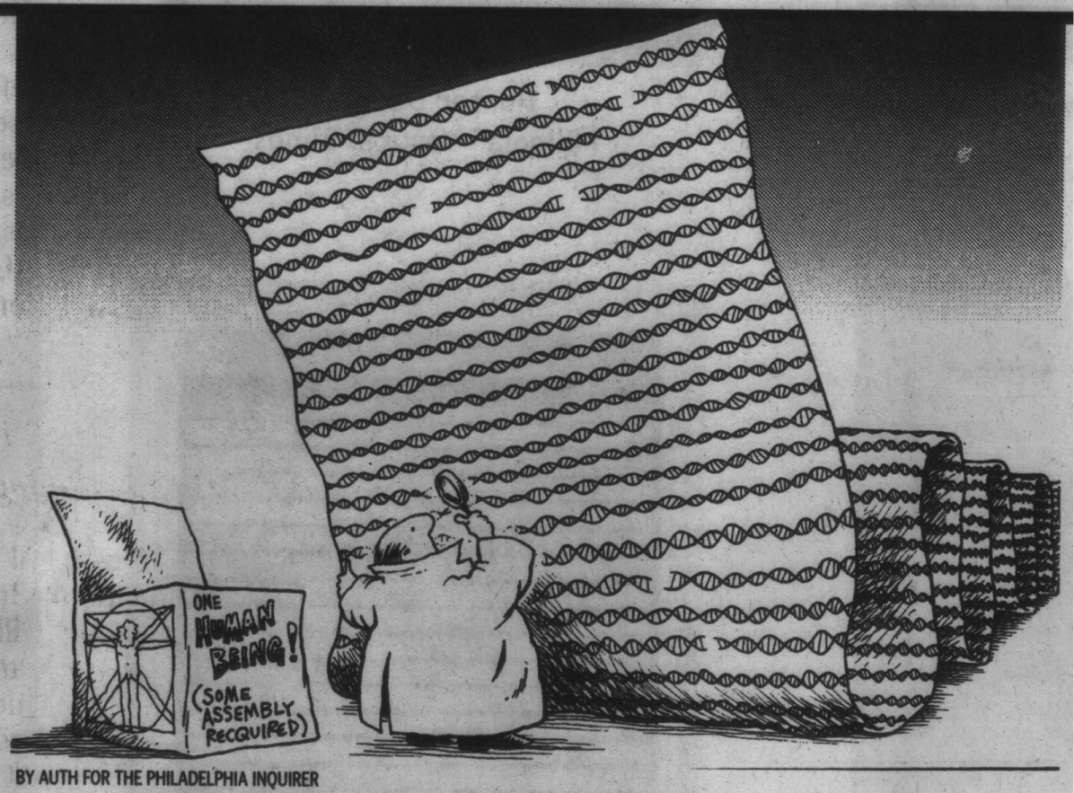
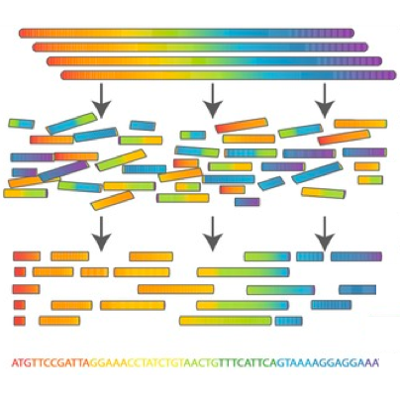
A few notes about sequence assembly
We will use many tools that use “reference sequences,” usually consisting of genomes or transcriptomes that have already been previously assembled
But how do you get a reference sequence from the raw data you get from a sequencer?
Reconstructing very long sequences (eukaryotic chromosomes can exceed 100 Mb) is not an easy task

Slide 3
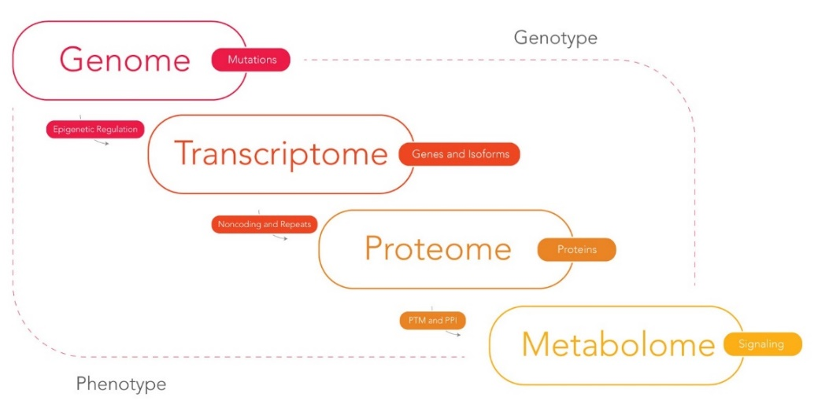
Genome or transcriptome: how do we choose?
The genome is much larger -> requires more sequencing effort -> more cost, more time, more effort (e.g., in humans only 1% of the genome is transcribed)
The transcriptome is a reduction of the genome, but it represents only the transcribed portion, so it is by its nature limited to regions translated into proteins + UTRs
Cannot study regulatory elements
Very narrow applications (basically studies of gene expression and alternative splicing)
Higher complexity than one might imagine: transcripts are expressed at very different levels, whereas a genome will have uniform sequencing coverage

Slide 4
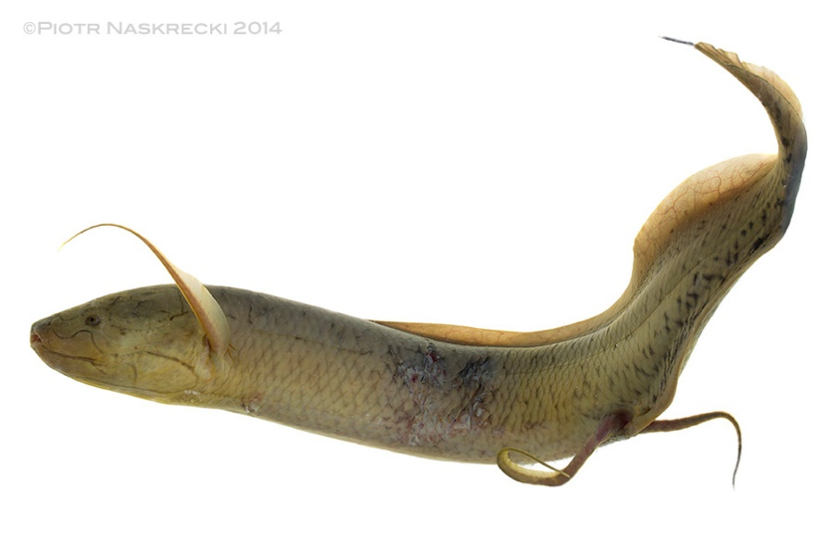
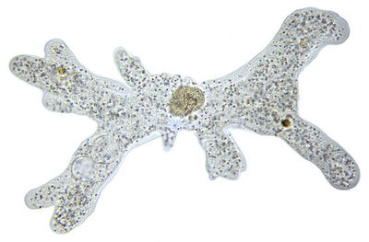
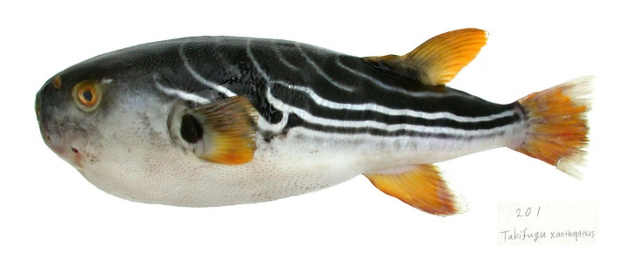
Genome or transcriptome: how do we choose?
It depends on the application
It depends on the target organism
If you have a choice, it is always advisable to work on a reference genome, even for gene expression studies (youn can better handle paralogies, allelic variants, etc.
In some cases we are forced to work on a transcriptome (lack of funds, size, etc.)
As costs come down, it gradually becomes easier to work even on non-model organisms and more complicated targets
130 Gb genome!!!!
670 Gb genome!!!!
0,3 Gb genome!!!!

Slide 5
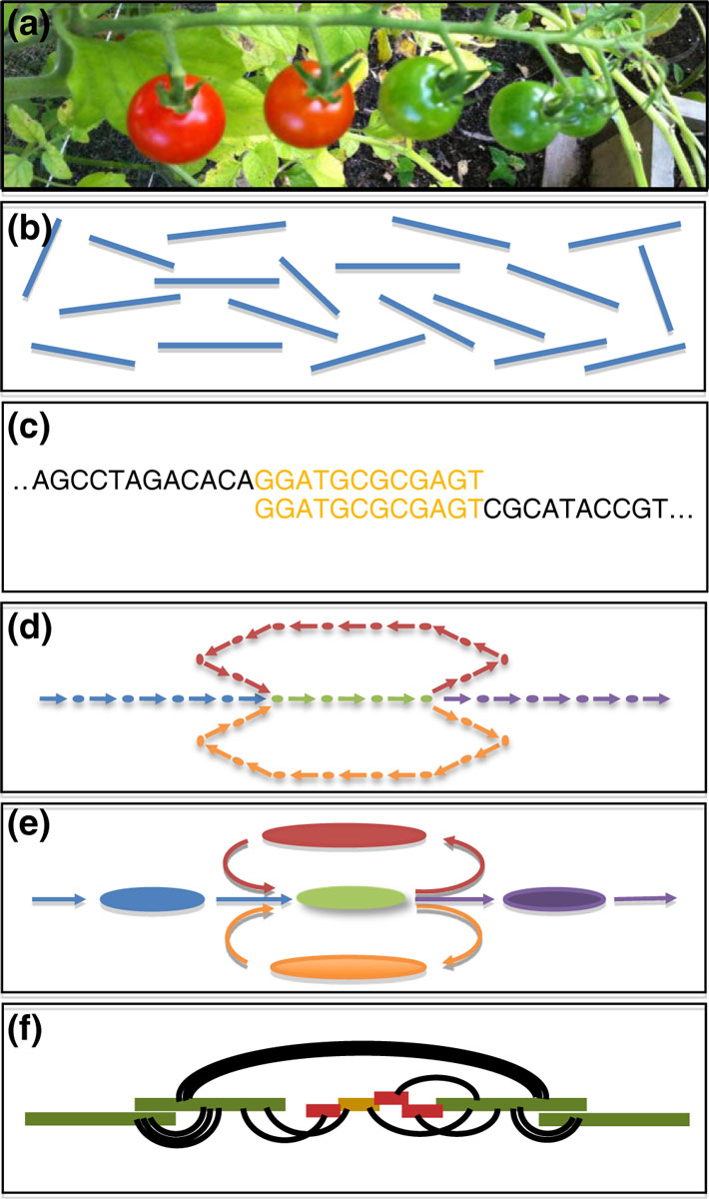
A simple scheme for a de novo assembly (with second-generation reads)
(a)Sequencing of DNA (or RNA) from the biological sample of interest.
(b)The output of sequencing are millions (sometimes billions!) of short, disordered reads generated from random locations in the genome (or transcriptome)
(c)The reads are compared with each other to discover regions of overlap
(d)These overlaps are assembled into a large “graph” in which nodes represent k-mers connected to each other according to mutual overlaps
(e)The graph is refined to correct errors and simplify the relationships between k-mers in long regions of contiguity (the contigs)
(f)The k-mer information and other accessory information (e.g., paired end reads) are used to orient and reunite contigs into longer scaffolds, resolving any conflicts
Schatz et al. Genome Biology 2012 13:243

Slide 6
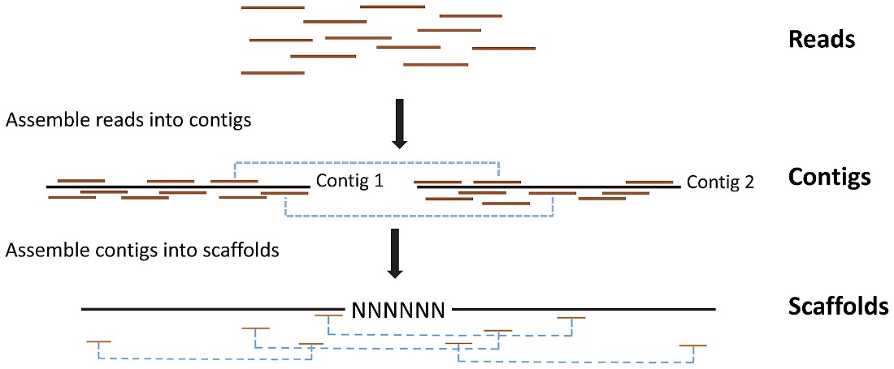
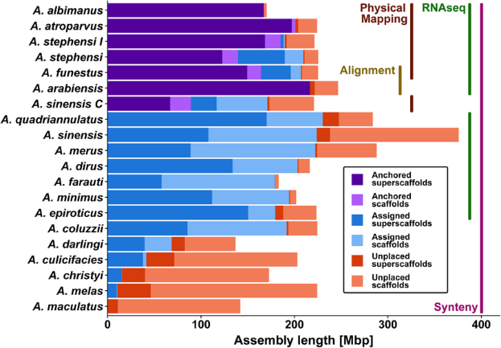
A few key definitions
Contigs: are genome chunks whose nucleotide sequence, reconstructed from reads, is known and supported with a good level of confidence
Scaffolds: are longer portions of genome sequence, which include contigs whose position and orientation to each other are known, but which can be separated from gaps of estimable size
Placed scaffolds: are the scaffolds assigned to a specific position in a chromosome
Unlocalized scaffolds: are the scaffolds attributable to a chromosome, but whose location or orientation are unknown
Unplaced scaffolds: are the scaffolds not attributed to any chromosome
The set of placed scaffolds constitutes a chromosome (N.B. often the attribution of the chromosome, with sequence-karyotype correspondence, is difficult, and is therefore referred to as linkage groups)

Slide 7

Let’s plan how to sequence a genome
How large is the genome of interest?
How many repeated elements does it have and how are they distributed?
Is a genome of a species close to the one of interest already available to get an idea of its characteristics?
What kind of sequencing should I use and what kind of libraries?
What quality of assembly do I want to achieve?
Illumina? PacBio/ONT? Illumina + long reads, and in what proportion? How many reads do I need to get a genome with desired coverage? In case of paired-end libraries, what size should I provide for the inserts? Can/should I combine additional libraries to improve scaffolding?

Slide 8
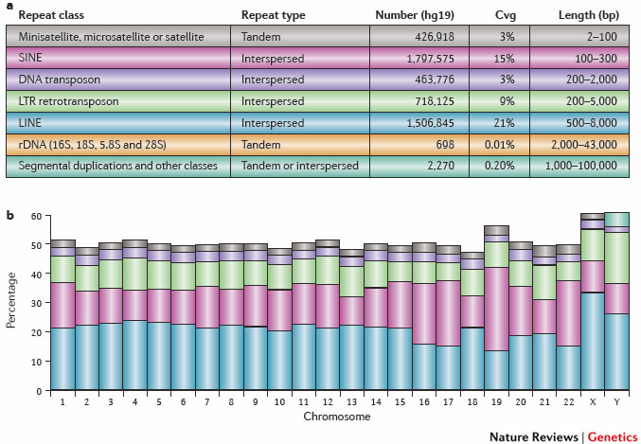
Repeats: a huge problem for genome assembly
Many genomes are rich in repeated elements.
50% of the human genome!
Most common source of assembly errors.
If I use reads with size n > the size of the repetitive region I overcome the problem
Old-style” solution (now abandoned): Illumina mate-pair libraries with longer library fragments (resulting in greater distance between the two reads of a pair, more details in later slides)
Current approach (due to reduced cost and error rate): PacBio, Nanopore, combined with the use of Hi-C libraries (sequenced in paired-end mode, as we will see later)
Sanger was definitely better than Illumina in this respect! Longer reads, but more expensive and with lower throughput

Slide 9
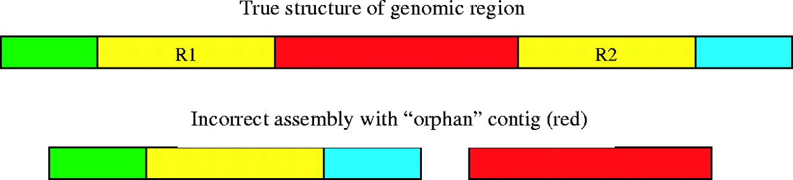
What might happen when the assembly algorithm enounters a repeat?
Salzberg S L , and Yorke J A Bioinformatics 2005;21:4320-4321
Assemblies might «collapse» in regions nearby a repeated element

Slide 10
How can reads be assembled?
Depends on the type of reads.
For long reads (> 500 nt) overlap/layout/consensus (OLC) algorithms work best , originally developed for Sanger reads
For short reads best to use algorithms based on De Brujin graphs.
OLC methods have been used for years with Sanger reads, and today are used for PacBio and ONT reads
For assemblies of second-generation reads, methods based on De Brujin graphs are used.
There are several algorithms for the two strategies in each case, the choice of which depends on many factors: CPU and RAM memory required, execution time, accuracy of assembly with the type of reads available

Slide 11
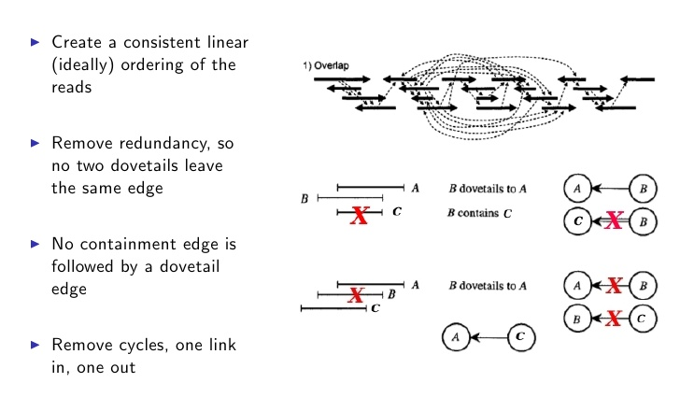
Overlap Layout Consensus methods
Calculate overlays, i.e., where there are k-mers shared by two or more reads
Assemble layout graphs and simplify them by removing redundant reads
Generate a consensus sequence based on the alignment between the remaining reads
The aim is to identify a linear Hamiltonian path ->assembly of a linear genome

Slide 12
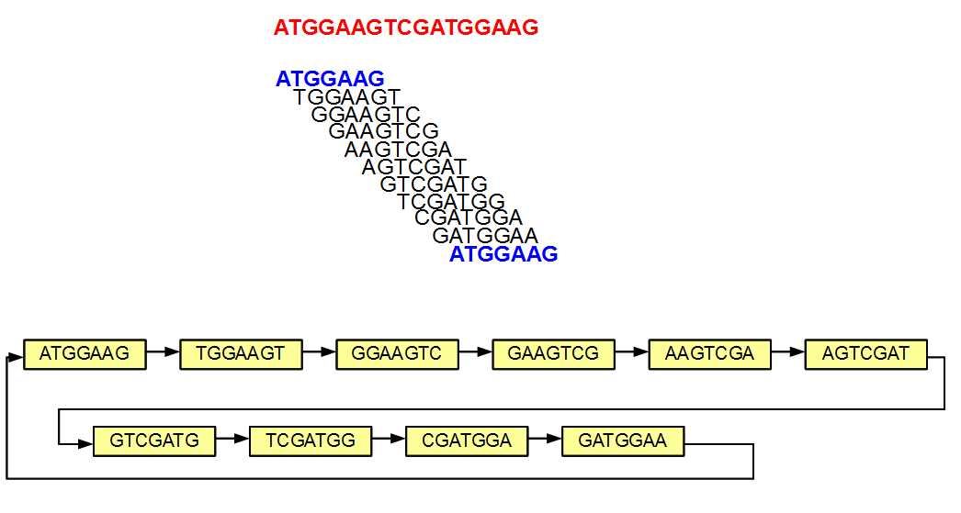
What is a k-mer?
The k-mers are all possible substrings of length k that are contained in a string of length n
In the example at the side, the sequence in red is associated with all possible k-mers that make it up of length k=7
It should become apparent how the overlap between k-mers can be exploited for an assembly

Slide 13
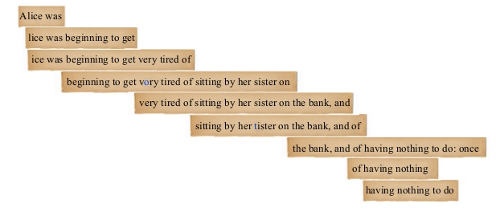
OLC assembly – an example with text
Computationally too complex for short reads!
Tends to create fragmentation -> many contigs
Complexity increases exponentially with genome size
It is way too slow!
It is, however, an approach that is far from “dead!” Assemblers that use long reads make use of methods inspired precisely by OLC assemblies

Slide 14
De Brujin graph

Slide 15
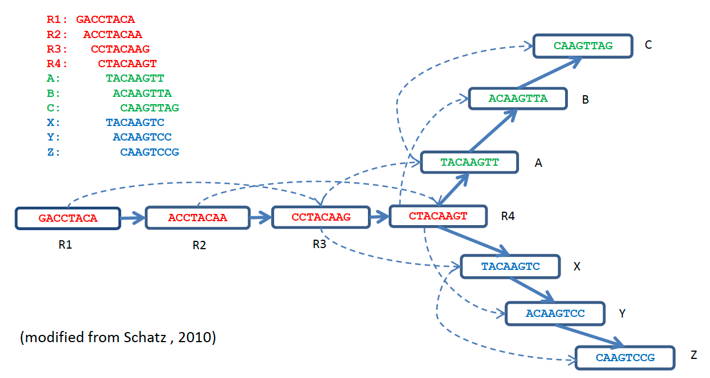
Alternative paths... K-mer 4 in common and then I have two alternatives -> opening a “bubble”

Slide 16
Why are paired-end reads so important?
Without pairing the assembly generates many contigs with unknown mutual orientation
Contig
Consensus (15- 30Kbp)
This is made possible by the fact that the distance between paired reads is known (we select it in the library preparation step by fragmenting the DNA and choosing the desired size fragments!)
The greater the distance between paired-end reads the more efficient the process will be
However, we need a congruent number of reads that confirm the pairing information (one observation is not enough)
Reads
?
Paired reads allow for “bridging,” bringing contigs together into longer units of contiguity (scaffolds)
2-pair
Mean & Std.Dev.
is known
Scaffold

Slide 17
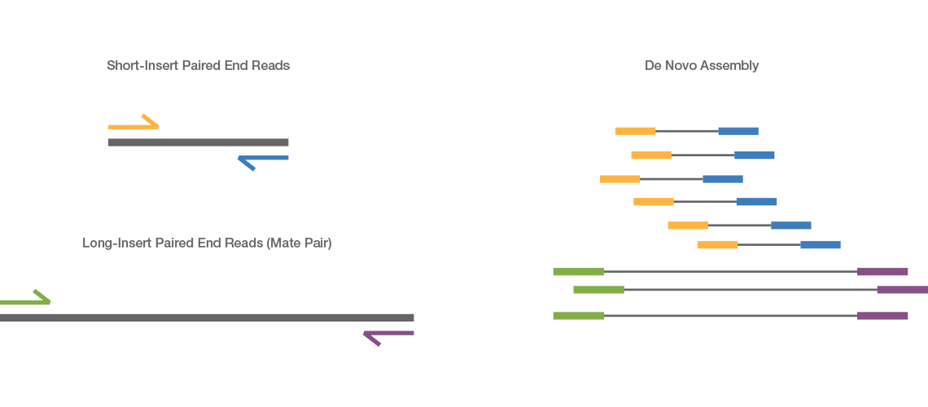
Illumina mate-pair libraries
Used very frequently BEFORE the advent of high quality third generation reads.
Now they are no longer used. The more widespread use of long reads on the one hand, and Hi-C and Omni-C libraries (which we will discuss later) on the other has made them redundant
Much larger insert size -> larger distance between paired reads -> creation of longer bridges -> more efficient scaffolding
Use of Nextera tagging technology
Use for genome finishing, NOT for assembly step. Used exclusively for scaffolding step
Distance between mate-pair reads: up to 12 Kb
Distance between paired-end reads in whole genome sequencing approaches : 300-500 bp

Slide 18
Several gaps are usually present in genome and transcriptome assemblies
Physical gaps
Sequencing gaps
sequencing gap - we know the order and orientation of contigs by paired reads that act as a “bridge.” The gap is “filled” by strings of N (NNNNNNNN...). We can find them internally to the scaffolds (between one contig and another)
physical gap - We have no information regarding the relationship to adjacent contigs. They could potentially correspond to the ends of chromosome sequences (if we assemble a genome) or messenger RNAs (if we assemble a transcriptome)

Slide 19
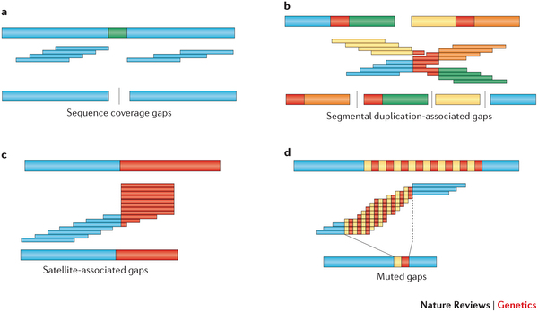
Other sources of issues
It is related to low coverage, either because the total coverage obtained from the library is not sufficient or because we have compositional biases that have affected fragmentation -> determines the presence of a gap
Segmental duplications (regions in red) -> major problems...This breaks contigs and risk creating chimeras
With satellite DNA sequences the assembly algorithm gets into a “loop” from which it cannot get out and consequently truncates the sequence
Repeats that are identical or which may be mistakenly “collapsed” -> the sequences before and after the repeats are correct, but the overall length in the assembled sequence is incorrect (shorter)
Sometimes it can be difficult to notice the complications to which these problems lead, especially if they result not in fragmentation but in the generation of apparently good contigs...

Slide 20
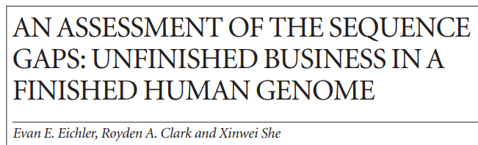
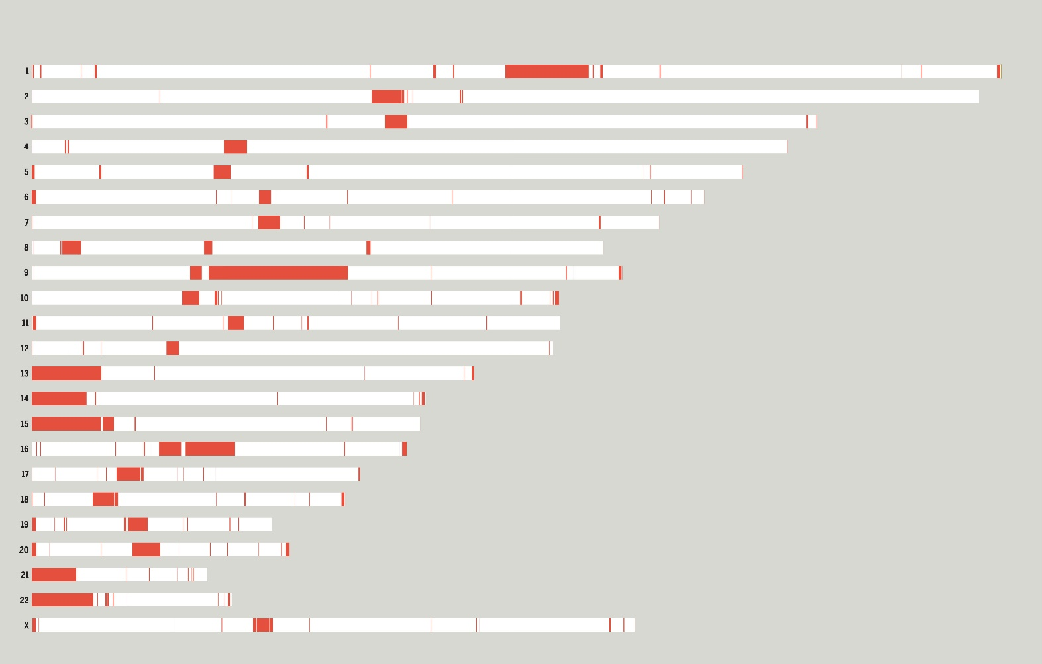
Gaps in the human genome
We have previously talked about the T2 project,” which led to filling the many remaining gaps in the reference genome assembly
Specifically, prior to the efforts of the T2T consortium, the human reference genome still contained:
-368 “unresolved issues”
-regions of difficult-to-resolve ambiguities
-102 gaps
These concerned: rRNA gene clusters, segmental duplications, satellite DNA arrays, centromeric sequences, etc.
Remember that each white bar is a chromosome, each red region is an unresolved part of the reference assembly!

Slide 21
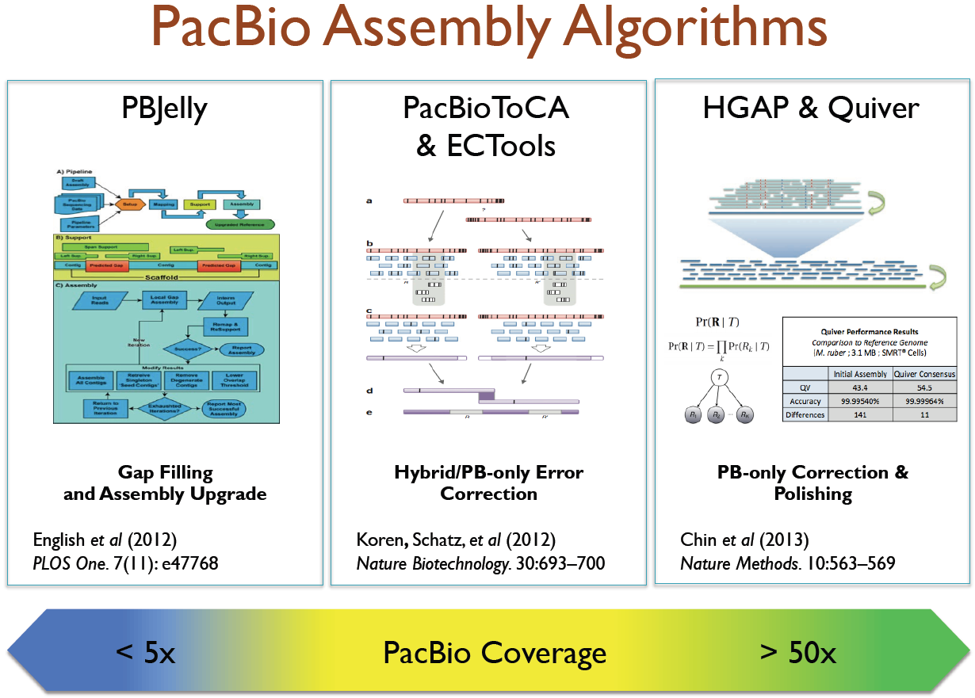
De novo assembly strategies: simultaneous handling of long and short reads
The past few years have often seen the combined use of Illumina sequencing approaches and PacBio and Oxford Nanopore long reads.
This was a very attractive strategy particularly for sequencing highly complex and large genomes
Different assembly strategies, dependent mainly on the coverage of long reads available
N.B. Due to the improved quality of the latest generation of HiFi and ONT reads (and cost reduction), many assembly strategies today do NOT use Illumina reads for assembly, only for scaffolding!

Slide 22
SEQUENCING AND ASSEMBLY STRATEGIES NEED TO BE PLANNED BEFOREHAND
Option 1 - assemblies made exclusively with short reads with high coverage
Possible only for relatively small and low-complex genomes, otherwise risk of obtaining highly fragmented assemblies
One must aim for sequencing depths > 100X In any case, even for assembling genomes > 50 Mb in size, complementary strategies had to be planned with the preparation of special libraries: mate-pair (now not used anymore)
Advantage: low cost, applicable even if the extracted DNA is of poor quality
Problem: chromosome-scale quality assembly could hardly be achieved, at best a draft genome could be obtained
I this strategy still presently used? NO
It was mostly used in the pre-2015 period, when PacBio and Nanopore reads cost “too much” and had a very high error rate Today NO ONE would fund a genomic sequencing project in eukaryotes with only short reads

Slide 23
SEQUENCING AND ASSEMBLY STRATEGIES NEED TO BE PLANNED BEFOREHAND
Option 2 - assemblies made with high coverage short reads + low coverage long reads
Similar to the previous approach, but long reads (ONT or PacBio CLR) could be used to do gap filling, i.e., to assemble contigs into longer scaffolds (similar to what was done by mate pair reads)
Advantage: they allowed for improved assembly contigs, with a modest increase in overall cost
Problem: many errors remained in regions where scaffolding occurred, due to the high error rate of long reads. These errors could not be corrected in an appropriate way because of low sequencing coverage
Are these approaches still presently used? NO, for the same reasons listed on the previous slide. Declining costs and error rates recommend investing more funds on long reads, unless you have an older generation PacBio sequencer available in house

Slide 24
SEQUENCING AND ASSEMBLY STRATEGIES NEED TO BE PLANNED BEFOREHAND
Option 3 - assemblies made exclusively with high coverage long reads, short reads for polishing only
This approach has become increasingly attractive because of reduced sequencing costs. Need to plan sequencing with at least 30-40X PacBio coverage, and greater than 60X (but preferably >100X for highly heterozygous genomes) with ONT. Combination with high coverage of short reads (usually Illumina, >100X if possible). Popular type of approach until about 2020, with PacBio CLR reads (no HiFi) and ONT before major improvements implemented on error rate
Advantage: use of reads generated with the same platform for assembly, guaranteed to get very long average contigs. Polishing of the assembled sequence can be done with the long reads themselves (tools such as Arrow, Racon, etc.), or with parallel use of second-generation short reads (Illumina), with higher coverage and lower cost. Alternatively, polishing can also be done BEFORE assembly, on the long reads themselves. N.B. in this case the short reads are not used for assembly, but only for error reduction.
Problem: high cost, poor ability to handle genomic regions with high heterozygosity (see next slides), difficulty in achieving chromosome-scale assemblies. Possible residual presence of misassemblies. N.B. these problems, very important in the pre-reads PacBio Hi-Fi era, have been largely overcome, making polishing less crucial

Slide 25
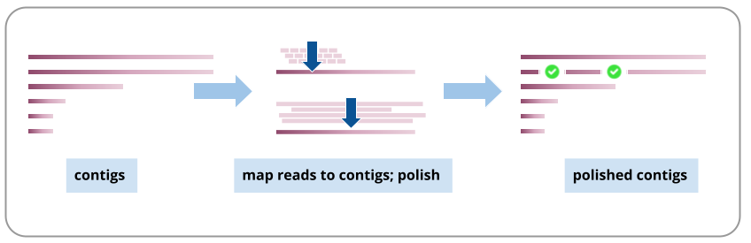
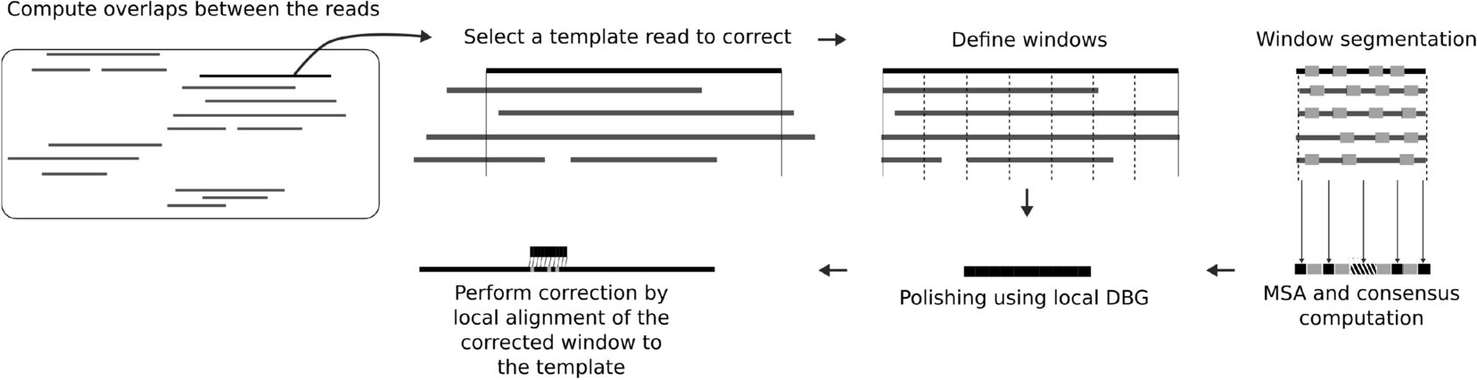
POLISHING
Polishing: sequencing error correction procedure, which usually takes advantage of “coverage,” that is, the fact that each position of the genome to be assembled has been read multiple times, assumed in most cases to be correctly
Example 1: post-assembly polishing
The reads are mapped against contigs and their consensus is used to correct any errors that may be present
Example 2: Pre-assembly polishing
The reads are mapped to the long reads to correct errors prior to assembly

Slide 26
SEQUENCING AND ASSEMBLY STRATEGIES NEED TO BE PLANNED BEFOREHAND
Option 4 - assemblies made exclusively with high coverage long reads, Illumina reads (from Hi-C/Omni-C libraries) for scaffolding only
Very popular approach today, used by all large genomic sequencing consortia (WGP, DToL, EBP, etc.). Needs use of high-quality third-generation reads (mainly PacBio Hi-fi reads with about 50X coverage, or ONT with higher coverage (due to higher error rate), >100X
Advantage: use of very long, high quality reads. All funds (or nearly all) can be focused on increasing coverage with Hi-fi or ONT reads. Polishing is not required, as long as the coverage is sufficiently high, although it can always be done if Illumina reads are available. Illumina Hi-C or Omni-C libraries (we will study these later) sequenced in PE mode allow excellent scaffolding even with relatively low coverage (30X). There is the possibility of chromosome phasing (reconstructing both alternative haplotypes.
Problem: obtaining DNA of sufficient quality and quantity to use this approach, both for HiFi and Hi-C libraries!

Slide 27

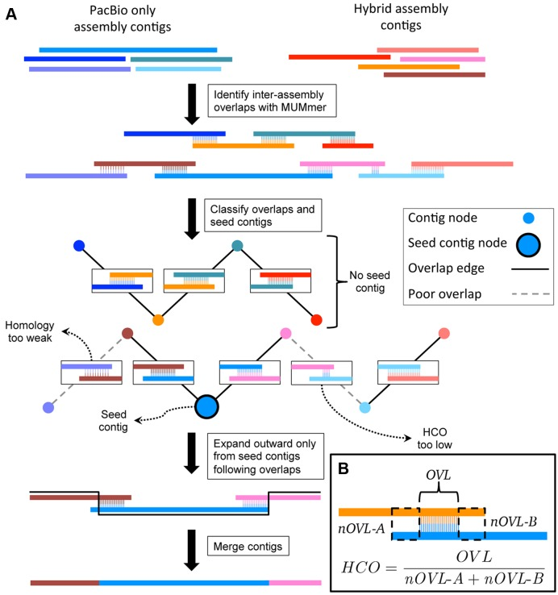
SEQUENCING AND ASSEMBLY STRATEGIES NEED TO BE PLANNED BEFOREHAND
Option 5 - “custom” approaches
It is possible to combine different approaches, using both long reads and short reads for the assembly steps and then for polishing in the case of unusual and particularly complex genomes
Disadvantages: to date there is no single, well-defined protocol, and it is not easy to find the right balance of coverage between the two sequencing approaches. Expensive approach. It is often necessary to develop algorithms specifically for particularly complex projects
Example: axolotl genome (32 Gb!): development of assembly software called MARVEL
Advantages: versatile approach, works quite well with complex genomes with high heterozygosity

Slide 28

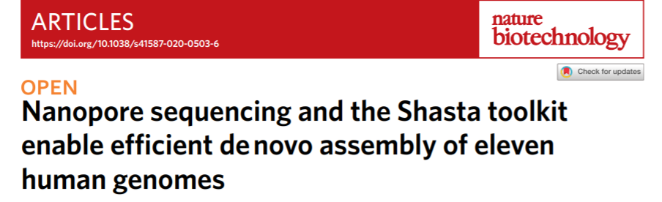
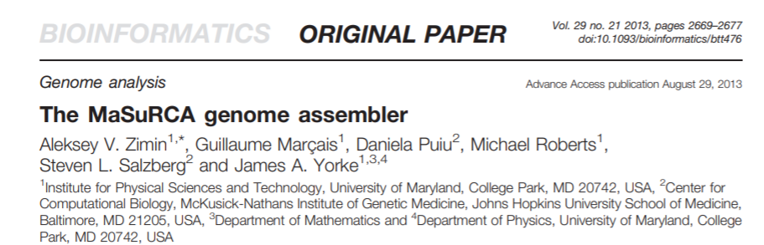
DE NOVO GENOME ASSEMBLY ALGORITHMS
A FEW EXAMPLES
CANU (long reads only) + HiCanu (for an HiFi reads approach only, it generates two alternative haplotypes)
Hifiasm (long reads only – PacBio HiFi, it generates two alternative haplotypes)
SMARTdenovo (long reads only – ONT)
Shasta (long reads only – ONT)
FALCON (long reads only -> it generates two alternative haplotypes)
Raven (long reads only)
Wtbg2 (RedBean, hybrid assembly)
Flye (long reads only)
MaSuRcA (hybrid assembly, OLC + De Bruijn graph)
Platanus (short reads only); Platanus-allee –> specialized for the reconstruction of both haplotypes

Slide 29
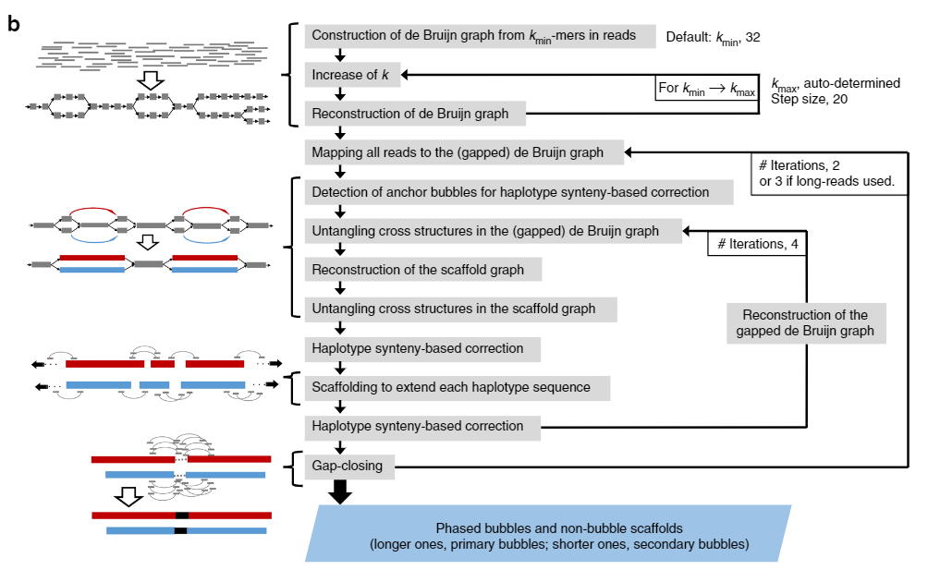
Two examples of assembly pipelines
Platanus (below) vs Canu (right hand side)
N.B. many assemblers include within them polishing and/or scaffolding modules and often work with iterative loops

Slide 30
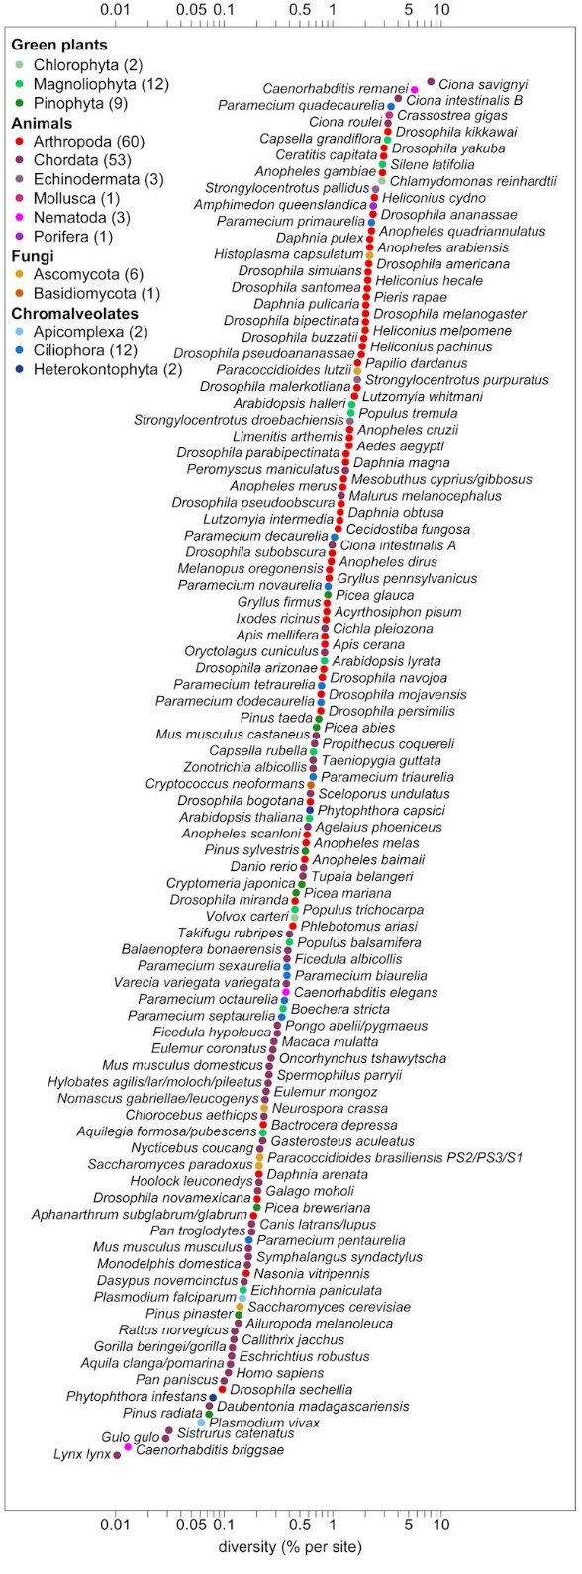
Another issue: heterozygosity
Heterozygosity is defined as the extent to which the sequences of the two homologous chromosomes diverge
It basically depends on the genetic variability of the population and therefore changes considerably from species to species
Typically species with a small reproductive population will have low heterozygosity and vice versa
Mode of reproduction also affects--marine species that reproduce by dispersing gametes tend to have high heterozygosity
Human-> very low heterozygosity (0.1%)

Slide 31
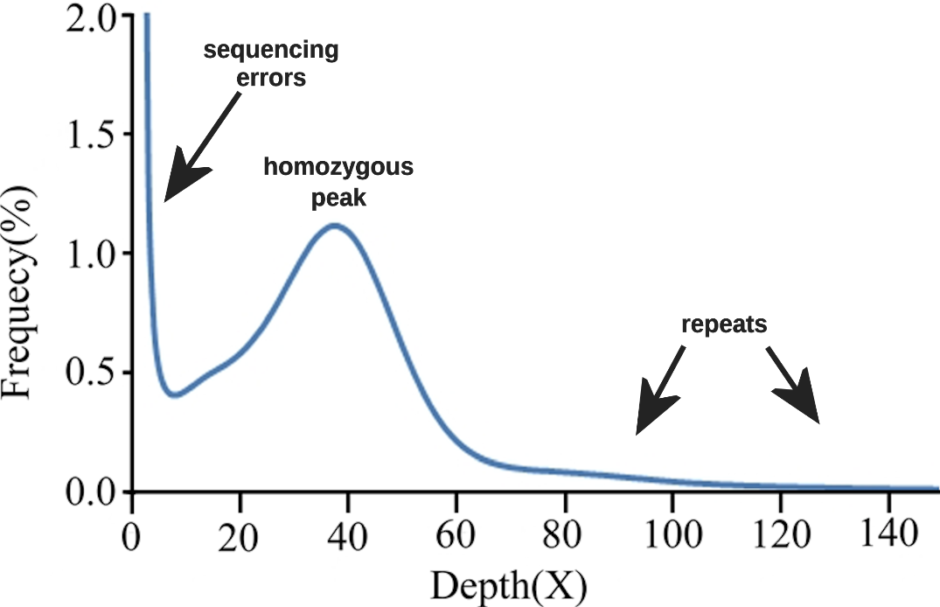
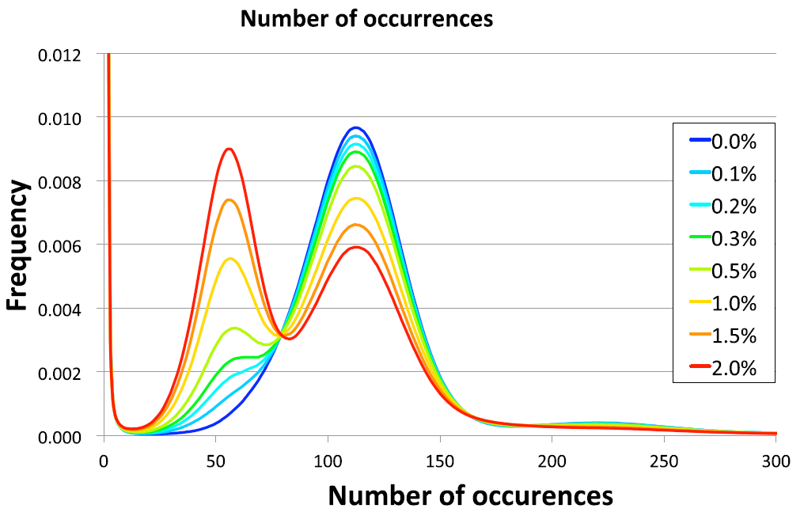
Come si valuta l’eterozigosità e che problemi può causare?
The greater the relative height of the peak on the left increases, the more heterozygous the genome is
In a genome in complete homozygosity you will notice a single peak with coverage equal to the sequencing depth of the genome
In a heterozygous genome you will always notice a second peak, more or less high, located exactly in the middle of the first one
You will always notice a high peak at zero due to k-mers that contain sequencing errors
In the right part of the graph you can see the k-mers found many times in the genome, that is, those derived from repeated regions
In the case of highly heterozygous genomes, differences between the two homologous chromosomes may lead to the separate assembly of the two haplomes
In essence, the graphs follow two alternative paths and assemble some genomic regions where differences are concentrated as different regions
As a result, the size of the assembled genome increases relative to the actual size
Evaluate heterozygosity by graphs of the distribution of k-mers with software such as Jellyfish

Slide 32
How can we handle heterozygosity?
Option 1: ignore it. Attempt to generate a single haploid genome assembly, “collapsing” any polymorphisms and allelic variants (as originally done for the human genome) -> monoploid assembly. Approach possible only with species with low heterozygosity
Option 2: Generate a reference haploid assembly, plus a collection of “accessory” scaffolds representing the alternative haplotype, relating only to genomic regions characterized by sequence hypervariability
Option 3: Generate a diploid assembly, with the two alternative haplotypes. This approach requires the use of “ploidy-aware” assemblers, such as Platanus-allee, FALCON-unzip, HiCanu and Hifiasm, or involves the use of post-assembly tools such as Haplomerger
N.B.#1: to generate a de novo genome assembly, one ALWAYS starts from a SINGLE INDIVIDUAL, to limit technical problems related to heterozygosity
N.B.#2: usually in species with high heterozygosity, the size of the genome assembly exceeds the expected size of the haploid genome

Slide 33
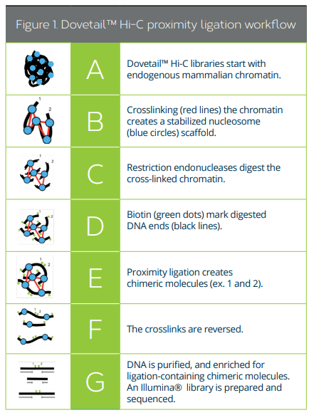
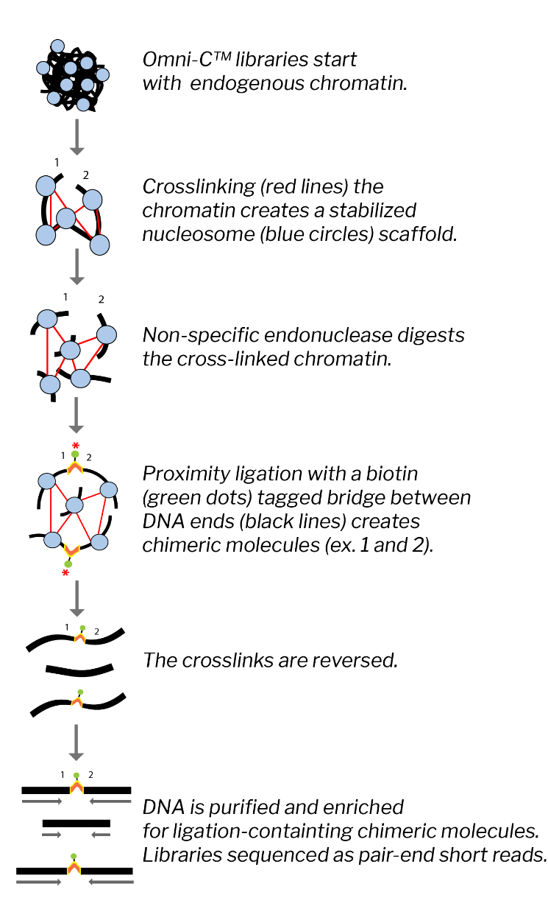
CHROMOSOME PHASING: A SMALL REVOLUTION
Chromatin conformation capture libraries: Hi-C and Omni-C libraries
1)chromatin crosslinking by glutarate
2)Enzymatic cutting of the DNA chain
3)Proximity ligation with biotin-labeled bridges
4)Reversion of crosslinks
5)Purification of fragments

Slide 34
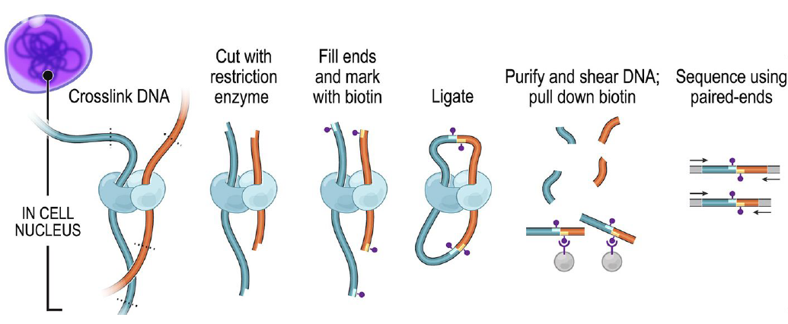
CHROMOSOME PHASING: A SMALL REVOLUTION
Notice how the 2 ends of the fragments included in the library carry sequences originally far apart in the chromosome, but spatially close. Illumina paired-end sequencing creates very long “bridges”

Slide 35
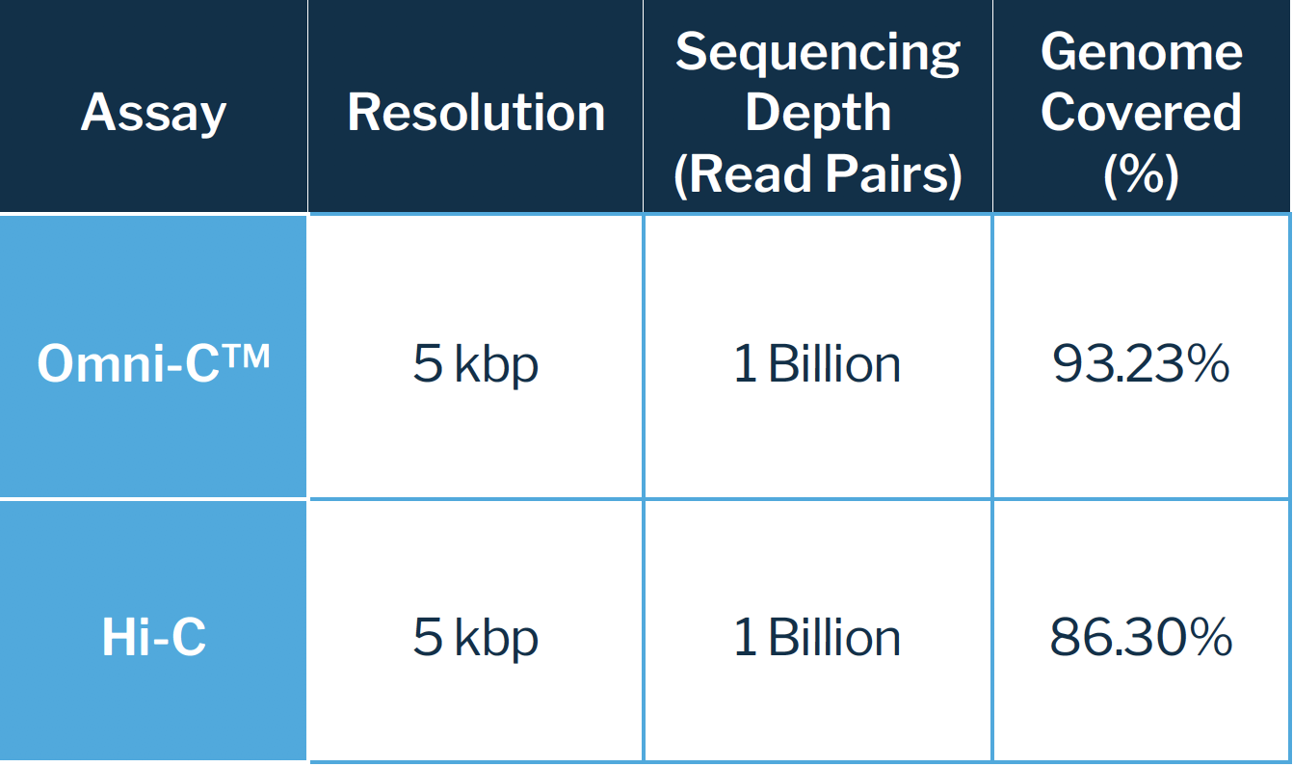
CHROMOSOME PHASING: A SMALL REVOLUTION
We get chimeric DNA fragments that correspond to regions very distant from each other in the linear sequence of genomic DNA, but very close spatially to each other in the 3D chromatin structure
Difference between Hi-C and Omni-C libraries : the former cut with a restriction enzyme (specific cut, not random), the latter with a nonspecific endonuclease -> greater genome coverage, more uniformity
Sequencing should be done in paired-end mode with Illumina (or BGIseq, prospectively also with AVITI or Onso)
For Hi-C or Omni-C libraries we need to use a genome coverage close to 30X

Slide 36
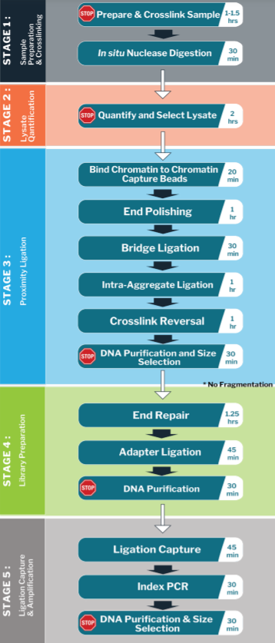
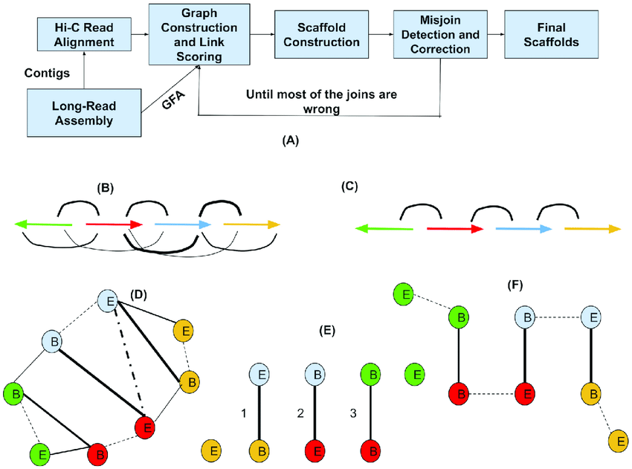
Hi-C and Omni-C: a few additional notes
Must start from very fresh biological samples: blood or tissue. Required about 1 million cells (nucleated!) or about 50 milligrams of tissue
Procedure for preparing the libraries laborious: 2 days of work
These libraries are used exclusively for scaffolding, but not for assembly or polishing (they are not evenly distributed along the genome)
New technical challenges for assemblies: development of new software specifically for scaffolding with libraries of this type (long-range information): SALSA2, 3D-DNA, etc.

Slide 37
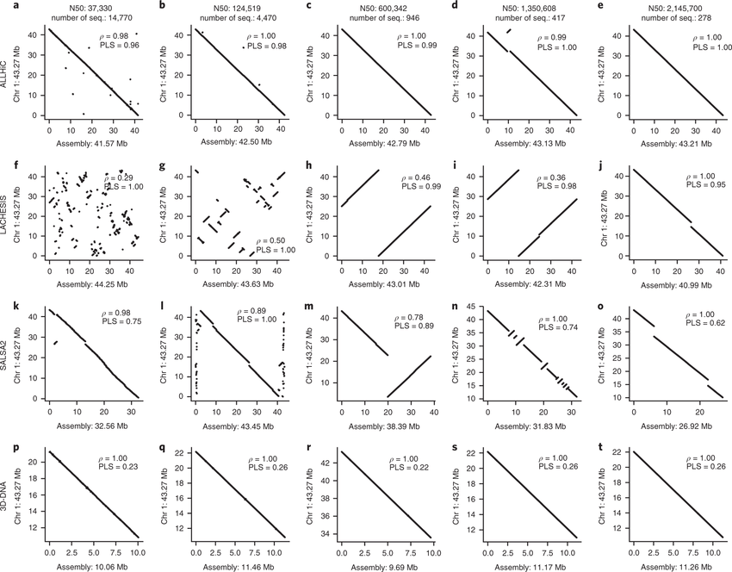
“Scaffolders” for Hi-C and Omni-C libraries compared.
Remember that scaffolding cannot work miracles if the starting assembly is of poor quality!
One needs in any case to start from good quality de novo assemblies (high N50, see next slides for an explanation)The better the starting quality, the fewer errors made (large inversions and shuffling of scaffolds)

Slide 38
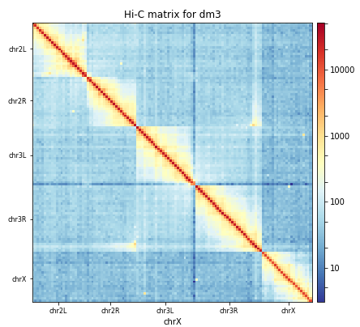
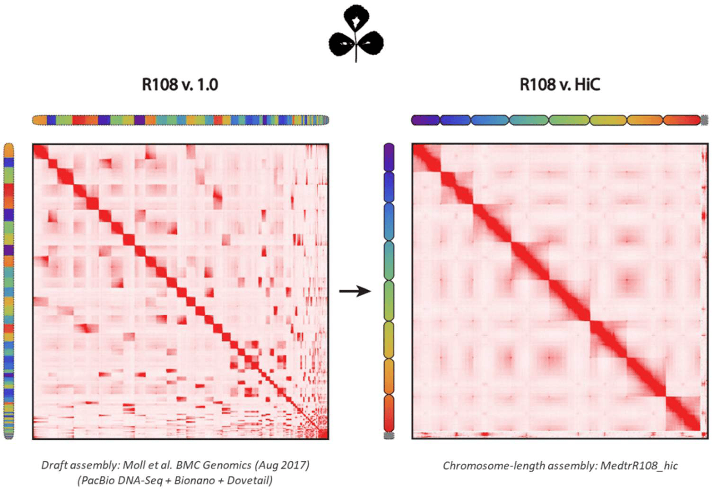
What does a contact map related to a library obtained by chromatin proximity ligation look like? The graphs below represent the density of contacts observed between pairs of paired-end library reads
Left ideal case: intrachromosomal contacts very well evident, interchromosomal contacts rare, simple delineation of individual chromosomes, density peak follows bisector of graph (indicates no erroneous inversions or creation of chimeric chromosomes related to erroneous fusion of multiple scaffolds
Right -> Comparison of a contact map obtained in the same genome for a highly fragmented “draft” assembly and for a chromosome-scale assembly. The contact map can be used to reorder scaffolds and figure out which ones are derived from the same chromosome

Slide 39
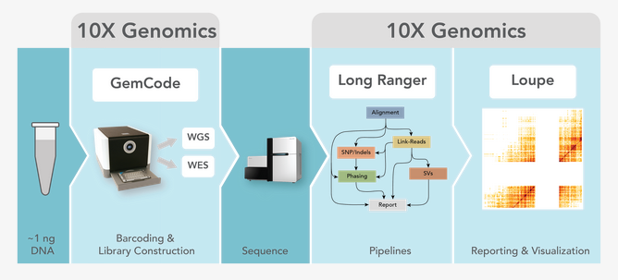
TECHNOLOGICAL INNOVATION RUNS FAST…
Innovative techniques that were just born within a very few years are abandoned
Example: 10X Genomics Chromium. Basic idea: create barcoded libraries for each individual DNA molecule (chromosomes), so that the assembly of each chromosome can proceed separately -> computational complexity reduction
Approach taken off the market recently, but the same technology has been used by 10X Genomics to develop techniques for single-cell genomics

Slide 40
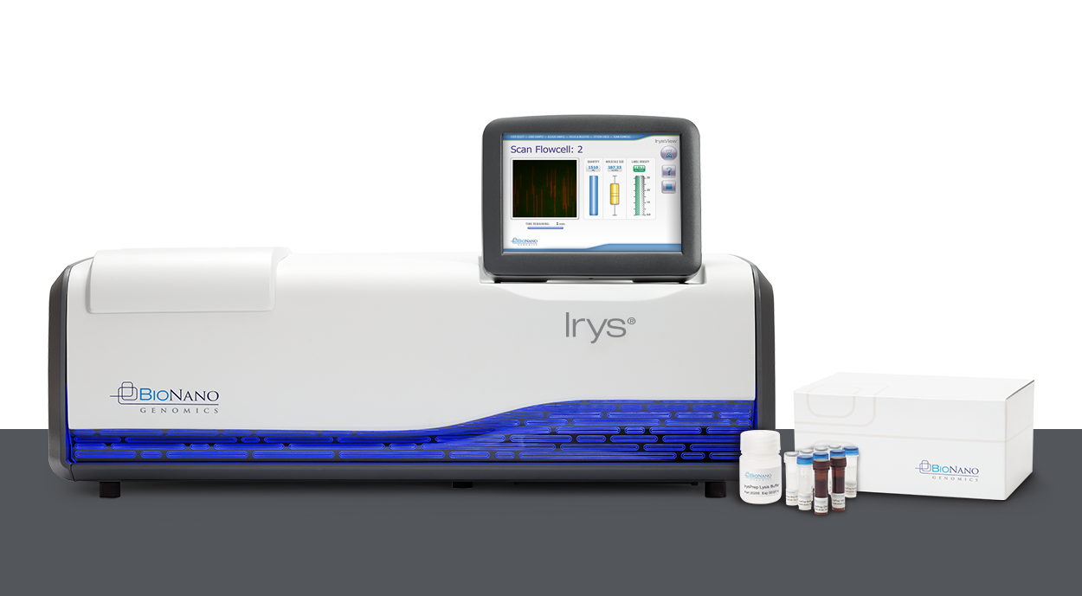
OPTICAL MAPS
Bionano optical maps - Saphyr and Irys platforms
Whole genome imaging
Study of structural variations with high resolution: translocations, large indels, inversions, etc.
Not true sequencing (in the sense that individual nucleotides are not determined), but it is a useful complementary strategy to further improve the quality of complex genome assemblies

Slide 41
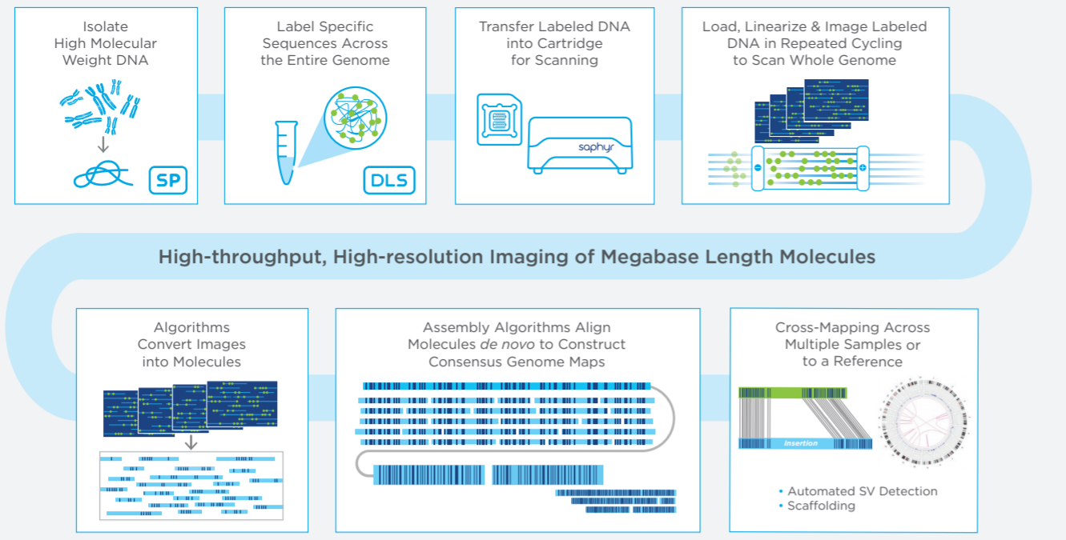
OPTICAL MAPS
Starting with ultra-high molecular weight DNA
Added fluorescent molecules that bind specific DNA sequences, creating unique fluorescence patterns for each genomic region
Linearized and labeled DNA passes through nanochannels
Construction of optical maps based on fluorescence patterns that help detect structural changes. Currently used mainly in humans and model organisms, but has already found application in other targets

Slide 42
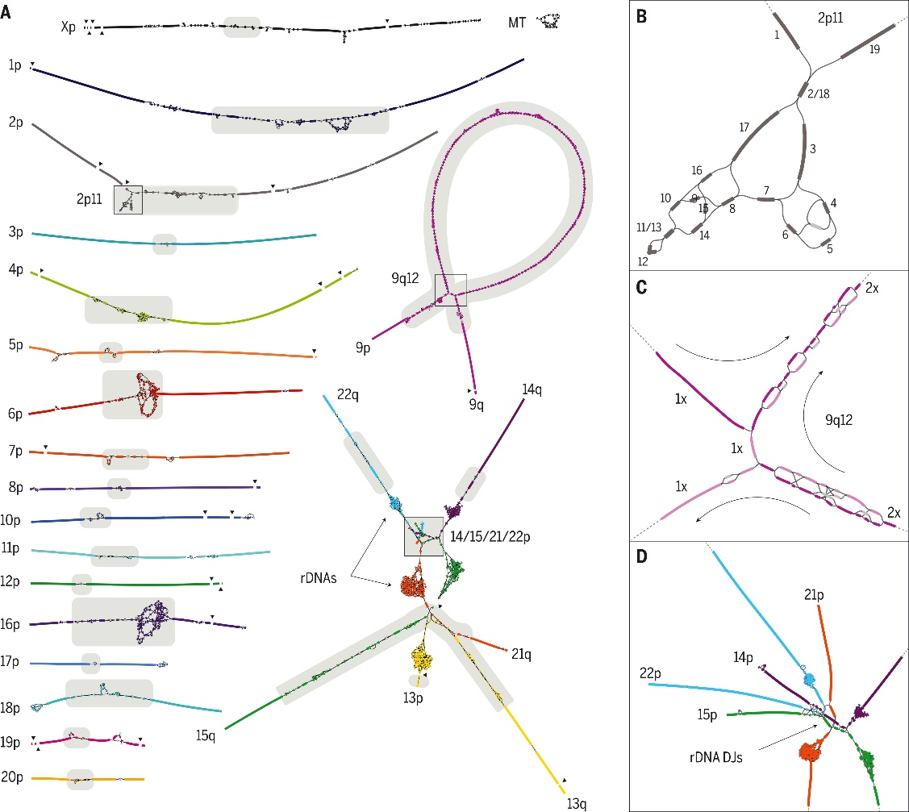
How the “gaps” in the human genome were filled by the T2T consortium - technical aspects
Combination of many of the techniques we have discussed!
30X coverage with PacBio HiFi reads
120X coverage with ultralong ONT reads
100X coverage Illumina reads (generated from PCR-free libraries)
70X coverage reads Illumina Hi-C
In addition, development and application of ad hoc bioinformatics approaches for managing and assembling these data

Slide 43

Once we have an assembly, how do we evaluate its quality?
If I have an estimate of the size of the genome, I can estimate how close the size of the assembled genome comes to it
How many scaffolds have I obtained? How is their length distributed?
Are the contigs and scaffolds assembled correctly?
Do I find all the genes I expect in my assembly? If a housekeeping gene is missing maybe something is wrong!
What about the repeats? How did I handle them?

Slide 44
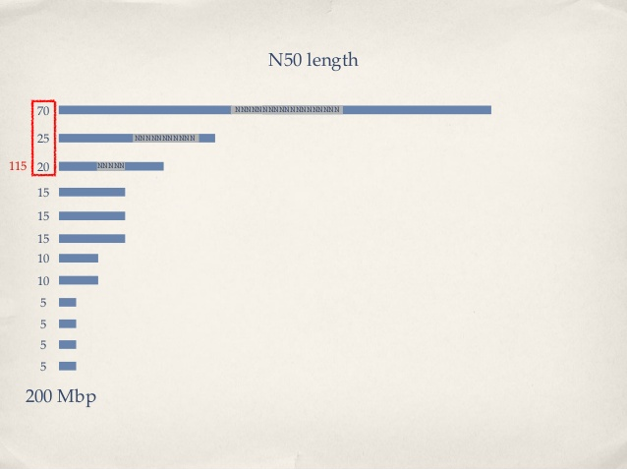
Quality measure based on the length of contigs (or scaffolds): the N50
N50 = length of the shortest contig in a set of contigs that globally reach 50% of the length of the assembly
That is: if I sorted all contigs from longest to shortest, calculated the sum of their lengths, and stopped as soon as I reached half of the total length, how long would the contig I stopped on be?

Slide 45
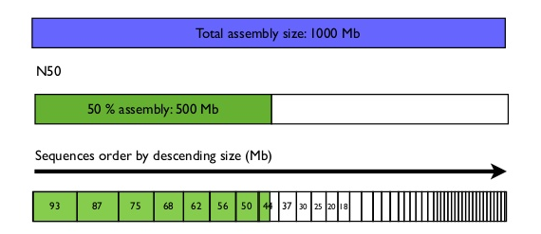
Other useful metrics
Sometimes N25 or N75 is reported.
The meaning is the same, but 25% or 75% of the total length of the assembly is taken as the reference
L50 (or L25/L75), on the other hand, refers to the number of contigs required to achieve 50 (or 25/75) % of the total length of the assembly
N.B. these metrics are applicable to both contigs and scaffolds and therefore the best values should tend to be obtained by working on the scaffolds
L50 = 7 sequences
N50 = 44 Mb

Slide 46
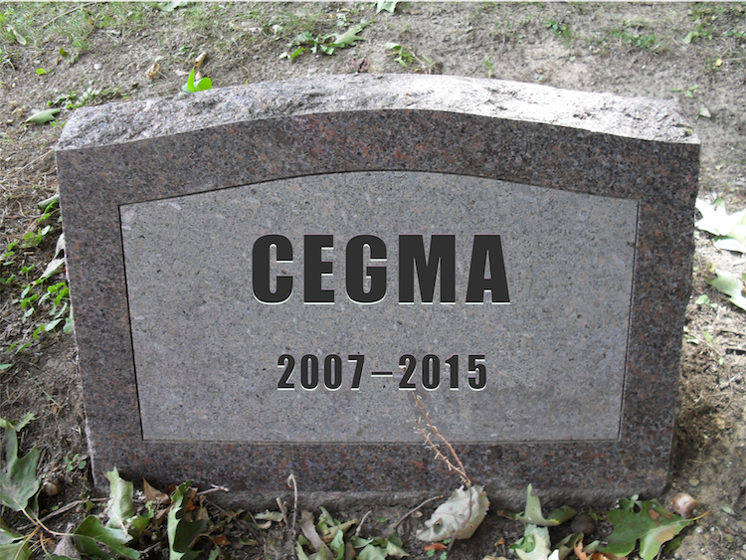
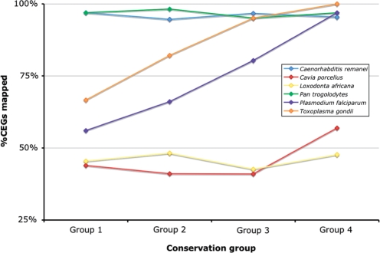
Evaluate the number of assembled genes
CEGMA: Core Eukaryotic Genes Mapping Approach
We can assess whether a set of genes conserved in most eukaryotes is present in an assembly
Also useful for de novo assembly of transcriptomes
In the event that a low-quality assembly will be missing some conserved genes or, if present, these will be partially fragmented-After 2015 this tool was replaced by its successor, namely BUSCO

Slide 47

BUSCO: a similar approach
Benchmarking Universal Single-Copy Orthologs, it replaced CEGMA
«Collections of orthologous groups with near-universally-distributed single-copy genes in each species, selected from OrthoDB root-level orthology delineations across arthropods, vertebrates, metazoans, fungi, and eukaryotes»
Also excellent for assessing transcriptome completeness, not only in terms of presence/absence, but also in terms of % of assembled length compared with that expected if the transcript was complete
Based on the use of HMMs

Slide 48
OrthoDB is the reference dataset for BUSCI
It is a database of genes that need to be:
1)Orthologous
2)Single-copy
3)Evolutionarily conserved
Depending on the target species, we can choose a more or less extensive reference database (e.g., Mammalia or Metazoa rather than Eukaryota)

Slide 49
An example: comparative assessment of bivalve mollusk assemblies using BUSCO
Can I figure out which genome is “better”?
We note the presence of fragmented BUSCOs (could indicate low N50)
Duplicated BUSCOs, on the other hand, could indicate that redundant genomic sequence has been assembled, perhaps due to high heterozygosity

Slide 50
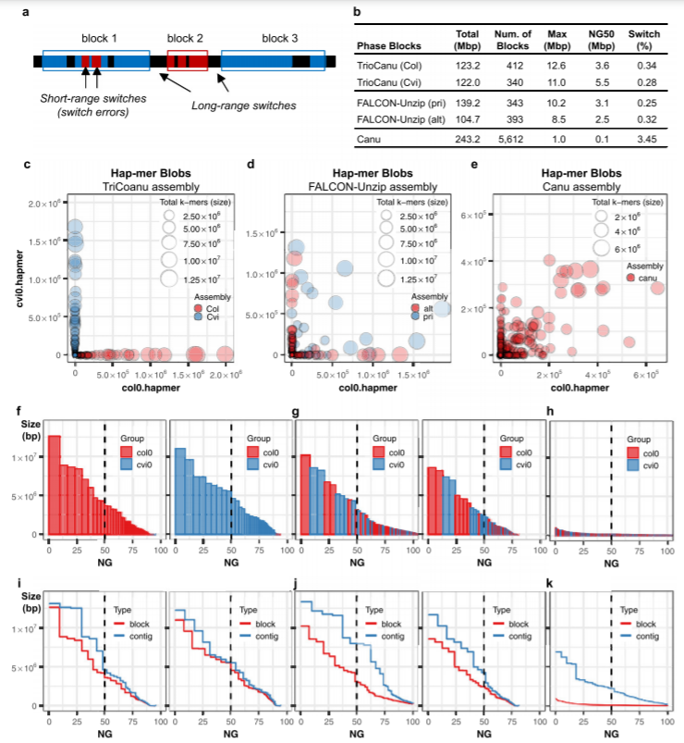
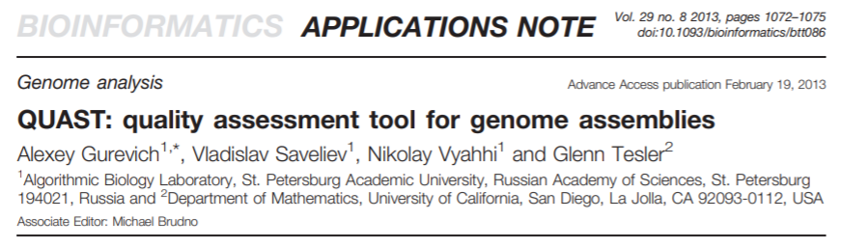
Software for evaluating the quality of an assembly
Some software includes packages of several tools that estimate various parameters and metrics simultaneously
Example: QUAST
The development of new techniques and the drive toward phasing the two haplotypes have led to the development of additional tools that can evaluate these aspects as well.
-Example: Merqury (what % of k-mers is represented within my assembly?)

Slide 51
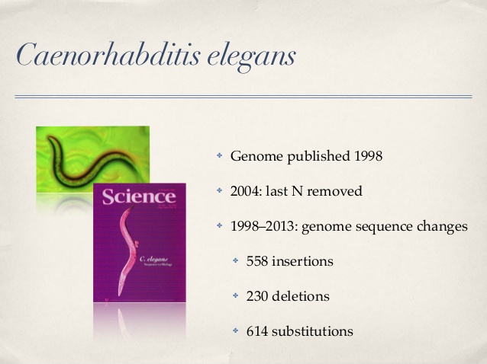
Let's keep in mind that no genome is perfect.... Technological improvements help!
We have already talked about this for the human genome, selling the progress made by the T2T consortium, but let's keep in mind that as far as “standard” genomes are concerned, this level of attention so far has not been there!
Genome finishing is a practice for now used only in model organisms or very small genomes

Slide 52
No assembly strategy is perfect!
Each target genome has its own distinct characteristics and technical difficulties
An assembler that is “good” for one species might be “bad” for another
A very good assembler in a given ratio of long to short reads might perform worse when this ratio is unbalanced

Slide 53
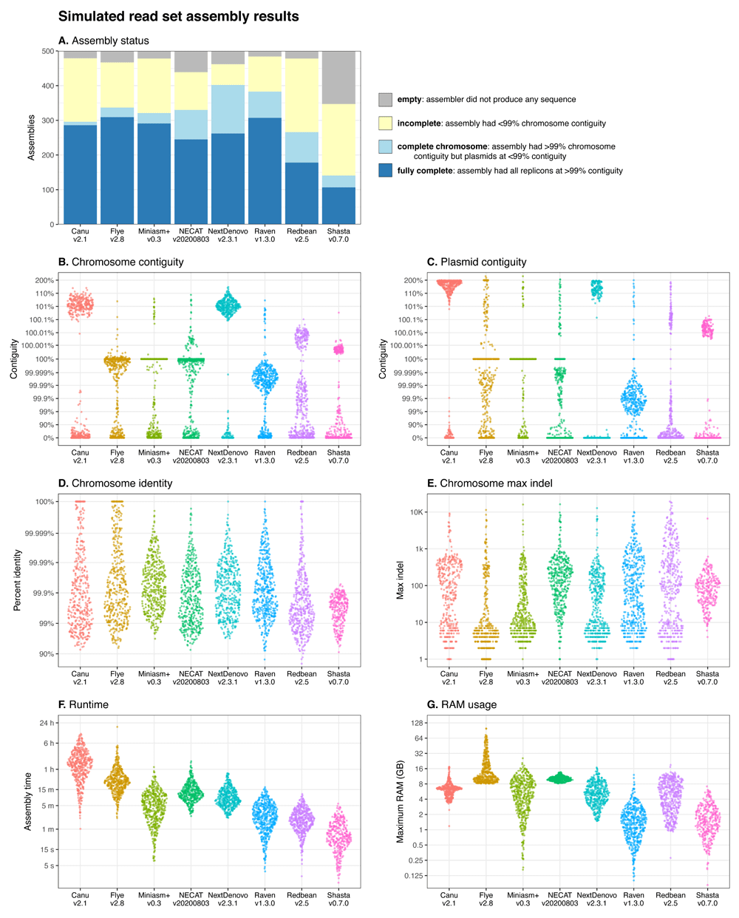
This is also necessary because it is not enough to evaluate quality... Time and hardware resource parameters come into play!
Any genome assembly approach must necessarily come to terms with the economic and computational resources available, as well as having to ask whether the appropriate biological material can be sourced to proceed with the preparation of libraries compatible with the chosen sequencing strategy.

