Slide 1
LEZIONE 6
Whole genome resequencing and targeted resequencing approaches

Slide 2
Pre-processing or raw sequencing data
Independently of the type of application (e.g., this also applies to sequencing approaches dedicated to de novo assembly of genomes seen in the last block of slides) the raw reads CANNOT be directly used, as is, for any type of analysis
When I obtain sequencing data, I must ask myself:
1) Have I obtained a number of reads consistent with my expectations?
2) Do the reads I have obtained meet, in quality and length, what was agreed upon with the sequencing center?
3) In case I sequenced multiple libraries in parallel (thanks to the addition of barcodes), is the number of reads obtained for the different samples uniform or unbalanced?
4) Do the reads obtained actually match exclusively the target organism of our analysis (this is not always 100% certain because of exogenous contamination!)?

Slide 3
Pre-processing or raw sequencing data
In addition to these considerations, I have to ask how much the presence of any sequencing errors may affect data analysis or interpretation of results
If sequencing errors are not adequately removed, they could result in the misidentification of genetic polymorphisms
For this reason, minimizing the presence of errors is especially critical for resequencing approaches, whose primary goal is precisely to detect the presence of mutations in heterozygosity or homozygosity (in case the organism is diploid)
How can a truly existing mutation be discriminated from a sequencing error when these are present at a very high rate?
The problem becomes even more important when the interest is to detect mutations associated with only a fraction of the cells analyzed (e.g., cancer genomics)

Slide 4

TRIMMING – When and why?
Trimming is the procedure that processes raw sequencing data into so-called “clean reads”
Raw sequencing data, depending on the sequencing technique used, may contain errors
Sequencing errors can adversely affect all downstream data analysis (e.g., by preventing the mapping of reads to the reference genome, or by producing errors in de novo assembly, or by misidentifying sequencing errors as polymorphisms)
These errors should, as far as possible, be eliminated
Naturally, this procedure should be performed BEFORE analysis begins. N.B. in this procedure is different from polishing, which refers specifically to long reads with high error rates is can take place either on the reads themselves before assembly or after assembly has taken place
Trimming is a term typically used in gardening

Slide 5
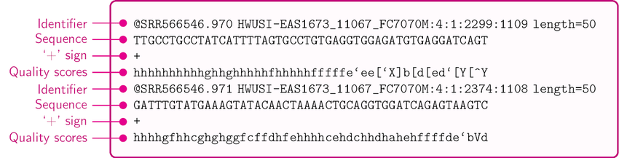
TRIMMING – Why?
Raw sequences are made available in FASTQ format. These are text files that include, (i) the nucleotide sequence and (ii) the quality scores.
Quality scores can be read as numerical values and can be interpreted as histograms
These values indicate the confidence with which the basic process calling was carried out
It is possible to set an arbitrary minimum quality threshold -> Bases with scores below the threshold can be removed
Quality scores depend on the quality of the signal (luminous, pH change, current, etc.) detected relative to the background noise

Slide 6
A few examples
This region has low quality, but the rest of the read seems OK and can be maintained
Very poor quality read: the “N's” indicate ambiguous nucleotides. The read should be discarded completely
Almost all of the read is of poor quality: it should be trimmed, but would remain of residual length too small to be of use
In this case some bars are quite low. Whether or not to perform trimming depends on the threshold chosen

Slide 7
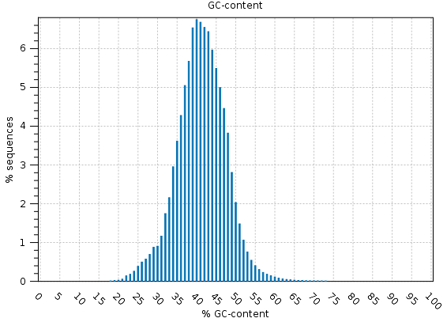
Sequencing data overview
It is often useful to observe the nucleotide composition of reads to check the distribution of GC content
Each genome has its own characteristic GC content, and we expect to observe that the reads have a Gaussian distribution around this mean value
In addition to this, it is critical to check the composition of the reads on a base-by-base basis. No compositional bias is expected, that is, we do not expect to see over-representation of certain nucleotides at any particular position. In the example on the left-hand side, you can see the presence of a compositional bias in the first 15 bases or so, which will have to be removed by trimming. These biases usually depend on the not entirely random ligation of adaptors or the presence of adaptor

Slide 8
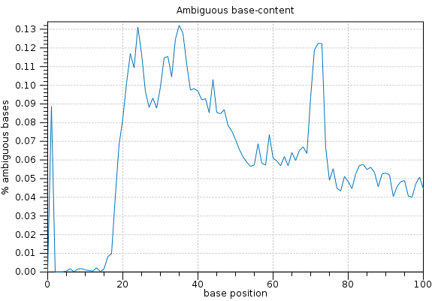
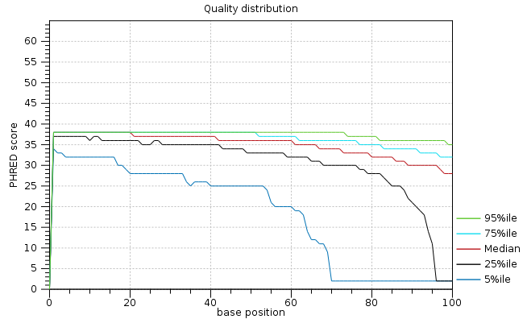
Sequencing data overview
One can monitor the content in ambiguous (“N”) bases along the sequence of reads. Usually, these bases are rather rare and evenly distributed along the reads. A non-random distribution may indicate problem with al library. N.B. In Illumina sequencing with two-channel detection, stretches of ambiguous bases are read as stretches of G
The average quality of the reads tends, in sequencing-by-synthesis methods based on cluster generation, to decrease toward the end, due to increased background noise (also related in part to signal “phase shift” related to the occasional non-incorporation of nucleotides in some cycles)
The adjacent graph shows the average PHRED quality score of a given fraction of reads (e.g., 5% corresponds to the fifth percentile of reads with the worst quality score). In the example, if we refer to the 95th percentile, we note that the average quality always remains very high

Slide 9
Trimming by quality
The ultimate goal of the trimming strategy is to remove ambiguous and low confidence bases, keeping only The data that can be trusted
Quality scores are usually expressed as PHRED scores, which depend on the probability of reading error (see table at right)
Quality score thresholds should be set carefully based on the expected error rate in relation to the selected sequencing mode
This means that I don’t want to throw everything away if the error rate is pretty high, but I can be more stringent if the average quality is very high

Slide 10
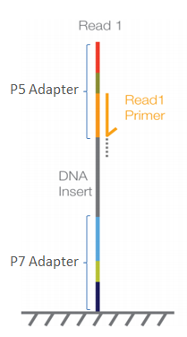
Adapter trimming
But what we have said so far is not enough! It is often the case that residual adapters are included in the reads, which can result from botched size selection or the formation of chimeric products during library preparation
Why does this happen? The library preparation protocol might occasionally result in chimaeric constucts due to ligation and PCR artifacts
We need to be aware of the sequences of primers, adapters, and barcodes used for library preparation (which depend on the kit used) and create a list of these sequences that the software used for trimming will look for
The tool responsible for trimming will look for these sequences and remove them -> some reads will be reduced entirely, others will simply be shortened

Slide 11
Adapter trimming
The presence of adaptors can often be detected by analysis of quality reports
Since reads should result from random DNA fragmentation, we should not expect any compositional bias with respect to position
Frequency of observation of the 4 nucleotides along the sequence of reads should be constant
N.B. The presence of a compositional bias at one end of the reads does not always indicate the presence of an adapter, but could also indicate the not entirely random ligation of sequencing adapters to fragments with a certain nucleotide composition
Deviations from the expected distribution indicate the possible presence of adapters. These should be removed, specifying the list of sequences used by the library preparation kit

Slide 12
Trimming – expected outcome
We expect to obtain clean reads, ready for immediate use for all downstream analyses
We need to keep in mind that as a result of the trimming process, the obtained reads may be much shorter, on average, than the raw reads, and that their number may have significantly decreased (because they were entirely removed, or because they remained too short -> even a minimum threshold of residual length can be set by the user)
We need to ask whether the number of reads left is sufficient for the applications we need. In case the average quality of the reads is not very high, and their number drops too much, it would be possible to run the procedure again with less stringent parameters, thus using soft trimming

Slide 13
Resequencing: what are its goals?
Identification of genetic variation in the population (population genomics studies) or in individuals (study of diseases or investigation of traces of natural selection)
What am I interested in? GWAS (Genome-Wide Association Study)? Interest in non-coding, regulatory, or protein-coding regions alone? Structural genomics studies (indel detection, inversions, translocations, etc.)? Targeted interest in a narrow panel of genes (e.g., in those involved in the development of certain diseases)?
Whole genome resequencing approaches -> sequencing coverage such as to ensure complete mapping of variation along the entire genome
Targeted resequencing -> targeted approaches in constructing libraries so as to reduce the complexity of the data produced by limiting the production of reads to certain target genomic regions
Cost and sequencing strategies depend on the type of application we have in mind and the goal of our study

Slide 14
Targeted sequencing
Reduced cost and complexity of analysis
I can analyze more samples at the same cost (because I can reduce the number of reads needed to analyze the single sample)
Exome sequencing approaches -> sequencing of all exons within a genome; I therefore exclude introns and intergenic regions, plus regulatory regions
Custom panels -> I select only a few specific targets, which may represent a subset of a few dozen or hundreds of genes, or fragments thereof (e.g., exons where mutations are known to be associated with certain diseases)
Targeted amplicon sequencing: a single target region is analyzed from which information is expected to be derived, for example, about the biodiversity of a sample -> metagenomics approaches (mitochondrial DNA), polymorphic targets (MHC locus), etc.

Slide 15
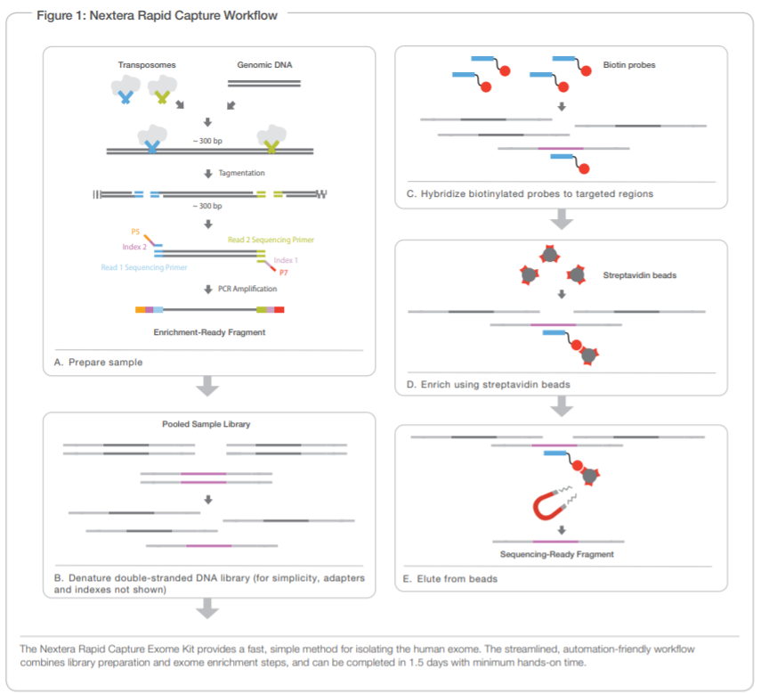
How do I selectively include only genomic regions of interest in a library?
Can use biotinylated + magnetic pulldown probes .
This approach may allow, depending on experimental design, isolation of regions from a few tens of Kb to over 50 Mb
Example in the figure: Illumina Nextera exome capture
Probes are complementary to target sequences (in this case exons)

Slide 16
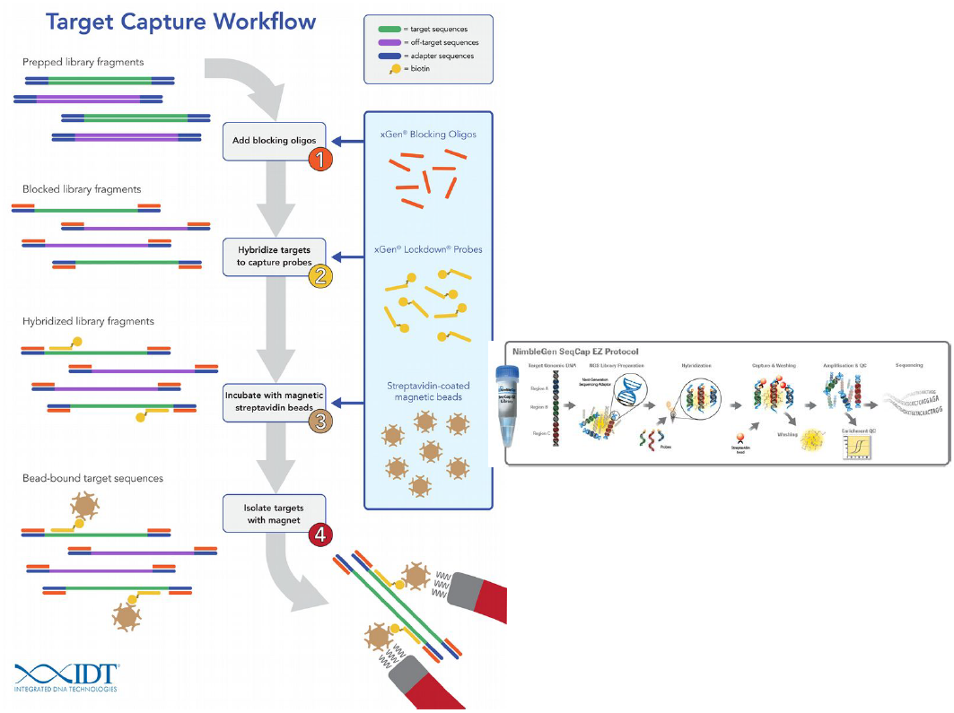
Example of the workflow of a commercial kit
A key goal is always to minimize the capture of “off-target” fragments
This kit (from IDT) uses “blocker” oligonucleotides that prevent hybridization between sequencing adapters present at the ends of library fragments

Slide 17
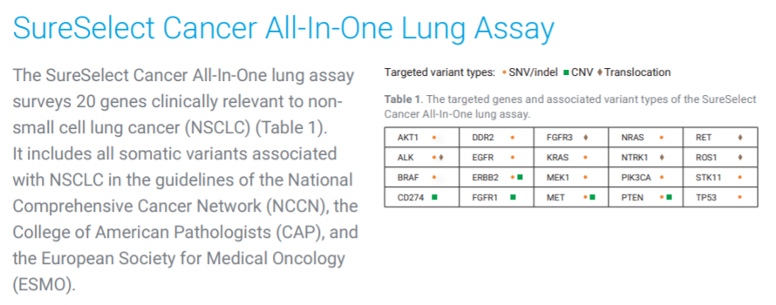
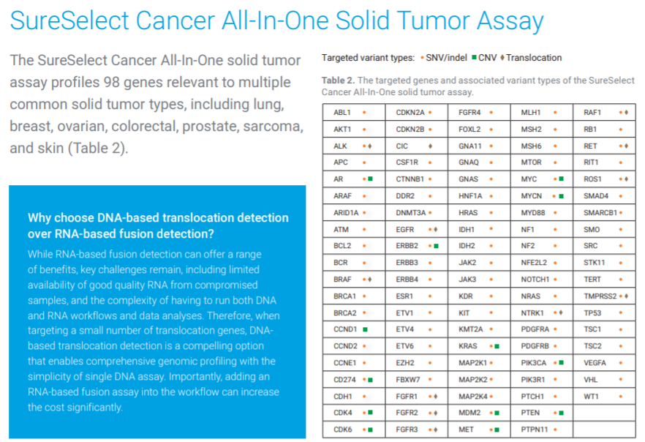
Target enrichment panels
Example: SureSelect lung cancer
20 target genes
Example: SureSelect Solid Tumor
98 target genes
The smaller the target panel, the fewer reads required -> lower overall cost, ability to sequence multiple barcoded libraries simultaneously, on “benchtop” sequencers

Slide 18
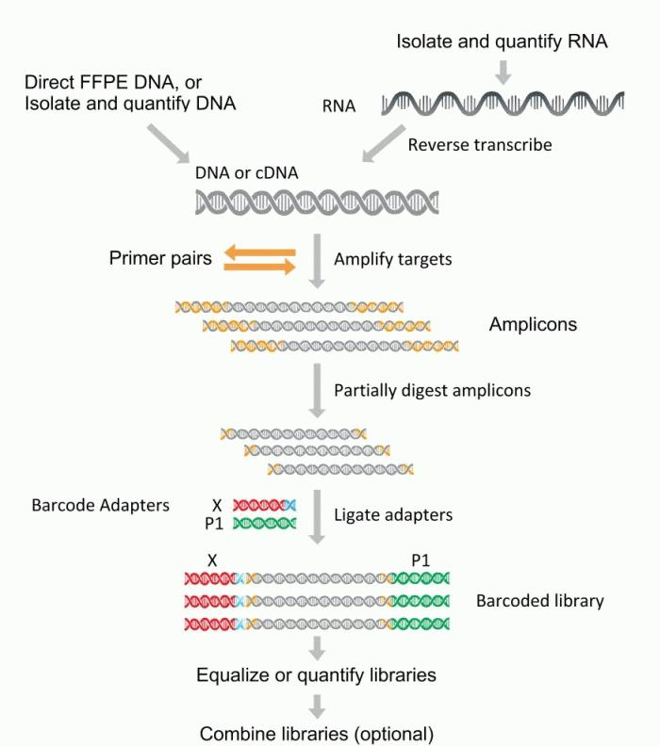
Ampliseq panels
Ability to simultaneously amplify (and then sequence) by multiplex PCR hundreds of genomic regions in a single project
N.B. also compatible with targeted sequencing from RNA, after retrotranscription into cDNA
Compatible with Illumina or IonTorrent sequencing (potentially also AVITI, BGIseq, Singular Genomics, Ultima Genomics and Onso)
Amplification sizes in the range of a few hundred bp (typically the entire amplicon should be sequenced in IonTorrent, or the two paired-end reads should be partially overlapping to cover the entire amplicon)

Slide 19
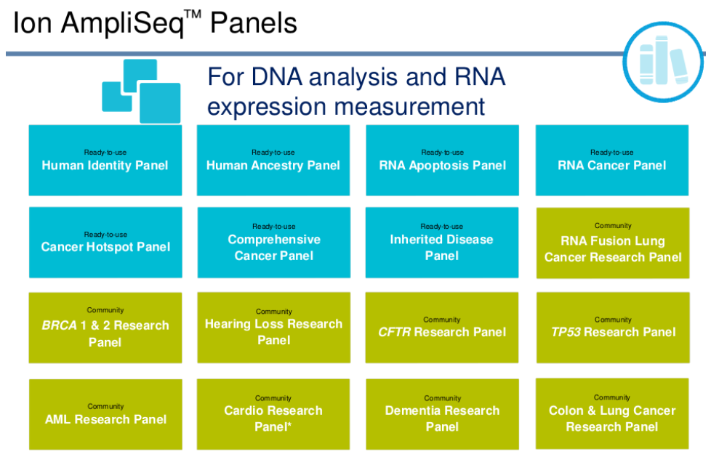
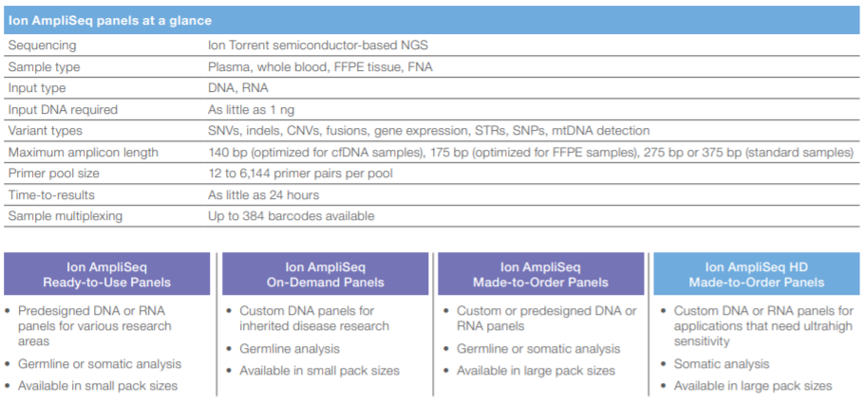
Ampliseq panels
Reduced DNA input: typically 50-100 ng, but for certain applications even less
Possibility of barcoding
12 to 6144 pairs of primers -> possible molecular targets
Amplicon size from 140 to 375 bp (IonTorrent)
Target: 20X coverage

Slide 20
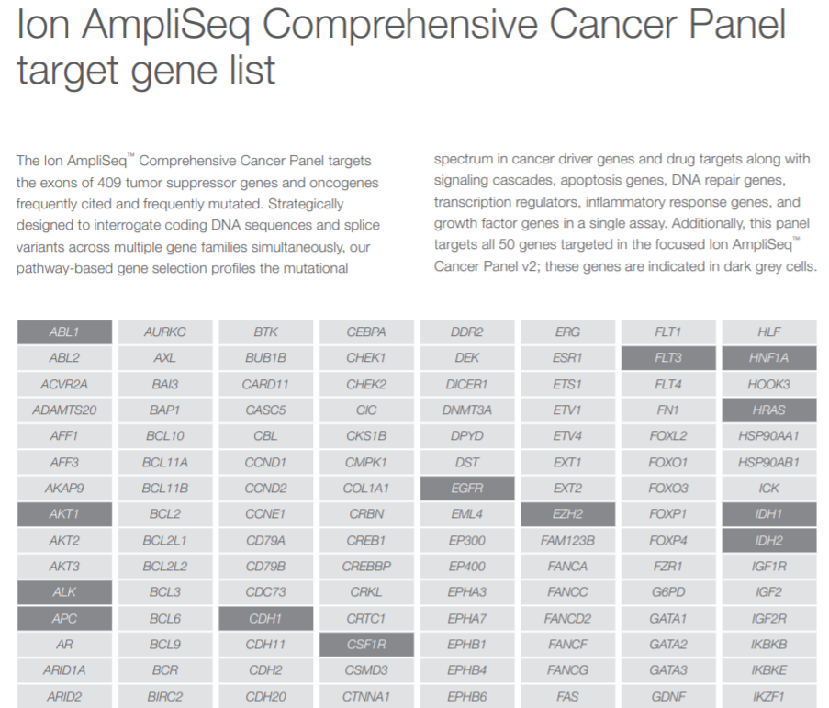
Example: Ampliseq comprehensive cancer panel
409 target genes, all exons covered
Targets are all oncogenes or oncosuppressors that have been frequently reported in the literature to be mutated in cancer diseases (COSMIC database)
Input: 40 ng of genomic DNA
Cost: about €1,000 for 8 reactions
The Hotspot Cancer Panel is significantly smaller (only 50 target genes - 207 amplicons) and naturally has slightly lower costs (96-reaction kit at 10 thousand euros)

Slide 21
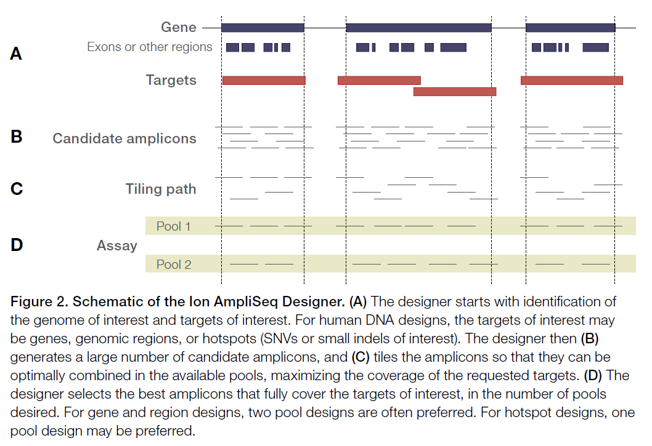
Example: Ampliseq exome panel
293,903 pairs of primers
Covers about 97% of the protein-coding exons annotated in the human genome
No UTR, no lincRNA, no miRNA
Input: 50 ng of genomic DNA
Rationale: about 85% of known mutations associated with inherited genetic diseases fall in coding exons or exon-exon junctions
Cost: about 1,000 euros for 8 reactions
Amplicon size (including adapters!): 225-275 bp
Average insert size: 202 bp -> similar to average length of human exons

Slide 22
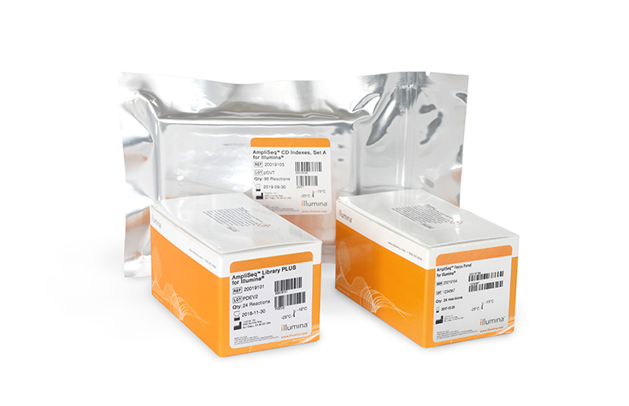
Example: Ampliseq custom panels
It is possible to have an algorithm design, entirely in silico, the best experimental design for a resequencing strategy on a custom dataset
Just select the name of the target genes (in case of model organisms) or provide the sequence in fasta format of the targets (also lends itself well to non-model species
The algorithm draws the primers so that the sample is analyzed in two distinct pools, to avoid overlapping (and hybridization) of amplicons
N.B. a similar approach is also possible for target enrichment
We must always keep in mind the maximum amplicon sizes so that these are compatible with the average length of the reads we expect to obtain

Slide 23
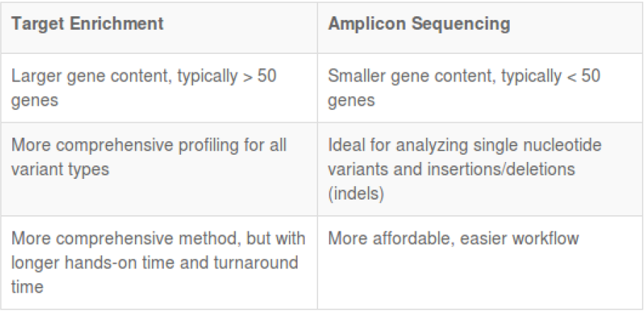
Amplicon sequencing vs target enrichment
N.B. THIS WAS ONLY AN ISSUE IN THE INITIAL STAGES! WE NOW HAVE DEFINITELY OVERCOME THIS PROBLEM

Slide 24
Whole Genome Resequencing (WGR)
This is certainly a more expensive approach than targeted approaches: coverage required usually >= 30X (if using Illumina)
Illumina strategy to detect SNPs and small indels, with costs that allow application even on a rather large number of samples
Example: genomic resequencing of different populations to derive information on genetic variation in the human genome (HapMap projects, 1000K genomes, etc.). Resequencing of a congeneric species, of selected “breeds” in breeding species, of a variety (especially in plants), of a bacterial strain, of a viral lineage (SARS-CoV-2), using an already available genome as a reference. Very important for medical genetics and population genetics
For the study of structural variants (wide indels, alternative haplotypes, copy number variation) -> long reads (not forgetting optical mapping approach, for highly detected structural variations). More expensive approach, limited to single individual, or at least to a limited number of subjects

Slide 25
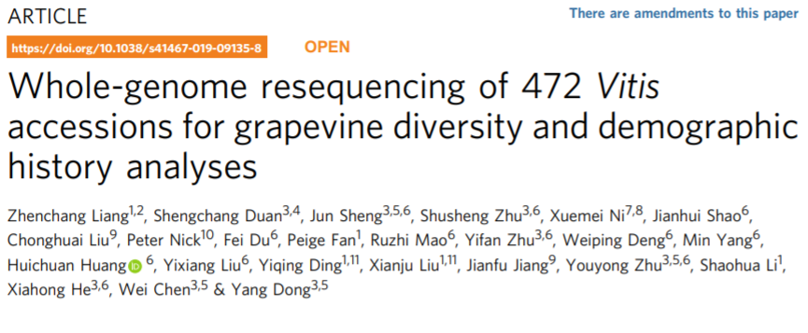
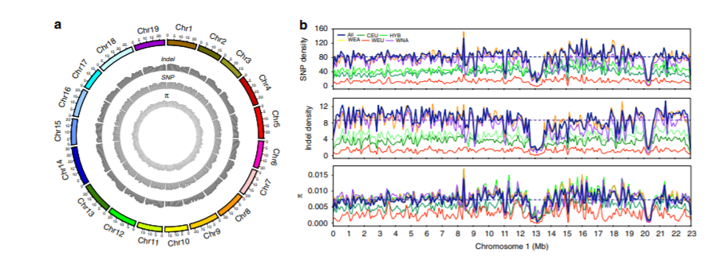
Whole Genome Resequencing (WGR)
The goal may be to perform variant detection.
As we have already mentioned this must depend on an accurate management of reads in the trimming phase
However, it also depends on a proper mapping strategy to avoid nonspecific alignments, especially in case of paralogous genes and repetitive sequences

Slide 26
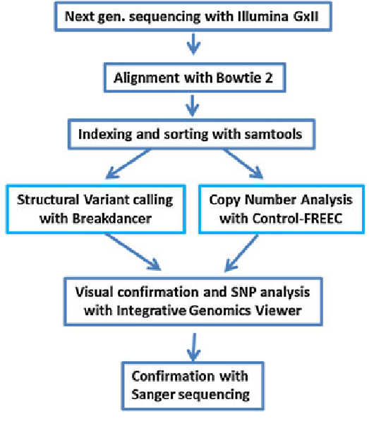
Whole Genome Resequencing (WGR)
It has many applications in biomedicine because it potentially allows identification of disease-associated variants
Used in population genomics for the identification of phenotypic variants
Sequencing coverage must be appropriate to allow me to discriminate real variants from possible bioinformatics artifacts, related to mapping reads that contain errors
How many variants do we expect to find for each individual genome position? In a diploid individual naturally at most 2 (so either 100% concordant reads, or with close to 50%-50% split between the two alleles)

Slide 27
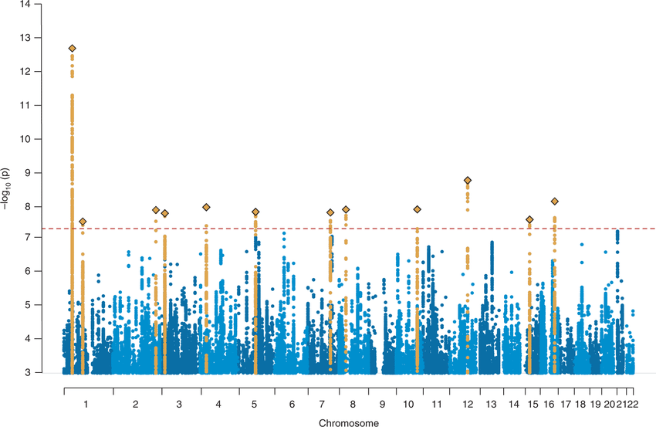
GWAS – Whole Genome Association Study
These are genetic association studies, analyzing whether a particular group of subjects of interest (e.g., suffering from a disease) shows a statistically higher frequency of mutations at certain loci than observed in a control group (e.g., healthy patients)
The two groups must be carefully controlled to be absolutely comparable for all other relevant factors (e.g., sex, age, other diseases, smoking/non-smoking status, etc.), so as to avoid the identification of spurious correlations
Results are usually shown graphically in the form of Manhattan plots and allow the identification, without any prior knowledge, of candidate genomic sites, facilitating in many cases the planning of targeted therapies
In a Manhattan plot, chromosomes are indicated on the X axis and the logarithm of the probability (of nonrandom association) is plotted on the Y axis. Peaks exceeding the (arbitrary) threshold indicate the location of candidate sites

Slide 28
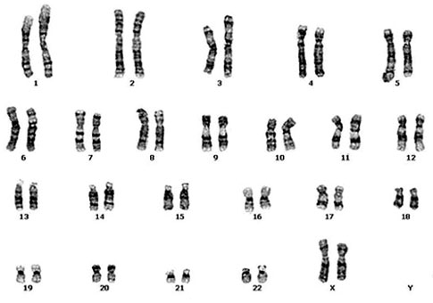
Variant detection – initial considerations
Every possible approach to liverying genetic variants is based on the process of mapping reads, after appropriate trimming process, to a database of reference sequences
This process is derived from the alignment between reads and targets according to a similarity threshold
Each read is mapped only if it reaches a certain arbitrarily chosen similarity threshold
The underlying concept is similar to that of BLAST: identify regions of homology and record their coordinates on the reference sequence, reporting them to any annotated genes and transcripts
???
ATTGATTATTAGCGCTCGCCCTACCCT
Which chromosome?
Which gene?
Which transcript?
Which specific genomic coordinates?

Slide 29
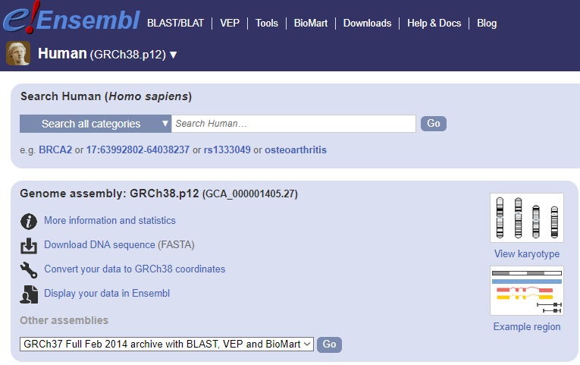
Variant detection – initial considerations
Mapping should always be done with clean reads, because the use of raw reads could lead to the mapping of reads containing errors, resulting in the calling of variants not really present but arising from sequencing errors
The reference sequence is usually a genome, but it can also be a transcriptome or a well-defined subset of their sequences
-For proper interpretation of mapping results, the reference genome/transcriptome must be annotated, i.e., it must allow association of the coordinates with which a read (and associated variants) are aligned with the features (genes/transcripts/promoters, etc.) annotated
Reference genomes are usually retrievable from genome browsers or appropriate databases. NCBI Genomes, UCSC, Ensembl, etc.
https://www.ensembl.org/

Slide 30
Variant detection – how to?
The stringency of the mapping depends on the alignment of the read with the reference sequence
It is necessary to set similarity thresholds, which in some algorithms can be defined as length fraction (establishing the minimum fraction of the length of reads to be aligned) and similarity fraction (establishing the minimum percentage of identical nucleotides in the alignment between read and reference)
These range from 0 to 1 (or 0% to 100%) and can be combined with each other
The higher these thresholds are, the more stringent the mapping procedure becomes -> fewer polymorphisms and mutations are tolerated than in the reference sequence
MAPPING STRINGENCY
LENGTH FRACTION – SIMILARITY FRACTION
0 0.1 0.2 0.3 0.4 0.5 0.6 0.7 0.8 0.9 1

Slide 31
Variant detection – an example
50 nt long reads, similarity fraction = 1, length fraction = 0,9
Example 1: The read is mapped: 49 identical nucleotides out of 50 total. The only SNP is located at the end of the read, so we have a continuous stretch of 45 identical nucleotides and the threshold of 0.9 for the length fraction parameter is met
Reference ATCGCGCTGCGTCGTTTGACTATCTCATCTTTCCCCATATATAGTCTAGC
|||||||||||||||||||||||||||||||||||||||||||||| |||
Read ATCGCGCTGCGTCGTTTGACTATCTCATCTTTCCCCATATATAGTCGAGC
Reference ATCGCGCTGCGTCGTTTGACTATCTCATCTTTCCCCATATATAGTCTAGC
||||||||||||||||||||||||| ||||||||||||||||||||||||
Read ATCGCGCTGCGTCGTTTGACTATCTTATCTTTCCCCATATATAGTCTAGC
Example 2: The read is not mapped: as before, 49 identical nucleotides are found out of 50 in total. The only SNP, however, in this case is located in the middle of the read. Since there is no continuous stretch of 45 identical nucleotides the 0.9 threshold of the length fraction is not met

Slide 32
Variant detection – How to?
Why may it be necessary/useful to vary the thresholds of the mapping parameters, so that some degree of divergence between reads and reference can be tolerated?
First, to allow mapping of reads that have some sequencing errors that could not be detected/removed during trimming (depends, of course, on the sequencing mode used). Using too stringent parameters could lead to discarding almost all reads, resulting in insufficient data (e.g., errors, despite being or rare, are still possible in Illumina reads), while too lax mapping could lead to confusing true polymorphisms with sequencing errors
Secondly, to analyze what really interests us: SNPs and other genetic variations. The reference genome is usually derived from a single individual -> regions where there are differences between this individual and the one from which I obtained the sequencing data would lead to areas without read mapping if the parameters used are too stringent. All individuals in a population are marked by some degree of inter-individual genetic variability, which depends on the species being considered (this concept is related to that of heterozygosity)

Slide 33
Variant detection – how to set parameters?
We always keep in mind the possibility of ambiguous mappings, related for example to the presence of paralogous genes (some reads might find a match with identical similarity in two distinct regions of the reference genome). The problem is obviously very relevant for short reads and diminishes for long reads
We must always ask ourselves what is the expected level of variation between the reads we have obtained and the reference sequence, based on these factors:
The sequencing platform and the expected error rate
The sequencing depth (coverage) we have used
The genomic characteristcis of our target organisms (ploidy, heterozygosity rate, etc.)
The aim of the analysis (SNP detection, whole genome resequencing, identification of somatic mutations, etc).

Slide 34
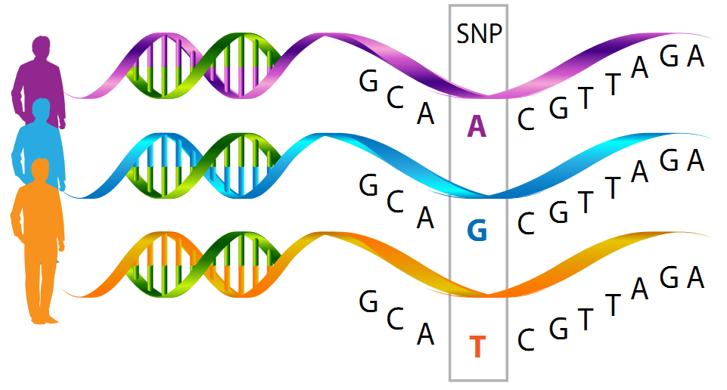
A practical example
In this case, the reference genome reports an A at the position of interest
However, from the literature, it is known that some individuals may show polymorphisms at this position: G or T. This information is usually retrievable from appropriate databases, such as ClinvAR IN NCBI
A SNP may or may not be linked to the development of a disease. It depends on its position (exon, intron, promoter, intergenic, etc.) and its effect on the encoded protein (synonymous or nonsynonymous substitution?), including on the 3D structure

Slide 35
A practical example
Let us imagine that we conducted Illumina sequencing with 100X coverage for a whole genome resequencing study (remember that the error rate is very low)
What situations do we expect to observe (assuming no errors)?
1)Homozygosity: 100% of the reads contain A, G or T
2)Heterozygosity: 50% of the reads contain one nucleotide and 50% of the reads contain another (e.g. 50% A and 50% G, 50% A and 50% T, or 50%G and 50% T)
Since sequencing errors are always possible, there would be nothing unusual in observing a situation with 99% A and 1% G -> it is useful to set a minimum threshold of observation frequency for calling a variant, to discriminate between errors and real variants. The expected situation should approach a 50%-50% frequency if a locus is in heterozygosity
N.B.: All this is not valid for tetraploid organisms (4n)! In this case we might observe 3 or even 4 variants simultaneously (with frequencies 50%-25%-25% or 25%-25%-25%-25%)
In the case of somatic mutations, these might be present with much lower frequency (this is because they affect only a subset of cells among those considered, a very important aspect in molecular oncology!)

Slide 36
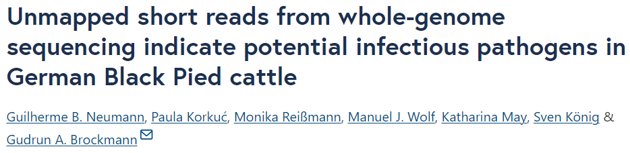
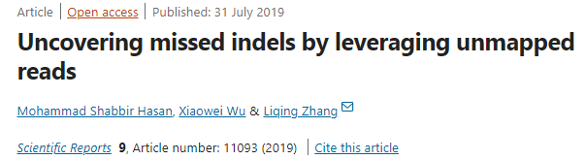
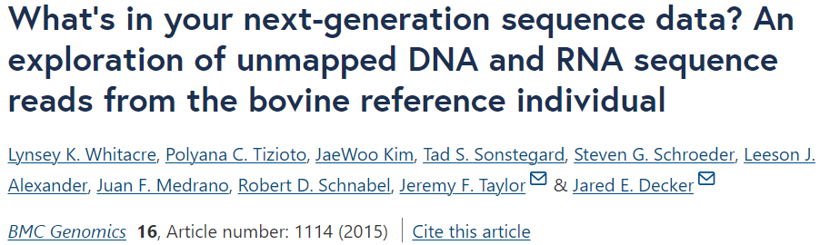
The fate of unmapped reads
Unmapped reads are generally discarded and not subjected to any additional analysis
However, they are far from being useless, as they can occasionally include a wealth of “hidden” information
This is, for example, the case of structural variants in pan-genomic approaches. Keep in mind that unmapped reads do not find any match against your reference, so they may include both inter-individual sequence variants (e.g. hypervariable alleles) and contamination that might be worth investigation. See a few examples below

Slide 37
Not just variant detection
-The reads mapping procedure (= alignment of reads against a reference genome) is the basis for a wide range of other -omics applications, each of which requires the use of very precise (and more or less stringent) parameters to optimize the analysis of the sequencing data produced. These include…
-RNA-sequencing: to calculate gene expression levels
-Bisulfite sequencing: to identify genomic regions subjected to methylation
-ChIP sequencing: to identify genomic regions recognized by target proteins (histones, transcription factors, etc.)
-ATAC-seq, Dnase-seq, FAIRE-seq, MAINE-seq, etc: to study chromatic accessibility
And many many others…

Slide 38
Resequencing approach: Covid-19
Target genome: 30Kb
Importance in tracking the emergence of variants that could have important phenotypic effects, altering transmissibility and/or ability to cause reinfection through immune escape phenomena
The SARS-CoV-2 genome accumulates, on average, about 1 mutation every 2 weeks
Viral RNA can be extracted from each swab (but beware! Also the RNA of the host is extracted in large excess, since mucosal cells are taken)
Therefore, direct sequencing cannot be done, and the approach to be used is “targeted” resequencing
Ability to enrich libraries by specifically sequencing only SARS-CoV-2
RNA extraction must be followed by a cDNA retrotranscription step
Limited to buffers from which a good amount of RNA can be obtained (those with Ct < 35)

Slide 39

Resequencing approach: Covid-19
The ARTIC network aims to provide standardized protocols for sequencing and bioinformatic analysis of SARS-CoV-2 genomes.
Focused on sequencing approaches via MinION (for convenience of use in the field), but adaptable to Illumina sequencing as well. Remember that ONT can generate very long reads, but nothing prohibits analyzing short amplicons!
The goal is to adhere to WHO recommendations regarding sharing of genomic sequencing data of pathogens related to outbreaks (see ancillary file on Moodle)
«In relation to disease outbreaks, there should be a commitment by all stakeholders and institutions involved to make publicly available full data on pathogen genomes in order to quickly generate open, interpretable, and actionable information”

Slide 40
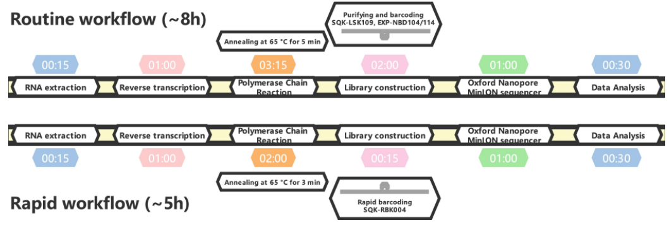
Resequencing approach: Covid-19
Development of rapid workflows, based on amplicon sequencing
Priming systems capable of amplifying the entire genome, via amplicons between 400 and 600 bp in length
It was possible to use protocols very similar to those previously developed for Zika, Ebola and other viruses

Slide 41
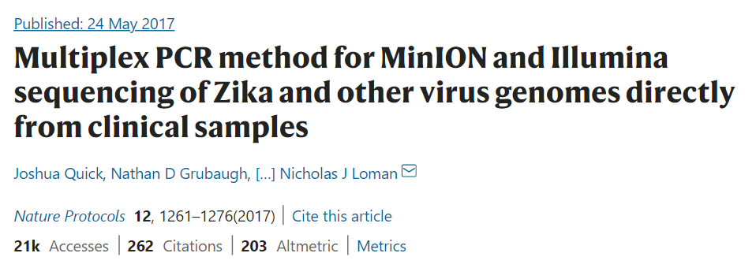
Resequencing approach: Covid-19
Why was it preferred to use an amplicon sequencing approach and not target capture enrichment? Here are some excerpts from a paper that explains it well
«The main benefits of the PCR-based approach […] are cost and sensitivity. In theory, both PCR and cell culture require only one viral copy, making them both exquisitely sensitive. In practice, however, the reaction conditions do not allow single-genome amplification, and, typically, multiple starting molecules are required. PCR also has limited sensitivity in cases in which the template sequence is divergent from the expected because of primer-binding kinetics. However, in an outbreak situation in which isolates are highly related, and low cost per sample and rapid turnaround time are required, PCR is particularly suitable.”

Slide 42
Resequencing approach: Covid-19
About the possibility to use target capture enrichment:
«Such methods, however, are limited by the efficiency of the capture step because of the kinetics of nucleic acid hybridization in complex samples such as those containing the human genome. The complete hybridization of all probes to targets can take hours (typical protocols suggest a 24-h incubation, although shorter times may be possible) and may never be achieved because of competitive binding by the host DNA. These methods suffer from a coverage bias, which worsens at lower viral abundances, resulting in increasingly incomplete genomes, as demonstrated by recent work on the Zika virus. They work best on samples with higher viral abundances and may not have the sensitivity to generate near-complete genomes for the majority of isolates in an outbreak. Probes for hybridization capture are also more expensive than PCR primers because they are usually designed in a fully overlapping 75-nt scheme, which can run to hundreds of probes per virus and thousands for panels of viruses.”

Slide 43
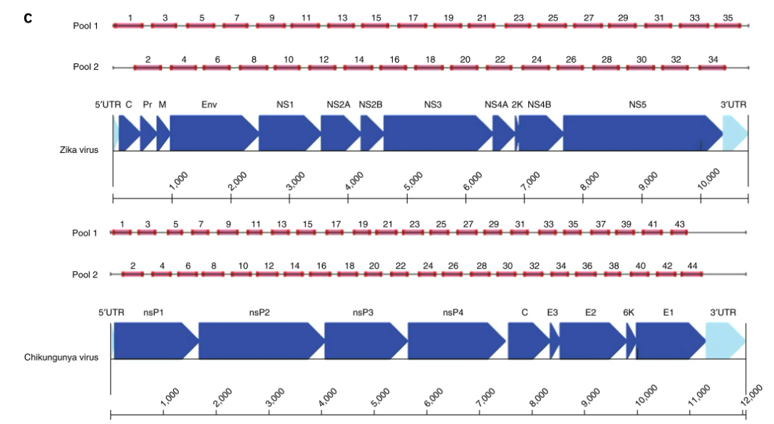
Resequencing approach: Covid-19
The pattern of primers design is critical!
We need to use at least two pools with alternatively designed primers so that the entire viral genome can be sequenced, without unwanted pairing between partially overlapping amplicons

Slide 44
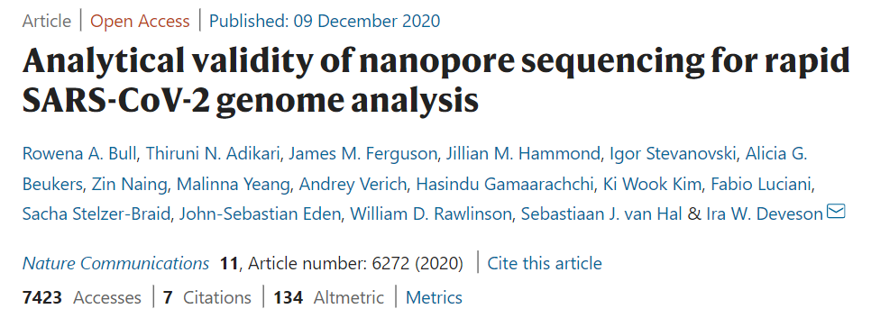
Resequencing approach: Covid-19
Why has ONT sequencing been used so much for SARS-CoV-2 sequencing?
«Viral WGS can be used to study the transmission and evolution of SARS-CoV-2, and is increasingly recognised as a critical tool for public health responses to COVID-19. Nanopore sequencing offers an alternative to established short-read platforms for viral WGS with several advantages. ONT devices: (i) are relatively inexpensive, highly portable and require minimal associated laboratory infrastructure; (ii) enable rapid generation of sequencing data and even real-time data analysis; (iii) require comparatively simple procedures for library preparation and; (iv) offer flexibility in sample throughput, accommodating single (e.g., Flongle), multiple (e.g., MinION/GridION) or tens/hundreds (e.g., PromethION) of specimens per flow-cell. Therefore, ONT sequencing could further empower SARS-CoV-2 surveillance initiatives by enabling point-of-care WGS analysis and improved turnaround time for critical cases, particularly in isolated or poorly resourced setting”

Slide 45
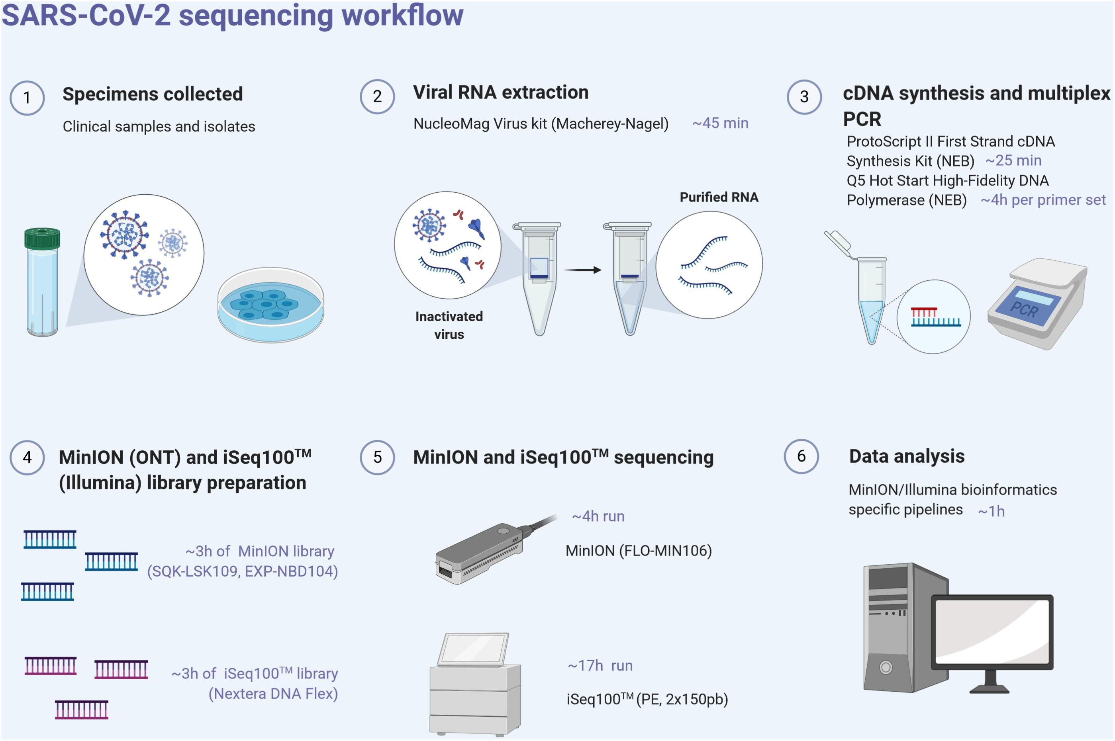
Resequencing approach: Covid-19

Slide 46
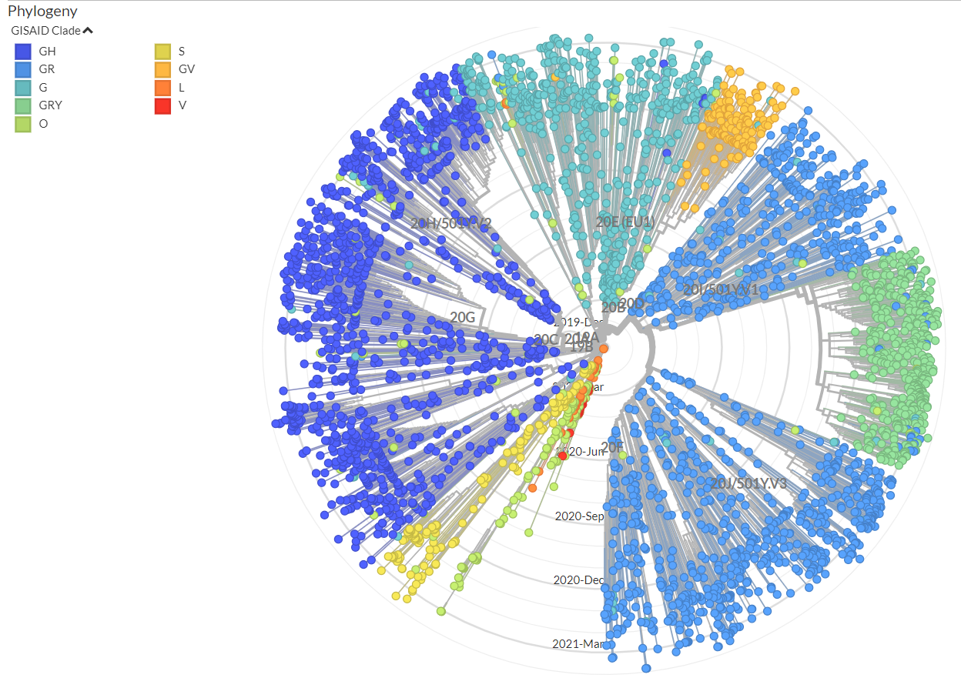
Resequencing approach: Covid-19
GISAID-NextStrain, previously developed for monitorning other viruses (influenza, Zika, West Nile, Ebola, ecc.)
https://www.gisaid.org
Publicly accessible portal to deposit, access and explore SARS-CoV-2 sequencing data
Over 20 million SARS-CoV-2 genomes sequenced

Slide 47
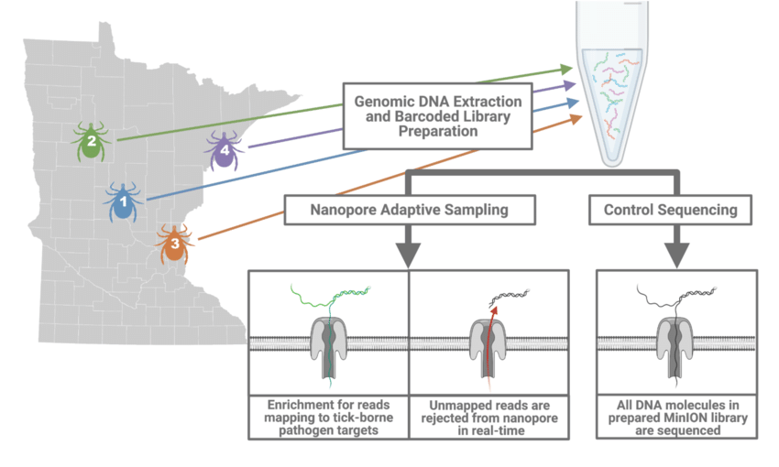
Targeted resequencing: new perspectives
Any targeted resequencing procedure, whether based on the design of primers or on the use of probes for targeted enrichment, requires steps in the laboratory that can be quite delicate, time-consuming, and are in any case subject to bias (amplification efficiency may be variable from target to target, hybridization between probes and genomic regions of interest may not be successful, etc.)
ONT adaptive sampling -> selection of genomic regions of interest is done directly at the sequencer level
How does it work? See the video on Moodle
A database of sequences of interest is provided for resequencing. DNA molecules are read in real-time for each pore, so it is possible to check whether what is being sequenced is of interest (it proceeds) or not (the molecule is discarded, freeing the pore for the next molecule)

