Slide 1
LECTURE 7
RNA-sequencing

Slide 2
RNA-sequencing: a definition
RNA-sequencing (often referred to simply as RNA-seq) is a technique for identifying RNA molecules and quantifying their expression in a biological sample
As misleading as the term may be, in reality this sequencing method requires retrotranscription of RNA to cDNA before proceeding with library preparation, with some exceptions where RNA molecules can be sequenced directly (e.g., ONT techniques)
Although it is a technique that potentially allows analysis of all different classes of RNA molecules, in reality it is most often focused on messenger RNAs or small RNAs (miRNAs)
Although it has always been a technique dedicated to the analysis of gene expression levels, in reality it can also be used to study other more properly structural aspects (e.g., alternative splicing and the presence of RNA editing) or to generate de novo assemblies of transcriptomes

Slide 3
RNA-sequencing: why do we analyze RNA?
Regulation of mRNA transcription directly influences protein synthesis and consequently protein abundance at the cellular level
Protein abundance in turn determines the cellular phenotype
Dysregulation of gene alteration is often the basis for disease development
Spatiotemporal regulation of gene expression regulates tissue development and response to environmental stimuli
Genomic sequencing can reveal the presence of polymorphisms and identify the presence of transcriptional control elements in the promoter of genes, but cannot provide direct (but only indirect) information on gene expression levels, which depend on countless intrinsic and extrinsic factors

Slide 4
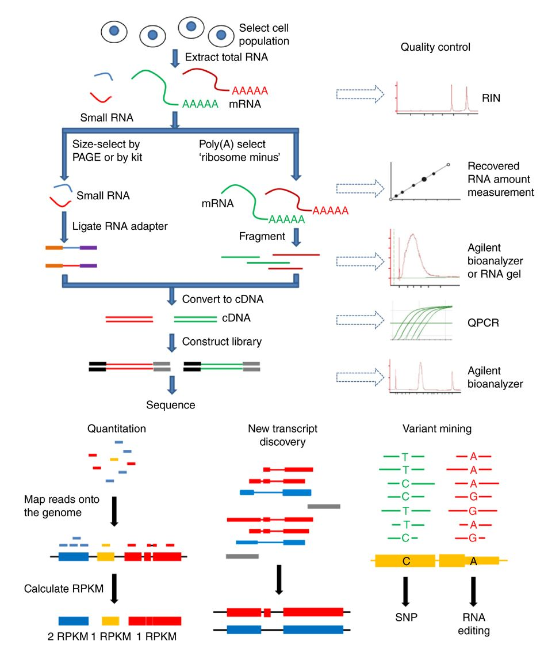
RNA-seq workflow
We see here a general outline of all the different steps that need to be considered in an RNA-seq experiment
Extraction of total RNA from the sample and verification of its quality
Selection of RNA classes of interest
Eventual fragmentation
Conversion to cDNA
Construction of sequencing libraries
Quality control of sequencing libraries
Analysis depending on the type of application

Slide 5
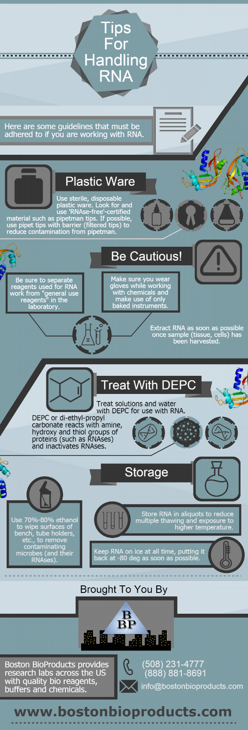
Extracting RNA from biological samples
Any extractive process requires the destruction of cells in the presence of detergents (sometimes by mechanical methods, depending on the biological starting material), and chaotropic agents (which cleave the binding between nucleic acids and proteins)
The goal of the extraction process is to obtain pure and intact RNA
RNA is a much more labile and perishable nucleic acid than DNA, partly because of the action of RNases, very stable enzymes capable of degrading RNA
It is therefore necessary to take special precautions when working with RNA
Labs working with RNA usually set up sections where only this nucleic acid is handled

Slide 6
How to handle RNA?
1)Keep reagents and consumables (e.g., plasticware) used for RNA extractionseparate . Avoid contact with kits containing RNase
2)Process samples as quickly as possible (but NOT in a hurry!) and keep them on ice
3)Use gloves and work in a clean environment
4)Use RNase-free water. To ensure its cleanliness, 0.05% DEPC (diethyl pyrocarbonate) can be treated, then destroyed by autoclave treatment
5)Heating the glassware to 250° can remove the Rnases
6) Appropriate RNase-free plasticware can be purchased from many suppliers. Combined treatment with NaOH and EDTA can remove contamination

Slide 7
Stabilizing extracted RNA
Ideally, RNA should be processed immediately to prepare sequencing libraries, but if this is not possible, preservatives should be used
The simplest and most intuitive method is immediate freezing of samples in liquid nitrogen before extraction, with storage at -80°C
A number of reagents have also been developed to preserve intact RNA in dissected tissues by immersion and penetration (N.B. these need to have been sufficiently minced). RNAstable (Biomatrica) and RNAlater (Qiagen)
RNAlater is a liquid solution that involves freezing the sample in each case. RNAstable results in vitrification of the sample
Following extraction, the RNA must be solubilized in buffers that usually contain TRIS and sodium acetate (to stabilize pH) and guanidinium salts, which act as chaotropic agents to denature proteins, including RNases

Slide 8
Extraction methods
Ionic detergents help solubilize lipid membranes: sodium dodecyl sulfate (SDS), sodium lauroyl sarcosinate (sarkosyl), cetyltrimethylammonium bromide (CTAB)
Particularly fibrous tissues can be difficult to treat because of the presence of collagen and connective tissue. A good strategy may be to provide a digestion step via proteinase K. For tissues rich in fat, an extraction mode using phenol/chloroform should be preferred
The phenol/chloroform extraction process creates two distinct phases. In the upper one the RNA remains solubilized, and in the interface the genomic DNA remains. N.B. in taking the upper phase it is always advisable to “sacrifice” part of the volume to avoid introducing contamination of genomic DNA
Alternatively, it is possible to use kits that use solid-phase extraction columns. The method is more expensive, but more practical and allows extraction in very small volumes
Eventual contamination of residual genomic DNA can be removed by treatment with DNase I

Slide 9
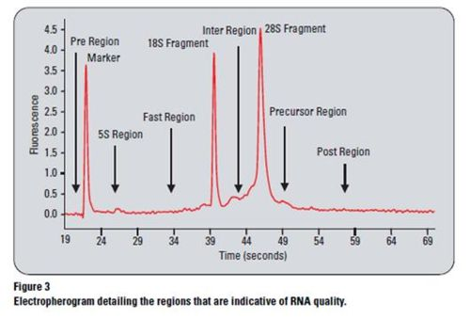
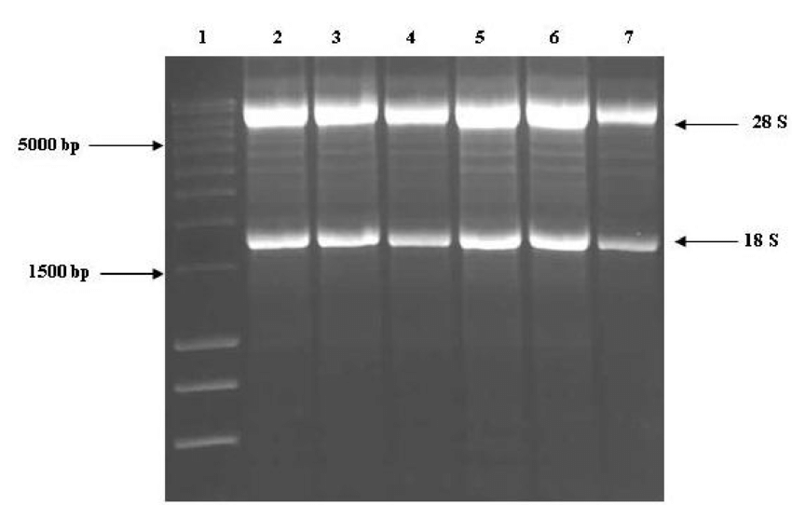
Checking the quality of extracted RNA
RNA quality can be checked by electrophoretic run on denaturing agarose gel. Since it is very abundant, the presence of two very prominent bands corresponding to 28S and 18S rRNA is noted
In case of degradation, the two bands become less obvious and a smear is noticeable
A faster alternative is to analyze an electropherogram obtained with systems similar to Agilent's Bioanalyzer/Tapestation

Slide 10
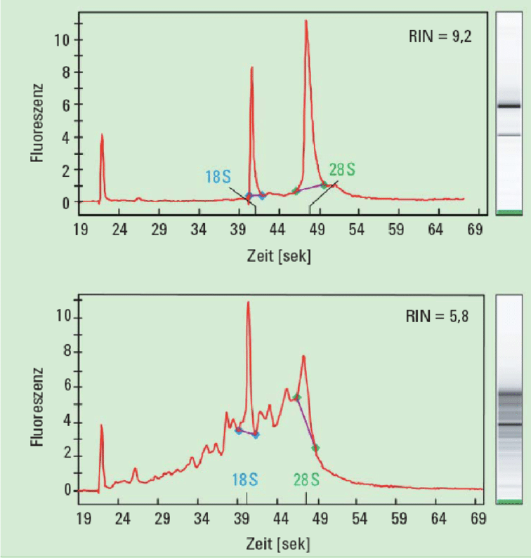
Checking the quality of extracted RNA
RNA quality can be assessed with a metric called RIN (RNA Integrity Number), derived from the ratio of these peaks to the background noise
For the preparation of a shotgun RNA-seq library, it is advisable to obtain a RIN >= 7. For 3'tag libraries (which we will discuss later), a slightly lower integrity level is acceptable
This metric should always be combined with a spectrophotometric analysis to assess the presence of contamination
The input required to prepare an Illumina shotgun library for RNA-seq is usually less than that required for a gDNA library (a few tens of ng)

Slide 11
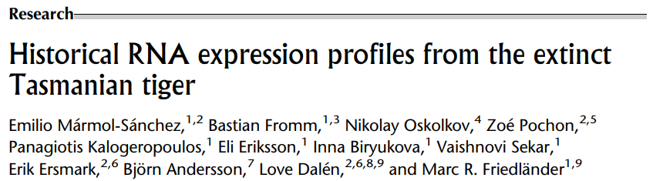
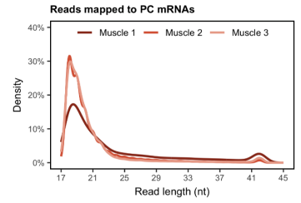
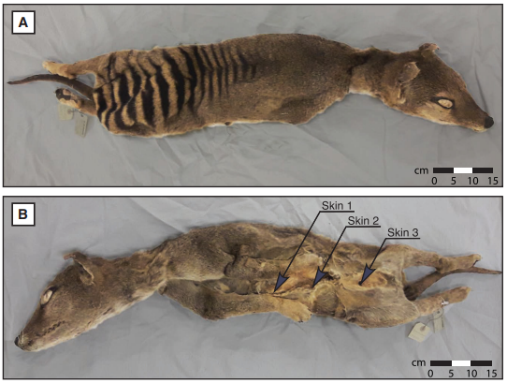
An extreme case: what might happen in case of highly degraded RNA?
Let’s see this brand new pioneering work, which is the first to succeed in sequencing RNA from an extinct species, thylacine
Sample desiccated and kept in museum at room temperature for 130 years
RNA obviously expected to be extremely degraded -> extraction protocol for small RNA, preparation kits used not for classical miRNA-seq libraries
Low mapping rate, high % trimmed reads and high % duplication (useful inclusion of UMI)
Distribution of mapped reads very down-shifted (<20bp, see the graph in the side picture)
High presence of RNA damage (deamination of A's, with A->I mutations, read by the sequencer as A->G, detected by comparison with the genome)
Beware of exogenous contamination! Researchers realized that the spike in reads at about 42 nt resulted from recent contamination, possibly human
FOR THE MORE CURIOUS, THE ARTICLE IS AVAILABLE ON MOODLE

Slide 12
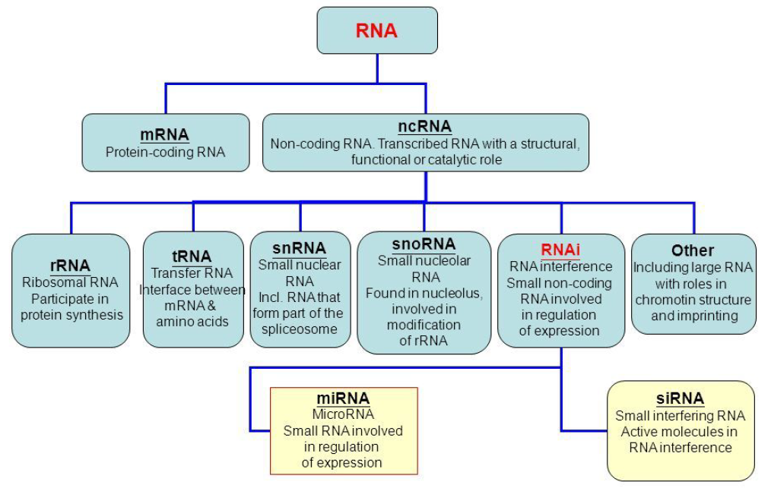
Which type of RNA are we interested in?
The type of RNA molecules in which we are interested determines the type of approach
Important in determining the mode to be adopted to select the molecules of interest
Important in choosing insert sizes and sequencing modes

Slide 13
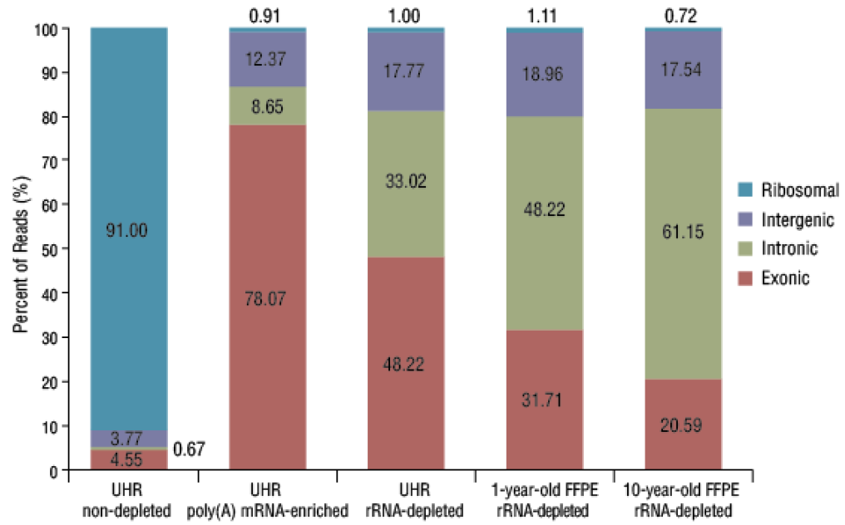
Ribosomal RNA removal
Two alternative approaches:
rRNA depletion
Poly-A selection
This is a necessary step, because more than 90% of the total RNA extracted from a biological sample can correspond to ribosomal RNA, which is abundant in all cells

Slide 14
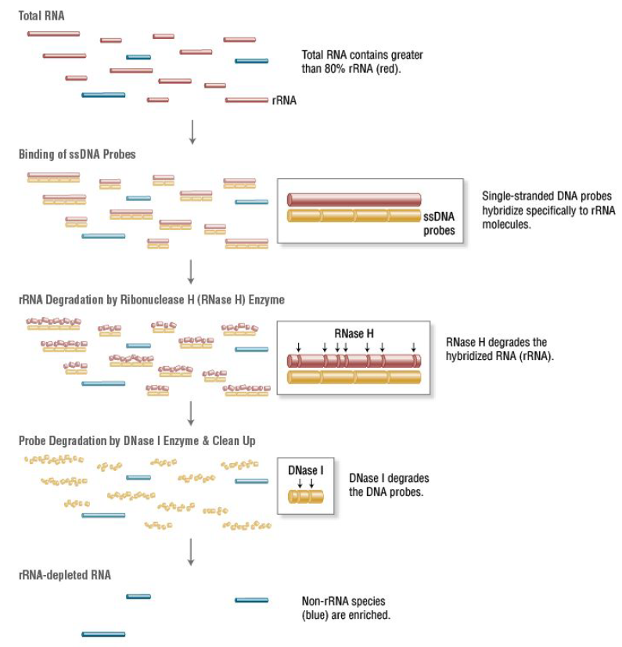
rRNA depletion
Use of single-stranded probes complementary to the sequence of rRNAs
OPTION 1
Use of the enzymatic activity of RNases H, which recognizes RNA/DNA double-stranded hybrids and digest the RNA strand
A second enzymatic step with DNase I removes the DNA probes
Only RNAs of other types remain in solution
Useful if the focus is not only on polyadenylated RNAs
PROBLEM: this does not work very well on non-model organisms whose rRNA sequence is divergent from “standard” ones

Slide 15
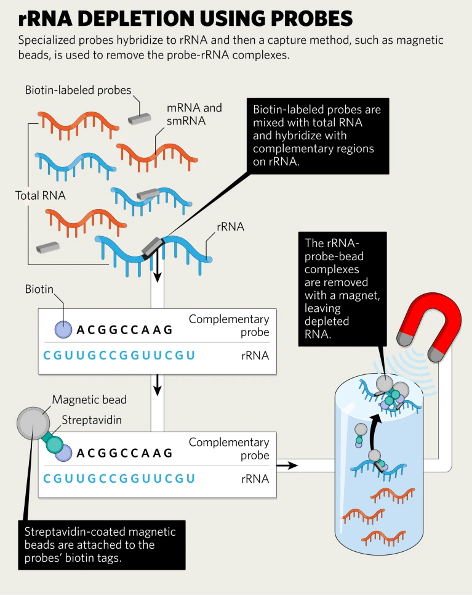
rRNA depletion
Use of single-stranded probes complementary to the sequence of rRNAs
OPTION 2
Use of rRNA complementary probes conjugated to biotin
Pull-down of probe/rRNA complexes using streptavidin-conjugated magnetic beads
Recovery of unhybridized mRNA from the solution
Advantage: no steps requiring enzymatic reactions

Slide 16
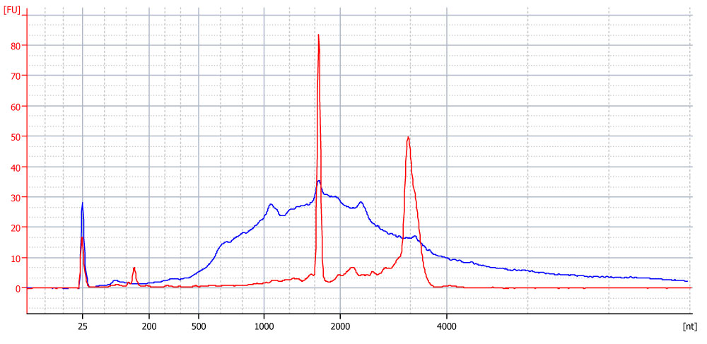
Poly-A selection
Biotinylated polyT probes are exploited to select only polyadenylated RNAs
Optimal strategy for mRNAs, but not ideal for other RNA classes
Allowing removal of more than 95% of ribosomal RNAs
N.B. polyadenylation is a universal signal in eukaryotes, but is not present in some prokaryotes and is used to direct an mRNA to degradation in many bacteria, as well as in mitochondria and plastids
Bioanalyzer profiles of a total RNA sample (red) and of the same sample following polyA-selection (blue)

Slide 17
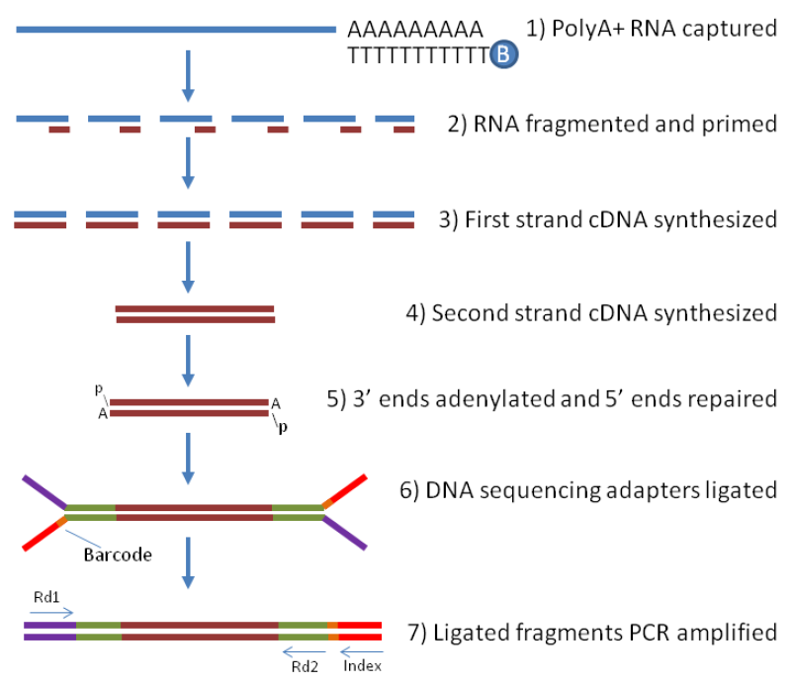
RNA-sequencing: library preparation
The workflow for preparing an NGS library for RNA-seq analysis with Illumina sequencing is very similar to that used for a genomic DNA library
The first step (in addition to gDNA approaches) involves removal of rRNAs, which are very abundant
It is necessary in each case to proceed to fragmentation
This may precede or follow cDNA retrotranscription (see next slide)
From here on, one proceeds as in a gDNA approach

Slide 18
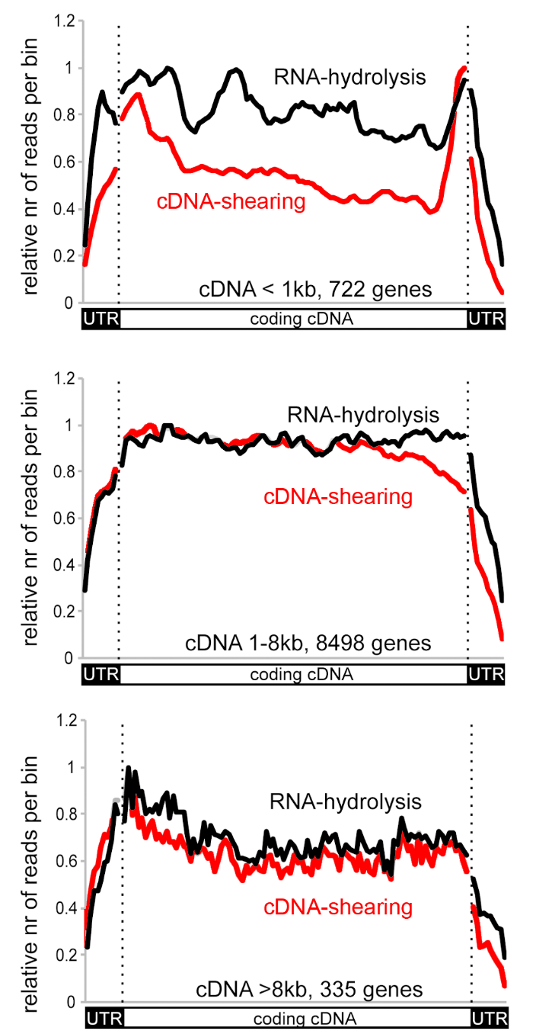
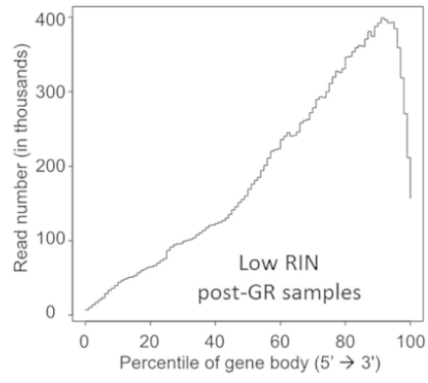
RNA-sequencing: library preparation
The fragmentation step can be performed directly on RNA, or following its retrotranscription into cDNA
A classic “shotgun” library, i.e., resulting from random RNA fragmentation, should generate reads distributed fairly evenly along the entire length of the transcript, but this is not always the case!
Note from the graph opposite the impact that RNA or cDNA fragmentation (post-retranscription) has on the distribution of reads in transcripts of different lengths
Poly-A selection often causes a bias of increased coverage toward the 3' end
As can be seen from the examples opposite, coverage biases are created in transcripts of different length classes
You can see a strong bias toward 3' in the presence of poor quality, partially degraded RNA

Slide 19
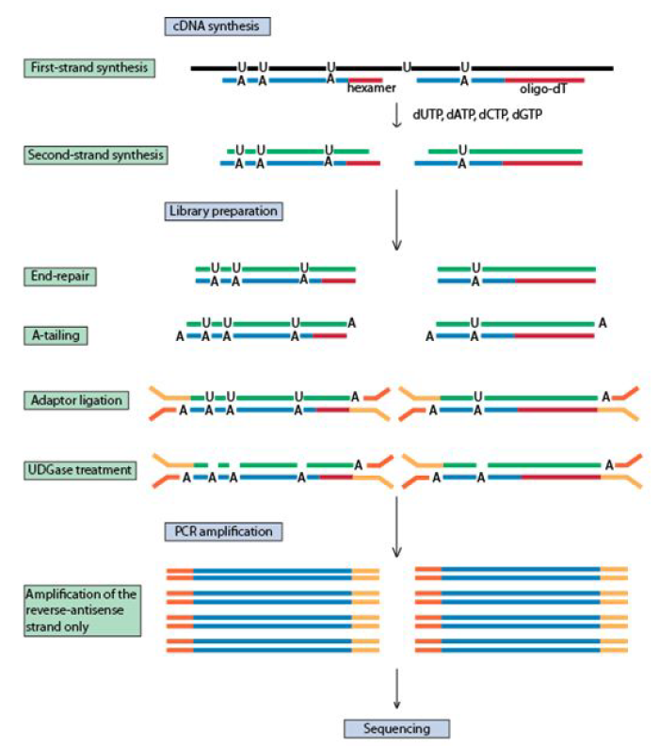
Stranded libraries
While the strand from which sequenced reads are derived in a gDNA approach is not a particularly important information, this information is critical for RNA-seq libraries
Whenever an ORF is present in a transcript, its directionality can be easily identified. However:
1) There is the possibility of antisense transcription
2) Noncoding transcripts (lincRNA and other types) are very abundant
A regular (not stranded) library preparation approach would not allow discrimination between sense and antisense transcripts

Slide 20
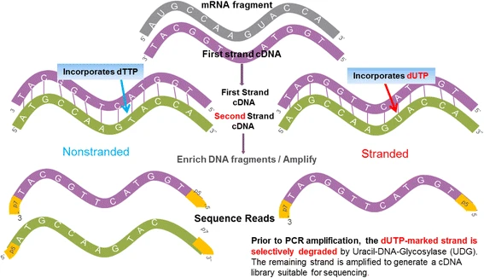
Stranded libraries
In unidirectional (or “stranded”) library preparation protocols, the first strand is synthesized with dTTP in the reaction mix, but the second strand with dUTP
This allows selective degradation of the second strand by the enzyme UDG (uracil-DNA-glycosylase), leaving the first strand as the only strand available for sequencing

Slide 21
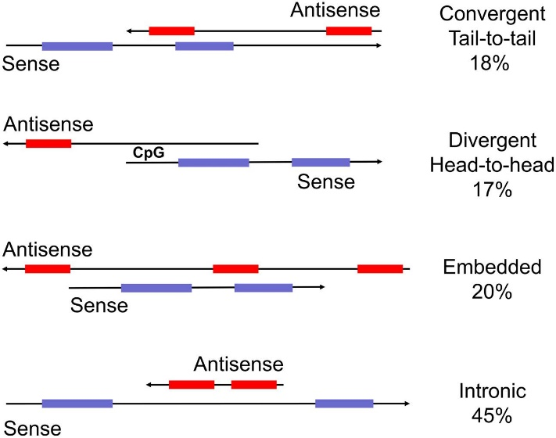
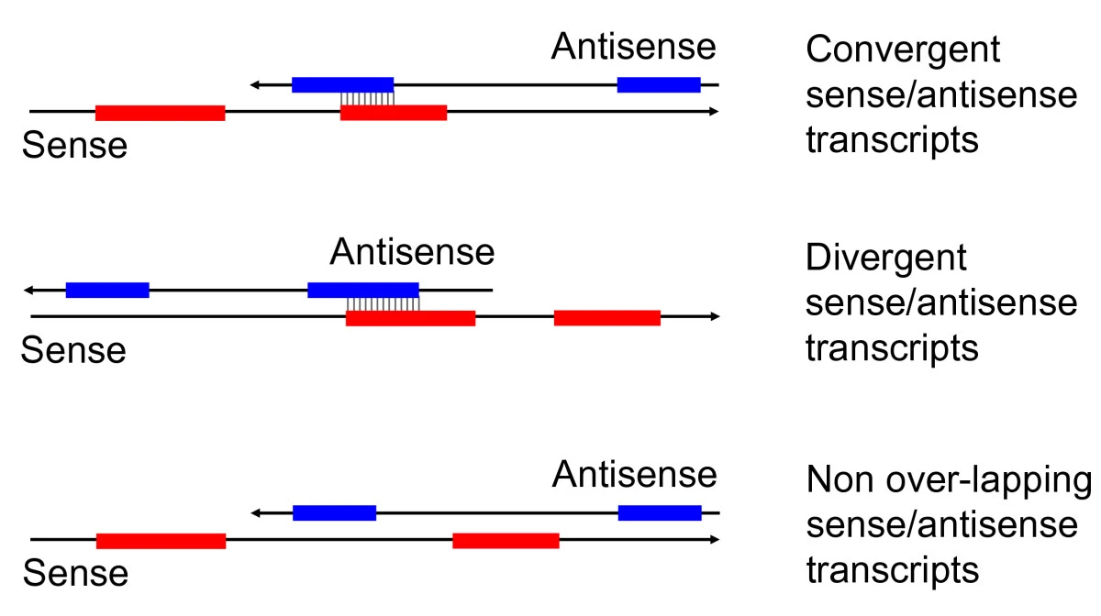
Stranded libraries
The problem of strand-specificity becomes the more relevant the less precise the ancillary information (=annotations) available for a reference genome are
There is a risk of confusing sense and antisense transcript expression signals IF they share partially overlapping exons
The problem is very important in case of de novo transcriptome assembly approaches, i.e., when no reference genome is available for mapping
The risk is to create chimeric transcriptomes that represent bioinformatics artifacts during assembly (especially if the goal is to generate a new transcriptome)

Slide 22
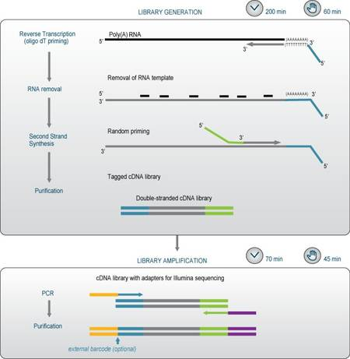
3’-tag libraries
Alternative approach that allows for largely simplified libraries enriched in the 3' end of mRNAs only
The inserts localize to the region in the immediate vicinity of the poly-A tail and thus fall in the 3' UTR
Use a combination of an oligo-dT primer and a random primer
Reduce the number of reads required for each library (less depth -> lower cost per sample)
Limited applications to gene expression studies, but not useful for alternative splicing study
Key technology for single-cell RNA-seq!
Sidebar example: QuantSeq 3' mRNA-Seq (Lexogen)

Slide 23
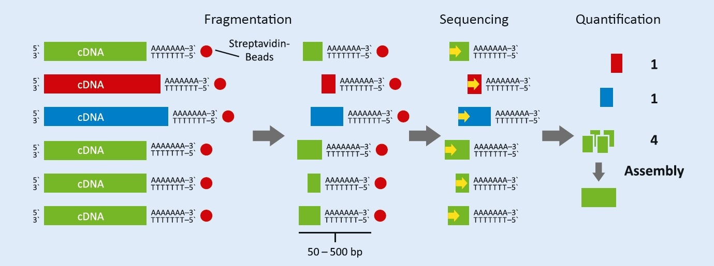
3’-tag libraries
Approach also developed by other companies (e.g., GenxPro MACE, Massive Analyses of CDNA Ends), with the use of biotin-conjugated oligo-dT probes
Main benefits: reduction of sequencing depth required per sample by 10-20 folds, no need for normalization for transcript length

Slide 24
RNA-sequencing: what is the goal?
Gene expression studies : assess which genes and transcripts are expressed in a biological sample and at what level -> comparison between samples for differential gene expression studies. Typically uses short reads (often with 3'-tag approaches, especially in model organisms)
Assessment of the role of alternative splicing, using an assembled genome as a reference. Typically uses long reads
Annotation of an assembled genome, due to alignment of RNA-seq data with scaffolds -> alignment will only occur at exons, leaving holes at introns (can use both short and long reads, with benefits of different types, i.e., high coverage of short reads for annotation of transcripts expressed at low levels vs more accurate annotation of full-length mRNA for long reads)
RNA editing study : by direct comparison of mRNA and gDNA from the same individual, identifying any polymorphisms (very promising direct RNA sequencing approach with ONT)
De novo assembly of transcriptomes: when a reference genome is not available. More practical and less expensive approach, making use of dedicated algorithms different from those used for de novo assembly of genomes (short or long reads)

Slide 25
RNA-sequencing: what is the goal?
The first question to ask yourself when proceeding with an experimental design is to whether you intend to collect qualitative data vs. quantitative data
Qualitative data : identification of expressed transcripts, exon-exon and exon-intron junctions, transcription start and polyadenylation sites -> basically everything related to the annotation of a transcript (and the corresponding gene). They include reference-based approaches (using a previously annotated genome as a reference) and de novo approaches (assembly from scratch of a transcriptome, e.g., in a non-model organism)
Quantitative data: estimating the expression levels of a transcript and the differential effect of a condition or treatment on the expression level of various splicing isoforms in an experiment that usually includes several biological replicates

Slide 26
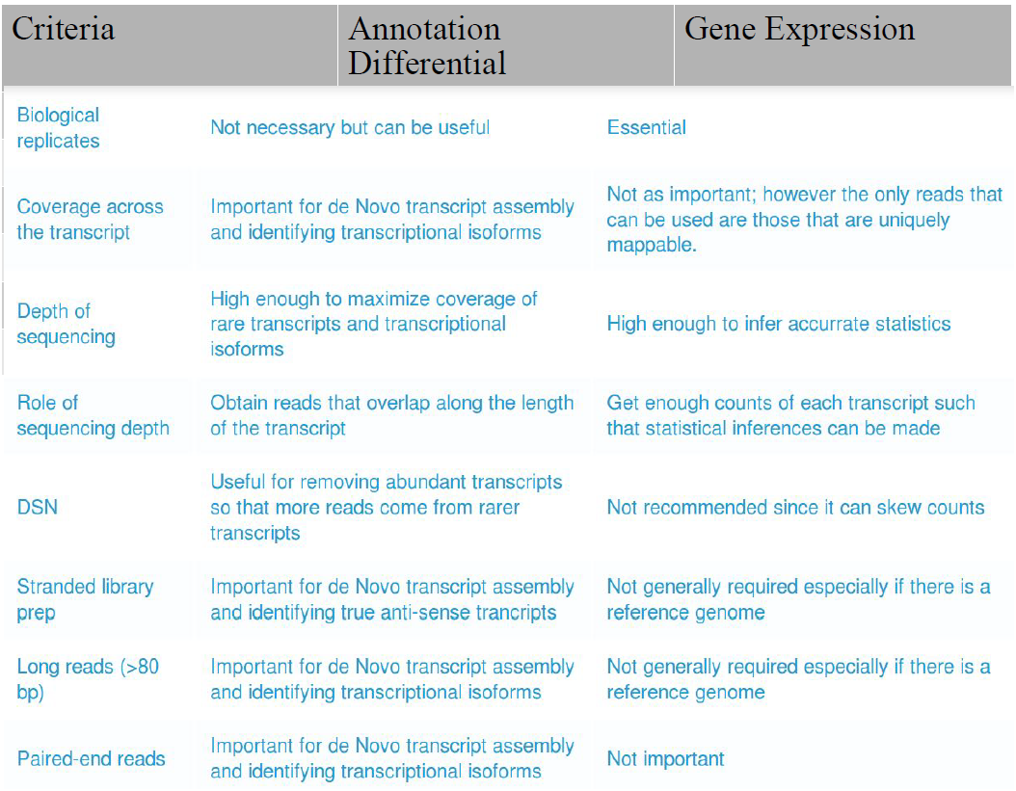
RNA-sequencing: what is the goal?
The table summarizes the key factors to be considered in the experimental design of an RNA-seq experiment

Slide 27
Qualitative data - challenges
The main objective of such an approach, i.e., to provide an accurate annotation of a transcript, can be achieved only with uniform coverage of the transcript throughout its length
No 3'tag approaches! It is necessary to achieve a classical shotgun library, in which the fragments are equally distributed along the entire length of the transcript, reducing positional bias
Problem #1: reads are almost always much shorter than the transcripts themselves (problem solvable with PacBio or ONT sequencing approaches, at the expense, however, of the lower number of reads obtained, which could lead to losing sight of poorly expressed transcripts visible only with Illumina ultra-high depth approaches)
Problem #2: Lack of a reference genome -> difficulty in obtaining the complete sequences of some complex or poorly expressed transcripts via de novo assembly approaches

Slide 28
How to choose read length?
For quantitative approaches based on mapping reads against an annotated reference genome, single-end sequenced Illumina reads are sufficient. The length of the reads is not critical; it is sufficient that it allows the reads to be mapped uniquely (together with the use of appropriate mapping parameters)
A single-end approach is also ideal for a 3'tag approach, again with short reads (50-100 nt)
A paired-end approach is essential for obtaining a de novo assembly of a transcriptome or for studying alternative splicing events (also for annotating a genome due to alignment with reads derived from RNA-seq)
An approach based on PacBio or ONT reads can allow whole transcriptomes to be sequenced end-to-end, providing very useful information to study alternative splicing in a better way than Illumina reads (it is difficult with short reads to correctly image splicing events that are far apart)

Slide 29
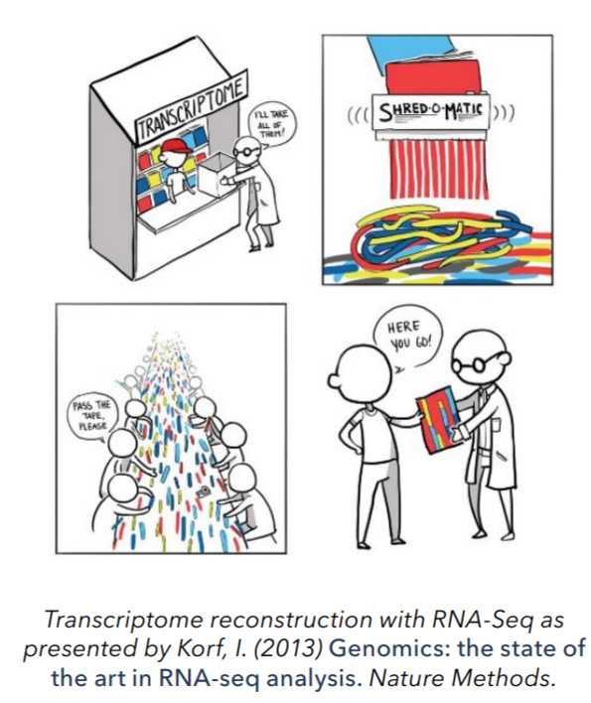
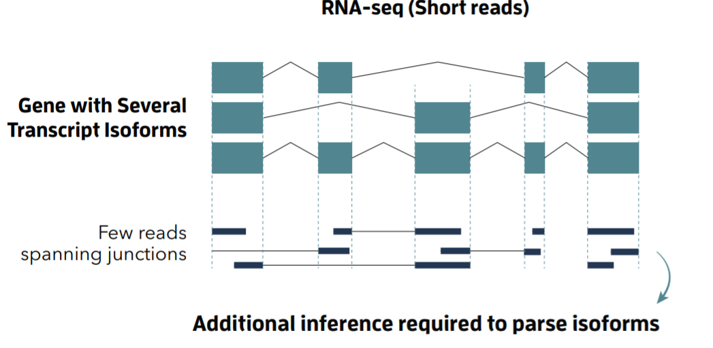
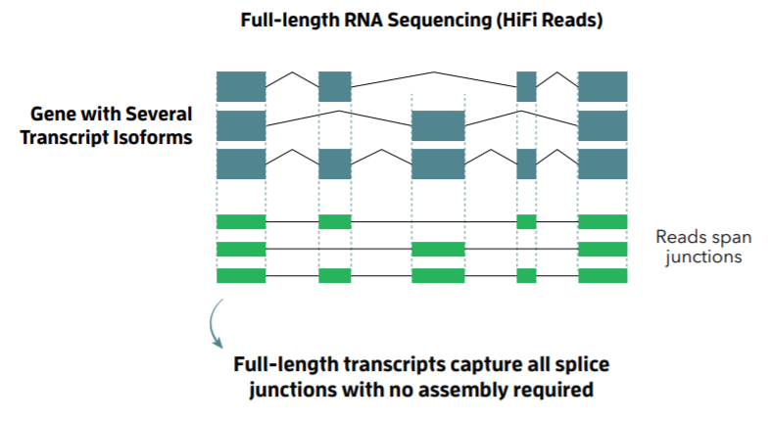
Long reads in transcriptomics
PROs: no need for assembly, possibility to study whole molecules; possibility to avoid retrotranscription step with ONT methods
CONs: high cost, lower throughput, higher error rate (be careful not to confuse errors and SNPs)
Possible applications: study of gene fusion events, alternative splicing

Slide 30
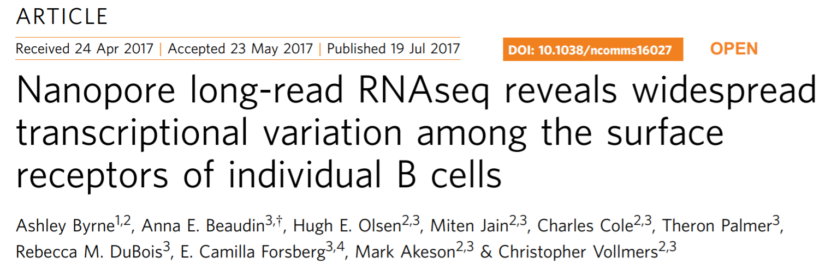
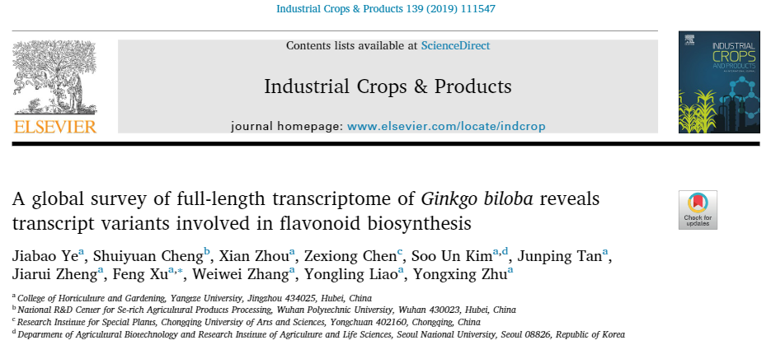
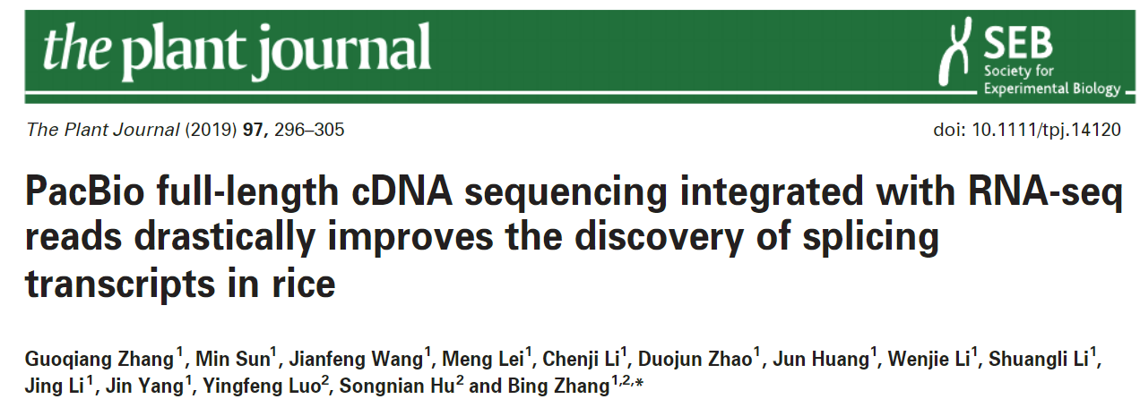
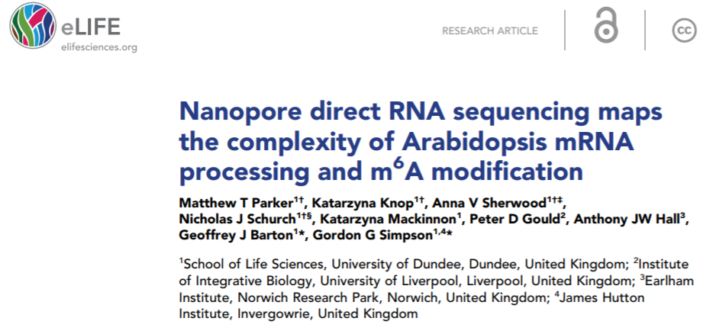
Long reads in transcriptomics

Slide 31
RNA-sequencing: some important additional info
Cellular mRNA content is not stable and depends on tissue, cell type and developmental stage, as well as cell cycle stage
Typically, however, to simplify calculations, we can consider that a cell of any mammalian tissue may contain about 10 to 30 pg of RNA -> much higher content than that of genomic DNA
In a single cell we assume to find up to 350 thousand mRNA molecules at the same instant, which can be traced back to about 12 thousand transcripts of different lengths (on average about 2 Kb)
Many of the genes encoded in the genome are not expressed in a particular tissue or cell type
Representation of transcripts is very unbalanced: some correspond to as much as 2-3% of total expression (produced by strongly tissue-specific and major genes), while others may be represented by as few as 10 mRNA molecules per cell

Slide 32
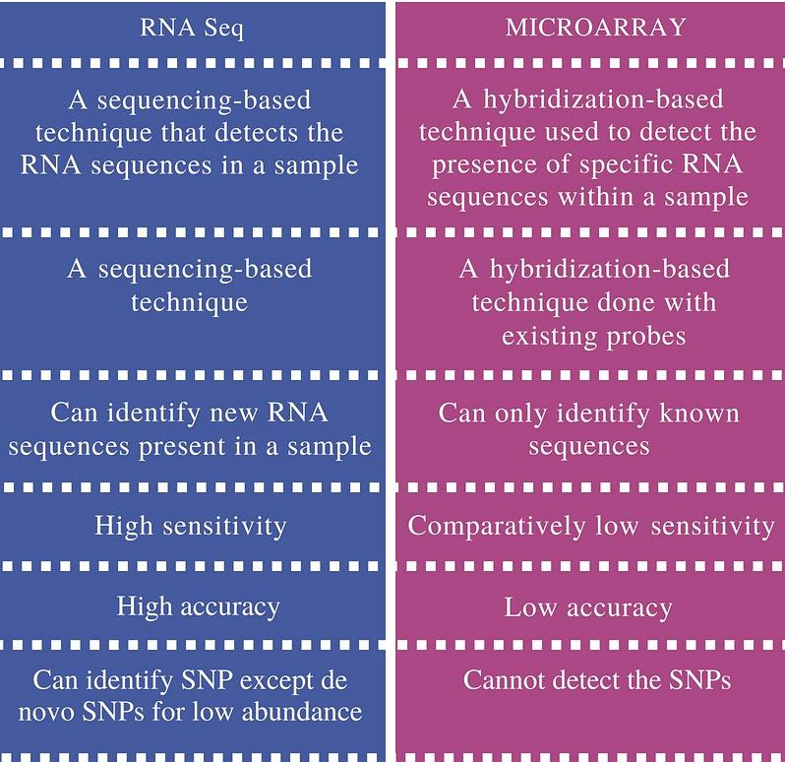
RNA-sequencing vs microarray
Except for some applications in model organisms, RNA-seq approaches have rapidly replaced microarray approaches due to several reasons
The first and most obvious is that microarray approaches do NOT allow the discovery of new transcripts
The sensitivity of RNA-seq methods, especially for genes expressed at low-to-medium levels, is much higher
Since they are based on competitive hybridization, microarrays are intrinsically inaccurate

Slide 33
Quantitative approach - challenges
There are many sources of variability among test samples, which should be taken into account in experimental design
1)Sampling variability: although sequencing potentially yields several tens of thousands of reads, these represent only a fraction of the totality of RNA molecules present in a biological sample. Particularly with low sequencing depth, errors could be introduced in the quantification of poorly expressed transcripts
2)Technical variability: dissection procedures, RNA extraction, sequencing library preparation itself may introduce biases
3)Biological variability: there are inevitably inter-individual variations, or even variations in the same individual potentially related to a wide variety of environmental factors. This is an inherent feature of complex biological systems

Slide 34
Experimental design: how many (and which type) of replicates do we need?
Decision regarding the number and type of replications (technical or biological) depends on a number of intrinsic and extrinsic factors
Extrinsic factors : easy to identify. They include the availability of samples (sometimes the rarity of samples, or the presence of regulations are limiting factors), the technical feasibility of the experiments, and often also the availability of funds
Intrinsic factors : much more difficult to identify, they are related to the complexity of the biological systems of interest. What is the expected level of inter-individual variability? How many samples might I need to obtain statistically robust data?
Technical replicates or biological replicates? Unless one is specifically interested in investigating technical aspects of RNA-seq it is always advisable to invest available funds in increasing the number of biological replicates. This is done while being careful to limit as much as possible the presence of factors that could lead to differences in the way samples are processed

Slide 35
Experimental design: how many (and which type) of replicates do we need?
The number of replicates considered has a direct influence on the number of type I and type II errors (false positives and false negatives) expected to be found
There is no precise rule to follow regarding the number of biological replicates to be analyzed, but nevertheless, it is possible to limit the risk of errors by trying to find an ideal combination of sequencing depth and number of biological replicates
To limit “background noise” in the experiment one should aim to achieve a number of reads greater than about 20 million per sample in a “classical” RNA-seq experiment (shotgun library), which can be reduced by about a factor of 10 (2 million reads per sample) for a 3'-tag library
These numbers are applicable to Illumina libraries and refer to experiments whose goal is to calculate gene expression levels
The minimum number of biological replicates to be considered is 3, but having funds available it would be desirable to increase this to at least 5 or more, depending on extrinsic factors that might pose problems

Slide 36
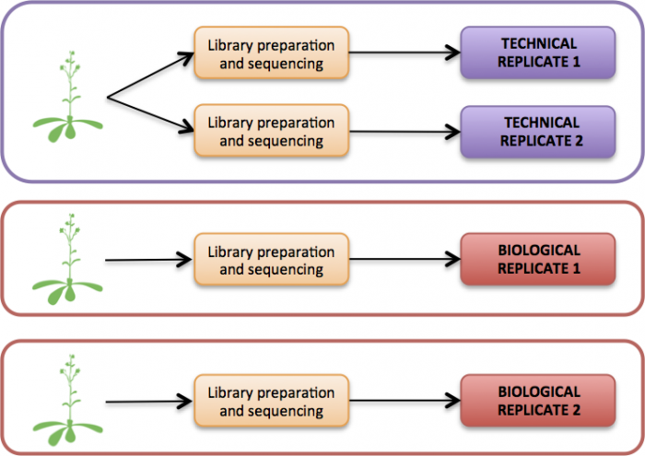
Experimental design: how many (and which type) of replicates do we need?
If the weight of intrinsic factors were difficult to assess a priori and the experimental setup was not particularly complex/there was ample availability of biological samples, it would be a good idea to plan to sample a very large number of biological replicates (even 10 or 20)
Preliminary sequencing of a limited number of replicates (3 or 5) could provide useful indications for choosing the final number on which to conduct the analysis

Slide 37
Quantifying gene expression levels in RNA-seq experiments: not a trivial task!
Gene expression levels are derived from digital counts, i.e., the number of reads that were mapped to genomic coordinates where annotations of each gene were present (better yet, to regions annotated as exons)
The number of reads per gene/transcript depend on:
Expression level
Transcript length
Sequencing depth

Slide 38
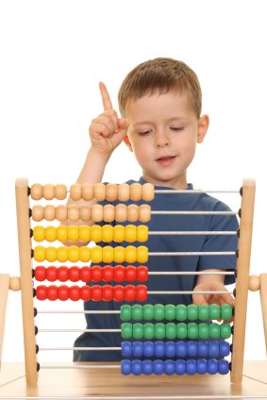
Expression level calculations: the basics
Align reads with a reference genome/transcriptome
Count the aligned reads for each gene/transcript
Convert the counts into relative expression levels
The mapping parameters are important, but even more important are the strategies with which to manage the counts and convert them to numerical values that allow for proper biological interpretation of the results

Slide 39
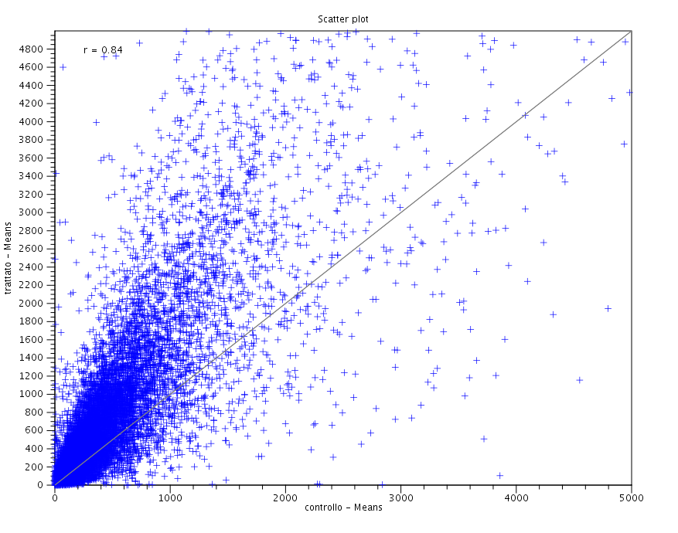
What about using raw read counts?
Risk of not taking into account different sequencing depth (quantification of libraries is not always accurate!)
See this case: the “treated” sample evidently was sequenced with greater depth -> all transcripts appear to be upregulated!
SCATTER PLOT: each point corresponds to a gene/transcript, with expression values plotted on the two axes -> allows pairwise comparison between 2 samples
In the example in the figure, the treated sample consists of about 60 Mreads, the control of about 20 Mreads... There is a 3X factor difference!

Slide 40
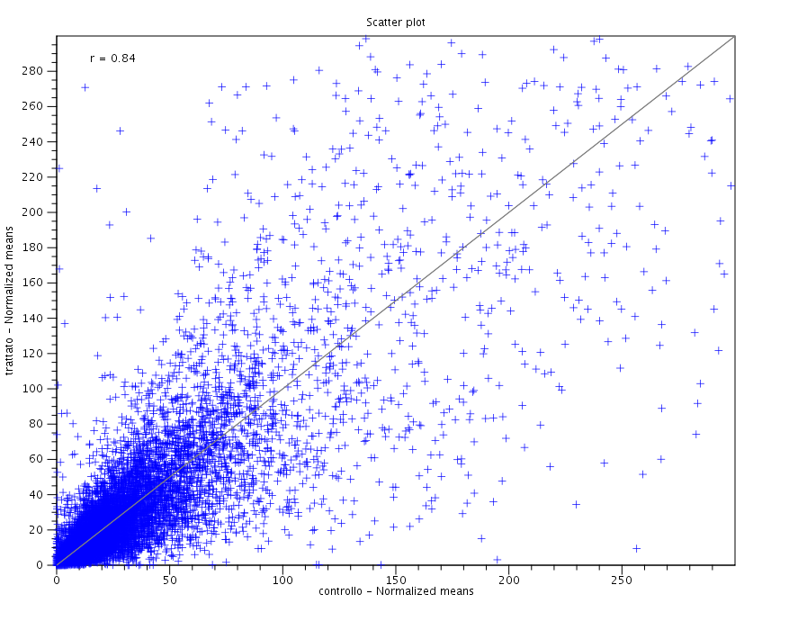
We need to normalize gene expression levels
Simplest case: normalization “by totals”
I normalize the counts so that the number of reads obtained for each library is the same
The sum - tory of the counts will have to give me the same number! -> e.g. counts per million (RPM, Reads Per Million, also called CPM - Counts Per Million)
Following normalization of the counts, the scatter plot is much more homogeneous, and we no longer notice many genes that deviate significantly from the bisector

Slide 41
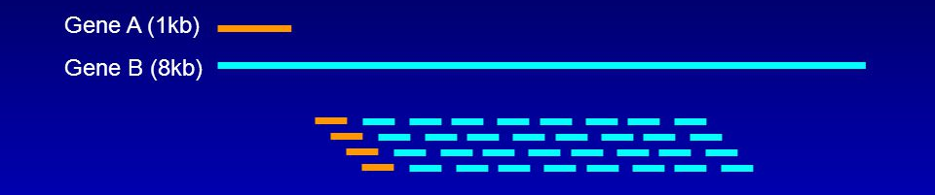
Is normalization «by totals» enough?
For many applications it may be sufficient
This is a type of “between-sample” normalization
However, it does not allow us to appreciate differences in expression between genes within the same sample
This happens because the length of mRNAs is variable: long mRNAs will, for the same expression, give rise to more reads than short mRNAs
The two genes above are expressed at the same level, although gene B generated 8 times the number of reads of gene A

Slide 42
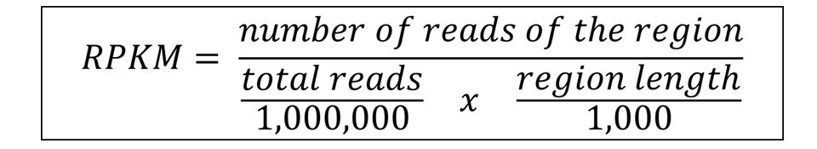
«within samples» normalization
RPKM (Reads Per Kilobase of exon per Million mapped reads)
It also normalizes “within samples” (uses length of transcripts as scaling factor)
THEORETICALLY it should also normalize “between samples” (uses number of total mapped reads, dependent on sequencing depth as scaling factor)... but we will see that in reality this type of measurement does not allow efficient comparison between samples

Slide 43
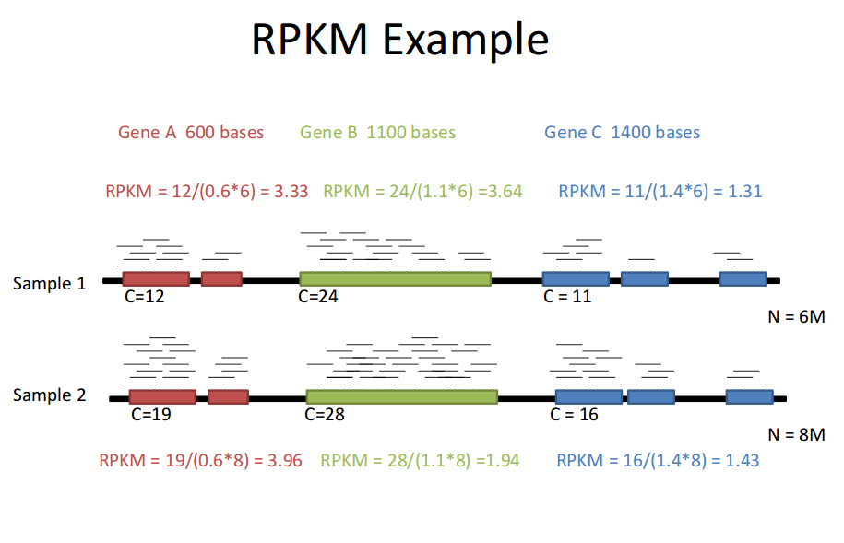
C = counts; N = total number of mappable reads (depends on sequencing depth!)

Slide 44
What is the difference between FPKM and RPKM?
FPKM = Fragments Per Kilobase of exon per Million mapped reads
The concept is the same as for RPKMs
The fragments, however, are counted, i.e., Paired-End reads (each pair of reads derive from a single insert)
This measure makes sense only for Illumina Paired-End sequencing.

Slide 45
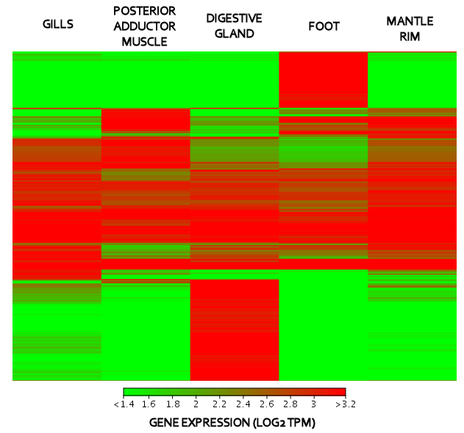
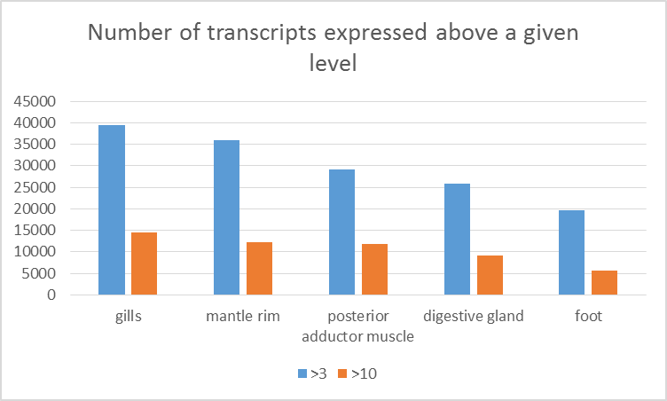
Not all samples are equal!
Some tissues (but also experimental samples!) will produce a few genes at very high levels that will “capture” most of the reads of a sequencing
Others will be less specialized and have a more even distribution of reads
The number of genes not expressed in different tissues/samples may vary!
This has an important effect on the units to be used for comparison between samples!

Slide 46

Let’s introduce a new metric: TPM
The summation of the RPKM/FPKM in the different samples will give me different values! RPKM/FPKMs are a “misleading” measure, since while they normalize for sequencing depth, they do not actually guarantee comparability “between samples”
TPM = Transcripts Per Million
This metric converts RPKM/FPKM so that their total sum reaches 1 million
This measure should make expression levels between samples more comparable, while maintaining comparability of expression levels between genes in the same sample such as RPKMs

Slide 47
However...
There is no way, with bioinformatics methods, to ensure direct comparability between samples
TPMs attempt to approximate an accurate measure, but are still dependent on the number of transcripts expressed (which can vary from cell to cell and tissue to tissue)
Take home message: comparing expression levels between different samples must always take into account the fact that we are working with relative abundances and not absolute abundances
If I wanted to obtain absolute measurements, I would have to rely on synthetic “spike-in” transcripts inserted with known concentrations at the library preparation stage

Slide 48
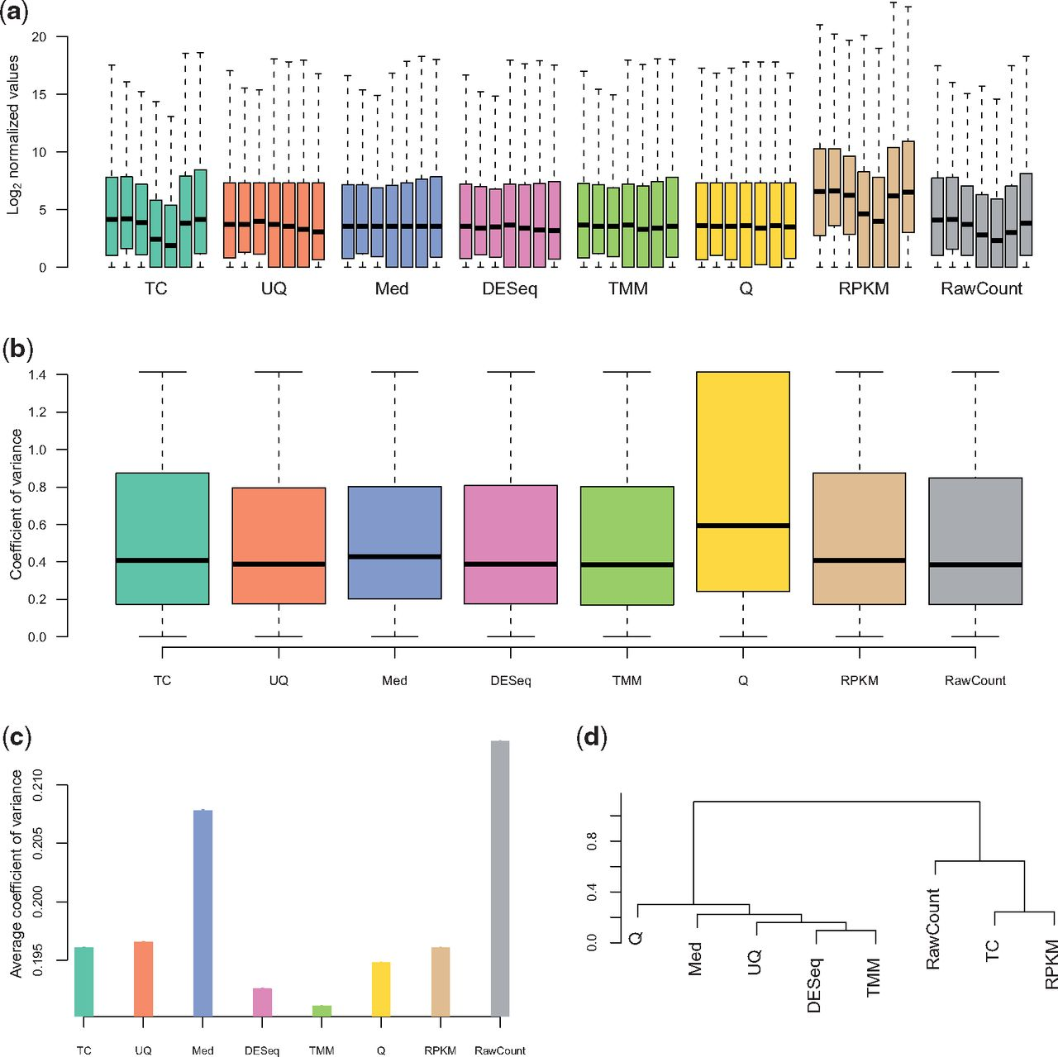
Many different strategies for normalization of RNA-seq data exist
They all have their advocates and detractors
It should benoted that only TPMs guarantee both “between-samples” and “within-samples” normalization
Many differential gene expression statistical analysis methods do not take transcript length into account, as they are more focused on comparing genes in different samples, and less on comparing different genes in the same sample

Slide 49
Another issue: how to handle reads mapping on multiple genes?
Each gene has several alternative splicing variants, annotated in the various genomes
In addition, some algorithms for de novo assembly of transcriptomes do generate splicing isoforms (e.g., the most popular method to date, Trinity)
Paralogous genes can be identical or nearly identical
Problem that varies by species
For example, in salmonid fish (WGD)
Less relevant with long reads
Less relevant with PE reads
How do I handle them?

Slide 50

Another issue: how to handle reads mapping on multiple genes?
Option 1: I discard them and use only the reads that map uniquely -> bad idea
Option 2: I map the unique reads first and then redistribute the multiple reads proportionally -> good idea
Option 3: I develop an algorithm that optimizes this system -> best idea -> Expectation-Maximization algorithms

Slide 51
From Patcher, MODELS FOR TRANSCRIPT QUANTIFICATION FROM RNA-SEQ, 2011

Slide 52
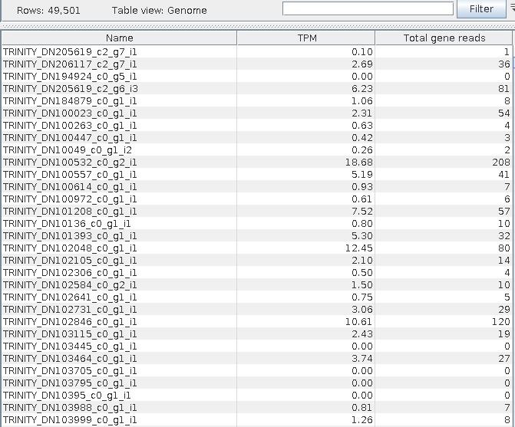
Which values are compared during a differential gene expression analysis?
Comparison between samples (or between groups of samples) is basically derived from the results from a mapping of reads to a reference genome or transcriptome
This process generates counts that can be normalized and converted into a set of gene expression values (RPKM, TPM, CPM, etc.)
The output obtained for each sample is then a numerical matrix, a table that associates an expression level with each gene or transcript. Each individual sample will be matched to its own table with expression levels

Slide 53
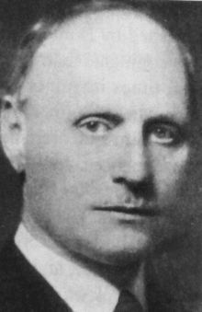
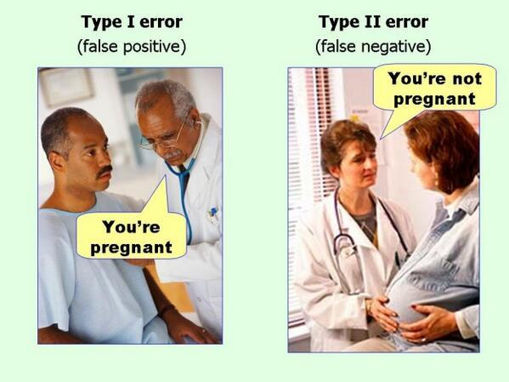
Key factors to be considered for a differential gene expression analysis
Comparison between samples (or between groups of samples) allows the identification of differentially expressed genes, and is therefore referred to as a differential gene expression (DGE) analysis
Detected genes (or transcripts) are marked with a fold change (FC) indicating the intensity of altered expression compared to a control. Its sign identifies down-regulated (sign -) or up-regulated (sign +) genes
However, the FC alone does not give us a measure of significance, which is given by a p-value, which is usually corrected to limit the number of false positives (type I errors) in multiple tests, with the False Discovery Rate (FDR) or Bonferroni correction method

Slide 54
Key factors to be considered for a differential gene expression analysis
Fold change cannot suffice because a comparison of two very small expression values (e.g., 0 and 0.000001) will give us a FC = +infinity...but we know very well that the value 0.000001 is not biologically significant and that, since expression values are derived from the number of reads counted, this comparison could be derived from zero counts vs. 1, thus values fully compatible with the case
FC and corrected p-value are calculated by a statistical analysis that considers the sample(s) of interest versus a control and of course varies depending on the number of technical or biological replicates available and the experimental design
The type of statistical test to be used in the various cases, however, will not be the subject of this course. However, let us recall its outputs: a list of genes or transcripts, paired with FC and corrected p-value

Slide 55
Key factors to be considered for a differential gene expression analysis
It is critical to start with correct expression values (usually normalized counts over total or TPM) to allow for proper comparison between samples (between samples)
Also important is the graphical display of results that can help us better understand how p-value and FC are determined
We usually use logarithmic or square-root transformation of expression data to distribute them more evenly in Cartesian space. This transformation has no effect on statistical analysis (which must analyze normalized, but not transformed, expression levels!) and serves only for graphical purposes

Slide 56
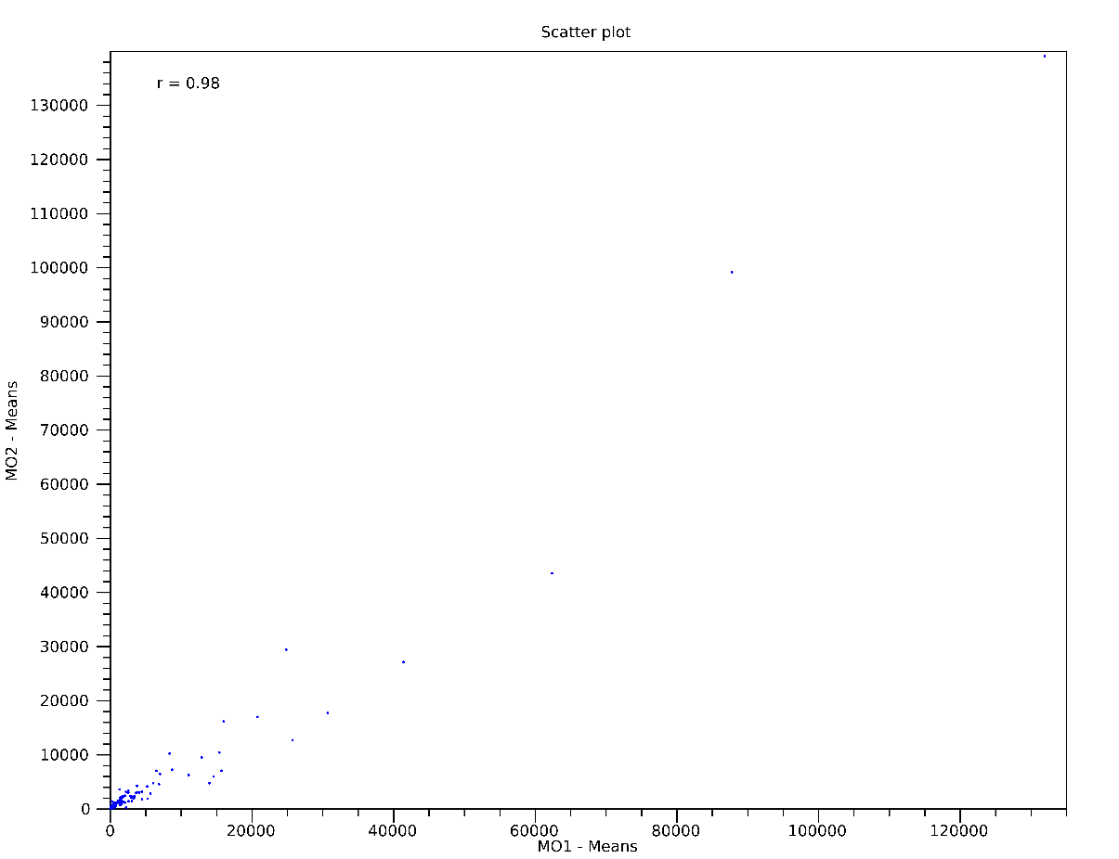
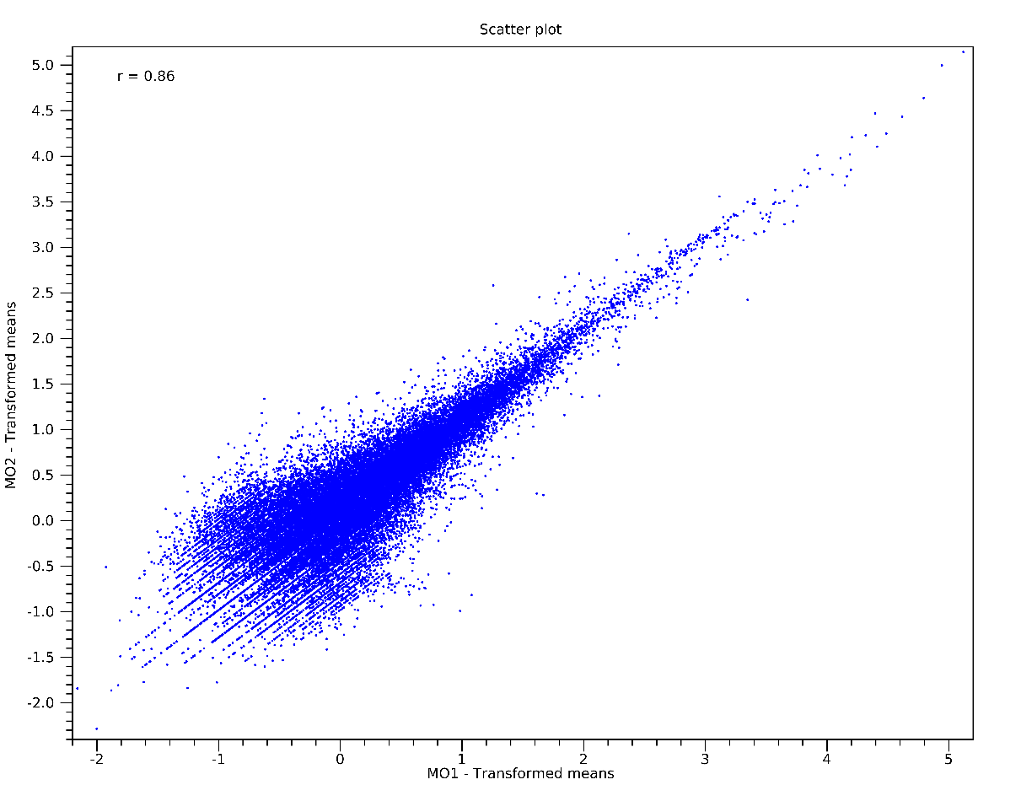
Logarithmic transformation of gene expression values
TPM log10 TPM
The two graphs show the same data! As you can see, however, in the graph on the left (normalized but untransformed data) all values are squashed toward the axis origin -> there are few highly expressed genes and most have medium/low expression levels. The graph on the right distributes them much better

Slide 57
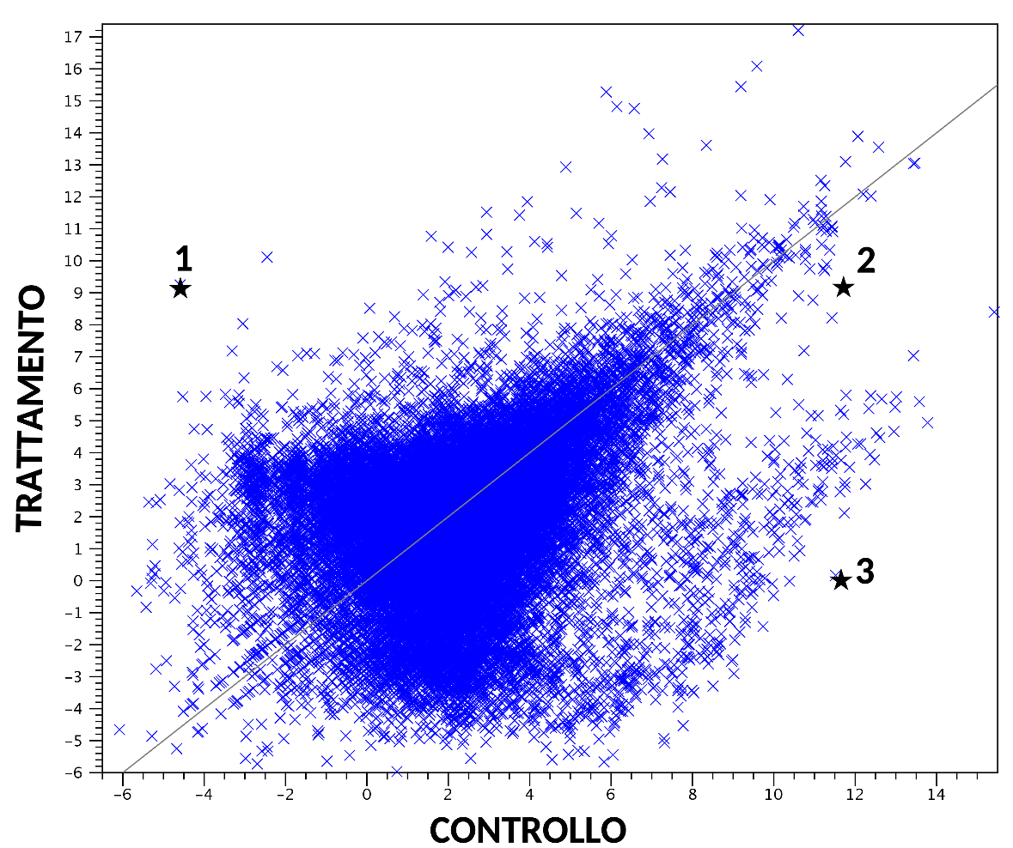
Scatter plot: interpretation
Expression levels in the two samples to be compared are plotted on the two axes
Genes expressed at similar levels in the two samples will be located near the bisector
Highly expressed genes in both samples will be present in the upper right sector (such as gene 2 in the example)
Lowly expressed genes in both samples will be present in the lower left sector
Differentially expressed genes (with high FC) will be located above or below the bisector
Gene 1 in the example is overexpressed in the treated sample, conversely gene 3 is underexpressed in the treated sample
We also note that gene 2 and gene 3 are expressed at the same level in the control
Gene 1 and gene 2 are expressed at the same level in the treated sample
A scatter plot, however, tells us nothing about the statistical significance of the Fold Change, i.e., it does not incorporate the p-value

Slide 58
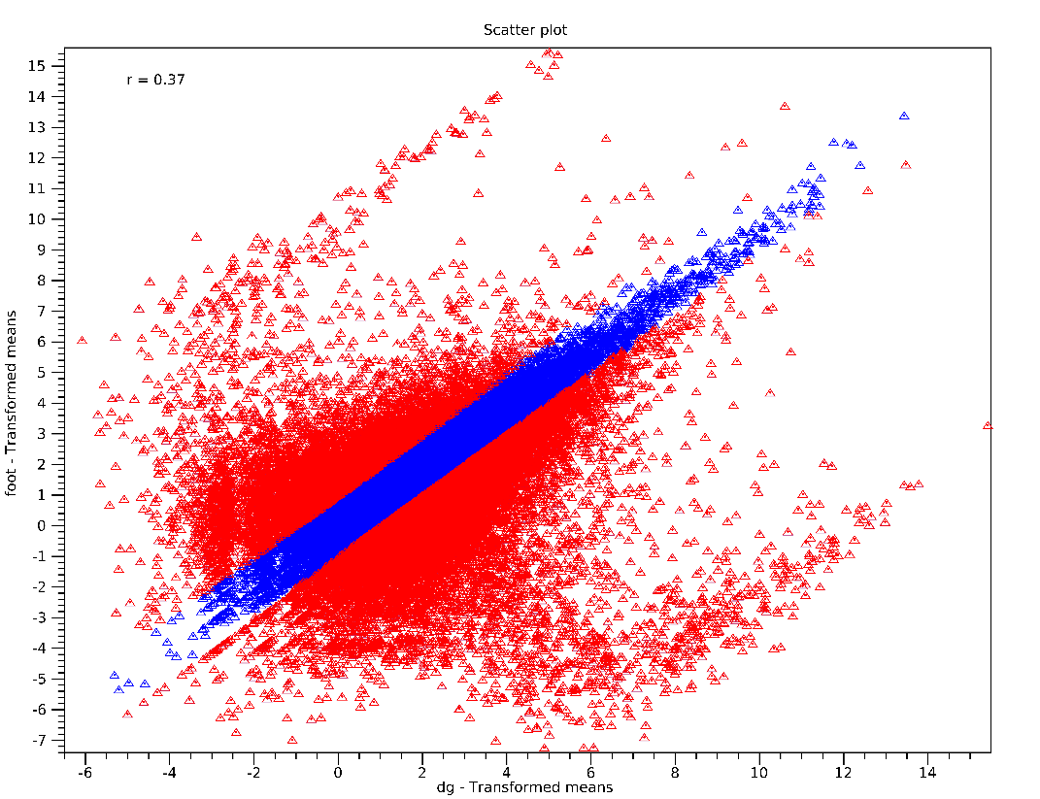
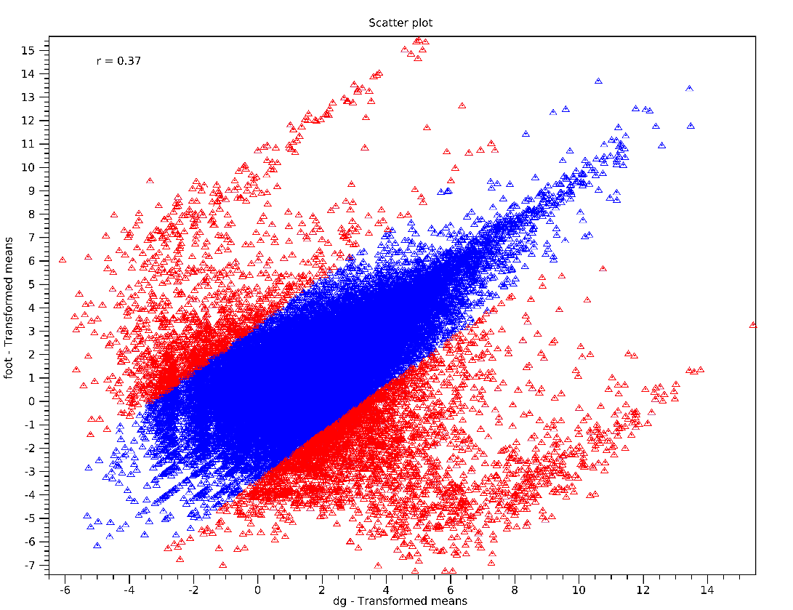
Filtering DEGs by Fold Change
Differentially expressed genes are marked in red
Left: FC > 2 (absolute); right: FC > 10 (absolute): notice the selection of genes with straight lines parallel to the bisector. The more I increase the FC, the further I move away from the bisector and the more stringent the analysis is. If I had selected only FC > +2 I would have selected only the overexpressed genes (above the bisector), conversely, with FC < -2, I would have selected the underexpressed ones (below the bisector)

Slide 59
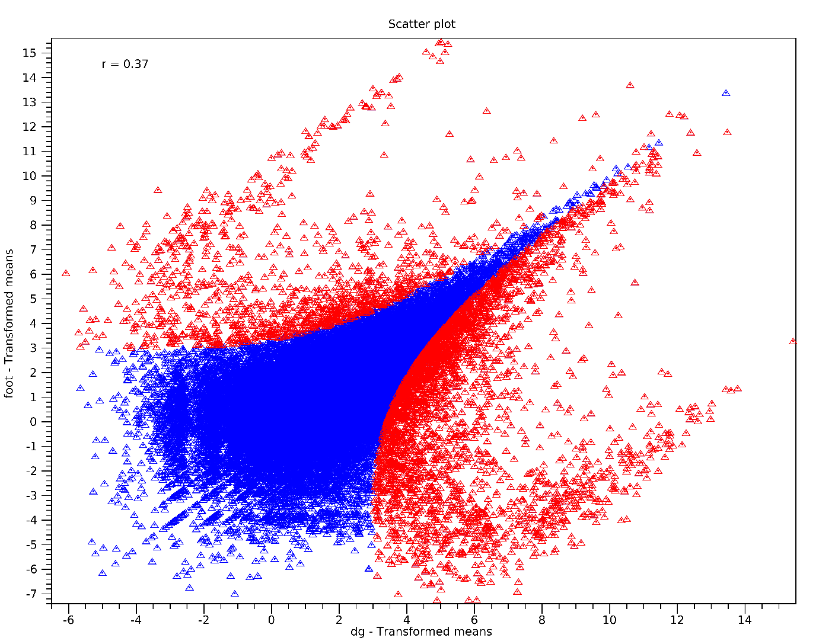
Filtering by FDR-corrected p-value
Notice how the selection in this case is done by curves. The value selected is FDR p-value < 0.05, that is, all genes that, regardless of FC, have a statistically significant FDR p-value
You can guess that for lowly expressed genes (= with low number of reads) higher FC levels are needed to achieve statistical significance
However, it seems that for highly expressed genes very small FC are sufficient to reach statistical significance (the curve is very close to the bisector). It is not necessarily the case that very small FCs (e.g., 1.5) are biologically significant

Slide 60

Let’s combine FDR p-value and FC…
Usually the selection of differentially expressed genes is done by the combination of FC and FDR-corrected pvalue
In this example, we have a combination of FC > |10| and FDR p-value < 0.05
Notice how at this point genes with low FC (<|10|) are no longer selected, despite significant p-value
At the same time genes with high FC but low expression are not selected
The selection of differentially expressed genes should be employed with the combination of these two parameters, the thresholds of which, however, remain arbitrary
As a rule, an FDR p-value < 0.05 is considered the gold standard, whereas with regard to FC there is more flexibility based on the intensity of the observed biological phenomenon

Slide 61

Volcano plot
As we have already mentioned, scatter plots do not incorporate p-values
Another type of plot called a volcano plot shows the p-values (on a negative logarithmic scale) on the Y axis and the FC (also on a logarithmic scale) on the X axis
Highly differentially expressed genes will be found toward the right (over-expressed) or left (under-expressed), and significance will be indicated on the Y-axis (highly significant genes at the top, insignificant at the bottom)
In the example, A is a very down-regulated gene, both in terms of FC and probability
B has a low FC of overexpression, but is very significant (with its high expression, small changes are sufficient to be significant)
C and D have similar FC, but D is much less significant than C (probably expressed at low levels)

Slide 62



Volcano Plot interpretation
Selection made on the basis of FC alone, regardless of statistical significance: selection made only on the X axis
Selection made on the basis of p-value only, regardless of FC: selection made on the Y-axis only
Selection made on the combination of the two factors: differentially expressed genes are found in the upper left quadrant (down-regulated) and upper right quadrant (up-regulated)

Slide 63


Volcano Plot – a few examples
Which thresholds have been used for DEG selection?

Slide 64


MA plots, not to be confused with volcano plots!
An MA plot represents a correlation between two other values:
1)The logarithm of the fold change, as in a volcano plot
2)The logarithm of gene expression levels (usually in the treated sample, or at any rate the one of interest that has been compared with a control or reference sample), expressed as a count, or as a TPM
An MA plot therefore does not directly show p-values. It is also usually presented “inverted” from a volcano plot, that is, with the fold change represented on the Y-axis. Highly expressed genes will always be found on the right side of the plot
N.B. since a MA plot only shows the expression levels of a single sample, in this case there is no need to normalize the counts (often represented as such and simply transformed to a logarithmic scale)

Slide 65

Heat map: meaning and interpretation
It allows us to graphically visualize the expression profiles of multiple tissues or experimental conditions simultaneously, unlike scatter and volcano plots that show us only pairwise comparisons
Usually used for a subset of genes (not the entire genome or transcriptome), showing only the most illustrative ones (e.g., highly expressed or with significant differences)
It is often associated with hierarchical clustering (the tree in the figure opposite, showing us groups of similarly regulated genes (co-regulated)
We note well in the example of foot- and digestive gland-specific gene clusters, expressed at a high level only in these two tissues
Genes are colored according to expression level. Again, logarithmically transformed values are usually used for simplicity of representation

Slide 66

Heat map: meaning and interpretation
Clustering can be performed with regard to both genes and samples
In this case, the graph also allows us to appreciate the similarity in the expression profiles of different samples, tissues, cells, treatments, and experimental points
Hierarchical clustering, as you can see, always proceeds by binary branching, that is, from a single “node” two “branches” branch off
As in a phylogenetic tree, the length of “branches” indicates the “distance” between samples

Slide 67

Principal Component Analysis (PCA)
This is another very useful and popular method to represent in a highly simplified way the most macroscopic differences between various biologic samples
The complexity of the numerical gene expression matrix is simplified into two (or sometimes 3) dimensions (principal components) that explain a given % of the variance
Samples with similar expression profiles would tend to cluster

Slide 68

PCA – un esempio
La PCA a volte permette di evidenziare dei trend e dei bias «nascosti» e a volte inaspettati nei dati di espressione
Il pannello A (basato sulle due PC principali) mostra che i campioni ottenuti da diversi tessuti, come atteso, clusterizzano tendenzialmente assieme
Il pannello B invece dimostra come ci sia anche una tendenza al clustering comune per campioni derivati dallo stesso centro ospedaliero, ma ciò è evidente solo per PC «minori» (PC5 e PC7 in questo caso)

Slide 69


Weighted analysis of gene co-regulation networks
Quanto è probabile che i trend di espressione di 2 geni siano così simili per caso?
In time-course experiments, in particular, it is possible to group genes on the basis of common temporal expression trends, such as in response to a given treatment. It is possible to hypothesize that genes showing the same expression profile are subject to regulation by the same transcription factors and are consequently involved in the same biological pathways

Slide 70
Weighted analysis of gene co-regulation networks
1)identify “networks” of co-regulation, i.e., shared patterns of gene expression
2)Tie them to “modules,” i.e., hypothetical biological pathways
3)Correlate modules to source data -> identify the most “interesting” modules with respect to experimental conditions
4)Test the robustness of the identified modules (e.g., with additional replicates, or with slightly different experimental conditions)
5)Identify “key drivers” in modules, so as to experimentally validate cause/effect relationships between treatments/diseases/experimental conditions and gene expression trends
ADVANTAGE: Construction of modules does not require a priori knowledge of the biological pathways involved. Modules identified on the basis of a very large number of observations will have a high chance of success in experimental validation

Slide 71

Weighted analysis of gene co-regulation networks

Slide 72
Graphical representation methods: when and why should you use them?
PCA: valid in any case I want to compare large -omics datasets, especially when there are many samples (best application = single-cell RNA-seq) -> I highlight large differences and similarities between samples
Scatter plot: exclusively RNA-seq or miRNA-seq experiments -> I highlight differentially expressed genes and identify outliers
MA-plot: originated as a representation for microarrays. It is also used (but more rarely) for gene expression experiments: I highlight DEGs with respect to their expression level in a sample
Volcano plot: typically used for RNA-seq and miRNA-seq, it makes no sense to use it for microarrays: it is the most intuitive and comprehensive way to show significant overall effects of a treatment and to highlight number of DEGs and extent of gene expression alterations
Heat map: originated with microarrays (N.B. in that case, however, relative fluorescence intensity values were shown), and suitable for gene expression experiments (RNA-seq, miRNA-seq), potentially also quantitative proteomics: useful for highlighting groups of co-regulated genes -> first step for defining “modules” and regulatory networks

Slide 73
De novo transcriptome assembly
What to do when a reference genome is not available and it is not possible/practical to sequence it entirely?
It is possible to obtain a collection of the expressed transcripts, by de novo assembly, through algorithms similar to those previously described, most often based on De Bruijn graphs
We prefer, for this approach, to use short reads sequenced in paired-end mode -> right balance between high coverage (see next slide) and possibility of obtaining full-length transcripts
Apparently, a de novo transcriptome assembly approach may seem simpler that a genome assembly approach, given that:
1)The expected size of the transcriptome is much smaller than that of the genome (includes only exons)
2)The problem related to repeats (almost always intronic or intergenic) does not arise

Slide 74
De novo transcriptome assembly
There are considerable problems to be faced!
1)Transcripts are expressed at very different levels and therefore their coverage is extremely variable. In some cases, it may exceed 10000X, in others be close to 1X
2)Poorly expressed transcripts may show insufficient coverage to be fully assembled (especially if I have introduced positional bias in library construction) -> fragmentation
3)Alternative splicing isoforms are present, which assembly algorithms must be able to handle in order to keep the isoforms separate or to merge them into a single consensus
4)Very similar paralogous genes and allelic variants of the same gene could pose a problem, creating chimeric contigs or causing fragmentation
5)Antisense transcripts that share overlapping exons, in nonunidirectional libraries, could also cause chimeric contigs

Slide 75

De novo transcriptome assembly – key factors
Reads obviously need to be carefully trimmed before de novo assembly
Results from rRNAs and mitochondrial and plastidial mRNAs should usually be removed
It is necessary to obtain as broad a representation of expressed transcripts as possible -> select multiple tissues, functionally diverse
Best to avoid pools of multiple individuals, especially in high-heterozygosity species, so as not to introduce problems of allelic variability
Aim for a minimum of about 100-200 million paired-end reads
Decontaminate the final assembly from any exogenous mRNAs (environmental contamination, viruses, parasites, technical contamination that occurred in the laboratory)

Slide 76


De novo transcriptome assembly – software
Trinity is by far the most widely used algorithm today for novo assembly of transcriptomes
Manages alternative splicing isoforms by creating distinct contigs
The assembly thus generated is very redundant (many exons are shared by multiple exons)
Alternatives widely used are Velvet, Oases and SPAdes

