Slide 1
LECTURE 8 Biological interpretation of the results of «omic» experiments

Slide 2
Biological interpretation of results
Usually, the result of a DGE analysis is a list of several hundred (but sometimes even several thousand!) differentially expressed genes, although as we have seen this number, if excessive, can be decreased by using more stringent parameters for statistical analysis
Impossible in any case to study them all one by one
I need to think of a heuristic type of analysis, allowing me to study whether there are patterns related to genes involved in certain functions
I can assess whether there is over-representation of certain annotations in the DE gene set (e.g. Gene Ontology, thus functional, or related to InterPro or Pfam conserved protein domains, indicative of gene families)

Slide 3
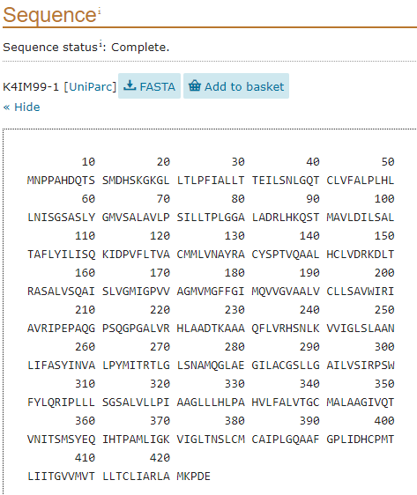
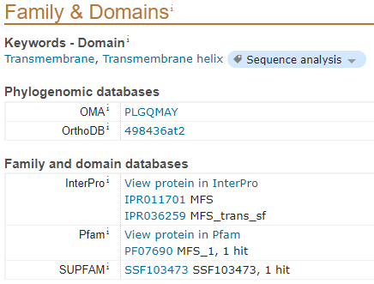
WHAT DO WE MEAN BY ANNOTATION?
This is a concept now encountered many times before....
Any sequence (nucleode or protein), usually reported in FASTA format, can be associated with one or more hypothetical functions, the presence of conserved domains, involvement in certain biological pathways, etc.

Slide 4
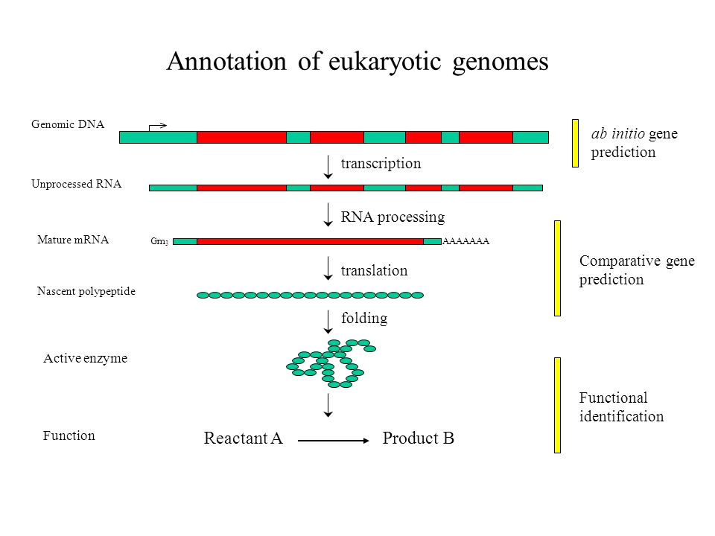
ANNOTATION: NUCLEOTIDIC vs AMINO ACIDIC SEQUENCES
Annotation can be carried out at different levels
Annotation of nucleotide sequences is not as simple as that of protein sequences
mRNA and genomic DNA sequences can be divided into coding regions (exons and ORFs) and non-coding regions (UTRs, intergenic regions, etc.)
A gene, the transcript it encodes, and the protein it translates may share the same functional annotation, but they are obviously characterized by very different structures and attributes (e.g., a regulatory region at the promoter level may be associated only with a gene, a phosphorylation site only with a protein, etc.)

Slide 5
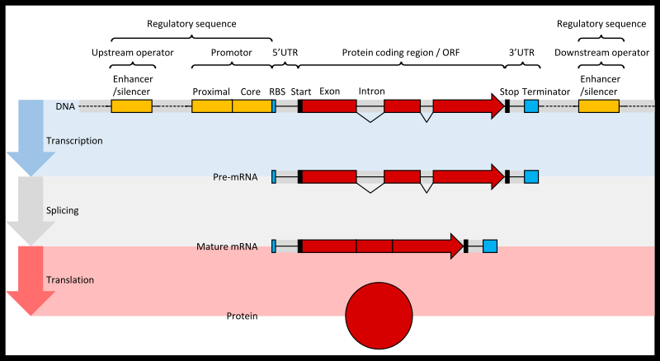
THE DIFFERENT LAYERS OF ANNOTATION

Slide 6
GENOME ANNOTATION
Regions of regulation: promoters, enhancers, silencers, etc.
Sites of sequence modification(e.g., methylation sites)
Gene annotations (exons, introns)
mRNA annotations (exon combinations, alternative splicing)
Primary sequence variations (SNPs, MNVs, insertions, deletions, etc.)
Repeats/Transposable elements
mRNA ANNOTATION
N.B. The annotation of mRNAs usually derives from that of genomic DNA.
However, it is also possible to annotate mRNA sequences directly where there is no genome available (de novo transcriptome assembly)
5’ UTR
Coding sequence (CDS)
3’UTR

Slide 7
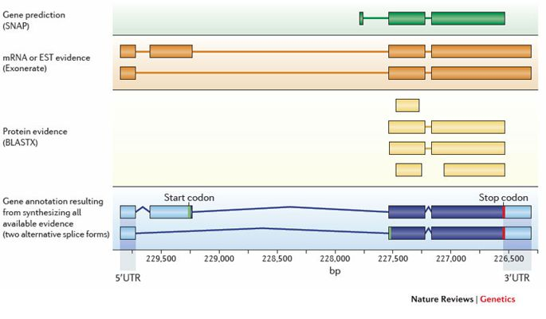
GENE PREDICTION
How are the genomic coordinates in which genes are predicted?
Combination between 3 lines of evidence:
1)De novo gene prediction (based on algorithms aimed at identifying characteristic motifs-transcription start sites, promoters, acceptor sites, and splicing donors)
2)Sequence homology (detected with BLASTx by comparison with a database of known sequences)
3)Alignment with known mRNA sequences (or with RNA-sequencing data)

Slide 8
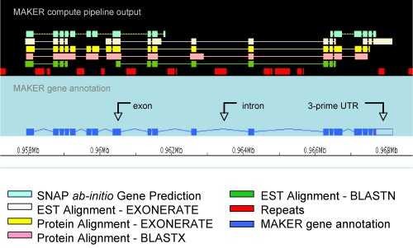
GENE PREDICTION ALGORITHMS
Must “weigh” all evidence in the most appropriate way
It is necessary to identify minimum scoring thresholds -> Poorly supported gene models will not be annotated
All genome annotation algorithms are quite complex and require manual input from the user
There is no single method for annotating genomes! Each genome has its own characteristics and problems. For example, acceptor and donor sites of splicing may have different consensus sequences in different organisms, percent GC content may vary, introns may have very different average lengths, etc.
Ad hoc developed methods can be used for some genomes -> those used for annotation of prokaryotic genomes are very simple (no introns, no repeats, etc.).

Slide 9
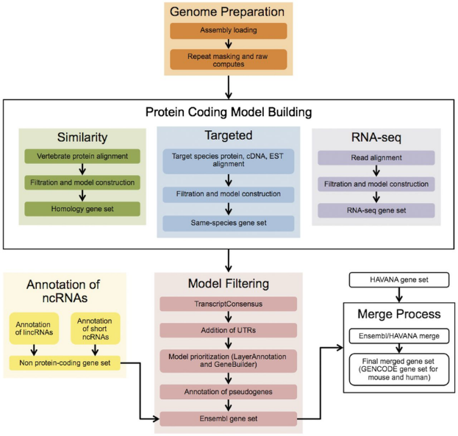
GENE PREDICTION ALGORITHMS
An example: the Ensembl gene annotation pipeline

Slide 10
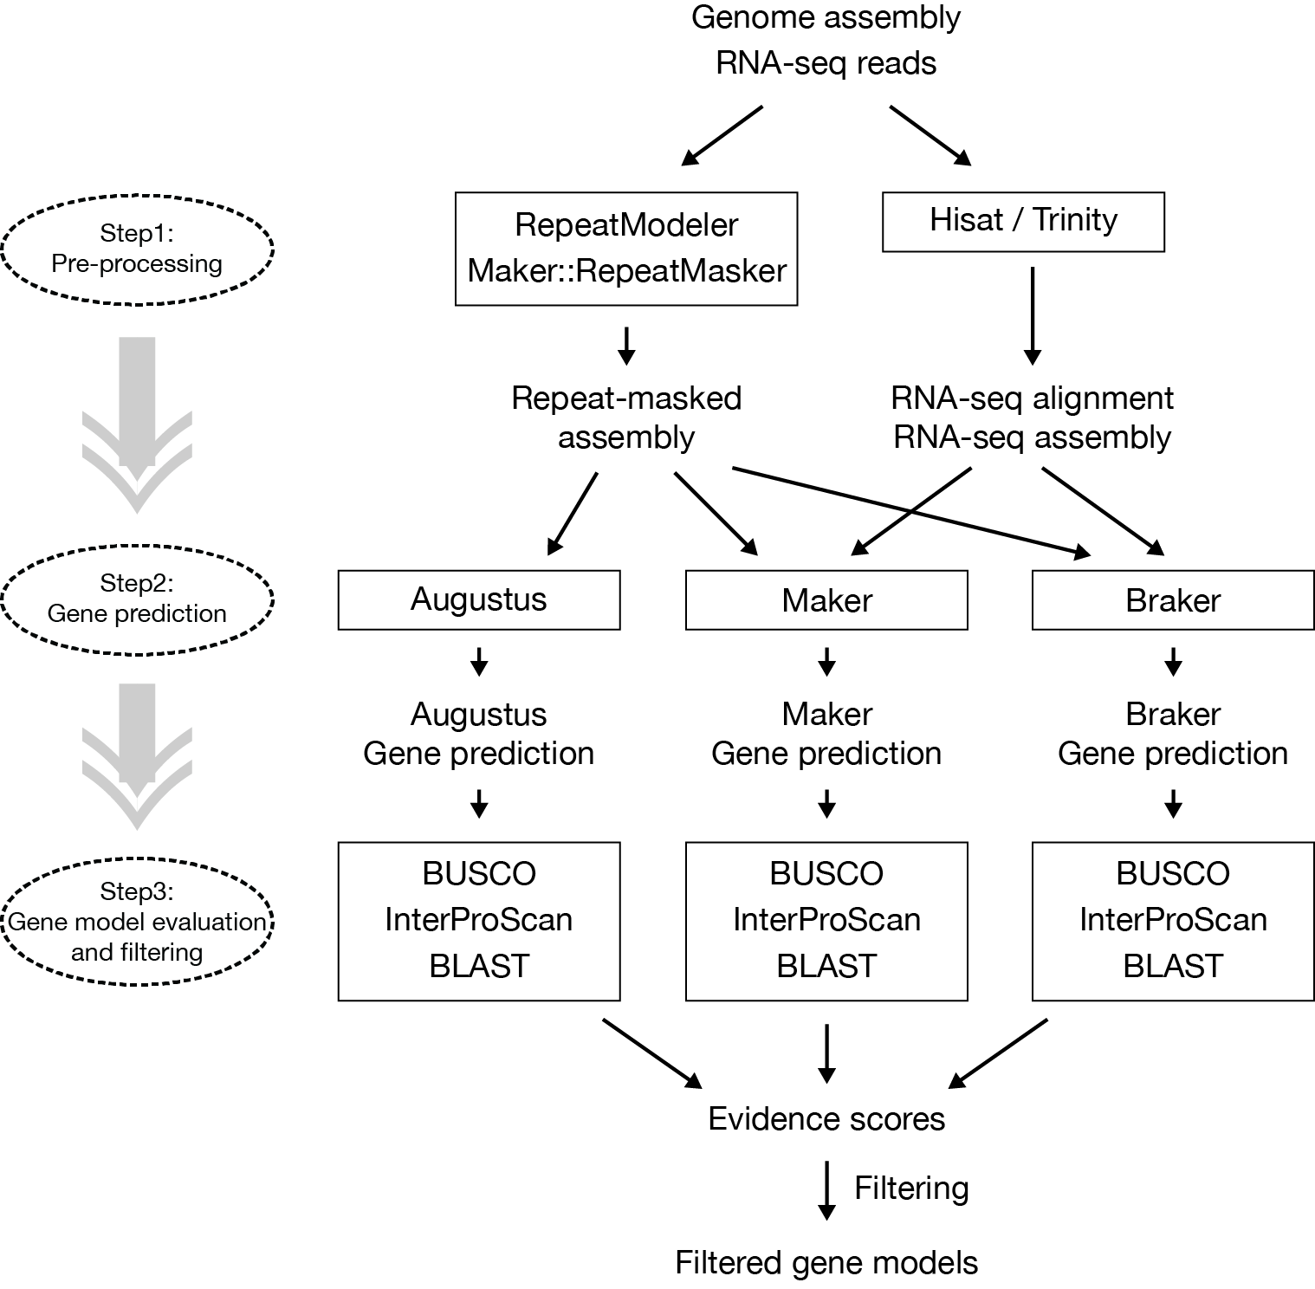
GENE PREDICTION ALGORITHMS
It is possible to combine predictions from different tools to obtain widely supported predictions, that is, those that are annotated in the same way (with the same coordinates) by all or most approaches
Example: TSEBRA2 is a tool specifically designed for this task

Slide 11
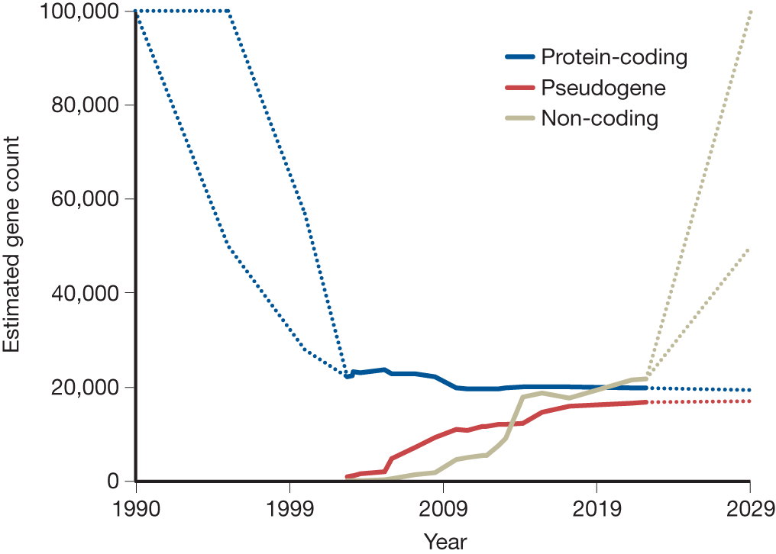
CODING GENES, NON-CODING GENES, PSEUDOGENES
If we look at how much the number of coding, non-coding and pseudogenes annotated genes in the human genome have varied over time, we would see that:
The number of coding genes-already much lower than expected-has further dropped slightly (some genes thought to be protein-coding are actually not)
Consequently, the number of annotated pseudogenes has increased, mainly due to the shift of some genes previously thought to be functional into this category
The number of non-coding genes has increased tremendously and will probably continue to do so
Da Amaral et al. 2023
Annotating noncoding genes is very problematic because of the difficulty of detecting homology and their high divergence between species. Their annotation relies mainly on alignment with RNA-seq data. The same problem affects the UTR annotation of protein-coding genes, with the result that many gene annotation pipelines are focused only on CDS

Slide 12
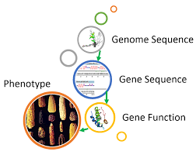
FROM STRUCTURAL TO FUNCTIONAL ANNOTATION
The annotation pipelines we have discussed so far were focused on assigning coordinates to features (= structural annotation)
We must, however, find a method to combine genotype and phenotype to proceed with biological interpretation
Functional annotation is based on comparing an unknown sequence with a database of sequences with known function
All functional annotation methods cone based on sequence homology. Although many alternative methods have been developed and are already partly available, BLAST and its variants remains by far the most widely used method for searching for similarities between an unknown sequence and those contained in a reference database
Sequence similarity makes it possible to infer probable functional similarities

Slide 13
Inferring gene/protein function with BLAST
With the concept of homology in mind, it should be clear that two homologous sequences are derived from a single ancestral sequence that had a well-defined function -> at the time of the speciation or gene duplication event that resulted in the two sequences under consideration, they performed the same function
But how confidently can we establish that they continue to do so today, after hundreds of thousands of years of independent evolutionary history, given some level of primary sequence divergence?
This is an arbitrary inference and never quite certain, thus requiring reasonable interpretation by the user
The higher the similarity (and the more prone to zero the e-value) the greater the degree of confidence in the functional annotation
N.B. However, function depends not only on primary sequence, but also on regulation (which determines where and when a gene is expressed)

Slide 14
BLAST: application to genomic studies
Annotation of introns and exons: mRNA (query) vs genome (database)
Functional annotation of genes (by homology/orthology): very similar genes among different species have a high probability of encoding proteins that maintain a similar function
Gene prediction: annotation of genes by similarity. For example, the structural organization of orangutan genes (number and position of exons and introns) can be predicted by aligning the unannotated orangutan genome with the annotated human genome
Many other applications: metagenomics (OTU assignment), comparative genomics/phylogenomics, and many more!

Slide 15
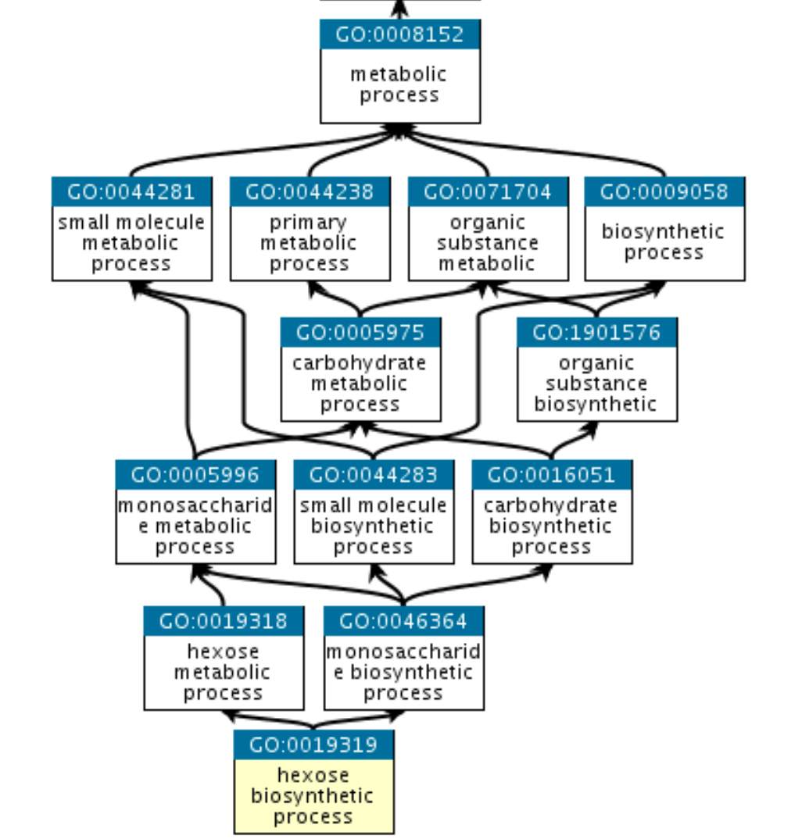
Functional annotation: databases
Gene Ontology: broad classification categories
(i) cellular component (ii) molecular function (iii) biological process
Organized on hierarchical planes, with parent/child relationships
Very useful for model organisms, but not so useful for others. There is a strong bias toward human/mouse/Drosophila/Arabidopsis
Molecular pathways specific to less studied taxa are often absent or underrepresented

Slide 16
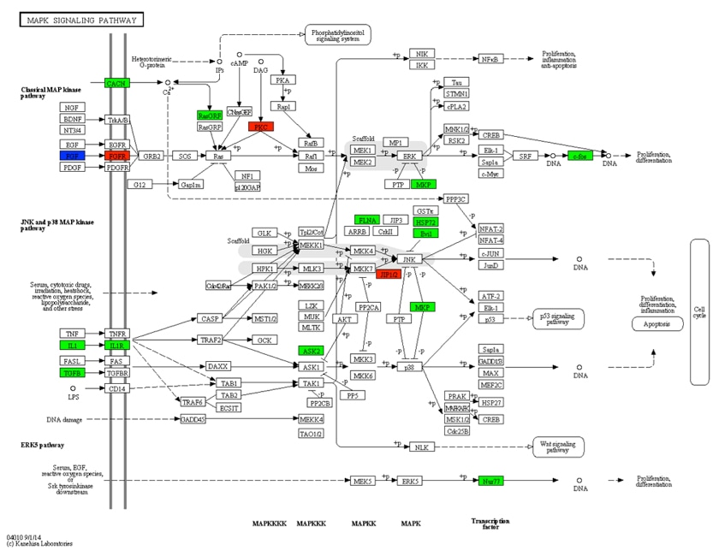
Functional annotation: databases
KEGG: “metabolic” annotation
KEGGs (and their protein products) are embedded in complex molecular networks of enzymatic reactions
They can be assigned annotations derived from the Enzyme Commission (EC), which are often and frequently associated with biochemical meanings
Depending on the type of functional annotation, these are in any case “inherited” from previously characterized genes and proteins

Slide 17
Biological interpretation: statistical tests
The analyses by which the involvement of a biological process in a response is assessed are called hypergeometric annotation tests or gene set enrichment analyses (GSEA)
Comparison is made between the entire reference genome or transcriptome and the subset of DE genes
The concept is similar to that of a chi squared test: if we have 10,000 total genes in the genome and 1,000 are DE, it means that 10% of the genes are DE
If in the genome we find 10 genes annotated as “actin,” in the subset of DEs I would expect only 10%, i.e., 1. If, on the other hand, I observe 5, there is an over-representation
I have to ask myself whether this over-representation is random or not (i.e., whether it is statistically significant or not)

Slide 18
Biological interpretation: statistical tests
The test returns me p-values for each annotation, as well as expected values (E) and observed values (O). The p-value is the more significant the greater the difference between O and E
Annotations with significant p-value indicate to me that that process or gene family is present more frequently than I expected among DE genes, and therefore I can hypothesize that these processes or gene families have something to do with the effects of the experiment
For example, if as a result of a heat stress experiment in a starfish, I observe that heat shock proteins have a p-value = 0.000002 (expected=5, observed=30), this is a strong indication that finding 6 times more HSPs in the DE gene set than expected is not due to chance, indicating that HSPs are likely involved in the heat stress response process

Slide 19
GSEA/Hypergeometric test – a schematic overview
RNA-seq experiment
(gene expression table)
Enrichment Table
Spindle 0.00001
Apoptosis 0.00025
ENRICHMENT
TEST
Interpretation
& Hypotheses
Experimental Data
A priori knowledge +
existing experimental data
Gene-set
Databases

Slide 20
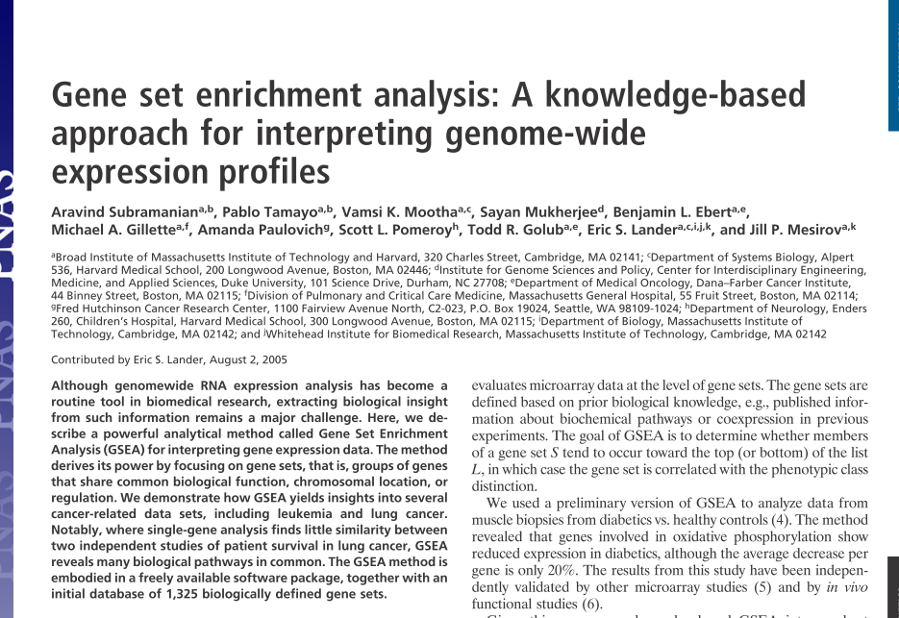
Functional enrichment test: a schematic overview
RNA-seq
Experiment
(gene expression table)
Gene-sets
Enrichment Table
SPP1
SPP2
CCCP
MTC1
…
Spindle 0.00001
Apoptosis 0.00025
FADD
TRADD
CYTC1
BAX
BAXL
CASP9
CASP10
….

Slide 21
Hypergeometric test on annotations: an example
GO term | description | count (genome) | observed -expected | FDR-corrected enrichment p-value
over-represented annotations
GO:0005622 | intracellular | 1418 | 455 | 5,91E-04
under-represented annotations
GO:0005737 | cytoplasm | 816 | 68 | 2,33E-10
GO:0005634 | nucleus | 1127 | 82 | 2,33E-10
GO:0016021 | integral component of membrane | 2487 | 267 | 2,33E-10
GO:0016020 | membrane | 2814 | 436 | 2,33E-10
GO:0005654 | nucleoplasm | 301 | 16 | 6,83E-05
GO:0043231 | intracellular membrane-bounded organelle | 214 | 18 | 0,00025
GO:0005730 | nucleolus | 149 | 8 | 0,00025
GO:0044424 | intracellular part | 335 | 40 | 0,00044
GO:0070062 | extracellular vesicular exosome | 367 | 29 | 0,00048
GO:0005813 | centrosome | 99 | 2 | 0,00050
GO:0005840 | ribosome | 105 | 3 | 0,00057
GO:0044444 | cytoplasmic part | 192 | 19 | 0,00363
GO:0043227 | membrane-bounded organelle | 111 | 7 | 0,00732
GO:0012505 | endomembrane system | 81 | 3 | 0,00942
These results are sorted on the basis of the p-value of enrichment. This depends not only on the number of (differentially expressed) genes observed minus the expected number, but also in the total number of annotations of that type present in a genome or transcriptome

Slide 22
P-values and multiple testing: why do we need to «correct» p-values?
How should we interpret a p-value? A p-value = 0.05 indicates that there is “only” a 5% probability that our result is a false positive. This is usually regarded as sufficient when dealing with single observations...
However, in “omics” experiments, there are as many observations (e.g., in an RNA-seq experiment there are as many as the number of genes), and consequently even such small error probabilities can lead to hundreds of false positives (i.e., differentially expressed genes that are actually not)
This is the so-called multiple testing problem, which is solved by correcting the p-value with two possible methods: the Bonferroni method or the Benjamini-Hochberg method (False Discovery Rate, or FDR)
An in-depth article on the subject is available on Moodle
“it does not matter whether you are interested in identifying a significant association with SNPs, differentially expressed genes (DEG) or enriched gene ontology (GO) terms, the moment you conduct multiple tests on the same samples or gene sets respectively, it would be essential to address the multiple testing issue by adjusting the overall false positive rate through calculating a´ or adjusting your raw P values […] for true positives to be teased out. This will in no doubt enhance reliability and reproducibility of research findings.”

Slide 23
Functional inference in model vs non-model species
These tests are limited to genes that are annotated! Especially in non-model species, where many genes are of unknown function, you can lose quite a bit of functional information, but it is nevertheless the only way forward
Genes with unknown function but possibly of interest can then be functionally characterized later with other approaches
Unfortunately for humans and mice, for which a considerable amount of literature is available, commercial databases have been developed such as Ingenuity Pathway Analysis and iPathwayGuide (but there are many other similar tools under development or even already available) that allows us to greatly implement biological hypothesis formulation
For all other organisms we are forcibly limited to hypergeometric tests and intense literature searches

Slide 24
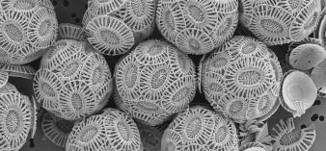
Non-model species: the standard approach
No genome available (often only transcriptome assembled de novo)
Little knowledge of biological pathways
Somewhat limited literature
Lack of sequence (and function) homology with nearest model organisms
We take advantage of Gene Ontology annotations (inferred by sequence similarity via BLAST) or conserved domains (InterPro/PFAM)
Without direct experimental evidence, a method is used to formulate a “best guess” hypothesis
Test hypergeometric/gene set enrichment analysis -> allows identification of annotations over-represented relative to expectations

Slide 25
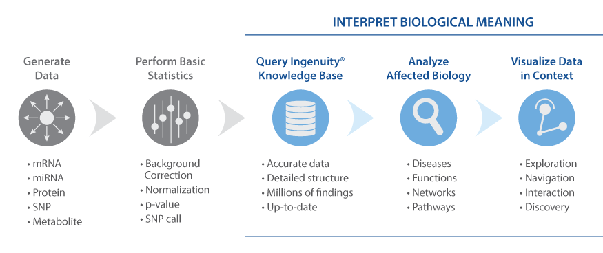
Approach in a model organism – an example of a commercial tool (IPA)
Geni/proteine di interesse
Dato un set di geni/proteine che sono attivati/repressi, quali sono gli effetti a valle?
C’è un effetto fenotipico, sulla funzionalità cellulare, o sullo sviluppo di malattie Quali sono i pathway che vengono coinvolti? Quali sono gli “upstream regulators” convolti, cioè cosa scatena gli effetti?
25

Slide 26
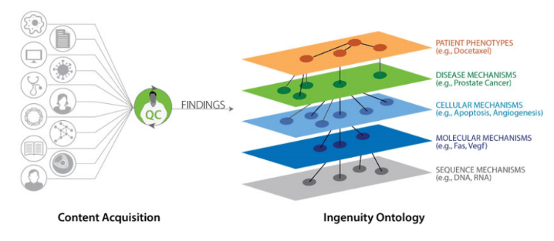
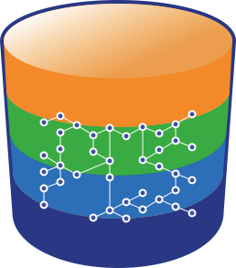
The Ingenuity knowledgebase
Multilevel organization of biomedical scientific literature data -> very large in human/mouse model but NOT in non-model organisms -> possibility of analysis restricted to biomedical field
Literature findings
MD/PhD level curators
The Ingenuity Knowledge Base
Biomedical Ontology
The Ingenuity Ontology

Slide 27
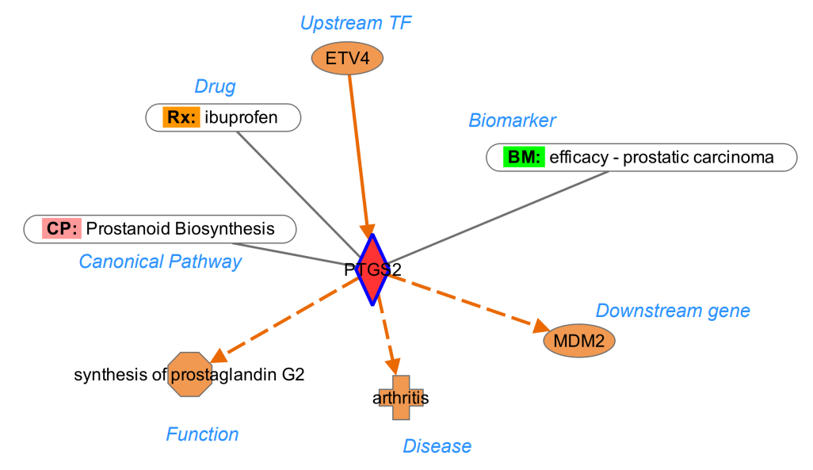
Every gene (or mRNA, or protein) can be linked with multiple types of information
-Transcription factors regulating its expression
-Information regarding possible relevance as a clinical biomarker
-Genes regulated by the gene of interest
-Diseases related to its mutation or dysregulation
-Biological function
-Involvement in canonical pathways (equivalent in essence to the biological processes of gene ontology)
-Possible drugs that block/modulate its activity

Slide 28
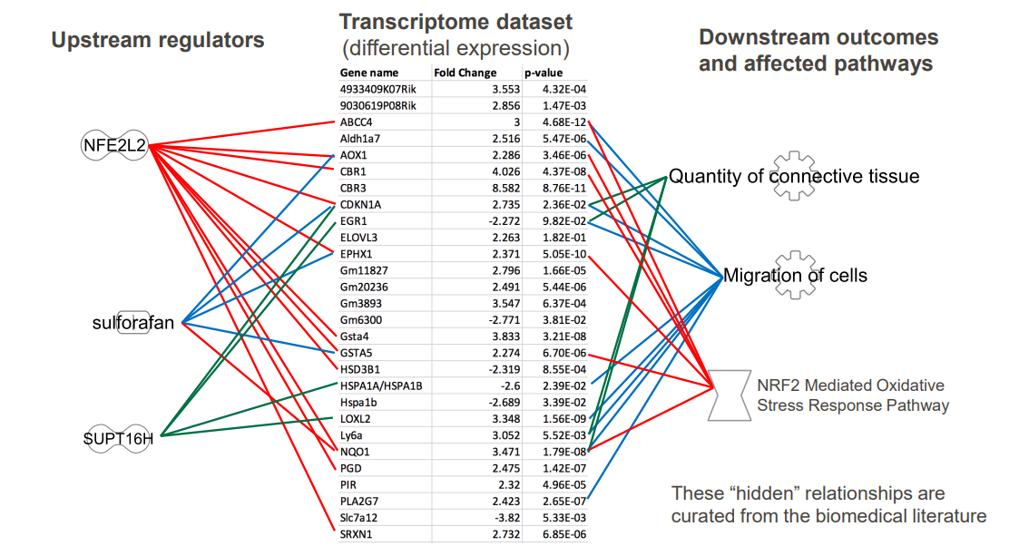
Final goal: exploit raw data to formulate new biological hypotheses
PREDICTION upstream regulators
OBSERVATIONS
set of genes of interest
PREDICTION
Downstream effects

Slide 29
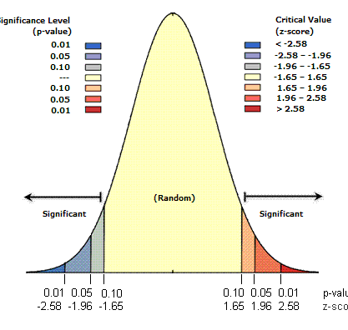
Predictions: statistical considerations
All predicted upstream regulators or downstream effects are associated with:
P-value: this is the probability that the observed pattern was created by a random process. A small p-value means that it very unlikely the observed pattern is the result of random processes, so you can reject the null hypothesis
Z-score: this value indicates by how many standard deviations the observation exceeds (in one direction or the other) the expected random distribution. In other words, it allows us to provide a direction (e.g. activation or repression) to each statistical significant observation

Slide 30
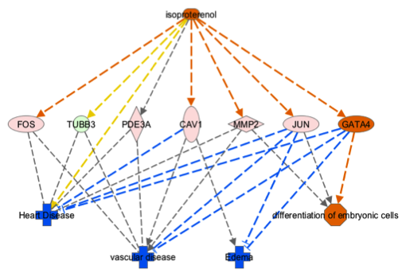
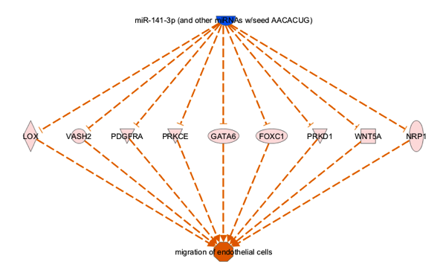
Building 3-layer interaction networks
The genes of interest (usually a set of DEGs) are placed in the middle layer. Upstream regulators are on top, downstream effects are at the bottom

Slide 31
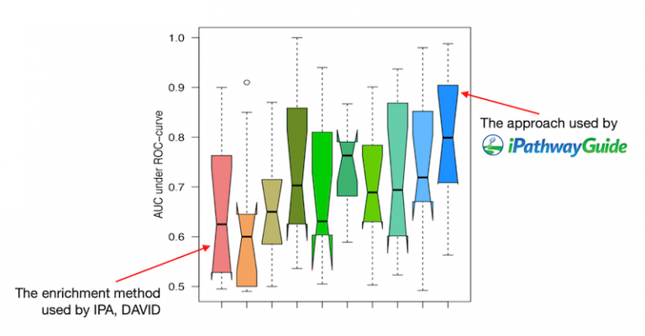
Another commercial tool as an alternative to IPA- iPathwayGuide
iPathwayGuide uses a statistical tool slightly different from the gene set enrichment we have previously discussed (also used by IPA), namely a so-called “topology based method” (TBM). The fundamental difference between the two methods is that non-topology based methods treat all genes as members of a “list” in which all genes have the same weight, whereas topology based methods also consider the position in the pathway and can therefore calculate their weight or impact
A recent study demonstrated better performance of TBM methods in application to real datasets

Slide 32
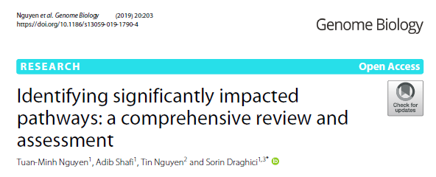
Which method is the best one?
“Overall, the result shows that no method is perfect. In general, TB methods appear to perform better than non-TB methods. This is somewhat expected since the TB methods take into consideration the structure of the pathway which is meant to describe the underlying phenomena”

Slide 33
Check Moodle for:
An example of a complete analysis carried out with Ingenuity Pathway Analysis
An example of a complete analysis carried out with iPathwayGuide

