Slide 1
LECTURE 9 Metagenomics

Slide 2
Definition
The term metagenomics refers to the application of modern genomic techniques to the study of microbial communities directly in their natural environment, thus bypassing the need to isolate and cultivate them in the laboratory
The difference is huge because (i) only a small fraction of microorganisms are culturable and (ii) different microorganisms require different culture media and optimal growth conditions
Although most often associated with the study of bacterial communities, this discipline can also be devoted to the study of viral communities (viromics) or unicellular eukaryotes

Slide 3
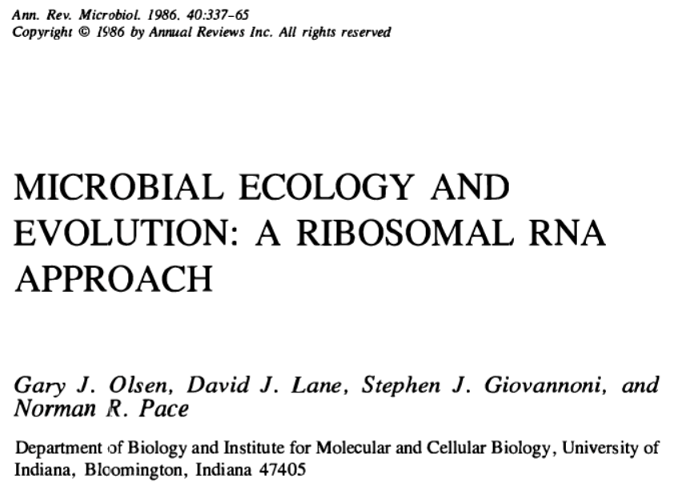
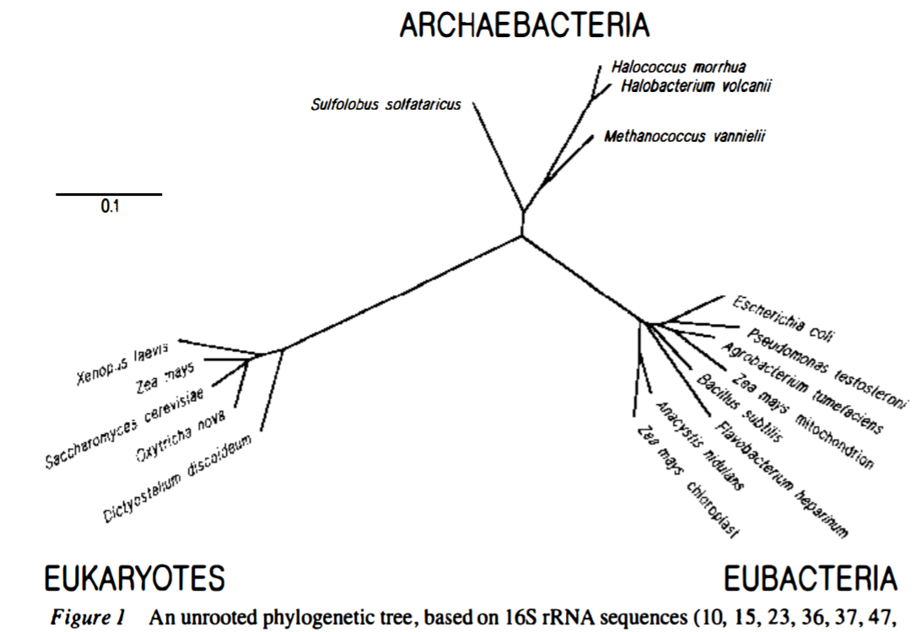
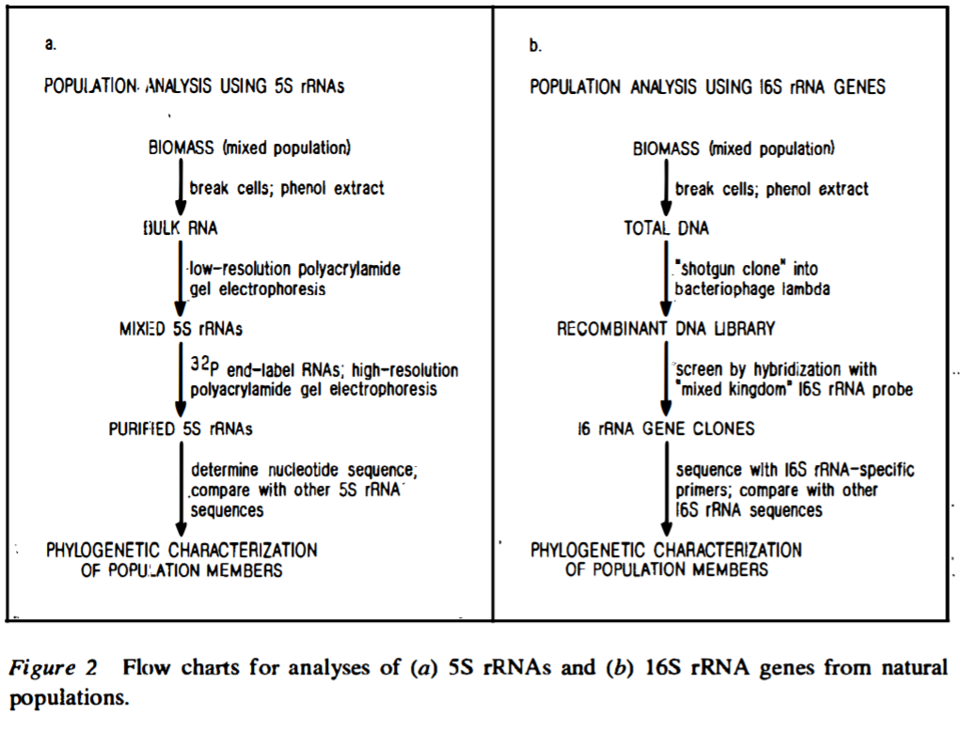
The origins
This approach stems from early pioneering studies conducted in the mid-1980s by Pace and colleagues. They had sensed the possibility of exploiting rRNA sequences as phylogenetic markers on a large scale by retrieving sequence data in a culture-independent manner

Slide 4
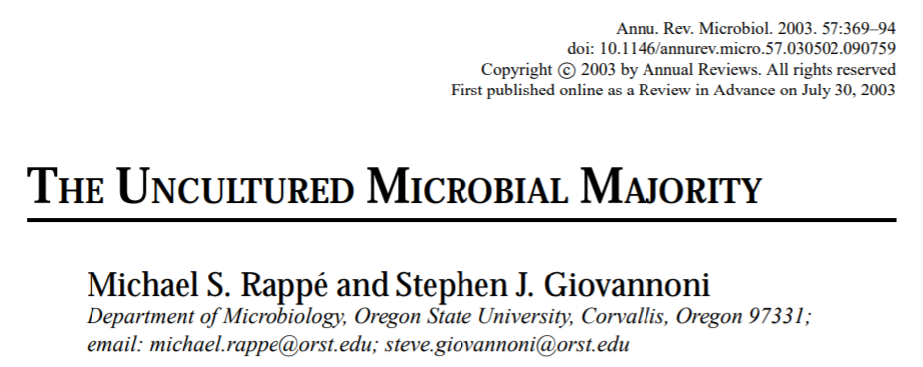
The origins
Since that time, the focus of microbiological research has shifted decisively from the minority represented by microorganisms that are possible to maintain in culture, to the majority of those that are not
It is estimated that over 99% of existing bacteria are not currently culturable
Overall, it is estimated that bacteria and Archea correspond to about 1000 trillion tons of biomass
Classical microbiological approaches are also very laborious, slow and require the use of different culture media, temperatures and nutrients depending on the species

Slide 5
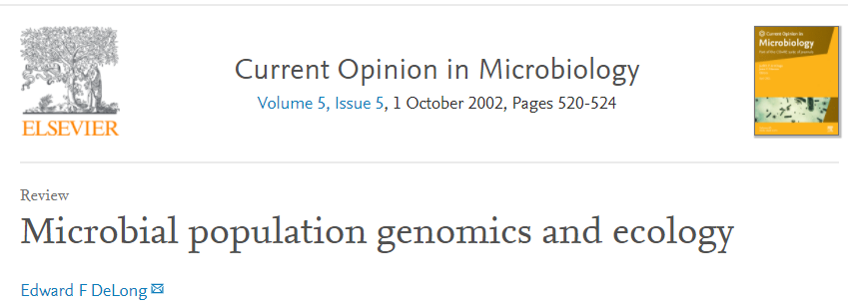
“The origins of biological complexity in microbial ecosystems are encoded within the collective genomes of the community. Cultivation-independent genomic studies provide direct access to the genomes of naturally occurring microbes, cultivated or not. Genome-enabled approaches are now significantly advancing current knowledge of genome content, diversity, population biology and evolution in natural microbial populations.”
“Based on rRNA trees, the main extent of Earth’s biodiversity is microbial. Our knowledge of the extent and character of microbial diversity has been limited, however, by reliance on the study of cultivated microorganisms. It is estimated that >99% of microorganisms observable in nature typically are not cultivated by using standard techniques.”

Slide 6
A rapidly expanding field
The motivations are the same as those that led to the genomics explosion
Reduced sequencing costs allow analysis of complex communities with much less time and investment than Sanger approaches
Applicability even in areas where funding availability is not as high as it is in biomedical fields (environmental biology, ecology, etc.)

Slide 7
Filling the gaps left by targeted genomics
Although the diversity of eukaryotes is enormous, the vast majority of genomic studies to date have focused on animals, land plants and fungi
Other very large but less economically interesting groups remain “neglected” and in fact almost entirely unknown
The presence of cryptic species, morphologically identical but reproductively and ecologically distinct, is extremely common

Slide 8
The different domains of metagenomics
By virtue of its ability to describe microbial communities in different contexts, metagenomics has found applications in the
-biotechnological domain (how can certain biochemical functions be exploited in research and industrial settings?)
-biomedical domain (how are alterations in the microbiome linked to the development of diseases?)
-ecological domain (how does the diversity of microbial communities contribute to the support of trophic chains)?
In addition, we can divide metagenomic approaches into “gene-centric” and “whole (meta)genome” approaches

Slide 9
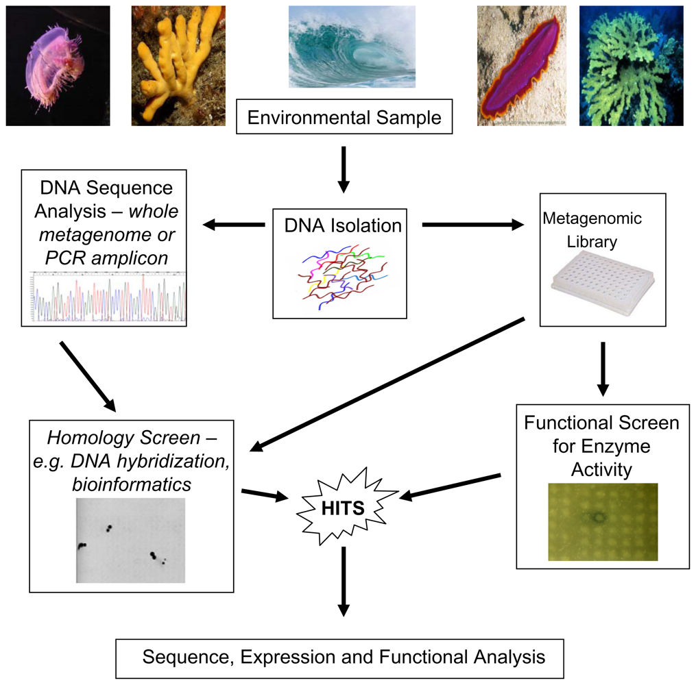
The «classical» approaches
It starts with the construction of a DNA library from an environmental sample.
Clones are then selected based on two alternative approaches:
Functional screening of clones bearing the sequence that confers certain properties
Screening for sequence homology, which assumes sequencing of the inserts

Slide 10
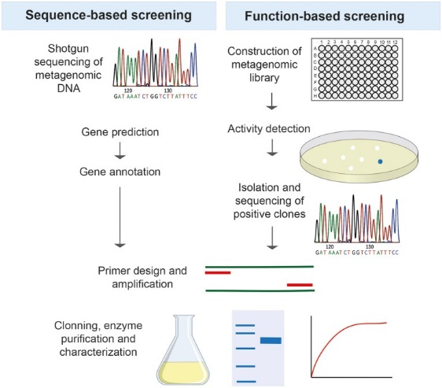
Functional screening
Functional screening involves heterologous expression of gene sequences obtained from the environmental sample in E. coli
Colonies characterized by the presence of certain functions (often metabolic or biochemical) are then isolated
The sequence of the insert can be determined later

Slide 11
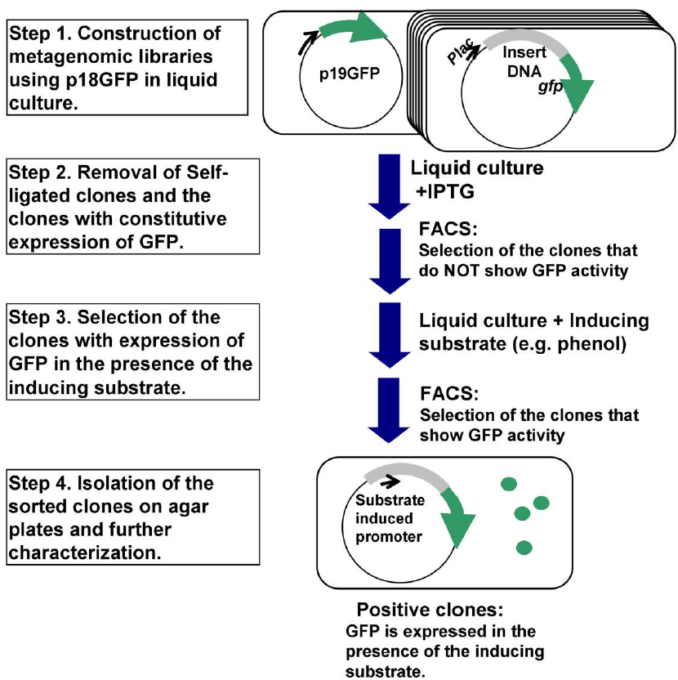
Functional screening
Functional screening very often takes advantage of the possibility of using reporter genes, the expression of which is induced in the presence of the metabolite produced by the gene encoding the function of interest
The reporter gene may be expressed, facilitating colony detection, only when the insert carries a gene encoding a protein with the function of interest

Slide 12
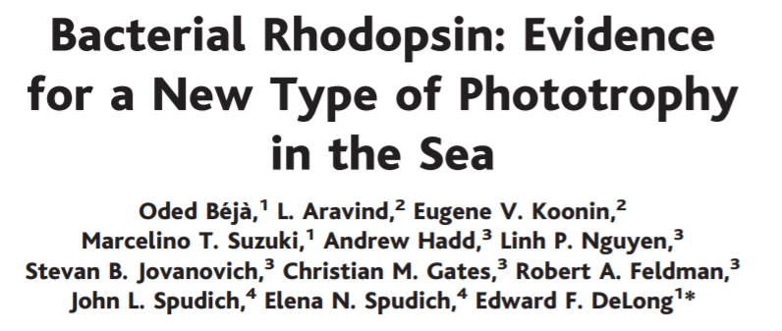
“Sequence-based” approaches
Diametrically opposed to the “function-based” approaches, the “sequence-based” ones select clones on the basis of the presence of a sequence showing some degree of homology with a sequence of interest (which must be at least partially already known)
One of the earliest examples of this is the discovery of the proteorhodopsin from a marine microbial community. The sequence, which showed homology with other rhodopsins already known in Archaea, was derived from an unculturable Gammaproteobacteria

Slide 13
The revolution brought by whole metagenome shotgun sequencing
As sequencing costs have declined, it has been possible to phase out these two classical approaches, moving toward a third approach based on sequencing the entire DNA library -> high-throughput approaches
Unlike its predecessors, this approach does not focus on a single gene or genome, but examines the entire biodiversity of the microbial community
It can allow the assessment of phylogenetic diversity among microbial components and also the level of intraspecific genetic diversity
It allows the detailed study of entire biochemical pathways in a community and the creation of true “gene collections” represented in the microbiome
In some cases, it may allow reconstruction of complete individual genomes of one or more components

Slide 14
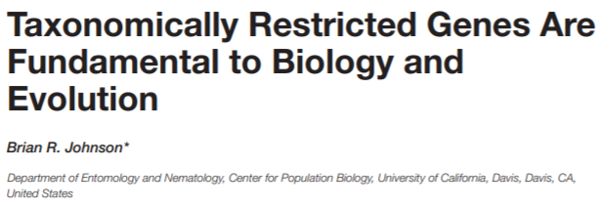
The revolution brought by whole metagenome shotgun sequencing
Another major advantage is being able to identify genes lacking homology with already known sequences -> huge potential for biodiscovery
Study of “orphan” or “taxonomically restricted” genes
Only possible approach to study virus diversity: while cellular organisms share rRNAs, viruses lack them!

Slide 15
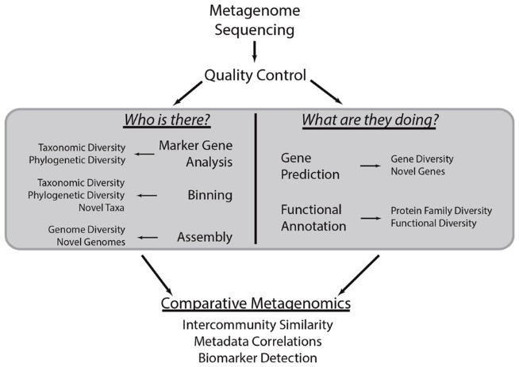
Which are the objectives of a whole metagenome shotgun analysis?
Step one: identify the community structure. Which organisms are present and in what abundance? This analysis must make use of marker genes, which are present in all organisms and useful for phylogenetic analysis
Step two: establish the functional diversity of the community. What functions are most represented among the genes present in the community components?

Slide 16
A dual approach
A whole metagenome shotgun sequencing (which is the proper metagenomic approach) undoubtedly has great potential, as it allows whole genomes to be reconstructed and functions associated with a microbial community to be explored
However, it is computationally complex, requires a high depth of sequencing, requires reads of adequate length combined with de novo assembly or mapping to reference databases, and depends on prior knowledge of the relationship between primary sequences and functions
Very often the interest stops at the first point, which is to study the structure of the microbial community. In this case it is possible to use phylogenetic markers with targeted sequencing approach, and we therefore speak of metabarcoding approaches

Slide 17
The complexity of microbial communities
Here, MetaSPAdes and MEGAHIT indicate two alternative algorithms for the de novo assembly of metagenomes

Slide 18
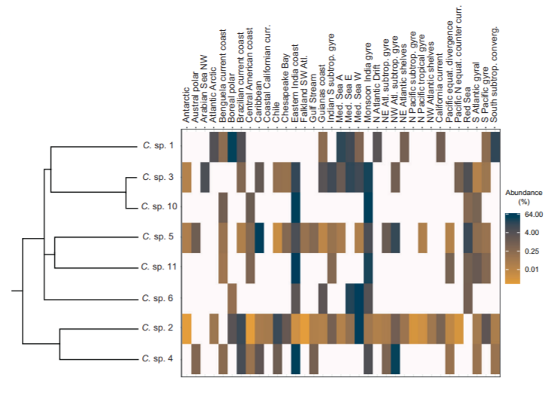
Applications in the ecological/environmental field
The complexity of a microbial community may be far greater than it may seem
Sequencing can reveal differences among cryptic species that are not detectable (or at least not easily detected) by microscopic observations
In the example here, we see an estimation of the relative abundance of different cryptic species of marine protists at different sampling sites

Slide 19
Diversity of microbial communities in nature
Let us consider two “extreme” examples
Communities related to the so-called “acid mine biofilm,” found associated with some metal and coal mines, are very simple
There are only 4 dominant species -> only a small sequencing effort is needed to derive complete genomes and study in detail the metabolic pathways associated with them
On the other end of the spectrum, we have the Sargasso Sea microbial community, which includes over 1800 species
Many of these had never been described before -> 148 new species
Altogether, the estimated new genes were about 1.2 million!

Slide 20
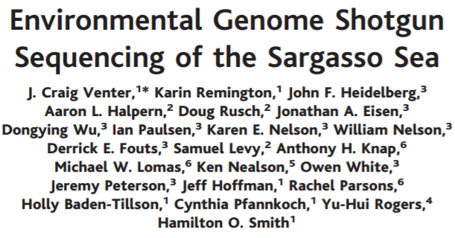
An example: the Sargasso sea microbial community
It is possible to estimate the abundance of different taxonomic groups based on their relative contribution to the total number of generated sequences attributable to the same gene family
N.B. in this case (this was 2004) the approach used was based on Sanger sequencing!

Slide 21
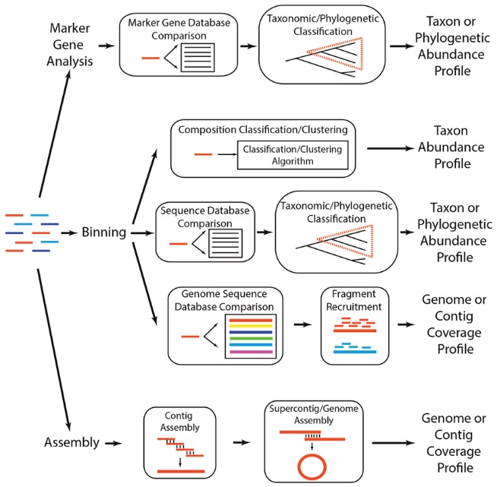
How can we identify what has been sequenced?
This task is not trivial, since most sequences will not find a 100% match with sequences already known and deposited in appropriate databases
It is possible to use marker genes (single genes or gene families) to assess, by phylogenetic analysis, which taxa are most highly represented
It is possible to assemble reads de novo to generate supercontigs (genome chunks) or even complete genomes for characterization
The most common strategy is binning, that is, assigning redundant sequences to the same OTU (Operative Taxonomical Unit), a concept to which we will return later

Slide 22
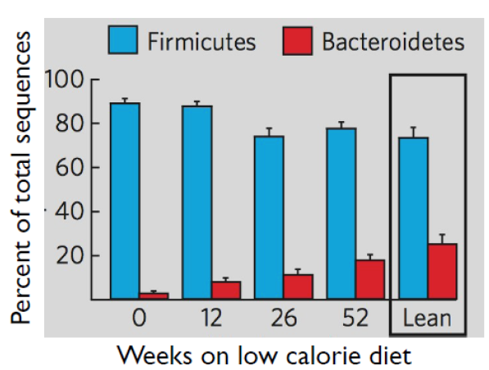
Applications to the biomedical field: an example
Ley et al. 2006
Human Gut Microbiomes associated with obesity. Nature 4441022-1023
A condition of obesity is related to an imbalance in the relative abundance of Firmicutes and Bacteroidetes in favor of the former

Slide 23
Profiling a microbial community
This approach is usually based on single marker genes
For bacteria, the marker of choice is16S ribosomal RNA
For eukaryotes, it is the 18S ribosomal RNA
Other markers may also be used (e.g., RpoB, the beta subunit of bacterial polymerase)
Since the molecular target is not large (as we will see we usually do not analyze the entire sequence of 16S or 18S rRNA, but only variable regions), this metabarcoding approach fits very well with Illumina PE sequencing (on a benchtop sequencer) or IonTorrent

Slide 24
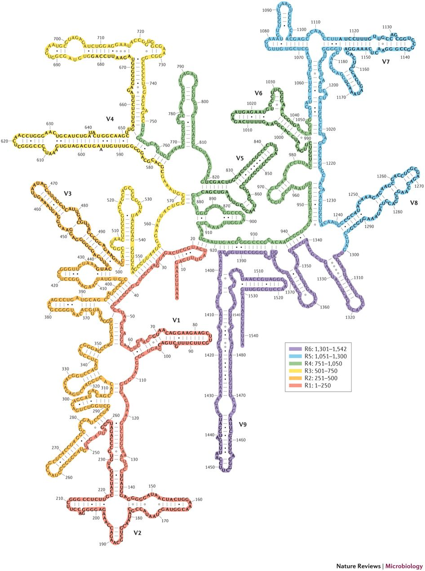
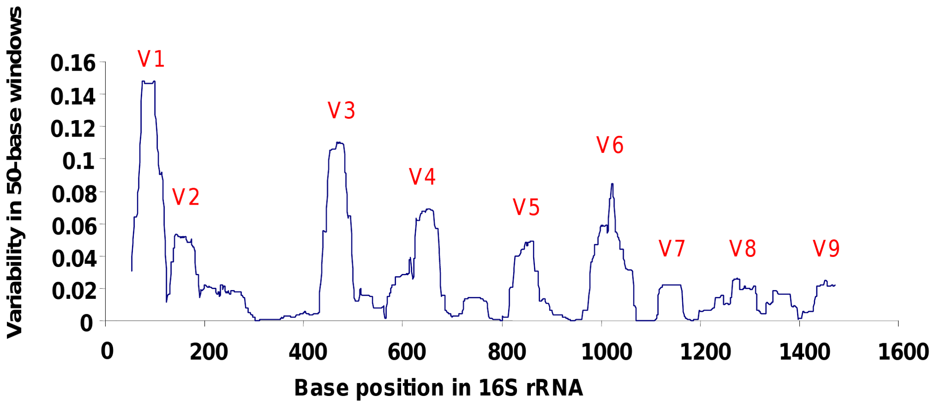
16S rRNA: why?
It is a sequence shared universally by all prokaryotes
It has highly conserved regions interspersed with highly variable regions V1-V9)
These can be amplified and sequenced by the use of degenerate primers drawn on their flanking regions
This bypasses the need for culture

Slide 25
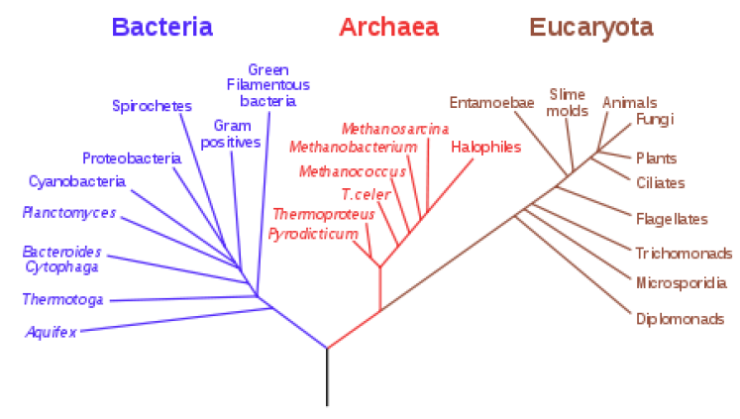
16S rRNA: why?
Variable regions of 16S rRNA can be regarded as “fingerprints” that allow for the unique identification of a given species
There are dedicated databases such as SILVA, which allow comparison with several million already determined sequences of bacteria and Archaea
Given the sharing of rRNA sequences by all cellular organisms, phylogeny based on 16S sequencing has made it possible to redefine the tree of life on the basis of genetic-molecular criteria and no longer just morphological criteria

Slide 26
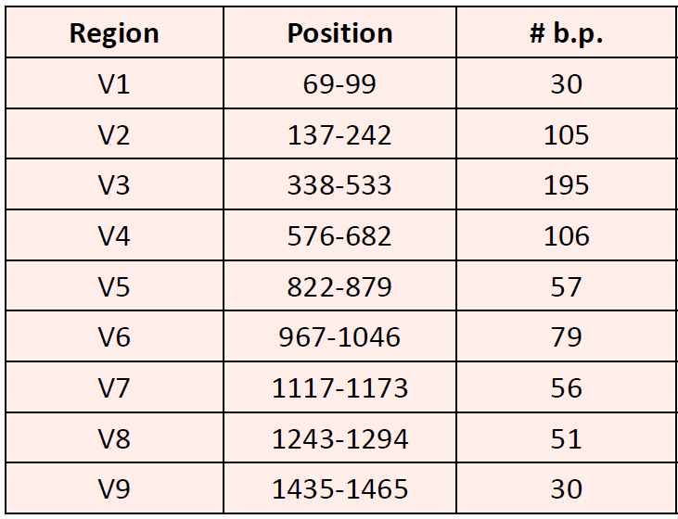
16S rRNA: how?
The 9 variable regions are distinguished by different length, but also by a varying degree of diversity
Their phylogenetic informativeness is therefore different, and the length also determines the choice of the type of sequencing to be performed (e.g., taking into account the length of reads)
N.B. the complete sequence of 16S rRNA is about 1600 nt long

Slide 27
16S rRNA metabarcoding: NGS with short reads
N.B. although we refer to “16S rRNA sequencing”, one should not be confused, because what is sequenced is the corresponding nuclear gene. Therefore, no retrotranscription takes place before the preparation of the library

Slide 28
16S rRNA metabarcoding: NGS with short reads
Illumina sequencing has always represented a good compromise between reads length and throughput
For approaches of this type, “benchtop” sequencers are sufficient, and thus the classically most widely used platforms for metabarcoding approaches have always been MiSeq platforms (in the case of Illumina sequencing, not forgetting the possibility of sequencing on IonTorrent platforms)
The choice of whether to use SE or PE sequencing depends on the length of the variable region of interest -> in some cases a single read is sufficient, otherwise paired reads must be overlaid and assembled
N.B. when preparing the library, we expect all inserts to be the same size

Slide 29
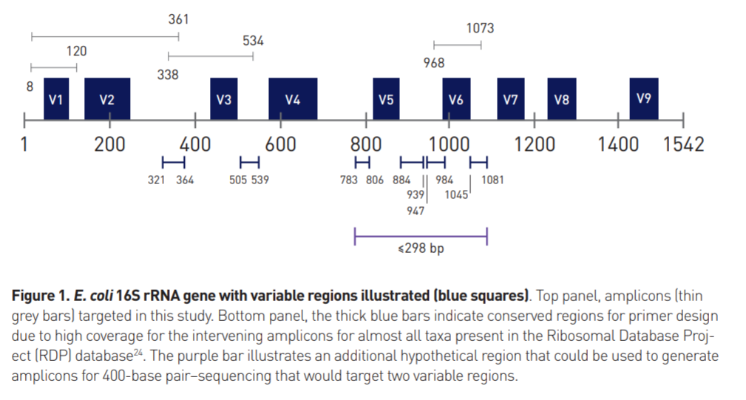
16S rRNA metabarcoding: Illumina or IonTorrent?
Longer reads offer the possibility of covering multiple variable regions simultaneously, and this increases the number of phylogenetically informative sites (= that contain analyzable polymorphisms)
Improved ability to discriminate taxa. Increased resolution (you can go down to genus and species, whereas with a single region you often stay at the order or family level)

Slide 30
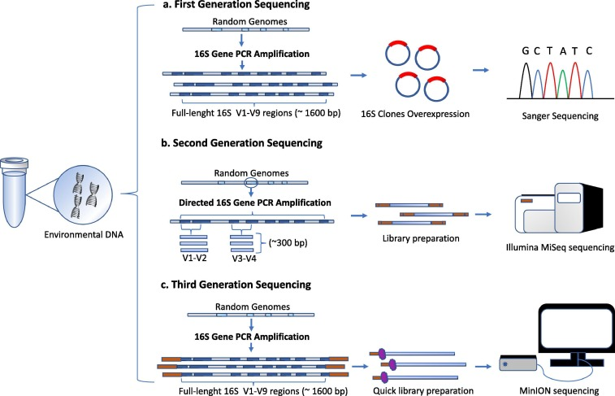
16S rRNA metabarcoding: full 16S gene sequencing with long reads
It is possible to seuqentiate the entire region of interest (approximately 1600 bp) with third-generation sequencing techniques
Since we always start from genomic DNA, this approach involves using degenerate primers to amplify the entire 16S gene

Slide 31
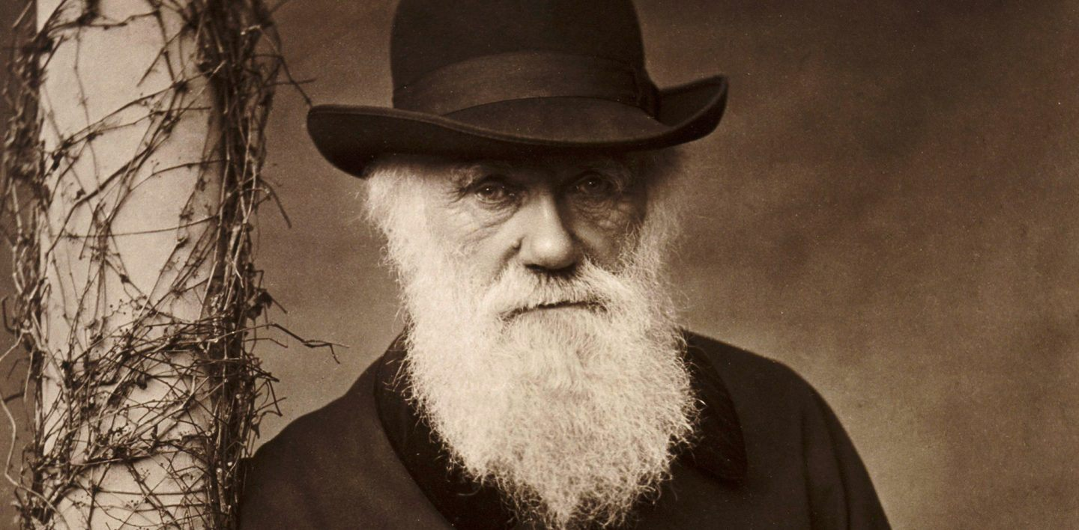
Defining the concept of species: not a simple task
«No single definition has satisfied all naturalists; yet every naturalist knows vaguely what he means when he speaks of a species”
Charles Darwin
On the origin of species, 1859

Slide 32
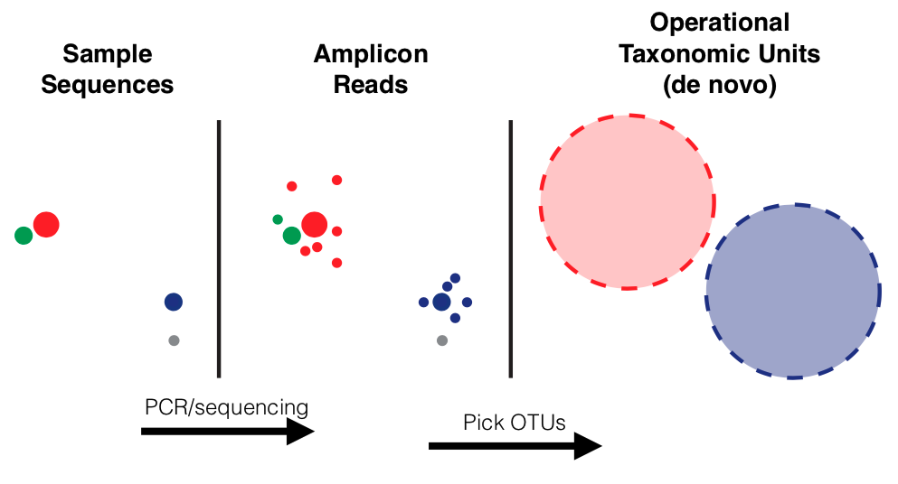
Defining the concept of species: not a simple task
It works very well as long as it refers to organisms that reproduce sexually
Becomes much more nuanced when approaching bacteria and fungi
There is the presence of plasmids, there is extensive horizontal gene transfer, the genome itself can be considered a pangenome
What about viruses? Concept of viral “quasispecies”
Operational Taxonomic Unit, OTU: Arbitrary definition of taxonomic unit based solely on the criterion of sequence divergence

Slide 33
Early attempts at defining the concept of species using molecular data
The concept of OTU comes from the work of Peter Sneath and Rober Sokal in the 1970s
Their basic idea was to be able to group organisms into groups on the basis of observable and quantifiable characters
This strategy was intended to be useful in standardizing the way organisms were classified, which were very confusing and often heterogeneous depending on the macrogroup of organisms being considered (e.g. zoologists vs botanists vs microbiologists, etc.)

Slide 34
The «binning» concept
In general, “binning” refers to the grouping of species, genera, and families on the basis of shared characteristics derived from analysis of certain properties of their sequences: frequency of observation of di-, tri-, or tetra-nucleotides, GC content, codon usage
In fact, the most common use of the term concerns the grouping of sequences derived from sequencing phylogenetic markers (e.g., 16S rRNA) on the basis of similarity criteria
A comparison is made between the generated sequences and a reference database
A minimum threshold of similarity is set above which assignment to a taxonomic group is made
>97% species, >90% genus, >80% family

Slide 35
The «binning» concept
Should more detailed classification be necessary, multiple phylogenetic markers could be used in combination (N.B. these must be housekeeping genes shared by all species of interest and NOT subject to horizontal gene transfer events!)
These are arbitrarily chosen thresholds, representing a kind of “rule of thumb” derived from empirical considerations
Some degree of divergence between the sequences and the reference contained in the database is always tolerated due to:
possible intraspecific variability
possible presence of sequencing errors
Use of thresholds that are too stringent would lead to erroneously reporting a higher level of diversity than is actually the case; use of thresholds that are too loose would lead to misclassifications

Slide 36
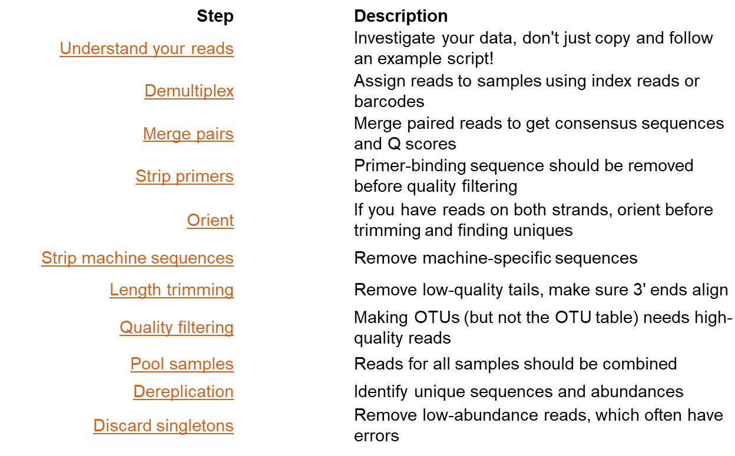
How do we handle sequencing data in a metagenomic analysis?

Slide 37
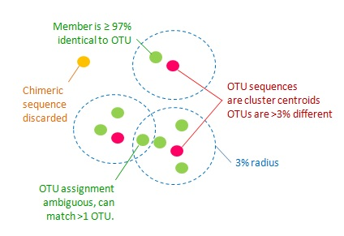
Criteria for clustering a read within an OTU
All sequences included in an OTU must have a mutual similarity level > 97% (use of accurate alignment algorithms important!)
Among all sequences in an OTU, one reference sequence must be identified, which should be the most abundant
Any chimeric sequences (possible sequencing artifacts or library preparation) should be removed
All nonchimeric sequences found within an OTU need to share identity level against the representative sequence above the threshold (remember that “singletons” should be removed)
N.B. some OTUs can create a continuous spectrum of similarity between sequences, and this results in the possible classification of some sequences into more than one OTU

Slide 38
Creation of «OTU tables»
An OTU table is simply a list of OTUs, characterized by a unique identifier and linked to a reference sequence
Observation frequencies, which are derived from the process of clustering the reads obtained from sequencing (of the selected phylogenetic marker), are associated with each OUT
Basically, the number of reads that fall into each OTU is counted and these numbers are related to the total number of informative reads (thus excluding chimeric reads and singletons)

Slide 39
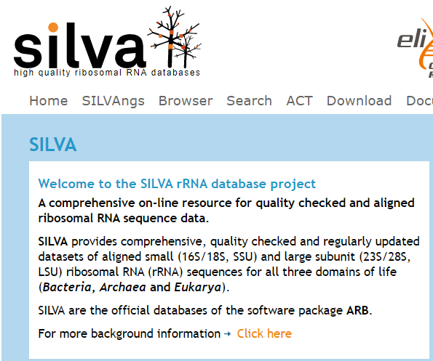
Assigning OTUs to taxonomic entries
The reference sequences of each OTU can be compared with a reference database
If the similarity between the reference sequence of the OTU and that of the database is sufficiently high, one can go to the species level, otherwise one stops at higher taxonomic levels
These databases include SILVA, a reference database for rRNA sequences of bacteria, Archaea and eukaryotes
The algorithms that perform this classification are inspired by BLAST, but have been further implemented to improve speed of execution with heuristic approaches (in particular, an algorithm called DIAMOND is used extensively)

Slide 40
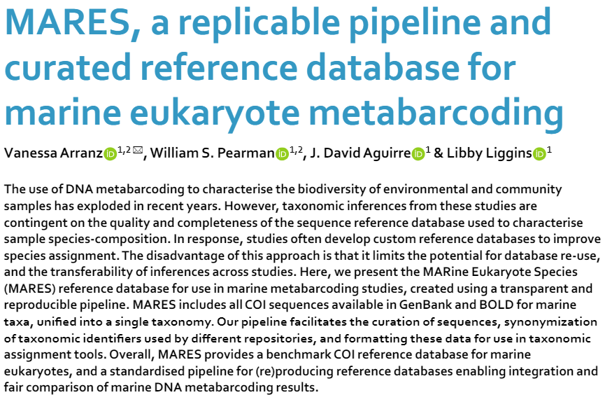
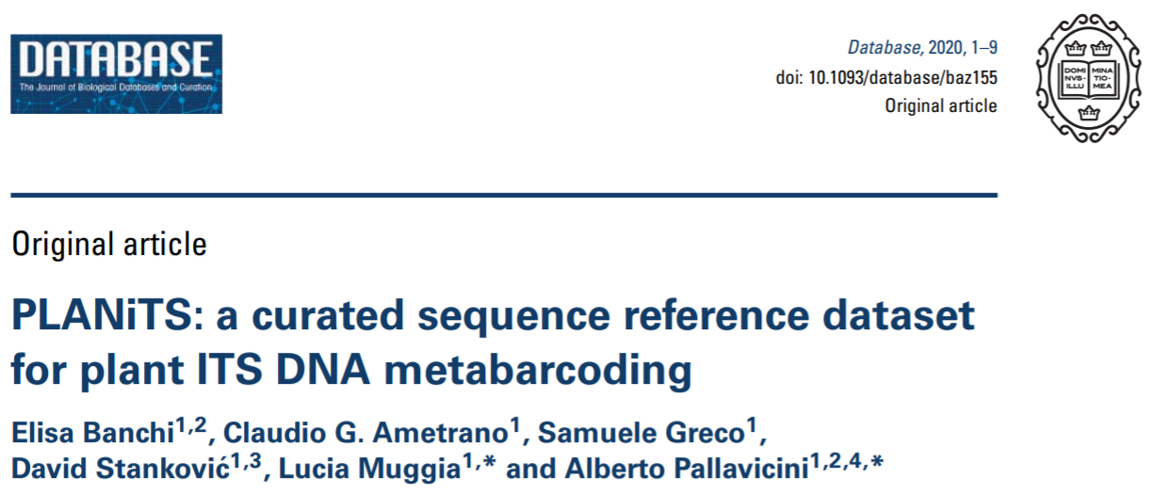
Other reference databases developed for specific purposes
The curation of databases by the scientific community remains extremely important
Very often it happens that databases contain incorrect or misclassified sequences, which can lead to rather gross “chain” errors
Specific consortia have developed databases that are small in size but focused on the analysis of specific biological contexts to improve the accuracy of OTU assignments

Slide 41
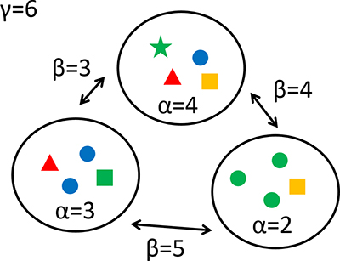
How is OTU diversity measured?
Alpha diversity: what and how many species are found in a given biological sample? With what relative abundance? -> “within sample” diversity
Beta diversity: how similar or different are two biological samples? What do they have in common? -> “between samples” diversity
Gamma diversity: «landscape diversity», ecological concept of more difficult application in metagenomics. Indicates the total variability on a very large scale, between groups of samples (e.g. microbiomes of marine environments vs microbiomes of freshwater environments)

Slide 42
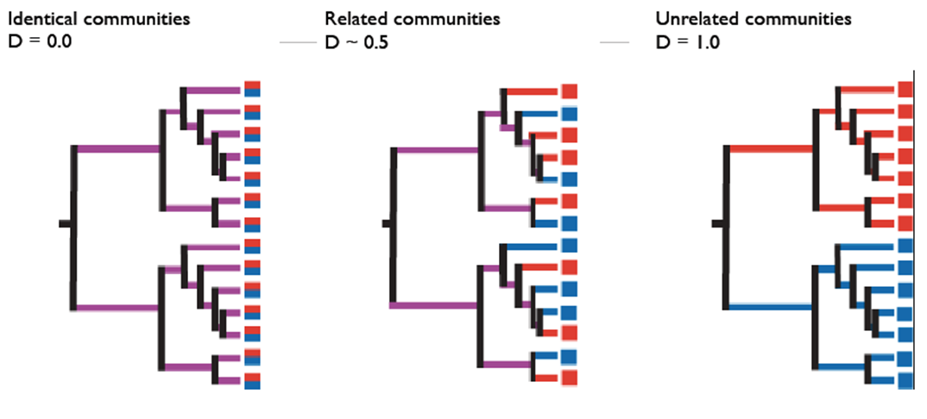
How is OTU diversity measured?
Alpha and beta diversity can be calculated with appropriate indices
Shannon, Chao or Simpson indices for alpha diversity
Sorensen index for beta diversity
The UniFrac distance is also often used to calculate beta diversity.
It is expressed as the fraction of the length of branches in a phylogenetic tree that can be traced to OTUs uniquely present in either sample

Slide 43
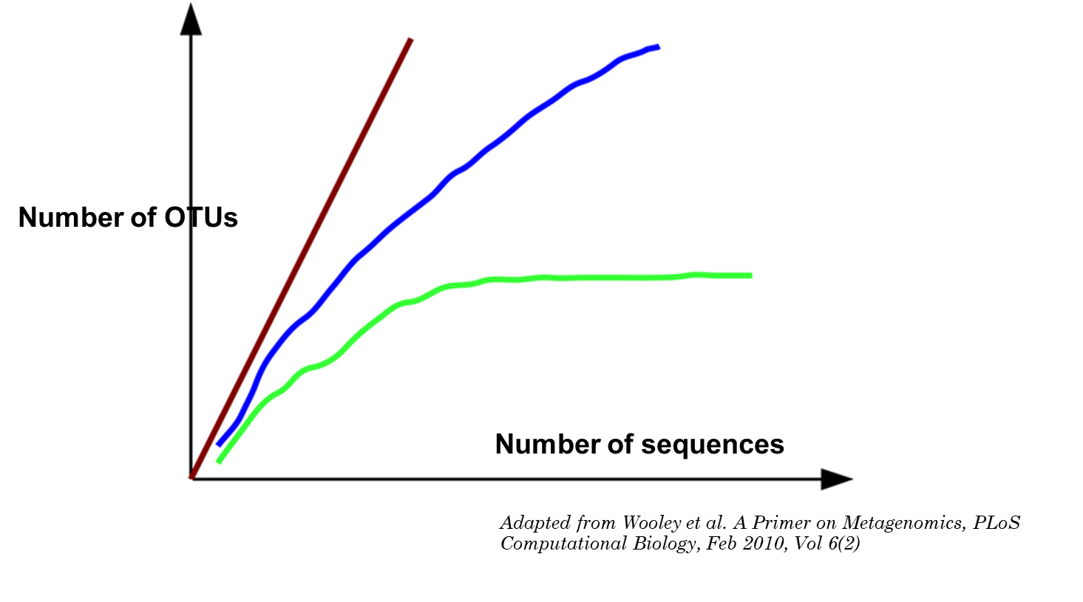
Which sequencing depth should we use?
This can be revealed to us by rarefaction curves, which tell us how thoroughly we have sampled the diversity of a microbial community
The more we sequence, the fewer new OTUs we expect to find (because the probability of not “seeing” sequences related to low abundant species drops)
Once we reach a certain point, the number of OTUs should stop growing, regardless of the depth of sequencing
A rarefaction curve does not tell us anything, per se, about what microbial species are present!
It is useful, however, as a quality control

Slide 44
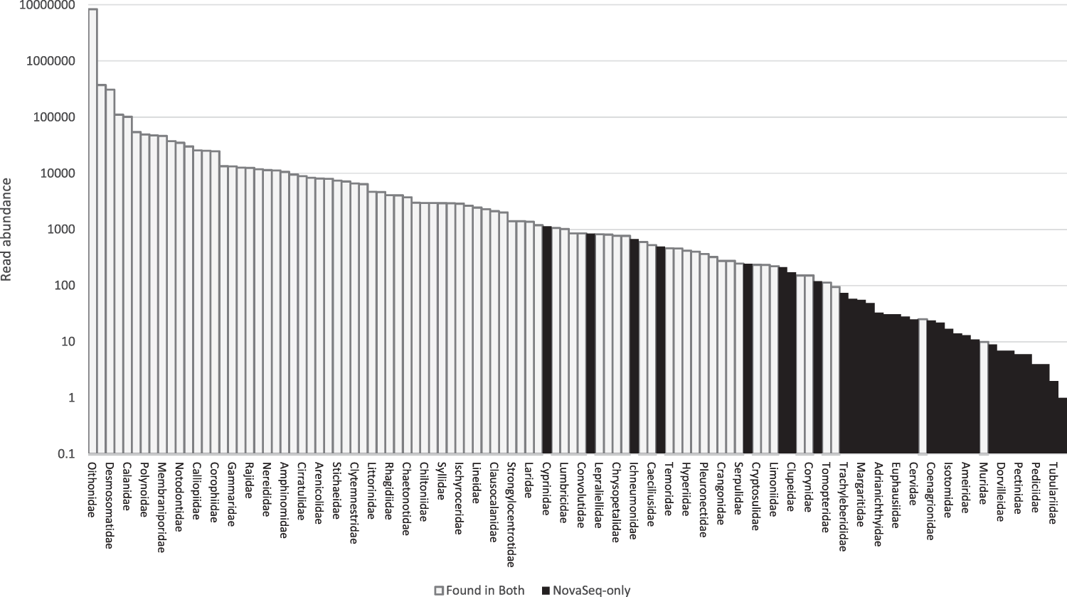
How many reads do we really need for a metabarcoding experiment?
There is no simple and universally valid answer to this question
It depends on the structure of the microbial community
It depends on the objectives of the study: for a comparison of the general population structure between different samples, relatively low coverage is sufficient, but if the interest is placed on very rare and poorly abundant species, then the number of reads can make a difference
It depends on the molecular marker and variable region chosen
Typically, the recommended output is about 100 thousand reads/sample, but even an output of about 20 thousand reads is acceptable for a rough analysis
This example compares the results of a metabarcoding experiment (based on COI) conducted on the same sample with a MiSeq sequencer (low reads) and a NovaSeq sequencer (high reads). The differences mainly concern low abundant taxa (in black), which were not detected by MiSeq. In this sample, full “saturation” was reached with about 10M reads.

Slide 45
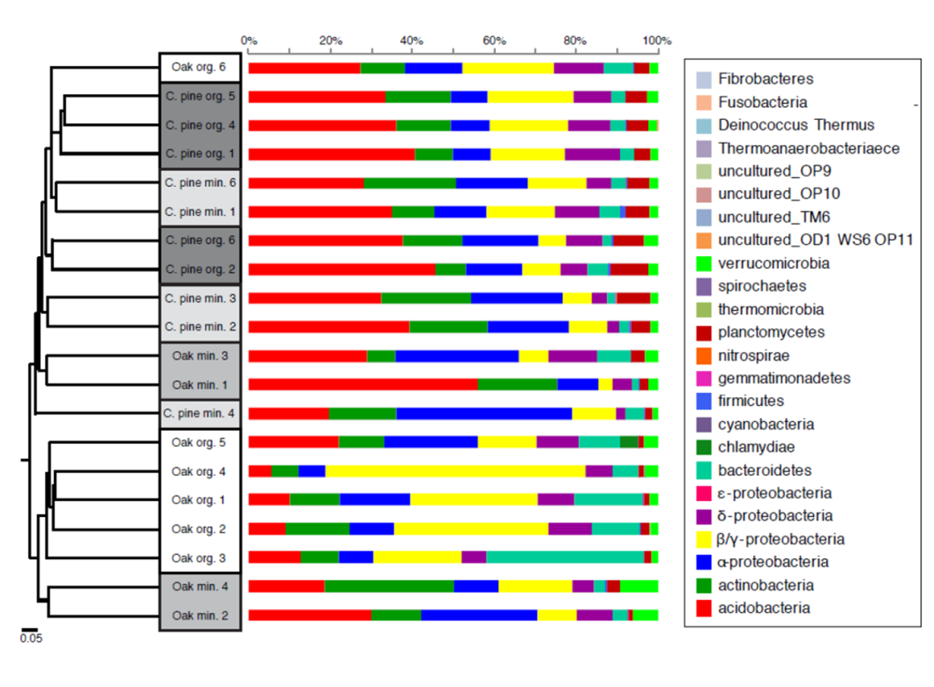
How can OTU diversity be graphically represented?
Option # 1: bar graphs
They report relative abundance (as a % of the total) for each OTU
OTUs can be traced (through comparison with appropriate databases) to certain taxonomic groups
Different OTUs can be grouped into groups based on different taxonomic ranks (genera, families, orders, etc.)

Slide 46
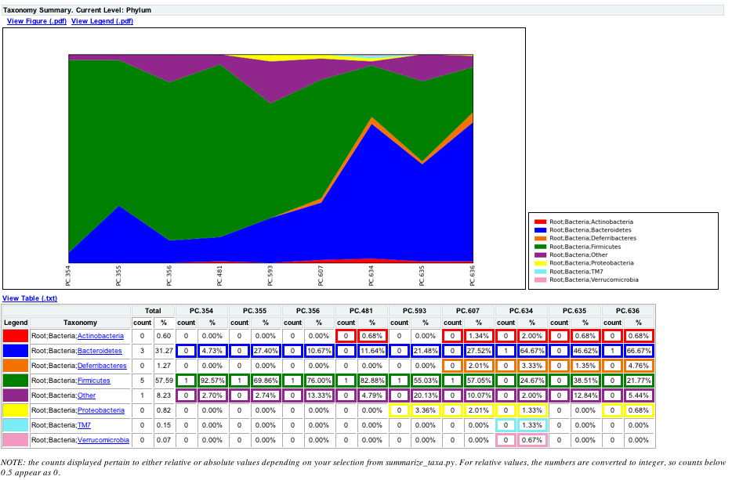
How can OTU diversity be graphically represented?

Slide 47
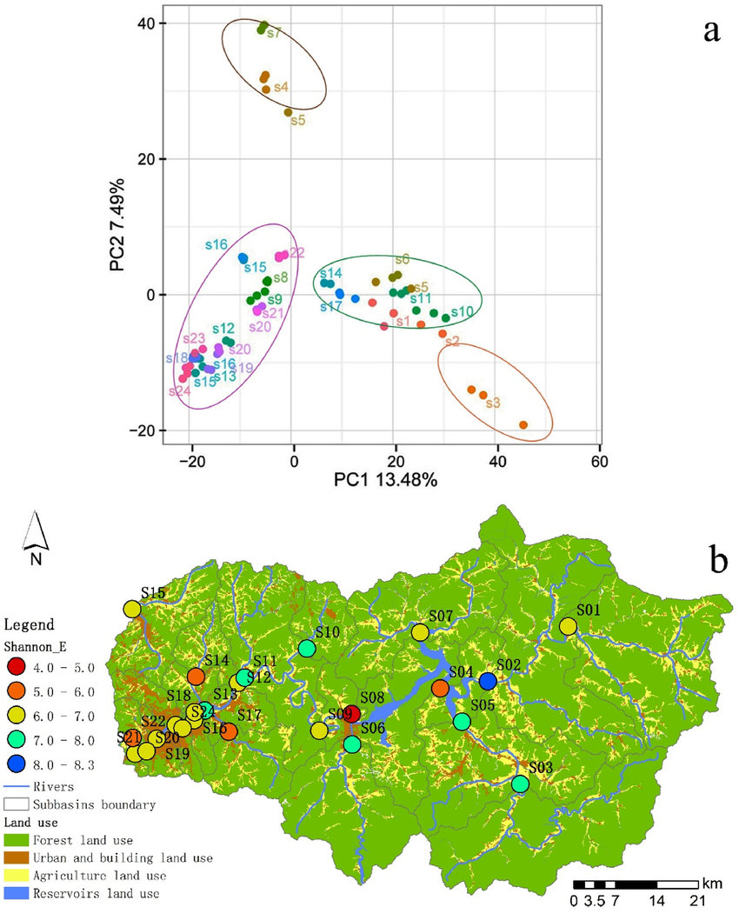
How can OTU diversity be graphically represented?
Option #2: PCA or other types of multidimensional scaling analyses
Similarly to what has been seen for RNA-sequencing experiments, clustering of samples in two-dimensional space can be observed
Microbial communities with similar composition to each other will position themselves in the same area of the 2D graph
They can be combined with maps to increase the level of information, especially when referring to ecological-environmental studies

Slide 48
Open challenges for metagenomics approaches
Sequence databases continue to suffer from some bias toward model microorganisms, from “common” and easily accessible environments, and largely culturable -> many sequences obtained of sequencing could not be traced to known genera or families
A significant fraction of the reads will continue to belong to some sort of uncharacterizable “microbial dark matter”
We can assess the relative abundance of different microorganisms in a biological sample, but not their absolute abundance! Beware, therefore, of making correlations that could be misleading without having a quantitative estimate of the number of bacterial cells observed per volume
Live or dead dilemma: DNA sequencing detects everything in a biological sample, but does not necessarily tell us which part of the microbiome is “active”

Slide 49
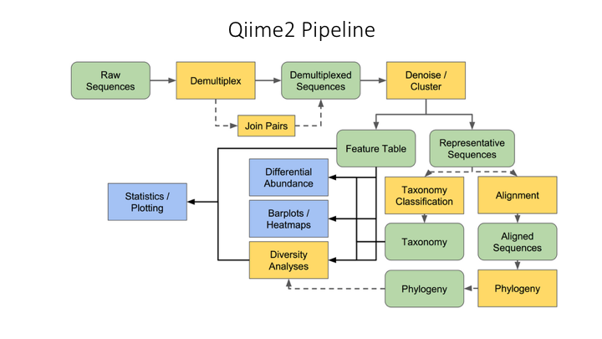
Metabarcoding analysis: an example of a workflow
Numerous analysis pipelines have been developed that allow all of the previously described operations to be performed with minimal user input
Among these, one of the most widely used is Qiime2

Slide 50
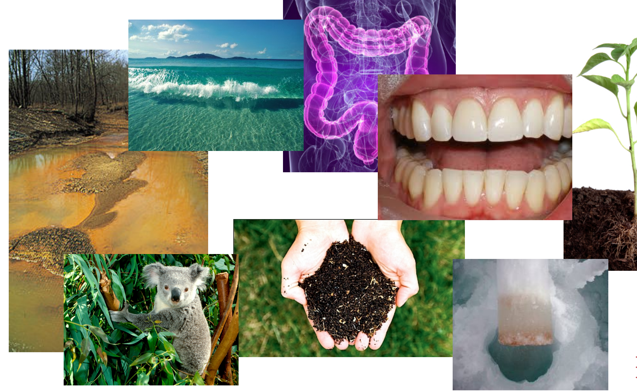
To what environments is a metagenomic approach applicable? More importantly, what do we mean by “environments”?

Slide 51
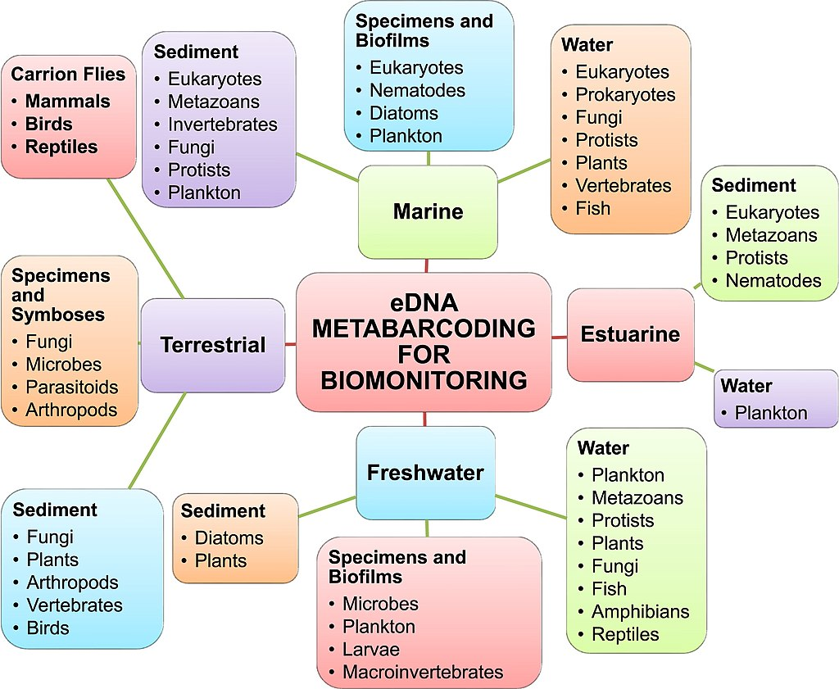
eDNA: a brief overview
eDNA (or environmental DNA) refers to traces of DNA present in the environment that can be identified without direct sampling of the species by amplification and sequencing of a target molecular marker
The markers are usually the same as those used for metabarcoding approaches
Therefore, we usually talk about eDNA metabarcoding approaches
However, the study of eDNA is not necessarily related to -omics applications and NGS sequencing: in fact, the study could also be focused on the identification of a single species of interest, because it is rare or pathogenic! Example: sewage water monitoring of SARS-CoV-2
Both the biological starting material and the purposes of analysis can be extremely different in eDNA approaches

Slide 52
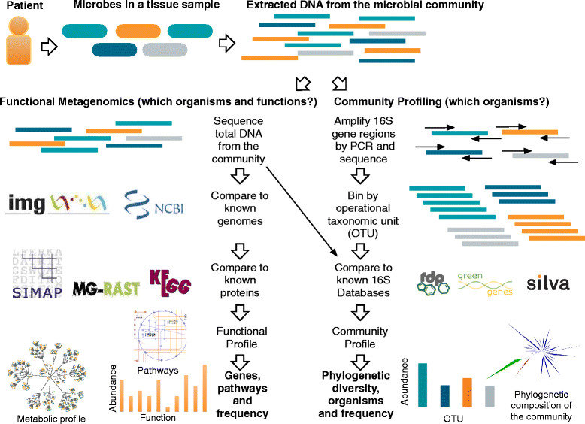
Beyond metabarcoding: whole genome shotgun sequencing of microbial communities

Slide 53
Beyond metabarcoding: whole genome shotgun sequencing of microbial communities
ADVANTAGES (AND DISADVANTAGES) COMPARED WITH STANDARD METABARCODING APPROACHES
Sequenced fragments are derived from any portion of the genomes of individual components of the microbiome (remember that genomic DNA fragmentation is, or should be, a random process)
This offers the possibility to explore the gene content of a community as a whole
However, reads from different microorganisms are mixed together (extraction is from a mix of many cells of different taxonomic origins) and all those derived from the same sample share the same barcode
A much higher number of reads is required than with a metabarcoding approach -> one switches to NovaSeq sequencers for Illumina approaches
It is potentially possible to obtain the complete genomes of individual microbial components of a community -> MAGs (Metagenome Assembled Genomes)

Slide 54
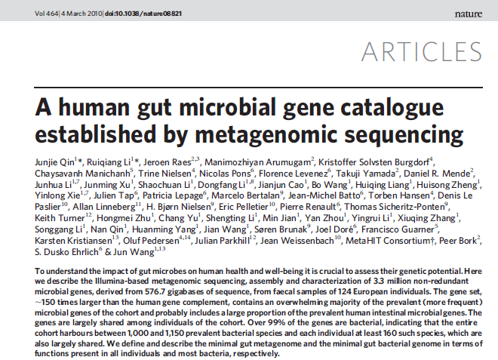
A case study: Meta-Hit
The purpose of this project was to define the existing associations between the human gut microbiome and the development of common diseases such as obesity and inflammatory bowel disease

Slide 55
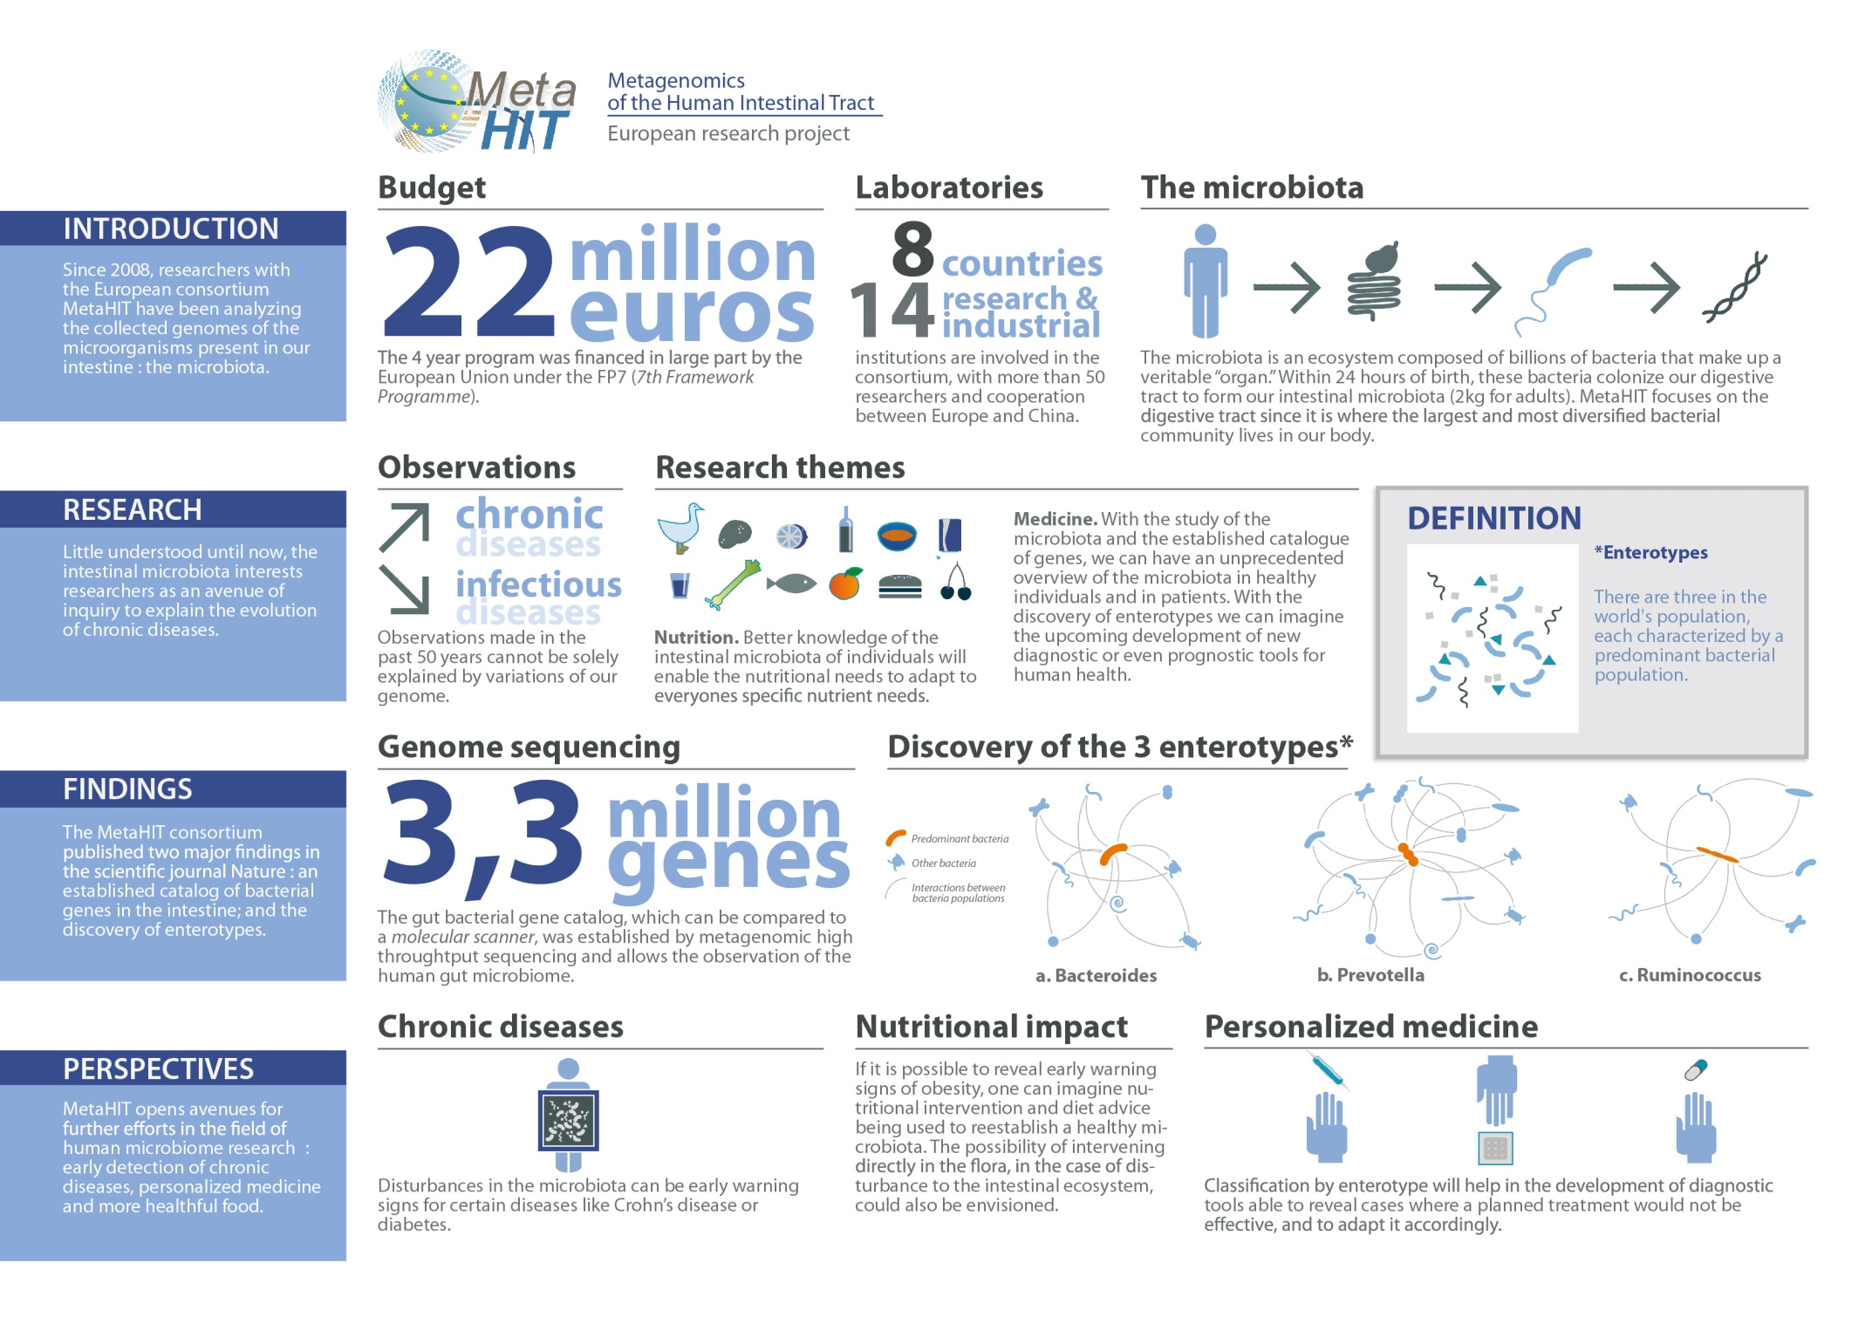
A case study: Meta-Hit
More than 14 million ORFs with length > 100 bp were identified
Following some redundancy removal, one is left with 3.3 million putative bacterial genes
This is a gene repertoire approximately 150 times larger than that constituted by the human genome
81% of these genes are not functionally annotated

Slide 56
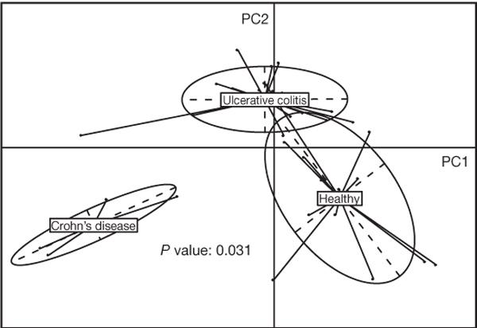
A case study: Meta-Hit
It was possible to highlight substantial differences in the composition of the gut microbiota of healthy individuals and those with chronic inflammatory diseases
This work laid a foundation regarding the possibility of personalized medicine approaches in these situations, including assessing the impact of diet on the structure of gut microbial communities

Slide 57
Challenges in whole-metagenome shotgun sequencing approaches
Communities are very large, and assembly is much more complex than assembling the genome of a single species (in spite of the relative simplicity of bacterial genomes)
Reads derived from phylogenetically related species risk creating chimeric contigs
Different genomes have different abundances and therefore contigs derived from different species will have different coverages -> different MAGs can have different quality and completeness
Difficult to discriminate between sequences with sequencing errors and reads derived from poorly abundance species
Very demanding hardware resources required, development of dedicated algorithms is still in its early stages
Euler, MetaVelvet, SoapDeNovo, MEGAHIT, MetaSPAdes are some of the algorithms used

Slide 58
Strategy for whole-metagenome shotgun sequencing approaches
Instead of aiming to assemble complete genomes, the simplest thing is to focus on obtaining Open reading Frames, which we can actually trace back to individual genes and thus to functional units that can be linked to Gene Ontologies, conserved protein domains, and enzyme functions
Functional annotation approaches can simply translate any sequence into the 6 possible reading frames, assuming that an ORF exceeding a certain length has a good chance of actually encoding a protein, and these can be compared with databases of sequences with known function
However, the vast majority of bacterial sequences will not be annotatable in any case, because there will be no detectable homology to other known sequences
One possible problem concerns the fragmentation of many ORFs, especially those that are particularly long. Third-generation approaches (ONT and PacBio) can partially solve these problems, but lead to increased costs and a decreased ability to detect low-abundance sequences

Slide 59
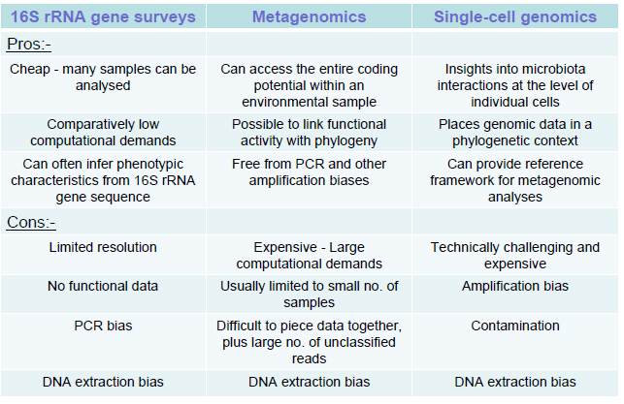
Should one pick a metabarcoding or a whole-metagenome shotgun sequencing approach?
The two approaches have their pros and cons.
The choice is mainly related to:
-cost: the metagenomic approach is much more expensive and the results more difficult to interpret
-objective: is it enough to study the structure of a community or do you want to also study it from a functional point of view?

Slide 60
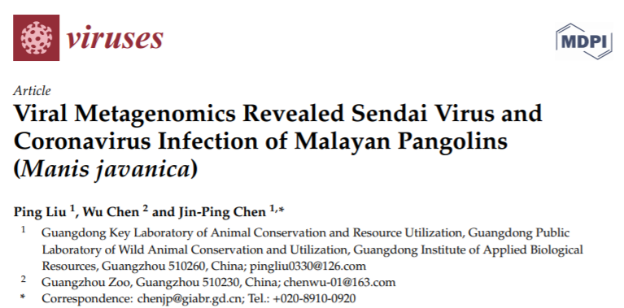
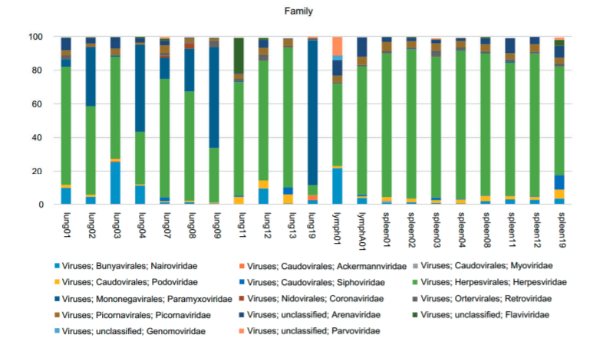
A recent application: viral metagenomics
Limited by the absence of shared phylogenetic markers
DNA viruses vs RNA viruses? Different ways of extracting and preparing libraries
Analyses tied to prior knowledge of sequence of known viruses
Databases such as ViPR (Virus Pathogen resource)

Slide 61
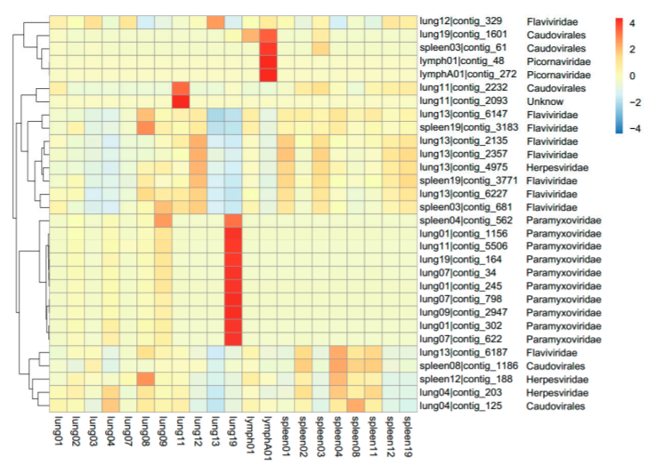
A recent application: viral metagenomics
Potential for viral discovery
Widely used in the study of coronaviruses in its potential natural hosts
Identification of some close relatives of SARS-CoV-2 (RmYN02 and RaTG13)

Slide 62
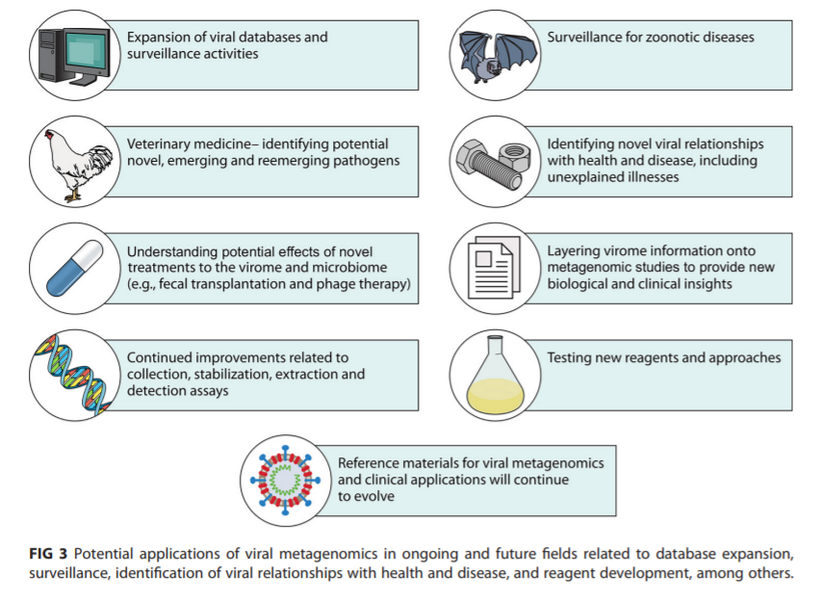
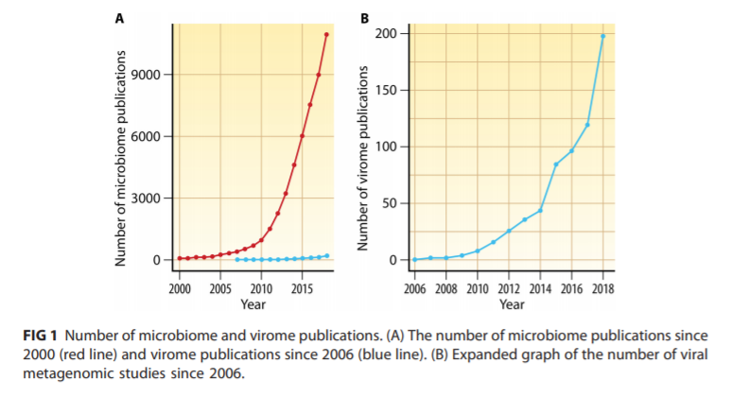
A recent application: viral metagenomics

