Slide 1
LECTURE 13 Other advanced omic techniques

Slide 2
How can we investigate actively transcribed mRNAs?
The RNA-seq technique offers the possibility of obtaining a “snapshot” of the mRNA molecules present at any given time in a cell or tissue
However, this does not give us the ability to know whether these molecules are the result of transcription that occurred minutes, hours, or even days earlier, since the half-life of mRNAs is highly variable and is determined by the 3'UTR and epitranscriptomic modifications
Thus, it may be useful to determine in more detail which mRNA molecules are (i) actively transcribed by RNA polymerase II or (ii) have already been directed to degradation by the normal cellular turnover of transcripts
N.B. these techniques are complementary but are not necessarily alternatives to ribosome profiling (Ribo-seq/ART-seq)! Ribosome profiling tells us what is being translated, whereas the techniques we are about to describe tell us what is being actively transcribed

Slide 3
Gro-seq – Global Run-On-Sequencing
N.B. this technique is limited to in vitro systems because of the use of labeled nucleotides!
Identifies active sites of nucleotide incorporation by RNA polymerase II, which works in the presence of 5-bromouridine-5-triphosphate (Br-UTP)
Fragmented RNAs of recent synthesis are isolated by immunoprecipitation, using anti-5-bromo-2-deoxyuridine antibodies -> technique therefore also called Bru-seq
Incorporation is followed by normal RNA-seq library preparation
It requires a reference genome (with the most information obtainable when paired with a classical RNA-seq)

Slide 4
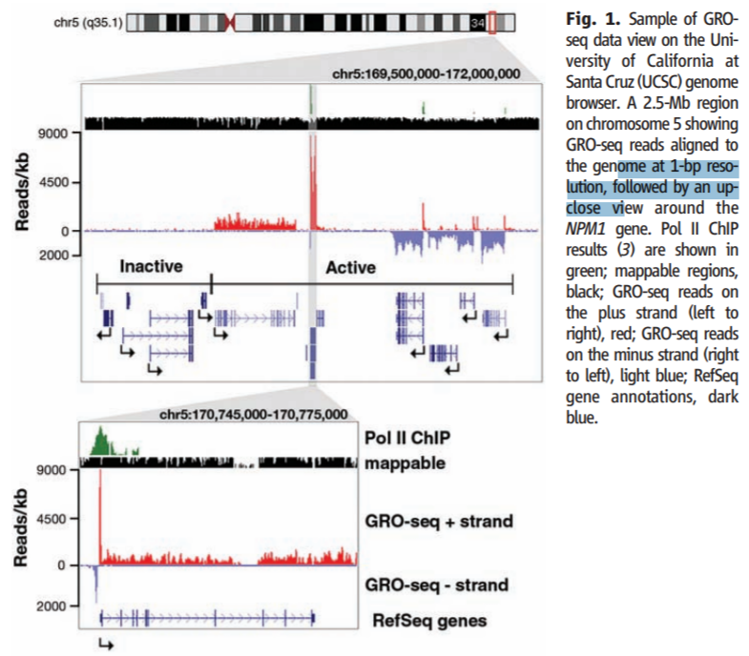
Gro-seq – Global Run-On-Sequencing
N.B. In a Gro-seq, nascent mRNA chains, i.e., pre-mRNA before splicing, are sequenced
The reads will therefore be distributed along the entire length of the gene and not just on the exons (as expected in an RNA-seq instead)

Slide 5
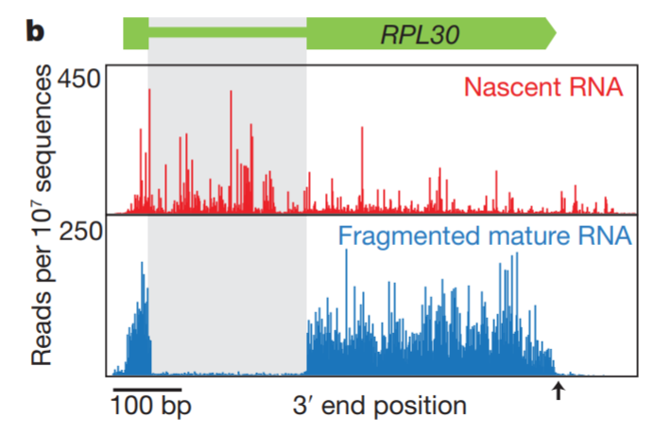
NET-seq – an alternative
Native Elongating Transcript sequencing
Unlike GRO-seq, application not limited to in vitro models (but it also requires a reference genome for complete interpretation)
Uses antibodies that can specifically recognize components of the RNA polymerase II elongation complex to isolate nascent mRNA molecules

Slide 6
BruChase-seq: studying long-lived mRNAs
This method exploits a pulse-chase technique (i.e., incubation with labeled nucleotides followed by incubation of unlabeled nucleotides). Applicable only on in vitro systems
Fundamental approach for studying the temporal dynamics of transcription
In the first step, transcripts will incorporate Br-UTP, but in the subsequent time interval until RNA extraction, all nascent mRNAs will incorporate UTP
Only the “oldest” transcripts found in the mix can be isolated by immunoprecipitation and sequenced. Short-lived transcripts, on the other hand, will not be isolated
Can be paired with regular RNA-seq to obtain a comprehensive overview of the transcriptomic landscape

Slide 7
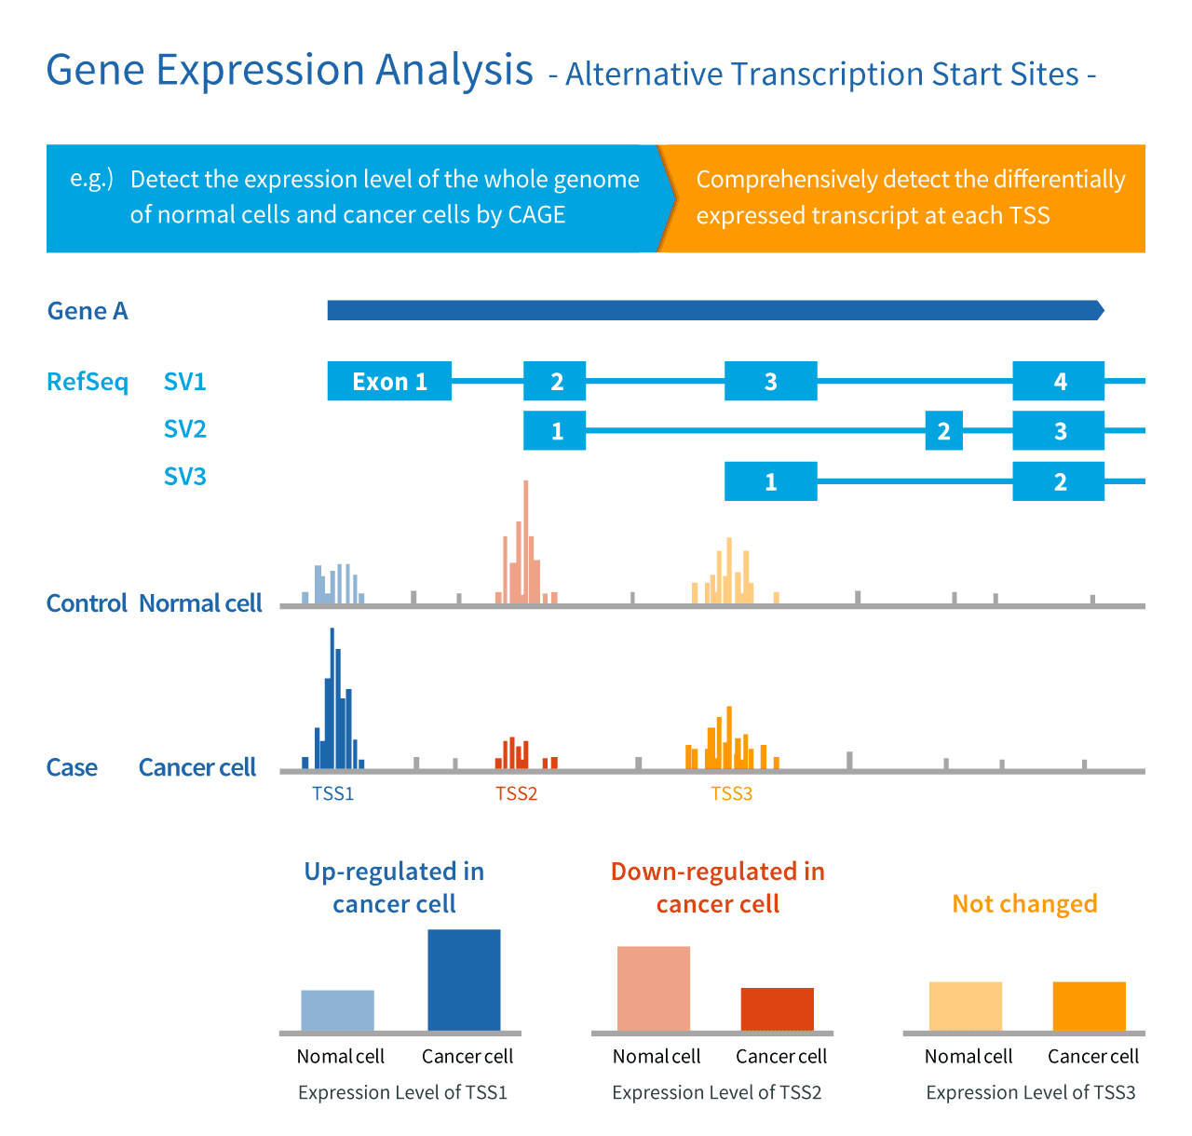
Mapping polyA sites and transcription start sites (TSS)
We have previously discussed the 3'-tag-seq technique, which, in addition to being a cost-effective alternative to a classical RNA-seq, also allows alternative polyadenylation sites to be mapped by enriching reads in the 3'UTR near the poly-A tail
A similar technique is used to map alternative 5'-capping sites: CAGE-seq

Slide 8
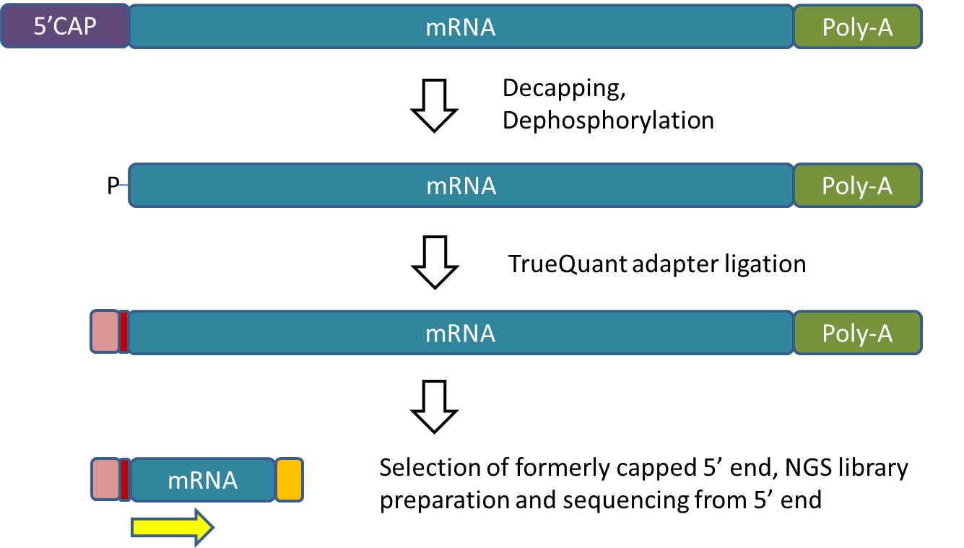
CAGE-seq
Technique inspired by 5'RACE, which solves the problem of the absence of a conserved sequence at the 5' of mRNAs
The CAGE-seq technique involves decapping mRNAs and adding a biotinylated adaptor at the 5' for selection of the mRNA/cDNA double strand that is created as a result of retrotranscription
Cap-less or nonretranscribed RNAs are degraded with Rnase (which does not degrade double-stranded targets)
The reads are mapped against the reference genome, resulting in mapping peaks at the 5' end of the first transcribed exon

Slide 9
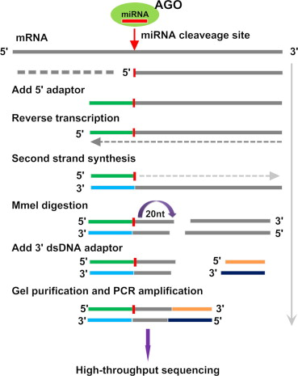
PARE-seq – «degradome-seq»
Parallel Analysis of RNA Ends
This is a technique that can map the mRNAs targeted for degradation by miRNAs
Fragmentation of mRNA by Ago (driven by specific recognition by miRNAs though complementarity) leaves a partial product with a free phosphate group at the 5’ end, which can be exploited to insert an adaptor
This is used for reverse transcription and to insert a cut site for MmeI (which cuts 20nt at the 3'), producing fragments of defined length, to which the second set of adapters are then ligated
'The resulting reads will be localized to the 5' end of the fragments of mRNA molecules undergoing degradation: these regions can be used to identify a consensus recognized (by complementarity) by miRNAs, and is therefore a powerful tool to infer potential mRNA/miRNA interactions, in particular if paired with miRNA-seq

Slide 10
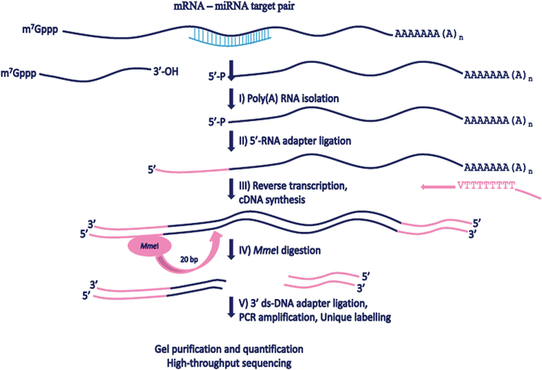
PARE-seq – «degradome-seq»
Note MmeI cleavage site: enzymatic cut always happens 20 nt downstream to a recognition site, which is included in the first adapter and is therefore shared by all mRNAs subjected to degradation. Short reads are fine for generating «tags» to be mapped against the reference genome

Slide 11
Population genomics: RAD-seq
RAD: Restriction-site associated DNA sequencing
Initial approach, as we shall later see “superseded” by other, more practical methods
Population genetics studies were typically conducted using a small number of known molecular (nuclear or mitochondrial) markers
How to exploit the potential of NGS?
Genomic DNA can be processed with restriction enzymes, which recognize cleavage sites present with an estimable frequency within a genome -> we can predict the number of loci that can be analyzed with RAD-seq in a target genome
Some SNPs may be present in the vicinity of the cut site. These observations will be rare for the single locus, but over large numbers it will be statistically likely to detect several of them in each individual, many of which are shared by all (or most) individuals in a population. The resulting reads containing informative SNPs are referred to as RAD tags

Slide 12
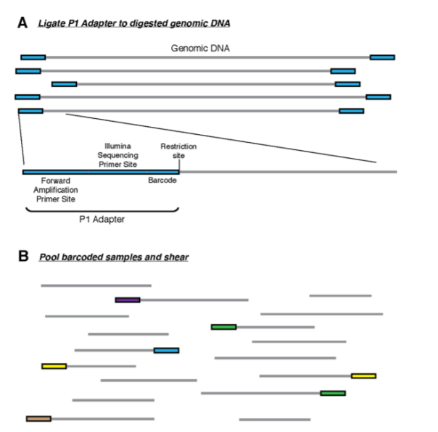
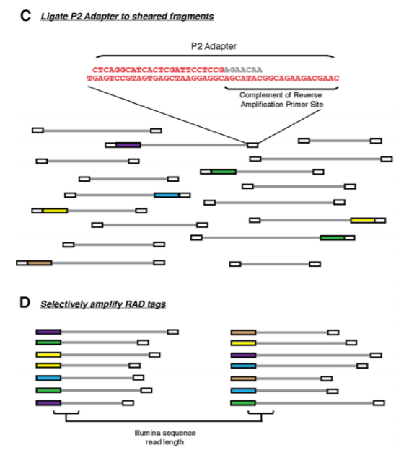
Preparation of the libraries generates fragments whose 5' end, sequenced in single-end mode, corresponds to the region flanking the cut site recognized by the restriction enzyme (since some fragments generated are very long, it is also necessary to proceed with physical fragmentation before adding a second adapter)
The rad tags, highlighted in different colors, correspond to the sequenced regions of these fragments

Slide 13
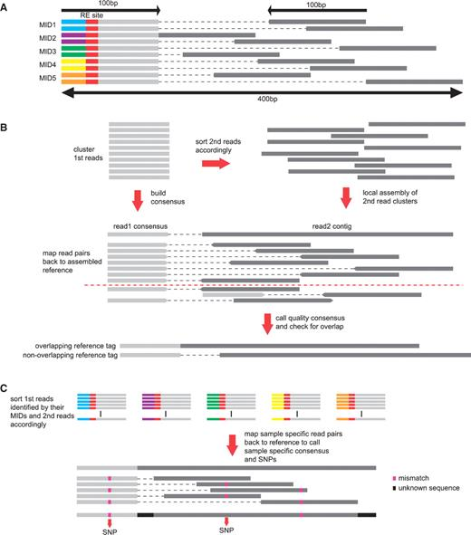
RAD-seq
Computer analysis proceeds by detecting the presence of SNPs in RAD tags, associated with different individuals. Sequencing is usually done for pools of many individuals, since each library contains a barcode, and a fairly small number of reads are needed for the individual sample
In this case, following removal of the barcodes and restriction site, the reads can be (optionally) mapped against a reference genome (paired-end sequencing in not needed, but it can be performed if the reads are mapped against a genome to improve mapping specificity)
All the reads obtained at the 5’end of each tag (raid 1 in PE sequencing) will all be aligned with each other, while reads 2 will be slightly offset depending on the size range of the selected fragments
The goal is to map the presence of SNPs associated with certain populations by calculating their frequency of observation

Slide 14
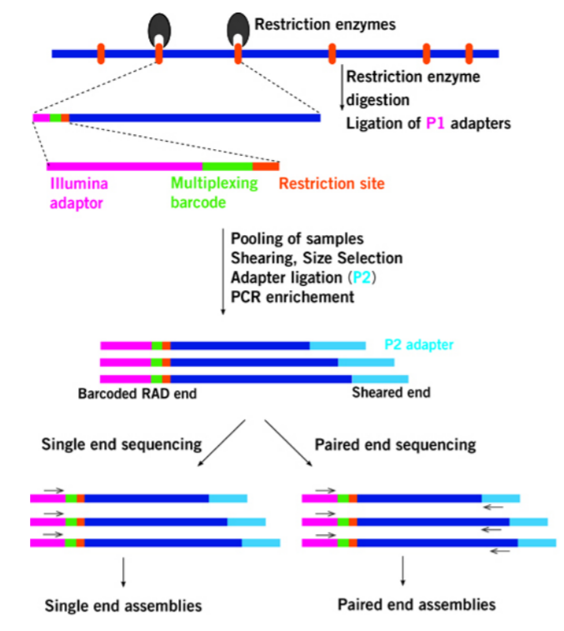
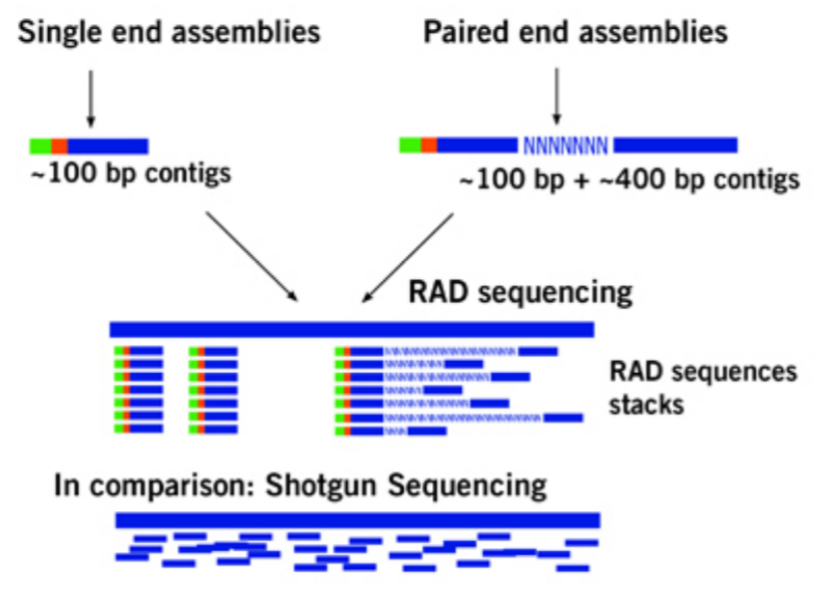
RAD-seq vs WGR
The required sequencing coverage is much lower, since not all genomic regions are represented

Slide 15
ddRAD-seq
Dd = double digestion
In this case the DNA fragmentation step is replaced by digestion with a second restriction enzyme (which cuts with much higher frequency than the first one)
This approach does not require a reference genome (the reads can be grouped into “stacks” according to their similarity and length (their length is expected to be sufficient to represent regions present a single time in the genome) -> is also applicable to non-model species
Comparison of different populations/individuals can lead to discovery of SNPs located near restriction sites that can serve as markers for population genetics studies
If a reference genome is available, these can be mapped and functionally investigated

Slide 16
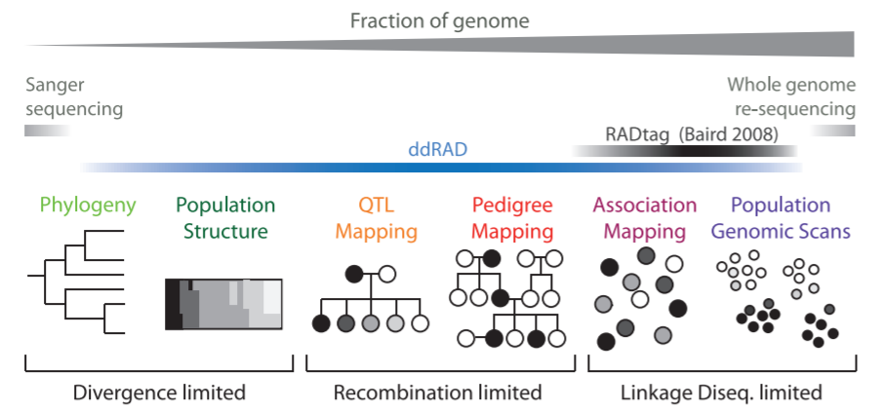
ddRAD-seq
Short, single-end sequenced reads are sufficient
Obviously, this approach cannot represent a complete map of all the SNPs present in a genome -> the number of loci depends on the frequency with which we expect cut sites to be present in the genome
The choice of restriction enzymes is critical! These should be chosen (along with the number of reads) based on the size of the genome (see next slides)

Slide 17
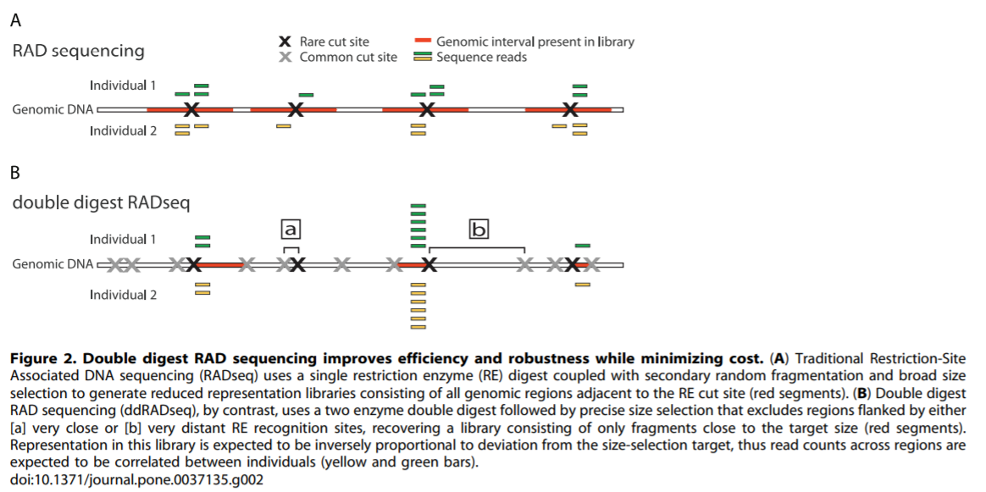
RAD-seq vs ddRAD-seq
The step of size selection of library fragments is critical. It is important that there is no difference in the protocol used for comparison among all samples included in a study

Slide 18
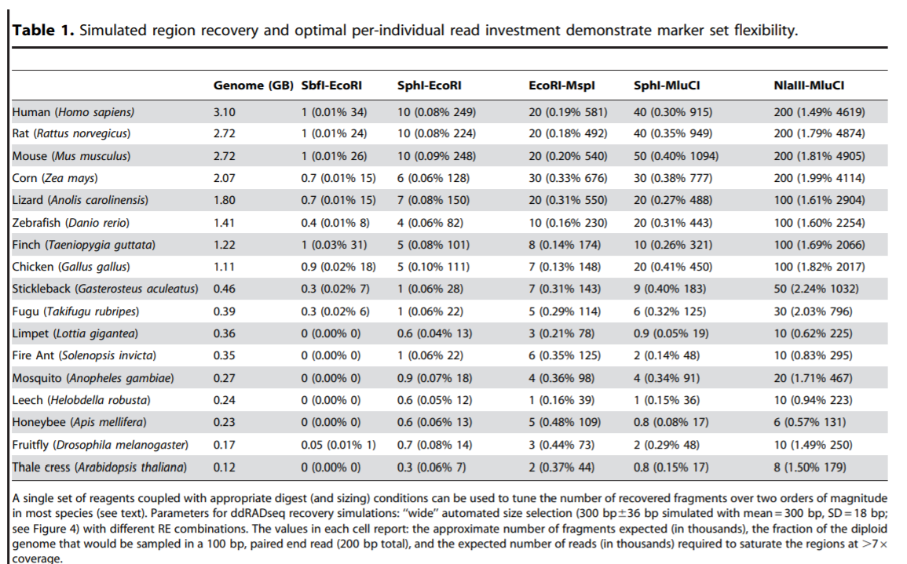
Selecting the right restriction enzyme combination in a key aspect in ddRAD approaches
Examples of combinations between different restriction enzymes in ddRAD approaches on different reference genomes
Numbers indicate:
Number of expected cut sites (in thousands)
% of genome represented
Number of reads required to obtain a complete profile (in thousands)

Slide 19
2b-RAD
Similar approach to ddRAD, but uses type IIB restriction enzymes
These perform a cut upstream and downstream of the restriction site, generating fragments of defined length
N.B. a single restriction enzyme is used: no sonication (as in RADseq) and no second digestion (as in ddRAD)
33nt in the case of using BsaXI or 36nt in the case of using AlfI
Very dense SNP maps are generated, allowing many loci to be analyzed simultaneously and requiring low sequencing coverage

Slide 20
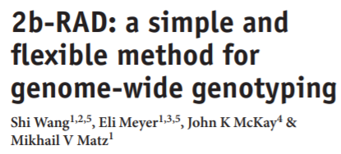
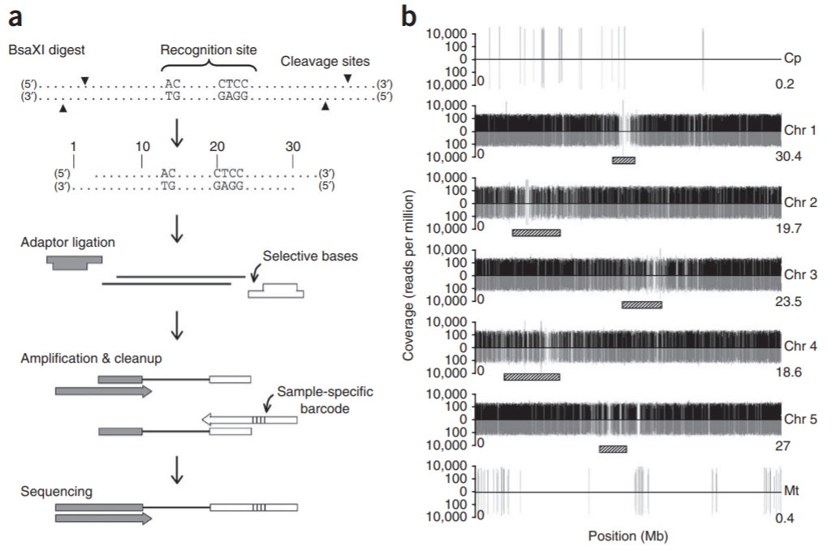
2b-RAD
Since the resulting fragments will all have the same size, the size selection step will not be necessary
The library fragments, unlike RAD-seq and ddRAD approaches, will all be the same size

Slide 21
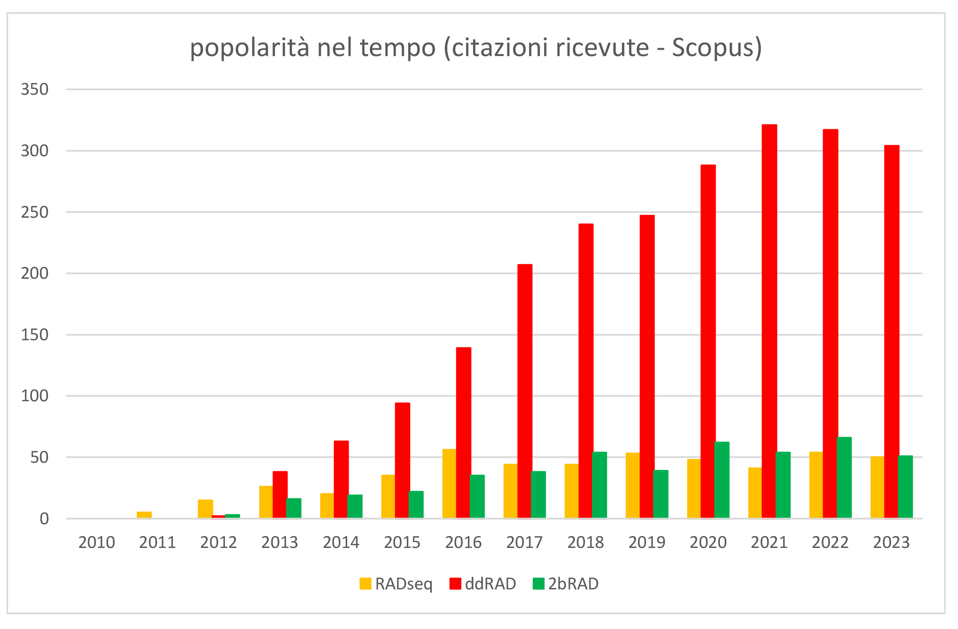
RADseq/ddRAD/2bRAD – reference papers
RADseq: Davey & Blaxter, 2010, Briefings in Functional Genomics, https://doi.org/10.1093%2Fbfgp%2Felq031
ddRAD: Peterson et al. 2012, Plos One, https://doi.org/10.1371/journal.pone.0037135
2bRAD: Wang et al, 2012, Nature Methods, https://doi.org/10.1038/nmeth.2023

Slide 22
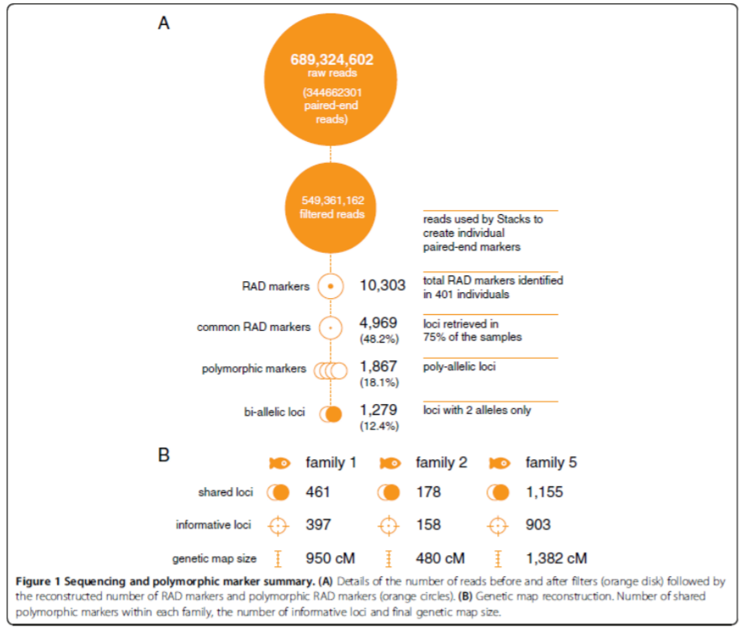
Target loci need to be selected before the analysis
Only a portion of the data produced by RAD/ddRAD/2b-RAD approaches are useful for doing population genetics studies
Some reads belong to poorly represented sites due to the phenomenon of fragment size selection (fragments are too long or too short and therefore are often excluded
Some loci may be missing in some individuals (because a SNP falls on the cut site)
Many loci are polyallelic -> selection usually falls on biallelic sites only

Slide 23
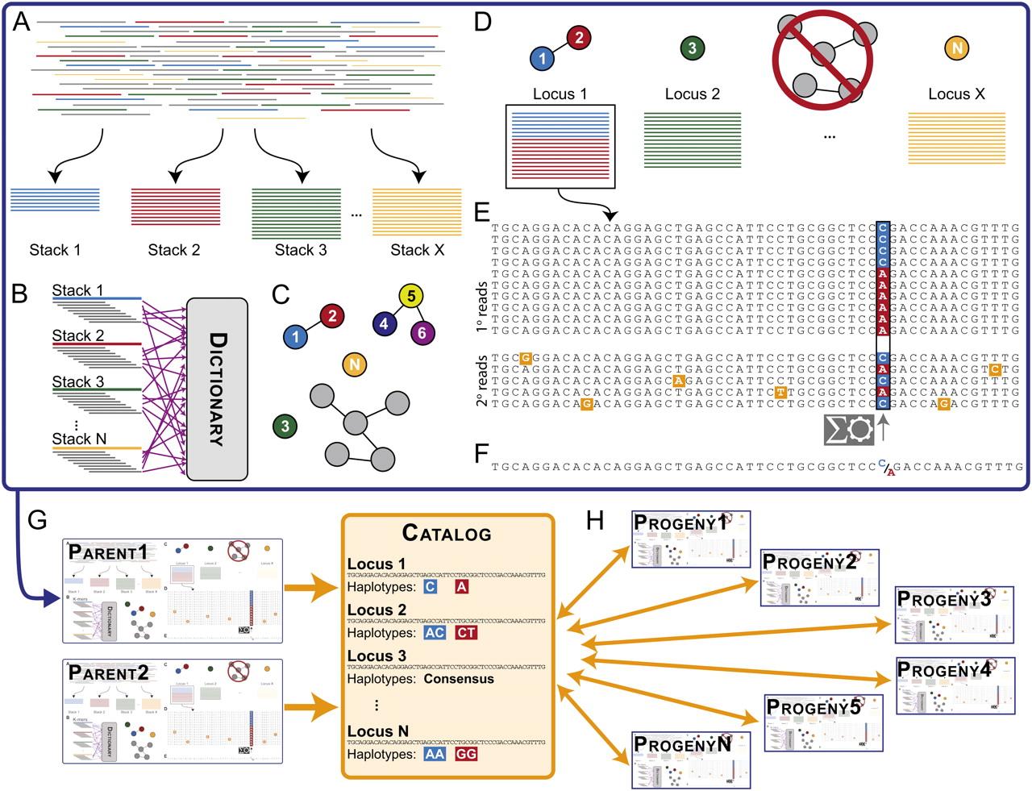
The «stack» concept
The reads generated by these approaches are “tags” that tend to align at well-defined loci, with the same start and end points (determined by the length of the reads or by the type of enzyme, in the case of 2bRAD)
They may or may not, in different individuals or populations, include a single informative SNP
The algorithm must therefore group them into “stacks,” i.e., groups of reads that can be traced back to single loci, discriminating real SNPs from sequencing errors and, above all, avoiding mixing together reads derived from different loci

Slide 24
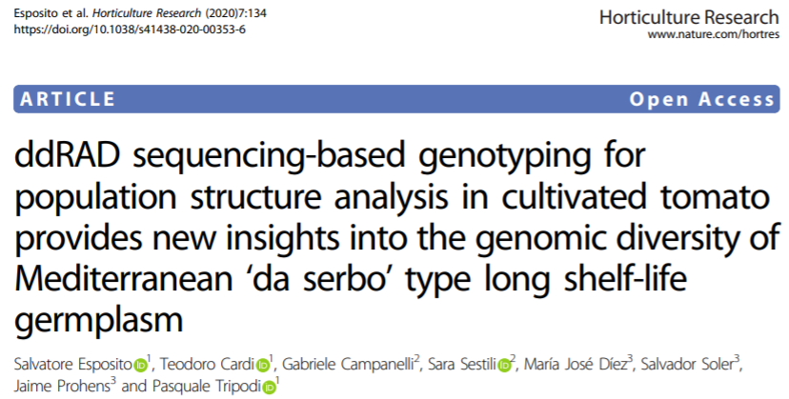
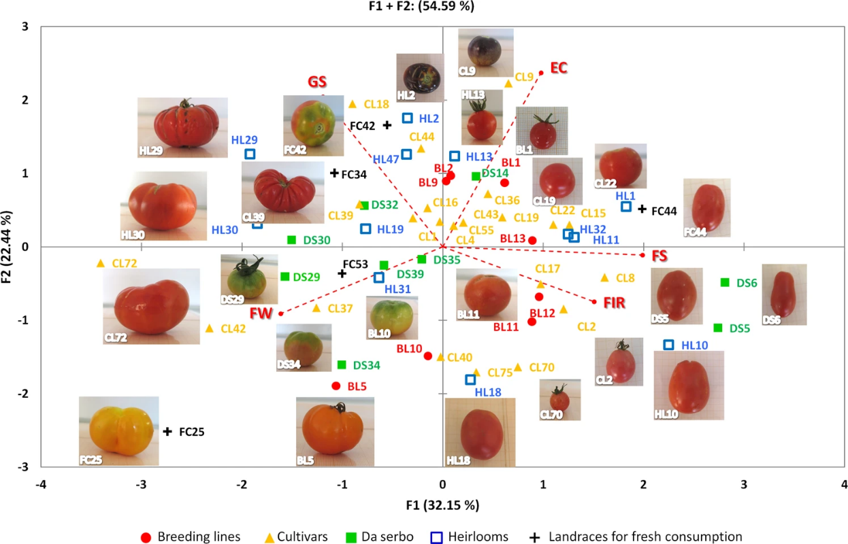
Interpreting results: an example
Note the use of PCA-like graphs, similar to those previously observed for RNA—seq and metagenomics

Slide 25
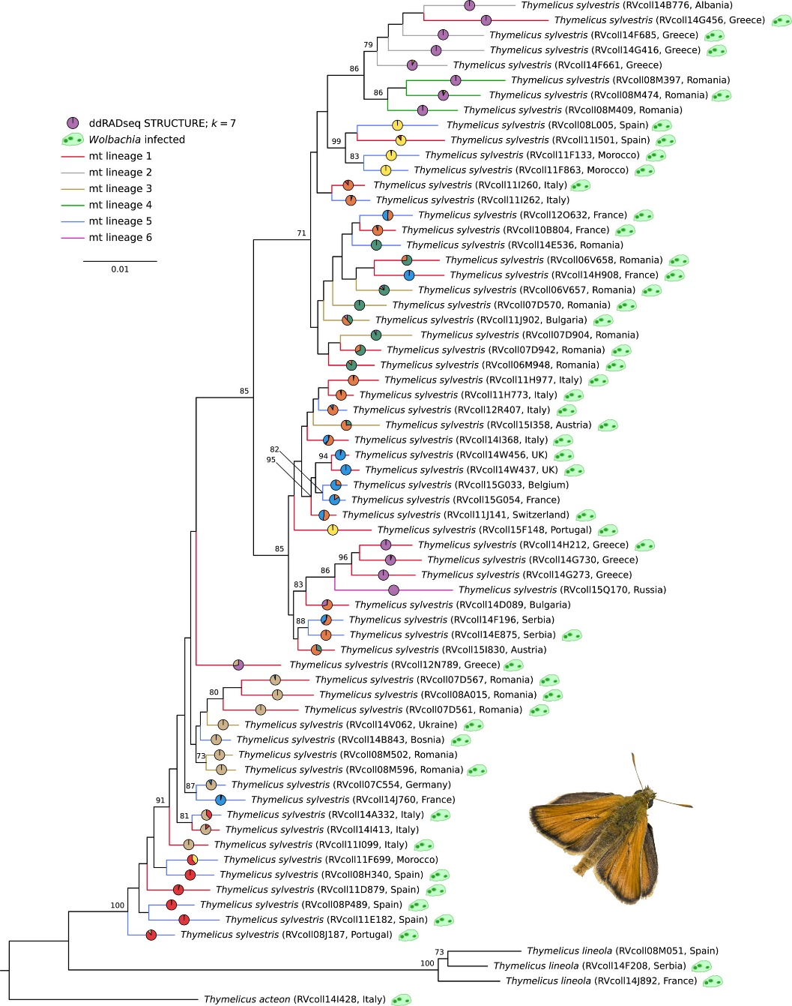
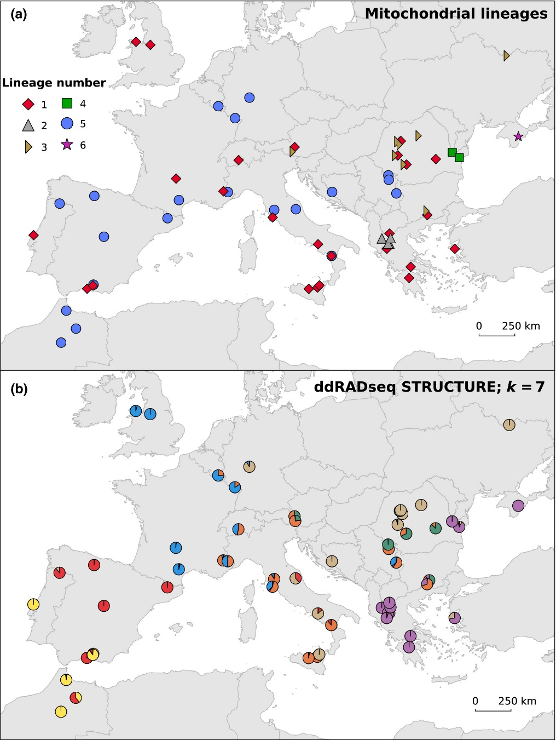
Interpreting results: an example
There is the possibility of comparing data from “classical” markers (e.g., COI) with RAD, ddRAD or 2bRAD approaches
Usually, an optimal (but still arbitrary) number of populations is identified, based on the diversity of sequencing data, to organize the results

Slide 26
RAD/ddRAD/2b-RAD – advantages and limitations
Require lower number of reads than WGR approaches (2bRAD < ddRAD < RAD)
High versatility (choice of number of loci to analyze based on number of individuals/populations and genome size)
Applicable without the need for a reference genome -> limited cost for non-model species
Difficult application to very large genomes, with a very high number of repeats, polyploid, or having high heterozygosity
Complex bioinformatic analyses
Techniques subject to PCR amplification bias during library preparation
Many of the sequencing data produced are not usable or informative and therefore need to be discarded

