Slide 1

Economic Geography
4 – Transport and location
121EC
A.Y. 2024/2025
Dr. Giuseppe Borruso
Department of Economics, Business, Mathematics and Statistics
University of Trieste
E-mail. giuseppe.borruso@econ.units.it
Ph. +39 040 558 7008
Skype: giuseppe.borruso
Notes:
Slides with (*) in footnotes have been modified by Jean-Paul Rodrigue materials. (see copyright). I have modified and elaborated materials in order to be suitable for the current course.
Copyright © 1998-2010, Dr. Jean-Paul Rodrigue, Dept. of Global Studies & Geography, Hofstra University. For personal or classroom use ONLY.

Slide 2
Learning Objectives
In this lesson we will:
  Introduce the importance of Transport in Location;
  Present the factors characterizing a transport system;
  Examine the growth factors in transport demand;
  Scale of spatial organization of transport
  The spatial structure of transport costs
  Route selection issues

Slide 3
Maritime transport

Slide 4
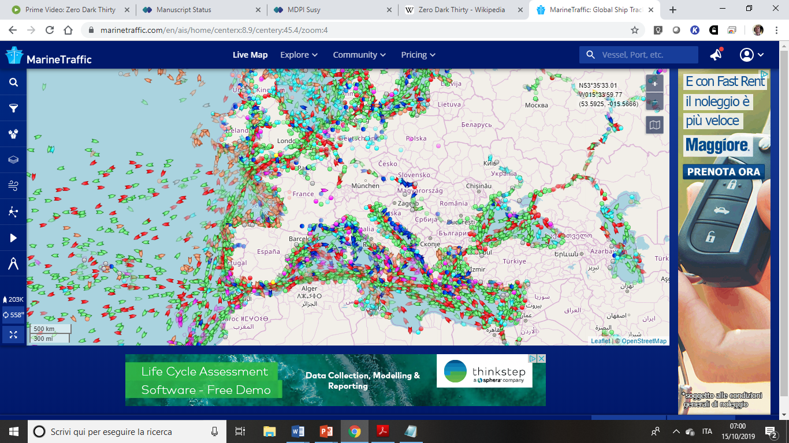
https://www.marinetraffic.com/en/ais/home/centerx:9.0/centery:45.4/zoom:4

Slide 5
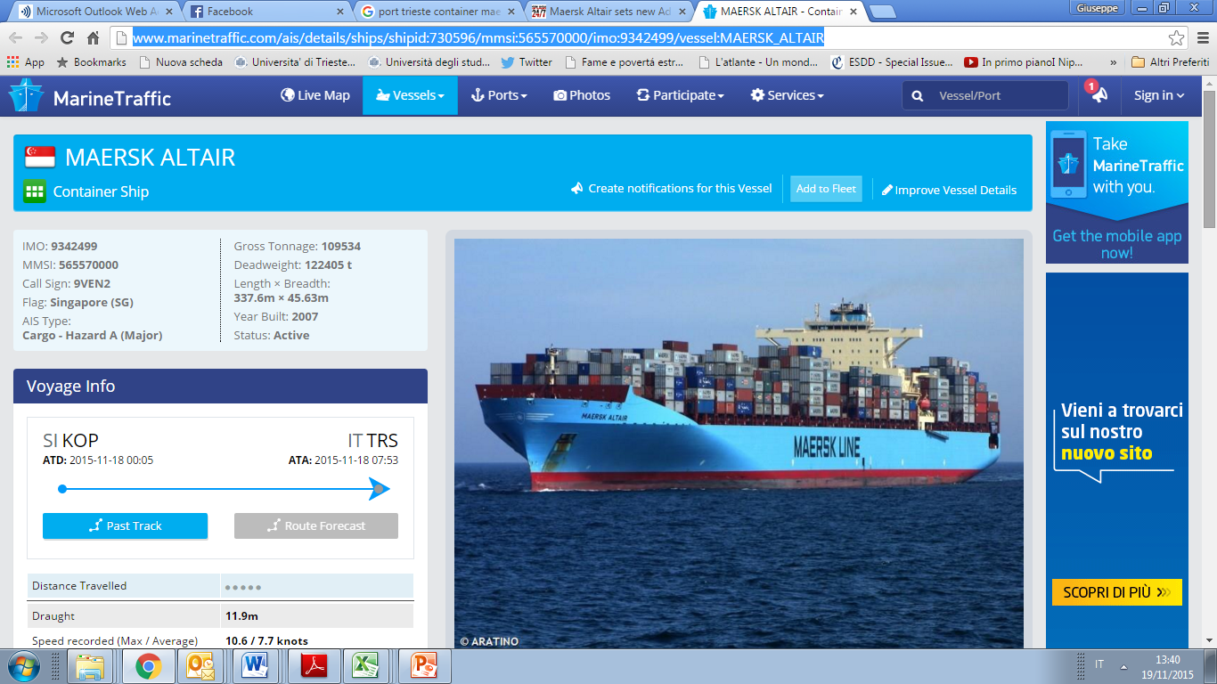
http://www.marinetraffic.com/ais/details/ships/shipid:730596/mmsi:565570000/imo:9342499/vessel:MAERSK_ALTAIR

Slide 6
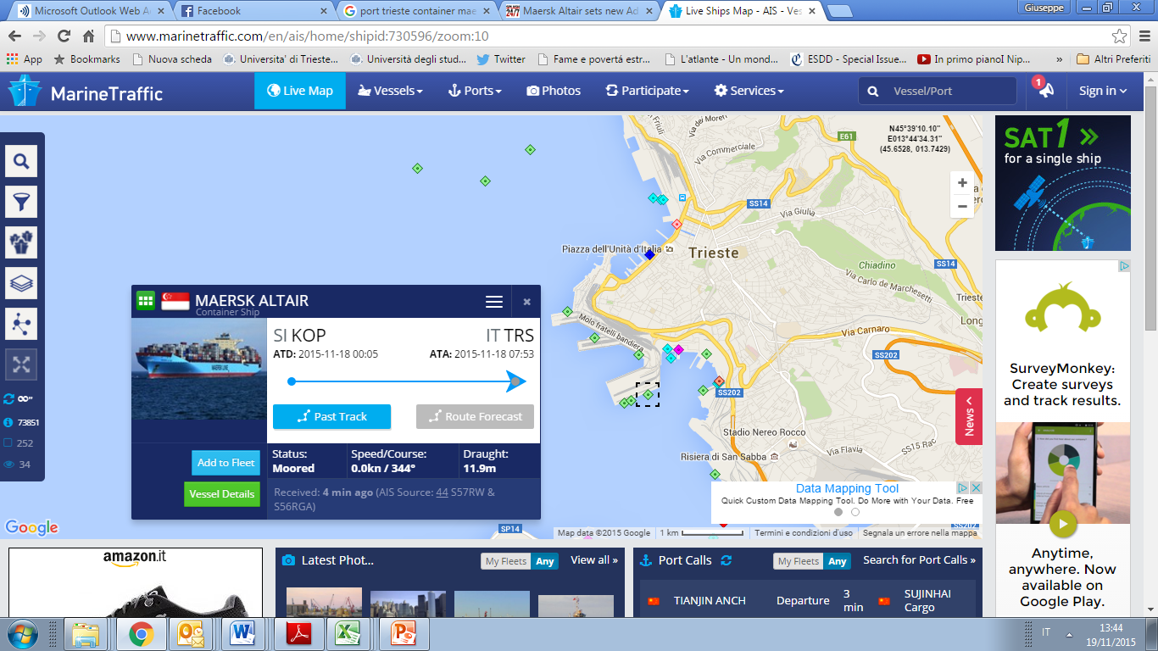
Large containerships in the Adriatic Sea
http://www.marinetraffic.com/en/

Slide 7
Relative advantages of different transport modes
Transport | Main technical advantage | Use
Rail | Minimal resistance to movement, general flexiibility, safety | Interurban transport of goods and containers. Not good for short range
Motorway | Flexibililty (in terms of routes); high speed and easiness of movement | Individual transport. Average size of goods moved; door-to-door; interurban and short range transport
Inland waterway | High productivity and low power per tonn | Low – speed movement of goods of bulky dimension and low added value
Air transport | High speed | High added value goods if compared to mass and volume (2% of global merchandise weight; 40% of value!)
Pipelines | Continuous flow. Top reliability and safety | Liquids (pipelines) and gas where volumes are high and delivery is needed as continuous
Haggett, 2001, p. 244 (da HAY W.H., An introduction to Transportation Engineering, New York, Wiley, 1961. p. 283

Slide 8
Gateways and Hubs
Gateway
Hub
Corridor

Slide 9
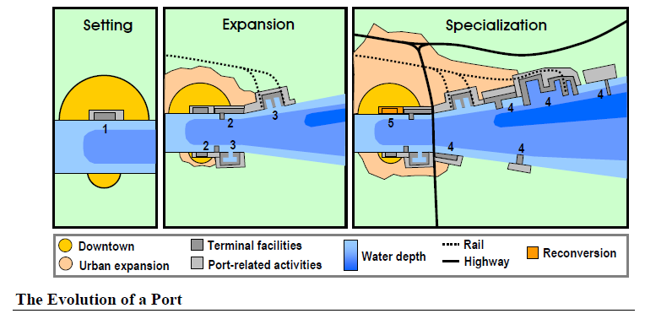
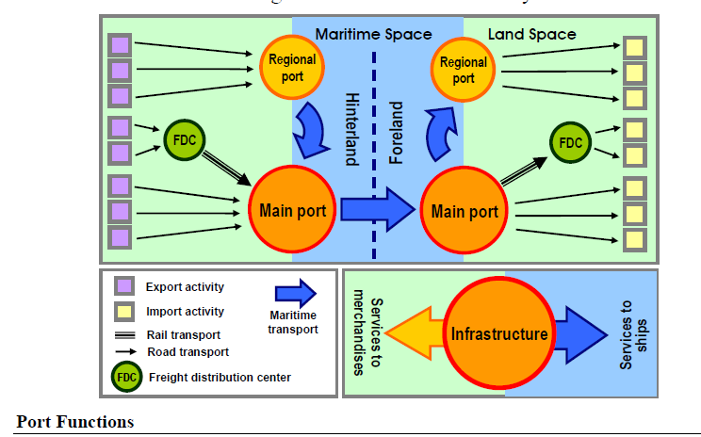

Slide 10
Modal
Gateways
Land
Logistics
Border
Manufacturing
Air
Maritime

Slide 11
The “Last Mile” in Freight Distribution
Massification
Atomization
Frequency
Capacity
GLOBAL
HINTERLAND
REGIONAL
LOCAL
Shipping Network
Corridor
Segment
Customer
“Last Mile”
Gateway
Inland
Terminal
Distribution
Center

Slide 12
L’effetto di rifrazione come conseguenza della diversificazione dei costi di trasporto per unità di distanza
A
Costa
Mare
α
C
C’
C’’
Costa
Obiettivo: minimizzare costi di trasporto da
porto A a località B nell’entroterra
Costo f_{a} = (trasporto via mare) basso
Costo f_{b} = (trasporto via terra) alto
Se: costi omogenei; isotropia spaziale
=> C = punto di transito
Se: distanza massima per modo di trasporto più economico => C’’ = punto di transito
Loesch: legge di rifrazione ottica: via di minimo costo passa per C’, dove
β
Retroterra
B

Slide 13
International Seaborne Trade and Exports of Goods, 1955-2015
Notes:
Source: World Bank and United Nations, Review of Maritime Transport. Data in current USD.

Slide 14
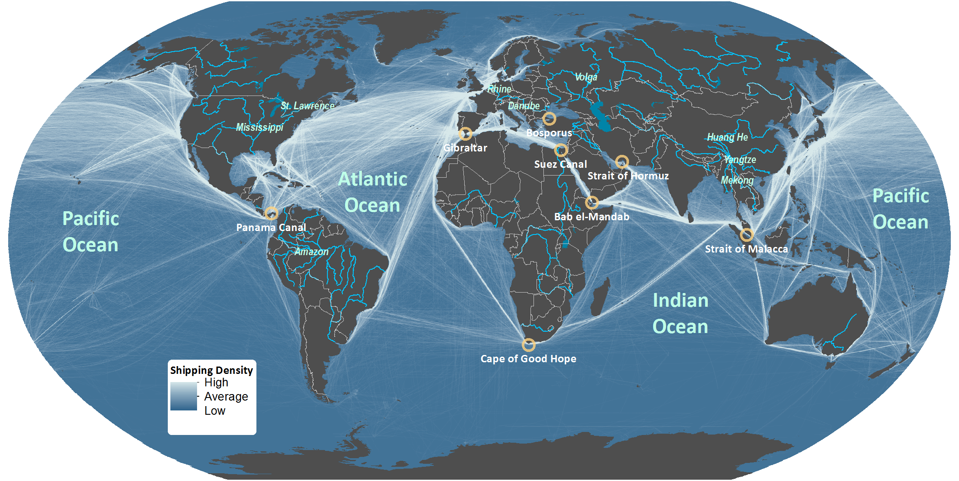
Domains of Maritime Circulation
Notes:
Source: Shipping density data adapted from National Center for Ecological Analysis and Synthesis, A Global Map of Human Impacts to Marine Ecosystems.
https://knb.ecoinformatics.org/#view/doi:10.5063/F1S180FS

Slide 15
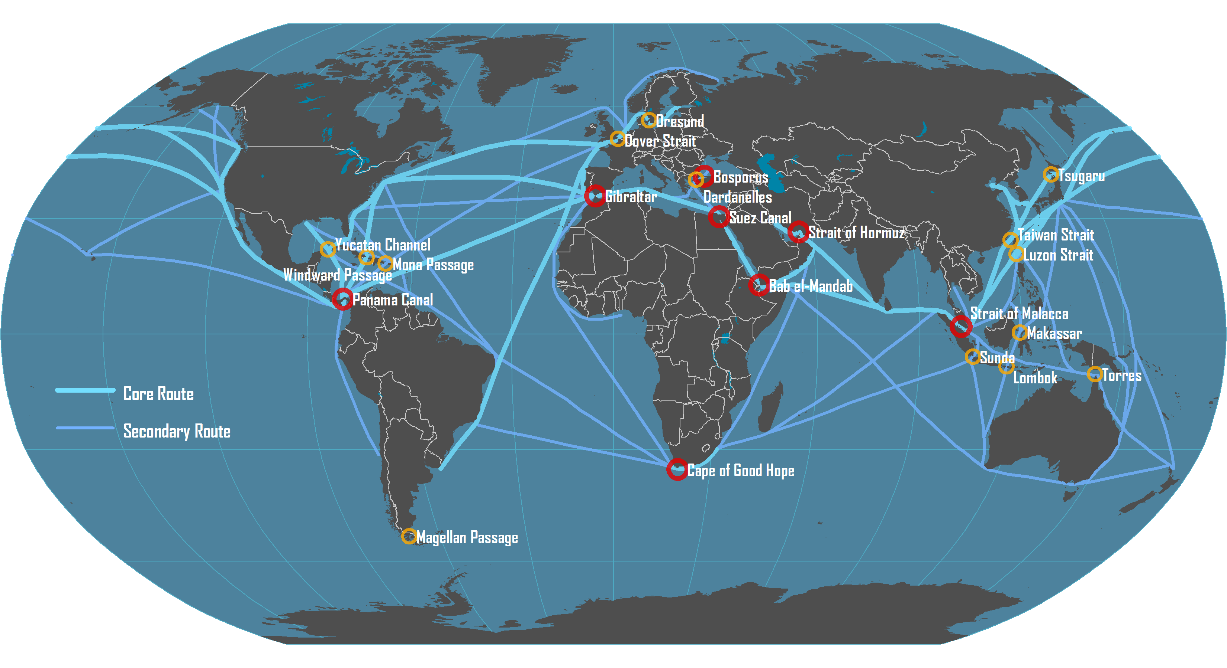
Main Maritime Shipping Routes

Slide 16

The Scales of Analysis of Maritime Transportation
Global Maritime Transport System
Global
Deep Sea Services
Maritime Range
Regional
Short Sea / Feeder Services
Port Cluster / Region / Hinterland
Port
Local
Terminal

Slide 17
The Concept of Maritime Range
HINTERLAND
FORELAND
EEZ
Customer
Port
Deep sea shipping service
Feeder
National Boundary

Slide 18
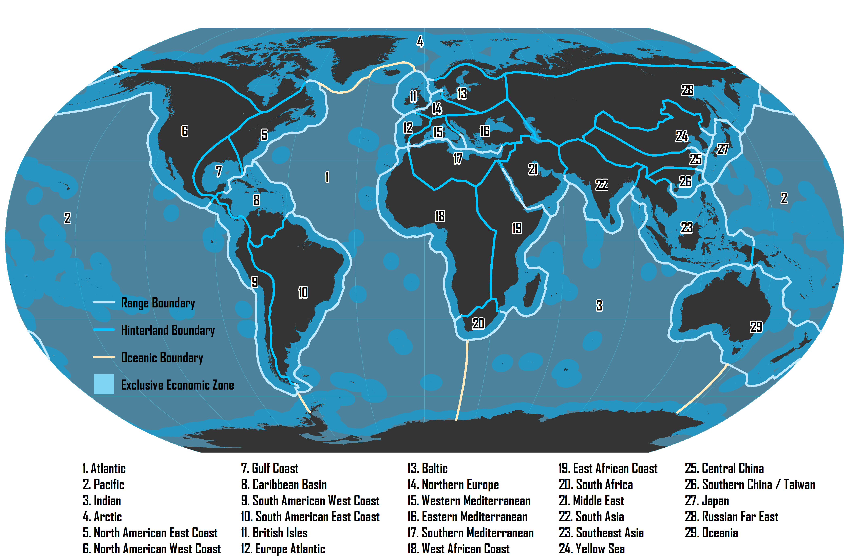
Major Maritime Ranges

Slide 19
Types of Maritime Routes
Port-to-Port
Pendulum
Round-the-World
Point to point services.
Empty backhauls.
Common for bulk freight.
Shipping service moving back and forth between two maritime ranges (seaboards).
Balancing the number of port calls and the frequency of services.
Can rely on transshipment hubs between ranges.
Servicing continuously a sequence of ports.
Sequence enables a round trip around the world.
Limited amount of ports per continent are serviced.
Involve a series of transshipment hubs.

Slide 20
Largest Ships by Category
MSC Oscar (2015)
LOA: 394 m
Beam: 59 m
Draft: 16 m
TEU: 19,224
Containership
TI Europe (2003)
LOA: 380 m
Beam: 68 m
Draft: 24.5 m
DWT: 442,000 t
Ultra Large
Crude Carrier
LOA: 362 m
Beam: 65 m
Draft: 23 m
DWT: 402,000 t
MS Ore Brazil (2011)
Bulk Carrier
Oasis of the Seas (2009)
LOA: 362 m
Beam: 60.5 m
Draft: 9.3 m
Passengers: 5,400
Cruise Ship

Slide 21
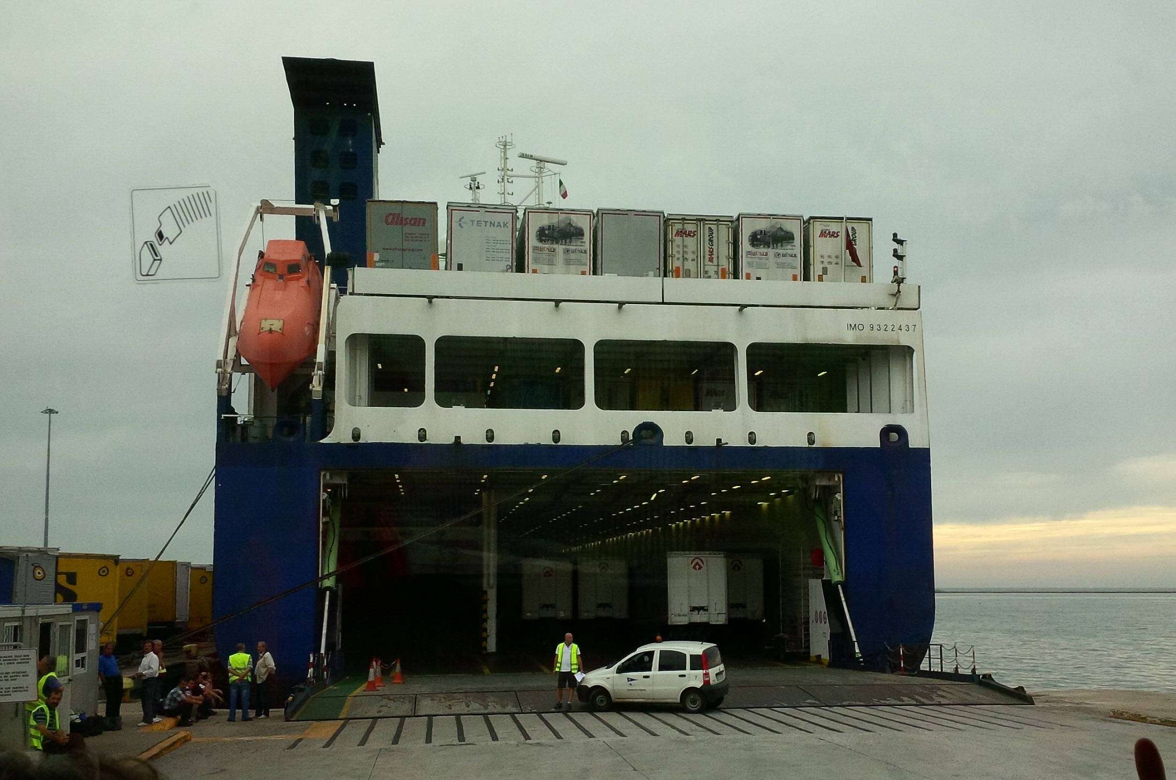
RO-RO ship

Slide 22
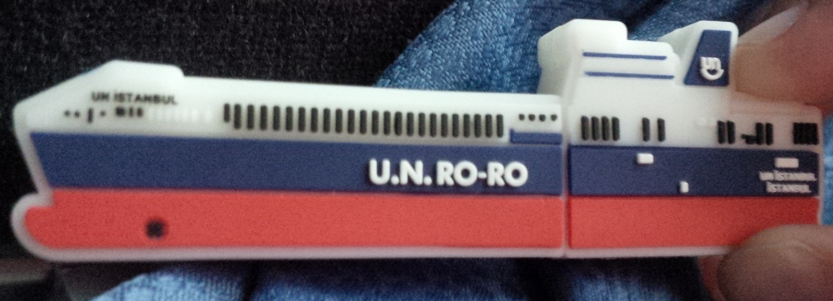
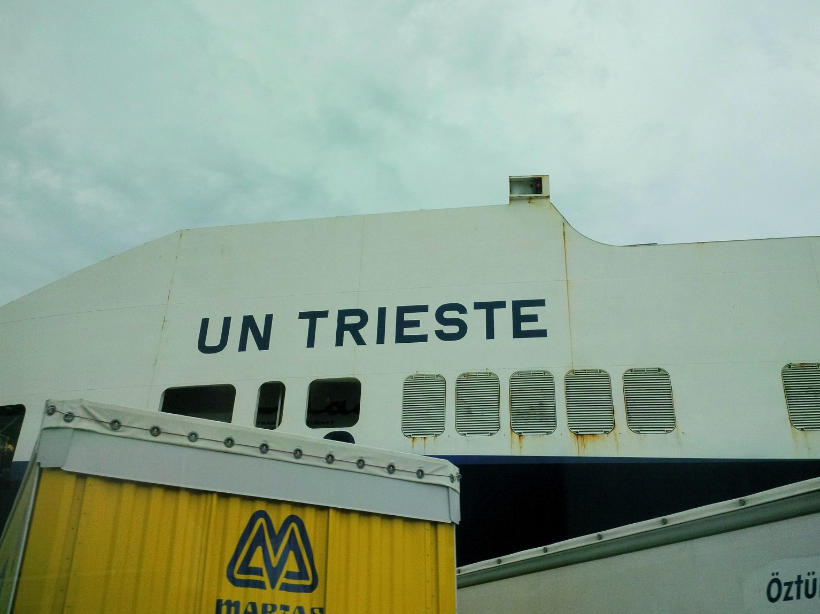
RO-RO ships

Slide 23
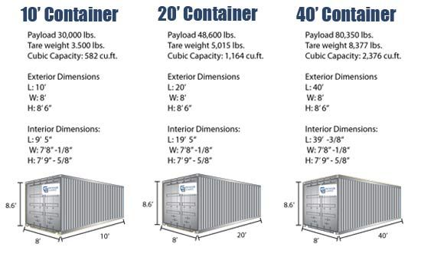
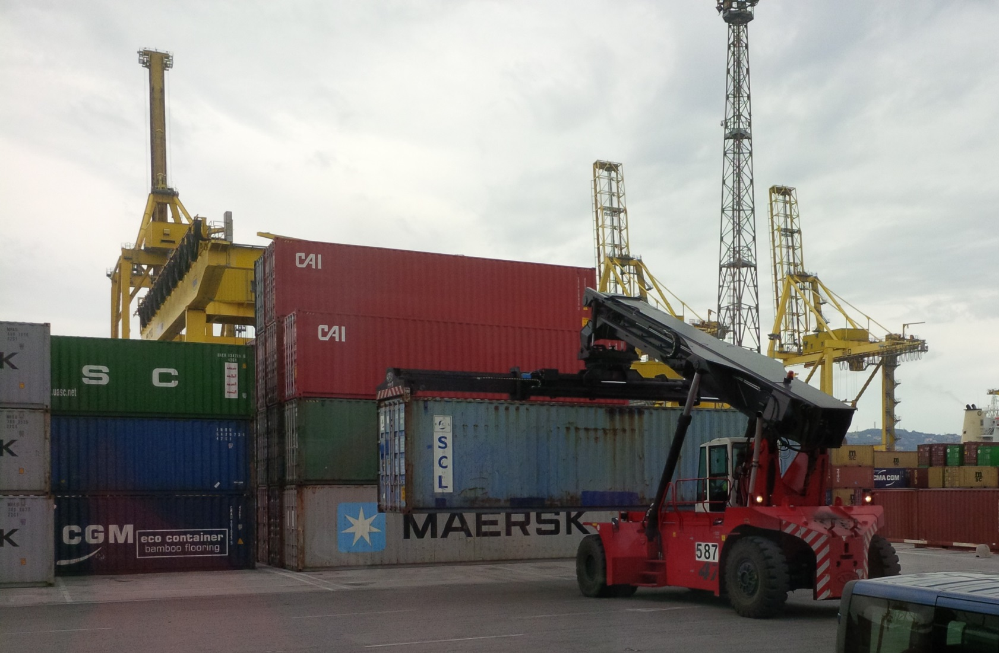
Containers’ handling in ports

Slide 24
World’s Largest Maritime Container Shipping Operators, 2010
 | Total |  | Owned |  | Chartered
Operator | TEU | Ships | TEU | Ships | TEU | Ships | % Chart
APM-Maersk | 2,038,760 | 543 | 1,118,663 | 207 | 920,097 | 336 | 45.1%
MSC | 1,621,453 | 410 | 858,591 | 202 | 762,862 | 208 | 47.0%
CMA CGM Group | 1,072,891 | 372 | 343,351 | 85 | 729,540 | 287 | 68.0%
APL | 584,923 | 145 | 170,373 | 45 | 414,550 | 100 | 70.9%
Evergreen Line | 554,292 | 151 | 319,263 | 87 | 235,029 | 64 | 42.4%
Hapag-Lloyd | 533,371 | 122 | 292,613 | 60 | 240,758 | 62 | 45.1%
COSCO Container L. | 486,277 | 131 | 271,305 | 87 | 214,972 | 44 | 44.2%
Hanjin Shipping | 447,206 | 98 | 104,068 | 19 | 343,138 | 79 | 76.7%
CSCL | 437,564 | 121 | 250,099 | 71 | 187,465 | 50 | 42.8%
CSAV Group | 431,435 | 118 | 41,410 | 8 | 390,025 | 110 | 90.4%
MOL | 358,616 | 93 | 159,706 | 29 | 198,910 | 64 | 55.5%
OOCL | 354,648 | 77 | 254,768 | 42 | 99,880 | 35 | 28.2%
NYK | 354,007 | 92 | 280,379 | 54 | 73,628 | 38 | 20.8%
Hamburg Süd Group | 331,994 | 107 | 137,726 | 37 | 194,268 | 70 | 58.5%
K Line | 330,775 | 85 | 199,537 | 36 | 131,238 | 49 | 39.7%
Notes:
Source: Alphaliner. http://www.axs-alphaliner.com/top100/index.php

Slide 25
World’s Largest Maritime Container Shipping Operators, 2015
 | Total |  | Owned |  | Chartered
Operator | TEU | Ships | TEU | Ships | TEU | Ships | % Chart
APM-Maersk | 3,035,043 | 594 | 1,738,510 | 262 | 1,296,533 | 332 | 42.7%
MSC | 2,676,623 | 502 | 1,052,055 | 190 | 1,624,568 | 312 | 60.7%
CMA CGM Group | 1,832,508 | 471 | 603,820 | 88 | 1,228,688 | 383 | 67.0%
Evergreen Line | 951,876 | 200 | 547,991 | 106 | 403,885 | 94 | 42.4%
Hapag-Lloyd | 919,386 | 171 | 507,741 | 69 | 411,645 | 102 | 44.8%
COSCO Container L. | 857,751 | 164 | 464,412 | 85 | 393,339 | 79 | 45.9%
CSCL | 698,595 | 135 | 486,802 | 65 | 211,793 | 70 | 30.3%
Hamburg Süd Group | 641,723 | 134 | 292,311 | 44 | 349,412 | 90 | 54.4%
Hanjin Shipping | 633,564 | 105 | 278,102 | 38 | 355,462 | 67 | 56.1%
OOCL | 577,233 | 108 | 349,019 | 49 | 228,214 | 59 | 39.5%
MOL | 568,938 | 99 | 170,446 | 25 | 398,492 | 74 | 70.0%
APL | 533,533 | 84 | 399,895 | 51 | 133,638 | 33 | 25.0%
Yang Ming Marine | 529,432 | 99 | 196,481 | 42 | 332,951 | 57 | 62.9%
NYK Line | 527,223 | 109 | 279,294 | 48 | 247,929 | 61 | 47.0%
UASC | 467,624 | 55 | 297,876 | 32 | 169,748 | 23 | 36.3%
Hyundai M.M. | 388,969 | 58 | 165,080 | 22 | 223,889 | 36 | 57.6%
K Line | 378,368 | 68 | 80,150 | 12 | 298,218 | 56 | 78.8%
PIL (Pacific Int. Line) | 367,551 | 151 | 290,904 | 120 | 76,647 | 31 | 20.9%
Zim | 357,482 | 80 | 43,555 | 10 | 313,927 | 70 | 87.8%
Wan Hai Lines | 206,343 | 87 | 169,267 | 72 | 37,076 | 15 | 18.00%
Notes:
Source: Alphaliner. http://www.axs-alphaliner.com/top100/index.php

Slide 26
World’s Largest Maritime Container Shipping Operators, 2015
Notes:
Source: Alphaliner. http://www.axs-alphaliner.com/top100/index.php

Slide 27
World’s Largest Maritime Container Shipping Operators, 2016

Slide 28
Main Alliances in Container Maritime Shipping
Name | Shipping Lines | Total Capacity (2015)
2M (2015) | Maersk, Mediterranean Shipping Co. (MSC) | 7.711 M TEU
Ocean 3 (2015) | CMA-CGM, China Shipping Container Lines (CSCL), United Arab Shipping Company (UASC) | 2.997 M TEU
CKYHE (2014) | China Overseas Shipping Co. (COSCO), K-line, Yang Ming Line, Hanjin, Evergreen | 3.348 M TEU
G6 (2012) | American President Lines (APL), Hapag Lloyd, Hyundai Merchant Marine, Mitsui (MOL), Nippon (NYK), OOCL | 3.513 M TEU

Slide 29
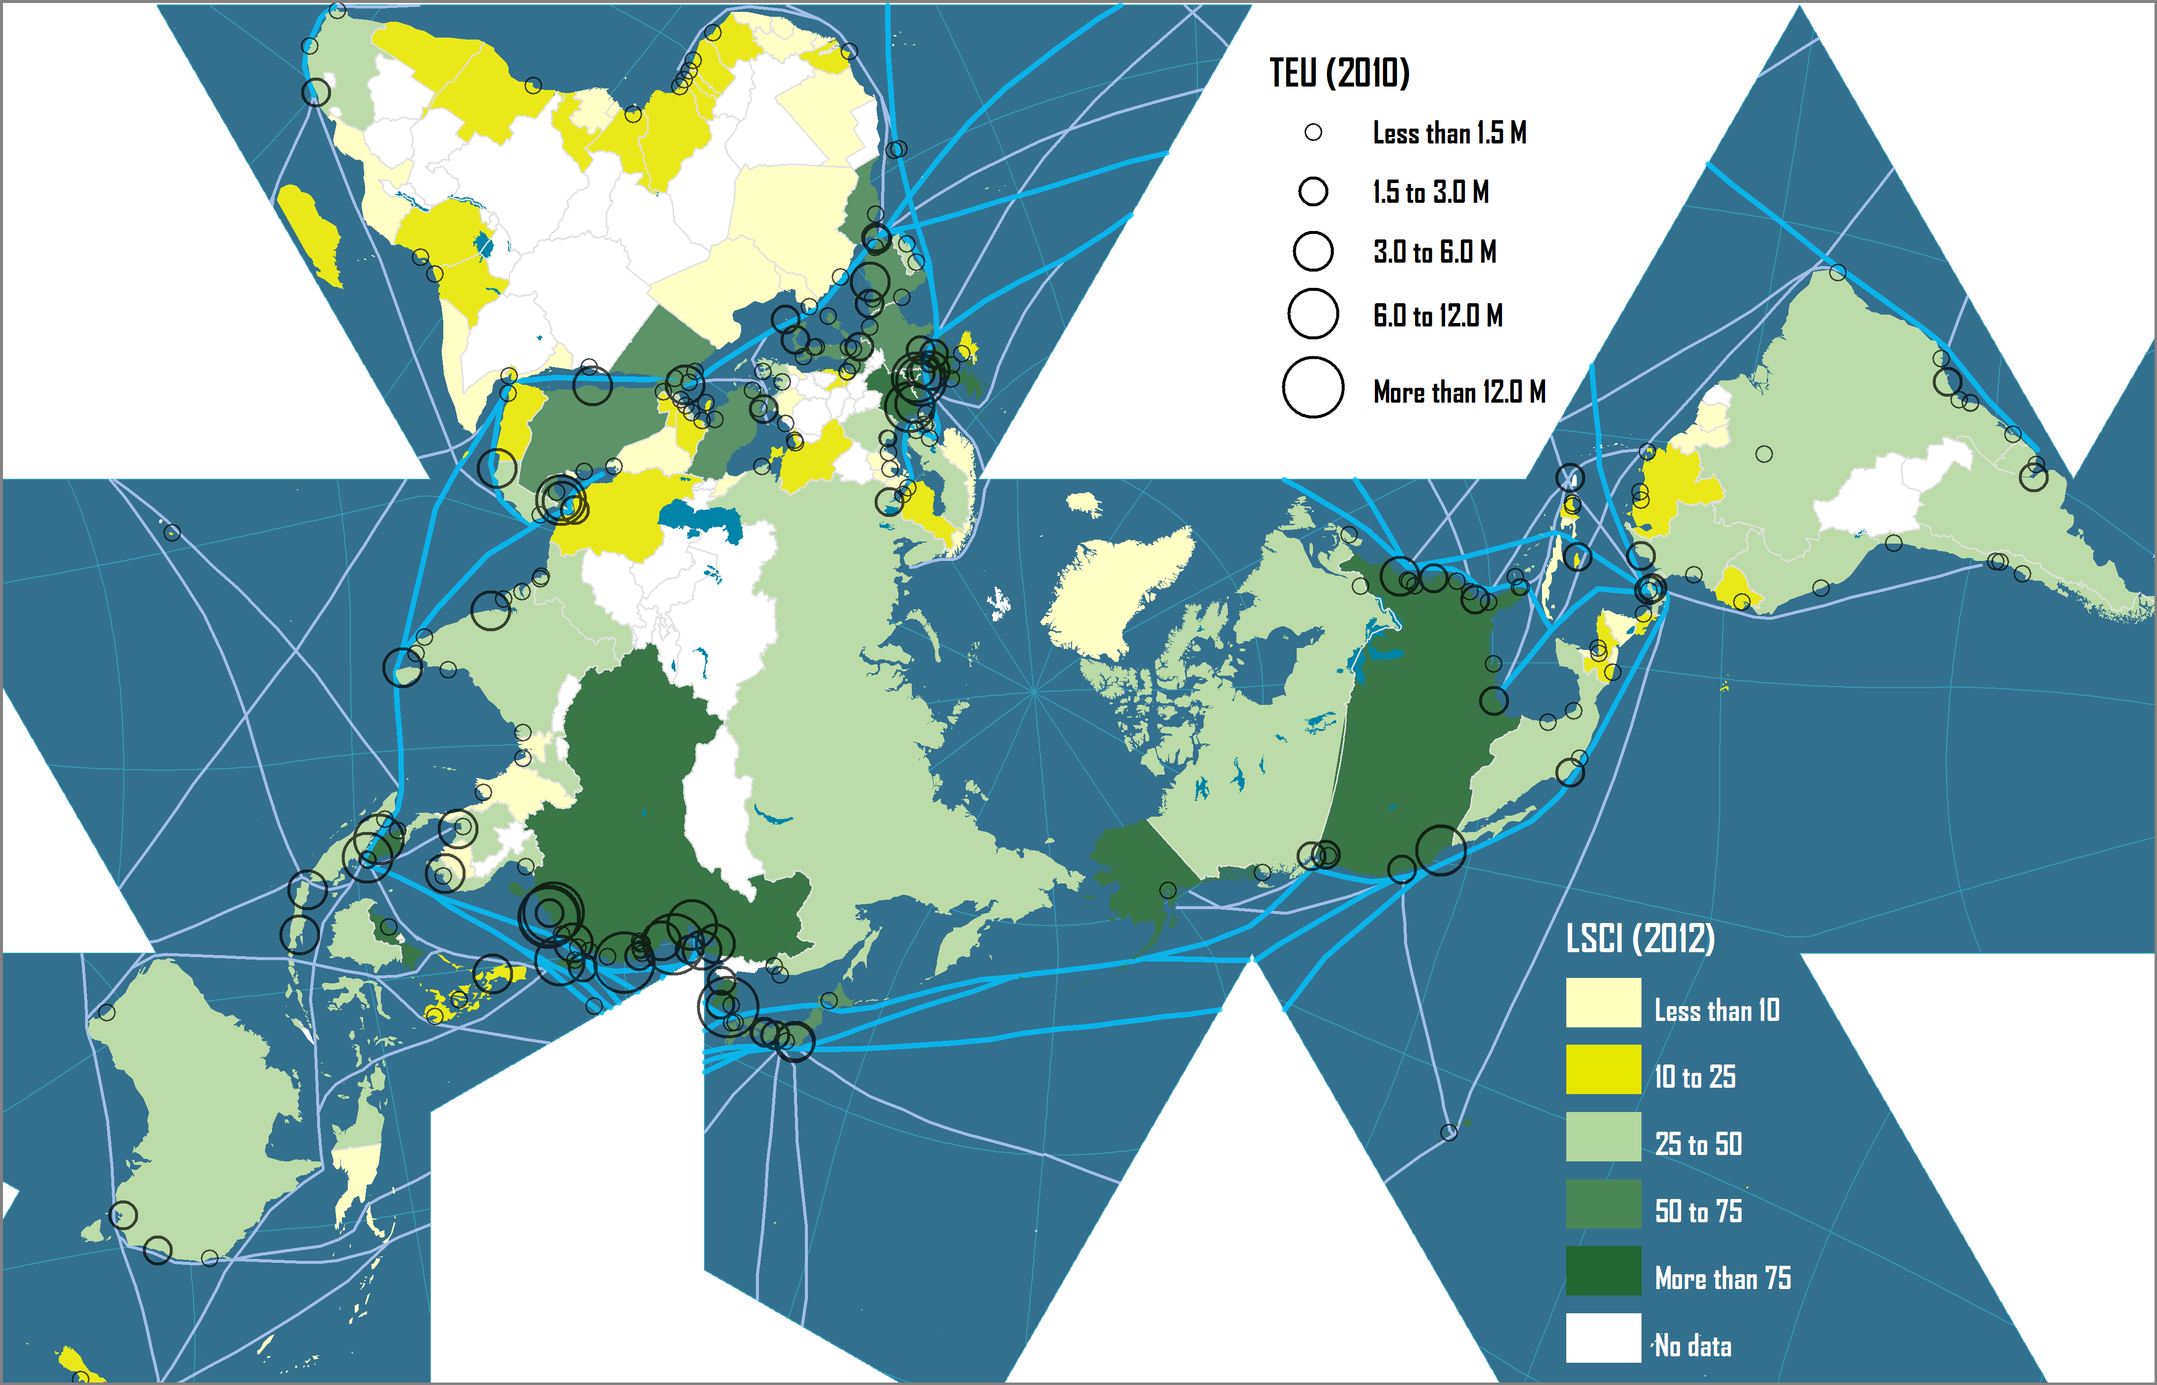
Liner Shipping Connectivity Index and Container Port Throughput
Notes:
Source: UNCTAD.

Slide 30
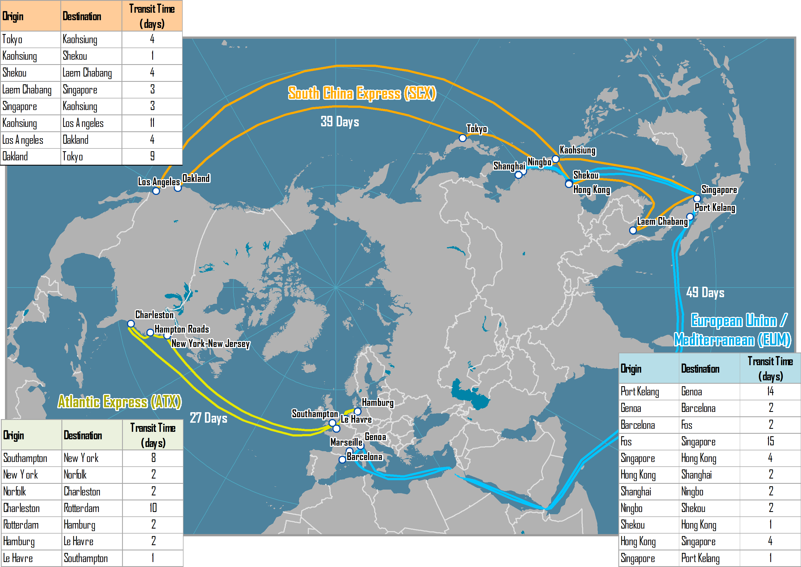
Three Major Pendulum Routes Serviced by OOCL, 2006

Slide 31
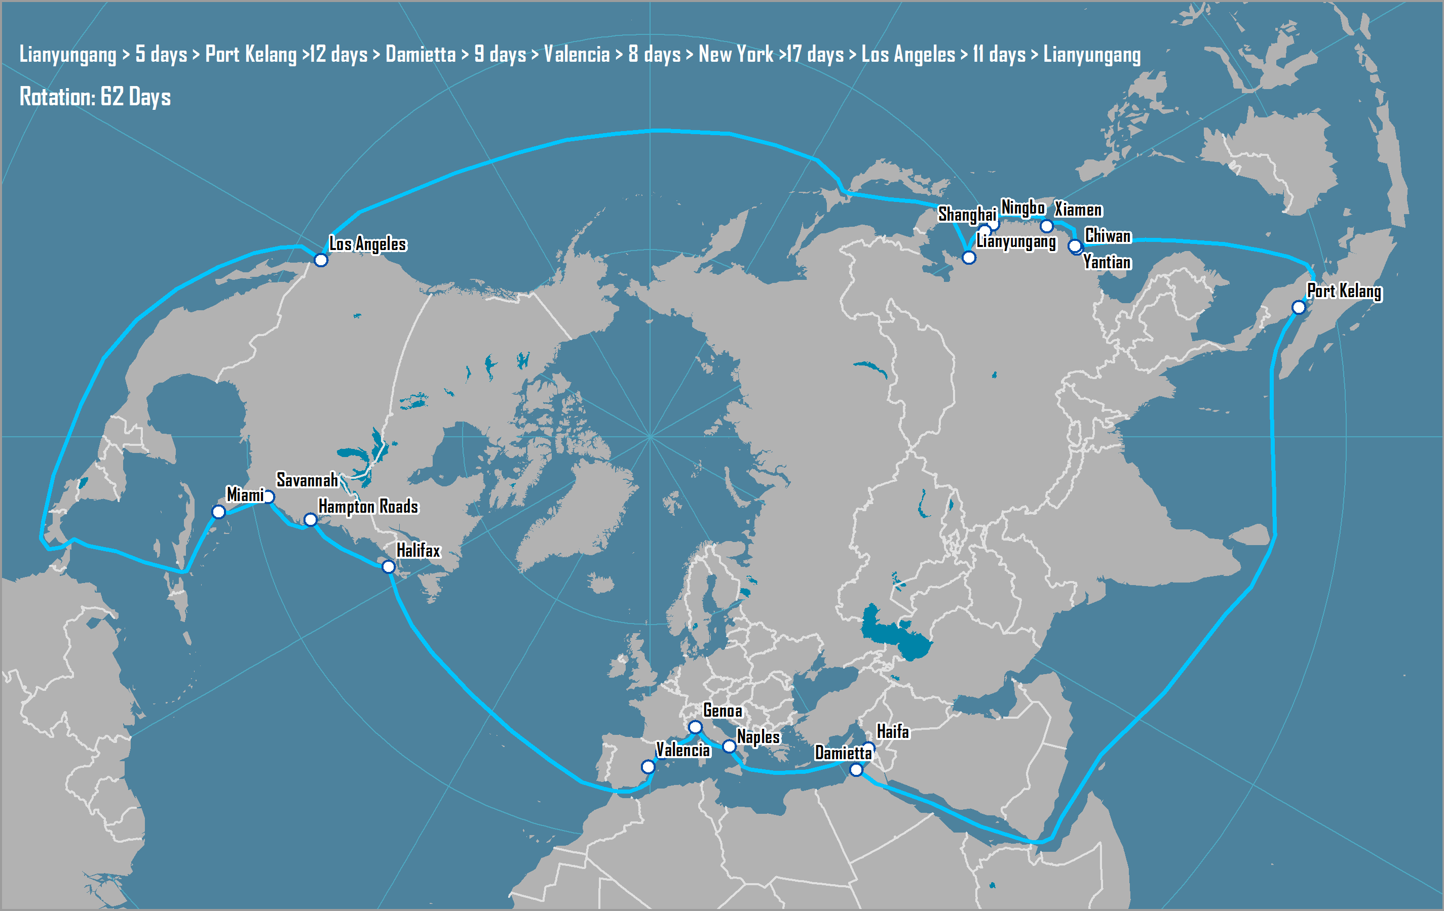
AMAX Round-the-World Route, 2005-2007
Notes:
Source: China Shipping http://www.chinashippingna.com/publish_dir/services/svcmaps/svcmap_amax.htm

Slide 32
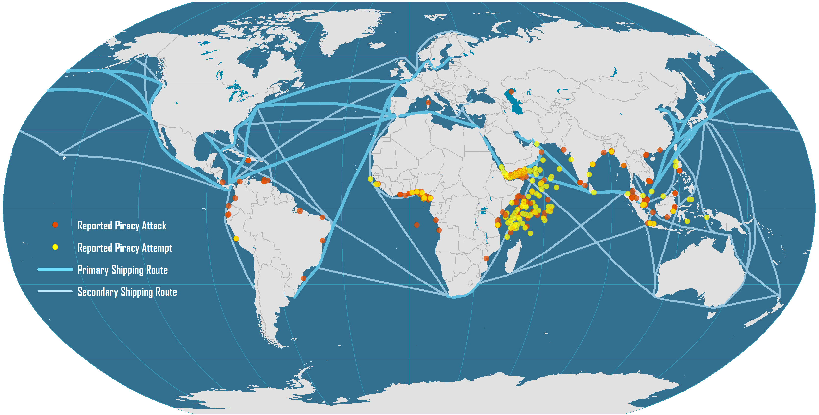
Global Maritime Piracy, 2008-2009
Notes:
Source: ICC International Maritime Bureau. Encoding of piracy events by William Moreto.

Slide 33
Evolution of Containerships
Early Containerships (1956-)
137x17x9
(LOA – Beam – Draft)
Containers across
6
500 – 800 TEU
meters
4
A
200x20x9
4
8
Fully Cellular (1970-)
10
1,000 – 2,500 TEU
215x20x10
Containers high on deck
5
Containers high below deck
4
13
Panamax (1980-)
6
3,000 – 3,400 TEU
250x32x12.5
5
B
Panamax Max (1985-)
8
3,400 – 4,500 TEU
290x32x12.5
17 bays
6
Post Panamax I (1988-)
15
4,000 – 6,000 TEU
300x40x13
17 bays
9
C
5
Post Panamax II (2000-)
17
6,000 – 8,500 TEU
20 bays
9
340x43x14.5
6
20
D
New-Panamax (2014-)
10
12,500 TEU
366x49x15.2
22 bays
6
Notes:
Source: Ashar and Rodrigue, 2012. All dimensions are in meters.

Slide 34
Evolution of Containerships
22
Post Panamax III (2006-)
10
11,000 - 15,000 TEU
397x56x15.5
8
E
23
24 bays
Triple E (2013-)
10
18,000 TEU
400x59x15.5
8

Slide 35
The Largest Available Containership, 1970-2015 (in TEUs)
“Triple E” Class
(18,000 TEU)
E “Emma” Class
(12,500 TEU)
S “Sovereign” Class
(8,000 TEU)
C10 Class
(4,500 TEU)
L “Lica” Class
(3,400 TEU)
R “Regina” Class
(6,000 TEU)
Notes:
“Triple E” Class (2013)
E “Emma” Class (2006)
S “Sovereign” Class (1997)
R “Regina” Class (1996)
C10 APL (1988)
L “Lica” Class (1981)

Slide 36
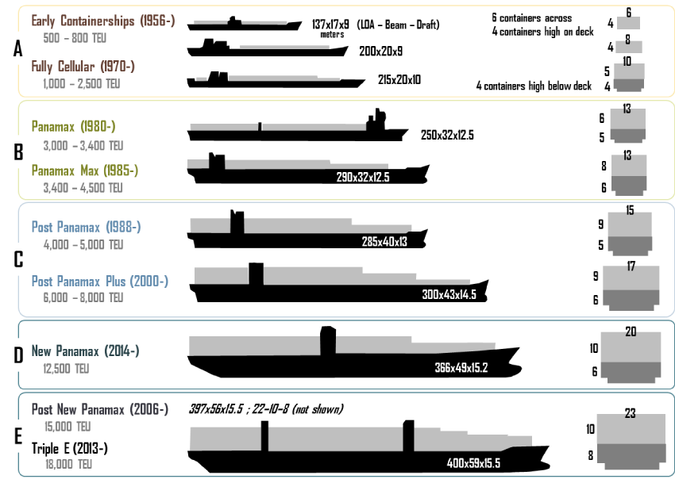
Evolution of Containerships
http://people.hofstra.edu/geotrans/eng/ch3en/conc3en/containerships.html

Slide 37
Characteristics of Some Historical Containerships
Year | Name | Capacity (TEU) | Yard | Length (m) | Width (m) | Draft (m) | Speed (knots)
1956 | Ideal X | 58 | US | 174.2 | 23.6 | ? | 18.0
1968 | Elbe Express | 730 | B&V | 171.0 | 24.5 | 7.9 | 20.0
1981 | Frankfurt Express | 3,430 | HDW | 271.0 | 32.3 | 11.5 | 23.0
1991 | Hanover Express | 4,407 | Samsung | 281.6 | 32.3 | 13.5 | 23.0
1995 | APL China | 4,832 | HDW | 262.0 | 40.0 | 12.0 | 24.6
1996 | Regina Maersk | 6,700 | Odense | 302.3 | 42.8 | 12.2 | 24.6
2001 | Hamburg Express | 7,506 | Hyundai | 304.0 | 42.8 | 14.5 | 25.0
2003 | OOCL Shenzhen | 8,063 | Samsung | 319.0 | 42.8 | 14.5 | 25.2
2005 | MSC Pamela | 9,200 | Samsung | 321.0 | 45.6 | 15.0 | 25.0
2006 | Emma Maersk | 14,500 | Odense | 393.0 | 56.4 | 15.5 | 24.5
Notes:
Source: adapted from F. Mewis and H. Klug (2004) “The Challenge of Very Large Container Ships – A Hydrodynamic View”, 9th Symposium on Practical Design of Ships and Other Floating Structures, Luebeck-Travemuende, Germany.

Slide 38
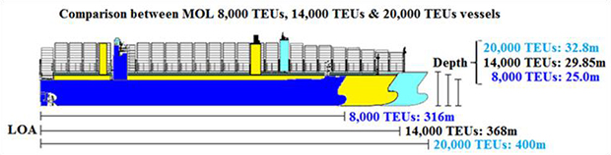
The increase in capacity of containeships
Shipbuilding company | Samsung Heavy Industries | Imabari Shipbuilding
Length | 400.0m | 400.0m
Breadth | 58.8m | 58.5m
Designed draft | 14.5m | 14.5m
Load draft | 16.0m | 16.0m
TEU capacity | 20,150 TEU | 20,150 TEU
Main engine | MAN B&W G95ME | MAN B&W G95ME
http://www.mol.co.jp/en/pr/2015/15013.html
Notes:
MOL Expands Large-scale Containership Fleet
-Building and Chartering Six 20,000 TEU Containerships for More Competitive Services-
TOKYO—Mitsui O.S.K. Lines, Ltd. (MOL; President: Koichi Muto) today announced that the company has signed a deal for construction of four 20,000 TEU containerships with Samsung Heavy Industries (President and CEO: Dae-young Park; Headquarters: Seoul, Korea). MOL also concluded an MOU for long-term chartering of two 20,000 TEU containerships with Shoei Kisen Kaisha, Ltd. (President: Yukito Higaki; Headquarters: Imabari-shi, Ehime Prefecture). The two containerships will be built at Imabari Shipbuilding Co., Ltd. (President: Yukito Higaki; Headquarters: Imabari-shi, Ehime Prefecture). The six vessels will be launched and delivered in 2017, and will serve the Asia-Europe service.
The 20,000 TEU type is the world's largest among delivered and on order containerships. The newbuilding vessels will adopt various highly advanced energy-saving technologies, which will further reduce fuel consumption and cost, in comparison with 14,000 TEU types that MOL currently operates. The main engines have the specifications which enable LNG use as fuel in the future remodeling.
MOL continues to offer high-quality and competitive services through fleet expansion.

Slide 39
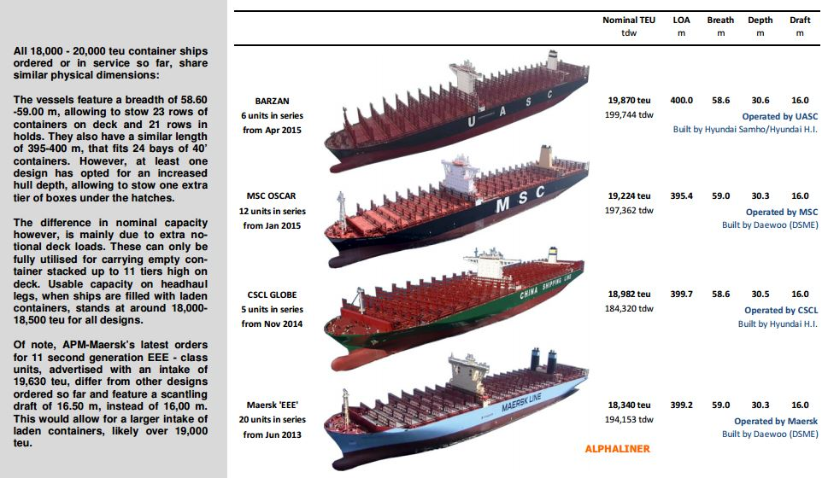
The containership gigantism
http://www.hellenicshippingnews.com/wp-content/uploads/2015/08/World%E2%80%99s-largest-containerships-Aug-2015.jpg

Slide 40
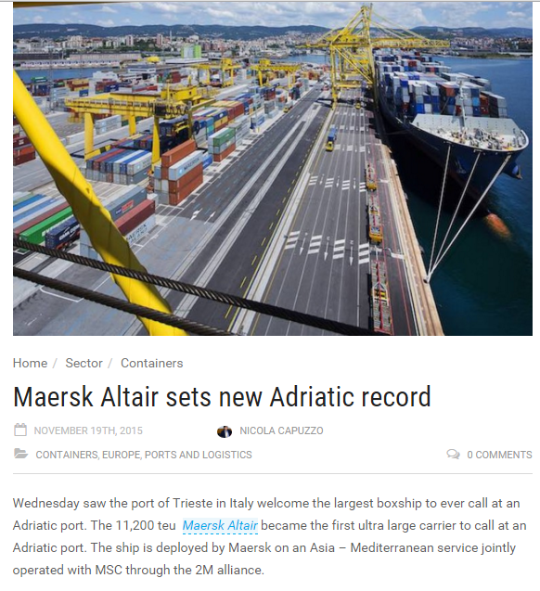
http://splash247.com/maersk-altair-sets-new-adriatic-record/

Slide 41
The Disadvantages of Scale in Maritime Shipping
Port of call issues
Less ports able to accommodate larger ships.
Pressures for expensive port infrastructure improvements.
Terminal operations
Higher throughput; Equipment and yard management issues.
Gate access and hinterland connections.
Supply chain constraints
Lead time issues.
Cargo risks (insurance).
Security and custom inspection issues.
Lower frequency; Risks to schedule reliability.
Higher inventory levels.

Slide 42
Characteristics of Some Historical Containerships
Year | Name | Capacity (TEU) | Yard | Length (m) | Width (m) | Draft (m) | Speed (knots)
1956 | Ideal X | 58 | US | 174.2 | 23.6 | 8.0 | 18.0
1968 | Elbe Express | 730 | B&V | 171.0 | 24.5 | 7.9 | 20.0
1970 | Sealand Navigator | 2,361 |  | 247.6 | 27.5 | 11.1
1972 | Liverpool Bay | 2,961 | B&V | 248.6 | 32.3 | 13.0 | 23.0
1981 | Frankfurt Express | 3,430 | HDW | 271.0 | 32.3 | 11.5 | 23.0
1991 | Hanover Express | 4,407 | Samsung | 281.6 | 32.3 | 13.5 | 23.0
1995 | APL China | 4,832 | HDW | 262.0 | 40.0 | 12.0 | 24.6
1996 | Regina Maersk | 6,700 | Odense | 302.3 | 42.8 | 12.2 | 24.6
1998 | Sovereign Maersk | 8,200 | Odense | 332.0 | 42.8 | 14.5 | 24.7
2001 | Hamburg Express | 7,506 | Hyundai | 304.0 | 42.8 | 14.5 | 25.0
2003 | OOCL Shenzhen | 8,063 | Samsung | 319.0 | 42.8 | 14.5 | 25.2
2005 | MSC Pamela | 9,200 | Samsung | 321.0 | 45.6 | 15.0 | 25.0
2006 | Emma Maersk | 14,700 | Odense | 397.0 | 56.0 | 16.0 | 24.5
2009 | MSC Beatrice | 13,798 | Samsung | 366.1 | 51.2 | 15.0 | 25.2
2012 | MSC Marco Polo | 16,000 | Daewoo | 396.0 | 53.6 | 16.0 | 25.1
2013 | Maersk Mc-Kinney Møller | 18,270 | Daewoo | 399.0 | 59 | 14.5 | 23.0
2015 | MSC Oscar | 19.224 | Daewoo | 394.0 | 59 | 16.0 | 22.8
Notes:
Source: adapted from F. Mewis and H. Klug (2004) “The Challenge of Very Large Container Ships – A Hydrodynamic View”, 9th Symposium on Practical Design of Ships and Other Floating Structures, Luebeck-Travemuende, Germany.

Slide 43
Specifications for Very Large Post-Panamax Containerships
 | “Triple E Class” (Maersk Mc-Kinney Møller) | “E Class” (Emma Maersk) | “S Class” (Sovereign Maersk)
Capacity (TEU) | 18,270 | 14,700 | 8,400
Length (meters) | 399 | 397 | 348
Width (meters) | 59 | 56 | 44
Containers (wide) | 23 | 22 | 17
Draft (meters) | 14.5 | 16 | 15
Deadweight (tons) | 194,150 | 156,900 | 105,000
Speed (knots) | 23 (19 optimal) | 25.5 | 25
Insured value | $140 M | $100 M | $50 M
Notes:
Source: Alphaliner.

Slide 44
Potential Impacts of Larger Containerships on Maritime Transport
Systems
Shipping Network
Port Operations
Hinterland
Cascading of ship assets; Less port of call options; Changes in the frequency of services; Increase in transshipment.
Dredging; Improved equipment; More yard storage.
Increased congestion; Pressure to invest in infrastructures; Modal shift; Setting of inland ports.

Slide 45
Average TEU per Port Call by Containership Size along a Maritime Range
Notes:
Source: Adapted from ISL Bremen

Slide 46
World Cellular Container Fleet, 2015
Notes:
Source: Alphaliner.

Slide 47
Operating Costs of Panamax and Post-panamax Containerships (in USD)
Notes:
Source: Drewry Shipping Consultants Ltd.

Slide 48
Maritime Deviation
5
4
2
D5
D4
D2
1
D1
Deviation
3
D3
Main Maritime Route

Slide 49
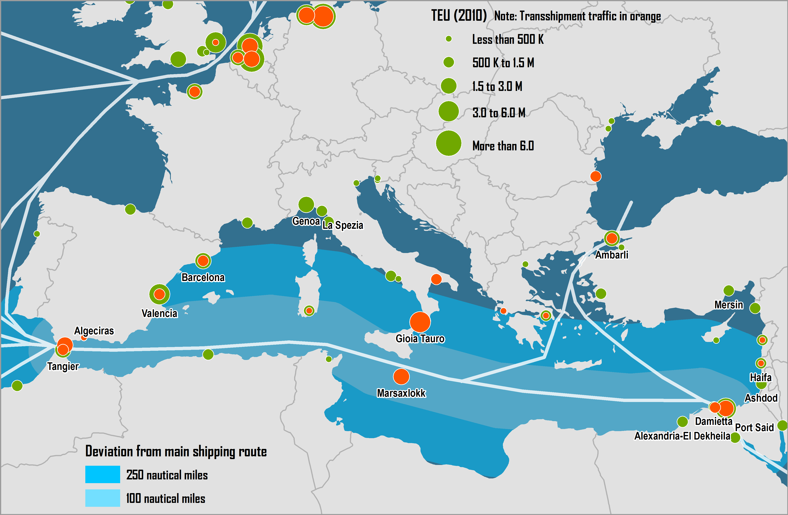
Deviation from the Main Shipping Route of Mediterranean Container Ports
Notes:
Source: Rodrigue, J-P and T. Notteboom (2010) “Foreland-Based Regionalization: Integrating Intermediate Hubs with Port Hinterlands”, Research in Transportation Economics, Vol. 27, pp. 19-29.

Slide 50
Tonnage by Country of Registry, 2013
Notes:
Source: DOT-MARAD, http://www.marad.dot.gov/library_landing_page/data_and_statistics/Data_and_Statistics.htm

Slide 51
Maritime Shipping Characteristics
 | Tramping | Liner Shipping
 | Transportation Demand
Number of shippers | Few | Many
Quantity | Large | Small
Density | High (weight) | Low (volume)
Unit value | Low | High
Regularity | Low | High
 | Transportation Supply
Contract | Vessel | Freight (bill of lading)
Vessels | Liquid and bulk | General cargo
Frequency | Low | High
 | Implications
Freight | Liquid and main bulk commodities | Minor bulk and general cargo (containerized)
Services | Supply / demand regulation | Prior to demand
Freight elasticity | Low | Low
Markets | Developing / developed countries | Developed / developed countries
 | Share in Maritime Transport (2000)
Tons | 70% | 30%
Value | 20% | 80%
Notes:
Source: adapted from P. Cariou (2003) Co-operation agreements in Liner Shipping.

Slide 52
Types of Maritime Cargo
Commodity type | Examples | Maritime Transshipment | Inland distribution
Liquid
A) Normal pressure and temperature | Crude oil, most oil products, wine, slurried coal | Pump/pipe | Pipeline
B) Other pressure and temperature | Liquefied gases (LNG, LPG), heavy oils, latex, bitumen, vegetable oils | Pumps, temperature controlled pipelines | Temperature controlled pipelines
Dry Bulk
A) Flowing | Grain, sugar, powders (alumina, cement) | Pneumatic / suction, conveyor, grabs | Pipes, conveyors, barge, rail wagon, lorry
B) Irregular | Coal, iron ores, non-ferrous ores, phosphate rock | Grab, conveyor | Conveyor, barge, rail wagon, lorry
Neo Bulk | Forest products, steel products, baled scrap | Lift-on/lift-off, roll-on/roll-off | Barge, rail wagon, lorry
Wheeled Units | Cars, lorries, rail wagons | Roll-on/roll-off | Rail wagon, lorry
Refrigerated/chilled cargo | Meat, fruit, dairy produce | Lift-on/lift-off | Rail wagon, lorry
Notes:
Source: adapted from D. Hilling and M. Browne (1998) “Ships, Ports and Bulk Freight Transport” in B. Hoyle and R.D. Knowles, Modern Transport Geography, London: Wiley.

Slide 53
Cargo, Trade and Ship Characteristics
Cargo Type | Trade Characteristics | Vessel Size
General Cargo
Conventional | Varied small consignments, Numerous consignees, Slow handling rates, Various routes, Numerous ports | Small
Unitized (containers) | More uniform cargo, Rapid handling, Many ports | Medium to large
Dry Bulk
Grain | Small to medium consignments, Varied handling rates, Many restrictive ports | Small to medium
Ores/coal | Large consignments, Long hauls, Moderate handling rates, Specialized terminals, Few ports | Medium to very large
Liquid
Crude oil | Very large consignments, Long hauls, Few routes, Specialized terminals, Few ports | Very large to ultra large
Oil products | Small shipments, Numerous consignees, Many ports | Small to medium
Notes:
Source: adapted from D. Hilling and M. Browne (1998) “Ships, Ports and Bulk Freight Transport” in B. Hoyle and R.D. Knowles (eds), Modern Transport Geography, London: Wiley, p. 246.

Slide 54
Characteristics of Short Sea Shipping Services
Characteristics | Regional Short Sea Services | Feeder Services | Ferry Services
Market | Regional or intra-corporation cargo | Feeder cargo (from/to deepsea services) | Regional cargo over short distances
Frequency | Fixed schedule with low frequency | Shipping line schedule | Fixed schedule with high frequency
Service orientation | Regional loop | Transshipment hubs | Point to point
Operations | Lift-on/Lift-off (Lo/Lo); Roll-on/Roll-off (Ro/Ro) | Lift-on/Lift-off (Lo/Lo) | Roll-on/Roll-off (Ro/Ro)
Cargo type | Containers, break bulk, Ro/Ro | Containers | Trucks, trailers, passengers
Infrastructure Requirements | Shore-side cranes, warehouses and container storage areas | Shore-side cranes and container storage areas | Minimal (quays), particularly if vessels have self-sustaining ramps
Competition | Road and rail transport (if present) | Direct port calls. Ferry services. | Road and air transport (if present). Feeder services.
Notes:
Source: I-95 Corridor Coalition (2005) “Short-Sea and Coastal Shipping Options Study”. http://144.202.240.28/pman/projectmanagement/Upfiles/reports/full343.pdf

Slide 55
Regional Short Sea Services
Feeder Services
Ferry Services

Slide 56
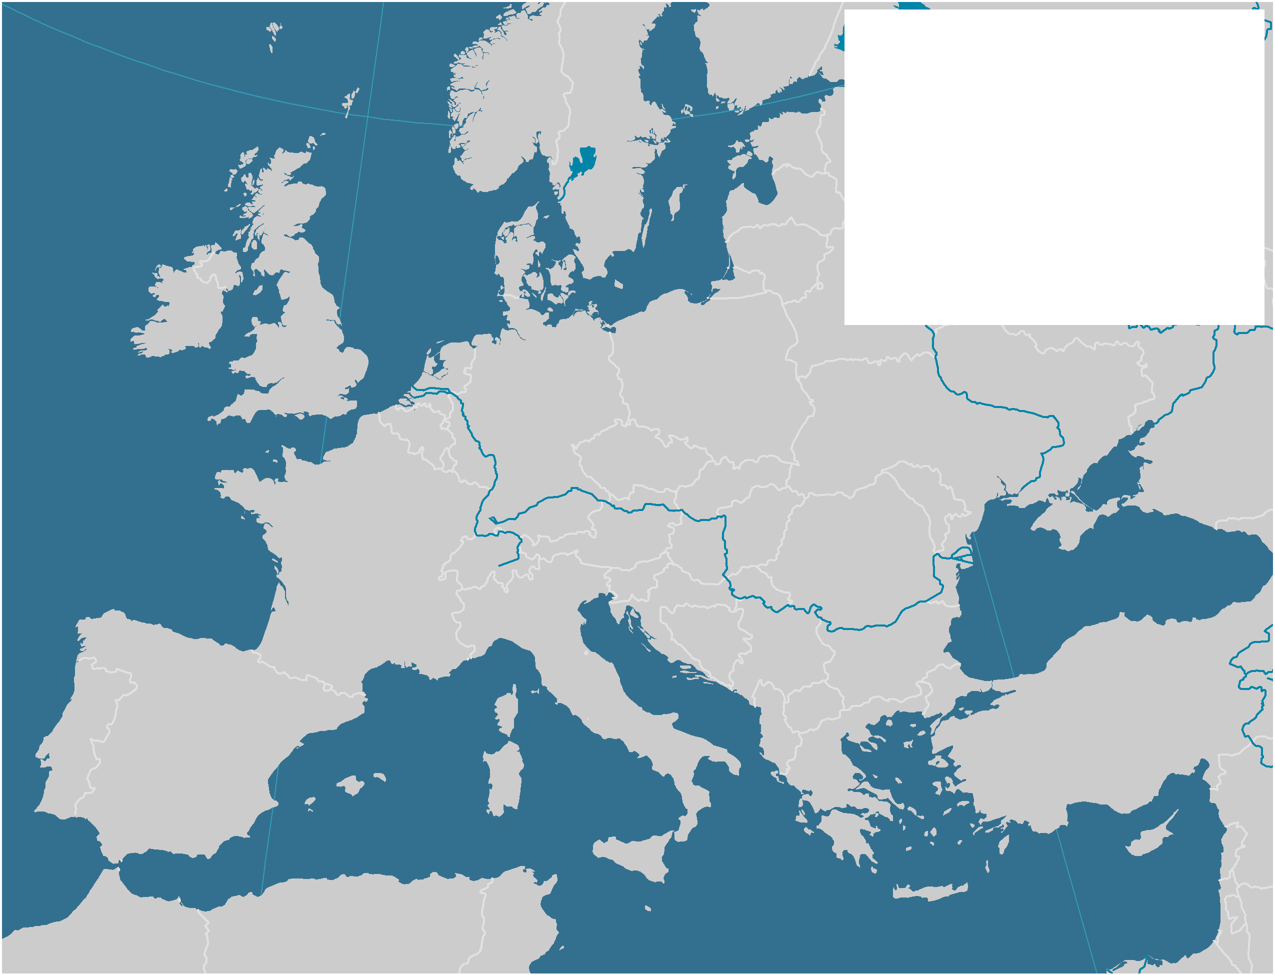
The European Short Sea Shipping Market
North
Sea
52
41
125
Cargo Carried (Million tons)
51
43
Baltic
110
Main Short Sea Shipping
Corridor
Atlantic
Ocean
443
536
From
To
Cargo Transited
(Million tons)
84
59
123
50
56
60
75
74
256
130
Black Sea
210
72
42
134
61
581
56
Mediterranean
Notes:
Source: Data from Eurostat.

Slide 57
Types of Pendulum Routes
Symmetrical
Asymmetrical
Inter-Hub
Notes:
CABOTAGE.

Slide 58
Factors Impacting Maritime Shipping Networks
Frequency of Service
Fleet and Vessel Size
Number of Port Calls
2
2
2
2
2
2
2
2
3
3
3
2
2
2
2
2
2
3
3
3
Port calls per week
4,000 TEU
5,000 TEU
Port calls per week

Slide 59
Pendulum Services and Cabotage
Country 1
A
Pendulum Service
D
B
E
Cabotage
C
F
Country 2

Slide 60
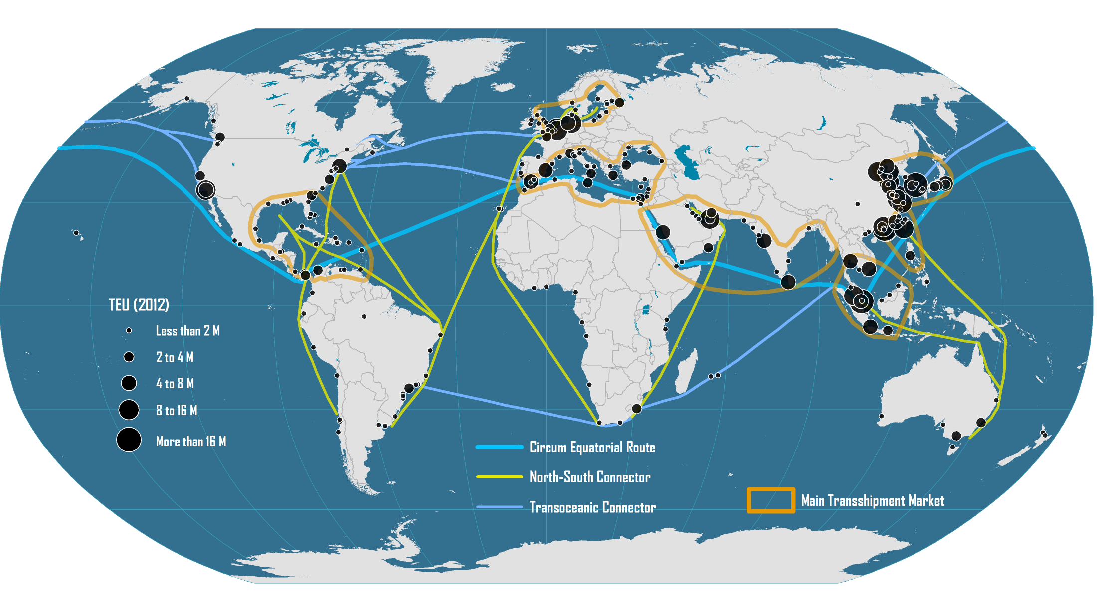
Emerging Global Maritime Freight Transport System

Slide 61
The Maritime Transport Life Cycle and Main National Actors
Financing and Insurance
UK & Scandinavia
1. Building
2. Ownership
3. Registration
4. Operations
5. Scrapping
Korea & China
(72%)
Greece, Japan &
China (38%)
Panama, Liberia
& Marshall Islands
(42%)
Denmark &
Switzerland (30%)
India, Bangladesh, China &
Pakistan (92%)
Seafarers
Philippines & Indonesia
Hong Kong, Netherlands, Singapore & UAE (44%)
Global Terminal Operators
Notes:
Source: Adapted from UNCTAD, Review of Maritime Transport, various issues. J. Hoffmann (2014) “Who controls the world's fleet? Trends in the ship owning countries”, Maritime Money Geneva Forum.

Slide 62
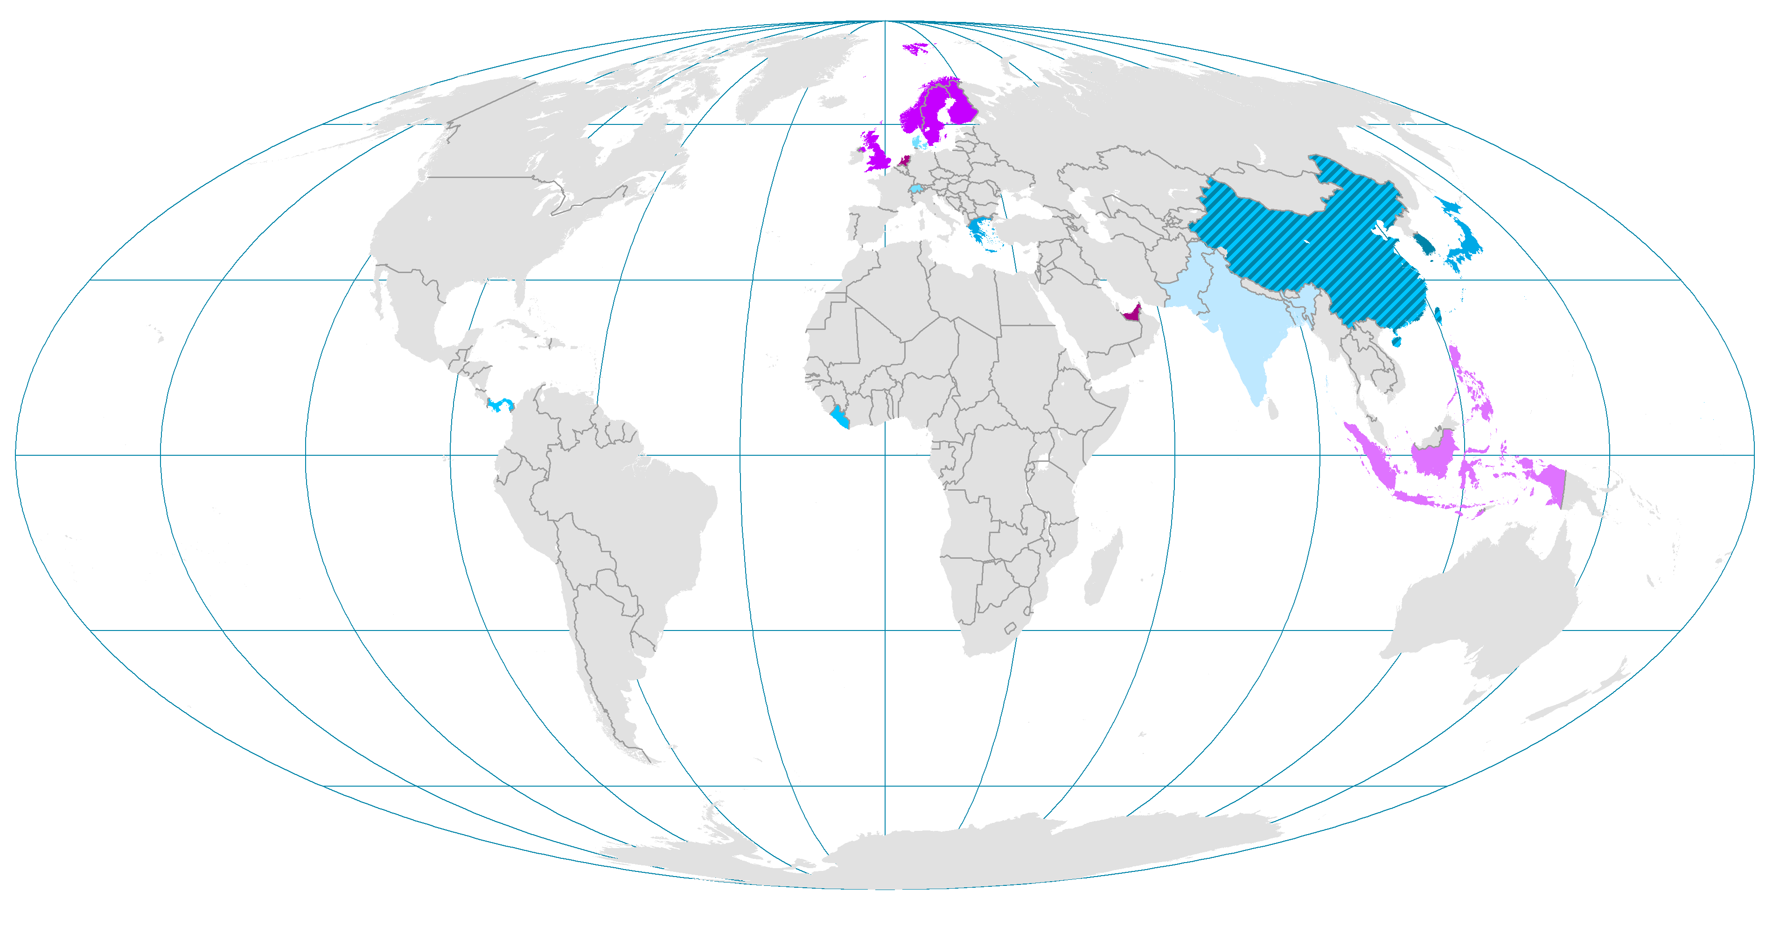
The Maritime Transport Life Cycle and Main National Actors
Hong Kong, Netherlands,
Singapore & UAE (44%)
UK & Scandinavia
Philippines & Indonesia
Financing and Insurance
Global Terminal Operators
Seafarers
SUPPORT
CORE
1. Building
2. Ownership
3. Registration
4. Operations
5. Scrapping
China, South Korea & Japan (91%)
Greece, Japan &
China (38%)
Panama, Liberia
& Marshall Islands
(42%)
Denmark &
Switzerland (30%)
India, Bangladesh, China &
Pakistan (95%)

Slide 63
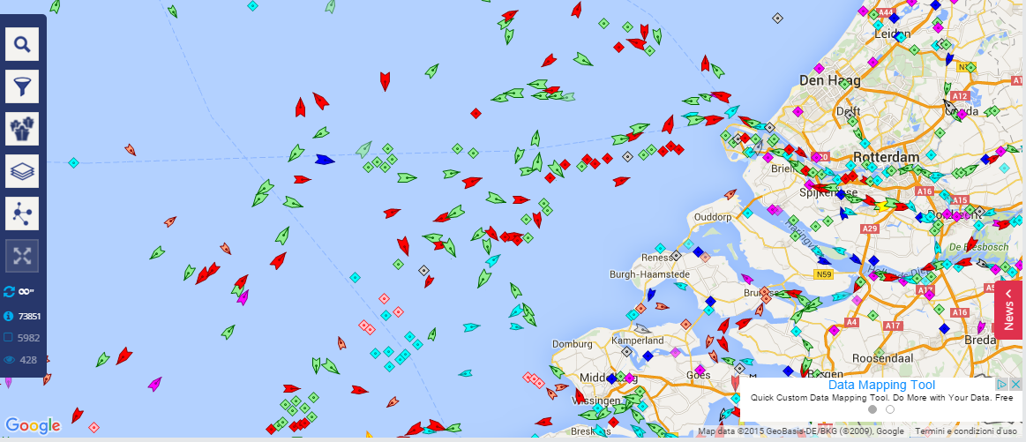
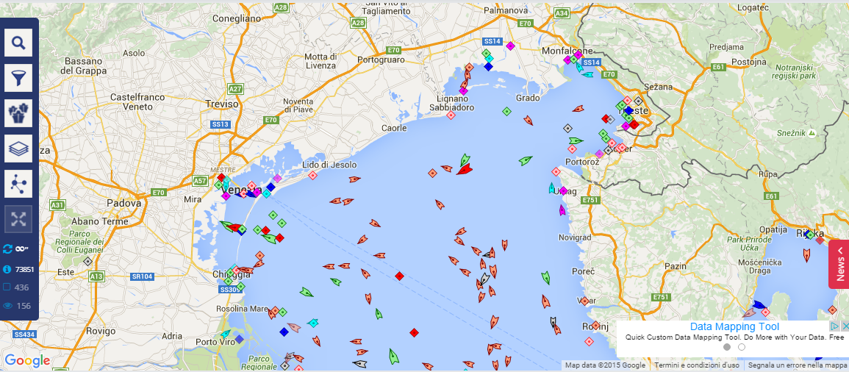
Marine traffic in Europe – 2 examples

