Slide 1
Economic Geography 6 – Transport and location
121EC
A.Y. 2023/2024
Dr. Giuseppe Borruso
Department of Economics, Business, Mathematics and Statistics
University of Trieste
E-mail. giuseppe.borruso@econ.units.it
Ph. +39 040 558 7008
Skype: giuseppe.borruso
Notes:
Slides with (*) in footnotes have been modified by Jean-Paul Rodrigue materials. (see copyright). I have modified and elaborated materials in order to be suitable for the current course.
Copyright © 1998-2010, Dr. Jean-Paul Rodrigue, Dept. of Global Studies & Geography, Hofstra University. For personal or classroom use ONLY.

Slide 2
Road transport

Slide 3
Linearity, Capacity and Surface of Roads
Hard Surface
Wheeled vehicle
Linear Road
2 domestic
animals
Capacity
1 or 2 domestic
animals
1 domestic
animal
Curved Road
Soft Surface
1 person
Linearity

Slide 4
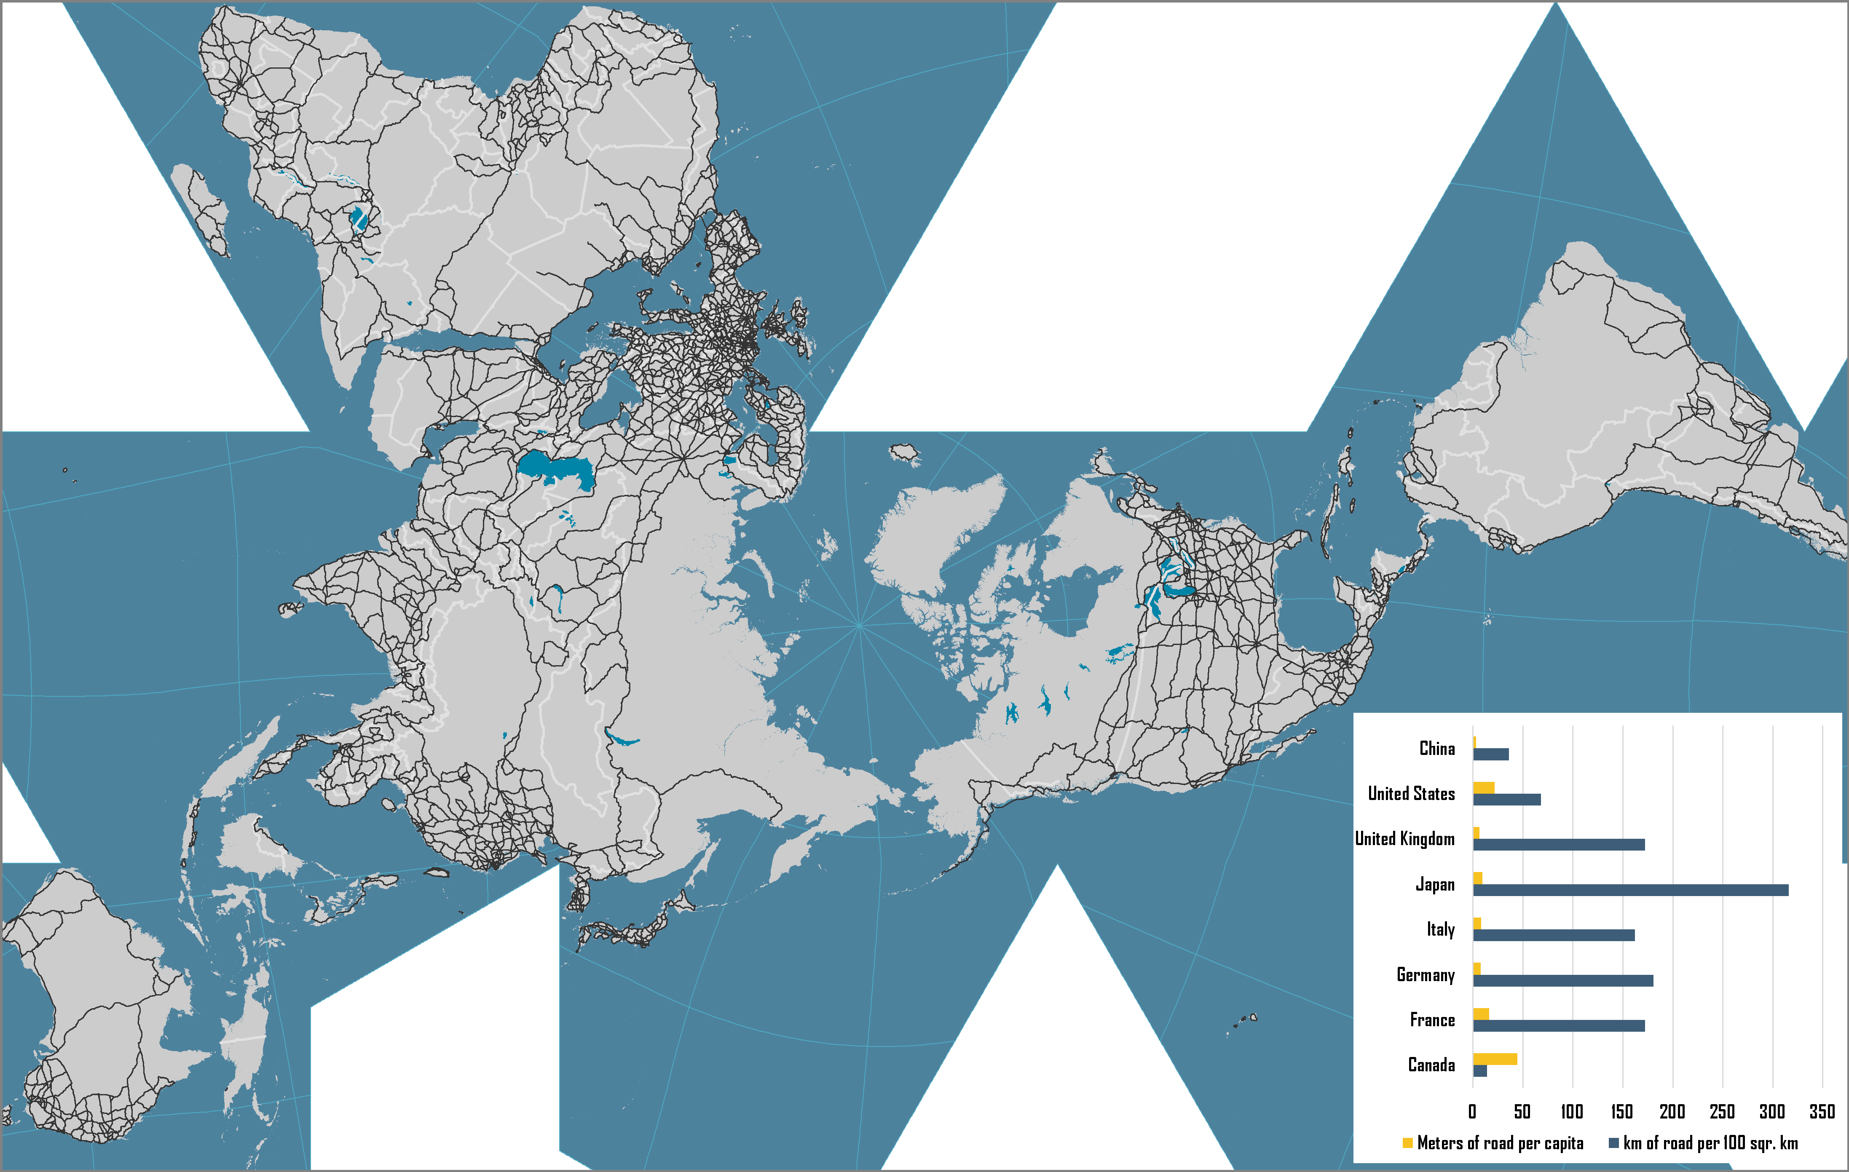
World Road Network

Slide 5
Road Transport Density Measures, 2000s
Notes:
Source: US Department of Transportation, BTS, G-7 Countries: Transportation Highlights

Slide 6
World Automobile Production and Fleet, 1965-2014
Notes:
Source: US Department of Energy, Transportation Energy Data Book. http://www-cta.ornl.gov/data/chapter3.shtml

Slide 7
Rail transport

Slide 8
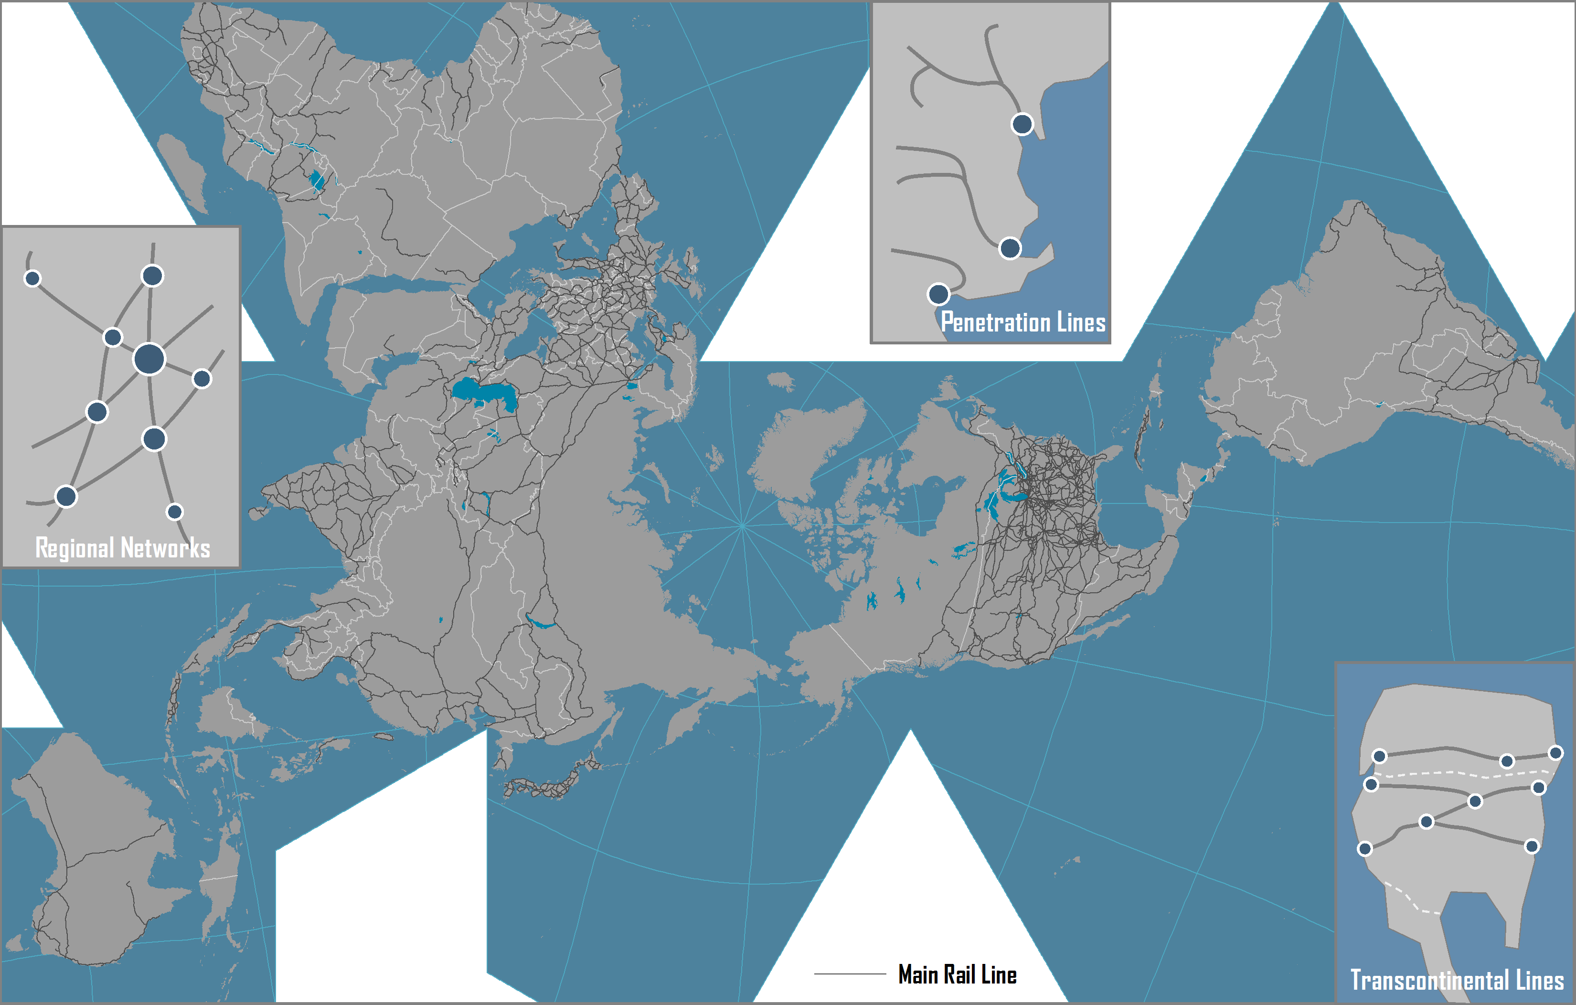
World Rail Network and Rail Systems

Slide 9
Geographical Settings of Rail Lines
Penetration Lines
Regional Networks
Transcontinental Lines

Slide 10
Conceptual Corridor Development
A
B
C
D
E
F
Notes:
Source: adapted from Taaffe, E.J., H.L. Gauthier and M.E. O'Kelly (1996) Geography of Transportation, Second Edition, Upper Saddle River, NJ: Prentice Hall.

Slide 11
Economic Rationale of Rail Transportation
Market Area | Longest service area for inland transport (average length of 1,300 km). Service both the passengers and freight markets. Intermodal integration favored market segmentation and specialization.
Capacity | A wagon can carry 50 to 100 tons of freight. Economies of scale (unit trains and doublestacking).
Costs | High construction and maintenance costs. High operating costs: labor (60%), locomotives (16%) and fuel & equipment (24%). Shipping costs decrease with distance and load. Transshipments and train assembly increase costs.
Benefits | Accelerated industrialization. Support agricultural and energy supply systems. Intermodal connecting with international trade.
Regulation | Conventionally highly dependent from government subsidies. Governments financing, mainly for the sake of national economic imperatives. From regulation to deregulation. Private ownership and operations.

Slide 12
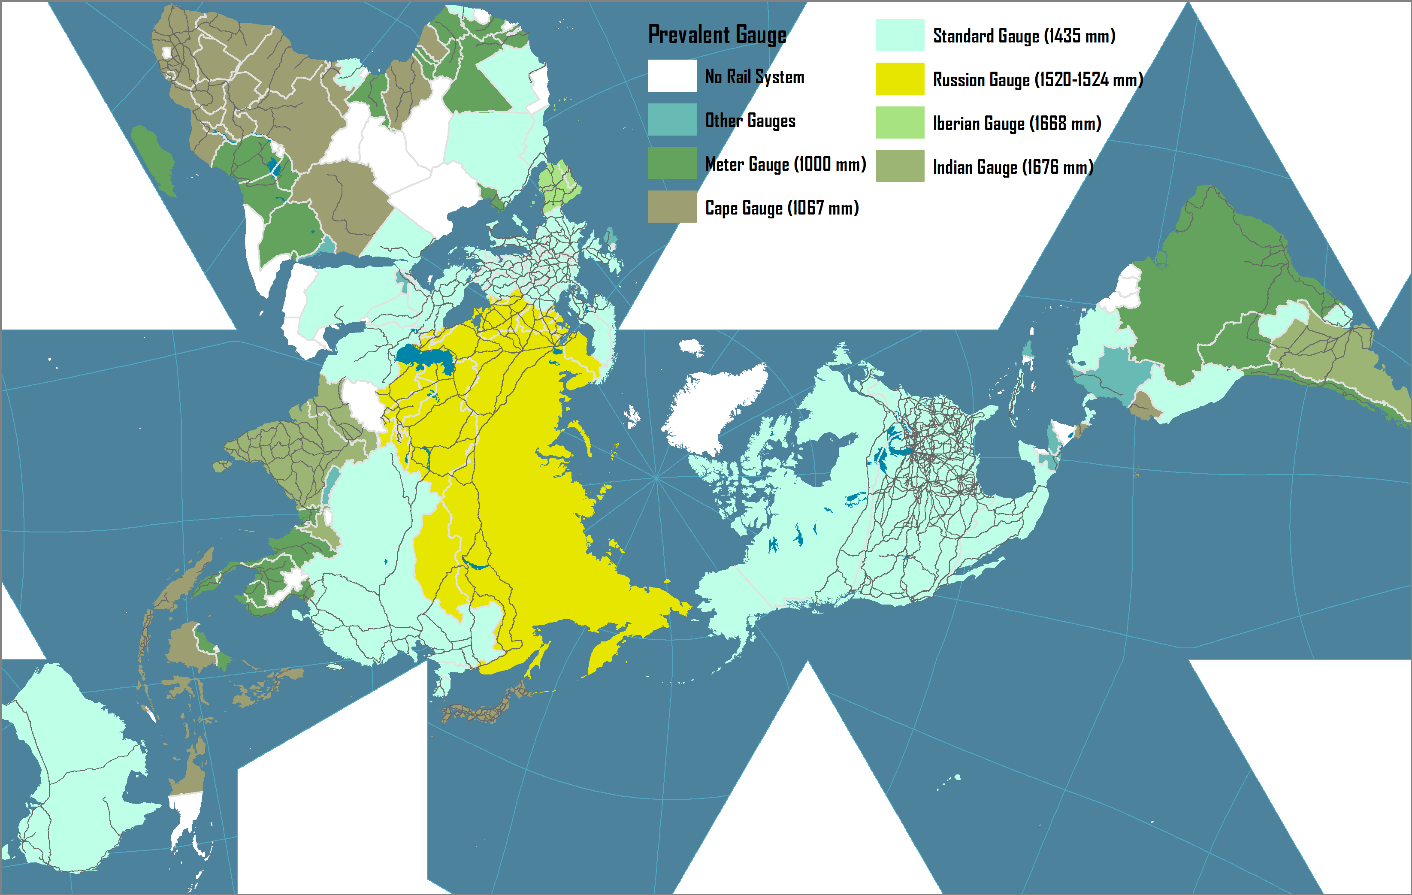
Major Gauges of the Global Rail Systems, 2008
Notes:
Source: CIA World Fact Book. https://www.cia.gov/library/publications/the-world-factbook/fields/2121.html

Slide 13
Spatial Performance of Rail and Road Transportation

Slide 14
Bypassing Effect of High Speed Rail
A
Intercity line
Rail station
High speed rail line
High speed rail station
Closed intercity line
Closed rail station
B

Slide 15
Comparison Between European, North American and Pacific Asian Railways
Issue | Europe | North America | Pacific Asia
Organisation | Separation of infrastructure from operations (for accountancy purposes) | Separation by region (markets) (private companies and concessions of vertically integrated companies) | Infrastructure and operations publicly owned
Market focus | Passenger oriented | Freight oriented | Passenger oriented
Ownership | Infrastructure mainly publicly owned with a few exceptions (e.g. UK). Freight equipment and terminals increasingly privately owned and operated. | Private | Public
Distances | Short to medium | Medium to long | Short to long
Notes:
Source: adapted from: C. Nash and C. Rivera-Trujillo (2004) “Rail regulatory reform in Europe – principles and practice”, STELLA Focus Group 5 synthesis meeting, Athens.

Slide 16
 | European Union | United States
Ownership of rail infrastructure | Close to 90% state owned | Entirely private
Technical characteristics | Low axle load (standard 22,5t), electric traction limiting height of loads, differences among EU countries (loading gauge, track gauge, power supply standards) | High axle load (standard 36t), no electric traction, max. axle weight 31,8t, national railroad infrastructure standards (USA and Canada)
Capacity | 400-750 meter in length, single stack, 80-120TEU or 40-60 semitrailers | 1300-3000m in length, double-stack, 250-600TEU or 120-280 semitrailers
Operators | 10 large operators | 6 large class I operators
Competition | Strong competition limited by informal national and political regulations | Semi oligopolistic competition according to regions
Operations | Dense network with numerous long and short-distance corridors. Average intermodal train distance ca. 500km. Sea containers and short-sea containers distribution in rail shuttle. | Large network with main long-distance corridors from gateway ports Average intermodal train distance 1000-1200km (US West) and 2500-3500km (US East). Sea containers distribution in port-hinterland trains. After transloading to domestic containers and semitrailers distribution in port-hinterland trains. Domestic containers and semitrailers in mostly in West- East directions.

Slide 17
Main Advantages of Railway Infrastructure Investment
Group | Benefit | Description
Public sector | Lower highway congestion and maintenance | Potential substitution effect. Each intermodal train can take 280 trucks off the roadways, while each bulk and merchandise train can remove up to 500 trucks. Every passenger train displaces hundreds of automobiles.
 | Improved safety and security | Freight railroads are safer than trucks. Railroads have one-fourth the rate of fatalities of trucks for intercity transportation, on a per ton-mile basis.
 | Economic growth | Economies of scale provide long distance transport services at a lower cost.
 | Environment | On average, railroads are three or more times more fuel efficient than trucks.
Shippers | Lower transit times | Reduced transit times lower shippers’ costs by lowering the inventory carrying costs of the transported goods.
 | Lower logistics costs | Due to economies of scale, freight rail can provide long-haul transportation services at a lower rate than trucks.
 | Improved reliability | Expanded rail capacity lowers the variability in transit time by reducing the uncertainty created from delays. Improved transportation on-time performance lowers manufacturing costs, both from reducing stock-outs and shut-downs, and from the ability to safely maintain lower inventory levels.
Rail operators | Increased ridership or traffic | Expanding freight capacity can increase the revenue of the freight railroads through increased business opportunities.
 | Improved reliability | Expanded rail capacity lowers the variability in transit time by reducing the uncertainty created from delays.
Notes:
Source: adapted from CSX Corporation (2007) U.S. Department of Transportation Corridors of the Future Program Application: The Southeast I-95 Corridor

Slide 18
Intermodal Transport

Slide 19
Intermodalism and Transmodalism
Intermodalism
Origin
Destination
Road
Rail
Maritime
Transmodalism
Origin
Destination
Rail
Rail

Slide 20
Major Steps in Intermodal Integration
Advanced Containers
Advanced Terminals
Regionalization
Intermodal rail crane (1985)
Doublestacking; IBCs (1985)
Intermodal Integration
Deregulation (1980s)
COFC (1967)
Transatlantic (1966); Containerships (1968)
Standardization (size and latching) (1965)
Containerization (1956)
TOFC (1950s)
Pallets (1930s)
Time

Slide 21
Integrated Transport Systems: From Fragmentation to Coordination
Factor | Cause | Consequence
Technology | Containerization & IT | Modal and intermodal innovations; Tracking shipments and managing fleets
Capital investments | Returns on investments | Highs costs and long amortization; Improve utilization to lessen capital costs
Alliances and M & A | Deregulation | Easier contractual agreements; joint ownership
Commodity chains | Globalization | Coordination of transportation and production (integrated demand)
Networks | Consolidation and interconnection | Economies of scale, efficiency and control.

Slide 22
The Benefits of Containerization
Transport Costs
Lower freight rates
Inventory Costs
Lower storage costs
Faster inventory turnover
Service Level
Time reliability
Higher frequency
Lower insurance rates
Lower packing and packaging costs
Minimal load unit

Slide 23
The Four Revolutions of Containerization
1- Containerization of Maritime Transport Systems
Container port
2- Containerization of Inland Transport Systems
Gateway
Pendulum
Services
Corridor
Intermodal terminal
3- Intermodal and Transmodal Operations
Inland Port
Transshipment
hub
Transloading
Notes:
Asaf Ashar: “The revolutions relate to a series of technological breakthroughs, expanding the boundaries of the shipping system in the pursuit of economies of scope. The first revolution was the unitization of cargo, or containerization, focusing on the ship to shore transfer process and inducing the development of specialized ships and ports. The second was the expansion of containerization to land transport modes, or intermodalism, using the marine boxes for the entire ship to door transport process. This revolution was facilitated by the development of unit-trains with articulated, double stack railcars, on or near dock intermodal yards to handle them, domestic containers (in the US) and near dock transloading terminals to transfer the content of marine to domestic boxes, and hinterland “dry” ports, serving as extensions of the marine ones. The third revolution included the development of transshipment, or ship to ship transfer, linking together different shipping services and expanding the reach of container shipping to smaller ports. The fourth revolution, as depicted there, revolves around a far reaching rationalization of the worldwide service pattern of shipping services intended to create a comprehensive, integrated network, defined there as the global grid. The core service pattern of this grid is cross- Panama, bi-directional (counter rotating) equatorial round the world (ERTW), functioning as the “ring road” for the major east/ west trades,”

Slide 24
The Four Revolutions of Containerization
Phase 1
Phase 3
Inland Port
Transshipment
hub
Phase 2
Phase 4
Gateway
CER
Intermodal
terminal

Slide 25
Intermodal Transport Chain
Composition
‘Last mile’
Interchange
Transfer
‘First mile’
Local / Regional Distribution
Decomposition
National / International Distribution
Transport Terminal

Slide 26
Intermodal Transportation as an Integrative Force
Multimodal Point-to-Point Network
Intermodal Integrated Network
C
C
A
A
B
B
Transshipment
Rail
Road
D
D
Transshipment
F
F
E
E

Slide 27
Integrated Freight Transport Systems: Intermodal and Transmodal Operations
Transloading facility
Road
Distribution Center/ Cross-docking
On-dock rail
Intermodal operations
Rail
Thruport
Maritime
Port container yard
Intermediate Hub
Transmodal operations

Slide 28
Conditions and Outcomes of Intermodal Transport
Conditions
Outcomes
Load Unit
Intermediate and finished goods in load units of less than 25 tons.
Lower Total Transport Costs
From economies of scale and the use of more effective modes and intermodal operations.
Modal Continuity
Sequence of connected infrastructure; an intermodal transport chain.
Modal shift
Each mode according to their respective time and cost advantages.
Transport Distance
Distances above 500 km (longer than one day of trucking) usually require intermodal transportation.
Consolidation / Deconsolidation
The requirement to consolidate and deconsolidate load units at intermodal terminals.
X
Cargo Value
Suitable for intermediate cargo values. Low and high value shipments are usually less suitable.
Higher load factor
Less LTL and more TL. Better utilization of existing capacity.
Frequency of shipments
Cargo flows need to be continuous and in similar quantities.
Less empty backhaul
Less vehicle-km of empty backhauls due to modal shift, higher load factor and consolidation.

Slide 29
Multimodal Transport System
National / Continental
Maritime / Land interface
Gateways and Hubs
A
B
C
Intermodal Corridor
Gateway or Hub
Regional
E
H
Intermodal terminal
Satellite Terminals
and Inland Ports
A
B
C
Distribution center
F
G
Modal Link
Local
E
H
Competition or
Complementarity
Distribution Centers
F
G

Slide 30
Driving Forces of Containerization and Intermodalism
Containerization
Unitization
Cellular ships
Specialized terminals
Land consumption
Standardization
Gantry cranes
Transshipment
Multi-rate structure
Management and coordination
Mergers
Modal integration
Logistics
Control over cargo
Multimodal operators
Through rates and billing
Deregulation
Intermodalism
Notes:
Source: adapted from Hayuth, Y. (1987) Intermodality: Concept and Practice, Essex: Lloyds of London Press.

Slide 31
Main Physical Characteristics of Containers
Type | Cubic Capacity | Tare Weight | Payload Weight | Gross Weight | Length / Width / Height
20 Footer | 33.2 cubic meters (1,170 cubic feet) | 2,150 kg - 2,220 kg (4,740 lb - 4,894 lb) | 21,850 kg - 28,160 kg (48,171 lb - 62,082 lb) | 24,000 kg - 30,480 kg (52,911 lb - 67,197 lb) | 6.058 m / 2.438 m / 2.591 m (20‘0" / 8'0“ / 8'6“)
40 Footer | 67.7 cubic meters (2,391 cubic feet) | 3,720 kg - 3,740 kg (8,201 lb - 8,245 lb) | 26,760 kg - 28,760 kg (58,996 lb - 63,405 lb) | 30,480 kg - 32,500 kg (67,197 lb - 71,650 lb) | 12.192 m / 2.438 m / 2.591 m (40'0“ / 8'0“ / 8'6")
40 Footer High Cube | 76.4 cubic meters (2,700 cubic feet) | 3,730 kg - 3,950 kg (8,223 lb - 8,708 lb) | 26,750 kg - 28,550 kg (58,974 lb - 62,942 lb) | 30,480 kg - 32,500 kg (67,197 lb - 71,650 lb) | 12.192 m / 2.438 m / 2.896 m (40'0“ / 8'0“ / 9'6")
40 Footer High Cube Reefer | 67.7 cubic meters (2,391 cubic feet) | 4,810 kg (10,604 lb) | 29,190 kg (64,353 lb) | 34,000 kg (74,957 lb) | 12.192 m / 2.438 m / 2.896 m (40'0“ / 8'0“ / 9'6“)
45 Footer High Cube | 86.5 cubic meters (3,055 cubic feet) | 4,740 kg (10,450 lb) | 28,280 kg (62,350 lb) | 33,020 kg (72,800 lb) | 13.716 m / / 2.438 m / 2.896 m (45'0“ / 8'0“ / 9'6“)
48 Footer High Cube | 98.8 cubic meters (3,489 cubic feet) | 5,140 kg (10,865 lb) | 25,340 kg (56,350 lb) | 30,480 kg (67,197 lb) | 14.630 m / 2.591 m / 2.908 m (48'0“ / 8'6“ / 9'6 1/2")
Notes:
Source: adapted from APL, Equipment Specifications, http://www.apl.com/equipment/

Slide 32
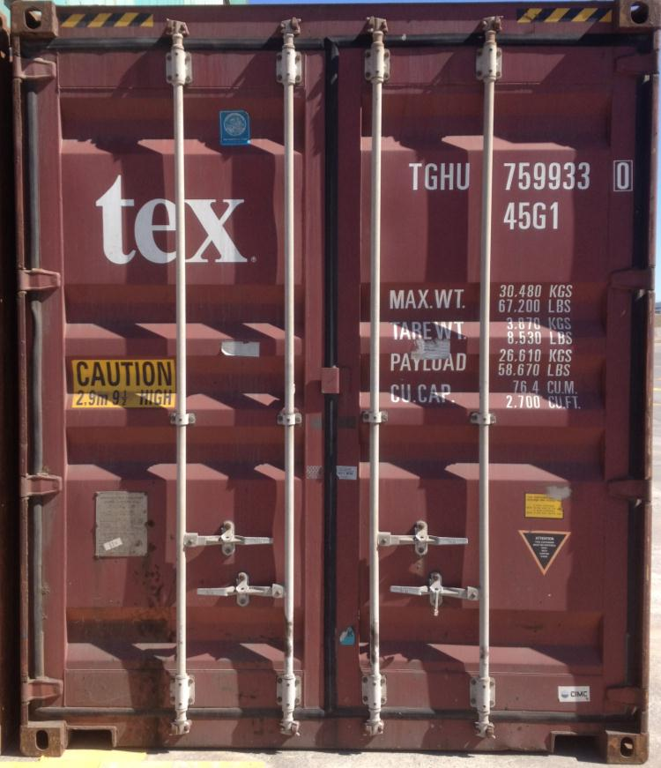
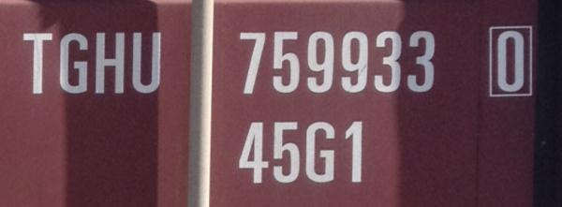
Container Identification System
Owner Code (3 letters): TGH
Product Group Code (1 letter): U
Registration Number (6 digits): 759933
Check Digit (1 digit): 0
Size & Type Code (4 digits/letters): 45G1
Operational Characteristics
Maximum weight: 30,480 kg
Container weight: 3,870 kg
Payload weight: 26,610 kg
Cubic capacity: 2,700 cubic feet

Slide 33
World Container Traffic and Throughput, 1980-2015
Notes:
Source: Drewry Shipping Consultants.

Slide 34
Containerization Growth Factors
Derived Economic and income growth
Globalization (outsourcing)
Fragmentation of production and consumption
Substitution Functional and geographical diffusion
New niches (commodities and cold chain)
Capture of bulk and break-bulk markets
Incidental
Trade imbalances
Repositioning of empty containers
Induced
Transshipment (hubbing, relay and intersection)
Notes:
Source: Adapted from Dewry Shipping Consultants.

Slide 35
Containerization Growth Factors
Substitution-Based
New niches (commodities and cold chain)
Capture of bulk and break-bulk markets
Containerization
Incidental
Trade imbalances
Repositioning of empty containers
Induced
Transshipment (hubbing, relay and intersection)
Derived
Economic and income growth
Globalization (outsourcing)
Fragmentation of production and consumption

Slide 36
Advantages of Containerization
Factor | Advantage
Standard transport product | ISO standard. Specialized ships, trucks and wagons. Unique identification number and size type code.
Flexibility of usage | Commodities (coal, wheat), manufactured goods, cars, frozen products. Adapted containers for dry cargo, liquids (oil and chemical products) and refrigerated cargo. Reuse of discarded containers.
Costs | Low transport costs; 20 times less than bulk transport. Economies of scale at modes and terminals.
Velocity | Fast transshipment operations. Low terminal turnaround times (port time reduced from 3 weeks to about 24 hours).
Warehousing | Own warehouse; Simpler and less expensive packaging. Stacking capability on ships, trains (doublestacking) and on the ground.
Security and Safety | Contents of the container is unknown to carriers. Can only be opened at the origin, at customs and at the destination. Reduced spoilage and losses (theft).

Slide 37
Challenges of Containerization
Factor | Challenge
Site constraints | Large consumption of terminal space (mostly for storage); move to urban periphery. Draft issues with larger containerships (more than 13 meters).
Infrastructure costs | Container handling infrastructures and equipment (giant cranes, warehousing facilities, inland road, rail access), are important investments.
Stacking | Complexity of arrangement of containers, both on the ground and on modes (containerships and double-stack trains). Restacking difficult to avoid.
Empty movements | Many containers are moved empty (20% of all flows). Either full or empty, a container takes the same amount of space. Divergence between production and consumption; repositioning.
Theft and losses | High value goods and a load unit that can opened or carried (on truck). Vulnerability between terminal and final destination. 10,000 containers are lost at sea each year (fall overboard).
Illicit trade | Common instrument used in the illicit trade of goods, drugs and weapons, as well as for illegal immigration. Concerns about the usage of containers for terrorism.

Slide 38
Advantages and Drawbacks of Containerization
Advantages
Drawbacks
Standardization
ISO standard (modes and equipment). Unique identification number and size type code.
Site Constraints
Large consumption of terminal space. Draft issues with larger containerships.
Flexibility
Commodities, manufactured goods, liquids and refrigerated goods.
Capital Intensiveness
Container handling infrastructures and equipment are important investments.
$
Costs
Low transport costs. Economies of scale at modes and terminals.
Stacking
Complexity of arrangement of containers, both on the ground and on modes.
$
Velocity
Fast transshipment operations.
Low terminal turnaround times.
Repositioning
Divergence between production and consumption; repositioning. 20% of all containers.
Warehousing
Own warehouse; simpler and less expensive packaging. Stacking capability.
Theft and Losses
High value goods vulnerable to thefts, particularly between terminal and final destination.
Security & Safety
Contents unknown to carriers. Reduced spoilage and losses.
Illicit Trade
Illicit trade of goods, drugs and weapons, as well as for illegal immigration.

Slide 39
Container Shipping Costs and Cargo Value
Products | Items / 40 Foot Container |  | Retail Value (USD) |  | Freight / Value (%)
 | Low | High | Low | High | Low | High
Clothing (low value) | 90,000 | 130,000 | 225,000 | 520,000 | 0.56 | 1.91
Clothing (mid range) | 25,000 | 60,000 | 500,000 | 3,600,000 | 0.08 | 0.86
Sports shoes | 18,000 | 28,000 | 350,000 | 2,520,000 | 0.12 | 0.23
Bicycles | 1,200 | 1,600 | 240,000 | 480,000 | 0.60 | 1.79
Toys (low quality) | 20,000 | 60,000 | 60,000 | 720,000 | 0.40 | 7.17
Consumer electronics (small) | 2,800 | 3,600 | 170,000 | 430,000 | 0.67 | 2.53
Consumer electronics (large) | 240 | 480 | 70,000 | 140,000 | 2.07 | 6.14
Appliances (small) | 600 | 1,200 | 45,000 | 100,000 | 2.90 | 9.56
Appliances (large) | 100 | 130 | 30,000 | 65,000 | 4.16 | 14.33
Furniture (assembled) | 250 | 600 | 20,000 | 150,000 | 1.93 | 21.50
Furniture (flat packed) | 1,000 | 3,000 | 70,000 | 360,000 | 0.80 | 6.14
Automobile parts | 600 | 15,000 | 50,000 | 375,000 | 0.77 | 8.60
Notes:
Source: OECD (2005) DSTI/DOT/MTC(2005)5/REV1
http://www.marisec.org/shippingfacts/uploads/File/MaritimeTransport&IndustrialRelocation.pdf?SID=3f22944566000a0e22f9181df5ce3508

Slide 40
Containerized Cargo Flows along Major Trade Routes, 1995-2015 (in millions of TEUs)
Notes:
Source: UNCTAD, Review of Maritime Transport, various years.

Slide 41
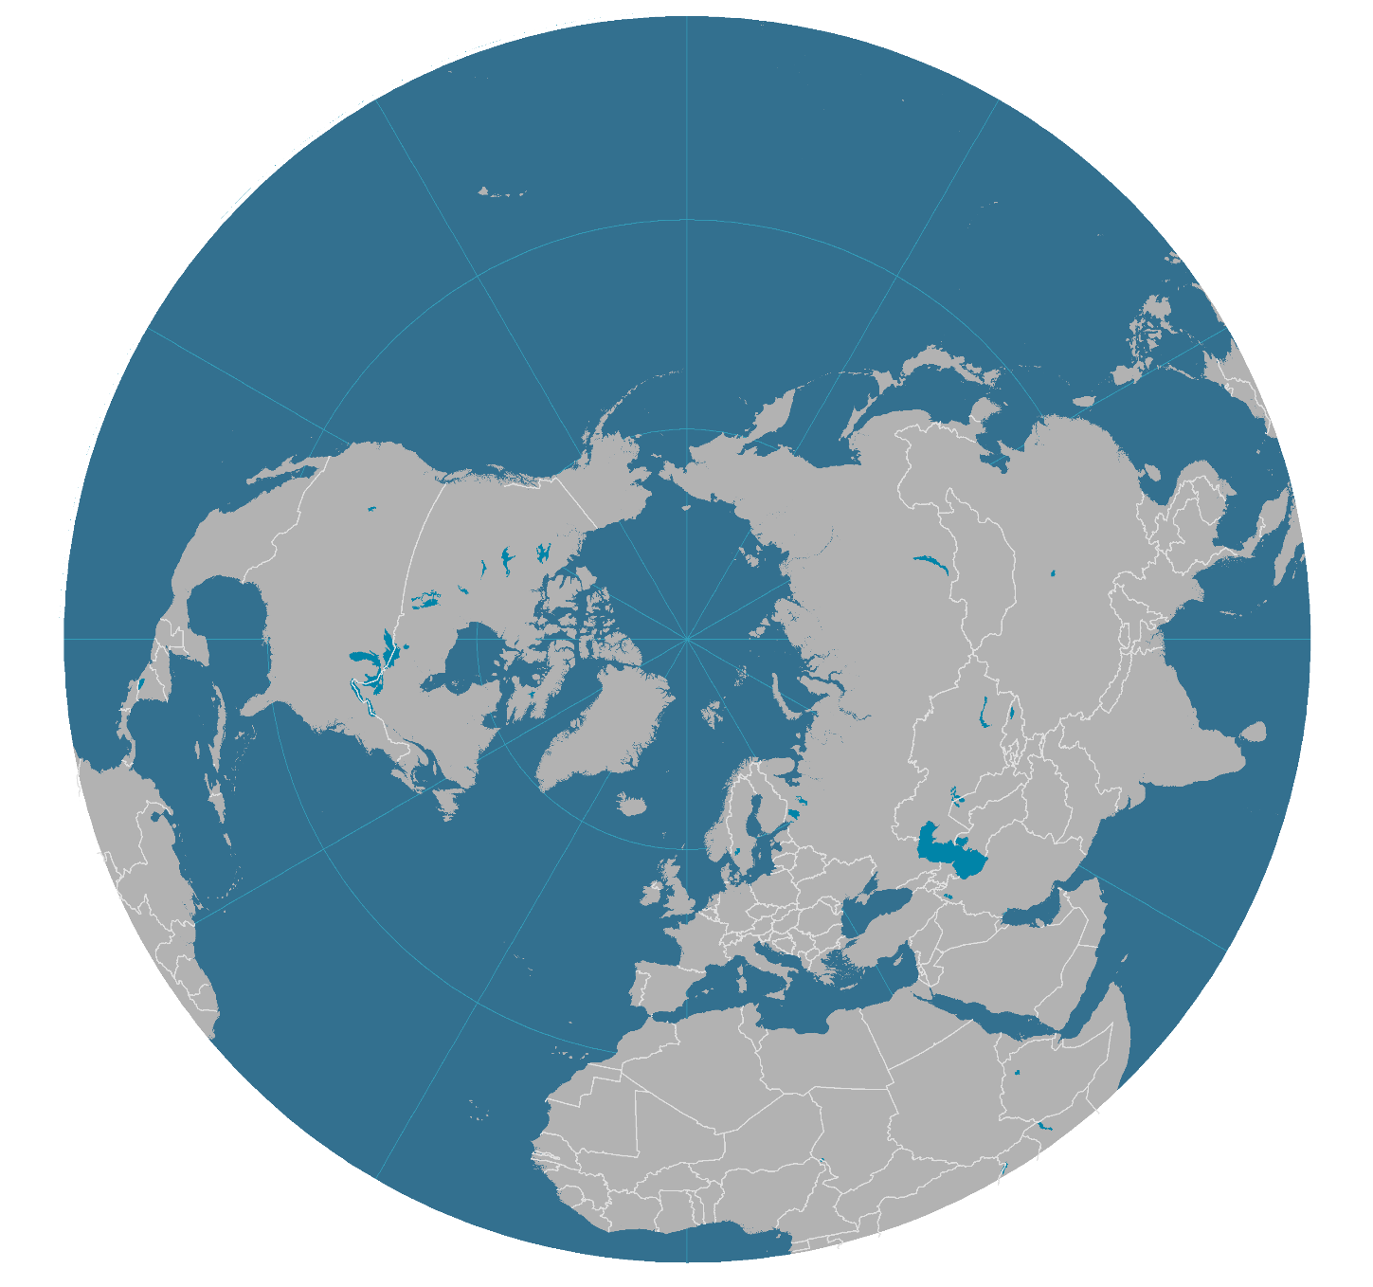
Containerized Cargo Flows along Major Trade Routes, 2012
Million TEUs
13.3 (+175%)
Growth (2006-2012)
13.1
6.9 (+48%)
Asia
16.0
27.0
North America
6.3 (+178%)
10.5
Imports (M TEUs)
13.7 (+293%)
2.7 (+55%)
17.3
Europe
3.6 (+23%)
9.0
Exports (M TEUs)

Slide 42
Economies and Diseconomies of Scale in Container Shipping
Costs per TEU
Transshipment
Inland Transportation
Maritime Shipping
Capacity in TEU

Slide 43
Functional Integration of Supply Chains
Maritime
Distribution
Inland Distribution
Shipping
Agent
Custom
Agent
Rail / Trucking
Trucking
Stevedore
Freight
Forwarder
Distribution
center
Shipping Line
Carrier
Customer
Economies of scale
Megacarrier
Level of functional integration
Notes:
Source: adapted from Robinson, R. (2002) “Ports as Elements in Value-Driven Chain Systems: The New Paradigm”, Maritime Policy and Management, Vol. 29, No. 3, pp. 241-255.

Slide 44
Impacts of River / Sea Shipping
Origin
Road / Rail
Fluvial Port
Fluvial
Seaport
Maritime
River/sea
Fluvial
Road / Rail
Destination
A
B
C
Notes:
Source: adapted from Charlier, 1994.

