Slide 1
The lesson of today is dedicated to the two terms that define the contents of this teaching course, entitled «Biomonitoring for global change detection».
The two words are obviously «change» and «biomonitoring».
On the first one, «change», the questions are: what is change for us (if we speak of environment, of course), if it has a positive or negative sense for you, what is your perception of the change, what are the factors that obstacle its perception by people (and politicians) etc. etc.

Slide 2
I suggest to consider these four topics:
1) Territory
2) Climate
3) Society
4) Pollution
(5) Information
(6) Food

Slide 3
F.C.C.’s perceptions of occurred environmental changes
Premises: F.C.C. is 40 year old, therefore his personal experience is shorter than that of M.T., but still double than yours…
Territory: progressive change of slopes of Pordenone Prealps, with a strong recolonization by woods lost in the past because of woodcutting for heating. Strong diffusion of Ailanthus altissima. Important urbanization of peri-urban areas of Pordenone and Udine by US-style shopping centers (many of them almost abandoned or with very little commerce). Progressive abandonment of countryside and mountain towns by the population in favour of the biggest ones -> houses used as holidays/touristic accomodations; expansion of vineyards in low Friulian plain (Prosecco world success).
Climate: general increase in temperatures (all seasons); increased periods of drought and high temperatures; increased extreme events, e.g. hail progressively getting bigger; less bora events and less snow (even in mountains); decrease in glacier dimensions (austrian glacier observed directly at years of distance).
Society: increased immigration, general increase in the awareness of the population (especially young people) to environmental issues, increased accessibility to information (good but also bad), increased distrust towards science.
Pollution: clear improvement of air quality despite the increase of private and commercial transportation of goods and people. Strong decrease of wood burning for household heating.

Slide 4
M.T.’s perception of occurred environmental changes
Premises: M.T. is 60 year old, therefore his personal experience is a little more long than that of yours…
Territory: very evident change in the landscape, with devasting urbanization of some parts of Trieste (periphery of T.) and the Karst, disappearance of rural landscape and rural (also architectonically interesting) houses, many new roads (mostly in the nearby Friuli); disappearance of «eroic» vineyards on terraces, colonized by woods in the «Costiera». More recently: extensive tree death (mainly Pinus nigra plantations and Ostrya carpinifolia woods).
Climate: declining precipitations; increased periods of drought and high temperatures; less bora events and less snow; higher CO₂ concentration in the atmosphere (sic!). For each of these factors I could give some evidences related to my orchard in the «Costiera», where I spend my weekends from the age of eleven taking care of my plants…
Society: decrease in conflicts between Italians and Slovenians, immigration, transformation in an interracial society.
Pollution: clear improve of air quality; less events of crude oil spillover in the sea; still heavy air pollution by road traffic.

Slide 5
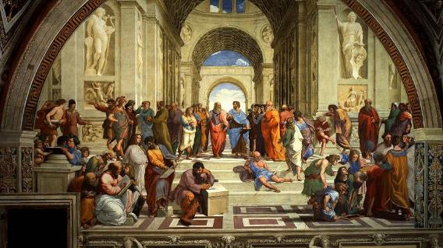
πάντα ῥεῖ
Pánta rheî or Panta rei (in ancient Greek: "everything flows") is a famous aphorism attributed to Heraclitus (but in reality never explicitly formulated in what we know of his writings) with which the subsequent philosophical tradition wanted to synthetically identify the thoughts of this philosopher regarding the theme of becoming.
Plato, in his Cratylus, writes: «Heraclitus says that "everything moves and nothing stands still"».
«One cannot descend into the same river twice and one cannot touch a mortal substance twice in the same state, but due to the impetuosity and speed of change it disperses and gathers, comes and goes.».
(22 B 91 Diels-Kranz)
In this fragment Heraclitus underlines how man can never have the same experience twice, since every entity, in its apparent reality, is subjected to the inexorable law of change.

Slide 6
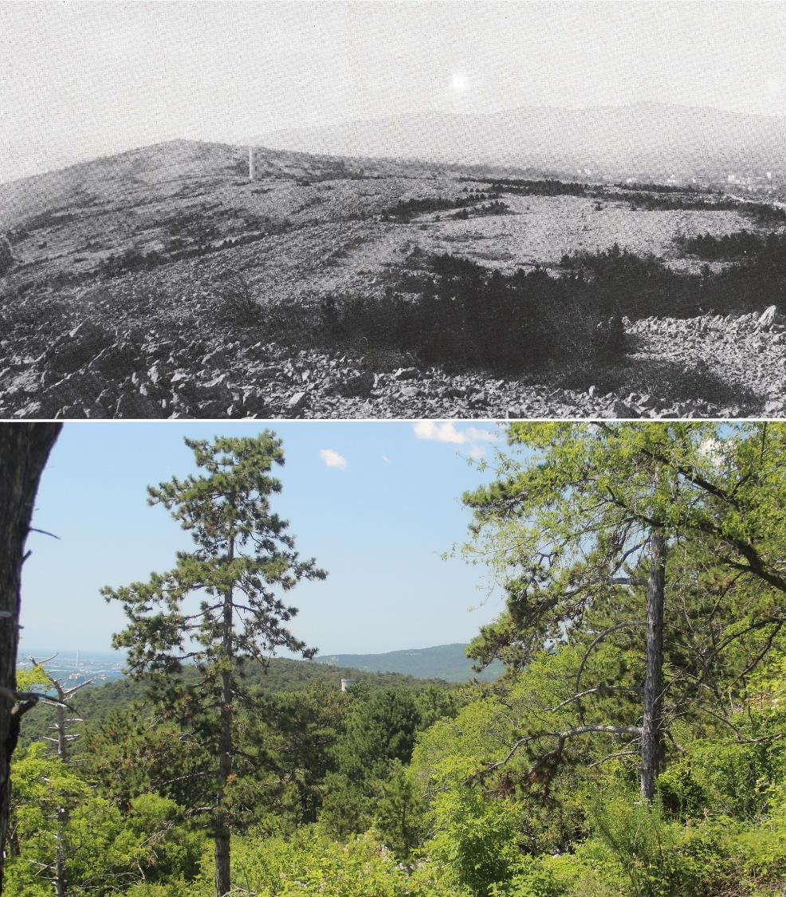
Karst near Trieste, landscape of the Karst edge towards Aurisina, with Mt. Hermada on the horizon. Comparison between c. 1900 and 2022.

Slide 7
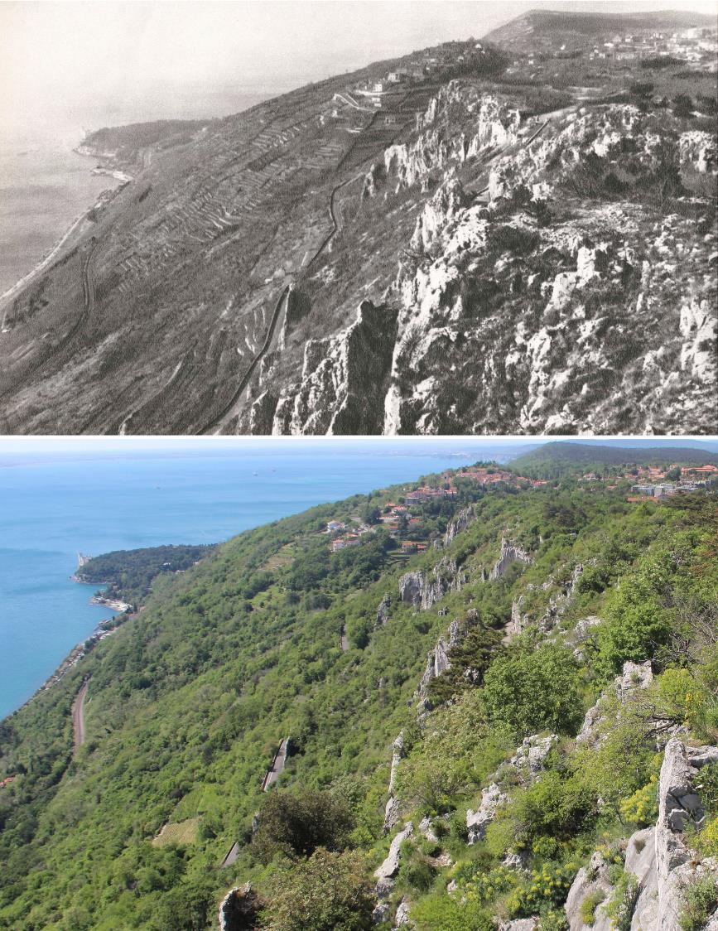
The «Costiera» near Trieste towards Miramare Castle, as seen from the Karst edge of Mt. Grisa. Comparison between c. 1900 and 2022: the terraces hosting the vineyards are almost completely disappeared, substituted by woody vegetation. In the foreground (right corner), the village of Contovello has considerably enlarged, but the modern photograph does not show the heavy urbanization of the Karst edge, started already in the ‘50s of the last century.

Slide 8
Please, try to make a comparison with the extant situation, as seen, e.g., using Google maps or other web instruments.
High Friulian plain, with the Julian pre-Alps in the foreground. Source: Italia per immagini, TCI, Torino, 1958 (?).

Slide 9
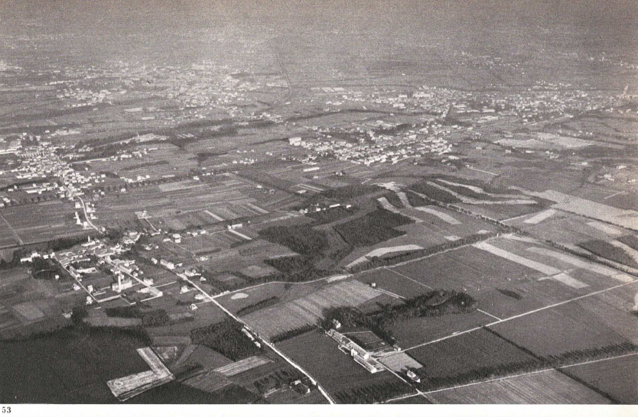
Lombard plain between Seveso and Meda. Source: Italia per immagini, TCI, Torino, 1958 (?).

Slide 10
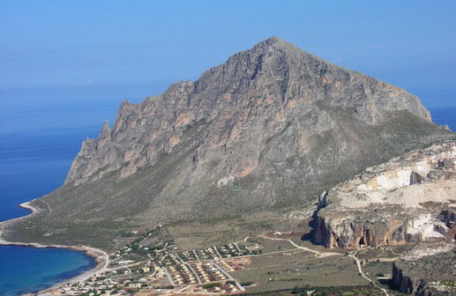
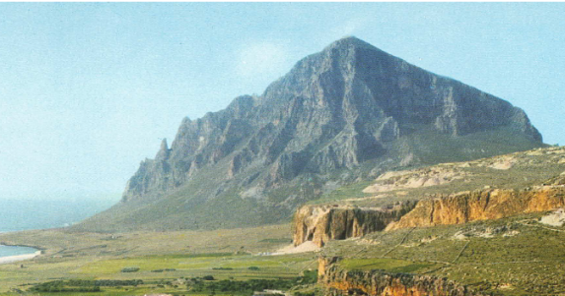
Sicily, Thyrrenian coast, Mt. Cofano. Source: Italia per immagini, TCI, Torino, 1958 (?).

Slide 11
BIOMONITORING consists of the measurement - extended in time and space - of the response effects to possible variations or environmental pressures manifested by organisms, in particular by those that prove to be particularly sensitive - or rather - "reactive": we could define them as "environmental sentinels" or biomonitors.
It is important to underline the "time" factor: monitoring presumes a verification extended over time (for us also over space), possibly at regular intervals, which allows us to follow the variations in response over time (and space).

Slide 12
From The Oxford Dictionary
Monitor, verb
to watch and check something over a period of time in order to see how it develops, so that you can make any necessary changes.
monitor something - exs.: (1) Students are tested regularly in literacy and numeracy to monitor progress. (2) This device allows diabetics to monitor their blood glucose levels at home.
monitor whether/how, etc… - exs.: (1) The project engineer monitors whether everything is completed according to the plan specifications.
monitor somebody to watch or check somebody over a period of time, so that you can see if any problems develop and take action to stop or correct this - exs.: (1) If we can identify individuals at risk for recurrent depression, we may be able to monitor them more carefully.

Slide 13
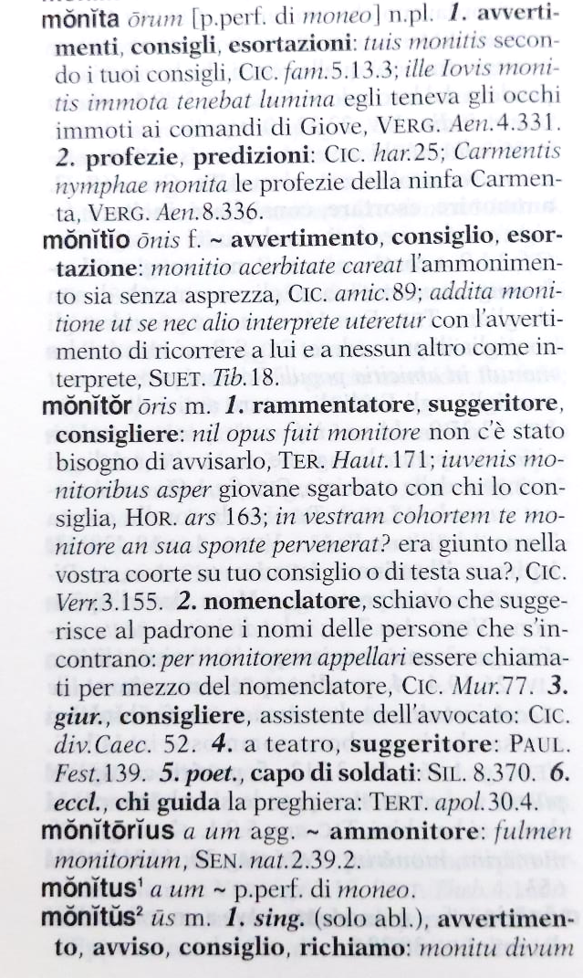
The root is from Latin; also in our language, italian, many words have the root «monit-», es. monito (in the sense of warning, absent in the derived English word), ammonire, ammonimento, etc.

Slide 14
The term "biomonitoring" was introduced by occupational medicine to define the direct measurement of elements, toxic chemical compounds or their metabolites in the human body, for example in body fluids such as blood, urine, saliva, sperm, or milk.
In health risk assessment, this approach allows us to know the real levels of substances to which the individual subject is exposed, significantly improving epidemiological research.
The Center for Disease Control and Prevention (CDC) of the U.S.A. set the standard, publishing a biennial report, “On Human Exposure to Environmental Chemicals”, based on a statistically representative sample of the population of that country.
The program started in 1976 on lead and some pesticides and is still going on.

Slide 15
Now the term biomonitoring has a broader meaning. It indicates the set of methodologies that use communities of organisms, species, individuals, or their metabolic processes and derived biomaterials that are reactive towards pollutants, to obtain information on the state of the environment, in particular to estimate possible deviations from "normal" or background values.
Biomonitoring allows estimating biological effects over time (trend monitoring); that is, it provides more general information on the state of health of the environment by evaluating the change of target organisms present in the study area (or specifically introduced) in terms of biomarkers, morphological modifications, species rarefaction or disappearance etc.

Slide 16
Biomonitoring has several advantages:
generally limited management costs (for materials and setup);
possibility of studying changes in time and space;
possibility of having, with relative ease and speed, adequate coverage of the territory, also in terms of statistical sampling density;
estimation of the combined effects of multiple stressors on living beings (*).

Slide 17
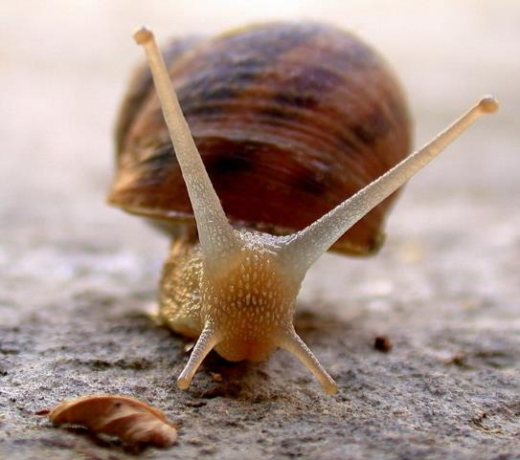
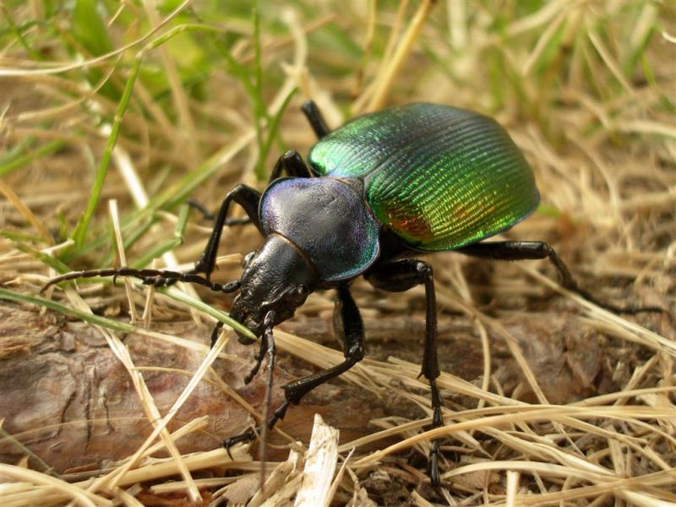
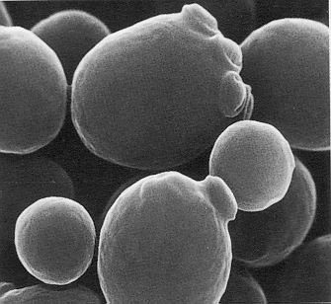
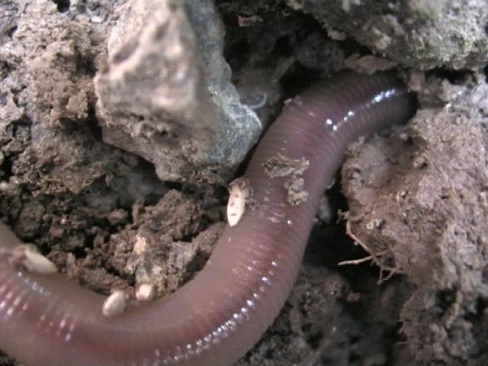
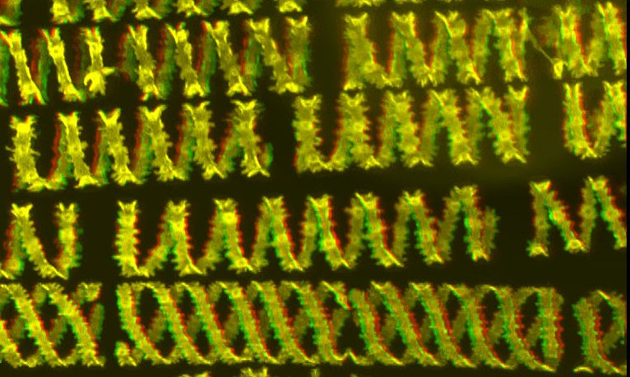
Practically every organism is able to provide information on the environment in which it lives, especially if it is compared with others (concept of the "ecological niche" or ecological hyper-space), but above all if it is "interrogated" in the right way..
Plants, yeasts, insects, birds, earthworms, molluscs, …. They are all potential “biomonitors”… if you know well their biology s.lat.

Slide 18
Potentially every organism is an environmental indicator since, by definition, the very fact of being alive gives us information on the presence of specific conditions which are compatible to the life of that organism.
Among all organisms, there are many that have a physiology and ecology that is partially or largely unknown, and in any case too complex, for which it is difficult to identify a response attributable to specific causes.
For this reason, specific groups of organisms are selected, because particularly reactive toward a specific factor or groups of factors. The choice also depends on the specialization (and scientific strength) of the people who study them: a deep knowledge of the biology of that group of organisms is of paramount importance to assure scientifically sound results.

Slide 19
It should not be surprising that a living being is a (precious) source of information about the environment.
Any organism carries out a continuous exchange of substances with the environment that surrounds it: gases, water, minerals, organic compounds are transformed into new substances which, in turn, are put back into circulation and will be used by other organisms.
For instance, since harmful substances are commonly present in a polluted biosphere, organisms take in them together with nutrients, and this can "leave its mark".
In some cases, we can measure the content of these harmful substances directly in the body of the organism, in other it is preferable to quantify the effects of these harmful substances at metabolic, cellular or higher level (see later).

Slide 20
The ideal biomonitor should be:
ubiquitously present;
easily available and easily identifiable;
stationary and always available;
capable of reacting to environmental variation, but sufficiently resistant to environmental stress.
Many good reasons might suggest to consider this short list “false” or “misleading”. Actually, different biomonitors can be selected on the basis of the aims of our study, or on the basis of the subject of our study.

Slide 21
From an operational point of view, we are talking about
active biomonitoring, when "biomonitors" are deliberately introduced into the territory to be examined (they are therefore "allochthonous");
passive biomonitoring, when individuals or populations already present in the area are exploited (they are therefore "native“ or “autochthonous”).
In the first case it is a matter of defining the standard exposure conditions of the material, then proceeding with the exposure itself.
In the second case, in theory, field work can begin immediately, because it involves collecting material that is already available on site, and which has been exposed to environmental conditions for a definable time based on the life cycle of the target organism .

Slide 22
In both cases, the choice of sampling/exposure sites plays a particularly important role, which should depend primarily on precise sampling strategies aimed at:
optimize the coverage of the territory in question;
minimize disturbing factors;
optimize the cost/information ratio as much as possible.

Slide 24
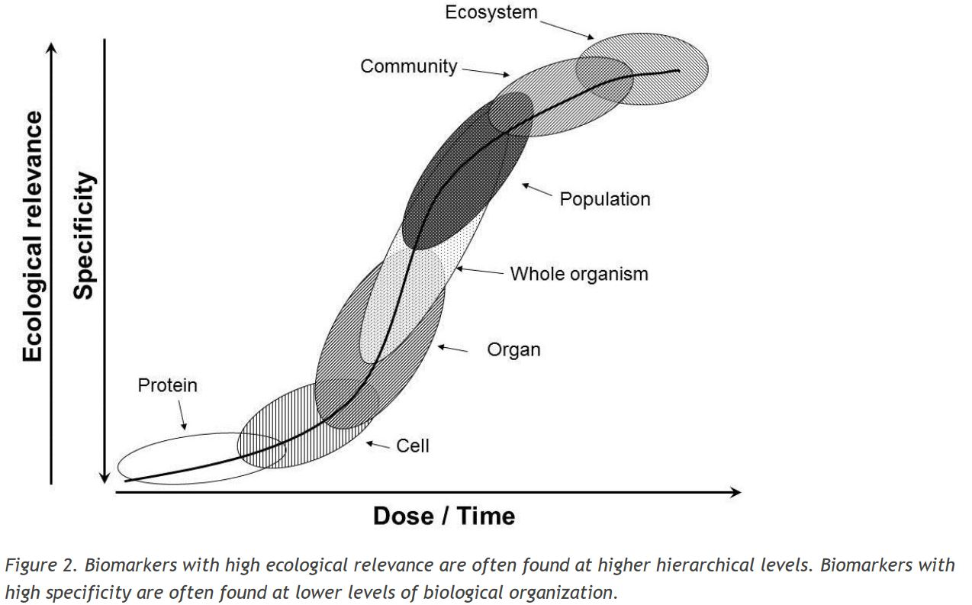
LATE EFFECTS
Impairment of
Ecosystem functioning: - trophic webs
- ecosystem services
- nutrients cycles
Changes in composition, decrease in biodiversity
Changes in composition, age distribution, reduced reproduction, etc.
Impaired signalling, expression and transduction
Health, behaviour, morphology
Altered physiology
Molecules
early EFFECTS
Impaired/altered metabolic functioning, homeostasis, growth and reproduction

Slide 25
The categories characterizing this complex figure (cell, organ, population etc.) are unified by a basic concept of our discipline, Biology.
Which one???
It is the concept of species.
In a time in which the term «biodiversity» in used everywhere, surprisingly, many scientists show a certain difficulty in using explicitly this term. The word «organism» has become progressively more frequent in the literature instead of «species», and is used as an alternative to it, but also to «individual».
Now, the concept of species, with its name («scientific name», actually the binomial name with its contradictions) is a powerful instrument to get top quality scientific information from the literature (the scientific literature).

Slide 26
Another important point is that biologists and naturalists should be the first to apply, use and defend the concept of species, because we are the «specialists» who can decide what is a good species, and we know how to handle all the rules behind its name, we should have the knowledge to correctly identify them (quite a difficult task, sometimes!), and find them (=to sample them).

