Slide 1
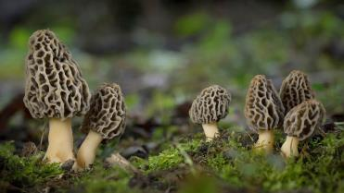
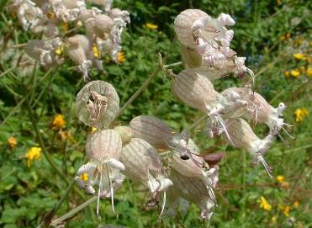
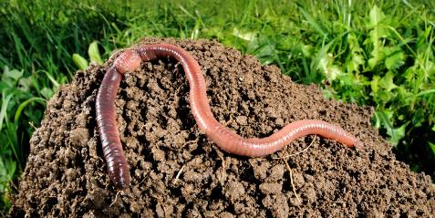
Organisms? Better species…
Spugnòla
Erba di Sileno
Sclopit
Grisol
Schioppettini
…
Lombrico

Slide 2
Organisms? Better species…
Spugnòla
Morchella esculenta (L.) Pers.
Erba di Sileno
Sclopit
Grisol
Schioppettini
Silene nutans L.
Lombrico
Lumbricus terrestris L.

Slide 3
What can you find in the web by typing the
common name and what by typing the scientific name?

Slide 4
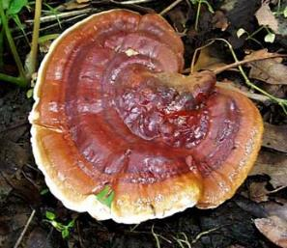
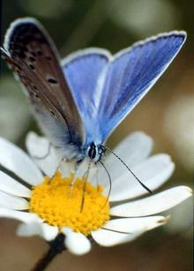
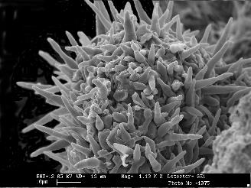
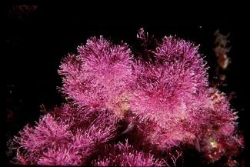
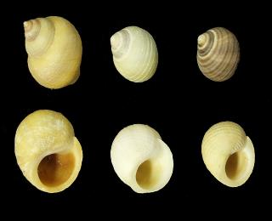
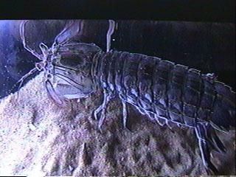
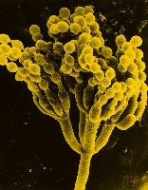
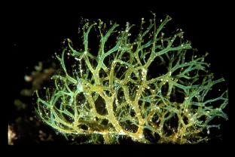

Slide 5
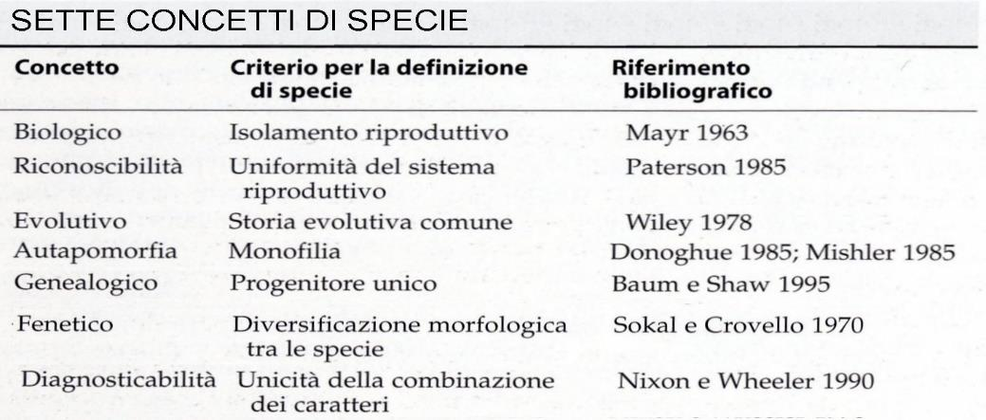
At least seven different SPECIES concepts apply in Biology
A
B
C
A = Biological/reproductive concept
C = Morphological concept
B = Evolutionary concept

Slide 6
This BIOLOGICAL concept of species emphasizes the importance of populations of individuals interconnected by genetic exchanges that occur following sexual reproduction, and which give rise to unlimitedly fertile offspring.
The guiding criterion is therefore the REPRODUCTIVE ISOLATION of the species compared to other species.

Slide 7
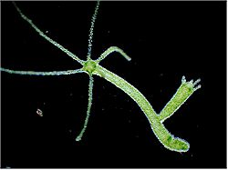
Sexual reproduction:
FUSION OF GAMETES (reproductive cells: e.g. egg cell + sperm)
Vegetative propagation:
From the name it is clear that it is particularly frequent among plant organisms.
budding (e.g. in Hydra, but also in yeast cells);
division or fragmentation of the individual mother;
production of vegetative propagules;
production of structures such as stolons, bulbils, rhizomes, etc.
“apomixis””
Inapplicability for extinct organisms

Slide 8
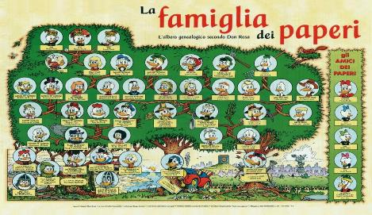
"phylogenetic" or "evolutionary" species concept
"A species is a single lineage of populations formed by progenitor-descendants that is distinct from other lineages and which has its own evolutionary tendencies and a well-defined historical destiny."
Simpson 1951, 1961; Wiley, 1978
This broad definition is intended to define species in terms of evolutionary processes and has the advantage of including both living and extinct organisms, regardless of their reproductive modes.
This definition finds strong support from phylogenetic reconstructions based on genetic analysis

Slide 9
This definition of species has relatively recent roots: the idea of ​​evolution appeared towards the second half of the 17th century, and only after the second half of the 19th century was it widely accepted. In previous times, on the contrary, it was believed that species were IMMUTABLE, having been created by God. Linnaeus himself, the most important systematist of the 18th century, and the young DARWIN supported the idea of ​​the FIXITY of species.
The strongest objection concerns the fact that this concept is difficult to use when trying to identify species in nature, because the criteria - "evolutionary trends" and "historical fate" are at best vague and difficult to know.

Slide 10
The concept of "morphological" species
It is the basis of the oldest and most frequently used method for recognizing species; it is the one used daily by all of us.
"The smallest set of natural populations permanently separated from others by a distinct discontinuity of character."
Du Rietz 1930; Cain 1954; Mayr 1963; Shaw 1964

Slide 11
Problematic aspects of this species definition:
1) The comparative criteria underlying this species definition may not reflect the actual phylogenetic relationships between organisms (A and B are similar in those characters, but may NOT even be related [lookalike experience]).
2) The application of this definition leads, for example, to underestimating the frequency of the so-called CRYPTICAL species ("hidden" species), so defined because they are morphologically almost indistinguishable, often coexist in the same territory, but are genetically isolated from each other due to, for example, of a different reproductive biology.

Slide 12
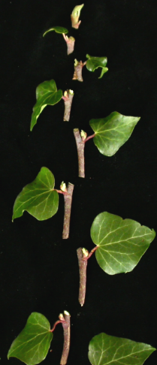
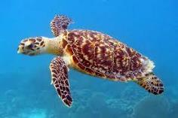
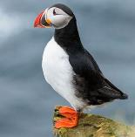
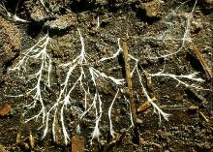
Individual
Treccani:
The term individual (from the Latin individuus, "undivided, indivisible", composed of in- and dividuus, "divided", which corresponds etymologically to the Greek ἄτομος, composed of ἀ- privative and stem of τέμνω, "to cut") indicates every single entity as distinct from others of the same species.
In biology, an individual means any animal or plant organism, uni- or multicellular, which cannot be divided without (at the same time) losing its own structural and functional characteristics.
That is, every animal or plant organism, uni- or multicellular, which if divided would lose its own structural and functional characteristics.
Unitary organisms
Modular organisms
Is it always valid?

Slide 13
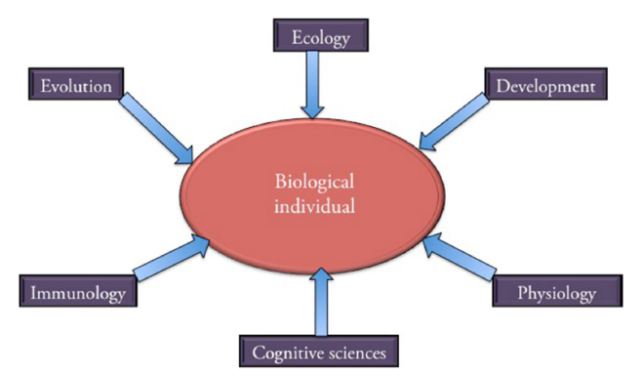
Individual
An accepted unifying concept/definition of biological individual does not exist
Many of the papers gathered in this special issue are interested in the monism–pluralism debate. Should we adopt several individuality criteria, or should we favor one criterion—and if so which one and with which arguments? Should we ground our concept of individuality in several biological domains or in one given domain—and, here again, if we opt for the monistic choice, on what basis should we do so?

Slide 14
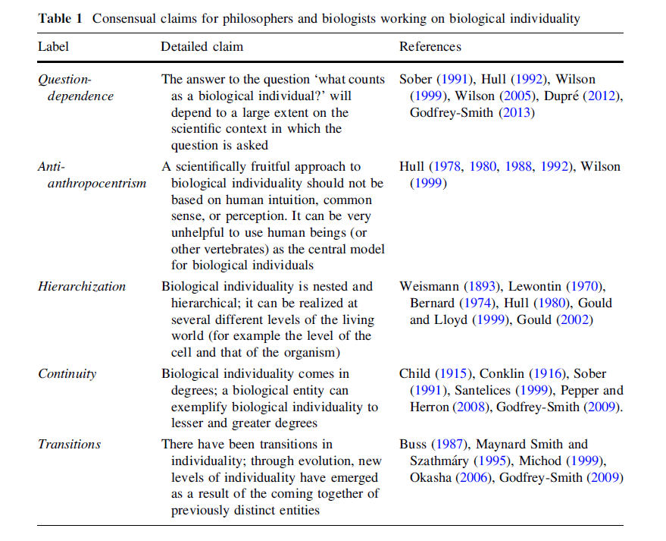

Slide 15
Population
A group of individuals of the same species that occupies a certain area in a certain time interval
The individuals of a population are interfertile/interfecund and, therefore, they share a common gene pool.
The reference to a defined spatial limit is implicit, e.g. the population of Arnica montana L. of the Bivera Mt.
It is subject to changes over time, e.g. the Italian population after the Second World War was different from today’s population.

Slide 16
The interactions among individuals and the environment generate new properties typical of group of individuals and, thanks to them, the triggering of control and autoregulation processes occur.
The most important are:
Abundancy of individuals in a population
The spatial distribution of individuals
The demographic structure
The genetic composition
Very variable over time
The group composition changes due to births, deaths and movement of individuals, etc.
Population Ecology
Measuring these properties over time in nature means taking pictures of the population that will need to be contextualized with the time-corresponding environmental conditions.

Slide 17
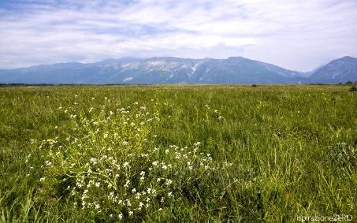
Community
The community is defined as a group of indiduals belonging to different species who occupy a determined area and interact between them directly (e.g. predator – prey; symbioses; plant-pollinators) or indirectly (competition for resources).
Stable meadow (magredo)
Garden
A stable community is an association of populations of species sharing similar ecological requirements in an environment characterized by stable ranges of abiotic factors that have reached equilibrium spontaneously.

Slide 18
The stable community is thus our reference as it is the repository of information of the normal sinecology of that association of species.
Sinecology: chapter of general ecology, animal or plant, which deals with the relationships that exist between the environment and groups of species and individuals, such as communities
Disturbances of the abiotic or biotic factors characterizing the «X» community might result in a change of the community equilibrium, resulting in impairments of populations of species -> decrease in individuals and in the worst case, biodiversity loss.
Monitoring over time and space the community structure could give us the means to identify ongoing changes caused by unknown disturbances
Identifying the cause requires a strong knowledge of the species comprising the community especially in their auotoecology and sinecology
Autoecology: Chapter of animal or plant ecology which, in opposition to synecology, investigates the relationships between the environment and a species, a race or other systematic category; or between the environment and single individuals, regardless, as far as possible, of the relationships that are established between the groups investigated and other systematic groups and individuals.

Slide 19
Back to species!
Species Ecological Niche:
Ecological niche is a term for the position of a species within an ecosystem, describing both the range of conditions necessary for persistence of the species, and its ecological role in the ecosystem. Ecological niche encloses all of the interactions between a species and the biotic and abiotic environment.
Hutchinson (1957) expressed this concept to represent it "mathematically": Niche is an "n-dimensional hypervolume", where the dimensions are environmental conditions and resources, that define the requirements of an individual or a species to practice its way of life, more particularly, for its population to persist. The "hypervolume" defines the multi-dimensional space of resources (e.g. light, nutrients, structure etc.) available to (and specifically used by) organisms, and "all species other than those under consideration are regarded as part of the coordinate system".

Slide 20
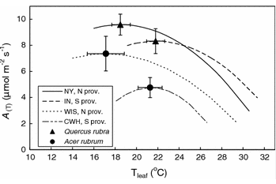
To describe the species niche, we need to describe the species answer to a number of abiotic and biotic factors.
PLANT SPECIES
ECOLOGICAL FACTORS (biotic and abiotic)
Following a typical physiological approach, the response of a plant to single factors, or combination of factors is investigated, typically with measurements that are carried out in the lab, in highly artificial conditions, on a number of individuals; the results are used to interpret e.g. the answer to specific abiotic factors (e.g. light, temperature) stressors (e.g. drought, nutrients), inferring the effects in terms of distribution limits of the species, or the survival ability of that species vs. other species.

Slide 21
An ecophysiological approach is applied when the measures are carried out directly in the field, under natural conditions, and from its results, more sound-based implications on the competition performance can be derived, particularly if more species of the same community are directly compared.
However, ecologists were able to overturn the perspective, i.e. to derive environmental relevant information from the presence of species whose precise ecological requirements are known.

Slide 22
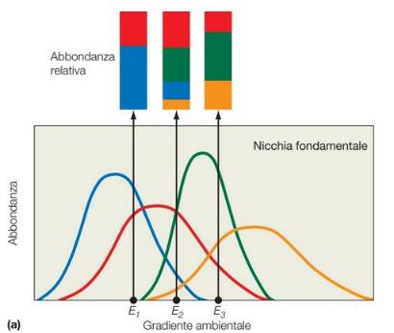
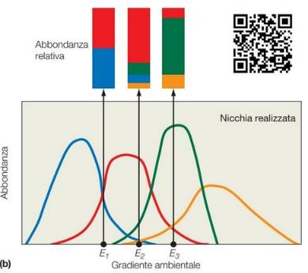
An organism free of interference from other species could use the full range of conditions (biotic and abiotic) and resources in which it could survive and reproduce which is called its fundamental niche.
As a result of pressure from, and interactions with, other organisms species are usually forced to occupy a niche that is narrower than this (i.e. inter-specific competition), or larger (i.e. facilitation and mutualism) and to which they are mostly highly adapted; this is termed the realized niche, whereas the fundamental niche describes the performance in monoculture.

Slide 23
The comparison of the answer to the single ecological factor allows to recognize steno- and eurioecious species, and to define the ecological optimum for that single factor.
30
90
180
300
900
1800
µmol photons m⁻² d⁻¹ x 86,400

Slide 24
The following step is to attribute a value in an arbitrary ordinary scale to represent numerically this.
30
90
180
300
900
1800
µmol photons m⁻² d⁻¹ x 86,400
According to the optimum
Single ecological factor: e.g. light
Species 1: 1-(2)
Species 2: 2-3
Species 3: 3-4
Species 4: 3-5
Species 1: 1
Species 2: 2
Species 3: 3?
Species 4: 4
1
2
3
4
5
Plant species are assigned so-called ecological indicator values (EIVs) on ordinal scales based on the “optima” or “centres” of their realised ecological niches along given environmental gradients (niche dimensions).
Direct lab or field measurements are not available for all the species, but EIVs of species x can be inferred from that of species y if the two species occur together in the same plant communities.

Slide 25
The idea of using the presence of plants to assess site conditions by qualitatively matching the most probable occurrence of plant species with environmental conditions was originally introduced to vegetation ecology by Cajander (1926) and Iversen (1936).
Subsequently, Ellenberg (1950a, 1950b, 1952) introduced the first explicitly quantitative approach within an agricultural context, to specify quantitatively the needs of specific crops for e.g. nutrients and temperature.
Later on, Ramensky et al. (1956) for the European part of the former USSR and Ellenberg (1974) for Central Europe, proposed comprehensive EIV systems for the wild vascular plants of larger territories.
Ramensky et al. (1956) published indicator values for grazing intensity, soil moisture and a combination of soil fertility and salinity.
Ellenberg (1974; new edition by Ellenberg et al. 1991) covered seven ecological variables: light regime, temperature, continentality, moisture, reaction (pH), nutrient status and soil salinity.

Slide 26
Ellenberg's indicator values were the first model of bioindication proposed and applied to the flora of Central Europe, and they have a long tradition in interpretation and understanding of plant communities and their evolution.
The latest edition of Ellenberg's indicator values applies a 9-point scale for each of seven gradients:
R - reaction (soil or water acidity/pH);
N - nitrogen (but really soil fertility or productivity, and not mineral nitrogen; perhaps better «soil nutrients»)
F - soil humidity or moisture
S - salt (soil salinity)
K - climatic continentality
L - light availability
T - temperature
ATTENTION! Since 1997, the term has also been used to refer to Dufrêne & Legendre's indicator value, which is a quantitative index measuring the statistical alliance of a species to any one of the classes in a classification of sites. In this context we can neglect this second definition, of scarce value for us.

Slide 27
The high utility of these indicator values led to an expansion to other regions, with more than 30 EIV systems being published so far. E.g., indicator values were published in 1977 for Switzerland (Landolt’s Indices), Great Britain (Hill and coworkers), France and several other national or regional floras.
Some of the more recent EIV systems not only expanded the approach to new regions, but also added other taxonomic groups (e.g. bryophytes, lichens), other niche dimensions (e.g. mowing tolerance, hemeroby, CSR strategy, organic content of the soil, soil texture) or assessed niche width in addition to niche position.
Very recently, new systems with a focus on Europe as a whole have been published: Hájek et al. (2020) published niche position, minimum and maximum for hydrological parameters for a comprehensive set of vascular plants and bryophytes occurring in mires, while Midolo et al. (2023) derived a set of five disturbance indicators for more than 6,000 European vascular plants. Recently, Tichý et al. (2023) presented a harmonized dataset of six of the original Ellenberg indicator values for almost 9,000 European vascular plant taxa.

Slide 28
Indicator values are widely applied in vegetation science and global change studies. They are suitable to indirectly assess environmental conditions and the drivers of observed vegetation differences in time or space (see review by Diekmann 2003).
The use of «ecological indicator values» is widespread, representing a useful instrument for an indirect characterization of the environment on the basis of the information provided by the species present in a specific area, community or habitat. E.g., to assess the site conditions of a vegetation plot or a plant community, the EIVs of all species present in that plot or community can be averaged for each niche dimension of interest.
EIV are particularly useful for checking the variation on both local and national scale, if the data source (vegetation data, list of species, and EIV themselves) are «robust».

Slide 29
In favour of EIVs….
Several factors can explain the success of their application. First, environmental variables may fluctuate strongly in time and space (e.g. Sercu et al. 2017), making one-time measurements scarcely representative of average conditions or critically limiting extremes (Shipley et al. 2017). Thus, the appropriate assessment of environmental variables often requires repeated measurements (not feasible in many projects) or is costly if to be done across numerous plots. Additionally, measurements obtained at different times and with different techniques and equipment may not be directly comparable.
In contrast, the plant species composition of a site is an expression of the species’ responses to the prevailing environmental conditions integrated across the study area (e.g. a plot) over longer time periods (several months to several years). Therefore, bioindication using EIVs offers a less time-consuming and cheaper alternative to the direct measurement of local environmental variables.
Finally, most historical vegetation data do not contain measurements of environmental data.
The ability to reconstruct past environmental conditions from historical relevés or floristic occurrence data can thus be very valuable in assessing trends in environmental change and their effects on biodiversity.

Slide 30
Against EIVs…
The use of EIVs have also been criticised.
One line of criticism holds that indicator values have been assigned to plant species mainly based on expert judgement, rather than on accurate measurements.
Secondly, although large regional differences in the niches of species have been demonstrated, EIVs have often been applied outside the region for which they were developed. This could potentially lead to misinterpretations, but also explains why so many authors proposed their own EIVs for their specific area of interest.
Another line of critique has warned against averaging indicator values and subjecting them to parametric statistics, since they were defined on ordinal scales. However, analysing mean EIVs does not lead to statistical issues, since the arithmetic means of values of any distribution per se follow a normal distribution.
Ewald (2003) demonstrated the robustness of the correlation of weighed mean of EIVs with environmental measurements, even when species lists were incomplete

Slide 31
One time more, being based on species, the correct identification of species is of paramount importance.
However, the more than 30 national and regional EIV systems lack consistency in scaling and coding of the ecological indicators, as well as in plant nomenclature, impeding analyses at the continental scale.
These issues have partly been solved by the recently published pan-European EIV systems (Hájek et al. 2020; Midolo et al. 2023; Tichý et al. 2023) but their coverage of indicators and taxa, respectively, is far from complete. Thus, there is still an urgent need for an integrated and comprehensive EIV system for Europe.
Very recently (2023), Dengler et al. published «Ecological Indicator Values for Europe (EIVE) 1.0», a consistent ecological indicator value system for Europe for five of the main plant niche dimensions: soil moisture (M), soil nitrogen (N), soil reaction (R), light (L) and temperature (T).
They rescaled the indicator values of each dimension to a continuous scale, in which 0 represents the minimum and 10 the maximum value present in Europe.
Taxon names were harmonised to the Euro+Med Plantbase.
For each of the five dimensions, European values for niche position and niche width were calculated by combining the values from the individual EIV systems.
Using T values as an example, we externally validated our European indicator values against the median of bioclimatic conditions for global occurrence data of the taxa.

Slide 32
In total, the Authors derived European indicator values of niche position and niche width for 14,835 plant taxa.
The newly developed Ecological Indicator Values for Europe (EIVE) 1.0, together with all source systems, is available in a flexible, harmonised open access database.
For more detail: https://vcs.pensoft.net/issue/4448/

Slide 33
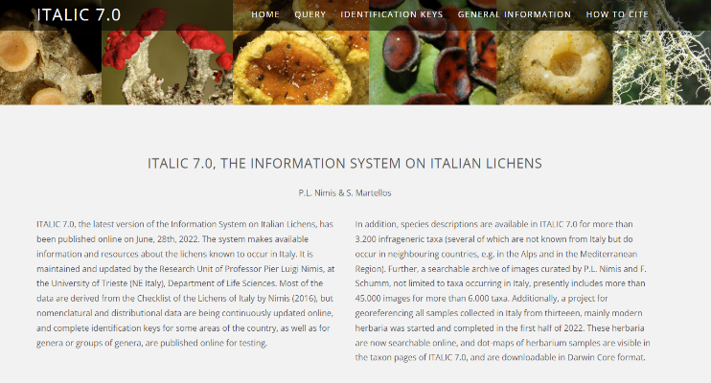
Examples of other datasets:
Italic 7.0, the information system of Italian lichens (https://italic.units.it/index.php)

Slide 34
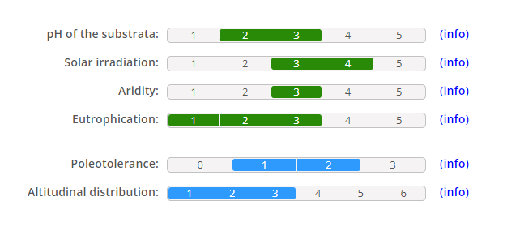

Slide 35
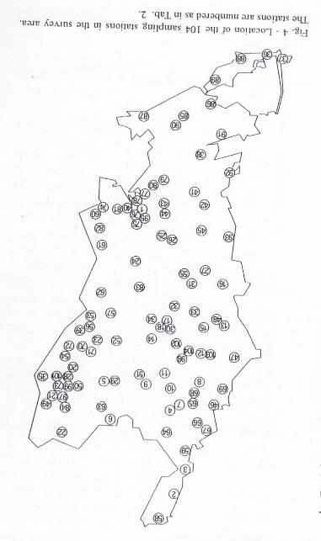
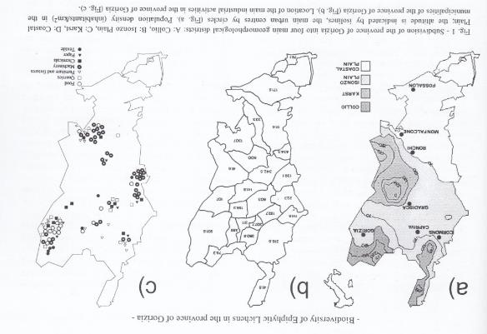

Slide 36
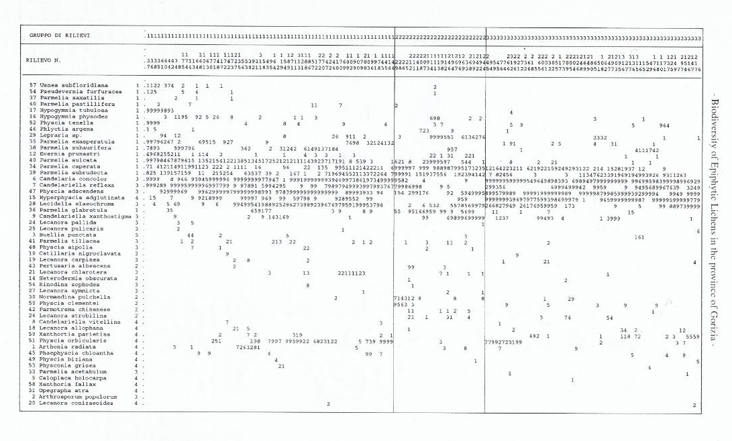
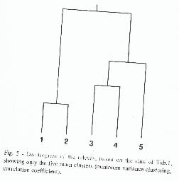

Slide 37
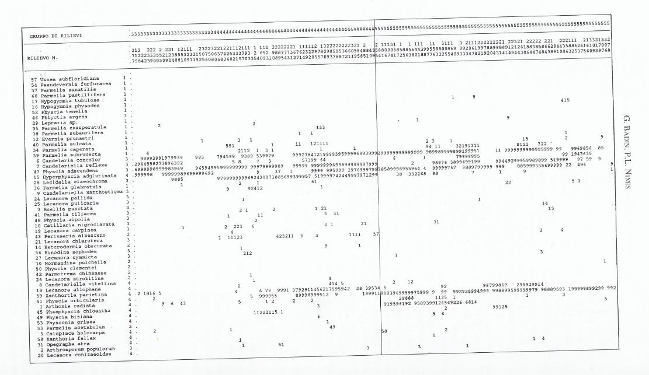

Slide 38
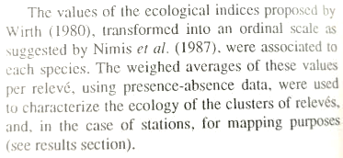
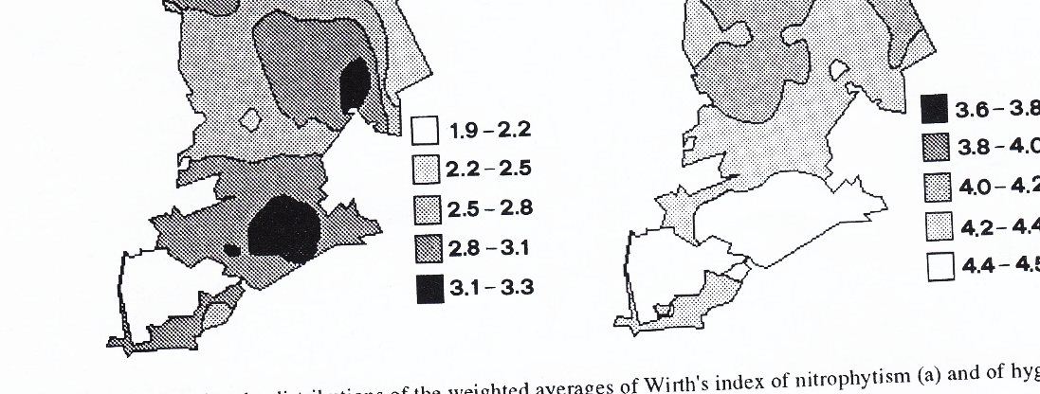

Slide 39
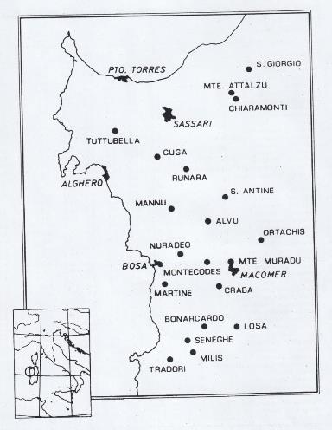
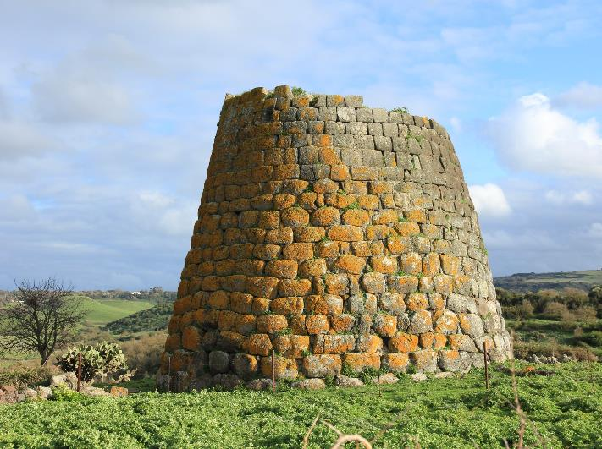
Not all EIVs have been given on the basis of an expert’s assessment…
N
S
Nuraghe Nieddu, Codrongianos

Slide 40
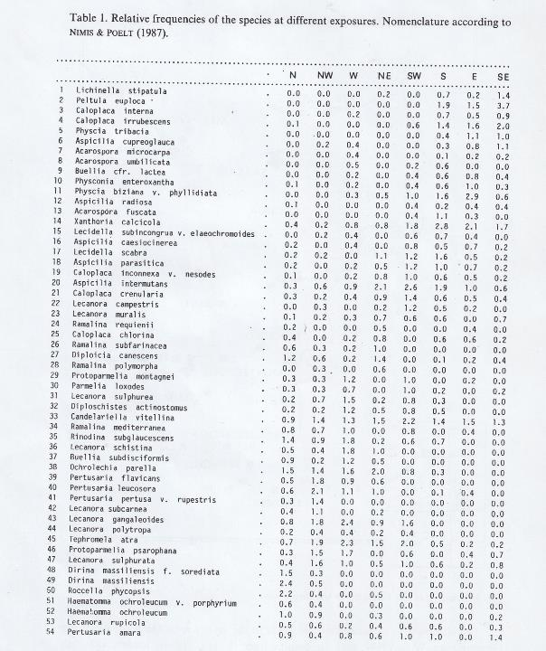
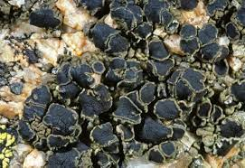
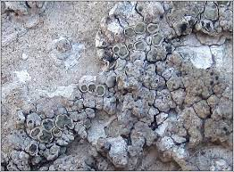
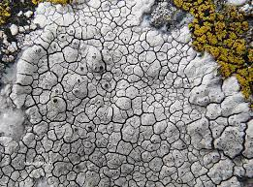
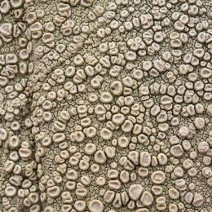
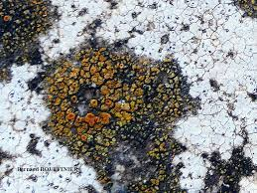
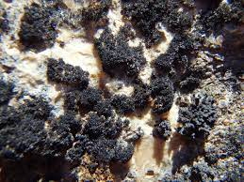

Slide 41
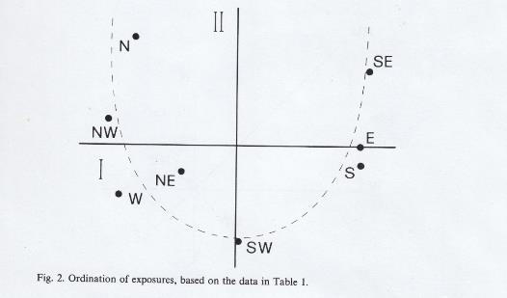
Dendrogram of species, to identify groups of species with similar frequencies at different aspects (N, NE, E, SE etc.)
Ordination of exposures (on a floristic basis)
0
Similarity
1

Slide 42
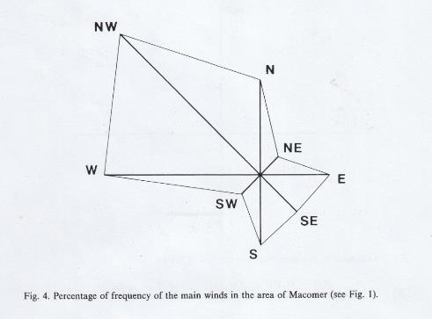
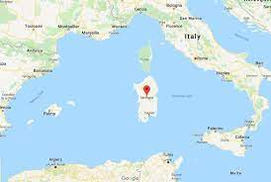

Slide 43
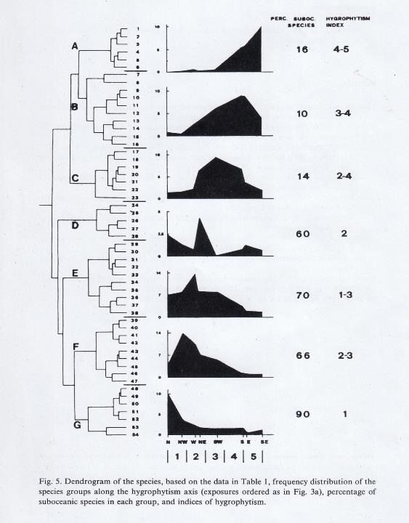

Slide 44
After such premises, we must discuss why we want to make use of biomonitoring techniques, based on organisms, to characterize or detect or predict possible environmental changes. The discussion is open…

