Slide 1

Economic Geography
2 – Location theories: the Von Thunen Model
121EC
A.Y. 2024/2025
Dr. Giuseppe Borruso
Department of Economics, Business, Mathematics and Statistics
University of Trieste
E-mail. giuseppe.borruso@econ.units.it
Ph. +39 040 558 7008
Skype: giuseppe.borruso
Notes:
Slides with (*) in footnotes have been modified from Jean-Paul Rodrigue materials. (see copyright). I have modified and elaborated materials in order to be suitable for the current course.
Copyright © 1998-2010, Dr. Jean-Paul Rodrigue, Dept. of Global Studies & Geography, Hofstra University. For personal or classroom use ONLY.

Slide 2
Learning Objectives
In this lesson we will:
  Revise the importance of models in economic geography
  Introduce the simplifying assumptions and hypothesis of most location models
  Describe the Von Thunen model of agricultural organization

Slide 3
Topics
Location theories:
  Spatial organization of Agriculture
  Market and location of services
  The location of industries
  Human settlements =>
Retail and transport Geography
Geodemographics – GIS & Retail Geography
Notes:
Diparimento di Scienze Geografiche e Storiche - Introduzione ai GIS
3

Slide 4
Geographical models and the study of human space (1/2)
Replay
Model = an idealized representation of the real world, built to present some properties (social and economical phenomena).
Models become necessary as reality is complex

Slide 5
Geographical models and the study of human space (2/2)
Replay
Economic geography contributed to implementing theories based on the use of the geographical space and on criteria that orientate the location of human settlements and production activities
=>
how humans transform their environment to satisfy their needs
In time Geography and Economics reduced space to its essentials, by which analyse to understand the dynamics of an organized system (settlements or production).
Economic geographers simulated reality from empirical observations in order to understand and explain the complexity of the geographical space.
The simplification become a geographical economical model, based on inductive research (top down) rather than the micro and macro approach proper of economics.
First geographical economical models and the economical ones share schematic and simplified representations of reality and the reduced number of elements of reality (new geography and quantitative geography).
A model as a simplified description of reality to represent social and / or economical phenomena.
The models to be examined will focus on the localisation of :
  Agriculture
  Industry
  Services (including transport)
  Human settlements

Slide 6
Rent: Ricardo vs Von Thunen
David Ricardo
von Thünen
differences in productivity between two pieces of land, using same capital and technology
importance of differences in distance to markets and thus of transportation costs
Notes:
Diparimento di Scienze Geografiche e Storiche - Introduzione ai GIS
6
(*)

Slide 7
Key Principles of Ricardo's Theory
Land as a Fixed Factor: Ricardo recognized that land, unlike labor or capital, was a fixed factor of production. This means that the quantity of land available for cultivation was limited and could not be increased significantly in the short run.
Differential Productivity: Ricardo assumed that different plots of land had varying levels of fertility. Some land was more productive than others, yielding higher crop yields per unit of input.
Intensification of Cultivation: As population grew and demand for food increased, farmers would intensify cultivation on the most fertile land. This involved using more labor, capital, and other inputs to extract maximum output from the land.
Marginal Land: Eventually, as demand for food continued to rise, farmers would be forced to cultivate less fertile land, known as marginal land. This land would require more inputs to produce the same level of output as the more fertile land.
Rent as a Surplus: Ricardo argued that the rent of agricultural land was determined by the difference in productivity between the most fertile land and the least fertile land required to produce a given quantity of food. This difference represented a surplus value that could be extracted by the landowner.
Rising Rent with Population Growth: As population grew and demand for food increased, the marginal land brought into cultivation would become less fertile. This would lead to a rise in the rent of the more fertile land, as the difference in productivity between the most fertile and least fertile land would widen.

Slide 8
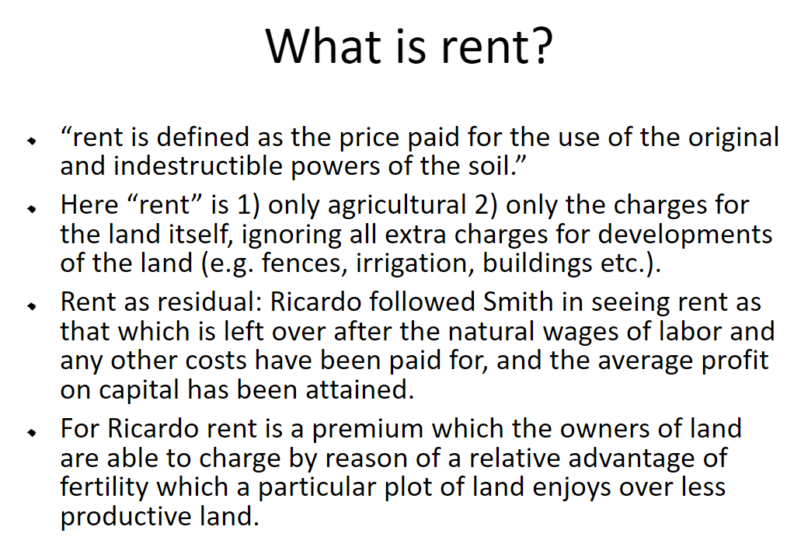

Slide 9
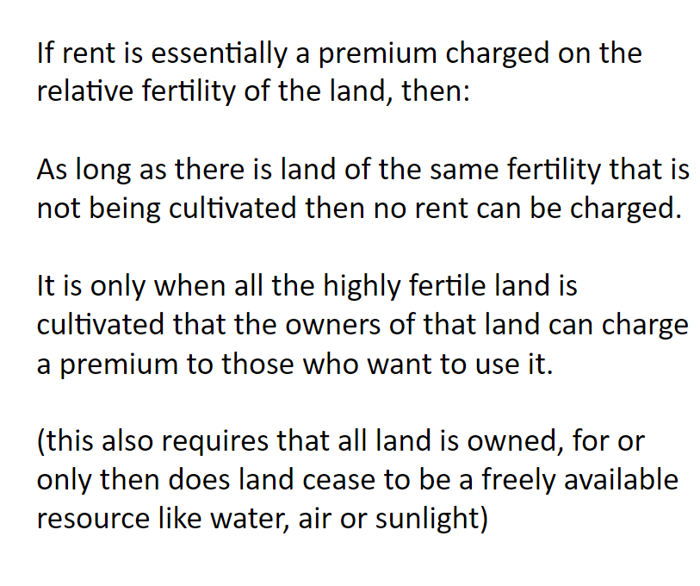

Slide 10
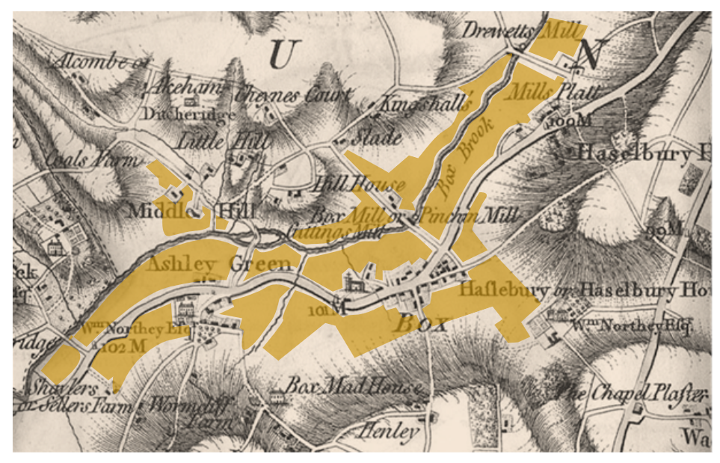
The Corn Laws and the extension of cultivation

Slide 11
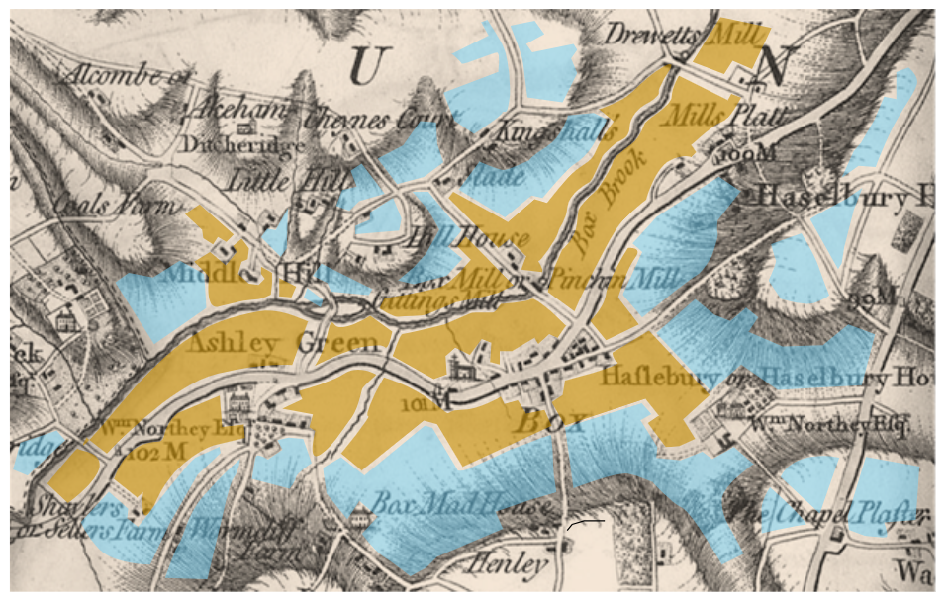
The Corn Laws and the extension of cultivation

Slide 12
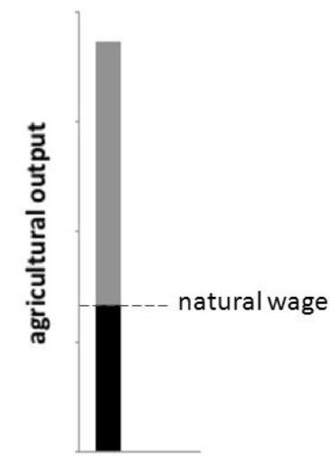
Rent in terms of agricultural output
One portion of this output will go to reproducing the agricultural workers at the level of subsistence or the “natural wage.”
The rest is the “surplus product” which will be divided between the landlord's rent and the capitalist farmer’s profit.
What determines the division of this surplus product?
Ricardo’s theory of the equalization of the rate of profit implies that capitalist farmers will not be able to consistently make more than the average rate of profit.
If the landlord demands a rent so high that the capitalist farmer cannot make the average rate of profit then no capitalist will rent the land.
Yet if the capitalist demands a rent so low that she makes more than the average rate of profit then the landlord will easily be able to find other capitalists who will rent the land for less
Therefore rent will tend to be set just high enough for the capitalist to make the average rate of profit.

Slide 13
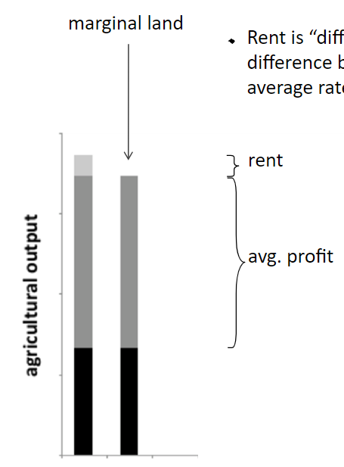
Marginal Land
Rent is “differential” for Ricardo because it is defined as the difference between the total surplus agricultural product and the average rate of profit in the economy as a whole.
    Land of less fertility will be cultivated as long as its surplus product is at least as much as the average rate of profit.
    Ricardo calls this land the “marginal land” since it is the least fertile land which is profitable to cultivate.
    Because rent is the difference between the total surplus product and the average rate of profit, the marginal land may be defined as the “land which yields no rent.”
    Less fertile land will not be profitable to cultivate unless the average rate of profit falls relative to the prices of the agricultural output.
    One way this may happen is if the population rises, driving up food prices and drawing more capital into agriculture.
    This will lead to land of less fertility being brought under cultivation

Slide 14
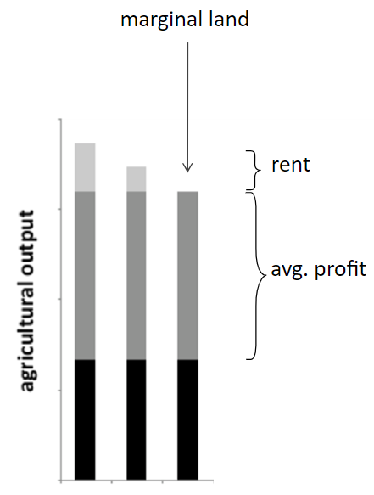
Marginal Land
The productivity of the capital invested in this newly cultivated land will be less than the capital previously invested in agriculture.
Since all surplus on other lands above the level of the marginal land is taken by landlords as rent, the extension of cultivation has the effect of driving down profits on all land.
Rising agricultural prices may mean that the total product of the new marginal land is equal in value to the total product of the previous marginal land. However, since the natural wage is fixed by the costs of subsistence it will absorb a larger proportion of this value and the relative share of profits will be diminished in terms of both physical output and value.
Rising agricultural prices due to the increased difficulty of agricultural production will cause wages to rise in all other sectors as capitalists will have to pay their workers more in order to maintain them at a subsistence level.
This will cause profits to decline in all sectors of the economy.
Also, if the population continues to rise, increasing the demand for agricultural goods, a greater and greater proportion of total capital will flow into the agricultural sector and the diminishing productivity of capital in agriculture will increasingly regulate the average rate of profit.

Slide 15
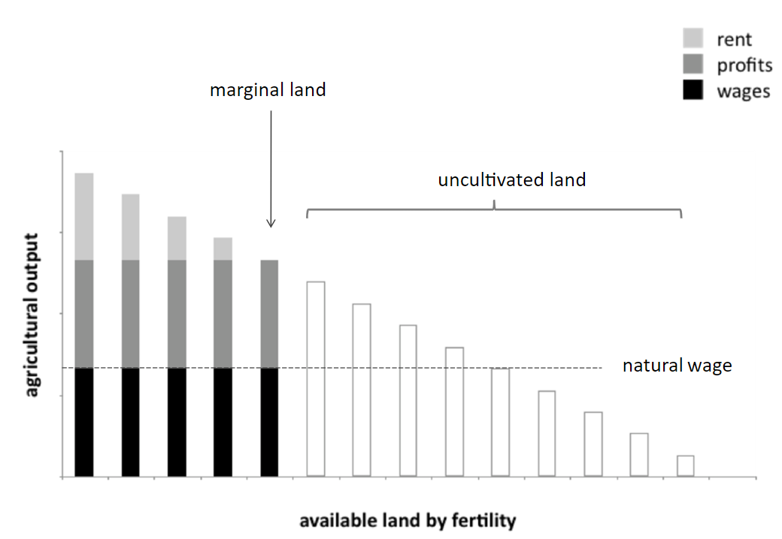

Slide 16
Implications of Ricardo's Theory
Distribution of Income: Ricardo's theory suggested that as population grew and economic development progressed, the share of income going to landowners would increase relative to the share going to workers and capitalists.
Land as a Source of Economic Power: The theory implied that landowners, who controlled the most productive land, would have significant economic power and influence.
Policy Implications: Ricardo's theory was used to argue for free trade in agricultural products. He believed that free trade would reduce the rent of land by increasing competition and lowering food prices.
Ricardo, David. Principles of Political Economy and Taxation. London: John Murray, 1817.

Slide 17
David Ricardo on Economic Rent
Economic rent on land is the value of the difference in productivity between
a given piece of land and the poorest piece of land (or the land most distant from the market)
producing the same goods (bushels of wheat) under the same conditions (of labour, capital, technology, climate)
Essence of argument: wide differences in production and marketing costs between the best and worst lands called into production to feed a given population
Productivity of agricultural land defined by:
  the natural fertility of the soil: as utilized by given technology and stock of capital
  the distance from the market in which the grains (or other agricultural goods) are sold
  the productivity differences involve the costs of both producing and marketing the grains in a given market.

Slide 18
Location theories
Different models adapted to different kinds of activities
Similar starting points
From simplified models to more complex ones
Hypothesis – generally a common starting point for the different models:
  Homogeneity and isotropy of space
  (no differences in morphology of space; no transport asymmetries; ecc.)
  Fertility of land is homogeneous – if a rent exists, it depends on transport costs based on distance
  Perfect competition (same price throughout the market; freedom of movements of factors of production; no transport costs)

Slide 19
Location theories (Agriculture)
Von Thunen (1/2)
John Heinrich Von Thunen (Jever, Oldemburg – East Germany 1783 - 1850): agronomer
number of important and original anticipations of modern economic theory:
  concepts of economic rent,
  diminishing returns,
  opportunity costs,
  the marginal-productivity theory of wages
  a pioneer in the economic theory of location
Ricardo and Von Thunen recognized that differences in the cost of producing agricultural products result from utilization of land of different quality and location
Ricardo focused on differ­ences in soil fertility
Von Thunen focused in differences in land location
  recognized that those products that are bulky in rela­tion to value are more costly to transport than those that are less so and that some farm products cannot stand a long period in transit because of their perishability
Problem: devise the best (most profitable) system of land utilization

Slide 20
Key Principles of Thünen's Theory
Johann Heinrich von Thünen, a 19th-century German agricultural economist, developed a theory of location rent that focused on the spatial distribution of economic activities around a central city. His theory was primarily concerned with the factors that influenced the location of different agricultural activities and the rent paid for land in different locations.
Central City: Thünen assumed a central city as the focal point of economic activity. This city served as the market for agricultural products and other goods.
Land Use Rings: Thünen proposed a model of land use around the central city, where different agricultural activities were concentrated in concentric rings. The location of each activity was determined by the balance between the value of the product, the cost of transportation to the market, and the rent of the land.
Transportation Costs: Thünen emphasized the role of transportation costs in determining the location of economic activities. He argued that the profitability of different agricultural activities depended on the balance between the value of the product and the cost of transporting it to the market.
Location Rent: Thünen defined location rent as the difference between the value of a product produced on a particular piece of land and the cost of producing and transporting it to the market. Land with a higher location rent would be more valuable and command a higher price.
Land Use Patterns: Thünen's model predicted the following land use patterns:
  Intensive Agriculture: Activities with high value-to-weight ratios, such as dairy farming and horticulture, would be located closest to the city to minimize transportation costs.
  Extensive Agriculture: Activities with low value-to-weight ratios, such as grain production and livestock raising, would be located farther from the city, where land was cheaper and transportation costs were less significant.
  Forestry: Forests would be located at the outermost ring, where land was least valuable and transportation costs were highest.

Slide 21
Location theories (Agriculture)
Von Thunen (2/2)
John Heinrich Von Thunen (Jever, Oldemburg – East Germany 1783 - 1850): agronomer
1826: The isolated state
  Effects of a unique urban central market on the distribution of cultivations in a homogeneous space
  accessibility to the market (town) can create a complete system of agricultural land use.
Assumptions:
  The city is located centrally within an "Isolated State" which is self-sufficient and has no external influences.
  A large town (market) is situated in the center of a fertile plain that has neither canals nor navigable rivers
  Means of transport is a horse-drawn wagon or a similar
  All land within the plain is of equal fertility, and there are no other comparative advantages of production between plots
  At a considerable distance from the city, the plain ends in an uncultivated wilderness
  “isotropic plain” no site differences, no transportation barriers or roads
  “Isolated State” i.e. no trade with other communities
  all farmers receive the same marketplace price for the same crop at a given time
  all farmers seek to maximize profits, and they all have perfect information
  there is only one form of transportation (which is also uniform across the plain)
  the cost of transportation is directly proportional to distance (e.g. $x per mile)
  =>
Von Thunen hypothesized that a pattern of rings around the city would develop.
Concentric rings in a circular space with the market city at centre;
Rings are organized according to the production techniques of the time;
Positional rent articulates a physically uniform space in zones with specific land uses, corresponding to computable distances from the central place.
Notes:
The city is located centrally within an "Isolated State" which is self-sufficient and has no external influences.
The Isolated State is surrounded by an unoccupied wilderness.
The land of the State is completely flat and has no rivers or mountains to interrupt the terrain.
The soil quality and climate are consistent throughout the State.
Farmers in the Isolated State transport their own goods to market via oxcart, across the land, directly to the central city. Therefore, there are no roads.
Farmers act to maximize profits.

Slide 22
Von Thunen’s model of land use
The isolated state
Central market
Dairy & vegetables
forestry
Intensive crop rotation
Arable and pastures
Three-field crop rotation system
Extensive stock grazing
Notes:
Diparimento di Scienze Geografiche e Storiche - Introduzione ai GIS
22
(*)

Slide 23
Von Thunen’s model of land use
There are five rings of agricultural activity surrounding the city.
Dairying occur in the ring closest to the city.
  Since vegetables, fruit, milk and other dairy products must get to market quickly, they would be produced close to the city (no refrigerated oxcarts!)
Timber and firewood would be produced for fuel and building materials in the second zone.
  Before industrialization (and coal power), wood was a very important fuel for heating and cooking. Wood is very heavy and difficult to transport so it is located as close to the city as possible.
Intensive farming is located in the third zone
The fourth zone consists of extensive fields crops such as grains for bread.
  Since grains last longer than dairy products and are much lighter than fuel, reducing transport costs, they can be located further from the city.
The fifth zone occupies Three-field crop rotation system
Ranching is located in the final ring surrounding the central city.
  Animals can be raised far from the city because they are self-transporting. Animals can walk to the central city for sale or for butchering.
Beyond the fourth ring lies the unoccupied wilderness, which is too great a distance from the central city for any type of agricultural product.
Notes:
Diparimento di Scienze Geografiche e Storiche - Introduzione ai GIS
23
(*)

Slide 24

Von Thunen’s model of land use
Positional rent articulates a physically uniform space in zones with specific land uses, corresponding to computable distances from the central place.
Land uses given by
Where
  R_{p} = monetary rent of a unit surface in a given point p of the space [location rent per unit of land];
  R = physical rent of the same unit surface
  [yield per unit of rent];
  p = market price for each unit/weight of product at the marketplace
  [market price per unit of commodity];
  c = production cost at the location of growing
  [production cost per unit of commodity];
  t = transport cost per unit of distance between the growing location and the market
  [transport rate per unit of distance];
  d = distance between the point (growing location) from the market
The function becomes a line:
  y = a - bx
  With different parameters for each production in space.
  Zones derive from the crossing of different rent functions
  depending on a set of transport costs R_{i}t_{i}d

Slide 25
Von Thunen’s model of land use
Transport cost per unit
t_{a}
Transport
Costs
t_{b}
t_{c}
t_{d}
distance

Slide 26
Von Thunen’s model of land use the rent function
R_{a}
A
Rent
a: colture a
b: colture b
c: colture c
R_{b}
R_{c}
R_{d}
b
a
5
10
distance
c
 | R | p | c | t | d₀
a | 60 | 2.000 | 1.000 | 200 | 5
b | 50 | 3.000 | 2.200 | 80 | 10
c | 100 | 1.500 | 1.200 | 20 | 15
d | 50 | 2.000 | 1.600 | 50 | 8
=> D₁ = 2,5; D₂ = 5
Notes:
Diparimento di Scienze Geografiche e Storiche - Introduzione ai GIS
26

Slide 27
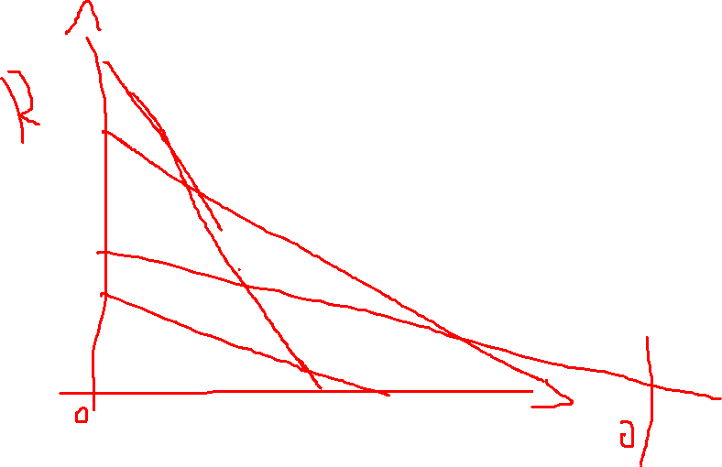

Slide 28
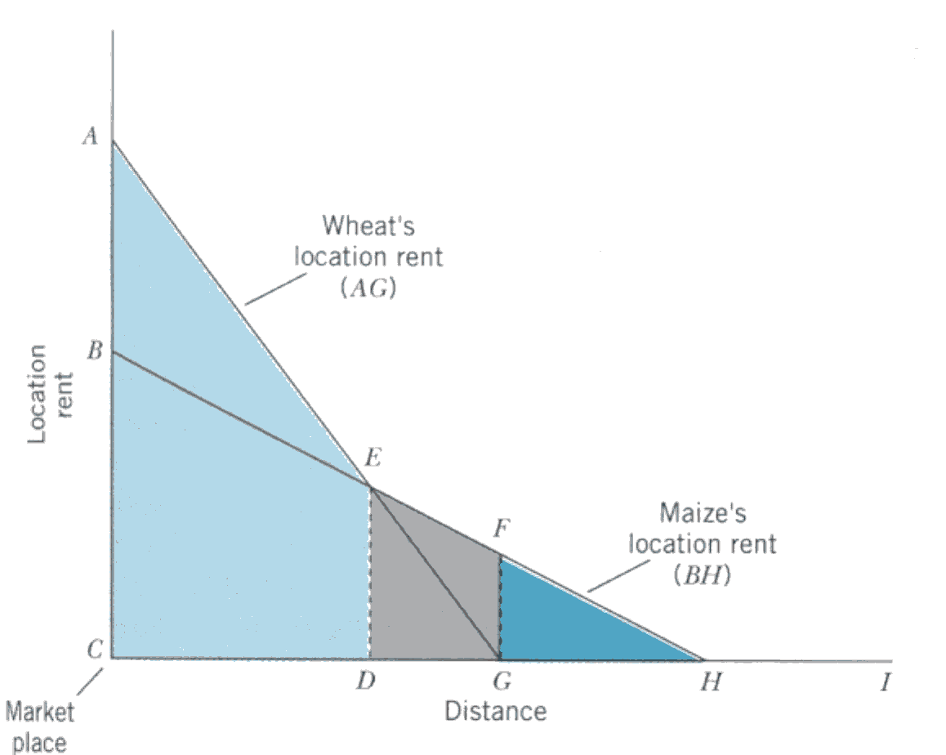
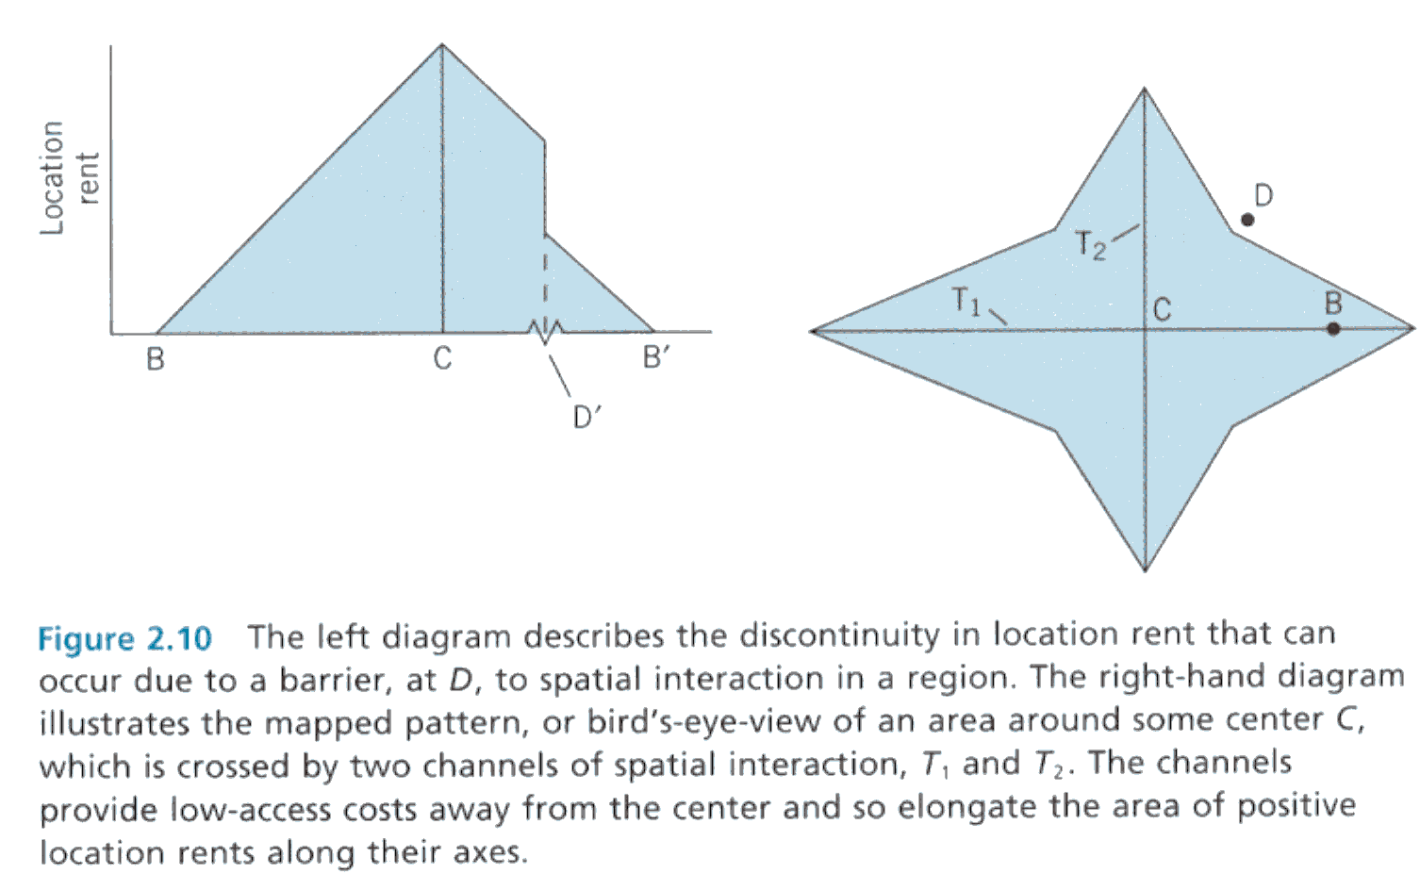
Notes:
Hanink (1997) Economic Geography, page 39 (a, b); page 54 (c)

Slide 29
Von Thunen’s model of land use
The isolated state
Modified conditions
Secondary market
Central market
River
dairy & vegetables
forestry
Intensive crop rotation
Arable and pastures
Three-field crop rotation system
Extensive stock grazing
Notes:
Diparimento di Scienze Geografiche e Storiche - Introduzione ai GIS
29
(*)

Slide 30
Implications of Thünen's Theory
Spatial Organization of Economic Activity: Thünen's theory provided a framework for understanding the spatial distribution of economic activities around cities. It explained why certain activities were located closer to the city while others were located farther away.
Land Values: The theory also explained why land values varied with distance from the city. Land closer to the city had higher location rents and, therefore, commanded higher prices.
Future applications (i.e., Bid Rent Theory) Urban Development: Thünen's model provided insights into the factors that influenced urban growth and development. It suggested that cities would tend to expand outward, with different land uses arranged in concentric rings.

Slide 31
Von Thunen’s model of land use applied to mainland USA
Forest
Dairy
Wheat
Dairy
Forest
Wheat
Corn and
Soybeans
Vegetables
Beef Cattle
and Sheep
Vegetables
Beef Cattle
and Sheep
Corn and
Soybeans
Cotton and
Tobacco
Specialty
Crops
Cotton and
Tobacco
Assumptions
1. New York City the only market
2. Crops ranked by rent paying ability
3. No terrain variation
4. Climatic variation considered
Specialty
Crops
Assumptions
1. New York City the only market
2. Crops ranked by rent paying ability
3. No terrain or climatic variation
A
B
Notes:
Diparimento di Scienze Geografiche e Storiche - Introduzione ai GIS
31
(*)
Stutz, R. and A. de Souza (1998), "The World Economy: Resources, Location, Trade and Development." Third Edition, Toronto: Prentice Hall. P. 268.

Slide 32
Von Thunen’s model: critiques and limits
SINCLAIR R., VON THÜNEN AND URBAN SPRAWL, Annals of the Association of American Geographers Vol 57 Issue 1, pages 72–87, March 1967
In explaining agricultural patterns near urban areas, Von Thünen's theory is generally applicable where the primary force determining the pattern is transport cost to the market.
=> the pattern of agricultural land use is one of decreasing intensity with distance from the city.
Von Thünen's theory still applies in underdeveloped parts of the world, but no more valid in developed areas.
In many advanced industrialized parts of the world, the basic forces determining agricultural land use near urban areas are associated with urban expansion.
Where these forces are in operation, the agricultural pattern quite often is one of increasing intensity with distance from the city, quite the reverse of the pattern generalized by Von Thünen's theory.

Slide 33
Von Thunen’s model: critiques and limits
Rent
Rent
R_{x}
X
R_{by}
R_{by}
Y
Y
R_{z}
Z
distance
5
10
distance
5
10
SINCLAIR R., VON THÜNEN AND URBAN SPRAWL, Annals of the Association of American Geographers Vol 57 Issue 1, pages 72–87, March 1967
Why rent curves with negative slopes?
Sinclair hypothesizes an increase in land use values moving out from an urban centre

Slide 34
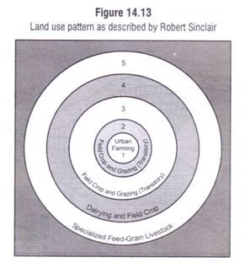
Von Thunen’s model:
Sinclair’s model
metropolitan expansion is perceived as a
displacement threat
investments rise with distance from the
frontier to the outer edge
four types of farming; fifth is a
wider regional speciality far
from the city
(i) urban farming (small producing units: poultry-keeping,
greenhouses, mushroom-raising, and other building-oriented uses)
(ii) vacant and temporary grazing, (empty spaces to be sold for speculation or grazing only under short-term leases)
(iii) transitory field crop and grazing (little investment beyond the short term)
(iv) dairying and field crop farming (farmers begin shifting towards more extensive agriculture).
(v) specialised feed-grain livestock or Corn Belt agriculture
http://www.yourarticlelibrary.com/wp-content/uploads/2014/02/clip_image028_thumb.jpg

Slide 35
Ricardo and Thünen's Rent Theories
David Ricardo and Johann Heinrich von Thünen, both influential economists of the 19th century, developed theories of rent that, while sharing some fundamental principles, also had distinct perspectives.
While Ricardo and Thünen shared a common understanding of rent as a surplus generated by land, their theories differed in terms of their focus and the factors they considered important in determining land rent. Ricardo emphasized the role of agricultural productivity and population growth, while Thünen focused on spatial considerations and transportation costs. Both theories contributed to our understanding of the economic role of land and the factors that influence its value.
Notes:
Diparimento di Scienze Geografiche e Storiche - Introduzione ai GIS
35
(*)

Slide 36
A Comparison of Ricardo and Thünen's Rent Theories
Commonalities
Rent as a Surplus: Both Ricardo and Thünen viewed rent as a surplus value generated by land. This surplus was attributed to the land's superior productivity compared to less fertile or less favorably located land.
Land as a Fixed Factor: Both theorists recognized that land, unlike labor or capital, was a fixed factor of production. This fixed nature of land played a crucial role in their theories of rent.
Notes:
Diparimento di Scienze Geografiche e Storiche - Introduzione ai GIS
36
(*)

Slide 37
A Comparison of Ricardo and Thünen's Rent Theories
Differences
Focus on Agricultural Land: Ricardo primarily focused on agricultural land in his theory of rent. He argued that the rent of agricultural land was determined by the difference in productivity between the most fertile land and the least fertile land required to produce a given quantity of food.
Spatial Considerations: Thünen, on the other hand, introduced spatial considerations into his theory of rent. He developed a model of land use around a central city, where the rent of land varied with its distance from the city. He argued that the highest rents were paid for land closest to the city, where transportation costs were lower.
Transportation Costs: Thünen emphasized the role of transportation costs in determining land rent. He argued that the profitability of different agricultural activities depended on the balance between the value of the product and the cost of transporting it to the market.
Notes:
Diparimento di Scienze Geografiche e Storiche - Introduzione ai GIS
37
(*)

Slide 38
A Comparison of Ricardo and Thünen's Rent Theories
Main Points of View
Ricardo: Ricardo's theory of rent focused on the distribution of economic surplus between landowners and other factors of production. He argued that as population grew and demand for food increased, the rent of agricultural land would rise, leading to a redistribution of income in favor of landowners.
Von Thünen: Thünen's theory of rent was more concerned with the spatial organization of economic activity. He argued that the rent of land was determined by its location relative to the market and the transportation costs associated with producing and transporting goods. His model provided insights into the pattern of land use around cities and the factors that influenced the location of different economic activities.
Notes:
Diparimento di Scienze Geografiche e Storiche - Introduzione ai GIS
38
(*)

Slide 39
Von Thunen Rent and the city
From the isolated state….
…to the bid rent theory applied to urban areas

Slide 40
The bid-rent (I)
...a step forward
Pattern of land uses depend on a variety of settlements’ decisions
Decisions guided by economic process operating within the system. The distribution of urban areas’ use represent a visual and structured phenomenon.
Basic aspects:
  Each activity derives utility from every site of the urban area;
  Utility is measured by the rent an activity is willing to pay for the use;
  Among the different rents from the utility of the site, the maximum one will determine the market value
The location rent curve can be regarded as a “bid-rent curve” (Alonso, 1960), because it gives an indication of how much farmers would be prepared to pay for a unit of land at varying distance from the market.

Slide 41
Bid rent and land use
...a step forward
1 – bid rent lines
2 – Overlay of rents
rent
B- Industry and retail
A- Retail
Distance
City borders
C - Apartments
D – Detached
houses
Notes:
Diparimento di Scienze Geografiche e Storiche - Introduzione ai GIS
41
(*)

Slide 42
Bid-rent
...a step forward
A
rent
Area A: commercial land use
Area B: industrial land use
Area C: residential land use
B
C
C’
A
B
P
A’
Q
B’
distance
C
Curva AA’: commercial activities’ rent
Curva BB’: industrial activities rent
Curva CC’: residential ativities rent
Notes:
Diparimento di Scienze Geografiche e Storiche - Introduzione ai GIS
42

Slide 43
Variations to bid-rent theory
...a step forward
A – CBD
B – Commerce / industry
C – residential high– medium density
D – sub-centres
E – Suburbia
rent
A
B
C
D
E
Notes:
Diparimento di Scienze Geografiche e Storiche - Introduzione ai GIS
43
(*)

Slide 44
Land use value for activity sector according to the distance from the CBD
...a step forward
Retail
Residential (several components families)
Land use value
Residential (single families)
Distance from the centre
Notes:
Diparimento di Scienze Geografiche e Storiche - Introduzione ai GIS
44
(*)

