Slide 1
Future of
Retail
KPMG per COOP Alleanza 3.0
Roberto Giovannini
April 2021

Slide 2
Context for Change
Innovate the Business Model in the Retail sector | 3
Retail Outlook | 7
Prioritized Trend 1: Business Model | 15
Prioritized Trend 2: Discounters | 25
Prioritized Trend 3: Reducing Cost of Doing Business | 32
Prioritized Trend 4: Customer Power | 38
Prioritized Trend 5: Innovation | 44
Appendix: Focus on Business Innovation | 61

Slide 3
Innovate the Business Model in the Retail sector
KPMG approach
01

Slide 4
Route to Innovative Business Model
Today
Meeting 1
Meeting 2
Presentation
Operative meeting with business managers
Customize the approach on your needs
Our proposal to New Business Model
Feedback from top managers
Design the approach on your needs
Visioning
The Future of Retail and Foodservice market presentation
Operative meeting with business managers
Business focus and increase managers commitment
Customized approach
Sharing ideas
Brainstorming
Customize
Share
Define Next Best Action (NBA)

Slide 5
Outlining the client journey: 4 steps of work
In order to pivot to a winning business model, we recommend a four-step approach: define, design, pilot, and implement change.
01
Define your business model based on current and future markets, propositions and brands, as well as clients and channels
Business
Model
There are three options when defining your business model: Build, buy or partner
02
Design
If you have chosen to build, the following design, pilot and implement steps can help you pivot to your winning business model. KPMG’s 8 Connected Capabilities can then be used to design your approach to success
03
Pilot
Clients may pilot their strategy through functional sectors using KPMG’s sub-capabilities, which may illuminate the larger potential for change in the client’s point of view
04
Implement
Whether functional or enterprise-wide, clients may use KPMG’s Connected roadmap to stimulate change and succeed with their new business model

Slide 6
Defining using a business model diagnostic
Vision
KPMG’s 9 levers of value can be used to identify the client’s ideal business model based on current and future markets, propositions, brands, and competition, as well as consumer segments and channels.
KPMG’s 9 Levers of Value Strategic Framework
Key strategic considerations
KPMG 9LoV framework
Key components
1
WHAT TO AIM FOR
Financials and ambition
Financial model
Vision, mission and higher purpose
Financial and strategic outcomes
Investment and risk appetite
Capital structuring
WHERE TO PLAY
2
Markets
Business model
Drivers of profitable growth for any business
Helps determine where the business will play, including the role it will play in consumers’ lives
Must be aligned to the financial model requirements
3
Propositions and brands
4
Consumers and channels
5
Drivers of operational excellence for any business
Helps determine how any business will win
The operating model must be aligned to the business model requirements
HOW TO EXECUTE AND WIN
Core business processes
6
Technology and operations infrastructure
Operating model
7
Organizational structure, governance,
and risk controls
8
People and culture
Management information and key performance indicator dashboards
9
Measures and incentives

Slide 7
Global Retail Outlook
02

Slide 8

Global Retail Outlook
Global consumer spending
Global channel overview
Region-wise real GDP growth^{1,2} (%)
CAGR 2010-2024F
E-commerce:17.0%
Supermarkets:1.3%
Health and Beauty: 1.6%
Home and Garden: 1.5%
Hypermarkets: 0.4%
Mixed Retailers: (0.3)%
Leisure and Personal: 0.3%
Electronics & Appliance:(0.6)%
Discounters: 3.4%
Convenience Stores: 3.3%
Home Shopping: 0.5%
Direct Selling: 0.5%
Vending: (1.5)%
  Global economic outlook:
  After a 2.8 percent growth in 2019, the real GDP is expected to decline by 4.4 percent in 2020. Growth is expected to pick up in the subsequent year, to reach 4.2 percent by 2022.
  EU’s real GDP growth rate has been declining since 2018
  (2.3 percent in 2018; 1.7 percent in 2019) and is estimated to be around -7.6 percent in 2020, while in emerging and developing Asian economies the real GDP is estimated to decline by 1.7 percent in 2020.
  Global inflation (y-o-y percent change) is expected to be
  3.2 percent in 2020 (slightly lower than 3.5 percent in 2019); in 2021 however, inflation is expected to rise to 3.4 percent.
Store versus non-store
E-commerce 2019
15.9% non-store retailing
100%= GBP1,588.5 billion
Note: 1) Real GDP growth (annual percent change; code: NGDP_RPCH) 2) As per the latest data, IMF has excluded the UK from the EU
Source: IMF, accessed 19 November 2020; Figures correspond to the last available release of October 2020 Edition of World Economic Outlook Database
Note: Total consumer spending is considered in GBP billion at 2019 constant prices (and fixed exchange rates). Retail spending is calculated as sum of consumer spending on food and non-alcoholic beverages, clothing and footwear, household good and services and alcoholic beverages and tobacco. For store and non-store retailing ‘retail value RSP excl. sales tax’ at 2019 constant prices (and fixed exchange range) is considered
Source: Euromonitor, accessed 19 November 2020

Slide 9
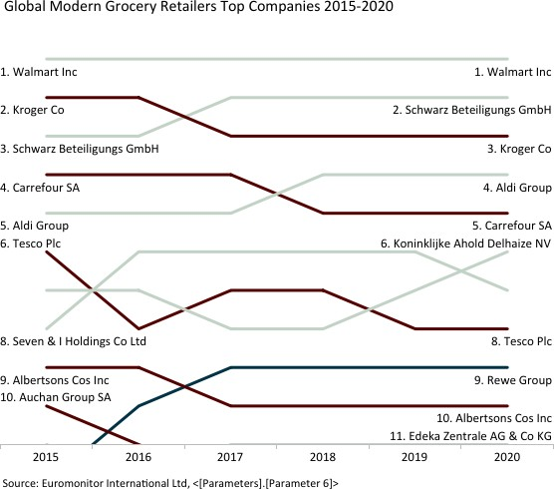
Global Modern Grocery Retailers Top Companies 2015-2020
Convenience-focused retailers lose share during lockdowns
Within the top 10 companies in modern grocery retailers, there was no significant change except that Koninklijke Ahold Delhaize NV overtook Seven & I Holdings to rank sixth in 2020.
Seven & I Holdings primarily operates convenience stores, which drove its relatively weak performance in 2020 as the channel struggled in the face of pandemic-related reductions in consumer mobility. On the other hand, Ahold Delhaize’s larger formats benefited from one-stop trips and stockpiling behaviours.
Among the top five players, Walmart lost value share slightly, which is analysed that other emerging channels such as contactless distribution channels also rocket in the US by competing with major groceries.

Slide 10
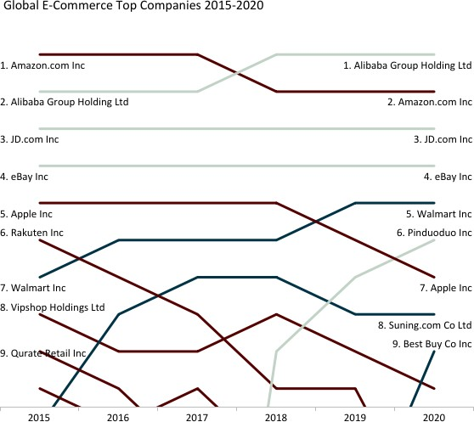
Global E-Commerce Top Companies 2015-2020
Alibaba company leads e-commerce, Amazon has stronger brand power
The top five players in global e- commerce maintained their positions in this fiercely competitive space in 2020. Alibaba Group Holding’s eight global e-commerce brands were largely able to gain value share with strategies such as expanding the reach of Taobao live to help foodservice or institutional providers go direct to consumer.
The second largest player in e- commerce, Amazon, responded with prioritising the stocking of staples and medical supplies to meet demand for online orders during lockdown.
Walmart is the only player gaining value share within the top five as the company rapidly expanded its omnichannel offerings with click-and-collect services in 2020.

Slide 11









Most challenging industry trends and business impact
In the current face of disruption, it is no longer possible for the retailers to drive profit through conventional modes of cost cutting — they need to re-invent themselves to stay relevant
Most challenging industry trends
Business impact
Industry shift expected
For most firms, emergence of new competitors w ith a disruptive business model is a key challenge
More than 50 percent of the board members expect
to see the follow ing industry shifts by 2020:
31% New competitors w ith disruptive business model
Upended traditional business models
57%
changes — high investment required 56%
Expensive to cope w ith multi-faceted
56%
56%
55%
53%
About 57 percent board members feel that
manufacturers w ill sell many
more products
28% Demand for speed and efficiency
Expensive to cope with multi-faceted changes — high investment required
Most supply chains w ill be demand driven and customer centric
Shipping and fulfilment options w ill be
more important than price
Physical store and digital channels w ill
be fully integrated
Physical stores that do not reinvent
themselves w ill not survive
Many stores existing today w ill close due
to underperformance
25% Rapid grow th of new technology
25% Retailers creating ow n products
Cost pressures leading to margin
compression — especially for traditional
retailers
24% Competition from platform firms
Pressure on retailers to understand
consumers in a more holistic w ay
24% Shifting demographics/expectations
23% Convergence of sectors
53%
Use of artificial intelligence w ill be
critical to survive
Competition beyond range and price
Source: KPMG 2018 Global Consumer Executive Top of Mind Survey (consumer and retail sector)
Source: KPMG 2018 Global Consumer Executive Top of Mind Survey
(consumer and retail sector)
© 2019 KPMG LLP, a UK limited liability partnership and a member firm of the KPMG network of independent member firms affiliated with KPMGInternational Cooperative (“KPMG International”), a Swissentity. All rights reserved.

Slide 12














10+1 key challenges shaping the retail landscape
Growth
Efficiency
Customer
People
Protection & compliance
Business model
Discounters
Reducing cost of doing business
Consumer power
Innovation
Supply chain and fulfilment
Emerging technology
Internationalisation
Consolidation
Purpose and reputation
People and ways of working
Five existing trends have accelerated and need to be prioritized

Slide 13

Four existing trends have accelerated and need to be prioritized
Business models and
partnerships
Declining margins and
productivity — Cost of doing business
Customer power
Innovation
Customer demands and use of channels have been evolving over recent years resulting in increased complexity to deliver with limited capabilities and capital
Retailers will need to reconsider their business models and consider partnerships to stay relevant
With current disruption and debt equity of technology and talent today, retailers need to evolve with the times or be left behind
The cost of doing business is only increasing while profit margins are declining, so a radical re-think of costs is needed
If retailers don’t know who their customers are and why they want to interact with their brand, they are very likely to disappear
Retail is transitioning from a push (B2C) to a pull (C2B) model
Technology is challenging the rules of engagement and customers are becoming more demanding, forcing retailers to tap into innovative thinking and social media, to ensure brand prominence.
IMPLICATIONS
Omni-channel/seamless retail accelerated
Reinventing the role of the physical and digital channels
Boom in online across generations
Localisation and personalization
Accelerated partnerships for complementary services
Cost of goods: Inventory management, Range proliferation
Financial management in lean times and access to capital
Physical space reduction and lease agreements
Supply chain optimization
Workforce optimization
Single view of customer critical
Offer authentic to customer value proposition
Essential items vs. non-essential
Post-COVID recession
Consumers emphasizing experiences over products
Retail and foodservice are converging
New mid-sized formats and strategic partnerships are being developed to complete the service portfolio
Even retail is interested in ghost kitchens
Brand players shop Retail through M&A

Slide 14
Five priority challenges
03

Slide 15

Priority challenge 1
Business Model
Business models and partnerships
Even before COVID-19, it was becoming increasingly clear that store-based retailing has passed its zenith.
While many physical stores will certainly return to growth, it is clear that the days of being able to drive growth through physical stores are over.
Many are looking to platform companies to help deliver some of those important capabilities.
Reducing cost of doing business
Discounters
Consumer power
Innovation

Slide 16




Retail industry has evolved ...
Traditional Retail
Chain-
stores
Since 1945, retail has undergone four evolutionary phases. At present, all these four phases coexist alongside the traditional form of retailing in the shape of independent stores
Chain Stores
Multi-
format
Multi-format
Online Market
Places
Pure Players
Multi-channel
Multi- channel and online
Platform
Omni channel
Omni- channel and
Pureplay
?
What next?
© 2019 KPMG LLP, a UK limited liability partnership and a member firm of the KPMG network of independent member firms affiliated with KPMG International Cooperative (“KPMG International”), a Swiss entity. All rights reserved.

Slide 17

Seven types of consumer commerce businesses will succeed in the future
The word ‘retail’ is likely to become redundant and will be replaced by ‘consumer commerce’; seven types of business models will emerge as winners going forward.
1
2
3
4
5
6
7
Platform business
Multinational retailers
National Heroes
Value-based retailers
Brands
Category specialists
Independent/Mutuals
Platform businesses are increasingly dominating the go-to-market channels. They take a broader approach to the market and target both B2B and B2C offerings.
Large multinational retail players will transform themselves into platform businesses and will grow their capabilities via M&A.
Domestic Heroes and Wholesalers will focus
on cross-border partnerships to tap into synergies and create scale. Partnering to enhance 1) buying power, 2) tech and innovation, and 3) talent will impart strength to compete with the likes
of Amazon.
Discounters (fastest-growing physical channel globally) have historically been more profitable than legacy retailers. They will now have to evolve their online value proposition to profitably survive in the future.
Brands are increasingly seeking to embrace a Direct to Consumer approach to maximize their margins and bypass retailers. In many cases Brands are leveraging platform ecosystems either indirectly or directly to deliver their proposition.
The smaller country-focused firms (with 2% or lesser market share in their categories) offer true expertise and product innovation, and serve a loyal customer base. As their share grows, they will have to decide which route to market to take.
Mutuals and Neighbourhood retailers have the unique ability to directly gather and respond to changing community needs. Mutuals will likely need to build their online membership platform in order to compete with growing loyalty programs and rapid-response supply chains.

Slide 18

7 Winning Business Models with different strategies
Business Model | Description
Platform-based Retail | Platform-based businesses are retailers that have harnessed the digital market to deliver omni-channel products and services. Platforms provide a retail ecosystem offering customers numerous propositions, from retail products to banking services, in order to maximize customer lifetime value.
Multinational Retailers | Multinational retailers are large, international businesses that deliver products and/or services globally. MN retailers have often benefited from ecosystem partnerships to expand reach, grow customer bases, and enhance multi-purpose capabilities.
National Heroes | National Heroes are long-standing retailers that leverage nationalistic identities to deliver a range of targeted products and services within a defined geographic region. National Heroes often have the advantage of securing a loyal customer base and leveraging loyalty programs to meet customer needs.
Value-based Retailers | Value-based retailers aim to undercut the market by providing products and services at a lower price than regular retailers. Generally, value-based retailers do not provide specialty products and therefore must compete against other discounters, mid-market retailers, and specialty providers alike.
Brands | Brands are increasingly seeking to embrace a Direct to Consumer approach to maximize their margins and bypass retailers. In many cases Brands are leveraging platform ecosystems either indirectly or directly to deliver their proposition.
Category Specialists | Category specialists are businesses that offer unique and focused products and/or services targeted toward a specific retail category or a defined customer. Specialists may provide a platform for brands that fit their business model or may deliver their own product directly to consumers.
Independent/ Mutuals | Mutuals are retailer- or consumer-owned businesses that aim to focus on the needs of their members. Mutuals have a unique business model that focuses on meeting the needs of the majority, rather than simply increasing profit, thereby uniting retailers and customers under a common goal.

Slide 19





Retailers are witnessing a strategic squeeze
The retail industry is facing margin compression owing to rising costs, lower pricing power and the need to invest in digital transformation
Increasingly customized service
Price w ars
Primarily among the food retailers to maintain their market share
Platform
Service
New online entrants to
the market
E.g. Amazon offering same- day/one-hour delivery at relatively low er prices
Increasingly quality offerings with low costs.
Attractive locations. Maximized value-for-money.
Traditional Retailers
vs
Ongoing investment in
digital transformation
Investment in
omni-channel platforms to drive sales, market share and customer loyalty
Traditional Retailers cannot remain in the middle of the pack but must evolve their business model
Discounters
Increasing cost pressure
Rise in fuel and commodity prices, staff costs(introduction of national living w age and apprentice levy), rental rates and fall of pound (ow ing to the EU referendum)
Product
vs
Choice
Value
© 2019 KPMG LLP, a UK limited liability partnership and a member firm of the KPMG network of independent member firms affiliated with KPMGInternational Cooperative (“KPMG International”), a Swissentity. All rights reserved.

Slide 20
Platform-based businesses are dominating the league table
Companies operating as platform businesses have become the most valuable companies in the world with top 7 companies (Microsoft, Amazon, Apple, Alphabet, Facebook, Alibaba and Tencent) accounting for £4.0 trillion of market cap
Rank 2019^{(a)}
Platform-based businesses observed a significant growth over the past 10 years — reaching to the top of league table of the most valuable companies in the world
Market capitalization (in £ billion)
4
5
6
8
9
12
13
21
68
84
338
383
485
572
601
1077
1518
2430
2645
2826
Note: (a) Market Capitalization as on 24 July 2009 and 03 July 2019, sourced via DataStream and S&P Capital IQ; accessed 3 July 2019
Notes:
The top three companies by market cap are all platforms
Companies operating as platform businesses have become the top most valuable companies in the world with top 7 companies (Apple, Amazon, Alphabet, Microsoft, Facebook, Alibaba and Tencent) accounting for £3.9 trillion (Market Capitalisation) registering ~1050% increase as compared to 2009
As of July 2018, the three most successful platforms (in terms of market cap) were Apple, Amazon and Alphabet. The number of platforms at the top of economy is growing rapidly. Additionally, as per 2018 Forbes’ list, the top five most valuable brands were platform companies (Apple, Google, Microsoft, Facebook and Amazon)
The growth of platforms is not restricted to developed economies such as the United States; platform companies such as Alibaba, Tencent, Baidu, and Rakuten have taken over China and much of Asia
Alibaba, for instance, has controlled approximately 80 percent of the Chinese e-commerce market while Baidu has more than 70 percent of Chinese search. Tencent, is presently the most valuable company in Asia, has nearly 1billion users on its WeChat messaging platform and is by estimates the largest gaming company in the world and Didi Kuadi, China’s response to Uber, dominates the taxi market
In India, Amazon is competing with local platforms Snapdeal and Flipkart for control of India’s rapidly growing e-commerce market. Paytm is the dominant payments platform, and Ola Cabs is competing with Uber and Didi for dominance in India’s transportation sector
According to Applico, investors value platforms more than their linear equivalents. In the S&P 500 index, pure platform businesses or businesses for which a platform is a significant part of their business have an average revenue multiple of 8.9. On the other hand, linear businesses are valued between two to four times revenue on average, depending on their business model. This gap is widening over time, as platforms perform better over both the short and the long term along key financial metrics. For instance, they deliver more rapid growth, better return on capital and significant profit margins. As a result, platforms have rapidly taken over other business models to the top of the economy, since the early 2000
Platforms are expected make up~5 percent of the overall S&P 500 index by 2020 and will account for the majority of the top valuations in the S&P 500 within the next five to ten years
Furthermore, next generation retail is arriving fast and the rise of platforms has changed the way consumers interact with brands. It is no longer enough to be ‘omni-channel’, as the era of ‘omni-platform’ has arrived, to remain relevant and profitable retailers must adapt how they do business. Proactive strategies that leverage the full potential of the various types of platform businesses are few and far between. And of course, the pace of change is getting faster. Platforms’ radical and relentless focus on innovation through technology is changing the way consumers shop, and manufacturers sell, at a alarming pace
Platforms have helped retailers reduce the need to invest significant financial resources. Whether it’s a large retailer expanding capacity on Black Friday by running its IT infrastructure in the cloud, retailers of all sizes with e-commerce shop fronts on Amazon or customer communities coming up on social media services, it’s the platform providers that make the investment and take the risk, not the retailers
A platform ultimately enables the value creation by facilitating transactions. While a linear business creates value by manufacturing products or services, platforms create value by building connections and “manufacturing” transactions
“Amazon, Facebook, Alibaba and other platform business models have turned the world of retailing upside down. Retailers need to transform their customer offer and organizational models to survive, and thrive, in this brave new world. It’s time for a proactive approach”
Source: Market Capitalisation as on 24 July 2009 and 24 July 2018, sourced via DataStream and S&P Capital IQ; accessed 25 July 2018; The platform era and its impact on the retail industry, Retail Think Tank; Next generation retail The rise of the omni-platform, KPMG Boxwood; Platform Business Model – Definition | What is it? | Explanation, Applicoinc: The World's Most Valuable Brands, Forbes; accessed 26 July 2018

Slide 21
Leading to a shift from traditional business model to platform model
Platform business model is expected to eventually become the operating model for retailers as Amazon, Alibaba and other platform business models have turned the world of retailing upside down
Traditional business model
Traditional business model operates in a linear supply chain and sells the goods and services directly to buyers at a mark-up through the store/online channel
Platform business model
Platform business model facilitates the exchange of products and services between two or more user groups — a consumer and a producer
Inventory is owned by third parties
Tax rates paid by platform business is less than the traditional retailers
360 degree touchpoints offers convenience to the customer; value creation happens within one ecosystem
Provides in-store customer experience (personal touch)
Non tech-savvy customers prefer to shop from stores
High inventory (traditional retailers own their inventory) and operating cost
No additional value and margins for the retailers
Shift in growth towards platform and e-commerce-based retailers
Not widely adopted in Western countries
— Under scrutiny in Europe for regulatory approval
High investment in digital marketing to create brand awareness
Tesco
Morrisons
Sainsbury’s
Amazon
Alibaba Group
Tencent
Notes:
Platform vs. Linear Business Models
A platform is a business model that facilitates the exchange of value between two or more user groups, usually a consumer and a producer. Platforms harness and create large, scalable networks of users and resources that can be accessed on demand. Platforms create communities and markets with network effects that allow users to interact and transact. Platform business such as Facebook, Uber, or Alibaba, do not directly create and control inventory via a supply chain the way linear businesses do
An important part of the platform business model is that inventory is owned by third parties and is not on the balance sheet of the platform company. The platform is only focused on building and facilitating an external network
Whereas, linear companies create value in the form of goods or services and then sell them directly to customers downstream in their supply chain. Linear businesses own their inventory and it becomes a part of their balance sheets
Not all the platform company takes a pure platform approach. Companies such as Apple and Amazon take a hybrid (omni-channel) approach that combines linear and platform business models. Combination of these two business models is expected to be very effective and profitable—allowing a business to capitalise on the strengths of each business model
Successful platforms have strong moats (ability to maintain competitive advantage over its competitors) in the form of their networks and operate at a scale that positions them to dominate their industries
E-commerce presents a major challenge for tax administrations, given the often multi-jurisdictional nature of the transactions and the potential anonymity of the parties. However, the scenario may change in future following a Supreme court decision (The US Supreme court in decision (June 2018) gave states the ability to require online and out-of-state retailers to collect and send them state sales taxes). Brick-and-mortar retailers in states are required to collect taxes on a state's behalf. Until now, that requirement didn't apply to online retailers with no physical presence, such as an office or warehouse, in a given state. Instead, consumers were responsible for sending states the necessary taxes—something that most people don’t do
Source: Market Capitalisation as on 24 July 2009 and 24 July 2018, sourced via DataStream and S&P Capital IQ; accessed 25 July 2018; The platform era and its impact on the retail industry, Retail Think Tank; Next generation retail The rise of the omni-platform, KPMG Boxwood; Platform Business Model – Definition | What is it? | Explanation, Platform vs. Linear: Business Models; Applicoinc; Online VS Offline retail, Statement Agency; Supreme Court sales tax ruling will hit your online shopping bill; More sales taxes; CNET; accessed 27 July 2018

Slide 22
In addition more and more businesses are selling their platform capabilities to other retailers
Platform businesses will take their models one step further by offering their platform capabilities (i.e. PaaS1) directly to other retailers
Ocado | OSP
Platform-as-a-service
PaaS offers a ready-made white label platform solution that can be rebranded by the user
Increasingly retailers are being inclined to adopt a quick, proven ‘off the shelf’ platform solution, as opposed to the alternative of creating their own solution from scratch
UK-based online retailer Ocado, designed a proprietary smart platform that integrates its supply chain functions
Ocado provides this end-to-end platform solution as a part of its managed service offering, to grocery retailers across the globe (e.g. Kroger, Sobey’s, Aeon)
Last Mile
Provides the back-end technology, software systems and user interface
Allows retail partners to evolve and scale with limited capital investment
Improves time to market
Last Mile Platform empowers brands, manufacturers and retailers to compete against pure online players by incorporating technology into delivery operations
Last Mile creates consistency by engaging online and offline customers in a seamless, fluid experience
Operational dependence on a third party
Can entail expensive fees
Alibaba | Tmall
Tmall is Alibaba's signature B2C e-commerce platform via which overseas merchants can enter China’s online retail market by paying an upfront fee every year in addition to commission fees2 based on product categories
Brands operate their own stores on Tmall’s platform with unique identities — this enables them to control their own branding and merchandising
Ocado (OSP)
Alibaba (Tmall)
Note:1) Platform-as-a-service 2) A pre-determined percentage of Gross Merchandise Volume (GMV) for Alipay transactions
Notes:
https://intra.ema.kpmg.com/sites/KPMGI/GMC/TL/Thought%20Leadership/Consumer-Markets/2019/Global%20Retail%20Trends%202019%20%E2%80%93%20Web%20PDF.PDF
https://www.ocadotechnology.com/press-releases-1/2018/12/12/ovum-puts-ocado-smart-platform-on-the-radar
http://results16.ocadogroup.com/media/168633/Ocado-Smart-Platform.pdf
http://thegrinlabs.com/wp-content/uploads/2017/05/Tmall.pdf
Kroger: In February 2019, Kroger (US supermarket giant) partnered with Ocado (UK online supermarket) to build two automated customer fulfillment centers (CFCs)
The CFC model is an automated warehouse facility with digital and robotic capabilities, also known as a ‘shed’
Each shed will operate on the Ocado Smart Platform (OSP) suite
Morrisons: Ocado provides Morrisons with automation technology, logistics, distribution services and an end-to-end online platform. This includes the webshop and mobile apps, the routing and planning software, the warehouse systems and head office systems needed to support and operate their online retail business.
Sobeys (Canada): In January 2018, Ocado signed a partnership agreement with Sobeys Inc. (“Sobeys”) to launch an online grocery business in Canada, using the Ocado Smart Platform (OSP). The transformational agreement involves Sobeys building a distinct eCommerce department and will allow the firm to enter an entirely new online market - Toronto - where it has previously chosen not to offer customers an online service.
ICA (Sweden): May 2018 saw Ocado sign a partnership agreement with Sweden’s leading grocer - ICA Group (ICA) - to launch a home delivery e-commerce service using Ocado Smart Platform (OSP). With this agreement, Ocado has tailored its product offering to accommodate ICA’s business model which is based upon independent retailer-owned stores
Tmall
https://www.alizila.com/kroger-set-to-launch-store-on-tmall-global/
https://about.tmall.com/?spm=3.7128306.0.0.529342f93rhCX3#place

Slide 23



Case study: Amazon
Amazon strategy is focusing selling services more than products
Amazon’s portfolio^{(a)}
Founded: 1994
Amazon Prime
Subscribers:
Increased to 100 million in the US only
(December 2018)
in the US
US$12.99 per month
or
US$119 annual subscription in the UK
£7.99 per month
or
£79.00 Annual subscription
Zappos
Woot!
Online retailer
Started business as an online
book seller
Mobile robotic
fulfilment systems
Amazon
Robotics
Twitch.tv
Live streaming
video platform
Revenue: £182.7 billion in 2018 (30.9
percent y-o-y increase)
Amazon Alexa
Virtual assistant
Amazon
IMDb
Internet movie
database
Headquarter: Seattle, the US
Social cataloging
w ebsite
Goodreads
310 million active customers
(January 2018)
Amazon
Prime
Internet retailer
Spoken audio
entertainment
Audible
Amazon’s Prime subscribers increased to 15 million in the UK (March 2019)
Spark
Social media platform
Supermarket Chain
Whole Foods Market
“Amazon’s goal is to make it ‘irresponsible’ to not be a Prime member”
— Jeff Bezos, CEO, Amazon
Amazon
Payments
Online payments
processing service
Note:
(a) Captures key offerings within the company’s portfolio/ecosystem
© 2019 KPMG LLP, a UK limited liability partnership and a member firm of the KPMG network of independent member firms affiliated with KPMGInternational Cooperative (“KPMG International”), a Swissentity. All rights reserved.

Slide 24


Case study: Walmart (Flipkart)
In May 2018, Walmart acquired 77 percent stake in Flipkart to expand into Indian e-commerce market; Walmart is expected to launch Flipkart IPO in next four years
Flipkart’s portfolio^{(a)}
Founded: 2007
Fashion
E-commerce
Myntra
PhonePe
UPI based payments
Started business as an online book seller
Flipkart adopted Marketplace model in February 2013; also introduced ‘next-day’
shipping guarantee
Fashion and Lifestyle
E-commerce
Online retail
Electronics
Jabong.com
Letsbuy
Revenue: £3.6 billion in 2018 (50 percent y-o-y increase)
Flipkart
Mapmy India
Digital Map company
Flipkart
E-commerce platform
Headquarter: Bangalore, India
Online electronic
payment
FX
MART
Ngpay
Online electronic
payment
Greater than 100 million registered users (2018)
Walmart acquired 77 percent stake in Flipkart for £12.7 (US$16) billion in May 2018
“This investmentis of immense importance for India and will help fuel our ambition to deepen our connectionw ith buyers and sellers and to create the next wave of retail in India.” — Binny Bansal, Co-founder, Flipkart
2GUD
Flipkart Supermart
Online refurbished
Goods
Online grocery store
Note:
(a) Captures key offerings within the company’s portfolio/ecosystem
© 2019 KPMG LLP, a UK limited liability partnership and a member firm of the KPMG network of independent member firms affiliated with KPMGInternational Cooperative (“KPMG International”), a Swissentity. All rights reserved.

Slide 25
Priority challenge 2
Discounters
Discounters
Discounters continue to evolve their proposition in line with customer expectations, leading to a change in shoppers’ perception
Business models and partnerships
Reducing cost of doing business
Consumer power
Innovation

Slide 26






Four levers to reduce cost of doing business (4/4)
Discounters continue to evolve their proposition …
Both food and non-food discounters operate on ‘value for money’ model, but differ in terms of online presence and advertising spend. Moreover, in a bid to stay relevant they are continuously evolving — reflected in B&M’s (a non-food player) acquisition Heron Foods
Food discounters
Non-food discounters
Efficiently tapped into the shifting demographics
Superior e-commerce/online presence
Home Bargains and Wilko Retail have a transactional website
Lidl has no online presence, however, according to the Grocer, Lidl has said that it is actively exploring e-commerce in the UK for the first time
Aldi’s online presence was traditionally limited to trading its wine
and Specialbuys, until it extended to selling spirits online in 2018
Venture into food sector
B&M acquired frozen food specialist Heron Foods; added frozen
foods offering to ~80 B&M stores
Non-food discounters have not broadened the appeal in the same
way as the food discounters
Leading non-food discounters retain a more traditional skew
toward those consumers who require a value alternative
Aldi and Lidl, on the other hand have tapped into the shifting
demographics — evident in their foray into premium products
Spend more on advertising
85.2%
Lidl and Aldi together accounted for 85.2 percent of the discount sector’s total recorded above-the-line, online display and direct mail advertising expenditure in 2017
Notes:
Technology impact-adoption matrix (2019) — supply chain innovation during 2020-21 will heavily leverage analytics
Matrix has been taken from the 2nd annual joint survey of supply chain executives from JDA Software, Inc. and KPMG LLP (KPMG) details the key innovation investments across retail, manufacturing and logistics in 2019
Per the analysis, supply chain innovation, over the next 2 years, is likely to heavily leverage analytics (Cognitive and AI) to address complex problems – be it forecasting, fleet routing or inventory optimization
Source: https://scm.dk/new-jda-and-kpmg-survey-says-artificial-intelligence-most-impactful-supply-chain-technology-cxos
Inditex:
Source: https://www.essentialretail.com/news/five-features-inditex-digital/
Otto
https://digital.hbs.edu/platform-rctom/submission/autonomous-stock-replenishment-at-online-retailer-otto/
Sources:
2018: https://intra.ema.kpmg.com/sites/KPMGI/GMC/TL/Thought%20Leadership/US/2018/Digital%20Supply%20Chain%20in%20Retail%20and%20Manufacturing%20-%20A%20State%20of%20the%20Industry%20Benchmark.pdf
https://www.incisiv.com/animated-infographic-state-of-the-industry-digital-supplychain-performance
https://www.idginsiderpro.com/article/3535079/can-technology-save-the-retail-supply-chain.html
https://www.mckinsey.com/business-functions/operations/our-insights/supply-chain-40--the-next-generation-digital-supply-chain
https://www.gartner.com/smarterwithgartner/gartner-top-8-supply-chain-technology-trends-for-2018/
https://scm.dk/new-jda-and-kpmg-survey-says-artificial-intelligence-most-impactful-supply-chain-technology-cxos

Slide 27





Four levers to reduce cost of doing business (4/4)
...in line with customer expectations …
While discounters perform well on value for money and time parameter; range of products, ease of checkout and availability of products are the key potential areas of improvement
Why should I engage with the value channel?
What do I want to see more?
Value for money; Less confusing; Saves time
— Besides value for money, hard discount stores are often convenient and easy to shop around, given the low choice complexity
Broader range and availability of products
— Those in the age group of 35-54 wanted to see improvements in range and availability of products
Option to choose between value and premium range (food-discounters)
— Premium range introduced — attracting new set of consumers, who traditionally would not have shopped at discounters
Ease of checkout
— Lidl shoppers pointed ease of checkout as an area of improvement — as its format is based on speed
Location;
Ease of access
— For instance, Poundland’s key strength is its high street store locations, allowing ease of access
Online presence
— For B&M shoppers introduction of an online service is a key area of improvement
Lesser stigma attached to shopping at discounters
Quality of products
— Those aged 16-34 would want improvement in quality — highlighting that for certain shopper groups, shopping at discounters is not just about low prices
— 75 percent of shoppers feel that stigma about
shopping at discounters has fallen away
Source: Mintel survey, 2018
Notes:
Technology impact-adoption matrix (2019) — supply chain innovation during 2020-21 will heavily leverage analytics
Matrix has been taken from the 2nd annual joint survey of supply chain executives from JDA Software, Inc. and KPMG LLP (KPMG) details the key innovation investments across retail, manufacturing and logistics in 2019
Per the analysis, supply chain innovation, over the next 2 years, is likely to heavily leverage analytics (Cognitive and AI) to address complex problems – be it forecasting, fleet routing or inventory optimization
Source: https://scm.dk/new-jda-and-kpmg-survey-says-artificial-intelligence-most-impactful-supply-chain-technology-cxos
Inditex:
Source: https://www.essentialretail.com/news/five-features-inditex-digital/
Otto
https://digital.hbs.edu/platform-rctom/submission/autonomous-stock-replenishment-at-online-retailer-otto/
Sources:
2018: https://intra.ema.kpmg.com/sites/KPMGI/GMC/TL/Thought%20Leadership/US/2018/Digital%20Supply%20Chain%20in%20Retail%20and%20Manufacturing%20-%20A%20State%20of%20the%20Industry%20Benchmark.pdf
https://www.incisiv.com/animated-infographic-state-of-the-industry-digital-supplychain-performance
https://www.idginsiderpro.com/article/3535079/can-technology-save-the-retail-supply-chain.html
https://www.mckinsey.com/business-functions/operations/our-insights/supply-chain-40--the-next-generation-digital-supply-chain
https://www.gartner.com/smarterwithgartner/gartner-top-8-supply-chain-technology-trends-for-2018/
https://scm.dk/new-jda-and-kpmg-survey-says-artificial-intelligence-most-impactful-supply-chain-technology-cxos

Slide 28



Four levers to reduce cost of doing business (4/4)
…leading to a change in shoppers’ perceptions …
Majority of customers in the UK now perceive Aldi and Lidl as a ‘supermarket’ and are using it as a main shop in addition to top-up shop
Supermarket and hypermarket shoppers
Discount shoppers
More than half of London shoppers say they would shop at Aldi or Lidl if there was a store closer to them
Aldi shoppers
Lidl shoppers
_{2%}2% 2%
_{5%} 2%
4%
47% using Aldi for main shopping (y-o-y 6 percent point growth) — the same proportion as supermarket shoppers
4%
7%
5%
32%
8%
47%
47%
7%
53% of UK shoppers now perceive Aldi as a supermarket; similar to 50% who perceive the same for Lidl
35%
39%
51%
IGD predicts: £1 in every £7 spent on groceries will be spent at a discount store by 2023
Main shop
Top-up shop
Evening meal
Food to go
Non-food
Health & beauty
Other items/services
Source: IGD, How shopper perceptions of discounters are changing, 24 September 2018
Notes:
Technology impact-adoption matrix (2019) — supply chain innovation during 2020-21 will heavily leverage analytics
Matrix has been taken from the 2nd annual joint survey of supply chain executives from JDA Software, Inc. and KPMG LLP (KPMG) details the key innovation investments across retail, manufacturing and logistics in 2019
Per the analysis, supply chain innovation, over the next 2 years, is likely to heavily leverage analytics (Cognitive and AI) to address complex problems – be it forecasting, fleet routing or inventory optimization
Source: https://scm.dk/new-jda-and-kpmg-survey-says-artificial-intelligence-most-impactful-supply-chain-technology-cxos
Inditex:
Source: https://www.essentialretail.com/news/five-features-inditex-digital/
Otto
https://digital.hbs.edu/platform-rctom/submission/autonomous-stock-replenishment-at-online-retailer-otto/
Sources:
2018: https://intra.ema.kpmg.com/sites/KPMGI/GMC/TL/Thought%20Leadership/US/2018/Digital%20Supply%20Chain%20in%20Retail%20and%20Manufacturing%20-%20A%20State%20of%20the%20Industry%20Benchmark.pdf
https://www.incisiv.com/animated-infographic-state-of-the-industry-digital-supplychain-performance
https://www.idginsiderpro.com/article/3535079/can-technology-save-the-retail-supply-chain.html
https://www.mckinsey.com/business-functions/operations/our-insights/supply-chain-40--the-next-generation-digital-supply-chain
https://www.gartner.com/smarterwithgartner/gartner-top-8-supply-chain-technology-trends-for-2018/
https://scm.dk/new-jda-and-kpmg-survey-says-artificial-intelligence-most-impactful-supply-chain-technology-cxos

Slide 29


Four levers to reduce cost of doing business (4/4)
Globally, the food discounters segment is consolidated…
The top three players in each geography nearly make up the entire market in the food discounters segment
Norway
Food | Non-food
Rema 1000 (47.4%) | Europris
Kiwi (42.1%) | Nille
Coop Prix (10.4%)
UK
Food | Non-food
Aldi (61.5%) | B&M Retail Ltd
Lidl (38.4%) | Home Bargains
Jack’s (0.1%) | Steinhoff
US
Food | Non-food
Aldi (60.2%) | Dollar Stores
Save-A-Lot (23.2%) | Ollie’s
Grocery Outlet (7.6%) | Five Below
42%
Denmark
Food | Non-food
Netto (Salling group) (35.5%) | Normal
Rema 1000 (29.2%) | Flying Tiger Copenhagen
Fakta (FDB group) (19%)
36%
35%
11%
Mexico
Food
Bodega Aurrera (55.2%)
Soriana (12%)
Ley Express (5.1%)
2%
22%
Germany
Food | Non-food
Aldi (39.7%) | TEDi
Lidl (25.8%) | Action
Netto Marken- Discount (17.4%) | Kik
Middle East
Food
VIVA (launched in February 2018)
Brazil
Food
Dia (91.1%)
Todo Dia (8.9%)
3%
Market share controlled by food
discounters as a % of grocery retailing
Note: Market share of food-discounters as of 2018 by Euromonitor mentioned in bracket; Market share of non-food discounters unavailable
Notes:
Technology impact-adoption matrix (2019) — supply chain innovation during 2020-21 will heavily leverage analytics
Matrix has been taken from the 2nd annual joint survey of supply chain executives from JDA Software, Inc. and KPMG LLP (KPMG) details the key innovation investments across retail, manufacturing and logistics in 2019
Per the analysis, supply chain innovation, over the next 2 years, is likely to heavily leverage analytics (Cognitive and AI) to address complex problems – be it forecasting, fleet routing or inventory optimization
Source: https://scm.dk/new-jda-and-kpmg-survey-says-artificial-intelligence-most-impactful-supply-chain-technology-cxos
Inditex:
Source: https://www.essentialretail.com/news/five-features-inditex-digital/
Otto
https://digital.hbs.edu/platform-rctom/submission/autonomous-stock-replenishment-at-online-retailer-otto/
Sources:
2018: https://intra.ema.kpmg.com/sites/KPMGI/GMC/TL/Thought%20Leadership/US/2018/Digital%20Supply%20Chain%20in%20Retail%20and%20Manufacturing%20-%20A%20State%20of%20the%20Industry%20Benchmark.pdf
https://www.incisiv.com/animated-infographic-state-of-the-industry-digital-supplychain-performance
https://www.idginsiderpro.com/article/3535079/can-technology-save-the-retail-supply-chain.html
https://www.mckinsey.com/business-functions/operations/our-insights/supply-chain-40--the-next-generation-digital-supply-chain
https://www.gartner.com/smarterwithgartner/gartner-top-8-supply-chain-technology-trends-for-2018/
https://scm.dk/new-jda-and-kpmg-survey-says-artificial-intelligence-most-impactful-supply-chain-technology-cxos

Slide 30
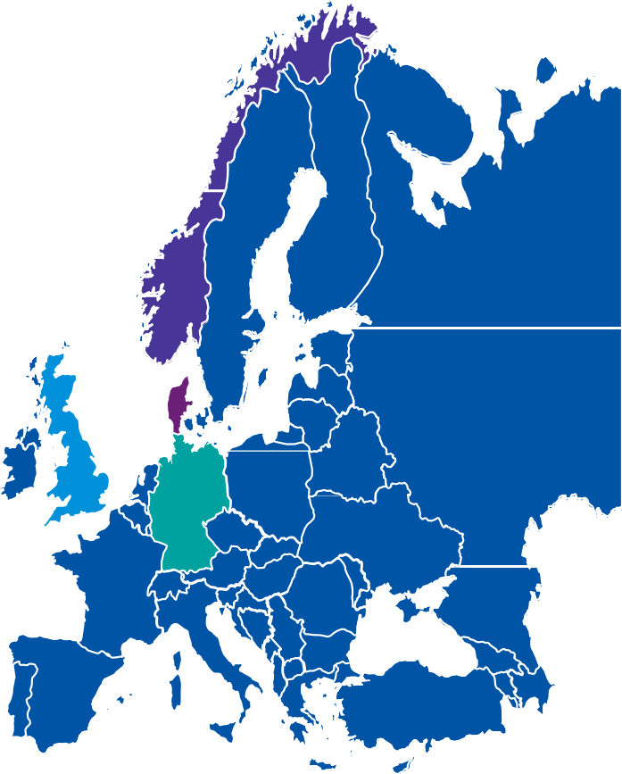
Four levers to reduce cost of doing business (4/4)
…in Europe the focus is on network expansion…
Expanding physical presence is a key focus area for discounters in Europe. outlet modernisation, loyalty programs, enhanced product assortment and new payment methods, are also on the list
Norway
Denmark
Key theme: High market penetration; shift towards
larger stores; broader choice of fresh produce
Key theme: Aggressive network expansion; loyalty programs
Discounter’s market is in hands of local chains
— Rema 1000 is driving grow th via netw ork expansion, w hile
Kiw i is focusing on organic grow th of existing outlets
Country w ith one of the highest density of discount stores
in Europe
— Major players (Salling Group, Lidl) are looking to new store concepts involving larger outlets , w ider product offers and more fresh produce
— Both Rema 1000 and Kiw i continues to benefit from customer loyalty programs, Æ loyalty programme and Trumf, respectively
— Aldi plans to open stores w ith a sales area of 850 sq. m.
and a gross area of 1,200 sq. m. in future
UK
UK
Germany
Germany
Key theme: Expanding presence; intense
competition for best sites expected
Key theme: Outlet modernisation; new payment
methods
Lidl and Aldi are battling for the first spot
— Sizeable opportunities for growth in London and the
south east, but intense competition for the best sites
Owing to market saturation, more focus on outlet
modernisation, experience and inorganic growth
Aldi is addressing consumer demand for higher quality and
fresh products, clearer structure and a more open design for easy access
- Also introduced new payment methods (mobile
payments) — addressing needs of millennial
Lidl is developing its assortmentstrategy
— Discounters and developers expected to w ork in tandem to
unlock these sites
— Cities and tow ns w ill see multiple stores from the same
discounter, w hich risks self-cannibalisation of sales
Notes:
Technology impact-adoption matrix (2019) — supply chain innovation during 2020-21 will heavily leverage analytics
Matrix has been taken from the 2nd annual joint survey of supply chain executives from JDA Software, Inc. and KPMG LLP (KPMG) details the key innovation investments across retail, manufacturing and logistics in 2019
Per the analysis, supply chain innovation, over the next 2 years, is likely to heavily leverage analytics (Cognitive and AI) to address complex problems – be it forecasting, fleet routing or inventory optimization
Source: https://scm.dk/new-jda-and-kpmg-survey-says-artificial-intelligence-most-impactful-supply-chain-technology-cxos
Inditex:
Source: https://www.essentialretail.com/news/five-features-inditex-digital/
Otto
https://digital.hbs.edu/platform-rctom/submission/autonomous-stock-replenishment-at-online-retailer-otto/
Sources:
2018: https://intra.ema.kpmg.com/sites/KPMGI/GMC/TL/Thought%20Leadership/US/2018/Digital%20Supply%20Chain%20in%20Retail%20and%20Manufacturing%20-%20A%20State%20of%20the%20Industry%20Benchmark.pdf
https://www.incisiv.com/animated-infographic-state-of-the-industry-digital-supplychain-performance
https://www.idginsiderpro.com/article/3535079/can-technology-save-the-retail-supply-chain.html
https://www.mckinsey.com/business-functions/operations/our-insights/supply-chain-40--the-next-generation-digital-supply-chain
https://www.gartner.com/smarterwithgartner/gartner-top-8-supply-chain-technology-trends-for-2018/
https://scm.dk/new-jda-and-kpmg-survey-says-artificial-intelligence-most-impactful-supply-chain-technology-cxos

Slide 31


Four levers to reduce cost of doing business (4/4)
…while digital channels gain traction in the US and LATAM
In the US, discounters are focusing on expansion and omni-channel strategy; whereas, for the first time a food discounter (VIVA) has set its foot in the Middle East, with an aim to tap into rising demand for cheaper groceries
US Middle East
Key theme: Omni-channel strategy; product assortment Key theme: VIVA – the first discounter in the country
US
Middle East
Lidl’s entry and Aldi’s grow ing network in the US
  Aldi expanded partnership w ith US grocery delivery
specialist Instacart
  Is piloting a click-and-collect service
Started stocking products marketed as organic, natural, vegan or gluten-free (mostly private labels) — in line w ith the trend of healthy eating
In 2018 Landmark Group opened four outlets of Viva,
driven by demand for cheaper groceries
VIVA offers a range of private label products (80 percent);
at least 30 percent cheaper than supermarkets
Stores operate in high density neighbourhoods and
house ~1,200 products
Future plans include launch of a home delivery service
Latin America
India
Latin America
Key theme: Discounters, such as Market99 have tapped into the price sensitivity of the consumers
Key theme: Alternative payment strategies; digital transformation
— Bodega Aurrera, WalMart’s mini-grocer format in Mexico,
is investing in digital transformation and marketing
— Key characteristics of Market99:
Range of over 5,000 products
Offers private labels; 20–40 percent cheaper than peers
Products sourced locally, as w ell as, from international
markets such as, Turkey, Thailand, Vietnam and China
More than 50 stores across 20 Indian cities
— In Brazil, Walmart´s Todo Dia brand proved unsuccessful; 80 percent stake sold to PE Advent International
Notes:
Technology impact-adoption matrix (2019) — supply chain innovation during 2020-21 will heavily leverage analytics
Matrix has been taken from the 2nd annual joint survey of supply chain executives from JDA Software, Inc. and KPMG LLP (KPMG) details the key innovation investments across retail, manufacturing and logistics in 2019
Per the analysis, supply chain innovation, over the next 2 years, is likely to heavily leverage analytics (Cognitive and AI) to address complex problems – be it forecasting, fleet routing or inventory optimization
Source: https://scm.dk/new-jda-and-kpmg-survey-says-artificial-intelligence-most-impactful-supply-chain-technology-cxos
Inditex:
Source: https://www.essentialretail.com/news/five-features-inditex-digital/
Otto
https://digital.hbs.edu/platform-rctom/submission/autonomous-stock-replenishment-at-online-retailer-otto/
Sources:
2018: https://intra.ema.kpmg.com/sites/KPMGI/GMC/TL/Thought%20Leadership/US/2018/Digital%20Supply%20Chain%20in%20Retail%20and%20Manufacturing%20-%20A%20State%20of%20the%20Industry%20Benchmark.pdf
https://www.incisiv.com/animated-infographic-state-of-the-industry-digital-supplychain-performance
https://www.idginsiderpro.com/article/3535079/can-technology-save-the-retail-supply-chain.html
https://www.mckinsey.com/business-functions/operations/our-insights/supply-chain-40--the-next-generation-digital-supply-chain
https://www.gartner.com/smarterwithgartner/gartner-top-8-supply-chain-technology-trends-for-2018/
https://scm.dk/new-jda-and-kpmg-survey-says-artificial-intelligence-most-impactful-supply-chain-technology-cxos

Slide 32

Priority challenge 3
Reducing Cost of Doing Business
Declining margins and
productivity — Cost of doing business
Most retailers recognize that conventional forms of cost cutting are no longer enough to shore up margins and rebuild the business.
Even after the aggressive cost-containment strategies rolled out in the immediate aftermath of the response to COVID-19, most retailers recognize they will need to go further if they hope to return their business to profitable growth in the years ahead.
Expect to see a flurry of investments focused on improving the value of existing assets over the coming year.
Retail margins are under pressure. Higher costs to manage e-commerce supply chains, mounting supplier demands to pass on raw-material cost inflation, higher investments to combat new competition, COVID-driven rental pressure and steadily escalating labour costs — are all eroding the margins.
North America
Europe
Uk
EBIT Margin (%, rolling 4 quarter basis)
EBITDA Margin (%)
EBITDA Margin (%)
7.5%
6%
8.0%
6.8%
6%
6%
4.5%
5.3%
4.7%
5.5%
2.5%
0.5%
Jun 2011
Jun 2014
Oct 2016
Sep 2019
2009
2013
2017
2020E
2010
2013
2019
2020E
— UBS estimates
— IMF, Scope ratings
— British Retail Consortium (BRC)
Note: Most statistics are closest approximations from graphs and might not be exact in terms of decimal places

Slide 33
Four levers to reduce cost of doing business (1/4)
I. Range rationalization
After years of product proliferation which have added to cost, complexity and confusion, retailers are now turning to rationalization of assortment to boost efficiencies and lift profits.
Trend accelerated by COVID
Range rationalization: choice vs efficiency
Driven by the need to cater to customer preferences, high degree of product diversity has become the norm — but the avalanche of new products has often generated higher costs without a clear payoff…
What range rationalization can be applied to?
7.5k vs. 30k SKUs
A typical discounter has 7.5k SKUs versus 30k for a traditional supermarket¹
30% cut
Tesco removed ~30 percent of its product lines as a part of its ‘Project Reset’
Drivers of rationalization: discounter models
Accelerator: COVID-19 — will instate a new balance between choice and efficiency
Store level
How many categories?
Which categories?
Category roles
Category weightages
Category level
Sub-categories & segments
Segment roles
Segment weightages
Product level
Branded products
Private labels
Unique SKUs
… more SKUs mean:
Increased cost of inventory (specially holding costs)
Low forecast accuracy, and difficultly to achieve
fill-rate targets — resulting in dissatisfied customers
Demand for particular SKUs might
not be high enough to clear inventory
Maintaining data on massive number
of SKUs is time-consuming and laborious
Key benefits
01
02
03
Simplified working capital exposure
Higher inventory turnover, enhanced cash flow and higher return, due to optimised SKUs
Reduction in 1) warehousing, 2) cost of capital, and 3) obsolescence tied directly with inventory reduction
Efficiencies in supply chain and store operations
Smaller range means — 1) streamlined in-store logistics, 2) fewer in-store staff to fill shelves, 3) stable supplier relations, and 4) lesser wastage
Also, sourcing large volumes across small number of SKUs imply more buying power
Opportunity to optimize workforce
Right-sizing the assortment implies lesser workforce requirement in head offices and lesser staff to manage supplier relationships
Note:1) Kantar World Panel
Notes:
Sources:
https://www.linkedin.com/pulse/benefits-product-rationalization-stephen-p-crane-cscp/
https://www.supplychainquarterly.com/articles/2109-sku-rationalization-finding-the-right-balance-between-too-many-and-too-few
https://www.theguardian.com/business/2015/jan/30/tesco-cuts-range-products
https://www.thesun.co.uk/money/6576872/tesco-project-reset-scrapping-products-lidl-aldi/
https://www.cin7.com/blog/inventory/what-is-sku-rationalization-and-why-is-everybody-doing-it/
https://8020consulting.com/sku-rationalization-profitability-capital/
https://retailanalysis.igd.com/news/news-article/t/tesco-cuts-80-of-nutricentre-range-in-project-reset/i/10837
https://www.thegrocer.co.uk/big-brands-lose-listings-in-tescos-latest-project-reset/567964.article
https://www.kantarworldpanel.com/dwl.php?sn=publications&id=684
Tesco:
Launched project reset in 2015-16; entailed an attempt by Tesco to streamline their brand choices (Seen about ~3phases)
Undertook an 18-month exercise to radically simplify its product offer
80% of NutriCentre range cut (range slashed from 26,000 lines to just 6,000)
Higgidy, Kerrygold and Danepak were among the big brands to have lost shelf space

Slide 34










II. Real estate
Four levers to reduce cost of doing business (2/4)
Upheaval in the retail sector wrought by the pandemic is altering the approach to lease agreements, both for the time being and into the foreseeable future
Following factors have put the existing rental models under pressure…
Trend accelerated by COVID
v
80%
The "showrooming” trend
— Consumes test and receive advice on products before buying them online
Boom in online shopping
Ruptured the traditional correlation of footfall w ith turnover
Per UBS¹, 1% increase in online penetration — can result in closure of ~8k to 8.5k stores
Store closures
Initially 15k stores predicted to close in the US in 2020; estimate revised to 20-25k ow ing to the pandemic²
In the UK 17,565 shops expected to shut dow n in the UK in 2020³
Direct impact of the pandemic
Property groups collected meagre rents
Intu collected just 29% of due rent on
March’s rent day
Hammerson received 37% and British Land
collected 43% of rent due in March-April
… of retail property landlords in the UK expect the pandemic to permanently change the terms of shop occupancy
…resulting in retailers rethinking the a physical selling space — as well as the
Move from quarterly fixed rent to turnover-based monthly rent
Usually comprises a base and variable rent (either all or some portion isnot fixed, and based on sales) Base rent Performance rent (% of turnover)
mount, location and cost of their ir relationship with the landlords
Implications:
Shorter leases to become popular; renegotiations to kick-out
clauses and revise term length to maximize flexibility
Need to rethink real estate grow th; instead, excess CAPEX to be diverted to other business areas
  Necessity of 25% real estate reduction in mature markets
  A selective and smarter approach to store opening in
emerging markets
Retailers w ith multiple stores under the same landlord are
likely to negotiate better terms⁴
v
40%
Key considerations:
Treatment of click and collect
orders and online sales
… of landlords in the UK are more likely to consider factors such as footfall and turnover when asking for rent
New metrics needed to calculate rents as store functionality evolves
Base rent
Performance rent (% of turnover)
Shift relies on data sharing and trust betw een landlords and tenant
New Look and Pret a Manager began talks w ith landlords over turnover-based rents for UK operations; Inditex⁵ plans to have few er stores in the future, closing ~1,200 stores in 2020-21
— Per Colliers International
(property consultancy, 2020)
Note:1) Forbes 2) Per Coresight Research 3) Per Centre for Retail Research 4) Say accept modest rent rise in profitable stores to get major concessions in struggling ones 5) Owner of Zara and Massimo Dutti
© 2019 KPMG LLP, a UK limited liability partnership and a member firm of the KPMG network of independent member firms affiliated with KPMGInternational Cooperative (“KPMG International”), a Swissentity. All rights reserved.

Slide 35
Four levers to reduce cost of doing business (3/4)
III. Workforce optimization
Workforce optimization can be a key differentiator for retailers looking to cut cost and maintain high-quality customer service.
While retailers have usually resorted to cutting staff at head offices, distribution centers and stores for cost reduction…
… more and more will now come to rely on technology to make workforce leaner and productive.
Bed Bath & Beyond plans to
lay off 10 percent of its corporate workforce (~500 workers); part of a plan to save US$85 million yearly
Birchbox laid off
25 percent of its staff globally to cut costs
RPA and AI are automating tasks
42%
… of CIOs in retail/consumer goods sector, across the globe, plan to replace more than 10 percent of roles with AI/automation by 2024
— Harvey Nash / KPMG CIO Survey 2019
Carrefour targets cutting 3,000 jobs in France
as apart of cost saving plan
Auchan cut 517 jobs in
France to reduce costs; aims for an EBITDA margin of 6 percent by 2022
Growing market for workforce management software…
… entails cost-saving potential for retailers
US$6 billion
US$9.3 billion
US$2.5 m
per annum
… possible savings, if a retailer with US$5 billion turnover and 60,000 workforce, adopts an efficient time and labor solution
CAGR:9.2%
— Global, ResearchAndMarkets, 2020
— Cedar ROI study
Tech-driven benefits for retail — Global
Effective workforce management results in higher revenues and reduced costs
Retailers are tapping into workforce optimization solutions
Retailers’ AI investment³
Retail AI cost savings⁴
RPA cost savings⁵
In 2023
US$12 billion
In 2022
US$340 billion
25-50%
cost saving on
effective deployment
Costs of store labor operations account for
7–15% of the sales — second largest cost for a retailer, after COGS¹
Coop Värmland: Leveraged a forecast-based workforce optimization solution — reduced personnel costs by 6–8%²
Note: 1. Link 2. Link 3. Juniper Research, 2019 4.Capgemini 5. Institute of RPA
Notes:
Bed Bath & Beyond
Will lay off 10% of its corporate workforce, totaling approximately 500 workers, as part of restructuring efforts
Retailer aims to simplify its field operations, reduce the number of management positions and outsource certain functions as part of a wider effort to rebuild the foundation of its business model
Restructuring is expected to save $85 million annually
Efforts include:
Streamlining the company’s leadership structure, resulting in the departure of six C-level executives;
Raising $250 million by selling half its real estate to a private equity firm and leasing back the space;
Announcing plans to invest $400 million in stores, supply chain infrastructure, IT and digital projects
Source: https://retailtouchpoints.com/topics/store-operations/workforce-scheduling/bed-bath-beyond-cuts-corporate-workforce-by-10-in-restructuring-effort
Birchbox
The DTC beauty brand, in Feb 2020, laid off 25% of its staff globally to create savings and operating efficiencies
In 2016, Birchbox underwent two rounds of layoffs affecting 80 people total, and exited its Canadian operations
https://www.retaildive.com/news/birchbox-cuts-25-of-global-staff/571922/
Auchan
Retailer Auchan In Jan 2020 disclosed plans to cut 517 jobs in France as part of efforts to reduce costs to cope with fierce competition from the likes of Amazon
Unlisted Auchan Retail, the retail arm of the Auchan group, said the plan, which also includes a greater focus on e-commerce and local products, involves the voluntary departure of head office and support services staff in France
Auchan Retail said it aimed to achieve an earnings before interest, taxes, depreciation and amortization (EBITDA) margin of 6% by 2022 and for that it would need to seek additional savings of 1.1 billion euros.
https://www.reuters.com/article/us-auchan-jobs/retailer-auchan-to-cut-517-jobs-in-france-idUSKBN1ZD1HR
Coop
Swedish grocery retailer Coop Värmland saved a remarkable 6-8% on personnel costs by using RELEX’s workforce optimization solution in their stores
They were able to have staff scheduled when needed (and not scheduled during low-workload windows), this improved both employee engagement and store aesthetics, with fully stocked shelves and tidier aisles.
https://www.relexsolutions.com/case-studies/coop-varmland/
With head offices having multiple roles, in the complex omni-channel network, it is more likely for different teams to be carrying out similar or overlapping work — this increases costs, hinders flexibility and impacts the ability to serve customers
RPA and AI are automating tasks in retail
The annual Harvey Nash and KPMG survey of 3,645 chief information officers (CIOs) (2019) found that robots are set to replace more than half a million retail jobs in the UK by 2024 as retailers increasingly look to automation to improve efficiency
Further, per ONS, two thirds (135,000) of cashier jobs in UK retail are at high risk of being automated
According to the Brookings Institution, for the retail trade sector (US), the automation potential is more than half at 53% — already replacing jobs through self-checkout kiosks, AI concierges, mobile payment systems and Amazon Go-style stores
https://www.brookings.edu/wp-content/uploads/2019/01/2019.01_BrookingsMetro_Automation-AI_Report_Muro-Maxim-Whiton-FINAL-version.pdf
https://footwearnews.com/2019/business/technology/automation-retail-sales-jobs-ai-1202786189/
https://www.retail-systems.com/rs/Robots_To_Replace_Half_A_Million_UK_Retail_Jobs.php
https://www.chargedretail.co.uk/2019/10/24/500000-uk-retail-jobs-to-be-replaced-by-robots-by-2024/
Growing market for workforce management software…
https://www.prnewswire.com/news-releases/workforce-management-wfm-industry-report-2020-2025-a-9-3-billion-opportunity-by-2025--301061972.html
…entails cost-saving potential for retailers
Cedar ROI study states that systematic Labor Management enables a small-sized enterprise with 5,000 employees and about USD 300 million in payroll to save approximately USD 6.0 million per year
A retailer with USD 5.0 billion turnover and 60,000 workforces could save USD 2.5 million annually by implementing an efficient time and labor solution that simplify time entry administration
https://medium.com/@techierepo/workforce-management-market-size-share-industry-analysis-340d2a7aa1f
Other links:
http://www.retailthinktank.co.uk/retail-think-tank-says-decline-in-retail-health-is-beginning-to-bottom-out/
https://www.prnewswire.com/news-releases/workforce-management-wfm-industry-report-2020-2025-a-9-3-billion-opportunity-by-2025--301061972.html

Slide 36
Four levers to reduce cost of doing business (4/4)
IV. Technology and value chain
Retailers are spending their IT budget on technology to save costs. Gartner estimated retailers to invest US$203.6 billion in technology in 2019, with CIOs targeting platforms for analytics, digital marketing, e-commerce and AI.
Flurry of investments expected in front and back office technologies, and in the IT infrastructure…
Front-end
Back-end
Inditex — scaling up its IT infrastructure
Customer experience/ convenience: | Smart mirrors; Autonomous shopping carts; Automatic/Self-checkout
Merchandising: | Virtual trial rooms; Digital assistants/ kiosks (product search); AR/VR
Promotion: | Beacons; Analytics-driven contextual communications
Loyalty Programs: | Blockchain based loyalty
Communications: | Chatbots for sales support; Smart shop assistants/humanoids
PoS engagement: | Multi-nodal purchase options: click & collect; mobile POS, digital wallets
Inventory/ Supply Chain: | Inventory scanning (Drones); Automated inventory tracking; predictive analytics
Logistics: | Drone delivery; self-driving trucks; delivery robots
Finance: | RPA to automate finance function; IoT enabled processes; use of cryptocurrencies
Assortment mix: | RFID chips; In-store customer behavior analysis
Supplier management: | Blockchain (contract management, payments); Spend/spatial analytics; Sensors/wearables
The Spanish clothing retailer is developing a proprietary IT architecture as a part of its €2.7 billion digital transformation strategy. It will:
Connect e-commerce platform to inventories, purchasing, distribution and orders
Enable scaling up of online operations in a bid
to enhance contribution of online sales to
25 percent of total revenue by 2022
<< Enablers >>
<< Enablers >>
IT infrastructure
Data-driven insights
Otto — optimized replenishment via machine learning (ML)
Supply chain innovation during the two years (2020–21) will heavily leverage analytics…
Cloud platforms have become a popular enabler of IT developments by facilitating rapid growth while offsetting rising IT costs. With increasing data availability through IoT and mobile devices, retailers are also moving from a centralized analytics centre to the ‘last mile’, or highly localized data centers within a region
High planned adoption
The German e-commerce player leveraged ML-based autonomous product replenishment solution to balance product availability and inventory levels
IoT
AI/ML
Cognitive/
predictive analytics
Technology impact-adoption matrix²
Blockchain
Pilot testing
90%
Accuracy in forecasting what SKUs will be sold over the next 30 days
20%
Reduction in inventory levels
AV/ Driverless trucks
RPA
Low planned adoption
Drones
Low impact
Disruptive impact
Note: 1. Per Computer Weekly, Gartner 2. As at 2019; Matrix based on survey results from retail, manufacturing and logistics industries Link; AI: Artificial Intelligence and Machine Learning; IoT: Internet of things; AV: Autonomous vehicles
Notes:
Technology impact-adoption matrix (2019) — supply chain innovation during 2020-21 will heavily leverage analytics
Matrix has been taken from the 2nd annual joint survey of supply chain executives from JDA Software, Inc. and KPMG LLP (KPMG) details the key innovation investments across retail, manufacturing and logistics in 2019
Per the analysis, supply chain innovation, over the next 2 years, is likely to heavily leverage analytics (Cognitive and AI) to address complex problems – be it forecasting, fleet routing or inventory optimization
Source: https://scm.dk/new-jda-and-kpmg-survey-says-artificial-intelligence-most-impactful-supply-chain-technology-cxos
Inditex:
Source: https://www.essentialretail.com/news/five-features-inditex-digital/
Otto
https://digital.hbs.edu/platform-rctom/submission/autonomous-stock-replenishment-at-online-retailer-otto/
Sources:
2018: https://intra.ema.kpmg.com/sites/KPMGI/GMC/TL/Thought%20Leadership/US/2018/Digital%20Supply%20Chain%20in%20Retail%20and%20Manufacturing%20-%20A%20State%20of%20the%20Industry%20Benchmark.pdf
https://www.incisiv.com/animated-infographic-state-of-the-industry-digital-supplychain-performance
https://www.idginsiderpro.com/article/3535079/can-technology-save-the-retail-supply-chain.html
https://www.mckinsey.com/business-functions/operations/our-insights/supply-chain-40--the-next-generation-digital-supply-chain
https://www.gartner.com/smarterwithgartner/gartner-top-8-supply-chain-technology-trends-for-2018/
https://scm.dk/new-jda-and-kpmg-survey-says-artificial-intelligence-most-impactful-supply-chain-technology-cxos

Slide 37




Automation and AI is being infused with processes across
the value chain…
Adoption of intelligent automation across the retail value chain makes retail operations faster, cleverer and leaner
Cognitive and
intelligent automation
In-store stock replenishment
Driverless grocery stores
In-store customer behaviour analysis
In-store bots for shelf scanning
Hyper personalisation
Sales forecasting
Pricing decisions
Advanced demand planning
Self checkout
Delivery Robots (e.g. Dominos Robotic Unit)
Virtual reality
Space optimisation
Dynamic pricing + promotion
Guided shopping
Drones for inventory scanning
AI driven visual w arehouse inspection
Advanced inventory management
Proximity marketing
Mass personalisation
Product content and catalogue management
Product selection
Product design
Voice product search
Chatbots for sales support
Smart shop assistants, humanoids (e.g. Pepper)
Investment decision making
Retail theatre
Strategy and
Proposition
Attract
Buy
Supply
Sell
Relate
Onshore production
Warehouse automation
Self-driving delivery trucks
Automated inventory tracking
Autonomous service robots
Drone delivery
Smart shopping trolley
Item retrieval (Chloe/Solebox)
Amelia and other bots
Automated ordering
Physical automation
AI infused
© 2019 KPMG LLP, a UK limited liability partnership and a member firm of the KPMG network of independent member firms affiliated with KPMGInternational Cooperative (“KPMG International”), a Swissentity. All rights reserved.

Slide 38
Priority challenge 4
Customer power
Customer power
In today's environment, customers care less about breadth of assortment and more about availability. And that could change the way many retailers operate.
As different countries moved into lockdown status and ‘non-essential’ retail stores closed their doors and grocery store shelves emptied, those retailers who knew their customers had a clear advantage.
Business models and partnerships
Discounters
Reducing cost of doing business
Innovation

Slide 39
The four drivers of consumption will continue to shape consumer purchase decisions during and in a post COVID world
Value
Convenience
With economic uncertainty likely to be an important factor for the short-to-mid term, value will continue to remain an important driver for the foreseeable future. Value-led propositions in food and non-food are expected to continue to win. In that context though a lack of an online proposition could be a real hindrance in the future both in food and non-food .
Convenience will be a real winner both online and in proximity shopping. Consumers are still willing to pay for convenience.
However, the nature of convenience has changed in the short term at least (e.g. top-up shopping is more problematic) and so changes in convenience requirements need to be monitored.
Experience
Choice
Experience will continue to be important but the nature of experience will need to evolve.
Some consumer groups will have either experienced their first regular online purchases while others will have deepened their online spend and need to be retained. Reinventing experience in the physical environment will also need to be taken into account resulting in changed store layouts.
The COVID-19 health crisis has resulted in retail supply chains experiencing significant pressures. This has led to the creation of ‘minimum viable ranges’ which is likely to endure once the crisis has passed. A reduction of choice would reduce supply chain complexity and working capital exposure while also addressing certain sustainability criteria.

Slide 40
Value — hunt for value, driven by price-savvy consumer
Established purchase drivers: value, convenience and experience
Ever-growing pressure on household budgets coupled with evolution of smartphones/internet, encouraged shoppers to accept more value-focused products/services.
Discounters benefiting from shoppers’ quest for value for money
Retailer market share¹; %share, 12 weeks to 22 Feb 2020, 23 Feb 2019
Value has always been a factor in consumer behavior but with time the consumer perception of value has changed
In economic terms, value is used to describe the balance of cost to quality or service; in recent times, value implies a singular focus on cost to purchase
Catalysts for shift in people’s shopping behavior and value orientation
Growing pressure on household budgets — discounters (Aldi, Lidl, B&M) took advantage of price-savvy shoppers and grabbed the market share
Tech-enablement — for example, price comparison websites allow consumers to compare similar products across retailers quickly and easily
    Food discounters (Aldi and Lidl) now occupy the second spot with a combined market share of 15.7% (for 12 weeks to 22 Feb 2020)
    Shoppers want to pay less for more and will search until they find a suitable solution
    81%
    of customers do online research before committing to purchase²
    89%
    of these customers begin their buying process with a search engine²
    75%
    of people don’t think that quality goes hand in hand with high prices²
Note:1) Nielson; 2) KPMG global retail trends 2019
Notes:
Value, convenience and experience are the winning consumer drivers. While value retailers have succeeded in moving the balance somewhat towards a greater focus on cost, they are also increasingly improving their appeal in other aspects such as style and brand consideration
https://assets.kpmg/content/dam/kpmg/xx/pdf/2019/02/global-retail-trends-2019-web.pdf
https://assets.kpmg/content/dam/kpmg/pl/pdf/2018/04/pl-Raport-KPMG-Disruptive-influences.pdf
https://www.retailgazette.co.uk/blog/2020/03/sainsburys-the-only-big-4-grocer-to-record-sales-growth/

Slide 41
Convenience — fundamental for time-poor consumers
Established purchase drivers: value, convenience and experience
Convenience is not new but is an increasingly important trend — time-pressed consumers expect a seamless ‘anytime, anyhow, anywhere’ shopping experience.
Convenience has become the market norm…
The frictionless retail approach:
Consumers are increasingly looking for convenience as they are more time-poor than ever
With speed and ease of shopping becoming increasingly important for time-pressed, digitally connected shoppers — c-store format is witnessing growth
C-stores offer an effortless way to shop (owing to its proximity, long opening hours, shorter queues, wide range) for top-up purchases, meals and food-to-go, in the shortest time possible
Grocery retailers are tapping into the growth of convenience culture
Seamless
channel integration
Proximity
Range & choice: one-stop shop
Delivery:
free and same day; free returns;
click and collect
Ease of transaction: checkout free
… with the standards for convenience continuing to escalate
Growing preference for online ordering
‘Click and Collect’ becoming more popular
72%
of all purchases across the festive period were made online; 25% of these were via internet, for convenience¹
23%
of people opted for click and collect¹
Tesco
Plans to launch a new chain of high-end convenience stores, Tesco Finest
Sainsbury
Opened its first ‘On the Go’ store at Mansion House, London — a new convenience format
Plans to convert 130 local stores in ‘busy urban locations’ into ‘On the Go’ stores
Free returns becoming important
Home delivery key for time stretched shoppers
63%
of consumers stated that free service was critical when returning goods (vs. 54% 2018)¹
68%
shoppers opted for home delivery¹
(vs. 63% in 2018)
Note:1) KPMG annual retail survey 2020
Notes:
Busy lifestyle has made convenience a key shopping criteria. Convenience is not just free or fast shipping. Convenience is related to an overall consumer experience that eases the shopper journey while providing additional services
Mintel 2019 predicts that convenience stores will increasingly consider more premium but fresh ranges with holistic ingredients.
Tesco has unveiled high-end convenience ‘Finest stores’ in a bid to evolve ahead of competitors and boost profits
February 2020: Sainsbury’s unveiled a new format store selling pre-cooked food on-the-go, including pizzas, sushi and freshly squeezed juices. Nine more On the Go stores will open across Edinburgh, Bristol, Glasgow and London over the coming months. Customers can choose to eat-in - for the first time perch tables have been placed at the front of store giving customers somewhere to enjoy freshly made food from an in-store pizza oven, bakery and Sushi Gourmet concession as well as hot porridge and drinks from a self-service coffee machine and orange juicer
https://www.nielsen.com/wp-content/uploads/sites/3/2019/04/the-quest-for-convenience-5.pdf
https://www.marketingweek.com/sainsburys-convenience-urban-shoppers/
https://www.conveniencestore.co.uk/news/sainsburys-opens-first-on-the-go-store-ahead-of-wider-uk-roll-out/601935.article
https://www.proactiveinvestors.co.uk/companies/news/222522/why-tescos-finest-convenience-stores-make-perfect-sense-222522.html
https://www.retail-week.com/grocery/opinion-how-retailers-can-win-in-the-age-of-convenience/7032538.article?storyCode=7032538&authent=1
https://www.mirror.co.uk/money/sainsburys-new-convenience-stores-cities-21480425
https://www.forbes.com/sites/blakemorgan/2019/05/21/50-retail-innovation-stats-power-customer-experience/#1487b745447e

Slide 42
Experience — immersive and personalized
Established purchase drivers: value, convenience and experience
Consumers demand seamless, responsive, relevant and consistent experiences with products, services and interactions; above all, tailored and personalized for them.
Customer experience is more important than ever — as consumers now engage with retailers beyond the transactional experience
25%
of respondents said they go in-store to soak up the shopping experience rather than simply purchasing goods¹
22%
of loyalty scheme members value personalization such as birthday rewards¹⁺
Retailers are focusing on immersive shopping and creating a unique customer experience that meets/exceeds customer expectations
Selfridges (UK-based high-end department store)
Opened in-store cinema — first department store across the globe to permanently accommodate such facility
Indoor skating bowl with professional skateboarders offering lessons
Giant crystal-encrusted Pegasus by artist Damien Hirst within an in-store restaurant
60,000 sq.ft. accessories hall in the London flagship — promoted as the largest destination for luxury accessories
Bass Pro Shops (US-based sporting goods retailer)
Stores are more like a theme park — giant aquarium with live fish, wildlife dioramas, specialty restaurants, ocean-themed bowling alleys and shooting arcade
In addition to hunting, fishing and boating items, the customers could engage in live events, group tours, live fishing tackle demos
Offers access to a meeting room for hunting, fishing, camping organizations
Lush (UK-based cosmetics retailer)
Launched its own tablet till system, enabling staff to roam around and customers to checkout anywhere in the store
Interactive layout for product demonstrations — e.g. large sinks to show its colourful bath bombs
In-store technology: Lush Lens (visual search tool to get product info) and Lush Concierge (voice-activated assistant)
Extensively trained employees to create friendly and personal interactions with shoppers
Note:1) KPMG annual retail survey 2020
Notes:
Personalisation on its own is not enough to transform a retailer. Personalisation it is just one way of addressing the understanding that the customer wants to be treated as an individual. By creating a more immersive experience, retailers can drive people to their stores and ensure they leave not just with products but also memories.
Hyper personalization is the next step in obsession with data. Retailers tap into real time behavioral data to understand consumers on an emotional level and take analytics technologies to the next level. AI, image recognition and mood analysis provide deep and detailed understandings of consumer attitudes, reactions and patterns
https://assets.kpmg/content/dam/kpmg/it/pdf/2020/01/Global-customer-experience-excellence-2019.pdf
https://www.kampanje.com/contentassets/6eca8b50aac7475d85225a66732e6894/kpmg-customer-experience-excellence-analysis.pdf
https://www.retailgazette.co.uk/blog/2019/11/selfridges-the-first-department-store-in-the-world-with-an-in-store-cinema/
https://www.retailgazette.co.uk/blog/2019/10/selfridges-posts-another-record-year-of-sales/
https://stores.basspro.com/us/nc/concord/8181-concord-mills-blvd.html
https://internetretailing.net/location/location/how-selfridges-is-reimagining-the-department-store-as-retail-changes-20349
https://www.retailgazette.co.uk/blog/2019/04/comment-high-street-survive-retailers-must-put-customer-experience-first/
https://www.retailgazette.co.uk/blog/2019/08/retailers-understanding-customers/
https://www.ft.com/content/fa51c53e-70bc-11e5-9b9e-690fdae72044
https://www.exchangesolutions.com/wp-content/uploads/2017/09/Whitepaper_In-Store-Retail_Amazon-Isnt-Killing-Brick-and-Mortar.pdf
https://sgbonline.com/bass-pro-to-open-location-in-west-virginia/
https://sgbonline.com/133564-2/
https://econsultancy.com/how-lush-is-raising-the-bar-for-in-store-experience/

Slide 43
Choice — the new crucial consumption driver
New layer of purchase drivers: choice, privacy, purpose
Choice and the size of product ranges have become ‘battle grounds’ for retailers, with those at the extreme ends of the spectrum (online players offering ‘unlimited’ choice, and discounters with ‘limited’ choice but offering value for money) witnessing growth.
Online shopping has opened up an ‘infinite shelf’…
Consumers have unlimited choice — endless online shelves offer greater stock availability and wider/exclusive ranges
    Platform players will continue to grow, as unlike traditional retailers their volume of choice is not limited by availability of shelf space
    94%
    … of consumers found a better product selection online than in-store¹
    119
    million
    … products on Amazon.com as of April 2019²
… putting platform businesses and value players in the front seat and incumbents under pressure
Incumbents (Tesco, Sainsbury’s) playing in the ‘middle’ ground and trying to provide best of ‘both worlds’ are not only losing on customers, but also facing operational complexity and high working capital costs
    Platform players:
    ‘unlimited’ level of choice
    Discounters:
    curated ‘limited’ level of choice
    Conversational Commerce will help consumers traverse unlimited choice
Use digital technology to match supply and demand — reducing transaction costs
Incurs low fixed costs — thus, invests more in technology and R&D
Can diversify into new markets at low marginal cost — simply add a third party to its network
Spend significantly less on labor
Offer limited assortment — convenient and easy to shop
      Number of products in Aldi is ~2,000 vs. ~25,000 in Tesco
  Simplified supply chain and low capital expenditure — thus, offers low-priced products
    Adoption of voice ordering will give platform players another compelling competitive advantage
Note:1) KPMG annual retail survey 2020; 2) Scrape Hero, April 2019
Notes:
Choice and the size of product ranges have proved interesting ‘battle grounds’ for retailers in recent years, with those at the extreme ends of the spectrum delivering strong results. Those retailers offering either a perceived ‘unlimited’ level of choice, or alternately a strictly ‘limited’ and curated choice, have appealed most strongly to consumers. Next year will continue to be a difficult trading year for those whose offer falls somewhere in the middle; trying to provide ‘the best of both worlds’ to the shopper will not only miss the mark for consumers, but impact on working capital and operational complexity.
Sources:
https://assets.kpmg/content/dam/kpmg/xx/pdf/2019/05/consumer-currents-issues-driving-consumer-organizations.pdf
https://www.ofcom.org.uk/__data/assets/pdf_file/0025/149146/online-nation-report.pdf
https://mobilemarketingmagazine.com/uk-consumers-social-media-shopping-bazaarvoice
https://www.ofcom.org.uk/__data/assets/pdf_file/0028/155278/communications-market-report-2019.pdf
https://assets.kpmg/content/dam/kpmg/uk/pdf/2019/01/kpmg-annual-retail-survey-2019.pdf
https://blog.hubspot.com/service/omni-channel-experience
https://www.theguardian.com/business/2019/mar/07/almost-90-of-uk-shoppers-use-amazon-research-reveals
https://www.cobbleweb.co.uk/marketplace-trends-2019-uk-opportunities/
https://www.ft.com/content/ab23ddde-6740-11e9-a79d-04f350474d62
https://www.independent.co.uk/news/business/news/boots-store-closures-uk-job-losses-high-street-walgreens-a8933161.html
https://assets.kpmg/content/dam/kpmg/xx/pdf/2019/02/global-retail-trends-2019-web.pdf
https://www.theguardian.com/business/2019/jun/03/amazon-open-pop-up-shops-uk-town-centres-high-street
https://www.calcalistech.com/ctech/articles/0,7340,L-3747943,00.html
https://www.retailtimes.co.uk/76-of-uk-consumers-research-or-get-inspiration-online-before-they-make-a-purchase-um-reports/
https://www.weforum.org/projects/platforms-and-ecosystems-enabling-the-digital-economy

Slide 44
Priority challenge 5
Innovation
Innovation
Technology is challenging the rules of engagement and customers are becoming more demanding, forcing retailers to tap into innovative thinking and social media, to ensure brand prominence.
Business models and partnerships
Discounters
Reducing cost of doing business
Customer power

Slide 45
7 innovation future drivers
1
From we to me
Deep retail is resulting in hyper–personalisation. Today it’s possible (and even likely) that retailers know what you need before you do.
2
The rise and rise of voice
Excitement around AI is running high and its impact is growing.
3
Planet friendly is due to arrive
Sustainability no longer optional. One third of consumers choose to buy brands based on their social/environmental impact.
4
Consumer get price savvy
Paying less for more and bragging about it has become a trend in itself. With more options and information, consumers prefer to do their own product research
5
Experiental retail is coming to life
Experiential retail, or “retailtainment”, is the future. In this changing market, people cherish and are investing in experiences over material possessions
6
From transaction to service provider
Platform businesses have re-shaped and re-invented the word of retailing. They are now taking their models one step further — developing solutions
7
Social currency will be more transactional
Consumers’ willingness to share on social media, social currency, has great brand-building potential for retailers.
Notes:
Technology impact-adoption matrix (2019) — supply chain innovation during 2020-21 will heavily leverage analytics
Matrix has been taken from the 2nd annual joint survey of supply chain executives from JDA Software, Inc. and KPMG LLP (KPMG) details the key innovation investments across retail, manufacturing and logistics in 2019
Per the analysis, supply chain innovation, over the next 2 years, is likely to heavily leverage analytics (Cognitive and AI) to address complex problems – be it forecasting, fleet routing or inventory optimization
Source: https://scm.dk/new-jda-and-kpmg-survey-says-artificial-intelligence-most-impactful-supply-chain-technology-cxos
Inditex:
Source: https://www.essentialretail.com/news/five-features-inditex-digital/
Otto
https://digital.hbs.edu/platform-rctom/submission/autonomous-stock-replenishment-at-online-retailer-otto/
Sources:
2018: https://intra.ema.kpmg.com/sites/KPMGI/GMC/TL/Thought%20Leadership/US/2018/Digital%20Supply%20Chain%20in%20Retail%20and%20Manufacturing%20-%20A%20State%20of%20the%20Industry%20Benchmark.pdf
https://www.incisiv.com/animated-infographic-state-of-the-industry-digital-supplychain-performance
https://www.idginsiderpro.com/article/3535079/can-technology-save-the-retail-supply-chain.html
https://www.mckinsey.com/business-functions/operations/our-insights/supply-chain-40--the-next-generation-digital-supply-chain
https://www.gartner.com/smarterwithgartner/gartner-top-8-supply-chain-technology-trends-for-2018/
https://scm.dk/new-jda-and-kpmg-survey-says-artificial-intelligence-most-impactful-supply-chain-technology-cxos

Slide 46
From transaction to service provider…
Retail
Foodservice
Packaged
Prepared
Processed
Fresh
Cooking meals
Talking about food
20th century: Packaged food and drinks within a few minute’ drive
21° century: Freshly-preparated food and drink within a click’s reach
«Food as Fashion»: From something we make, to something we buy, share, and discuss, in more channels than ever
Notes:
Technology impact-adoption matrix (2019) — supply chain innovation during 2020-21 will heavily leverage analytics
Matrix has been taken from the 2nd annual joint survey of supply chain executives from JDA Software, Inc. and KPMG LLP (KPMG) details the key innovation investments across retail, manufacturing and logistics in 2019
Per the analysis, supply chain innovation, over the next 2 years, is likely to heavily leverage analytics (Cognitive and AI) to address complex problems – be it forecasting, fleet routing or inventory optimization
Source: https://scm.dk/new-jda-and-kpmg-survey-says-artificial-intelligence-most-impactful-supply-chain-technology-cxos
Inditex:
Source: https://www.essentialretail.com/news/five-features-inditex-digital/
Otto
https://digital.hbs.edu/platform-rctom/submission/autonomous-stock-replenishment-at-online-retailer-otto/
Sources:
2018: https://intra.ema.kpmg.com/sites/KPMGI/GMC/TL/Thought%20Leadership/US/2018/Digital%20Supply%20Chain%20in%20Retail%20and%20Manufacturing%20-%20A%20State%20of%20the%20Industry%20Benchmark.pdf
https://www.incisiv.com/animated-infographic-state-of-the-industry-digital-supplychain-performance
https://www.idginsiderpro.com/article/3535079/can-technology-save-the-retail-supply-chain.html
https://www.mckinsey.com/business-functions/operations/our-insights/supply-chain-40--the-next-generation-digital-supply-chain
https://www.gartner.com/smarterwithgartner/gartner-top-8-supply-chain-technology-trends-for-2018/
https://scm.dk/new-jda-and-kpmg-survey-says-artificial-intelligence-most-impactful-supply-chain-technology-cxos

Slide 47
History of clothing gives clues to rise of new, personalized food systems
From sewing to ready-to-wear to fast fashion and beyond
The history of clothing and fashion suggests an explosion in choices is coming to the food and drink industries. Cooking is not going away, but likely will account for less and less of an average consumer’s day. Liberated from daily food prep, more consumers will have more time to ponder choices and desires.
Food then becomes as much an expression of personal identity as what we wear, accelerating a process that has gained steam throughout the last 50 years. What the coming fresh food economy potentially offers is the ethos of the restaurant - freshness, customization, curation, artistry at every meal occasion.
Notes:
Technology impact-adoption matrix (2019) — supply chain innovation during 2020-21 will heavily leverage analytics
Matrix has been taken from the 2nd annual joint survey of supply chain executives from JDA Software, Inc. and KPMG LLP (KPMG) details the key innovation investments across retail, manufacturing and logistics in 2019
Per the analysis, supply chain innovation, over the next 2 years, is likely to heavily leverage analytics (Cognitive and AI) to address complex problems – be it forecasting, fleet routing or inventory optimization
Source: https://scm.dk/new-jda-and-kpmg-survey-says-artificial-intelligence-most-impactful-supply-chain-technology-cxos
Inditex:
Source: https://www.essentialretail.com/news/five-features-inditex-digital/
Otto
https://digital.hbs.edu/platform-rctom/submission/autonomous-stock-replenishment-at-online-retailer-otto/
Sources:
2018: https://intra.ema.kpmg.com/sites/KPMGI/GMC/TL/Thought%20Leadership/US/2018/Digital%20Supply%20Chain%20in%20Retail%20and%20Manufacturing%20-%20A%20State%20of%20the%20Industry%20Benchmark.pdf
https://www.incisiv.com/animated-infographic-state-of-the-industry-digital-supplychain-performance
https://www.idginsiderpro.com/article/3535079/can-technology-save-the-retail-supply-chain.html
https://www.mckinsey.com/business-functions/operations/our-insights/supply-chain-40--the-next-generation-digital-supply-chain
https://www.gartner.com/smarterwithgartner/gartner-top-8-supply-chain-technology-trends-for-2018/
https://scm.dk/new-jda-and-kpmg-survey-says-artificial-intelligence-most-impactful-supply-chain-technology-cxos

Slide 48
…to open new opportunities in other market not covered
Grocery Food Retail & Foodservice
(US$; World)
44%
Consumer Foodservice
US$ 2.958,6 billion
Packaged Food
US$ 2.349,6 billion
Market not covered by Grocery Retailers
Soft Drinks
US$ 541,9 billion
Hot Drinks
US$ 151,8 billion
Alcoholic Drinks
US$ 756,6 billion
Notes:
Technology impact-adoption matrix (2019) — supply chain innovation during 2020-21 will heavily leverage analytics
Matrix has been taken from the 2nd annual joint survey of supply chain executives from JDA Software, Inc. and KPMG LLP (KPMG) details the key innovation investments across retail, manufacturing and logistics in 2019
Per the analysis, supply chain innovation, over the next 2 years, is likely to heavily leverage analytics (Cognitive and AI) to address complex problems – be it forecasting, fleet routing or inventory optimization
Source: https://scm.dk/new-jda-and-kpmg-survey-says-artificial-intelligence-most-impactful-supply-chain-technology-cxos
Inditex:
Source: https://www.essentialretail.com/news/five-features-inditex-digital/
Otto
https://digital.hbs.edu/platform-rctom/submission/autonomous-stock-replenishment-at-online-retailer-otto/
Sources:
2018: https://intra.ema.kpmg.com/sites/KPMGI/GMC/TL/Thought%20Leadership/US/2018/Digital%20Supply%20Chain%20in%20Retail%20and%20Manufacturing%20-%20A%20State%20of%20the%20Industry%20Benchmark.pdf
https://www.incisiv.com/animated-infographic-state-of-the-industry-digital-supplychain-performance
https://www.idginsiderpro.com/article/3535079/can-technology-save-the-retail-supply-chain.html
https://www.mckinsey.com/business-functions/operations/our-insights/supply-chain-40--the-next-generation-digital-supply-chain
https://www.gartner.com/smarterwithgartner/gartner-top-8-supply-chain-technology-trends-for-2018/
https://scm.dk/new-jda-and-kpmg-survey-says-artificial-intelligence-most-impactful-supply-chain-technology-cxos

Slide 49




Ghost kitchens allow grocery to adapt their operations to delivery
Virtual restaurants
Brands that only exist online, only produce for delivery. Can operate own kitchen space or work with partners, either through third party ghost kitchens or existing physical restaurants.
Ghost Kitchens,
Dark Kitchens< Shared Kitchens
Delivery-only kitchens that can be owned by
brand or a third party working with multiple
brands. Brands using ghost kitchens can also
operate physical restaurants or virtual-only.
Physical
«Brick-and-mortar» restaurants
Can use separate ghost kitchen facilities to
serve delivery more efficiently. Virtual
restaurants can also operate out of physical
restaurant kitchens..
Notes:
Technology impact-adoption matrix (2019) — supply chain innovation during 2020-21 will heavily leverage analytics
Matrix has been taken from the 2nd annual joint survey of supply chain executives from JDA Software, Inc. and KPMG LLP (KPMG) details the key innovation investments across retail, manufacturing and logistics in 2019
Per the analysis, supply chain innovation, over the next 2 years, is likely to heavily leverage analytics (Cognitive and AI) to address complex problems – be it forecasting, fleet routing or inventory optimization
Source: https://scm.dk/new-jda-and-kpmg-survey-says-artificial-intelligence-most-impactful-supply-chain-technology-cxos
Inditex:
Source: https://www.essentialretail.com/news/five-features-inditex-digital/
Otto
https://digital.hbs.edu/platform-rctom/submission/autonomous-stock-replenishment-at-online-retailer-otto/
Sources:
2018: https://intra.ema.kpmg.com/sites/KPMGI/GMC/TL/Thought%20Leadership/US/2018/Digital%20Supply%20Chain%20in%20Retail%20and%20Manufacturing%20-%20A%20State%20of%20the%20Industry%20Benchmark.pdf
https://www.incisiv.com/animated-infographic-state-of-the-industry-digital-supplychain-performance
https://www.idginsiderpro.com/article/3535079/can-technology-save-the-retail-supply-chain.html
https://www.mckinsey.com/business-functions/operations/our-insights/supply-chain-40--the-next-generation-digital-supply-chain
https://www.gartner.com/smarterwithgartner/gartner-top-8-supply-chain-technology-trends-for-2018/
https://scm.dk/new-jda-and-kpmg-survey-says-artificial-intelligence-most-impactful-supply-chain-technology-cxos

Slide 50
Ghost kitchen and the modularisation of the restaurant industry
Restaurant-as-a-service: Eight platform components
Brand
Marketing
Food preparation
Real Estate
Concept selection
Menu design
Advertising
Social media
Loyalty
Kitchen equipment
Staffing
Site selection
Leasing
Supply Chain
Ordering & Delivery
Payment & Tech
Packaging
Ingredient sourcing
Vendor management
Ordering apps
Delivery couriers
Payments platforms
POS system
Delivery-optimized packaging
Waste management
Notes:
Technology impact-adoption matrix (2019) — supply chain innovation during 2020-21 will heavily leverage analytics
Matrix has been taken from the 2nd annual joint survey of supply chain executives from JDA Software, Inc. and KPMG LLP (KPMG) details the key innovation investments across retail, manufacturing and logistics in 2019
Per the analysis, supply chain innovation, over the next 2 years, is likely to heavily leverage analytics (Cognitive and AI) to address complex problems – be it forecasting, fleet routing or inventory optimization
Source: https://scm.dk/new-jda-and-kpmg-survey-says-artificial-intelligence-most-impactful-supply-chain-technology-cxos
Inditex:
Source: https://www.essentialretail.com/news/five-features-inditex-digital/
Otto
https://digital.hbs.edu/platform-rctom/submission/autonomous-stock-replenishment-at-online-retailer-otto/
Sources:
2018: https://intra.ema.kpmg.com/sites/KPMGI/GMC/TL/Thought%20Leadership/US/2018/Digital%20Supply%20Chain%20in%20Retail%20and%20Manufacturing%20-%20A%20State%20of%20the%20Industry%20Benchmark.pdf
https://www.incisiv.com/animated-infographic-state-of-the-industry-digital-supplychain-performance
https://www.idginsiderpro.com/article/3535079/can-technology-save-the-retail-supply-chain.html
https://www.mckinsey.com/business-functions/operations/our-insights/supply-chain-40--the-next-generation-digital-supply-chain
https://www.gartner.com/smarterwithgartner/gartner-top-8-supply-chain-technology-trends-for-2018/
https://scm.dk/new-jda-and-kpmg-survey-says-artificial-intelligence-most-impactful-supply-chain-technology-cxos

Slide 51
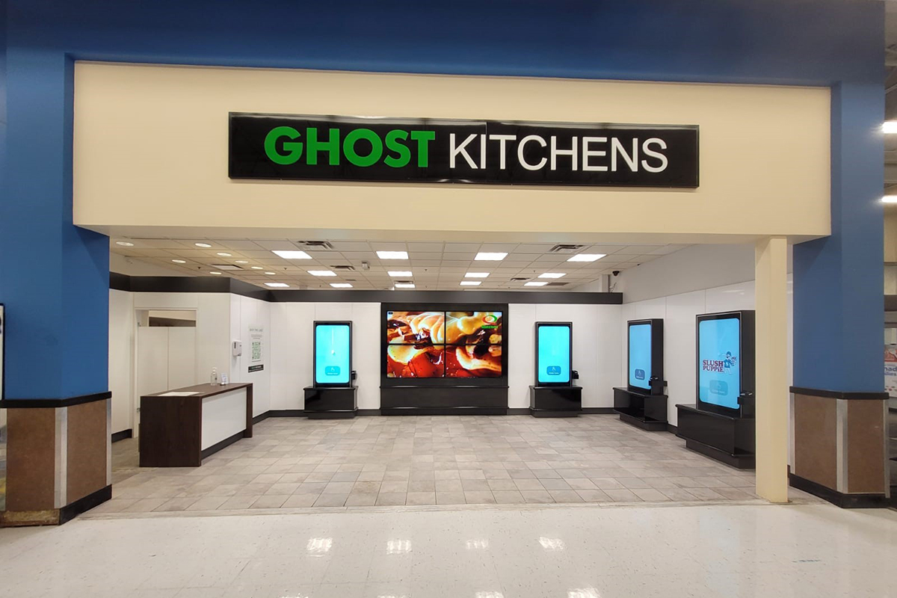
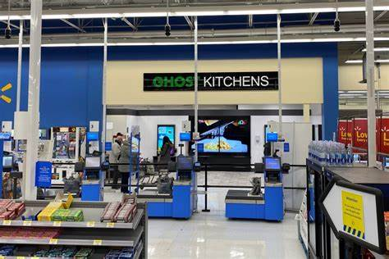
Case example: Walmart
«Retail & Ghost Kitchen»
Thanks to the partnership with Canadian start-up “Ghost Kitchen”, American giant Walmart is set to "set a precedent" in the relationship between retail & ghost kitchens.
The dark kitchen market is on track to reach 1 trillion in value by 2030. But in light of the latest news coming out of America, that value could be revised upward.
Ghost Kitchen with Walmart:
After the announcement, at the beginning of March, of the new investment plan of the American giant, a revolutionary pilot project was announced in collaboration with the Canadian start-up “Ghost Kitchens”, which involves the installation of a ghost kitchen in a supermarket in Ontario. This will allow users to order ready-to-eat food through the retailer's app or even through Uber Eats or Doordash (and others..), then picking it up at the agreed time inside the store.
Ambition and innovation:
The initiative will later be expanded to other locations in Ontario and Quebec. In fact, Ghost Kitchens President Marc Choy said, "Our goal is to open a Ghost Kitchen every 12 km across Canada and be able to reach every Canadian, in every urban market within 30 minutes, 24/7."
Ho.Re.Ca & Retail:
The Canadian project can truly be seen as the first step toward further evolving the ghost kitchen market. No more independent installations, perhaps in anonymous urban areas, but a further service available to retailers and consumers.
Pictures of the Ghost Kitchen test at Walmart in Ontario
©2021 Copyright owned by one or more of the KPMG International entities. KPMG International entities provide no services to clients. All rights reserved.

Slide 52
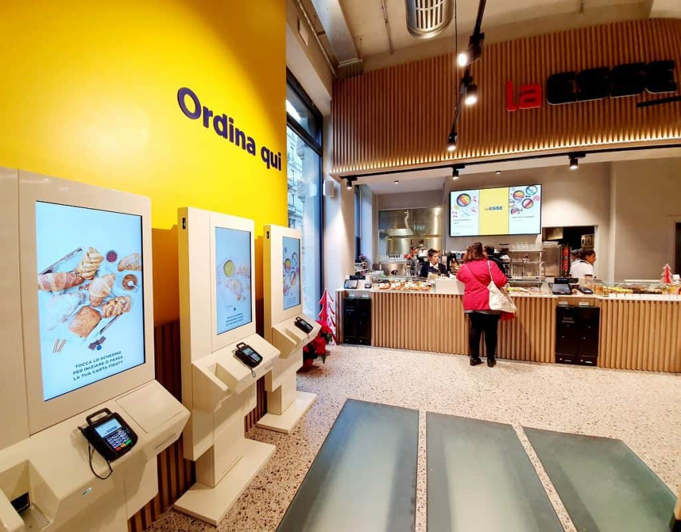
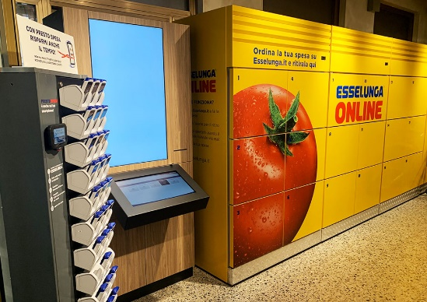
Case example: Esselunga
«Esselunga & RistoRetail: integrating retail with foodservice as a business evolution»
Analyzing the dynamics of the competitive arena, the Italian case of Esselunga emerges, which, with "La Esse", has created a new format able to unite Retail & Foodservice. Through the development of this new store format, it combines both the market with products on the shelf with an innovative bar with open kitchen that characterizes "La Esse" from a small neighborhood supermarket.
In December 2019 Esselunga opened the first "La Esse" store in Milan, in Corso Italia.
This new format (of approx. 400 square meters on three levels) combines the mabrket with shelf products with a bar with an open kitchen, a format that can combine "shopping" and a counter service with on-site consumption thanks to the seating provided in the bar. At the counter there are also pastry products, from the Elisenda pastry shop, a project of Esselunga with the Cerea brothers, patron of the starred restaurant "da Vittorio" in Brusaporto. In addition, the store also features the "Locker", already present in the main "traditional" stores and the "Esselunga Spesa a Casa" service for home shopping.
Services portfolio:
Market with products on the shelf;
Bar with open kitchen and pastry shop with "Elisenda" products;
Bar reservation totem;
Seats for consumption on site;
"Locker" open 24/24;
"Pesto Spesa" (also present with App);
Esselunga Spesa a Casa" home delivery service.
Reservation totems in "La Esse" stores
"Locker" open 24/24 also present in the format "La Esse".
©2021 Copyright owned by one or more of the KPMG International entities. KPMG International entities provide no services to clients. All rights reserved.

Slide 53
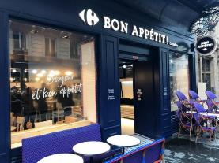
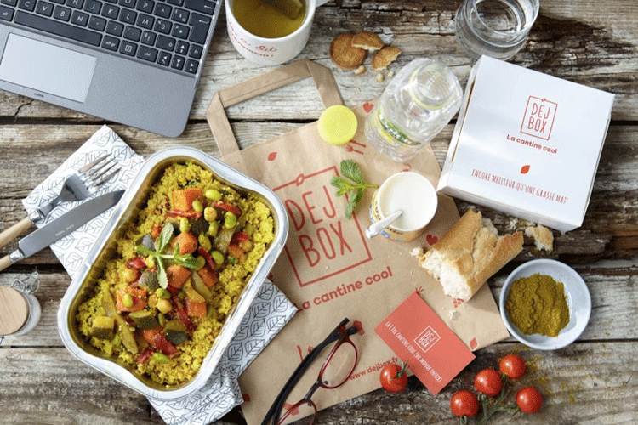
Case example: Carrefour
«Even outside national borders the Retail is approaching Foodservice and Delivery»
The French giant Carrefour, with a view to developing an open innovation strategy, has completed in the last two years strategic operations that can expand its service portfolio.
In Q2 2019, it opened its first restaurant in Paris while in Q1 2020, on the other hand, it completed the acquisition of Dejbox, a startup that delivers lunches to the corporate segment.
Carrefour & Bon Appétit: the RistoRetail also transalpine
In Q2 2019, Carrefour opened its first restaurant, on rue Rambouteau in Paris. Presented as a "test" - but responding to the global trend of distribution to focus on catering to expand customers and vary sources of income - it offers healthy meals. In fact, the offer includes fresh and balanced products from organic farming and fair trade, to be enjoyed on site or to take away, which, Carrefour points out in a press release, continues on its strategy towards "healthier food for all", in line with the "Act for food" initiative, inaugurated by ceo Alexandre Bompard. The restaurant, with its welcoming atmosphere, features self-service.
Carrefour & Dejbox: expanding product portfolio with food delivery for the corporate world
In Q1 2020, Carrefour completed the acquisition of Dejbox, a startup that delivers lunches to employees. A move to expand its food e-commerce offering that is part of a broader open innovation strategy.
Carrefour aims to achieve both:
New product segment in ready-to-eat meals;
New customer base.
The Bon Appétit restaurant in Paris
An example of food box offered by Dejbox
©2021 Copyright owned by one or more of the KPMG International entities. KPMG International entities provide no services to clients. All rights reserved.

Slide 54

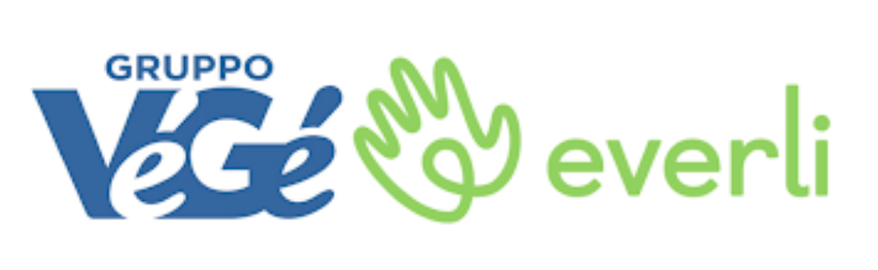
Case example: Vegè
«Development of new medium-sized formats and strategic partnerships to complete the service portfolio»
Following the path indicated by Esselunga with "La Esse", also Vegè, the brand in second place in Italy for number of stores (3,585 stores with 35 associated companies), plans to launch a new medium-sized format in 2021.
In addition to this, the Vegè group has signed an agreement with Everli, a platform for "home shopping", to enrich its portfolio of services in a widespread manner.
Vegè & Everli
Starting from the end of January, Vegè has signed a partnership agreement with Everli for the extension of the home shopping service guaranteed by Everli to the whole national network of the Vegè Group. The agreement reached between the VéGé Group and Everli will last three years and will transfer on a national scale the collaborations already successfully activated by Metro Italia and Bennet, companies that are part of the VéGé network.
A project aimed at relaunching the brand, which has been under study for some time but has remained on stand-by due to the health emergency, is planned for 2021 and foresees the development of points of sale designed and structured to be the evolution of the supermarket format.
In fact, the current trend rewards a medium-sized point of sale format that is able to offer the best calibrated mix of hospitality, convenience, deep and qualified food assortments - with particular attention to fresh and very fresh products - and personalized service.
All member companies and new entrepreneurs who will join the group from 2021 will be able to choose to join the project with the new VéGé stores, following all the characteristics of the new format.
Through this partnership, the Vegè Group secures a partner for "home shopping" for all its 3,585 stores.
©2021 Copyright owned by one or more of the KPMG International entities. KPMG International entities provide no services to clients. All rights reserved.

Slide 55
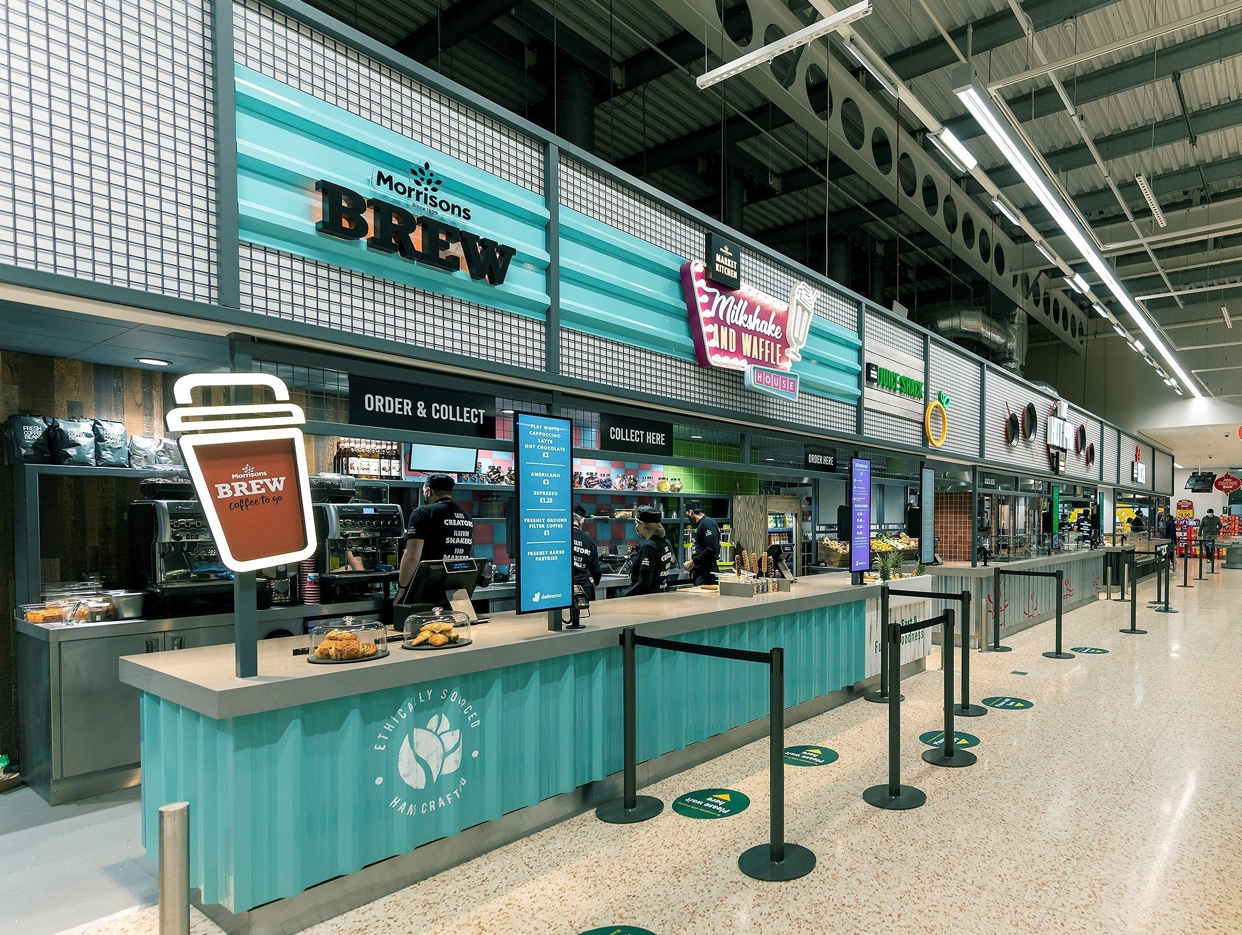
Case example: Morrison
«The launch of a Market Kitchen to combine Retail & Foodservice»
Also in the United Kingdom, thanks to the Morrisons chain, initiatives are being launched to unite Retail and Foodservice, to create hybrid solutions capable of intercepting the needs of customers and creating fully integrated "Food market" hubs that go beyond the concept of the "traditional" supermarket.
Market Kitchen to combine Retail & Foodservice
In the Morrisons store in Edgbaston (Birmingham, UK), the chain is inaugurating the new 'Market Kitchen' that can unite the world of traditional Retail with Foodservice.
The new format means customers can have their breakfast, lunch or dinner freshly prepared by a chef, or opt for a few 'ready-to-eat' meals from the counter at the same time they go shopping. What's more, customers don't even need to leave their homes to enjoy their meals, as they can have their food delivered to their door via Deliveroo.
"Chefs use our fresh Market Street ingredients to create delicious seasonal dishes for customers that are made to order. This means customers can pop in and grab their next meal while also buying the foods they need for future meals. And, thanks to our partnership with Deliveroo, customers across Birmingham will be able to enjoy their favorite dishes from our menu without leaving their kitchen."
Morrison's Market Kitchen in Edgbaston (Birmingham, UK)
©2021 Copyright owned by one or more of the KPMG International entities. KPMG International entities provide no services to clients. All rights reserved.

Slide 56
Case example: Glovo
«Quick Commerce through dark stores»
Glovo opens 15 physical dark stores, 100 hires expected.
Present in over 200 Italian cities, Glovo invests in "fast micro-spending". The company plans to open 15 physical dark stores in Milan, Turin and Rome, with the aim of opening 200 worldwide by the end of 2021.
Glovo, the multi-category home delivery platform, announced the closing of its €450 million Series F funding round. Led by Lugard Road Capital and Luxor Capital Group, the round was also attended by previous investors - Delivery Hero, Drake Enterprises and GP Bullhound - confirming their confidence in the company given the strong growth potential of the online delivery sector.
The investments of this round, the largest ever made by a Spanish startup, will be used to strengthen its services in the 20 markets where it operates, with a particular focus on the development of Quick Commerce. The home shopping delivery service aims to make Glovo the "App for the city".
"We have opened our second dark store in Milan and the first in Turin. We aim by the end of the year to have at least 15 in the area, planning over 100 hires as dedicated staff - says Elisa Pagliarani, general manager of Glovo Italy -. Shopping is a segment of our service that in the last year has grown by 400%. Thanks to the distribution of our physical warehouses in the nerve centres of the city, with the same ease with which food is ordered, customers can receive their last minute shopping at home [...]".
The Quick Commerce service through dark stores is complementary to the shopping service already offered by Glovo through supermarkets, thanks to agreements with partners such as Carrefour or Gruppo Végé. Dark store shopping is aimed at consumers who want to satisfy an immediate need. It rewards speed and choice.
©2021 Copyright owned by one or more of the KPMG International entities. KPMG International entities provide no services to clients. All rights reserved.

Slide 57
Case example: Alibaba–Starbucks Partnership
Creating an order and delivery experience (powered by the Alibaba Ecosystem) will enable Starbucks to offer a seamless ’Starbucks Experience’ for customers across channels, and transform the coffee industry in China
Overview
Starbucks to collaborate across key businesses within the Alibaba
ecosystem
Including Ele.me, Hema supermarket, Tmall, Taobao and Alipay to
elevate the Starbucks Experience for Chinese customers
Introduced ‘Starbucks Delivery’ program
Allow ing customers to order and receive coffee w ithout visiting a store, by leveraging Ele.me’s on-demand delivery platform
Currently delivers in 11 cities across China (Nov 2018) w ith plans to
expand to 2,000 Starbucks stores across 30 cities (by y/e 2018)
Partnering w ith Hema supermarkets to create ‘Starbucks Delivery
Kitchens ’
These stations w ill service delivery orders for surrounding areas
Plans to integrate a ‘virtual store’ into all of Alibaba's popular apps/ services
Including Taobao, Tmall and Alipay to gain access to
approximately 500 million active users
Benefits for Starbucks?
— Starbucks w ill be able to further unify a seamless Starbucks Experience betw een its stores and online, by leveraging the Alibaba ecosystem and New Retail infrastructure
Notable success …
Shanghai Reserve Roastery – Starbucks interactive coffee store is pow ered by Alibaba technology
Allow s consumers to place and pay for orders digitally via an app, engage w ith AR experiences, view menus, order special blends and book customised experiences
©2021 Copyright owned by one or more of the KPMG International entities. KPMG International entities provide no services to clients. All rights reserved.

Slide 58
Case example: Carrefour LeMarche
Carrefour Le Marche store is poised to compete with Alibaba’s Hema supermarkets in the smart phone-equipped battle to change the way that China buys food
Overview
In May 2018, Carrefour, the French retailer, opened its first-ever smart supermarket, named Carrefour Le Marche in Shanghai in partnership w ith Tencent Group
Shoppers are required to create a Carrefour account before they enter the store and link it to their WeChat profile and pay with just a face scan, or use WeChat to pay online
  In the store, customer can scan the code on the item with Carrefour mini program in WeChat, add it to the e-trolley, and choose to pay online via WeChat Pay
  To use face scan for check-out, customers have to scan their face and register through WeChat Pay. After finishing shopping, they can just smile to the camera to complete the payment process
Carrefour Le Marche Store adopts an electronic label system, with
prices centrally set by the system
Carrefour and Tencent:
In January 2018, Carrefour signed a strategic agreement to collaborate w ith Tencent on sharing of
data, payment technology, and consumer loans
Tencent’s tie-up w ith Carrefour is poised to compete Alibaba’s Hema high-tech supermarket chain
©2021 Copyright owned by one or more of the KPMG International entities. KPMG International entities provide no services to clients. All rights reserved.

Slide 59

Case example: Coca Cola
«Brand players shop Retail through M&A»
Coca-Cola vs Nestlé
Coca-Cola responds to Nestlé's purchase of Starbucks coffee (or rather, the license to produce and market it) in order to establish its presence in the field in America, where business was struggling to take off.
Brand players shop Retail through M&A
And so Coca-Cola, for about 4.4 billion euros, acquired one of the world's leading coffee shops, Costa Coffe, with over 3,500 stores in 32 countries. James Quincey, CEO of Coca-Cola, said "Hot beverages are one of the few remaining segments in the overall beverage landscape where Coca-Cola does not have a global brand," paving the way for what may represent a true "coffee platform" for Coca-Cola.
©2021 Copyright owned by one or more of the KPMG International entities. KPMG International entities provide no services to clients. All rights reserved.

Slide 60

















Key lessons for the retailers
01
Data is sacred. Retailers should
Be socially responsible or risk losing customers and brand integrity.
06
listen to it and let it influence
business decisions.
02
Think personalization. From experience, to products, to services, consumers want and are willing to pay for personalization.
Value, convenience and experience are the winning consumer drivers for Retailers, and need to excel in at least one.
07
03
Provide price savvy consumers with value. Shoppers want to pay less for more and will search until they find a suitable solution.
Social media is one of the most powerful tools retailers can use to reach and understand customers.
08
04
Humans are becoming more comfortable with robots and are happy to interact with chatbots and smart speakers. Use this to advantage with consumers and business.
Lean and smart has to be the future of efficient retailing.
09
05
Give consumers a good experience. Experience is everything and consumers are willing to pay for it.
Think consumer centricity. As always, it
is about the consumer.
10
©2021 Copyright owned by one or more of the KPMG International entities. KPMG International entities provide no services to clients. All rights reserved.

Slide 61

Appendix
Focus on Business Innovation

Slide 62

Four levers to reduce cost of doing business (4/4)
Technology is challenging the rules of engagement…
Trend 1: From we to me
Case Study | American brand offering personalised hair care
Function of Beauty
Uses data, AI machine-learning to develop hyper-personalised products
Customer fills an extensive questionnaire , called the ‘Style Quiz’
Answ ers are fed into an algorithm that pulls from hundreds of ingredients, to
create a unique shampoo and conditioner combination
Shoppers can choose the colour of the product, have their name put on the bottle, select the bottle size , and also choose their preferred scent
One off purchase of hair products can be made, or customers can sign up
to a subscription service
Deep retail is resulting in hyper–personalisation. Today it’s possible
(and even likely) that retailers know what you need before you do.
— For a long time, smartphone has been a source of data. How ever, the new frontier in personalisation w ill analyse real-time emotional data, eye tracking and DNA in addition to purchases and view s, to pinpoint exactly w hat customers need in real time
In 2019 w e w ill see retailers tap into real time behavioural data to understand consumers on an emotional level and take analytics technologies (AI, image recognition mood analysis ) to the next level — providing deep detailed understandings of consumer attitudes, reactions and patterns
Trend 2: The rise and rise of voice
Case Study | American Chabot offering tailored skin care suggestions
HelloAva
Excitement around AI is running high and its impact is growing. In 2019 we will see AI’s impact on retail grow substantially in two key areas:
01. Smart speakers 02. Chatbots
Can a chatbot replace a dermatologist’s recommendation for skin care products?
That’s the idea behind American start-up, HelloAva
HelloAva determines customer skin type via a 12-question SMS or
Facebook Messenger conversation
The bot then recommends skin products and regimens based on the
person's answ ers
The bot can also connect the customer w ith a human advisor for more personal service
Voice controlled shopping is set to explode over the next four years to US$40 billion by 2022 — driven by rising use of smart speakers at home
In 2019 there w ill be a surge in development of chatbots — chatbots w ill be involved in 85 percent of all types of business to customer interaction by 2010 (per Gartner and Juniper)
Notes:
Technology impact-adoption matrix (2019) — supply chain innovation during 2020-21 will heavily leverage analytics
Matrix has been taken from the 2nd annual joint survey of supply chain executives from JDA Software, Inc. and KPMG LLP (KPMG) details the key innovation investments across retail, manufacturing and logistics in 2019
Per the analysis, supply chain innovation, over the next 2 years, is likely to heavily leverage analytics (Cognitive and AI) to address complex problems – be it forecasting, fleet routing or inventory optimization
Source: https://scm.dk/new-jda-and-kpmg-survey-says-artificial-intelligence-most-impactful-supply-chain-technology-cxos
Inditex:
Source: https://www.essentialretail.com/news/five-features-inditex-digital/
Otto
https://digital.hbs.edu/platform-rctom/submission/autonomous-stock-replenishment-at-online-retailer-otto/
Sources:
2018: https://intra.ema.kpmg.com/sites/KPMGI/GMC/TL/Thought%20Leadership/US/2018/Digital%20Supply%20Chain%20in%20Retail%20and%20Manufacturing%20-%20A%20State%20of%20the%20Industry%20Benchmark.pdf
https://www.incisiv.com/animated-infographic-state-of-the-industry-digital-supplychain-performance
https://www.idginsiderpro.com/article/3535079/can-technology-save-the-retail-supply-chain.html
https://www.mckinsey.com/business-functions/operations/our-insights/supply-chain-40--the-next-generation-digital-supply-chain
https://www.gartner.com/smarterwithgartner/gartner-top-8-supply-chain-technology-trends-for-2018/
https://scm.dk/new-jda-and-kpmg-survey-says-artificial-intelligence-most-impactful-supply-chain-technology-cxos

Slide 63


Four levers to reduce cost of doing business (4/4)
…and customers are becoming more demanding —
Trend 3: Planet friendly is due to arrive
Case Study | Dutch firm launched world’s first plastic-free aisle
Ekoplaza
Sustainability no longer optional. It has become a shopping priority for the green generation — one third of consumers choose to buy brands based on their social/environmental impact (per Unilever research)
In 2019 w e w ill see companies
make more meaningful
commitments where they can
have significant impact that aligns
w ith values of company, its brands
and target audiences
Launched plastic-free aisles in Amsterdam
- Introduced w ooden and metal shelves , and labels made from
cardboard
Introduced compostable biomaterials packaging for 700 products such
as lentils and fresh meat
1 in 5 consumers w ould choose a brand if its sustainability credentials w ere made clearer on packaging
US$1.1
billion
Creates
opportunity worth
Trend 4: Consumers get price savvy
Case Study | American app that targets the price savvy customer
ShopSavvy
Allow s users to scan barcode of any product and compare all the best
prices on the internet and at near by stores
App also alerts consumers if a retailer follow s a price matching policy
Claims to have a largest database of retailers , products and prices
Has now become the w orld's most popular shopping app — has more
than 100 million dow nloads and over 50 million product scans a month
Further, the app lets consumers to share deals w ith friends, set price alerts , make w ish-lists and recommends top offers in 450 categories
Paying less for more and bragging about it has become a trend in itself. With more options and information at their disposal, consumers prefer to do their own product research
81% shoppers do online 89% of these consumers research before committing begin their buying process to the purchase w ith a search engine
— MineWhat Study 2015, sourced via Retail Trends 2019 (KPMG)
Consumers are educated on pricing strategies and are now prioritising value
They expect the price to reflect their mission: value(s), convenience and experience
Notes:
Technology impact-adoption matrix (2019) — supply chain innovation during 2020-21 will heavily leverage analytics
Matrix has been taken from the 2nd annual joint survey of supply chain executives from JDA Software, Inc. and KPMG LLP (KPMG) details the key innovation investments across retail, manufacturing and logistics in 2019
Per the analysis, supply chain innovation, over the next 2 years, is likely to heavily leverage analytics (Cognitive and AI) to address complex problems – be it forecasting, fleet routing or inventory optimization
Source: https://scm.dk/new-jda-and-kpmg-survey-says-artificial-intelligence-most-impactful-supply-chain-technology-cxos
Inditex:
Source: https://www.essentialretail.com/news/five-features-inditex-digital/
Otto
https://digital.hbs.edu/platform-rctom/submission/autonomous-stock-replenishment-at-online-retailer-otto/
Sources:
2018: https://intra.ema.kpmg.com/sites/KPMGI/GMC/TL/Thought%20Leadership/US/2018/Digital%20Supply%20Chain%20in%20Retail%20and%20Manufacturing%20-%20A%20State%20of%20the%20Industry%20Benchmark.pdf
https://www.incisiv.com/animated-infographic-state-of-the-industry-digital-supplychain-performance
https://www.idginsiderpro.com/article/3535079/can-technology-save-the-retail-supply-chain.html
https://www.mckinsey.com/business-functions/operations/our-insights/supply-chain-40--the-next-generation-digital-supply-chain
https://www.gartner.com/smarterwithgartner/gartner-top-8-supply-chain-technology-trends-for-2018/
https://scm.dk/new-jda-and-kpmg-survey-says-artificial-intelligence-most-impactful-supply-chain-technology-cxos

Slide 64


Four levers to reduce cost of doing business (4/4)
…forcing retailers to tap into innovative thinking
Trend 5: Experiential retail is coming to life
Case Study | Home furnishing retailer hosted a sleepover at its store IKEA
Hosted a sleepover for 100 customers at one of their shops The night included all the trimmings of a classic sleep over and featured a sleep expert with tips for a good night’s rest, including how to find a mattress basis customer suitability The idea for the event came from the consumer insights gained via social media
“Social media has opened up a unique platform for us to interact directly with our customers. Listening to what they want is what we do best, and the Big Sleepover is just one example of how we’re using such instant and open feedback to better inform our marketingactivity.” — IKEA’s UK PR and internal communications manager
Case Study | Acquisition to build business across platform IKEA
IKEA acquired TaskRabbit, a freelance labour online marketplace, to build its business across the platform and boost digital customer service capabilities TaskRabbit connects temporary w orkers to a variety of different jobs, including delivering purchases, cleaning homes, and even assembling furniture Customers can now get Ikea’s products assembled by accessing TaskRabbit’s pool of 60,000 independent w orkers The acquisition boosted Ikea’s online sales
Experiential retail, or retailtainment, is the future. In this changing market,
people cherish and are investing in experiences over material possessions
Millennials are the driving force behind this shift
By creating a more immersive experience, retailers can drive people to their stores and ensure they leave not just w ith products but also memories
78% millennials w ould choose to spend money on a desirable
experience or event over buying some desirable product
In 2019 w e w ill see retailers ramp up focus on curating compelling experiences
Trend 6: From transaction to service provider
Platform businesses have re-shaped and re-invented the word of retailing.
They are now taking their models one step further — developing solutions
and products which they offer directly to other retailers¹
Platforms that are dominating the retail industry, know that by selling a service w here they can create the means of connection, results in the provider having all the pow er
Not all retailers have the resources or mandate to develop their ow n platform models, but they w ill need to build, buy or collaborate to compete. For those w ho are not platform players, collaboration w ill be key
We w ill see companies invest in a business but not get involved directly, consequently seeing
the rise of joint
ventures in 2019
Note 1. In exchange, they will harvest the data to continue to deepen their understanding of consumer behaviours
Notes:
Technology impact-adoption matrix (2019) — supply chain innovation during 2020-21 will heavily leverage analytics
Matrix has been taken from the 2nd annual joint survey of supply chain executives from JDA Software, Inc. and KPMG LLP (KPMG) details the key innovation investments across retail, manufacturing and logistics in 2019
Per the analysis, supply chain innovation, over the next 2 years, is likely to heavily leverage analytics (Cognitive and AI) to address complex problems – be it forecasting, fleet routing or inventory optimization
Source: https://scm.dk/new-jda-and-kpmg-survey-says-artificial-intelligence-most-impactful-supply-chain-technology-cxos
Inditex:
Source: https://www.essentialretail.com/news/five-features-inditex-digital/
Otto
https://digital.hbs.edu/platform-rctom/submission/autonomous-stock-replenishment-at-online-retailer-otto/
Sources:
2018: https://intra.ema.kpmg.com/sites/KPMGI/GMC/TL/Thought%20Leadership/US/2018/Digital%20Supply%20Chain%20in%20Retail%20and%20Manufacturing%20-%20A%20State%20of%20the%20Industry%20Benchmark.pdf
https://www.incisiv.com/animated-infographic-state-of-the-industry-digital-supplychain-performance
https://www.idginsiderpro.com/article/3535079/can-technology-save-the-retail-supply-chain.html
https://www.mckinsey.com/business-functions/operations/our-insights/supply-chain-40--the-next-generation-digital-supply-chain
https://www.gartner.com/smarterwithgartner/gartner-top-8-supply-chain-technology-trends-for-2018/
https://scm.dk/new-jda-and-kpmg-survey-says-artificial-intelligence-most-impactful-supply-chain-technology-cxos

Slide 65



Four levers to reduce cost of doing business (4/4)
…and social media, to ensure brand prominence.
Trend 7: Social currency will be more transactional
Consumers’ willingness to share on social media, social currency¹, has great brand-building potential for retailers.
Case Study | Use of social media to create brand identity
Birds Eye
Hosted a pop-up restaurant in London, w here customers had to settle their
bill w ith Instagram pictures of food and hashtag #BridsEyeInspirations
Aim w as to build strong brand image on social media, inspired by a
research finding² w hich stated that:
  52 percent of consumers regularly take pictures of their food
  11 percent take at least take one picture of their food a w eek, and
  9 percent are unable to go a day w ithout capturing w hat they’re
consuming
About 80% of generation Z, and 74% millennial
shoppers say social media influences their purchases
— Retail Dive Survey 2017, via Retail Trends 2019 (KPMG)
More and more, consumers are relying on community and w ord-of-mouth instead of advertisements for product recommendations
In 2019, w e w ill see retailers trading in
social currency
Seeing the value in this persisting trend, retailers are turning to social media advertising
With targeted ads , firms reach very specific groups based on demographics, interests, behaviour and more
Forw ard-thinking retailers have capitalised using the pow er of social media to connect meaningfully w ith
customers
There are over six million Facebook advertisers and over tw o million Instagram advertisers
Social Media ad-spend is grow ing more than 20 percent annually. Per eMarketer, in 2018, a quarter of
all UK digital spend (approx. US$5 million) w as channelled into social media platforms
“We wanted to tap into this trend and create a newreason for people to talk about and sample our newest additions to the Inspiration range”
— Margaret Jobling, Birds Eye marketing director,
Instagram Shop-able posts — allow s shoppers to view business profiles and products, and purchase them through the app
Snapchat Selfie commerce — allow s users to click on a button to access the retailer’s shopping page, w ithout leaving the app
Note 1. Social currency: the entirety of actual and potential resources which arise from the presence in social networks and communities, including both digital and offline 2. eMarketer research
Notes:
Technology impact-adoption matrix (2019) — supply chain innovation during 2020-21 will heavily leverage analytics
Matrix has been taken from the 2nd annual joint survey of supply chain executives from JDA Software, Inc. and KPMG LLP (KPMG) details the key innovation investments across retail, manufacturing and logistics in 2019
Per the analysis, supply chain innovation, over the next 2 years, is likely to heavily leverage analytics (Cognitive and AI) to address complex problems – be it forecasting, fleet routing or inventory optimization
Source: https://scm.dk/new-jda-and-kpmg-survey-says-artificial-intelligence-most-impactful-supply-chain-technology-cxos
Inditex:
Source: https://www.essentialretail.com/news/five-features-inditex-digital/
Otto
https://digital.hbs.edu/platform-rctom/submission/autonomous-stock-replenishment-at-online-retailer-otto/
Sources:
2018: https://intra.ema.kpmg.com/sites/KPMGI/GMC/TL/Thought%20Leadership/US/2018/Digital%20Supply%20Chain%20in%20Retail%20and%20Manufacturing%20-%20A%20State%20of%20the%20Industry%20Benchmark.pdf
https://www.incisiv.com/animated-infographic-state-of-the-industry-digital-supplychain-performance
https://www.idginsiderpro.com/article/3535079/can-technology-save-the-retail-supply-chain.html
https://www.mckinsey.com/business-functions/operations/our-insights/supply-chain-40--the-next-generation-digital-supply-chain
https://www.gartner.com/smarterwithgartner/gartner-top-8-supply-chain-technology-trends-for-2018/
https://scm.dk/new-jda-and-kpmg-survey-says-artificial-intelligence-most-impactful-supply-chain-technology-cxos

Slide 66
Thank you

Slide 67
home.kpmg/socialmedia
© 2021 Copyright owned by one or more of the KPMG International entities. KPMG International entities provide no services to clients. All rights reserved.
KPMG refers to the global organization or to one or more of the member firms of KPMG International Limited (“KPMG International”), each of which is a separate legal entity. KPMG International Limited is a private English company limited by guarantee and does not provide services to clients. For more detail about our structure please visit https://home.kpmg/xx/en/home/misc/governance.html.
The information contained herein is of a general nature and is not intended to address the circumstances of any particular individual or entity. Although we endeavor to provide accurate and timely information, there can be no guarantee that such information is accurate as of the date it is received or that it will continue to be accurate in the future. No one should act on such information without appropriate professional advice after a thorough examination of the particular situation.
The KPMG name and logo are trademarks used under license by the independent member firms of the KPMG global organization.

