Slide 1
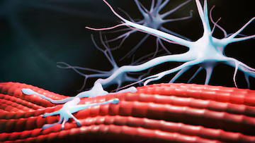

Intl. Master Degree
in Neuroscience
SEMINARS
Inositol 1,4,5-trisphoshate in skeletal muscle: from excitation-contraction coupling
to excitation-transcription coupling
Prof. Pompeo Volpe
Dipartimento di Scienze Biomediche
Università degli Studi di Padova
Almost 40 years ago Inositol 1,4,5-trisphoshate (IP₃) was found to induce Ca²⁺ release from sarcoplasmic reticulum and the complex enzymatic machinery responsible for its synthesis and catabolism was discovered in skeletal muscle. Moreover, Acetylcholine was shown to induce PtdInP2 breakdown and IP₃ synthesis. The inevitable question, whether IP₃ could be the messenger in EC coupling, led to a negative answer.
More recently, IP₃ receptors (IP₃R) were found to be enriched at postsynaptic components of the NMJ, surrounding the subsynaptic nuclei and close to the motor endplate. The subsynaptic IP₃R isoform distribution appears to be controlled by innervation through a prevailing mechanism based on electrical activity. This opens a new scenario in which IP₃R could be included in the growing list of atrogenes.
Wednesday
November 13, 2024
at 11.30 a.m.
Aula ex-CLA
Building C1
dsv.units.it

